Slide 1
NATURAL POLYMERS ACID’S DERIVATIVES, NATURAL RESINS, DRYING OILS, SHELACK ETC.
Dr. Ladislav Pospíšil

Slide 2
Time schedule
LECTURE | SUBJECT
1 | Introduction to the subject – Structure & Terminology of nature polymers, literature
2 | Derivatives of acids – natural resins, drying oils, shellac
3 | Waxes
4 | Plant (vegetable) gums, Polyterpene – natural rubber (extracting, processing and modification), Taraxacum_kok-saghyz
5 | Polyphenol – lignin, humic acids
6 | Polysaccharides I – starch
7 | Polysaccharides II – cellulose
8 | Protein fibres I
9 | Protein fibres II
10 | Casein, whey, protein of eggs
11 | Identification of natural polymers
 | Laboratory methods of natural polymers’ evaluation

Slide 3
Products
Natural Products
Renewable Sources
UNRENEWABLE SOURCE
Modified Natural Products
Synthetic Products
Why do we put the Oils in the Natural Polymers ?
POLYMERS arising by radical Reaction from some of the Natural Oils

Slide 4
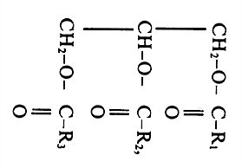
Fats & Oils
Vegetable Fats (Oils)
Glycerides
Higher Fatty acids ( > 10 C Atoms)
Saturated
Unsaturated
One double Bond
More then one double Bond
Isolated
Conjugated

Slide 5
OILS
Oil is a Liquid constituted (composed) of the Molecules, which comprise the hydrophobic hydrocarbon Chains. So they are not soluble (are INSOLUBLE) in the Water. They have lower Density then the Water has.
Food, edible Oils are the Vegetable liquid TRIGLYCERIDES. They can have one or more unsaturated Bonds between the Carbon Atoms. The more has the such Oil of the unsaturated Bonds between the Carbon Atoms, the less is its Viscosity.
Technical Grade Oils are mostly based on the utilisation of the so called MINERAL OILS, which are the Mixture of the HYRDOCARBONS manufactured by the Crude Oils Processing. The next Group of the Technical Grade Oils are the SILICONE OILS, which are manufactured by Synthesis (Polymerisation) from the Silicon based monomers.

Slide 6
Glycerides of the Higher Fatty acids ( > 10 C Atoms) 1
How to characterise in Practice the Unsaturation
of the Higher Fatty acids
IodineVALUE – Determination according to prof. Hanush
REACTION:
-C=C- + IBr -C=C-
I
Br
The IODINE VALUE (or IODINE ADSORPTION VALUE or IODINE NUMBER or IODINE INDEX)
IBr + KI I₂ + KBr
I₂ + 2Na₂SO₄ 2 NaI + Na₂S₄O₆

Slide 7
Glycerides of the Higher Fatty acids ( > 10 C Atoms) 2
The FATS are dividing the IODINE VALUE (IV) accordingly:
Drying Oils – IN > 120 % w/w
Half Drying Oils – IN > 60 - 120 % w/w
NON Drying Oils – IN < 60 % w/w
Fat (Oil) | Iodine Value (% w/w)
Cow Butter | 26 – 40
Beef Tallow melted | 40 – 48
Pig Lard | 53 – 77
Ricin Oil | 81 – 90
Peanut/Groundnut Oil | 84 – 100
Oilseed rape Oil | 94 – 106
Soybean (Soy bean) Oil | 114 – 138
Suflower Oil | 127 – 136
Linseed/Flaxseed Oil | 170 - 204

Slide 8
EN ISO STANDARDS
EN ISO 660
Animal and vegetable fats and oils - Determination of acid value and acidity
EN ISO 3961
Animal and vegetable fats and oils - Determination of iodine value
EN ISO 3657
Animal and vegetable fats and oils - Determination of saponification value

Slide 9
The IODINE VALUE (or IODINE ADSORPTION Value or IODINE NUMBER or IODINE INDEX) in chemistry is the mass of iodine in grams that is consumed by 100 grams of a chemical substance. Iodine numbers are often used to determine the amount of unsaturation in fatty acids.
This unsaturation is in the form of double bonds, which react with iodine compounds. The higher the iodine number, the more C=C bonds are present in the fat. It can be seen from the table that coconut oil is very saturated, which means it is good for making soap. On the other hand, linseed oil is highly unsaturated, which makes it a drying oil, well suited for making oil paints.
In a typical procedure, the fatty acid is treated with an excess of the Hanuš or Wijs solution, which are, respectively, solutions of iodine monobromide (IBr) and iodine monochloride (ICl) in glacial acetic acid. Unreacted iodine monobromide (or monochloride) is then allowed to react with potassium iodide, converting it to iodine, whose concentration can be determined by titration with sodium thiosulfate

Slide 10
The FATY ACIDS OF OUR INTEREST A WHY THEY ARE SO FOR US?
The common FATY ACIDS which are contained in the Vegetable Oils
FATY ACID’S name | Carbon Atoms Number | Double Bonds Number | Formulae | Iodine Value
Lauric | 12 | --- | CH₃(CH₂)₁₀COOH | ---
Myristic | 14 | --- | CH₃(CH₂)₁₂COOH | ---
Palmitic | 16 | --- | CH₃(CH₂)₁₄COOH | ---
Steraic | 18 | --- | CH₃(CH₂)₁₆COOH | ---
Oleic | 18 | 1 | CH₃(CH₂)₇CH=CH-(CH₂)₇COOH | 90
Linolic | 18 | 2 | CH₃(CH₂)₄CH=CH-CH₂-CH=CH (CH₂)₇COOH | 181
Linolenic | 18 | 3 | CH₃CH₂CH=CH-CH₂-CH=CH-CH₂-CH=CH (CH₂)₇COOH | 274

Slide 11
The FATY ACIDS - Sources and a Manufacturing Technology
Vegetable Oily Seeds
TECHNOLOGY
COLD PRESSING (Analogue of the so called Virgin Olive Oil)
Hot PRESSING (Analogue of the so called Olive Oil for Cooking)
Hydrocarbon's hot Extraction (Analogue of the so called Olive Oil for Soap and Cosmetic)
WASTES, so called OIL CAKE > Animal's Feeding

Slide 12
Boiled linseed Oil : modified (treated) Linseed Oil
Boiled linseed Oil adjusted (mixed): it contains some other Oils also, not the Linseed Oil only
CHEMICAL BASIS OF THE MODIFICATION (TREATMENT):
The –OOH Groups are arisen on the double Bonds of the higher fatty Acids
Impregnating Linseed Oil: diluted by the volatile organic Solvents to decrease the Viscosity and so increase the Infusion to the impregnated Material, usually the Wood

Slide 13
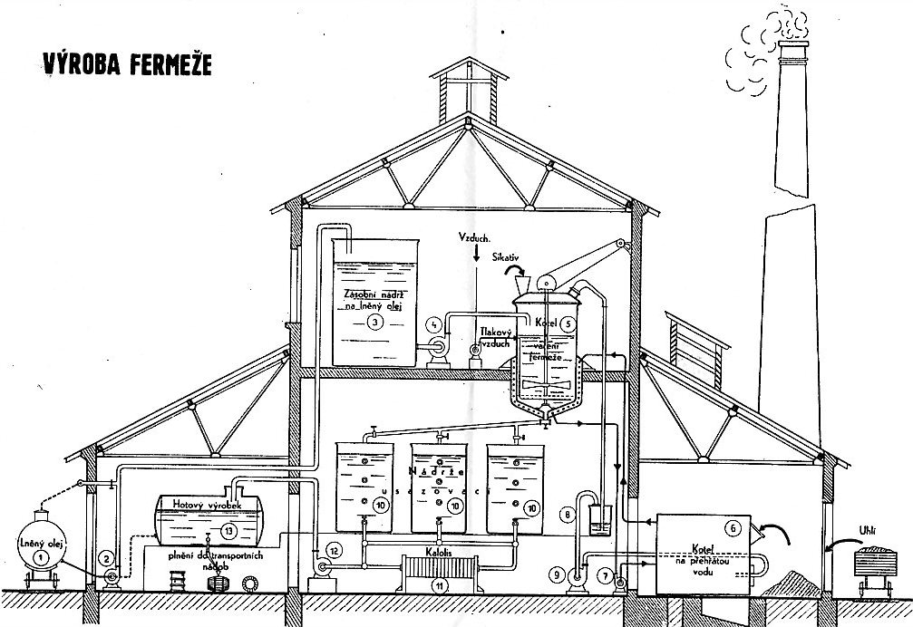
Boiled linseed Oil MANUFACTURE
AIR
SICCATIVE
Raw linseed Oil
Steam-jacketed Kettle

Slide 14
The FATY ACIDS OF OUR INTEREST AND THEIR COMPOSITIONS
COMPOSITIONS OF THE TYPICAL VEGETABLE OILS
ACID | Linseed Oil (% w/w) | Poppy/Poppy-seed Oil (% w/w) | Walnut oil (% w/w)
Palmitic | 6 | 10 | 8
Stearic | 4 | 2 | 3
Oleic | 22 | 11 | 15
Linolic | 15 | 76 | 61
Linolenic | 52 | --- | 12
OTHER | 1 | 1 | 1
Ratio of the Palmitic to Stearic Acids | 1,5 | 5,0 | 2,6
These Oils are used for the Oil based Paints and they are so called DRYING OILS

Slide 15
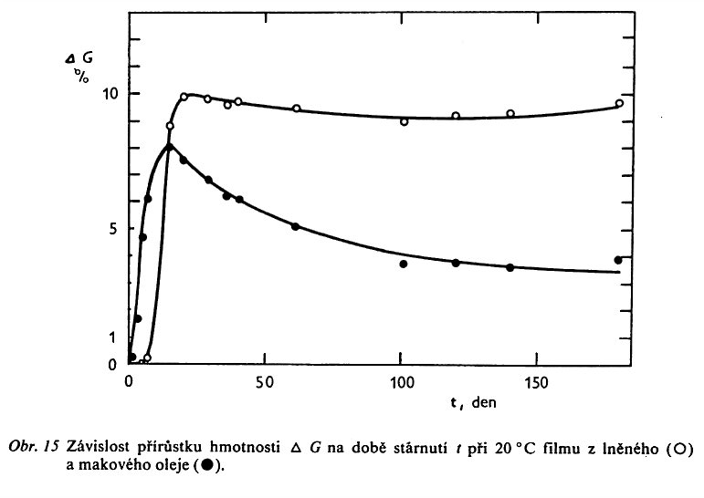
What is that of „OIL DRYING“
IT IS NOT REAL DRYING (Evaporation of the Solvent)!
It is in Reality a Multistage Radical initiated Reaction, where the Group –OOH (Hydroperoxide) is arisen at first (Mass is increasing) , which then can initiate by its Decomposition a Crosslinking of the unsaturated Compounds (Fatty Acids in the Glycerides) and so the Mass is decreasing again
Δ G is here Δ of the Mass, not the Gibbs free Energy Change (Δ)!

Slide 16
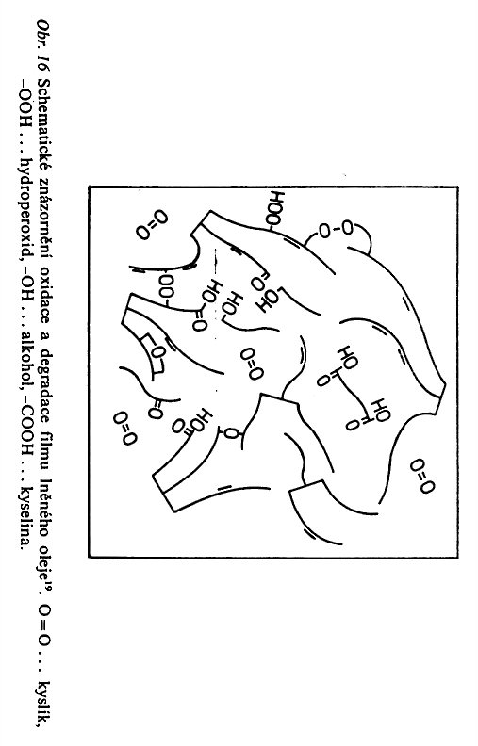
What is that of „OIL DRYING“ Better said, it is Solidification
Schematic showing of the OXIDATION and DEGRADATION of the Linseed Oil Film
O=O …Oxygen, -OOH … Hydroperoxide, -OH … Alcoholic Group,
-COOH … Carboxylic Group

Slide 17
How to accelerate „OIL DRYING“?
Transition Valence Metals, e.g. Fe³⁺ , Co²⁺ , Mn²⁺ , Pb⁺²
So called SICCATIVE
M^{(n+1)+} + R-OOH M^{n+} + R-OO. + H⁺
The Metal in the lower Oxidation State react with the Hydroperoxide decomposing it and increasing its Oxidation State back up. The Cycle is closed so.
M^{n+} + R-OOH M^{(n+1)+} + R-O. + HO⁻

Slide 18
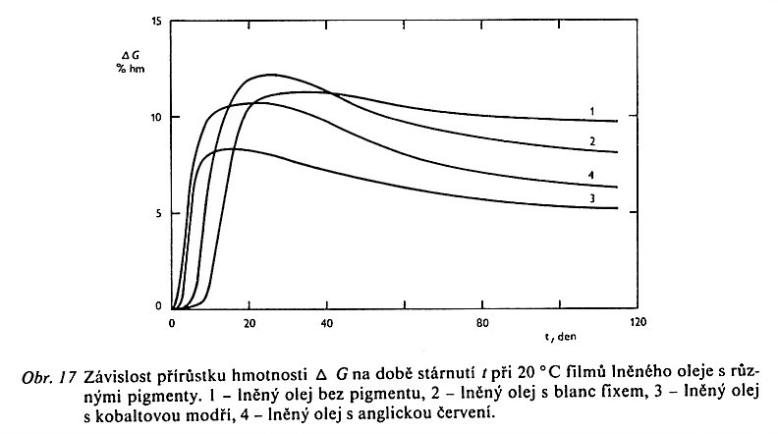
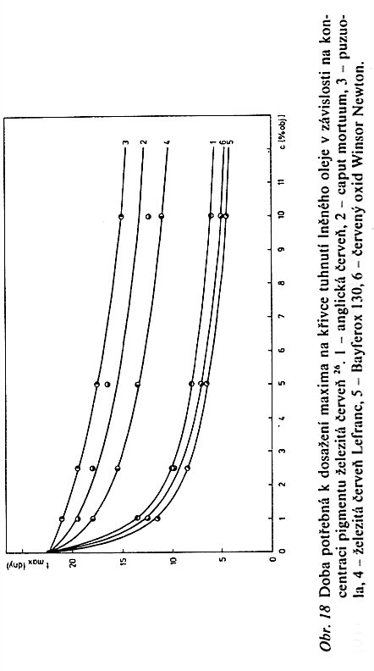
Data from a Literature
Ferric Red are the Iron oxides with the Red-brown Colour Shades
G as the Function of the Aging time t at 20 °C:
Linseed Oil without any Pigments
Linseed Oil with the ZnSO₄ Pigment
Linseed Oil with the Cobalt Blue Pigment
Linseed Oil with the English Red Pigment
Time necessary to reach the Maximum on the „OIL DRYING“ Curve as the Function of the Ferric Red Pigment of the various Grades:
English Red
Caput Mortuum
Puzuola
Ferric Red Lefrane
Bayferox
Windsor Newton
Δ G is here Δ of the Mass, not the Gibbs free Energy Change (Δ)!
www.precheza.cz
Ferric Pigments FEPREN

Slide 19
How to DECELERATE „OIL DRYING“ and alternatively Protect the „Dry“ Film against undesirable Degradation?
UV Stabilisers – against the Light Degradation
HALS,
UV Absorbers,
Excited States Scavengers
………..
Inhibitors of the Radical Reactions acting against the „OIL DRYING“?

Slide 20
Natural RESINS
They are gained by Bleeding (Resin Tapping) from the Tree Injury or the purposely done Cuts of the Tree’s, mainly the Fir Trees (e.g. Pine Tree)
They are MIXTURES of the mainly Terpenoid’s Compounds (the only Exception is SHELACK) and Essential/Ethereal Oils
They are the Viscous Liquids, called also as BALSAMS or DISCHARGES (This mixtures)
These BALSAMS are divided to RESINS & Essential/Ethereal Oils by Distillation to the SOLID MATERIAL (SOLIDS) & LIQUIDS

Slide 21
Natural RESINS
Bleeding (Resin Tapping)
BALSAM (DISCHARGE)
Terpenoid
(SOLID
MATERIAL)
Essential/Ethereal Oils (LIQUID)

Slide 22
Natural RESINS versus Essential/Ethereal Oils
Natural RESINS are the oligomeric, viscous, low Volatile Materials (Mixture of the Compounds)
Essential/Ethereal Oils are the Volatile, even at low Temperature. They are Water insoluble, oily Substances of their Mixtures, frequently aromatic and having the acrid/pungent Taste.
They are TERPENOIDE in both cases

Slide 23
Shellac
Shellac is NOT the Vegetable Product!
Shellac is the Animal Product, Insect’s Secrete
Shellac doesn't contain Terpenoide Acids, but the Polyhydroxy Acids, mainly (up to 50 % w/w) of the Aleuritic Acid and its Oligomers
HOCH₂(CH₂)₅CH(OH)CH(OH)(CH₂)₇COOH
Shellac is highly polar Substance > Solubility in the EtOH and in the other Alcohols and Glycols
Shellac is Water insoluble, but it is soluble in the alkali Solutions > the Binder for the China Ink

Slide 24
Shellac – various Grades

Slide 25
Shellac - Use
HISTORICAL USE
gramophone RECORDS, even before the Use of the PVC Copolymers!
IT WAS FILLED BY THE VERY FINE GROUND SLATE!
CURRENT USE
Manufacture of the musical Instrument – the by Hand Varnishing of the Violin and also for some by Hand Vvarnishing of the woodwind Instruments made of the light Wood.
Surface Treatment of Wood by Shellac Polish at Restoration Work, what give the Wood excellent Gloss.
Furnace polishing (in the 18.–19. Centuries).
Food Additive E904, e.g. Impregnation of the Fruit and Vegetable Surface to keep the Freshness.

Slide 26
ISOPRENE – basic Unit of the TERPENOIDS
Systematic Name | 2-methyl-buta-1,3-dien
Other names | 2-methyl-1,3-butadien
Summary Formula | C₅H₈
TERPENOIDS – the main Components of the NATURAL RESIN
DENOMINATION | CARBON ATOMS NUMBER | State of Matter at normal Temperature (23 °C)
MONOTERPENOID | 10 | Liquid
SESQUITERPENOID | 15 | Liquid
DITERPENOID | 20 | Solid State
TRITERPENOID | 30 | Solid State

Slide 27
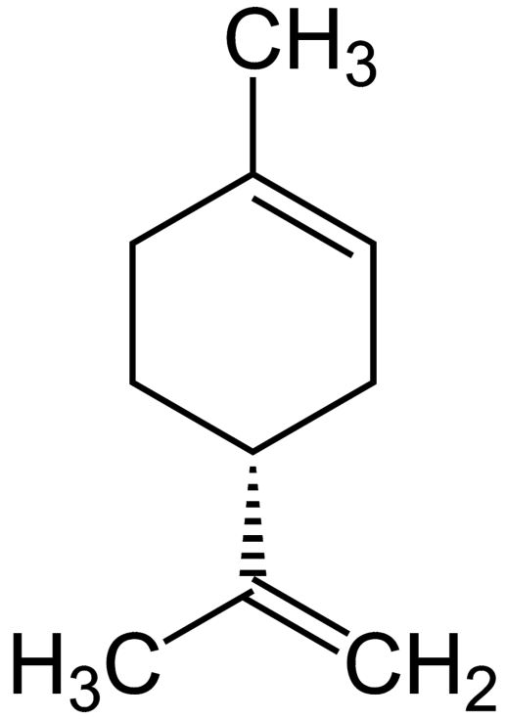
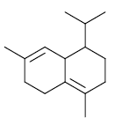
MONOTERPENE
LIMOLENE
(in the Orange Peel)
SESQUITERPENE
δ KADILENE

Slide 28
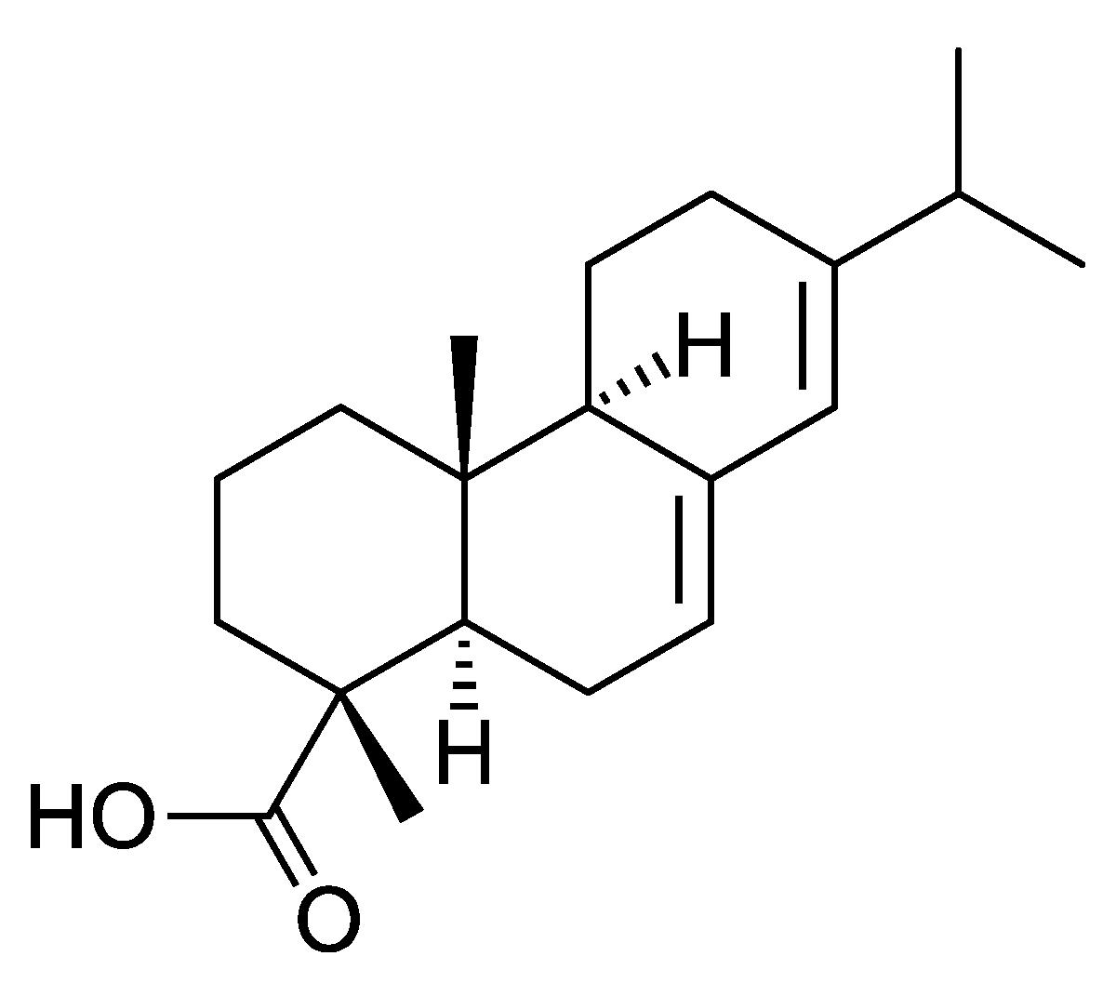
DITERPENE
Abietic Acid

Slide 29
The most important natural Resins
Physical and Chemical Properties of the natural Resins
Resin | Acid Number (mg KOH/g) | Saponification Number (mg KOH/g) | Iodine Value (% I₂/g) | Softening Temperature (°C)
Colophone | 140 – 180 | 147 – 195 | 200 - 225 | 73 – 79
Venice Turpentine | 75 - 95 | 105 - 120 | 120 - 145 | 136 – 138
Sandarac | 130 - 150 | 180 - 200 | 70 - 100 | - 120
Copal Mannila | 130 - 150 | 180 - 200 | 70 - 100 | - 120
Damara | 25 - 40 | 35 - 40 | 55 - 65 | 84 – 86
Mastix | 60 - 65 | 85 - 100 | 70 - 85 | 73 – 74
Shellac | 40 - 60 | 200 - 250 | 4 - 10 | 82 - 88

Slide 30
Natural Resins – an Example
Fir Trees > PINE
> Turpentine BALSAM (DISCHARGE)
> DESTILATION of the Essential/Ethereal Oils > Turpentine > Thinner (Diluent ) of the Boiled linseed Oil and Oil’s based Paint
> The Rest after DESTILATION (Bottoms) is the RESIN = COLOPHONE

Slide 31
COLOPHONE
Hard and Brittle at Room Temperature
It is changing Hard to Soft at approx. 70 °C
It melts at approx. 120 °C
It is soluble in the Alcohols, Esters, Aromatics, Chlorine substituted Solvents, Ketones, Turpentine etc.
It contains mostly Abietic acid > its Oxidation results as the Brittleness, Reduction of the Solubility etc.
It is soluble in the Alkali > RESIN’S SOAPS
Co⁺² Salts > SICCATIVE
Cu+2 Salts > Pigment & SICCATIVE
Hot Melts
Soldering > it destroys the Oxide’s Layers

Slide 32
COLOPHONE (eng. Rosin or Colophony or Greek Pitch, Yellow Rosin)
Colophony or Greek Pitch > it is derived fro the Old Greek Town Colophon, fames for the export of the COLOPHONE
Other uses:
Surface Treatment of the Violin Bow to increase the Friction with the Strings
If mixed with some Waxes is used for Iron on the old paintings to the new under laid Canvas (Textile) > RENTOALAGE
Pharmacy
Food Industry
.............

Slide 33
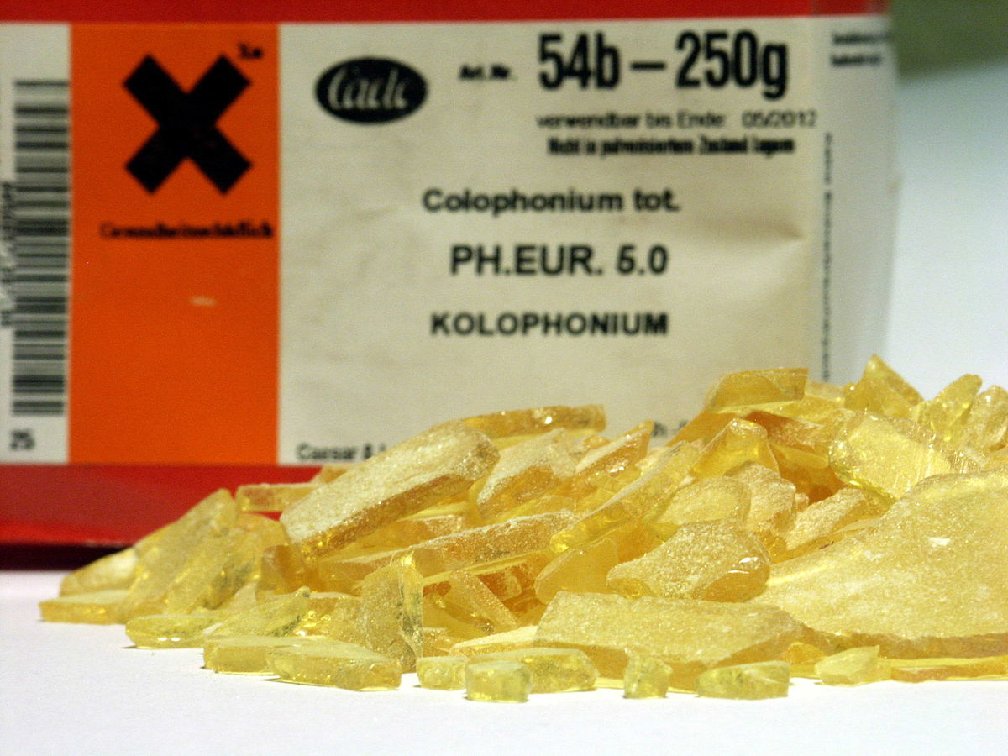
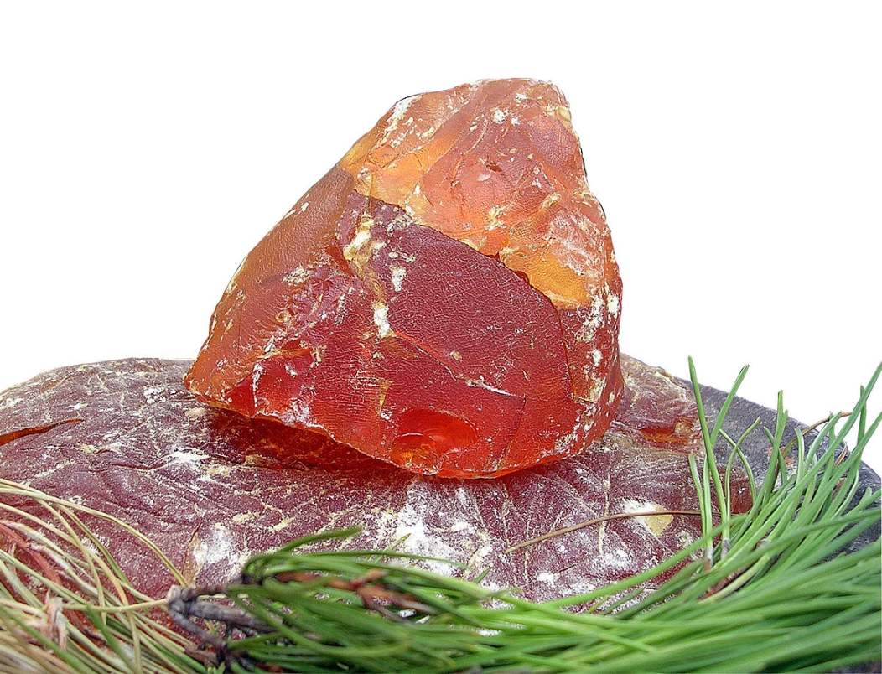
COLOPHONE (eng. Rosin or Colophony or Greek Pitch)

Slide 34
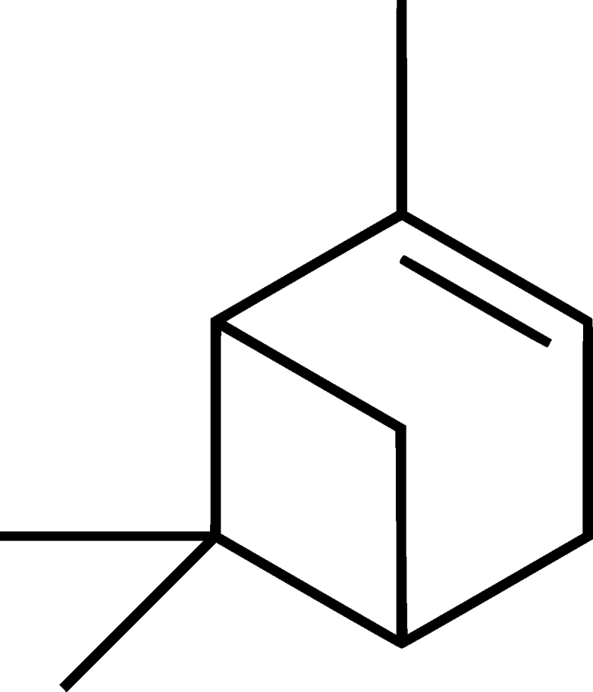
Essential/Ethereal Oils Example - Turpentine
The main Components are PINENE (α, β)
Solvent for the Oils based Paints
As the Mixture with the Beeswax or the Carnauba Wax is used as the Furnace Polishing Agent
Synthesis of the fragrant Substances, e.g. Camphor

Slide 35
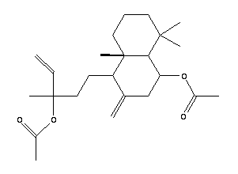
Venic (Venetian) Turpentine
Add to oil paints, mediums and varnishes for an exquisite jewel-like quality and tough, enamel-like surface. Derived from European larch trees, this resin has the CONSISTENCY OF HONEY and is offered in its pure, undiluted state. Dilute with 20% turpentine and use sparingly to a 5% maximum of the total paint mixture.

Slide 36
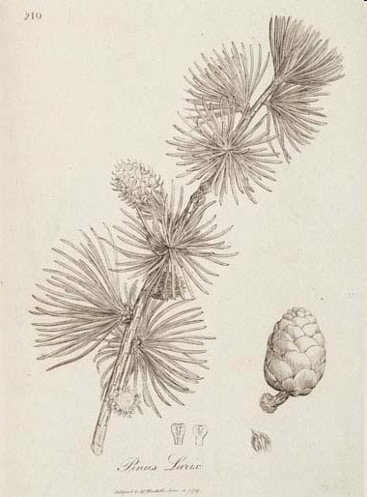
Venic (Venetian) Turpentine
European Larch

Slide 37
Some Remarks more
The Trivial Names are most common in the Chemistry of the Natural Substances, frequently related to the place of the Occurrence of the Substance in Question
There are also the other Substances besides the main Natural Substances (Polymers) in the common Natural Substances Samples (Materials)
The Composition and the Amount of the accompanying Substances are related to the Substance’s Source and Place of the Origin, the harvesting Season etc.

Slide 38
Let’s go to the other RESINS and BALSAMS (DISCHARGES)
DITERPENOIDE RESINS

Slide 39
Let’s go to the other Resins & Balsams (DISCHARGES)!
Canada Balsam (Balsam of Fir)
It is taken from the Canadian Fir
It is used for the Assembling of the Optical Devices, because having very suitable refractive Index, very close to that of the optical Glass
Venic (Venetian) Balsam
It is taken from the European Larch
It forms the Glossy not yellowing Film
It was used in Painting (Oil Painting) in the time of Rubens already, mixed with the Nuts Oil and Mastix

Slide 40
Copal

Slide 41
Copal is a name given to tree resin, particularly the aromatic resins from the copal tree Protium copal (Burseraceae) used by the cultures of pre-Columbian Mesoamerica as ceremonially burned incense and for other purposes. More generally, the term copal describes resinous substances in an intermediate stage of polymerization and hardening between "gummier" resins and amber.
Copal is highly soluble in the EtOH and is (was) valuable ingredient in making a good wood varnish. It became widely used in the manufacture of furniture and carriages.

Slide 42
COPAL versus Novolacs Novolacs = Synthetic Condensate of Phenol + Formaldehyde
NOVOLACS are good soluble in the EtOH,
NOVOLACS resulting in the glossy and hard Paints (Coatings),
NOVOLACS can be used as the COPAL in the alcohol Varnishes, which were formerly called (in a simple Slang) only as „COPALS“,
NOVOLACS were sometimes used for the falsification of the genuine COPAL in the alcohol Varnishes

Slide 43
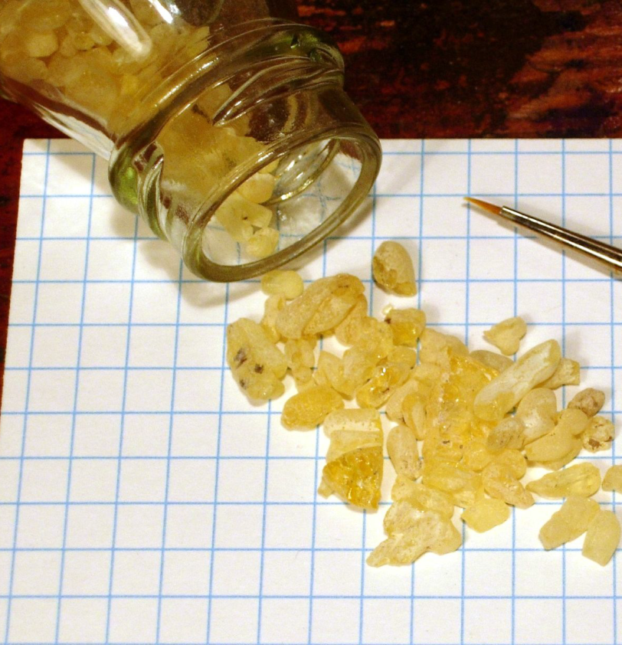
Sandarac
It is taken from the Coniferous Tree which is growing in the Nord Africa
It is used for the protective Coating on the Pictures and Antiquities
It is the Components of the Oil Varnishes, being soluble in the:
Turpentine,
Aromatics,
Amyl alcohol.

Slide 44
Let’s go to the other RESINS and BALSAMS (DISCHARGES)
TRITERPENOIDE RESINS

Slide 45
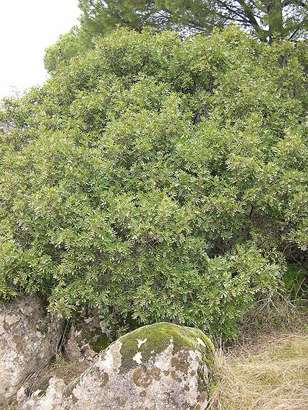
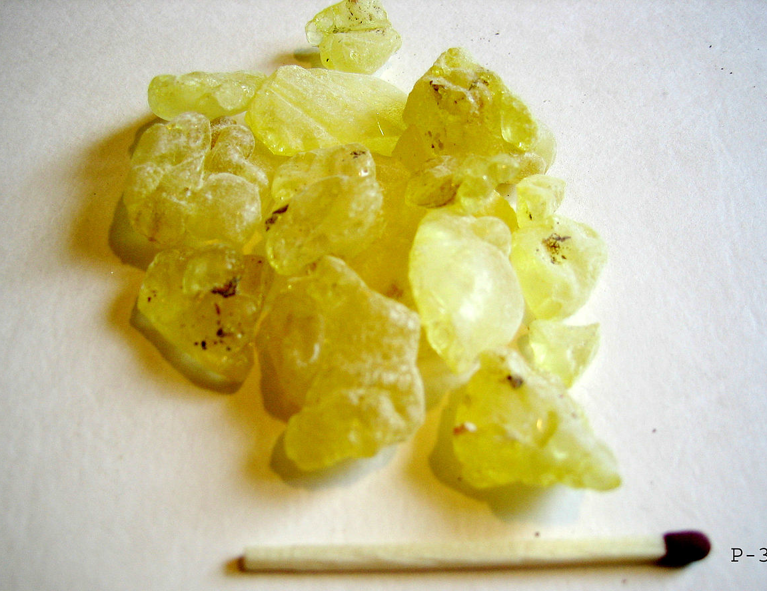
Mastic (Mastix)
Mastic (Mastix) is the Resin, which is taken from the little Bush MASTIC TREE (Pistacia lentiscus) growing on the Greek Island Chios.

Slide 46
Mastic is used in some varnishes. Mastic varnish was used to protect and preserve photographic negatives. Mastic is also used in perfumes, cosmetics, soap, body oils, and body lotion.
Chios Mastic is a known spice in the Eastern Mediterranean. It is commonly used for baking and cooking, adding its aroma to foodstuffs such as brioches, ice-cream and other desserts. It is especially known to the Arabian cuisine, but recently mastic is also increasingly used in Japanese cooking.
One of the earliest uses of Mastic was as chewing gum; hence, the name. Mastic-flavored chewing gum is sold in Syria, Lebanon, Turkey, and Greece. Mastic is used in ice cream, sauces, and seasoning in Lebanon. In Egypt, mastic is used in vegetable preserves, in jams that have a gummy consistency, in soups, and in the preparation of meats. In Morocco, mastic is used in the preparation of smoked foods.
Mastic has been used as a medicine since antiquity and is still used in traditional folk medicine of the Middle East.
Mastic contains antioxidants and also has antibacterial and antifungal properties.
Mastic is the Components of the Oil Varnishes, being soluble in the:
Turpentine,
Aromatics,
Amyl alcohol.

Slide 47
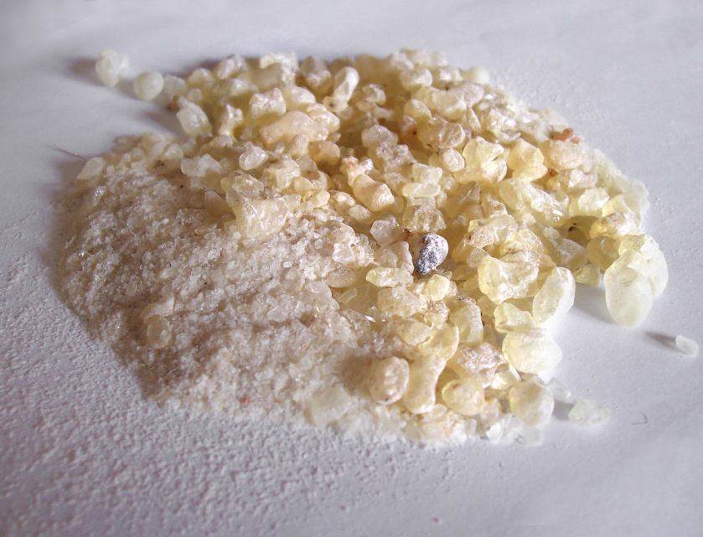
Dammar gum
DAMMAR GUM has a low IODINE VALUE > low Tendency to Yellowing and Polymerization
Dammar gum as the Component of the Varnishes gives them high Gloss
DAMMAR GUM is soluble in the: Turpentine, Alcohols, Ketones, Esters, …

Slide 48
DAMMAR, also called DAMMAR GUM, or DAMAR GUM, is a resin obtained from the trees in India and East Asia. Most is produced by TAPPING TREES, however, some is collected in fossilised form from the ground. The gum varies in colour from clear to pale yellow, while the fossilised form is grey-brown. DAMMAR GUM is a triterpenoid resin, containing a large number of triterpenes and their oxidation products. Many of them are low molecular weight compounds (dammarane, dammarenolic acid, oleanane, oleanonic acid, etc.), but dammar also contains a polymeric fraction, composed of polycadinene.
DAMMAR GUM is used in foods, as a clouding or glazing agent, and in incense, varnish and other products. Dammar varnish, made from dammar gum mixed with turpentine, was introduced as a picture varnish in 1826; commonly used in oil painting, both during the painting process and after the painting is finished.
Dammar crystals are also dissolved in molten paraffin wax to make batik, to prevent the wax from cracking when it is drawn onto silk or rayon.
Dammar crystals are dissolved into beeswax with pigment added to harden it in order to make encaustic paints.
Dammar resins were often used in the past to caulk ships, frequently together with pitch or bitumen.

