Slide 1
NATURAL POLYMERS Polysaccharide II CELLULOSE 3
Cellulose is the most widespread BIOPOLYMER on Earth, up to 1,5×10⁹ tons per annum is arising
Dr. Ladislav Pospíšil

Slide 2
Time schedule
LECTURE | SUBJECT
1 | Introduction to the subject – Structure & Terminology of nature polymers, literature
2 | Derivatives of acids – natural resins, drying oils, shellac
3 | Waxes
4 | Plant (vegetable) gums, Polyterpene – natural rubber (extracting, processing and modification), Taraxacum_kok-saghyz
5 | Polyphenol – lignin, humic acids
6 | Polysaccharides I – starch
7 | Polysaccharides II – celullosis
8 | Protein fibres I
9 | Protein fibres II
10 | Casein, whey, protein of eggs
11 | Identification of natural polymers
 | Laboratory methods of natural polymers’ evaluation

Slide 3
Cellulose
ZnCl₂
Acetic & butyric acid anhydrides
H₂SO₄
&
HNO₃
Acetic acid anhydride
vulcanized fiber
Cellulose
nitrate
Cellulose Acetate
Cellulose Acetato
butyrate
Gun cotton
Films
Foils
Varnishes Acetate rayon/silk
Foils
Plastics
EXPLOSIVES
Colloidal cotton
(collodium)
Celluloid
Films
Varnishes

Slide 4
Cellulose
NaOH & CH₃Cl & CH₃CH₂Cl
or
Benzylchloride & monochloracetic acid
Cooper hydroxide Ammonium Complex (Schweitzer reagent)
NaOH & CS₂
Cellulosedithiocarbamate
Methylcellulose
Ethylcellulose
Benzylcellulose
Carboxymethylcellulose
Viscose
Cuprammonium Rayon
Viscose
Rayon
Cellophane
Glue
Thickener
Consume Goods

Slide 5
Cellulose Modification I
PRODUCT | PROPERTIES | USE
Regenerated Cellulose
Viscose | Similar to native Cellulose | Fibres
Cellophane | Transparent, colourless | Foils for Foodindustry and technical Use
Cellulose Acetate | Transparent, colourless, soluble in organic Solvents | Varnishes ,Glue, Foils , Cine-film (HISTORY), Fibres , ………
Cellulose Propionate | Similar to Cellulose Acetate, but higher temperature Resistance and Strength | Thermoplastic for engineering Parts and electrotechnics
Cellulose Acetobutyrate | Gloss, dimensional Stability, Light exposure Resistance | Varnishes, Injection Moulding (Glasses Frames, Furnace handles etc.)

Slide 6
Cellulose Modification II
PRODUKT | VLASTNOST | POUŽITÍ
Cellulose Nitrate | Nitration level accordingly, e.g. Camphor plasticized > Celluloid | Varnishes, Foils , Thermoplastic, EXPLOSIVES
Methylcellulose, ethylcellulose | Methylation level accordingly soluble in organic Solvents or in Water also, film forming, emulsifying Agent | Glues, emulsifying Agent, textile Sizing
Benzylcellulose | As the Methylcellulose and ethylcellulose | Varnishes, Electroinsulation
Carboxymethylcellulose | Colloidal and emulsifying Properties, soluble in hot Water, Sodium salt is soluble in the cold Water also | Glues, textile Sizing, protective Colloid, Thickener

Slide 7
Cellulose Modification III
PRODUKT | VLASTNOST | POUŽITÍ
Hydroxyethylcellulose | Film forming, soluble in Water and in the Mixtures Water + ethanol | Hair spray, Thickener for Paints (THIXOTROPIC EFFECT)

Slide 8
Cuprammonium Rayon
α Cellulose Content must be very high, > 95 %w/w and more
So that so called LINTRES (Cotton) having the α Cellulose Content up to 99 % w/w are used for this Technology

Slide 9
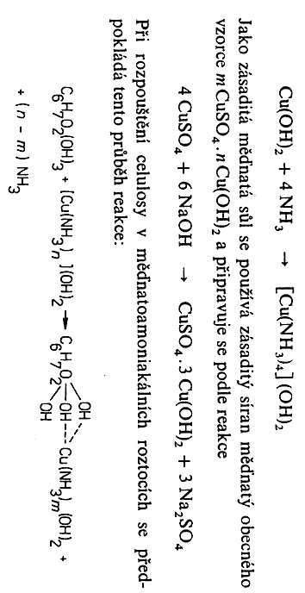
The Substance mCuSO₄.nCu(OH)₂ is used as the basic Salt and is prepared as follows:
The following Reaction course is supposed during Dissolution of Cellulose in the Cooper hydroxide Ammonium Complex (Schweitzers reagent):
Schweitzers reagent = Kuamox

Slide 10
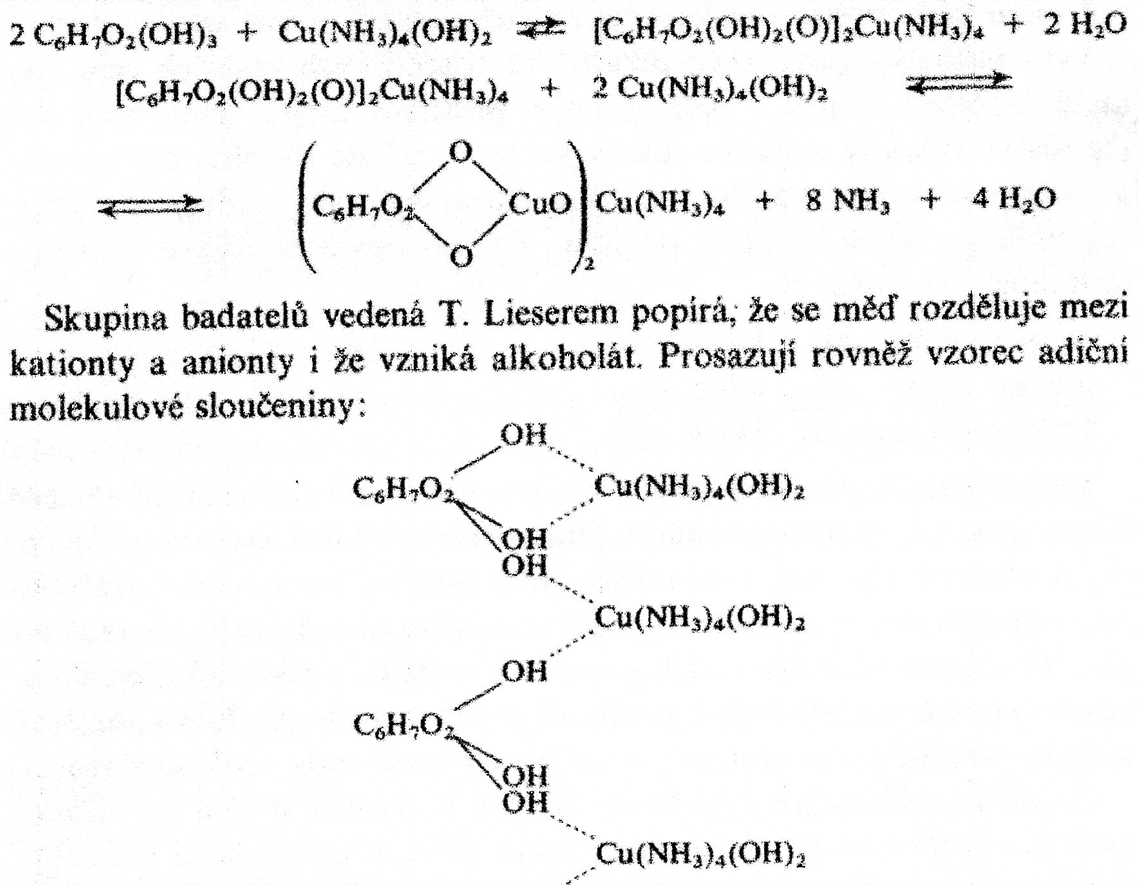
Another possibilities to express the Reactions course during Cellulose Dissolution are presented here (above & bellow)

Slide 11
Viscose Fibre
ALKALICELLULOSE –β and γ Cellulose are separated by PRESSING > THE Rest is α Cellulose (18 % w/w NaOH is used for this Process)
NaOH is separated from Hemicelluloses and lower MW Celluloses by Dialysis
α Cellulose Content should be 90 – 92 %w/w for Rayon and > 95 % w/w for Tire cord fabric
XANTOGENATION
ALKALICELLULOSE + CS₂ > SOLUTION
Wet Spinning to Coagulant (Precipitant)

Slide 12
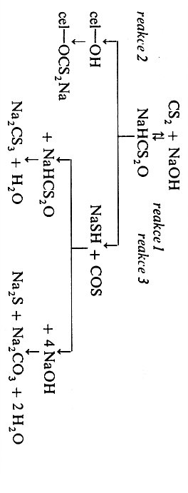
ALKALICELLULOSE
⇓
Xantogenation
Carbonylsulfide
SIDE REACTIONS
REGENERATION

Slide 13
The Reaction of NaOH with basic Cellulose Chain part (GLUCOSE) can go via two following Schemes:
This Reaction accordingly Cellulose forms with NaOH chemical Compound of alcoholates Type, in this Case CELLULOSATE:

Slide 14
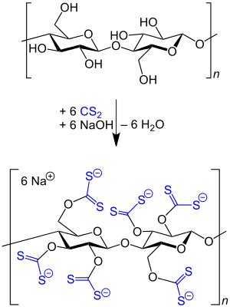
Carbons C6 are the most reactive, because having the lowest Steric Hindrance!
XANTOGENTION CELLULOSE
TRISUBSTITUTED Cellulose Derivatives is the maximal Substitution, because of Steric Hindrance of reaction possible Sites

Slide 15
Comparision of Cuprammonium Rayon and Viscose Fibre
Schweitzers Reagent
CELLULOSE XANTOGENATE
ALKALICELLULOSE
REGERATED CELLULOSE

Slide 16
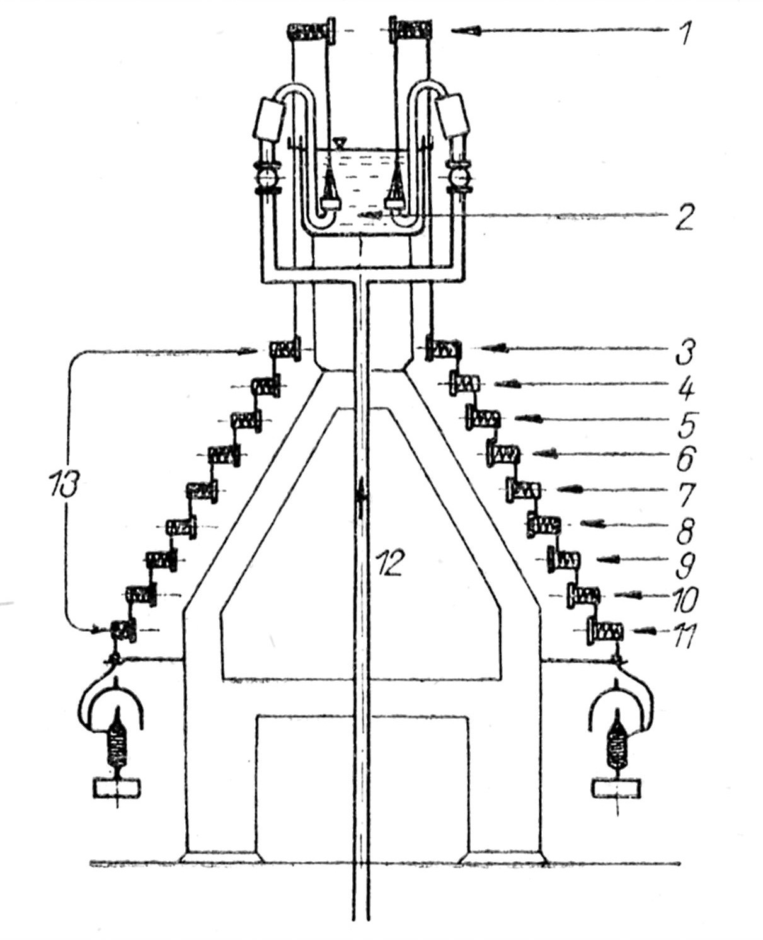
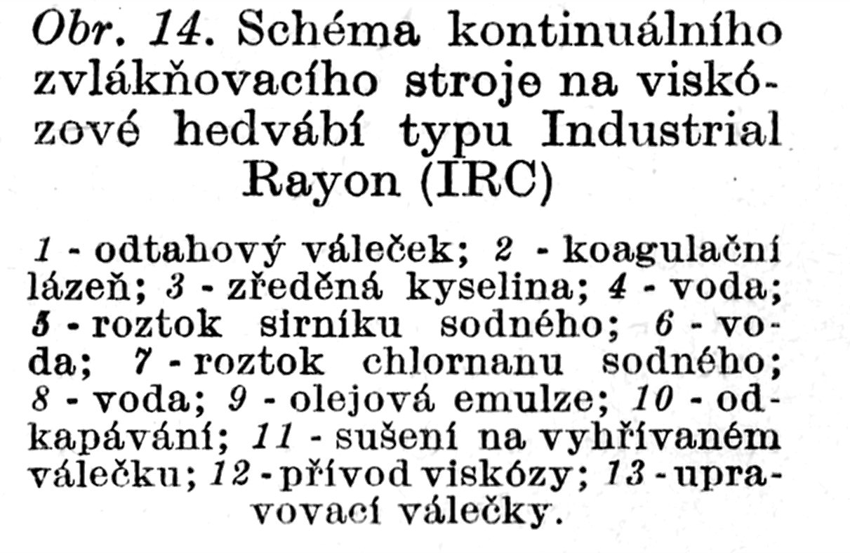
It was approx. 50 years ago:
Viscose Fibre was the Dominant Manmade type
Technology was developed up to almost Perfection
Why is it today the only minor Fibre one?
Technology INDUSTRIAL RAYON Scheme of the Continuous Spinning of Viscose

Slide 17
Why is it today the only minor Fibre one?
Technological demanding character
Too much Technological production Steps
Time consuming, Process is very long-lasting
Solvents’ Regeneration is necessary
Expences
Technology has many complicated Machines
Solvents’ Regeneration
Environment Protection
CS₂
Europe didn’t invest to e.g. Multi-skin Buildings and/or CS₂ Adsorption or Absorption

Slide 18
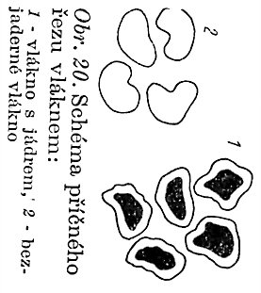
Slowly Precipitation (Coagulation) > uniform Structure in Fibre Crosscut > HIGHER TENSILE STRENGHT > TIRE CORD
SKIN
CORE with different Structure
Fibre Crosscut Scheme:
Fibre with Core
Fibre WITHOUT CORE

Slide 19
Current us of VISCOSE CORD
CORD = Rayon of extremly high TENSILE STRENGHT
Manufacture of CARBON FIBRES:
PAN (polyacrylonitrile) – the main Raw Material today
Black Coal-tar pitch (By-product in Production of Coke (Coking plant)) – the minor Raw Material today
Viscose Cord – the IGNORED Raw Material today
Viscose Cord – Tire carcass (formerly)

Slide 20
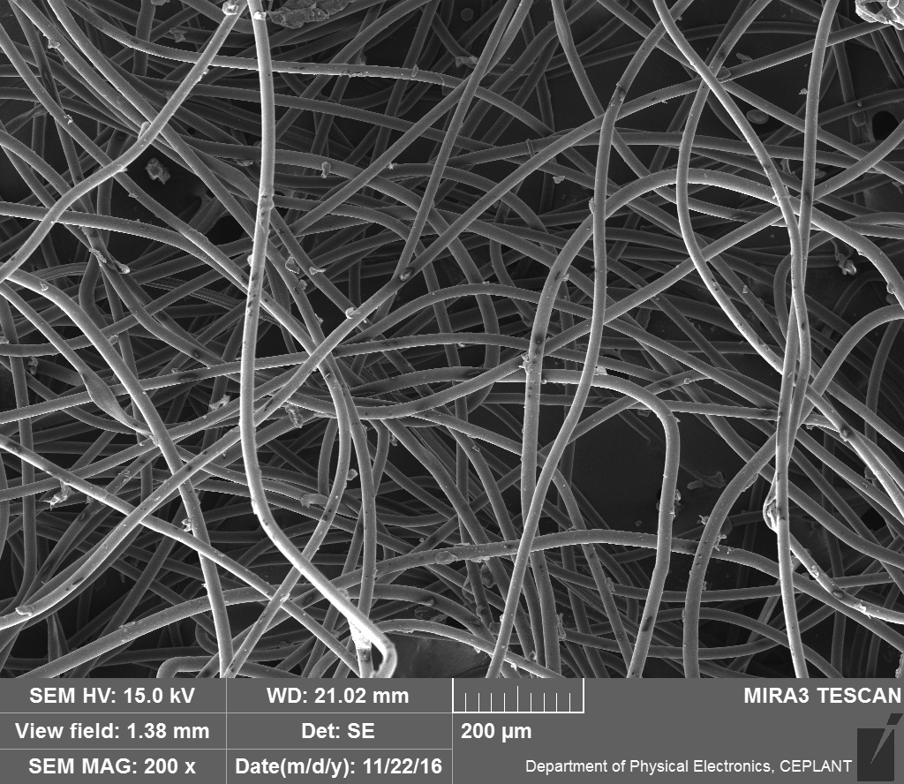
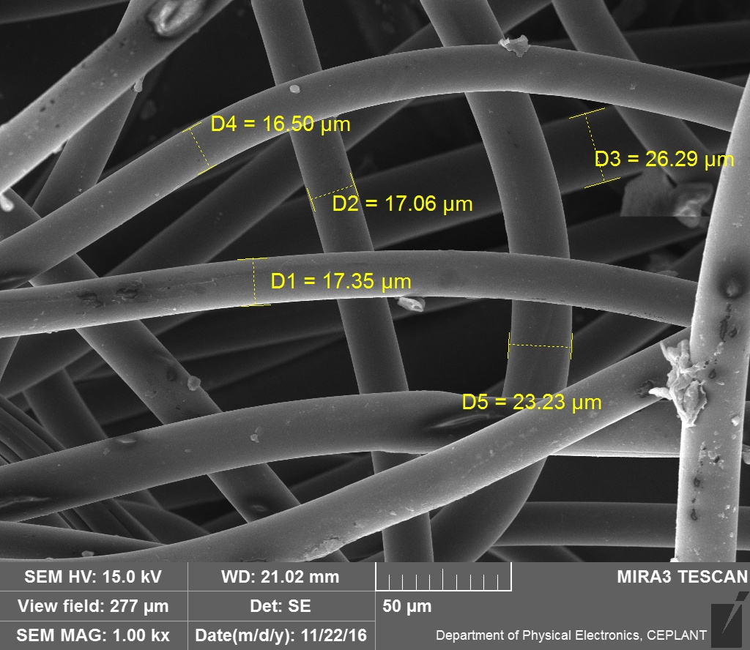
Viscose Rayon
Nonwoven Textile

Slide 21
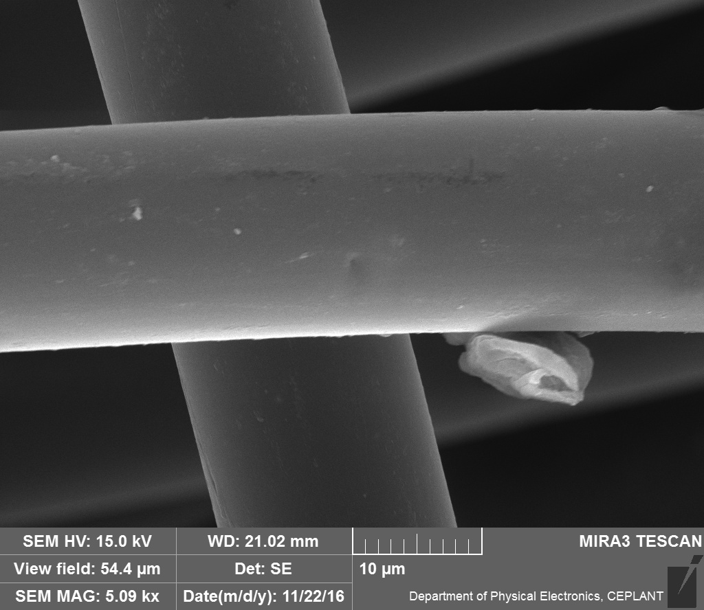
Viscose Rayon
Nonwoven Textile

Slide 22
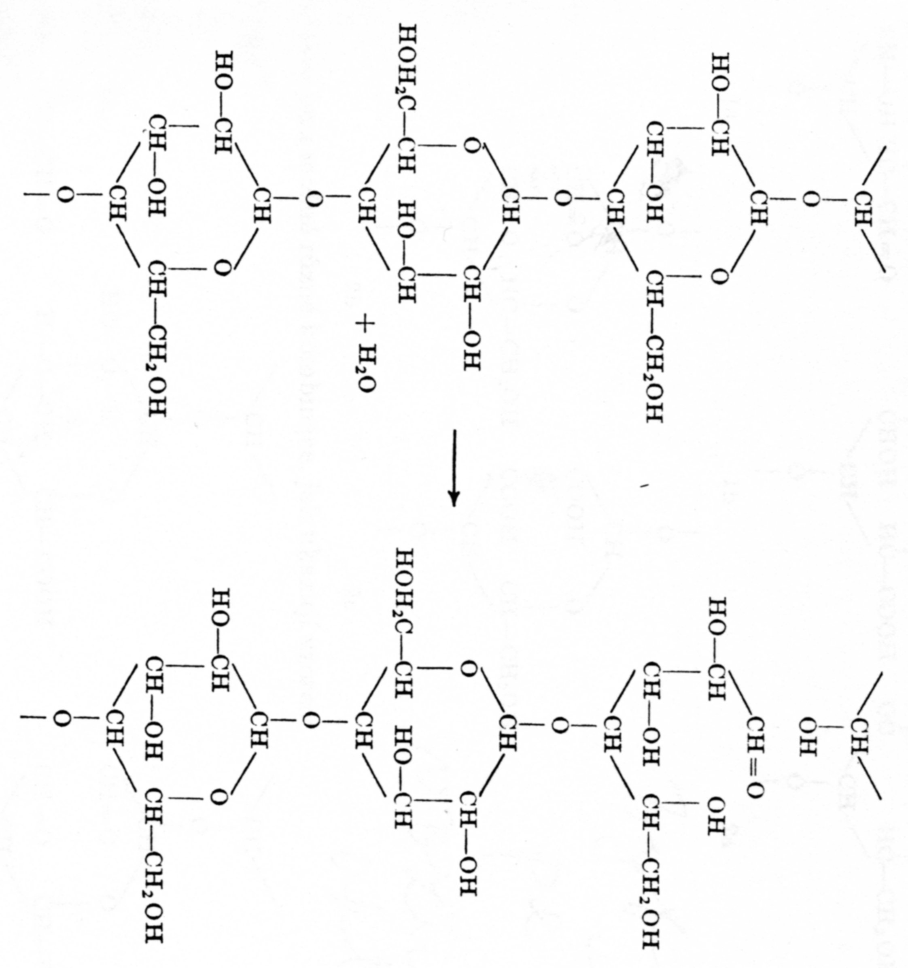
Cellulose hydrolysis 1
Catalysed mainly by INORGANIC ACIDS
(HCl, H₂SO₄)
CHAIN Scission

Slide 23
Cellulose hydrolysis 2
Catalysed mainly by INORGANIC ACIDS
(HCl, H₂SO₄)
It is sufficient to prepare Cellulose by 1 % Solution of these Acids and dry at 60 – 70 °C
The Result is so called HYDROCELLULOSE, having the lower MW > the Reaction see the last Picture
HYDROCELLULOSE has other Properties:
It gives the REDUCING SACCHARIDES REACTION > the ENDGROUPS after Scission are ALDEHYDES
It has higher Solubility in Alkalis (NaOH), MW accordingly

Slide 24
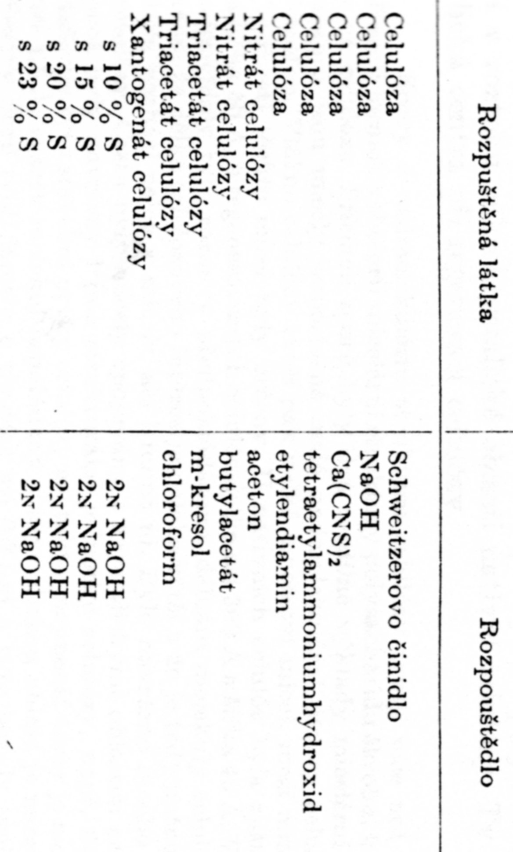
Cellulose Solvents
The Derivatives of Cellulose are presented in this Table mostly!
Dissolved Substance
Solvent
This was found out be me in the Original literature only!
The latest Trends:
IONIC LIQUIDS,
METLS OF SOLTS (e.g. ZnCl₂ . 4H₂O.

Slide 25
What were the REASONS to start the Production of Viscose Rayon?
ENDLESS FIBER
Substitution of the Natural Silk
It can coloured in Mass
Possibilities of the various Diameters
Possibility to control the Mechanical Properties by Drawing etc.
Utilisation the other sorts of Cellulose then the Cotton only
???????????????

Slide 26
Oxidised Cellulose
Company SYNTHESIA Pardubice (Czech Republic) > Trade name OKCEL
POWDER
TEXTILE
Use
Medicine – haemostatic (styptic) agent, absorbable Covering of the open wound
Technical –Varnishes, foils (films), ……..
Production Technology
Cotton Oxidation
H₂O₂, HNO₃, Hypochlorite, …
Oxidised Cellulose Types (Kinds)
Changes of the main Chain done by Oxidation
Different Solubility in Water and in NaOH water Solution

Slide 27
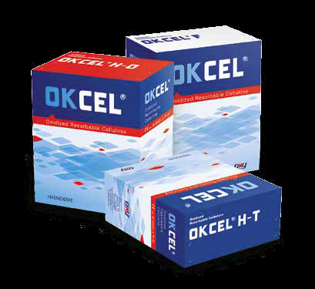
OKCEL: Humane Medicine and Surgery
OKCEL® is a quality oxidized cellulose based haemostat designed for
controlling internal bleeding during surgical procedures, includig minimally
invasive procedures. It is perfectly accepted by organism and fully absorbed.
Thanks to protection against infection, OKCEL® products help with the
tissue regeneration and thus enhance the healing effect. OKCEL® products
are available in various sizes and shapes and can be customized to meet
individual customer requirements.
OKCEL® H-T
heavy duty textile form of oxidized cellulose
OKCEL® H-D
cotton wool form of oxidized cellulose
OKCEL® F
cotton wool form of oxidized cellulose

Slide 28
Oxidised Cellulose – basic Description of Oxidation Process 1

Slide 29
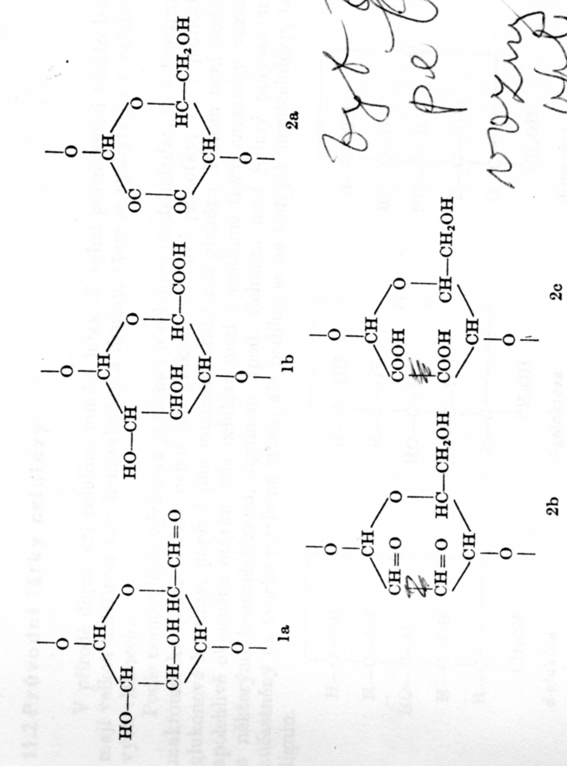
Oxidised Cellulose – basic Schema of Oxidation Process 2

Slide 30
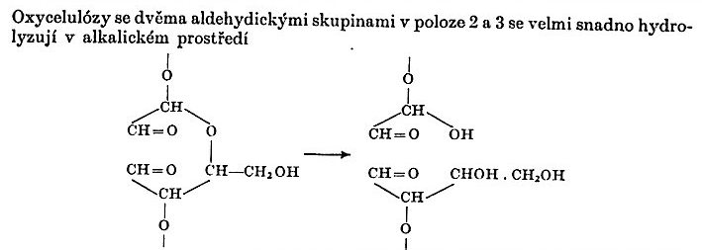
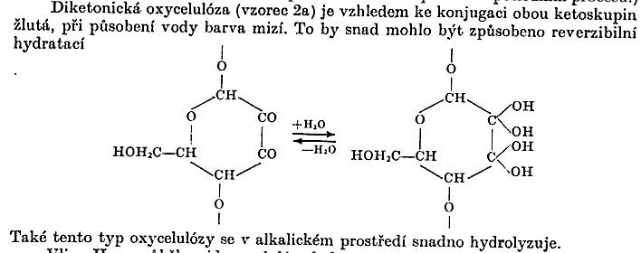
Oxidised Cellulose with two to aldehydic Groups (-CH=O) in the Positions 2 and 3 is very easy to hydrolyse in the alkali Medium
Diketonic Oxidised Cellulose is due to Conjugation of both Ketogroups yellow, the Water have effect on this Colour, which is dissipating. It could be caused by a reversible Hydratation.
This type of the Oxidised Cellulose is also easy to hydrolyse.

Slide 31
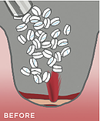
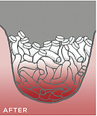
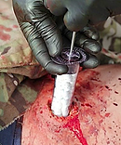
Cellulose haemostatic (styptic) agent
XStat® is a first-in-kind hemostatic device for the treatment of gunshot and shrapnel wounds. XStat works by injecting a group of small, rapidly-expanding sponges into a wound cavity using a syringe-like applicator. Each sponge contains an x-ray detectable marker. In the wound, the XSTAT sponges expand and swell to fill the wound cavity within 20 seconds of contact with blood. This creates a temporary barrier to blood flow and provides hemostatic pressure.
US Patent 8,828,050 B2

Slide 32
Podrobný popis výrobku Kompres Medicomp nester.10x10cm/100ks 4218251
Kompres z netkaného textilu Medicomp může být v mnoha oblastech na oddělení i v ambulanci vhodnou alternativou ke klasickému mulovému kompresu.
Kompresy z netkaného textilu Medicomp z 60 % viskózy a 34 % polyesterových vláken mají otevřenou, mulu podobnou strukturu. Proto mají velmi dobrou savou schopnost, jsou měkké a prodyšné. Netkaný textil je čistě mechanicky stabilizován a bez pojidel i optických bělicích látek. Pro hospodárné použití jsou k dispozici kompresy z netkaného textilu Medicomp s různým počtem vrstev a s rozdílnými rozměry, sterilizované pro přímé použití i nesterilizované. Speciálně k ošetření ran s drenáží, při tracheotomiích a extenzích i jako ochrana při aplikaci kanyl a sond jsou k dispozici kompresy z netkaného textilu Medicomp Drain ve tvaru Y.
Ke všeobecnému ošetření ran; jako tampon a jako kompres při ambulantních a stacionárních zásazích.

Slide 33
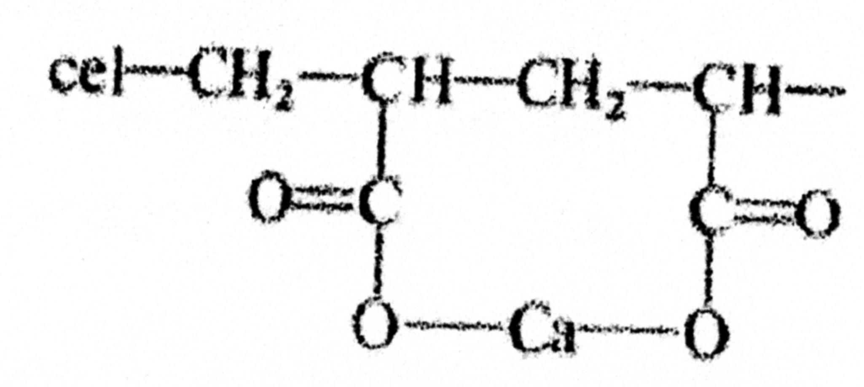
Cellulose GRAFTING to get Haemostatic (styptic) agent
Cellulose GRAFTING by ACRYLIC ACID
The Haemostatic (styptic) is done by influence of Ca⁺² Salt of the Acrylic Acid

Slide 34
Nitrocellulose 1
Company SYNTHESIA Pardubice (Czech Republic) > an Example >>>
Industrial nitrocellulose type A
Nitrocellulose type A with nitrogen content 10,6-11,3% is characteristic with good solubility in alcohol-type solvents and good solubility in ethyl alcohol (up to 100 %). It forms films with Available wetting agents: ethanol, isopropanol, water – 30 or 35%. thermoplastic and good mechanical properties
Use
Explosives
Civilian – Plastics, Varnishes, Foil, ……..
Manufacture Technology
Oxidation of Wood Pulp or Cotton
HNO₃
They are ideal for wood finishing, metal, leather, coating lacquers, for production of printing inks, nail varnishes and membranes.
The manufacturing programme consists of two basic type ranges of industrial nitrocellulose, differing in their nitrogen content, viscosity, solubility in solvents and resulting nature of the film.

Slide 35
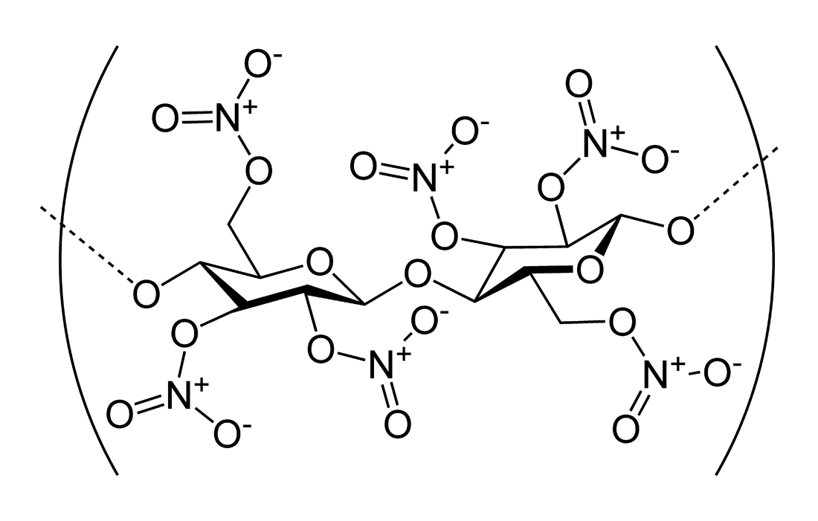
Nitrocellulose 2
Collodium is a Solution of Nitrocelluose in ether and ethanol, having a syrup like Consistency used in Surgery as a „Liquid bandage" and for a Holding of a Covering on a given Place. Applied on the Skin, it forms the dry elastic Cellulose Film.
The ACRYLATES are currently used for this Purpose as the Spray also.
Nitrocellulose having high nitration Level
Pyroxylin = another ENGLISH name for Nitrocellulose

Slide 36
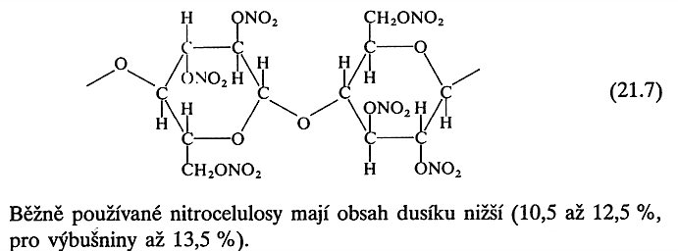
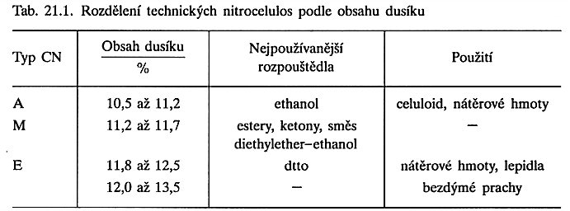
The currently used Nitrocellulose has the Nitrogen content lower. Approx. 13,5 % w/w for the Explosive and 10,5 – 12,5 % w/w for the Civilian use.
Dividing of the Nitrocellulose based on the Nitrogen content (An EXAMPLE ONLY!)
Nitrocellulose Type | Nitrogen content (% w/w) | Mostly used Solvents | Use
A | 10,5 – 11,2 | Ethanol | Celluloid, paints (Varnishes (lacquers))
M | 11,2 – 11,7 | Esters, ketons, mixture of diethylether - ethanol | Paints (Varnishes (lacquers))
E | 11,8 – 12,5
 | 12,0 – 13,5 | --- | Explosives

Slide 37
Nitrocellulose 3
Solvent Varnishes (lacquers)
The lower Nitrogen Content > Solubility in EtOH and Aromatics > POLISHES
The middle Nitrogen Content > Solubility in ethylacetate & butylacetate > nitrocellulose lacquer > quick-drying >Hard layer
If a more elastic film is necessary > ELASTIC AFTER ADDITION OF PLASTICIZERS > PTHALATE PLASTICIZERS
Former USE was also:
Car organic Solvent Varnishes (lacquers) > Water based materials now
Ski Runner organic Solvent Varnishes (lacquers)

Slide 38
Nitrocellulose 4/1 - CELLULOID
Nitrocellulose wetted by Alcohol (100 weight Parts) s mixed in a kneading Mixer with Camphor (27 to 33 weight Parts) and the other Ingrediens (Plasticizers, Pigments, Colouring agents, Stabilizers) are added and this all is further mixed. To get good homogeneity, some Ethanol is further added. It is mixed at 40 – 50 °C for several Hours. The Filtration is the next Step. The Ethanol is evaporated during kneading at two Roll mill, at which the Homogenisation is finished. The Matter is then fully Gelantioned. The Calendered Sheets are hot pressed to a desired Thickness and after it are dried at 30 – 50 °C for several Hours to remove the Rest of the Ethanol. The last Manufacture step is a Polishing.
An Advantage of the Celluloid is very good colourability, possibility of do various Graving and easy Processing. A Disadvantage is Flammability and the Manufacturing labour intensity. The freshly made Celluloid has the Camphor smell, which is lowering in the course of time. The Celluloid is soft and mouldable after heating to approx. 70 – 100 °C (Thermoforming). It is decomposed at temperatures over approx. 170 °C. Its Importance and Production volume is lowering steadily.
Made of Celluloid: Combs,Table tennis Balls, Art Products etc.

Slide 39
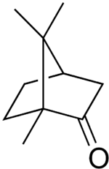
Nitrocellulose 4/2 - CELLULOID
GENERAL
Systematic name | 1,7,7-trimethylbicyklo[2.2.1]heptan-2-on
Anglický name | Camphor
Summary formula | C₁₀H₁₆O
Appearance | White crystalsy, aromatic smell
Identification
Registration number CAS |  | 76-22-2
properties
Molecular weight |  | 152,23 g/mol
Mlting point |  | 175-177 °C
Boliling temperature |  | 204 °C
Density |  | 0,990 g/cm³
Solubility in water |  | 1,2 mg/l
Camphor

Slide 40
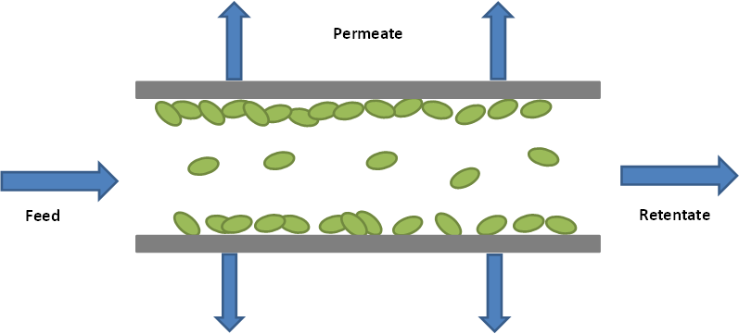
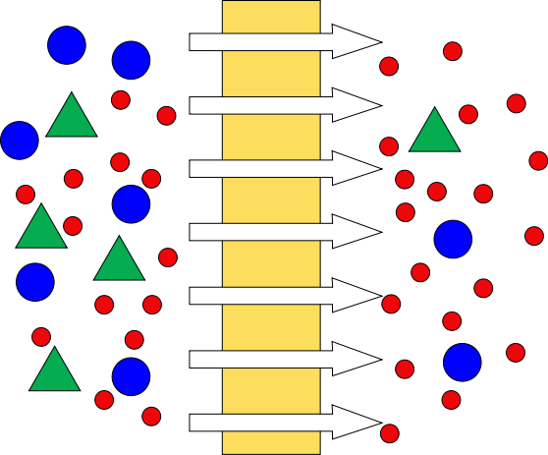
Nitrocellulose 5 - ULTRAFILTRATION
ULTRAFILTRATIONS, so called also as MEMBRANE FILTRES, are the Micro porous films manufactured by Casting of the Nitrocellulose Solution. Their filtration Efficiency is done by the presence of the Ultrafine pores, being of 0,1 – 5,0 mm.
An Example
Pores diameter (μm)
Diameter range
(μm) Diameter mean
Value (μm)
0,1 – 0,3 0,25
0,3 – 0,5 0,40
0,6 – 0,9 0,85
1,0 – 1,2 1,1
2,0 – 5,0 ---

Slide 41
CELLOPHAN
Manufacturing similar to Viscose Rayon, it is from Solution, but by Casting from the flat Die to the Precipitant
Film is brittle > so it is plasticized by Glycerol (approx. 10 – 15 % w/w)
It is often surface treated by Nitrocellulose Varnish > Food Wrap and Cigarette Wrap (BOPP now)
It is mouldable after Moistening > Capping of the Glasses etc.
Water Vapour permeable after Moistening SEMIPERMEABLE MEMBRANE > HEMODIALYSIS (Formerly)

Slide 42
α Cellulose Content must be high, approx. 89 – 90 %w/w for the Manufacture of CELOPHANE
CELULOSE
XANTOGENATION
Once more this Schema

Slide 43
Acetát celulózy > vlákna, plasty
Kdysi vyráběla SYNTHESIA Pardubice
Nyní např. www.mazzucchelli.it > pro designové výrobky, např. brýle

Slide 44
Cellulose Acetate > Fibers, Plastics
A Current producer e.g. www.mazzucchelli.it > for design Products, e.g. Glasses Frames

Slide 45
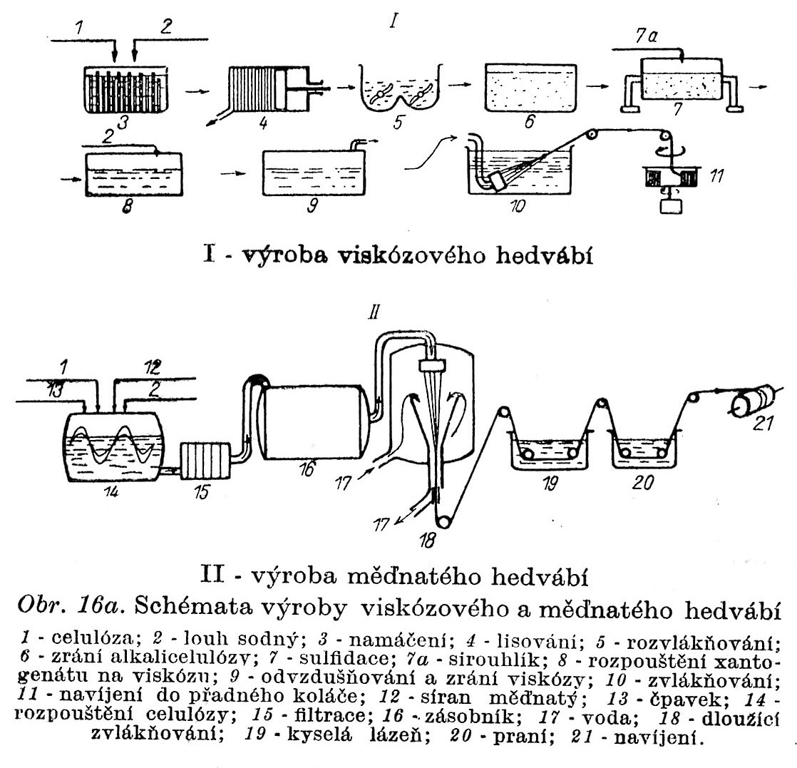
Cellulose based Fibres – Manufacture Schemas I
VISCOSE Rayon Manufacture
Cuprammonium Rayon Manufacture
1) Cellulose, 2) NaOH Solution, 3) Caustic dip, 4) Pressing, 5) Fibrillation, 6) Alkalicellulose Maturing, 7) Sulfidation, 7a) CS₂, 8) Dissolving Carboxymethylcellulose to VISCOSE, 9) Deaeration and Carboxymethylcellulose Maturing, 10) Spinning, 11) Filament Winding, 12) CuSO₄, 13) NH₃, 14) Cellulose Dissolving, 15) Filtration, 16) Tank, 17) Water, 18) Drawing Spinning, 19) Acid Liquor, 20) Washing, 21) Filament Winding

Slide 46
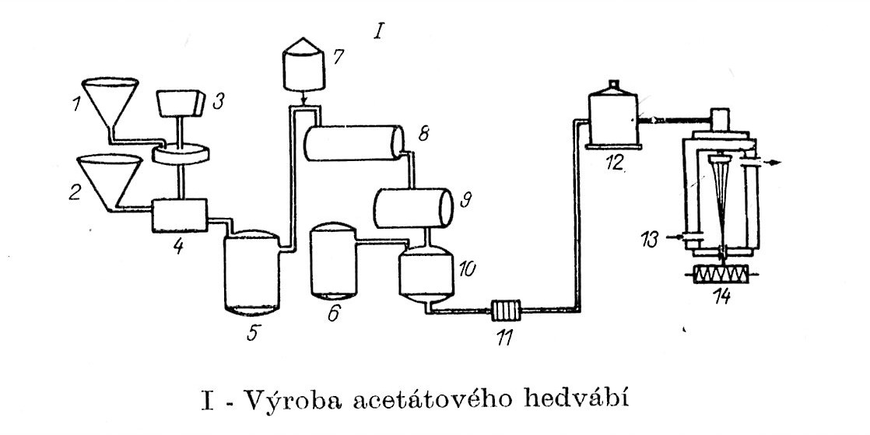
Cellulose based Fibres – Manufacture Schema II
Cellulose Acetate Rayon Manufacture
1) Acetic Acid, 2) Acetanhydride, 3) Cellulose, 4) Kneading, 5) Triacetate tank, 6) Acetone, 7) Water, 8) Precipitation, 9) Hydrolysis, 10) Dissolving of the Secondary Acetate, 11) Filtration, 12) Tank for the Spinning Solution, 13) Hot Air, 14) Spinning & Winding

Slide 47
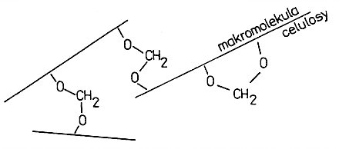
Vazba molekul celulózy > sesíťovaná vlákna
Vazba přes –OH skupiny na RŮZNÝCH ŘETĚZCÍCH JE ŽÁDOUCÍ
Vazba přes –OH skupiny na jednom řetězci není žádoucí
Umělý pergamen – H₂SO₄ > balení tuků
Vulkánfíbr – ZnCl₂ > kufry, složky

Slide 48
Fibers Crosslinking – molecular Schema
Forming the Bond via –OH Groups on Different Chains is desirable!
Forming the Bond via –OH Groups on the same Chain is Undesirable!
Artificial Parchment paper – Treatment by H₂SO₄ > Packaging of Fats
Vulcanized fibre – Treatment by ZnCl₂ > Luggage, Office letter folder

Slide 49
Microcrystalline Cellulose
Inertní látka pro přenos účinné látky léčiv a potravinových doplňků
Nakypřovací prostředek v potravinách
Vláknitá přísada do potravin

Slide 50
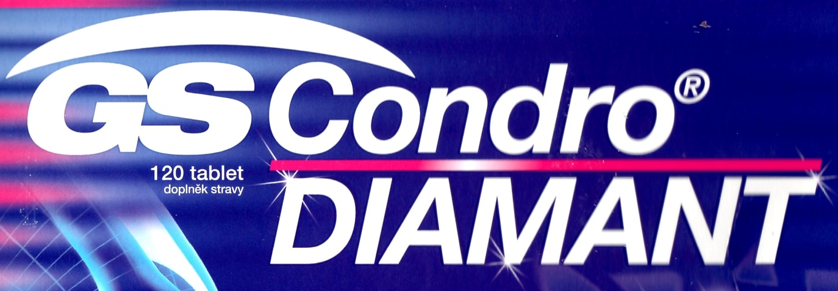
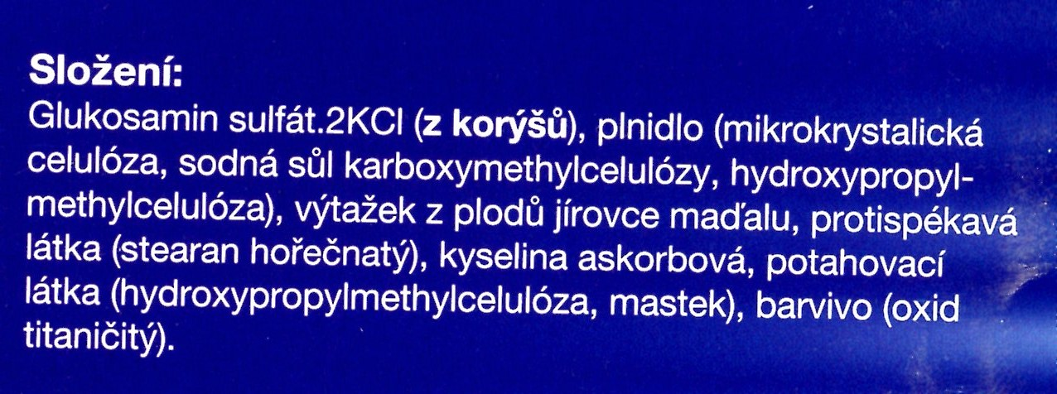
Cellulose Derivatives in Pharmacy
Neutral and Additive Substances based on the CELLULOSE

Slide 51
Nanocellulose
Nanocellulose, or microfibrillated cellulose (MFC)
is a material:
composed of nanosized cellulose fibrils with a high aspect ratio (length to width ratio). Typical lateral dimensions are 5–20 nanometers and longitudinal dimension is in a wide range from tens of nanometers to several micrometers. It is pseudo-plastic and exhibits the property of certain gels or fluids that are thick (viscous) under normal conditions, but flow (become thin, less viscous) over time when shaken, agitated, or otherwise stressed. This property is known as thixotropy. When the shearing forces are removed the gel regains much of its original state. The fibrils are isolated from any cellulose containing source including wood-based fibers (pulp fibers) through high-pressure, high temperature and high velocity impact homogenization (see manufacture below).
Nanocellulose can also be obtained from native fibers by an acid hydrolysis, giving rise to highly crystalline and rigid nanoparticles (generally referred to as nanowhiskers) which are shorter (100s to 1000 nanometers) than the nanofibrils obtained through the homogenization route. The resulting material is known as nanocrystalline cellulose (NCC).

Slide 52
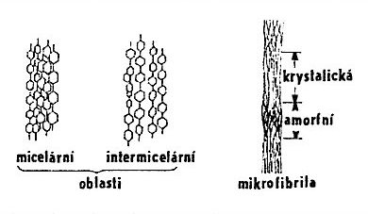
Supermolecular Structure of Cellulose I
crystalline
AMORPHOUS
Space between the Microfibrils is filled by HEMICELLULOSE & LIGNIN
Micellar Intermicellar
REGIONS
Microfibril
Fibrils are selectively broken in the AMORPHOUS REGIONS > CRYSTALLINE NANOPARTICLES ARE RESULTING
Hierarchy of STRUCTURES in CELLULOSE:
Macromolecule,
Microfibril,
Fibril,
LAMELAE.
AMORPHOUS CELLULOSE:
easy to swell
is more reactive than the crystalline one

Slide 53
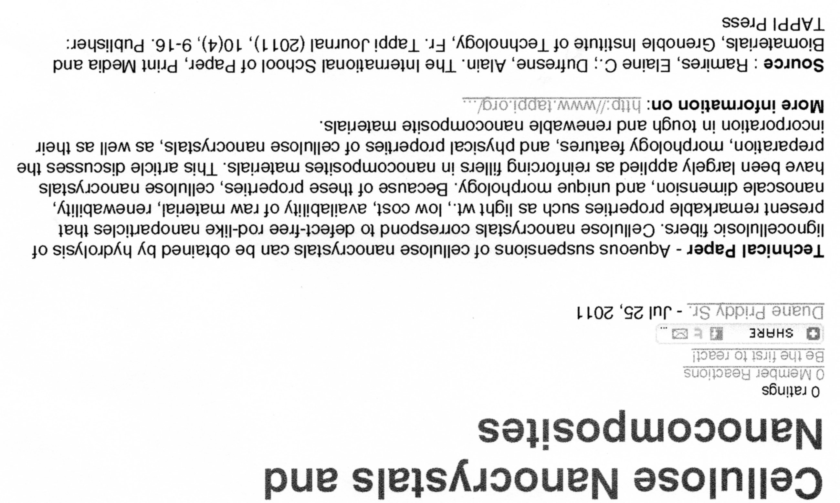
Nanocelulóze je věnována pozornost již MINIMÁLNĚ 10 let, hlavně ve Švédsku, Finsku a Norsku

Slide 54
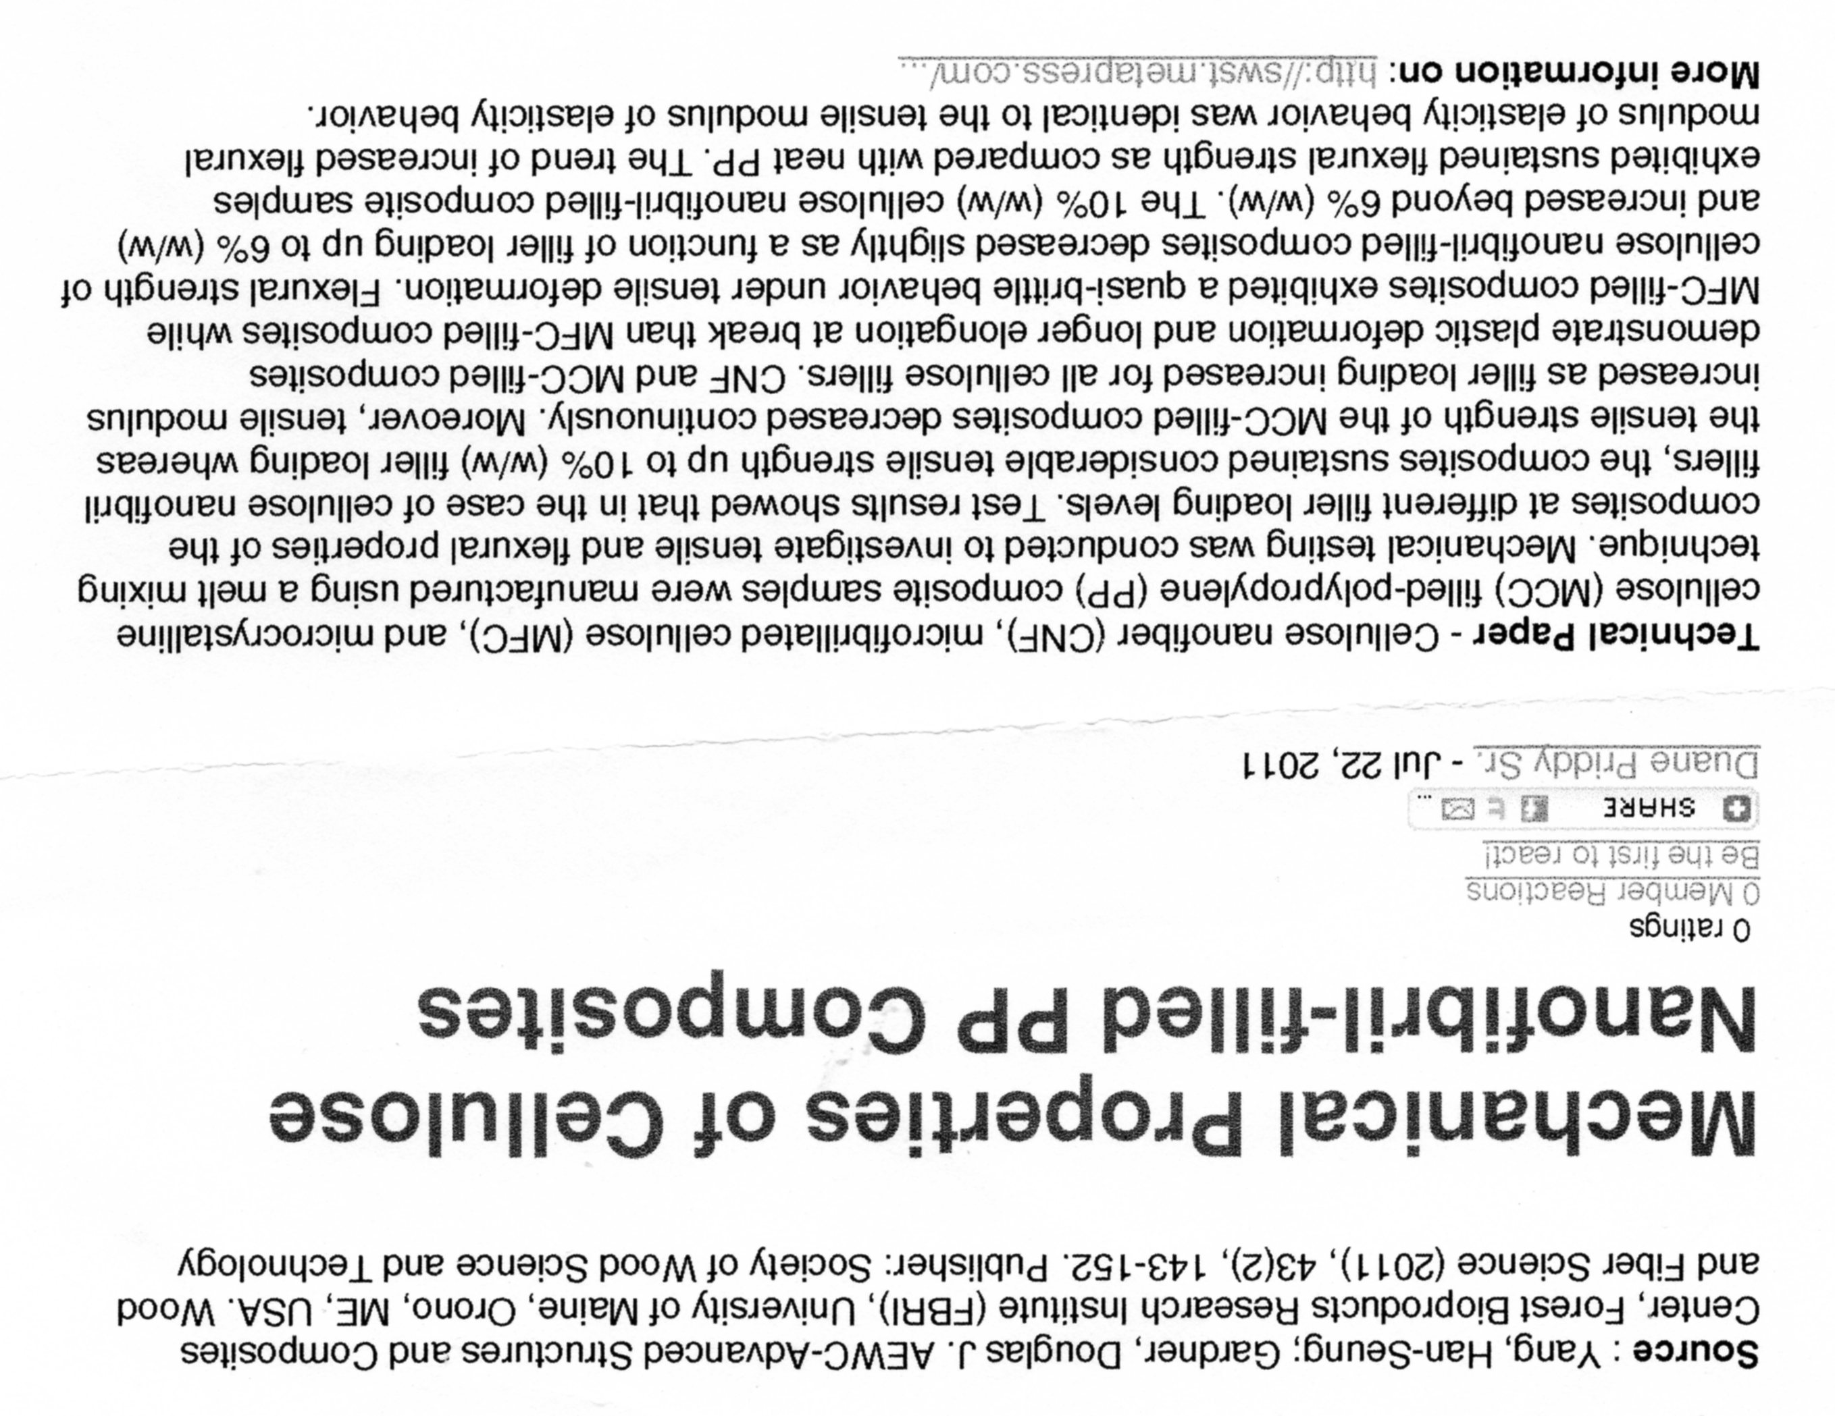

Slide 55
Nanocellulose
AFM height image of carboxymethylated
nanocellulose adsorbed on a silica surface.
The scanned surface area is 1 μm² >
FIBRES HAVE DIAMETER approx. 80 – 100 nm

Slide 56
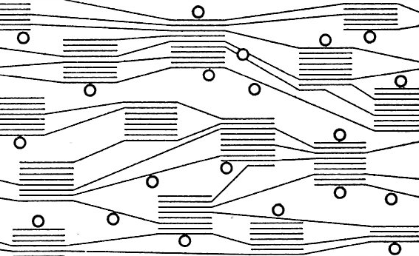
Cellulose as the IONEXCHANGER
Microstructure Schema of the Cellulose Fibres based Ion exchanger
Lines – Cellulose Chains, Circles - Ion exchanging Groups

