Slide 1
NATURAL POLYMERS 4 Lignin, Humic acids etc.
Dr. Ladislav Pospíšil
29716@mail.muni.cz

Slide 2
Time schedule
LECTURE | SUBJECT
1 | Introduction to the subject – Structure & Terminology of nature polymers, literature
2 | Derivatives of acids – natural resins, drying oils, shellac
3 | Waxes
4 | Plant (vegetable) gums, Polyterpene – natural rubber (extracting, processing and modification), Taraxacum_kok-saghyz
5 | Polyphenol – lignin, humic acids
6 | Polysaccharides I – starch
7 | Polysaccharides II – celullosis
8 | Protein fibres I
9 | Protein fibres II
10 | Casein, whey, protein of eggs
11 | Identification of natural polymers
 | Laboratory methods of natural polymers’ evaluation

Slide 3
Tree – Approximate Composition
PART | approx. % w/w
Tree stump + plant root system | 20
Branches | 15
Tree trunk – divided below | 65
Treetop | 5
Bark | 5
The only approx. 55 % w/w of the Tree BIOMASS is so converted to the Sawtimber or the Wood pulp!

Slide 4
COMPOSITION of the WOOD (ELEMENTS)
Component | Content approx. ( % w/w)
Carbon | 50
Oxygen | 42
Hydrogen | 6
Nitrogen | 1
Other elements | 1
COMPOSITION of the WOOD (Polymers & Oligomers)
Component | Content approx. ( % w/w)
Cellulose | 40 – 50
Lignin | 20 – 30
Hemicellulose | 20 – 30
Water | Up to 14
Other (e.g. Terpenes, Waxes, Rosins, Fatty acids, Resin acids, Pectines etc.) | The Rest to 100

Slide 5
WOOD – Approximate Composition
The chemical composition of wood varies from species to species, but is approximately 50% carbon, 42% oxygen, 6% hydrogen, 1% nitrogen, and 1% other elements (mainly calcium, potassium, sodium, magnesium, iron, and manganese) by weight.^{[21]} Wood also contains sulfur, chlorine, silicon, phosphorus, and other elements in small quantity.
Aside from water, wood has three main components. Cellulose, a crystalline polymer derived from glucose, constitutes about 41–43%. Next in abundance is hemicellulose, which is around 20% in deciduous trees but near 30% in conifers. It is mainly five-carbon sugars that are linked in an irregular manner, in contrast to the cellulose. Lignin is the third component at around 27% in coniferous wood vs. 23% in deciduous trees. Lignin confers the hydrophobic properties reflecting the fact that it is based on aromatic rings. These three components are interwoven, and direct covalent linkages exist between the lignin and the hemicellulose. A major focus of the paper industry is the separation of the lignin from the cellulose, from which paper is made.
In chemical terms, the difference between hardwood and softwood is reflected in the composition of the constituent lignin. Hardwood lignin is primarily derived from sinapyl alcohol and coniferyl alcohol. Softwood lignin is mainly derived from coniferyl alcohol.^{[22]}
Extractives
Aside from the lignocellulose, wood consists of a variety of low molecular weight organic compounds, called extractives. The wood extractives are fatty acids, resin acids, waxes and terpenes.^{[23]} For example, rosin is exuded by conifers as protection from insects. The extraction of these organic materials from wood provides tall oil, turpentine, and rosin.

Slide 6
WOOD –EXAMPLE OF STRUCTURE transversal sectional view
Anatomic Structure of the Coniferous species
J – Tracheides of the Spring Wood, L - Tracheides of the Summer Wood, S – Pitchy tubule

Slide 7
Ammonia
Formaldehyde
Methane
Hydrocarbones
HYDROGEN
Methanol
Synthese gas
Wood gas
Charcoal
Gas
Wheel grease
Wood oil
Fuels & Chemicals
Gasification
Carbonizing
WOOD
BIOMASS
Liquidizing
Glucose
Thermal energy
Incineration
Decomposition
Hydrolysis
Molasses
2-furalaldehyde
Sulfate
Sulfite
Natron
PROCESS
Pulping
Lignin
Paper
Cellulose fibres
Cellulose
Derivatives
Saccharides
Mechanical wood pulp Paper
Xylose
Pulp
Hemicelluloses
WOOD AS THE CHEMICAL RAW MATERIAL
Lignin
Thermal energy
The other routes of exploitation
Waste liquor

Slide 8
WOOD GAS as CHEMICAL RAW MATERIAL & FUEL from RENEWABLE SOURCES
Component (% vol.) | Mean value
O₂ in the Sample* | 1,815
CO₂ | 10,946
H₂ | 18,600
CO | 22,050
CH₄ | 1,620
N₂ | 44,000
Ar** | 0,569
ethane | 0,018
ethylene | 0,128
The other components | 0,254
SUM (Total) | 100,000
What is possible to be used for production of the
Wood gas?
Which are the Advantages versus Disadvantages of the Wood gas?
Wood gas in the HISTORY?

Slide 9
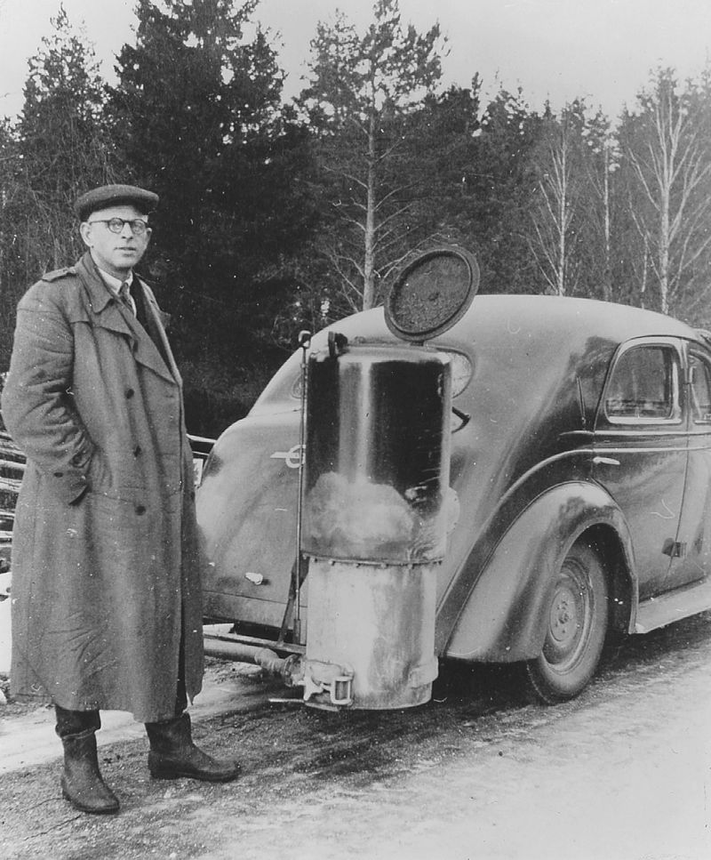

Slide 10
Manufacture of CELLULOSE
NATRON
SULFITE
SULFATE
WE GO THROUGT IT IN DETAIL LATER

Slide 11
Polyphenolic compounds
Polyphenols are a Group of Chemical Compounds contained in Plants. They are characterized by Presence more then one Phenolic unit or building block in a Molecule.
Polyphenols are divided in general:
Hydrolysable tannins (esters of gallic acid and glucose or the other sachcarides)
Phenylpropanoides, e.g. lignins,
Flavonoids
Condensed tannins

Slide 12
LIGNIN 1
The main NONcelullosis part of Wood (20 – 30 % w/w), coniferous tree has more Lignin then broad-leaved tree
It forms the adhesive component between celullose Fibres > WOOD is so the COMPOSITE MATERIAL!
Amorphous macromolecular substance , a Mixture of up to now not entirely revealed composition > there are many Formulas of Lignin (see the next slides)
Lignin is probably chemically bonded to POLYSACCHARIDES in the Wood
PHENYLPROPANE derivatives are considered as the Basic building unit of the Lignin

Slide 13
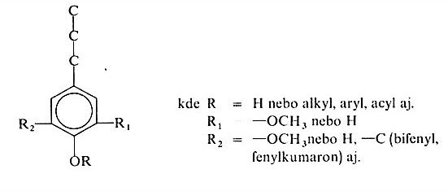
LIGNIN 2
Derivatives of PHENYLPROPANE

Slide 14
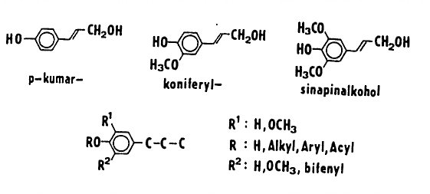
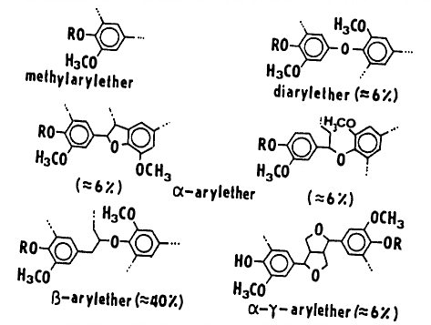
LIGNIN 3
Derivatives PHENYLPROPANE creating LIGNIN
Crosslinking of lignin via ETHEREAL BRIDGE

Slide 15
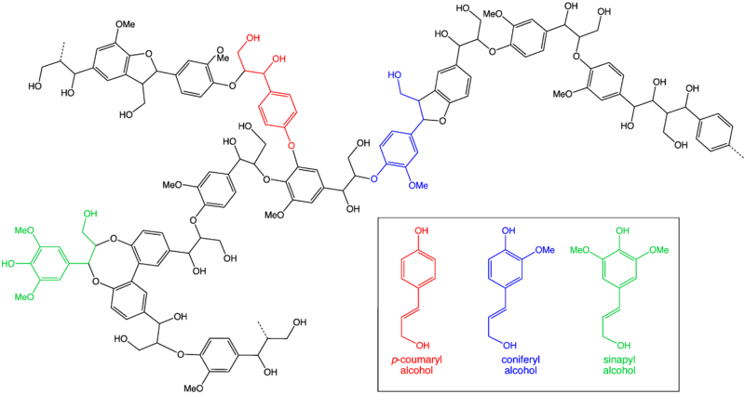
LIGNIN 4 – POSSIBLE FORMULAS I

Slide 16
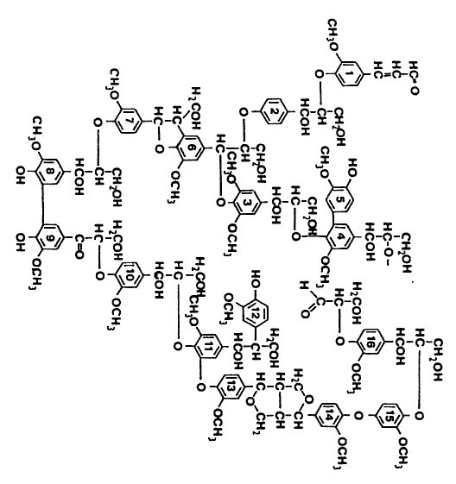
LIGNIN 5 –POSSIBLE FORMULAS II

Slide 17
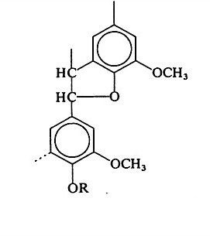
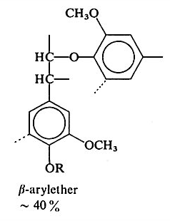
LIGNIN 6 – How is it gained?
LIGNIN is the WASTE MATERIAL at Production of the Chemical Production of the Pulp
Problem of its Utilisation is, that LIGNIN is not well defined Substance, but LIGNIN from various Sources is different as to the Composition
Reactive point is the Ethereal Bridge > the Possibility to produce Methanol via Cleavage
–OCH₃ Group

Slide 18
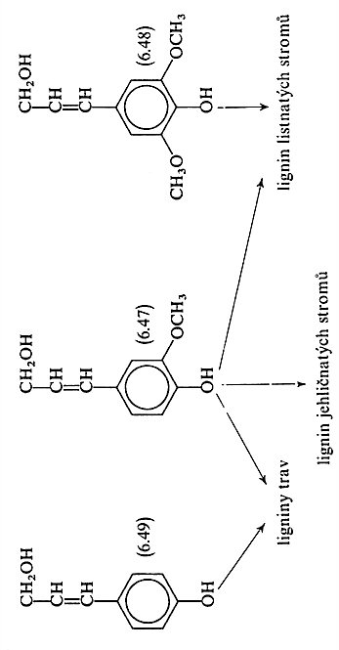
LIGNIN 7 – Problem of its Utilisation is, that LIGNIN is not well defined Substance, but LIGNIN from various Sources is different as to the Composition
The BASIC SUBSTANCES for various LIGNINS
Grass LIGNIN
Broad-leaved tree LIGNIN
Conifer tree LIGNIN

Slide 19
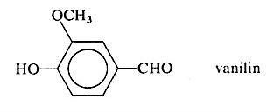
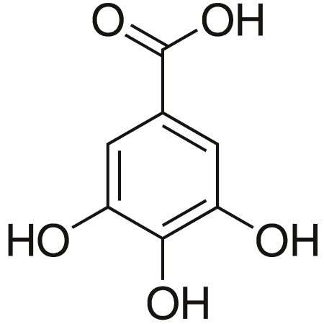
LIGNIN 8 – Chemical and other Utilisation
Chemical – it is up to now only the Minimal one
Vanillin
Other Utilisation:
The main part,so called „Waste liquor“, is combusted up to now
Kyselina gallová
Gallic acid
VALORIZATION OF LIGNIN – CHEAP WASTE POLYMER IS WAITING FOR YOU!

Slide 20
LIGNIN 9 – Chemical and other Utilisation
Chemical – it is up to now only the Minimal one
The very interesting Process of the Chemical Utilisation of LIGNIN has appeared last year on Internet. It should result up to terephthalic acid

Slide 21
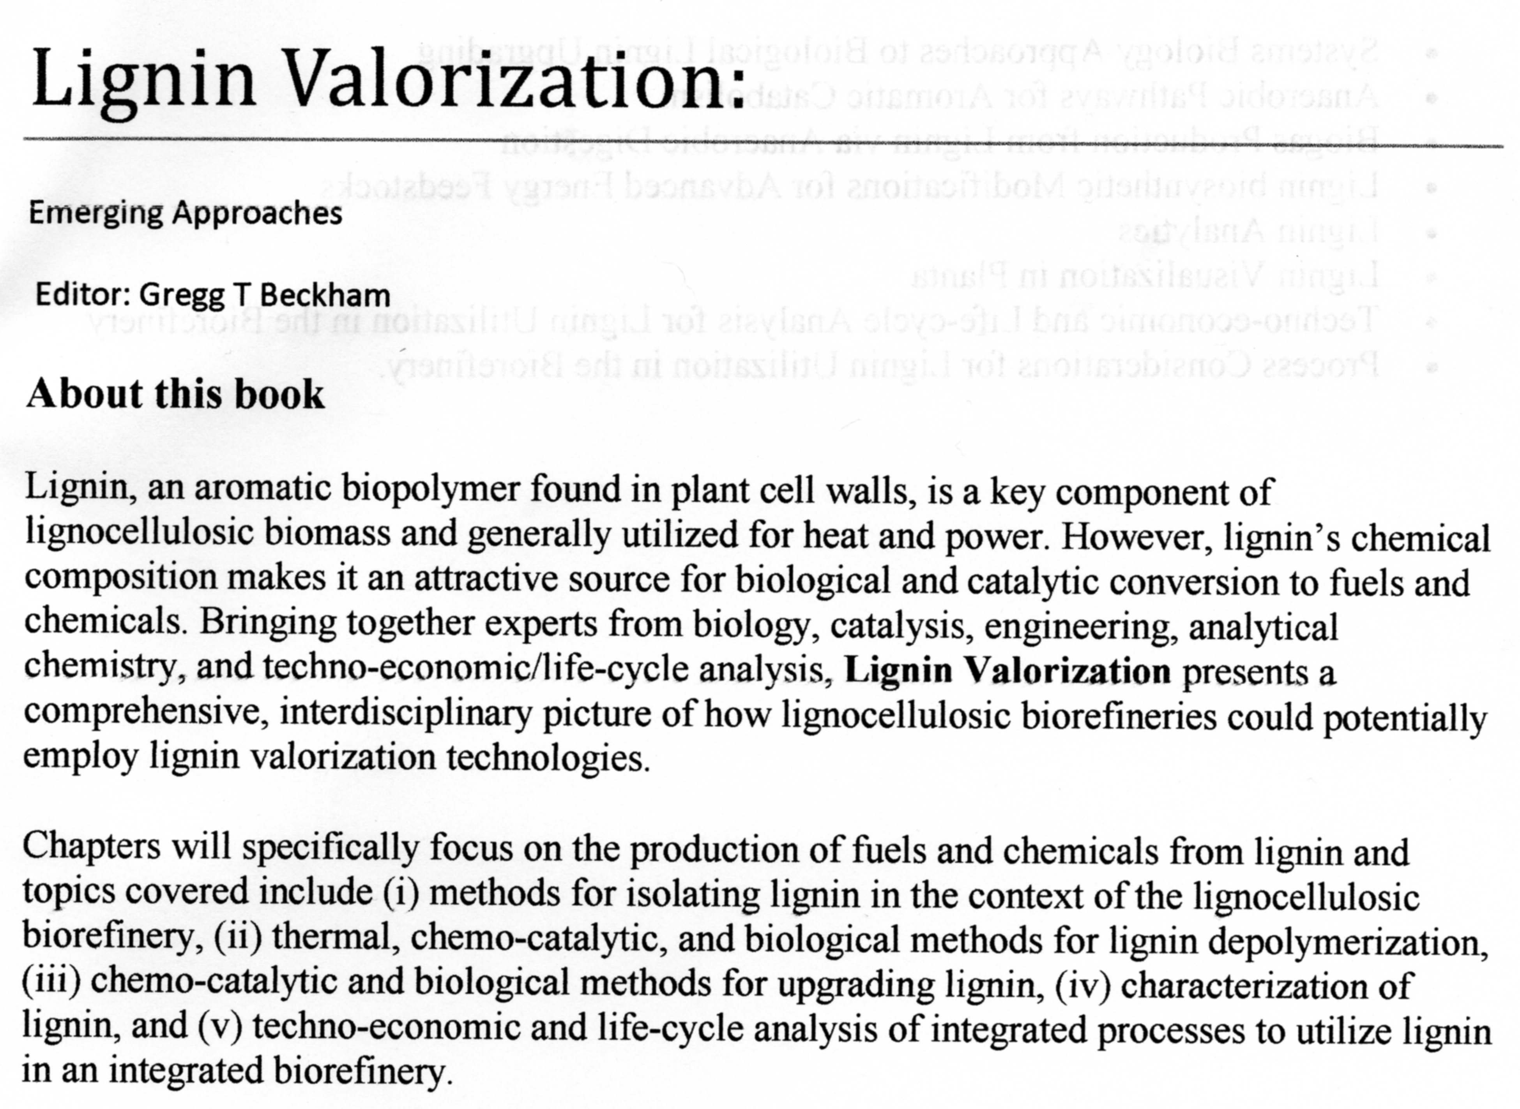
LIGNIN 10 – the LATEST LITERATURE It will be issued in 2018 or 2019
Emerging Approaches
(RSC Publishing, Royal Society Chemistry)
Editor: Gregg T Beckham

Slide 22
Tannins
Tannins are the Plant Polyphenols of the bitter or/and astringent taste, coagulating proteins and alkaloids
Tannins are used for Vegetable tanning of Rawhide to Leather
Tannins are from the Chemical point of view big Polyphenolic Compounds, which contains hydroxyl and carboxyl Groups possessing ability to bound themselves to Proteins and other Macromolecules
Tannins have usually MW of approx. from 500 to 3 000 g/mol.

Slide 23
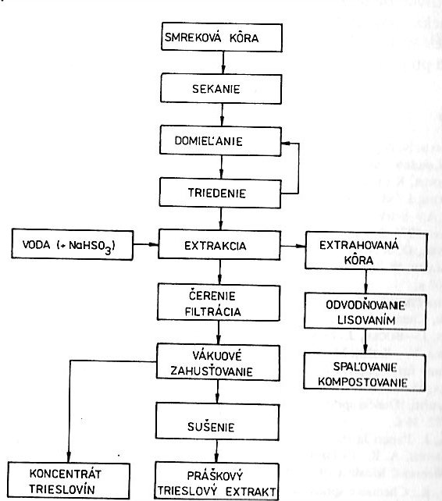
Converting of Spruce Bark to Tannin
Spruce Bark
Shredding
Milling
Sorting
Water + NaHSO₃
EXTRACTING
Extracted Bark
Fining (Clarifying) & Filtration
Dewatering by Pressing
Vacuum thickening
Combustion or Agricultural Use
Drying
Tannin Concentrated Solution
Tannin Powder

Slide 24
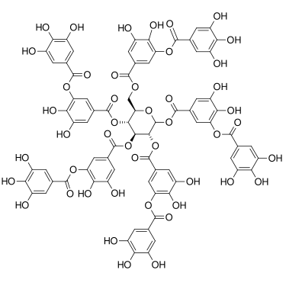
Tannin – one of the POSSIBLE STRUCTURES

Slide 25
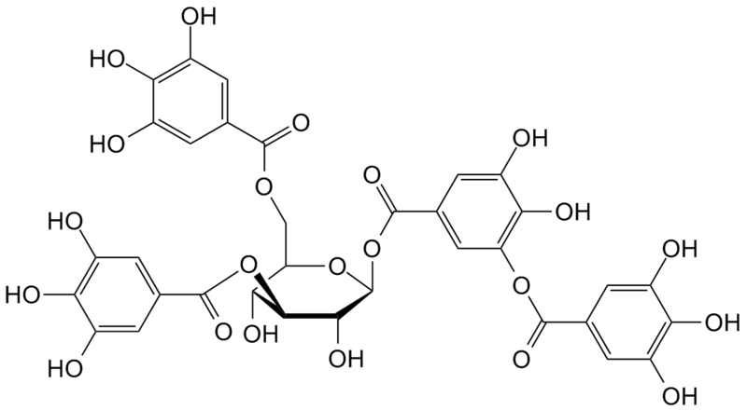
Tannin – other of the POSSIBLE STRUCTURES

Slide 26
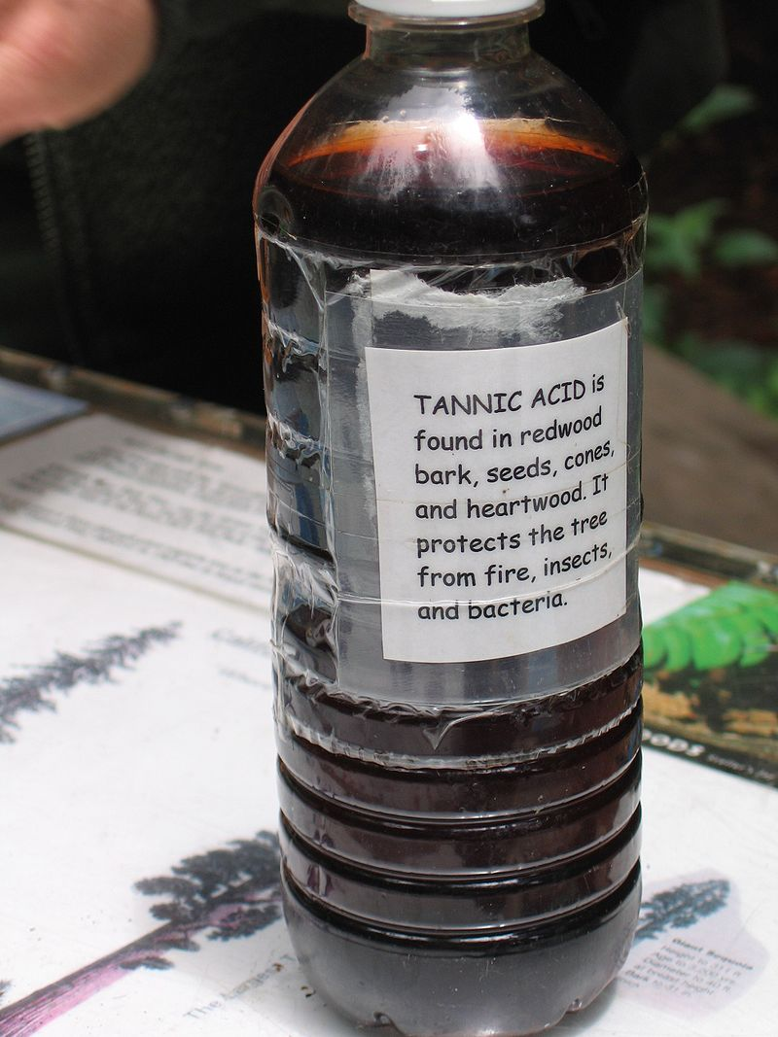
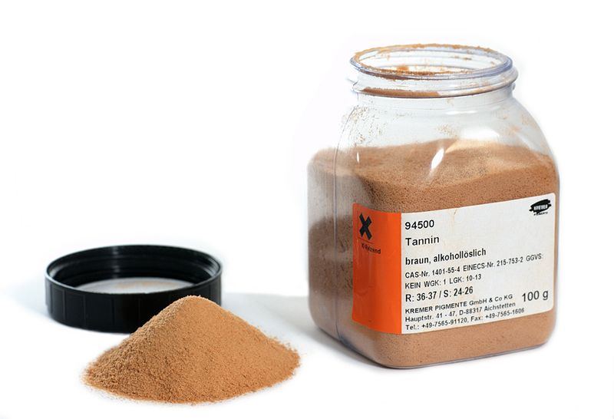
Tannin = tannic acid or digallic acid or gallotannic acid or gallotannin

Slide 27
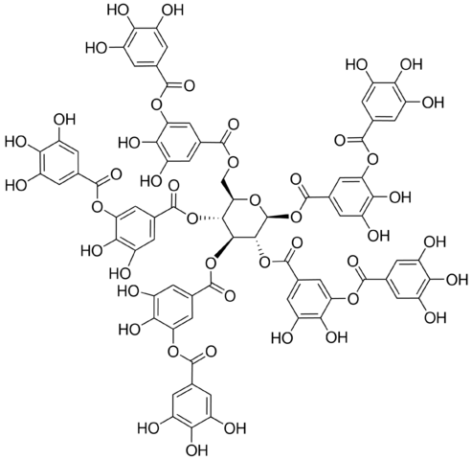
Product SIGMA ALDRICH
Tannic acid
5 Products
Synonym: Gallotannin, Tannin
CAS Number: 1401-55-4
Empirical Formula (Hill Notation):
C₇₆H₅₂O₄₆
Molecular Weight:
1701.20
Beilstein Registry Number:
8186396
Properties
Chemical formula | C₇₆H₅₂O₄₆
Molar mass | 1701.19 g/mol
Density | 2.12g/cm³
Melting point | decomposes above 200 °C
Solubility in water | 2850 g/L
Solubility | 100 g/L in ethanol 1 g/L in glycerol and acetone insoluble in benzene, chloroform, diethyl ether, petroleum, carbon disulfide, carbon tetrachloride.
Acidity (pK_{a}) | ca. 10

Slide 28
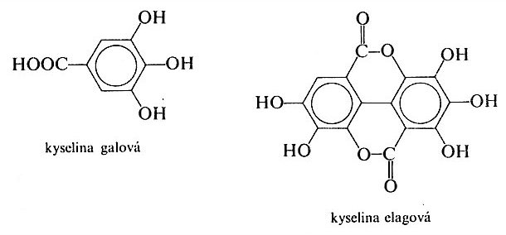
Gallic acid
Ellagic acid
Hydrolysable tannins = Gallotannic acid
+
Bound saccharides

Slide 29
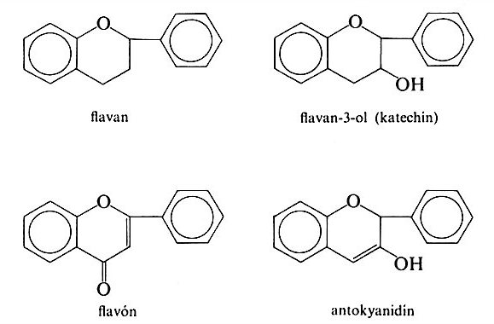
Flavonoids > condensed tannins

Slide 30
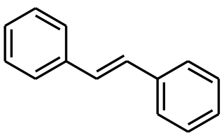
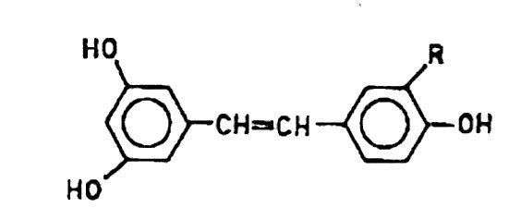
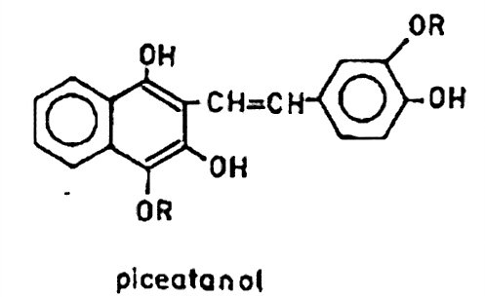
Tannins derived from STILBENE
Cis i trans

Slide 31
Flavonoids > condensed tannins
&
Hydrolysable tannins = Gallotannic acid & Ellagic acid
+Bound saccharides
&
Tannins derived from STILBENE
They are frequently occurring together in one Plant extract

Slide 32
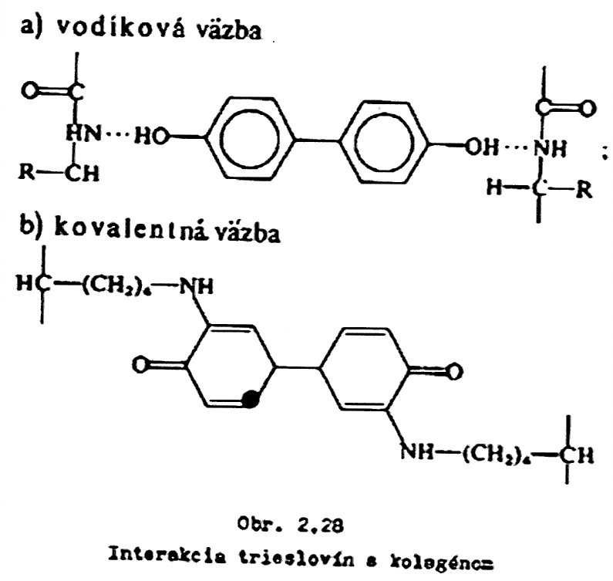
Vegetable tanning of Rawhide to Leather
Hydrogen bond
Covalent bond
Interaction of Tannins with Collagene

Slide 33
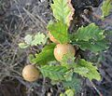
Iron gall ink ink 1
Iron gall ink (also known as iron gall nut ink, oak gall ink, and common ink) is the Ink purple-black colour, made from salts of Iron and taninn from plant sources. It is concerned organometallic compound dispersed in Water, in which is stabilized by the binding agent and this additive ensures remaining of the pigment Dispersion in the Solution. It currently used in Europe 12.Century since.
gallnut, gall-apple >

Slide 34
Iron gall ink ink 2
Simple Recipe
Tannin = tannic acid
Green vitriol (FeSO₄)
ARABIC GUM > Plant gum
Water

Slide 35
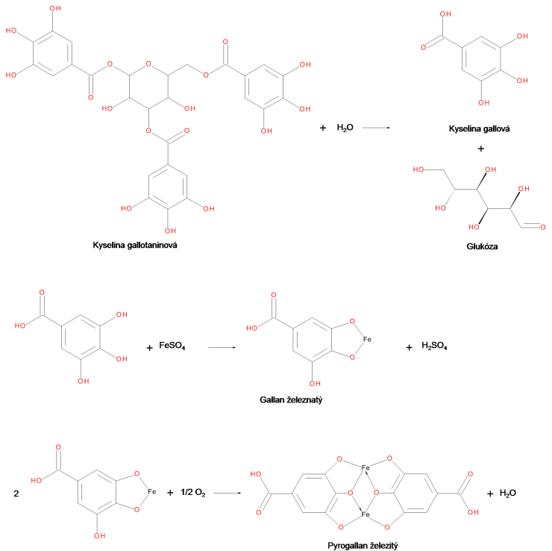
Iron gall ink ink 3
Gallic acid
Tannic acid
Glucose
Fe⁺²
Ferrous Gallic salt
Fe⁺³
Ferric Gallic salt

Slide 36
Iron gall ink 4
Fe⁺²
Fe⁺³
Chemical Basis of the Iron gall ink is as follows:
Reaction of the Iron Oxidation number/state Change ions’ from FERROUS (Fe²⁺) to FERRIC (Fe³⁺) state by atmospheric OXYGEN and via this way Change of the Colour from the Pale-grey solution to Purple-black
Chemical Basis of the Iron gall ink BLEACHING is as follows:
Reaction of the Iron Reduction from FERRIC (Fe³⁺) to FERROUS (Fe²⁺)
How to Refresh the reduced FERROUS (Fe²⁺) ?
OXIDATION from FERROUS (Fe²⁺) to FERRIC (Fe³⁺) state
DURABILITY OF THE Iron gall ink is increased by the Reaction with Cellulose or Collagen

Slide 37
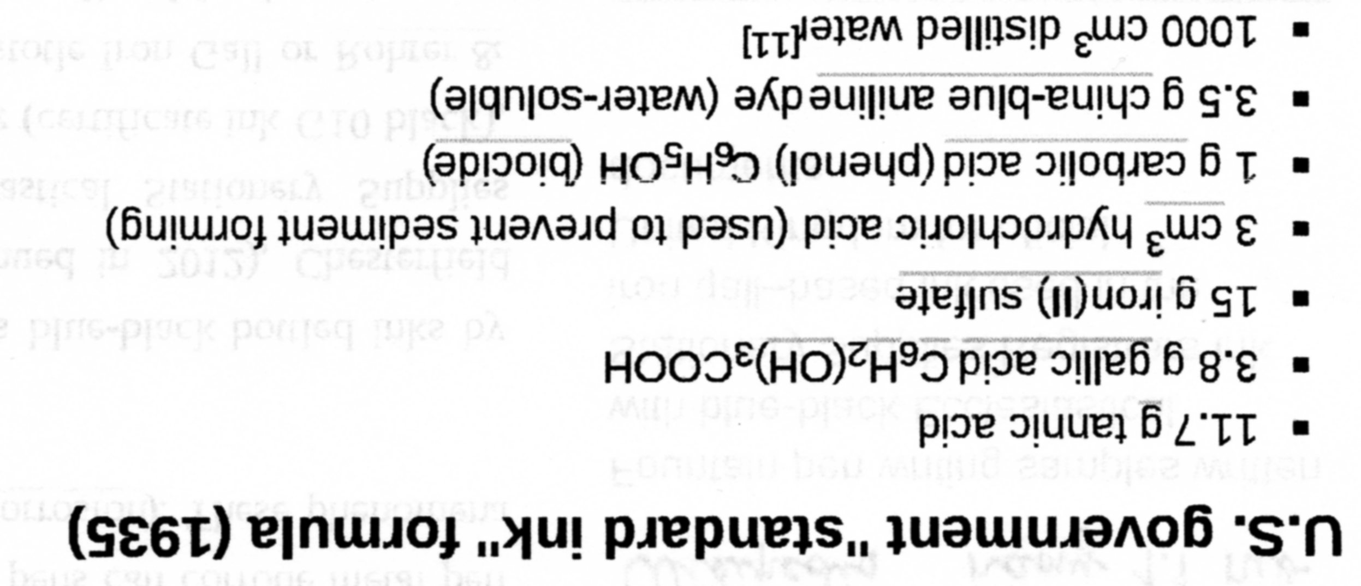
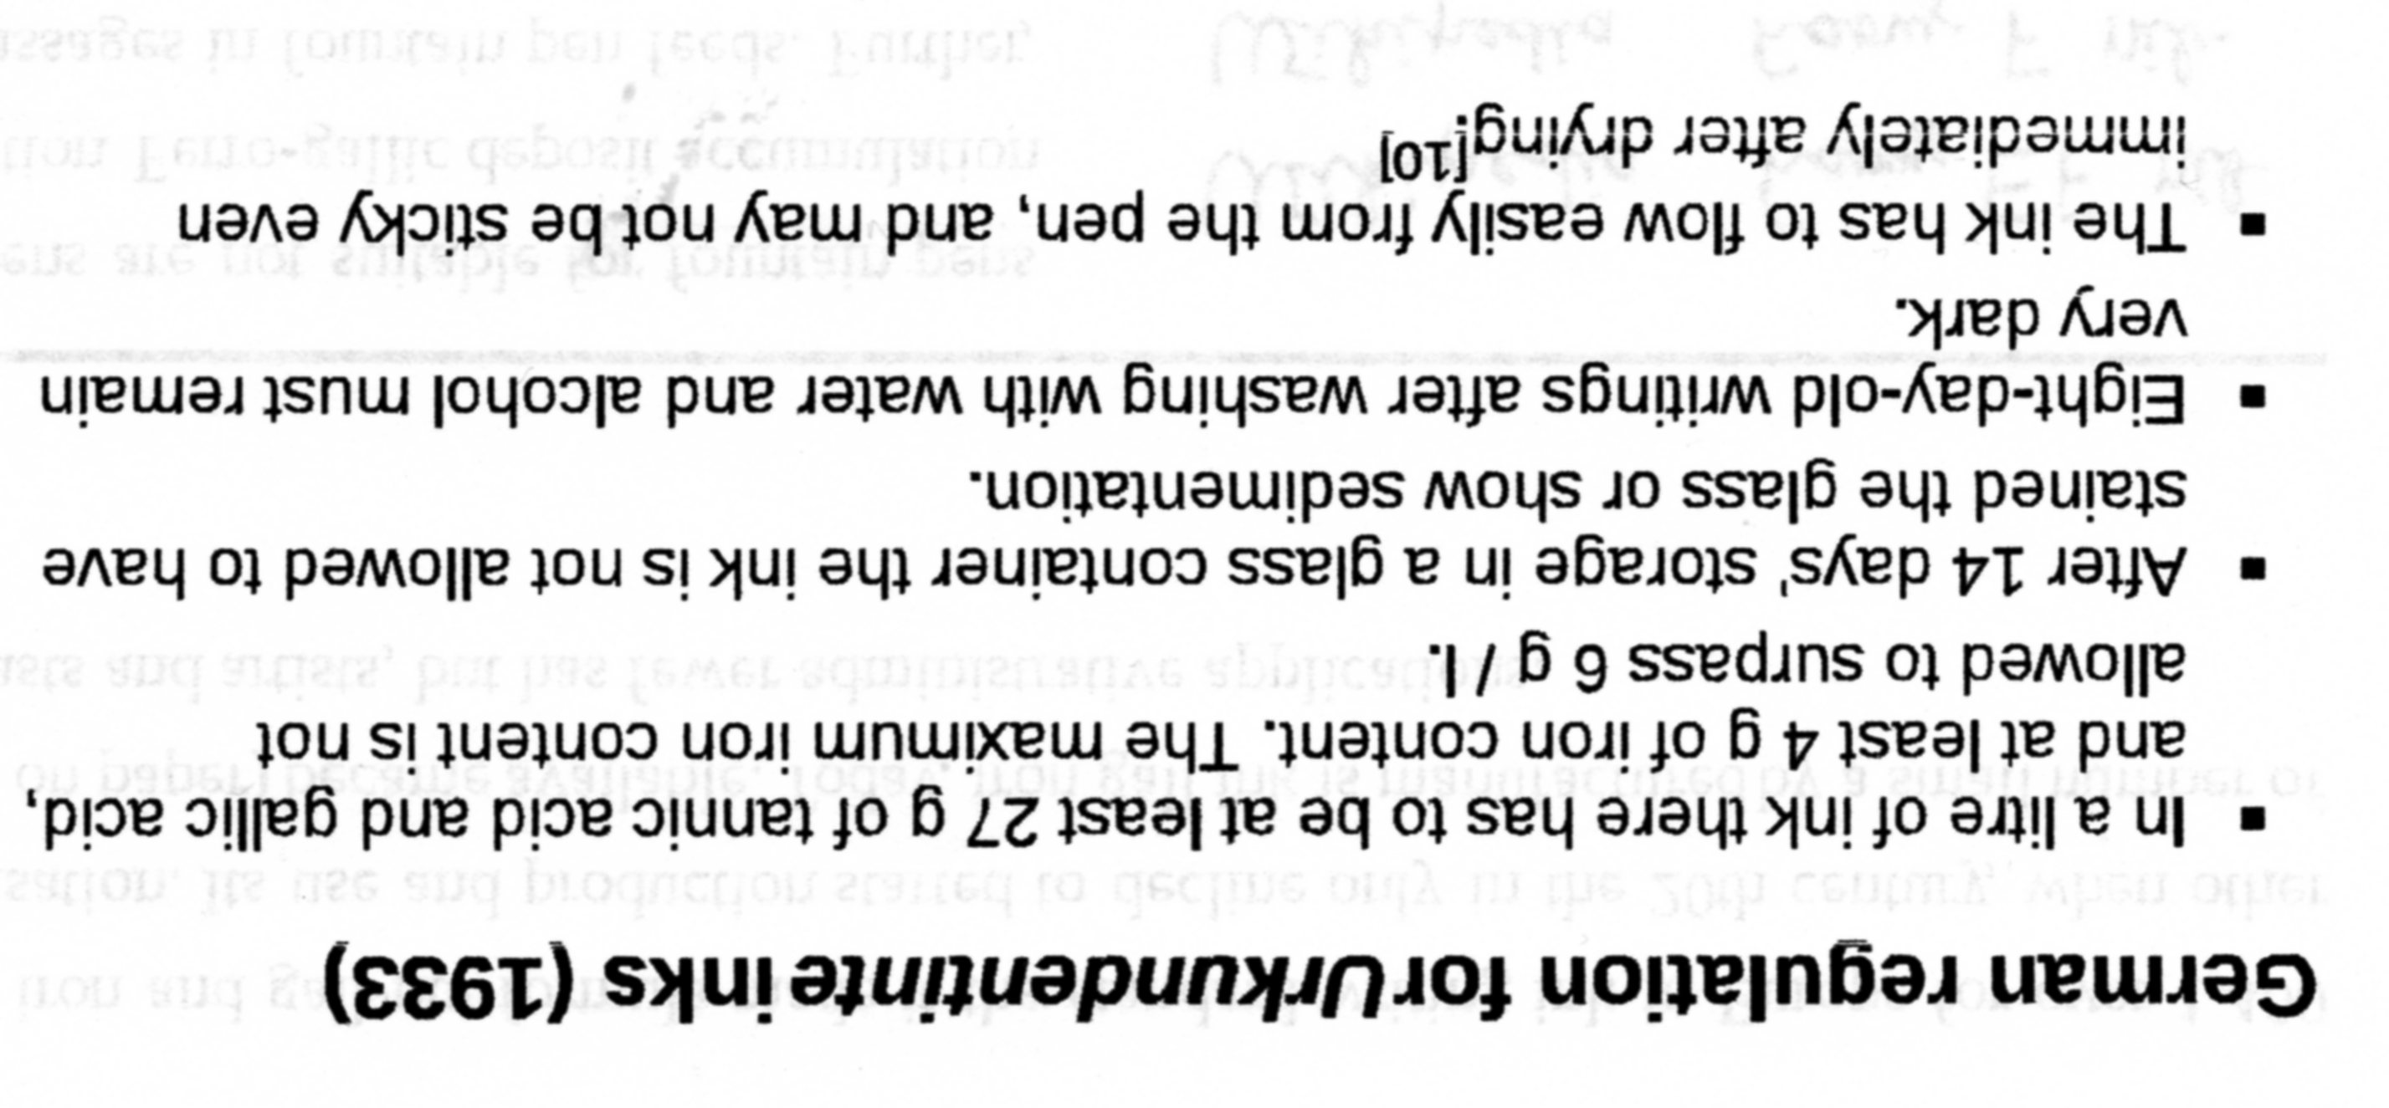

Slide 38
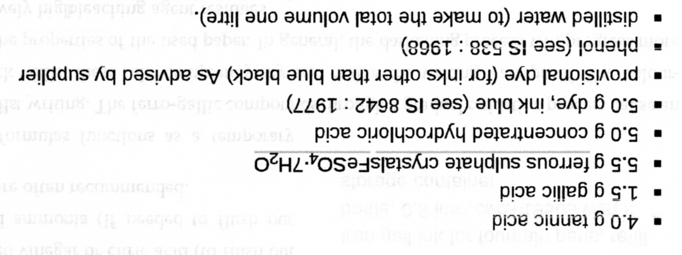

Slide 39
INK versus China ink
INK is composed from: ……………
China ink is composed from : ………

Slide 40
Tanins & Food Industry
Clarifying of the Fruit juice in combination with Gellatin
It coagulate the Proteins

Slide 41
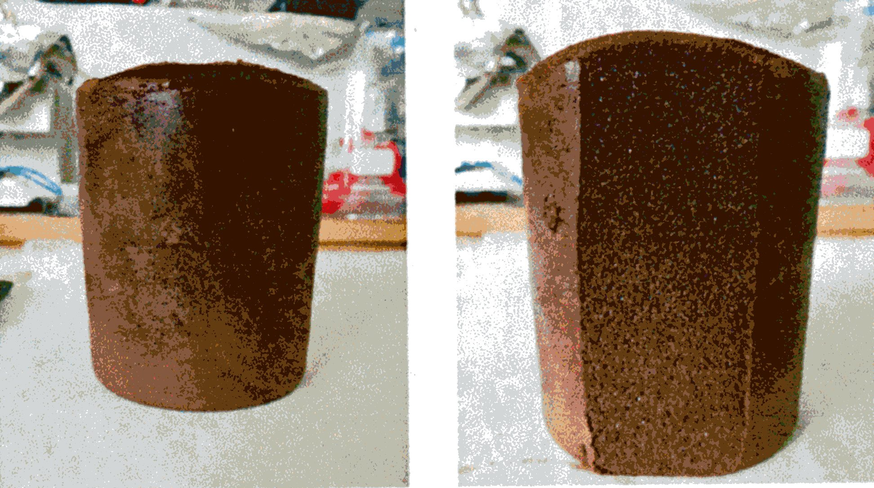
Tanin – quite new Use
It must be CROSSLINKED by something!

Slide 42
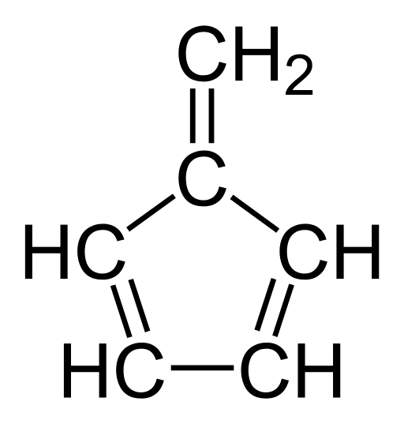
Humin substances
Humin substances are natural organic substances arising by decomposition of mainly plants’ remains.
Humin substances are only difficult further decomposed and are contained in the Soil, Peat, Coal and some Water sources at very high Level.
Humin substances are divided according their solubility in Water to:
Humins,
Humine acids,
Fulvene acids.
FULVENE

Slide 43
Humin Acids 1
Humin acids are insoluble in Water at pH 2 and lower, but are soluble at higher pH. The Typical colour is brown to black-brown
Humin acids contain –OH and –COOH groups

Slide 44
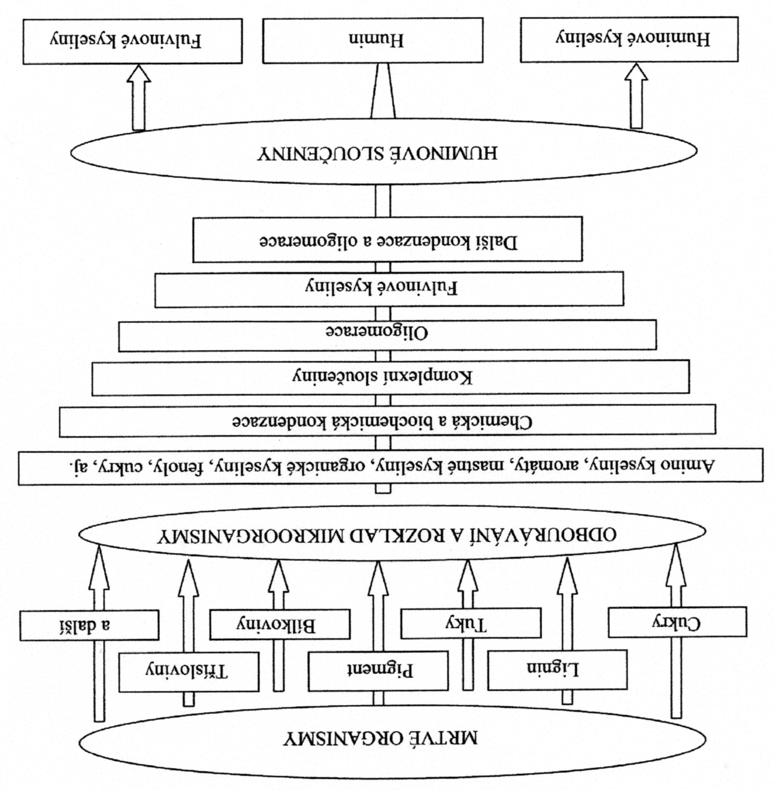
DEAD BIOMASS
Tannin
Saccharides &
Polysaccharides
Other
Fats
Proteins
DEGRADATION & DECOMPOSITION
Amino acids, aromatics, fatty acids, organic acids, phenols, saccharides and the other
Chemical & Biochemical Condensation
Complex Compounds
Oligomeric Compounds
Fulvene acids
Subsequet Oligomerisation and Condensation
Humin Compounds
Humin acids
Humin
Fulvene acids

Slide 45
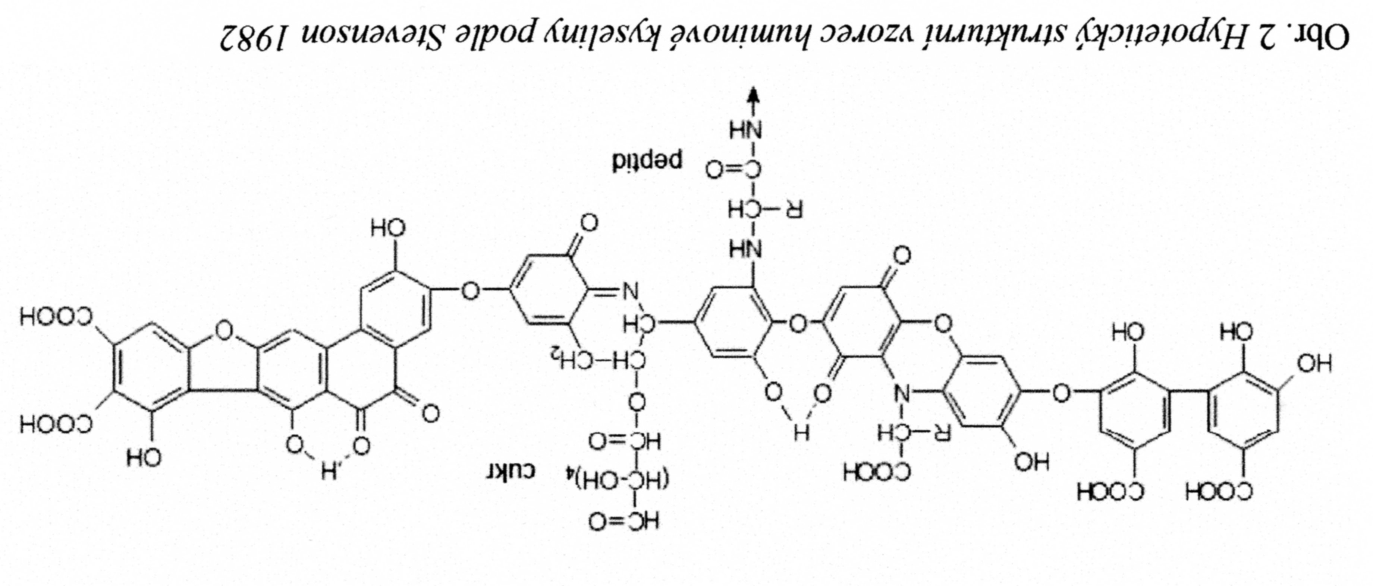
Humin Acids 2
HYPOTHETICAL FORMULA of Humin Acids according to Stevenson (1992)

Slide 46
Humin substances
Humin substances are used mainly for the Plant nutrition. Although it is not a Fertilizer as it is usually meant (Material containing N, P, K), it enables easier intake of the Plant nutrition , stimulating formation of the Root system. Thank this the Plant is able to absorb better Water and nutrition. It promotes photosynthesis and improves the Soil properties.
Humin substances are supplied for agriculture use as the Solution, powders or pellets. They are able to be applied as a Spray, possibly combined with the other Fertilizers or Chemicals for Plant protection.

Slide 47
1. Generation of the Biodegradable synthetic plastics – Brown coal Humates I have worked with it!
EXTRACTION FROM THE BROWN COAL – it is a Part, which is not enough transformed to Coal (lower carbon content) > It was a Dry dark brown powder solid.
What was the Target:
ADDITIVATION OF THE LDPE TO PRODUCE A BIODEGRABLE FILMS

