Slide 1
NATURAL POLYMERS
PROTEINS I
Dr. Ladislav Pospíšil

Slide 2
Time schedule
LECTURE | SUBJECT
1 | Introduction to the subject – Structure & Terminology of nature polymers, literature
2 | Derivatives of acids – natural resins, drying oils, shellac
3 | Waxes
4 | Plant (vegetable) gums, Polyterpene – natural rubber (extracting, processing and modification), Taraxacum_kok-saghyz
5 | Polyphenol – lignin, humic acids
6 | Polysaccharides I – starch
7 | Polysaccharides II – celullose
8 | Protein fibres I
9 | Protein fibres II
10 | Casein, whey, protein of eggs
11 | Identification of natural polymers
 | Laboratory methods of natural polymers’ evaluation

Slide 3
Chemistry of Peptides and Proteins
Supermolecular Structure of Peptides and Proteins

Slide 4
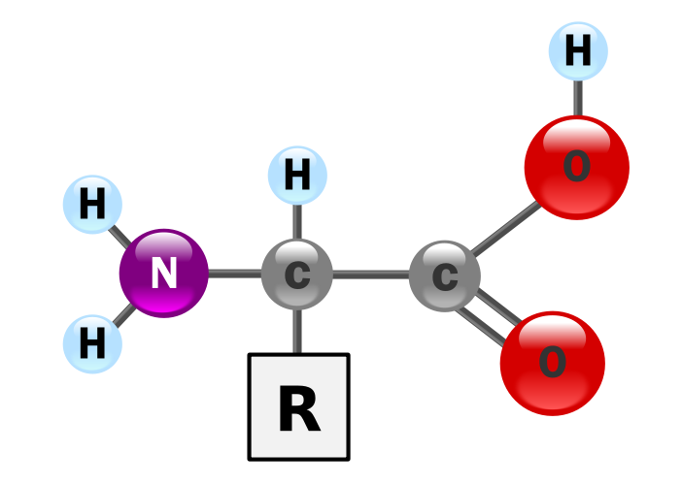
Chemistry of Peptides and Proteins
In the structure shown BELLOW the SLIDE, R represents a side chain specific to each amino acid. The carbon atom next to the carboxyl group (which is therefore numbered 2 in the carbon chain starting from that functional group) is called the α–carbon. Amino acids containing an amino group bonded directly to the alpha carbon are referred to as alpha amino acids. These include amino acids such as PROLINE which contain secondary amines, which used to be often referred to as "imino acids".

Slide 5
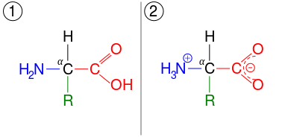
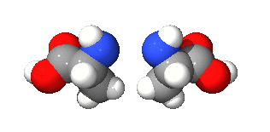
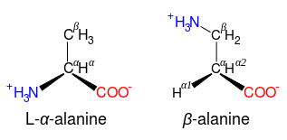
Chemistry of Peptides and Proteins
An amino acid in its (1) un-ionized and (2) zwitterionic forms
amfion
Převzato z NĚMČINY
β-alanine and its α-alanine isomer

Slide 6
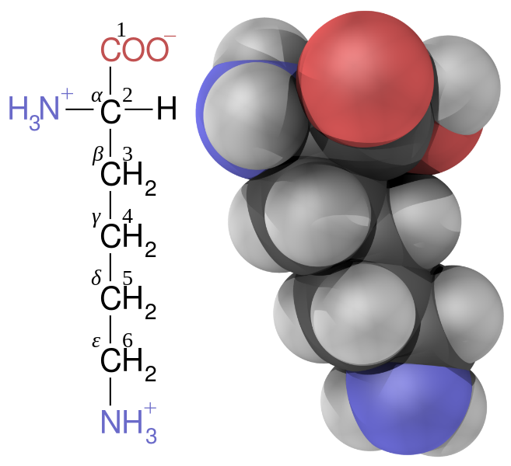
Chemistry of Peptides and Proteins
LYSINE– it has „LENT“ one H+ Cation here !

Slide 7
Amino acids are the structural units (monomers) that make up proteins. They join together to form short polymer chains called peptides or longer chains called either polypeptides or proteins. These polymers are linear and unbranched, with each amino acid within the chain attached to two neighboring amino acids.
Twenty-two amino acids are naturally incorporated into polypeptides and are called proteinogenic or natural amino acids.
Proteinogenic amino acids are amino acids that are incorporated biosynthetically into proteins during translation. The word "proteinogenic" means "protein creating". Throughout known life, there are 22 genetically encoded (proteinogenic) amino acids, 20 in the standard genetic code and an additional 2 that can be incorporated by special translation mechanisms
A peptide bond, also known as an amide bond, is a covalent chemical bond linking two consecutive amino acid monomers along a peptide or protein chain.
The peptide bond is synthesized when the carboxyl group of one amino acid molecule reacts with the amino group of the other amino acid molecule, causing the release of a molecule of water (H₂O), hence the process is a dehydration synthesis reaction (also known as a condensation reaction).

Slide 8
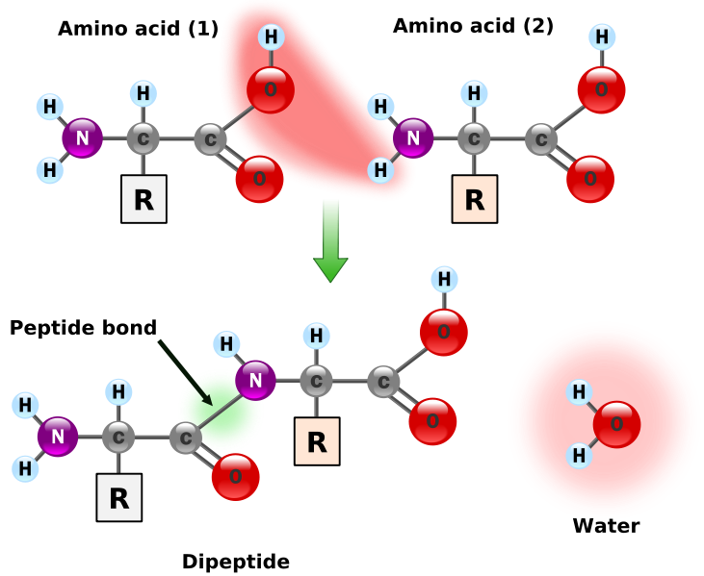
Chemistry of Peptides and Proteins

Slide 9
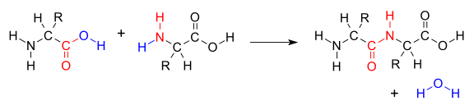
A peptide bond, also known as an amide bond, is a covalent chemical bond linking two consecutive amino acid monomers along a PEPTIDE or PROTEIN CHAIN
PEPTIDES are short chains of amino acid monomers linked by peptide (amide) bonds.
PROTEINS are large biomolecules, or macromolecules, consisting of one or more long chains of amino acid residues. A linear chain of amino acid residues is called a polypeptide. A protein contains at least one long polypeptide. Short polypeptides, containing less than 20–30 residues, and are commonly called peptides, or sometimes oligopeptides.

Slide 10
Chemistry of Peptides and Proteins
HIERARCHI
AMINOACID = monomer
PEPTID = oligomer
PROTEIN = polymer

Slide 11
AminoACIDS with aliphatic Side chain
Glycine Gly (G)
Alanine Ala (A)
Valine Val (V)
Leucine Leu (L)
Isoleucine Ile (I)
AminoACIDS with Carboxyl or Amide Group in the Side chain
(Acid Groups)
Asparagic Acid Asp (D)
Asparagine Asn (N)
Glutamic Acid Glu (E)
Glutamine Gln (Q)
AminoACIDS with Amine Group in the Side chain
(Basic Groups)
Arginine Arg (R)
Lysine Lys (K)
AminoACIDS with Aromatic nucleus (ring) or Hydroxyl Group in the Side chain
Histidine His (H)
Phenylalanine Phe (F)
Serine Ser (S)
Threonin Thr (T)
Tyrozine Tyr (Y)
Tryptophane Trp (W)

Slide 12
AminoACIDS with Sulphur Atom in the Side chain
Methionine Met (M)
Cysteine Cys (C)
AminoACIDS with the SECONDARY AMINE
ProlinE Pro (P)
21. AminoACID (CONTAINING Se)
SelenocysteinE SeCys
22. AminoACID
Pyrolysine Pyl

Slide 13
Chemistry of Peptides and Proteins
Class | Name of the amino acids
Aliphatic | Glycine, Alanine, Valine, Leucine, Isoleucine
Hydroxyl or Sulfur-containing | Serine, Cysteine, Threonine, Methionine
Cyclic | Proline
Aromatic | Phenylalanine, Tyrosine, Tryptophan
Basic | Histidine, Lysine, Arginine
Acidic and their Amide | Aspartate, Glutamate, Asparagine, Glutamine

Slide 14





Biogenic aminoacids
Glycine (Gly, G)
Alanine (Ala, A)
Valine (Val, V)
Leucine (Leu, L)
Isoleucine (Ile, I)

Slide 15

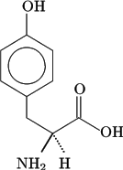


Biogenní aminokyseliny
Threonine (Thr, T)
Tyrosine (Tyr, Y)
Methionine (Met, M)
Cysteine (Cys

Slide 16




Biogenní aminokyseliny
Lysine (Lys, K)
Asparagová ACID (Asp, D)
Asparagine (Asn, N)
Glutamic ACID (Glu, E)
Glutamine (Gln, Q)

Slide 17

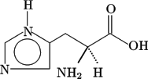
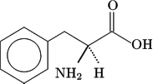
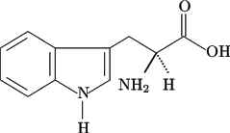
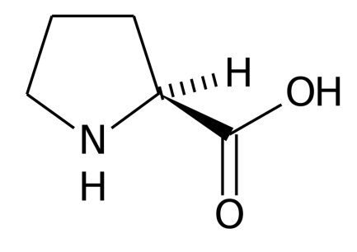
Biogenní aminokyseliny
Arginine (Arg, R)
Histidine (His, H)
Phenylalanine (Phe, F)
Tryptofane (Trp, W)
Proline (Pro, P)

Slide 18
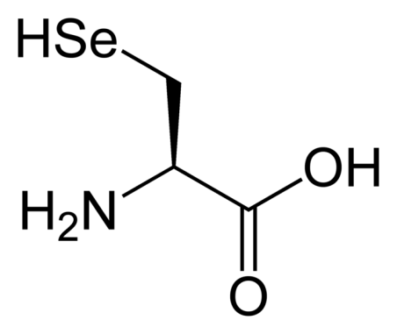
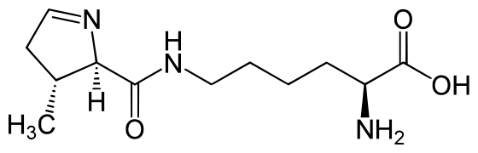

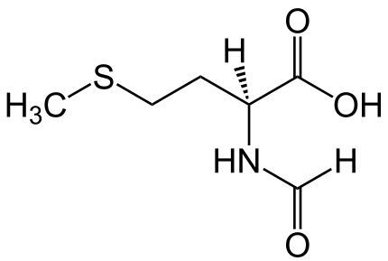
Biogenní aminokyseliny
Selenocysteine (SeCys,U)
Pyrolysine (Pyl,O)
Serine (Ser, S)
N-formylmethionine (fMet)

Slide 19
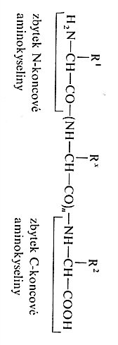

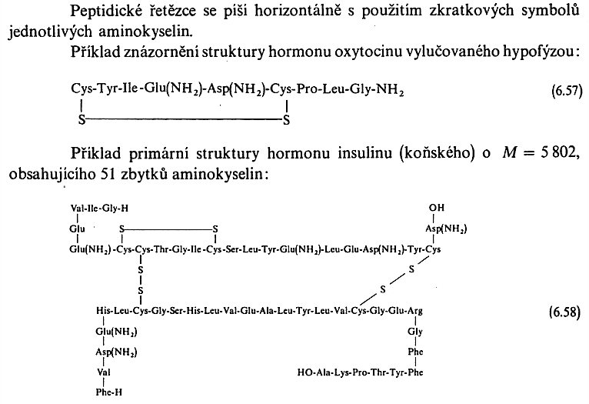
Chemistry of Peptides and Proteins
The Rest of N- ending Amino acid
The Rest of C- ending Amino acid
Peptide Chains are written horizontally using the Abbreviations of the particular Amino acids. An Example showing the Structure of the Oxitocine Hormone is as follows:
An Example showing the Structure of the Horse Insulin Hormone
(M = 5 802, containing 51 Amino acids) is as follows:

Slide 20
SCLEROPROTEINS or fibrous proteins
The roles of such proteins include protection and support, forming connective tissue, tendons, bone matrices, and muscle fiber. A SCLEROPROTEIN forms long protein filaments, which are shaped like rods or wires. SCLEROPROTEINS are structural proteins or storage proteins that are typically inert and water-insoluble. A SCLEROPROTEIN occurs as an aggregate due to hydrophobic side chains that protrude from the molecule.
A SCLEROPROTEIN'S peptide sequence often has limited residues with repeats; these can form unusual secondary structures, such as a collagen helix. The structures often feature cross-links between chains (e.g., cys-cys disulfide bonds between keratin chains).

Slide 21
Composition of the Fibrous Proteins
Aminoacid | R | Aminoacid Content (% Molar)
H₂N-CHR-COOH (Abbreviation) |  | Merino Wool | Silk Fibroin | Beef Collagen
Glycine (Gly) | -H | 59,4 | 44,8 | 38,0
Alanine (Ala) | -CH₃ | 15,7 | 29,4 | 11,9
Valine (Val) | -CH(CH₃)₂ | 5,8 | 2,2 | 2,2
Leucine (Leu) | -CH-CH(CH₃)₂ | 7,9 | 0,5 | 2,8
Isoleucine (Ile) | -CH₂-C₆H₅ | 3,3 | 0,7 | 1,3
Serine (Ser) | -CH₂-OH | 11,8 | 12,1 | 1,5
Threonine (Thr) | -CH(CH₃)OH | 7,6 | 0,9 | 4,3
Tyrosine (Tyr) | -CH₂C₆H₄OH | 4,8 | 5,2 | 1,9

Slide 22
Composition of the Fibrous Proteins
Aminoacid | R | Aminoacid Content (% w/w)
H₂N-CHR-COOH (Abbreviation) |  | Merino Wool | Silk Fibroin | Beef Collagen
Tryptophan (Trp) |  | 1,4 | 0,2 | ---
Lysine (Lys) | -(CH₂)₄NH₂ | 2,6 | 0,3 | 2,8
Arginine (Arg) | -(CH₂)₂ –N=C(NH₂)₂ | 8,2 | 0,5 | 5,4
Histidine (His) |  | 0,8 | 0,2 | 0,5
Hydroxylysine | -(CH₂)₂CH(OH)CH₂NH₂ | Traces | --- | 0,8
Asparagic Acid (Asp) | -CH₂COOH | 6,9 | 1,3 | 0,1
Glutamic Acid (Glu) | -(CH₂)₂COOH | 13,8 | 1,0 | 0,1
Methionine (Met) | -(CH₂)₂SCH₃ | 0,5 | 0,1 | 0,8

Slide 23
Composition of the Fibrous Proteins
Aminoacid | R | Aminoacid Content (% w/w)
H₂N-CHR-COOH (Abbreviation) |  | Merino Wool | Silk Fibroin | Beef Collagen
Cystine (Cys-S-S-Cys) | -CH₂-S-S-CH₂CH(NH₂)COOH | 6,4 | 0,1 | ---
Cystein (Cys) | -CH₂SH | 0,4 | --- | ---
Proline (Pro) |  | --- | --- | 4,81,
Hydroxyproline |  | --- | --- | 10,3
Lanthonine | -CH₂-S-CH₂CH(NH₂)COOH | 0,01 | --- | ---
HO--

Slide 24
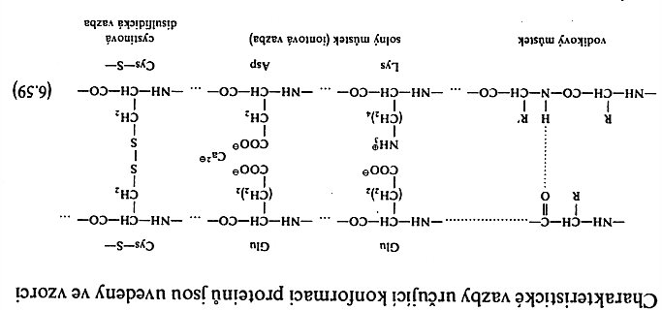
Chemistry of Peptides and Proteins
The Characteristic Bonds which determine Protein Conformation are in the following Formulas:
Hydrogen Bond
Ionic Bond
Cystein disulfide Bond

Slide 25
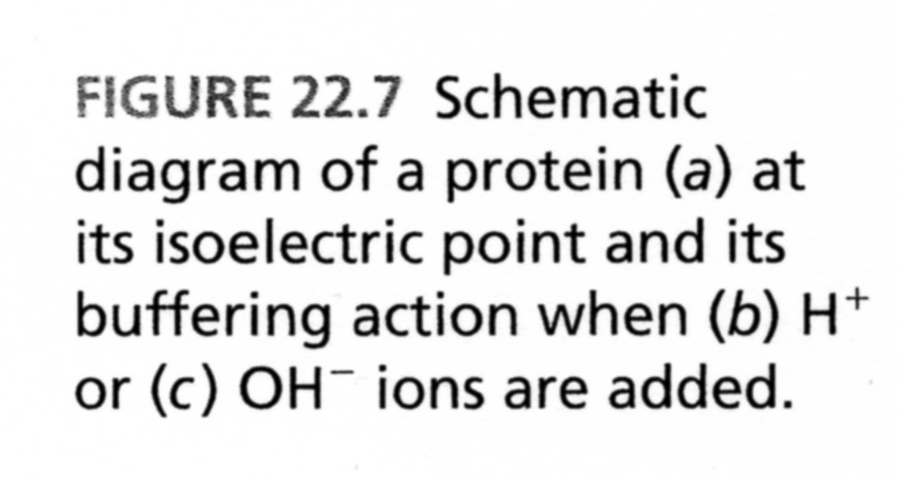
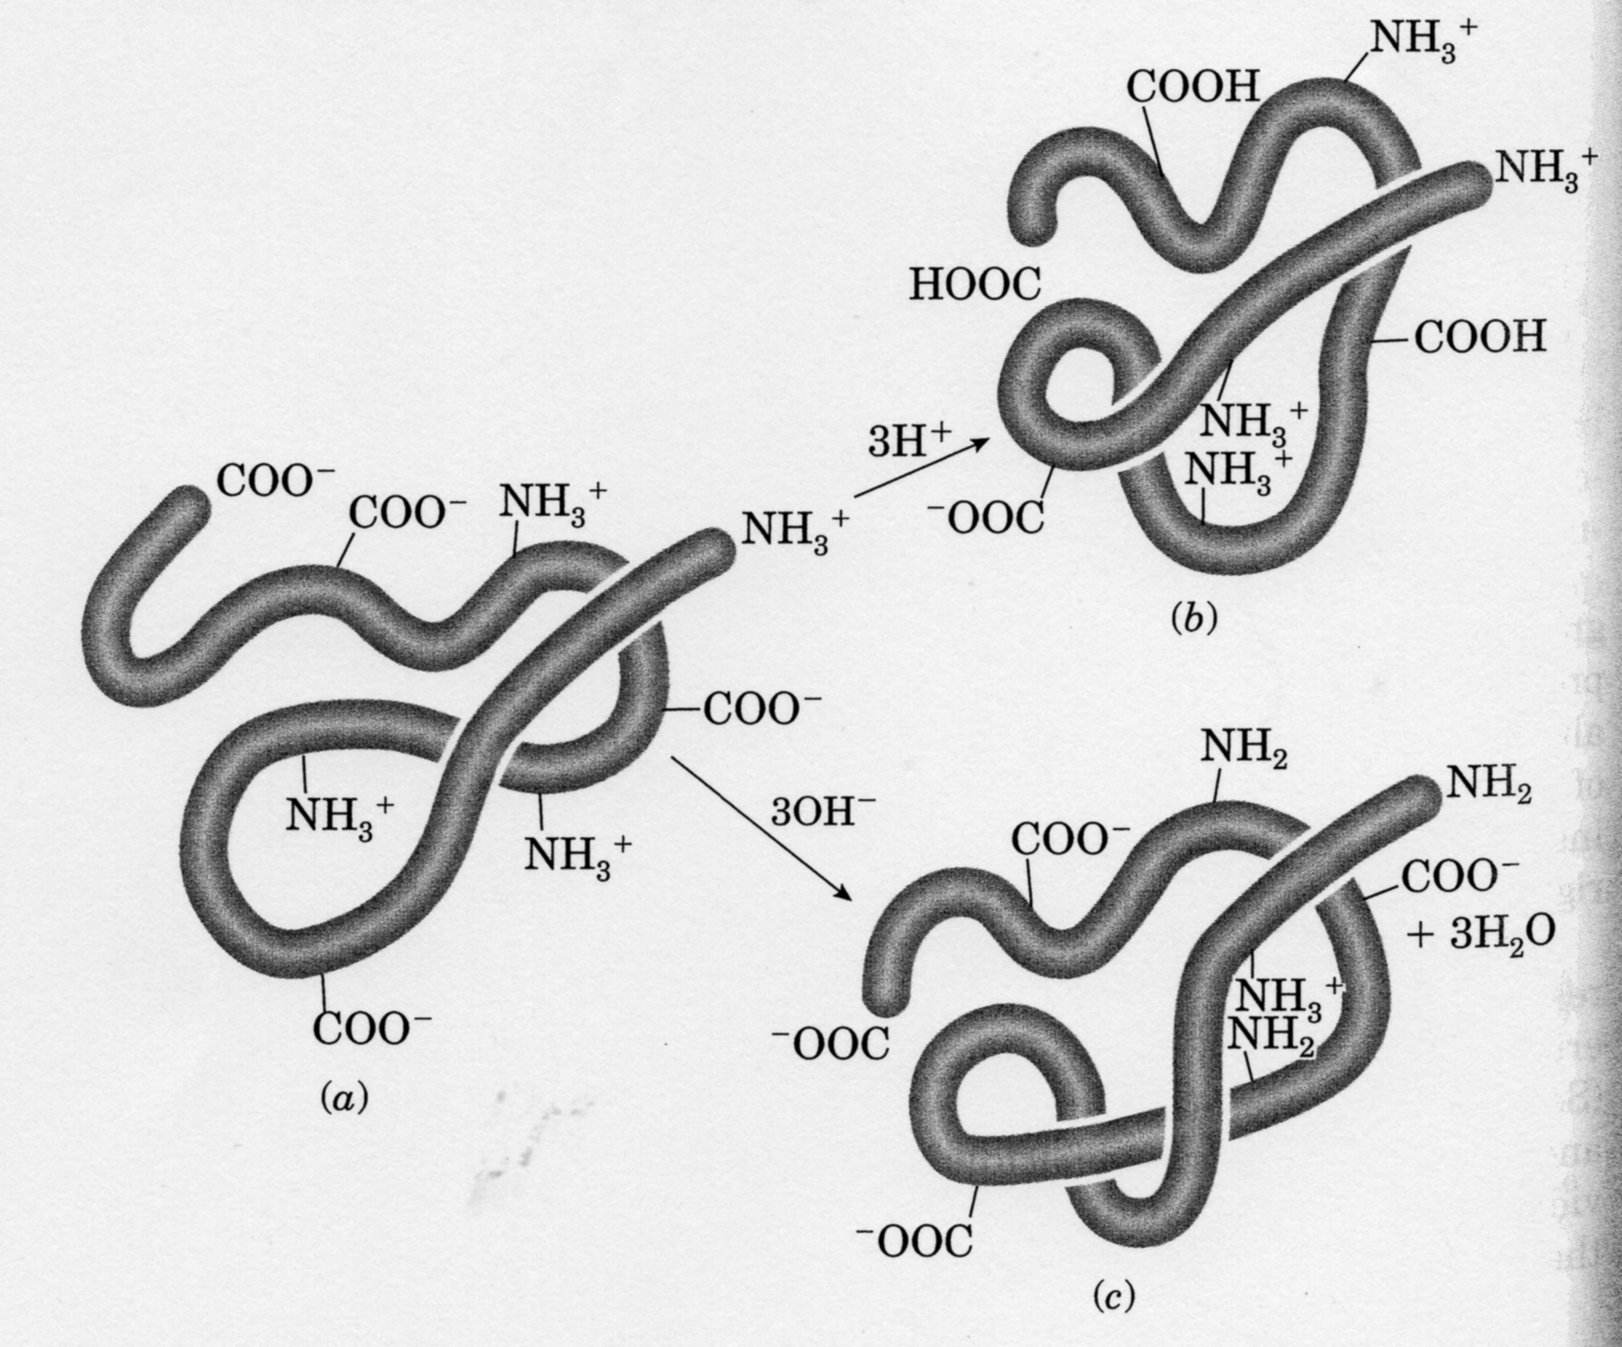

Slide 26
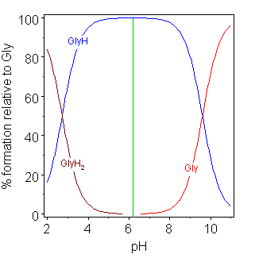
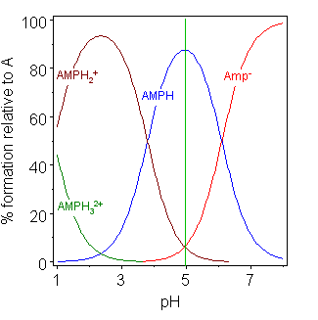
Chemistry of Peptides and Proteins
The isoelectric point (pI, pH(I), IEP), is the pH at which a particular molecule carries no net electrical charge in the statistical mean. The standard nomenclature to represent the isoelectric point is pH(I), although pI is also commonly seen, and is used in this article for brevity. The net charge on the molecule is affected by pH of its surrounding environment and can become more positively or negatively charged due to the gain or loss, respectively, of protons (H⁺).
glycine pK = 2.72, 9.60
adenosine monophosphate pK = 2.15, 9.16, 10.67

Slide 27
Chemistry of Peptides and Proteins
For an amino acid with only one amine and one carboxyl group, the pI can be calculated from the mean of the pKas of this molecule.
pI = (pKa + pKb)/2
Each Amino acid contains at least two Groups, which are able to dissociate giving: -COOH a -NH₃⁺ and they form conjugated Bases -COO⁻ a -NH₂.
The Acid and their conjugated Base are in the proton Equilibrium:
R-COOH ↔ R-COO⁻ + H⁺R-NH₃⁺ ↔ R-NH₂ + H⁺
It is depends on the Environments (Conditions) pH Value, so on the H⁺ Concentration, how is the Equivalence set. The Carboxylic Group is the stronger Acid and so the H⁺ is easily cleaved from this Group then taken by this Group.

Slide 28
pK and pl Values of Amino Acids
Name | pK |  |  | pI at 25°C
 | pK α-CO₂H | pK NH₃ | pK R-group
Alanine | 2.35 | 9.87 |  | 6.11
Arginine | 2.18 | 9.09 | 13.2 | 10.76
Asparagine | 2.18 | 9.09 | 13.2 | 10.76
Aspartic Acid | 1.88 | 9.60 | 3.65 | 2.98
Cysteine | 1.71 | 10.78 | 8.33 | 5.02
Glutamic Acid | 2.19 | 9.67 | 4.25 | 3.08
Glutamine | 2.17 | 9.13 |  | 5.65
Glycine | 2.34 | 9.60 |  | 6.06
Histidine | 1.78 | 8.97 | 5.97 | 7.64
Isoleucine | 2.32 | 9.76 |  | 6.04
Leucine | 2.36 | 9.60 |  | 6.04
Lysine | 2.20 | 8.90 | 10.28 | 9.47
Methionine | 2.28 | 9.21 |  | 5.74
Phenylalanine | 2.58 | 9.24 |  | 5.91
Proline | 1.99 | 10.60 |  | 6.30
Serine | 2.21 | 9.15 |  | 5.68
Threonine | 2.15 | 9.12 |  | 5.60
Tryptophan | 2.38 | 9.39 |  | 5.88
Tyrosine | 2.20 | 9.11 | 10.07 | 5.63
Valine | 2.29 | 9.74 |  | 6.02

Slide 29
Chemistry of Peptides and Proteins
Of the 22 standard amino acids, 9 are called essential amino acids because the human body cannot synthesize them from other compounds at the level needed for normal growth, so they must be obtained from food.^{[52]} In addition, cysteine, taurine, tyrosine, and arginine are considered semiessential amino-acids in children (though taurine is not technically an amino acid), because the metabolic pathways that synthesize these amino acids are not fully developed.^{[53][54]} The amounts required also depend on the age and health of the individual, so it is hard to make general statements about the dietary requirement for some amino acids.
Essential | Nonessential
Histidine | Alanine
Isoleucine | Arginine*
Leucine | Asparagine
Lysine | Aspartic acid
Methionine | Cysteine*
Phenylalanine | Glutamic acid
Threonine | Glutamine*
Tryptophan | Glycine
Valine | Ornithine*
 | Proline*
 | Selenocysteine*
 | Serine*
 | Tyrosine
(*) Essential only in certain cases

Slide 30
Amino acid > Peptide > Protein
Amino acid – monomer, L- configuration only
Peptide – it has less then 50 Amino acids, it is MW up to approx. 5*10⁵, it goes through Cellophane membrane at DIALYSIS
Protein – MW is over approx. 5*10⁵ to X*10⁶, X ∈(1;10)
Determination of the Peptide and Protein Composition
Acid hydrolysis to Amino acids
Chromatography (Thin layer, GPC)

Slide 31
Peptides X PROTEINS
Peptides
PROTEINS
It contains β and γ Amino acids also
Configuration both D and L
It belongs here:
Glutathione (biological redox system)
HORMONE
ANTIBIOTICS
TOXINE (death angel and the other TOXIC mushrooms, bee poison etc.)
α Amino acids only
Configuration D only

Slide 32
Structure Hierarchie of Peptides and Proteins
Primary structure – the Amino acids Sequence of the Protein
Secondary structure – No covalent Interactions in the Backbone of the one Polypeptide (Protein) Chain, usually the near Parte of the Backbone (α – Helix and/or β − Sheet)
Tertiary structure – various Interactions between the Backbones of more then the one Polypeptide (Protein) Chain of Chains or remote NO neighbouring) Segments of one Chain
Quaternary structure – Interactions between the Chain Bundles, between the Tertiary structures
Tertiary & Quaternary Structures – we give attention to this in the next Lesson!

Slide 33
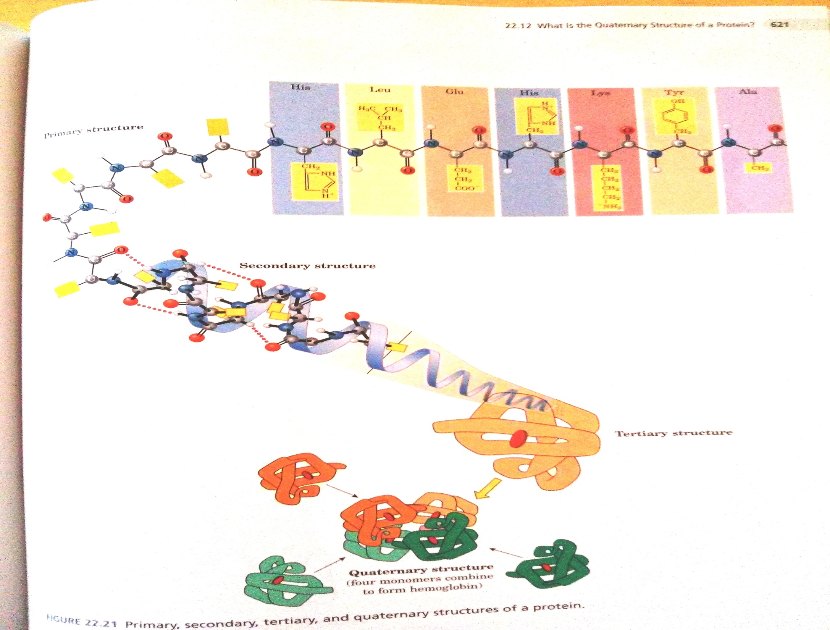

Slide 34
Proteins dividing – the Occurrence of other Components in Macromolecule accordingly
Simple protein – they are broken by Hydrolysis to Amino acids only
Compound protein – they are broken by Hydrolysis to Amino acids, Saccharides, Fats, …
  LIPOPROTEINE (Fats)
  GLYKOPROTEINE (Saccharides)
  FOSFOPROTEINE (Phosphate groups > KASEIN)
  CHROMOPEROTEINE (Colorants, e.g. Haemoglobin, Melamine)

Slide 35
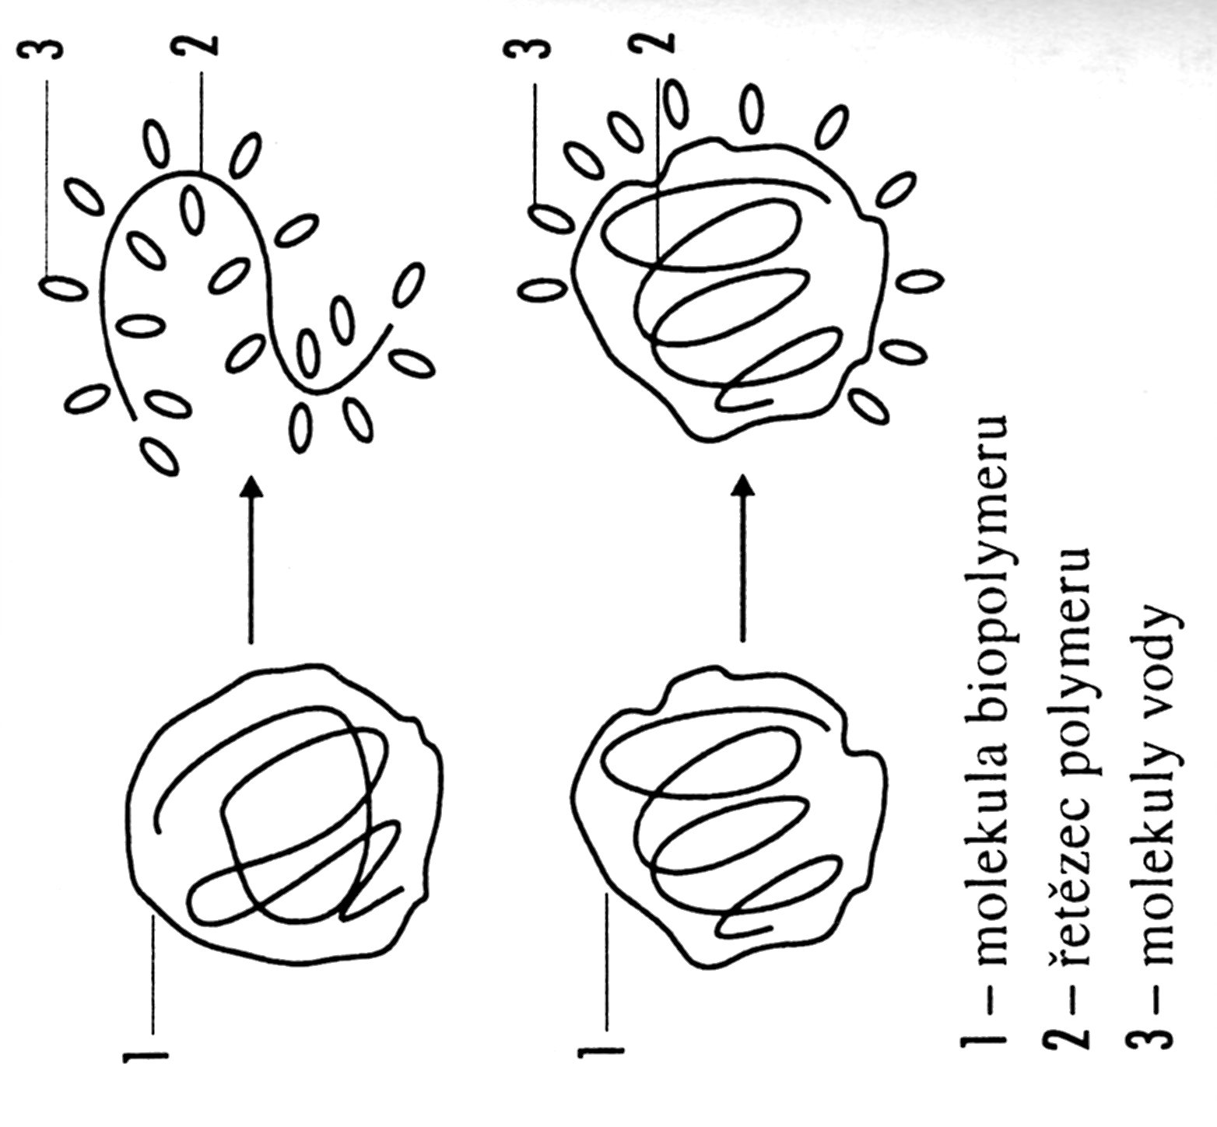
Solubility versus SWELING
Biopolymer Molecule
Biopolymer Backbone
Water or the other Solvent (Solvating Agent) Molecule

Slide 36
Proteins dividing – Macromolecules’ Solubility in Water of accordingly
SOLUBLE (SFEROPROTEINE)
  HEAT > COAGULATION
  Albumin > Egg white
  Glutelin > Glutelin from Wheat
UNSOLUBLE (SKLEROPROREINE)
  Keratin α and β
  Collagen

Slide 37
Proteins dividing – Macromolecules’ Shape and Supermolecular Structure accordingly
FIBRILAR > natural/genuine Silk, Hair, animal Hair, Muscles, fibrous connective Tissue
GLOBULAR > ENZYM, Egg white, Milk white, INSULIN, …

Slide 38
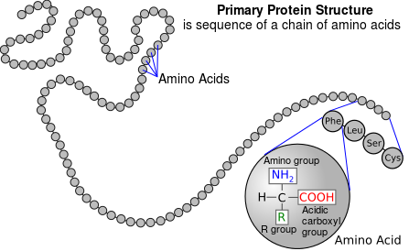
PRIMARY STRUKTURE of Proteine I

Slide 39
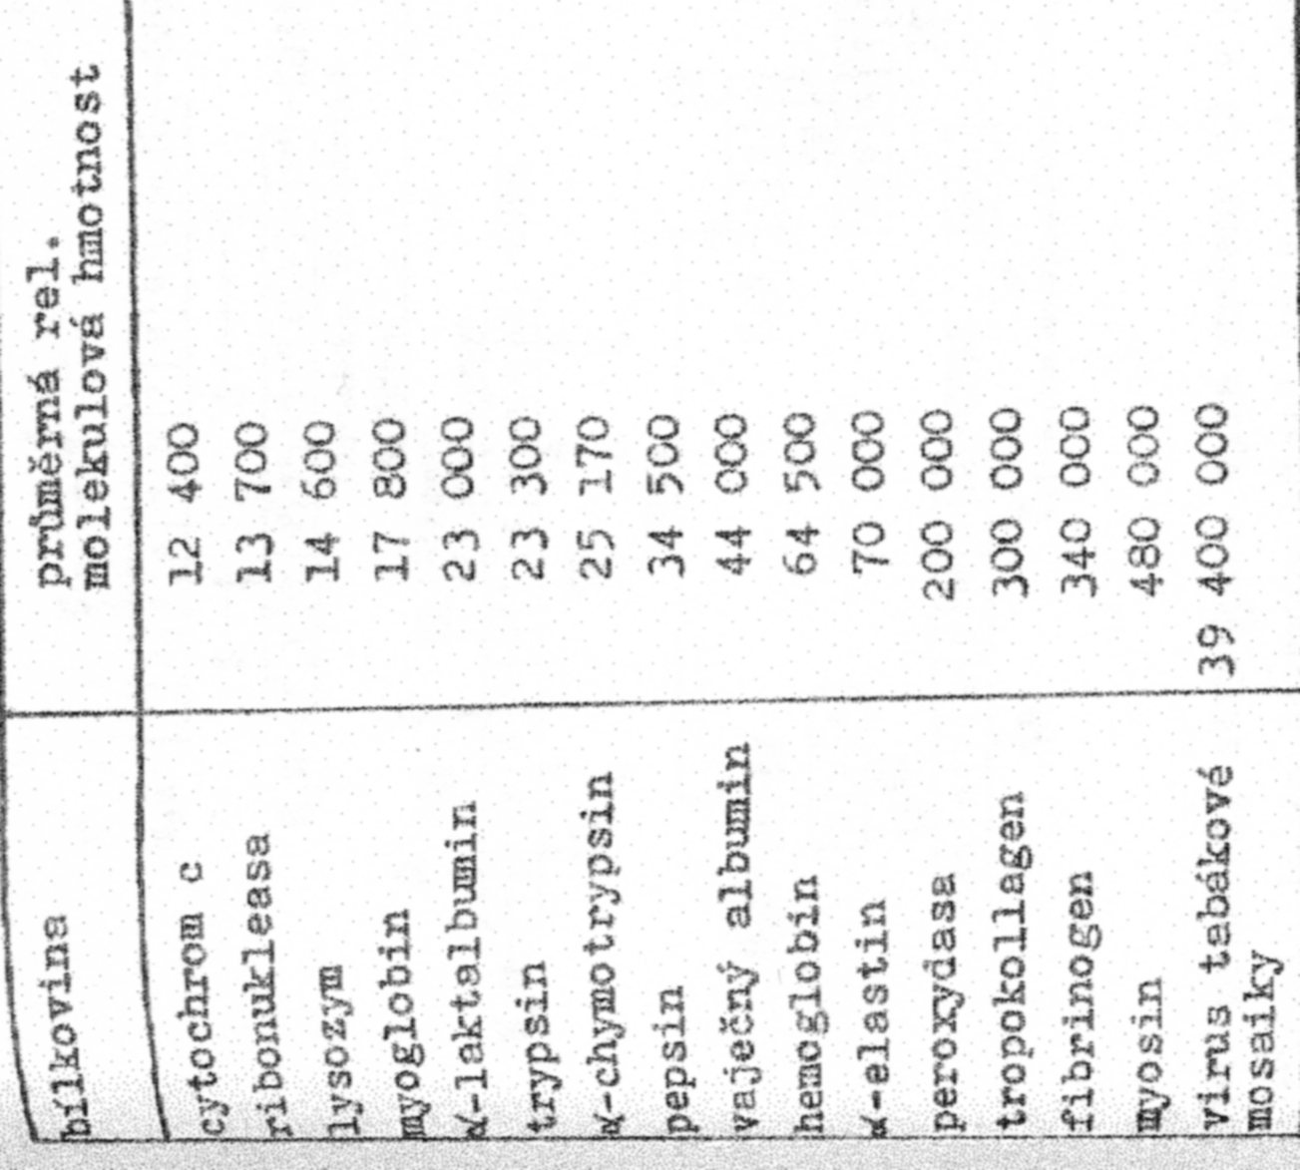
Proteines Molecular Weight
Protein
MW (Relativ, Mean)
Tobacco mosaic virus
I do not know, if it is the M_{n} or the M_{w}

Slide 40
PRIMARY PROTEINS STRUCTURE II
DETERMINATION OF THE AMINO ACIDS’ SEQUENCE
PROTEINS are broken (cleaved) to Amino acids by ENZYMS - the given ENZYM break (cleave) only the Bond between the Definite AMINO ACIDS
Using the Different ENZYMS - Different Grafts (Broken Parts) > AMINO ACIDS SEQUENCE Determination

Slide 41
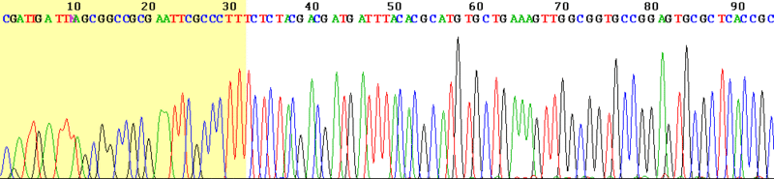
PRIMARY PROTEINS STRUCTURE III
DETERMINATION OF THE AMINO ACIDS’ SEQUENCE
Breaking (Cleaving) on the well define points (only the Bond between the Definite AMINO ACIDS ) to shorter Parts by ENZYMS „restriCTIVE endonuCleasES“ (their Number is approx. 200 Types)
Consecutive Breaking (Cleaving) of this shorter Parts taken by Primary Breaking (Cleaving) by „restriCTIVE endonuCleasES“ again, but other Types then used primary
Electrophoretic Sorting (Separation) of the Grafts (Broken Parts)
Computer Processing of the Results

Slide 42
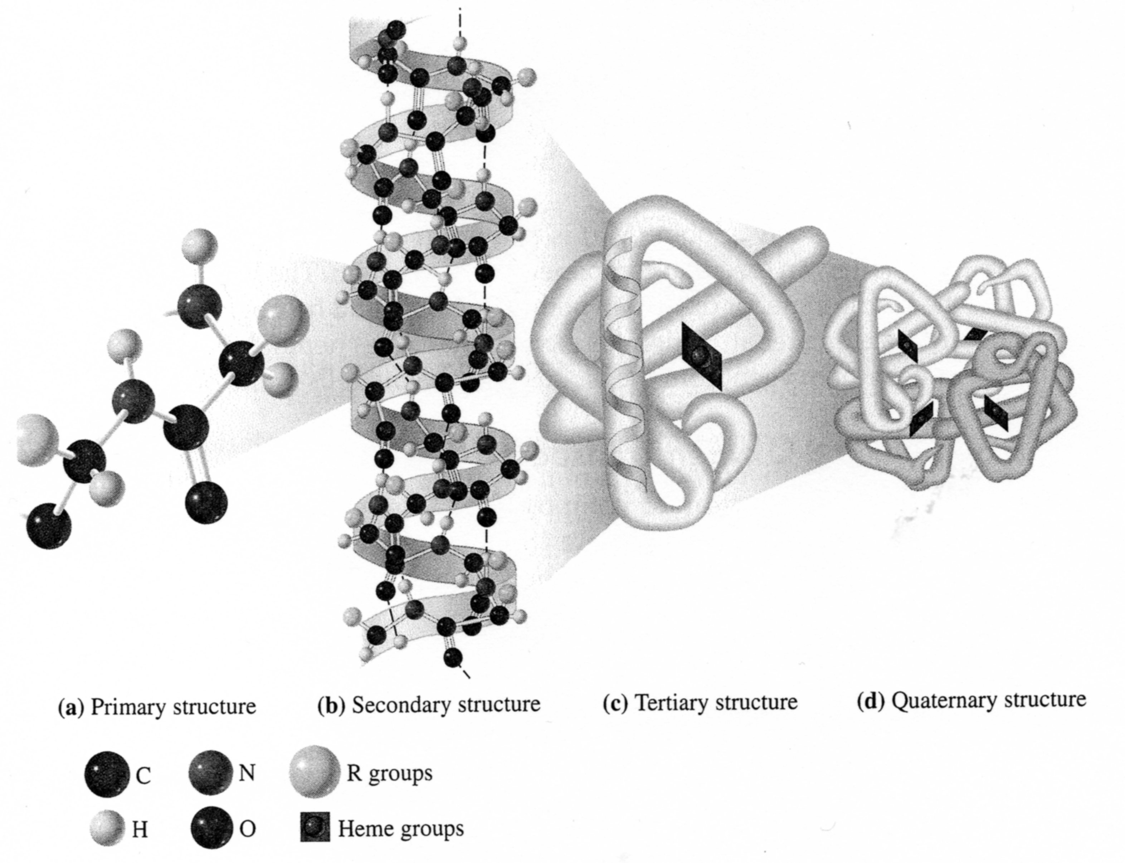
Protein SECUNDARY STRUCTURE I

Slide 43
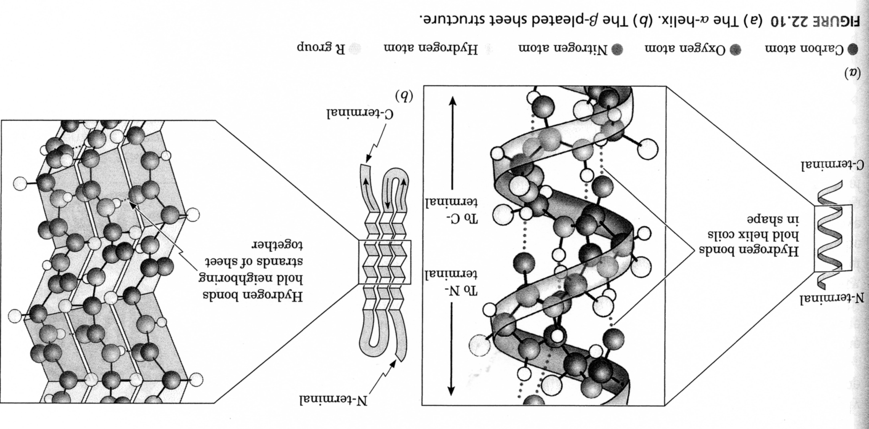
Protein SECUNDARY STRUCTURE II A
Left-handed Helix

Slide 44
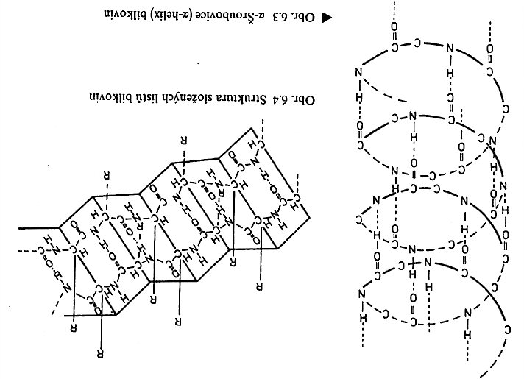
Protein SECUNDARY STRUCTURE II B
β Skládaný list
Left-handed α Helix

Slide 45
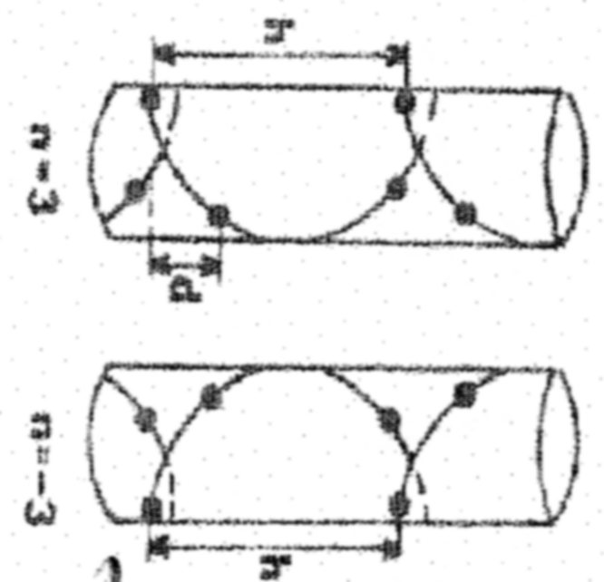
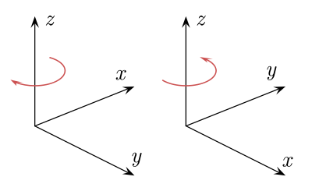
Protein SECUNDARY STRUCTURE III
Right-handed Helix
Right-handed
RIGHT HAND > thumb UP > Fingers round oriented in the Row Direction
Left-handed
LEFT HAND > thumb UP > Fingers round oriented in the Row Direction
Left-handed Helix

Slide 46
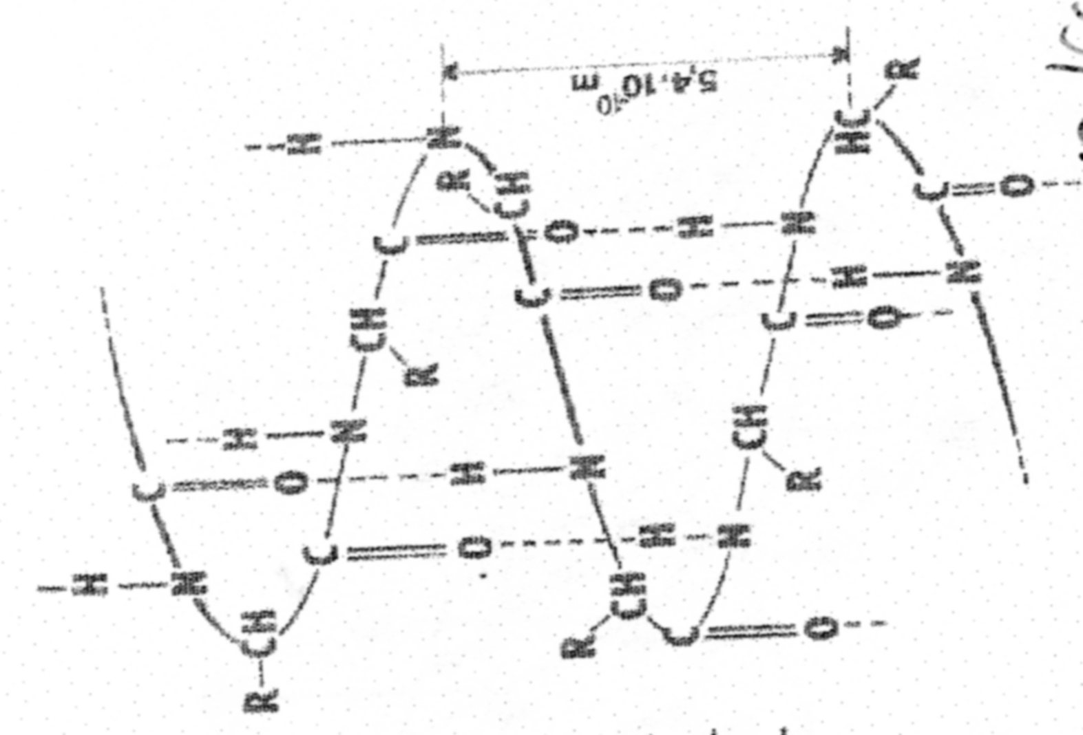
Protein SECUNDARY STRUCTURE IV
Right-handed α Helix
Left-handed α Helix

Slide 47
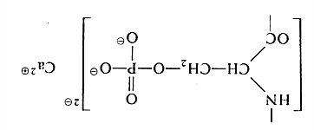
Casein – the main Amino acid Components
Glutamic acid (Glu, E)
Proline (Pro, P)
Serine (Ser, S)
Casein is the PHOSPHOPROTEID

Slide 48
Amino acids Content in various Proteins
Amino acid | PROTEIN
 | Gelatine | Casein | Egg white | Egg yellow
 | (Molar %)
Hydroxyproline | 6 | 0 | 0 | 0
Asparagic acid | 4 | 6 | 10 | 11
Theorine | 2 | 3 | 4 | 6
Serine | 4 | 5 | 7 | 11
Glutamic acid | 7 | 18 | 12 | 13
Proline | 12 | 15 | 5 | 5
Glycine | 35 | 3 | 6 | 6
Alanine | 12 | 4 | 9 | 8
Valine | 2 | 8 | 9 | 7
½ Cystine | 0 | 0 | 2 | 2
Methionine | 1 | 2 | 1 | 2

Slide 49
Amino acids Content in various Proteins
Amino acid | PROTEIN
 | Gelatine | Casein | Egg white | Egg yellow
 | (Molar %)
Isoleucine | 1 | 6 | 6 | 5
Leucine | 3 | 9 | 10 | 9
Thyrosine | 0 | 4 | 1 | 2
Phenylalanine | 1 | 4 | 4 | 3
Lysine | 3 | 6 | 7 | 5
Histidine | 1 | 3 | 2 | 2
Arginine | 5 | 3 | 5 | 4
Gelatine = Denaturated Collagen

Slide 50
Casein – characteristics
Cacein Type (Sort) | Water | Fat | Ash | Acidity
Acid, grain | 9,5 | 0,3 | 1,7 | 9,9
Acid, Cheese, Lumps | 7,8 | 0,4 | 4,1 | 7,6
Acid, Salt, Lumps | 7,1 | 0,2 | 5,7 | 6,7
Rennet coagulated | 8,3 | 0,6 | 8,0 | 7,9
CASEIN versus QUARK
CASEIN is manufactered from the skimmed (fat-free) MILK, THE HIGH FAT CONTENT IS a DEFECT!
QUARK is manufactered from the Whole (fat) MILK, but it can be also manufactered as the Fat-free or Low Fat Product!

Slide 51
Casein – Charasteristics
Protein Part of Milk
Four Types of Casein recognised: αS1, αS2, β, κ (kappa)
Casein is gained by precipitating of Milk using Acids or Enzymes
MW = approx. 75 000 – 350 000
Insoluble in Water
Soluble in Acids or Bases
Alkali Solutions have the dispergation (dispersion) Ability

Slide 52
From Casein to Cheese
Casein
  ENZYMEs
    PROTEASE - it cleavages peptide Bond in the Middle of the Casein Backbone > ALBUMOSE & PEPTONS are the Results
    PEPTIDASE - it cleavages peptide Bond on the End the Casein Backbone
    AMINASE – it cleavages Amino acids (UNDSIBABLE)
Cheese = cleavaged CASEIN
„Holes “ in Cheese = it is done by Bacterias & Enzymes, which release CO₂

Slide 53
ENZYMS
PEPTONES:
Any of various water-soluble protein derivatives formed by partial hydrolysis or digestion of proteins by an acid or enzyme, used in culture media in bacteriology.
CASEIN
Protease
Aminopolypeptidase
Albumose
Peptones
ALBUMOSE:
Any of a class of substances derived from albumins and formed by the enzymatic breakdown of proteins during digestion
Polypeptidase
Polypeptides
(PROTEINS)
Dipeptidase
Dipeptides
Amidase
Desamidase
Aminoacids
NH₃, volatile acids, H₂S

Slide 54
ALBUMOSE – they are only the shorter Proteins from CASEIN
PeptonES - they are Proteins in general or the Mixture of Proteins which results from Proteins by partial Hydrolysis done by Enzyme Pepsin and HCl in Stomach
It is stated, that PeptonES have 3 – 4 Amino acids.
PeptonES are further cleaved in the Small intestine by Trypsin and Chymotripsin, which are further cleaved in to the individual Amino acids.

Slide 55
Casein – Use
Glus
Paints
Galalit (Thermoset crosslinked by FORMALDEHYDE)
…………..

Slide 56
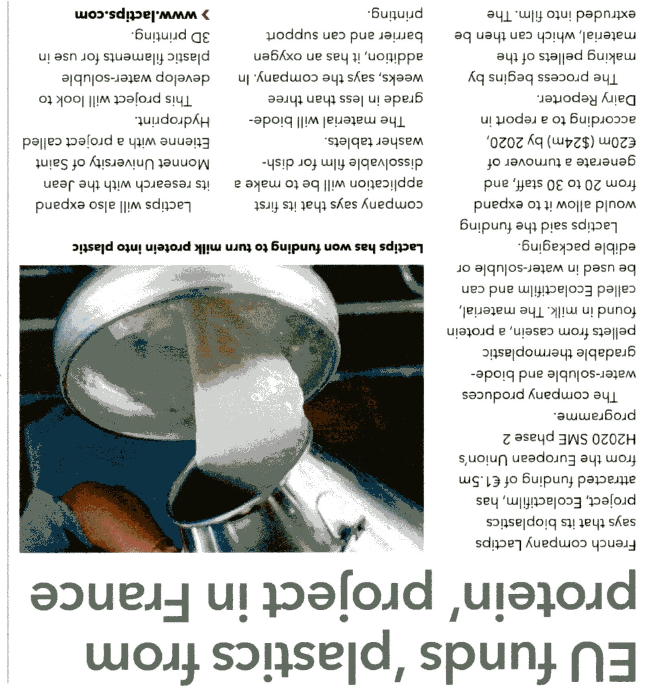
Galalit is coming back (returning)!

Slide 57
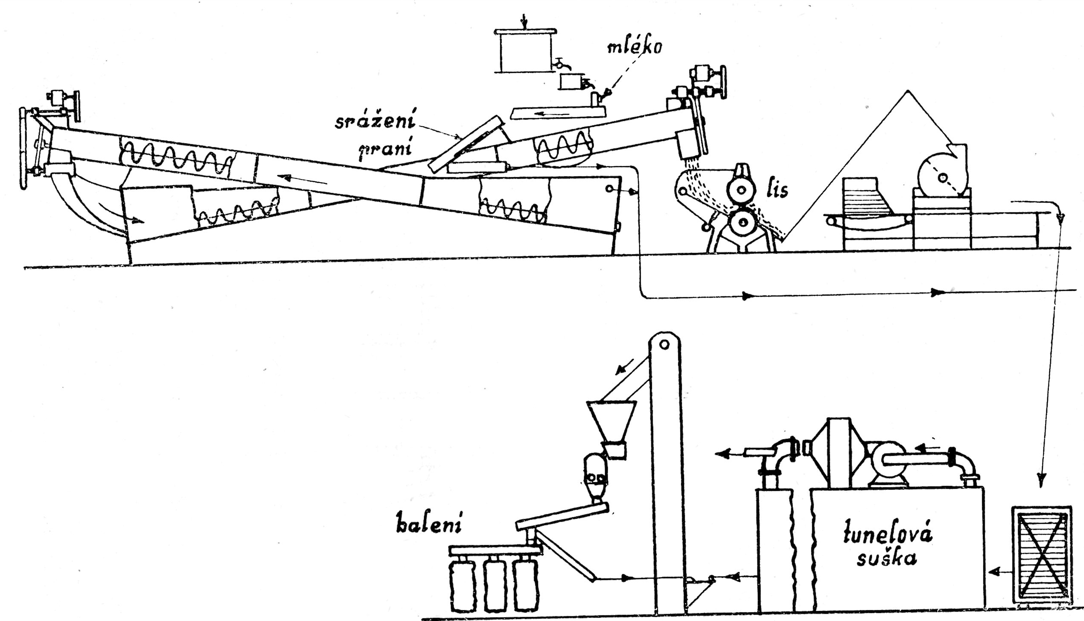
Continual Manufacture of CASEIN
The BYPRODUCT is WHEY (Proteins, Saccharides, Inorganic Substances etc. …)
Acid Dosing (HCl or H₂SO₄)
MILK
Precipitation & Washing
Press
First Washing Trough
Second Washing Trough + Chopper
Trough
Packing
Tunnel Dryer

Slide 58
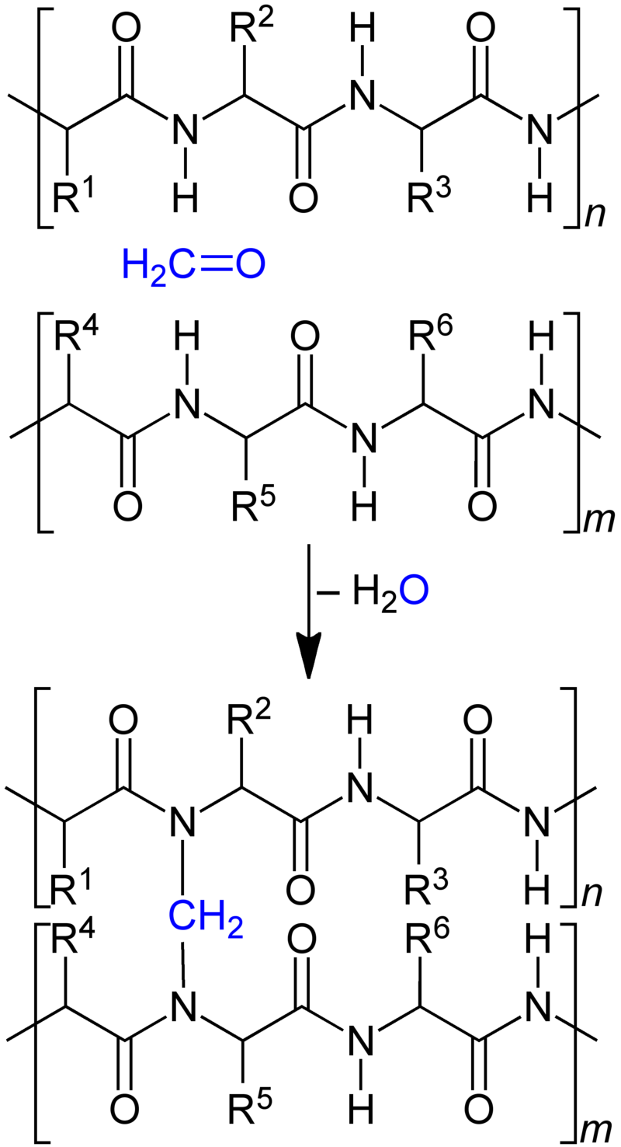
CASEIN Crosslinking by Formaldehyde
Procedure :
Prepare formulation from the CASEIN Paste, pour it into 4 % w/w Formaldehyde and leave it mature several Days
Form the Product from the CASEIN Paste + Formaldehyde (approx. 5 – 10 parts of CASEIN + 1 part of Formaldehyde , leave it several Hours or several Days mature at Temperature of 30 – 40 °C

Slide 59
Casein Glues
CASEIN Glue with Ammonia :
50 g of pure (industrial Grade) CASEIN is mixed with 250 ml Water and is slightly heated.
15 g of Ammonia is mixed with a bit of Water and is poured into heated CASEIN. The Solution boils over and CO₂ is released. CASEIN Glue is mixed up to point, when the releasing of CO₂ is finished.
CASEIN Glue with Lime:
4 Parts of Fat free QUARK is mixed with 1 Part of well matured (two Years old) Ca(OH)₂. The Glue is finished after 10 Minutes. CASEIN Glue with Lime must be freshly prepared every Day. It is diluted by 2 – 3 Parts of Water if used for binding Agent for Paints.
CASEIN Glue with NaHCO₃:
50 g of NaHCO₃ is dissolved in hot Water is chilled at continuous mixing. Add 500 g of Fat free QUARK and mix it in the Kitchen mixer. Leave it stay for 30 Minutes. Dilute it by cold Water to desired Consistency. CASEIN Glue with NaHCO₃ is suitable as the Glue and/or binding Agent for Paints.

Slide 60
Casein Paints
CASEIN Glue – a simple Recipe:
One Soup Spun (approx. 10 g) of Borax (Na₂[B₄O₅(OH)₄]·8H₂O) is dissolved in approx. 250 ml of Water. Fat free QUARK is mixed with the Borax Solution. Leave it stay for 20 Minutes and mix one more.
CASEIN based Paints working:
The Pigments are mixed with a bit of Water to a Paste. Mix 1 Part of the Coloured Paste with 1 Part CASEIN Glue and 3 Parts of Water.
CASEIN based Wall Paint:
2 kg fat free QUARK
90 g of Borax (Na₂[B₄O₅(OH)₄]·8H₂O) is dissolved in 500 ml of Water and this Solution is mixed together
Mix it in the Kitchen mixer for 20 Minutes and leave it for 20 Minutes stay
It is diluted by 8 Litres of Water for basic Painting
Mix 1 – 2 Parts of the Pigments Water Paste with 1 Part of the CASEIN Glue and 2 – 3 Parts of Water .

Slide 61
Egg Proteins – the main Amino acids Components
Glutamic acid (Glu, E)
Serine (Ser, S)
Glycine (Gly, G)
Leucine (Leu, L)

Slide 62
Amino acids Content in various Proteins
Amino acid | PROTEIN
 | Gelatine | Casein | Egg white | Egg yellow
 | (Molar %)
Hydroxyproline | 6 | 0 | 0 | 0
Asparagic acid | 4 | 6 | 10 | 11
Theorine | 2 | 3 | 4 | 6
Serine | 4 | 5 | 7 | 11
Glutamic acid | 7 | 18 | 12 | 13
Proline | 12 | 15 | 5 | 5
Glycine | 35 | 3 | 6 | 6
Alanine | 12 | 4 | 9 | 8
Valine | 2 | 8 | 9 | 7
½ Cystine | 0 | 0 | 2 | 2
Methionine | 1 | 2 | 1 | 2

Slide 63
Amino acids Content in various Proteins
Amino acid | PROTEIN
 | Gelatine | Casein | Egg white | Egg yellow
 | (Molar %)
Isoleucine | 1 | 6 | 6 | 5
Leucine | 3 | 9 | 10 | 9
Thyrosine | 0 | 4 | 1 | 2
Phenylalanine | 1 | 4 | 4 | 3
Lysine | 3 | 6 | 7 | 5
Histidine | 1 | 3 | 2 | 2
Arginine | 5 | 3 | 5 | 4
Gelatine = Denaturated Collagen

Slide 64
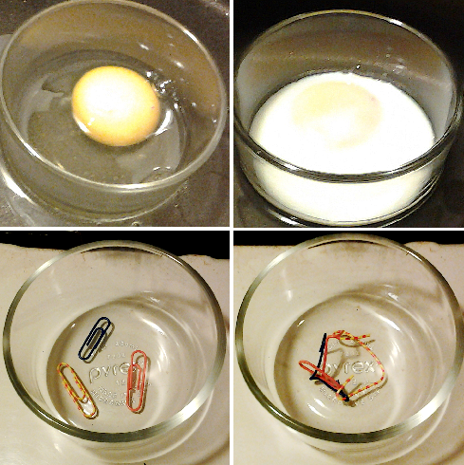
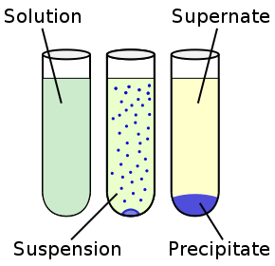
Denaturation is a process in which proteins or nucleic acids lose the quaternary structure, tertiary structure and secondary structure which is present in their native state, by application of some external stress or compound such as a strong acid or base, a concentrated inorganic salt, an organic solvent (e.g., alcohol or chloroform), radiation or heat.^{[3]} If proteins in a living cell are denatured, this results in disruption of cell activity and possibly cell death. Denatured proteins can exhibit a wide range of characteristics, from loss of solubility to communal aggregation
CoagulaTION BY HEAT
ANALOGY with paper Clips

Slide 65
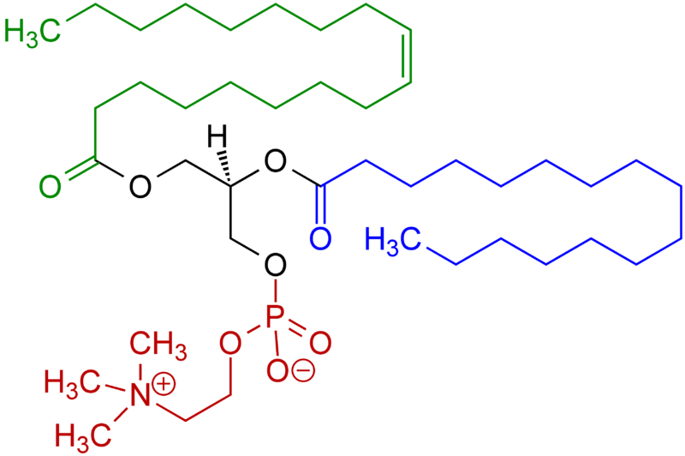
Egg Proteins – Use1
Paints
PHOSPHOLIPID LECITINE – emulsifying Agent
It is Part of the Egg yellow, but is NOT its Protein Part

Slide 66
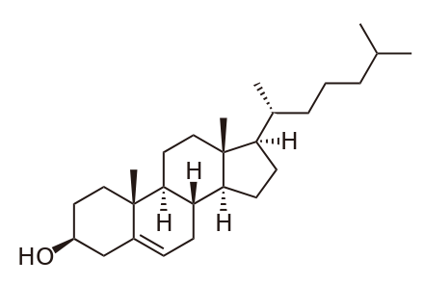
Egg Proteins – USE 2
Paints
CHOLESTEROL – STEROID & emulsifying AgentIt is Part of the Egg yellow, but is NOT its Protein Part

Slide 67
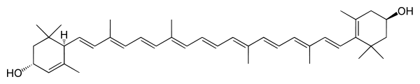
It is Part of the Egg yellow, but is NOT its Protein Part
Luteine - Colorant in the Egg yellow
Chemical Name | β,ε-karoten-3,3'-diol
Summary Formula | C₄₀H₅₆O₂
CAS registration Number | 127-40-2
Appearance | Solid, red – orange Crystalic Matter
Molar Mass | 568,871 g/mol
Melting Temperature | 190 °C
Solubility in Water | no
Solubility in Fats | yes

Slide 68
Egg White &Drinks
Clarifying of Fruit Juices
Probably the oldest Clarifying Agent for Fruit Juices and Wine

Slide 69
Whey
Whey is a yellow-green Liquid, which is the Rest gained after precipitation of Milk using Acids or Enzymes. Whey is in fact Milk Serum. It looks like in Practise, that the Milk is precipitated and the Solid Part is CASEIN and the Liquid Part is Whey.
Dried Whey arises also as the By-product at Manufacture of Cheese and/or QUARK.
Whey contains Vitamins B1, B2, B6, B12 and further Vitamins C and E. As to Inorganic Elements it contains Mg, P, Ca, K, Na, Zn. It contains also the Saccharide LACTOSE.
Whey has antiflammable Effect when used externally, so it is suitable for the sensitive Skin also. The other Uses as Dermatologic Agents are also widely used.

Slide 70
Whey –contained PROTEINS
Whey protein is a mixture of globular proteins isolated from whey
Whey protein is the collection of globular proteins isolated from whey, a by-product of cheese manufactured from cow's milk. The protein in cow's milk is 20% whey protein and 80% casein protein, whereas the protein in human milk is 60% whey and 40% casein. The protein fraction in whey constitutes approximately 10% of the total dry solids in whey. This protein is typically a mixture of beta-lactoglobulin (~65%), alpha-lactalbumin (~25%), bovine serum albumin (~8%)(see also serum albumin), and immunoglobulins. These are soluble in their native forms, independent of pH.
β-Lactoglobulin is the major whey protein of cow and sheep's milk (~3 g/l),
α-Lactalbumin is an important whey protein in cow's milk (~1 g/l) that enhances efficiency of brain function,
Serum albumin, often referred to simply as albumin is a globular protein. Serum albumin is the most abundant plasma protein in mammals.
An antibody (Ab), also known as an immunoglobulin (Ig), is a large Y-shaped protein produced by B cells that is used by the immune system to identify and neutralize foreign objects such as bacteria and viruses.

Slide 71
Plant Proteins
Proteins are usually related with Animal Products, but Proteins can be also of the Plant Origin:
Glutens (glutelins)
Prolamins (gliadins)
They are MOSTLY Water insoluble (approx . 80 % of them)
Plant | Group | Protein | Remark, more Specific
Wheat, Barley, Rye | Gluten | glutenin | 8 – 13, sometimes also 15 % w/w Proteins
Rice |  | oryzenin
Wheat, Rye | Prolamin | gliadin | coeliac disease, allergy to Gluten
Corn |  | zein
Barley |  | hordein | GLYCOPROTEIN, coeliac disease, allergy to Gluten
Legumes | Pea, Bean, Lentil, Soya, Ground-nut etc., up to 45 % w/w Proteins

Slide 72
Prolamins are a group of plant storage proteins having a high proline content and found in the seeds of cereal grains: wheat (gliadin), barley (hordein), rye (secalin), corn (zein), sorghum (kafirin) and as a minor protein, avenin in oats. They are characterised by a high glutamine and proline content and are generally soluble only in strong alcohol solutions. Some prolamins, notably gliadin, and similar proteins found in the tribe Triticeae (see Triticeae glutens) may induce coeliac disease in genetically predisposed individuals.
Gluten is a composite of storage proteins termed prolamins and glutelins and stored together with starch in the endosperm (which nourishes the embryonic plant during germination) of various cereal (grass) grains. It is found in wheat, barley, rye, oat, related species and hybrids (such as spelt, khorasan, emmer, einkorn, triticale, kamut, etc.) and products of these (such as malt). Glutens, and most especially the Triticeae glutens, are appreciated for their viscoelastic properties. It gives elasticity to dough, helping it rise and keep its shape and often gives the final product a chewy texture.
Gliadin (a type of prolamin) is a class of proteins present in wheat and several other cereals within the grass genus Triticum. Gliadins, which are a component of gluten, are essential for giving bread the ability to rise properly during baking. Gliadins and glutenins are the two main components of the gluten fraction of the wheat seed. This gluten is found in products such as wheat flour. Gluten is split about evenly between the gliadins and glutenins, although there are variations found in different sources.
Gliadin is the water-soluble component of gluten, while glutenin is insoluble. There are three main types of gliadin (α, γ, and ω), to which the body is intolerant in coeliac (or celiac) disease. Diagnosis of this disease has recently been improving

