Slide 1
NATURAL POLYMERS Polysaccharide I STARCH 2
Dr. Ladislav Pospíšil

Slide 2
Time schedule
LECTURE | SUBJECT
1 | Introduction to the subject – Structure & Terminology of nature polymers, literature
2 | Derivatives of acids – natural resins, drying oils, shellac
3 | Waxes
4 | Plant (vegetable) gums, Polyterpene – natural rubber (extracting, processing and modification), Taraxacum_kok-saghyz
5 | Polyphenol – lignin, humic acids
6 | Polysaccharides I – starch
7 | Polysaccharides II – celullosis
8 | Protein fibres I
9 | Protein fibres II
10 | Casein, whey, protein of eggs
11 | Identification of natural polymers
 | Laboratory methods of natural polymers’ evaluation

Slide 3
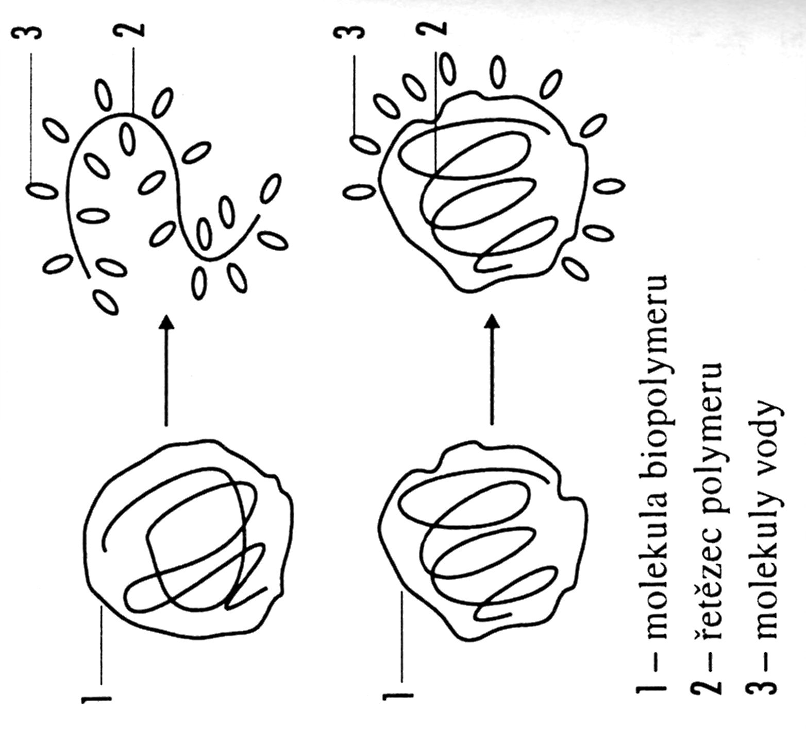
SOLUBILITY versus SWELLING
Biopolymer molecule
Polymer Chain
Water molecule or other Solvent (solvation agent)

Slide 4
Dissolving OF STRACH
NATIV STARCH is not soluble in the Cold Water, having Water in the in the Capillaries and Hydrogen bonds only, approx. 14 – 16 % w/w of Water
NATIV STARCH after pouring to Water at the Laboratory Temperature – the only the other Pores are filled by Water
NATIV STARCH in the Water at Temperature increasing to approx. 50°C – it is SWELLING, Hydrogen bonds are destroyed a DISPERSION OF Swollen (hydrated) Particles in Water
The FULL HYDRATATION occurs (maximal for the particular Starch) after taking another Water and a Gel are arising (amylopeCtin) or High Viscosity Solution (amylOSE)
THE RESULTING STATE IS called GELATION STARCH

Slide 5
Behaviour of Starch in Water
Laboratory Temperature: the Reversible filling of the Capillaries in the Starch Particle only
Temperature Increasing: the steady Hydratation and Destruction of the Hydrogen bonds, AMYLOSE DISOLVING, the only Swelling of the AMYLOPECTIN
Temperature Increasing & Mixing: Hydrogen bonds are destroyed and so called „ GELATION STARCH (GELLING) POINT (Peptisation)“
GELATION STARCH (GELLING) POINT is characteristic for each type native or modified Starch

Slide 6
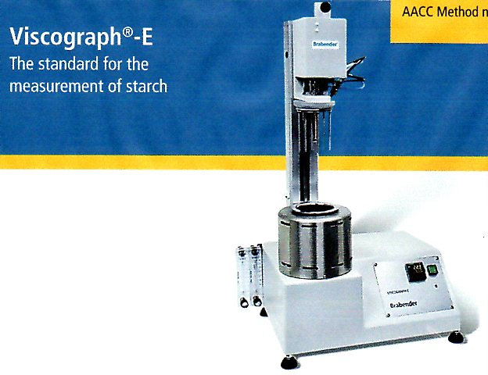
STARCH GELLING Curves of Starch in Water
Suited for starch and flour
Usage for acid and lye
Small sample size (5 - 15 g)
Short measuring times
Speed (0 - 300 min⁻¹)
Temperature measurement within the sample
Heating / cooling rates of up to 10°C / min
No follow-up costs
Evaluation in BU, mPas, cP or cmg
Modified ROTATION VISCOSIMETER

Slide 7
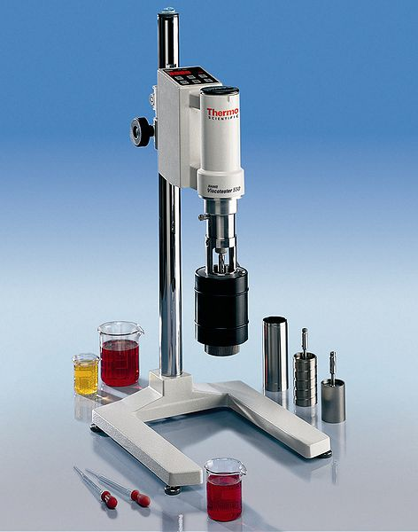
ROTATION VISCOSIMETER
Modified ROTATION VISCOSIMETER
Standard ROTATION VISCOSIMETER

Slide 8
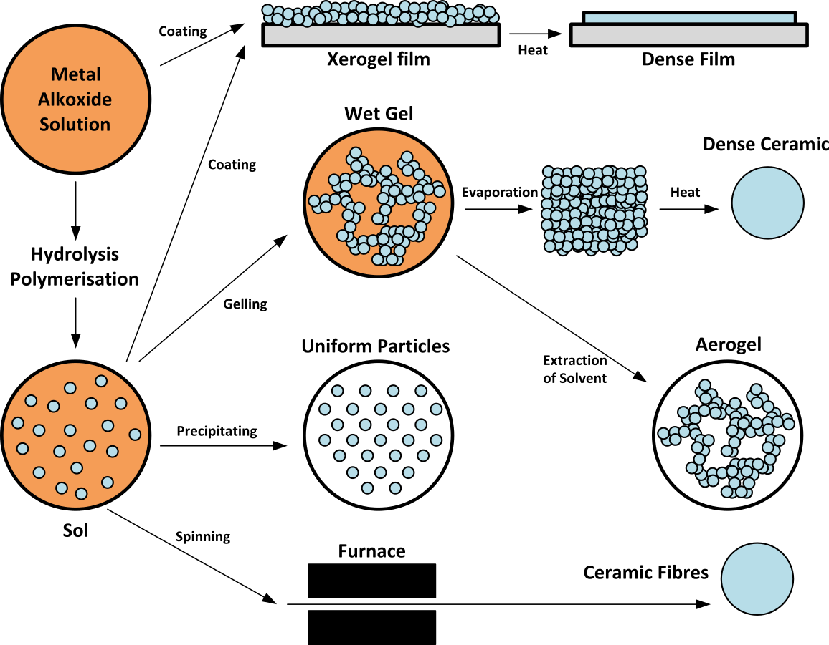
It is related to STARCH

Slide 9
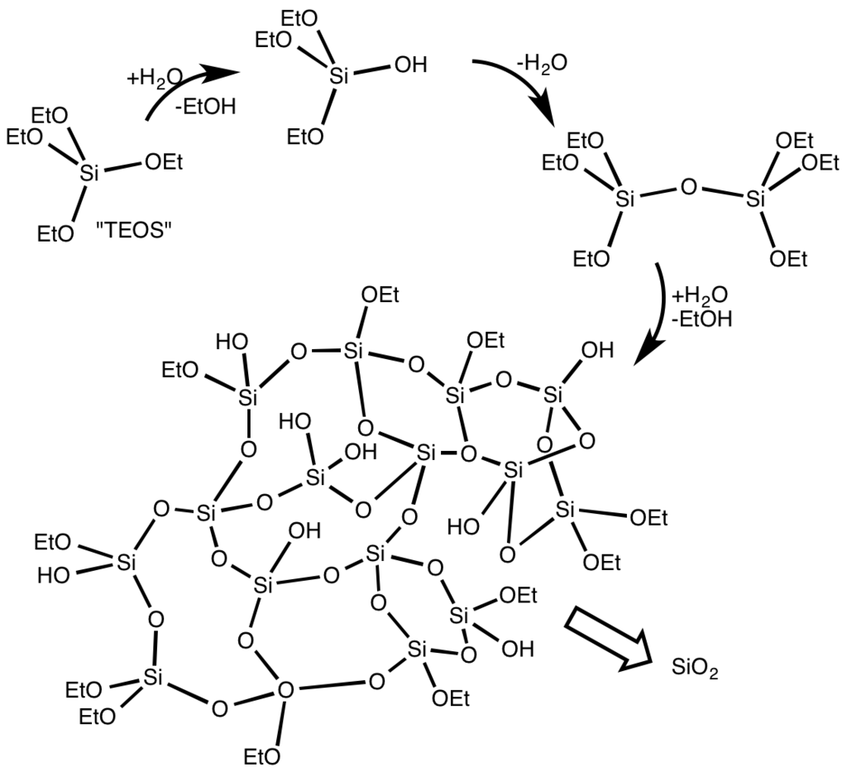
SOL –big Particles in Solution
Solid GEL is formed by Calcination

Slide 10
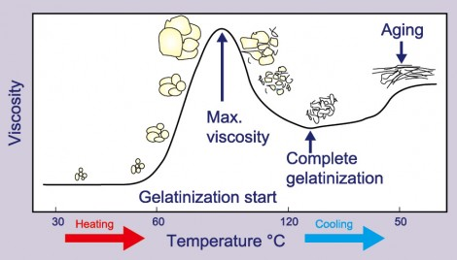
STARCH GELLING Curves of Starch in Water – in GENERAL
STARCH GELLING POINT
RETROGRADATION

Slide 11
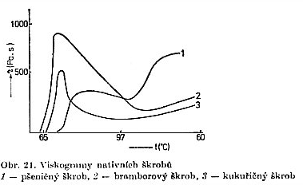
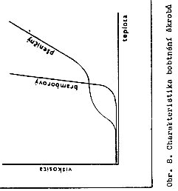
STARCH GELLING Curves of various sorts of Starch in Water 2
STARCH GELLING POINT
Corn Starch
Potato Starch
Swelling characteristics of Various Starches
Viscosity curves of native Starches:
1) Wheat Starch, 2) Potato Starch, 3) Corn Starch

Slide 12
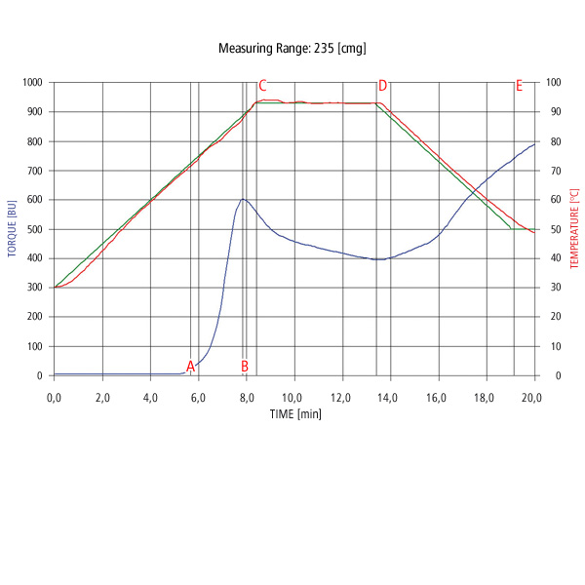
STARCH GELLING Curves of Starch in Water1
STARCH GELLING POINT
Suited for starch and flour
Usage for acid and lye
Small sample size (5 - 15 g)
Short measuring times
Speed (0 - 300 min⁻¹)
Temperature measurement within the sample
Heating / cooling rates of up to 10°C / min
No follow-up costs
Evaluation in BU, mPas, cP or cmg
Take notice of the course Temperature measurement and Points its Changes!
Brabender is the German manufacturer of such Devices
BU = Brabender Unit

Slide 13
STARCH GELLING Curves of Starch in Water 3
STARCH GELLING POINT
RETROGRADATION = viscosity Increasing with Temperature Decreasing > GEL FORMING
Coast along (INCREAS) after Temperature switching to Constant Temperature
Gradual dissolving of the Shorter chains and their Diffusion to Water > VISCOSITY INCREASING
Hydrogen bonds Destruction between Starch chains and hydratation of the all Starch particle, Three-dimensional network > GEL
Releasing of the Smaller Hydrated Structures > SOL

Slide 14
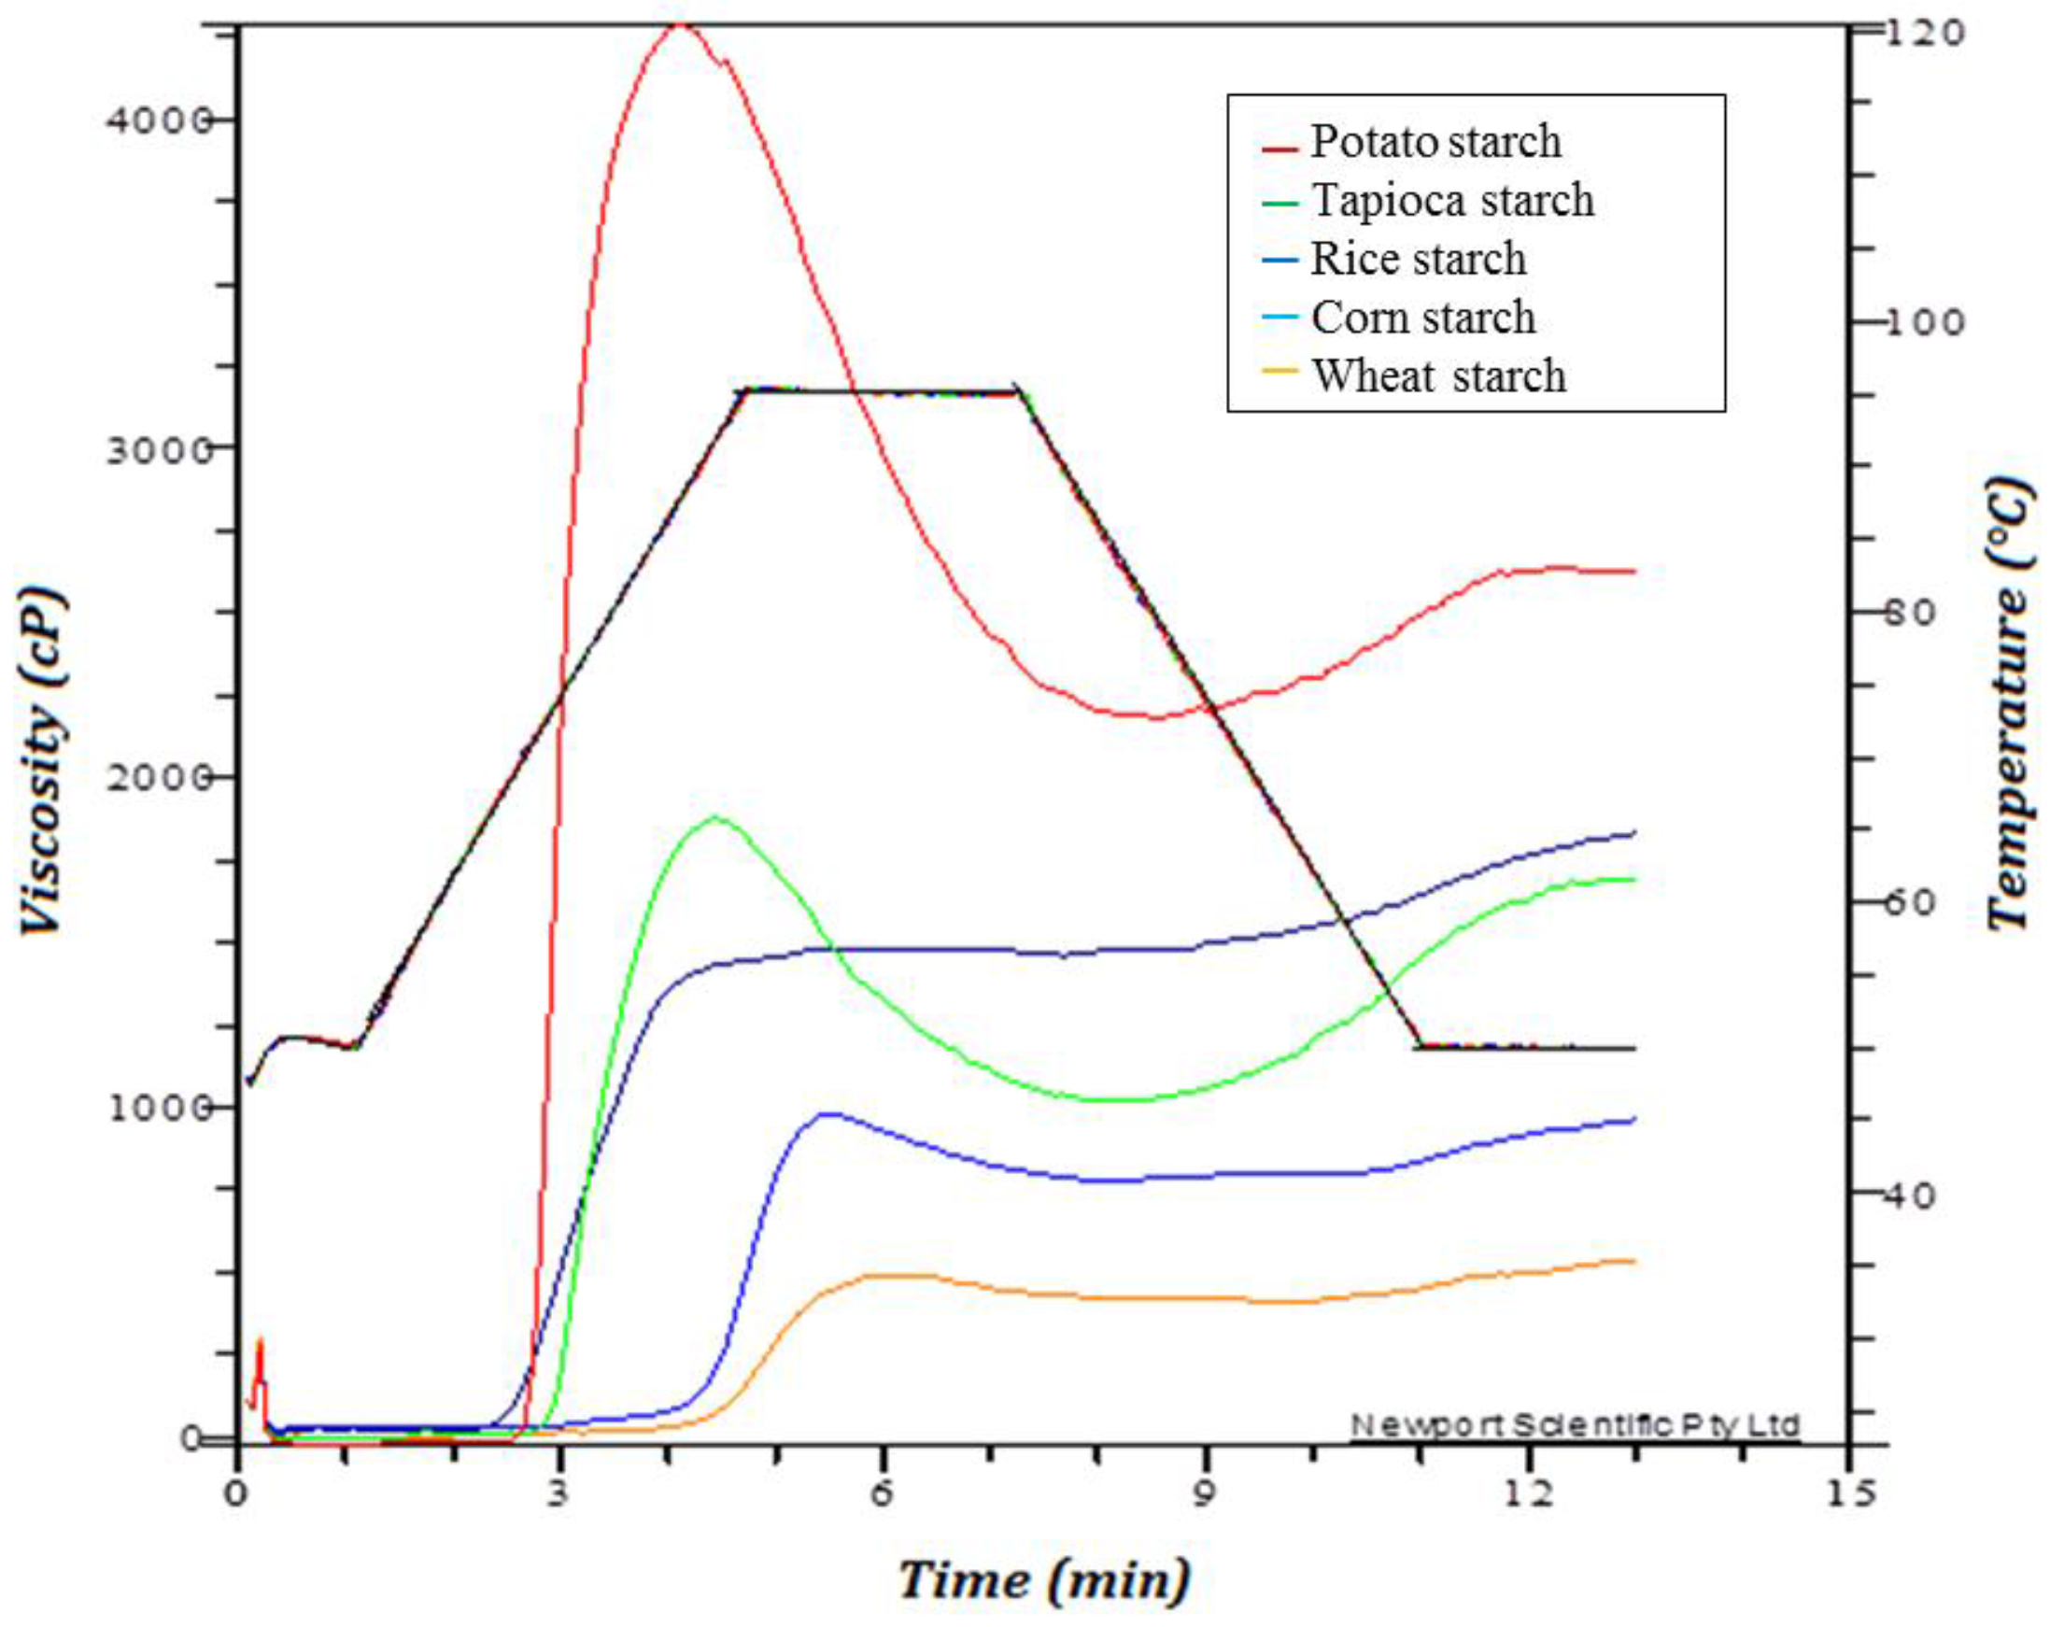
STARCH GELLING Curves of Starch in Water 4
STARCH GELLING POINT
RETROGRADATION

Slide 15
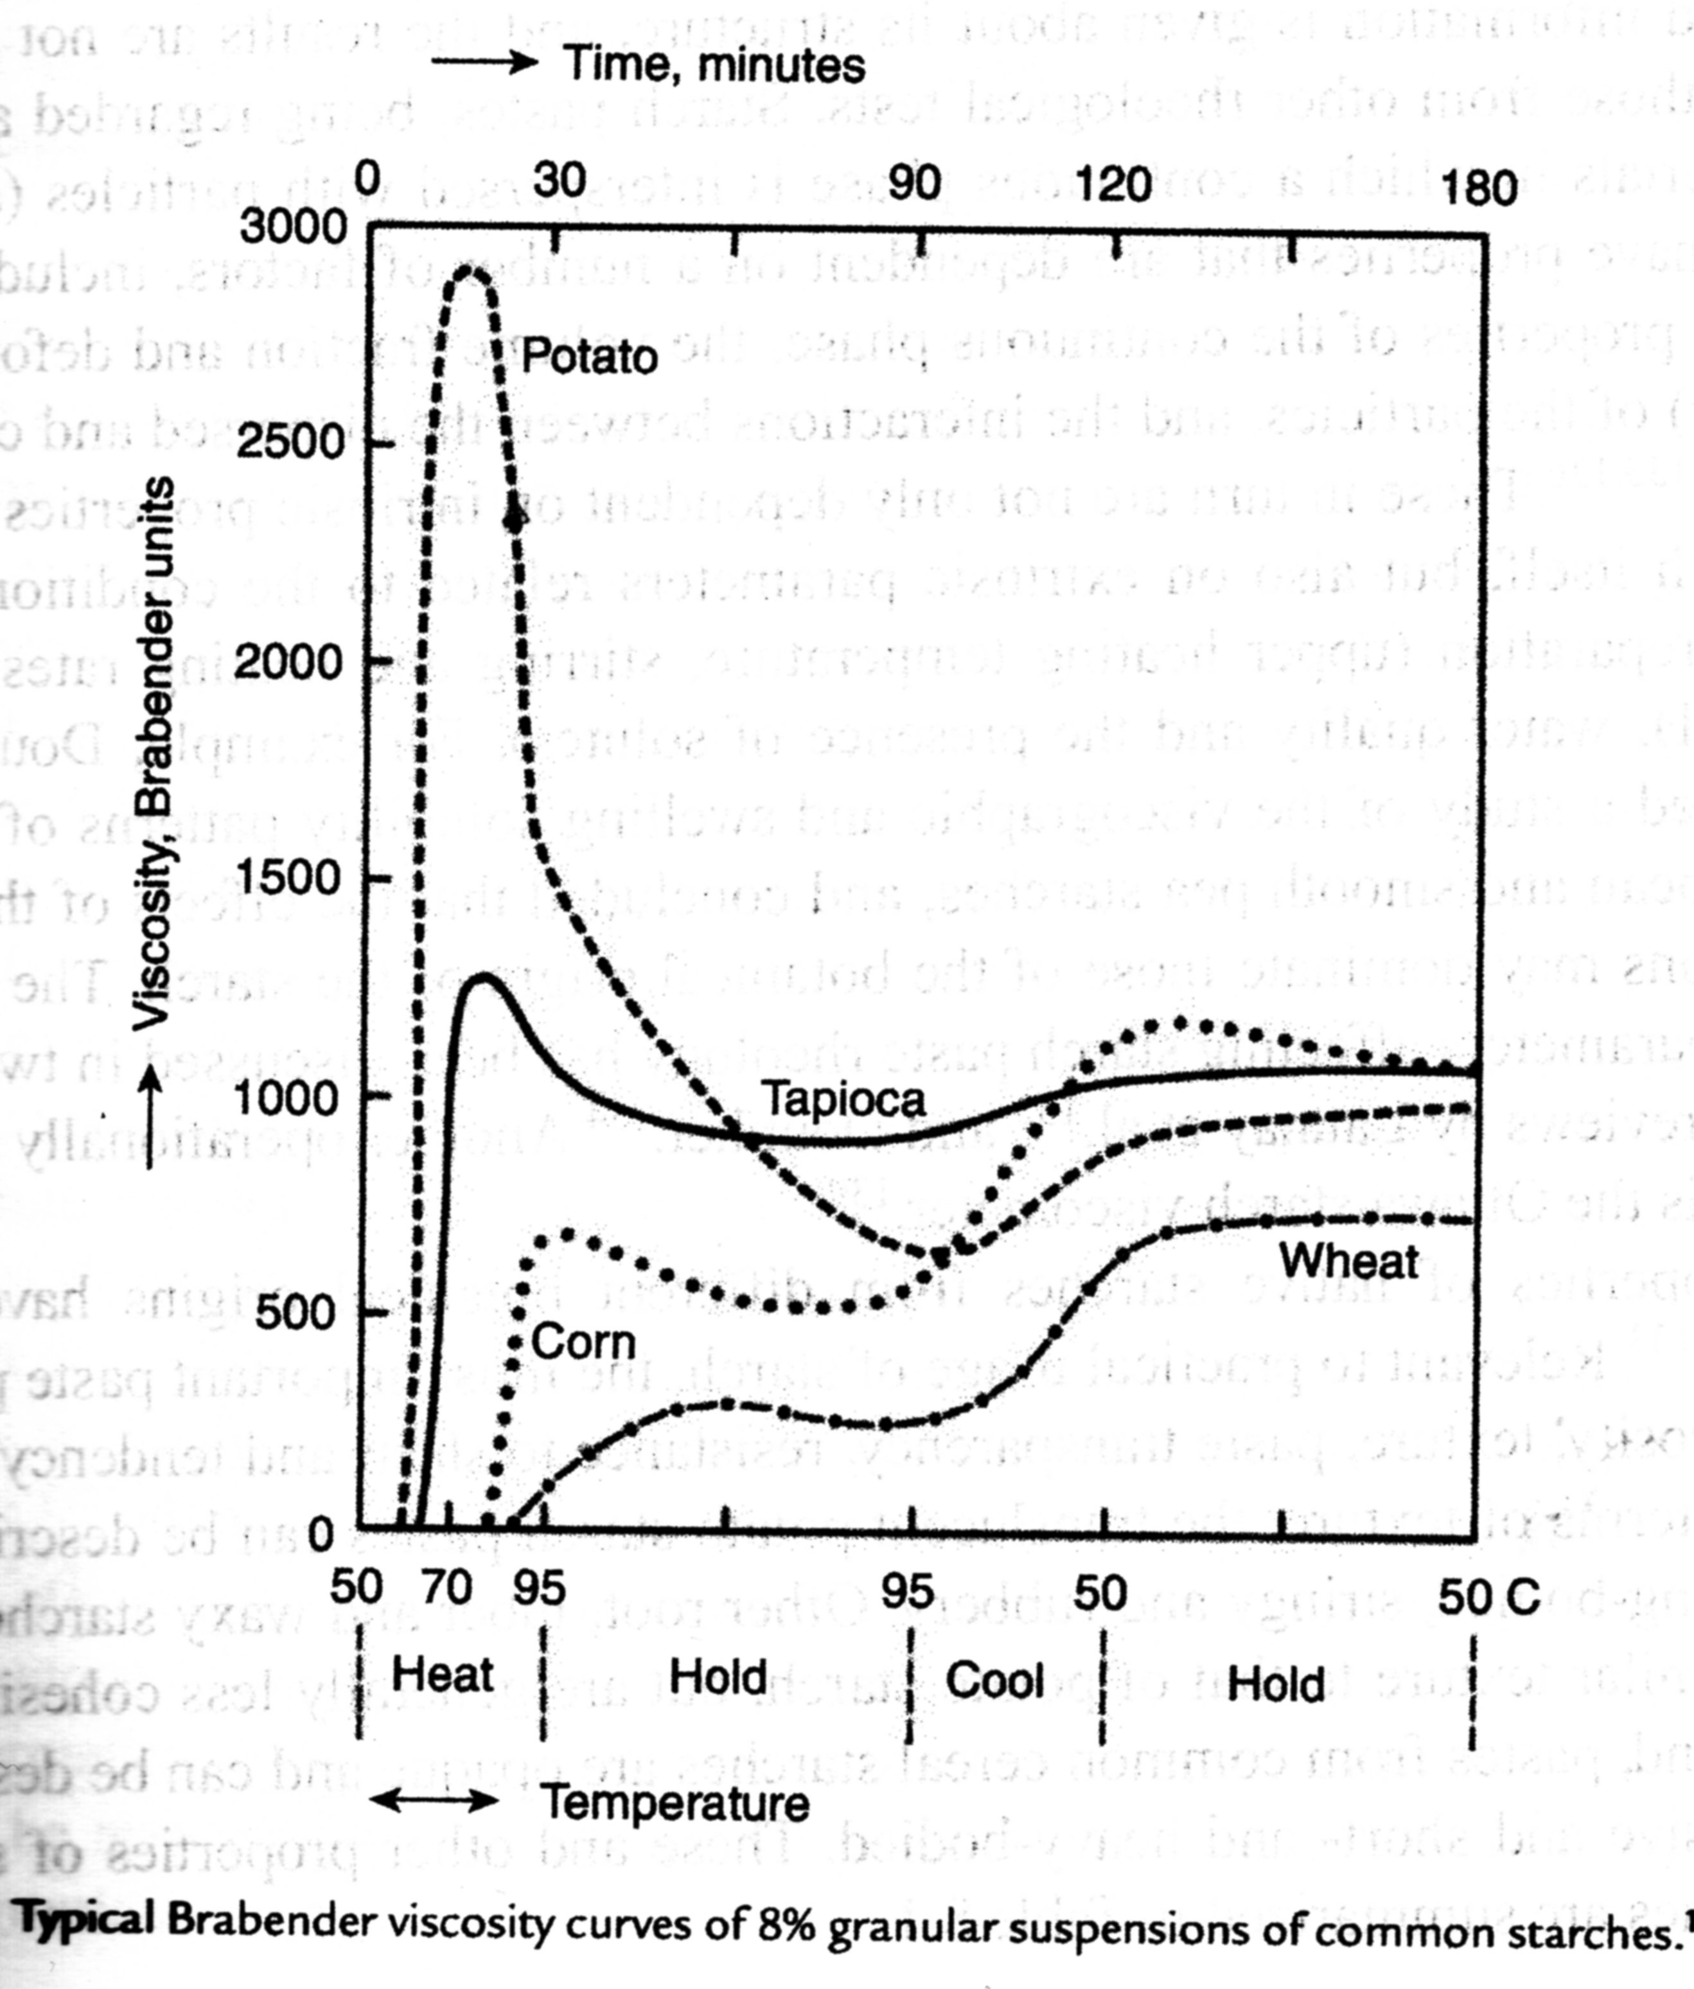
STARCH GELLING Curves of Starch in Water 5
STARCH GELLING POINT
RETROGRADATION

Slide 16
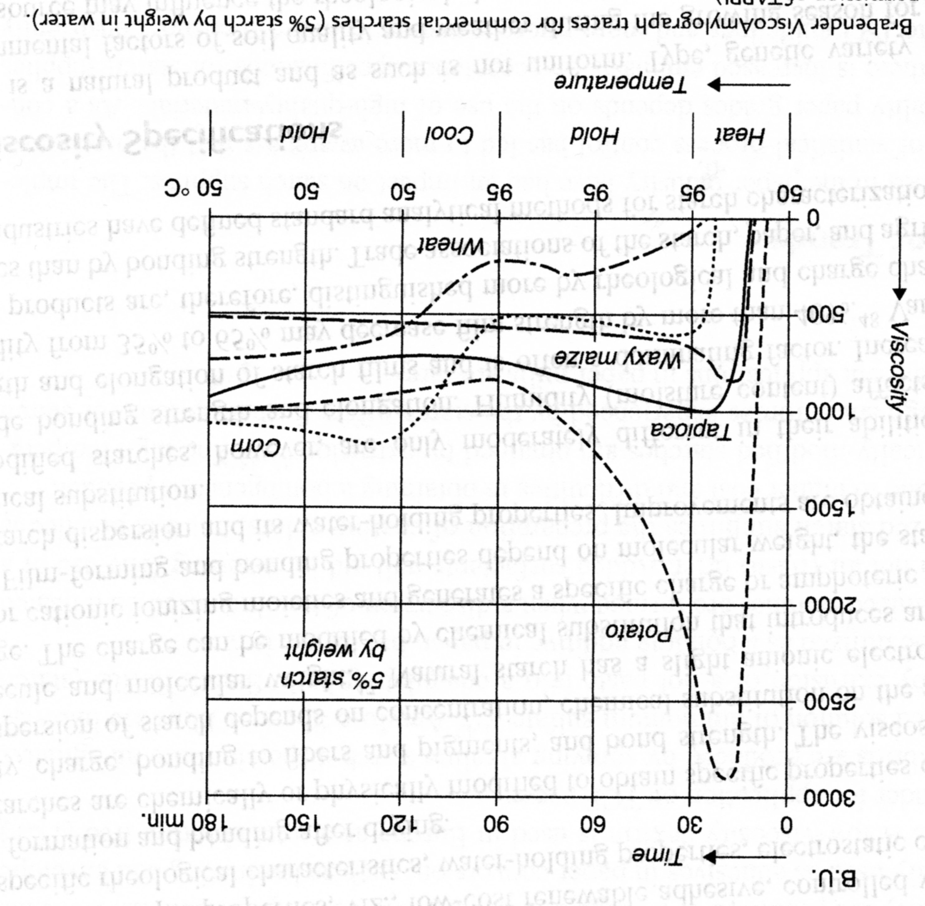
STARCH GELLING Curves of Starch in Water 6
STARCH GELLING POINT
RETROGRADATION

Slide 17
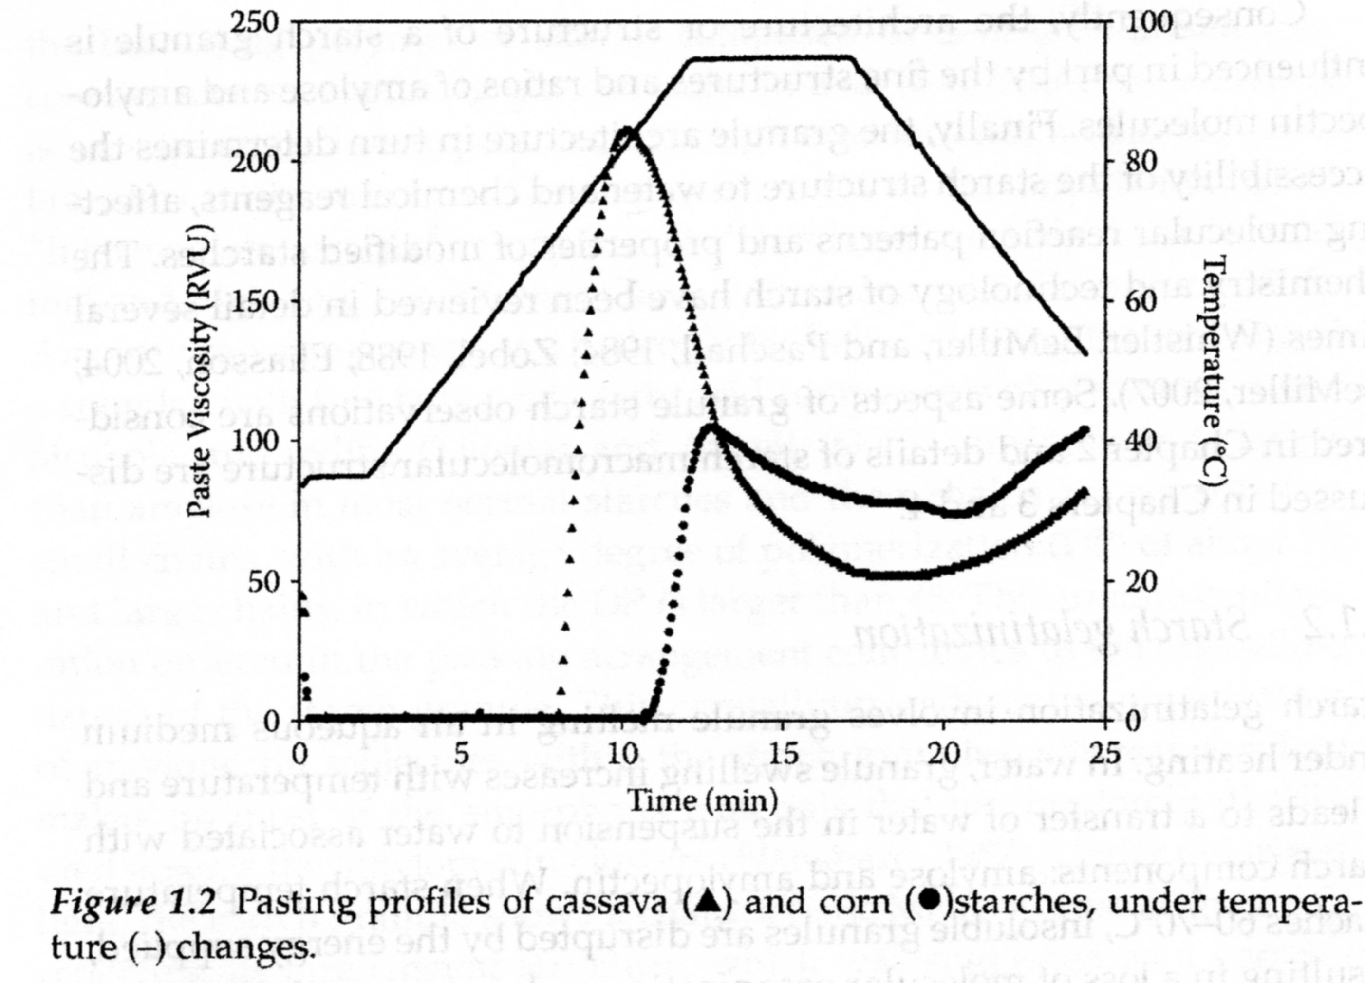
STARCH GELLING Curves of Starch in Water 7
STARCH GELLING POINT
RETROGRADATION

Slide 18
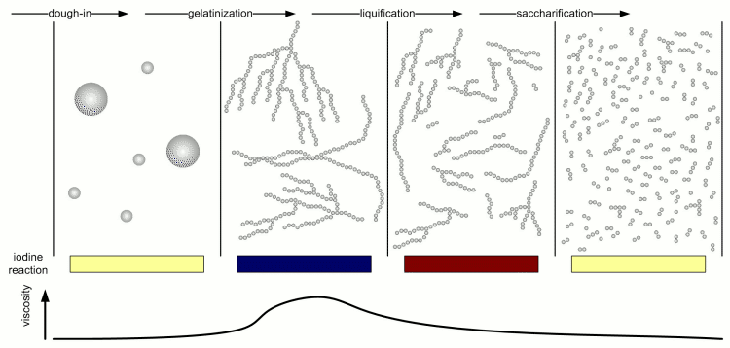
STARCH GELLING Curves of Starch in Water 8
Dough
STARCH GELLING POINT
Gradual Cleavage (Chain Scission) by Enzymes

Slide 19
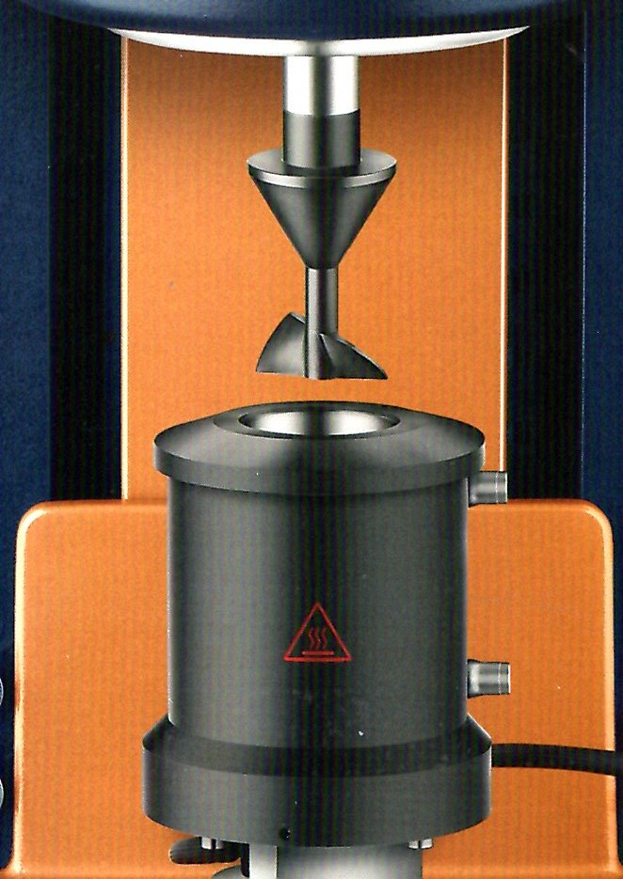
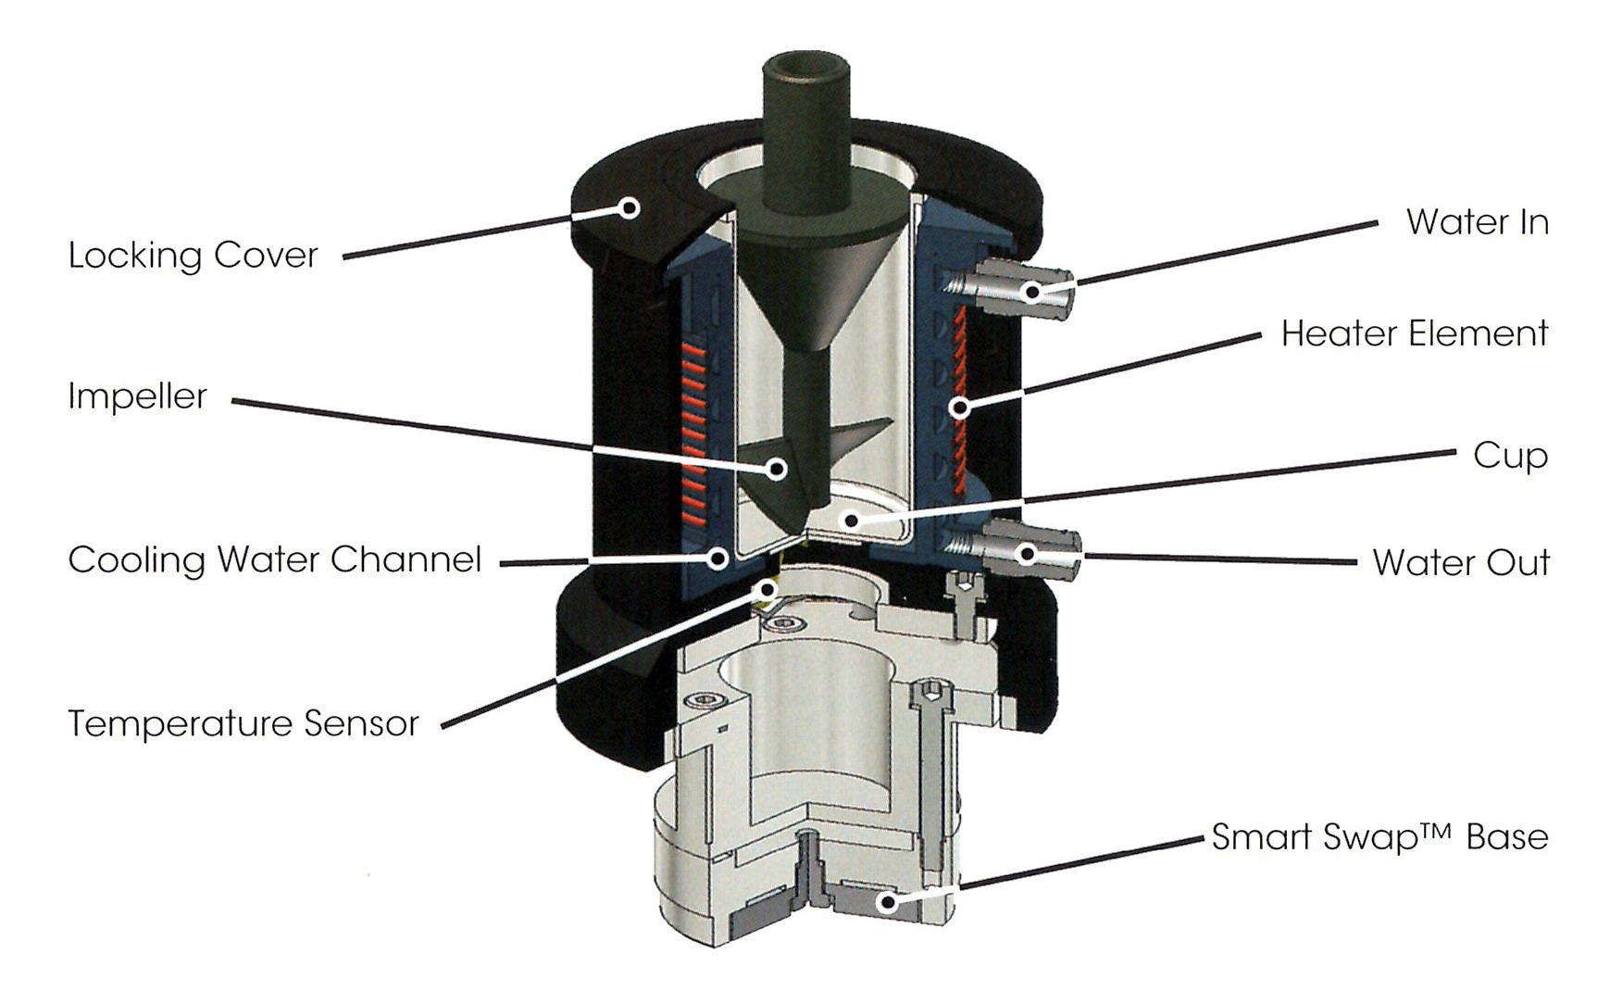
Another type of the Viscosimeter for Maesurement of the STARCH GELLING POINT 1

Slide 20
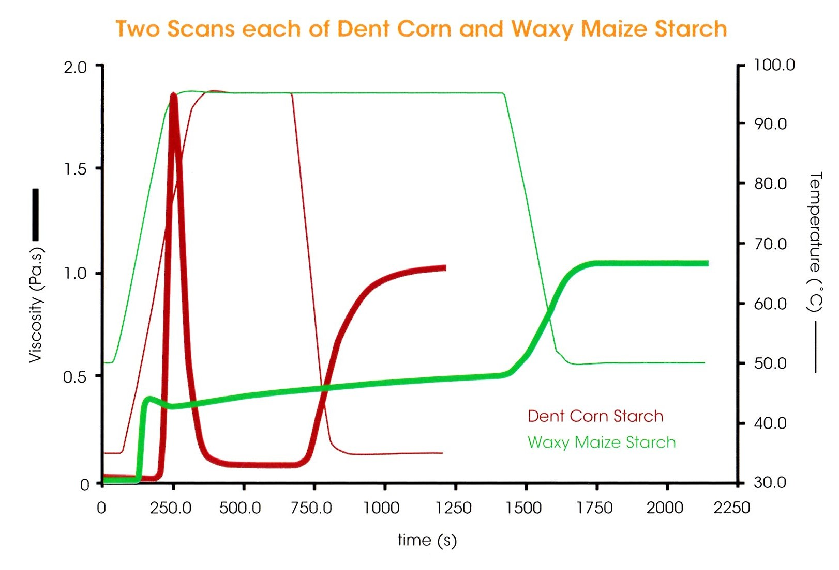
Another type of the Viscosimeter for Maesurement of the STARCH GELLING POINT 2
Various Sorts of Corn (Maize) Starch
Transition
GEL > SOL
VISCOSITY IS GIVEN IN THE SI UNITS!

Slide 21
STARCH GELLING POINT - various Starches
Starch | GELLING POINT Temperature (°C)
 | Starting | Final | Middle
Potato | 59 | 60 | 63,5
Corn (Maize) | 62 | 72 | 67
Wheat | 58 | 64 | 60
Rye | 57 | 70 | 61
Rice | 68 | 78 | 74,5
Pea | 55 | 70 | 65
Waxy Corn (Maize) | 63 | 72 | 65
Amylose Corn (Maize) | 67 | Full Gelling in the boiling Water | 80

Slide 22
STARCH GELLING POINT - various Additives to Water
Corn (Maize) Starch | GELLING POINT Temperature (°C)
Additives | Starting | Final | Middle
5 % w/w Saccharose | 60,5 | 72,5 | 67
10 % w/w Saccharose | 60 | 74 | 67
20 % w/w Saccharose | 65,5 | 78 | 74
40 % w/w Saccharose | 72 | 85 | 79,5
60 % w/w Saccharose | 84 | 96,5 | 90,5
0,2 % w/w NaOH | 55,5 | 69,5 | 64
0,3 % w/w NaOH | 49 | 65 | 59

Slide 23
STARCH GELLING POINT - various Additives to Water
Corn (Maize) Starch | GELLING POINT Temperature (°C)
Additives | Starting | Final | Middle
5 % w/w Na₂CO₃ | 64 | 72 | 70
10 % w/w Na₂CO₃ | 67 | 76 | 72
20 % w/w Na₂CO₃ | 77,5 | 87 | 82
30 % w/w Na₂CO₃ | 92 | 103 | 98
1,5 % w/w NaCl | 67,5 | 77 | 72
3 % w/w NaCl | 69,5 | 78,5 | 74
6 % w/w NaCl | 75 | 82,5 | 79,5

Slide 24
STARCH GEL BEHAVIUOR in Water
Decreasing Temperature: gradual Regeneration of the Hydrogen Bonds, mainly at AMYLOSE, the Starch having high Content of the AMYLOPECTIN (Branched macromolecule) has lower Tendency to RETROGRADATION
They precipitate from the Solution as the Flakes at low Concentration, up to approx. 3 % w/w
The Gel is formed at high Concentrations, having High Viscosity
This Process is called RETROGRADATION and it possible to retard it by Addition of e.g. Glucose, Fats or Inorganic Salts (e.g. NaNO₃)

