Slide 1
NATURAL POLYMERS
Polysaccharide I STARCH 3
Dr. Ladislav Pospíšil

Slide 2
Time schedule
LECTURE | SUBJECT
1 | Introduction to the subject – Structure & Terminology of nature polymers, literature
2 | Derivatives of acids – natural resins, drying oils, shellac
3 | Waxes
4 | Plant (vegetable) gums, Polyterpene – natural rubber (extracting, processing and modification), Taraxacum_kok-saghyz
5 | Polyphenol – lignin, humic acids
6 | Polysaccharides I – starch
7 | Polysaccharides II – celullosis
8 | Protein fibres I
9 | Protein fibres II
10 | Casein, whey, protein of eggs
11 | Identification of natural polymers
 | Laboratory methods of natural polymers’ evaluation

Slide 3
Why do we modify the STARCH?
HIGH VISCOSITY at even low Concentrations
LOW SOLUBILITY & DISPERSIBITY of the Starch particles
Strong Tendency to form stiff, threedimesional GEL (it is sometime advantageous, e.g. Cooking of a Blancmange (Pudding))

Slide 4
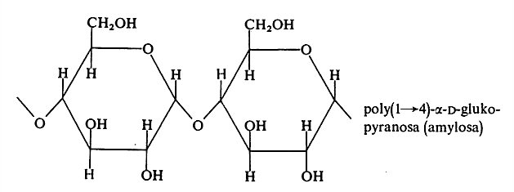
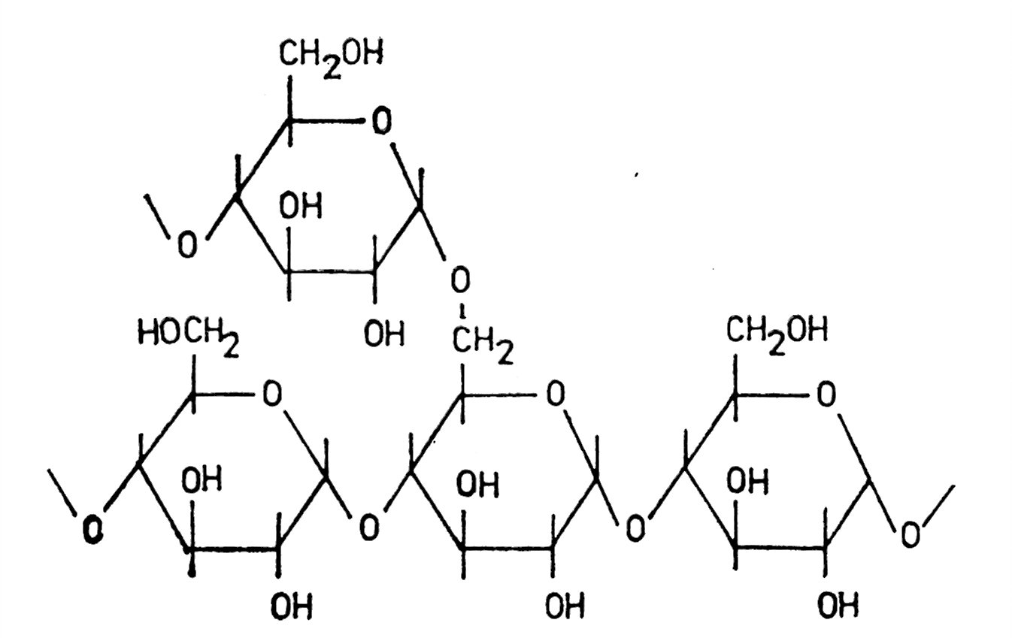
AMYLOSE & AMYLOPECTIN
MAIN CHAIN
BRANCHING
Where are a Potential Reactions Centres in these MACROMOLECULES?

Slide 5
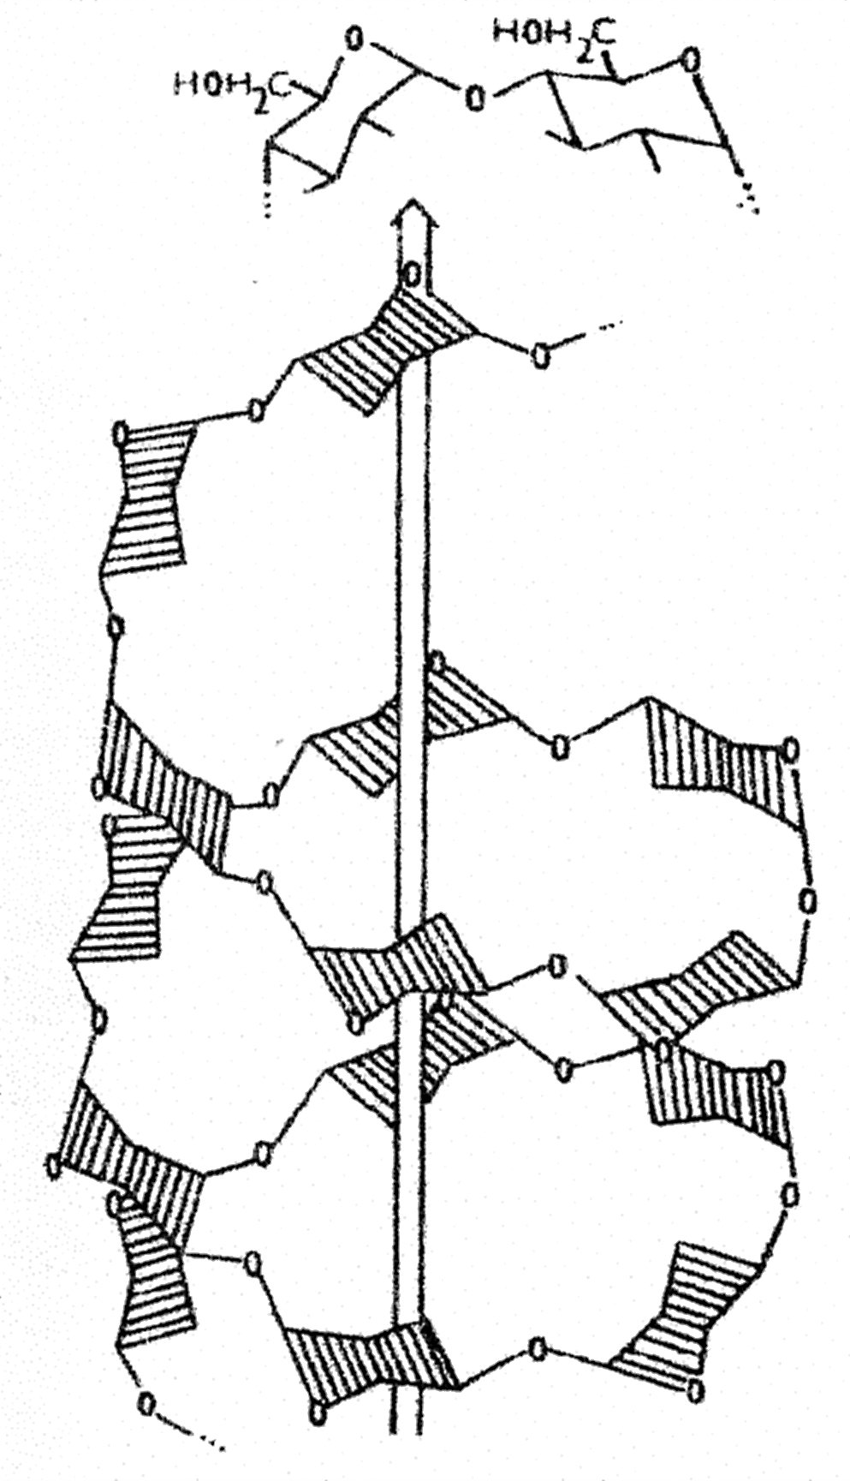
AmylosE
It forms the helix
Six GLUCOSE units are forming one Chain Spiral (Coil)
Bond 1 → 4 via –OH
300 – 1000 Units in a Macromolecule

Slide 6
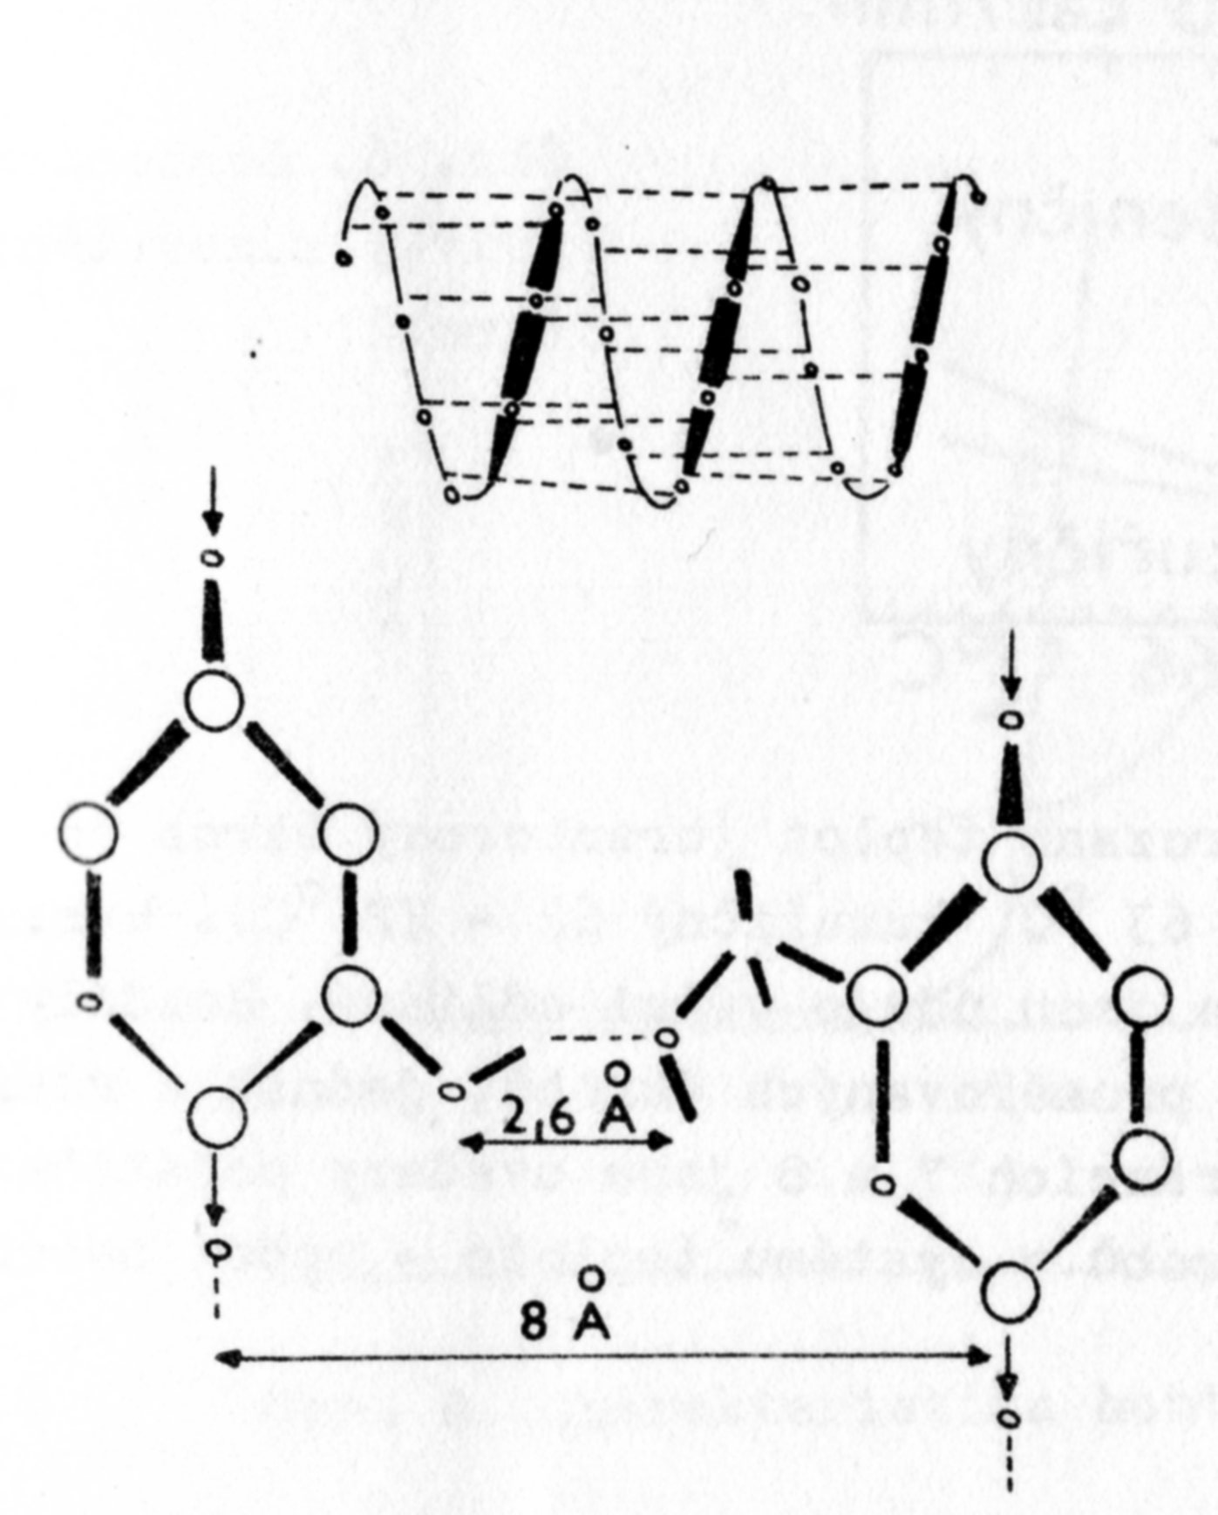
AmylosE
IntramoleCulAr HYDROGEN BONDS
These BONDS (Bridges) go via
– OH Groups, no via Water Molecules.
Water forms BONDS (Bridges) mainly between Macromolecules of Amylose, but not only there (AMYLOPECTIN is also employed).
OXYGEN

Slide 7
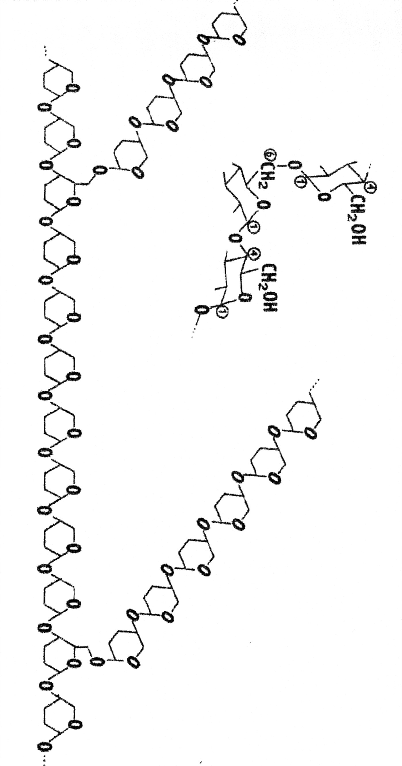
AmyloPECTIN
Usually doesn't form helix (only having very long branching chains is it possible)
Bond 1 → 6 via –OH and via – CH₂OH in the Point of Branching
Bond 1 → 4 via –OH in the Main Chain and also in side Chains
15 – 25 Units in the Branches

Slide 8
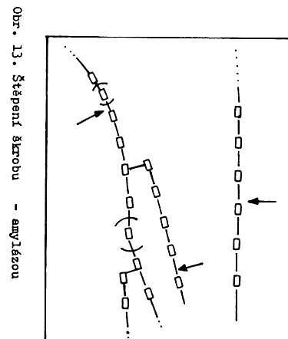
Process of Enzymatic modification of Starch
Rapid Decrease of the Solution (Paste) Viscosity
Chain scission by Enzym Amylase

Slide 9
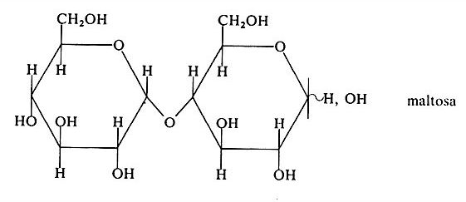
Process of Enzymatic modification of Starch to MALTOSE
Chain scission to MALTOSE by Enzymes α and β Amylases
Extent of Conversion accordingly it is possible classify these Products to:
Liquid syrups
Dried or thicken syrups
Glucose
MALTOSE is possible further scission up to GLUCOSE by Enzyme MALTASE

Slide 10
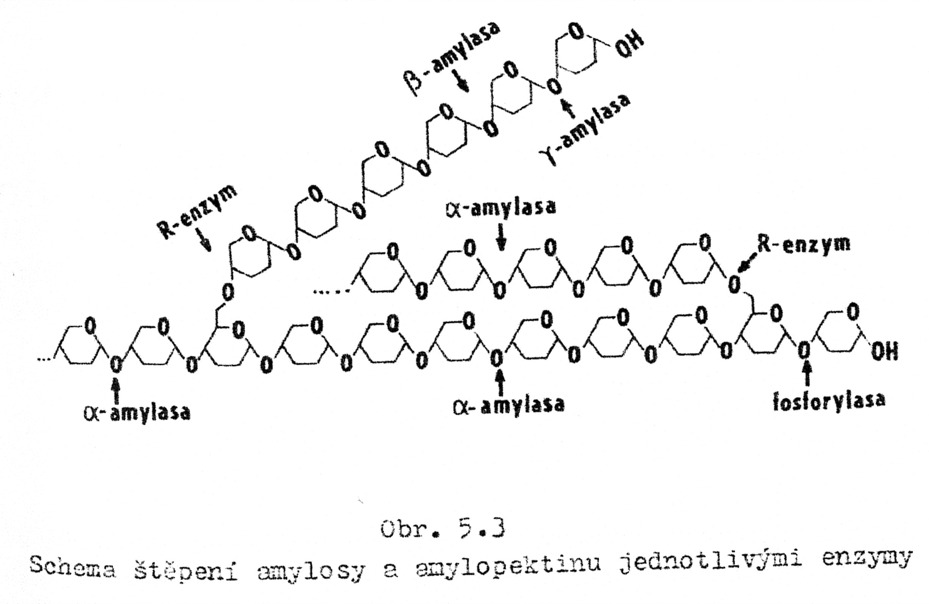
AMYLOSE Chain scission by Enzymes (α, β, γ Amylases, Phosphorylase, R-enzyme …

Slide 11
Process of HyDROLYtic modification of Starch
Acid catalysis using HCl or H₂SO₄ with Neutralisation after the end of Hydrolysis
Extent of Conversion accordingly it is possible classify these Products to:
Liquid syrups
Dried or thicken syrups
Glucose
It is possible to combine Hydrolytic and Enzymatic Chain scission

Slide 12
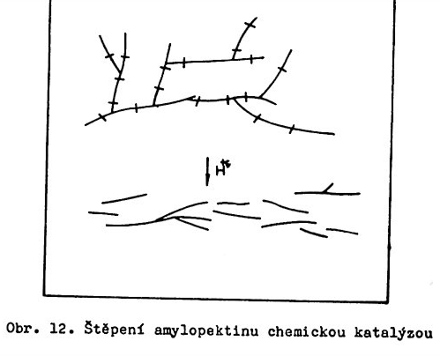
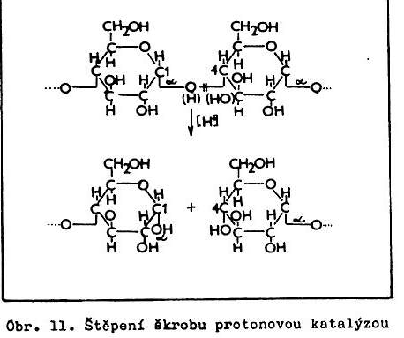
Process of Hydrolytic modification of Starch
Chain scission – Chemical catalysis by H⁺
There are not valid Proofs, if this Process is random or are there some Bonds in the Chain preferred
Chain scission – Chemical catalysis by H⁺

Slide 13
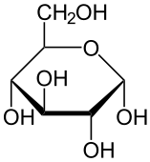

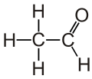

Enzymatic use of GLUcose from Saccharide to Alcohol
Pyruvite of conjugated Base of the Pyruvic acid
Vodka (in Russian)
Gorilka (in Ukrainian)
Schnaps (German)
Whisky (ENGLISH)
Rye whiskey, Grain alcohol (Czech)
Potato Spirit > Domestic RUM

Slide 14
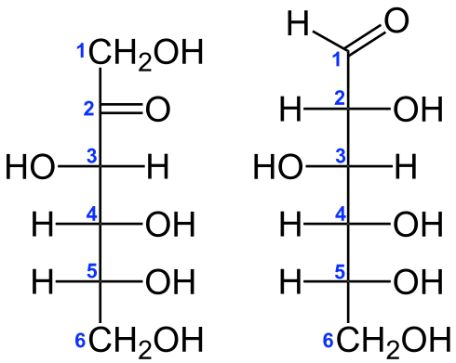
Enzymatic (Xylose isomerase) isomerisation of GLUKOSE to FRUCTOSE
FRUCTOSE is approx. of 1/5 more sweet then GLUCOSE.
It is found mainly in the Fruit.
FRUCTOSE
(KETOSE)
GLUCOSE
(ALDOSE)
D-xylose aldose-ketose-isomerisation

Slide 15
GENERAL SORTING OF the POLYMER REACTIONS
POLYMERANALOGIC REACTIONS
  It doesn't occur any DESIRABLE Chain scission of the MAIN Macromolecules’ Chains
DESTRUCTION REACTIONS
  It occurs a DESIRABLE Chain scission of the MAIN Macromolecules’ Chains
Both Reactions are usual at POLYSACCHARIDES

Slide 16
Summary of the STARCH MODIFICATIONS
Enzymatic
Thermal
Chemical
  Hydrolysis
  Oxidation
  Esterification (several variants)
  Starch Xanthate
  Starch Carbamate
  Starch ethers
Crosslinking
Grafting

Slide 17
Principal Use of STARCH
STRACH PROPERTIES | INDUSTRIAL BRANCH
Viscosity increasing | Food Industry
Gels’ Formation
Water Retention
Adhesive Properties | Paper Industry
Film Forming | Textile Industry
Biodegradable Properties | Biodegradable products, e.g. Bags etc.
Protective Colloidal Films | Polymer Dispersions

Slide 18
Starch Modification 1
It could be MECHNICAL (sorting particle size accordingly) or in Solution (sorting AMYLOSE and AMYLOPECTIN)
Starch
Hydrolysis
Fractionation
Oxidation
AMYLOSE
AMYLOPECTIN
Substitution
Oxidised Starch
Starch Ether
Starch Ester
Crosslinked Starch
Thermal
Modification
Degradated
Starch
Thermal
Modified
Starch
Classification of the Starch Modification technology according to the Chemical Connections

Slide 19
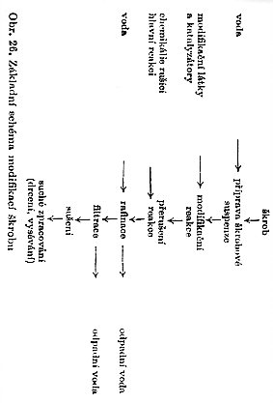
Starch Modification 2
Starch
It could be or is MECHNICAL (sorting Particle size accordingly)
Water
Starch Suspension Preparation
Substances for Modification and Catalysts
Modification
Reaction
Chemicals to interrupt the Main Reactions
Interruption of the Reactions
Water
Rafination
Waste Water
Fitration
Waste Water
It is the case of mainly the Heterogeneous Reaction
Drying
There is great Effort to do these Processes in the SUSPENSION! Why?
Processing of the Dry Matter
Basic Scheme of the Starch Modification

Slide 20
Starch Modification 3
Chemical Modification in the Water Suspension
  Hydrolysed Starch
  Oxidised Starch
  Starch Ether
  Starch Ester
  Crosslinked Starch
Chemical Modification in the Water Solution
  Hydrolysed Starch
  Oxidised Starch
  Starch Ether
Chemical Modification in the Organic Solvent Solution
  Starch Ether
  Starch Ester
Thermal Modification in Dry State
  Degradated Starch
  Oxidised Starch
  Starch Ester
  Crosslinked Starch
Thermal Modification in presence of Water
PREFERED

Slide 21
Starch Thermal Modification – EXAMPLE 1
Starch Water Suspension Cover on the heated Roll
Starch Paste formation, Hydrogen bonds between Starch Molecules breakage,
Water is so rapidly evaporated, that Hydrogen bonds between Starch Molecules can’t arise again
Dry Starch is formed from no-associated Macromolecules
Such Dry Starch is easy soluble in Water

Slide 22
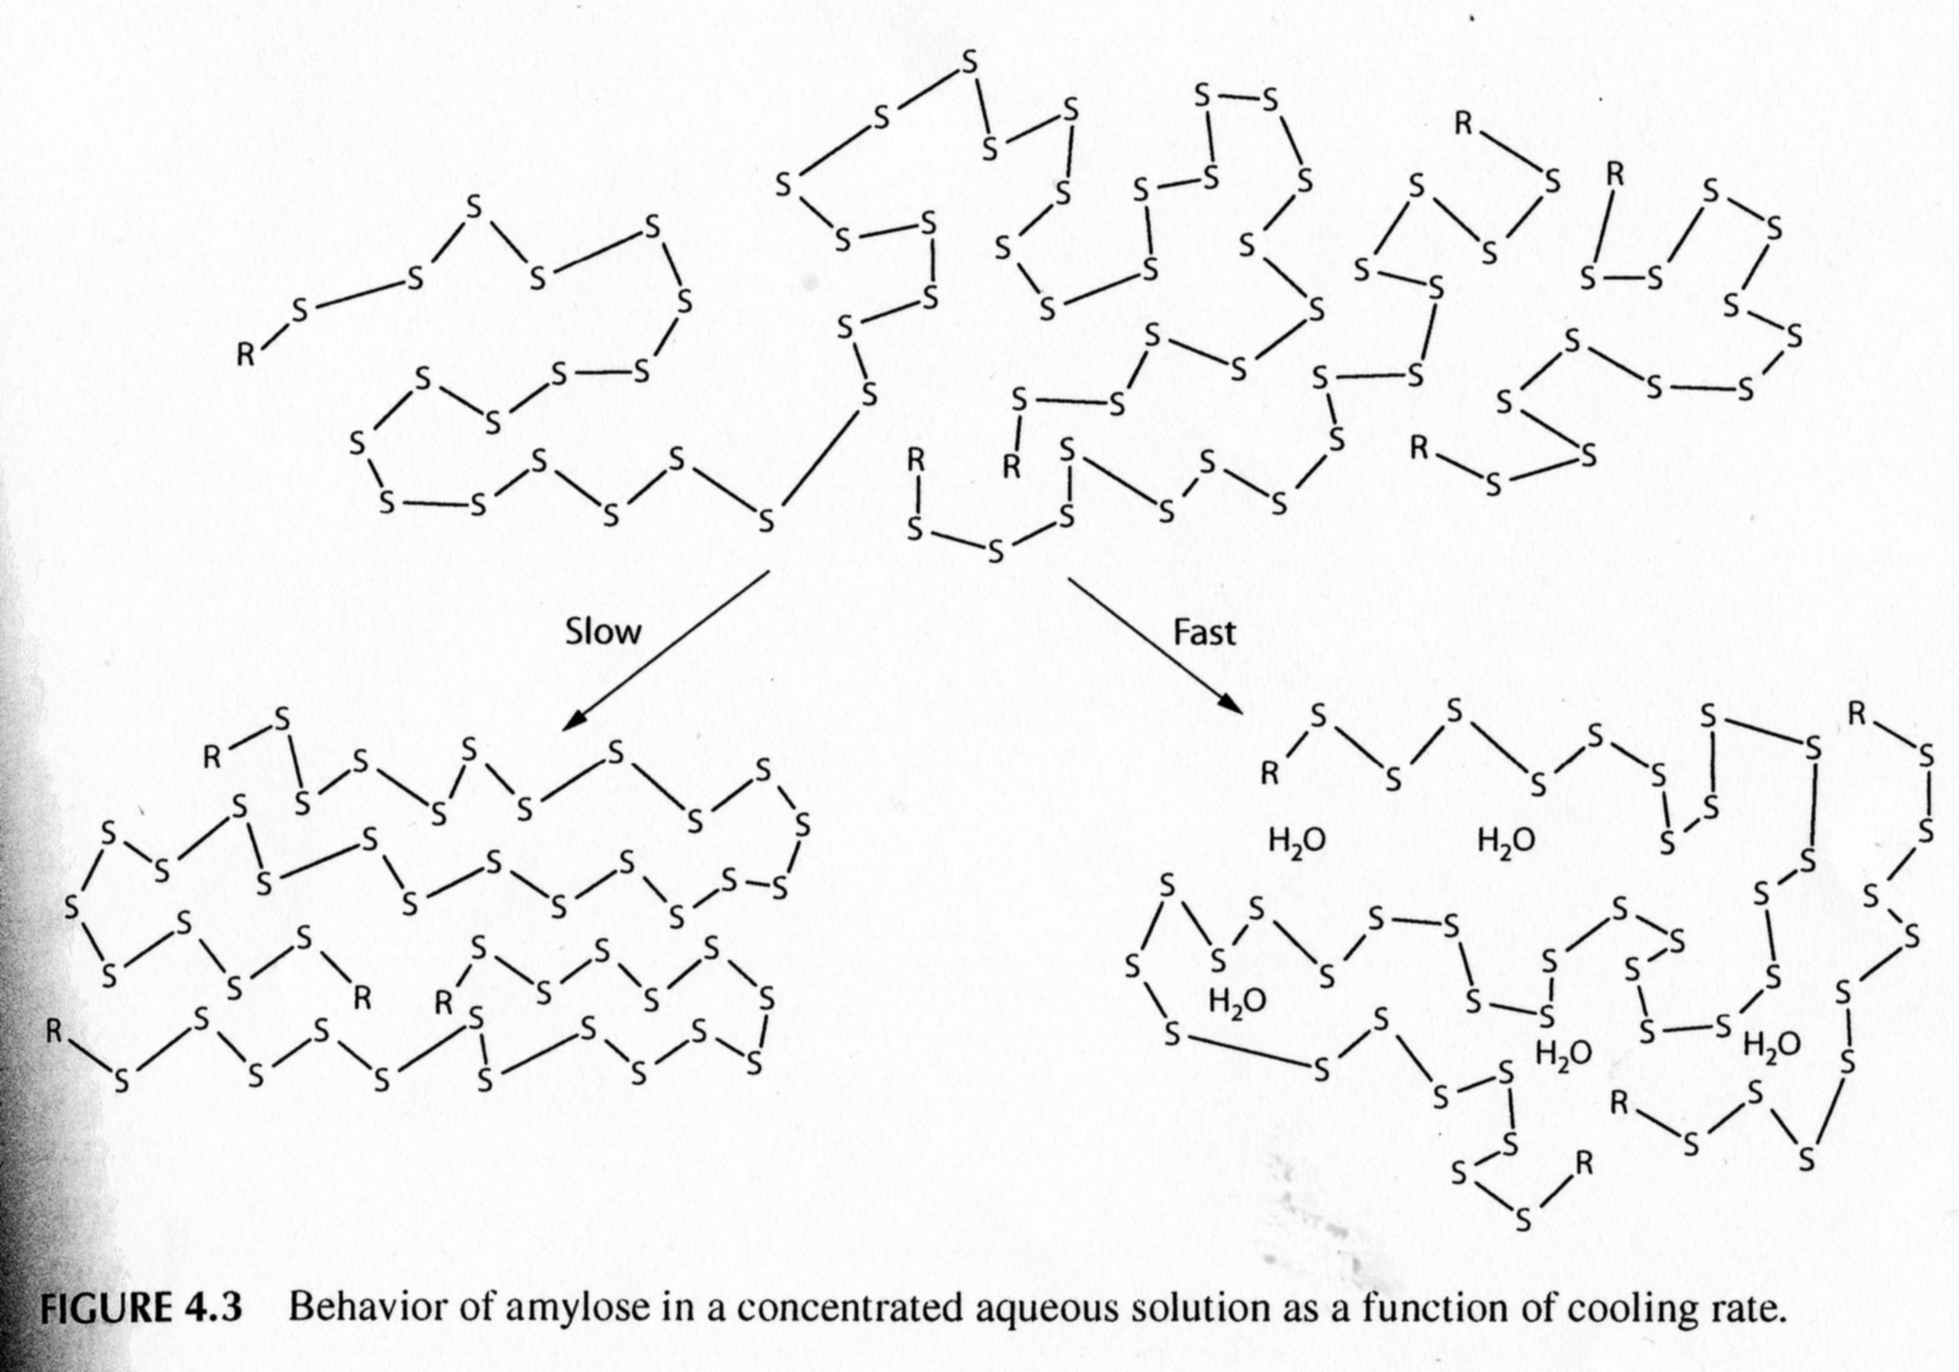
Starch Thermal Modification 2
Formation of Starch Paste and Hydrogen bonds between Starch Molecules breakage
Water is so rapidly evaporated , that Hydrogen bonds between Starch Molecules can’t arise again
Dry Starch is formed from no-associated Macromolecules
ASOCIOATED Starch MOLECULES

Slide 23
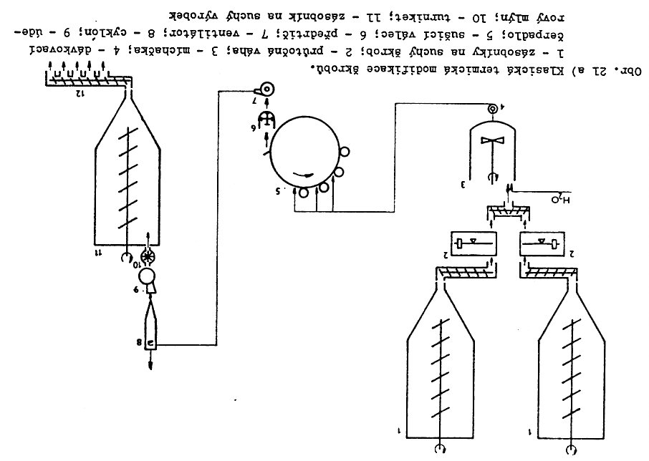
Starch Thermal Modification – Technology Diagram 3
Scrape away of the Dry Starch film
The actual Process occurs here!
The Classical Thermal Starch Modification
1) Dry Starch Hopper, 2) Automatic balances, 3) Mixer, 4) Metering pump, 5) Heated Roll, 6) Pregrinder, 7) Fan, 8) Cyclon, 9) Impact Mill, 10) Turnstile, 11) Dry product Hopper

Slide 24
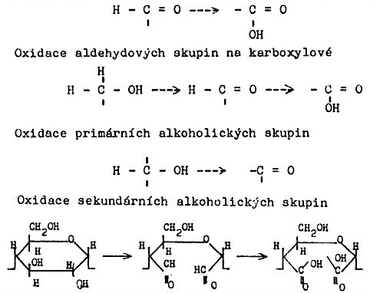
  NONSELECTIV Oxidation of Starch 1
Oxidation of the Carbonyl group in the OPEN FORM of GLUCOSE to -COOH
Oxidation of the – OH in CYKLIC FORM of GLUCOSE to =C=O and then up to -COOH
C6
Oxidation of the CYKLIC FORM of GLUCOSE by opening between
C2 a C3
C3
C2

Slide 25
  Oxidation of Starch
The most Important Modification Reactions
It can be done in both low and high pH Regions
The most Important is the Oxidation by sodium hypochlorite in the pH Region approx. 8 – 9 (slightly basic conditions)
It is used mainly for the Potato Starch, having high Capillarity and low Tendency to Retrogradation

Slide 26
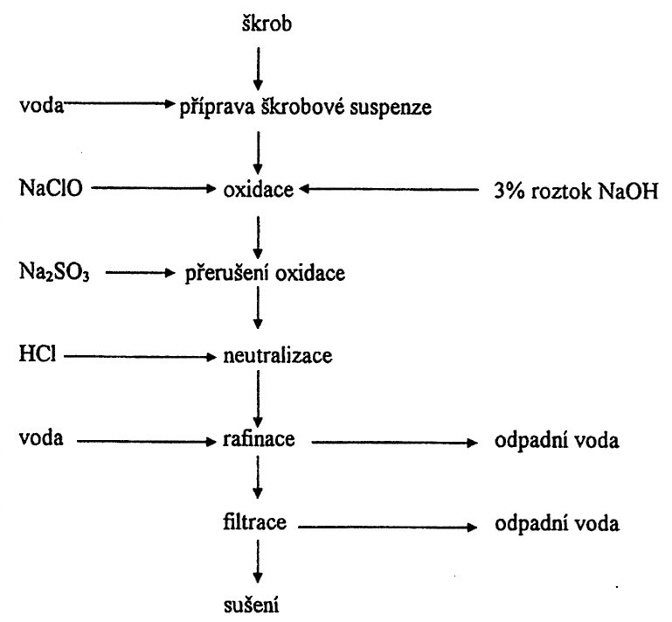
  NONSELECTIV Oxidation of Starch –Technology Diagram
Starch
TYPICAL FORMULATION
pH = 8 – 9
TEMPERATURE = 35 – 43 °C
Reaction time = 2 – 8 hours
activ chlorine (NaClO) = 3 – 45 g/kg Starch
3 % w/w Water Solution NaOH
Water
Starch Suspension Preparation
Oxidation
Interruption of the Oxidation
Neutralisation
DEPOLYMERisation in ALKALINE CONDITION > LOWERING of the MOLECULAR MASS (WEIGHT)
Waste
Water
Water
Rafination
Waste
Water
Fitration
Drying

Slide 27
  SELECTIV Oxidation of Starch on C 6 from –OH on – COOH using HNO₃
C 6
The Polymerisation Degree is not changing at such Oxidation – POLYMERANALOGIC CONVERSION

Slide 28
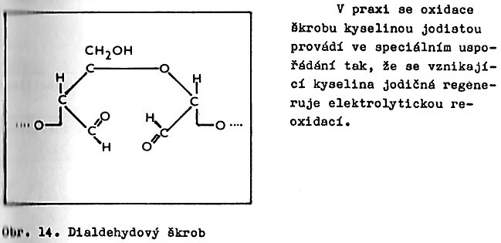
  SELECTIV Oxidation of Starch to Starch dialdehyde
Such Oxidation is performed by Periodic acid in the Special configuration so, that the Periodic acid is regenerating by Electrolysis
The Polymerisation Degree is not changing at such Oxidation in the Ideal case – POLYMERANALOGIC CONVERSION
Starch dialdehyde

Slide 29
  Starch Oxidation - sUMMARY
Higher Oxidation > Higher Chain scission > Lower Viscosity
Higher Chain scission > Lower Binding ability
Higher Chain scission > Higher Dispersion Stability. It is lower Retrogradation Tendency
High Porosity (Capillarity) Starches are suitable for Heterogeneous Reaction, because having higher Surface able to be Reaction Site

Slide 30
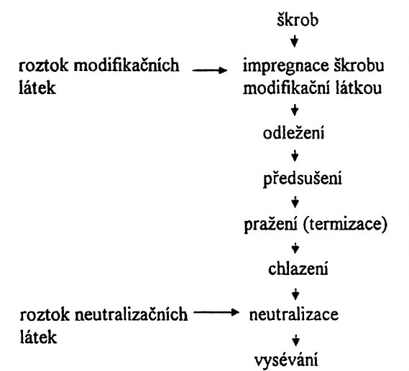
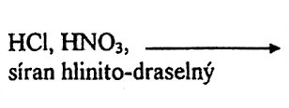
  DEXTRIN Production 1
Starch
Solution of the Modification Substances
Starch Impregnation by Modification Substances
Potassium aluminum sulfate
12 – 24 hours, for going through of Acids and/or Bases & Solutions of Additives Starch Particles
Agein
Predrying
Roasting
Chilling
Solution of Substances for Neutralisation
Neutralisation
Classification by Sieve (screening)

Slide 31
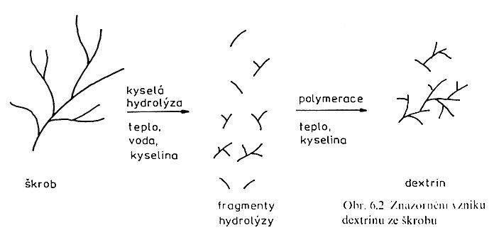
  DEXTRIN Production 2
Acid Catalysis
Polymerisation
Water
Heat
Acid
Heat
Acid
Starch
DEXTRIN
Fragments of Hydrolysis
Starch to DEXTRIN
It is fact STARCH HYDROLYSIS followed by POLYMERISATION (COMBINATION) of FRAGMENTS

Slide 32
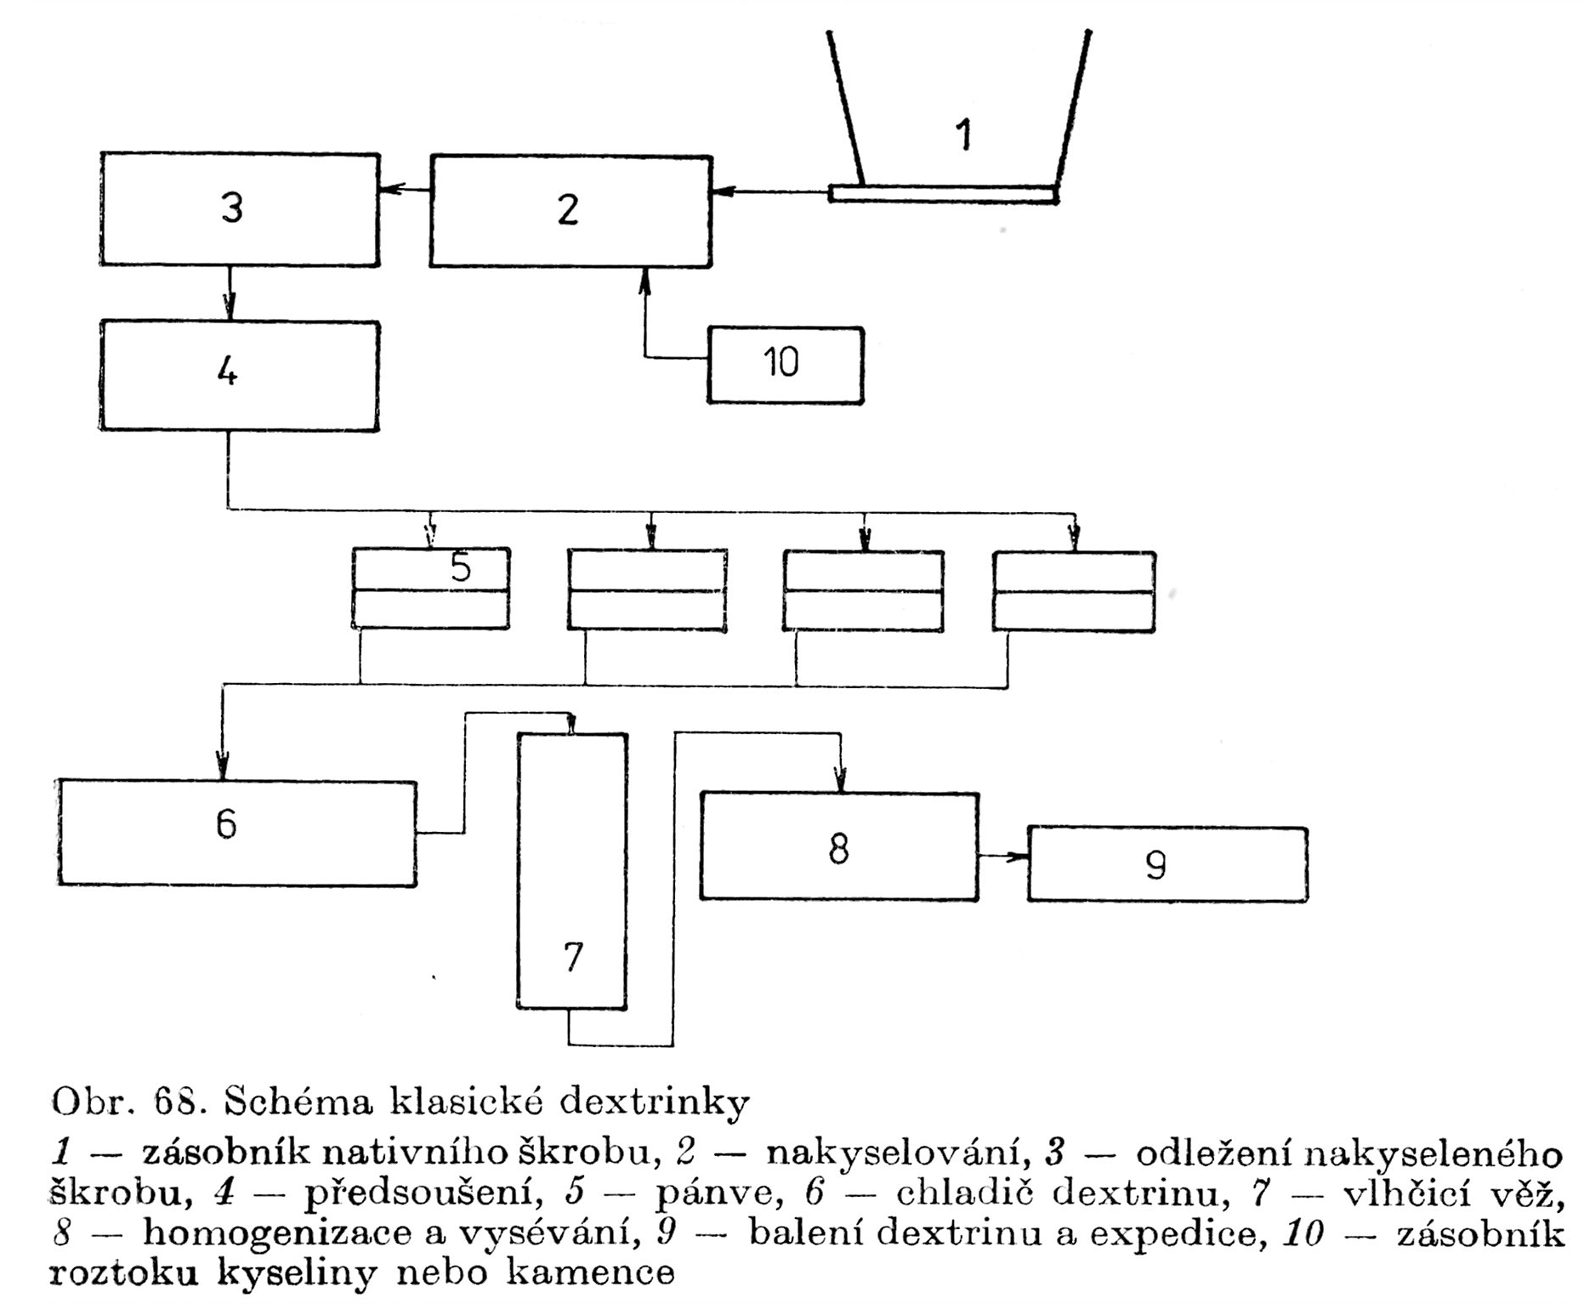
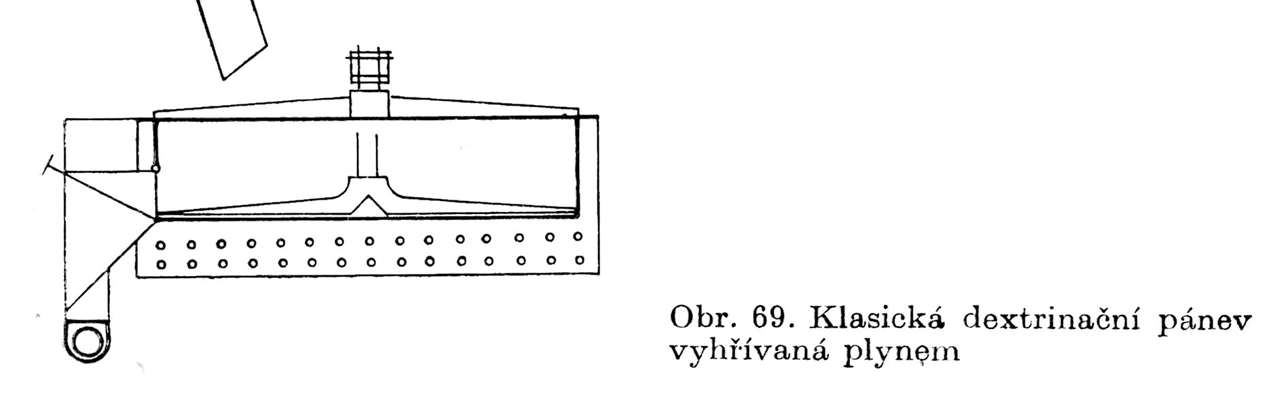
DEXTRIN Production
Diagram
DEXTRIN Factory:
1) Starch Hopper, 2) Acid Addition, 3) Agein, 4) Predrying, 5) Pans, 6) Dextrin Chiller, 7) Humidification Tower, 8) Homogesitation and Screening , 9) Dextrin Packaging, 10) Tank for Acid or Potassium aluminum sulfate Solution
DEXTRINATION
CLASSICAL PAN heated by Gas

Slide 33
DEXTRIN – basic characteristics
Characteristic | Starch | DEXTRIN Type
Approximate Production Conditions |  | White | Light yellow | Yellow | Yellowbrown
 |  | T = 135 °C, 0,05 – 0,15 % w/w HCl | T = 150 °C, 0,05 – 0,15 % w/w HCl | T = 165 °C, 0,05 – 0,15 % w/w HCl | T = 180 °C, 0,05 – 0,15 % w/w HCl
MW | AMYLOSE 30 000-160 000 & AMYLOPECTIN 100 000 - 1 000 000 | 20 – 30.10³ | 15000 - 2000 | 8000 - 3000 | Approx. 2000
Solubility in Water | 0 | 30 – 70 % w/w | Approx. 95 % w/w | Approx. 97 % w/w | Up to 99 % w/w
DE | 0 | 2 – 3 % w/w | 2 – 5 % w/w | 2 – 8 % w/w | 2 – 5 % w/w ?
Colour of the Iodine Complex | Blue | Blue -vilolet | Red-vilolet | Red | No Colour
Viscosity
Decreasing
DE – Dextrose Equivalent = GLUCOSE EKVIVALENT = %w/w reducing saccharides in dry dextrin
Starch itself is not reducing SACCHARIDE

Slide 34
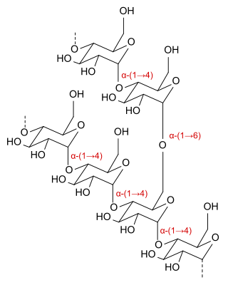
  DEXTRINS’ Structures
Process of so called „DEXTRINATION“ occurs also during e.g. baking of Bread! It is the brown Bread Crust

Slide 35
  DEXTRINS’ properties & the other DEXTRIN types
Colour from white over Yellow to Brown
They are usually fully soluble in Water
OTHER TYPES of DEXTRINs
Maltodextrin
is a shortchain starch sugar used as a food additive. It is produced also by enzymatic hydrolysis from gelled starch and is usually found as a creamy-white hygroscopic spraydried powder. Maltodextrin is easily digestible, being absorbed as rapidly as glucose, and might either be moderately sweet or have hardly any flavor at
all.
Cyclodextrin
The cyclical dextrins are known as cyclodextrins. They are formed by enzymatic degradation of starch by certain
bacteria, for example, Bacillus macerans. Cyclodextrins have toroidal structures formed by 6-8 glucose residues.
Energy Gels and Bars

Slide 36
  DEXTRINs’ use
Yellow dextrins
water-soluble glues in remoistable envelope adhesives and paper tubes,
in the mining industry as additives in froth flotation, in the foundry industry as green strength additives in
sand casting, as printing thickener for batik resist dyeing, and as binders in gouache paint.
White dextrins
a crispness enhancer for food processing, in food batters, coatings, and glazes, (E number 1400)
a textile finishing and coating agent to increase weight and stiffness of textile fabrics
a thickening and binding agent in pharmaceuticals and paper coatings.
As pyrotechnic binder and fuel, they are added to fireworks and sparklers, allowing them to solidify as pellets or "stars."
Due to the rebranching, dextrins are less digestible; indigestible dextrin are developed as soluble fiber supplements for food products.

Slide 37
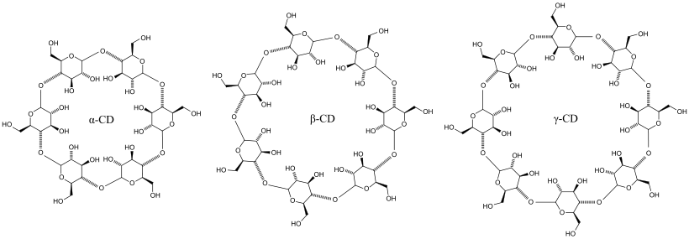
  CYCLODEXTRINS
In CYCLODEXTRIN molecule can be absorbed ethanol (alcohol) and so is formed so called „alcohol in Powder“, which is releasing alcohol when pouring in Water

Slide 38
  DEXTRINS - sUMMARY
PROBABLY the most Commonly used Product of the Starch Modification
It is substantial chemical transformation of Starch
Very wide Types’ Range of Use
Well sophisticated both continual and discontinuous technology
Process is employed at least since 19. Century

Slide 39


  Acetylation of Starch
Side Reaction lowering the Output

Slide 40
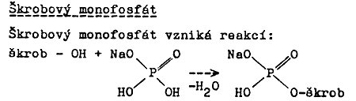
  Starch Monophosphate
Sodium Monophosphate is employed here!
Starch Monophosphate is resulting via the Following Reaction:
The Result is ANIONIC starch with LOW SUBSTITUTION LEVEL (0,02 – 0,1 g substitution Agent per 1000 g dry Starch). That is enough for good Water solubility in the cold Water.
The Crosslinking can occur simultaneously, but where is HIGH SUBSTITUTION LEVEL (0,1 – 0,2 g substitution Agent per 1000 g dry Starch), sometimes even over 1 (Corn Starch no swelling even in the Boiling Water even)

Slide 41
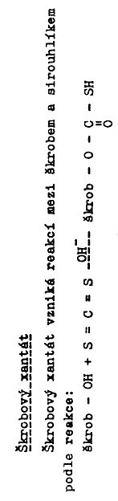
  Starch Xanthate
  Starch Xanthate
  Starch Xanthate is resulting via the Following Reaction of CS₂ and Starch

Slide 42


  Starch alkylethers
Starch
Starch
Starch
Starch
Starch alkylether
  Starch Carbamate
Starch
Starch

Slide 43
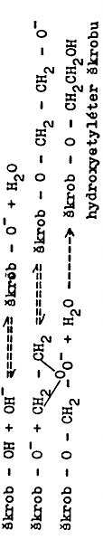
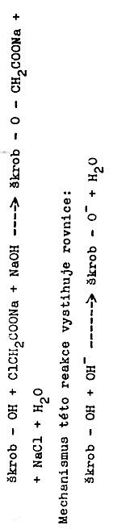


  Starch Hydroxymetylether
Starch
Starch
Starch
Starch
Starch
Starch
Starch Hydroxymetylether
  Starch Carboxymettylether
Starch
Starch
Reaction Mechanism is showing the following Equation:
Starch
Starch
Starch
Starch
Glycolic acid Lactone

Slide 44
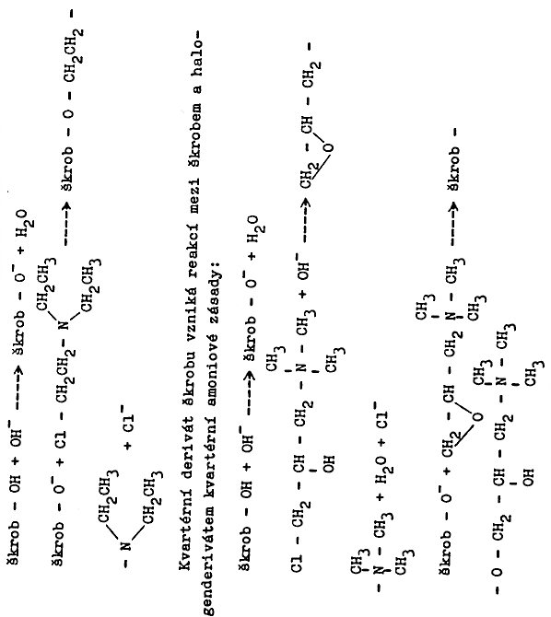
  Cationic Starch 1
Starch
Starch
Starch
Starch
Starch Quaternary Derivatives are resulting via Reaction of Starch with Halogen Quaternary Derivatives of amonium Base
Starch
Starch
+
Starch
Starch

Slide 45
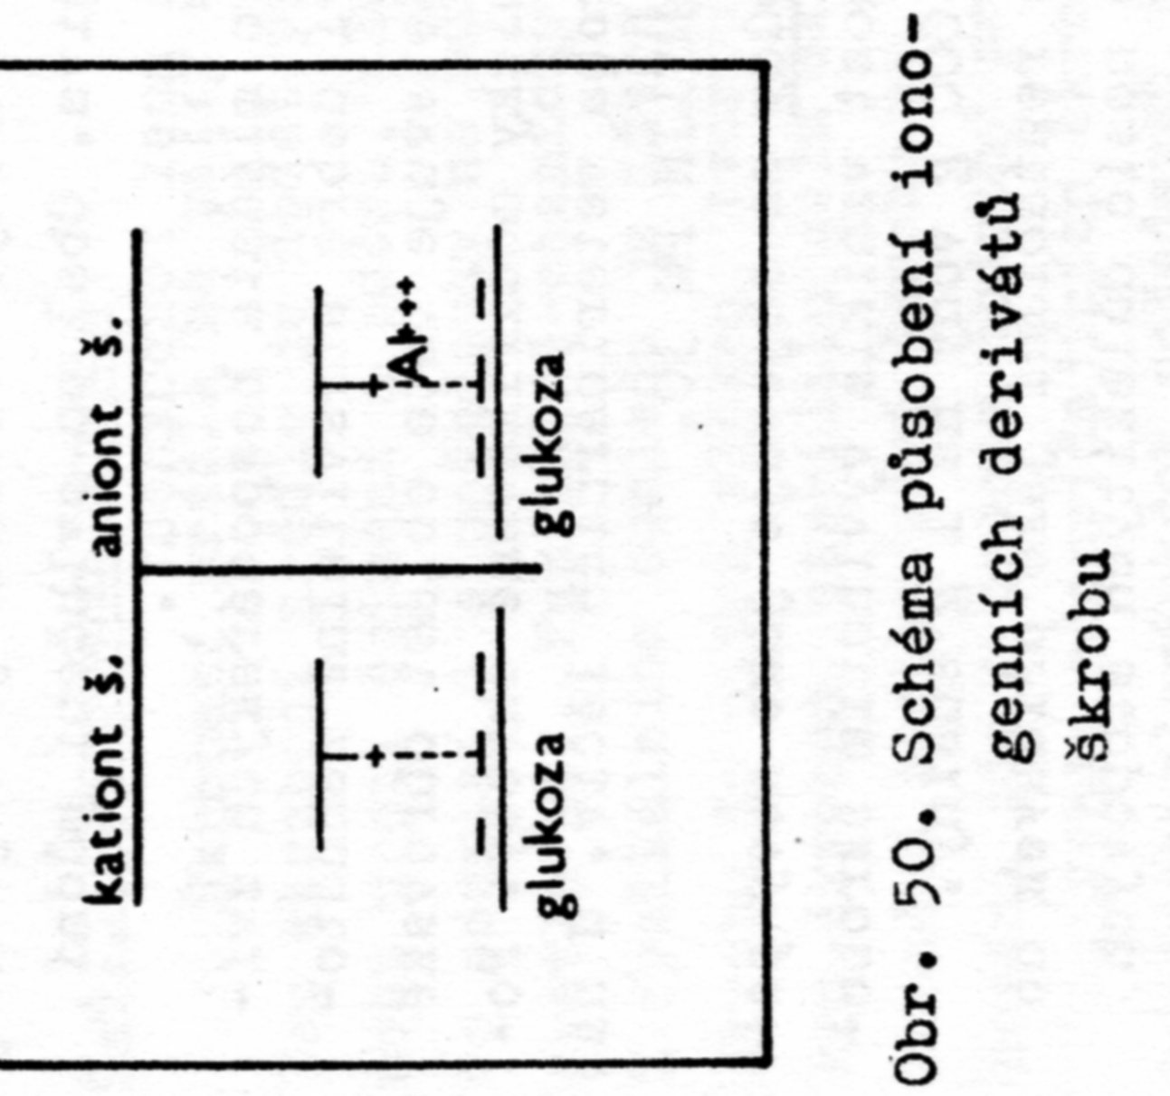
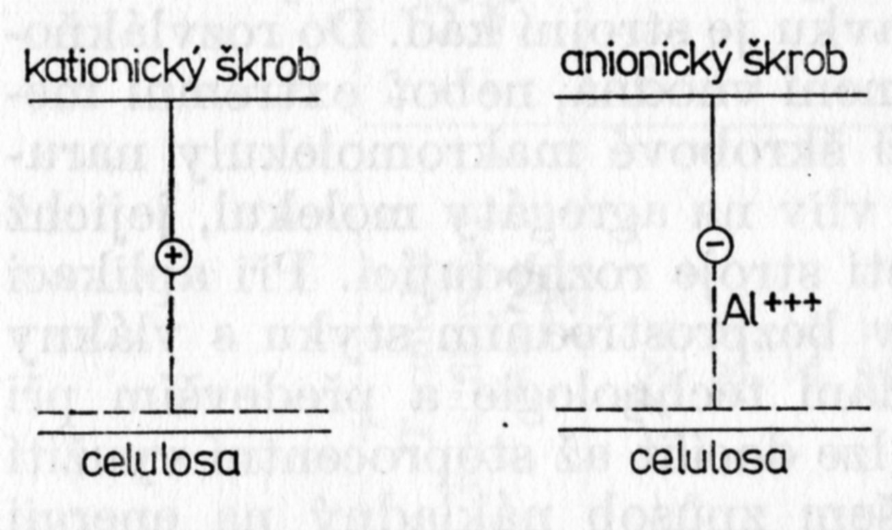
  Cationic Starch 2 – PAPER PRODUCTION
Addition of the CATIONIC STARCH improves Retention so called Extremely short Fibres, which arise from both waste Paper and Paper production Waste
Cationic Starch
Anionic Starch
ANIONIC STARCH needs for acting Cation Al⁺³, usually from KAl(SO₄)₄ (Potassium aluminum sulfate)
Cationic Starch
Anionic Starch
From CELULLOSE!
Diagram showing Influence of Ionogenic Starch Derivatives

Slide 46
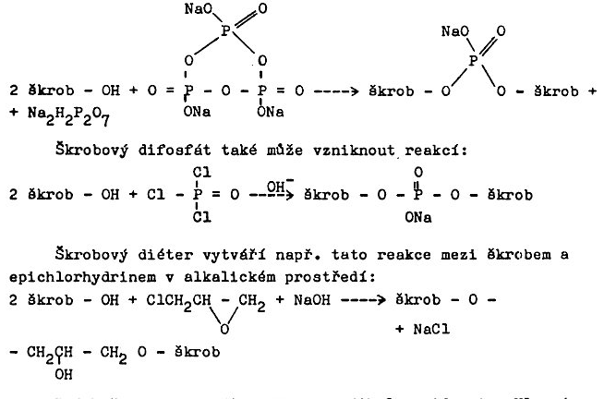
  Crosslinked Starch 1
Starch
Starch
Starch
Starch Diphosphate can results from the following Reaction also:
Starch
Starch
Starch
Starch Diether results via the following Reaction of Starch and Epichlorhidrine in alkaline Medium :
Starch
Starch
Starch

Slide 47
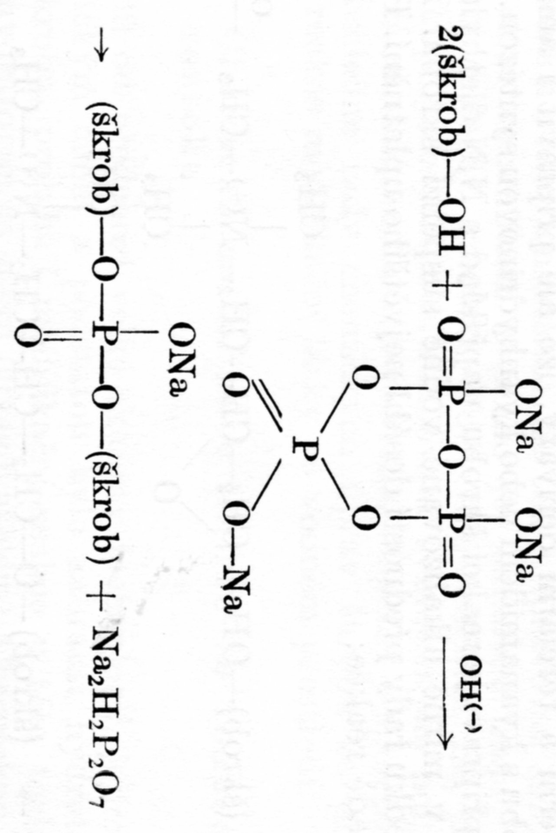
  Crosslinked Starch 2
Crosslinked Starch has HIGH SUBSTITUTION LEVEL sometimes even over 1 g substitution Agent per 1000 g dry Starch > Powdering agents in Pharmacy
ANIONIC STARCH can be formed simultaneously, but there is LOW SUBSTITUTION LEVEL (0,02 – 0,1 g substitution Agent per 1000 g dry Starch),
Trisodium phosphate is used here!

Slide 48
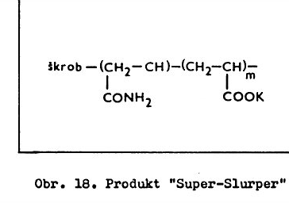
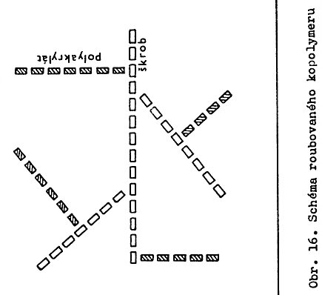
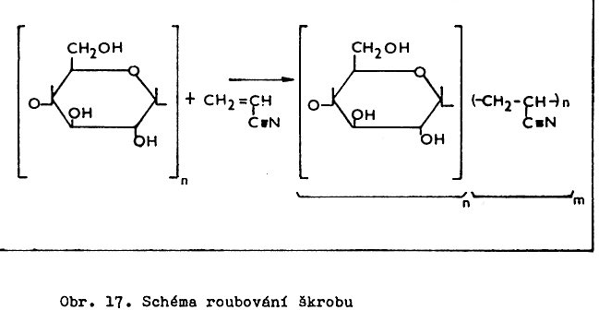
  Graft & Block Starch copolymers
Starch
Starch
Starch Block Copolymerisation Diagram
Starch grafting Diagram
Starch Block Copolymerisation Diagram

Slide 49
  Use of the Modified Starches
Paper Production and Treatment
Food Industry
Textile Industry
Glues
Pharmacy
Flocculants for Waste Water Treatment
……………..

Slide 50
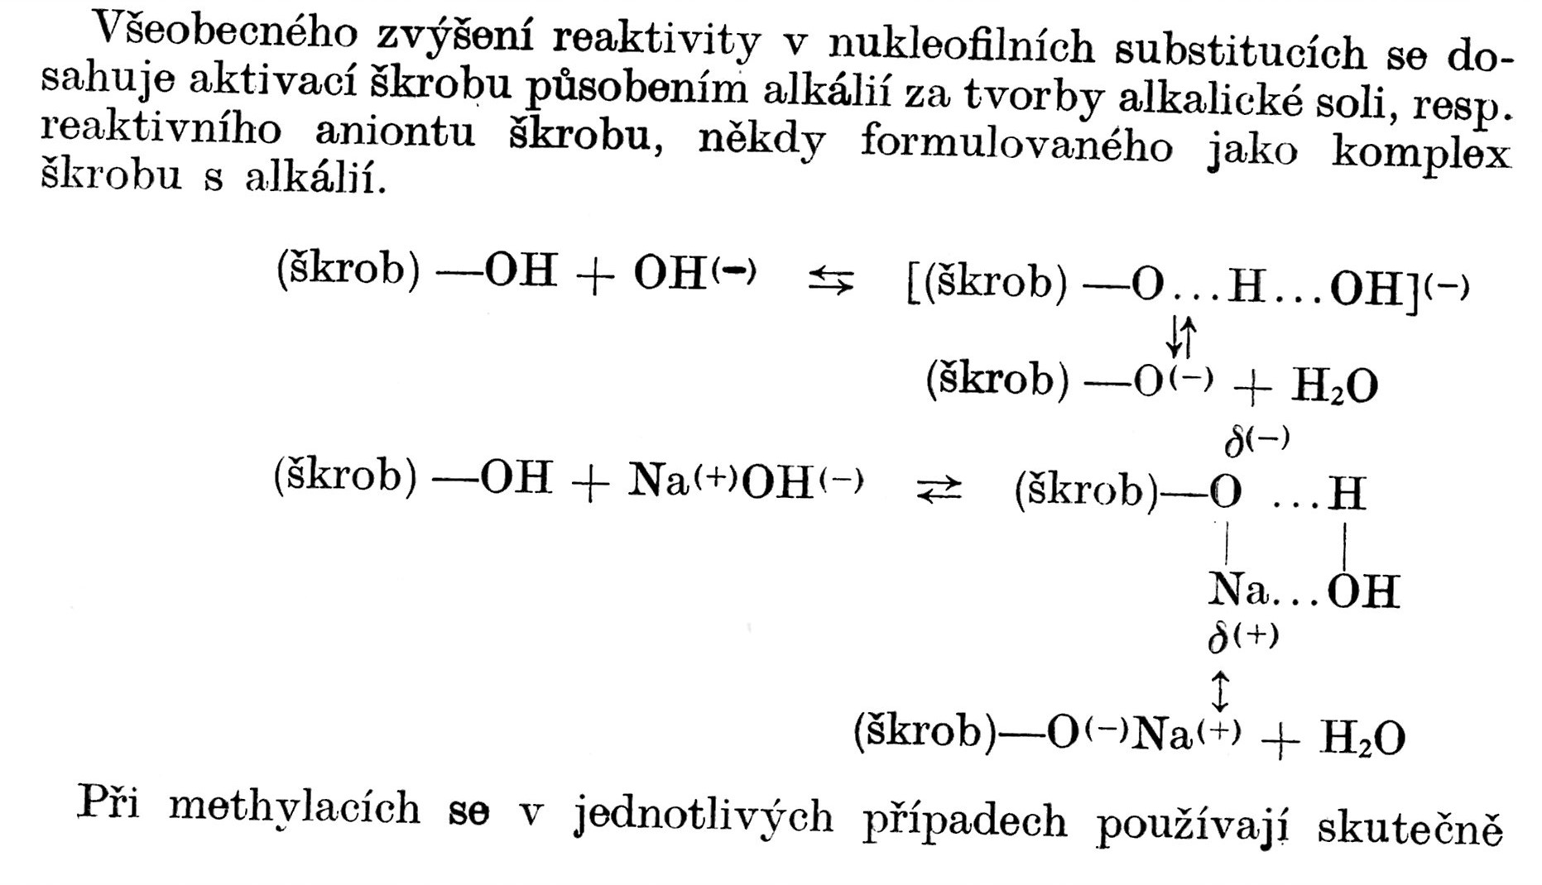
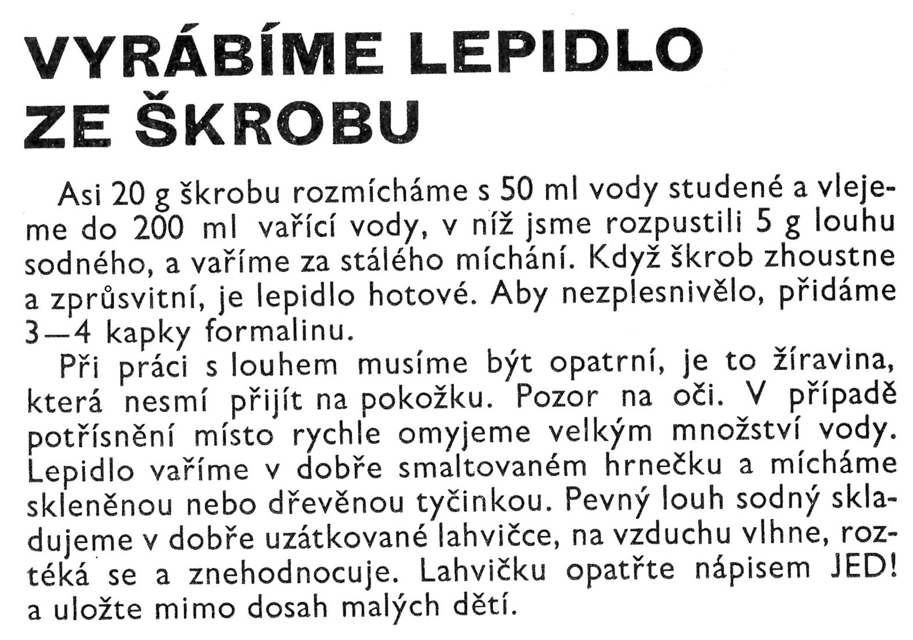
  Starch Glue (Adhesive)
The Reactivity of Starch in Nucleofilic Substitutions is generally increased by Activation by Alkali via forming the alkali Salt, sometime formulated as STARCH – ALKALI COMPLEX
Starch
Starch
Starch
Starch
Starch
LABORATORY EXAMPLE OF THE STARCH GLUE PREPARATION
Approx. 20 g of Starch mix with 50 ml of cold Water and pour into approx. 200 ml of boiling Water containing 5 g NaOH. Boil at permanent mixing. The Glue is finished, when the Viscosity has increased and the Solution is clear enough. The Glue is finished then. Add approx. 10 Drops of Formaldehyde to avoid Moulding.
The Potato and Corn Starches Mixture is usually used by Industry

Slide 51
Starch as the BIODEGRADABLE ADITIVE to Synthetic THERMOPLASTICS
The Degradation is usually necessary „PUSH AHEAD“ by Thermo oxidation
What was done by me
BIODEGRADABLE LDPE films (up to 40 % w/w Corn Starch )
The Inner part of the Shotgun shell
PP Fibres with Starch

Slide 52
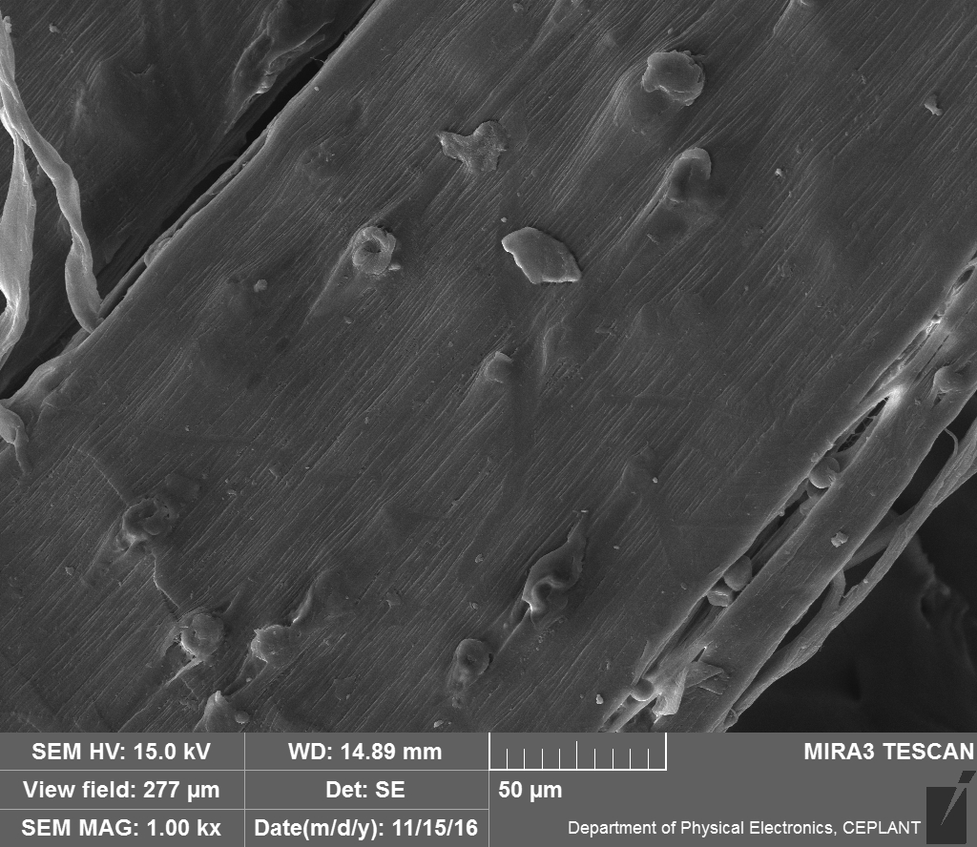
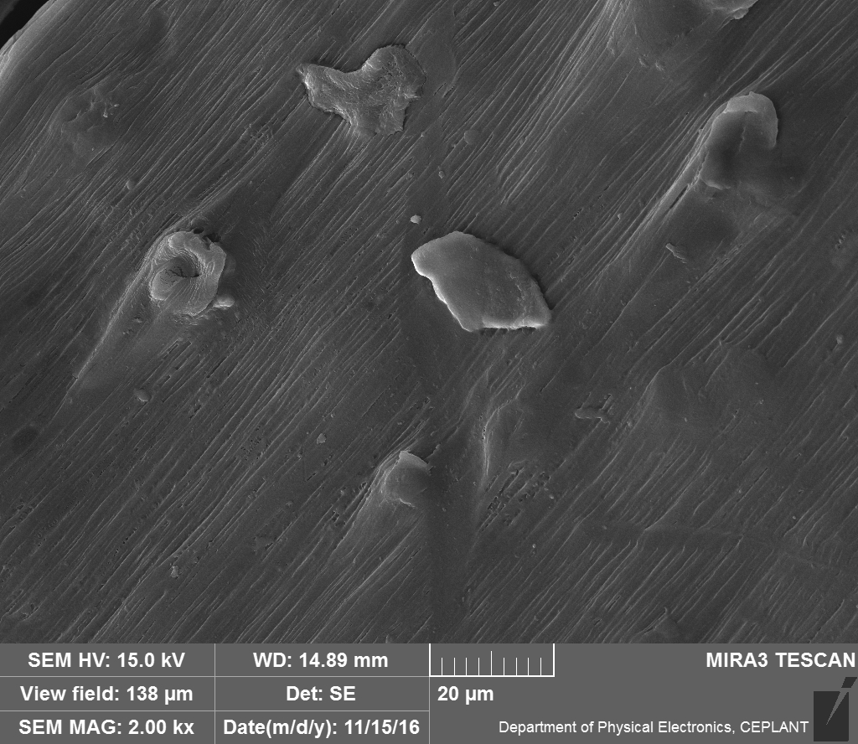
Polypropylene Fibres with Corn Starch 1

Slide 53
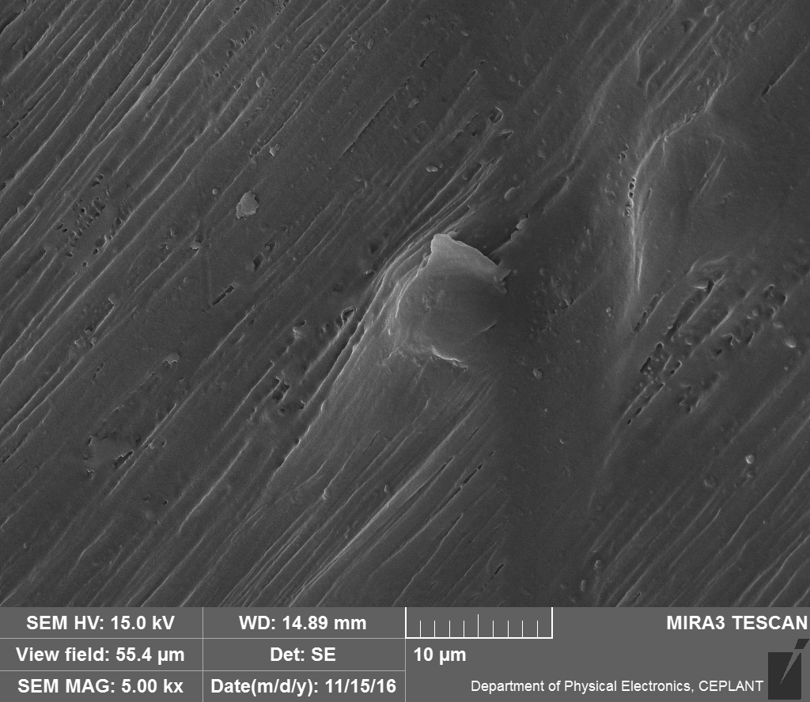
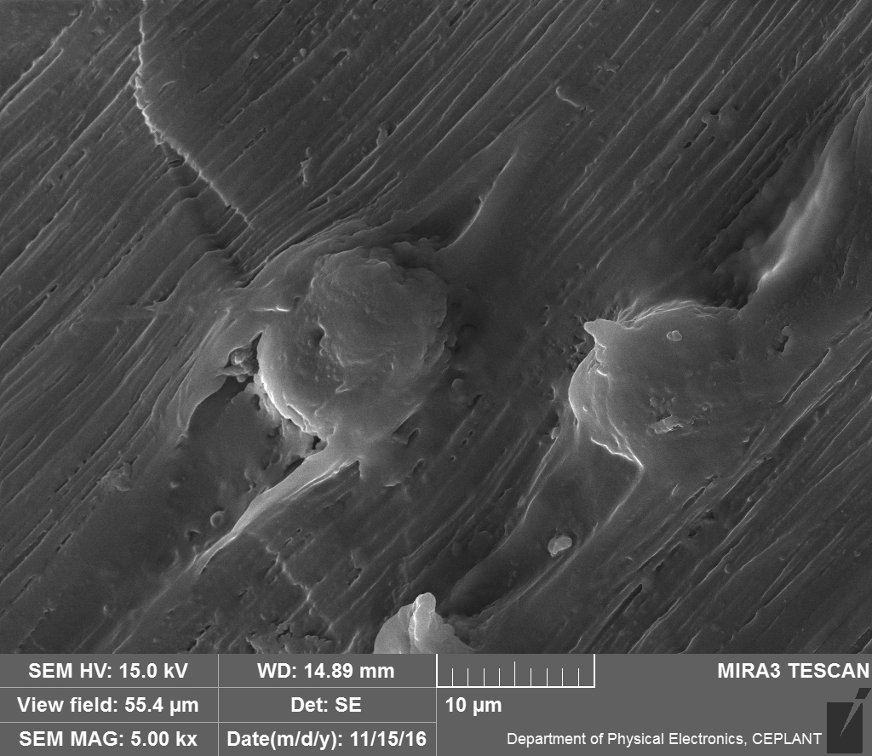
Polypropylene Fibres with Corn Starch 2
FIBRILATIONPP Fibres

Slide 54
THERMOPLASTIC STARCH
Processing by Technologies used for the SYNTHETIC THERMOPLASTICS, but very difficult (UP TO NOW)
It is necessary to use so called PLASTICIZERS – usually WATER & GLYCEROL
Products are BIODEGRADABLE
If combined with NATURAL FIBRES (e.g. Flax) > BIODEGRADABLE COMPOSITS

Slide 55
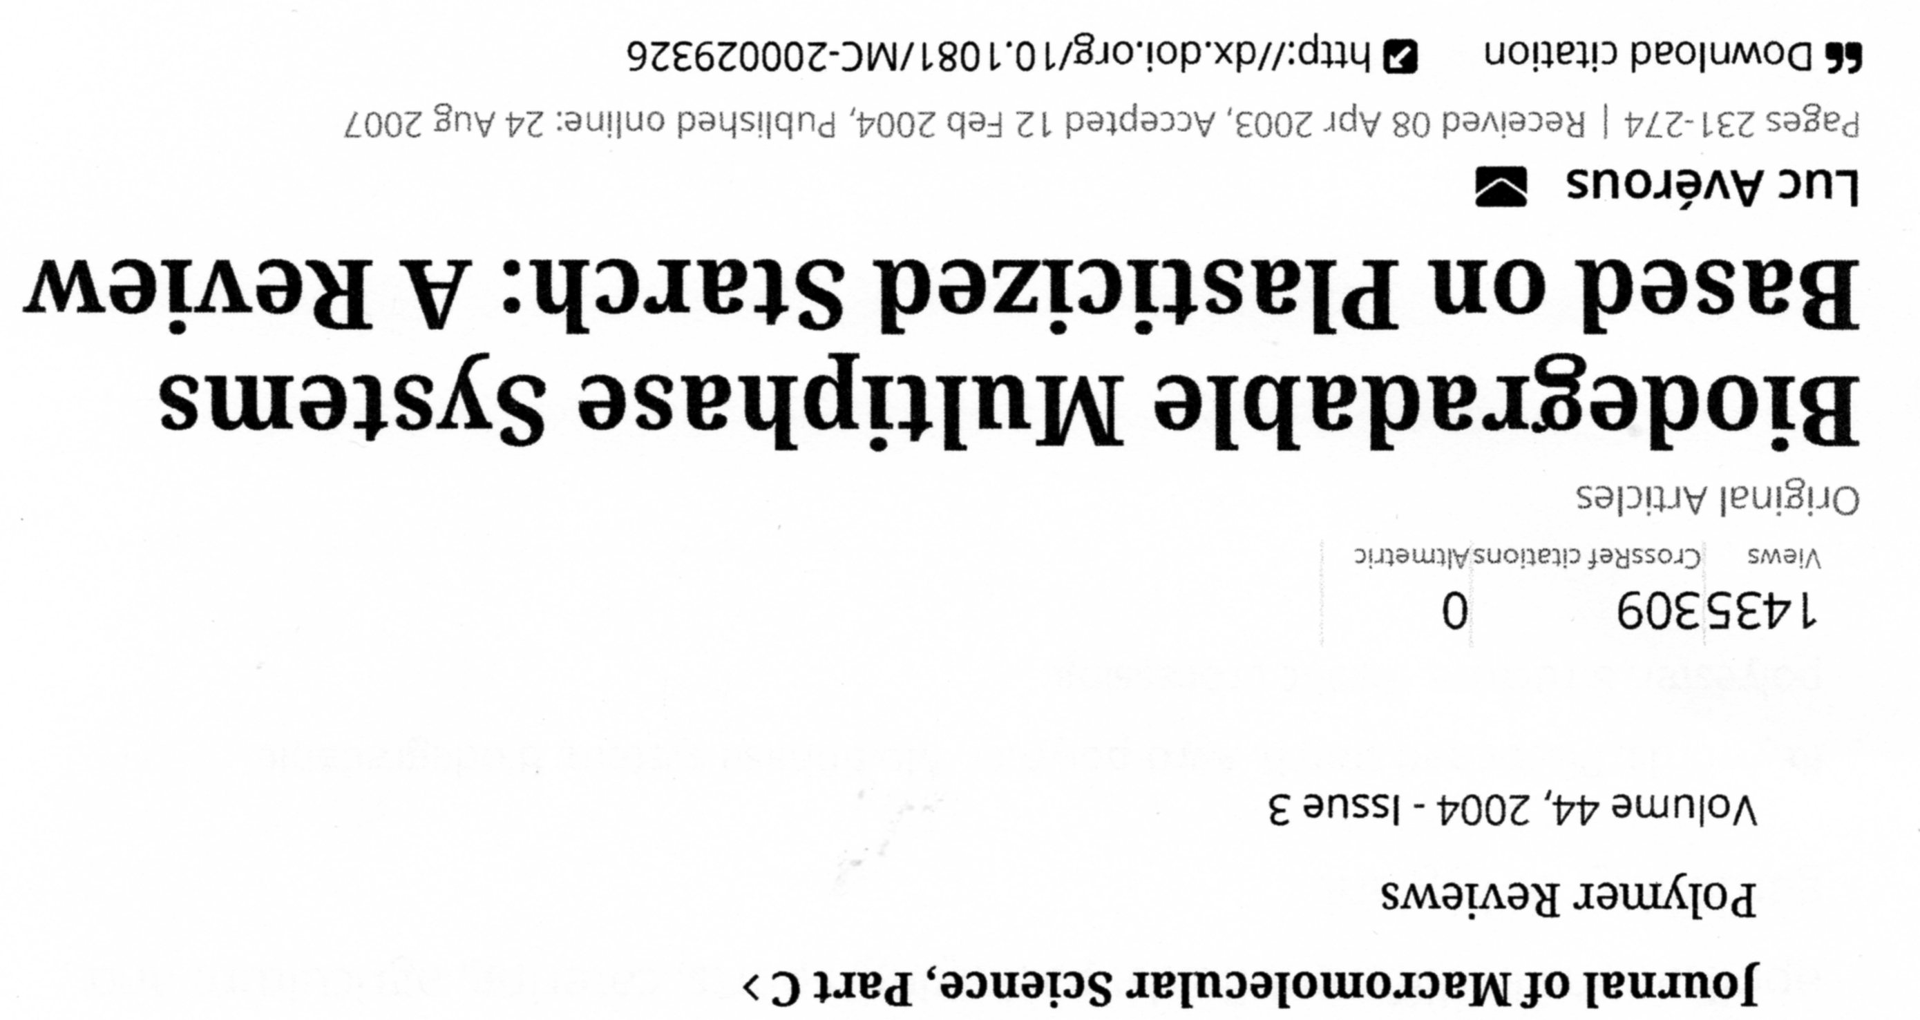
Ewa Rudnik: Compostable Polymer Materials, ISBN: 978-0-08-045371-2

Slide 56
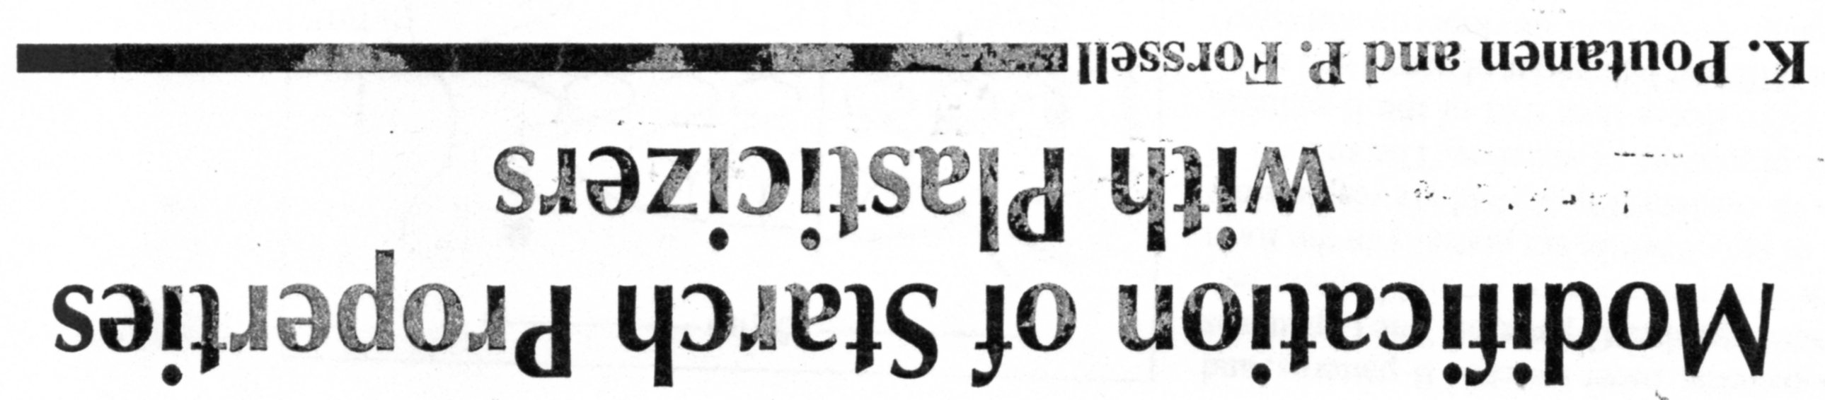
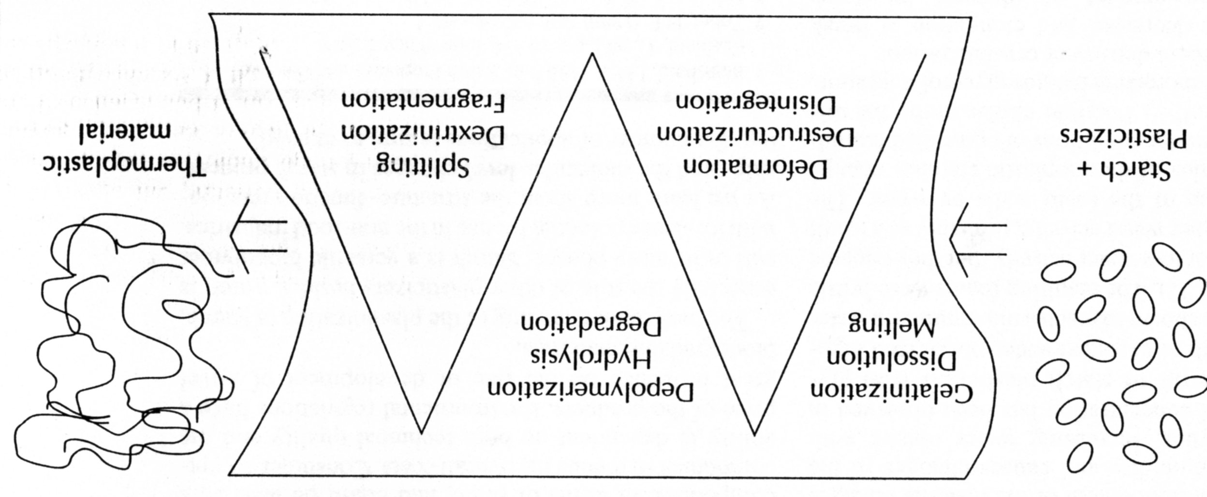
PLASTICIZERS – usually WATER & GLYCEROL

Slide 57
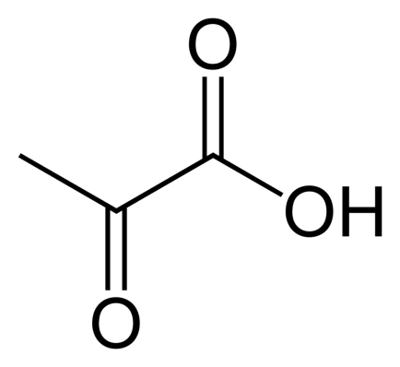
AGAR
Agar consists of a mixture of agarose and agaropectin. Agarose, the predominant component of agar, is a linear polymer, made up of the repeating monomeric unit of agarobiose. Agarobiose is a disaccharide made up of D-galactose and 3,6-anhydro-L-galactopyranose. Agaropectin is a heterogeneous mixture of smaller molecules that occur in lesser amounts, and is made up of alternating units of D-galactose and L-galactose heavily modified with acidic side-groups, such as sulfate and pyruvate.
AGAR & Food Industry
Clarifying (Fining) of the Wine and Fruit Juice
Thickening of Food
pyruvic acid
AGAR & Medicine
Bacterial and Mould culture/growth medium

Slide 58
The other useful POLYSACCHARIDES 1
Plantago ovata, known by many common names including blond plantain,^{[1]} desert Indianwheat, blond psyllium, and ispaghul, is a medicinal plant native to Western Asia and Southern Asia. The plant can be found growing wild in the southwestern United States, where it is considered a possibly introduced species.
It is a common source of psyllium, a type of dietary fiber.
Psyllium seed husks are indigestible and are a source of soluble fiber which may be fermented into butyrate – a pharmacologically active short-chain fatty acid – by butyrate-producing bacteria.

Slide 59
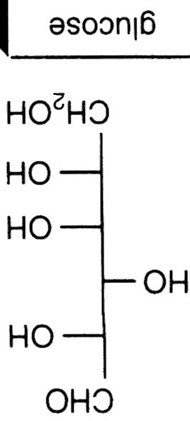
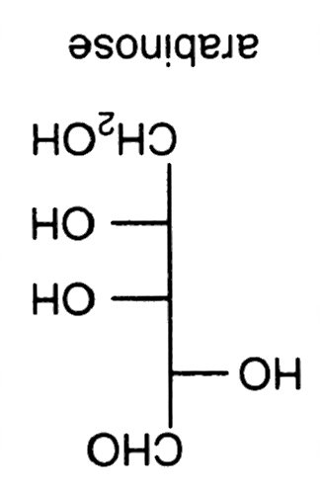


The other useful POLYSACCHARIDES 2A
They are HETEROPLYSACCHARIDES
Plant mucilages
HEXOSE
PENTOSE

Slide 60
The other useful POLYSACCHARIDES 2B
Plant mucilages
is made of plant-specific POLYSACCHARIDES or long chains of sugar molecules.This polysaccharide secretion of root exudate forms a gelatinous substance that sticks to the caps of roots. Root mucilage is known to play a role in forming relationships with soil-dwelling life forms. Just how this root mucilage is secreted is debated, but there is growing evidence that mucilage derives from ruptured cells. As roots penetrate through the soil, many of the cells surrounding the caps of roots are continually shed and replaced. These ruptured or lysed cells release their component parts, which include the polysaccharides that form root mucilage. These polysaccharides come from the Golgi apparatus and plant cell wall, which are rich in plant-specific polysaccharides. Unlike animal cells, plant cells have a cell wall that acts as a barrier surrounding the cell providing strength, which supports plants just like a skeleton.
They are HETEROPLYSACCHARIDES

Slide 61

Building Unit | Structure Unit
L-gulopyranuronic acid
Molar mass
10,000 – 600,000
ALGINATE
Alginic acid is a linear copolymer with homopolymeric blocks of (1-4)-linked β-D-mannuronate (M) and its C-5 epimer α-L-guluronate (G) residues, respectively, covalently linked together in different sequences or blocks.

Slide 62
Alginate absorbs water quickly, which makes it useful as an additive in dehydrated products such as slimming aids, and in the manufacture of paper and textiles. It is also used for waterproofing and fireproofing fabrics, in the food industry as a thickening agent for drinks, ice cream and cosmetics, and as a gelling agent for jellies.^{[citation needed]}
Alginate is used as an ingredient in various pharmaceutical preparations, such as Gaviscon, in which it combines with bicarbonate to inhibit reflux. Sodium alginate is used as an impression-making material in dentistry, prosthetics, lifecasting and for creating positives for small-scale casting.
Sodium alginate is used in reactive dye printing and as a thickener for reactive dyes in textile screen-printing.^{[citation needed]} Alginates do not react with these dyes and wash out easily, unlike starch-based thickeners.
As a material for micro-encapsulation.^{[7]}
Calcium alginate is used in different types of medical products including skin wound dressings to promote healing^{[8]} and can be removed with less pain than conventional dressings.[

Slide 63

Complex of the Cation Ca⁺² by Alginate – model „Egg in the Package“

Slide 64

Building Unit | Structure Unit
β−D-glucopyranuric acid
Chemical structure of one unit in a chondroitin sulfate chain. Chondroitin-4-sulfate: R₁ = H; R₂ = SO₃H; R₃ = H. Chondroitin-6-sulfate: R₁ = SO₃H; R₂, R₃ = H.
Chondroitin
Chondroitin is a glycosaminoglycan (GAG) composed of a chain of alternating sugars (N-acetylgalactosamine and glucuronic acid). It is usually found attached to proteins as part of a proteoglycan. A chondroitin chain can have over 100 individual sugars, each of which can be sulfated in variable positions and quantities. Chondroitin sulfate is an important structural component of cartilage and provides much of its resistance to compression.^{[1]} Along with glucosamine, chondroitin sulfate has become a widely used dietary supplement for treatment of osteoarthritis.

Slide 65
Chondroitin - Medical use
Although chondroitin is used in dietary supplements as an alternative medicine to treat osteoarthritis and also approved and regulated as a symptomatic slow-acting drug for this disease (SYSADOA) in Europe and some other countries, it is technically neither a medicine nor a disease-modifying treatment. See Clinical effects below. It is commonly sold together with glucosamine. Chondroitin and glucosamine are also used in veterinary medicine. Formulated with collagen and wound dressing matrix, one product that uses chondroitin sulfate is the veterinary wound gel Chondroprotec, which is applied over scrapes, burns, and lesions and serves to keep the wound moist and promote healing.
Chondroitin, along with commonly used glucosamine, should not be used to treat patients who have symptomatic osteoarthritis of the knee as evidence shows that these treatments fail to provide relief for that condition.

Slide 66

GUAR GUM - Plant gum
Chemically, guar gum is a polysaccharide composed of the sugars galactose and mannose. The backbone is a linear chain of β 1,4-linked mannose residues to which galactose residues are 1,6-linked at every second mannose, forming short sidebranches.
Thickening of Food, because having great influence on the Viscosity Increase, even at very low Concentration

Slide 67

SCIENTIFIC (EXACT) Biodegradability Evaluation of Disposable PLASTIC shopping Bags in Compost
It was done & published by:
Mendel Agriculture and Forestry University in Brno,
Faculty of Horticulture
This Article was published in the Czech journal „ODPADY“ (WASTE) last year

Slide 68
„Bio plastics“ shopping Bags tested
Sample | Sample Denomination | Material STATEMENT
1 | 100 % degradable shoping Bag KAUFLAND | HDPE, TDPA – fully degradable plastic Additives
2 | shoping Bag TESCO | HDPE, PE Pllets + special Additives D₂W
3 | Compostable degradable shoping Bag A | BIOflex 219 F
4 | Compostable degradable shoping Bag B | Starch, PCL - polylactone
5 | Compostable degradable shoping Bag C | Starch, PCL – polycaprolactone, Mater-Bi
6 | „BIOBAG“ for dogs Excrements | Starch, PLA
7 | Mater-Bi | Bioplastics Mixture, Corn Starch + Additives
8 | shoping Bag COOP | Oxo-degradable plastic, Fe, Mn and Co ions + Additive D₂W

Slide 69

Sample 7 (after 12 Weeks)
Almost undestroyed Samples 2, 8 and 1 (after 6 Months)
„Bio plastics“ shopping Bags tested
Sample | After 3 Months in the Compost | After 6 Months in the Compost
1 | Partly decomposed, approx. 10 % | Partly decomposed, approx. 10 % and Brittle Material
2 | Partly decomposed, approx. 10 % | Partly decomposed, approx. 10 % and Brittle Material
3 | Partly decomposed, approx. 10 %, some Cracks | Partly decomposed, approx. 50 %
4 | Partly decomposed, approx. 30 % | Decomposed, 100 %, all Materials are Starch based
5 | Decomposed, 100 %
6 | Decomposed, 100 %
7 | Decomposed, 100 %
8 | Partly decomposed, approx. 5 % | Partly decomposed, approx. 10 % and Brittle Material

