Slide 1
NATURAL POLYMERS POLYTERPENES HOPEFUL HERB: Taraxanum koksagyz
Dr. Ladislav Pospíšil
29716@mail.muni.cz

Slide 2
Time schedule
LECTURE | SUBJECT
1 | Introduction to the subject – Structure & Terminology of nature polymers, literature
2 | Derivatives of acids – natural resins, drying oils, shellac
3 | Waxes
4 | Plant (vegetable) gums, Polyterpene – natural rubber (extracting, processing and modification), Taraxacum_kok-saghyz
5 | Polyphenol – lignin, humic acids
6 | Polysaccharides I – starch
7 | Polysaccharides II – celullosis
8 | Protein fibres I
9 | Protein fibres II
10 | Casein, whey, protein of eggs
11 | Identification of natural polymers
 | Laboratory methods of natural polymers’ evaluation

Slide 3
POLYTERPENE = POLYISOPRENE
Appearance in NATURE
POLYTERPENE - are contained in approx. 2000 plants from various geographic regions
Trees, Bush, Herbs
The most important is the Tree: Hevea brasiliensis
HOPEFUL HERB: Taraxanum koksagyz

Slide 4
Rubber bush (Ficus elastica)
yields a milky white latex, a chemical compound separate from its sap and carried and stored in different cells. This latex was formerly used to make rubber, but it should not be confused with the Pará rubber tree, the main commercial source of latex for rubber making. Just as with Hevea brasiliensis, the latex of Ficus elastica is an irritant to the eyes and skin and is toxic if taken internally.
Gutta-percha (Palaquium gutta)
refers to trees of the genus Palaquium and the rigid natural latex produced from the sap of these trees, particularly from Palaquium gutta.
Palaquium gutta trees are 5–30 m tall and up to 1 m in trunk diameter. The leaves are evergreen, alternate or spirally arranged, simple, entire, 8–25 cm long, glossy green above, and often yellow or glaucous below.

Slide 5
Balatá (Manilkara bidentata)
Balatá is a large tree, growing to 30–45 m (98–148 ft) tall. The leaves are alternate, elliptical, entire, and 10–20 cm (3.9–7.9 in) long. The flowers are white, and are produced at the beginning of the rainy season. The fruit is a yellow berry, 3–5 cm (1.2–2.0 in) in diameter, which is edible; it contains one (occasionally two) seed(s). Its latex is used industrially for products such as chicle.
The latex is extracted in the same manner in which sap is extracted from the rubber tree. It is then dried to form an inelastic rubber-like material. It is almost identical to gutta-percha (produced from a closely related southeast Asian tree), and is sometimes called gutta-balatá.
.
Rubber root (Taraxacum_kok-saghyz )
is a perennial plant with a yellow composite flower. The Rubber latex is extracted from the Root of this Herb.
It is NOT the Dandelion!

Slide 6
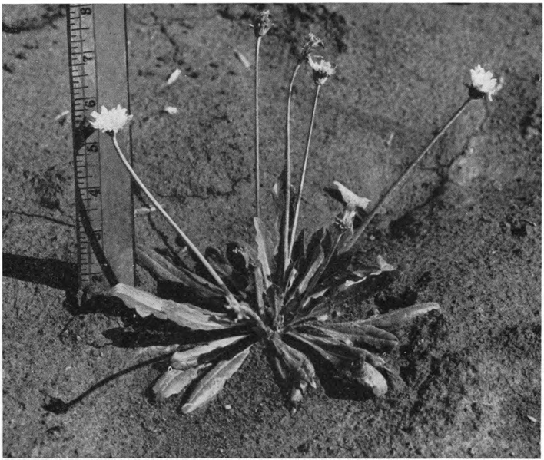
! Benchmark is in Inches!
Taraxacum kok-saghyz

Slide 7
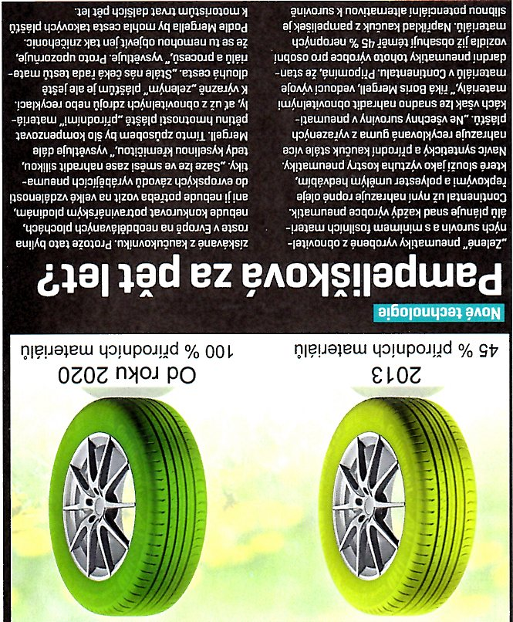
Taraxacum kok-saghyz
It is no Dandelion, it is only looking like!
Latex is in the Root (approx. 10 - 20 % w/w)
Per-hectare yield is stated as 200 kg/ha (hectare)
Experiments were conducted mainly in USSR and in USA
45 % w/w of the Natural products in 2013 year
100 % w/w of the Natural products in 2020 year
CONTINENTAL Company informs:
The Tire based on the Taraxacum kok-saghyz we launch in five years!

Slide 8
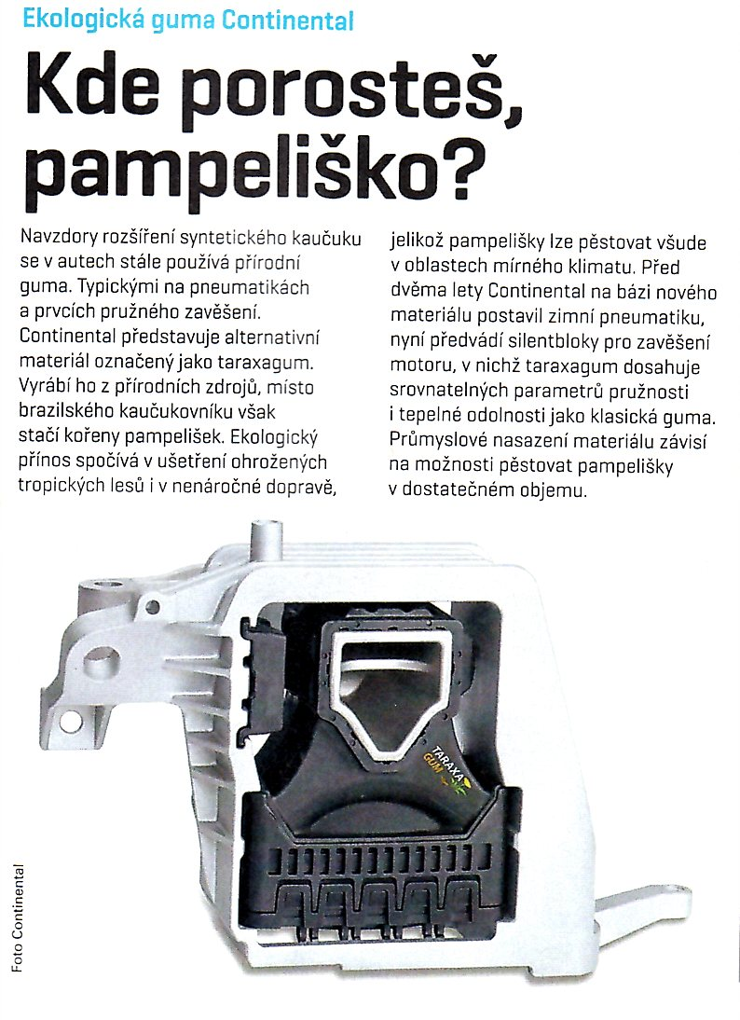
Rubber bush
Made of the Taraxacum kok-saghyz
Natural Rubber

