Slide 1
NATURAL POLYMERS 3 WAXES
Dr. Ladislav Pospíšil
29716@mail.muni.cz

Slide 2
Time schedule
LECTURE | SUBJECT
1 | Introduction to the subject – Structure & Terminology of nature polymers, literature
2 | Derivatives of acids – natural resins, drying oils, shellac
3 | Waxes
4 | Plant (vegetable) gums, Polyterpene –natural rubber (extracting, processing and modification)
5 | Polyphenol – lignin, humic acids
25.10. & 1. 11. | Polysaccharides I – starch
8.11. & 15. 11. | Polysaccharides II – celullosis
22. & 22. 11. | Protein fibres I
29. 11. & 6. 12. | Protein fibres II
13. & 20. 12. | Casein, whey, protein of eggs
20. 12. | Identification of natural polymers
 | Laboratory methods of natural polymers’ evaluation

Slide 3
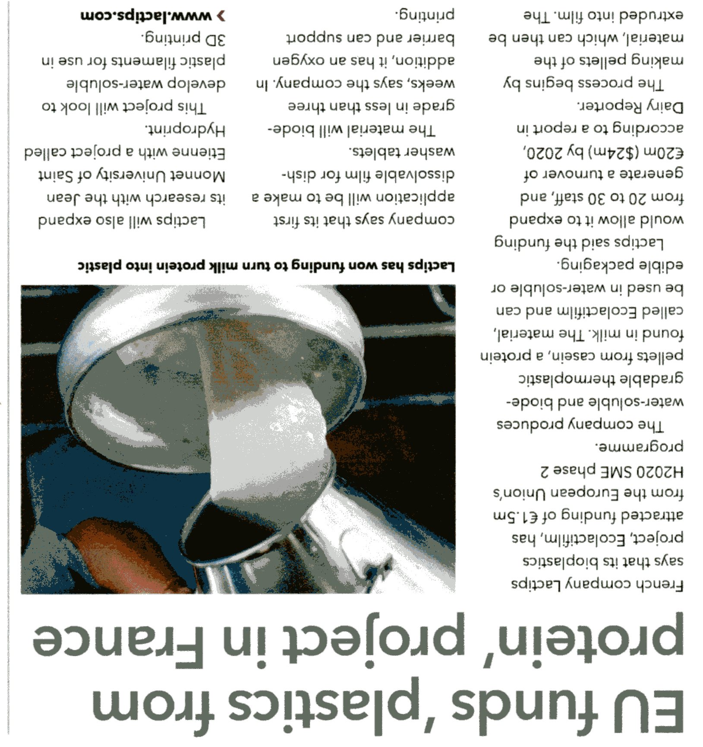
Latest news – CASEIN’s Return? (Download in December 2017)

Slide 4
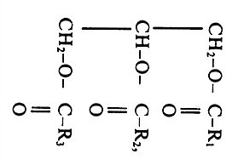
FATS –for a Reviving the Knowledge only (Lecture 2)
Vegetable Fats (Oils)
Glycerides
Higher fatty acids (> 10 C)
Saturated
Unsaturated
One double bond only
More double bonds
Isolated
Conjugated

Slide 5
What are the WAXes?
Waxes are organic compounds that characteristically consist of long alkyl chains. They may also include various functional groups such as fatty acids, primary and secondary long chain alcohols, unsaturated bonds, aromatics, amides, ketones, and aldehydes. They frequently contain fatty acid esters as well. Synthetic waxes are often long-chain hydrocarbons (alkanes or paraffins) that lack functional groups.
Cetyl palmitate, a typical wax ester.

Slide 6
What is the Difference between Oils and Wases?
Oils
Wases
Glycerides
Higher fatty acids(> 10 C) Unsaturated
One double bond only
More double bonds
Isolated
Conjugated
Alcohols with longer aliphatic chain (approx. C > 15)
The Waxes based od the DIOLS exist also
Higher fatty acids (approx. > 15 C), mostly SATURATED

Slide 7
Whye are Oils liquid and and Wases are solid (USUALLY, at standard temperature)?
Oils
Wases
Unsaturated
One double bond only
More double bonds
Isolated
Conjugated
What is the movability around the DOUBLE BOND?
How it influence the Crystallization Possibility?
Higher fatty acids (approx. > 15 C), mostly SATURATED
What is the movability around the SIMPLE BOND?
How it influence the Crystallization Possibility?
How POLYOLEFINES crystallize ?

Slide 8
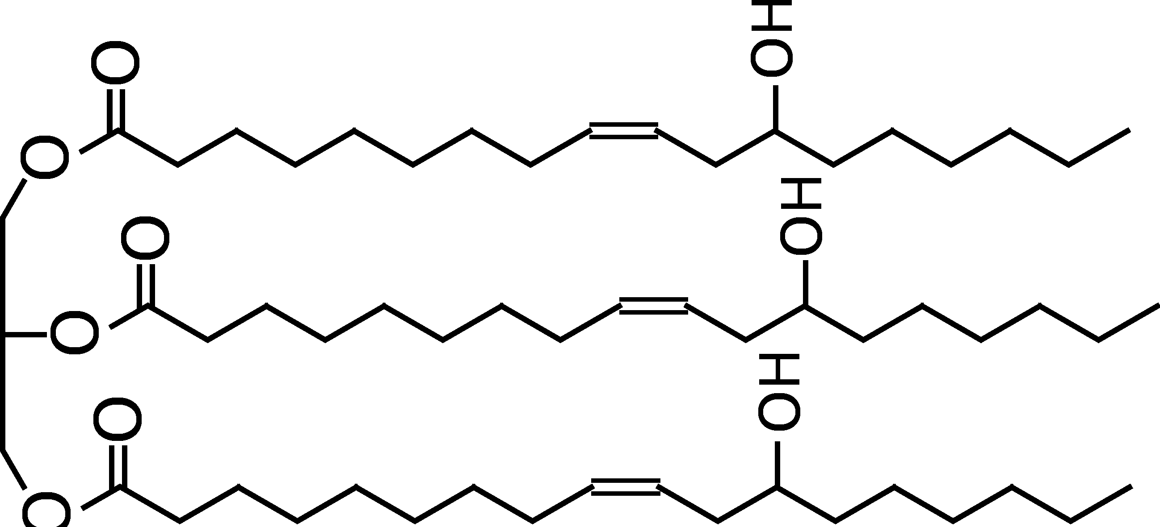
From the OIL to WAX Castor Oil
Three DOUBLE BONDS
HYDROGENATION
Free –OH groups remains!
WAX > Castor Wax

Slide 9
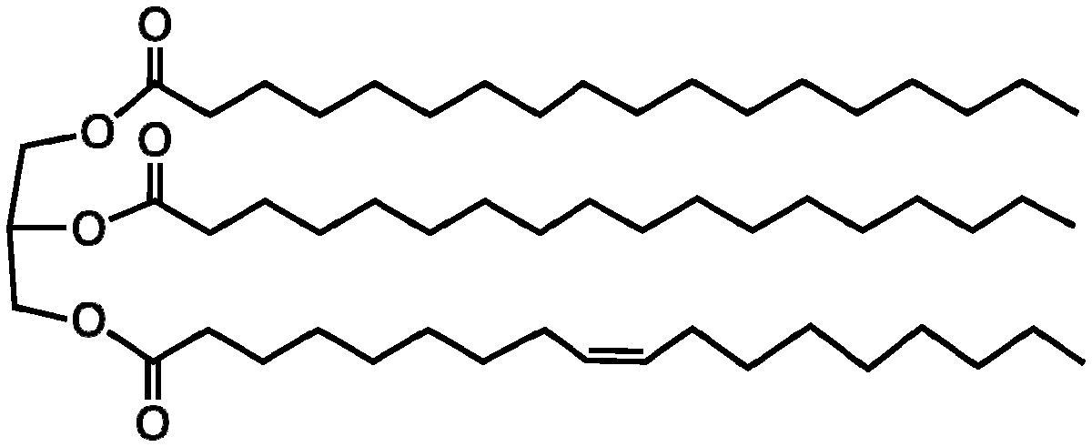
Something between OIL and WAX is Tallow, Suet
One DOUBLE BOND (Oleic acid) + TWO saturated fatty acids (Stearic acid)
For what was TALLOW used in the past and for what is used now?

Slide 10
Waxes – natural X synthetic
Natural products
Renewable sources
Animal origin (very rarely)
Vegetable product (prevails)
NONrenewable resources
Modified natural products
Synthetic products
Why put we WAXES in the Natural polymers?
Many of them have Molecular weight in the oligomeric region and many of them is possible to make by polymerysation of the alkenes or by depolymerISATION of POLYOLEFINS
OLIGOMERS = bridge between low MW and POLYMERS

Slide 11
Comparison of Oils and Fatts
Type of fat | Total fat (g) | Saturated fat (g) | Monounsaturated fat (g) | Polyunsaturated fat (g) | Smoke point
Sunflower oil | 100 | 11 | 20 | 69 | 225 °C
Soybean oil | 100 | 16 | 23 | 58 | 257 °C
Canola oil | 100 | 7 | 63 | 28 | 205 °C
Olive oil | 100 | 14 | 73 | 11 | 190 °C
Peanut oil | 100 | 17 | 46 | 32 | 225 °C
Rice bran oil | 100 | 25 | 38 | 37 | 250 °C
Lard | 100 | 39 | 45 | 11 | 190 °C
Suet (Tallow) | 94 | 52 | 32 | 3 | 200 °C
Butter | 81 | 51 | 21 | 3 | 150 °C
Coconut oil | 100 | 86 | 6 | 2 | 177 °C

Slide 12
The smoke point of an oil or fat is the temperature at which, under defined conditions, enough volatile compounds emerge when a bluish smoke becomes clearly visible from the oil. At this temperature, volatile compounds, such as free fatty acids, and short-chain degradation products of oxidation come up from the oil. These volatile compounds degrade in air to give soot. The smoke point indicates the temperature limit up to which that cooking oil can be used.^{[1]}

Slide 13
The iodine value (or "iodine adsorption value" or "iodine number" or "iodine index") in chemistry is the mass of iodine in grams that is consumed by 100 grams of a chemical substance. Iodine numbers are often used to determine the amount of unsaturation in fatty acids. This unsaturation is in the form of double bonds, which react with iodine compounds. The higher the iodine number, the more C=C bonds are present in the fat.^{[1]} It can be seen from the table that coconut oil is very saturated, which means it is good for making soap. On the other hand, linseed oil is highly unsaturated, which makes it a drying oil, well suited for making oil paints.
Acid value (or "neutralization number" or "acid number" or "acidity") is the mass of potassium hydroxide (KOH) in milligrams that is required to neutralize one gram of chemical substance.^{[1]} The acid number is a measure of the number of carboxylic acid groups in a chemical compound, such as a fatty acid, or in a mixture of compounds. In a typical procedure, a known amount of sample dissolved in an organic solvent (often isopropanol) and titrated with a solution of potassium hydroxide (KOH) of known concentration using phenolphthalein as a color indicator.

Slide 14
Saponification value (or "saponification number"/"Koettstorfer number",^{[1]} also referred to as "sap" for short) represents the number of milligrams of potassium hydroxide required to saponify 1g of fat under the conditions specified.^{[2]} It is a measure of the average molecular weight (or chain length) of all the fatty acids present. As most of the mass of a fat/tri-ester is in the 3 fatty acids, it allows for comparison of the average fatty acid chain length. The long chain fatty acids found in fats have a low saponification value because they have a relatively fewer number of carboxylic functional groups per unit mass of the fat as compared to short chain fatty acids. If more moles of base are required to saponify N grams of fat then there are more moles of the fat and the chain lengths are relatively small, given the following relation:
Number of moles = mass of oil / average molecular mass

Slide 15
Physical & Chemical Properties of some WAXES
WAX | Density (kg/m³) | Melting point (°C) | Iodine value (g I/100 g) | Acidity value (mg KOH/g) | Saponification value (mg KOH/g)
BeesWAX | 950-970 (23 °C) | 61-70 | 8-11 | 16-24 | 80-103
Lanolin (wool WAX) | 917-940 (15 °C) | 36-41 | 15-47 | 0,5 | 86-127
Japan WAX | 975-992 (15 °C) | 51-55 | 4,5-12,8 | 8-23 | 206-237
Carnauba WAX | 990-998 (15 °C) | 81-86 | 7-14 | 4-10 | 78-88
Montan WAX | 980-985 (29 °C) | 74-87 | 10-16 | 26 | 70-80
Ceresine | 880-920 (?? °C) | 55-80 | 7-10 | 0 | 0,0-0,1
Parafine | 883-915 (?? °C) | 55-88 | 0,5-2,5 | 0 | 0,0-0,3
Microcrystaline WAX | 900-940 (?? °C) | 63-85 | 0,0-1,5 | 0,1-0,2 | 0,05-2,00

Slide 16
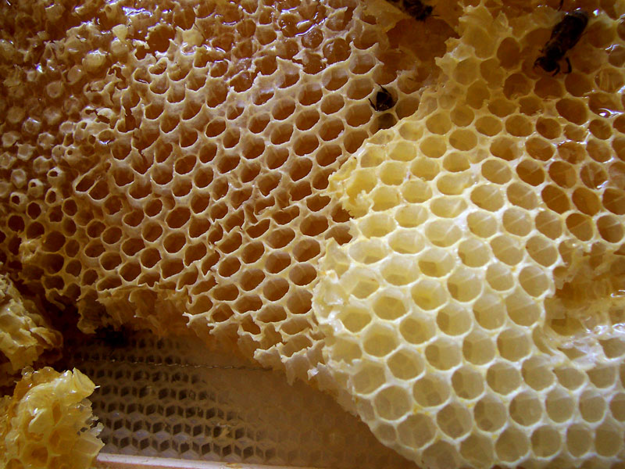
Beeswax is the INSECT WAX

Slide 17
Beeswax is FOOD ADDITIVE („E numbers“) (E901 - Glazing substances)
E900 - E999 CATEGORY: Glazing substances, sweeteners, packaging gases, propelans
Beeswax in the Greek Mythology
Odysseus was curious as to what the Sirens sang to him, and so, on the advice of Circe, he had all of his sailors plug their ears with beeswax and tie him to the mast. He ordered his men to leave him tied tightly to the mast, no matter how much he would beg. When he heard their beautiful song, he ordered the sailors to untie him but they bound him tighter. When they had passed out of earshot, Odysseus demonstrated with his frowns to be released. Some post-Homeric authors state that the Sirens were fated to die if someone heard their singing and escaped them, and that after Odysseus passed by they therefore flung themselves into the water and perished.

Slide 18
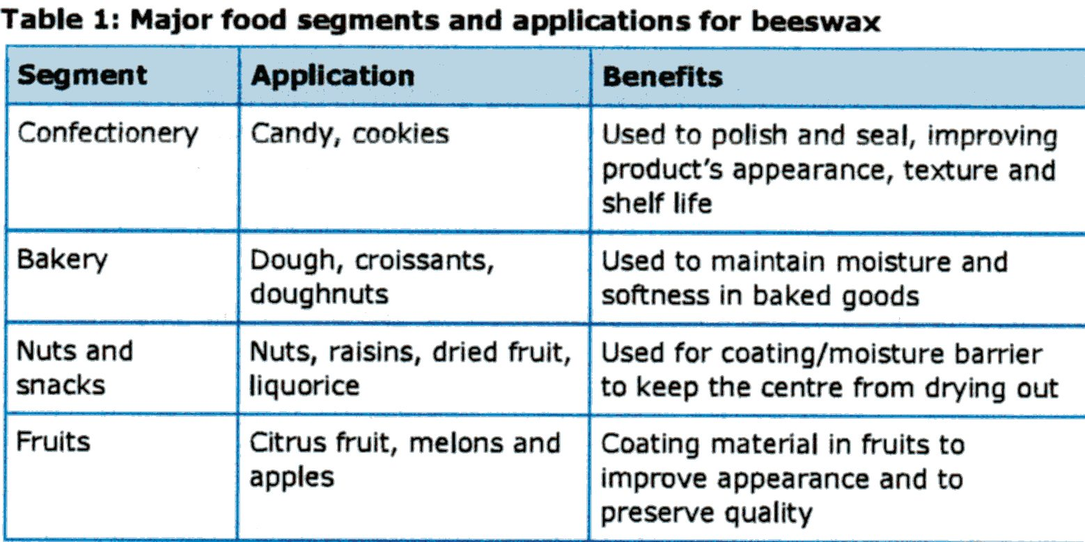
The current Price of BEESWAX
Approx. 5 – 7 EUR/kg

Slide 19
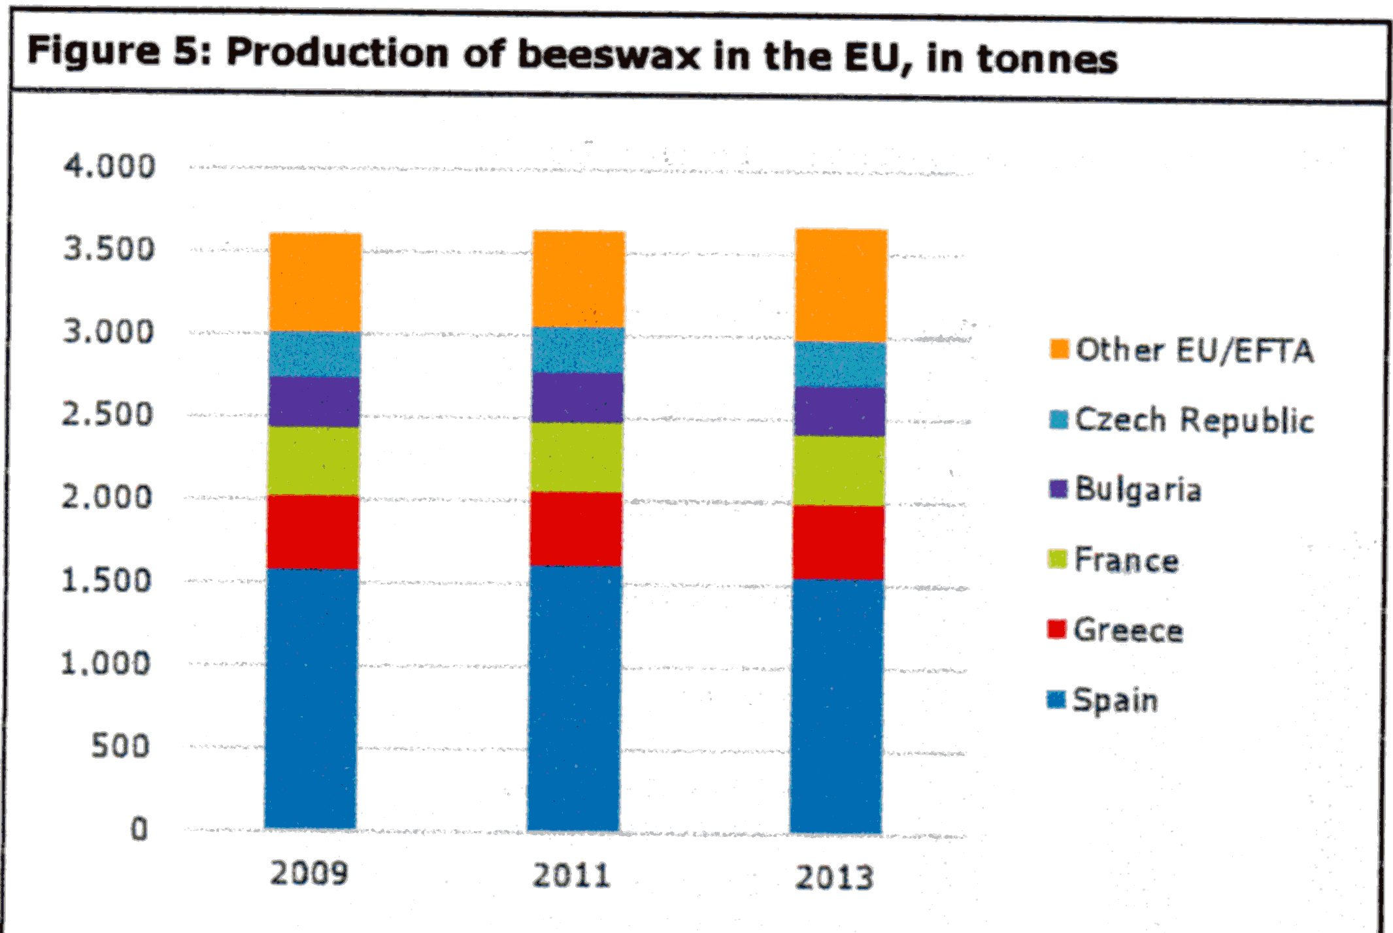
The major Producers of BEESWAX in EU

Slide 20
BEESWAX
triacontanyl (myricyl) palmitate CH₃(CH₂)₂₉O-CO-(CH₂)₁₄CH₃
This ester is considered as the MAIN COMPONENT in the approx. 285 up to now found items, approx. 111 NO identified items (Compounds) is waiting for your Effort!
Figures from different sources are different, so take the Figures as an Example of the Complexity of the Natural products only (see the next slide)
BEESWAX could be different place and and Beespecies accordinglly
Some Components are volatile

Slide 21
FRAction | PART | rEMARKS
Hydrocarbons | 14% | Mostly saturated C_{13 – 39} and cis alkenes C ₃₁ ₋ ₃₃
Monoesters | 35% | Mostly Palmitic acid with alcoholes C _{24 – 32}
Diesters | 14% | Containing 15-hydroxypalmitic acid bonded to α, ω 1-diols with palmitic or unsaturated acid
Triesters | 3% | Derived from triols
Hydroxy monoesters | 4%
Hydroxy polyesters | 8%
Acid esters | 1%
Acid polyesters | 2%
Free acids | 12% | Mostly C₂₄, lesser C₂₆ a C_{28,} but somewhere is presented as the main component „Cerotic acid“ – hexacosanoic acid
Free alcohols | 1% | Myricyl alcohol & CERYL ALCOHOL
Unidentified | 6%

Slide 22
Cerotic acid = hexacosanoic acid = cerotic acid (C₂₆H₅₂O₂)
myricylalcohol (triacontan-1-ol) C₃₀H₆₁OH
CERYL ALCOHOL
white crystalline alcohol C₂₇H₅₅OH occurring as an ester in waxes (as beeswax)

Slide 23
BEESWAX - Properties
Melting point 61 – 70 °C
Solubility:
Turpentine,
Amyl alcohol,
Toluene,
Gasoline,
Chloroform,
BEESWAX is plastic at room temperature, hard and brittle after cooling

Slide 24
BEESWAX - modifications
Falsification – addition of paraffin, stearic acid, …
Cleaning – melting in the boiling water, oxidation, ………..
Tack ability improvement > + resins, e.g. colophony
Stiffness improvement > + harder waxes
Boiling with alkali solutions > PUNIC WAX (soaps Na⁺, K⁺) with higher m.p.

Slide 25
BEESWAX in History
Casting of Metals „ Lost-wax casting “
Candles – probably by the Eastern Christians only now
Impregnation – thanks to saturated acids is not so sensitive to oxidation
Seals
………..

Slide 26
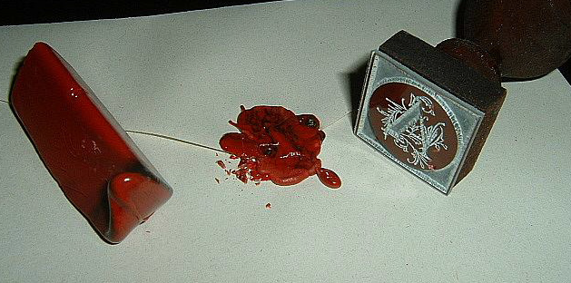
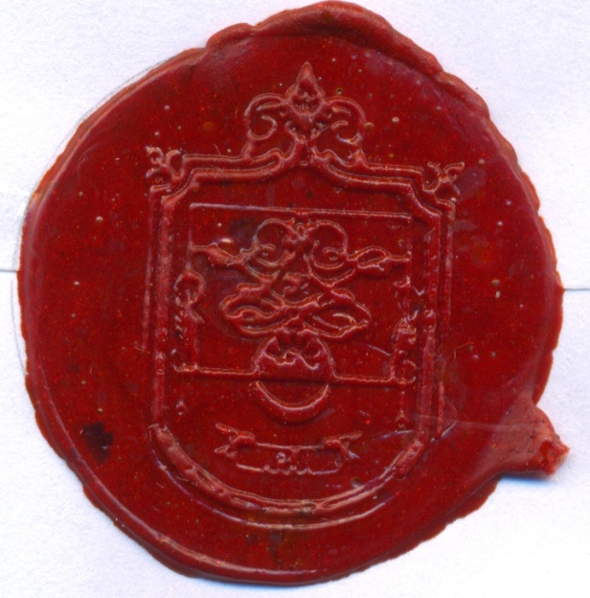
Another composition:
Beeswax,
Carnauba wax,
Colophony,
Chalk,
Pigments inorganic (WHY INORGANIC?)
Seals
From the 16th century it was compounded of various proportions of shellac, turpentine,
resin, chalk or plaster, and coloring matter (often vermilion, or red lead), but not necessarily beeswax. The proportion of chalk varied; coarser grades are used to seal wine bottles and fruit preserves, finer grades for documents. In some situations, such as large seals on public documents, beeswax was used.

Slide 27
BEESWAX in the modern World
Casting of Metals „ Lost-wax casting “
Impregnation – thanks to saturated acids is not so sensitive to oxidation
Glazing substances, Polishing agents
Food industry &Pharmacy – glossy surface of Candies and Pills
Conservation (Preservation) of metals and wood – It remains soluble for Centuries, low water vapour permeability > Polish for furniture
Conservation (Preservation) of historical painting

Slide 28
BEESWAX - verification of Purity
Ratio of ester value and acid value – it should be 3,6 – 4,3
Ratio of the Main components triacontanyl palmitate CH3(CH2)29O-CO-(CH2)14CH3 to cerotic acid CH3(CH2)24COOH, the two principal components, being 6:1 > METHOD?
Gas chromatography (GC) after transformation to methyl esters of acids

Slide 29
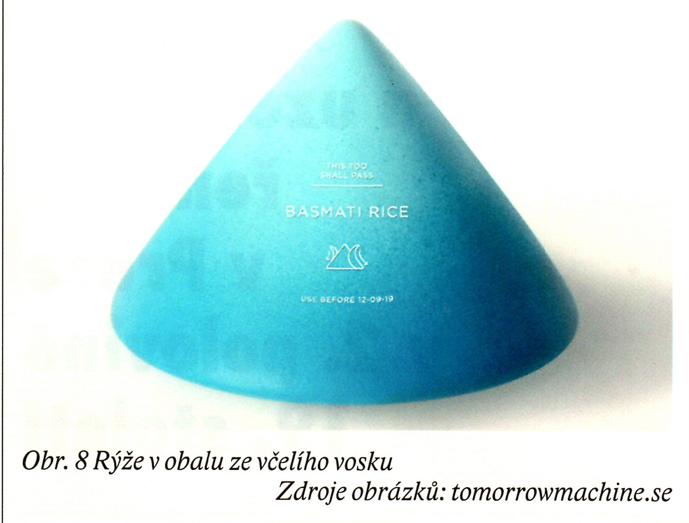
BEESWAX a bit unusual use
Rice in the Packaging made of BEESWAX

Slide 30
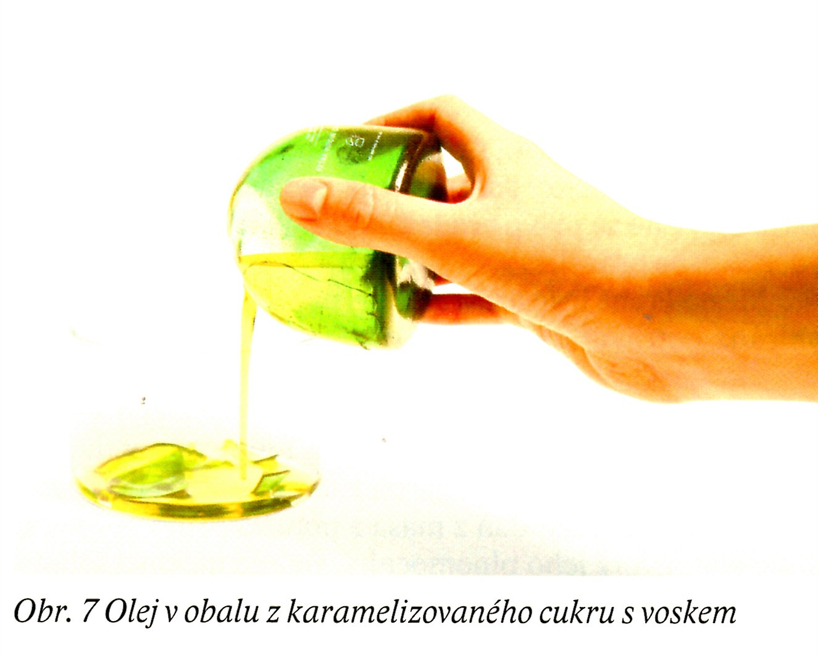
BEESWAX a bit unusual use
It is not stated, what WAX was used
Beeswax?
Paraffin wax?
The other natural wax?
Oil in the Packaging made of Wax & caramelized Sugar
Jaký olej? Co s cukrem a voskem?

Slide 31
We suddenly change direction of our Interest!
Natural Products > NONRENEWABLE SOURCES > OZOKERITE (earth wax –NATURAL PARAFFIN)

Slide 32
Ozokerite in history
Cleaning – melting and filtration
Cleaning - by H₂SO₄ and then by active carbon
Improvement of colour and removing of the nonmelted impurities
WAX DESTILLATION
CERESINE >Candles, Dilution of the BEESWAX
VASELINE >lubricant, base of the salves and ointments in pharmacy

Slide 33
Ozokerite at present
More likely mineralogical curiosity
Substituted mostly by a products made by crude oil distillation- more cheap
Substituted by metallocene waxes –possibility to set precisely properties, but they are more expensive

Slide 34
CERESINE 1
It WAS made by refining of OZOKERITE (chemical & physical) originally
IT IS MADE mostly by mixing of various products from crude oil refinery > cheap
It contains, unlike paraffin, branched and cyclic structures > plasticity at lower temperature, because having lower tendency to crystallize

Slide 35
CERESIN 2
Swelling in the many solvents and oils > WAX PASTES
Melting point approx. 60 – 70 °C
SOLUBILITY
Turpentine,
Toluen
Chloroform,
Gasoline,
Petrolether (hydrocarbons with chain length of C_{5–7} (Boiling point approx. 30–70 °C)

Slide 36
CERESIN 3 - USE
Conservation and oil tannage of leather
GENERALY: surface protection (preservation) agent, and not only of metals
WAX PASTES for making of models etc.
Substitution of the BEESWAX or its dilution

Slide 37
CERESIN 3 - použití
Konzervování (tukování) usní
Všeobecně jako prostředek povrchové ochrany, a to nejen kovů
Voskové pasty na modelování atd.
Náhrada včelího vosku nebo jeho ředění

Slide 38
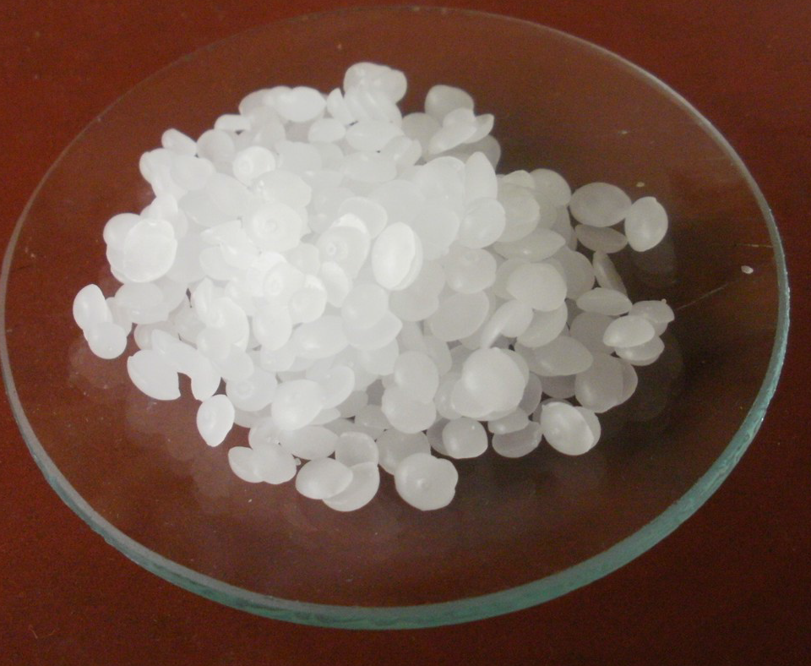
PARAFFIN 1
HDPE and LDPE look like!
WHY?
The hydrocarbon C31H64 is a typical component of paraffin wax.

Slide 39
PARAFFIN 2
It contains mostly LINEAR STRUCTURES
PARAFFIN = HIGHER alkane, approx. > C₂₆
Melting point approx. 45 – 70 °C
Boiling point 300 °C > vacuum distillation of the Crude oil products > crystallisation from the Mixture with oils
Density approx. 900 kg/m₃, similar to HDPE >WHY?
Excellent ELECTROISOLATION PROPERTIES
Excellent chemical resistance, also for HF acid > preparation of the glass bottles for HF acid

Slide 40
PARAFFIN 3
Excellent resistance to Weathering (UV, oxygen etc.)
Waterproof surface treatments > paper cups for beer, beverages and milk products in the past (now plastics)
Dilution of the more expensive Waxes (e.g. Beeswax), but there is danger of the Phases Separation
Polishing pastes, Candles, Ski waxes, …
The Part of the old painting Removers > it inhibits the fast Evaporisation of a Solvent

Slide 41
PARAFÍN 4 - another use
Component of the poisoned bait for rodents – a bait is flowing on water surface
Cosmetics – creams, medicine in the form of ointment or cream, lipsticks, makeup, greasepaint
Healing - body wrap
Waterproofing treatments, slip waxes, car and shoe polishing waxes, …………
Precise casting of metals or other materials
Impregnation of the Wood
Civil engineering – injection to the brickwork (dampf proofing), Impregnation of the building parts
Preservation of the Amuniation against humidity, e.g. dynamite charge
Potting of tissues in histology for cutting (TEM)

Slide 42
PARAFFIN 5 – How is it supplied
Paraffin is supplied either in the form off lakes or pellets or blocks
Current price (Wholesale) is for STANDARD GRADE approx. 2 EUR/kg (2006 - 2008). HDPE and LDPE available now at price approx. 3 EUR/kg
Coding od Paraffines: e.g. 60/62 or 50/52) gives the Temperature of congealing pour point a revolving thermometer, not the Melting Point!
ISO 2207 (ČSN 65 7115) Petroleum waxes - Determination of congealing pour point a revolving thermometer

Slide 43
Microcrystalline Wax It is again Product obtained by Distillation of the Crude Oil
Microcrystalline
Wax
CERESIN
PARAFFIN
It contains LINEAR & branched & CYCLIC STRUCTURES
Colourless
C₂₆ and more
Almost
transparent
It contains mostly LINEAR & branched & CYCLIC STRUCTURES
Mostly yellow like to brown, Colourless after Purification only
C₅₀ and more
Opalescent
It contains mostly LINEAR STRUCTURES
Colourless
C₂₆ and more
Almost
transparent

Slide 44
Microcrystalline Wax Use – similar to Paraffin
It is more sticky > it is better for the coverings
It gives them, if mixed with the other waxes, better mould ability
The other properties are like the paraffin

Slide 45
My favourite WAX MONTAN WAX 1
NATURAL PRODUCTS > UNRENEWABLE SOURCES > EXTCTION FROM THE WOODY LIGNITE OR YOUNG BROWN COAL
Montane Resins
Montan Wax
Asphalt

Slide 46
MONTAN WAX 2
Montane acid (C₂₈H₅₆O₂)> esters > Montan Wax
It is stated C₂₄ – C₃₀ pro „Montane acids“
It is contained in the following Waxes:
Montan Wax
Chinese Wax
Beeswax Wax

Slide 47
MONTAN WAX 3
Possibilities of the MODIFIED PRODUCTS preparation
Esters –SAPONIFICATION, also partly
Pure (Free) montane acid – formation of Salts Me⁺ či Me⁺²
Pure (Free) montane acid– esterification with diols (e.g. ethylenglykol) and triols (e.g. glycerine)
Many Waxes LICOWAX made by Clariant Company

Slide 48
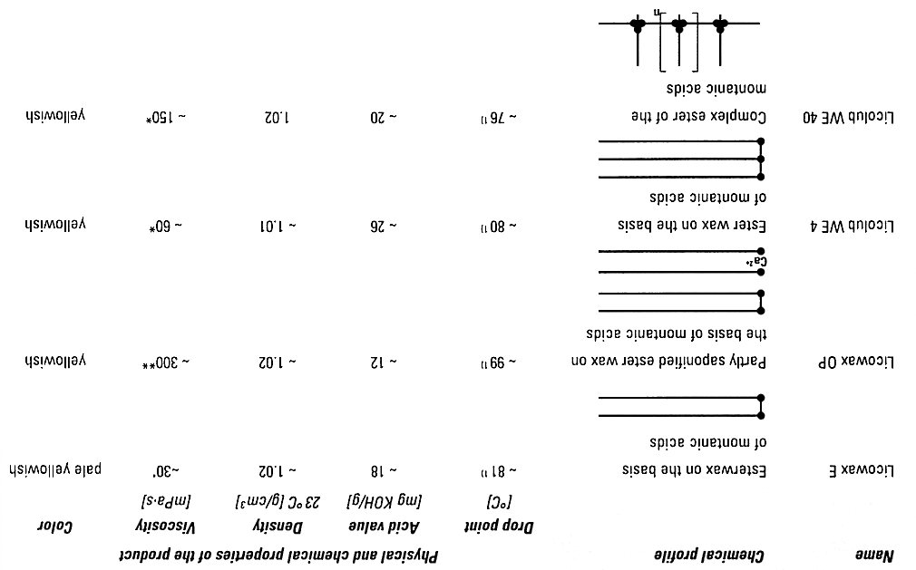
MONTANE WAX - CLARIANT 4

Slide 49
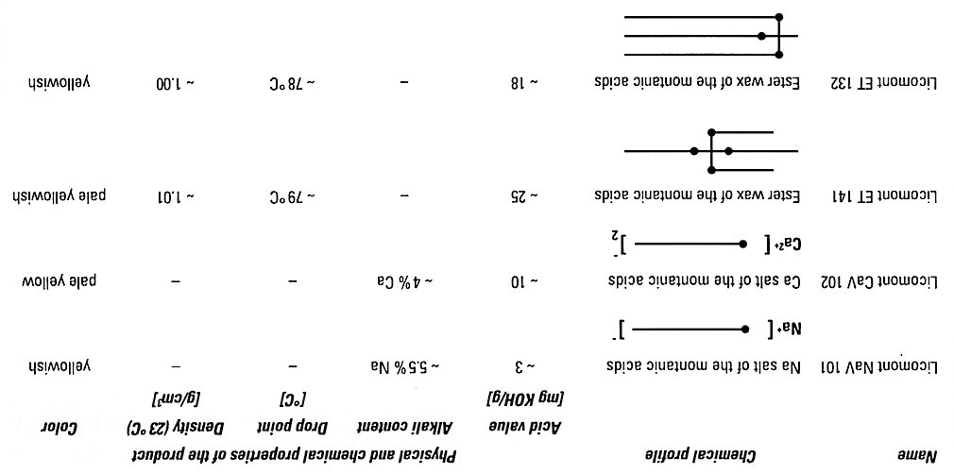
MONTANE WAX - CLARIANT 5

Slide 50
MONTANE WAX – Main use 6
GENERALLY: There, where is necessary , glossy and hard coating (surface)
Car polish – approx. one third of the world consumption
Shoe polish
Lubricant for plastics processing
The Substitution or modification of the BEESWAX
……………….

Slide 51
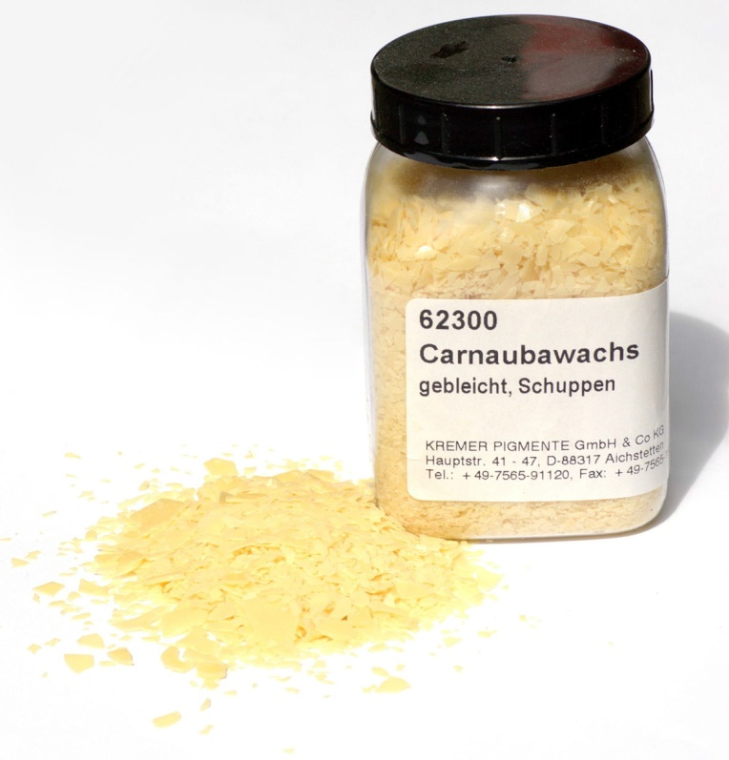
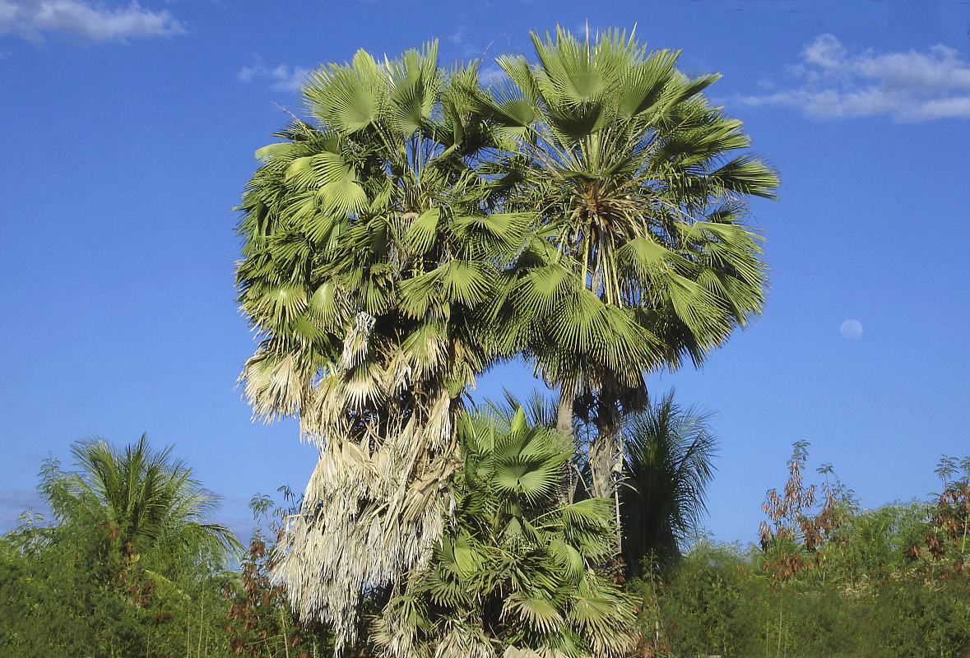
Carnauba Wax & Palm Tree

Slide 52
BACK TO THE PLANTS ! Carnauba Wax 1
Natural products > RENEWABLE SOURCES > WAXY COATING on the Leafs of the Carnauba palm, growing in Brazil
Air-dried Leafs > mechanical separation >cleaning by Melting & Filtration
Myricilcerotate – main Component (approx. 80 % w/w)
C₃₀H₆₁OOC₂₅H₅₁O (in the BEESWAX is stated boththis Acid and this Alcohol)

Slide 53
Carnauba Wax 2
High Melting Point, approx. 81 – 86 °C
The Addition of this Wax increases the Melting Point and the Hardness of other Waxes (e.g. Beeswax), like the Montane Wax
It is soluble at room temperature in diisopropylether and chloroform, at high temperature also in EtOH, turpentine, ketones, …
Polishing agents
Coating of medicines
Separation agent for plastic processing

Slide 54
The other Substances classified as WAXES
Lanoline – from the Waste after a Wool cleaning
Japanese wax – from the tree Fruits
Chinese wax – insect secret
Esparto wax – protective cover on the Esparto Grass
………………..

