Slide 1
LIFESPANS

Slide 2
Rodents for comparative aging studies: from mice to beavers
Key words:
Aging, Comparative studies, Rodents, Telomerase
https://www.ncbi.nlm.nih.gov/pmc/articles/PMC2527635/

Slide 3
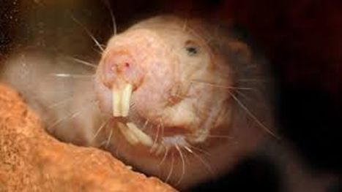
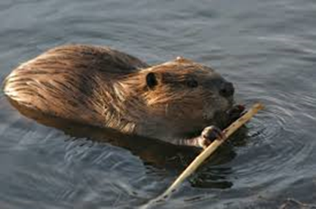
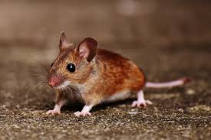
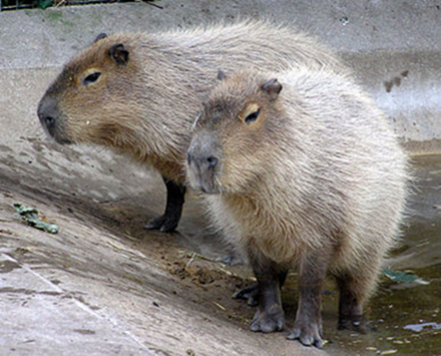
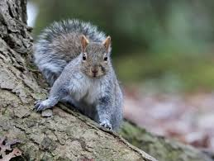
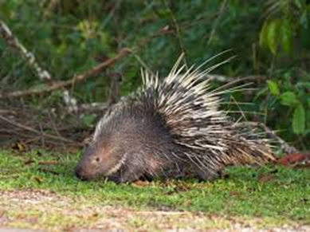
Rodents for comparative aging studies: from mice to beavers naked mole-rat squirrel mouse beaver porcupine capybara

Slide 4
species with large body mass and average lifespan (capybara),
large body mass and long lifespan (beaver and porcupine),
small body mass and short lifespan (mouse),
and small body mass and long lifespan (mole-rats).

