Slide 1
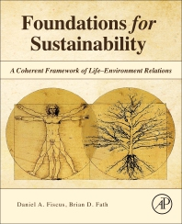
Foundations for Sustainability
Brian D. Fath, Ph.D.
Fulbright Distinguished Chair, Masaryk University, Brno, Czech Republic
Professor, Towson University, Maryland, USA
Senior Research Scholar, International Institute for Applied Systems Analysis, Austria

Slide 2
a new paradigm
Environmental concerns have become of paramount importance.
Certain global problems may soon be irreversible (e.g., deforestation, extinction, soil loss, climate change).
These are systemic problems that cannot be understood in isolation but rather are interconnected and interdependent.
Our actions intended to solve the problem actually makes it worse because unintended side effects make the problem worse

Slide 3
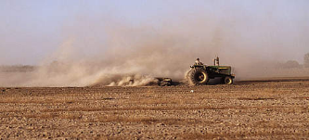
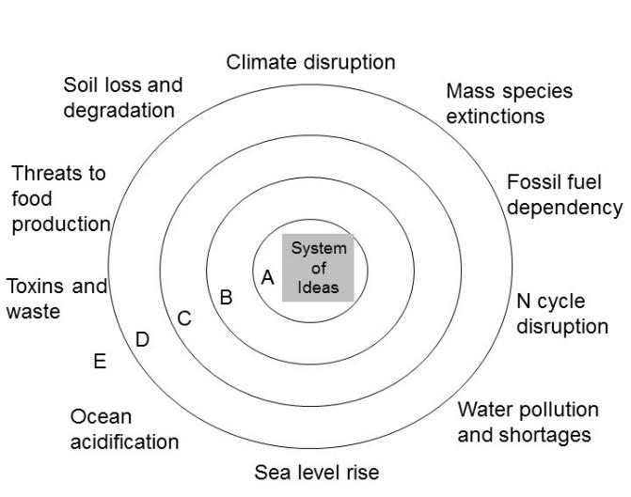
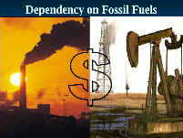
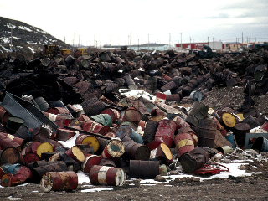
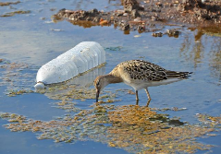
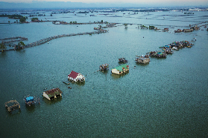
Environmental Challenges
Soil erosion
Yesterday’s solutions become today’s problems
Toxins and waste
Water pollution
Sea level rise

Slide 4
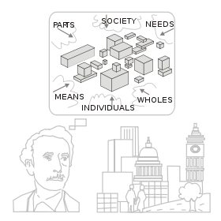
rise of systems thinking – from parts to wholes:
system – integrated whole whose essential properties arise from the relationships between its parts
systems thinking – the understanding of a phenomenon within the context of a larger whole
systems thinking is complementary to analytical thinking

Slide 5
Sustainability
What does it mean for a system to be sustainable?
What makes a system sustainable?
What role do humans play in sustainability?
Can we be sustainable given our current population and resource use level?

Slide 6
Sustainable Development
Sustainable Development: “development that meets the needs of the present generation without compromising the ability of future generations to meet their own needs” – Our Common Future/ Brundtland Report, 1987

Slide 7
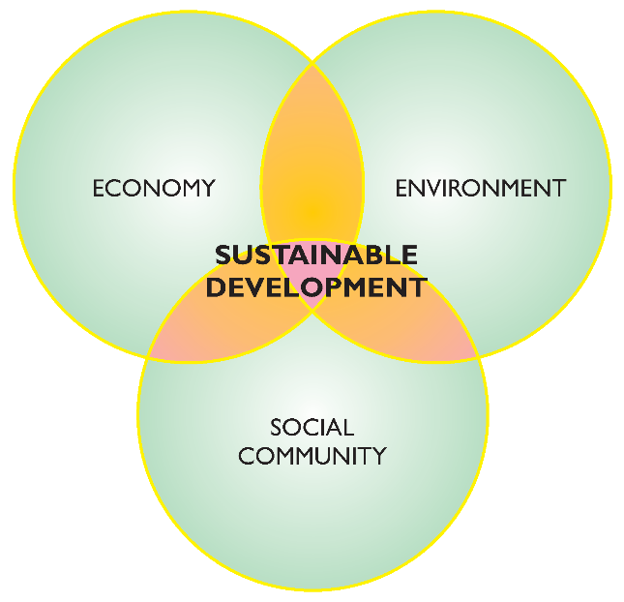
Three pillars of Sustainable Development

Slide 8
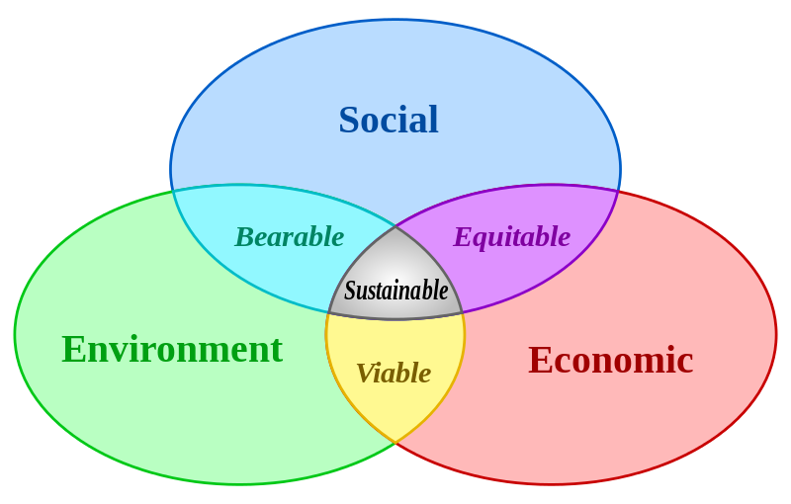

Slide 9
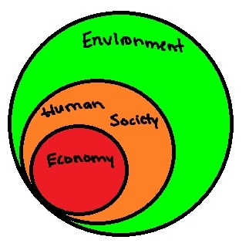
Environment is foundation for all aspects of sustainability, others are subsets

Slide 10
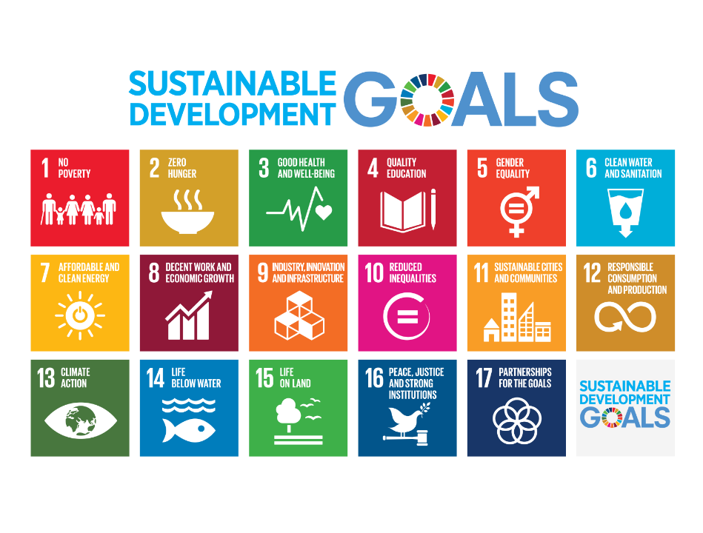
Adopted September 2015 – also called Agenda 2030

Slide 11
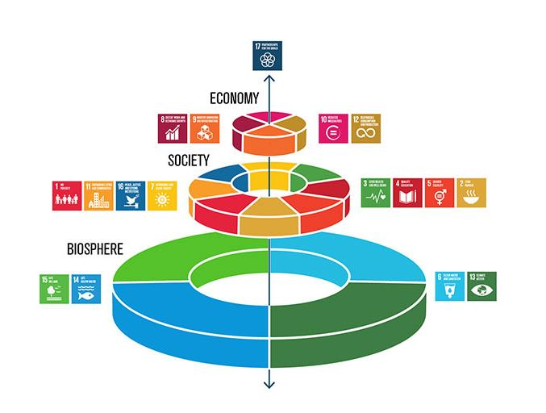

Slide 12
Sustainable Development vs Sustainability
Sustainable Development: “development that meets the needs of the present generation without compromising the ability of future generations to meet their own needs” – Our Common Future/ Brundtland Report, 1987
Sustainability: “the capacity to endure; how systems remain diverse and productive over time” – wikipedia
What are “our needs”?

Slide 13
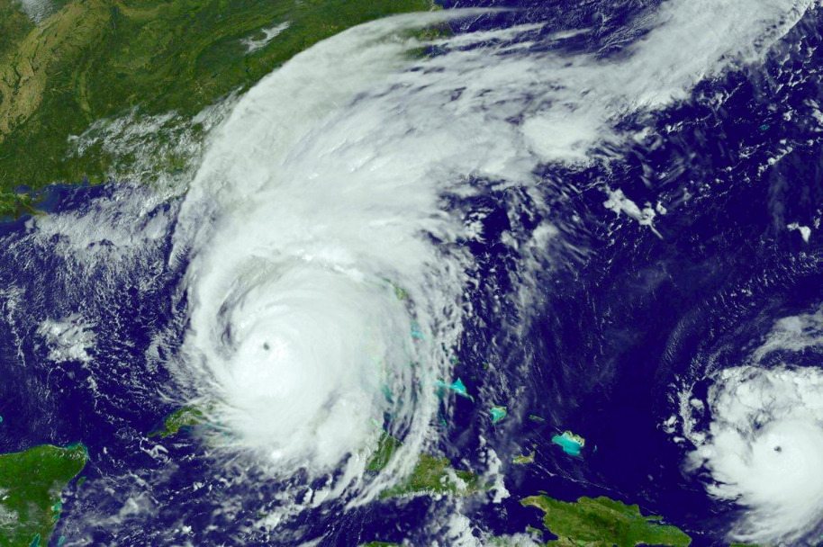
Hurricane
https://en.wikipedia.org/wiki/Hurricane_Irma

Slide 14
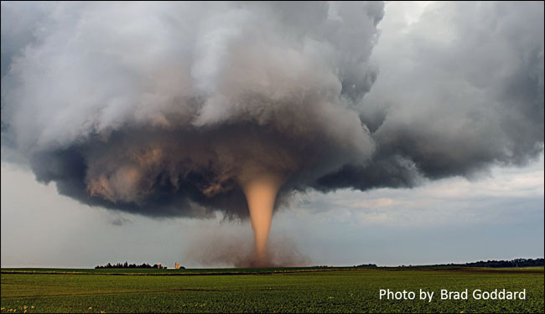
Tornado
https://www.weather.gov/safety/tornado

Slide 15
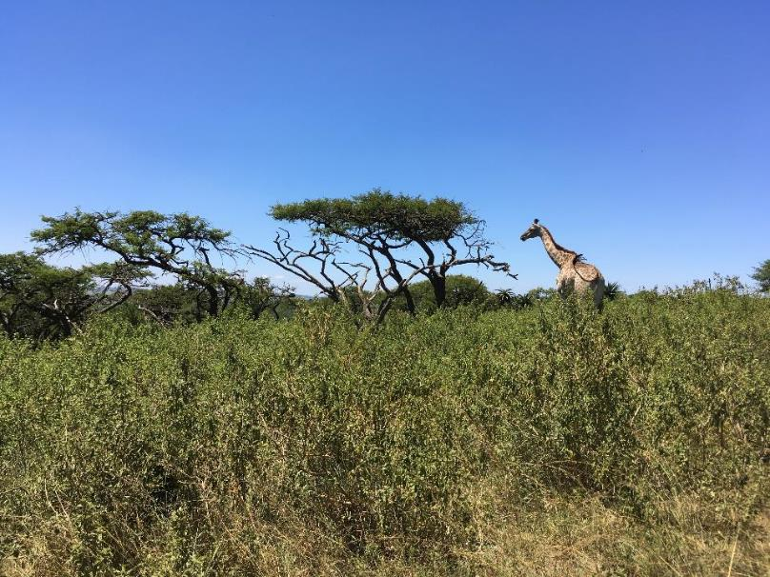
Ecosystem

Slide 16
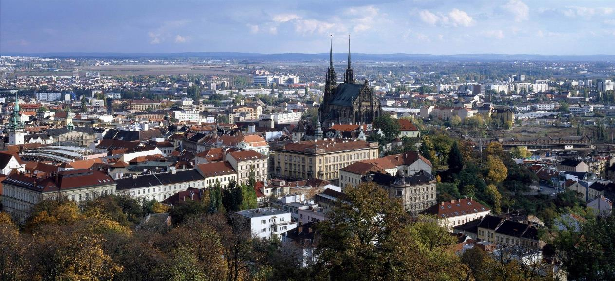
City

Slide 17
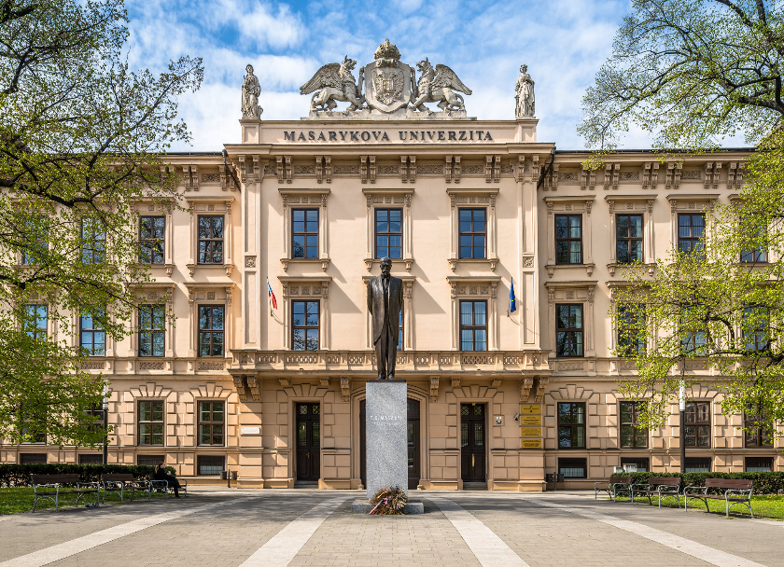
Campus

Slide 18
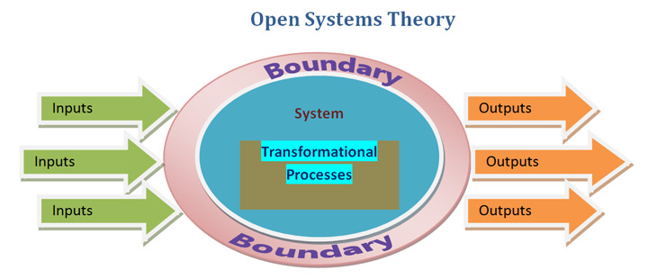
All are open systems with energy driving and maintaining the processes
All import, reuse, and export resources (water, wood, waste, minerals, metals, materials, etc.)

Slide 19
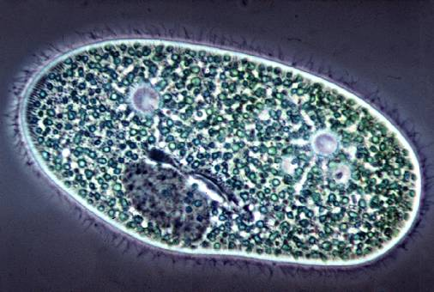
What is life?
A single cell possesses all the necessary aspects to be alive

Slide 20
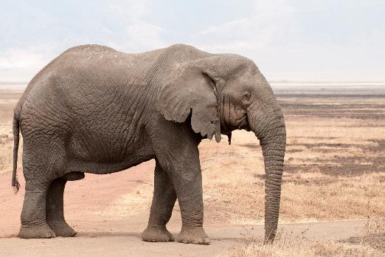
What is life?
Discrete Life
A single organism possesses all the necessary aspects to be alive

Slide 21
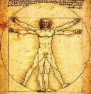
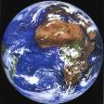
Mental models and outcomes Real impacts of choice of system boundaries
Inherent in this paradigm, life is separate from environment in mind and action
Once fragmented, it is possible and likely that the value of environment is seen and treated as less than the value of life
Environment is consumed and degraded as manifest in many symptoms of ecological crisis
Tragedy of the Commons
Humans win, environment degrades
Life
Environment
Figures by Dan Fiscus

Slide 22
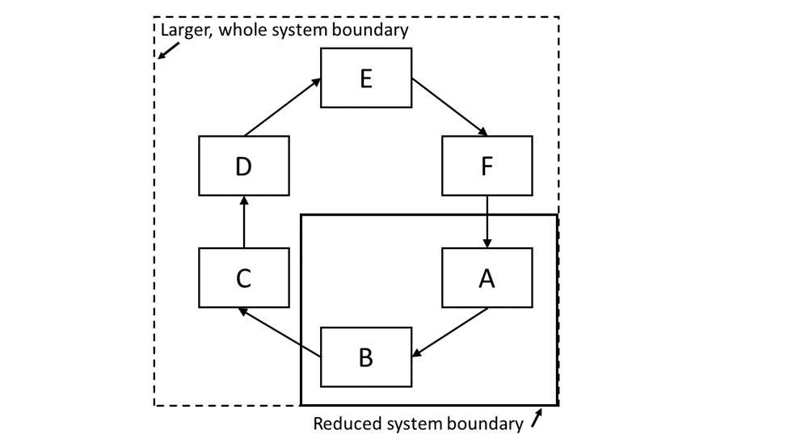
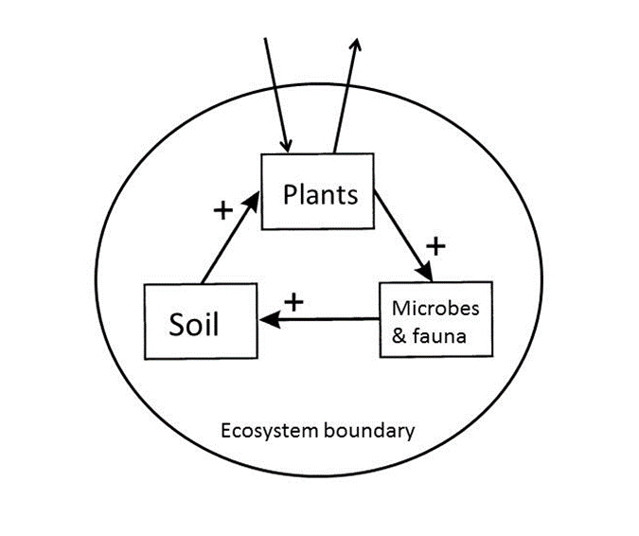

Slide 23
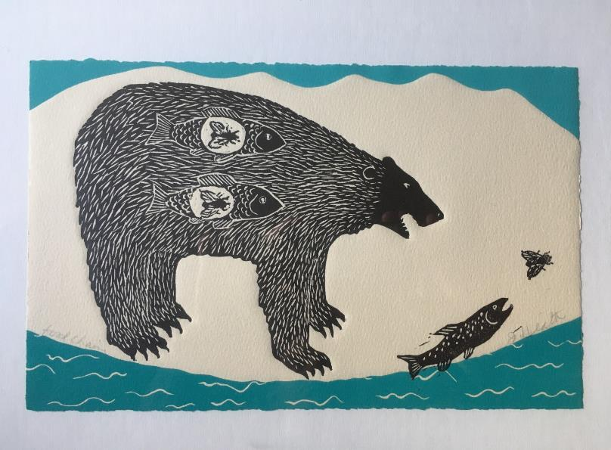
Ecosystem is full of
Interconnections and Interdependencies
Art work of Jan Heath, entitled “food chain”

Slide 24
A bottom up re-visioning is vital: A new holistic paradigm for life
Contrary to the dominant mainstream view, the basis of all current biology and life science education, it now is becoming clear that life is not only or even primarily an organismal property.
In the view actively emerging, life is not centered on organisms, nor is it primarily a localized, objectified or material phenomenon.
Life is inherently relational, distributed, and non-localized

Slide 25
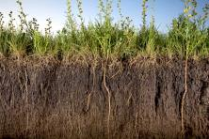
Environment and ecological interactions
Discrete Life
A single organism possesses all the necessary aspects to be alive

Slide 26
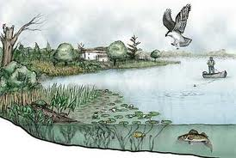
Interacting ecological community and its environment is an ecosystem
Sustained Life
An ecosystem possesses all the necessary aspects to sustain life

Slide 27
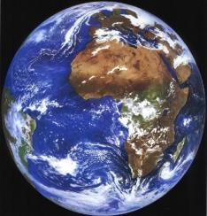
Life and environment are best understood and modeled as unified as a single “life–environment” system.
Bounty of the Commons
Humans win, environment improves
Fiscus D, Fath BD, Goerner S. 2012. E:CO 14(3), 44–88.

Slide 28
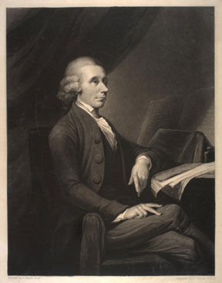
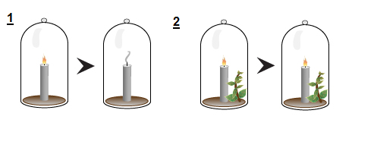
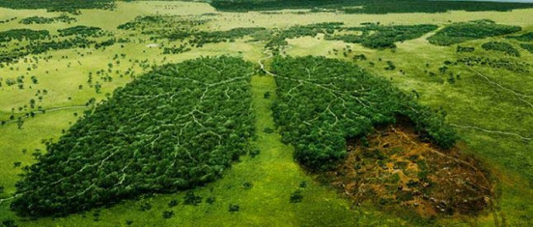
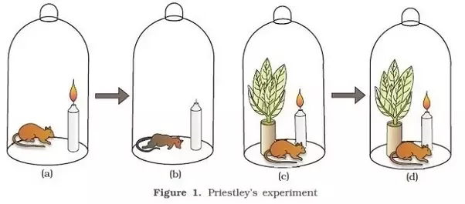
Joseph Priestley discovered oxygen in 1774
www.acs.org/content/acs/en/education/whatischemistry/landmarks/josephpriestleyoxygen.html

Slide 29
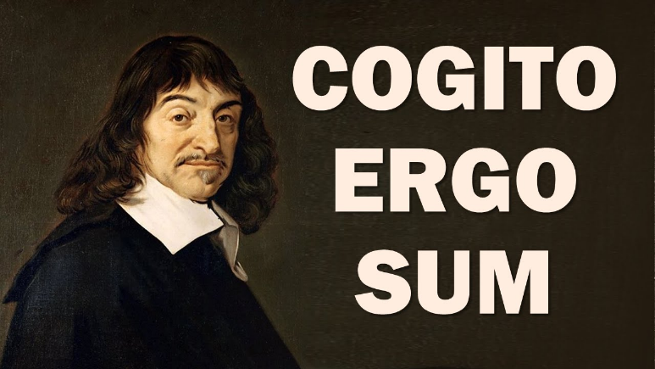
Rene Descartes Discourse on the Method (1637).
I think, therefore, I am
Founder of the “Cartesian” worldview

Slide 30
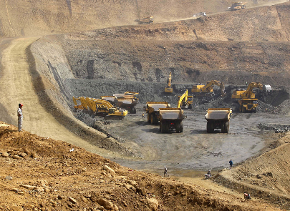
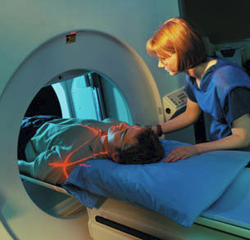
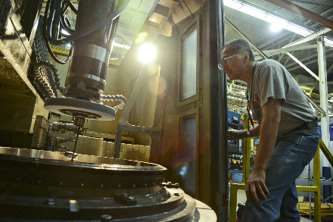
“To Descartes the material universe was a machine and nothing but a machine... This mechanical picture of nature became the dominant paradigm of science in the period following Descartes.
The Cartesian view of the universe as a mechanical system provided a “scientific” sanction for the manipulation and exploitation of nature that became typical of modern civilization.
The Cartesian approach has been very successful, especially in biology, but it has also limited the directions of scientific research. The problem has been that many scientists, encouraged by their success in treating living organisms as machines, tended to believe that they are nothing but machines.” (p. 25-26)
Capra and Luisi (2015). Systems View of Life
https://www.mmtimes.com/news/growth-mining-industry-expected-investments-rise.html
www.fda.gov/radiation-emittingproducts/radiationemittingproductsandprocedures/medicalimaging/medicalx-rays/ucm115317.htm
www.tinker.af.mil/News/Article-Display/Article/ 845655/grinding-it-out-no-job-is-too-big-or-small-for-548th-pmxs-machine-shop/

Slide 31
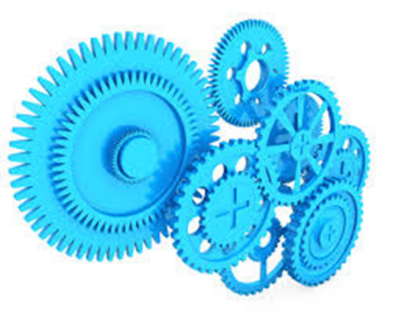
One major barrier is the dominant idea in mainstream science now – to treat the fundamental working unit of Nature as a “mechanism” – we have turned the world into the machine we have pictured it to be.
The suite of systemic problems listed above – showing a world and natural life support ecosystems literally “running out of gas” and “breaking down” in myriad ways – is not typical behavior of natural living systems.

Slide 32
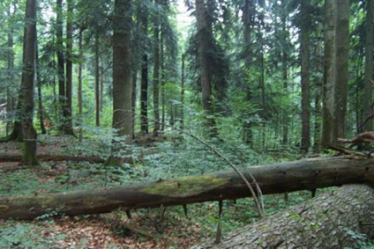
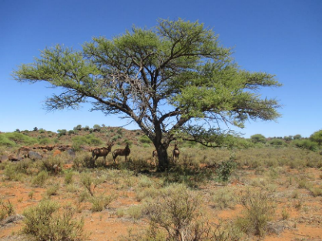
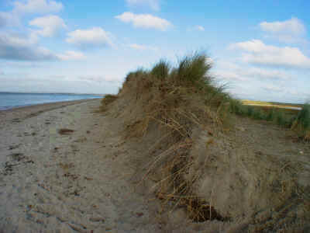
On the contrary, natural living systems normally self–organize continually and self–repair after disturbance. They grow, develop and improve in environmental quality over time (O₂ atmosphere, O₃ layer, soils, water purification, etc.)
These demonstrate the normal behavior of healthy Life systems is a win–win where life and environment both improve over time.

Slide 33
What can we learn from Nature?

Slide 34
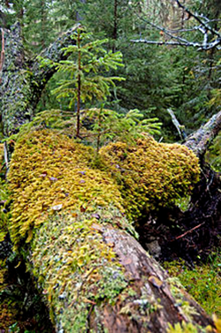
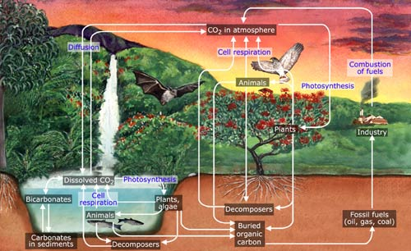
There are no trash cans in nature
Material is reused again and again through functional couplings

Slide 35
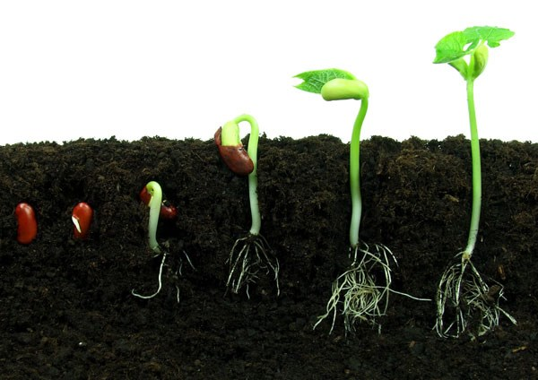
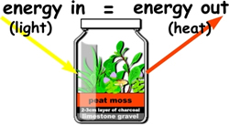
An ecosystem uses surplus energy to move further from thermodynamic equilibrium (physically driven biological aspect).
Another way of expressing that ecosystems can grow
http://tomatosphere.letstalkscience.ca/Resources/library/ArticleId/4791/seed-germination.aspx

Slide 36
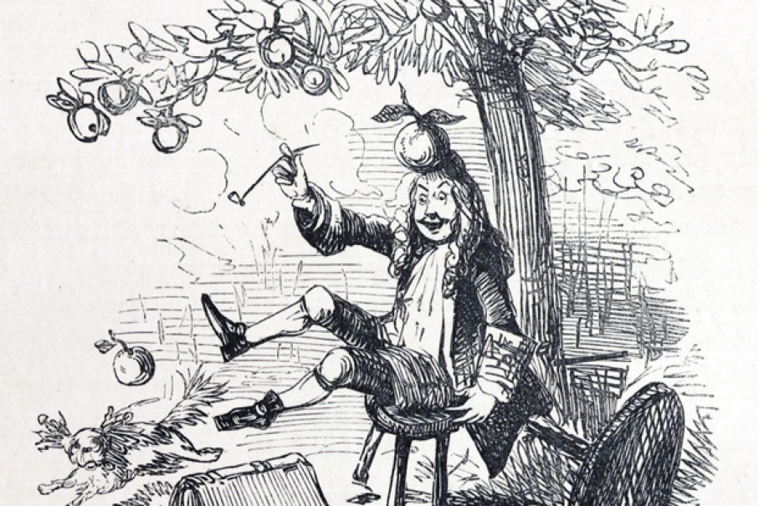
Newton’s Apple
He didn’t answer the corollary question:
How did the apple get above the ground in the first place?
https://history.howstuffworks.com/history-vs-myth/10-false-history-facts10.htm

Slide 37
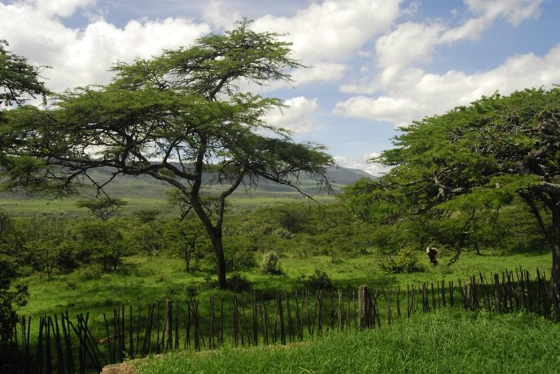
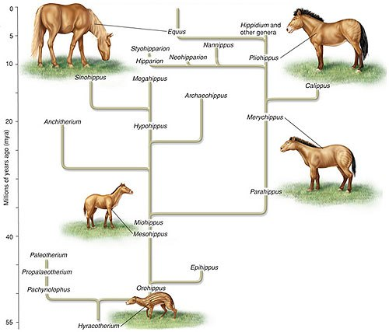
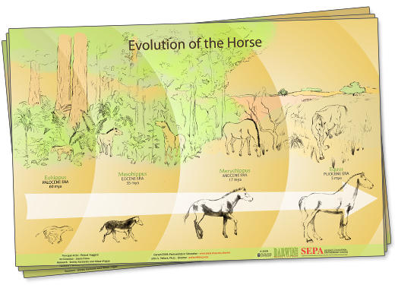
An ecosystem co-evolves by adapting to and modifying its environment (biologically driven biological aspect).

Slide 38
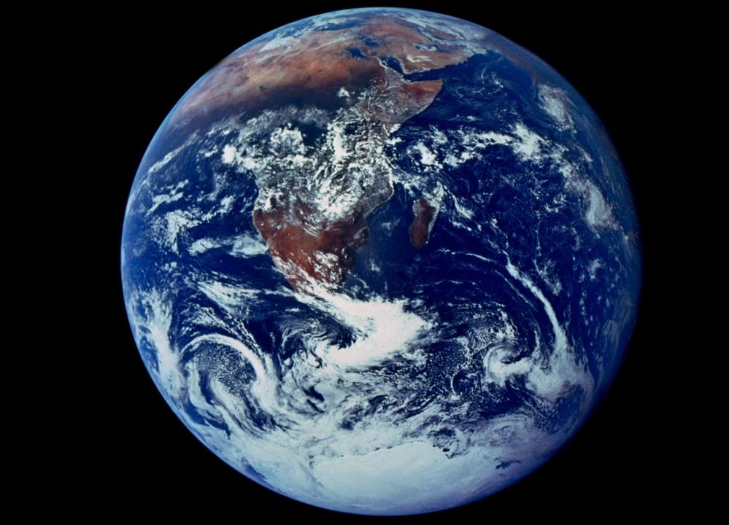
We live in a world full of life.
Nothing on Earth is entirely abiotic
Rather it is
With Life – conbiotic

Slide 39
Rene Descartes Discourse on the Method (1637).
Discrete Thought
Founder of the “Cartesian” worldview

Slide 40
“I think, therefore I exist.
That is, I think now, therefore I exist now. But I think only as long as I have a steady input of oxygen, water, and food to sustain my thinking via my life. And, after I am done thinking with aid of these vital materials, they are transformed and expelled not so much as waste but as food for the plants and other living beings that in turn create and supply my material needs.”
Sustained Thought
“I think, therefore, I am... we are... an ecosystem” Fiscus & Fath 2019
https://wmtllp.com/tax-advisory/trusts/woman-sitting-on-bench-by-the-lake-contemplating-nature/

Slide 41
Foundations for Sustainability - principles of Holistic Life Science:
1) Founded on Life as the basis of value, where Life is the Life–environment system as a unified whole
2) Anticipatory and accelerates scientific change toward the ultimate goal of a sustainable human environment relation and Life–environment relation
3) Balances holism with reductionism and synthesis with analysis
4) Equally emphasizes internalist and self–referential as well as objectivist perspectives
5) Is complex itself (employs impredicative logic, complexity theory, etc.) and able to help understand and guide complex human–natural systems
6) Is radically empirical, continually questioning, challenging, and transforming science assumptions and structures, especially when these distract from topics of greatest benefit to humanity and Life.

Slide 42
Conclusions
Change our dominant paradigm
Use systems thinking and ecosystem thinking
Find solutions that address the root causes of environmental problems
Ask yourself where does stuff come from: Food, clothes, electronics, water, energy
Where does it go when I flush it or throw it “away”?
See connections, make connections
Care about yourself, care about place
Enlist a cadre of excited, eager, and enthusiastic colleagues to explore, discuss, improve, spread, and implement these ideas!

Slide 43
THANK YOU FOR YOUR ATTENTION
bfath@towson.edu

Slide 45
Is sustainability still possible?
“Growing human populations are eating more meat, using more carbon-based energy, shouldering aside more natural resources, and tapping into more renewable and nonrenewable commodities than ever before.”
“If humanity fails to achieve sustainability, when, and how, will unsustainable trends end?”

Slide 46
Human Population
World 7,732,909,210

Slide 47
Great Acceleration

Slide 48
Anthropocene - term to denote the present time interval, in which human activities profoundly impact geology and ecosystems.

Slide 49
Anthropocene – urban perspective

Slide 50
Is sustainability still possible?
Why has it proved so hard to conform human behavior to the needs of a life-supporting future?
Our political and economic institutions evolved before anyone imagined the need to restrain human behavior out of concern for the future.

