Slide 1
Bi2003 Ecotoxicology
Ecotoxicological bioassays
Jakub Hofman

Slide 2
Content
Introduction – what, why, how, concept
Types of bioassays
Ecotoxicological bioassays’ design and results
Aquatic bioassays - examples
Soil bioassays – examples
Use of bioassays in praxis

Slide 3
Introduction – what, why, how, concept

Slide 4

Protection of environment / nature
Is and must be primary aim of sustainably developing society
why?
How to protect ?
Policy
Legislation
Research
Education
Ecotoxicology – offers knowledge and tools useful for the effective and reasonable environmental protection (these tools = ecotoxicological bioassays)

Slide 5
Ecotoxicology
Discipline on the border
of ecology and toxicology
studying and evaluating
direct and indirect effects
of man-made or natural harmful chemicals or other stressors
on animals (except human), plants and microorganisms
at all levels of biological organization

Slide 6

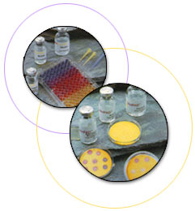
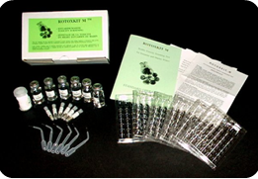
Ecotoxicity bioassay, ecotoxicity test
a tool (method, procedure ...) for ecotoxicological research and praxis – for environmental legislation and protection
biota (tissue, organism, population, ecosystem …) is exposed to chemicals (and/or other stress factors), in the lab (controlled conditions) or in the field (less controlled) and effects are evaluated and related to exposure – its experiment (!)
WHY? To understand the cause-effects relationships (causality, dose-response …)
  but sometimes also e.g. accumulation, biodegradation ...

Slide 7
Ecotoxicity bioassay, ecotoxicity test
toxicity test versus ecotoxicity test
→ see toxicology versus ecotoxicology

Slide 8
Why ecotoxicological tests ?
CHEMICAL ANALYSES ALONE CANNOT show real risk to living organisms:
real exposure varies according to bioavailability of toxic substances
in real environment, there is always mixture of toxicants that acts differently from individual compounds
negative effects of matrix itself, regardless of toxicant content, on organisms or interaction of matrix with effects of toxicants
spectrum of analytical methods (i.e. limit values) is limited and un-analysed significantly toxic substances may be present in the sample
ADVANTAGES of chemical analyses
- Reproducibility, standard-ability
- Exact numerical outputs understandable to all people: use in the law

Slide 9
Bioassays useful for:
prospective ecological risk assessment
  using bioassays for chemical compounds, pesticides
  using bioassays for materials, mixtures
  before they enter the environment

Slide 10
Bioassays useful for:
Objectives of the prospective approach:
evaluation of hazards of contaminants (individual and mixtures) and other stressors
analysis of relationships between concentration and effect ("dose-response relationship")
hazard quantification, risk assessment (including legislatively required assessment) and prediction of negative effects of real environmental samples
setting limit values for (legislative) regulation of chemical substances, pesticides and materials that may come in contact with the environment (waste, sludge, fertilizers…)
knowledge of processes and mechanisms related to the effects of contaminants (or other stressors) on biota, fate and bioavailability of contaminants in the environment and exposure of organisms
understanding causes of harmful effects of contaminants on organisms

Slide 11
Bioassays useful for:
retrospective ecological risk assessment
  using bioassays for real environmental samples
  searching the causalities between pollution and effects
ISO 19204:2017 Soil quality — Procedure for site-specific ecological risk assessment of soil contamination (soil quality TRIAD approach)

Slide 12
Bioassays useful for:
Objectives of the retrospective approach:
knowledge of the links (causality) between the occurrence and fate of contaminants (stressors) and the state of the biota
knowledge of past events and their regularities allows to estimate the development for the future in similar situations (prediction)
evaluation of interventions on real components of the environment in real ecosystems (evaluation of fertilization, remediation, assessment of contaminated sites…)
knowledge of processes and mechanisms related to the effects of contaminants (or other stressors) on the biota, the fate and bioavailability of contaminants in the environment and the exposure of organisms
understanding the consequences of the harmful effects of contaminants, especially at higher levels of the biological organization

Slide 13
Bioassays useful for:
Time: NOW !
RETROSPECTIVE
PROSPECTIVE
Risk assessment
Risk assessment
DISASTERS
PREDICTIONS for future
Bioassessment
Field assessment
Monitoring
Bioassessment
Field assessment
Monitoring
MIXTURES OF CHEMICALS
CONTAMINATED ENVIRONMENT
Lab studies
Lab studies
MIXTURES OF
TOXICANTS
INDIVIDUAL
TOXICANTS
Simulated small
ecosystems

Slide 14
Bioassays useful for:
Each methodological approach has its limitations and can be interpreted only with regard to its information content and focus
It is optimal to combine both approaches !!!

Slide 15
Types of bioassays

Slide 16
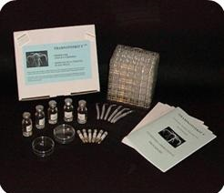
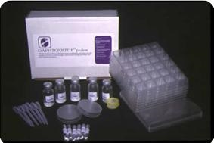
Bioassay development
old bioassays – acute, ecologically irrelevant, testing pure chemicals, pesticides
new bioassays – sublethal endpoints, ecological relevancy, chemical mixtures, miniaturization, simple to measure endpoints

Slide 17

Mikrobiotests
they use some dormant stages of testing organisms
practical = everything in one box
cheap and easy, however, often not very relevant for real situations
http://ebpi.ca/index.php?option=com_content&view=article&id=20&Itemid=50

Slide 18
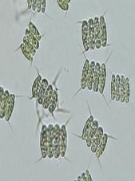
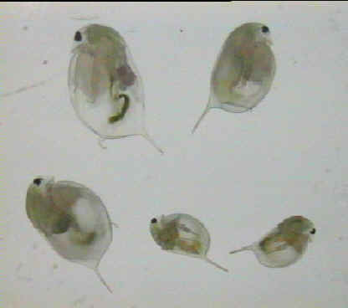
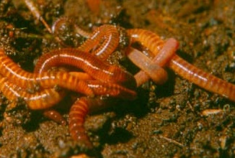

Differenciation of bioassays
According to the trophic level of test organisms:
  tests with producers, consumers, destruents
Depending on the duration of exposure and the nature of the effects:
  acute, semiacute (semichronic), sub-acute, chronic
    the specific length depends on the generation time of the organism (bacteria <<< trout), the classification is not completely uniform; Division usually into:
      acute = 24, 48 to 96 hours, usually assessment of lethality
      chronic - days, weeks to months, evaluation of non-lethal effects
According to the number of species involved:
  single species, two species, multi-species

Slide 19
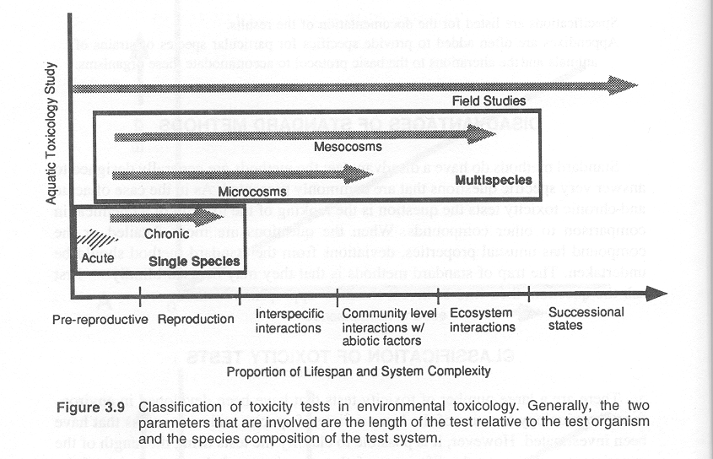
Differenciation of bioassays
According to the level of the biological system (and complexity):
  enzymes, bioprobes, in vitro cell and tissue cultures, intact living organism, population, micro / mesocosm, field experiments

Slide 20
Differenciation of bioassays
According to the type of sample:
  chemical substance, mixture of substances, natural sample from the environment
According to the tested matrix:
  water, soil, air, sediment, waste, chemical
According to the sample modification:
  leachate (organic solvent, DMSO, water…), contact (Solid Phase Tests), direct (Direct tests, Whole effluent test), TIE - toxicity identification evaluation
According to the evaluated effect:
  mortality tests, reproduction tests, escape tests, growth tests, teratogenicity tests, carcinogenicity, xenoestrogenicity, etc.
According to implementation:
  in situ and in vitro
+ process bioassays: bioaccumulation, bioconcentration, biodegration

Slide 21
Ekological relevance of the bioassays
the tested species should represent the relevant functional group
the test should respect the ecology of the organism
monitored responses should be ecologically relevant and indicate the state and function of the organism (survival, growth, reproduction, food intake and mobility)
when monitoring reproduction, the exposure should cover most of the life cycle
abiotic and biotic factors in the test should be similar to those in the habitat
exposure paths should mimic real exposures
the bioavailability of the contaminant should be similar to that in reality
concentrations should be environmentally realistic

Slide 22
Ekological relevance of test species
play a key role in the functioning of the ecosystem
they occur in a number of ecosystems in higher abundance
easy to use in field and laboratory conditions
they come into contact with pollutants
they are sensitive enough to stress
The problem of ecotoxicology in general:
I will use organisms A in the tests (for a number of reasons), but the target organisms in the system are B → what is the relationship of the results for A and B?
Example: Eisenia fetida - the most famous soil test

Slide 23
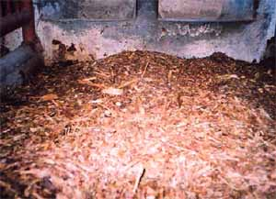
Earthworm species

Slide 24
Differenciation of bioassays
limit test / comparison test
concentration – response tests – preliminary, final

Slide 25
Standard-ability, legislation …
Law given tests
  Very little, especially for new chemicals, pesticides, waste
  The big boom in the use of bioassays in recent years - ecological criteria for environmental quality
Standardized, standardized
  Many tests
  Standardization ≠ duty, binding
  Economic reasons - accreditation of laboratories
Experimental
  A series of tests
  Space for efforts to achieve ecological realism
  Application of new knowledge about mechanisms and effects
  Ecological studies

Slide 26
Norms, standards, guidelines
Objective: to reduce interlaboratory variability
Over time, standard procedures have been developed for evaluating effects in laboratory tests up to in situ bioindication methods
Advantages:
  guaranteeing uniformity and repeatability of results
  comparability of results from different laboratories following the procedure
  validated results suitable for decision making
  little need for optimization
Disadvantages:
  very specific and limited informative value ("acute lethality for Daphnia crustaceans")
  usually suitable only for classification of substances (more - moderately - less toxic ...)
  limited number of standardized procedures, usually simple (acute) effects
  difficult to apply to other situations or to answer other questions
  only on a few model species - the question of transferability of results
  used in inappropriate situations (research, evaluation of cause and effect)
  it may not be applicable to a real environment

Slide 27

OECD guidelines – water 1
Test No. 201: Freshwater Alga and Cyanobacteria, Growth Inhibition Test | 2011
Test No. 221: Lemna sp. Growth Inhibition Test | 2006
Test No. 238: Sediment-Free Myriophyllum Spicatum Toxicity Test | 2014
Test No. 239: Water-Sediment Myriophyllum Spicatum Toxicity Test | 2014
Test No. 202: Daphnia sp. Acute Immobilisation Test | 2004
Test No. 211: Daphnia magna Reproduction Test | 2012
Test No. 231: Amphibian Metamorphosis Assay | 2009
Test No. 242: Potamopyrgus antipodarum Reproduction Test | 2016
Test No. 243: Lymnaea stagnalis Reproduction Test | 2016
Test No. 235: Chironomus sp., Acute Immobilisation Test | 2011
Test No. 218: Sediment-Water Chironomid Toxicity Using Spiked Sediment | 2004
Test No. 219: Sediment-Water Chironomid Toxicity Using Spiked Water | 2004
Test No. 233: Sediment-Water Chironomid Life-Cycle Toxicity Test Using Spiked Water or Spiked Sediment | 2010
Test No. 225: Sediment-Water Lumbriculus Toxicity Test Using Spiked Sediment | 2007
Test No. 224: Determination of the Inhibition of the Activity of Anaerobic Bacteria | 2007
Test No. 209: Activated Sludge, Respiration Inhibition Test (Carbon and Ammonium Oxidation) | 2010
Test No. 244: Protozoan Activated Sludge Inhibition Test | 2017
https://www.oecd-ilibrary.org/environment/oecd-guidelines-for-the-testing-of-chemicals-section-2-effects-on-biotic-systems_20745761

Slide 28
OECD guidelines – water 2
Test No. 210: Fish, Early-life Stage Toxicity Test | 2013
Test No. 212: Fish, Short-term Toxicity Test on Embryo and Sac-Fry Stages | 1998
Test No. 215: Fish, Juvenile Growth Test | 2000
Test No. 234: Fish Sexual Development Test | 2011
Test No. 236: Fish Embryo Acute Toxicity (FET) Test | 2013
Test No. 203: Fish, Acute Toxicity Test | 2019
Test No. 229: Fish Short Term Reproduction Assay | 2012
Test No. 204: Fish, Prolonged Toxicity Test: 14-Day Study | 1984
Test No. 230: 21-day Fish Assay | 2009
Test No. 240: Medaka Extended One Generation Reproduction Test (MEOGRT) | 2015
Test No. 241: The Larval Amphibian Growth and Development Assay (LAGDA) | 2015
Test No. 248: Xenopus Eleutheroembryonic Thyroid Assay (XETA) | 2019
https://www.oecd-ilibrary.org/environment/oecd-guidelines-for-the-testing-of-chemicals-section-2-effects-on-biotic-systems_20745761

Slide 29
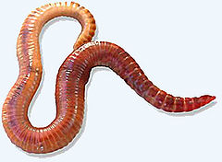
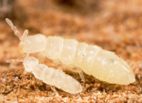
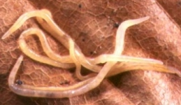
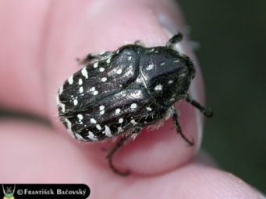
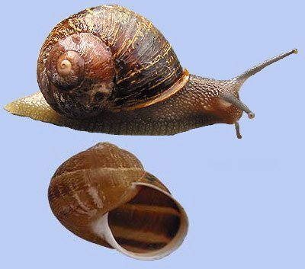
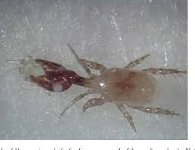
OECD guidelines - soil
Test No. 216: Soil Microorganisms: Nitrogen Transformation Test | 2000
Test No. 217: Soil Microorganisms: Carbon Transformation Test | 2000
Test No. 207: Earthworm, Acute Toxicity Tests | 1984
Test No. 222: Earthworm Reproduction Test (Eisenia fetida/Eisenia andrei) | 2016
Test No. 232: Collembolan Reproduction Test in Soil | 2016
Test No. 220: Enchytraeid Reproduction Test | 2016
Test No. 226: Predatory mite (Hypoaspis (Geolaelaps) aculeifer) reproduction test in soil | 2016
Test No. 228: Determination of Developmental Toxicity to Dipteran Dung Flies(Scathophaga stercoraria L. (Scathophagidae), Musca autumnalis De Geer (Muscidae)) | 2016
Test No. 208: Terrestrial Plant Test: Seedling Emergence and Seedling Growth Test | 2006
Test No. 227: Terrestrial Plant Test: Vegetative Vigour Test | 2006
https://www.oecd-ilibrary.org/environment/oecd-guidelines-for-the-testing-of-chemicals-section-2-effects-on-biotic-systems_20745761

Slide 30
OECD guidelines - other
Test No. 237: Honey Bee (Apis Mellifera) Larval Toxicity Test, Single Exposure | 2013
Test No. 213: Honeybees, Acute Oral Toxicity Test | 1998
Test No. 214: Honeybees, Acute Contact Toxicity Test | 1998
Test No. 245: Honey Bee (Apis Mellifera L.), Chronic Oral Toxicity Test (10-Day Feeding) | 2017
Test No. 246: Bumblebee, Acute Contact Toxicity Test | 2017
Test No. 247: Bumblebee, Acute Oral Toxicity Test | 2017
Test No. 228: Determination of Developmental Toxicity to Dipteran Dung Flies(Scathophaga stercoraria L. (Scathophagidae), Musca autumnalis De Geer (Muscidae)) | 2016
Test No. 223: Avian Acute Oral Toxicity Test | 2016
Test No. 205: Avian Dietary Toxicity Test | 1984
Test No. 206: Avian Reproduction Test | 1984
https://www.oecd-ilibrary.org/environment/oecd-guidelines-for-the-testing-of-chemicals-section-2-effects-on-biotic-systems_20745761

Slide 31

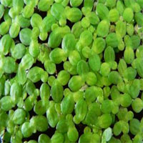
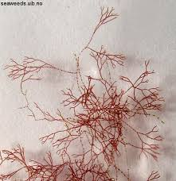
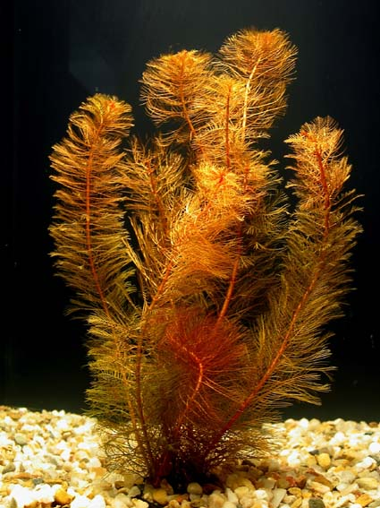
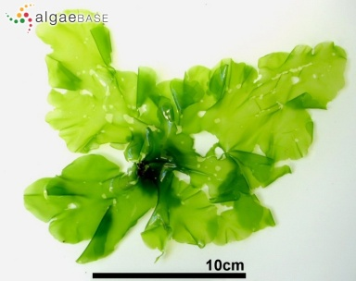
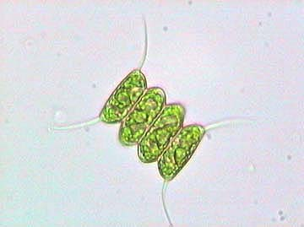
ISO standards – aquatic plants
ISO 8692:2012 | Water quality — Fresh water algal growth inhibition test with unicellular green algae
ISO 14442:2006 | Water quality — Guidelines for algal growth inhibition tests with poorly soluble materials, volatile compounds, metals and waste water
ISO 20079:2005 | Water quality — Determination of the toxic effect of water constituents and waste water on duckweed (Lemna minor) — Duckweed growth inhibition test
ISO 20227:2017 | Water quality — Determination of the growth inhibition effects of waste waters, natural waters and chemicals on the duckweed Spirodela polyrhiza — Method using a stock culture independent microbiotest
ISO 16191:2013 | Water quality — Determination of the toxic effect of sediment on the growth behaviour of Myriophyllum aquaticum
ISO 10253:2016 | Water quality — Marine algal growth inhibition test with Skeletonema sp. and Phaeodactylum tricornutum
ISO 10710:2010 | Water quality — Growth inhibition test with the marine and brackish water macroalga Ceramium tenuicorne

Slide 32
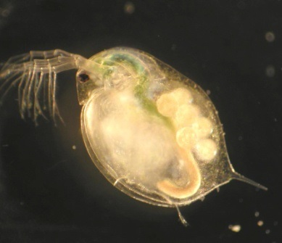
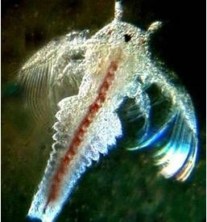
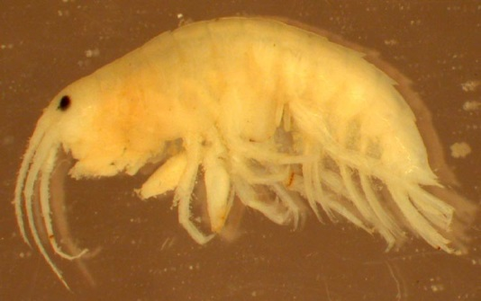
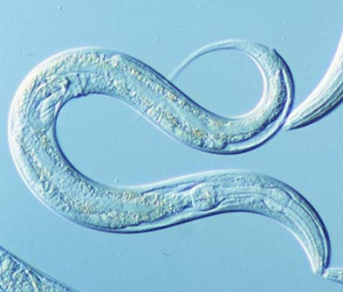
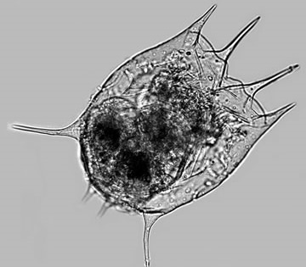
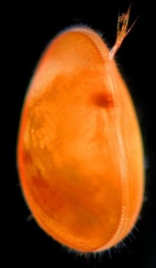
ISO standards – aquatic invertebrates
ISO 6341:2012 | Water quality — Determination of the inhibition of the mobility of Daphnia magna Straus (Cladocera, Crustacea) — Acute toxicity test
ISO 10706:2000 | Water quality — Determination of long term toxicity of substances to Daphnia magna Straus (Cladocera, Crustacea)
ISO 10872:2020 | Water and soil quality — Determination of the toxic effect of sediment and soil samples on growth, fertility and reproduction of Caenorhabditis elegans (Nematoda)
ISO 14371:2012 | Water quality — Determination of fresh water sediment toxicity to Heterocypris incongruens (Crustacea, Ostracoda)
ISO 14380:2011 | Water quality — Determination of the acute toxicity to Thamnocephalus platyurus (Crustacea, Anostraca)
ISO 14669:1999 | Water quality — Determination of acute lethal toxicity to marine copepods (Copepoda, Crustacea)
ISO 20665:2008 | Water quality — Determination of chronic toxicity to Ceriodaphnia dubia
ISO/TS 18220:2016 | Water quality — Larval development test with the harpacticoid copepod Nitocra spinipes
ISO 16303:2013 | Water quality — Determination of toxicity of fresh water sediments using Hyalella azteca
ISO 16778:2015 | Water quality — Calanoid copepod early-life stage test with Acartia tonsa
ISO 17244:2015 | Water quality — Determination of the toxicity of water samples on the embryo-larval development of Japanese oyster (Crassostrea gigas) and mussel (Mytilus edulis or Mytilus galloprovincialis)
ISO 20666:2008 | Water quality — Determination of the chronic toxicity to Brachionus calyciflorus in 48 h
ISO 19820:2016 | Water quality — Determination of the acute toxicity to the marine rotifer Brachionus plicatilis
ISO 19827:2016 | Water quality — Determination of the acute toxicity to the freshwater rotifer Brachionus calyciflorus

Slide 33
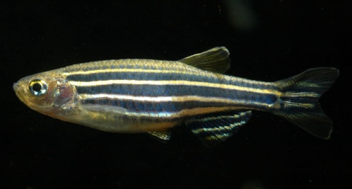
ISO standards – aquatic vertebrates
ISO 7346-1:1996 | Water quality — Determination of the acute lethal toxicity of substances to a freshwater fish [Brachydanio rerio Hamilton-Buchanan (Teleostei, Cyprinidae)] — Part 1: Static method
ISO 7346-2:1996 | Water quality — Determination of the acute lethal toxicity of substances to a freshwater fish [Brachydanio rerio Hamilton-Buchanan (Teleostei, Cyprinidae)] — Part 2: Semi-static method
ISO 7346-3:1996 | Water quality — Determination of the acute lethal toxicity of substances to a freshwater fish [Brachydanio rerio Hamilton-Buchanan (Teleostei, Cyprinidae)] — Part 3: Flow-through method
ISO 12890:1999 | Water quality — Determination of toxicity to embryos and larvae of freshwater fish — Semi-static method
ISO 10229:1994 | Water quality — Determination of the prolonged toxicity of substances to freshwater fish — Method for evaluating the effects of substances on the growth rate of rainbow trout (Oncorhynchus mykiss Walbaum (Teleostei, Salmonidae))
ISO 15088:2007 | Water quality — Determination of the acute toxicity of waste water to zebrafish eggs (Danio rerio)
ISO 23893-1:2007 | Water quality — Biochemical and physiological measurements on fish — Part 1: Sampling of fish, handling and preservation of samples
ISO/TS 23893-2:2007 | Water quality — Biochemical and physiological measurements on fish — Part 2: Determination of ethoxyresorufin-O-deethylase (EROD)
ISO 23893-3:2013 | Water quality — Biochemical and physiological measurements on fish — Part 3: Determination of vitellogenin
ISO 21115:2019 | Water quality — Determination of acute toxicity of water samples and chemicals to a fish gill cell line (RTgill-W1)

Slide 34
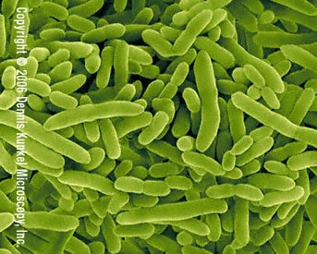
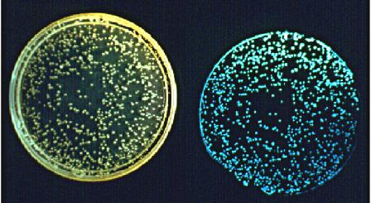
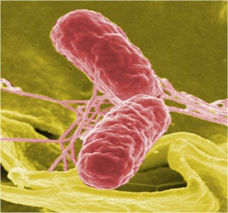

ISO standards – aquatic microorganisms
ISO 11348-1:2007/Amd 1:2018 | Water quality — Determination of the inhibitory effect of water samples on the light emission of Vibrio fischeri (Luminescent bacteria test) — Part 1: Method using freshly prepared bacteria — Amendment 1
ISO 11348-2:2007/Amd 1:2018 | Water quality — Determination of the inhibitory effect of water samples on the light emission of Vibrio fischeri (Luminescent bacteria test) — Part 2: Method using liquid-dried bacteria — Amendment 1
ISO 11348-3:2007/Amd 1:2018 | Water quality — Determination of the inhibitory effect of water samples on the light emission of Vibrio fischeri (Luminescent bacteria test) — Part 3: Method using freeze-dried bacteria — Amendment 1
ISO 10712:1995 | Water quality — Pseudomonas putida growth inhibition test (Pseudomonas cell multiplication inhibition test)
ISO 15522:1999 | Water quality — Determination of the inhibitory effect of water constituents on the growth of activated sludge microorganisms
ISO 11350:2012 | Water quality — Determination of the genotoxicity of water and waste water — Salmonella/microsome fluctuation test (Ames fluctuation test)
ISO 16240:2005 | Water quality — Determination of the genotoxicity of water and waste water — Salmonella/microsome test (Ames test)
ISO 13829:2000 | Water quality — Determination of the genotoxicity of water and waste water using the umu-test
ISO 13641-1:2003 | Water quality — Determination of inhibition of gas production of anaerobic bacteria — Part 1: General test
ISO 13641-2:2003 | Water quality — Determination of inhibition of gas production of anaerobic bacteria — Part 2: Test for low biomass concentrations
ISO 8192:2007 | Water quality — Test for inhibition of oxygen consumption by activated sludge for carbonaceous and ammonium oxidation
ISO 9509:2006 | Water quality — Toxicity test for assessing the inhibition of nitrification of activated sludge microorganisms

Slide 35
ISO standards – in vitro tests
ISO 19040-1:2018 | Water quality — Determination of the estrogenic potential of water and waste water — Part 1: Yeast estrogen screen (Saccharomyces cerevisiae)
ISO 19040-2:2018 | Water quality — Determination of the estrogenic potential of water and waste water — Part 2: Yeast estrogen screen (A-YES, Arxula adeninivorans)
ISO 19040-3:2018 | Water quality — Determination of the estrogenic potential of water and waste water — Part 3: In vitro human cell-based reporter gene assay
ISO 21427-1:2006 | Water quality — Evaluation of genotoxicity by measurement of the induction of micronuclei — Part 1: Evaluation of genotoxicity using amphibian larvae
ISO 21427-2:2006/Cor 1:2009 | Water quality — Evaluation of genotoxicity by measurement of the induction of micronuclei — Part 2: Mixed population method using the cell line V79 — Technical Corrigendum 1
ISO/CD 24295 | Water quality — Determination of the dioxin-like potential of water and wastewater — Method using in vitro mammalian cell-based reporter gene assay

Slide 36
ISO standards – biodegradation
ISO 11733:2004 | Water quality — Determination of the elimination and biodegradability of organic compounds in an aqueous medium — Activated sludge simulation test
ISO 10707:1994 | Water quality — Evaluation in an aqueous medium of the "ultimate" aerobic biodegradability of organic compounds — Method by analysis of biochemical oxygen demand (closed bottle test)
ISO 7827:2010 | Water quality — Evaluation of the "ready", "ultimate" aerobic biodegradability of organic compounds in an aqueous medium — Method by analysis of dissolved organic carbon (DOC)
ISO 10708:1997 | Water quality — Evaluation in an aqueous medium of the ultimate aerobic biodegradability of organic compounds — Determination of biochemical oxygen demand in a two-phase closed bottle test
ISO 11734:1995 | Water quality — Evaluation of the "ultimate" anaerobic biodegradability of organic compounds in digested sludge — Method by measurement of the biogas production
ISO 14592-1:2002 | Water quality — Evaluation of the aerobic biodegradability of organic compounds at low concentrations — Part 1: Shake-flask batch test with surface water or surface water/sediment suspensions
ISO 14592-2:2002 | Water quality — Evaluation of the aerobic biodegradability of organic compounds at low concentrations — Part 2: Continuous flow river model with attached biomass
ISO 14593:1999 | Water quality — Evaluation of ultimate aerobic biodegradability of organic compounds in aqueous medium — Method by analysis of inorganic carbon in sealed vessels (CO2 headspace test)
ISO 16221:2001 | Water quality — Guidance for determination of biodegradability in the marine environment
ISO 9408:1999 | Water quality — Evaluation of ultimate aerobic biodegradability of organic compounds in aqueous medium by determination of oxygen demand in a closed respirometer
ISO 9439:1999 | Water quality — Evaluation of ultimate aerobic biodegradability of organic compounds in aqueous medium — Carbon dioxide evolution test
ISO 9887:1992 | Water quality — Evaluation of the aerobic biodegradability of organic compounds in an aqueous medium — Semi-continuous activated sludge method (SCAS)
ISO 9888:1999 | Water quality — Evaluation of ultimate aerobic biodegradability of organic compounds in aqueous medium — Static test (Zahn-Wellens method)

Slide 37
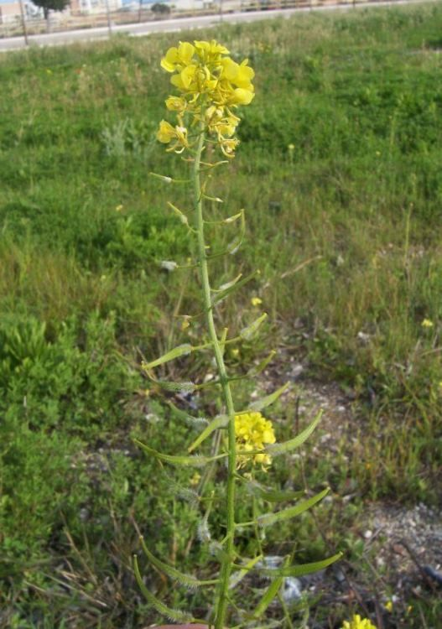
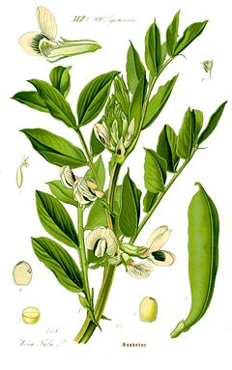
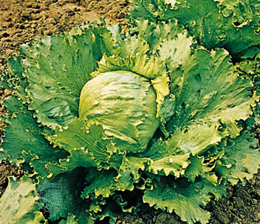
ISO standards – terrestrial plants
ISO 11269-1:2012 | Soil quality — Determination of the effects of pollutants on soil flora — Part 1: Method for the measurement of inhibition of root growth
ISO 11269-2:2012 | Soil quality — Determination of the effects of pollutants on soil flora — Part 2: Effects of contaminated soil on the emergence and early growth of higher plants
ISO 17126:2005 | Soil quality — Determination of the effects of pollutants on soil flora — Screening test for emergence of lettuce seedlings (Lactuca sativa L.)
ISO 18763:2016 | Soil quality — Determination of the toxic effects of pollutants on germination and early growth of higher plants
ISO 22030:2005 | Soil quality — Biological methods — Chronic toxicity in higher plants
ISO 29200:2013 | Soil quality — Assessment of genotoxic effects on higher plants — Vicia faba micronucleus test
ISO 21479:2019 | Soil quality — Determination of the effects of pollutants on soil flora — Leaf fatty acid composition of plants used to assess soil quality

Slide 38
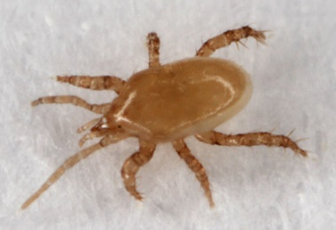
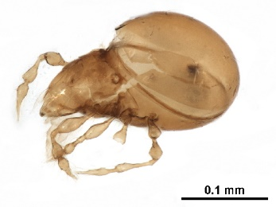


ISO standards – soil invertebrates
ISO 11268-1:2012 | Soil quality — Effects of pollutants on earthworms — Part 1: Determination of acute toxicity to Eisenia fetida/Eisenia andrei
ISO 11268-2:2012 | Soil quality — Effects of pollutants on earthworms — Part 2: Determination of effects on reproduction of Eisenia fetida/Eisenia andrei
ISO 11268-3:2014 | Soil quality — Effects of pollutants on earthworms — Part 3: Guidance on the determination of effects in field situations
ISO 11267:2014 | Soil quality — Inhibition of reproduction of Collembola (Folsomia candida) by soil contaminants
ISO 16387:2014 | Soil quality — Effects of contaminants on Enchytraeidae (Enchytraeus sp.) — Determination of effects on reproduction
ISO 21285:2019 | Soil quality — Inhibition of reproduction of the soil mite (Hypoaspis aculeifer) by soil contaminants
ISO 23266:2020 | Soil quality — Test for measuring the inhibition of reproduction in oribatid mites (Oppia nitens) exposed to contaminants in soil
ISO 15952:2018 | Soil quality — Effects of pollutants on juvenile land snails (Helicidae) — Determination of the effects on growth by soil contamination
ISO 17512-1:2008 | Soil quality — Avoidance test for determining the quality of soils and effects of chemicals on behaviour — Part 1: Test with earthworms (Eisenia fetida and E. andrei)
ISO 17512-2:2011 | Soil quality — Avoidance test for determining the quality of soils and effects of chemicals on behaviour — Part 2: Test with collembolans (Folsomia candida)
ISO 20963:2005 | Soil quality — Effects of pollutants on insect larvae (Oxythyrea funesta) — Determination of acute toxicity
ISO 18311:2016 | Soil quality — Method for testing effects of soil contaminants on the feeding activity of soil dwelling organisms — Bait-lamina test
ISO/DIS 24032 | Soil quality — In situ caging of snails to assess bioaccumulation of contaminants
ISO 23611-1:2018 | Soil quality — Sampling of soil invertebrates — Part 1: Hand-sorting and extraction of earthworms
ISO 23611-2:2006 | Soil quality — Sampling of soil invertebrates — Part 2: Sampling and extraction of micro-arthropods (Collembola and Acarina)
ISO 23611-3:2019 | Soil quality — Sampling of soil invertebrates — Part 3: Sampling and extraction of enchytraeids
ISO 23611-4:2007 | Soil quality — Sampling of soil invertebrates — Part 4: Sampling, extraction and identification of soil-inhabiting nematodes
ISO 23611-5:2011 | Soil quality — Sampling of soil invertebrates — Part 5: Sampling and extraction of soil macro-invertebrates
ISO 23611-6:2012 | Soil quality — Sampling of soil invertebrates — Part 6: Guidance for the design of sampling programmes with soil invertebrates

Slide 39
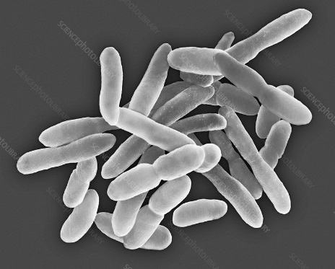
ISO standards – soil microorganisms
ISO 14238:2012 | Soil quality — Biological methods — Determination of nitrogen mineralization and nitrification in soils and the influence of chemicals on these processes
ISO 15685:2012 | Soil quality — Determination of potential nitrification and inhibition of nitrification — Rapid test by ammonium oxidation
ISO 18187:2016 | Soil quality — Contact test for solid samples using the dehydrogenase activity of Arthrobacter globiformis
ISO 17155:2012 | Soil quality — Determination of abundance and activity of soil microflora using respiration curves
ISO/TS 10832:2009 | Soil quality — Effects of pollutants on mycorrhizal fungi — Spore germination test
ISO/CD 23265 | Soil quality — Test for estimating organic matter decomposition in contaminated soil
ISO 16072:2002 | Soil quality — Laboratory methods for determination of microbial soil respiration
ISO 14240-1:1997 | Soil quality — Determination of soil microbial biomass — Part 1: Substrate-induced respiration method
ISO 14240-2:1997 | Soil quality — Determination of soil microbial biomass — Part 2: Fumigation-extraction method
ISO 23753-1:2019 | Soil quality — Determination of dehydrogenases activity in soils — Part 1: Method using triphenyltetrazolium chloride (TTC)
ISO 23753-2:2019 | Soil quality — Determination of dehydrogenases activity in soils — Part 2: Method using iodotetrazolium chloride (INT)
ISO/TS 29843-1:2010 | Soil quality — Determination of soil microbial diversity — Part 1: Method by phospholipid fatty acid analysis (PLFA) and phospholipid ether lipids (PLEL) analysis
ISO/TS 29843-2:2011 | Soil quality — Determination of soil microbial diversity — Part 2: Method by phospholipid fatty acid analysis (PLFA) using the simple PLFA extraction method
ISO 11063:2020 | Soil quality — Direct extraction of soil DNA
ISO 17601:2016 | Soil quality — Estimation of abundance of selected microbial gene sequences by quantitative PCR from DNA directly extracted from soil
ISO 20130:2018 | Soil quality — Measurement of enzyme activity patterns in soil samples using colorimetric substrates in micro-well plates
ISO/TS 20131-1:2018 | Soil quality — Easy laboratory assessments of soil denitrification, a process source of N2O emissions — Part 1: Soil denitrifying enzymes activities
ISO/TS 20131-2:2018 | Soil quality — Easy laboratory assessments of soil denitrification, a process source of N2O emissions — Part 2: Assessment of the capacity of soils to reduce N2O
ISO 11266:1994 | Soil quality — Guidance on laboratory testing for biodegradation of organic chemicals in soil under aerobic conditions
ISO 15473:2002 | Soil quality — Guidance on laboratory testing for biodegradation of organic chemicals in soil under anaerobic conditions
ISO 14239:2017 | Soil quality — Laboratory incubation systems for measuring the mineralization of organic chemicals in soil under aerobic conditions

Slide 40

US EPA - US Environmental Protection Agency
OPPTS - Office of Prevention, Pesticides & Toxic Substances
Group A - Aquatic and Sediment-dwelling Fauna and Aquatic Microcosms
850.1010 - Aquatic Invertebrate Acute Toxicity Test, Freshwater Daphnids (December 2016)
850.1300 - Daphnid Chronic Toxicity Test (December 2016)
850.1020 - Gammarid Amphipod Acute Toxicity Test (December 2016)
850.1025 - Oyster Acute Toxicity Test (Shell Deposition) (December 2016)
850.1035 - Mysid Acute Toxicity Test (December 2016)
850.1045 - Penaeid Acute Toxicity Test (December 2016)
850.1055 - Bivalve Acute Toxicity Test (Embryo-Larval) (December 2016)
850.1710 - Oyster Bioconcentration Factor (BCF) (December 2016)
850.1075 - Freshwater and Saltwater Fish Acute Toxicity Test (December 2016)
850.1400 - Fish Early Life Stage Toxicity Test (December 2016)
850.1730 - Fish Bioconcentration Factor (BCF) (December 2016)
850.1735 - Spiked Whole Sediment 10-Day Toxicity Test , Freshwater Invertebrates (December 2016)
850.1740 - Spiked Whole Sediment 10-Day Toxicity Test, Saltwater Invertebrates (December 2016)
https://www.epa.gov/test-guidelines-pesticides-and-toxic-substances/series-850-ecological-effects-test-guidelines

Slide 41
US EPA - US Environmental Protection Agency
OPPTS - Office of Prevention, Pesticides & Toxic Substances
Group B – Terrestrial Wildlife
850.2100 - Avian Acute Oral Toxicity Test (June 2012)
850.2200 - Avian Dietary Toxicity Test (June 2012)
850.2300 - Avian Reproduction Test (June 2012)
850.2400 - Wild Mammal Toxicity Testing (June 2012)
850.2500 - Field Testing for Terrestrial Wildlife (June 2012)
https://www.epa.gov/test-guidelines-pesticides-and-toxic-substances/series-850-ecological-effects-test-guidelines

Slide 42
US EPA - US Environmental Protection Agency
OPPTS - Office of Prevention, Pesticides & Toxic Substances
Group C – Terrestrial Beneficial Insects, Invertebrates, and Soil and Wastewater Microorganisms
850.3020 - Honey Bee Acute Contact Toxicity Test (June 2012)
850.3030 - Honey Bee Toxicity of Residues on Foliage (June 2012)
850.3040 - Field Testing for Pollinators (June 2012)
850.3100 - Earthworm Subchronic Toxicity Test (June 2012)
850.3200 - Soil Microbial Community Toxicity Test (June 2012)
850.3300 - Modified Activated Sludge, Respiration Inhibition Test (June 2012)
https://www.epa.gov/test-guidelines-pesticides-and-toxic-substances/series-850-ecological-effects-test-guidelines

Slide 43
US EPA - US Environmental Protection Agency
OPPTS - Office of Prevention, Pesticides & Toxic Substances
Group D – Terrestrial and Aquatic Plants, Cyanobacteria, and Terrestrial Soil Core Microcosm
850.4230 - Early Seedling Growth Toxicity Test (June 2012)
850.4100 - Seedling Emergence and Seedling Growth (June 2012)
850.4150 - Vegetative Vigor (June 2012)
850.4800 - Plant Uptake and Translocation Test (June 2012)
850.4300 - Terrestrial Plants Field Study (June 2012)
850.4500 - Algal Toxicity (June 2012)
850.4550 - Cyanobacteria (Anabaena flos-aquae) Toxicity (June 2012)
850.4400 - Aquatic Plant Toxicity Test Using Lemna spp. (June 2012)
850.4450 - Aquatic Plants Field Study (June 2012)
850.4600 - Rhizobium-Legume Toxicity (June 2012)
850.4900 - Terrestrial Soil-Core Microcosm Test (June 2012)
https://www.epa.gov/test-guidelines-pesticides-and-toxic-substances/series-850-ecological-effects-test-guidelines

