Slide 1
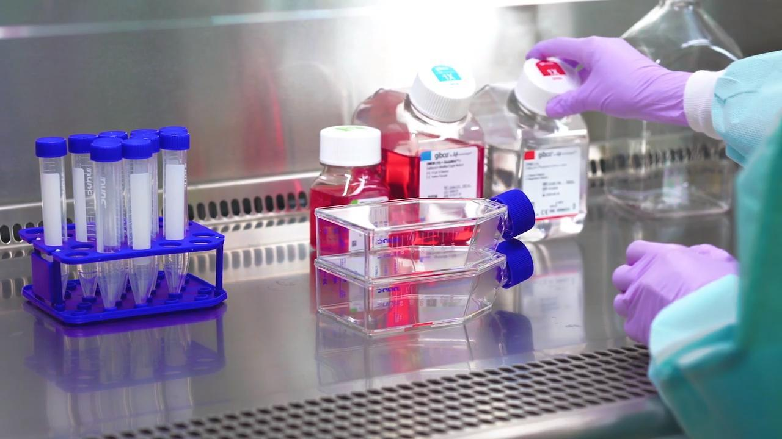
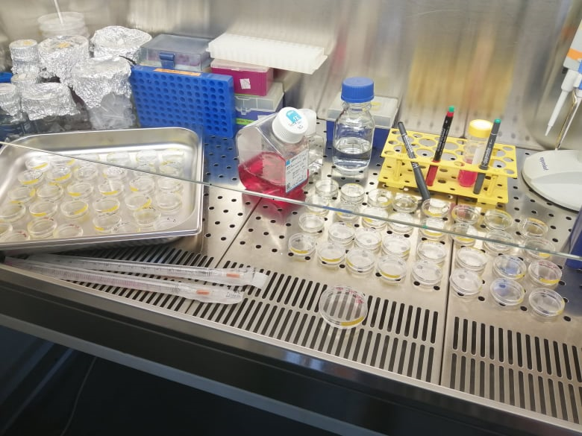
Kultivace buněk
Velmi důkladný postup: https://www.youtube.com/watch?v=nr1tV_LuqJk
Rozmrazení buněk a rychlá pasáž
https://www.youtube.com/watch?v=7d_kDu-P964

Slide 2
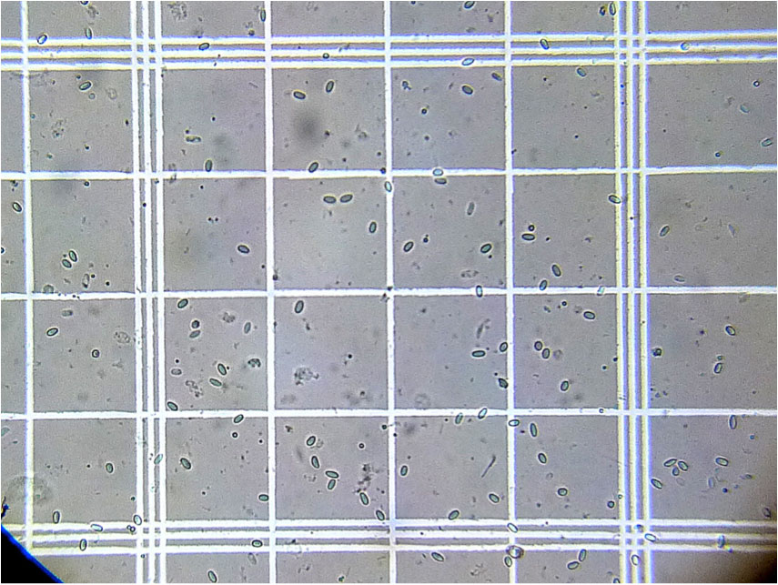
Výpočet:
bb/ul = Σ buněk x 250
počet čtverců
1/5 mm
Koeficient 250
1 x 1 x 1 = 1 = 0,004 mm³
5 5 10 250
0,004x250 = 1 ul

Slide 3
30 w po 0,1 ml = 3 ml
50x10*3 na jamku
1,5 x10*6 buněk celkem
2x10*6……. 1ml
1,5x10*6… 0,75ml

Slide 4
Western blotting
Sestavení gelů (naše aparatura)
Naše aparatura https://www.youtube.com/watch?v=EDi_n_0NiF4
Sestavení gelů (modrá aparatura) https://www.youtube.com/watch?v=hY3PnKrRh5k
Sestavení gelů (stojánek co se v nem rovnou jede) (https://www.youtube.com/watch?v=hY3PnKrRh5k)
Multicasking https://www.youtube.com/watch?v=0S_LSdQbneE
Postup https://www.youtube.com/watch?v=uFu8aie4QFI
Novinka: https://www.youtube.com/watch?v=pn7opcdXHq0

Slide 5
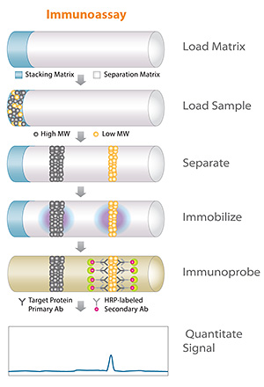
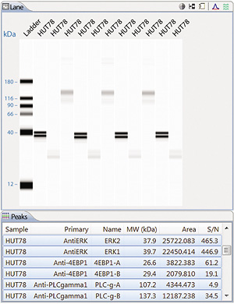
Protein simple https://www.proteinsimple.com/simple_western_overview.html https://www.youtube.com/watch?v=gil1vWU_6Vw
Interested in looking at all the proteins in your lysate? Just leave out the antibody and let Jess, Wes, Peggy Sue or Sally Sue do the work for you to add western blotting results of total protein in your sample. Target proteins separated by size are labeled with a biotin reagent and are detected by chemiluminescence using Streptavidin-HRP. At the end of the run, you've got relative quantitation for your protein of interest and total protein measurements of the sample.
What does Simple Western size data look like? Simple Western size-based assay data is processed automatically for you in Compass software. Sample data is displayed by lane in a virtual-blot like image similar to traditional western blot results with one big exception—not only do you get more information, you get it as soon as the assay is complete. Quantitative results such as molecular weight, signal intensity (area), % area, and signal-to-noise for each immunodetected protein are presented in the results table automatically.
Just need total protein? We've got that covered too!

Slide 6
Lyzační pufry
Radioimmunoprecipitation assay buffer SDS lyzate buffer
Kvantifikace Koncovka
10% 2-ME
BB
10-50 mM Tris-HCl, pH 7–8
150 mM NaCl
1% Triton X-100
0.1-0.5% deoxycholate,
0.1-0.5% SDS
100 mM TRIS pH 7,4
10% SDS
10% glycerol
Proteázový inhibitor
Fosfatázový inhibitor
Laemmli buffer
Reagent | Molecular weight | Concentration (M or %) |  |  | Add for 50 ml of 2X | Add for 50 ml of 4X
 |  | 1X | 2X | 4X
Tris base¹ | 121.14 | 0.0625 M | 0.125 M | 0.250 M | 0.747 g | 1.514 g
SDS² | 288.37 | 0.07 M (2%) | 0.14 M (4%) | 0.28 M (8%) | 2 g | 4 g
glycerol | 92.09 | 10% | 20% | 40% | 10 ml | 20 ml
2-mercapto-ethanol | 78.13 | 5% | 10% | 20% | 5 ml | 10 ml
Bromphenol blue³ | 691.94 | - | - | - | 100 mg | 200 mg

Slide 7
Další pufry nutné pro WB

Slide 8
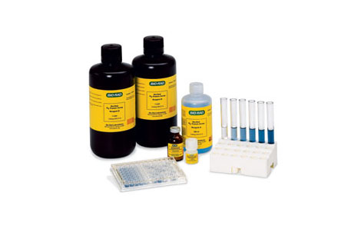
Kvantifikace proteinů
BioRad DC protein assay
  Založeno na Lowryho metodě – princip pomědění proteinů, redukce Folinova reagens
  5 ul standardů a vzorků
  20 ul A+S
  200 ul B
  Inkubace 10´/RT
  Měření absorbance při 700 nm

