Slide 1
Bi9393 Analytická cytometrie
Karel Souček, Ph.D.
Oddělení cytokinetiky
Biofyzikální ústav AVČR, v.v.i
Královopolská 135
612 65 Brno
e-mail: ksoucek@ibp.cz
tel.: 541 517 166
K. Souček Bi9393 Analytická cytometrie

Slide 2
Fluidika
připomenutí

Slide 3

Particle Delivery: Hydrodynamic Focusing
Conventional Instrumentation: Low Flow Rates (12µL/min)
Hydrodynamic core
Narrow particle focus = Narrow distribution
Laser Cross Sectional Area
Count
Intensity
Sample core is ‘pinched’ by fast flowing sheath
Sample volume ratios of 100 – 1000
Large ratios => low sample inputs
Resolution of particle populations
sheath
sheath
Notes:
To really understand what is different and unique about acoustic focusing, one first needs to understand the current most commonly used method for focusing, called hydrodynamic focusing.
In this method, the sample is injected into a stream of sheath fluid where it is completely surrounded by sheath, the sample core is then centered in the sheath fluid where the laser beam will then interact with the particles. Based on principles relating to laminar flow, the sample core remains separate but coaxial within the sheath fluid. The flow of sheath fluid accelerates the particles and restricts them to the center of the sample core. This process is known as hydrodynamic focusing. Where the sample core is narrow, the particles interact with the laser beam optimally and a narrow distribution results as seen in the histogram above.

Slide 4
Particle Delivery: Hydrodynamic Focusing
Conventional Instrumentation: High Flow Rate (60µL/min)
Hydrodynamic core
Broad particle focus = Broad distribution
Count
Laser Cross Sectional Area
Intensity
Increased sample input = increase core size
Particle distributions broadened, CVs increase
Instrument resolution decreased
Historically, low volumetric sample rates used (25 μl/min – 150 μl/min)
sheath
sheath

Slide 5
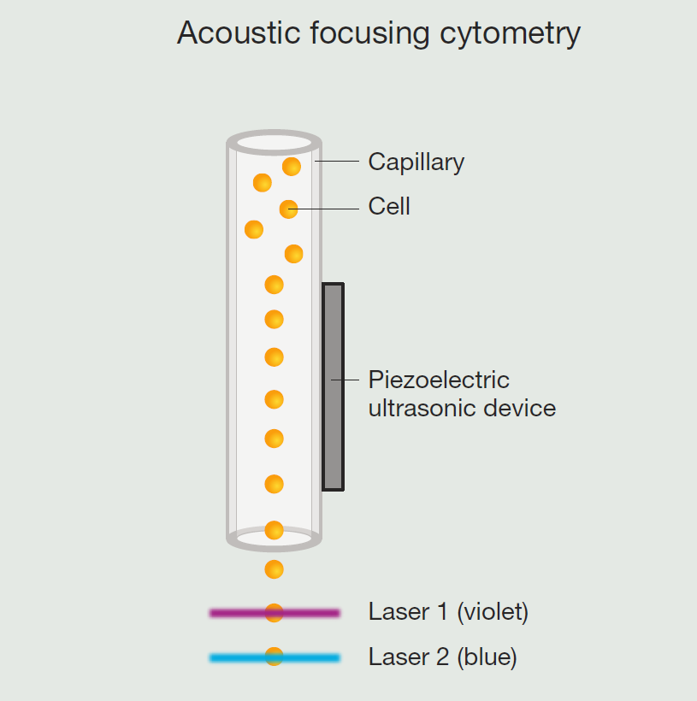
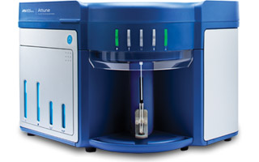
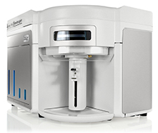
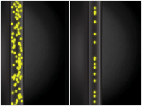
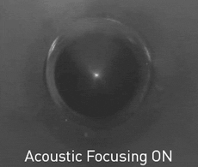

Attune® Acoustic Focusing Cytometer

Slide 6
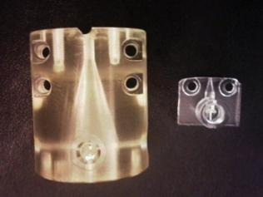
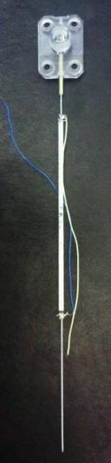
Acoustic Focusing = Better Precision
12 µL/min
Narrow particle focus = Narrow distribution
1000 µL/min
sheath
sheath
Acoustic focusing of particles occurs prior to mixing with sheath fluid
sheath
sheath
Acoustic focusing Module
Notes:
Fundamentals of acoustic focusing in flow cytometry:
Picture in the middle is a comparison of a manifold taken from a traditional hydrodynamic focusing cytometer (left) compared to a manifold taken from the Attune Cytometer and represented “in action” by the cartoons directly to the left and right of the photograph. The picture on the far right shows a full acoustic device as well as the manifold at the top.
Here, regardless of the sample volume that is moved through the flow cell, cells are focused by the acoustic device prior to entering the manifold and, ultimately, the flow cell.
So, at low sample volumes (left) and high sample volumes (right), focus is maintained.
This also means that very little sheath is needed. It is only used to allow for varying the amount of sample while maintaining the correct flow rate; and, is used to prevent reagent from staining the inside of the cuvette.

Slide 7
Principy průtokové cytometrie a sortrování
sorting
zpracování signálu
analýza dat
kompenzace signálu
K. Souček Bi9393 Analytická cytometrie

Slide 8
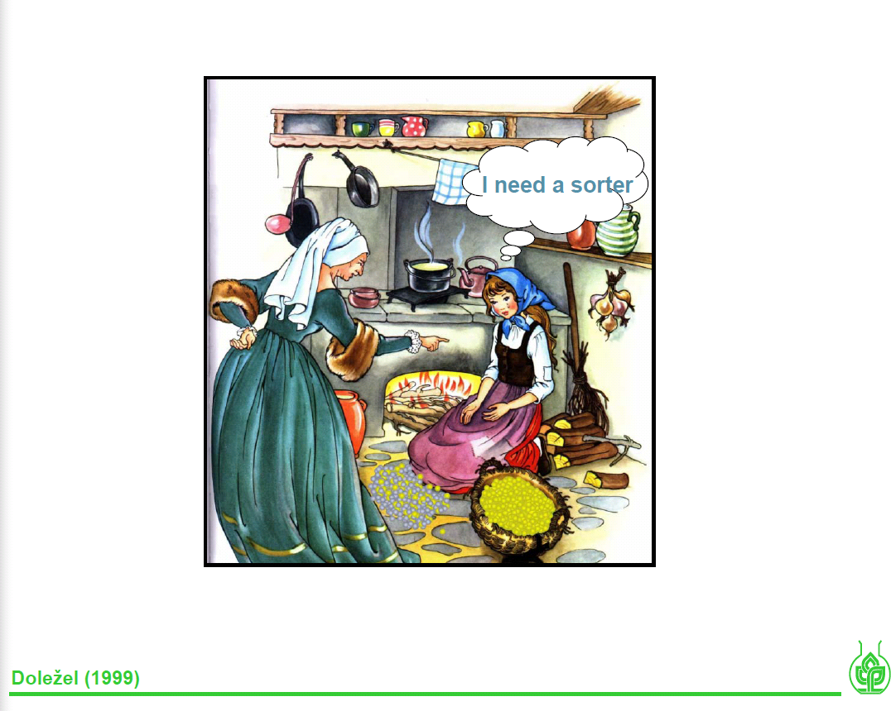

Slide 9
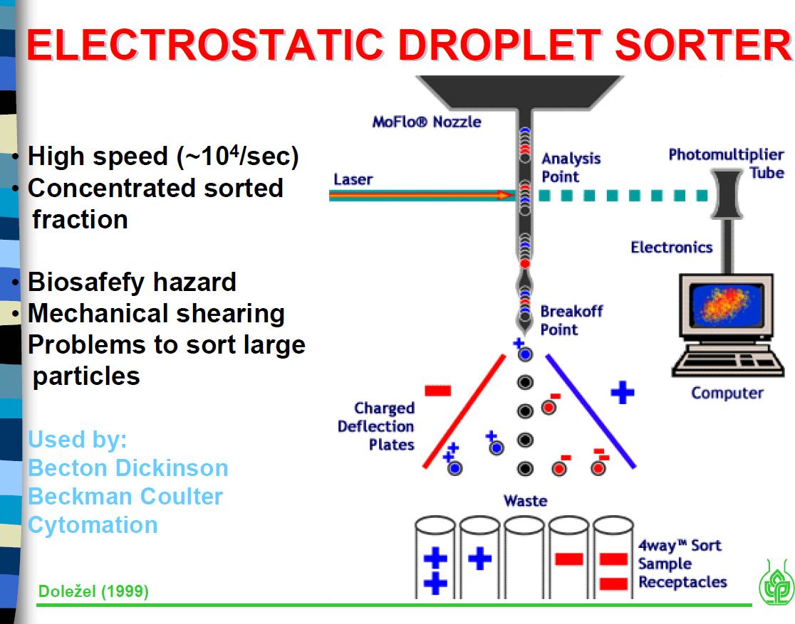

Slide 10


-----
+++++

Slide 11
-----
+++++

Slide 12
-----
+++++

Slide 13
+++++
+++++
-----
+++++

Slide 14
++
++
+++++
+++++
-----
+++++

Slide 15
+
+
+++++
+++++
-----
+++++

Slide 16
-----
+++++
+++++
-----
+++++

Slide 17
-----
-----
-----
+++++
+++++
+++++

Slide 18
- -
- -
- - - - -
- - - - -
-----
+++++

Slide 19
-
-
- - - - -
- - - - -
-----
+++++

Slide 20
-
- - - - -
- - - - -
-----
+++++

Slide 21
-
- - - - -
- - - - -
-----
+++++

Slide 22
-
-----
+++++
- - - - -
- - - - -

Slide 23

http://www.cyto.purdue.edu/cdroms/cyto10a/seminalcontributions/fulwyler.html

Slide 26

SORTING

Slide 27

SORTING
Frequency
Charge
Drop Delay
Amplitude

Slide 28
SORTING
Sheath Pressure
Frequency
Nozzle Size
Amplitude

Slide 29
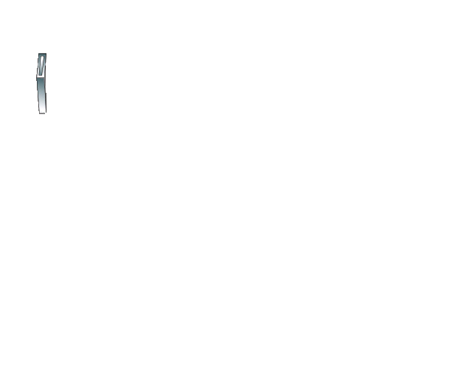
SORTING
Interrogation point
Drop delay
Breakoff

Slide 30
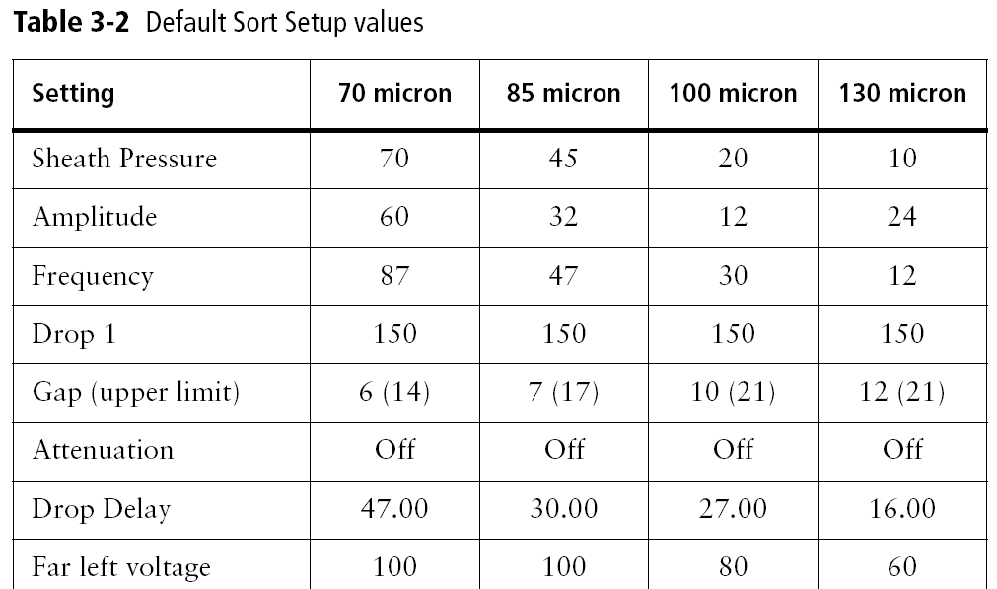
SORTING
Each sort setup includes:
Sheath pressure
Breakoff window values
Side Stream window values
Instrument window > Laser tab values

Slide 31
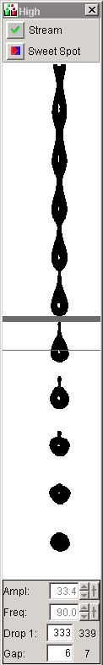
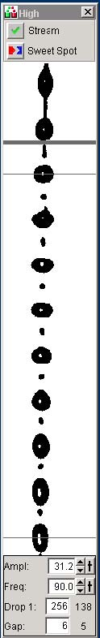
SORTING - Streams
Good
Bad

Slide 32
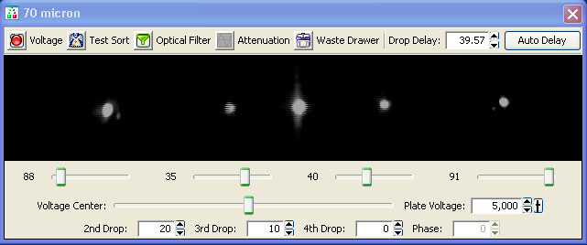
SORTING – Setup Side Streams

Slide 33
Drop Delay
interrogation point
drop delay
BD FACS™ Accudrop technology
Accudrop beads
Diode laser
Camera
Optical filter
breakoff
Waste
Notes:
Before sorting, you need to make sure that you have an accurate drop delay setting. The Aria has integrated Accudrop technology which provides a simple way to adjust the drop delay.
The components used for Accudrop:
Diode laser: A low-power red laser which illuminates the lower portion of the stream when the sort block door is closed (there’s a safety interlock).
Camera: Provides an image of the side streams visible in this window. (located behind the round window in the sort block)
Optical filter: Used for viewing the fluorescence from the droplets containing Accudrop beads. (point out the button on this image that moves the filter into place)
Accudrop beads: Beads that are excited by the diode laser and emit within the range of the optical filter.
The drop delay is the distance between the laser intercept and the last connected drop, measured in time. The system needs to know when to charge the stream so that the intended droplet is charged before it is detached from the stream.
This diagram shows the diode laser and the lower camera window. When setting the drop delay, the waste aspirator drawer is blocking the collection tubes, so all beads will go to waste. Essentially, Accudrop allows us to view the accuracy of our sort in real-time, without having to do a post-sort analysis.

Slide 34
Sorting - Sort Masks
Cells are randomized distributed over the stream

Slide 35
Sorting - Sort Masks
Trailing
Interrogated
Leading

Slide 36
Mask
A region of the stream monitored for the presence of cells
Determines how drops will be deflected if a sorting conflict occurs
Measured in 1/32 drop increments
4
8
16
4
8
16
Mask = 0
Mask = 8
Mask = 16
Mask = 32
Notes:
At the laser intercept particles are defined as wanted or not based on the gates you created in the software. However, while the particle is traveling down the stream another decision is made on whether or not the particle will be sorted based upon the Sort Precision mode.
A sort precision mode is made up of a combination of masks. A mask is a region of the stream that will be considered to make a decision if there’s a sorting conflict. Each mask is measured in 1/32 drop increments.
The next few slides will discuss each individual mask, then we’ll look at how those three masks are combined into precision modes.
Note to instructor: Encourage customers to hold questions about putting the masks together until after you’ve discuss the basic definitions of all three.

Slide 37
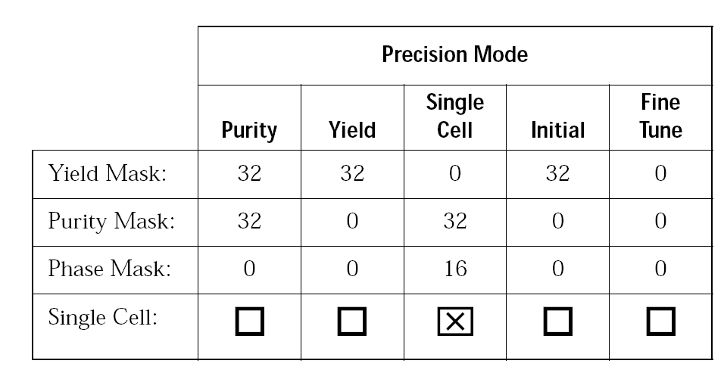
Conflict Resolution
Precision modes include three types of masks
  Yield
  Purity
  Phase

Slide 38
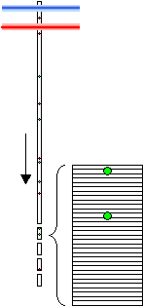
Sorting - Sort Masks
Sort decisions are determined by sort masks
Target particles in a drop with 1/32-drop resolution

Slide 39
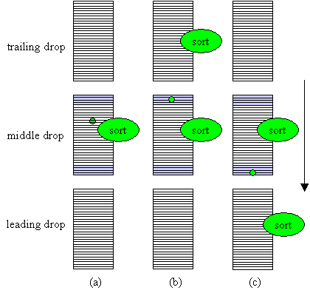
Sorting - Yield Mask
The yield mask defines how many drops will be sorted Yield mask of 8/32 indicated in blue; target particle shown in green
Yield Mask

Slide 40
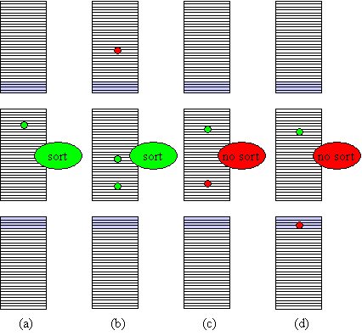
Sorting - Purity Mask
Purity mask of 8/32 in blue, 4/32 in each adjacent drop; target particles in green, non-target particles in red
Purity Mask
Purity Mask

Slide 41
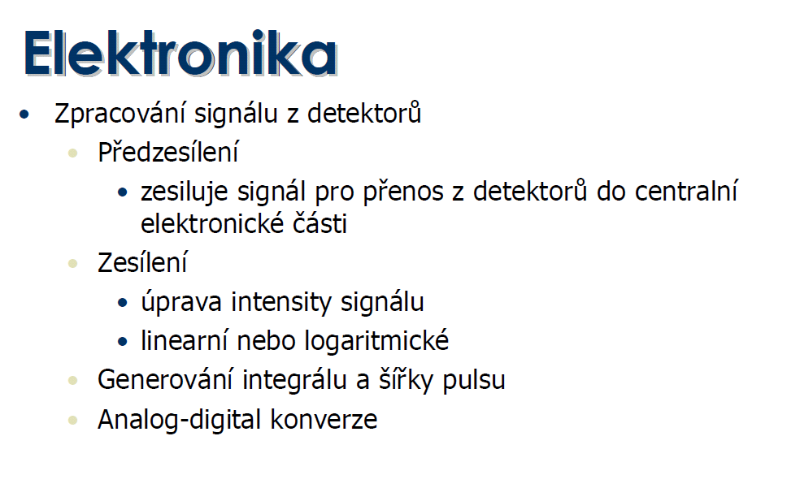

Slide 42
Flow Cytometry Standard data file format. FCS 3.1
http://www.isac-net.org/images/stories/documents/Standards/fcs3.1_normativespecification_20090813.pdf
Spidlen, J. et al. Cytometry. Part A : the journal of the International Society for Analytical Cytology 77, 97-100, (2010).

Slide 43
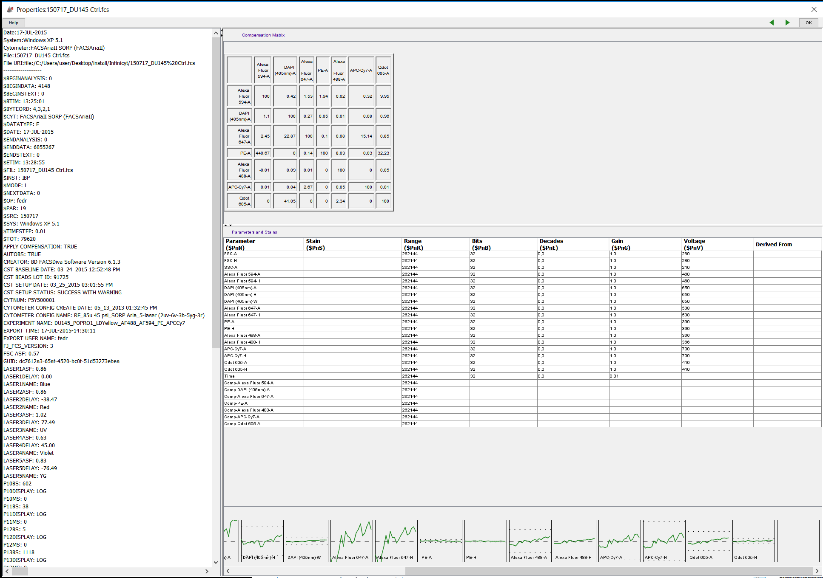

Slide 44


Slide 45
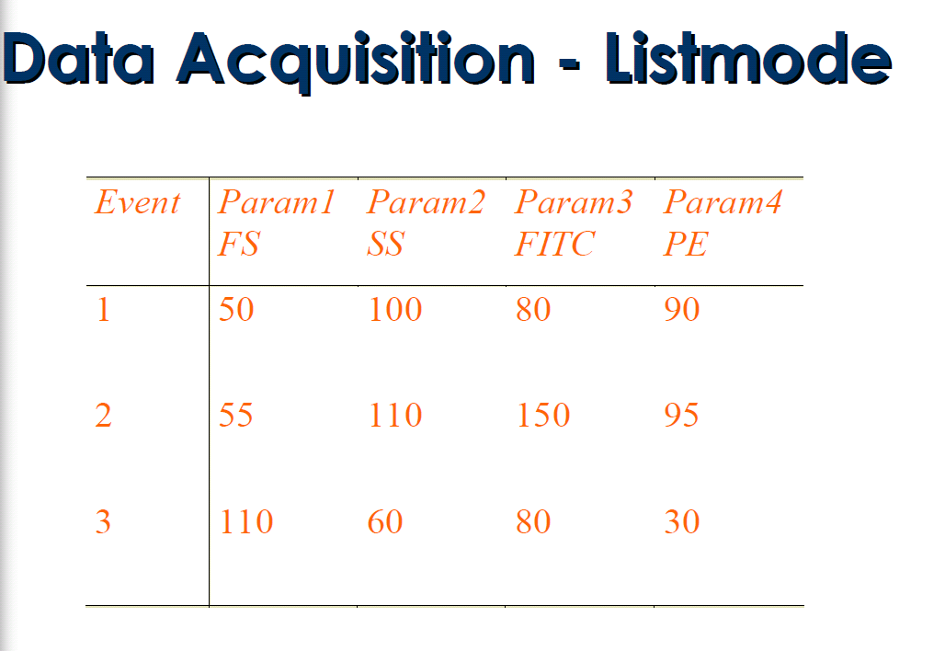

Slide 46
Creation of a Voltage Pulse
1
Laser
Voltage
Time
2
Laser
Voltage
Time
3
Laser
Voltage
Time

Slide 47
Height, Area, and Width
Pulse area(A)
Pulse Height (H)
Voltage
0
Pulse Width (W)
Time (µs)

Slide 48
Signal processing
dot plot
1000
FL-1 (H)
Zesílení signálu (!)
lin nebo log
0
1000
FL-2 (H)
Analog/digital
conversion
FSC ~ cell size
FL-1 (530/30nm) ~ green fluo.
FL- (H, W, A)
analog signal intesity
VOLTAGE
Height
FL-2 (585/42nm) ~ red fluo.
Width
Area ( ∫ )
time
K. Souček Bi9393 Analytická cytometrie

Slide 49
Analog to Digital Converter
16, 384
12420
7650
1985
340
baseline
Time

Slide 50
Analog to Digital Converter
Analog to Digital
Conversion
Signal
Out
Digital data to memory
Photon
In
Voltage In
PMT
Power Supply
Digitize
the pulse
16,384 levels
Sample
the pulse
10 MHz
Levels 0–1000 Volts

Slide 51
Parameters
14524
9568
10270
4004
3060
358
282
Area: Sum of all height values
Height: Maximum digitized value X 16
Width: Area/Height X 64K
Data is displayed on 262,144 scale

Slide 52
AD převodníky
2⁸ = 256
2¹⁰ = 1024
.
.
.
Počet bitů | # kanálů | rozlišení
8 | 256 | 39.1 mV
10 | 1024 | 9.77 mV
12 | 4096 | 2.44 mV
14 | 16384 | 610 μV
16 | 65536 | 153 μV
18 | 262144 | 38.1 μV
20 | 1048576 | 9.54 μV
22 | 4194304 | 2.38 μV
24 | 16777216 | 596 nV
Full scale measurement range = 0 to 10 volts
ADC resolution is 12 bits: 212 = 4096 quantization levels
ADC voltage resolution is: (10-0)/4096 = 0.00244 volts = 2.44 mV
K. Souček Bi9393 Analytická cytometrie

Slide 53
Kolik bitů?
Pokud konvertujeme analogový signál pomocí 8 bitového ADC – máme 256 kanálů (2⁸=256) odpovídajících rozsahu 0-10 V
Rozdíl mezi kanály je 10/256=~40mV
1V
10V
100mV
0 50 100 150 200 250
Channels
upraveno podle J.P.Robinson

Slide 54
Ideální logaritmický zesilovač
1 V
10 V
100 mV
Linearní
0 50 100 150 200 250
Log amp
1 mV
10 mV
100 mV
1 V
10 V
Log
0 50 100 150 200 250
Channels
upraveno podle J.P.Robinson

Slide 55
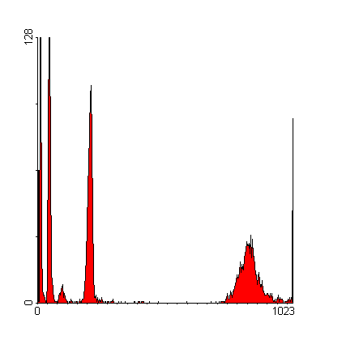
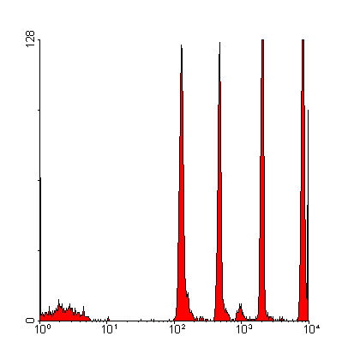
Logaritmické zesílení & dynamický rozsah
lin
log
upraveno podle J.P.Robinson

Slide 56
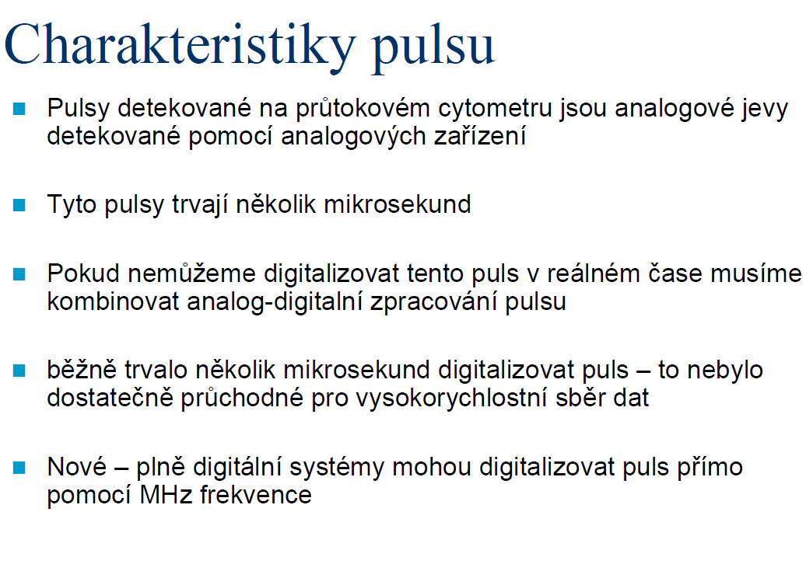

Slide 57
Kompenzace fluorescenčního signálu
…později

Slide 58
Analýza dat
Zobrazení dat
  histogram
  dot plot
  isometric display
  contour plot
  chromatic (color) plots
  3 D projection
Gating

Slide 59
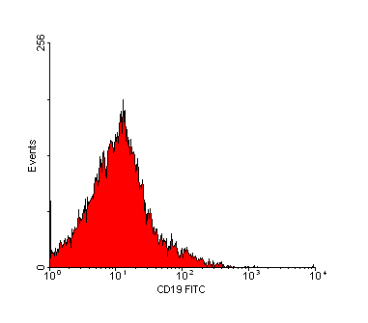
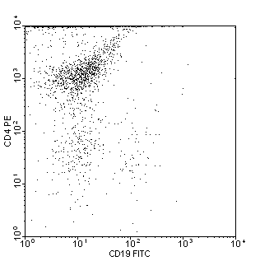
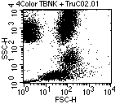
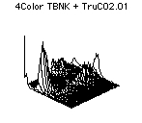
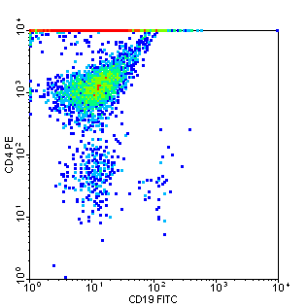
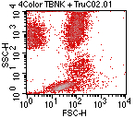
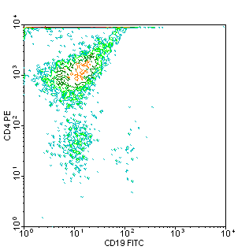
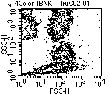
Způsoby pro zobrazení dat
K. Souček Bi9393 Analytická cytometrie

Slide 60
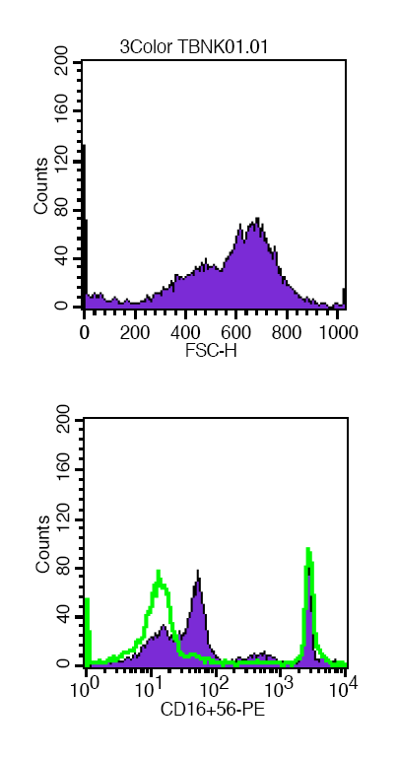
Histogram distribuce četnosti
Histogram zobrazuje četnost částic pro jeden parametr
Jednoduchý výstup
Nekorelujeme s dalším parametrem
Problém s identifikací populací
K. Souček Bi9393 Analytická cytometrie

Slide 61
Dot plot
Zobrazuje korelaci dvou libovolných parametrů
Jednotlivé tečky představují konkrétní změřené buňky (částice)
Hodnoty pro řadu částic mohou ležet ve stejném místě
Nemáme informaci o relativní denzitě částic
Problémy s vykreslením v případě velkých objemů dat
K. Souček Bi9393 Analytická cytometrie

Slide 62
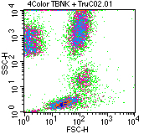
Density & contour plot
Density plot:
Zobrazuje dva parametry jako frekvenci četnosti
barva a nebo její odstín odpovídá četnosti částic
Contour plot:
spojnice spojuje body (částice) se stejnou hodnotou signálu
V podstatě simulujeme 3D graf – třetí rozměr je frekvence
K. Souček Bi9393 Analytická cytometrie

Slide 63
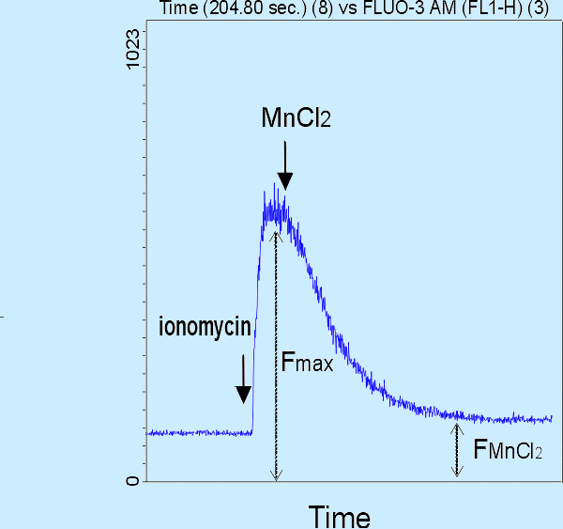
Čas jako jeden z parametrů
K. Souček Bi9393 Analytická cytometrie

Slide 64
3D zobrazení
2 parametry + četnost
3 parametry společně
K. Souček Bi9393 Analytická cytometrie

Slide 65
3 Color Combinations
APC
4+4+4=12
Positives
PE
4+4=8
FITC
Negatives
upraveno podle J.P.Robinson

Slide 66
3 Color Combinations
1000
PE-FITC Pattern
1000
TR-FITC Pattern
1000
TR-PE Pattern
APC
4+4+4=12
100
100
100
CD38
CD20
CD8
CD5
CD3
CD8
Phycoerytherin
CD3
CD20
10
CD4
10
CD8
10
IgM
K/L
Texas Red
Texas Red
CD3
CD20
IgG
CD20
CD7
CD8 (dim)
IgG
1
1
HLA-DR
CD2
1
CD2
CD10
L
K
.1
Negative
CD3
.1
CD3
.1
Negative
CD4
CD45
Negative
CD45
1
CD5
.1
1
10
100
1000
.1
1
10
100
1000
.1
10
100
1000
FITC
FITC
Phycoerytherin
PE
FITC
upraveno podle J.P.Robinson

Slide 67
„Gating“
Real-time gating vs. softwarový „gating“
Určení regionů
Strategie „gatingu“
Analýza kvadrantů
Boolean „gating“
zpětný „gating“

Slide 68
Real-Time vs. Software Gating
Real-time (live) gating:
-omezuje akceptovaná data během měření
Software (analysis) gating:
-vyřazuje určitá data během následné analýzy
upraveno podle J.P.Robinson

Slide 69

Určení regionů
Objektivní nebo subjektivní?
  -školení/schopnosti/trénink
Možné tvary:
  -obdelník
  -elipsa
  -“free-hand“ (polygon)
  -kvadrant
Statistika
- počet
- podíl (%)
- průměr, medián, S.D., CV, ….

Slide 70
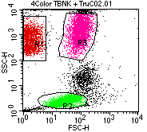
Region, gate
oblast (plocha) v grafu definovaná uživatelem
mnoho regionů v jednou grafu
ohraničujeme pomocí nich populace našeho zájmu
je možné je barevně odlišit
je definován stejně pro všechny vzorky v analýze
lze je kombinovat pomocí logických operátorů (AND, OR, NOT; Booleova logika)
K. Souček Bi9393 Analytická cytometrie

Slide 71
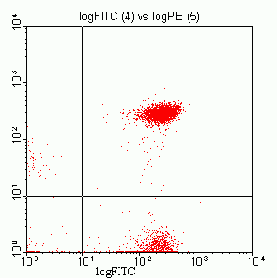
Using Gates
log PE
Region 1 established
Gated on Region 1
upraveno podle J.P.Robinson

Slide 72




Statistika
Aritmerický průměr
Geometrický průměr
Medián
– odhad střední hodnoty
– není ovlivněn extrémními hodnotami
Směrodatná odchylka
Koeficient variance
Modus – nejčastější hodnota
K. Souček Bi9393 Analytická cytometrie

Slide 73
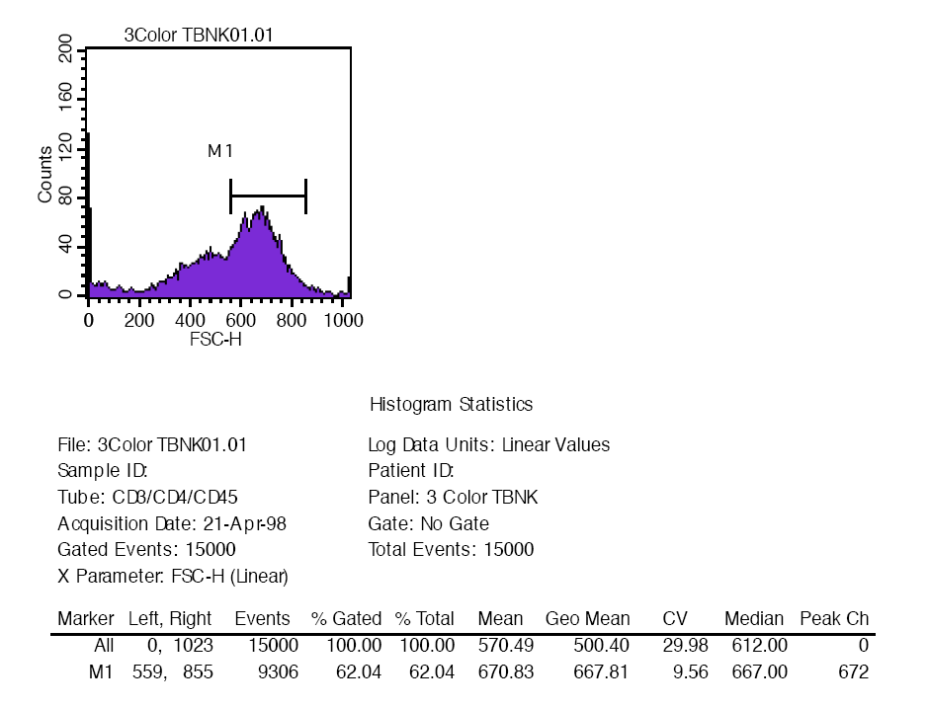
Statistika pro histogram
K. Souček Bi9393 Analytická cytometrie

Slide 74
Analýza kvadrantů
( - +)
(+ +)
(- -)
(+ -)
K. Souček Bi9393 Analytická cytometrie

Slide 75
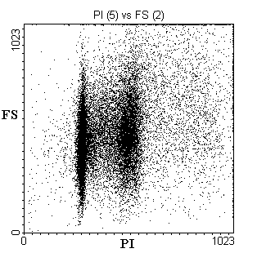
Logický „Gating“ (Booleova logika)
S překrývajícími se oblastmi máme mnoho možností:
upraveno podle J.P.Robinson

Slide 76
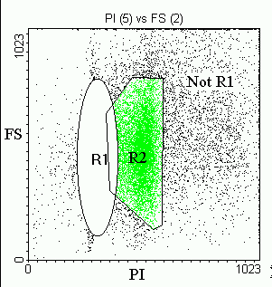
Boolean Gating
Not Region 1:
upraveno podle J.P.Robinson

Slide 77
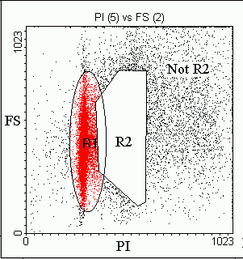
Boolean Gating
Not Region 2:
upraveno podle J.P.Robinson

Slide 78
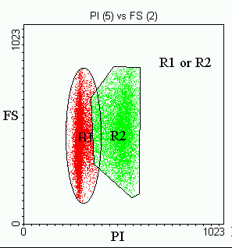
Boolean Gating
Region 1 or Region 2:
upraveno podle J.P.Robinson

Slide 79
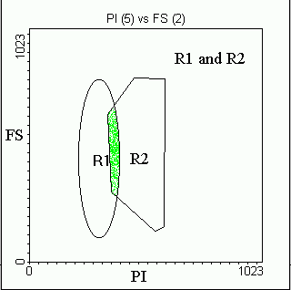
Boolean Gating
Region 1 and Region 2:
upraveno podle J.P.Robinson

Slide 80
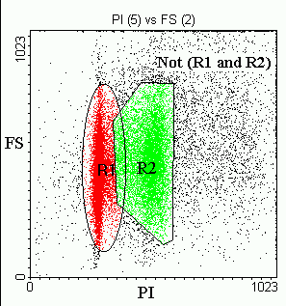
Boolean Gating
Not (Region1 and Region 2):
upraveno podle J.P.Robinson

Slide 81
Light Scatter Gating
Side Scatter Projection
Neutrophils
Scale
1000
200
100
50
40
Monocytes
30
20
15
Lymphocytes
8
0
200
400
600
800
1000
90 Degree Scatter
upraveno podle J.P.Robinson

Slide 82
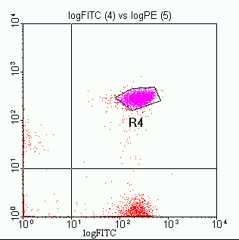
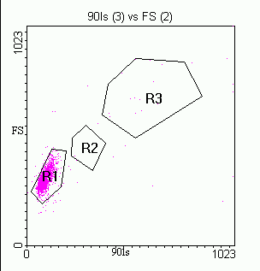
Back Gating
Back gate
log PE
Region 4 established
Back-gating using Region 4
upraveno podle J.P.Robinson

Slide 83
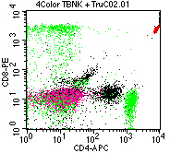
Back Gating
K. Souček Bi9393 Analytická cytometrie

Slide 84
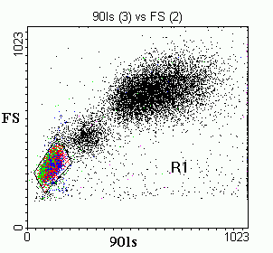
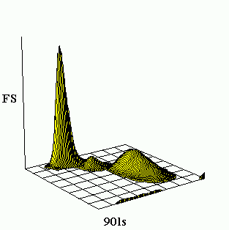
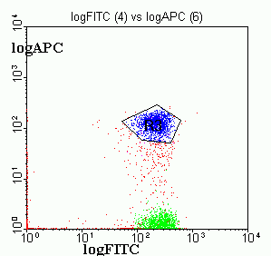


3 Parameter Data Display
FITC+
APC+
PE +
APC+
FITC+
PE+
upraveno podle J.P.Robinson

Slide 85


Nástroje pro analýzu dat
Výrobci HW
  Beckman Coulter
    Kaluza
  Becton Dickinson
    FACSDiva
    FACSSuite
    FlowJo
  BioRad
  Sony
  Milteney
  …
Univerzální platformy
  Komerční
    FlowJo
    FCS Express
    …
  Freeware
    Flowing Software
    Cyflogic
    BioConductor - Flowcore

Slide 86

Vícebarevné analýzy generují mnoho dat…
5 color
4 color
3 color
1 2 3 4 5 6 7 8 9 10
QUADSTATS
QUADSTATS
QUADSTATS
QUADSTATS
QUADSTATS
QUADSTATS
QUADSTATS
QUADSTATS
QUADSTATS
QUADSTATS
-+
++
-+
++
-+
++
-+
++
-+
++
-+
++
-+
++
-+
++
-+
++
-+
++
Log Fluorescence
Log Fluorescence
Log Fluorescence
Log Fluorescence
Log Fluorescence
Log Fluorescence
Log Fluorescence
Log Fluorescence
Log Fluorescence
Log Fluorescence
--
+-
--
+-
--
+-
--
+-
--
+-
--
+-
--
+-
--
+-
--
+-
--
+-
Log Fluorescence
Log Fluorescence
Log Fluorescence
Log Fluorescence
Log Fluorescence
Log Fluorescence
Log Fluorescence
Log Fluorescence
Log Fluorescence
Log Fluorescence
QUADSTATS
QUADSTATS
QUADSTATS
QUADSTATS
QUADSTATS
QUADSTATS
QUADSTATS
QUADSTATS
QUADSTATS
QUADSTATS
-+
++
-+
++
-+
++
-+
++
-+
++
-+
++
-+
++
-+
++
-+
++
-+
++
Log Fluorescence
Log Fluorescence
Log Fluorescence
Log Fluorescence
Log Fluorescence
Log Fluorescence
Log Fluorescence
Log Fluorescence
Log Fluorescence
Log Fluorescence
--
+-
--
+-
--
+-
--
+-
--
+-
--
+-
--
+-
--
+-
--
+-
--
+-
Log Fluorescence
Log Fluorescence
Log Fluorescence
Log Fluorescence
Log Fluorescence
Log Fluorescence
Log Fluorescence
Log Fluorescence
Log Fluorescence
Log Fluorescence
QUADSTATS
QUADSTATS
QUADSTATS
QUADSTATS
QUADSTATS
QUADSTATS
QUADSTATS
QUADSTATS
QUADSTATS
QUADSTATS
-+
++
-+
++
-+
++
-+
++
-+
++
-+
++
-+
++
-+
++
-+
++
-+
++
Log Fluorescence
Log Fluorescence
Log Fluorescence
Log Fluorescence
Log Fluorescence
Log Fluorescence
Log Fluorescence
Log Fluorescence
Log Fluorescence
Log Fluorescence
--
+-
--
+-
--
+-
--
+-
--
+-
--
+-
--
+-
--
+-
--
+-
--
+-
Log Fluorescence
Log Fluorescence
Log Fluorescence
Log Fluorescence
Log Fluorescence
Log Fluorescence
Log Fluorescence
Log Fluorescence
Log Fluorescence
Log Fluorescence
upraveno podle J.P.Robinson

Slide 87





Slide 88




Další způsoby vizualizace vícerozměrných dat
t-SNE, viSNE
  t-Distributed Stochastic Neighbor Embedding
  viSNE is a tool for reducing high-parameter data down to two dimensions
  visually identify interesting and rare biological subsets
  allow to gate single cell events across different samples.
SPADE
  Spanning-tree Progression Analysis of Density-normalized Events
  way to automatically identify populations in multidimensional flow cytometry data files
  clusters cells into populations and then projects them into a tree

Slide 89








Slide 90





Slide 91


The Flow Cytometry: Critical Assessment of Population Identification Methods (FlowCAP)
The goal of FlowCAP is to advance the development of computational methods for the identification of cell populations of interest in flow cytometry data. FlowCAP will provide the means to objectively test these methods, first by comparison to manual analysis by experts using common datasets, and second by prediction of a clinical/biological outcome.

Slide 92
Způsoby pomocí kterých lze upravit výsledky:
1. Odstranění „doublets“
2. Čas jako parametr pro kontrolu kvality
Příklad - pro DNA analýzu je třeba:
- odstranit „debris“ a shluky
- odstranit „doublets“
- udržovat konstantní průtok
K. Souček Bi9393 Analytická cytometrie

Slide 93



https://www.flowjo.com/learn/flowjo-university/flowjo/tutorial/33

Slide 94

Co je problém při vícebarevné detekci?
K. Souček Bi9393 Analytická cytometrie

Slide 95

Emission Spectra–Spectral Overlap

Slide 96
Kompenzace fluorescenčního signálu při vícebarevné detekci
Proces při kterém dochází k eliminaci všech fluorescenčních signálů kromě signálu z fluorochromu který má být na příslušném detektoru detekován
Nastavení pomocí mixu mikročástic či buněk označených/neoznačených příslušnými fluorochromy.
K. Souček Bi9393 Analytická cytometrie

Slide 97
Co je problém při vícebarevné detekci?
K. Souček Bi9393 Analytická cytometrie

Slide 98

Kompenzace fluorescenčního signálu při vícebarevné detekci
K. Souček Bi9393 Analytická cytometrie

Slide 99

“Bright” = good resolution sensitivity

Slide 100

Various fluorochromes-stain index

Slide 101

Choices for 6,- 8,- 10,- and more colors

Slide 102

Fluorochrome selection considerations

Slide 103

FITC Spillover
FITC
PE
585/42
PerCP-Cy5.5
695/40
530/30
Relative Intensity
500nm
550nm
600nm
650nm
700nm
750nm
800nm
Wavelength (nm)

Slide 104


FITC Compensation
FITC
530/30
PE
585/42
PerCP-Cy5.5
695/40
Relative Intensity
500nm
550nm
600nm
650nm
700nm
Wavelength (nm)

Slide 105


FITC Compensation
FITC
530/30
PE
585/42
PerCP-Cy5.5
695/40
Relative Intensity
500nm
550nm
600nm
650nm
700nm
Wavelength (nm)

Slide 106



FITC Compensation
Dot plot showing uncompensated FITC data
Dot plot showing compensated FITC data
Biexponential dot plot showing compensated FITC data

Slide 107



Slide 108


Slide 109


Slide 110
Kompenzace fluorescenčního signálu
FITC positive & negative
PE negative beads
#2
K. Souček Bi9393 Analytická cytometrie

Slide 111
Kompenzace fluorescenčního signálu
FITC positive & negative
PE negative beads
NONE!
K. Souček Bi9393 Analytická cytometrie

Slide 112
Kompenzace fluorescenčního signálu

Slide 113

Nastavení kompenzací
značené mikročástice – pro běžně konjugované fluorochromy
značené buňky – pro vitální značení
parametr - detektor amp.
FL1 - 544
FL2 - 434
kompenzace
FL1 - 1.1%FL2
FL2 - 17.5%FL1

Slide 114





Effects of Changing PMT Values
Correct Compensation
FITC Voltage Decreased by 5 V
FITC Voltage Increased by 5 V

Slide 115
Which marker for compensation?
Small errors in compensation of a dim control (A) can result in large compensation errors with bright reagents (B & C).
Use bright markers to setup proper compensation.

Slide 116

BD Comp Beads
Always positive
Bright staining
Save sample (HIV patients)
Use the same antibody for compensation and the real experiment

Slide 117





BD Comp Beads

Slide 118

Fluorescence Minus One
PBMC were stained as shown in a 3-color experiment. Compensation was properly set for all spillovers
Courtesy Mario Roederer

Slide 119

Tandemové značky

Slide 120


Tandemové značky - příklad

Slide 121
Tandems are light sensitive
CD8
CD3
PE-Cy7
PE-Cy5
Time Sample Left in Light
0 hours
PE
(FL2)
2 hours
22.5 hours

Slide 122
Kompenzace - literatura
Mario Roederer - Compensation in Flow Cytometry
Current Protocols in Cytometry (2002) 1.14.1-1.14.20 John Wiley & Sons, Inc.
M. Loken, D. R. Parks, & L. A. Herzenberg (1977). Two-color immunofluorescence using a fluorescence-activated cell sorter. J. Histochem. Cytochem. 25:899-907.
M. Roederer & R. F. Murphy (1986). Cell-by-cell autofluorescence correction for low signal-to-noise systems: application to EGF endocytosis by 3T3 fibroblasts. Cytometry 7:558-565.
S. Alberti, D. R. Parks, & L. A. Herzenberg (1987). A single laser method for subtraction of cell autofluorescence in flow cytometry. Cytometry 8:114-119.
C. B. Bagwell & E. G. Adams (1993). Fluorescence spectral overlap compensation for any number of flow cytometry parameters. in: Annals of the New York Academy of Sciences, 677:167-184.
K. Souček Bi9393 Analytická cytometrie

Slide 123

No Data Analysis Technique Can Make Good Data Out of Bad Data!
Shapiro’s 7th Law of Flow Cytometry

Slide 124
Shrnutí
sorting
zpracování signálu
vizualizace dat a „gating“
kompenzace
Na konci dnešní přednášky byste měli:
Znát základní principu sortování,
popsat způsob zpracování signálu,
rozumět lin / log zesílení signálu,
rozeznat jednotlivé způsoby vizualizace dat,
chápat základní principy „gatingu“,
znát princip kompenzace signálu při vícebarevné detekci.
K. Souček Bi9393 Analytická cytometrie

