Slide 1
F9180: Diagnostické metody 2
Time-Correlated Single Photon Counting Methods
Tomáš Hoder
Doporučená literatura:
[1] D.V.O’Connor and D.Phillips - Time-correlated Single Photon Counting, 1984
[2] W.Demtroeder - Atoms, Molecules and Photons, 2006
[3] W.R.Ware – Techniques of pulse fluorometry Time-Resolved Fluorescence
Spectroscopy in Biochemistry and Biology (NATO ASI Series A: Life Sciences)
vol 69, ed R.B.Cundall and R.E.Dale (New York: Plenum), 1983
[4] K.V.Kozlov et al. 2001 Spatio-temporally resolved spectroscopic diagnostics
of the barrier discharge in air at atmospheric pressure, J.Phys.D:Appl.Phys. 34 3164
[5] W.Becker 2007 Advanced Time-correlated Single Photon Counting Techniques
[6] W.Becker 2014 TCSPC Handbook

Slide 2
Overview
TC-SPC technique/idea
Time scales, where we can use it, where not
Light emission, fluorescence, quenching
Sensitivity, StNR, time resolution, PMT transit
Use in plasma-physics and synchronization
Selected examples for gas discharge quantitative spectroscopy

Slide 3

TC-SPC technique
micro-discharge
SYNC-Signal:
represents shape of the full light pulse
giving a time reference
MAIN-Signal:
random single photons
spatially resolved
spectrally resolved
START
STOP
Delay
relative
time information
single photon
accumulation
first counted photon
time
triggering possible on stochastically appearing events in time as the time reference is set on the discharge itself >>> cross-correlation spectroscopy

Slide 4
TC-SPC basics
Instead of having problems with slow
analogue PMT signal …
TC-SPC obtains light intensity by
counting pulses as a digital units in
subsequent time channels:
free of gain noise of PMT
free of electronic noise of accidental signals to PMT
high signal-to-noise ratio
(to PMT background counting rate)
higher time-resolution
(Transit Time Spread << Single Photoelectron Response/Transit time)
Becker 2006 Advanced TCSPC techniques

Slide 5
Basics

Slide 6
TC-SPC solves:
Problems of triggering/synchro – recording of irregular emission events
Problems of time resolution – no limitation by transit times or SER (single electron response) of detectors
Problems of sensitivity – statistical principles behind the accumulative recordings

Slide 7
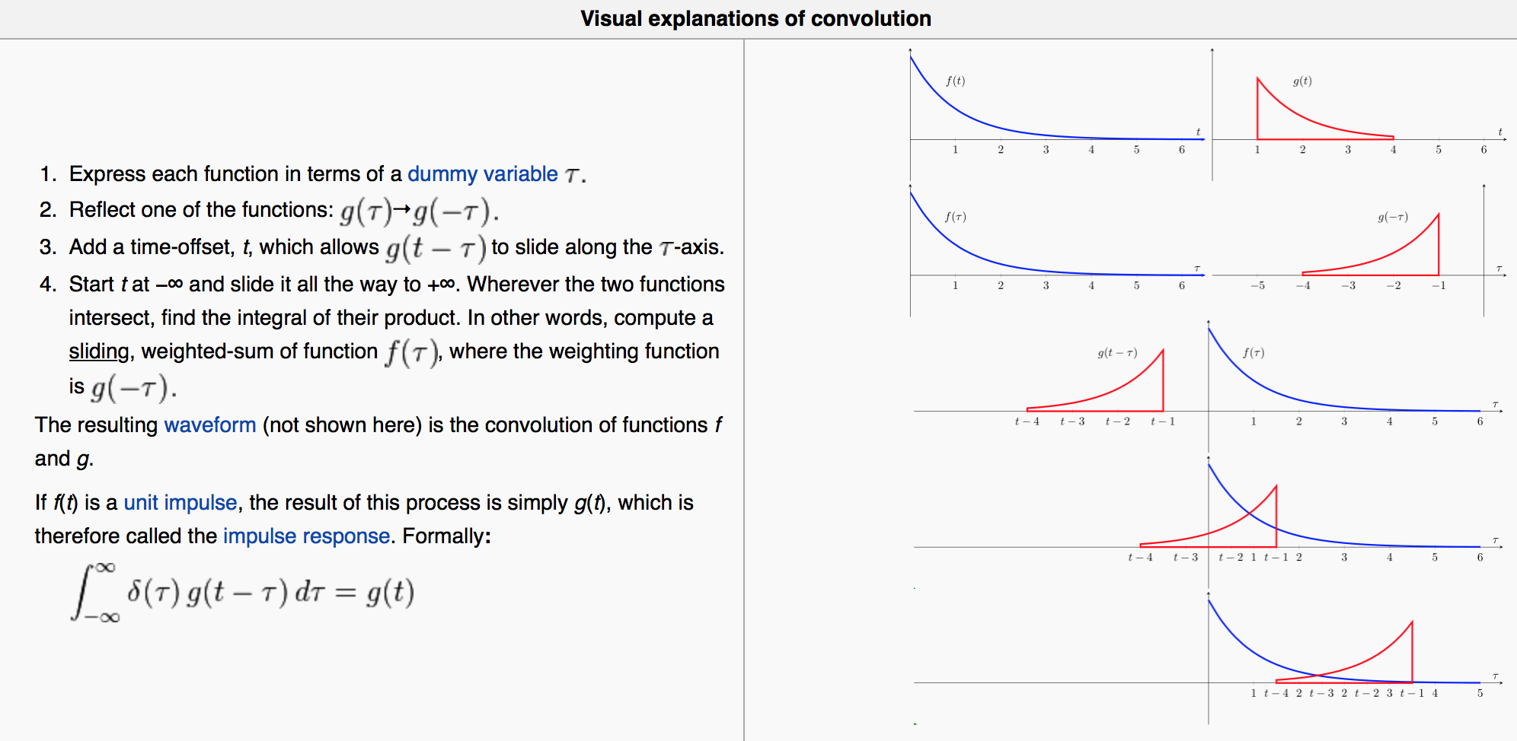
Convolution -> cross-correlation
wiki
(δ-fce)

Slide 8
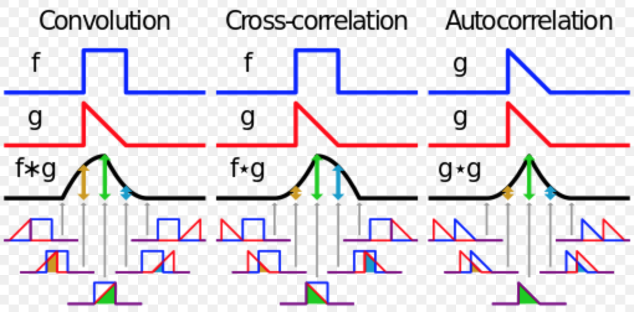
Relevant integral transformations:
wiki

Slide 9
Different time scales and appropriate light detection techniques
Gated cameras:
Time resolution from seconds to usually 2ns (new models down to 200 or even 50ps)
Almost impossible to synchronize to time-irregular emission events (random shot is the time consuming solution)
Sensitivity of the recording is given by the StNR of given device. Usually the noise increases linearly with number of accumulation cycles. Weak signals are not easy to record.
Notes:
EEDF relaxation ps … radiative lifetimes 10ns … effective quenching at 1atm ns … relaxation of chemical kinetics ns … streamer structure 10ps …

Slide 10
Different time scales and appropriate light detection techniques
Start-stop TCSPC:
Time resolution from hundreds of nanoseconds to 10ps
Possible to synchronize to time-irregular emission events with the same high resolution in time
Sensitivity of the recording is given by the StNR of given synchronization arrangement. Poisson statistics is the limiting mechanism.
Limited for high-frequency repetition emission events. Limited by the speed of electronics of the counter dealing with high-frequency input.
Time-to-amplitude converter
… first time 1961 by Koechlin (Thesis, Uni Paris)

Slide 11
Different time scales and appropriate light detection techniques
micro-discharge
SYNC-Signal:
represents shape of the full light pulse
giving a time reference
MAIN-Signal:
random single photons
spatially resolved
spectrally resolved
START
STOP
Delay
Reversed start-stop TCSPC:
Time resolution from hundreds of nanoseconds to 10ps
Possible to synchronize to time-irregular emission events
Sensitivity of the recording is given by the StNR of given synchronization arrangement. Poisson statistics is the limiting mechanism.
No limitation for high-frequency repetition emission events. Input processing only for the “main” signal.

Slide 12
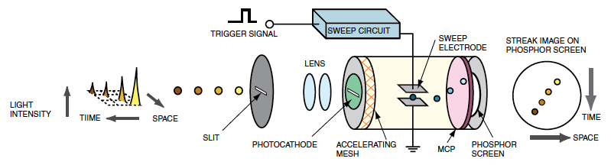
Different time scales and appropriate light detection techniques
Streak cameras:
Time resolution down to units of picoseconds (some new models down to hundreds of femtoseconds)
Sensitivity of the recording comparable to the TC-SPC

Slide 13
Different time scales and appropriate light detection techniques
Pump-and-probe technique:
Time resolution down to femtoseconds using femtosecond laser pulses
Possible to synchronize due to the synchronous generation of the fluorescence by the pumping laser pulse.

Slide 14
Light emission, fluorescence
Notes:
The main reason and use of TCSPC is in fluorescence lifetime imaging microscopy >>> proto ted lifetime, je to potřeba i ve fyzice plazmatu

Slide 15
Light emission, fluorescence

Slide 16
Light emission, fluorescence

Slide 17
Radiative lifetime measurement
(j = n)
(k = n)

Slide 18
Effective lifetime and quenching

Slide 19
Effective lifetime and quenching
Dilecce et al. 2010 J.Phys.D

Slide 20
TC-SPC technique
micro-discharge
SYNC-Signal:
represents shape of the full light pulse
giving a time reference
MAIN-Signal:
random single photons
spatially resolved
spectrally resolved
START
STOP
Delay
relative
time information
single photon
accumulation
first counted photon
time
triggering possible on stochastically appearing events in time as the time reference is set on the discharge itself >>> cross-correlation spectroscopy

Slide 21
Convolution >>> cross-correlation
wiki
(δ-fce)

Slide 22
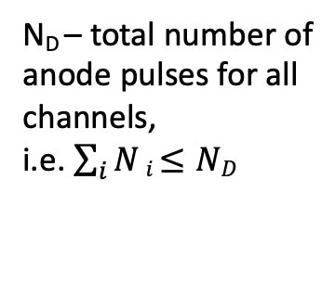

TCSPC statistics scheme
N_{A} number of counts (anode pulses) in i-th interval
N_{E}
z_{i}
w_{i}
TAC
N_{D}
N_{A}
TAC detekuje jen první foton
a tedy N_{A} $≠$ N_{i} !
N_{D} – total number of anode pulses for all channels,
i.e. $\sum_{i}{N}i$ $≤ND$
N_{i}
N_{i}=N_{A}
i-th channel

Slide 23
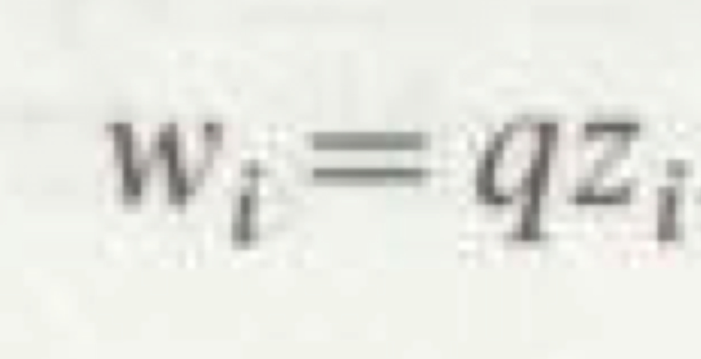
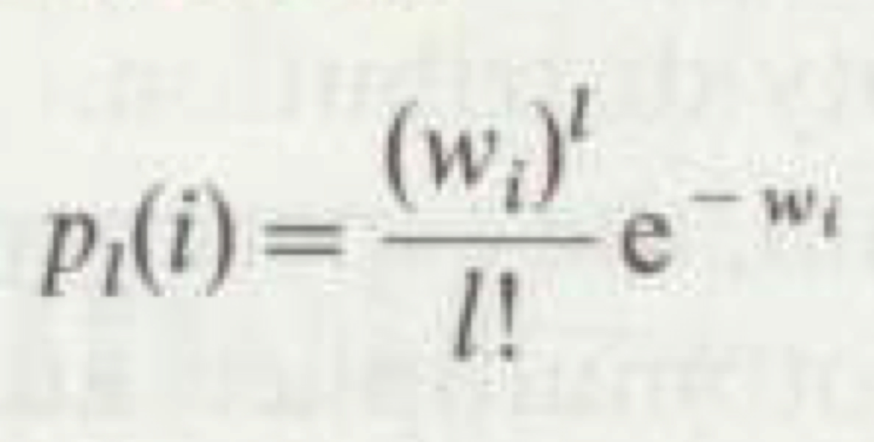
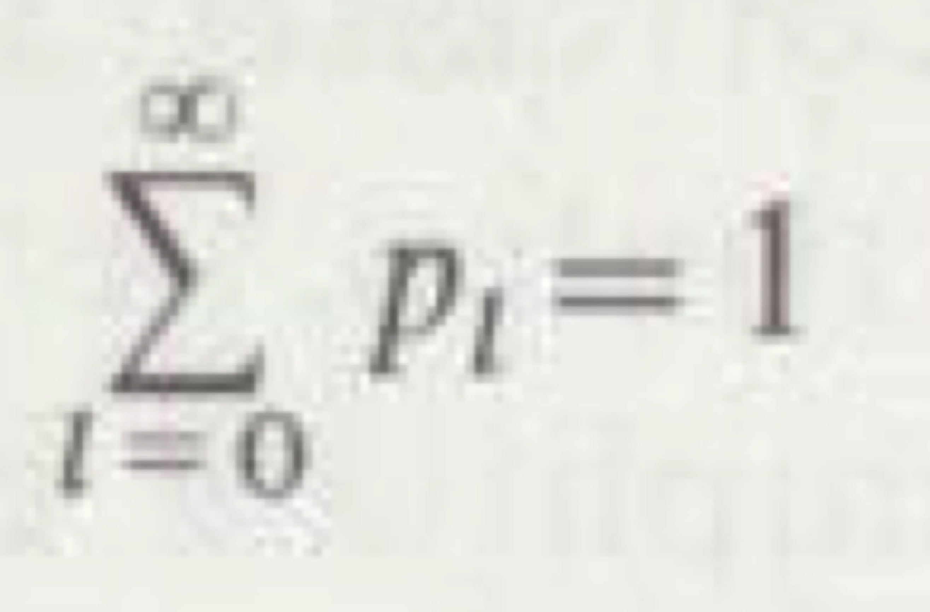
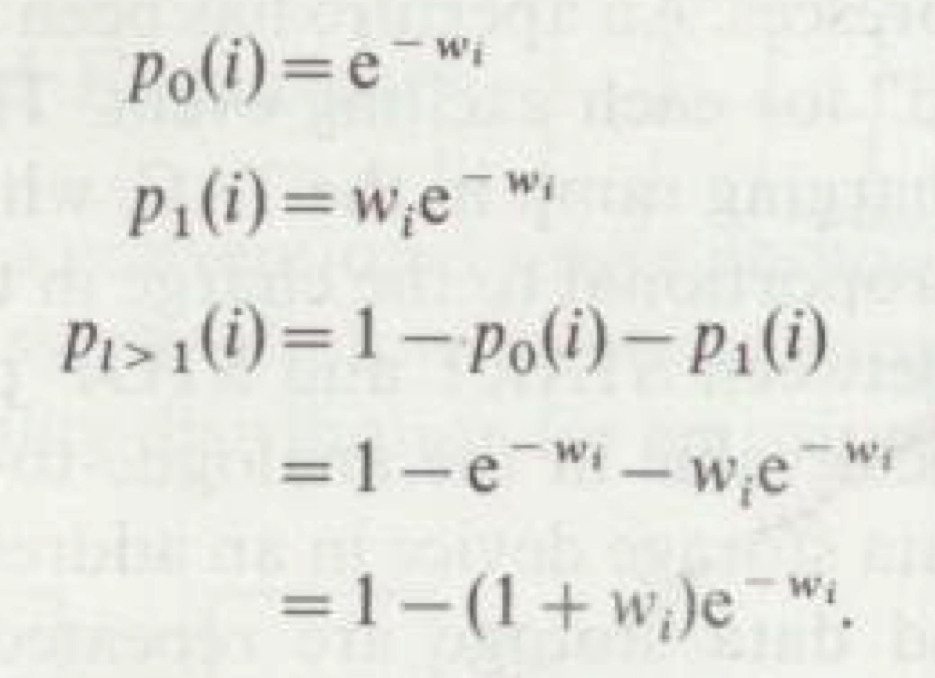
TC-SPC statistics basics 1
Photoelectrons generated by impinged
photons on the cathode with given quantum efficiency.
The probability of emission of l
photoelectrons in the i-th interval
is given by the Poisson distribution.
The Taylor series of the exponential function is (1-w_{i}+w_{i}²/2+…),
we take the first two.

Slide 24
TCSPC statistics scheme
N_{A} number of counts in i-th interval
N_{E}
z_{i}
w_{i}
TAC
N_{D}
N_{A}
N_{i}
N_{i}=N_{A}
i-th channel

Slide 25
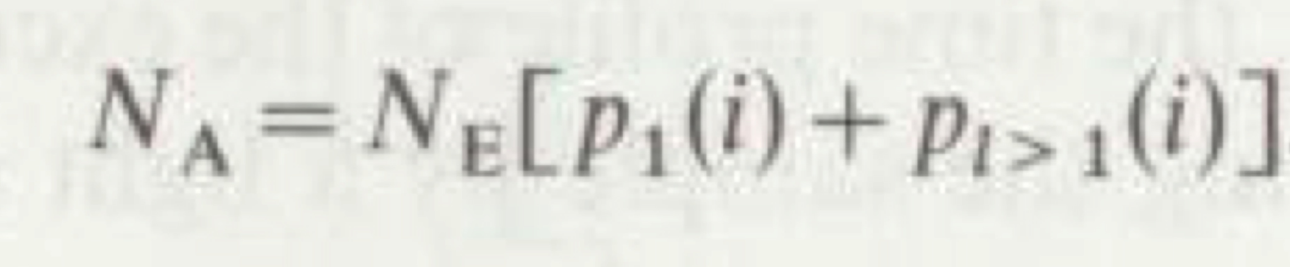
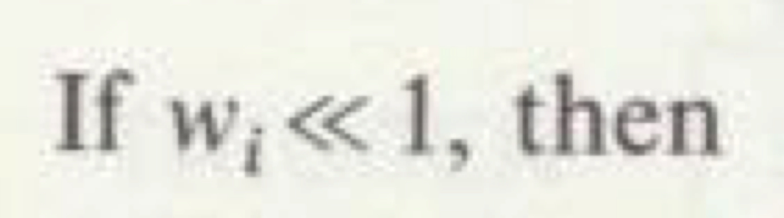
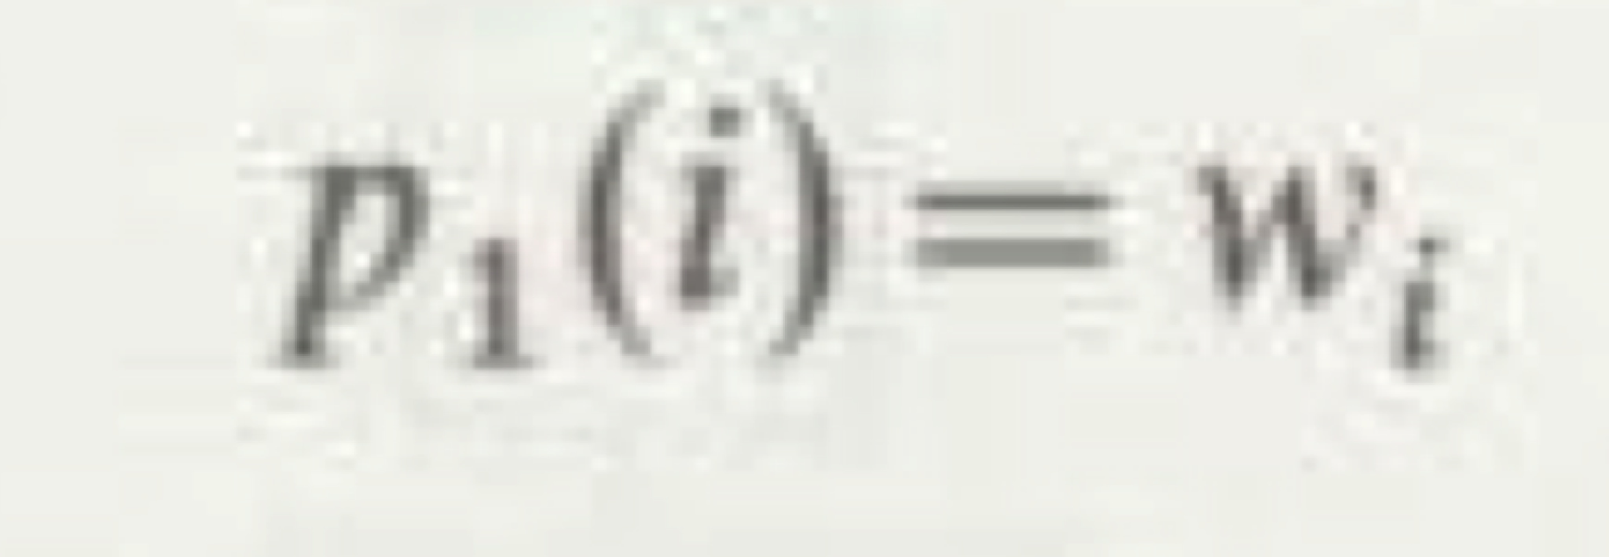
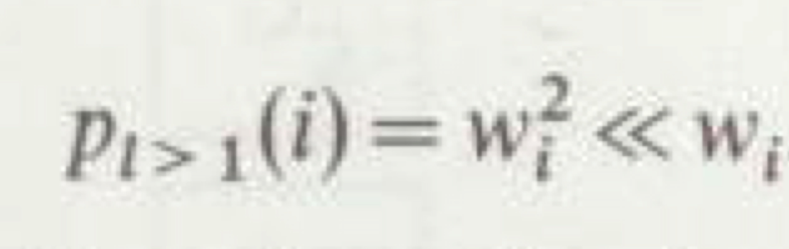
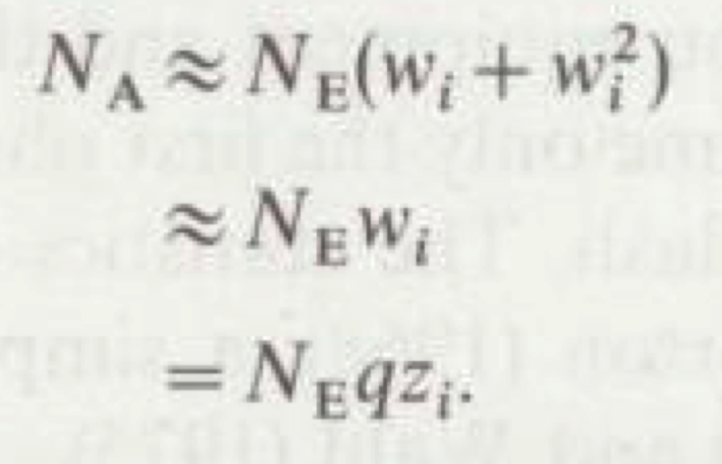
TC-SPC statistics basics 2
After a large number of excitation pulses N_{E},
the number of anode pulses N_{A} in the i-th interval.
After developing to Taylor series,
as shown before:
And it follows:
Therefore the number of anode pulses N_{A} is
proportional to the intensity of the fluorescence
at time t_{i}.

Slide 26
TCSPC statistics scheme
N_{A} number of counts in i-th interval
N_{E}
z_{i}
w_{i}
TAC
N_{A}
N_{i}
N_{D}
i-th channel
N_{i}=N_{A}

Slide 27
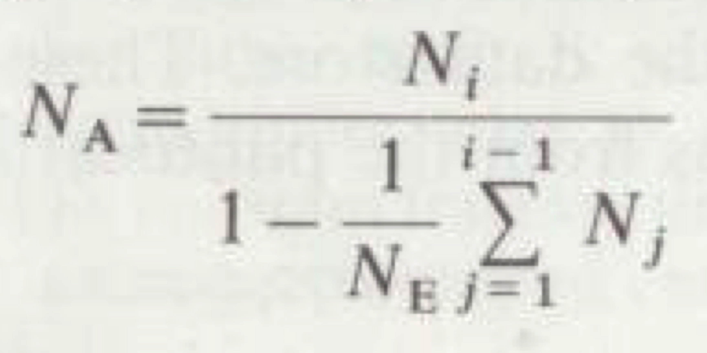
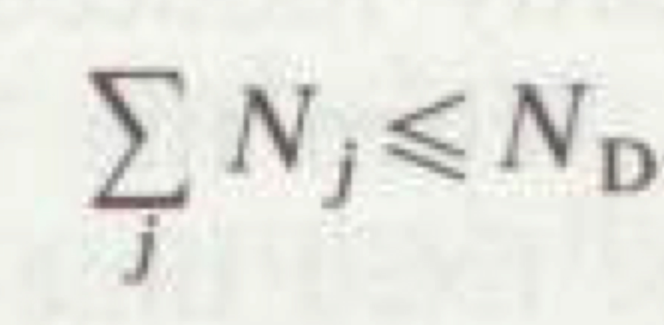
TC-SPC statistics basics 3
Relation of N_{A} to number of
Counts in the i-th channel N_{i}:
Because the TAC detects only the first photon
in given time interval for a given excitation cycle,
N_{A} is not the number of counts in the i-th channel N_{i}.
The true relation is given left.
Consequently the count in channel i is a measure
of the fluorescence intensity at time t_{i}.

Slide 28
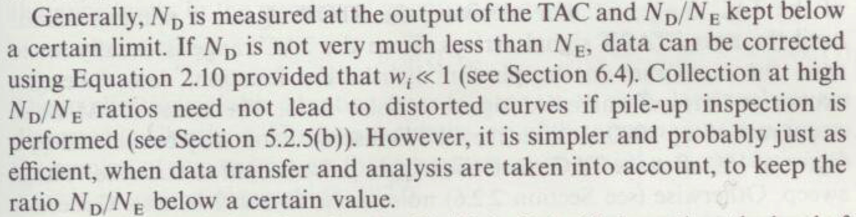
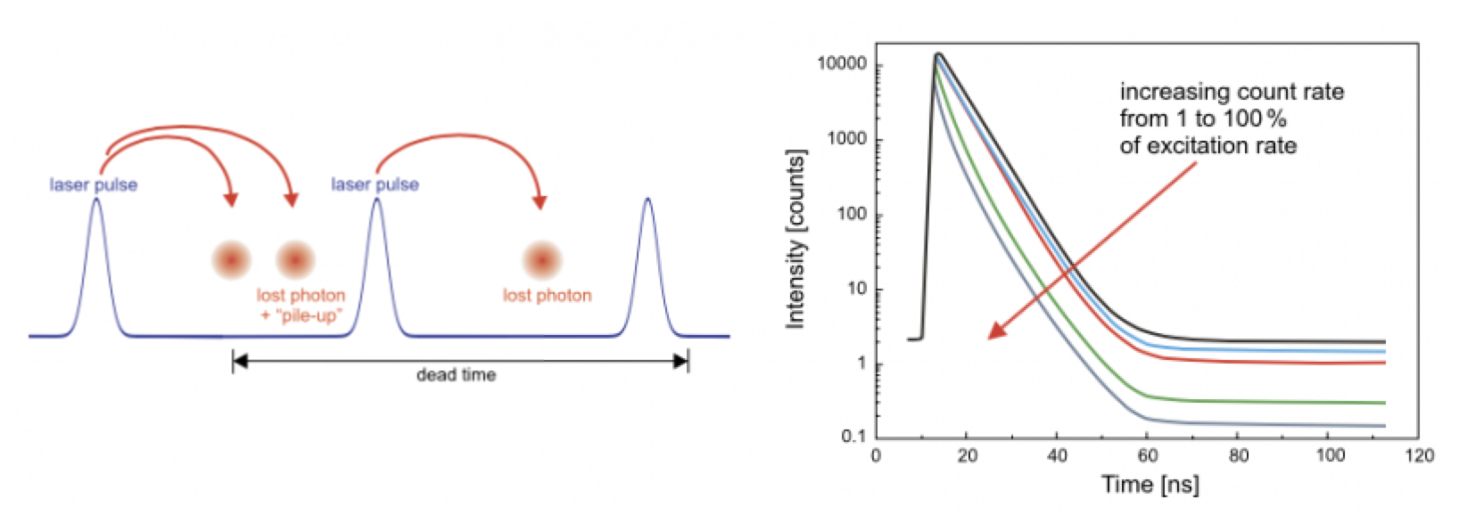
TC-SPC statistics basics 4
PILE-UP effect

Slide 29
Other issues to be aware of
Color effect (consequence of photoeffect)
Afterpulsing (consequence of PMT setup)
Ultra-short reflections
…

Slide 30
Sensitivity and precision
The effect of PMT noise is greatly reduced by the mode of TAC operation
>>> enhanced Signal-to-Noise ratio (up to 100x noise reduction)
Noise due to the dark counts on PMT (cooling, background subtraction …)
Noise due to the counting error, number of counts in each channel I(t_{i}) follows
a Poisson distribution with a standard deviation σ_{i} given by σ_{i}=(I(t_{i}))^{1/2}
It follows that to have 5% precision in the number of N_{i} counts in i-th channel,
where the the curve decayed to 1% of its maximum value, one has: 0.05=1/σ_{i} =1/(N_{i})^{1/2}
and N_{i} is 400, that means one has to measure 40000 counts in maximum
Signal-to-Noise ratio is given as well by the Poisson distribution and is equal
to the standard deviation:
Dynamic range (ratio between the largest and smallest value of measured quantity):
for ICCD typically 1000:1, streak 10000:1, for TCSPC usually 100000:1 and more

Slide 31
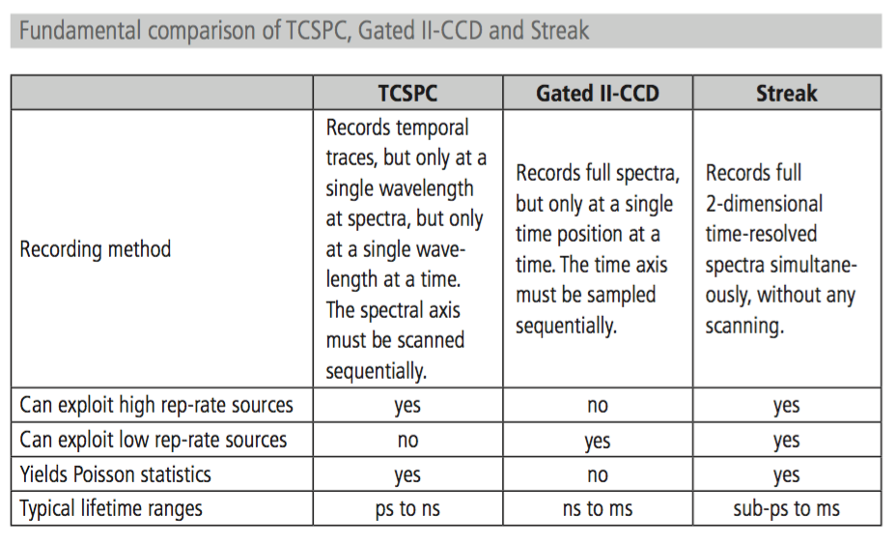
Comparison
Hamamatsu News 2009

Slide 32
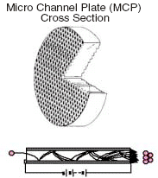
PMT and MCP structure
Gain of up to 10⁸

Slide 33
PMT resolution, transit time
Leading edge discrimination
CFD
pulse-height-induced timing jitter avoided
Becker 2006 Advanced TCSPC techniques

Slide 34
PMT resolution, transit time
Becker 2006 Advanced TCSPC techniques

Slide 35
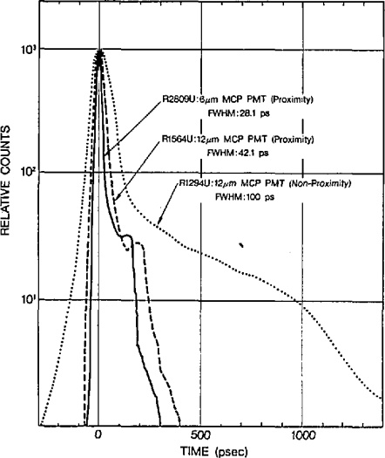
PMT transit time spread

Slide 36
PMT transit
Lakowicz 2006 Principles of fluorescence spectroscopy

Slide 37
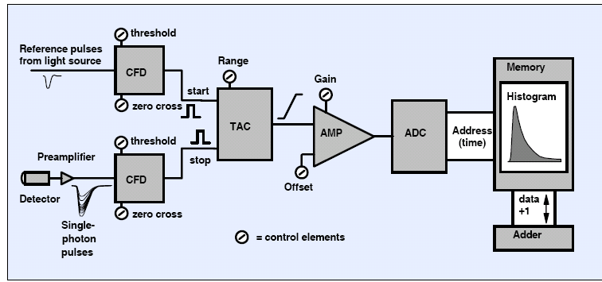
TC-SPC review
light intensity > 0.01 to 0.1 photons per signal period → Pile-Up Problem
Relatively slow recording speed and long data acquisition times
→ high repetition rates and low dead time (approx. 100 ns; i.e. 10⁷ photons/s)
Becker 2006 Advanced TCSPC techniques

Slide 38
Use in plasma-physics and signal synchronization
Short discharges with high repetition:
rf discharges, barrier discharges, Trichel
pulsing corona, self-pulsing
sparks
Synchronization via light pulse, current pulse, laser excitation or TTL of applied voltage waveform

Slide 39
Kinetic scheme dependent example
Streamer discharges generated in atmospheric pressure air
Spectra is dominated by the second positive system of molecular nitrogen
Relatively weak bands of first negative system are present as well

Slide 40
Kinetic scheme dependent example
Streamer discharges generated in atmospheric pressure air
Spectra is dominated by the second positive system of molecular nitrogen
Relatively weak bands of first negative system are present as well

Slide 41
Kinetic scheme dependent example
Streamer discharges generated in atmospheric pressure air

Slide 42
Trichel pulse corona
Breakdown in negative corona Trichel pulse

Slide 43
Setup for corona and calibration

Slide 44
Calibration
Streamer discharges generated in atmospheric pressure air

Slide 45
Trichel pulse electric field
SPS
FNS

Slide 46
Limits for TCSPC on streamers

Slide 47
Quantum mechanics based example
Obradovic 2008 APL

Slide 48
Quantum mechanics based example
Kuraica 1997 APL

Slide 49
RF discharge in helium at 1atm
Navratil 2015 TCSPC results

Slide 50
Quantum mechanics based example
Navratil 2015 TCSPC results

Slide 51
Summary
The principles and technical realization of the TCSPC technique were introduced
The measured fluorescence from the atomic/molecular transitions was followed back to its origin
Selected examples of quantitative high-resolution spectroscopy were presented

