Slide 2
Severoamerický kraton

Slide 3
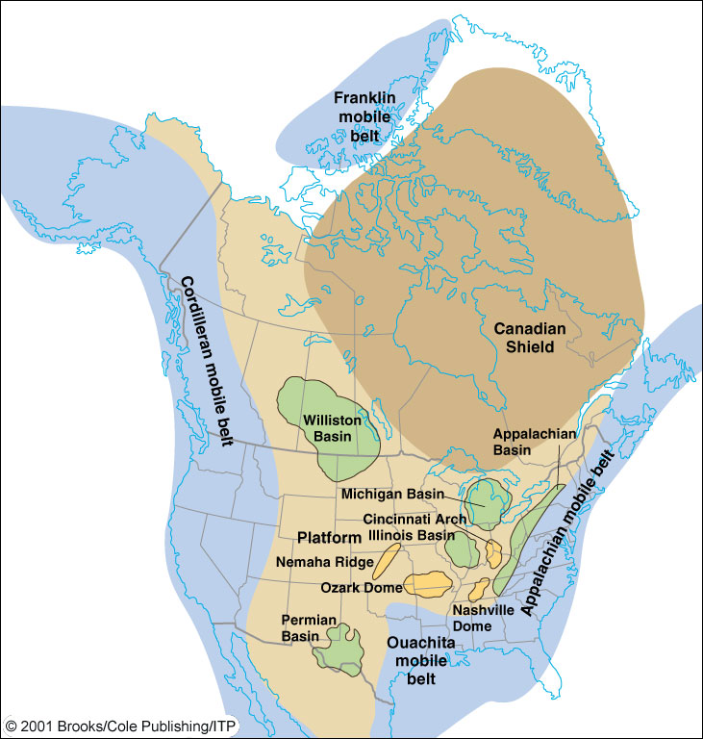

4
Canadian (Laurent) shield – not covered during Paleozoic, re-mainder of craton (light brown) was periodically cover-ed by epeiric (shallow, inland) seas. Green (basins) & yellow (domes) = local areas of gentle warpage of platform sedimentary rocks.
Appalachian Basin

Slide 4
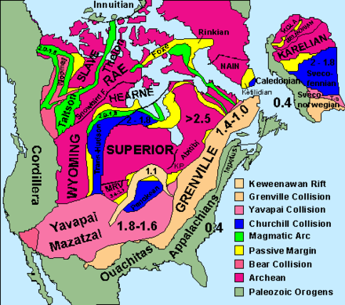
První významnou orogenezí byla na konci archaika orogeneze algomská (kenoranská), která vytvořila kraton Superior. V paleoproterozoiku Taltson – Thelon orogeneze přičlenila ke kratonu Rae kraton Slave. Hlavní část laurentského štítu byla vytvořena při transhudsonské orogenezi (1,8-1,9 Ga), menší části byly přičleněny při woopmayské. yavapaiské, mazatzalské a penocké orogenezi (1,5-1,8). Nejmladší proterozoickou orogenezi je grenvilská, která skončila před 1,0 Ga.

Slide 5
Algoman (kenoran) orogeny
The Algoman orogeny, known as the Kenoran orogeny in Canada, was an episode of mountain-building (orogeny) during the Late Archean Eon that involved repeated episodes of continental collisions, compressions and subductions. Five discrete accretionary events assembled fragments of continental and oceanic crust into a coherent Superior craton by 2.60 Ga. The final accretionary event involved addition of the Minnesota River Valley terrane (MRVT) from the south. Blocks were added to the Superior province along a 1,200 km (750 mi) boundary that stretches from present-day eastern South Dakota into the Lake Huron area; The current boundary between these terranes is known as the Great Lakes tectonic zone (GLTZ)

Slide 6
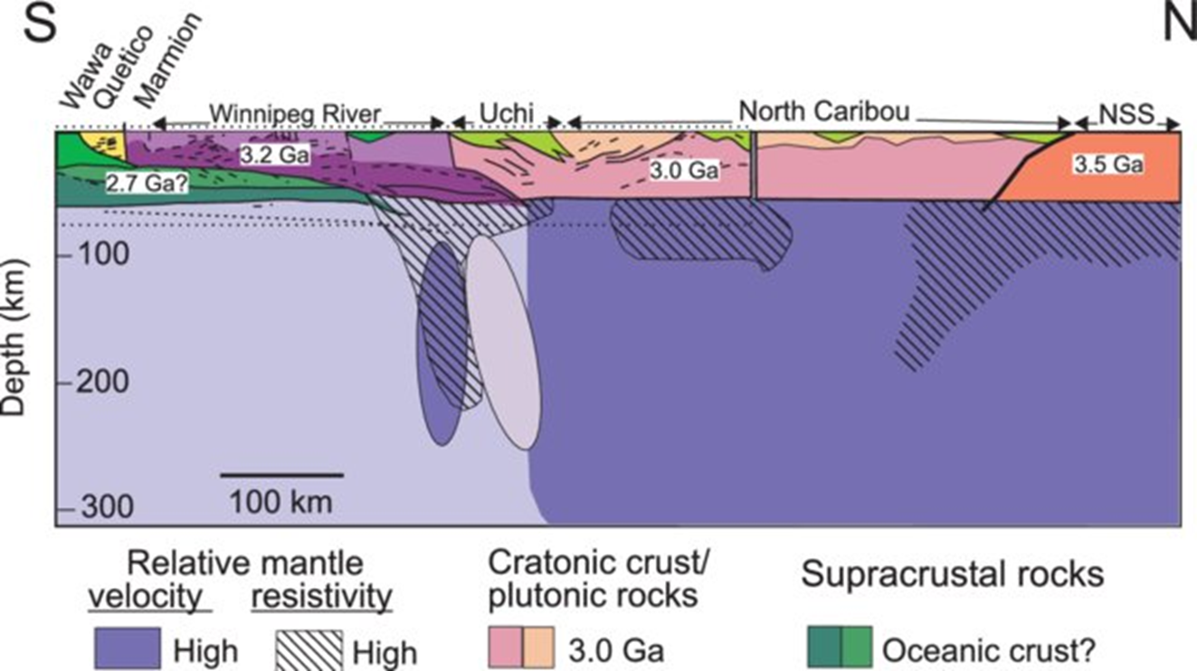
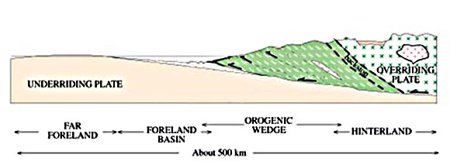
The Minnesota River Valley subprovince collided with and overrode the Superior province.

Slide 7
Taltson – Thelon orogeny
The Taltson magmatic and Thelon tectonic zones have historically been considered parts of a single orogen recording collision between the Slave craton and Buffalo Head terrane to the Rae craton between2.0 and 1.9 Ga.
We have provided two alternative models for the Talston orogeny. In the first, the Taltson orogen and the combined Thelon tectonic zone and Ksituan domain represent two separate orogenic belts. They record the accretion of the Slave craton and a superterrane that includes the Kiskatinaw-Chinchaga-Buffalo Head aeromagnetic domains and this amalgam was subsequently accreted to the southwest mar-gin of the Rae craton. In the second, where the Slave craton was already attached to the western Rae craton before the Taltson orogeny, the superterrane including the Kiskatinaw-Chinchaga-Buffalo Head aeromagnetic domains was accreted to the southwestmargin of Rae.

Slide 8
Fig. 11. Tectonic reconstruction cartoons hypothesizing the potential timelines of the Taltson orogeny. (a) Model 1. The Slave craton is an active part of separate Taltson and Thelon orogenies. (b) Model 2. The Slave craton was accreted to the Rae margin in advance of the Taltson orogeny. See text for discussion. Abbreviations: BC = Bear Creekforedeep; Bf = Bathurst fault; BH = Buffalo Head; Kiskatinaw and Chinchaga terranes; GSLsz = Great Slave Lake shear zone; Ho = Hottah terrane; Ks = Ksituan arc; Stz = Snowbirdtectonic zone; Ta = Taltson arc; Tao = Taltson orogen; Tbc = Taltson basement complex; Th = Thelon arc; Thtz = Thelon tectonic zone.

Slide 9
Fig. 1. Cratonic map of western Laurentia (after Hoffman, 1988; Ross et al., 1991). Precambrian lithostructural domains of northern Saskatchewan and northeastern Alberta
(dashed box, inset). Black polygons are regions mapped during this study: a = Careen Lake; b = Fournier Lake; c = Lloyd Lake. Hatched polygon in the Lloyd domain labelled
Cac indicates the extent of the Clearwater anorthosite complex.

Slide 10
Trans-Hudson orogen
The Trans-Hudson Orogen (THO) of North America is one of the earliest orogens in Earth's history that evolved through a complete Wilson Cycle. The trans-Hudson Orogen sensu stricto represents ca. 150 Ma of opening of the Manikewan Ocean, from c. 2.07-1.92 Ga, before it started to close in the interval 1.92-1.80 Ga. The Manikewan Ocean (Stauffer 1984) is the oceanic plate that once existed between the Superior Craton and the Hearne Craton (Fig. 2a), stretching from South Dakota to the Ungava Peninsula in northern Que´bec. Snowbird orogeny at ca. 1.90 Ga. during which the Rae craton was thrust over the Hearne is regarded as trans- Hudson orogen sensu lato.
The Trans-Hudson orogen sutured together the Hearne-Rae, Superior, and Wyoming cratons to form the cratonic core of North America in a network of Paleoproterozoic orogenic belts. The orogenic belts include at least three large continental fragments or micro-continents identified in the Manikewan Ocean ‘realm’ and identified as the Sask, Sugluk and Meta Incognita–Core Zone blocks and several oceanic and pericratonic arc and back-ar complexes (Figure 2a). There are two interpretation of Wyoming craton 1) together with Hearne forming one continental block 2) involved in a separate, younger collisional event at ∼1.77 Ga with Hearne

Slide 12
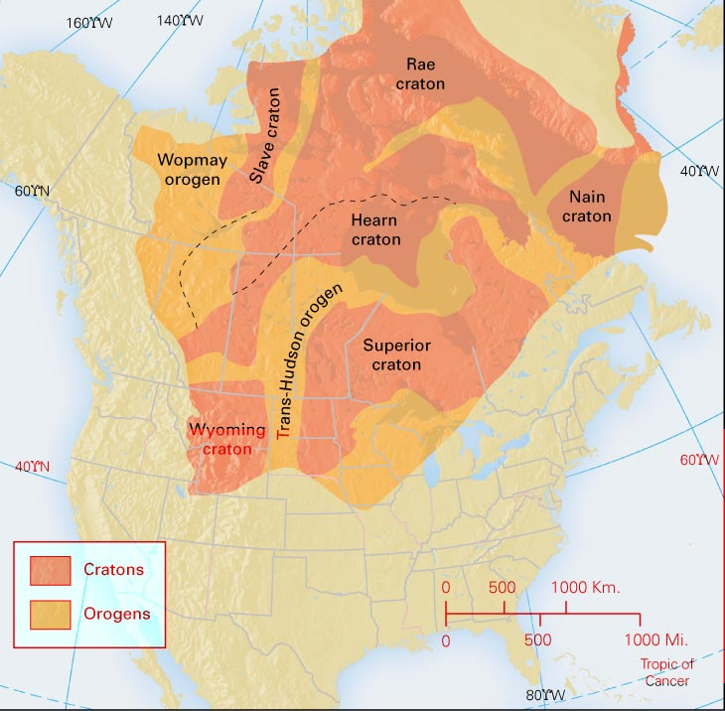

Slide 14
Snowbird orogeny
Snowbird orogeny at ca. 1.90 Ga. The Rae craton was thrust over the Hearne at this time and that uplift continued during dextral – oblique, strike-slip displacement during the early parts of the Trans-Hudson orogeny

Slide 15
Figure 4.9. Cartoon depicting the evolution of the Virgin River shear zone at three different times. (a) The proposed position of the various cratonic blocks at ca. 1.94 Ga, the culmination of the of the Taltson orogeny (M1r). A new subduction zone is nucleating southeast of the Rae craton bringing the Hearne craton and causing emplacement of the Snowbird arc. The north arrow pertains to the present-day position of the various cratonic elements. A cross section of this scenario is below. (b) The compressional stage of the Snowbird orogeny at ca. 1.90 Ga. The Taltson basement complex is folded around the core of the Rae craton after the Hearne craton docks. The cross section shows the fold and thrust belt of the Virgin River shear zone with slices of the Taltson basement complex and Rae craton thrust over the Hearne craton. (c) The Virgin River shear zone has converted to a dextral-oblique, strike-slip structure by 1.85 Ga but exhumation of the Rae block continues, loading the Hearne craton and leading to M3h metamorphism in the latter. The Taltson basement complex is dismembered along the Snowbird tectonic zone during this stage. See text for discussion. Original in colour.

Slide 16
Transhudson orogeny sensu stricto

Slide 17
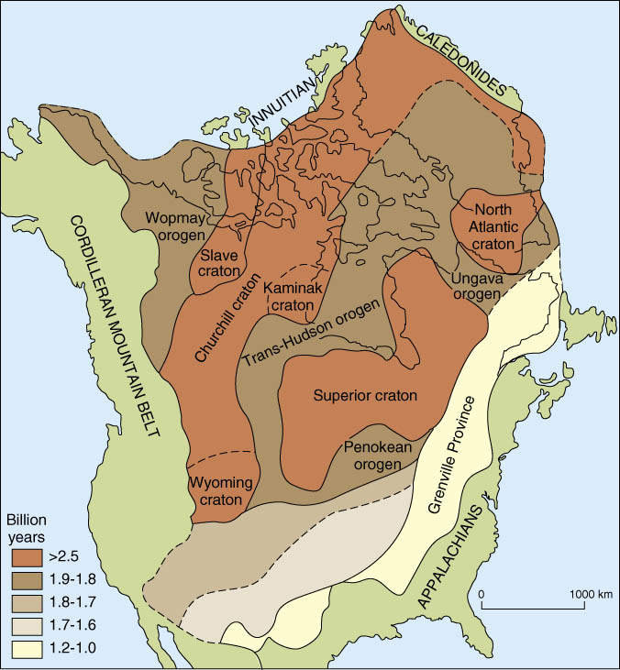

Slide 18
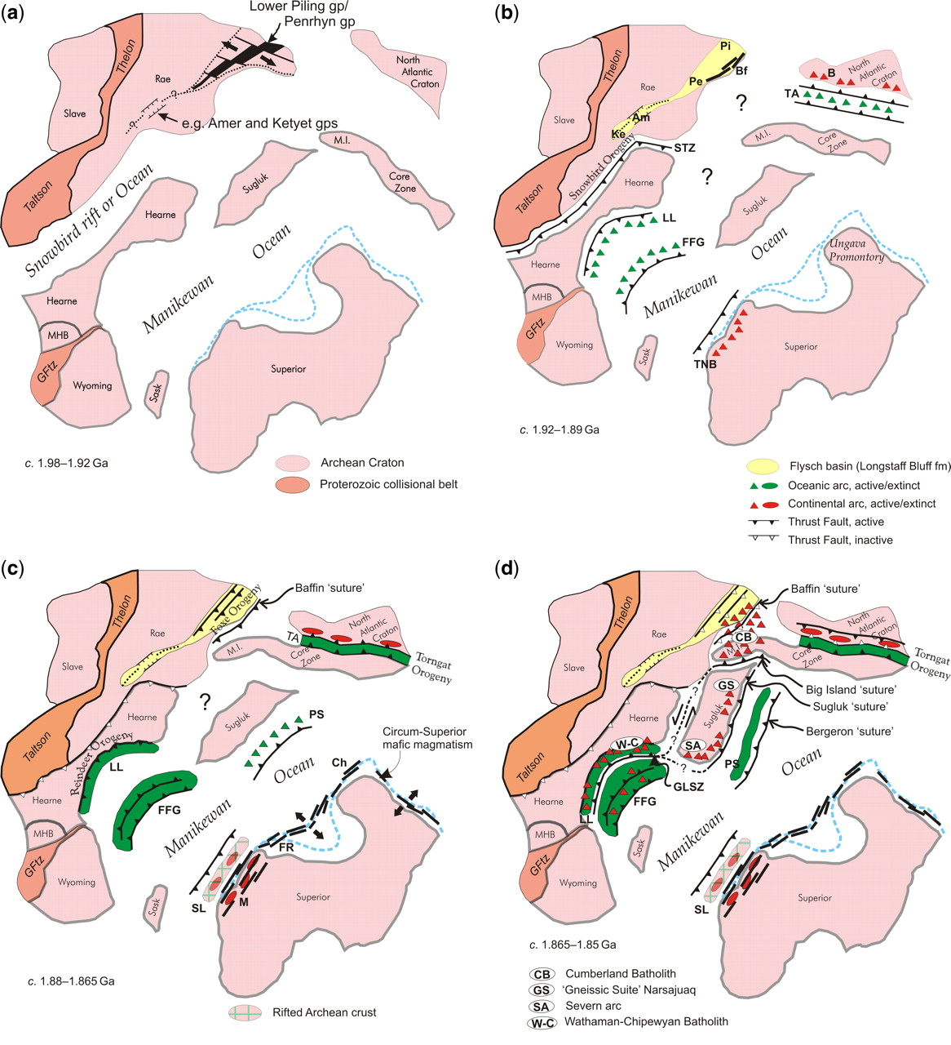

Slide 19
Fig. 2. Series of cartoons illustrating a map view of the geological evolution of the THO, with the main tectonic
elements shown: (a) main lithotectonic elements during the interval 1.98–1.92 Ga, prior to the onset of convergence;
(b) the interval 1.92–1.89 Ga; (c) the interval 1.88–1.865 Ga; (d) the interval 1.865–1.85 Ga; (e) the interval 1.85–
1.83 Ga; and (f) the interval 1.83–1.80 Ga. The blue coloured hashed lines represent possible extensions of the
Superior Craton at Moho. Although not discussed in text, evolution of North Atlantic Craton (shown here to include
Archaean basement rocks and their cover on Hall and Cumberland peninsulas on Baffin Island (e.g. Scott 1999;
Jackson & Berman 2000) and tectonostratigraphic elements of the New Quebec and Torngat orogens are after
Wardle et al. (2002). Abbreviations: Am, Amer group; B, Burwell arc; BeS, Bergeron suture; BS, Baffin suture; BiS,
Big Island suture; Bf, Bravo formation; Ch, Chukotat; FFG, Flin Flon–Glennie Complex; FR, Fox River belt; GFtz,
Great Falls tectonic zone; GLsz, Granville Lake structural zone; Hoare Bay group; KB, Kisseynew Basin; Ke,
Ketyet group; LL, La Ronge–Lynn Lake belts; LTSz, Lac Tudor shear zone; M, Molson dykes; MHB, Medicine Hat
block; M.I., Meta Incognita micro-continent; Pe, Penrhyn group; Pi, Piling group; PS, Parent arc and Spartan
forearc; PT, Pelican thrust; SL, Snow Lake belt; SS, Sugluk suture; STZ, Snowbird Tectonic Zone; TA, Tasiuyak
domain; TNB, Thompson Nickel Belt

Slide 20
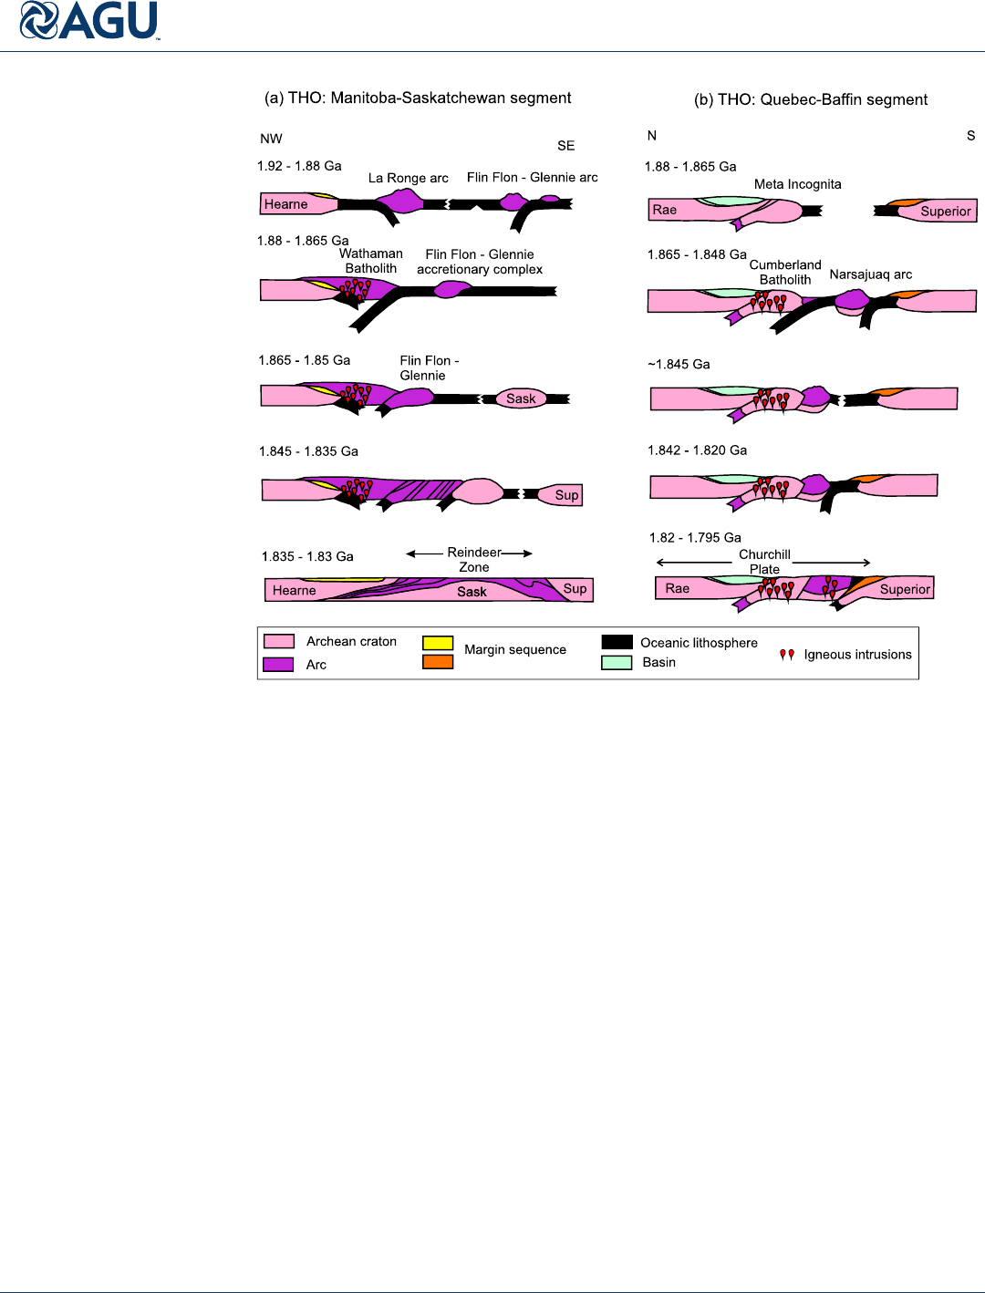

Slide 21
Columbia

Slide 22
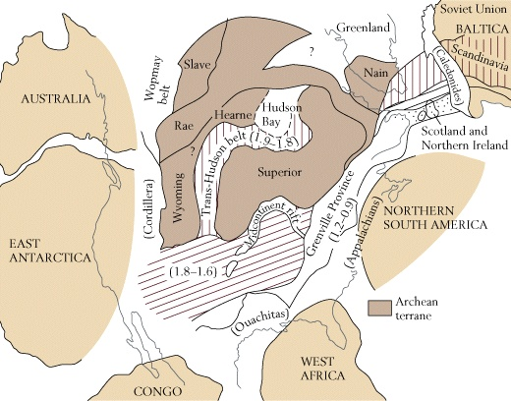
Continental Accretion
During Proterozoic, Laurentia was growing by accretion
Tranhudson orogeny:
1.95-1.85 bya
Suturing of ~six
microcontinents

Slide 23
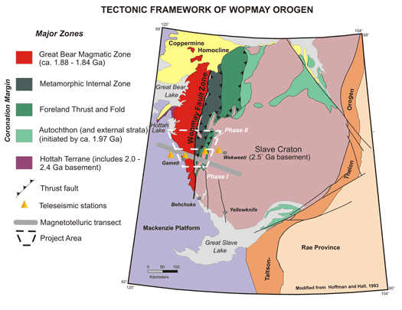
Woopmay orogeny
The Wopmay orogen is a Paleoproterozoic orogenic belt formed by the obduction of Hottah terrane, an arc-bearing microcontinent, onto the western margin of the Archean Slave craton at about 1.88 Ga.

Slide 24
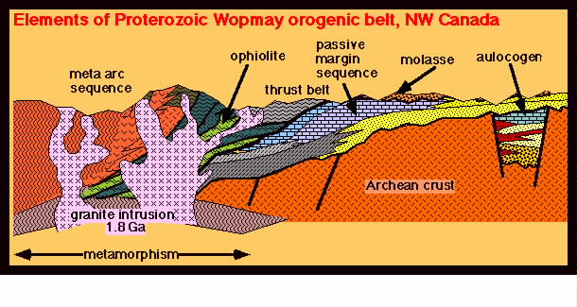
The Wopmay orogen can be subdivided into (east to west): a passive continental margin, the Wopmay fault zone, the Great Bear magmatic zone, and the Hottah terrane. The passive margin developed around 1970–1890 Ma on-top of the Slave Craton. The Wopmay fault zone is probably a suture between the Slave craton and the Hottah terrane.
Slave craton

Slide 25
Penokean orogeny
The Penokean orogeny began at about 1880 Ma when an oceanic arc, now the Pembine–Wausau terrane, collided with the southern margin of the Archean Superior craton marking the end of a period of south-directed subduction. The docking of the buoyant craton to the arc resulted in a subduction jump to the south and development of back-arc extension both in the initial arc and adjacent craton margin to the north. The newly established subduction zone caused continued arc volcanism until about 1850 Ma when a fragment of Archean crust, now the basement of the Marshfield terrane, arrived at the subduction zone. The convergence of Archean blocks of the Superior and Marshfield cratons resulted in the major contractional phase of the Penokean orogeny.
Evidence of the Penokean orogen is now largely confined to the Lake Superior region. Comparisons with more recent orogens formed by similar plate tectonic processes implies that significant parts of a once more extensive Penokean orogen have been removed or overprinted by younger tectonic events.

Slide 26
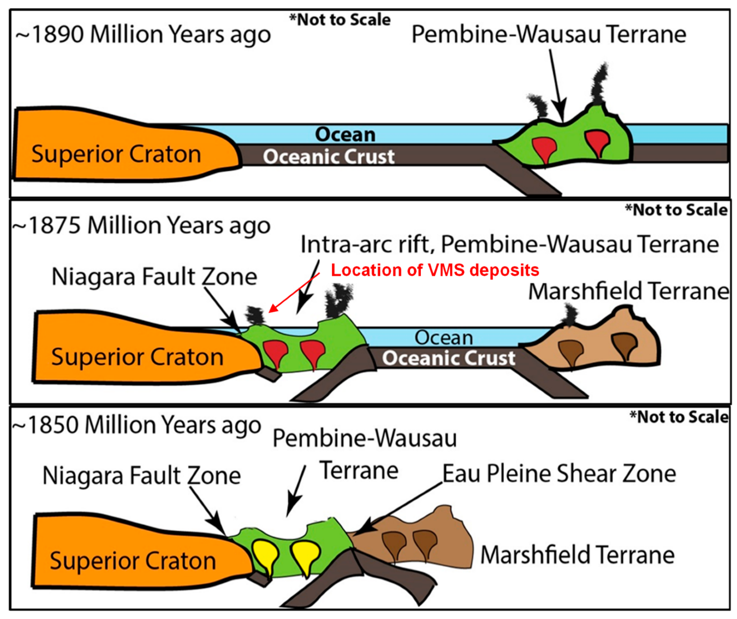
Penokeam orogeny
The Penokean orogeny was a mountain-building episode that occurred in the early Proterozoic about 1.86 to 1.83 billion years ago, in the area of Lake Superior, North America

Slide 27
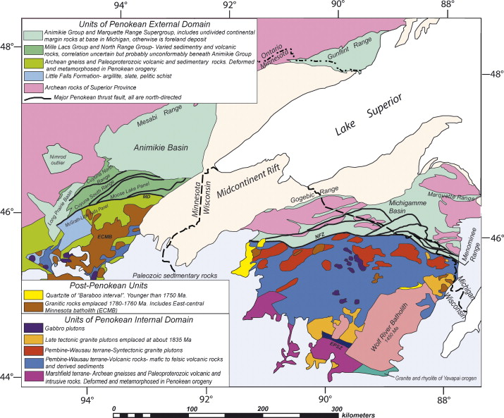

Slide 28
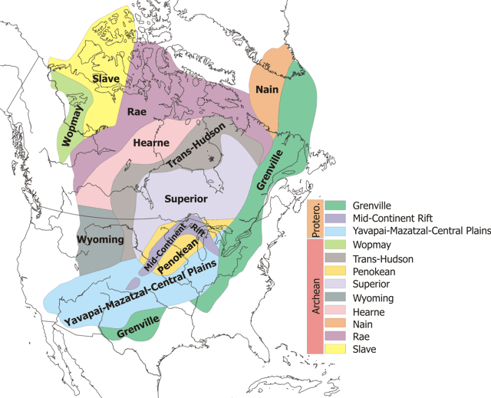

Slide 29
Accretionary tectonics
Accretionary provinces are composed of numerous 10 to 100 km scale terranes or blocks, separated by shear zones, some of which had compound histories as terrane sutures and later crustal assembly structures. Some accreted terranes contain older continental crustal material [Archean(?) Mojavia]. Major northeast-trending accretionary provinces are the Yavapai province (1.80– 1.70 Ga), welded to North America during the 1.71–1.68 Ga Yavapai orogeny; the Mazatzal province (1.70–1.65 Ga), added during the 1.65–1.60 Ga Mazatzal orogeny.
The Yavapai orogeny was an orogenic event in what is now the Southwestern United States from 1710 to 1680 Mya[1] in the Statherian Period of the Paleoproterozoic. Preserved in the rocks of New Mexico and Arizona, it is interpreted as the collision of the 1800-1700 Mya age[1] Yavapai island arc terrane with the proto-North American continent.
The Mazatzal orogeny was an orogenic event in what is now the Southwestern United States from 1650 to 1600 Mya[1] in the Statherian Period of the Paleoproterozoic. Preserved in the rocks of New Mexico and Arizona, it is interpreted as the collision of the 1700-1600 Mya age[1] Mazatzal island arc terrane with the proto-North American continent.

Slide 30
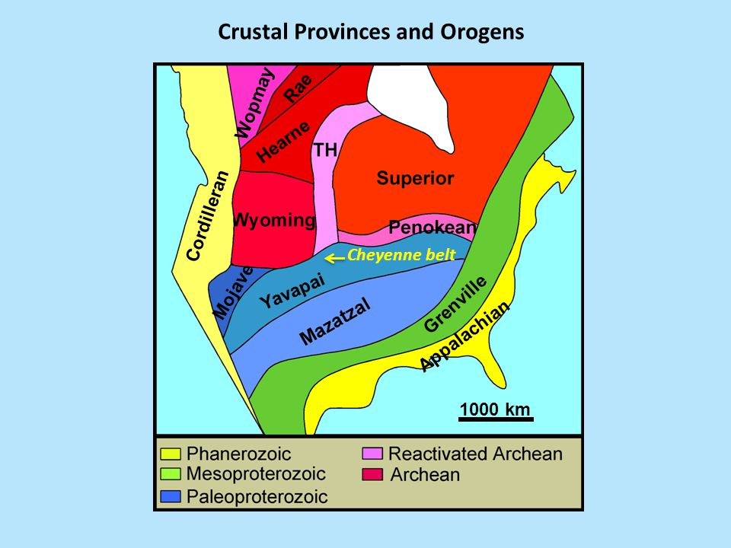

Slide 31
Granite-Rhyolite Province
Accretion continued in southwest Laurentia with the docking of 1550–1400 Ma juvenile crust Subduction was accompanied by continental `extension' or `rifting‚ and widespread 1480–1350 Ma A-type magmatism that defines the Granite-Rhyolite Province in southeastern Laurentia (Van Schmus et al., 1996; Whitmeyer and Karlstrom, 2007; Bickford et al., 2015) and also extends into the inboard Paleoproterozoic basement terranes of southwest Laurentia

Slide 32
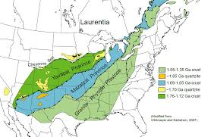

Slide 33
Grenville Orogeny
Late Mesoproterozoic Grenville Orogeny records convergence, arc accretion, and continent continent collision between ca. 1350 and 1000 Ma. Within the Grenville Province of south-eastern Canada, which is the most thoroughly studied portion of this composite orogen, this period of orogenesis included (1) an early accretionary stage at 1.3–1.2 Ga, (2) an interval of widespread magmatism at 1.18–1.08 Ga, (3) and a period of continent–continent collision at 1.08–0.98 Ga that was rapidly followed by uplift and exhumation of the orogenic core.
The Grenville orogeny was a long-lived Mesoproterozoic mountain-building event associated with the assembly of the supercontinent Rodinia. Its record is a prominent orogenic belt which spans a significant portion of the North American continent, from Labrador to Mexico, as well as to Scotland. It is assumed that two separate continental blocks collided with Laurentia - Baltica and Amazonia

Slide 34
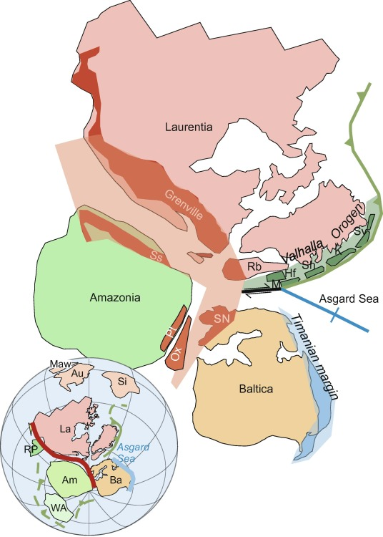

Slide 35
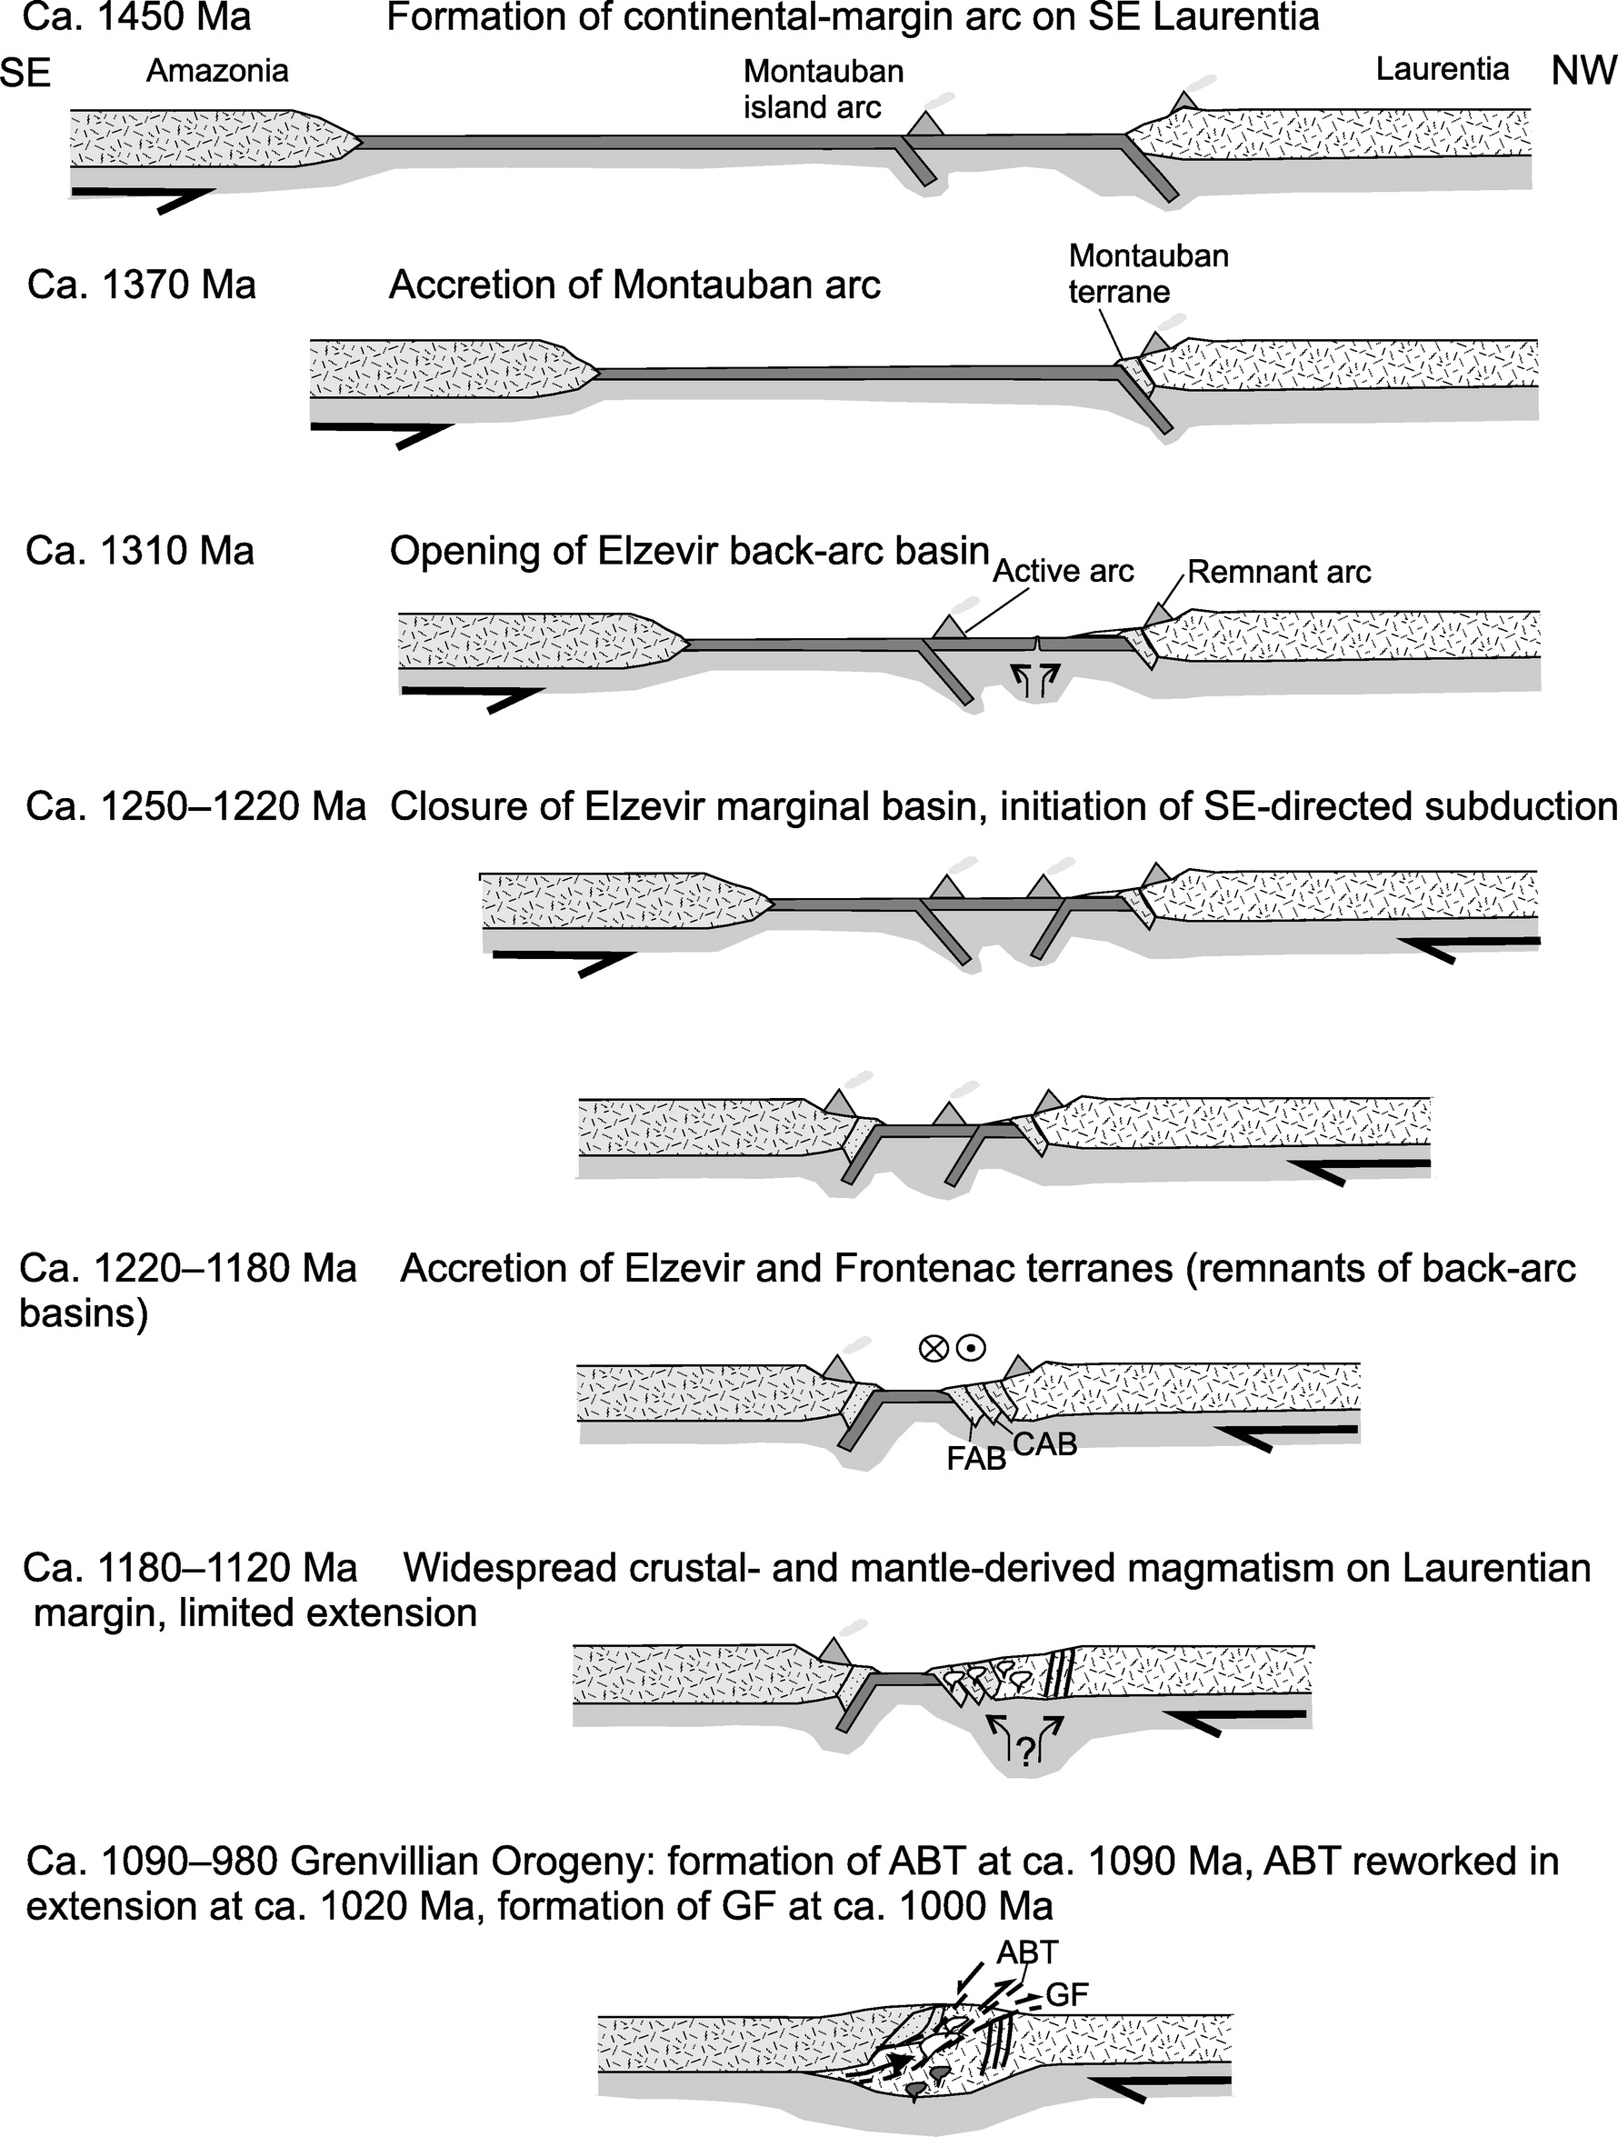
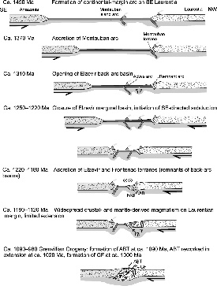
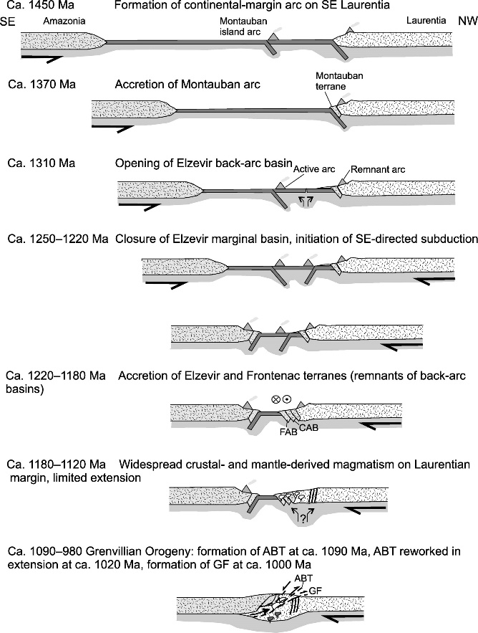

Slide 36
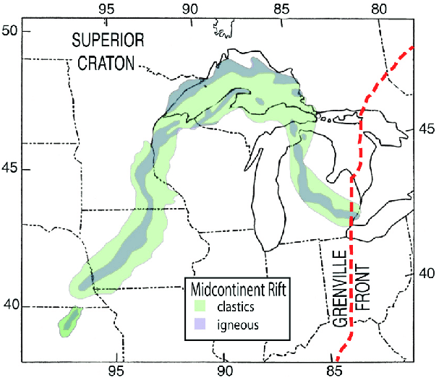
Midcontinent rift
The rift system may have been the result of extensional forces behind the continental collision of the Grenville Orogeny to the east which in part overlaps the timing of the rift development. Another model suggests the role of mantle plume. Later compressive forces from the Grenville Orogeny likely played a major role in the rift's failure and closure.

