Slide 1
English for Mathematicians I
Week 12 – Revison

Slide 2
Lesson 12
university vocabulary
language focus
  negative statements in mathematics
  it is (in)sufficient for … to …
geometry – revising 3D figures
video – History of mathematics – Part II

Slide 3
I. University studies
Fill in the gaps with the following words
assignment tutorial paper take/sit seminar study research failed enrol lecture pass dean dormitory scholarship associate professor revise conference vacation
If you get a …………… to a school or university, your studies are paid for by the school or university or some organization.
When he was a student at university he used to work during the summer ………. as a waiter.
You do not usually talk about homework at university. You use the word ………..instead.
A ……………. is when a teacher at a university or college discusses a subject with a group of students.
…

Slide 4
I. University studies
Fill in the gaps with the following words
scholarship
vacation
assignment
seminar (tutorial)
enrol
conference
research
paper
pass
10. lecture
11. study
12. failed
13. tutorial
14. take/sit
15. revise
16. Dormitory
17. associate professor
18. Dean

Slide 5
Translate into English
Žádný prvek z této množiny nesplňuje uvedený požadavek.
Tato rovnice neplatí pro žádné reálné x.
Tato nerovnost platí pouze pro jedno celé číslo.

Slide 6
III. Language Focus
1. a) Look and read (note: an “integral value” means an integer):
0˂x˂1 | No integral value satisfies this inequality.
x = √-1 | No real number satisfies this equation.
x is a prime number and x is even | Only one number satisfies these requirements.

Slide 7
satisfies these requirements.
b) Now write similar sentences about the following:
x is the square of an integer and the last digit of x is 3 | ……………value ……..
x² + 5 = 0 | b) ………..real value ……
0˂x˂2 | c) ……..integral value……
x² + 2x – 35 = 0 | d) …….positive value……
x = √2 | e) ……..rational number……
x is divisible by both 7 and 9 and x˂100 | f) ………value………
No integral
No
satisfies this equation.
Only one
satisfies this inequality.
Only one
satisfies this equation.
No
satisfies this equation.
Only one positive
satisfies these requirements.

Slide 8
III. Language Focus
2. Translate into English
Žádný prvek z této množiny nesplňuje uvedený požadavek.
Tato rovnice neplatí pro žádné reálné x.
Tato nerovnost platí pouze pro jedno celé číslo.
No element from this set satisfies the given requirement.
No real x satisfies this equation. / This equation is valid for no real x.
Only one integer satisfies this inequality. /
This inequality is valid only for one integer.

Slide 9
2. a) Look and read:
We are given the length of one side of a regular hexagon. This is sufficient for the area to be calculated.
We are given the length of one side of a triangle. This is insufficient for the area to be calculated.

Slide 10
b) Now say/write sentences about the following in the same way:
Given | Required
one side of a square | area
b) one side of a rectangle | area
c) the altitude of a cone | volume
d) the area of one face of a regular dodecahedron | surface area
e) the length of the non-parallel sides of a trapezium | area
f) the surface area of a sphere | volume
g) the area of the lateral faces of a prism | volume
h) a chord of a circle | area

Slide 11
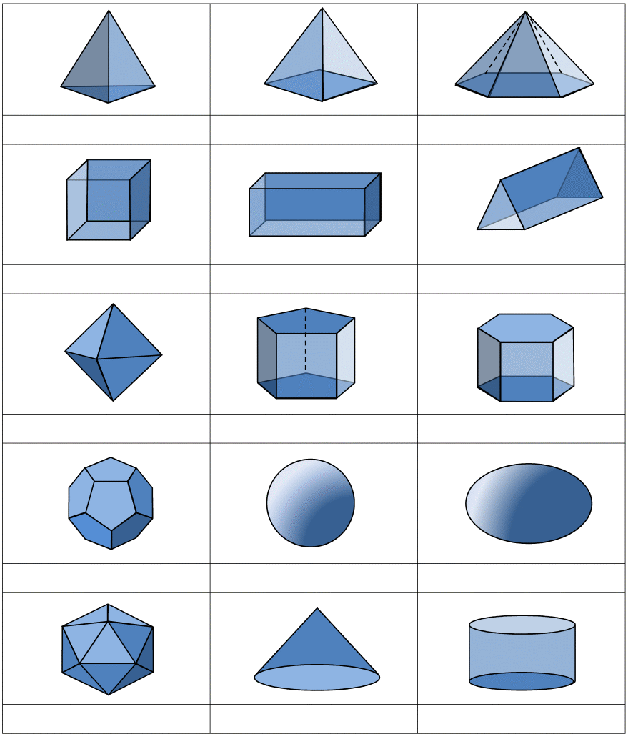
II. Geometry
1.
2.
3.
cuboid, cube, triangular prism,
pentagonal prism, hexagonal prism,
hexagonal pyramid, tetrahedron,
octahedron, icosahedrons,
dodecahedron, square-based pyramid,
sphere, cone, cylinder, ellipsoid
4.
5.
6.
7.
8.
9.
10.
11.
12.
13.
14.
15.

Slide 12
II. Geometry
1. tetrahedron
2.square-based p.
3. hexagonal pyramid
cuboid, cube, triangular prism,
pentagonal prism, hexagonal prism,
hexagonal pyramid, tetrahedron,
octahedron, icosahedrons,
dodecahedron, square-based pyramid,
sphere, cone, cylinder, ellipsoid
5. cuboid
(rectangular prism)
4. cube
6. triangular prism
7. octahedron
8.pentagonal prism
9. hexagonal prism
10. dodecahedron
11. sphere
12. ellipsoid
13. icosahedron
14. cone
15. cylinder

Slide 13
Video – History of Mathematics Part II – T/F
F (1650 BC)
The Rhind Mathematical Papyrus originated in 1615 B.C.
Egyptian workers got money for their work.
After the division of bread, each person gets 1 half, 1 third, and one fifth.
Egyptians used fractions for practical purposes, e.g. trade.
Horus lost both his eyes in a fight.
The geometric series appeared first in the Rhind Papyrus.
The concept of infinity was also discovered in the ancient Egypt.
F (food and drink)
F: dividing 9 loaves between 10 people: 1 half, 1 third, 1 fifteenth
T
F (one eye)
T
F (the concept was only implicit)

Slide 14
CREDIT TEST – week XIII.
Revise materials we have discussed in class.
Open the word document in our interactive outline week XIII.
Complete the tasks and upload the word document into odevzdávárna (for your group) by 15 January. (60% correctness)
Types of tasks: answer Qs, complete the missing words, describe a figure, write in mathematical symbols…
Complete the course questionnaire

