Slide 1
Chemical compounds in ecosystems
– introduction –
Luděk Bláha, SCI MUNI

Slide 2
Take home messages of this lecture:
Know the names, chemical properties (basic structural character) and sources of the main groups of pollutants
Explain what environmental factors (i.e. external) and what properties of chemicals (inherited) influence the behavior of compounds in the environment (logK_{ow}, H, persistence)…
… and thus condition the extent of bioavailability of compounds in the environment and exposure of organisms

Slide 3
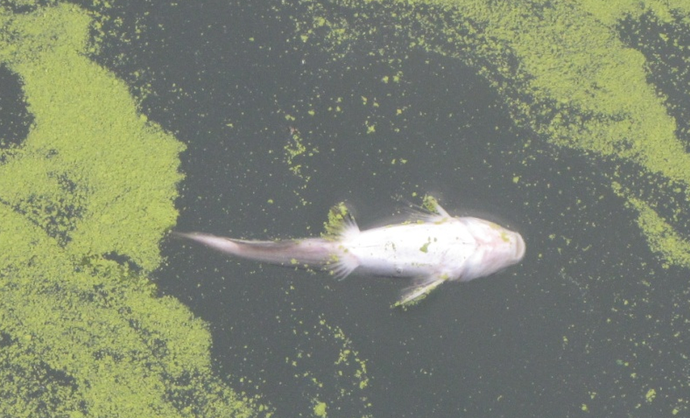
Important terms
Definitions are ambiguous... however, it is desired to understand the meaning of individual terms
TOXICANTS / TOXINS / ECOTOXICANTS
TOXICANTS
= compounds toxic in relatively low concentrations,
introduced into the environment by human activities
TOXINS
= natural tox. compounds – produced by plants, bacteria, animals
  Note - some examples of environmentally significant natural toxins, which are at the same time ecotoxicants: cyanobacterial toxins – environmentally relevant due to anthropogenic activities - eutrophication

Slide 4
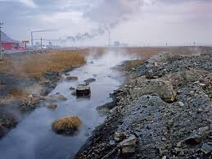
Ecotoxicants
Compounds selected from a wide range of chemical substances (petroleum and its products – organic compounds, pharmaceuticals, pesticides), which can be released into the environment and can cause specific effects/interactions in ecosystems
Each human activity is accompanied by introduction of (toxic) compounds into the environment
  products and side products of industry
  household waste (detergents, plastics ....)
  products used in agriculture
  wastes from transport
  veterinary and human pharmaceuticals
  other …

Slide 5
Ecotoxicants vs. Contaminants ?
Contaminants
Compounds polluting the environment
(Not necessarily directly toxic, but harmful at the end)
  ! nutrients (NOx and POx)
    are not ecotoxicants BUT do have many secondary effects
    → eutrophication
  ! organic communal waste
    not directly toxic BUT increases the content of organic carbon
    → decomposition processes → reduction of oxygen content → toxic to aquatic organisms
  ! toxic metals, polycyclic aromatic hydrocarbons (PAHs)
    natural occurrence in the nature BUT in “background” concentrations
  ! simple soaps
    released in high concentrations BUT rapidly hydrolyzed to nontoxic products

Slide 6
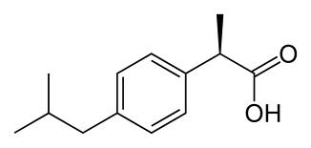
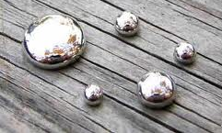
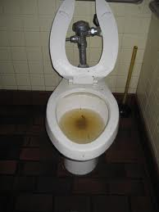
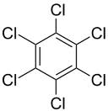
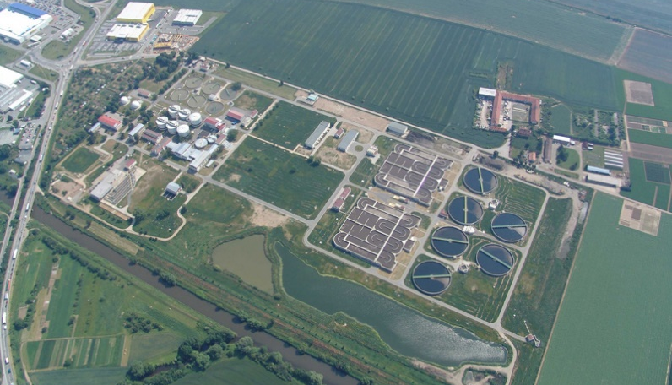
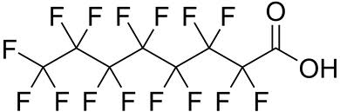
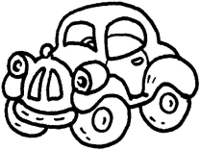
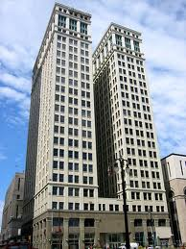
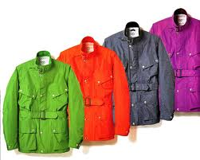



Contamination of water - chemicals ?
Degradable „nontoxic“
organic material
+ nutrients / fertilizers (N/P)
„Other“ chemicals

Slide 7
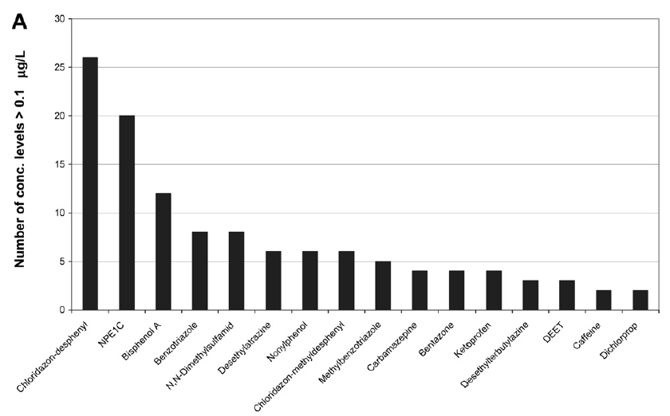
What chemicals for example?... In EU groundwaters?
Loos et al. Pan-European survey on the occurrence of selected polar organic persistent pollutants in ground water (Water Research 44, 2010, 4115-4126)

Slide 8
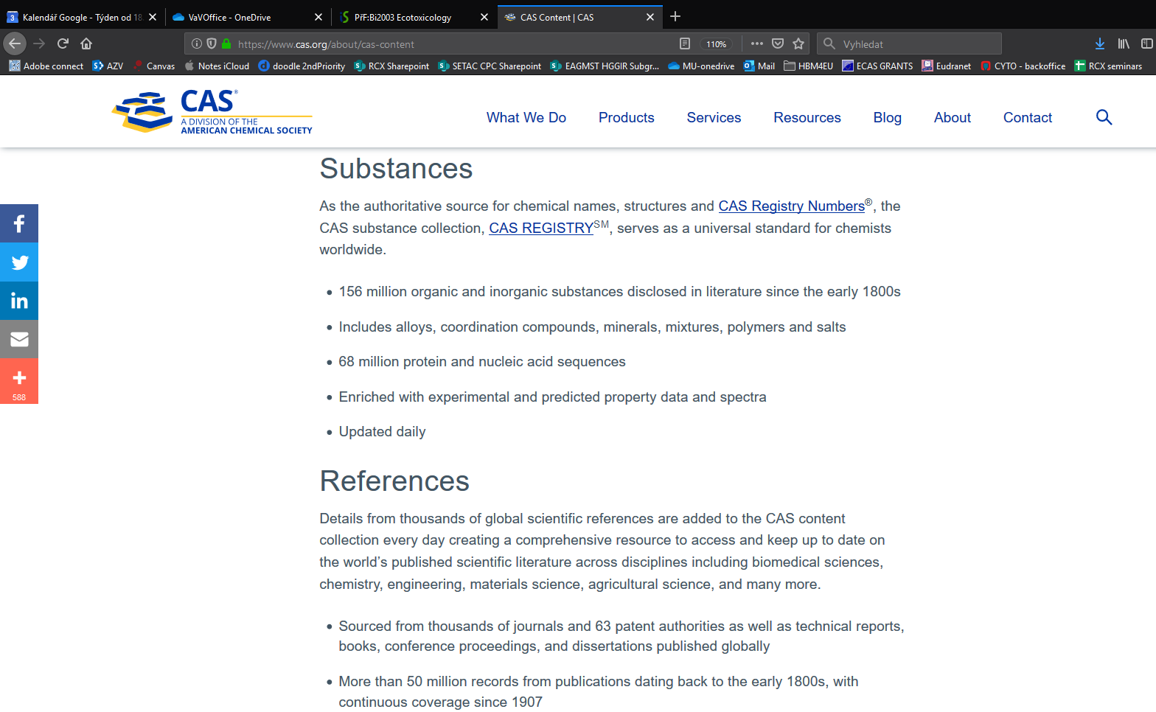
What numbers of CHEMICALS ?
www.cas.org

Slide 9
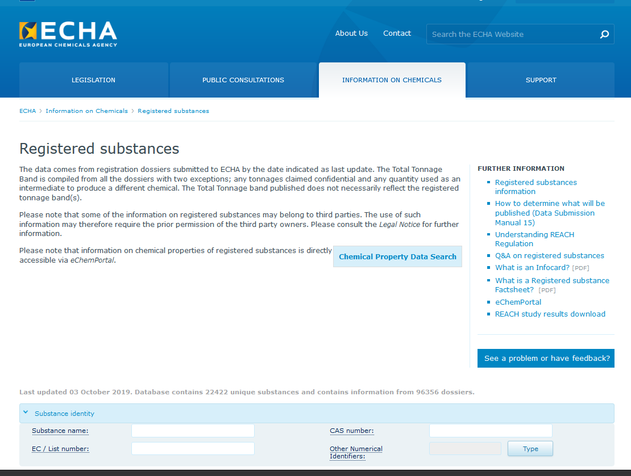
What numbers of CHEMICALS ?
https://echa.europa.eu/information-on-chemicals/ec-inventory
Cc
22,000
are used
by industry

Slide 10
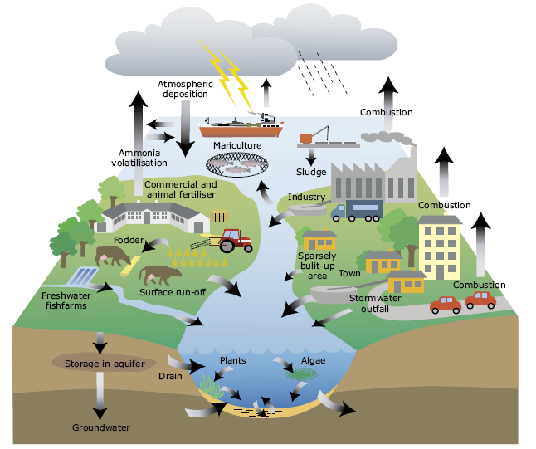
Sources... and examples of representative contaminants
Overview of contamination sources
  a student should have a general overview and be able to name representative examples
  POINT SOURCES (easier to control and penalize)
    communal wastewaters
    industrial wastewaters
    solid urban- and industrial wastes – damps / combustion
  DIFFUSE SOURCES (difficult to control)
    industry, engine emissions, energy production
    surface run-offs (roads, roofs, coatings...)
    agricultural activities
  LINE SOURCES (difficult to control)
    (highways) traffic

Slide 11
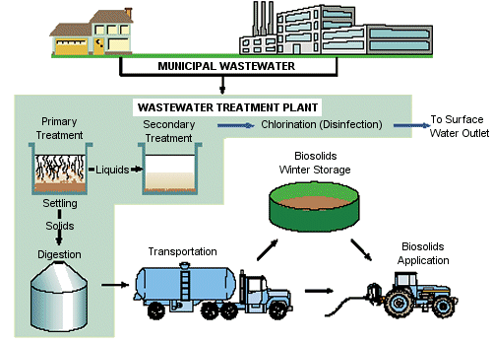
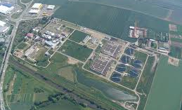
Communal wastewaters
Effect on environmental components
  Primary effect on water ... secondary also on soil and further influence on food chain (irrigation, WWT sludges)
Significant contaminants
  Nontoxic organic compounds (fecal pollution)
  PPCP (Pharmaceuticals and Personal Care Products)
    Pharmaceuticals
    Household chemicals (detergents, softeners, fragrances/musks)
  Polycyclic aromatic hydrocarbons (PAHs)
  Chlorinated compounds
  Toxic metals

Slide 12
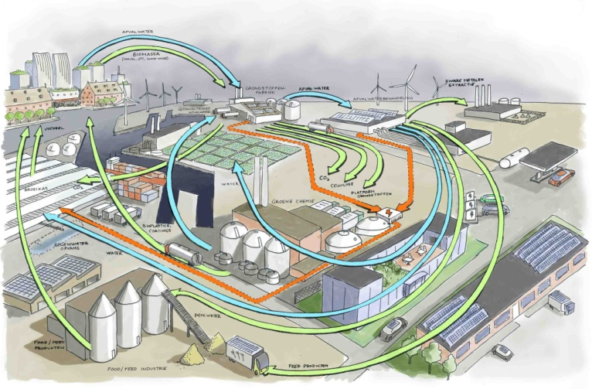
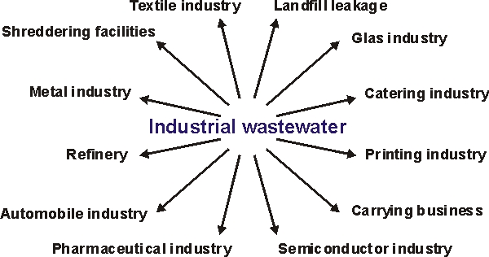
Industrial wastewaters
Effect on environmental components
  Primary effect on water ...
Significant contaminants
  Specific products regarding the industrial type, examples:
    Food industry – organic pollution, phytoestrogens
    Pulp and paper industry – chlorine, organochlorine compounds
    Metal processing – cooling and metalworking-fluids
    (chlorinated alkanes / paraffins)
    etc.
  Toxic metals
  Acids, solvents (incl. halogenated)
  Contaminants with global importance
    Polychlorinated dibenzo-p-dioxins and furans (PCDD/Fs)
    Polychlorinated biphenyls (PCBs)
    Polycyclic aromatic hydrocarbons (PAHs)

Slide 13
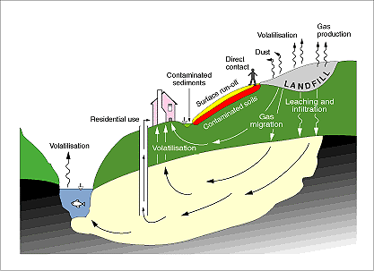
Landfills & Industrial zones (brownfields)
Effect on environmental components
  Primary effect on ground water (GW)
Significant contaminants
  Specific products regarding the industrial type and landfilling, frequent GW contaminants
    BTEX – benzene, toluene, ethylbenzene, and xylenes
    Low molecular weight halogenated solvents– e.g. ethylenes (TCE, DCE)
  Toxic metals
  Contaminants with global importance
    Polychlorinated dibenzo-p-dioxins and furans (PCDD/Fs)
    Polychlorinated biphenyls (PCBs)
    Organochlorine pesticides (OCPs)

Slide 14
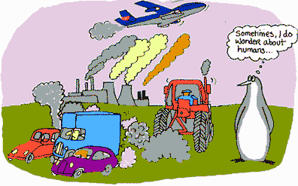
Industry, internal combustion engines, energy production
Effect on environmental components
  Diffuse pollution
  Primary effect on atmosphere + on all ecosystems
Significant contaminants
  Toxic metals (e.g. Pb, Cd etc.)
  CO, CO2
  Polycyclic aromatic hydrocarbons (PAHs)
  SOx, NOx
  Polychlorinated dibenzo-p-dioxins and furans (PCDD/Fs)
  Specific organic compounds used by industry
    Regarding the type of the industry
    Global importance e.g. Polychlorinated biphenyls (PCBs)

Slide 15
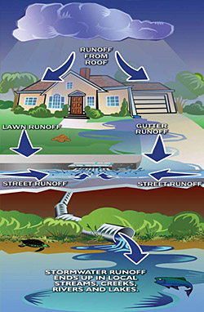
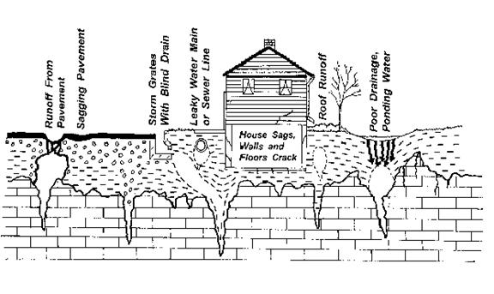
Surface run off
Effect on environmental components
  Diffuse pollution
  Primary effect on water (surface and ground)...
Significant contaminants
  Construction chemicals
  Chlorinated compounds
  Toxic metals
  Contaminants with global importance
    Polychlorinated dibenzo-p-dioxins and furans (PCDD/Fs)
    Polychlorinated biphenyls (PCBs)
    Polycyclic aromatic hydrocarbons (PAHs)

Slide 16
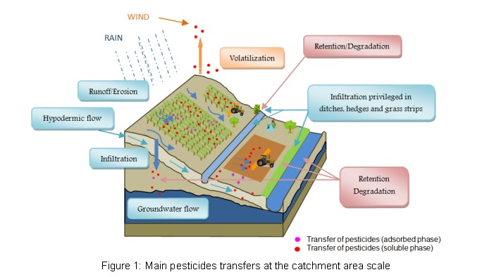
Agriculture
Effect on environmental components
  Diffuse pollution
  Primary effect on soil... but indirectly also on all other env. components
Significant contaminants
  Pant protection treatments (pesticides)
  Fertilizers (N-, P-) and contaminants therein (often e.g. Cd)
  Veterinary pharmaceuticals (→ application of manure)

Slide 17
Main groups of pollutants
Important terms, abbreviations... and structures

Slide 18
Compounds grouped by effect
Pesticides (Plant Protection Products: primarily agriculture use) | Toxic for pests | DDT, parathion,atrzine glyphosate (RoundUp)
Biocides (For household use) | Toxic to biota, including also anti-bacterial agents | Chlorine (bleach), Triclosan (antibacterial soaps)
Insecticides | Toxic for insect/arthropods | DDT, parathion
Herbicides | Toxic for plants | 2,4-D, glyphosate, atrazine
Fungicides | Toxic for fungi/moulds | Pesticides containing toxic metals (Hg, Cu)
Rodenticides | Toxic for rodents | Cyanide
Carcinogens | Induce cancer | Benzo[a]pyrene
Reprotoxins | Effect on reproduction | Ethinylestradiol
Endocrine disruptors | Effects on hormone systems | Ethinylestradiol, tributyltin

Slide 19
Compounds grouped by physico-chemical properties
Lipophilic (hydrophobic) | Soluble in fat / low solubility in water | DDT
Hydrophilic | Soluble in water | Phenol, modern insecticides
Neutral organic compounds | Uncharged compounds (do not ionize) | DDT, PCB
Radioactive compounds | Unstable, decay and emit radiation | Radon
Surfactants, detergents | Compounds lowering surface tension between two phases | Nonylphenol, alkylbenzene sulfonates
Persistent compounds | Very long half-life in the environment (do not degrade) | DDT, PCB
Volatile organic compounds | Volatile organic compounds (VOCs) | Acetone, Benzene, Formaldehyde, Xylene Perchloroethylene, Toluene etc.

Slide 20
Significant compounds grouped by their structure
Chlorinated hydrocarbons, organochlorine compounds |  | DDT, PCB, PCDD/Fs
PCBs | Polychlorinated biphenyls | PCB153
PAHs | Polycyclic aromatic hydrocarbons | Benzo[a]pyrene
PCDD/Fs | Polychlorinated dibenzo-p-dioxins and -furans | 2,3,7,8-TCDD
Toxic metals, heavy metals |  | Hg, Pb, Cd (+ others)
Organometallics |  | Alkyl tins, Methyl-mercury
OPs | Organophosphates | Compounds (insecticides) – e.g. parathion
BTEX | Benzene and its derivates –contamination of ground water and air (volatiles) | Benzene, Toluene, Ethylbenzene, Xylenes

Slide 21
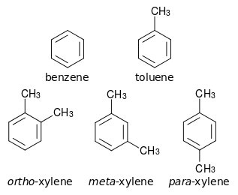
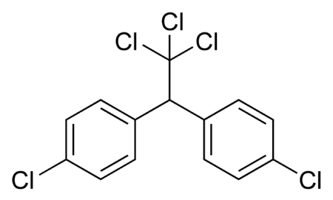
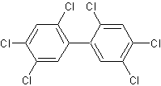
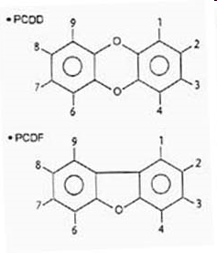
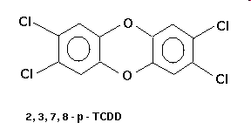

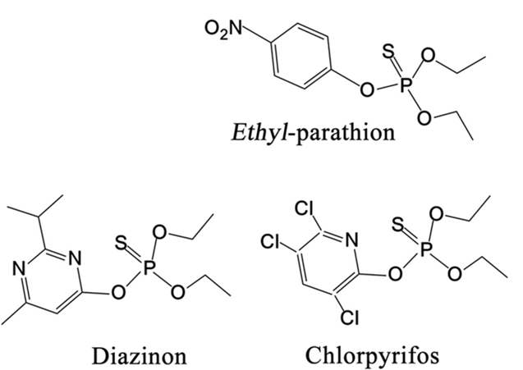
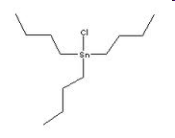
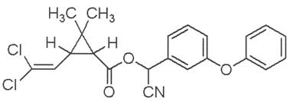
Student should be aware of the most important structures
DDT
PCB153 (very abundant)
BTEX
Polychlorinated dioxines and furans (PCDD/Fs)
Benzo[a]pyrene – example of PAHs
Tributyltin chloride
(Organometal)
Organophosphates
Cypermethrin

Slide 22
Further commont terms/abbreviations – groups of compounds
HPVC - High-production volume chemicals (from the REACH legislation)
CMR - Carcinogenic, mutagenic or reprotoxic (from the REACH legislation)
EDC - Endocrine disruptive compounds
POPs – Persistent organic pollutants (as defined in the Stockholm Convention)
OCPs – Organochlorine pesticides (e.g. DDT, lindane etc.)
PBT – Persistent bioaccumulative and toxic compounds
  very dangerous - specific legislation
PPCP - Pharmaceuticals and personal care products
PPP - Plant protection products
  (generally „pesticides“)
HCs - Halogenated compounds (usually at ground water contamination)
Emerging contaminants – generally polar compounds, which are not well studied, yet (previously most attention to persistent compounds!)

Slide 23
Environmental processes

Slide 24
Risk of compound presence to the environment – which parameters are determining?
Chart summarizes terms explained in the next part of the lecture
RISK
(e.g. % decline in population of salmonid fish in CZ)
This presentation
Properties of the substance
HAZARD
Is hazardous/toxic to fish?
What is the mode of action/toxicity type?
At what concentrations?
Situation in the environment
EXPOSURE
Is the compound in the water? (fate)
Is the compound in a form available to fish?
(bioavailability)
Does it enter the fish? (bioconcentration)
Can bioaccumulate?, Concentrates in the food chain (biomagnification)?
What is the bioavailable concentration?

Slide 25
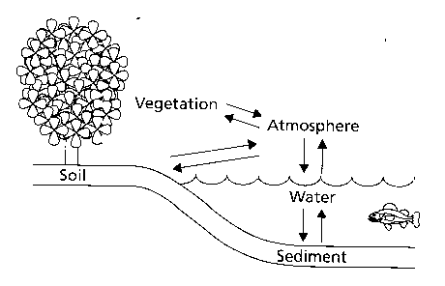
Environmental FATE of the compound determines the EXPOSURE
ENVIRONMENTAL FATE describes
? In which environmental compartments DISTRIBUTION between compartments
is the compound present
? How it migrates within the compartments TRANSPORT – e.g. by air
? How it transforms within the compartments TRANSFORMATION
– chemical and biological
EXPOSURE
Extent of exposure of an organism to a compound (in a specific concentration, for a specific time etc. = Exposure scenarios)

Slide 26
What parameters determine the fate of a chemical compound?
 | DISTRIBUTION | TRANSPORT | TRANSFORMATION
Compound properties | Polarity vs hydrophobicity (K_{ow}, water solubility) Volatility, boiling point, evaporation (H, boiling point) Reactivity vs stability and persistence (t1/2)
Environmental properties | Drift (pace, direction, type ...) Temperature Light (and its parameters) Chemical composition pH (free H+) Redox potential (... presence of O₂) Presence of inorganic ions / cation-exchange capacity (e.g. clay) Particles – type, size, amount Organic matter – type, amount (humic acids etc.)
Water
Sediments
Soil
Atmosphere
Biota properties vegetation, consumers... | Number / Motion / Size (surface) / Fat content (%) / Food chain level etc. etc.
K_{ow}, H, t1/2
The fate and resulting exposure of organisms is defined by a combination of listed parameters

Slide 27
Which parameters are especially crucial regarding the risk of ECOTOXICITY?
1) Tendency to enter the organism
- higher hydrophobicity (fat in organisms)
- partition coefficient octanol/water (K_{ow}, logP)
2) Stability (persistence, low degradability)
- long-term functionality in the environment
- half-life (t1/2)
3) Toxic effects in organisms
… information on each parameter is needed
1+2 – in this part of the course
3 – other lectures

Slide 28
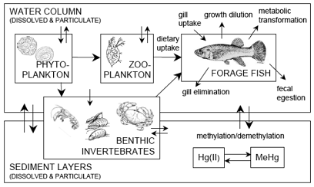
Entry of compound into the biota (transport from the environment into the organism)
Compound distribution between environmental compartments
  Partition processes between environmental compartments (compartments/matrices/phases)
      biota/atmosphere - sediment (soil) / water
      soil/atmosphere - water/atmosphere
BIOTA as one of the compartments
  important are partition processes “environment ← → biota”
      Atmosphere / biota
      Water / biota
      Sediment / biota
      Soil / biota
      Biota(food) / Biota (predator)

Slide 29
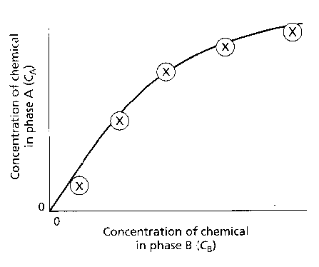
Partition processes between two phases in EQUILIBRIUM are consistent with the first order kinetics – defined by the Freundlich equation
K = slope in the linear part of the curve
Ca = K. Cb ^{1/n}
C – concentration in phases A (Ca) and B (Cb)
K – partition constant
n – nonlinearity constant
In case of a linear relationship (n=1) K = Ca / Cb
= “partition coefficient”
  The size of K determines the tendency of the compound to transfer from phase B into phase A
From a practical experiment (compound partitioning between two phases)
respective constants can be determined
log Ca = 1/n . log Cb + log K

Slide 30

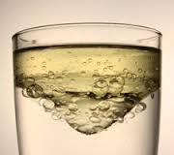
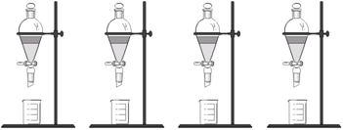

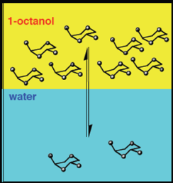
“Biota-Water” partition model
BIOTA / Water partition coefficient
  difficult to determine
  (standard procedure –bioconcentration determination: see further)
  Alternatively – model with n-octanol
N-octanol
  Immiscible with water, similar properties to fats or phospholipids of biological membranes
  n-octanol/water partitioning
    K_{ow} – partition coefficient
    Characterizes HYDROPHOBICITY (resp. LIPOPHILICITY)
    Often expressed as logK_{ow} (resp. logP)
Experimental K_{ow} determination
System
n-octanol/water + compound insertion
Shaking until equilibrium
is established
Chemical analysis of
concentrations
K_{ow} calculation
4 different initial concentrations
n-oct
water

Slide 31
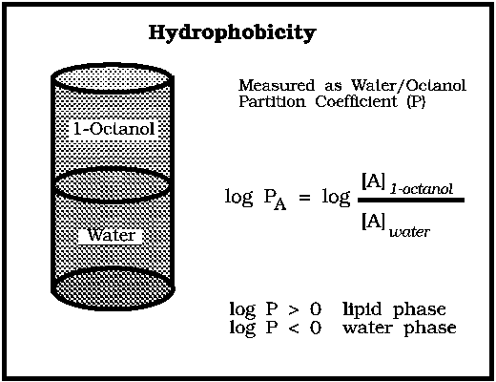
K_{ow} – examples
Compound | K_{ow} | logK_{ow} (logP) | K_bioaccumulation (experimental)
Lindane | 5 250 | 3.72 | 470
DDT | 2 290 000 | 6.35 | 1 100 000
Arochlor 1242 (PCB) | 199 600 | 5.30 | 3 200
Naphthalene | 3 900 | 3.59 | 430
Benzene | 135 | 2.13 | 13

Slide 32
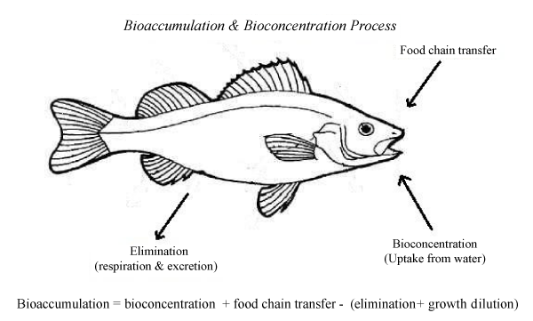

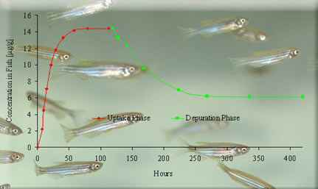
Bioaccumulation, Bioconcentration, Biomagnification
Bioconcentration
The extent of compound uptake into the organism (fish) from water
BCF – Bioconcentration factor
Experimental determination
Tests with fish (standard OECD 305)
Time consuming, demanding tests, tests with fish in vivo
It is possible to predict BCF from K_{ow}

Slide 33
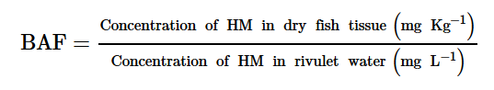
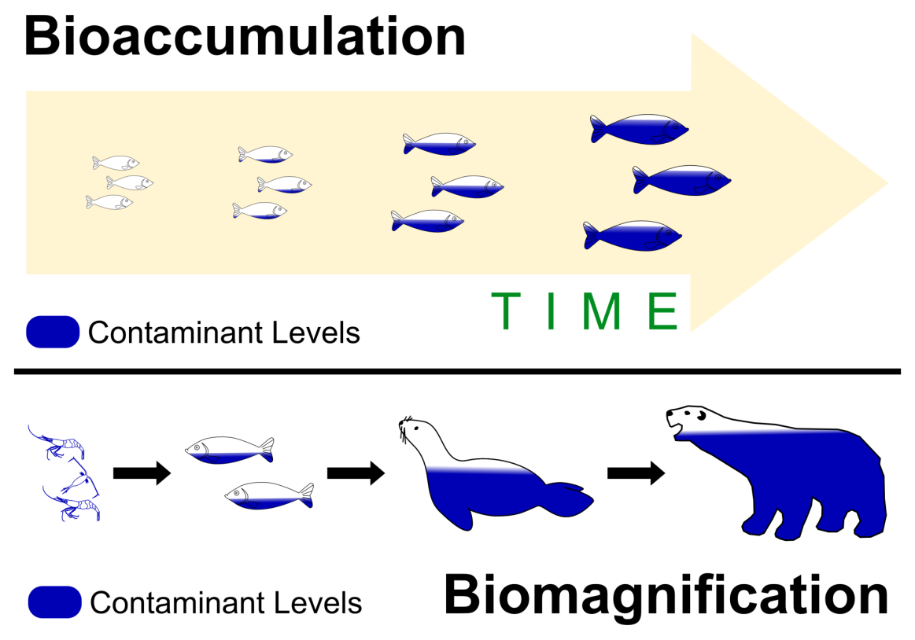
Bioaccumulation, Bioconcentration, Biomagnification
Bioaccumulation
Compound accumulation (all routes of exposure)
BAF – Bioaccumulation factor
Biomagnification
Increasing concentration of compounds in organisms via food chain
BMF – Biomagnification factor (C_{predator}/C_{food})

Slide 34
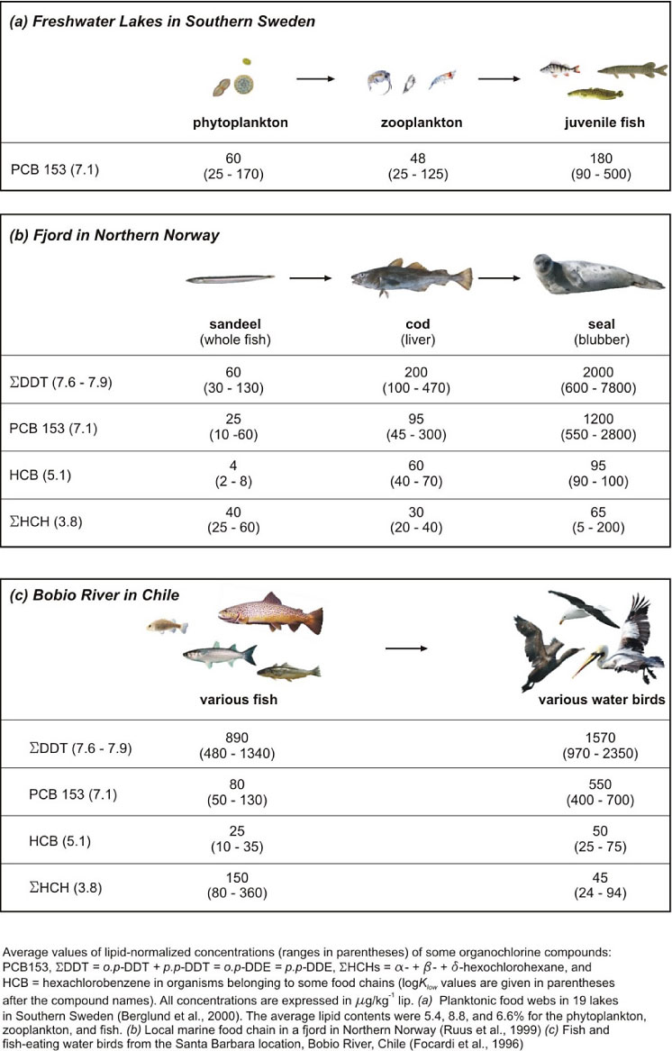
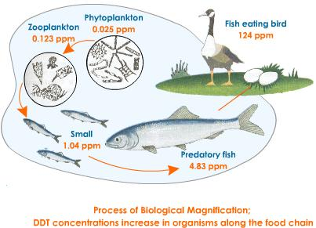
Biomagnification

Slide 35
ATMOSPHERE / WATER partitioning

Slide 36
ATMOSPHERE / WATER partitioning
- ionized compounds do not evaporate into the atmosphere
- significant partitioning (again) at organic neutral compounds
- partitioning between water- and liquid phase is described by the Henry‘s law:
p = H . C_{W}
p – partial pressure of a compound (Pa)
H – Henry‘s law constant (Pa.m³.mol⁻¹) – characteristic for a specific compound
C_{W –} concentration in water (mol . m³)
Note: boiling point of a specific compound is a measure of volatility
H (Pa . mol-1 . m-3) | Description
> 100 | Very fast released from water Example: halogenated aliphatic hydrocarbons (dichloroethane and such)
25-100 | Volatilization slower Example: chlorinated benzenes
1-25 | Sow volatilization Example: most of the PCBs
< 1 | Insignificant volatilization Example: high chlorinated PCDDs

Slide 37
Environmental transformation / Persistence

Slide 38
Environmental transformation – (bio)transformation
Types of transformation of organic compounds:
  partial structural change (e.g. introduction od OH into neutral fatty acids)
  degradation into smaller organic molecules
  total degradation of the org. compound (CO₂, H2O)
Main processes
  Chemical – regarding the type of the environment
    atmosphere – photochemical reactions, reactions with oxygen (!)
    water – hydrolysis, oxidations
    anoxic environment (sediments, ground water) – reductions
  Biotic (enzymatic)
    Ready biodegradability
      compound serves as a carbon source to microorganisms → CO₂ production
    Cometabolism
      microorganisms require other (main) C source (compound transformation as a part of „ancillary/other“ processes)
Result of transformation
  nontoxic products
  production of even more toxic products (! e.g. Hg → methyl-Hg)
Biodegradability vs Persistence
  Polar and reactive compounds – mostly short half-life
  Halogenated, neutral compounds – persistent in the environment

Slide 39
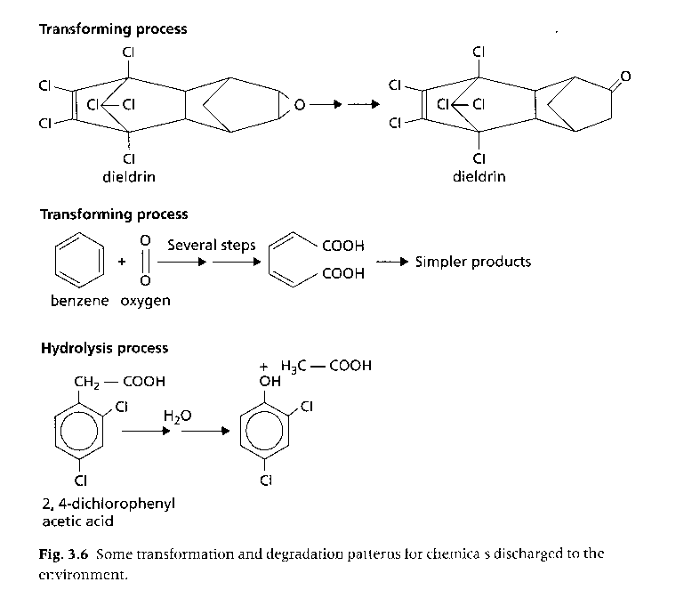
Simple transformation processes (with oxygen supply)

Slide 40
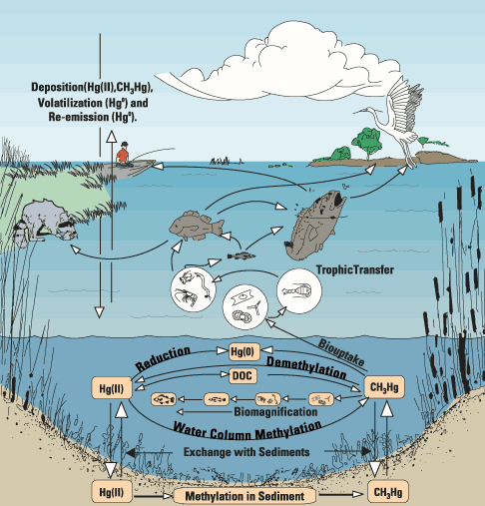
ANAEROBIC (no oxygen) biotransformation – example methylmercury
Me-Hg
Bioaccumulation
High toxicity
Look on web for
MINAMATA disease
CONVENTION

Slide 41
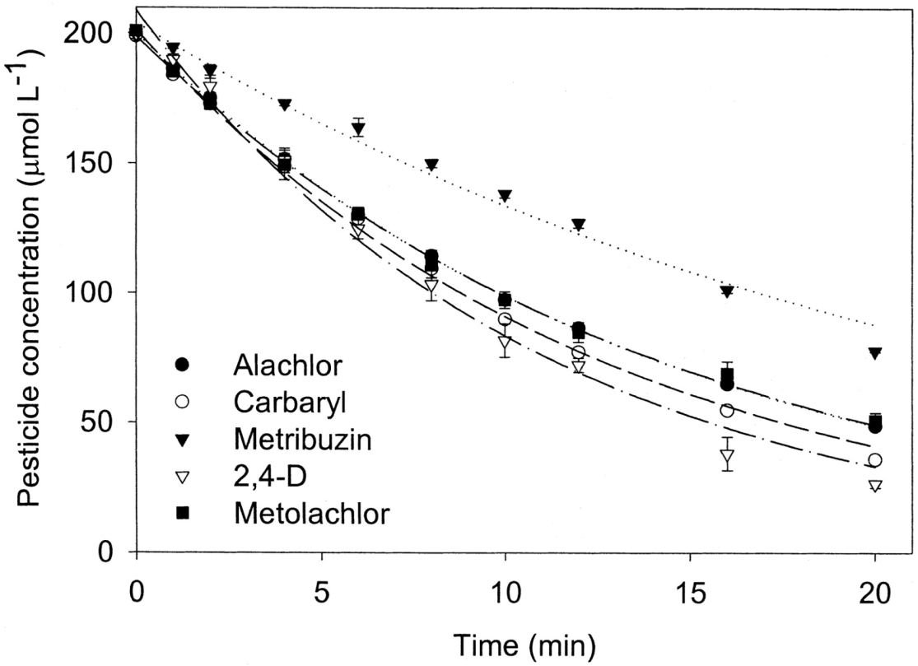
Persistence characterisation – half-life
Transformation kinetics – first order kinetics
  C_{t} = C₀ . e^{-kt}
  C_{t} – concentration in time t
  C₀ – initial concentration
  k – constant (degradation speed)
  t – time
After derivation (half-life)
    t_{1/2} = ln2 / k = 0.693 / k
Time (days)

Slide 42
Half-life of selected pesticides in soil - examples
Compound | Half-life in soil (years) (t1/2 or DT50 – disappearance time 50%)
Chlorinated compounds
DDT | 3-10
Dieldrin | 1-7
Toxaphene | 10
Organophosphate – chlorfenos | 0,2
Carbamate – carbofuran | 0,05 – 1

Slide 43
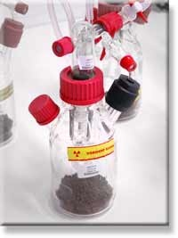
Degradation assessment in praxis (standards)
OECD recommendation – guideline 307
Aerobic and Anaerobic Transformation in Soil
  Introduction of examined compound (can be radioactively labelled)
  Incubation in time
    soil extraction (volatile fraction)
    assessment of decrease in concentration of introduced compound and transformation products formation
      Chemical methods (GC, LC etc.)
Example of standardized OECD guideline
Anaerobic Biodegradation Experiment see YOUTUBE
http://www.youtube.com/watch?v=Y_zFPkbrwSY

Slide 44
Fate (processes) in the environment → Exposure
→ BIOAVAILABILITY

Slide 45
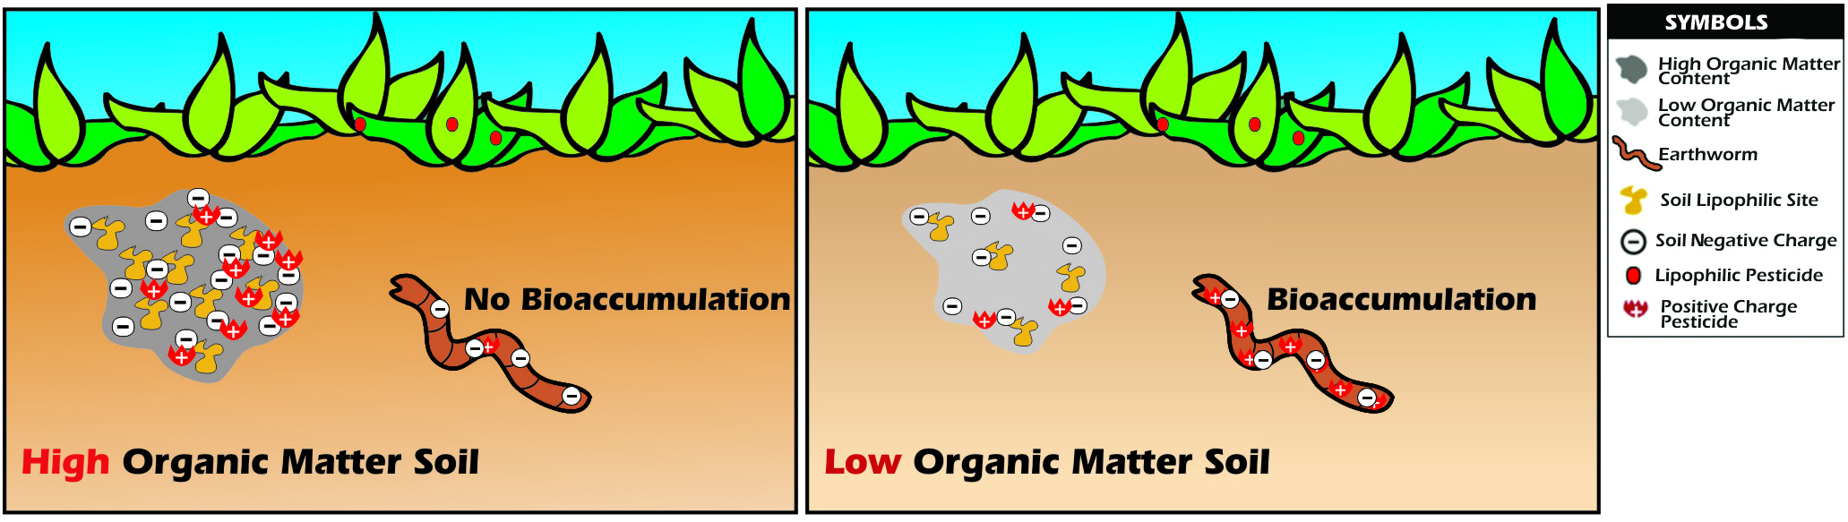
BIOAVAILABILITY
The term comes from pharmacology
  compound fraction that is effective in the body
In environmental sciences
  compound fraction, that can enter the organism = compound is in available form (it is not bound in the environment – e.g. to organic carbon etc.)
Bioavailability describes processes (relations) between
  Compounds present in the environment
  Entry (accumulation) of compounds into the organisms
  Environmental properties
Example - Soil
two distinct soils (high and low organic carbon content)
bioavailability (and thus bioaccumulation as well) is higher in the case of “low”

Slide 46

Bioavailability - examples
Toxic metals in waters vs. water hardness
-> higher water hardness (more Ca / Mg) – lower bioavailability / lower metal toxicity (competition with toxic metals for binding sites in biota)

Slide 47

Bioavailability - examples
Hydrophobicity – organic compounds vs. organic carbon (humins)
-> hydrophobic compounds – tendency to accumulate in fat / in biota
(at the same time also in dead organic matter - OC)
-> high OC content in the environment (in water): lower bioavailability of compounds

Slide 48


Bioavailability - examples
Toxic metals in water vs. pH / water composition
-> higher pH: metals present in insoluble hydroxides (lower bioavailability)
-> lower (acidic) pH – higher solubility and higher toxicity of metals

Slide 49
Where can the information on environmental properties be found?
(K_{ow}, t1/2 etc.)
Notes:
Where can the information on environmental properties be found

Slide 50

CAS – Chemical Abstract Services
  Provided/Operated by American Chemical Society (ACS)
  CAS Number – unique identifier
eChemPortal.org
Notes:
Look up information on one chemical “compound” that you could find in your bathroom

Slide 51
SUMMARY – questions 1/3
Describe what are toxicants, ecotoxicants, toxins, and give examples.
What are the main sources of toxic compounds in the environment? Provide an overview.
Which human activity releases into the environment the most polychlorinated biphenyls, polychlorinated dioxins, polycyclic aromatic hydrocarbons?
What is the main source of household chemistry (soaps, perfumes), pharmaceuticals for the environment?
What compounds are released into the environment from areal pollution sources? Give examples – source:compounds
What compounds enter the environment from point pollution sources? Give examples – source:compounds
What are pesticides? insecticides? herbicides? fungicides? rodenticides? carcinogens? reprotoxins? endocrine disruptors? organophosphates? pyrethroids? toxic metals?
Give example for each of the listed groups and describe the main features of the chemical structure (aromatic/aliphatic?, neutral/ionized?, halogenated?, hydrophilic or hydrophobic?, persistent or degradable?)

Slide 52
SUMMARY – questions 2/3
What key properties make a compound dangerous (hazardous) for the environment?
What does the term “environmental fate of compounds” define/describe?
Describe the main processes a compound can undergo in the environment and name the compound‘s properties (features) key for these processes.
What properties play a key role in entering of a chemical compound into the organism?
What is bioconcentration? What compound‘s property does it depend on?
What is K_{ow}? How can it be determined experimentally?
Which compound has higher K_{ow} - hexane OR hexanol?
Which compound has higher Henry‘s law constant - dichloromethane or dichlorobenzene?
What is biomagnification? Give an example of a compound that can be biomagnified and what levels does its BMF reach?
What is bioavailability? Give examples of different scenarios, when the bioavailability of a selected compound would be very high and very low.
The DDT concentrations in a river were determined as follows: (1) DDT bound to suspended particles 1 milligram/L water, (2) DDT dissolved in water 1 microgram/L water. What fraction (%) of DDT is approximately directly bioavailable for transfer through fish gills?

Slide 53
SUMMARY – questions 3/3
Which element plays a crucial role in chemical transformations of compounds in soil environment?
What major transformation processes do compounds undergo in different environmental matrices (air, soil, water, sediments)?
Define the half-life of a compound. Give examples of compounds with short and long half-life. How long are half-lives of these compounds?
How is the biodegradability of a chemical compound determined in practice?
How would the half-lives of benzo[a]pyrene (BaP) differ in the following scenarios? BaP bound to aerosol particles in the air, BaP bound to sediment on the bottom of a water reservoir/pond.
The concentration of triazine in soil is 120 mg/kg and the DT50 is 180 days. When can we expect the decrease of triazine to 10 mg/kg?

