Slide 1
NGS data analysis introduction
Bi7420: Moderní metody pro analýzu genomu
Vojta Bystry
vojtech.bystry@ceitec.muni.cz

Slide 2
Plan for Bi7420
NGS data analysis for non-bioinformatics
Focus on experiment planning and result interpretation
Introduction to NGS technology
Introduction analysis; NGS Overview
DNA resequencing
miRNA, lncRNA in cancer - Marek Mráz
DNA resequencing, Chip-seq (CLIP-seq)
RNA-seq
RNA-seq – single cell sequencing
The plan is open to change

Slide 3
What is NGS?
Next generation sequencing
New generation sequencing
HTP = High throughput
Massively parallel sequencing
Contrast to Sanger sequencing

Slide 4
What is NGS?
Illumina – sequencing by synthesis
Oxford Nanopore – Nanopore sequencing
Pacific Bioscience - Single Molecule, Real-Time (SMRT)

Slide 5
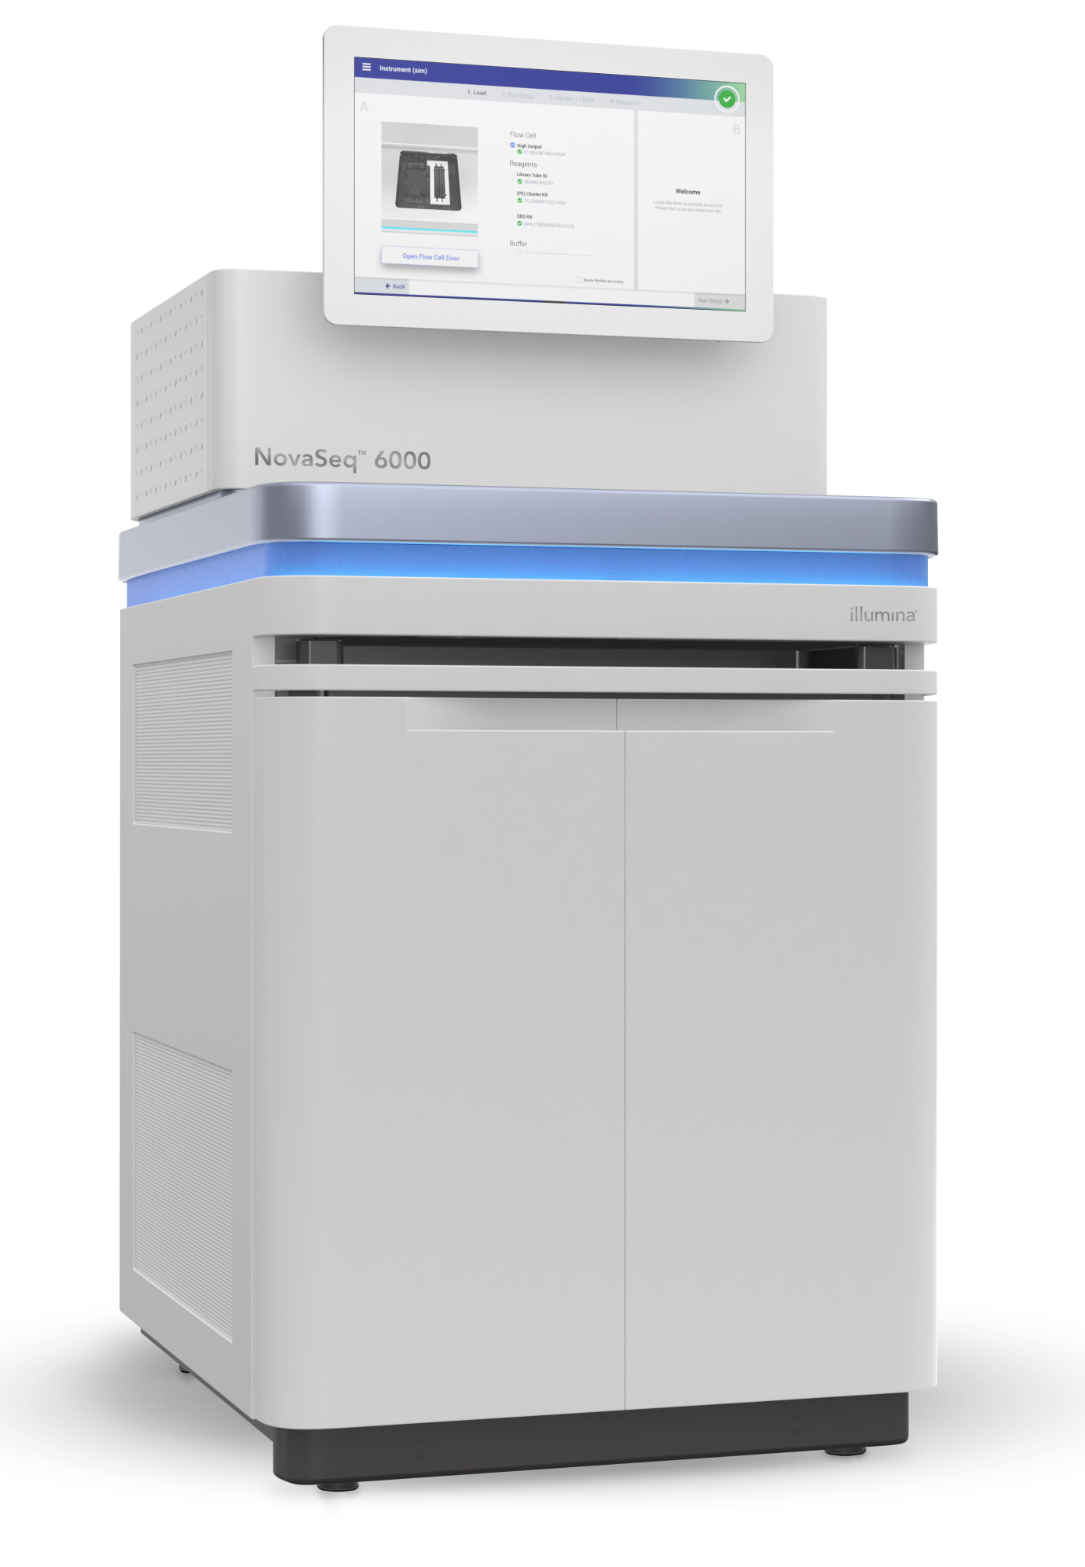
What is NGS?
Illumina – sequencing by synthesis
Oxford Nanopore – Nanopore sequencing
Pacific Bioscience - Single Molecule, Real-Time (SMRT)

Slide 6
Raw data
10^5 – 10^10 reads
75 – 300Bp
Could be pair-end

Slide 7
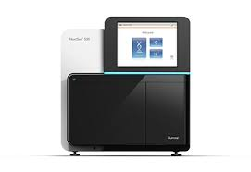
Basic workflow
Experimental
design
Library
preparation
Sequencing
Data analysis

Slide 8
Basic workflow
Experimental
design
Library
preparation
Sequencing
Data analysis
Why we sequence
What we sequence
How we sequence

Slide 9
Basic workflow
Experimental
design
Library
preparation
Sequencing
Data analysis
Why we sequence
What we sequence
How we sequence
Consultation regarding data analysis is highly advisable.

Slide 10
NGS library preparation
DNA
Select
some parts
RNA
Living material

Slide 11
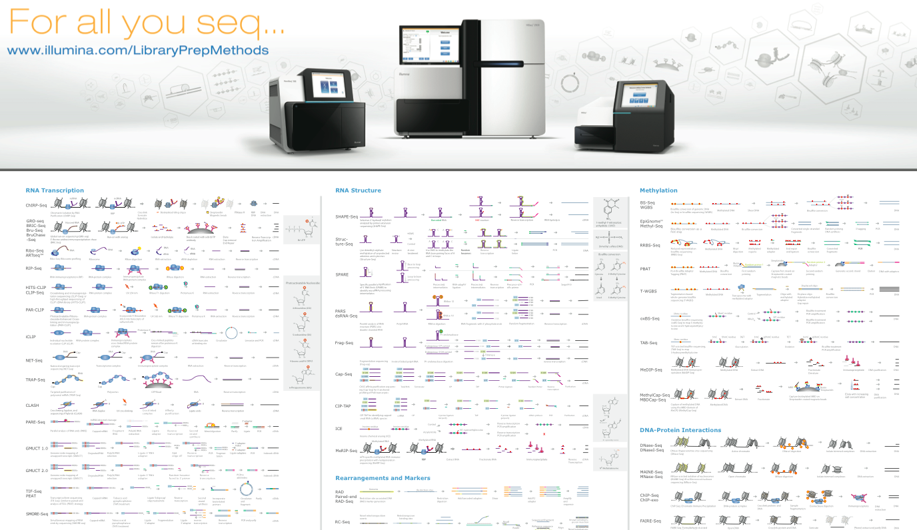
NGS library overview

Slide 12
NGS data analysis
Raw data
.fastq
Experiment design
de-multiplexing
QC
Not known
reference
Not ”classic” reference
Genome/Transcriptome Reference Mapping
.bam
Metagenomics
Reference assembly
Immunogenetic
VDJ-genes
CRISPR
sgRNA
QC
Methylation
Bisulfide-seq
Interaction
analysis
CHIP-seq
Expression analysis
RNAseq
Variant analysis
WES
…
12

Slide 13
NGS data analysis
Raw data
.fastq
Experiment design
de-multiplexing
QC
Not known
reference
Not ”classic” reference
Genome/Transcriptome Reference Mapping
.bam
Metagenomics
Reference assembly
Immunogenetic
VDJ-genes
CRISPR
sgRNA
QC
Methylation
Bisulfide-seq
Interaction
analysis
CHIP-seq
Expression analysis
RNAseq
Variant analysis
WES
…
13

Slide 14
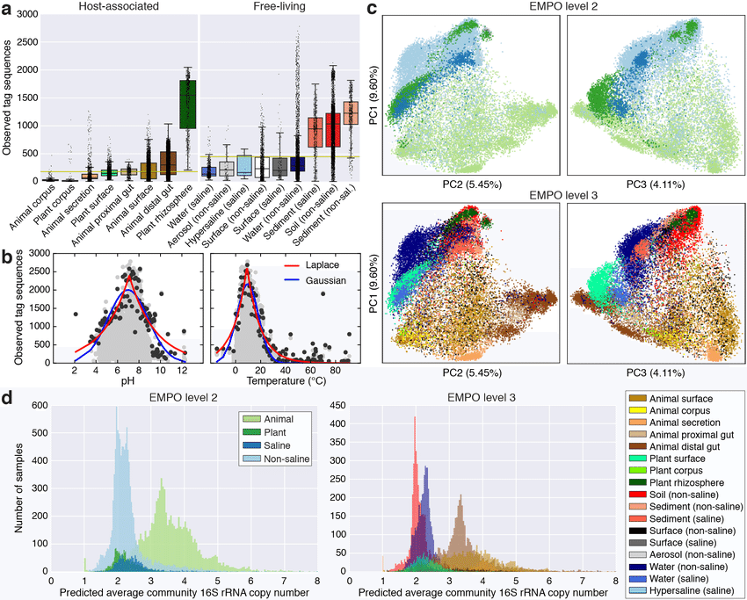
Metagenomics
Environmental statistics about populations
alpha, beta, gamma diversity
identify known bacterial species
eventually functional profiling
E.g. antimicrobial resistance genes
Sequencing techniques
16S rRNA sequencing
Shotgun metagenomic sequencing

Slide 15
Metagenomics – 16S rRNA vs. Shotgun
Factors | 16S rRNA sequencing | Shotgun Metagenomic Sequencing
Cost | ~$50 USD | Starting at ~$150 but price will depend on sequencing depth required
Sample preparation | Similar complexity to shotgun sequencing | Similar complexity to 16S rRNA sequencing
Functional profiling (profile microbial genes) | No (but ‘predicted’ functional profiling is possible) | Yes (but it only reveals information on functional potential)
Taxonomic resolution: Genus, species, strain? | Bacterial genus (sometimes species); dependent on region(s) targeted | Bacterial species (sometimes strains and single nucleotide variants, if sequencing is deep enough)
Taxonomic coverage | Bacteria and archaea | All taxa, including viruses
Bioinformatics requirements | Beginner to intermediate expertise | Intermediate to advanced expertise
Databases | Established, well-curated | Relatively new, still growing
Sensitivity to host DNA contamination | Low (but PCR success depends on the absence of inhibitors and the presence of a detectable microbiome) | High , varies with sample type (but this can be mitigated by calibrating the sequencing depth)
Bias | Medium to high (retrieved taxonomic composition is dependent on selected primers and targeted variable region) | Lower (while metagenomics is “untargeted”, experimental and analytical biases can be introduced at various stages)

Slide 16
Metagenomics – 16S rRNA vs. Shotgun
Study Examples
Assessment of the bacterial microbiome of Amazonian soil
16S rRNA sequencing may provide more taxonomic resolution
Changes in microbiome composition and antimicrobial gene carriage following fecal transplant
shotgun sequencing to assess both compositional and functional differences
Daily fluctuations in gut microbiome following 2 week dietary fiber intervention
shotgun sequencing to assess both compositional and functional differences

Slide 17
NGS data analysis
Raw data
.fastq
Experiment design
de-multiplexing
QC
Not known
reference
Not ”classic” reference
Genome/Transcriptome Reference Mapping
.bam
Metagenomics
Reference assembly
Immunogenetic
VDJ-genes
CRISPR
sgRNA
QC
Methylation
Bisulfide-seq
Interaction
analysis
CHIP-seq
Expression analysis
RNAseq
Variant analysis
WES
…
17

Slide 18
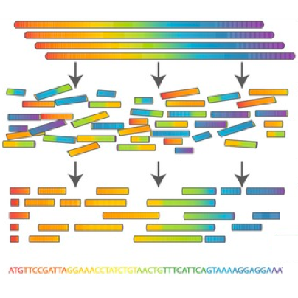
Reference Assembly

Slide 19
Reference Assembly

Slide 20
Reference Assembly
Genome – DNA – very hard and costly
Transcriptome – RNA
Multiple sequencing types highly beneficial
Pair-end
Long reads
Mate-pairs
Similar reference helpful – assembly by homology

Slide 21
NGS data analysis
Raw data
.fastq
Experiment design
de-multiplexing
QC
Not known
reference
Not ”classic” reference
Genome/Transcriptome Reference Mapping
.bam
Metagenomics
Reference assembly
Immunogenetic
VDJ-genes
CRISPR
sgRNA
QC
Methylation
Bisulfide-seq
Interaction
analysis
CHIP-seq
Expression analysis
RNAseq
Variant analysis
WES
…
21

Slide 22
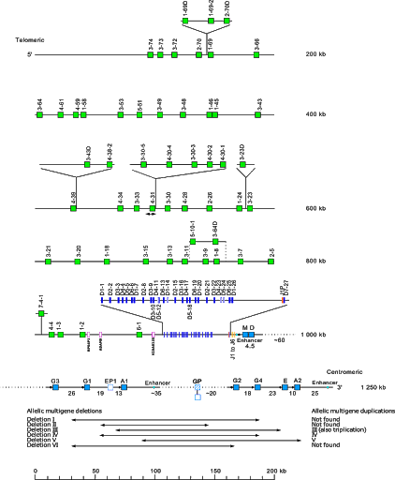
Immunogenetic
T-cell receptor , Immunoglobulin – (B-cell)
Gene rearrangement during cell maturation
VDJ recombination

Slide 23
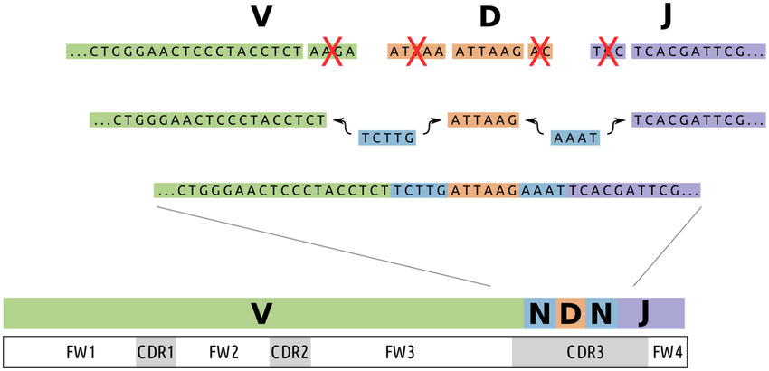
Immunogenetic
T-cell receptor , Immunoglobulin – (B-cell)
Gene rearrangement during cell maturation
VDJ recombination

Slide 24
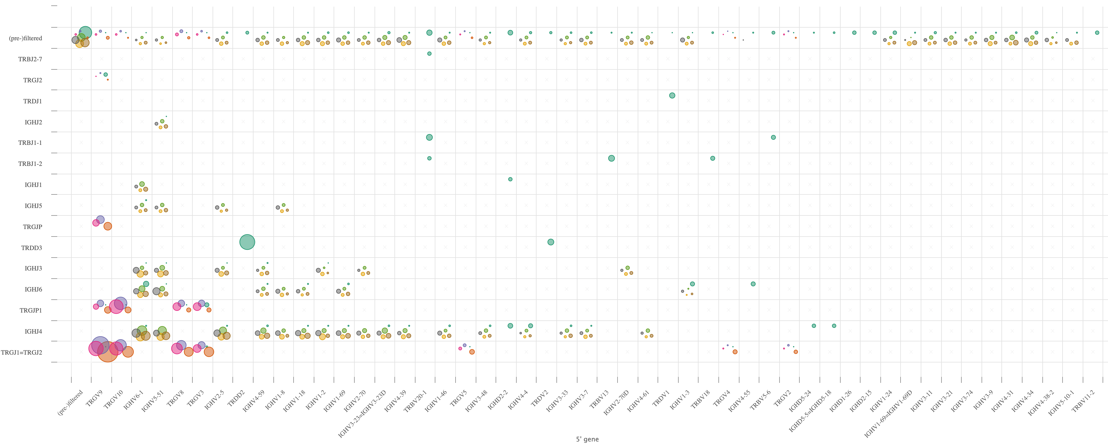
Immunogenetic
Different cell populations
Clonal studies
Repertoire usage
Main usage – blood malignancies (leukemias)

Slide 25
NGS data analysis
Raw data
.fastq
Experiment design
de-multiplexing
QC
Not known
reference
Not ”classic” reference
Genome/Transcriptome Reference Mapping
.bam
Metagenomics
Reference assembly
Immunogenetic
VDJ-genes
CRISPR
sgRNA
QC
Methylation
Bisulfide-seq
Interaction
analysis
CHIP-seq
Expression analysis
RNAseq
Variant analysis
WES
…
25

Slide 26
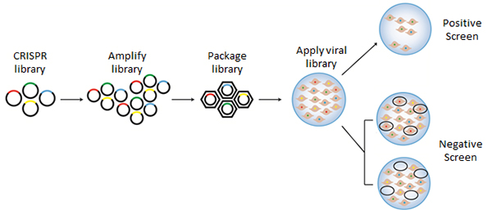
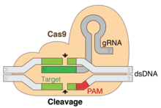
Genome-wide CRISPR-Cas9 knockout screens
Cas9 (CRISPR associated protein 9) is a protein which plays a vital role in the immunological defense of certain bacteria against DNA viruses
sgRNA libraries
Each sgRNA knockout specific gene
76,000 guide RNAs (sgRNAs) with four highly active guides per gene, targeting about 19,000 genes as well as non-targeting sgRNA controls
Lentivirus

Slide 27
Genome-wide CRISPR-Cas9 knockout screens
Screen selection + expansion/enrichment of surviving cells
NGS sequencing

Slide 28
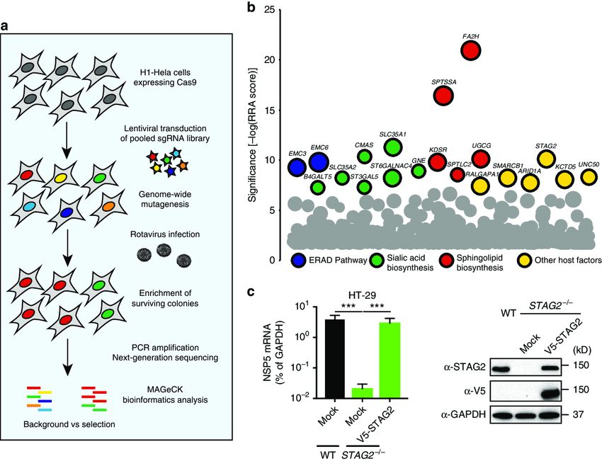
Genome-wide CRISPR-Cas9 knockout screens
NGS data analysis
Counting cells with different genes KD
Counting sgRNA fragments
Compare conditions

Slide 29
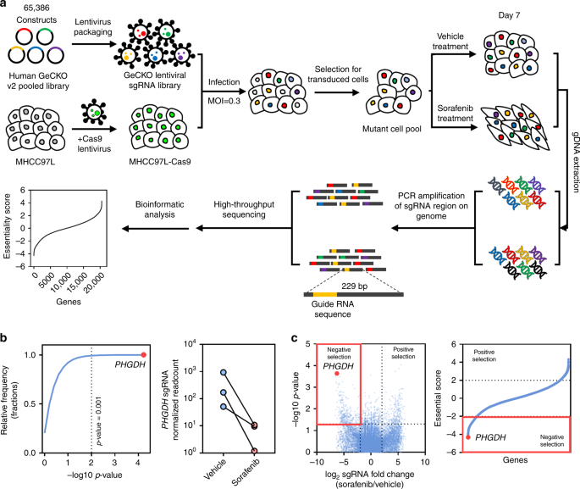
Genome-wide CRISPR-Cas9 knockout screens
Example study
Wei, L., Lee, D., Law, CT. et al. Genome-wide CRISPR/Cas9 library screening identified PHGDH as a critical driver for Sorafenib resistance in HCC.
Nat Commun 10, 4681 (2019). https://doi.org/10.1038/s41467-019-12606-7

Slide 30
NGS data analysis
de-multiplexing
Raw data
.fastq
Experiment design
QC
Not known
reference
Not ”classic” reference
Genome/Transcriptome Reference Mapping
.bam
Metagenomics
Reference assembly
Immunogenetic
VDJ-genes
CRISPR
sgRNA
QC
Methylation
Bisulfide-seq
Interaction
analysis
CHIP-seq
Expression analysis
RNAseq
Variant analysis
WES
…
30

Slide 31
De-multiplexing

Slide 32
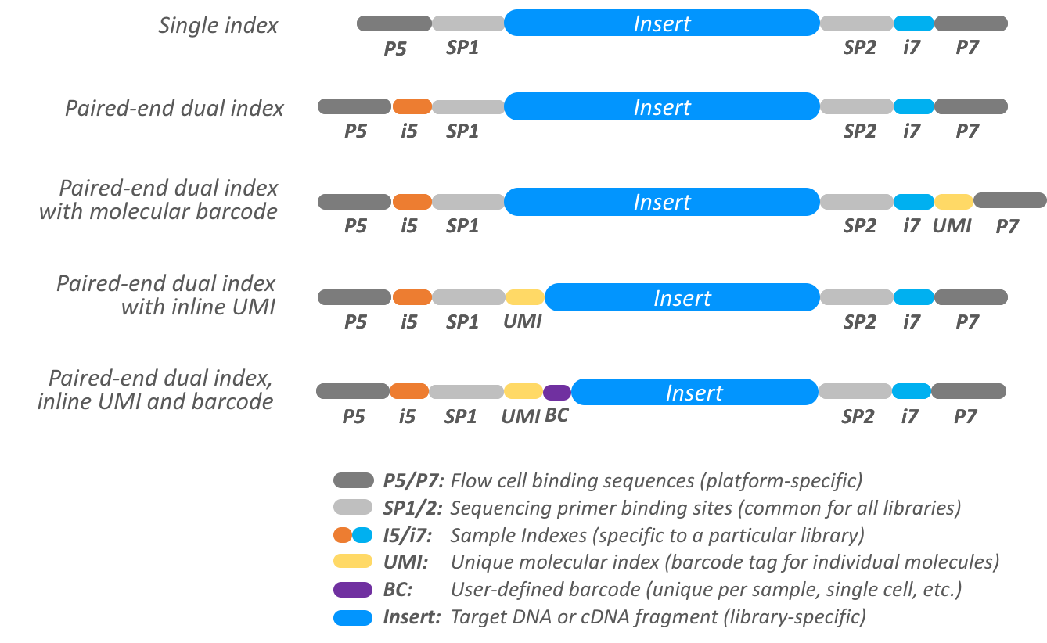
De-multiplexing
Bcl2fastq tool
Needs sample sheet with indexes
Number of barcode mismatches
Check undetermined

Slide 33
Primary data – fastq file

Slide 34
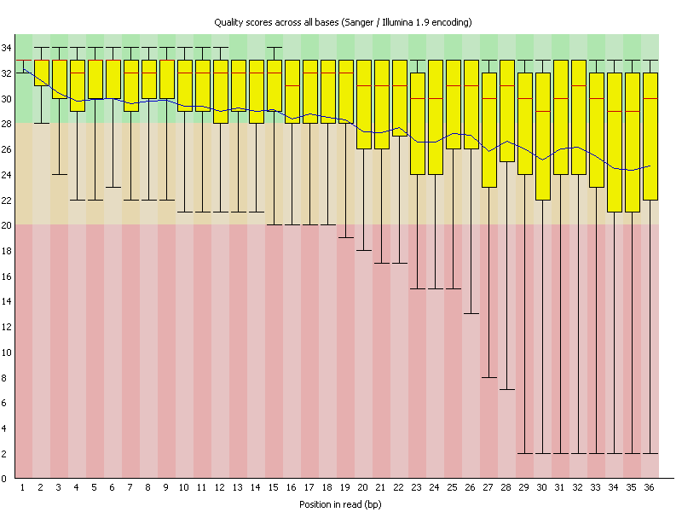
Fastq format - quality
Fastq - q stands for quality – coded phred score
CFFFFEFFGCEEGECFGGGGAFF87@E:++6C<++3:,8,33,,:,,,:,,:,,,
Quality | Error probability
5 | 31%
10 | 10%
20 | 1%
30 | 0.1%
Very good for early problem detection
Reasonable for trimming and read filtering
RNA seq - above phred score 5

Slide 35
Fastq – quality control
Fastqc - tool

Slide 36
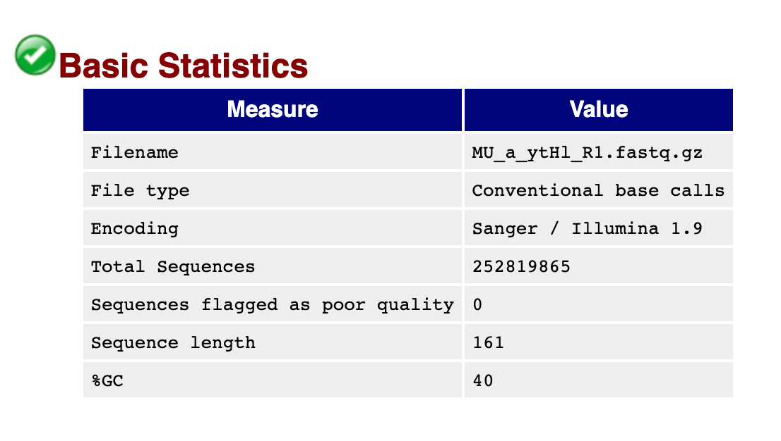
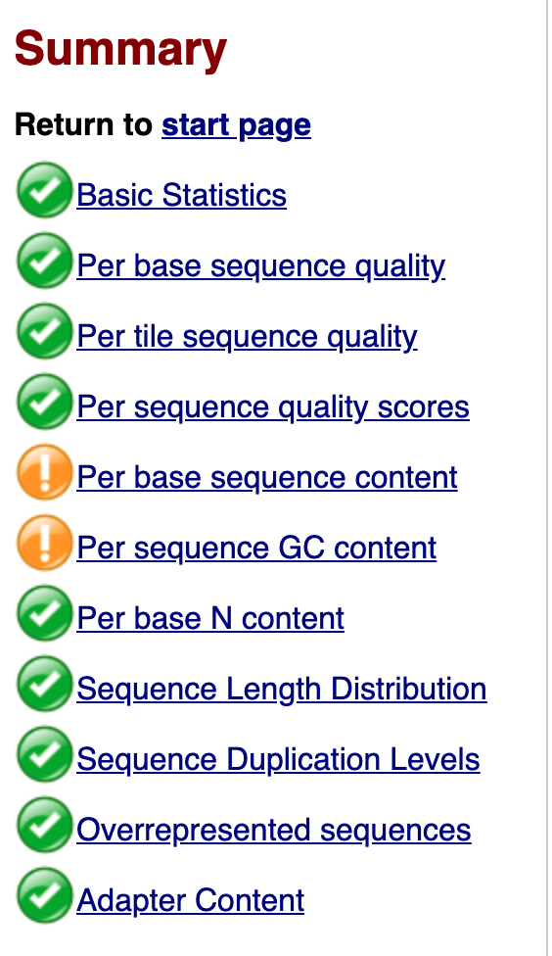
FastQC Report

Slide 37
CEITEC
@CEITEC_Brno
Thank you for your attention!
Vojta Bystry
vojtech.bystry@ceitec.muni.cz
www.ceitec.eu

