Slide 1
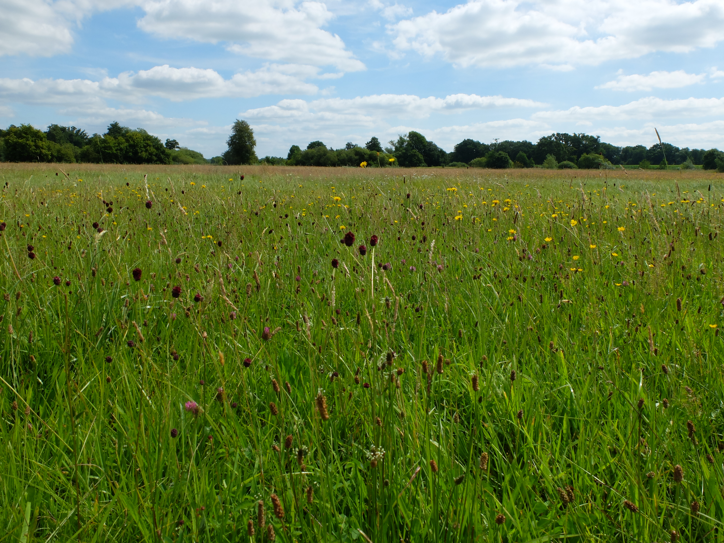
Notes:
This is one of the grasslands my data was collected on. The data is from my Master‘s thesis and the topic was:

Slide 2



Syntaxonomic revision of extensively managed,
mesic alluvial grasslands along the Wümme river
(Lower Saxony, Germany)
Nina Fahs
Notes:
Syntax…etc. – So the background is that we have

Slide 3
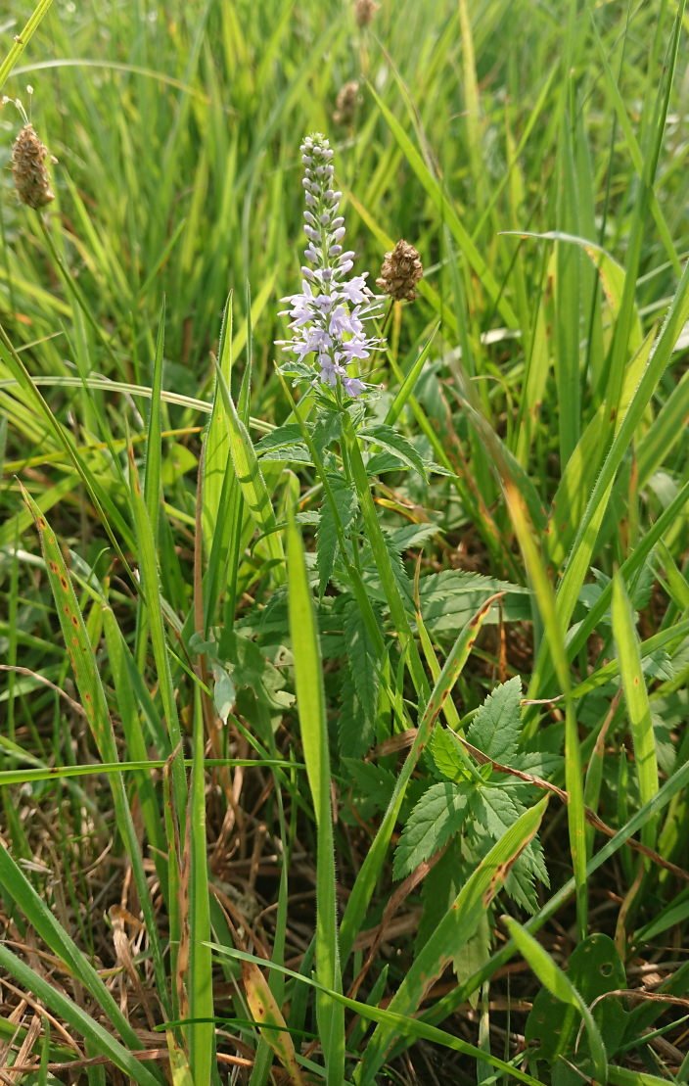
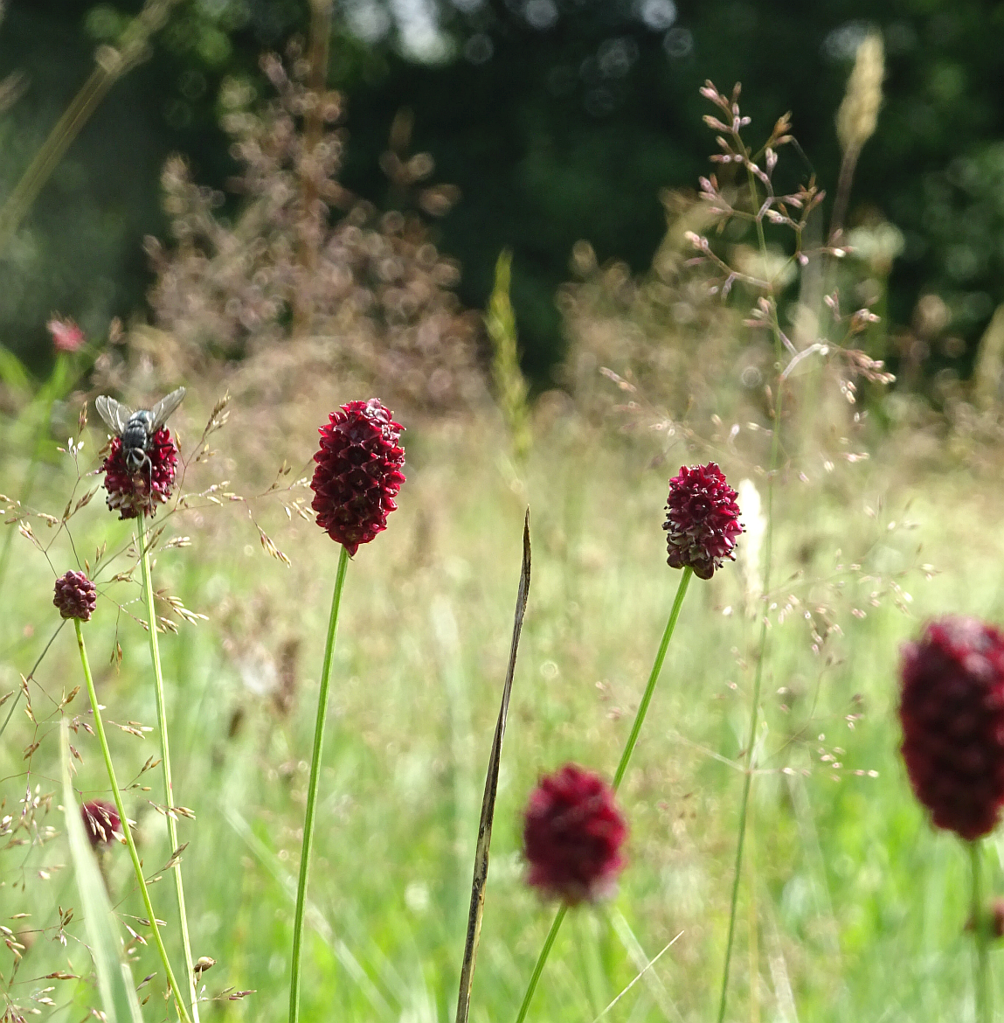
Notes:
These extensively managed grasslands in the North of Germany whose origin is kind of weird. This area used to be very, very wet. So formally there probably have been wet grasslands in the area. Then there was an intensive management in course of which also the river in the area was regulated which then decreased the water level in the whole area. About 20 years ago the state bought these lands and started to manage them extensively, but under these more mesic conditions. And we have quite an interesting species community developing there with two special plants, for at least our northern Germany region, this left one is Sanguisorba officinalis, the right one is Veronica longifolia. And the task now was to classify the species community, since we don‘t really know where it belongs to systematically.

Slide 4
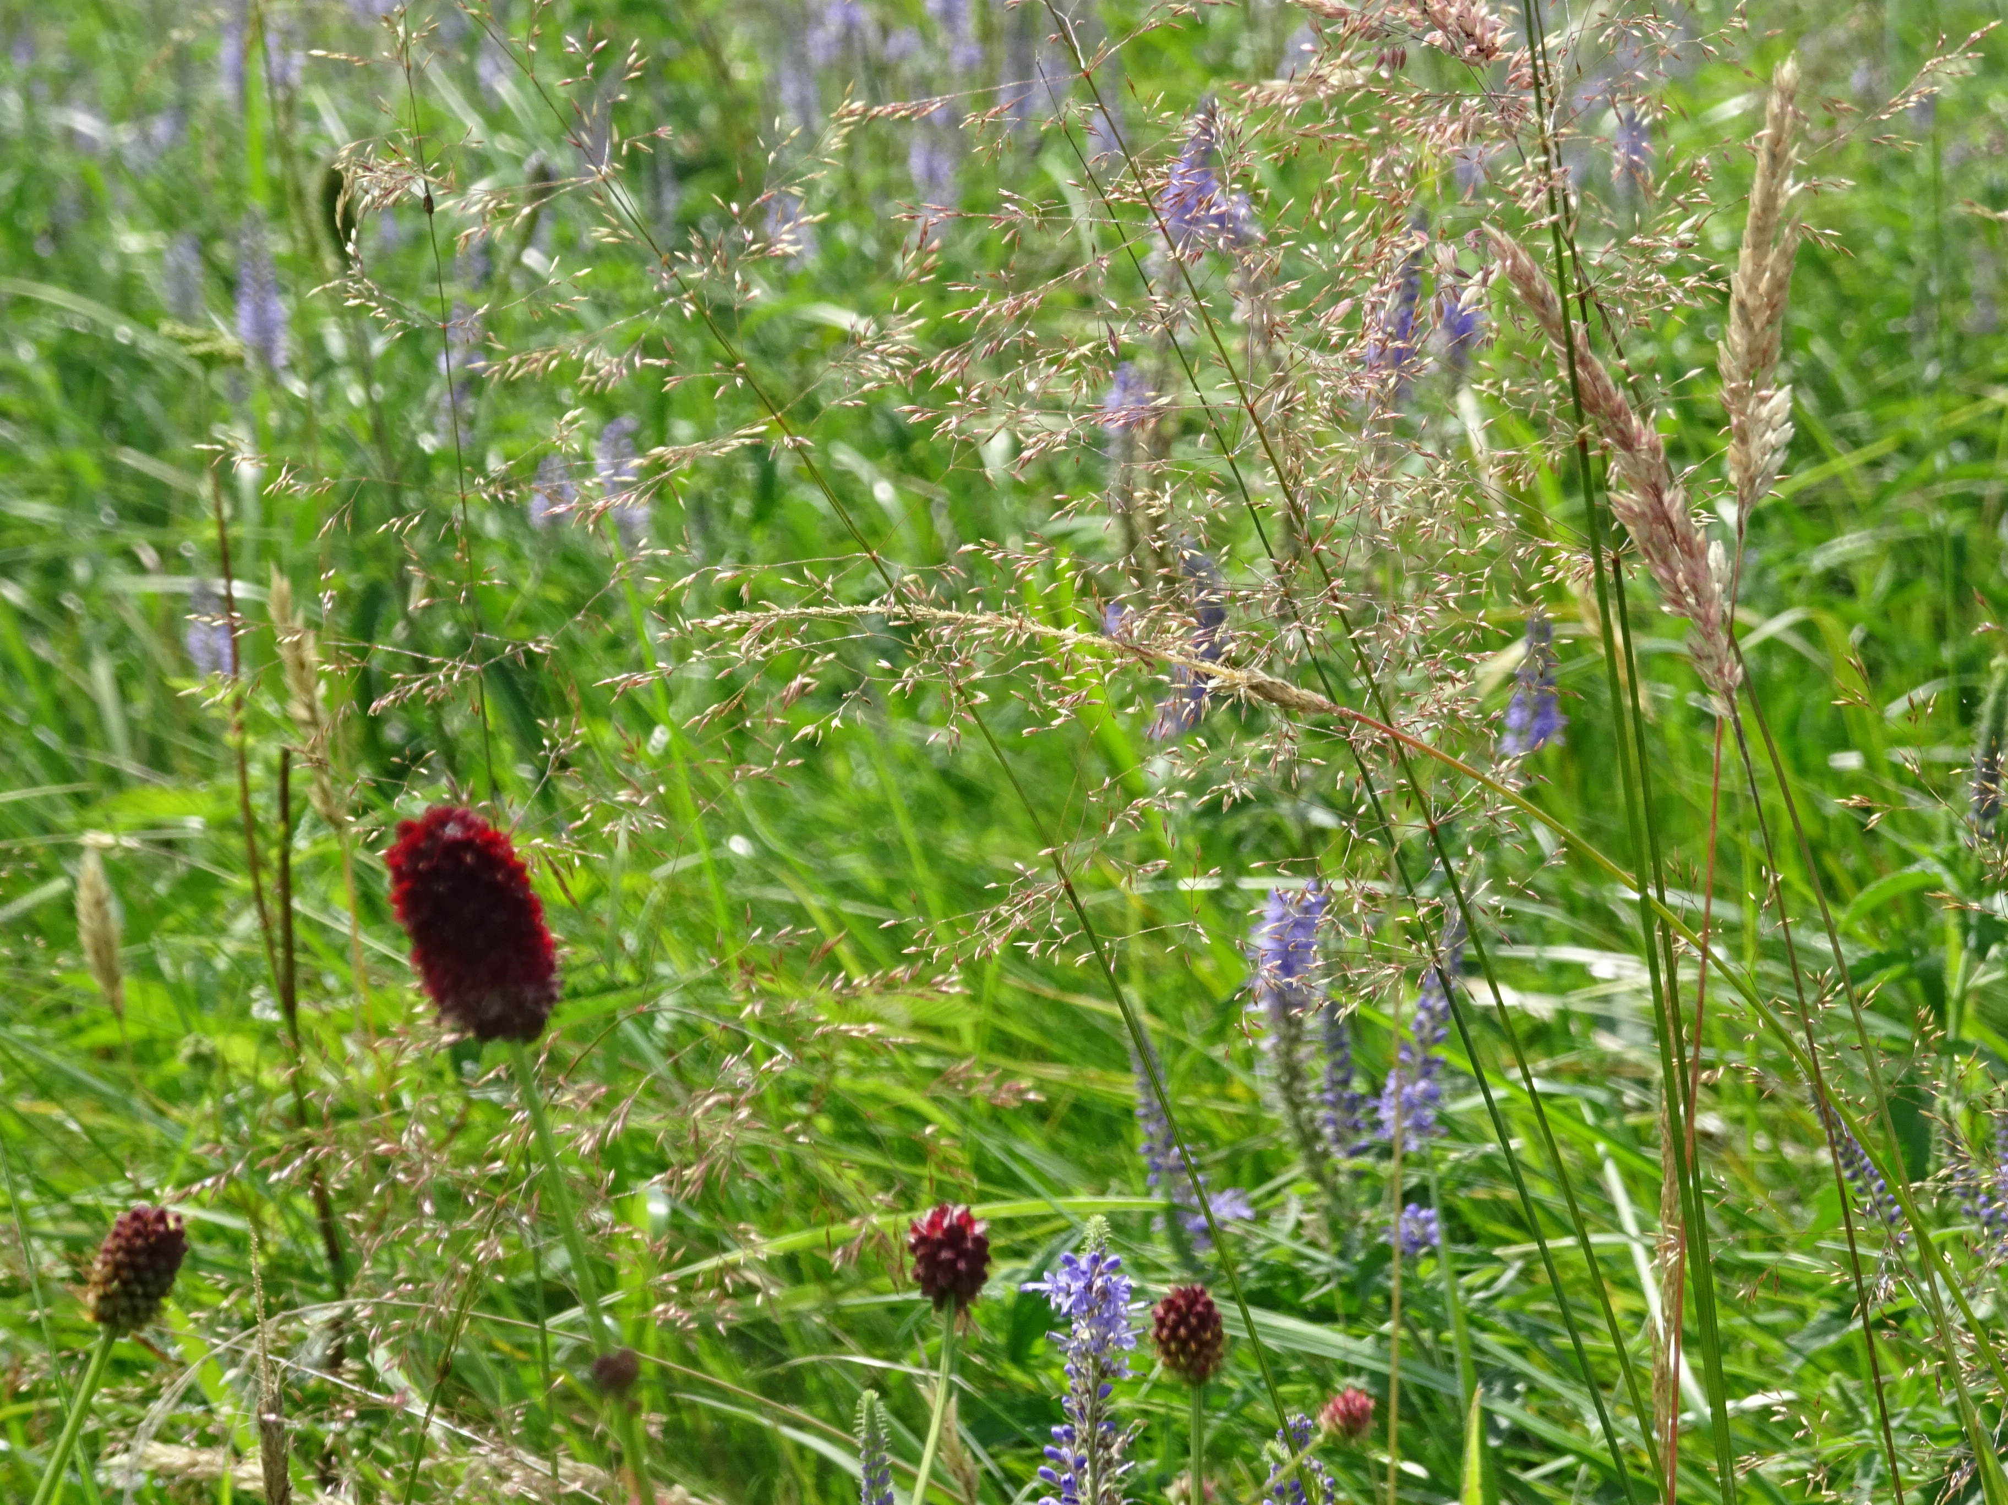
  Task: Syntaxonomic classification of the investigated grassland community
  Does this community exist somewhere else in Europe?
  If not: which is the community that is most similar?
  Is this community stable or do we actually see an intermediate state of a transforming grassland? Where could it be heading to?
  Is it a separate community or just a variation of a known community?
Notes:
There are several questions we can ask on the way. The first one, of course would be if this community, just like it appears in our region, exists somewhere else. We do not know the species community from that area, but maybe it exists in other European areas.
Then, if that is not the case, we should find out which species community that exists, and most likely has been described is most similar to the one investigated.
Of yourse, since the community is still developing, the question is how it will look like when we reach kind of like a stable community, if it stays how we see it now or in which direction it might be developing.
And then there is the point where we have to decide if we can see our community as something seperate or if it is a descibed community or a variation of one.

Slide 5
197 vegetation plots, 4x4m, percent cover
Notes:
What we did was first to take relevés recording all species appearing in 4x4 meters all along the study site. We had 197 plots in total with all the species here and their cover.

Slide 6
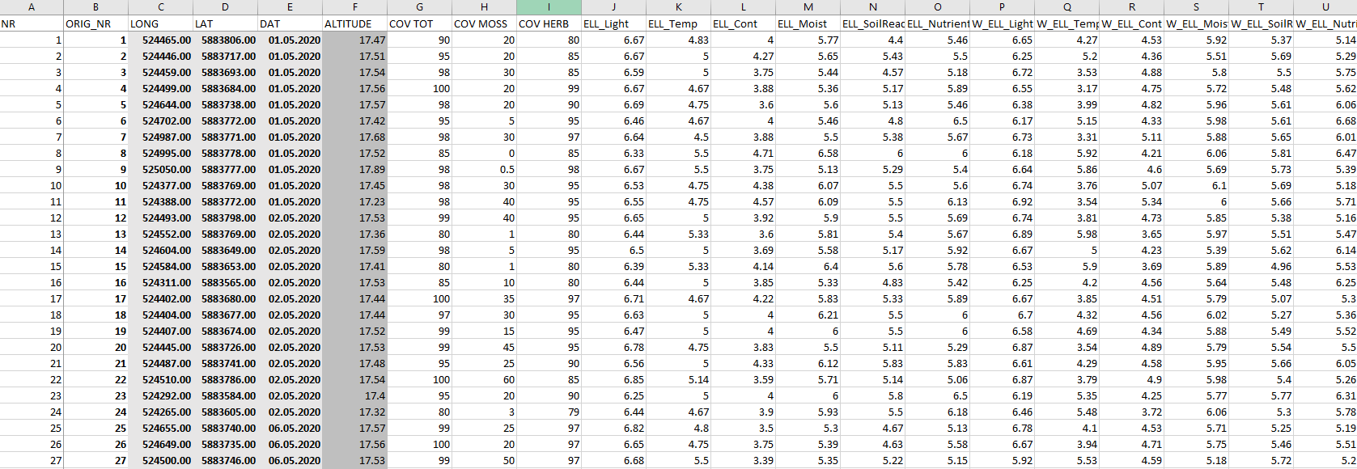

Slide 7
All records of mesic and wet grasslands from the European Vegetation Archive-database [154,028]; vegetation plot data with species identity and cover (or presence/absence)
Notes:
Then we applied for the records of all mesic and wet grasslands stored in the European Vegetation Archive. Those were 154,028. Of all these 154028 we have the species with coverage or at least presence/absence.

Slide 8
Finding the relevés most similar to the investigated community:
Vegetation plot data from the EVA-database [154 028]
Selection of relevant vegetation plots e.g. including at least ten of the most characterising species of the investigated community?
Calculation of a dissimilarity matrix of these data together with those from the investigated community (presence/absence data?)
Clustering and further investigation of the calculated groups
Notes:
And our idea was to first make a selection of these records from the database, based on something – for example to select all plots which include ten of the most characterising species form our area. This selection mainly had to be done because my computer couldn‘t process this large set of data.
Then, after calculating a dissimilarity matrix of these records together with our own records we did a clustering to find out which records are the most similar ones to ours.

Slide 9
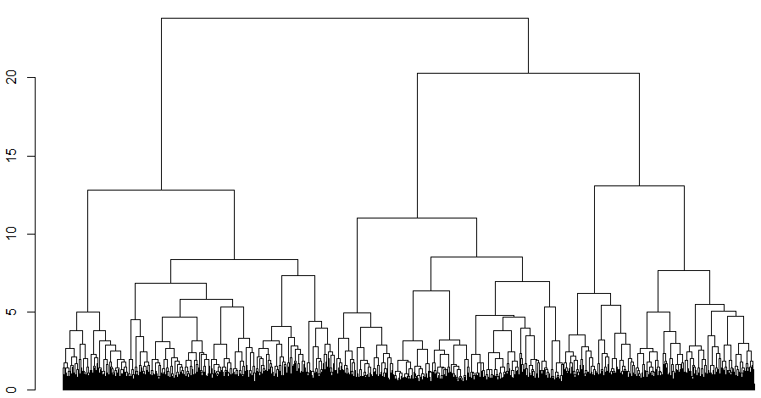
Dendrogramm of the clustering of the records including at least ten of the most characterising species of the investigated community
Ward‘s minimum variance Methode
14,227 records from the database
197 records from the investigated community
1
Bray-Curtis dissimilarity
6
4
5
9
10
13
14
2
3
7
8
11
12
195
2
Notes:
And we did get some results. We finally used 14,227 records from the database and our 197 and almost all our records were clustered into one group with records from Great Britain. When looking at the species identities it makes sense, however I don‘t know if what I did is statistically acceptable, if there are better ways to investigate this question.

Slide 10
  Task: Syntaxonomic classification of the investigated grassland community
  Does this community exist somewhere else in Europe?
  If not: which is the community that is most similar?
  Is this community stable or do we actually see an intermediate state of a transforming grassland? Where could it be heading to?
  Is it a separate community or just a variation of a known community?
Notes:
So yes, we know that the British community of floodplain meadows are the most similar and it makes sense, but questions like if it is a seperate community or just a variation, we could only answer through investigation of the community based on literature. Maybe there are better ways to more correctly anwer these questions.
I also don‘t know how to best present the results in a way to publish it… But maybe we can change that.

Slide 11
  Thank you!

