Slide 1
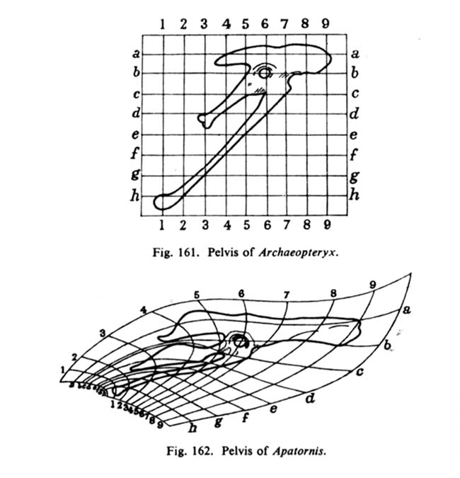
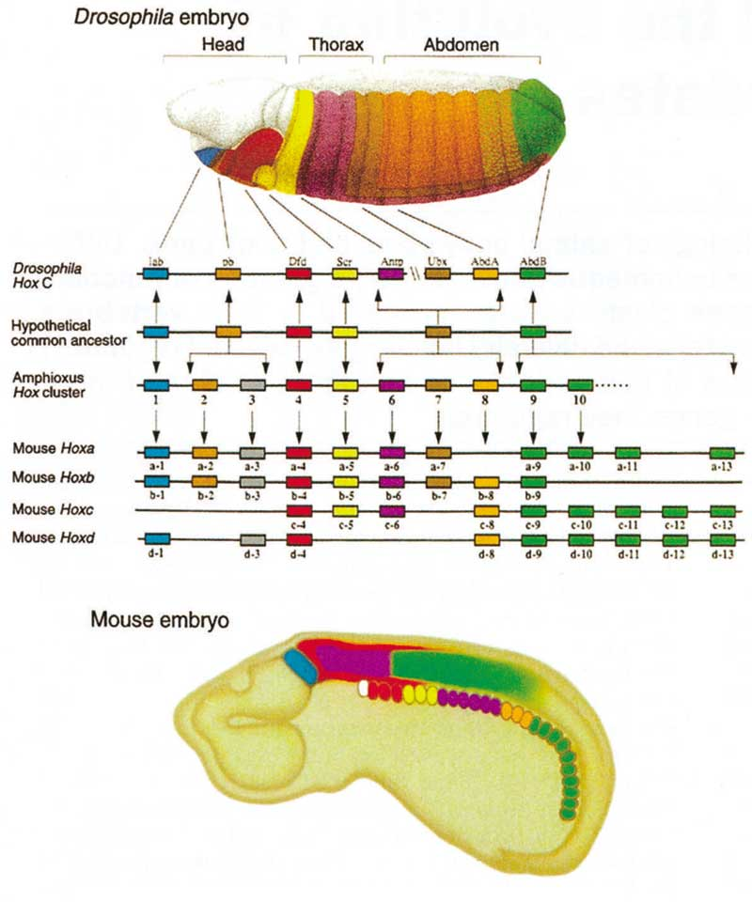
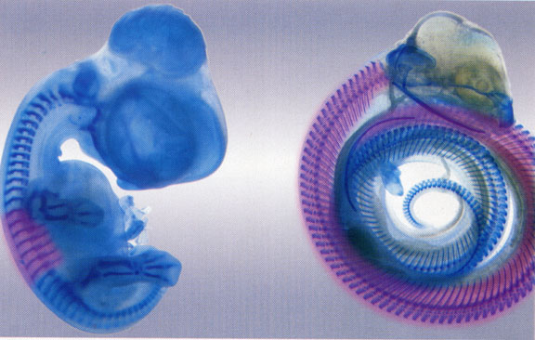
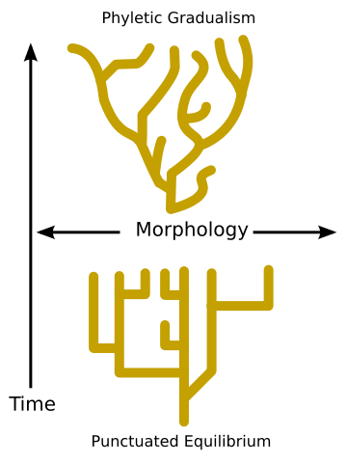
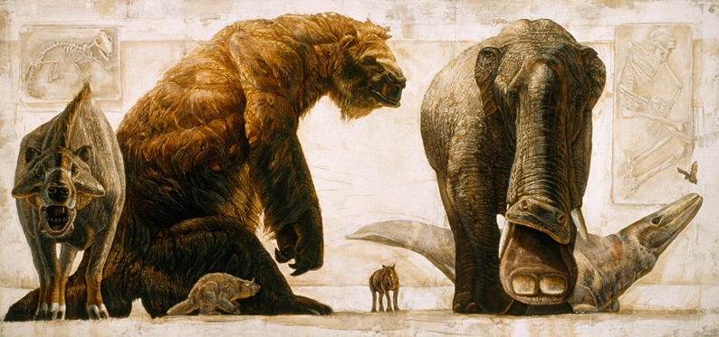
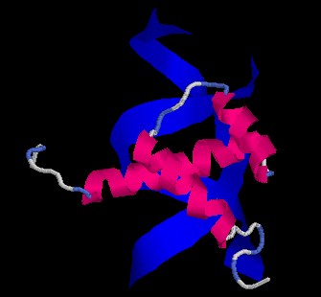
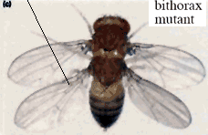
MACROEVOLUTION

Slide 2
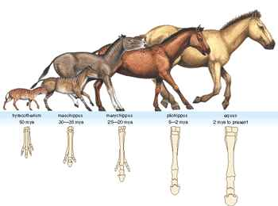
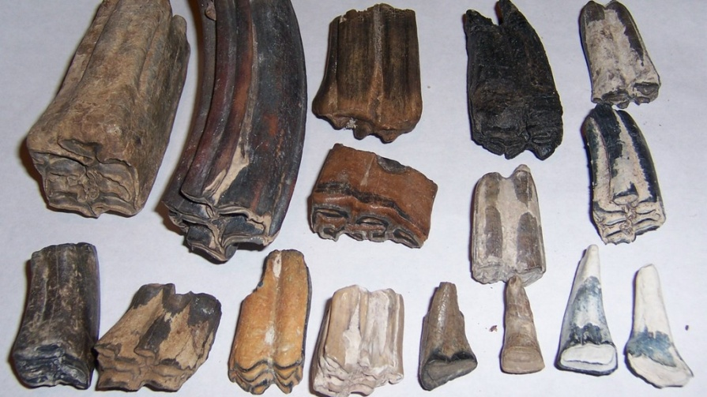
RATE OF evoluTION
PUNCTUATED EQUILIBRIA
Rate of evolution:
difference between trait values in time t₂ and t₁
Haldane (1949)
time interval t₂ - t₁
1 darwin = e-fold change in a trait over 1 million years

Slide 3
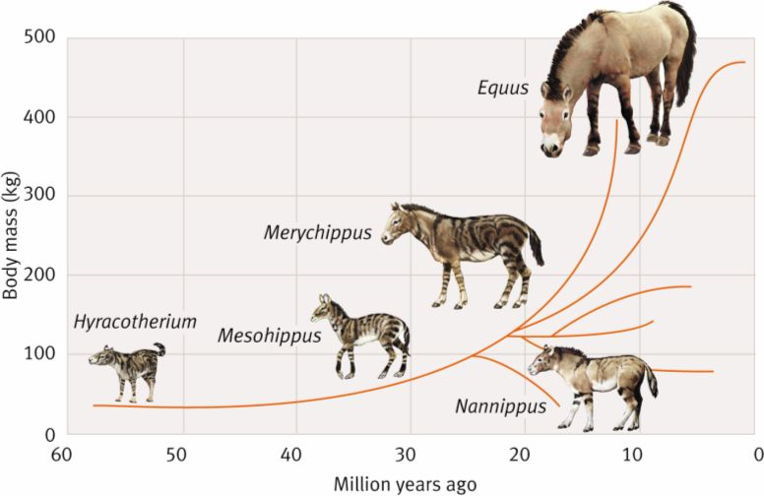
G. G. Simpson:
evoluce bradytelic (slow)
horotelic (standard, eg. horses)
tachytelic (fast)

Slide 4
Haldane (1949): Tertiary horses – 0.04 darwins
domestication – 10³ darwins
Kuertén (1959): Holocene mammals – 12.6 darwins
Pleistocene mammals – 0.5 darwins
Tertiary mammals – 0.02 darwins
… differences caused by different time intervals
disadvantages: 1. factor e is not biologically natural
2. uses absolute time
3. does not take into account measured time interval
4. impossible to compare areas/volumes/linear dimensions
⇒ Haldane (1949), Gingerich (1993): 1 haldane = change measured in units of standard deviation per generation

Slide 5
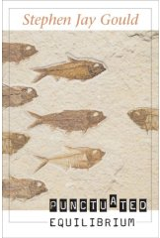
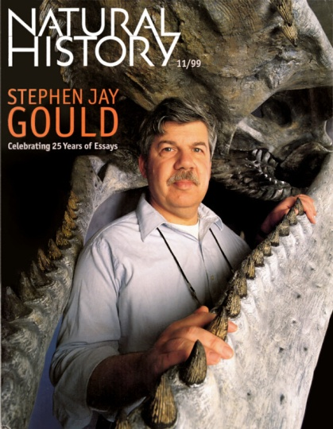
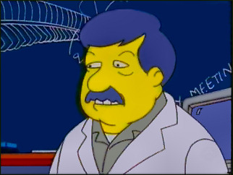
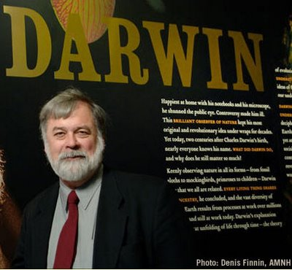
Theory of punctuated equilibria:
Stephen Jay Gould, Niles Eldredge (1972)
stasis vs. rapid change
S.J. Gould
N. Eldredge

Slide 6
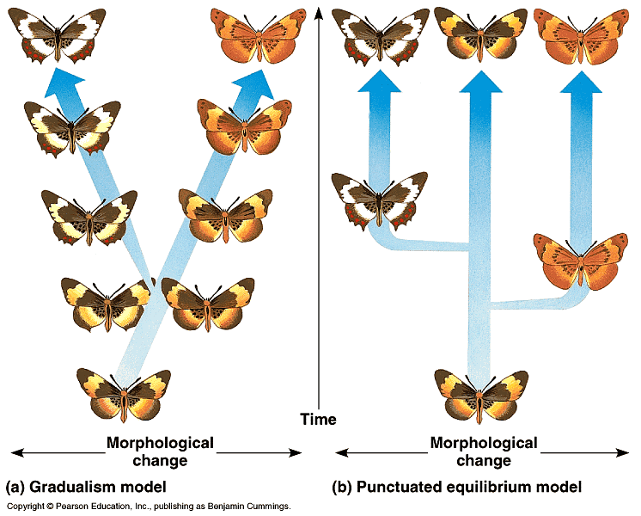
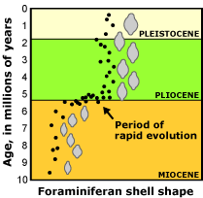
stasis vs. rapid change
stáze
Mechanism?
peripatric speciation
macromutation – R. Goldschmidt, The Material Basis of Evolution (1940): „hopeful monsters“

Slide 7
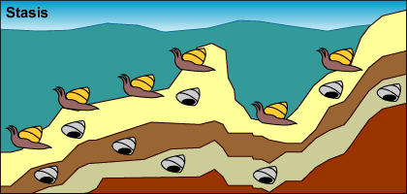
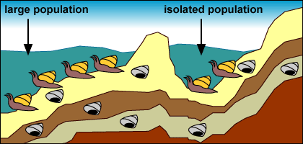
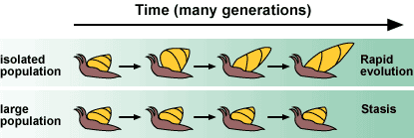
Peripatric speciation and punctuated equilibria

Slide 8
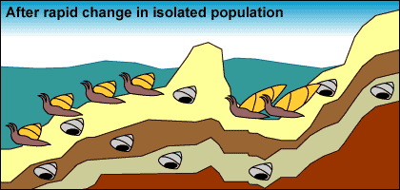
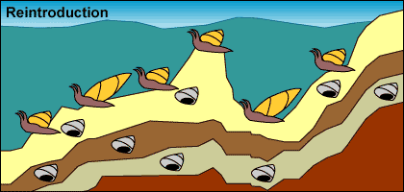
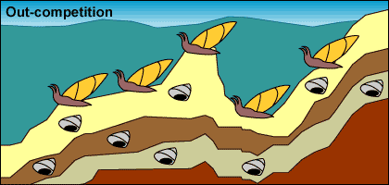

Slide 9
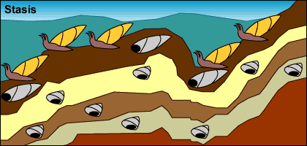
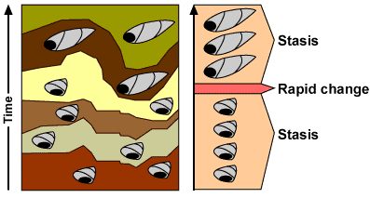

Slide 10
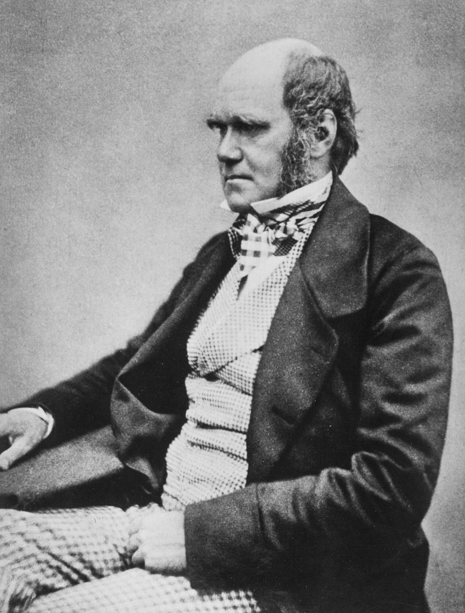
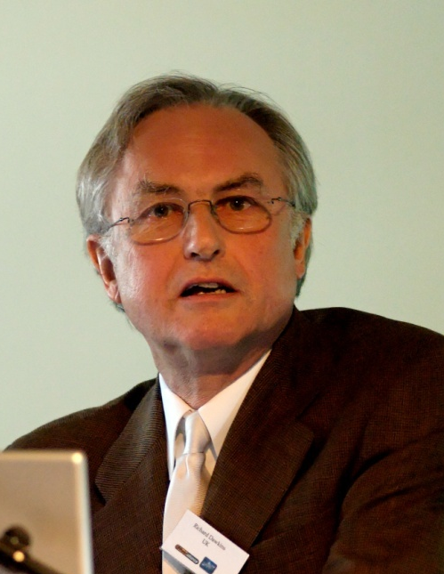
Species of different genera and classes has not changed by the same rate or to the same degree (see „living fossils“).
Periods during which species were changing were short relative to periods during which they stayed unchanged.
Except of (nonexisting) completely constant rate there is only variable rate – species change either in discrete steps (punctuationism) or gradually. Therefore, stasis is only an extreme case of slow evolution.
R. Dawkins: Blind watchaker

Slide 11
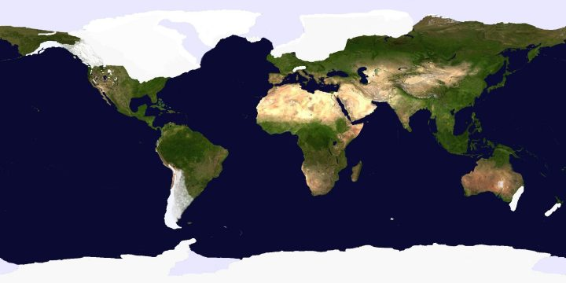
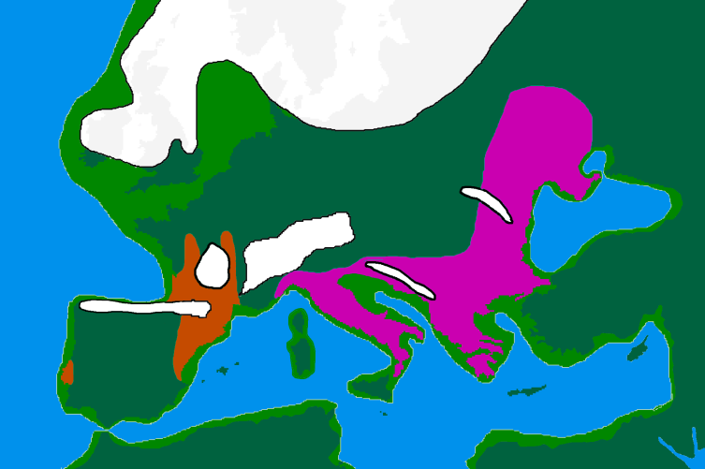
Punctuational proces typical for language evolution:
changes play an important role in periods of divergence of a new language
Bantu, Indoeuropean and Austronesian group: 10-33% differences connected with language splitting
How to explain stasis?
genetic or ontogenetic constraints
habitat tracking – glacial/interglacial cycles
short-term local divergence – rapid changes spatially limited

Slide 12
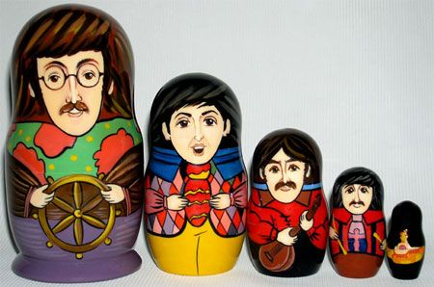
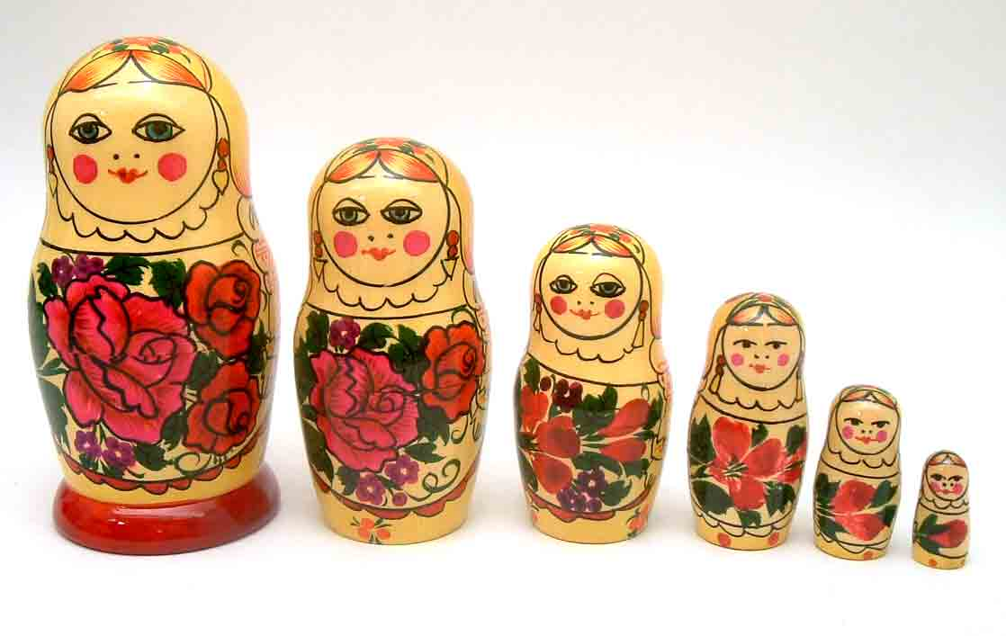
Relation between micro- and macroevolution
Steven M. Stanley (1975): macroevolution separated from microevolution
S.J. Gould (1980): „deposition of neo-Darwinism from the throne“, „effective
death of neo-Darwinism“
Modern Synthesis narrow, extrapolationistic and reductionistic
Is macroevolution really different from microevolution?
evolution of horses
Darwin´s finches
mammal evolution
evolution as „matryoshka“

Slide 13
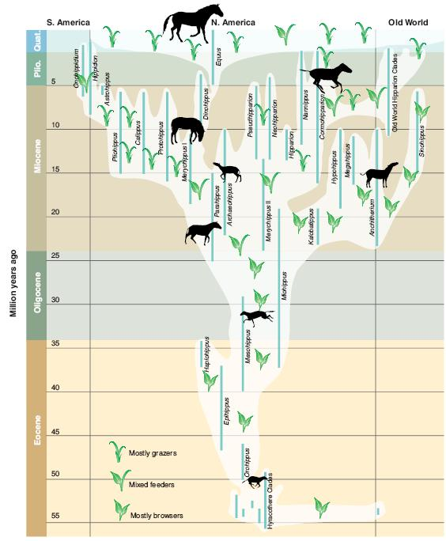
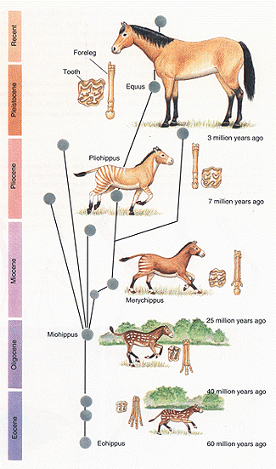
Evolution of horses:
2 dental dimensions
mean rate can be explained by acting of directional selection
(sufficient 2 selective deaths/million of individuals/generation)
if N_{e} < 10⁴ individuals, can be explained by drift alone
likewise also other fossils
grazing
browsing

Slide 14
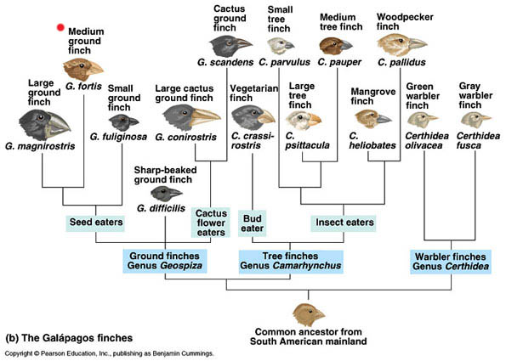
Darwin´s finches:
with known age of Galapágos enough time for diversification to 14 species
(in fact more complicated – reversions, possible extinction of some
species)

Slide 15
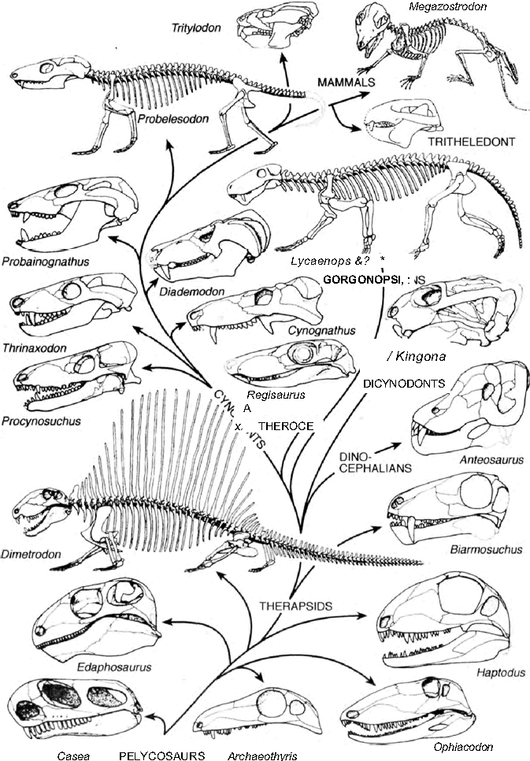
Evolution of mammals from therapsid reptiles:
changes gradual
large differences between reptiles and
mammals are adaptive in
individual links ⇒ same
mechanisms as in microevolution

Slide 16
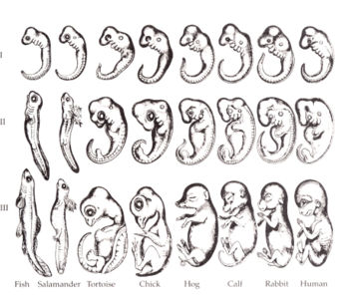
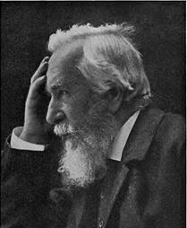
Relation of macroevolution and ontogeny
J. F. Meckel, E. Serres: embryos display traits of embryos of species
preceding on the Scala Naturae
Ernst Haeckel – biogenetic law (= recapitulation l.): ontogeny recapitulates
phylogeny (eg. gills during mammal embryonal development)

Slide 17
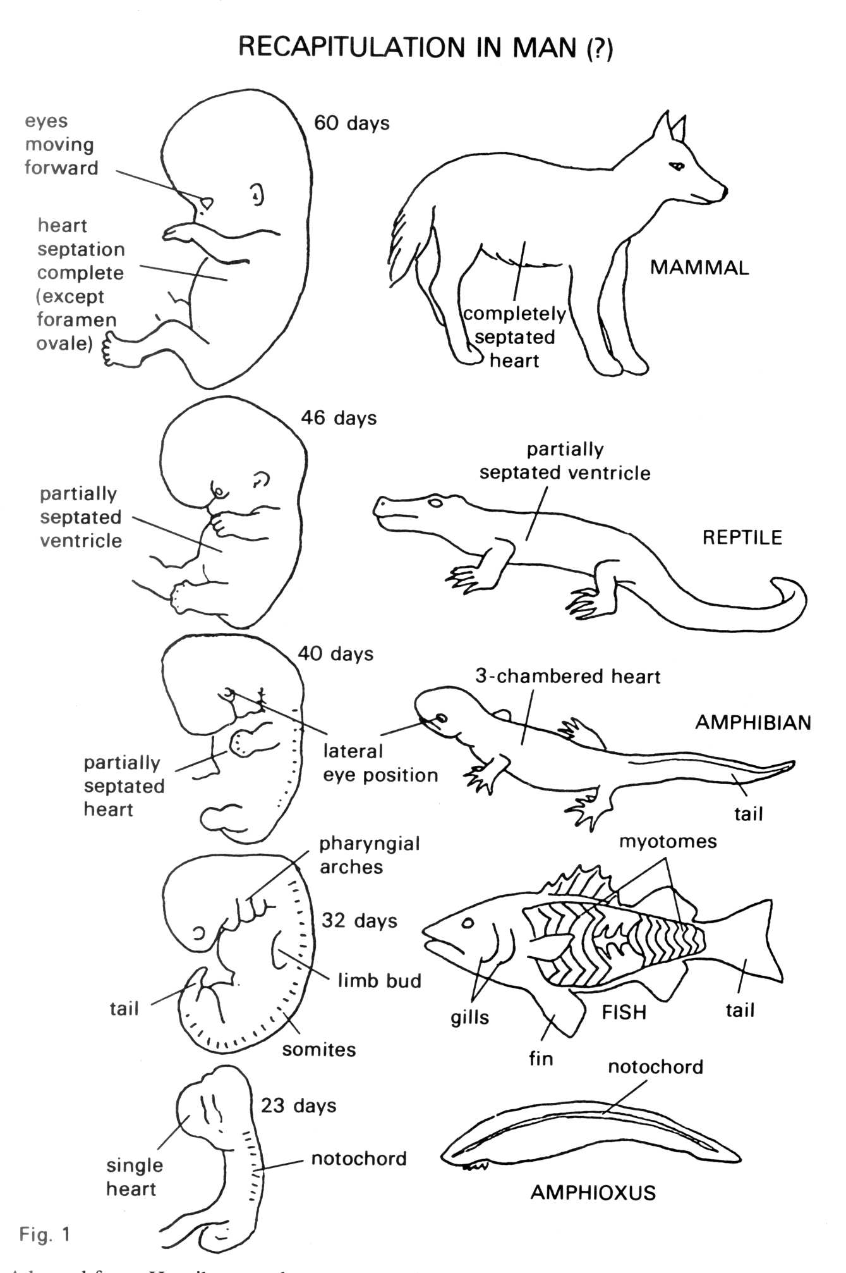

Slide 18
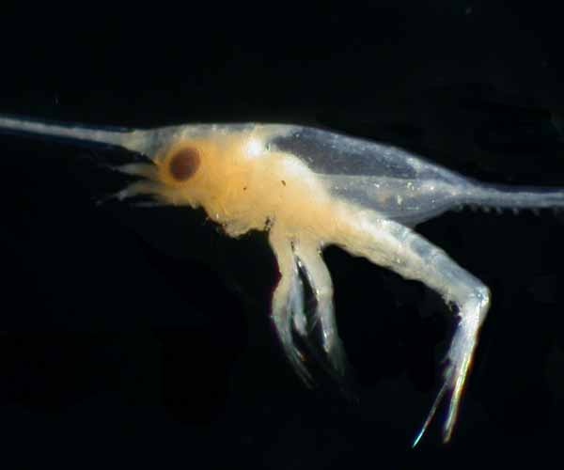
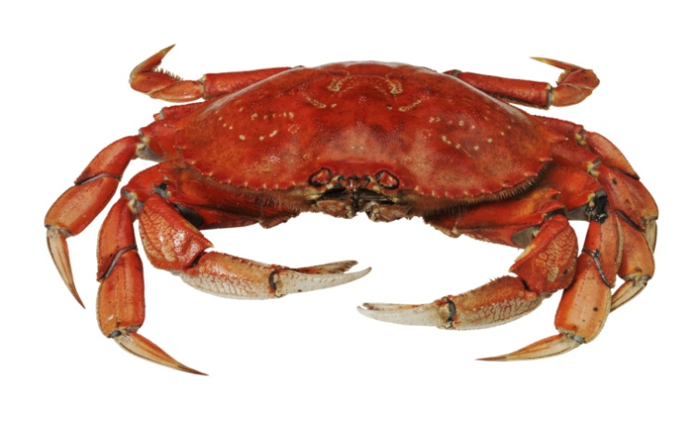
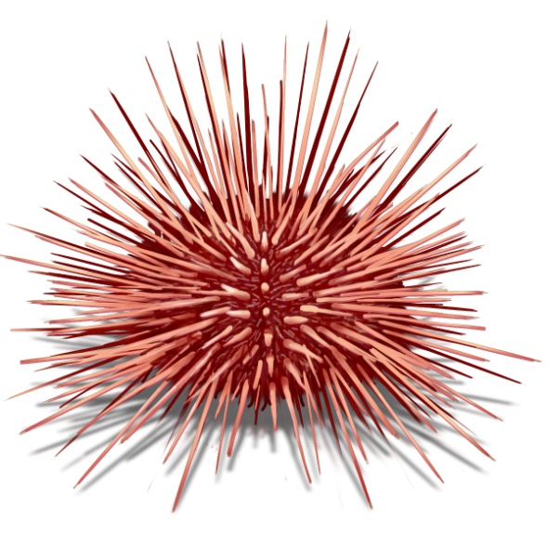
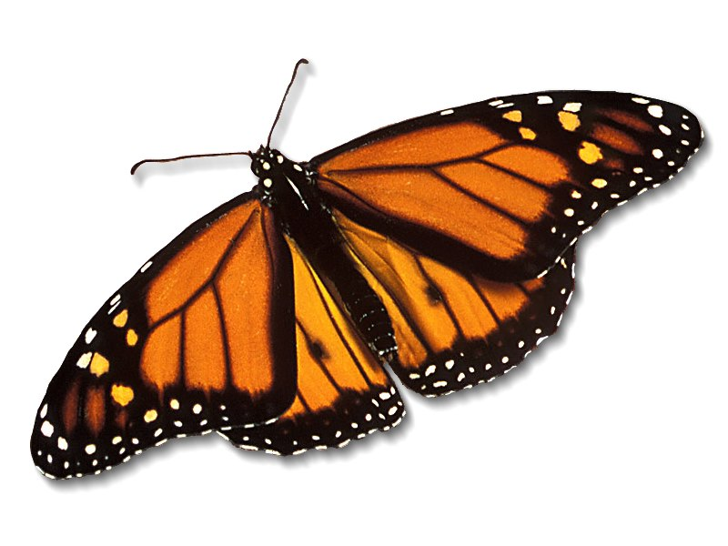
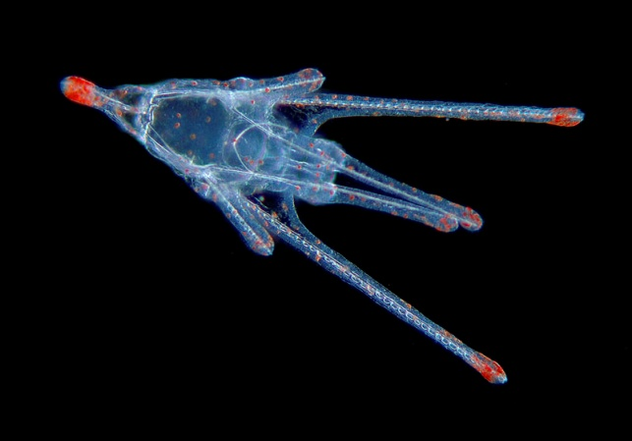
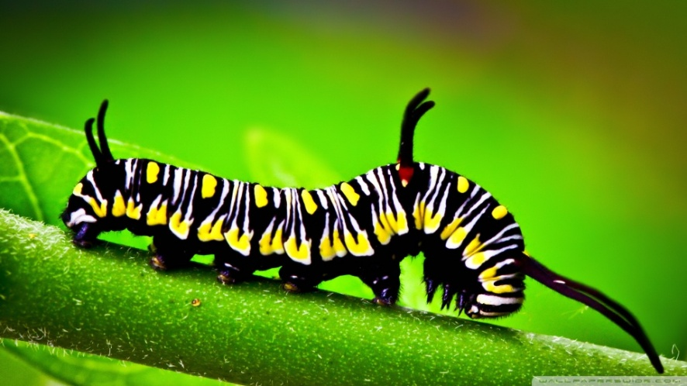
× specialized larval forms (= non-terminal addition): zoëa of crabs,
Müller´s larva of echinoderms, caterpillar of butterflies etc.
terminal vs. non-terminal addition

Slide 19
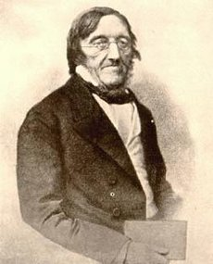
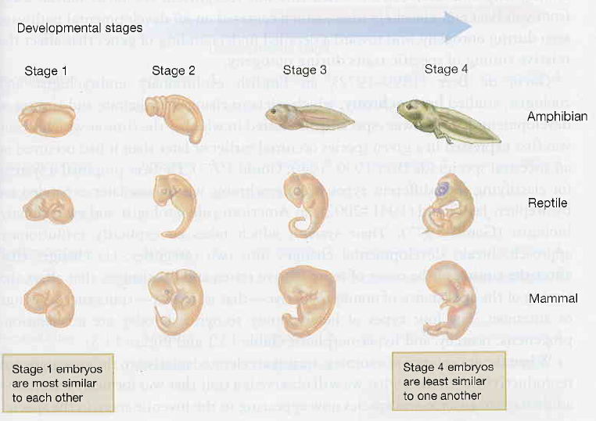
Karl Ernst von Baer – embryological laws:
Vertebrate embryos pass through stable stages during their development which are not identical to any animals species.
Embryos of related species are similar to each other and dissimilar to adults of ancestral species.

Slide 20
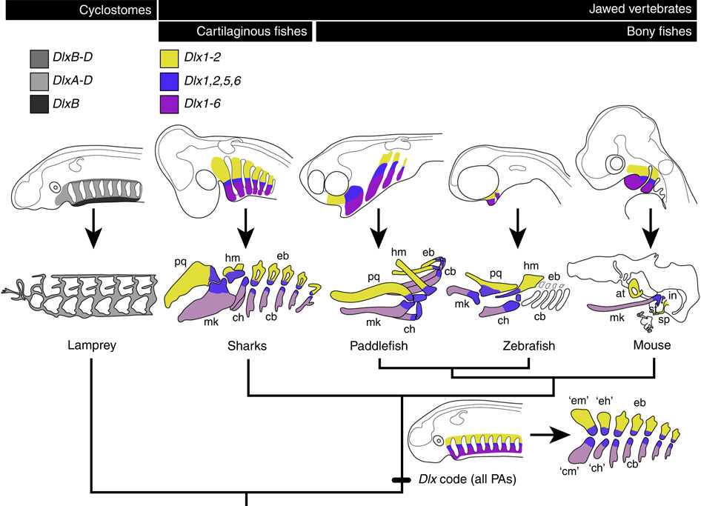
Karl Ernst von Baer – embryological laws:
1st law: General traits of a large animal group appear in
the embryo earlier than special traits (eg. cartilage
in bony fishes).

Slide 21
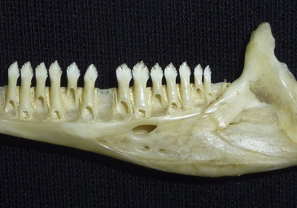
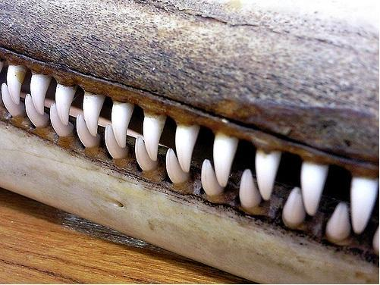
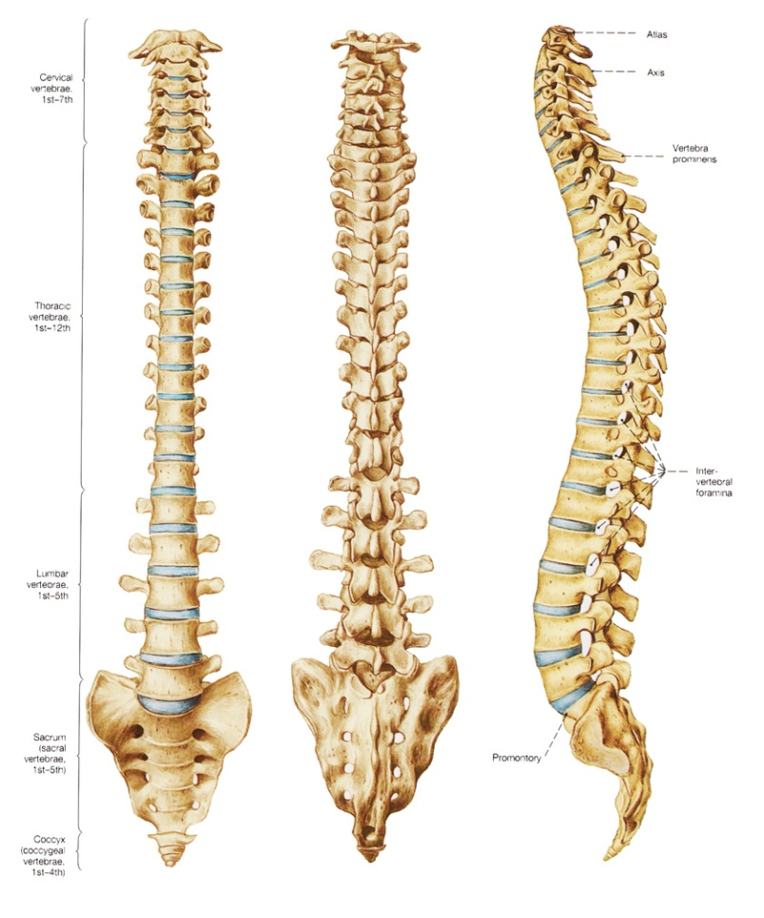
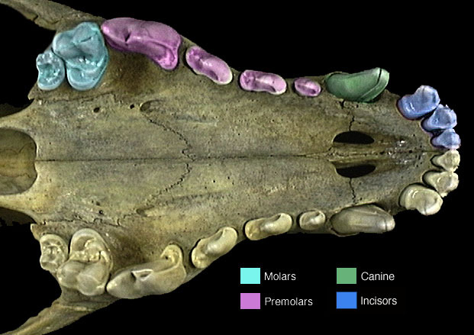
General principles of ontogeny and evolution:
modularization and individualization: serial homology and homonymy

Slide 22


General principles of ontogeny and evolution:
heterotopy = change of the position of a trait phenotypic expression
(eg. photosynthesis in succulent stem; sesamoid bones – patella,
ossified tendons in dinosaur tails, „panda´s thumb“)

Slide 23

General principles of ontogeny and evolution:
heterochrony and allometry

Slide 24
Heterochrony:
 |  | Somatic traits | Reproductive org.
peramorphosis
paedomorphosis
= change of timing of ontogenetic events:
1. speed of the process
2. timing of the process

Slide 25


Heterochrony:
 |  | Somatic traits | Reproductive org.
peramorphosis | hypermorphosis | -- | deceleration
 | acceleration | acceleration | --
paedomorphosis
hypermorphosis
acceleration → peramorphosis
hypermorphosis → peramorphosis
Megaceros giganteus

Slide 26

Heterochrony:
 |  | Somatic traits | Reproductive org.
peramorphosis | hypermorphosis | -- | deceleration
 | acceleration | acceleration | --
paedomorphosis | progenesis | -- | acceleration
 | neoteny | deceleration | --
neoteny
neoteny → pedomorphosis
progenesis → pedomorphosis

Slide 27



neoteny:
Ambystoma mexicanum

Slide 28




Slide 29


Slide 30

Neoteny in humans?

Slide 31

Human neotenic features compared to the chimp^{*)} (Wikipedia):
Head:
  rounded skull
  slender cranial bones
  reduced brow ridges
  large brain
  flat face
  broadened face
  hairless face
  hairs ontop head
  large eyes
  ear shape
  small nose
  small teeth
  small upper and lower jaw
Genitals:
  absence of baculum (os penis)
  presence of hymen
  anteriorly oriented vagina
  Limbs/posturer:
  legs longer than hands
  foot structure
  upright posture
„Naked“ body
*) some of them are not, in fact, neotenic!

Slide 32
Origin of macroevolutionary novelties:
change of function of a gene product:
pigment producing enzyme → change of coloration
digestive enzyme → change of sexual habits
loss of function:
genes suppressing own pathogenicity
deletion of host proteins recognized by parasites (eg. CCR5-Δ32
deletion in the CCR5 gene → resistency to the HIV and variola
…. 5-14% of Europeans, in Africans and Asiatics rare)
changes in gene regulation
prions – incorrect translation termination ⇒ bovine spongiform
encephalopathy,
scrapie of sheep and goats, kuru, Creutzfeld-Jakob disease in humans
role of gene duplications – more radical changes enabled
symbiosis, gene transfer (retroviruses)
homeotic genes

Slide 33





Homeotic (Hox) genes
William Bateson: „homeosis“ = anatomical changes of large extent
(eg. development of an extra finger, cervical vertebra instead of
thoracic, limb in ectopic position)

Slide 34

Homeotic (Hox) genes
Edward Lewis: homeotic genes = genes responsible for basic
segmentation of multicellular animals – homeotic mutations do not
change the number of segments but their identity
control of transcription of other genes (eg. Ubx probably regulates
hundreds of „target“ genes)
determination of basic body segmentation
high evolutionary conservativeness

Slide 35



Homeotic mutation
halteres
mutation of the Ultrabithorax gene: 3rd thoracic segment (T3) → T2
Bithorax
Antennapedia

Slide 36


Hox genes: basic antero-posterior body segmentation
linear clusters, same order as the segments
T
A
Hox gene effects are overlapping

Slide 37
Drosophila: 1 linkage group, 2 clusters:
Antennapedia (ANT-C)
Bithorax (BX-C)
vertebrates:
4 linkage groups

Slide 38


Slide 39


Slide 40

Homeobox: 180 bp → homeodomain
60 AA (expression regulation)
homeodomain

Slide 41

Hox-genes are highly conservative

Slide 42



ParaHox genes
MADS-box genes in plants

Slide 43


3 hypotheses of the origin of dipteran arrangement:
beetle
dragonfly
Ubx protein expression:
fruit fly
T2-T3 boundary

Slide 44

original function:
venation development
loss of
function ...
... but origin of halteres
in butterflies also scale morphology and wing coloration

Slide 45

Evolution of thoracic segments in crustaceans – shift of anteroposterior
boundary of expression of the Ubx gene:
thoracic segments: copepods – 6, lobster – 8, brine shrimps – 11 (ancestral)
movement → maxillipedes
strong Ubx expression
weak Ubx expression

Slide 46



shift of anteroposterior boundary of Ubx gene expression = position
of transition of locomotory segments and maxillipedes
např. opossum shrimps: 2nd segment, prawns: 4th segment
2nd thoracic limb of opossum shrimps = transitional segment between
1st (maxillipede) and 3rd limb (locomotion)

Slide 47



Besides transcriptional factors also regulatory enhancers:

Slide 48

Macroevolutionary trends
species selection
trends: real × passive (eg. wall effect)
Edward Drinker Cope: trend to bigger size
Species selection:
= preferential survival or proliferation of species
different speciation rates
different extinction rates

Slide 49
the trait connected with differential survival or speciation
these features independent of natural selection
trait is heritable during speciation
SS favours only nonadaptive trends
(otherwise = natural selection)
Necessary to prove:
higher speciation rate/lower extinction rate in lineages which deviate
from the average in the direction of the trend
the trend and distribution of varied speciation/extinction rates are not
caused by shift in fossil record
the trend and distribution of varied speciation/extinction rates are not
caused by natural selection

