Slide 1
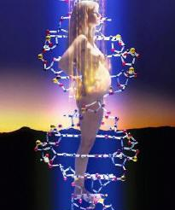
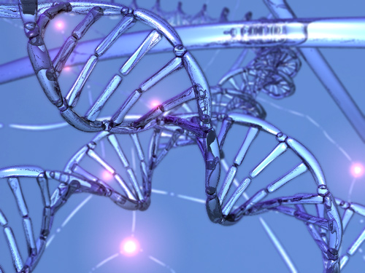
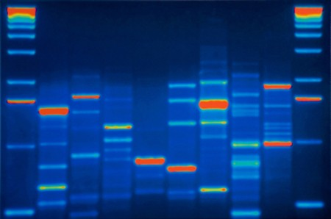
ORIGIN OF GENETIC VARIATION

Slide 2
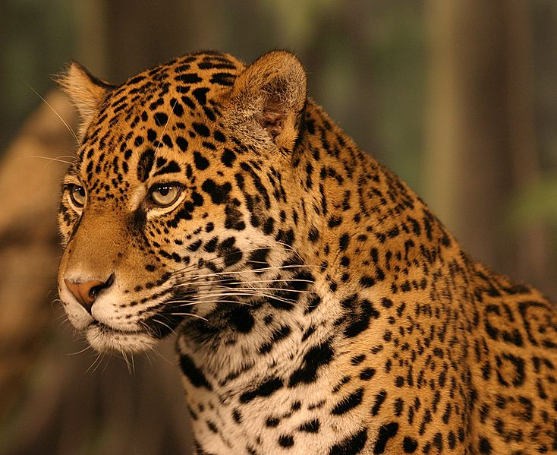
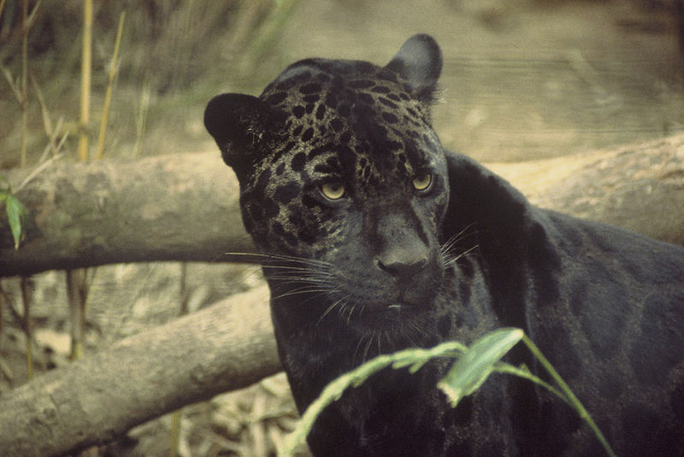
Consequence of the H-W principle:
if the assumptions of the H-W population hold true, polymorphism can be
maintained solely by random mating and Mendelian inheritance
BUT!
real populations usually differ from the model:
population size finite
mating may be nonrandom
migration
selection
emergence of new alleles by mutation

Slide 3
MAIN MICROEVOLUTIONARY MECHANISMS:
mutation (incl. transposition)
recombination
migration (gene flow)
nonrandom mating
natural selection
random genetic drift (incl. bottleneck, founder effect)
(molecular drive)

Slide 4
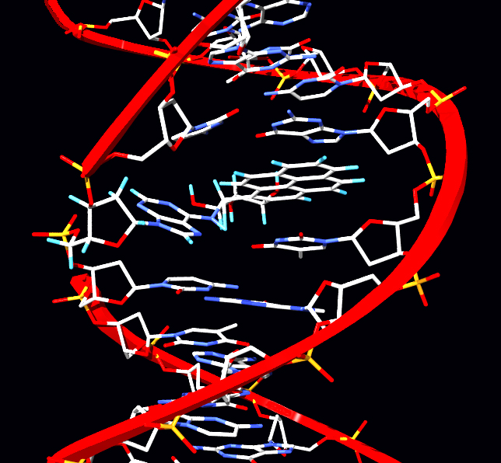
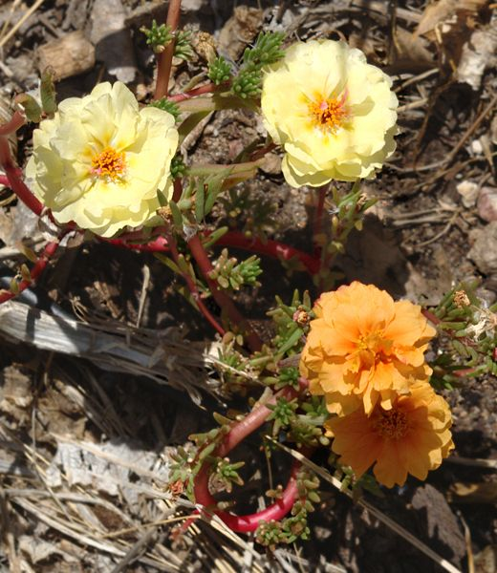
MUTATION
spontaneous × induced
in germ cells × somatic
according to their deleterious/beneficial effect:
beneficial (positive)
deleterious (lethal, negative)
neutral

Slide 5
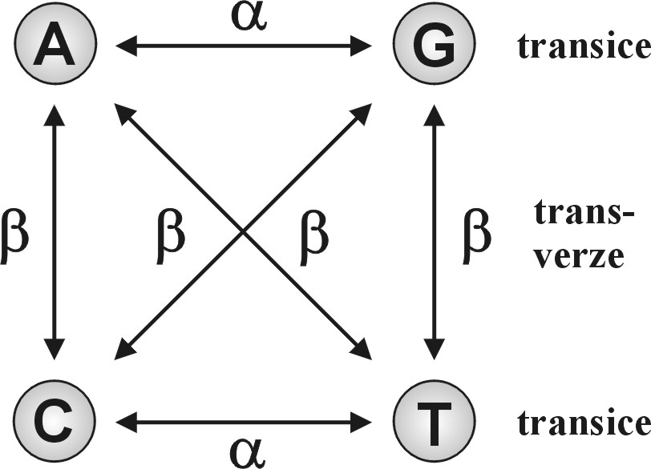
According to effect
point (gene)
chromosomal
genome
Point mutations:
substitutions (transitions, transversions)
synonymous nonsynonymous
GTC → GTA
Val → Val
GTC → TTC
Val → Phe
AAG → TAG
Lys → ochre (stop)
missense
nonsense

Slide 6
insertions ACGGT → ACAGGT
delections ACGGT → AGGT
}
indels → shift of reading frame
back mutations: generally 10-times lower frequencies
recurrent mutations → mutation pressure:
eg. when allele frequency A = 0,5; 2N = 2000, i.e. : N_{A} = 1000
after 1st generation → N = 1001 ⇒ increase to 0,5005
after 100 generations → 0,55 ...
⇒ change of allele frequencies by mutations very slow

Slide 7
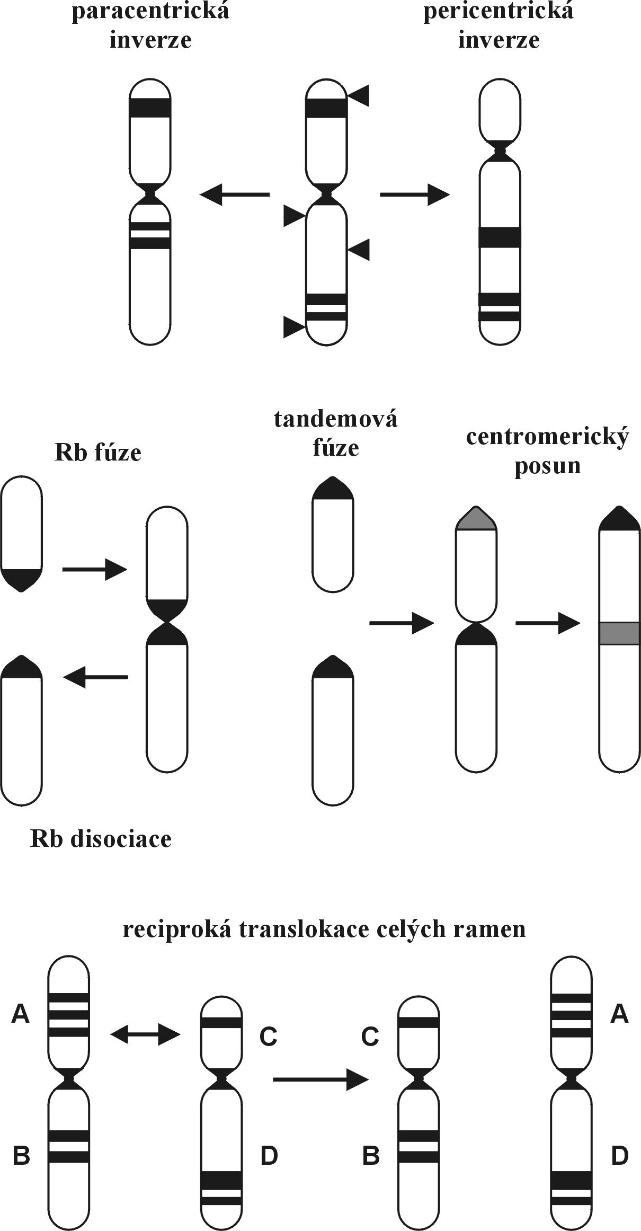
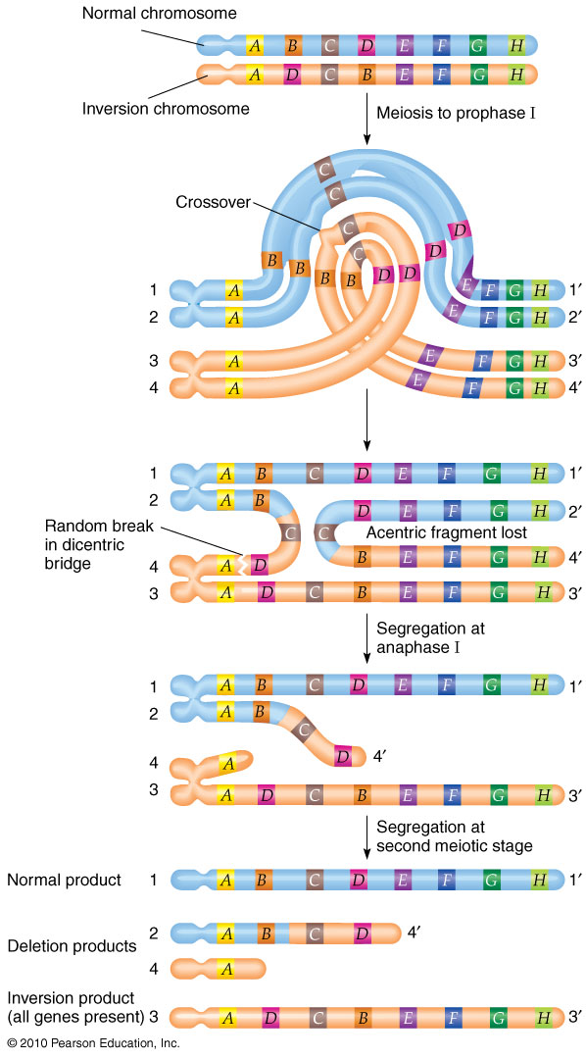
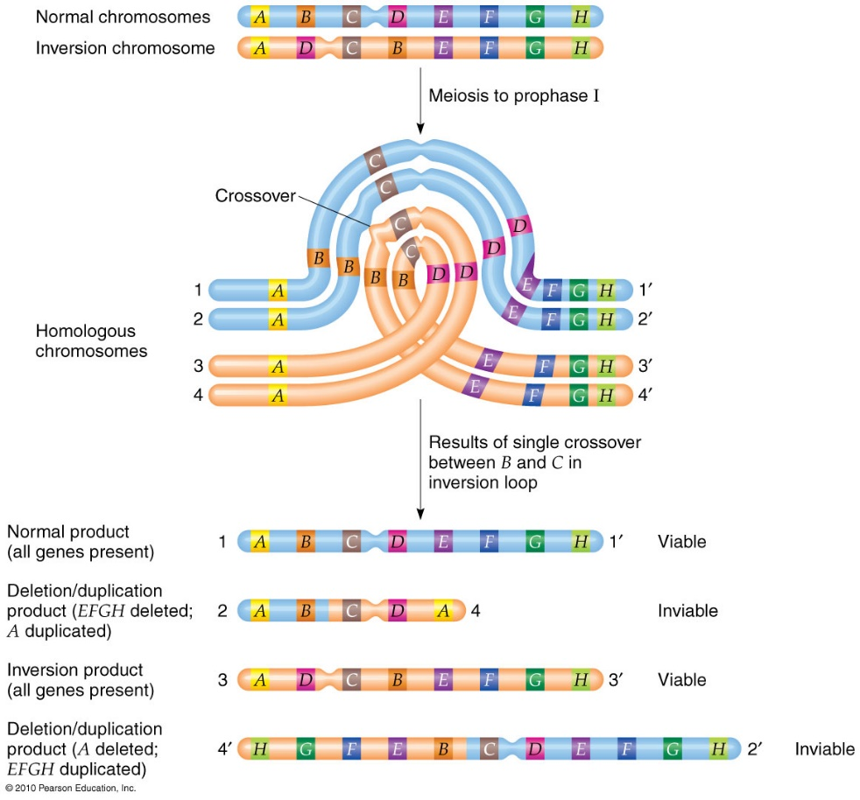
Chromosomal mutations (chr. rearrangements)
inversions
pericentric
paracentric
crossing-over
ale žádná
rekombinace!

Slide 8
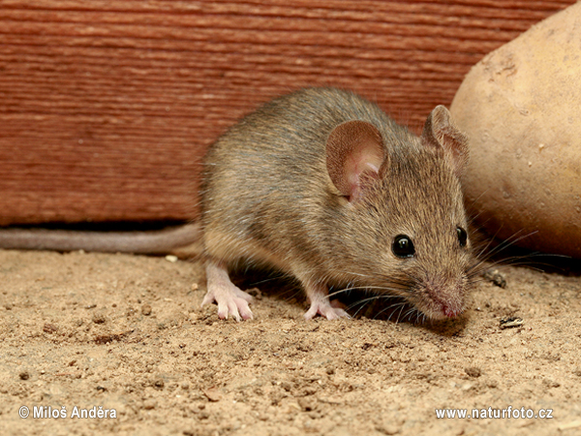
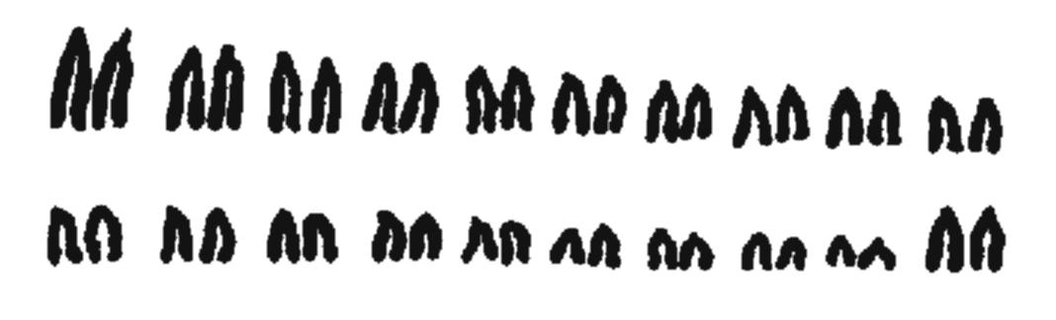
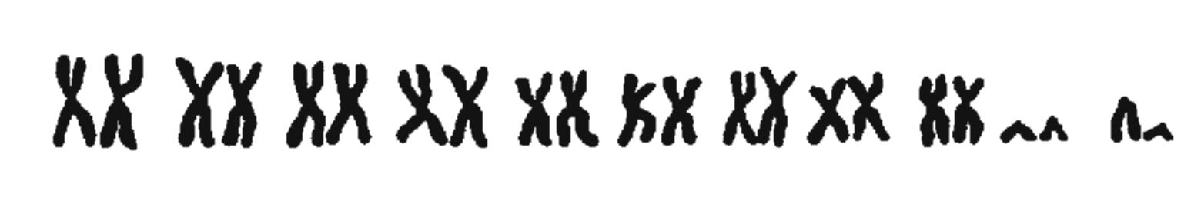
translocations
fusions and dissociations
(Robertsonian translocations)
house mouse

Slide 9
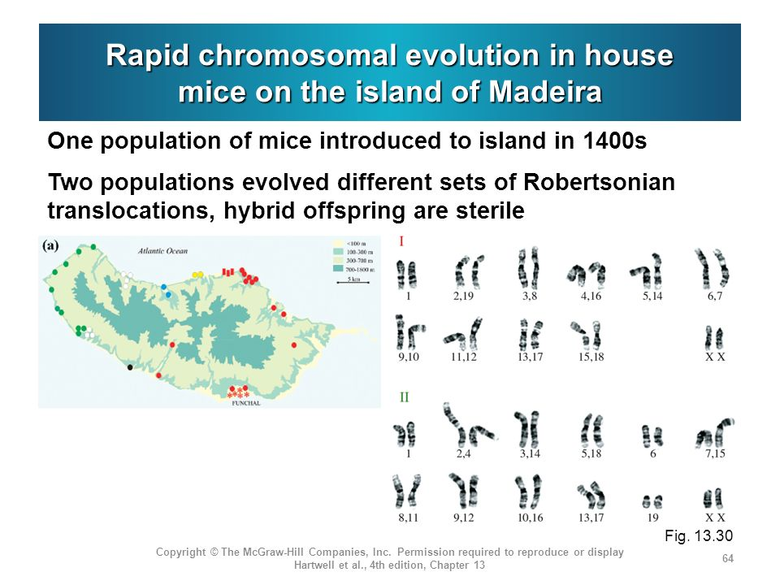

Slide 10
translocations
fusions and dissociations
whole-arm reciprocal translocations (WART)
house mouse

Slide 11
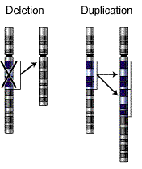
deletions
duplications
insertions

Slide 12
Genome mutations
-somies (monosomies, trisomies)
mostly incompatible with life
monosomies: the only viable = X0 (Turner syndrom)
trisomies: imbalance in gene dosage (increased expression of
the trisomic pair)
viable trisomies : XXY, XXX, XYY, Patau syndrom (chr. 13),
Edwards s. (chr. 18), Down s. (chr. 21)

Slide 13
-ploidies (polyploidy)
especially plants
in animals less frequent (invertebrates, fishes, amphibians)
during the vertebrate evolution 2 rounds of whole genome duplications
(2R-hypothesis)
polyploid individuals usually bigger (increased cell volume)
odd multiples of the genome → problems in meiosis ⇒ reproductive barrier
(not always – eg. triploid frogs)
autopolyploidy: combination of two identical genomes
fusion of cells
endoreplication
abortive cell cycle
allopolyploidy: combination of two different genomes
fusion of diploid gametes
polyspermy

Slide 14
Randomness and mutation rate (μ)
mutation effects random, position and rate nonrandom
transitions > transversions
mutation „hotspots“: CpG in animals (methylated C → T); TpT in Procaryota
„SOS reactions“ in Bacteria, minisatellites (VNTR), microsatellites (STR)
mtDNA > nuclear DNA
sex chromosomes > autosomes
influence of proximity of the replication start, centromeres, telomeres, repetitive
sequences, intensity of transcriptions
cold-blooded animals: > temperature ⇒ > μ
RNA viruses (HIV)
parasites
antigens, immunoglobulins
> μ of somatic mutations
males > females: humans 6x, rodents, fox: 2x … more cell divisions in germ cells

Slide 15
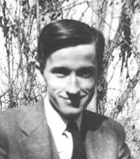
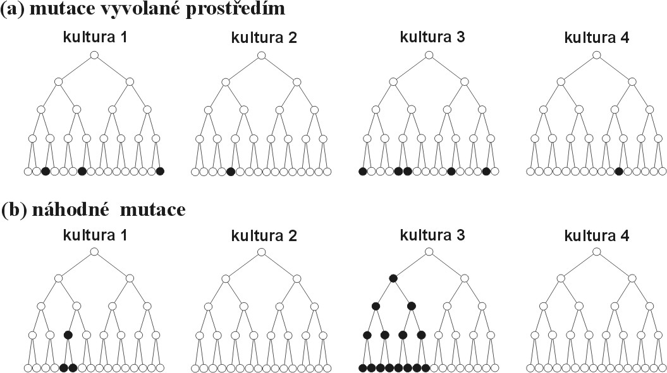
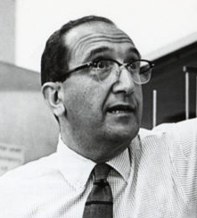
Adaptive (directed) mutations?
Max Delbrück, Salvador Luria (1943):
fluctuation test
directed mutations
random mutations

Slide 16
RECOMBINATIONS
mutations → new alleles
recombinations → new genotypes (exception = intragenomic recombination)
Vytvoření zlomu na jednom chromozomu.
Štěpení Holidayova spoje
Invaze řetězce do homologního chromozomu.
Spojení řetězců homologních chromozomů. Holidayův spoj
Migrace Holidayova spoje. Vytvoření heteroduplexu.
Heteroduplex

Slide 17
in many organisms crossing-over important for right meiosis
(at least 1 c-o per chromosome, otherwise aneuploidies)
women with > c-o → > children
children of older women → > recombinations
differences in various parts of chromosome (near centromeres and telomeres etc.,
differences among organisms)
small chromosomes > recombination frequencies
recombination „hotspots“:
humans ∼25 000
absent in Drosophila and Caenorhabditis elegans
frequent appearance and disappearance
demise of 1 point often compensated by increased aktivity of a neighbour point

Slide 18
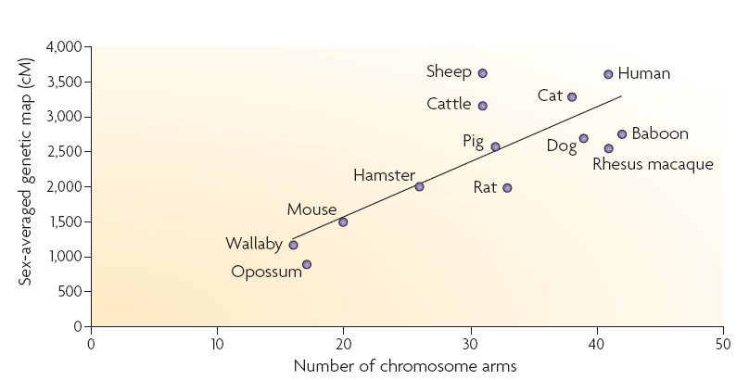
differences in recombination rate between sexes:
- Haldane-Huxley rule: if one sex doesn´t recombine, it is the heterogametic sex
- if both sexes recombine, mostly in females > recombinations
(man 1,7x, mouse 1,3x)
differences between species:
- species with more small chromosomes → more recombinations than species
with less large chromosomes
- correlation with the number of arms: more recombinations in karyotypes with
large numbers of chrom. arms (at least 1 c-o/arm to avoid aneuploidies?)

Slide 19
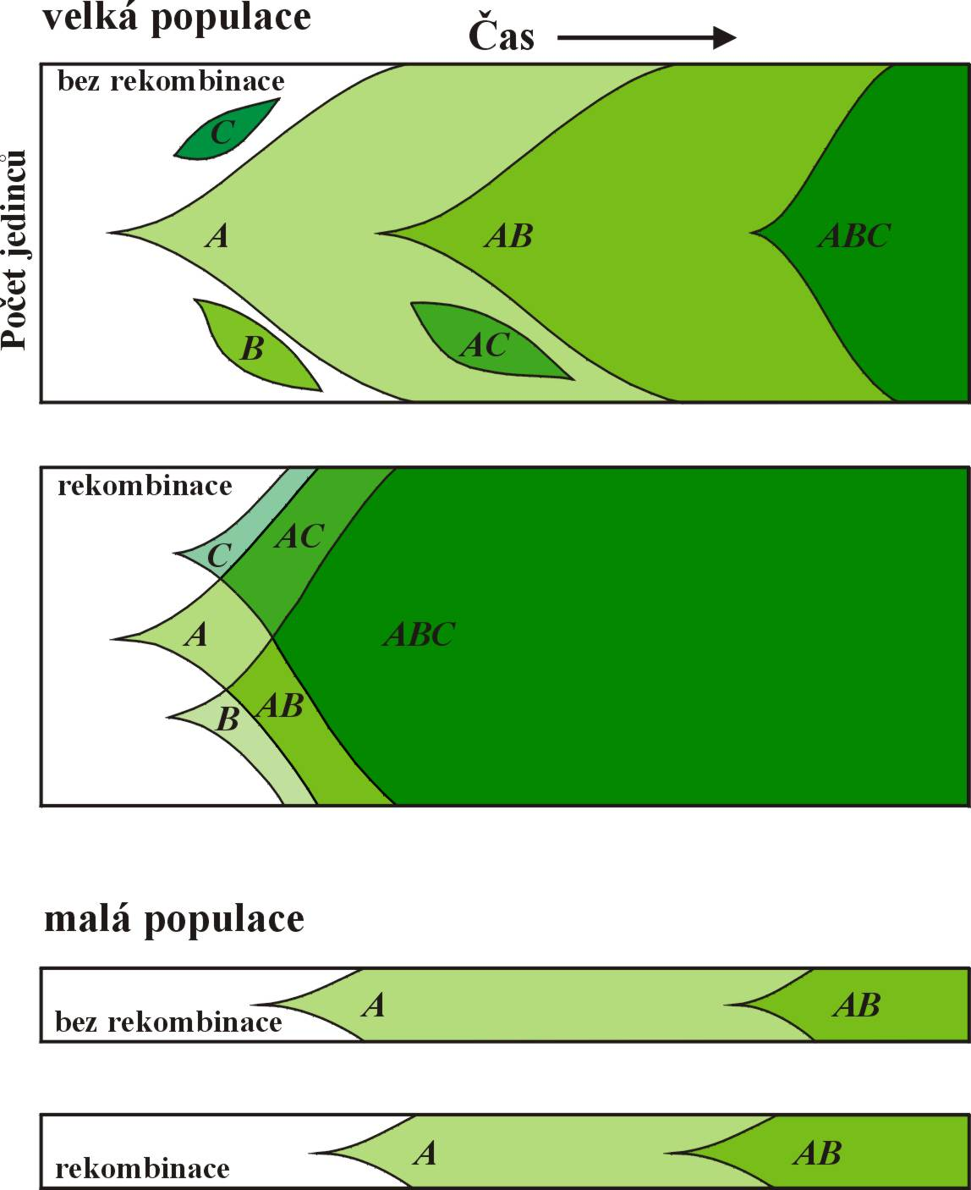
EvoluTIONARY CONSEQUENCES
OF reCombinaTION:
large populations
no recombination
Recombination
and polymorphism:
absence of recombination
⇒ linkage disequilibrium
recombination
small populations

Slide 20
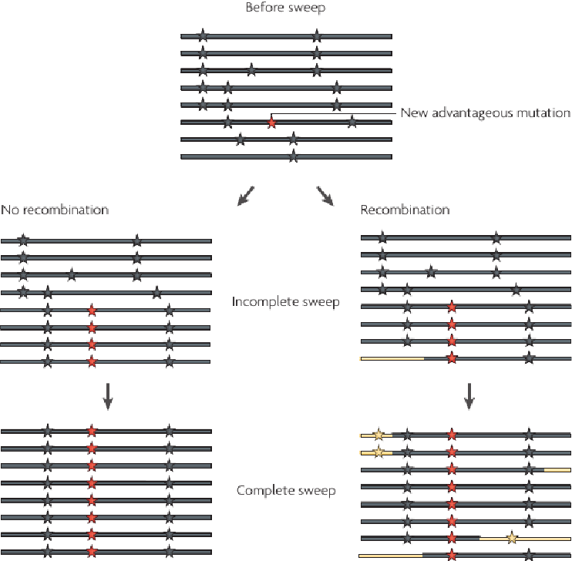
EvoluTIONARY CONSEQUENCES
OF reCombinaTION:
Recombination and polymorphism:
pozitivní selekce: hitchhiking (draft) → selective sweep (selekční smetení)
negativní selekce: background selection
→ loss of polymorphism

Slide 21
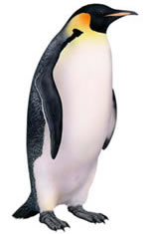
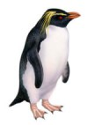
MIGRATION (GENE FLOW)
Migration rate, m = proportion of gene copies appearing in
the population by immigration from other populations in the given
generation
m
m
gene flow increases variation in the deme

Slide 22
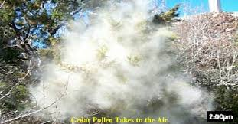
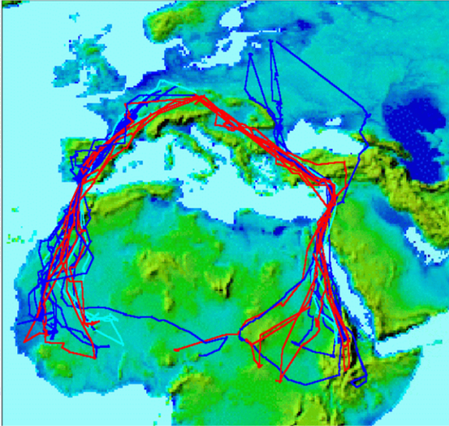
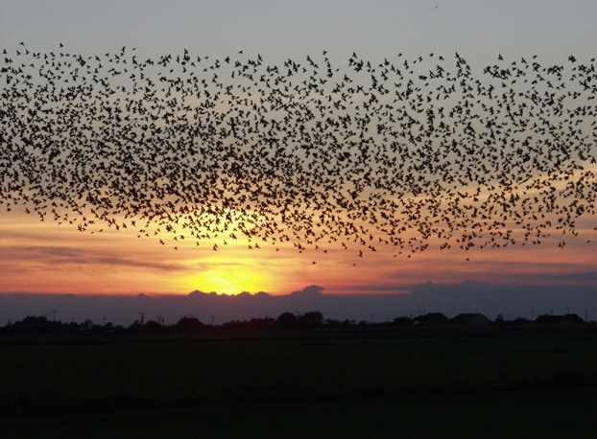
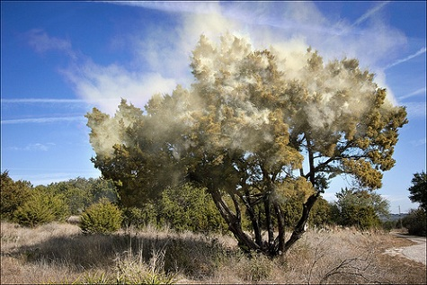
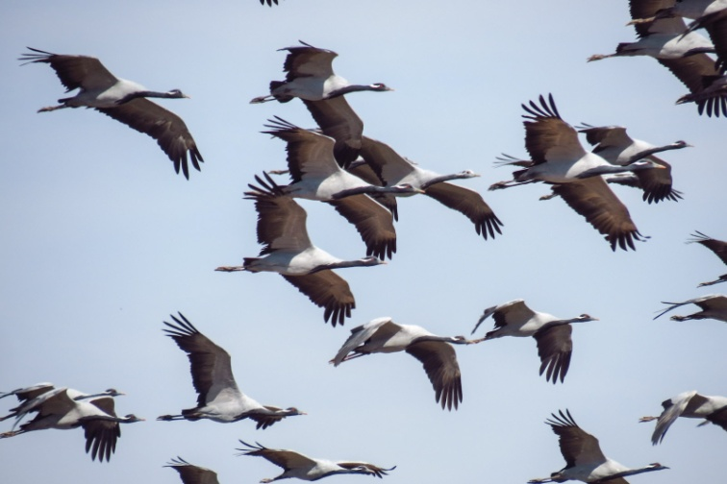
MIGRATION (GENE FLOW)
long-distance migration but no gene flow
gene flow but no migration

Slide 23
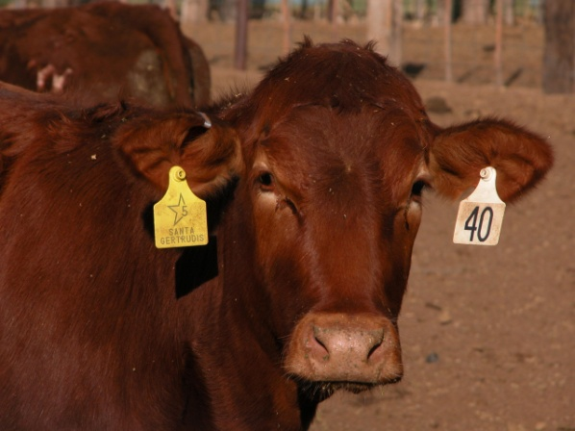
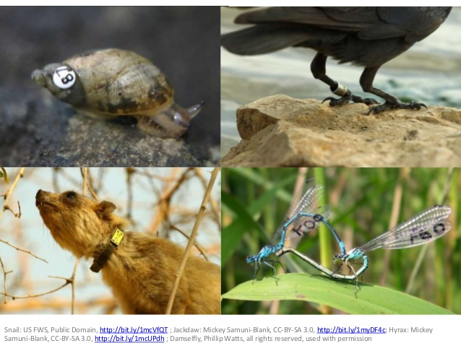
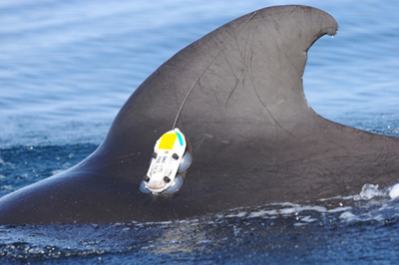
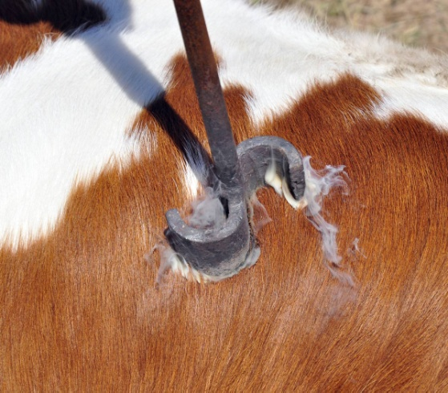
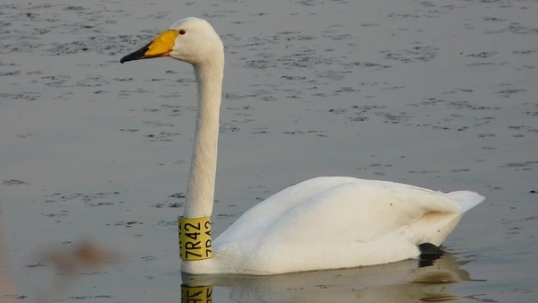
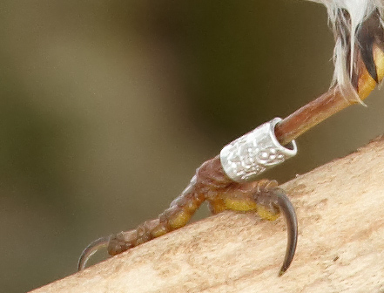
MetHodS OF genE FLOW ESTIMATION:
1. direct
capture-mark-recapture (CMR)
finger clipping, special dyes, tattooing, tags, rings, collars,
genetic marking

Slide 24
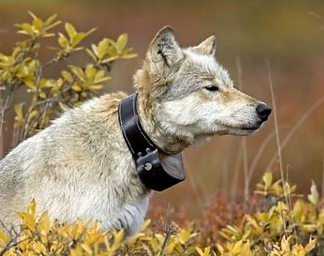
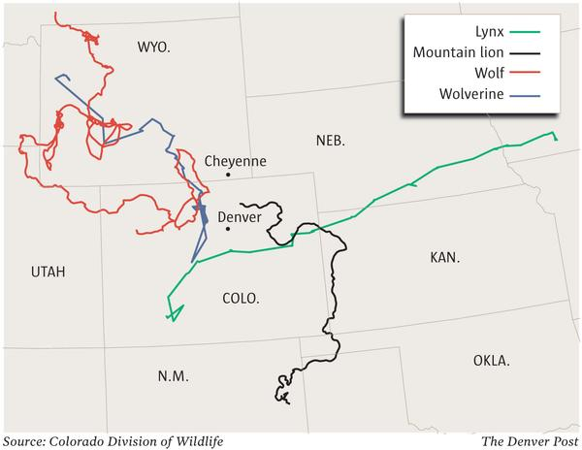
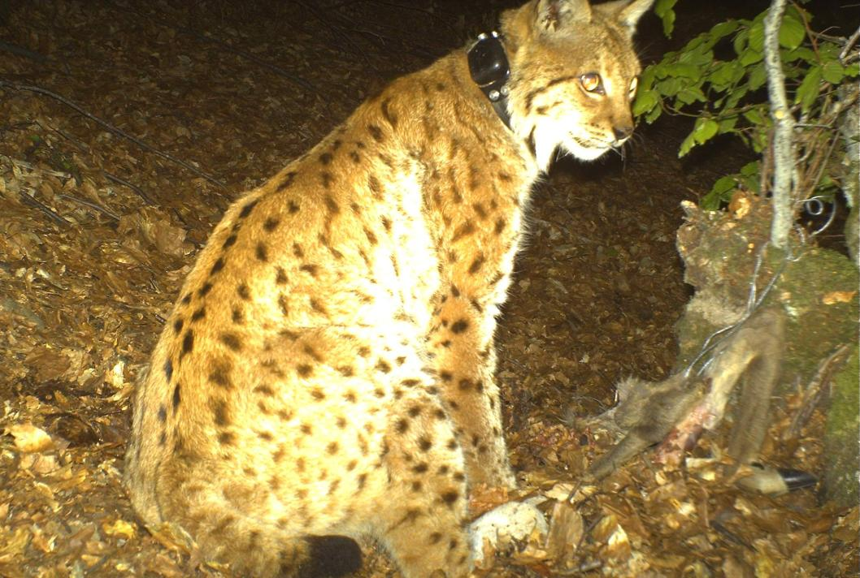
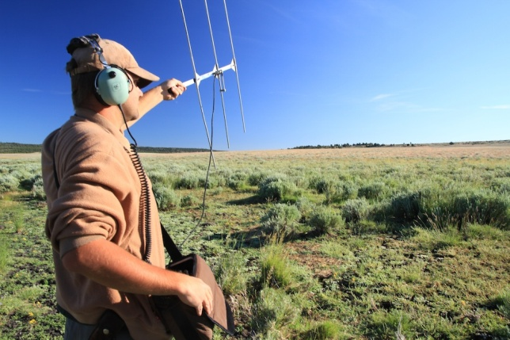
1. Direct methods
remote tracking – telemetry
transmitters, anntenas; GPS systems
... more expensive, time consuming
Risk of underestimation of gene flow!!

Slide 25
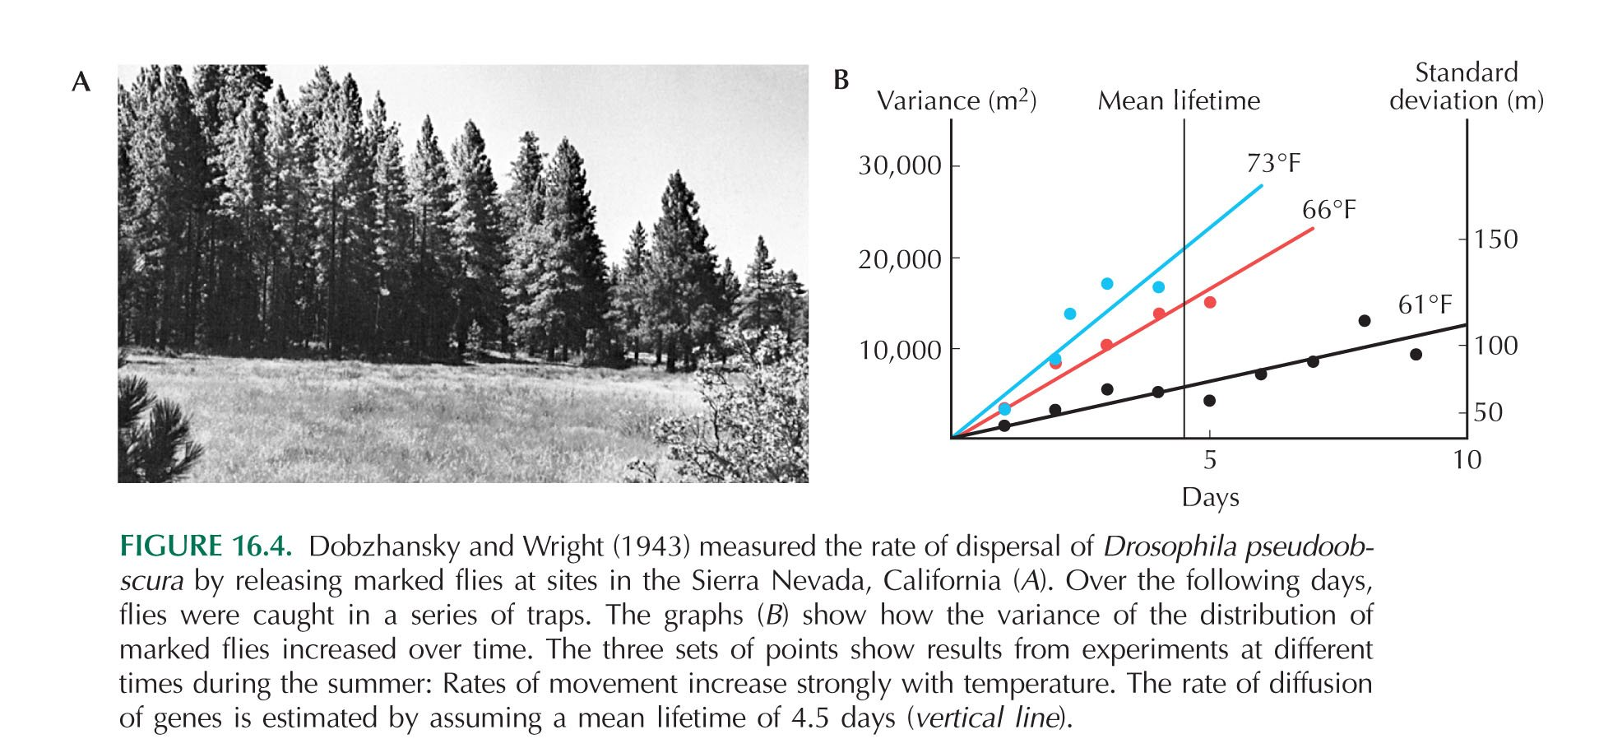
2. Indirect methods
molecular markers
gene flow models
maximum likelihood and Bayesian programs
dispersal: distance between parents and offspring

Slide 26
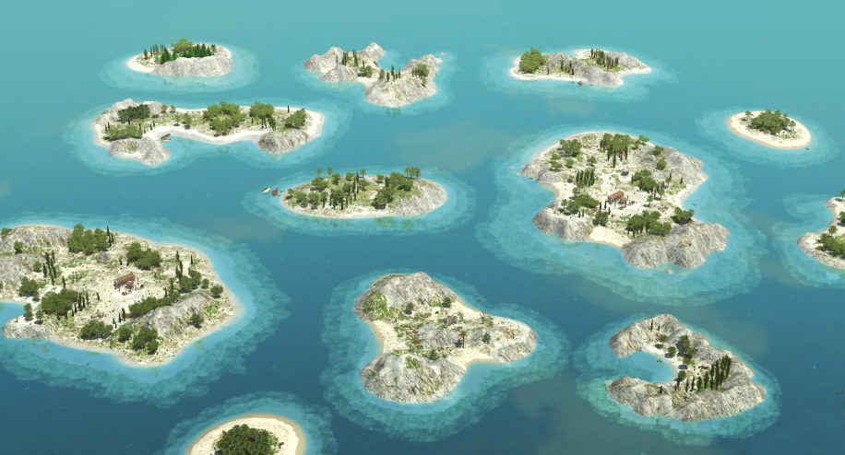
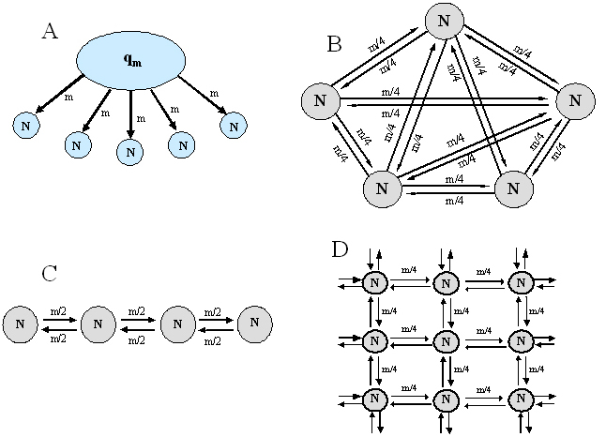
A) Island model
S. Wright (F-statistics): F_{ST} = 1/(4Nm + 1) ⇒ Nm = (1/F_{ST} ‒ 1)/4
… Nm = number of migrants per generation
island
model
Island model can be also asymmetric:
continent-island model

Slide 27
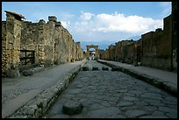
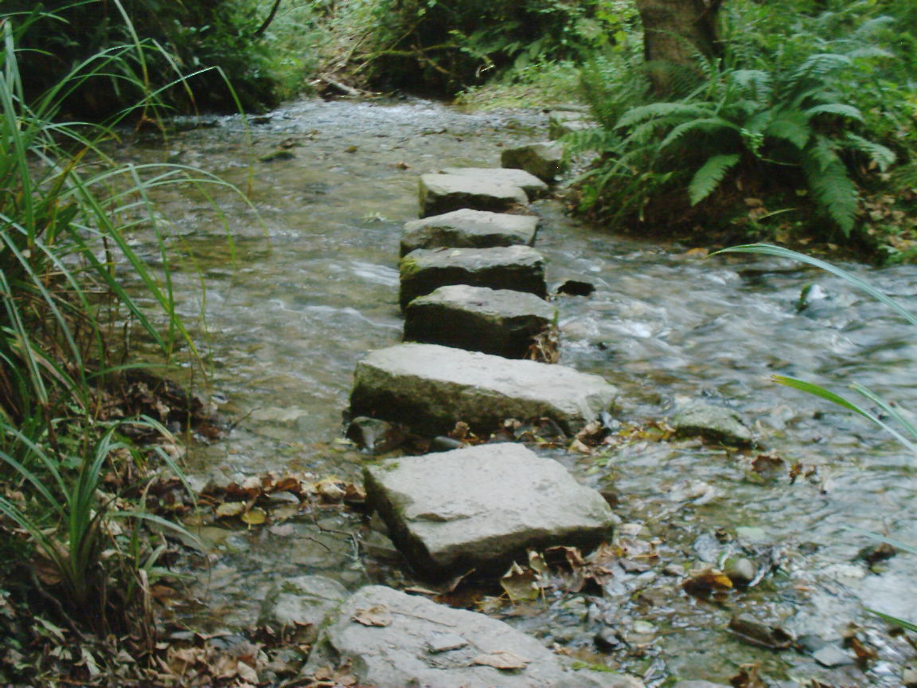

B) Isolation by distance models
discontinuous = stepping stone model
2D stepping-stone model
1D stepping-stone model

Slide 28
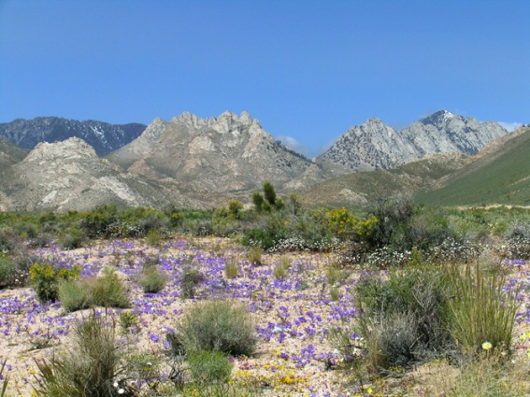
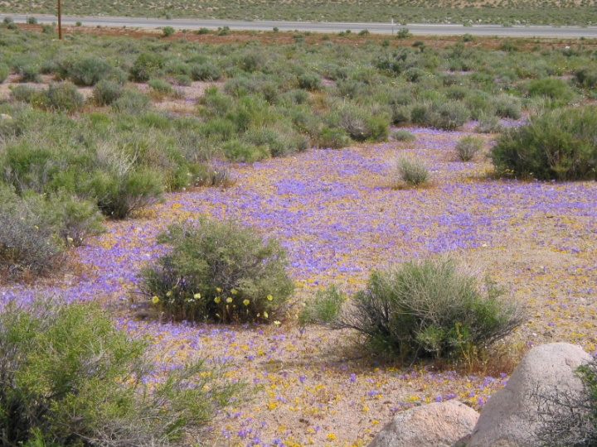
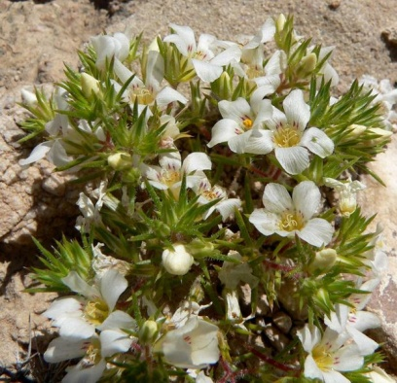
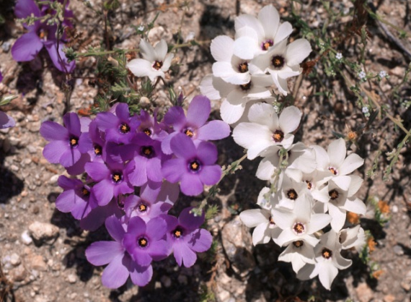
B) Isolation by distance models
continuous
Linanthus parryae (Polemoniaceae), Mojave Desert (California)
T. Dobzhansky, Sewall Wright
L. parryae

Slide 29
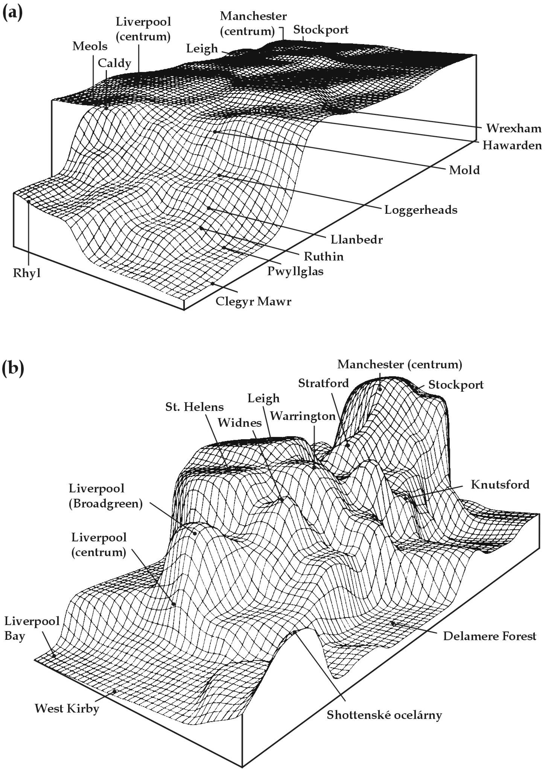
Gene flow consequences:
genetic homogenization of subpopulations,
preventing their genetic divergence
in many species migration severely
reduced
Eg.: melanic forms of moths
in England

Slide 30
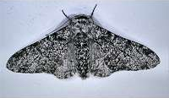


peppered moth (Biston betularia)
scalloped hazel
(Odontoptera [Gonodontis] bidentata)

Slide 31


Diffusion of neutral alleles due to gene flow between demes
Deme 2
Deme 1
Deme 2
cline
after first contact „stepped“ cline
Deme 1
Geographic scale
Notes:
31

Slide 32


Geographic scale
Notes:
32

Slide 33


Geographic scale
Notes:
33

Slide 34


Geographic scale
Notes:
34

Slide 35


Geographic scale
Notes:
35

Slide 36


Sewall Wright - F-statistics:
S
I
T

Slide 37
F_{IS} (= inbreeding coefficient)
→ reduction of HZ in a subpopulation due to inbreeding
F_{IS} = (H_{S} ‒ H_{I})/H_{S} -1 ≤ F_{IS} ≤ +1
F_{ST} (= fixation index) → reduction of HZ due to population substructuring
F_{ST} = (H_{T} ‒ H_{S})/H_{T} 0 ≤ F_{ST} ≤ +1
F_{IT} → reduction of HZ both due to population substructuring and inbreeding
F_{IT} = (H_{T} ‒ H_{I})/H_{T}
(1 ‒ F_{IS}) (1 ‒ F_{ST}) = 1 ‒ F_{IT}

