Slide 1
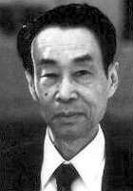
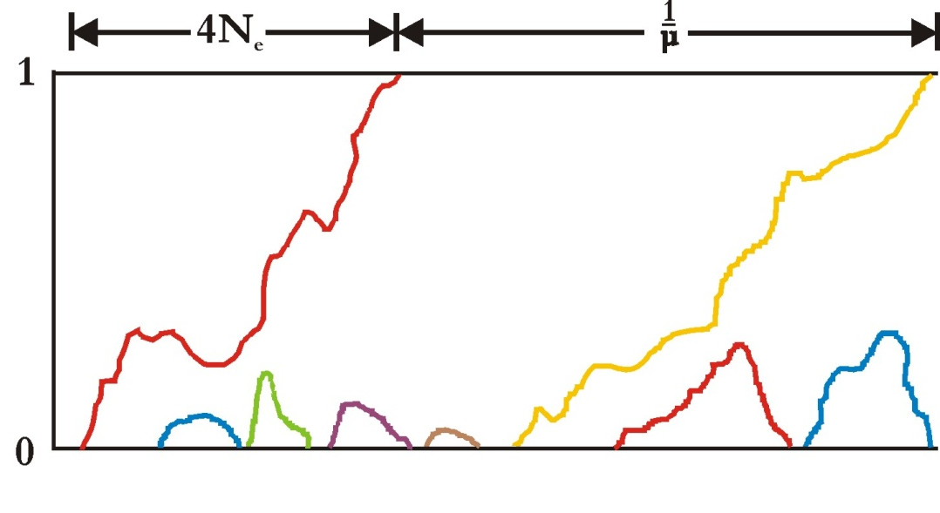
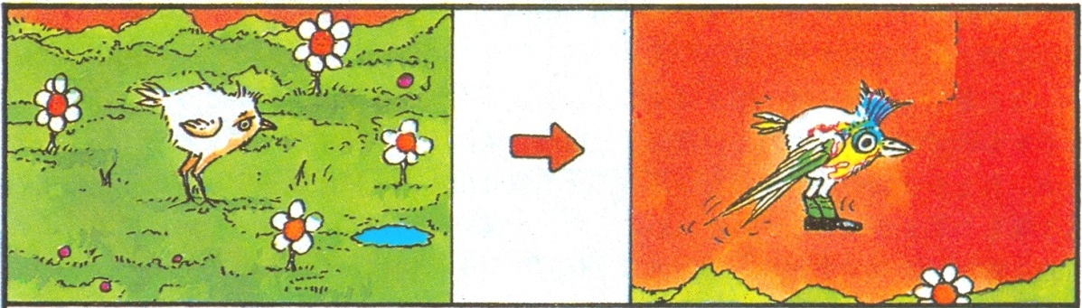
MOLECULAR EVOLUTION
ζ
α₁
α₂
α₁
G_{γ}
α2
δ
β
100
40
200
400
500

Slide 2
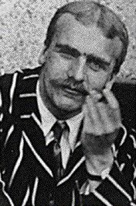
Substitutional load and the cost of natural selection
substitution = replacement of one allele by other (tj. fixation of a new allele)
if an individual do not reproduce, we call it genetic death
J.B.S. Haldane (1957):
advantageous mutation → fixation and replacement of a deleterious allele
as long as the original allele exists in the population, mean fitness is lower
than maximal fitness
J.B.S. Haldane

Slide 3



substitutional load^{*)}: ; when L = 0
in general
it measures to what extent an average member of the population is less fit
than the best fit genotype
it expresses probability that an average individual dies before his/her
reproduction
*) in general = genetic load; other loads: mutational: emergence of a deleterious allele;
segregational: cost of homozygotes under overdominance

Slide 4
Cost of natural selection:
We can envisage replacement of one allele in a population by another as
a „selective death“ of the original allele
The higher is the strength of selection, the more of the original (less advantageous) alleles are removed from the population (they „die“)
If the natural selection was too strong it could cause extinction of
the whole population ⇒ overproduction of the offspring necessary!
eg. if the ratio of non-surviving to surviving alleles is 0,1/0,9, each survivor have to produce by 1/9 more descendants,
but if the ratio is 0,999/0,001 → by ∼1000 more descendants!
Haldane: upper limit of the cost of natural selection ≈ substitution of 1 gene per 300 generations
⇒ evolution cannot run too fast, the cost of selection would be too high

Slide 5
NEUTRAL THEORY OF
MOLECULAR EVOLUTION
Modern Synthesis: selection vs. drift debate
beginning of the 1960s → amino acid sequences in proteins
1966: protein elektrophoresis
Richard Lewontin and Jack Hubby - Drosophila pseudoobscura;
Harry Harris - humans
→ high level of polymorphism

Slide 6
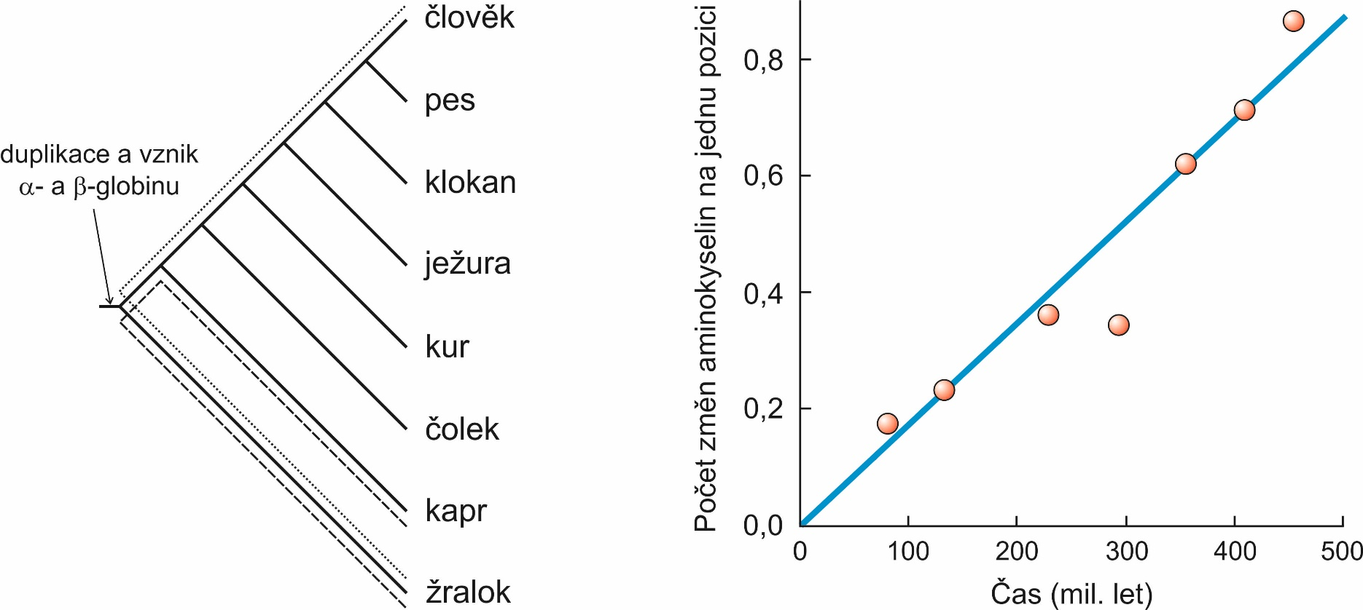
Data gathered till the end of 1960s suggested that:
Rate of evolution at the molecular level is constant

Slide 7
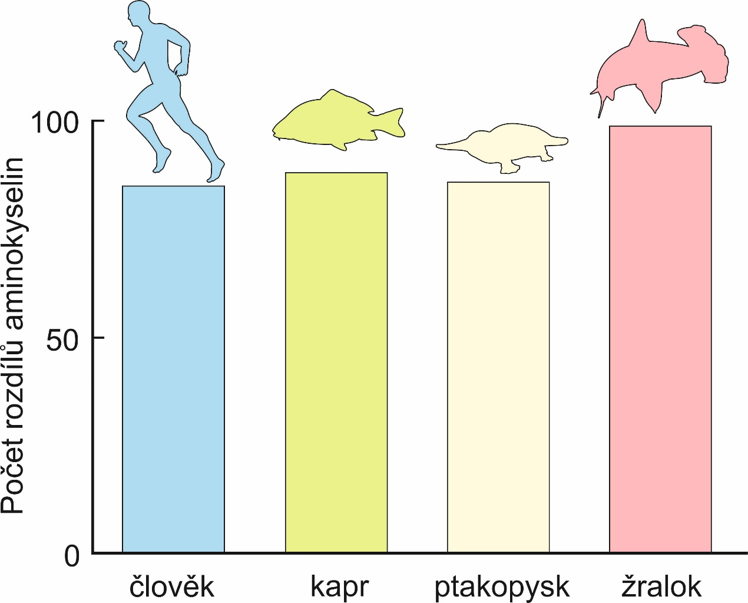
Rate of evolution at the molecular level is constant
human
carp
platypus
shark
comparison of AA differences between α- and β-globin

Slide 8
Data gathered till the end of 1960s suggested that:
Rate of molecular evolution is high
Genetic variation in natural populations is too high
... both would require too high cost of natural selection ⇒
polymorphism cannot be maintained by selection

Slide 9
Why so high polymorphism in populations?
Motoo Kimura: because alleles are selectively neutral, it lasts many
generations till a new mutation is fixed – meanwhile the population
must be polymorphic = transient polymorphism
During the process of fixation often a new allele appears by mutation ⇒
in a sufficiently large population at each point in time there is a large
amount of variation
Population is in equilibrium between drift
and mutation
M. Kimura
M. Kimura (1968)
J.L. King & T.H. Jukes (1969)
neutral theory of
molecular evolution

Slide 10
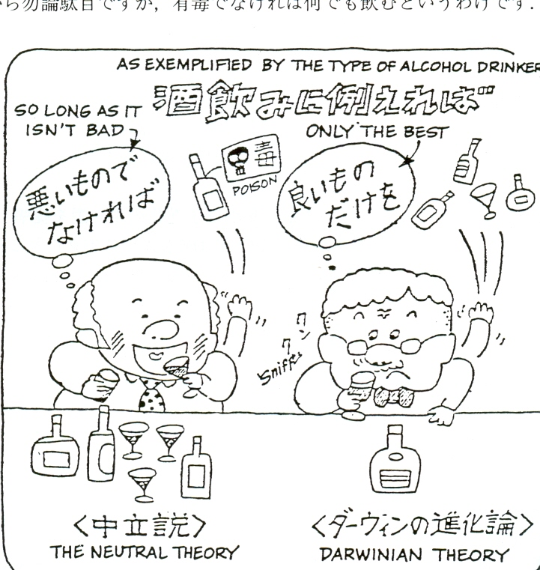

Slide 11
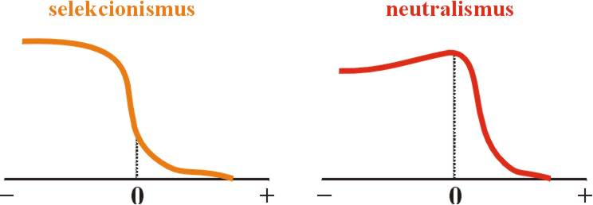
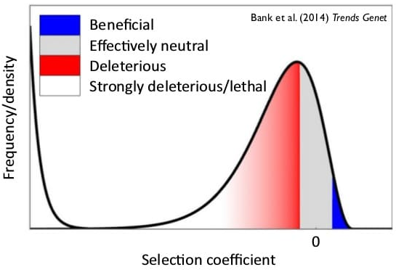
Basic principles of the neutral theory:
1. most allele substitutions in a population are neutral (⇒ drift)

Slide 12
mostly only 1 allele in the population
fast fixation of a beneficial mutation
fast extinction of a deleterious mutation
parallel occurrence of several alleles
neutral allele is fixed randomly

Slide 13
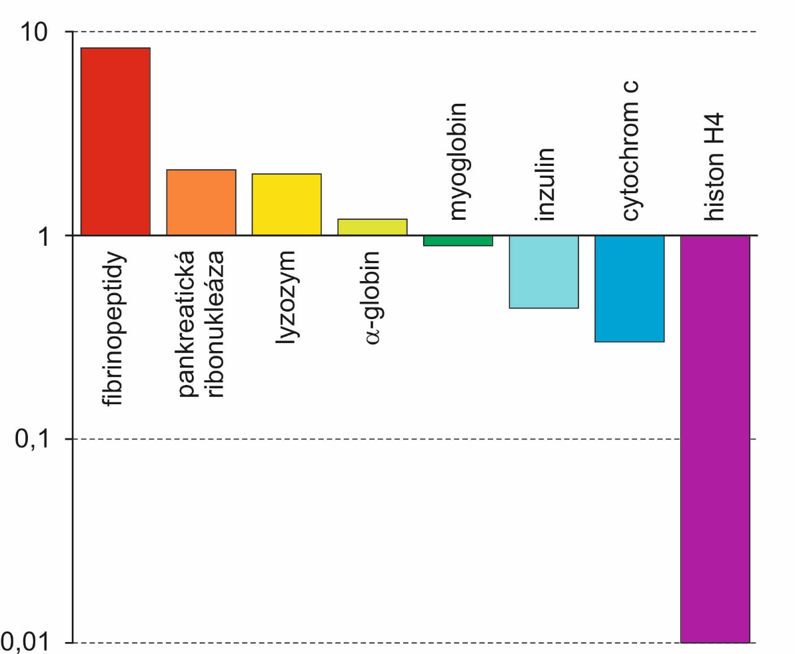
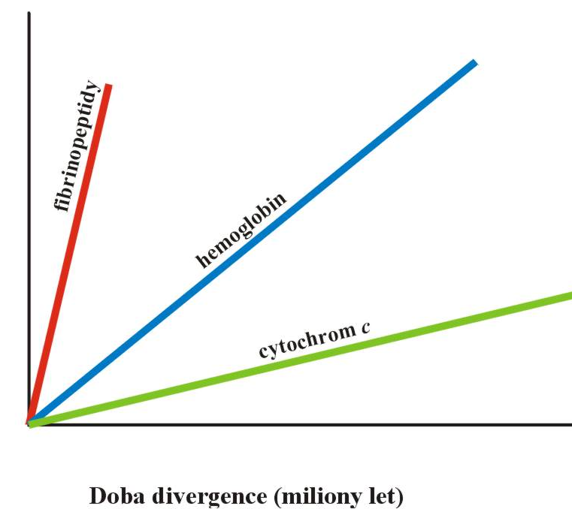
2. evolutionary rates in differently important proteins
are different
fibrinopeptides 8,3
pancreatic ribonuclease 2,1
lysozyme 2,0
alpha-globin 1,2
insulin 0,44
cytochrome c 0,3
histone H4 0,01

Slide 14

2. evolutionary rates in differently important proteins
are different
synonymous
(× 10⁻⁹/year)
nonsynonymous
(× 10⁻⁹/year)

Slide 15
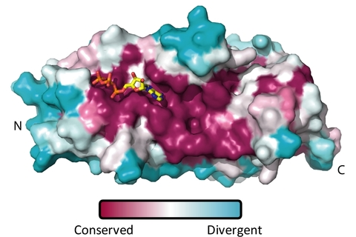
3. diverse evolutionary rate in different parts of proteins
(binding sites × structural areas)
Eg.: transient receptor potential vanilloid (TRPV) channel protein:
ATP molecule
binding sites are more conserved

Slide 16
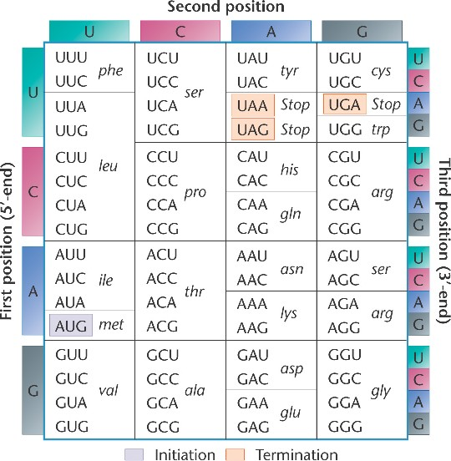
4. different evolutionary rates at individual codone positions
64 codons...
... but 20 aminoacids
all nonsynonymous!

Slide 17
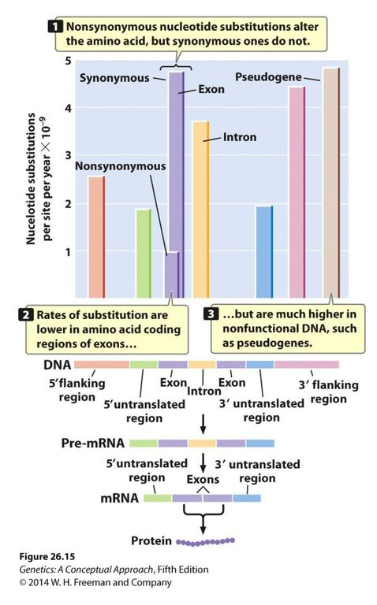
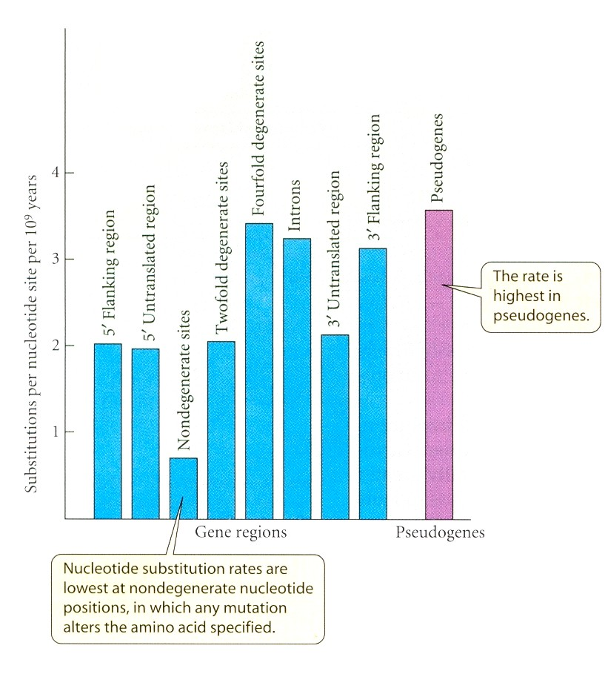
... and in different parts of genome

Slide 18
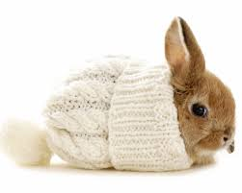

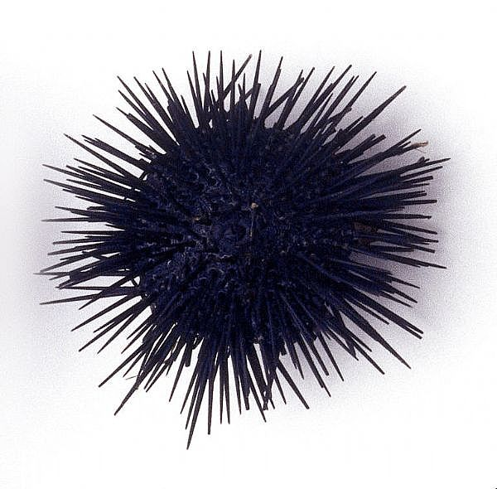
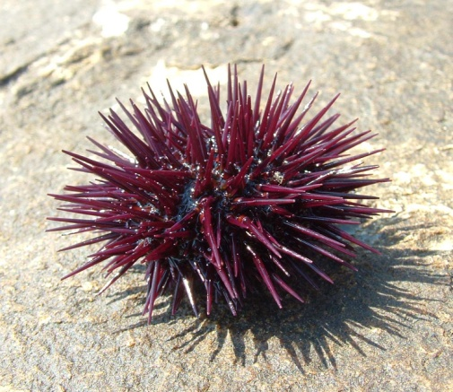
excess of synonymous nucleotide substitutions → esp. at the 3rd position
M. Kimura (1977): mRNA sequences of humans and rabbits →
of 53 nucleotide positions 6 differences, of them only 1 nonsynonymous
× theoretically only 24% of differences should be synonymous
likewise M. Grunstein (1976):
evolutionary rate of Histone H4 in 2 sea urchin species
84 bp mtDNA → 9 of 10 differences synonymous

Slide 19
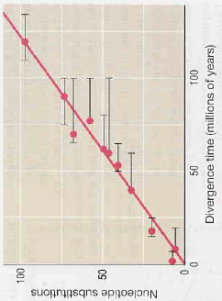
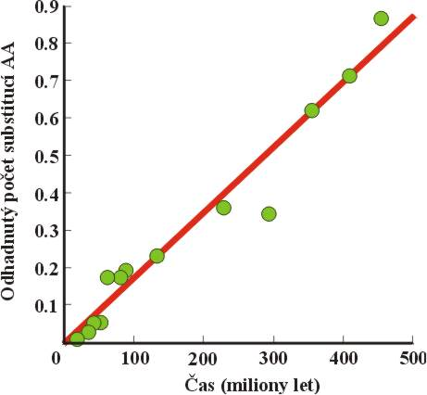
5. evolutionary rate of a given protein in various species
roughly constant
Kimura (1983), vertebrates, α-globin:
Wilson (1977), mammals, 7 proteins:

Slide 20
mostly does not concern morphological, physiological, and behavioural
trais
cannot explain adaptations
many deleterious mutations, however, these rapidly removed by selection
selection acts also at the molecular level but most mutations have only
small effects on fitness ⇒ important role of drift
Haldane´s cost of selection was overestimated:
selection mostly soft, not hard
frequency-dependent selection rather than overdominance
selection does not affect individual loci independently (epistasis)

Slide 21
Theoretical principles of neutral theory:
Mean time to fixation of a novel mutation
= 4N_{e}
Mean interval between fixations
= 1/μ
moderately sized population: mutations more frequent
In small populations faster fixations but
longer interval between them:
small population:
mutations infrequent

Slide 22
Theoretical principles of neutral theory:
Mean time to fixation of a novel mutation
= 4N_{e}
Mean interval between fixations
= 1/μ
Frequency of substitutions (replacements of
one allele by another in populations):
1/(2N_{e}) × 2N_{e}μ = μ
⇒ rate of neutral evolution is
independent of N_{e}, depends only
on frequency of neutral mutations μ !

Slide 23
Mean balanced heterozygosity:
larger populations ⇒ higher heterozygosity
, where θ = 4N_{e}μ
continual emergence of new mutations ⇒ increase of variation
× its erosion by drift
⇒ continual replacement of one allele by another
Equilibrium between mutation and drift ⇒ polymorphism
(contrary to the mutation-selection eq.) is transient

Slide 24
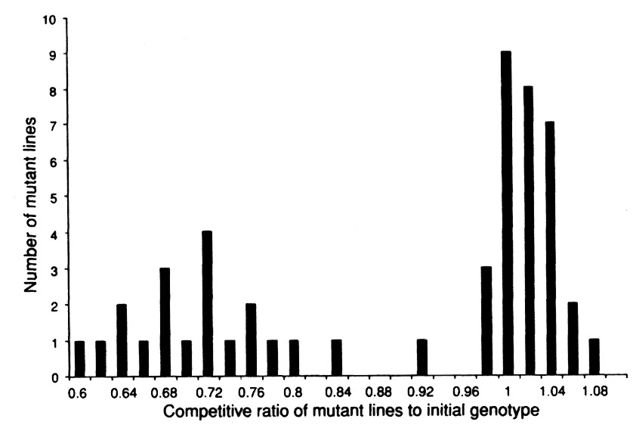
Rate of neutral mutations:
Zeyl & DeVisser (2001):
yeast Saccharomyces cerevisiae
50 replicated populations,
1 individual in each generation
the experiment does not detect extremely deleterious (lethal) mutations
bimodal distribution of mutations
deleterious
advantageous

Slide 25
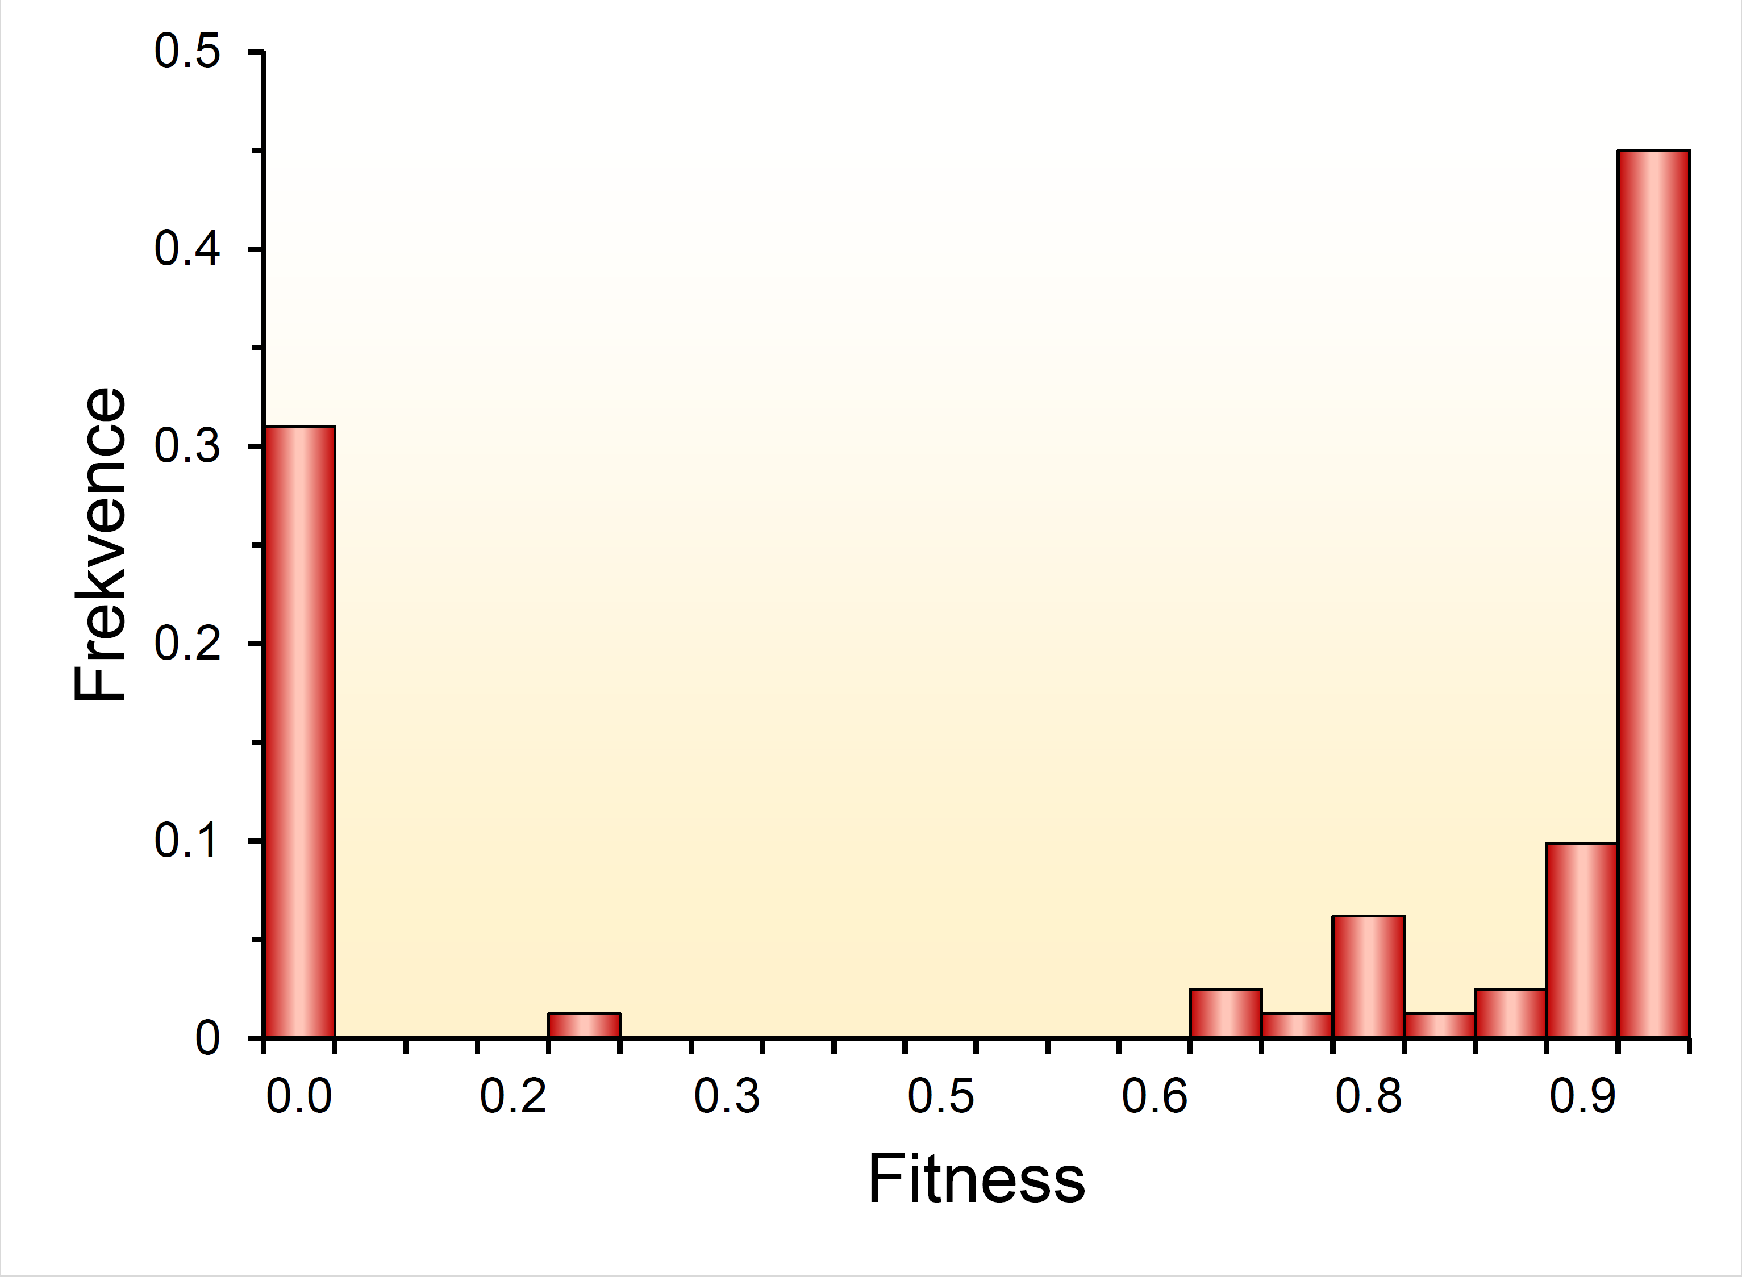
RNA viruses
yeast

Slide 26
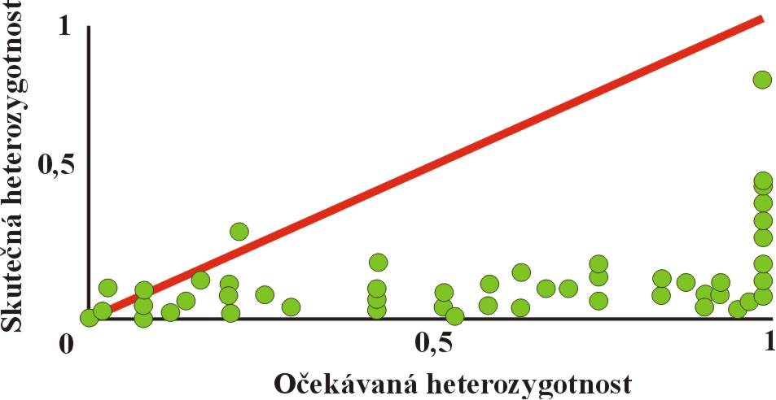
Test of neutral theory: range of heterozygosity
heterozygosity according to NT
Observed heterozygosity
Expected heterozygosity
Observed heterozygosity lower than predicted by NT

Slide 27
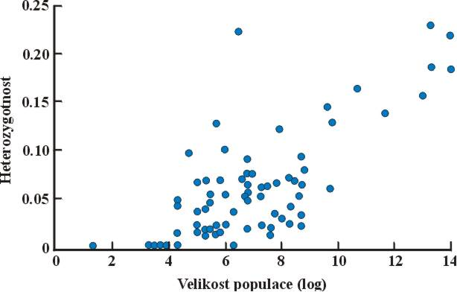
Test of neutral theory: range of heterozygosity
Heterozygosity
Population size (log)
Given the enormous range of population sizes, the range of heterozygosities is too small

Slide 28

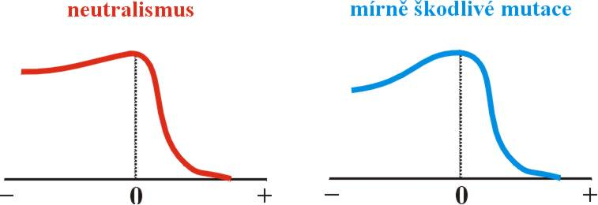
Tomoko Ohta tried to explain the deviations of the observed range of heterozygosity from predictions:
slightly deleterious mutations (SDM)
in small populations alleles behave as effectively neutral
neutralism
slightly deleterious mutations
also substitutions of slightly deleterious alleles
Notes:
Pozn.: protože q = 1/(2N), bude čitatel v rovnici zjednodušen na 1 – e^2s

Slide 29
Fixation probability of neutral,
beneficial, and deleterious mutation:
Eg.:
What is the fixation probability of a mutation in a population of N_{e} = 1000?
neutral mutation (s = 0): P = 0,05%
advantageous mutation (s = 0,01): P = 20%
advantageous mutation (s = 0,001): P = 2%
deleterious mutation (s = -0,001): P = 0,004%
as s → 0
higher „neutrality“
Notes:
Pozn.: protože q = 1/(2N), bude čitatel v rovnici zjednodušen na 1 – e^2s

Slide 30
We can conclude that
1) Not all advantageous mutations may be fixed in
the population
2) Conversely, with low probability also deleterious mutations can be fixed

Slide 31
What is the fixation probability of a mutation in a population of N_{e} = 10 000?
neutral mutation (s = 0): P = 0,005%
advantageous mutation (s = 0,01): P = 20%
advantageous mutation (s = 0,001): P = 2%
deleterious mutation (s = -0,001): P = 2.10⁻¹⁷%
in a large population P of an advantegous allele is the same as in a small one but for a deleterious allele P → 0

Slide 32
Conclusions:
1) In large populations selection plays a much more important role; conversely, with decreasing population size the role of drift is increasing
2) Harmfulness of a mutation is inversely proportional to population size: the more it approaches zero, the larger the population may be for allele fixation (drift exceeds negative selection) and vice versa: the stronger selection against an allele, the smaller the population must be to allow drift to play a substantial role
3) This means that in small populations slightly deleterious mutations behave as effectively neutral

Slide 33
MoleCulAr CLOCK
Zuckerkandl & Pauling (1962-65)
AA and/or nucleotide substitution rate is constant
effect of generation time:
dependency on absolute or
generation time?

Slide 34

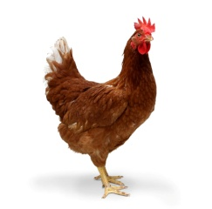


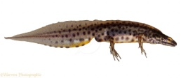
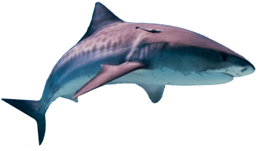
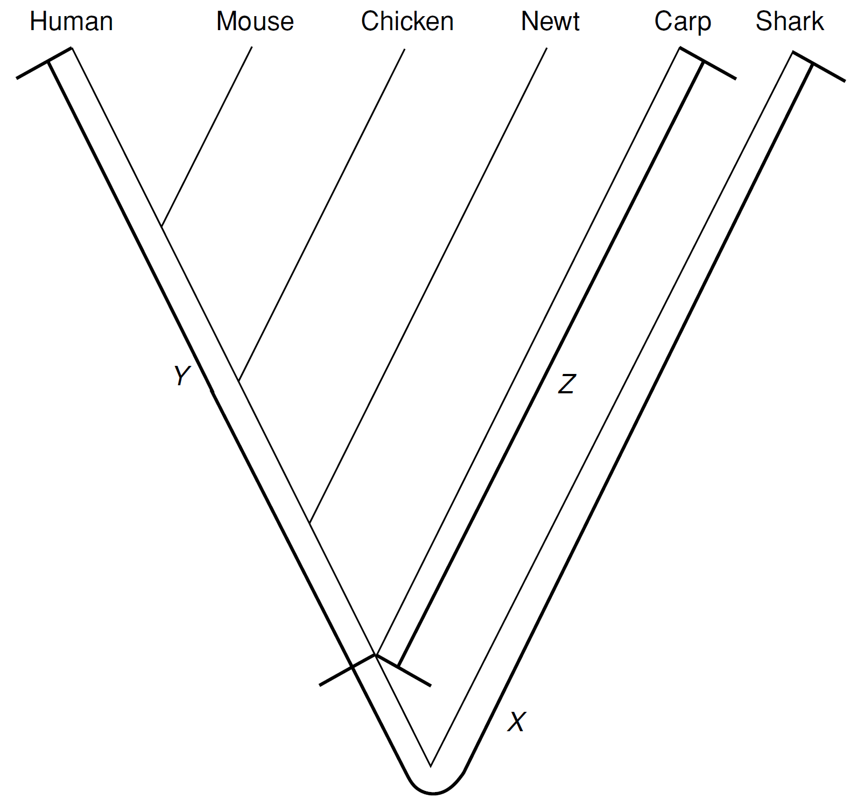
AA sequences of the α-chain of hemoglobin of 6 vertebrate species:
despite being morphologically more similar, the distance of the shark from humans is the same as from the carp
⇒ AA differences are cumulating constantly in time regardless of the phenotypic evolution
the same distance between the human or mouse from the shark as between the carp and shark ⇒ no generation time effect
XY = XZ

Slide 35
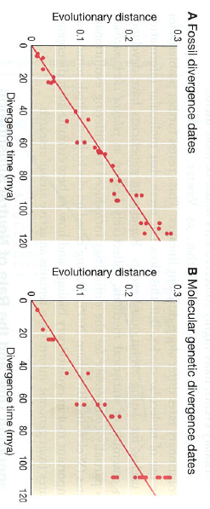
Generation or absolute time?
Accumulation of neutral substitutions in placental mammals:
both dating methods show almost constant rate independent of generation time

Slide 36
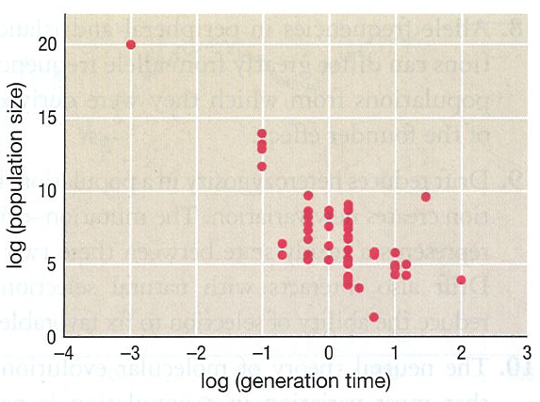
Population size and generation time:
species with larger populations tend to have shorter generation times
⇒ potential explanation of absolute time dependence: in smaller
populations also slightly deleterious alleles are fixed

Slide 37
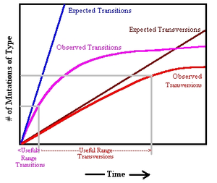
But molecular clock does not „tick“ with the same pace
in different groups
eg. cetaceans < „artiodactyls“< primates < murine rodents
in primates Old World monkeys > „apes“ > humans
Problem of sequence saturation:
→ using an appropriate evolutionary model („straightening“ of the curve)
relaxed molecular clock method

Slide 38
CONCERTED evoluTION aND moleCulAr DRIVE
ribosomal DNA
globin genes
the ape species pairs differ by ∼ 2,5 AA substitutions in the α1 i α2 gene ...
ζ
α₁
α₂
ε
G_{γ}
α2
δ
β
... only few differences accumulated between the α1 a α2 gene ...
100
40
200
... in fact this duplication is older than 300 million years
400
current genes have emerged through a series of duplications
500
molecular clock is invalid in this case, the genes do not
evolve independently – the evolution is concerted

Slide 39
Gabriel Dover (1982): Molecular drive
mechanism different from selection and drift
Mechanisms of concerted evolution:
1. unequal crossing-over
×
gain of a mutant copy
1
2
3
×
×
1
2
3
loss of a
normal copy
copy loss
2
3
×
gain of a mutant copy
1
1
2
3
3
copy gain
... etc. ...

Slide 40
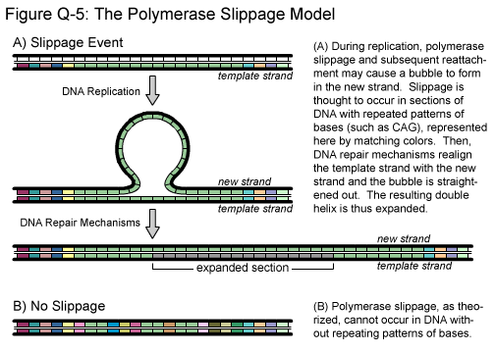
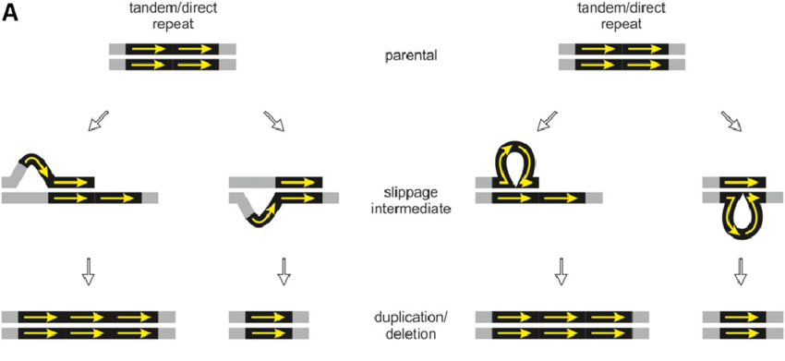
2. replication slippage

Slide 41
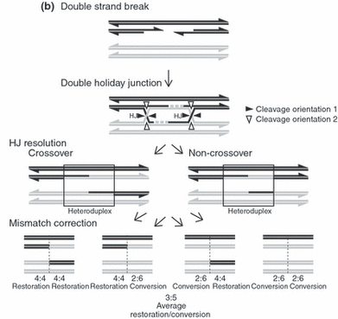
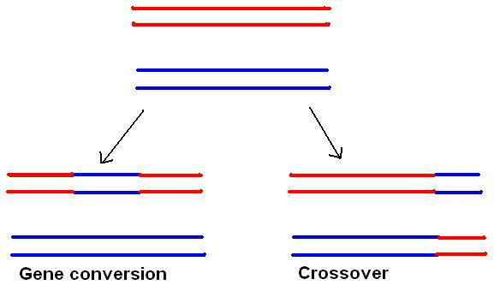
3. gene conversion
Conclusions:
a consequence of unequal crossing-over and slippage =
change of a copy number
a consequence of unequal c-o and gene conversion =
sequence homogenization

