Slide 1
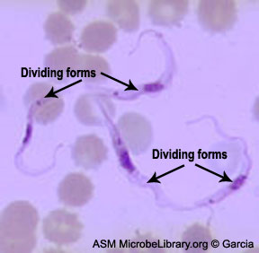
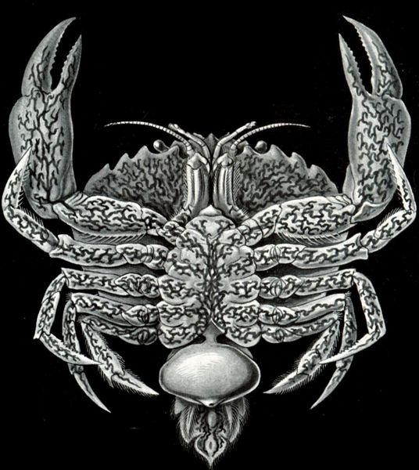
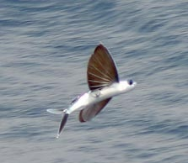
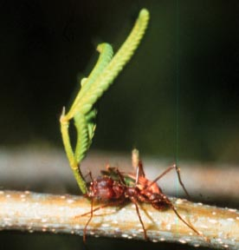
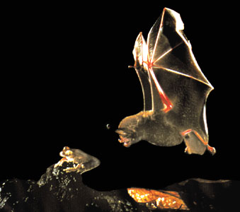
ADAPTATION AND NATURAL SELECTION

Slide 2
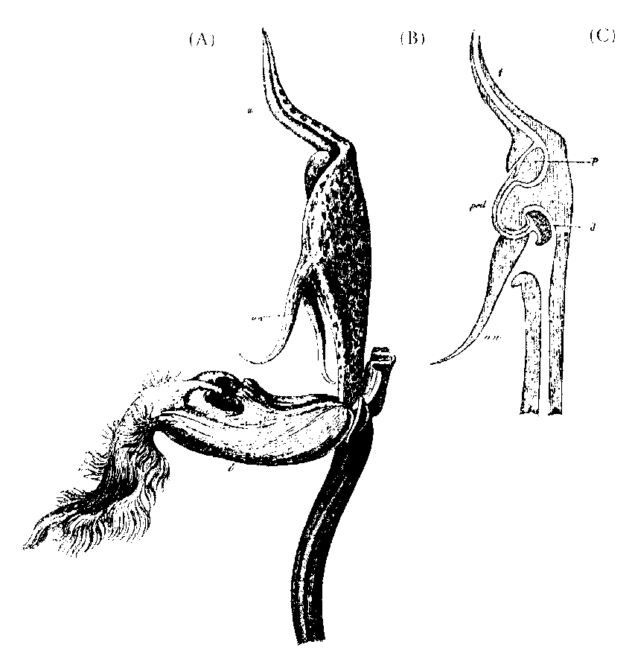
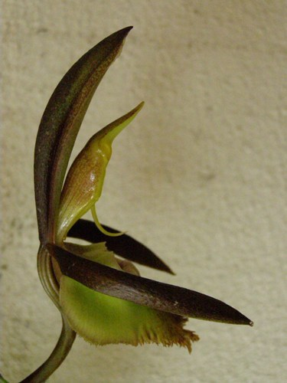
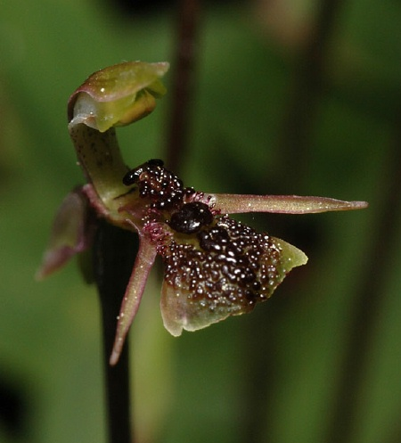
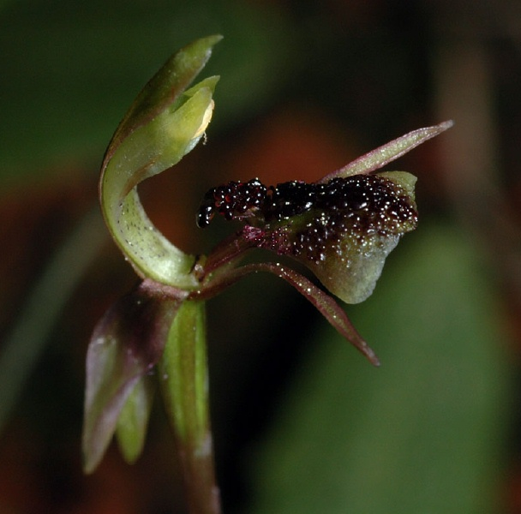
Catasetum saccatum
Chiloglottis formicifera

Slide 3
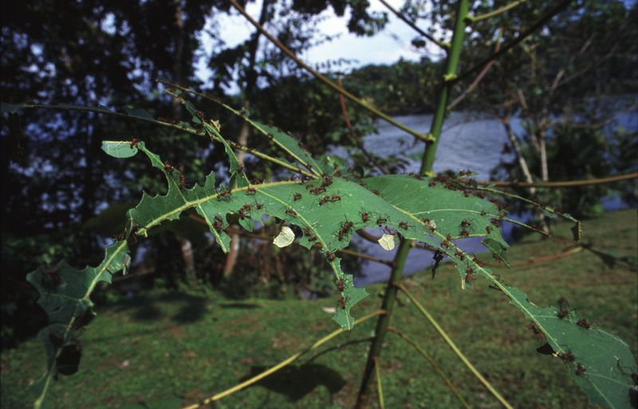
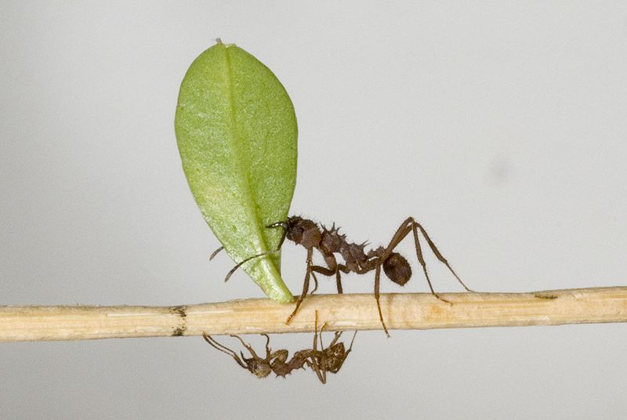
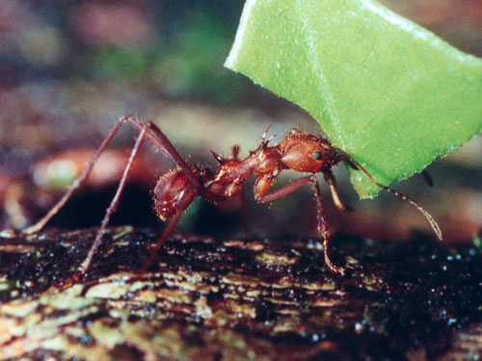
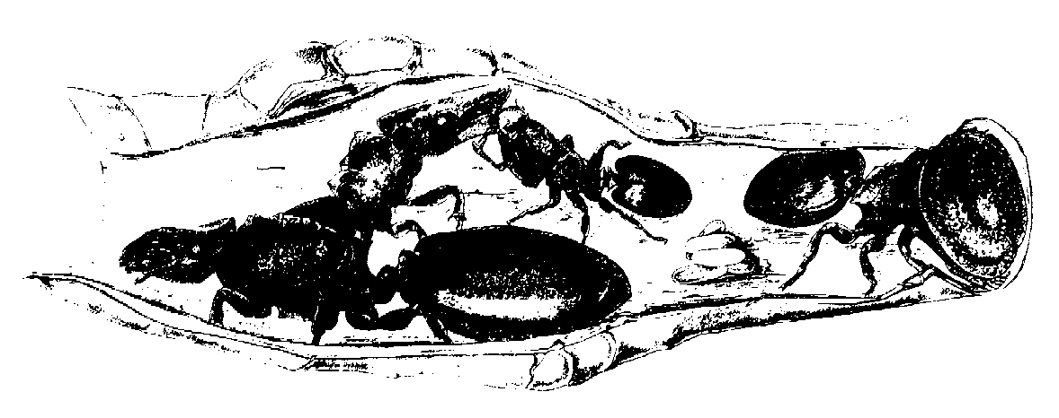
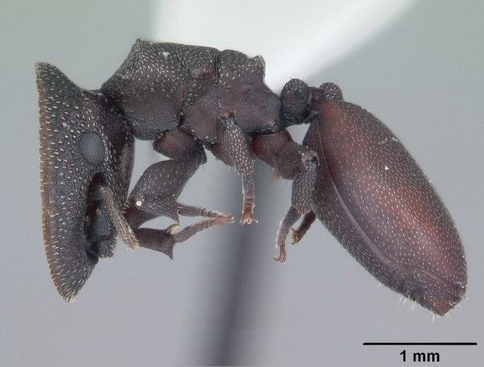
Atta, Acromyrmex: bigger workers – cutting leaves,
soldiers – their protection,
small workers – chewing leaves, growing fungi
Zacryptocerus varians

Slide 4
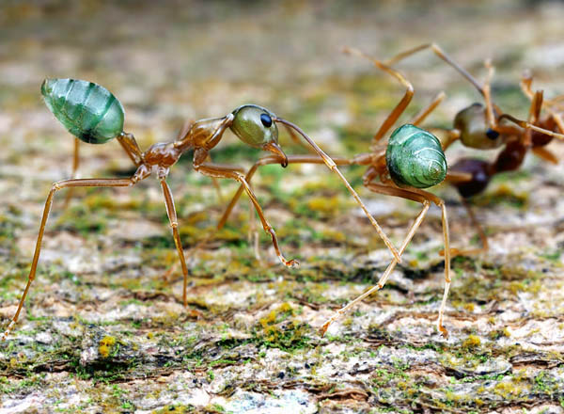
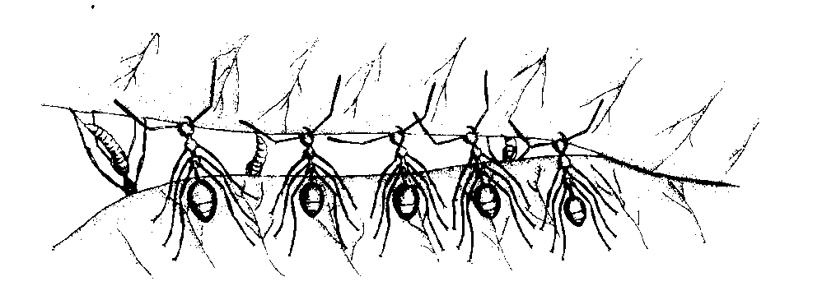
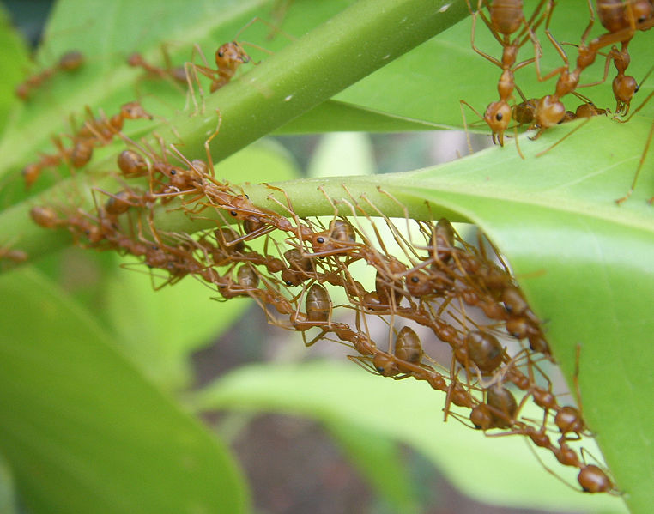
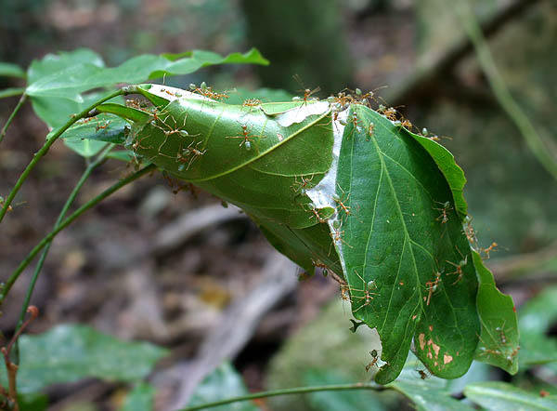
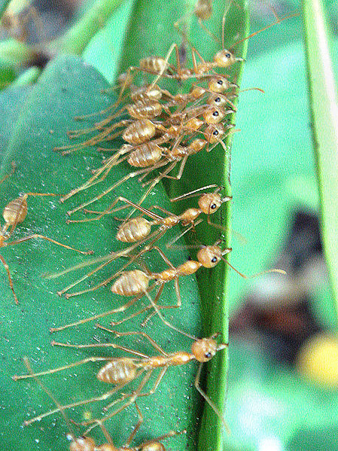
Oecophylla smaragdina
parasites × hosts

Slide 5
life-history strategies = timing and way of investing to survival and reproduction through the whole life of an individual
eg. timing of sexual maturity, aging, number and size of offspring, semelparity vs. iteroparity
Eg.: guppies, northern Trinidad and Tobago:
upper and lower part of the river separated by waterfalls → barrier both for guppies and predators upper: moderate predation pressure (Rivulus hartii) lower: strong predation pressure (eg. Crenicichla alta)
→ different coloration, antipredatory behaviour, life-history parameters (different number and size of offspring, age of the first reproduction, timing of senescence)

Slide 6
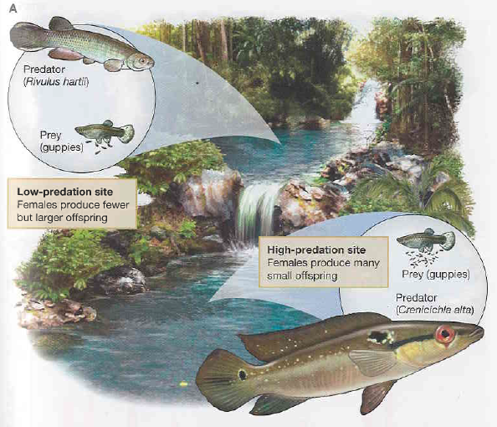
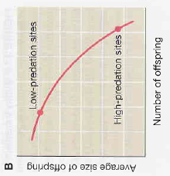
fewer but larger offspring, later reproduction
many small offspring, early reproduction
evolutionary trade-off

Slide 7
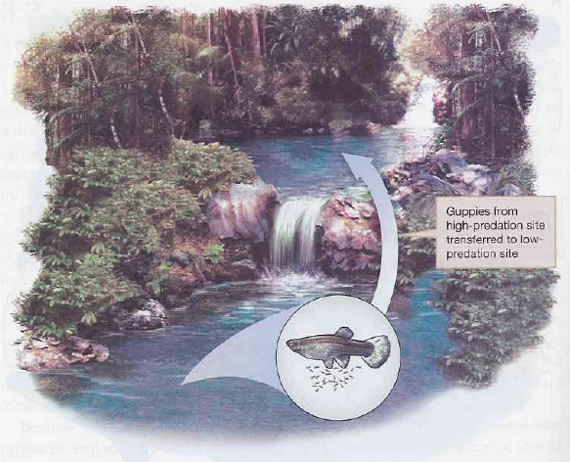
David Reznick, John Endler et al. (1990):
transfer of 100 males and 100 females from high-predation site to low-predation site → after 5 and 12 years females produced fewer larger offspring this characteristic heritable

Slide 8
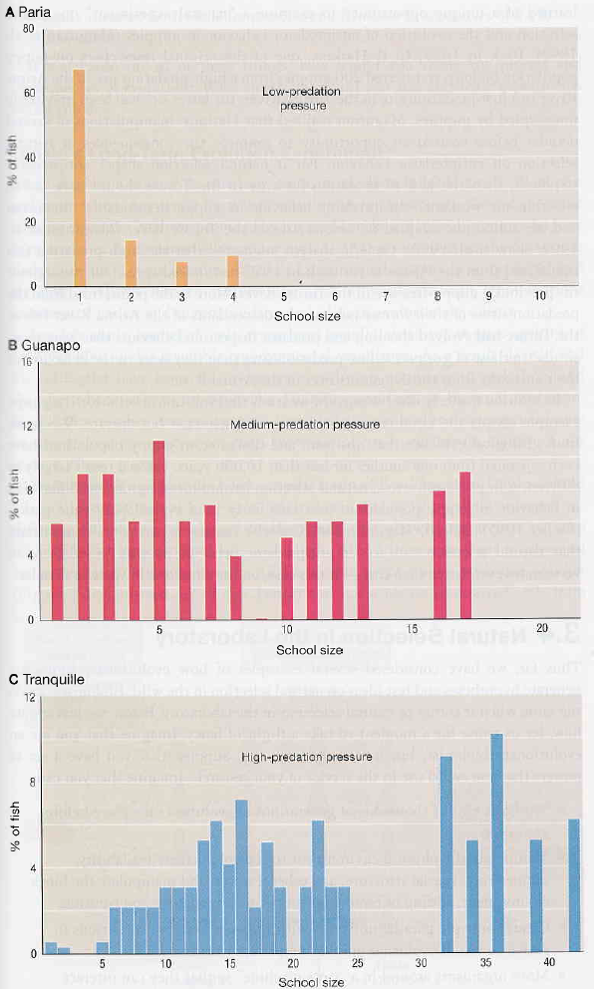
high-predation site guppies form larger and tighter shoals

Slide 9
What the evolutionary theory must explain:
origin of complex adaptation
origin of traits such as recombination, sexual reproduction, programmed life span including senescence and death, segregation distortion etc. which do not (or seemingly do not) provide organisms any benefit cooperation within and between × antagonism within species (eg. infanticide) and between species (eg. host castration by parasites)
„harmful“ adaptations (eg. bee sting)

Slide 10
process of adapting
ADAPTATION
trait of an organism
trait which allows better survival and reproduction
natural selection necessary but also considering history
(flea winglessness × Collembola)

Slide 11
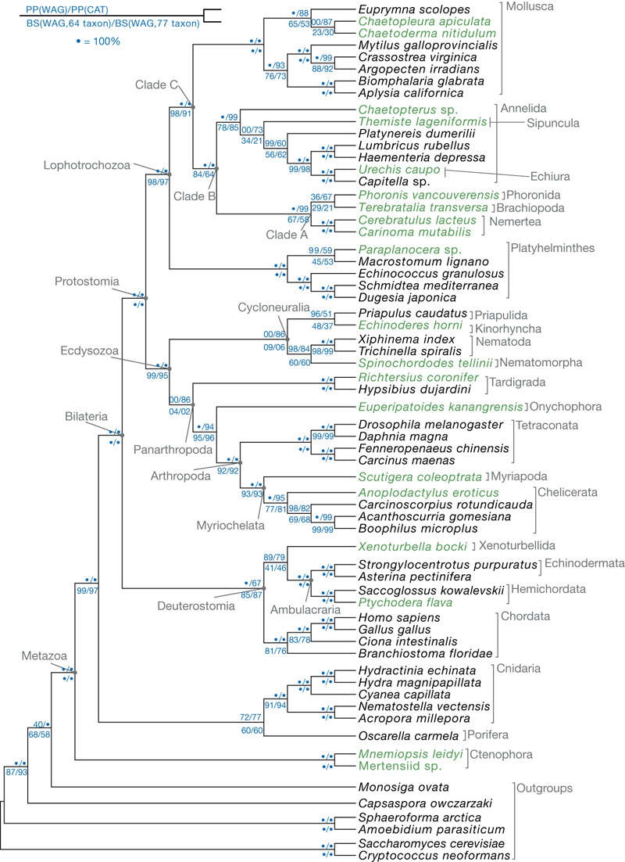
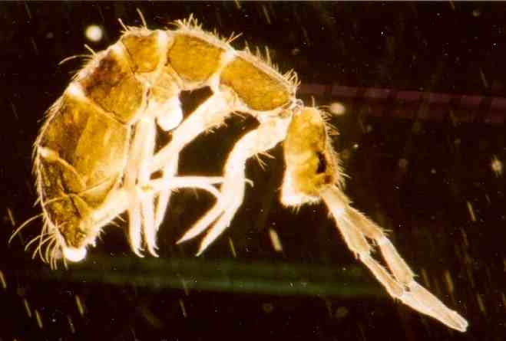
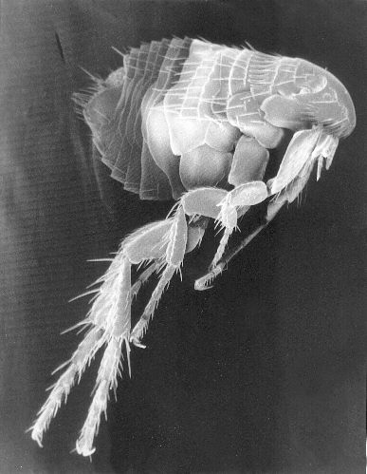
springtail has no wings because all its ancestors were wingless
Collembola
Protura
Insecta
flea has lost its wings secondarily
… likewise wingless species of fruit flies etc.

Slide 12
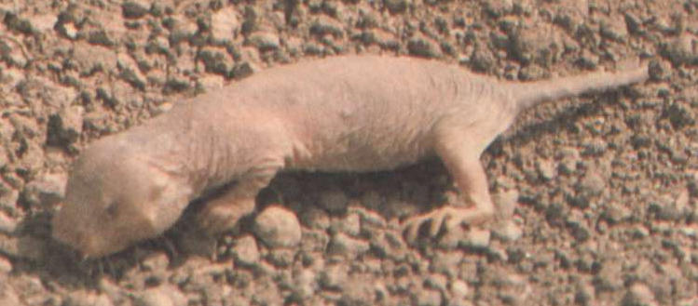
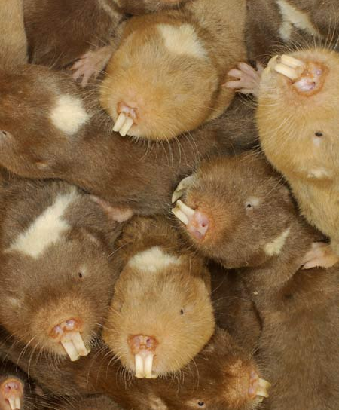
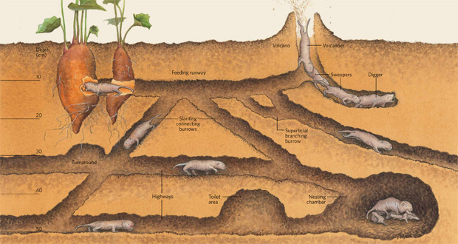
Heterocephalus glaber
Fukomys sp.

Slide 13
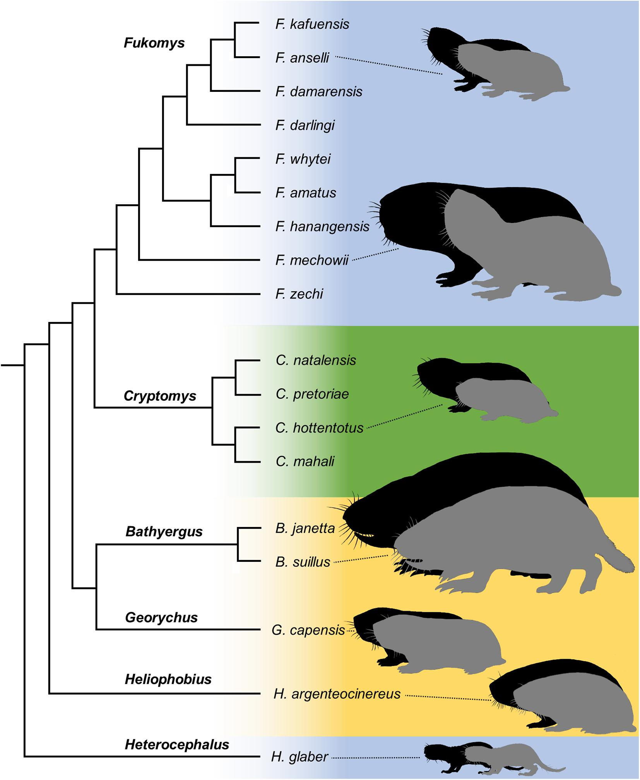
eusocial
social
solitary
Caspar et al. Front. Ecol. Evol. (2021)

Slide 14
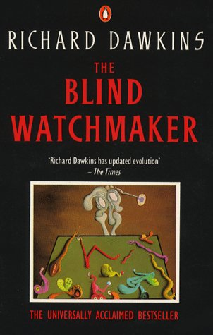
adaptations known for a long time - philosophers, natural theologians (St. Augustine, St. Thomas Aquinas, William Paley)
notion of a watchmaker, today „argument from design“
× David Hume
Richard Dawkins: Blind Watchmaker
Explaining adaptations:
supernatural being
lamarckism, adaptive mutation zebra and lion: the ability of muscle strengthening is itself adaptive
orthogenesis ... mechanism?
natural selection

Slide 15
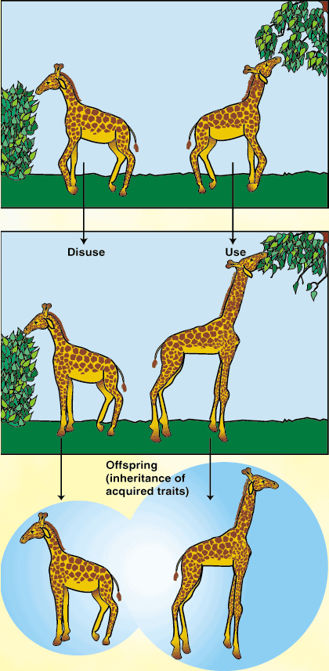
Coadaptation
= complex adaptation requiring coordinated changes of more than 1 part
Herbert Spencer: giraffe´s neck – parallel changes of bones, muscles, and vessels
× genes do not act independently
gene level (→ gene complexes, „supergenes“)
organ level
species level ... see also Origin of sexual reproduction

Slide 16
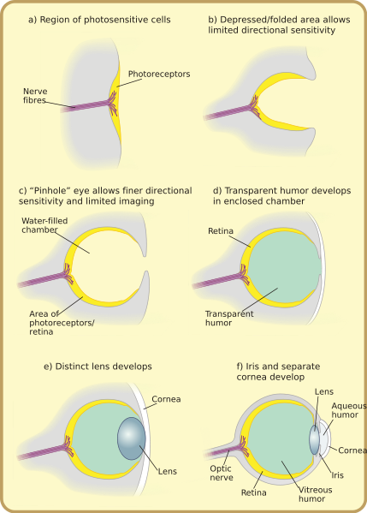
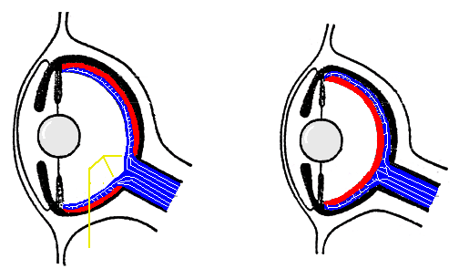
EVOLUTION OF COMPLEX TRAITS
1. Functional intermediary traits
octopus
vertebrates
Nautilus
Evolution of camera-type eye:
How can a half-eye be functional?
cephalopods, vertebrates

Slide 17
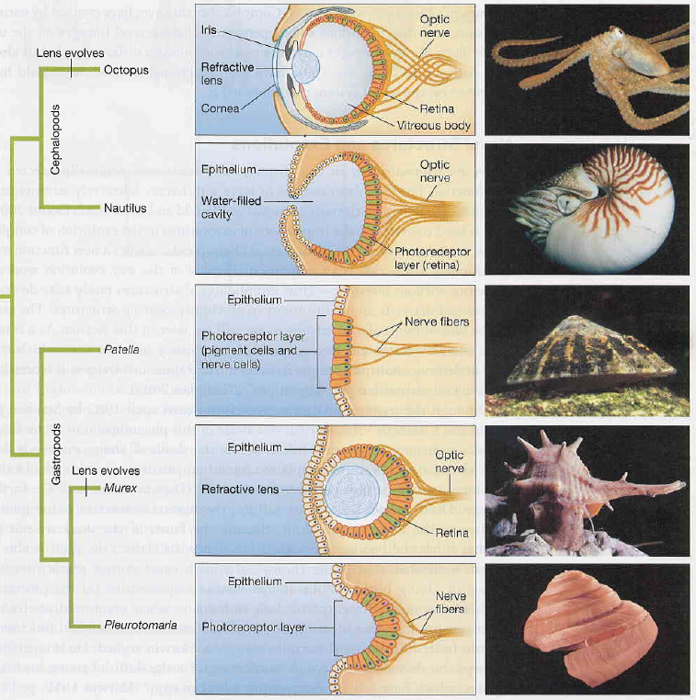
cephalopods:

Slide 18
Evolution of a complex camera-type eye – computer simulation:
photosensitive organs → independent origin 50-100× in different groups of invertebrates
Nilsson & Pelger (1994):
layer of photosensitive cells between dark cell layer below and transparent protective layer on top
random changes <1% → less advantageous changes rejected
criterion = ability to distinguish objects in space (optical physics → potential for quantification)

Slide 19
Evolution of a complex camera-type eye – computer simulation:
d = diameter
∼ 1000 steps: pinhole eye
∼ 2000 steps: camera-type eye
∼ 400 000 generations

Slide 20
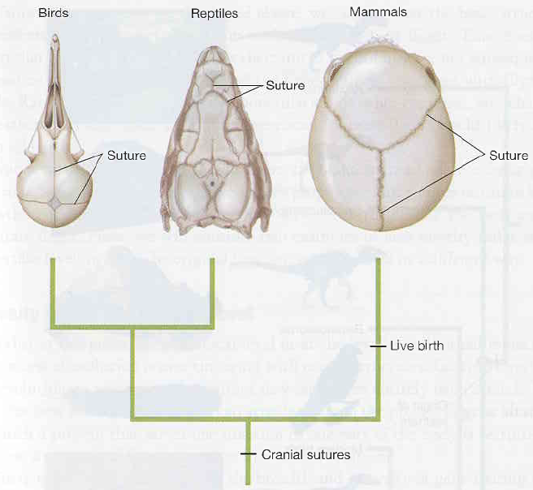
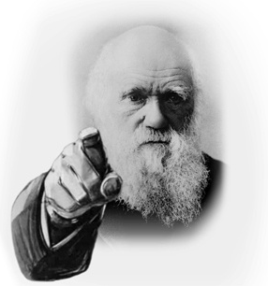
2. Exaptation
Complex traits seldom originate de novo, rather modification of existing structures
François Jacob (1977): evolutionary tinkering
exaptation = function shift, ie. usage of a trait for another purpose
Eg.: mammal cranial sutures (birth relief)
suture probably enabled brain growth
must have been other purpose!

Slide 21
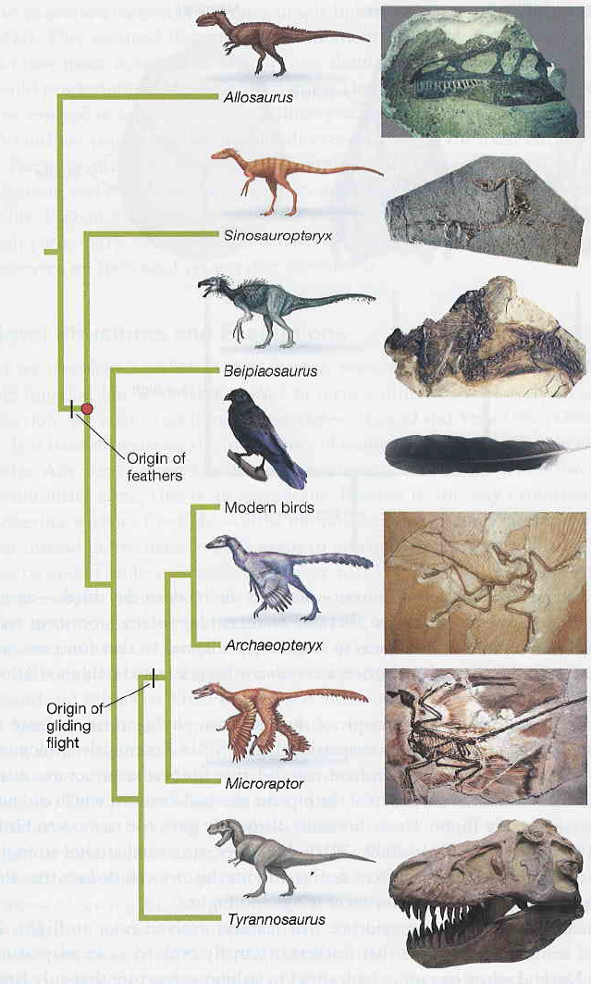
Eg.: bird feathers single origin
theropod dinosaurs
Prum and Brush (2002):
„Concluding that feathers evolved for flight is like maintaining that digits evolved for playing the piano.“

Slide 22
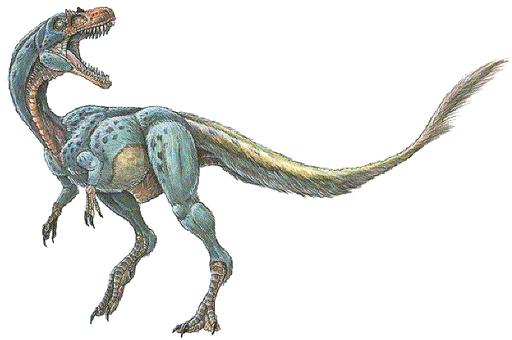
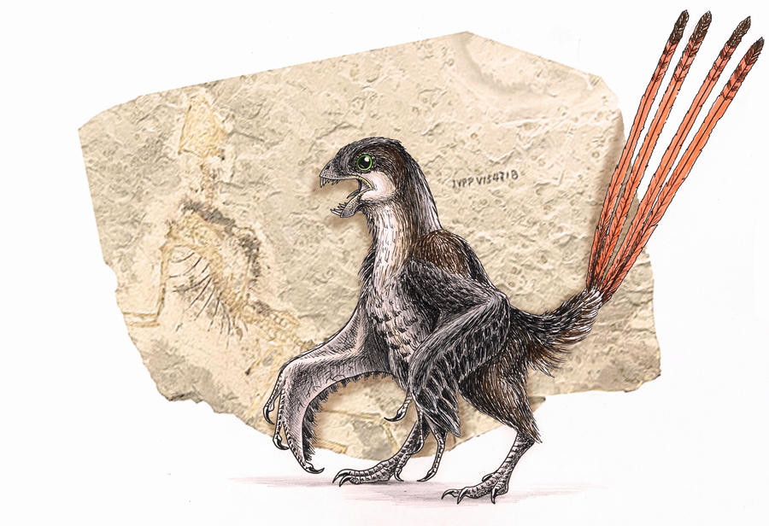
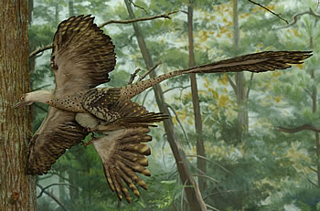
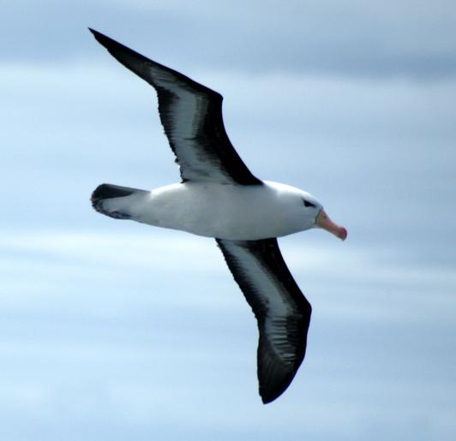
Bird feathers:
1. thermoregulation
2. protection against solar radiation
3. signalling
4. sense of touch (like vibrissae)
5. pray catching
6. defence
7. water protection
Dilong paradoxus thermoregulation
Microraptor gui: gliding
Epidexipteryx hui
birds:
active flight

Slide 23
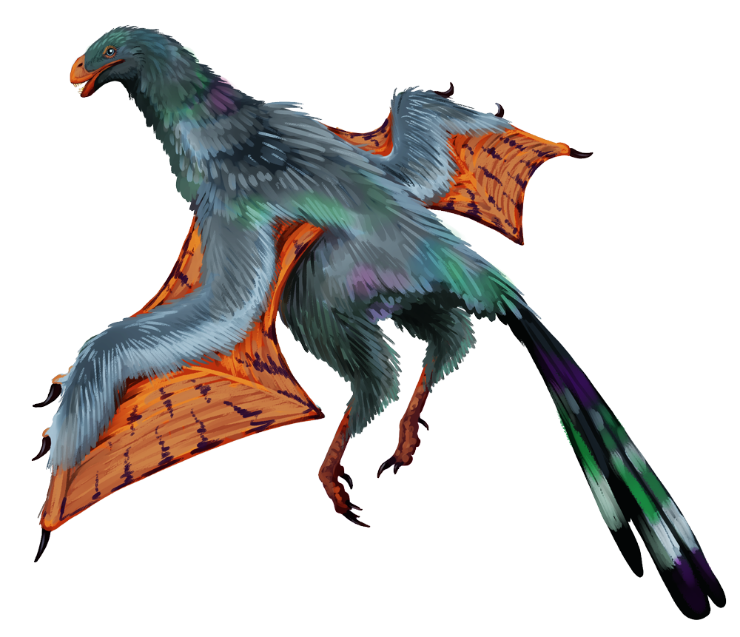
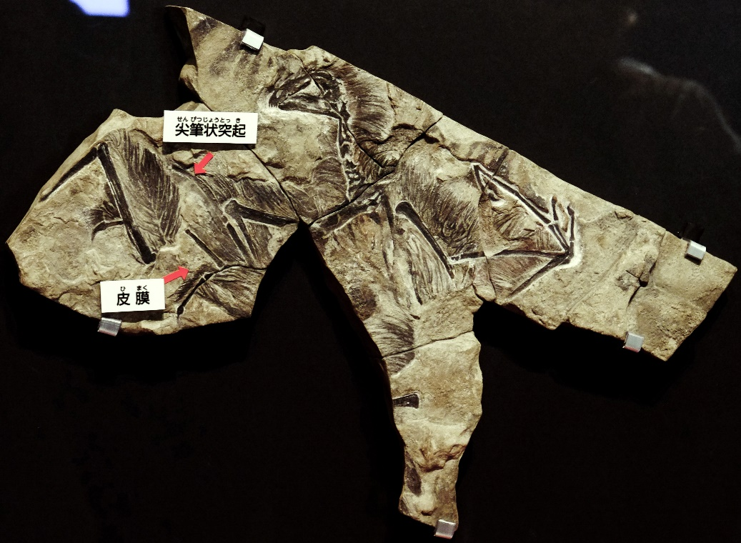
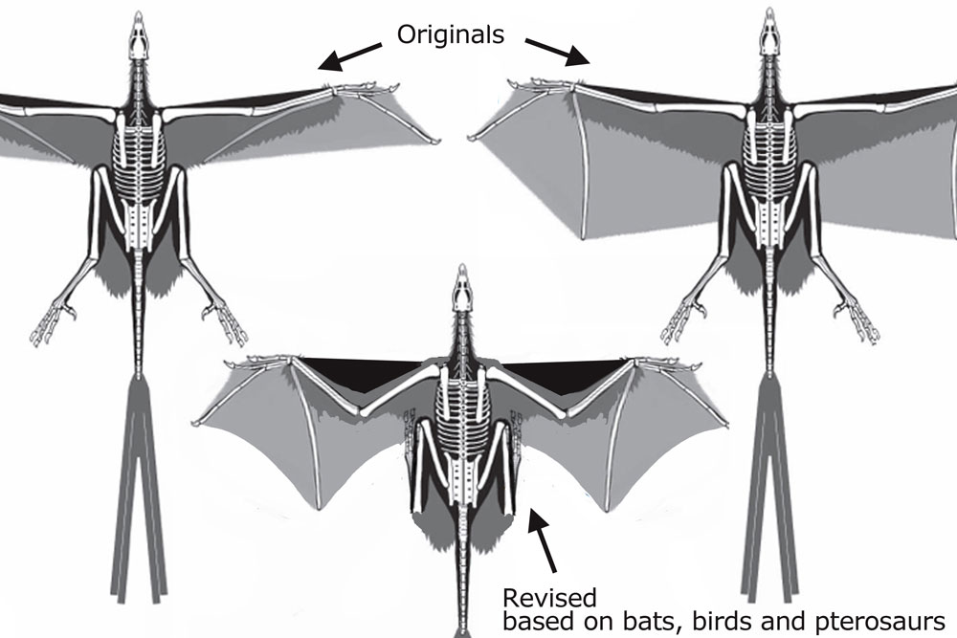
Yi qi
Yi qi: combination of feathers
and patagium

Slide 24
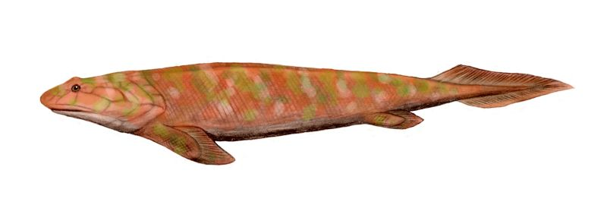
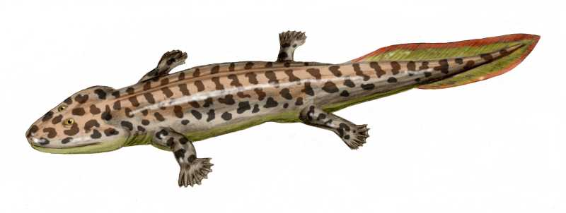
Eg.: lobe-finned fishes – seabed movement → shore climbing
Tiktaalik
Panderichthys (Rhipidistia)
Acanthostega
Eg.: insect cuticle (integument → skeleton); mammalian mammary glands (sweat glands)
Stephen J. Gould, Elizabeth Vrba (1982): avoiding teleology: the term „preadaptation“ → exaptation
= broader meaning – including originally neutral traits
likewise term co-option

Slide 25
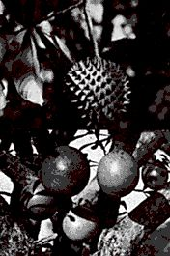
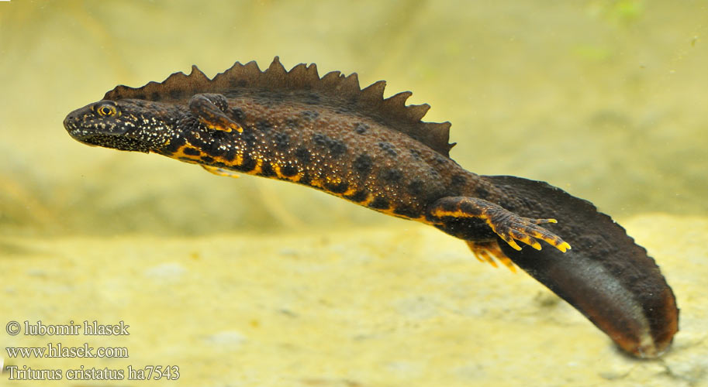
Evolutionary constraints
Are adptations always optimal?
time lag: neotropical anachronisms
genetical constraints: overdominance (lethal system of chromosome 1 in Triturus cristatus)
Cresentia alata

Slide 26
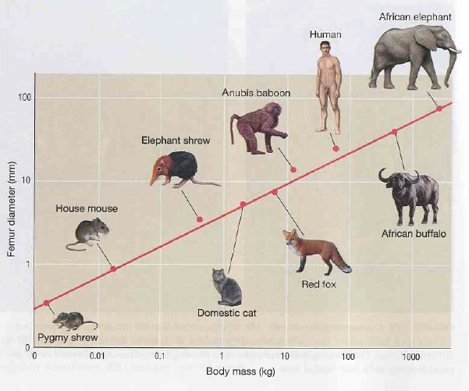
physical constraints:
mass grows with third power
bone strength grows with second power (bone cross-section)

Slide 27
ontogenetic constraints:
deviation of production of various phenotypes or restriction of phenotypic variation caused by structure, character, composition or dynamics of the ontogenetic system
Pegasus´s wings cannot arise de novo
ontogeny is „canalized“

Slide 28
David Raup (1966):
morphospace described by 3 variables
D = tightness of the coil
T = translation rate
W = expansion rate
only some shapes realized

Slide 29
historical constraints
change of adaptive landscape

Slide 30
Eg.: laryngeal nerve – one of branches of the vagus nerve (nervus vagus)
Myllokunmingia > 530 MY
amphioxus

Slide 32
conflict at different levels: selection at the gene level vs. selection at the organismal level
trade-off of various adaptive needs: parallel breathing and eating when the secondary palate is absent
trade-off between life-history parameters (number of offspring × age of the first reproduction)
time distribution between various activities (eating, recreation, …)

Slide 33
Methods of study of adaptation:
structural complexity: the more complex, the higher probability of a trait being adaptive
usefulness, demonstration of function: Bergmann and Allen rule, falcon wing × accipiter wing etc.
comparative method: association with phylogenetic analýysis
experiment
non-phylogenetic statistical methods assume that all the compared species are equally related ...
Sometimes even an experiment is not conclusive whether the trait is adaptive → danger of confusing function and effect:
eg. alkaloids and terpenes of plants (repelling insects × waste products of metabolism)

Slide 34
Is every trait adaptive?
physical and chemical laws: hemoglobine colour, return of a fish to water
cultural inheritance of some behavioural patterns
drift: pseudogenes; shift to parthenogenesis in Drosophila mercatorum; loss of structures due to accumulation of lethal mutations
correlation with the selected trait: hitchhiking, pleiotropy
multiple peaks in the adaptive landscape

Slide 35
Is every trait adaptive?
multiple peaks in adaptive landscape: cryptic or aposematic colouration; locomotion of kangaroos × zebras
phylogeny: winglessness, eusocial behaviour of mole rats
skunk
antelope
zorilla
kangaroo

Slide 36
Stephen Gould, Richard Lewontin (1979): The spandrels of San Marco and the Panglossian paradigm: A critique of the adaptationist programme. Proceedings of the Royal Society of London, Series B, 205: 581-598.
Voltaire: Candide

Slide 37
strictly speaking, this is not spandrel
but pendetive ...
... this is spandrel

