Slide 1
Lasers basics principles
Vítězslav Otruba, Karel Novotný

Slide 2
Simplest configuration?

Slide 3
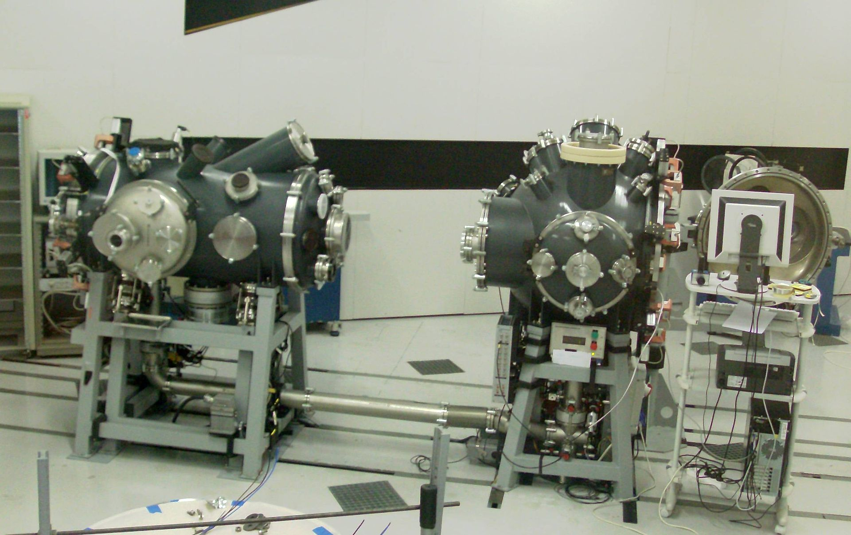
High energetic lasers - PALS Prague Asterix Laser System
The vacuum chambers at the PALS laboratory in Prague, where a 1 kJ pulse creates plasma for X-ray generation

Slide 4
Lasers – Light Amplification by Stimulated Emission of Radiation
Spectral range 1 mm – 50 nm, (experimentally) X ray range up to 1 nm, extreme experiments up to 0,01 nm –radiation generators especially (XASER)
For sub millimeter wave range MASERS (Microwave Amplification by Stimulated Emission of Radiation) - mainly as low noise radio signal amplifiers

Slide 5
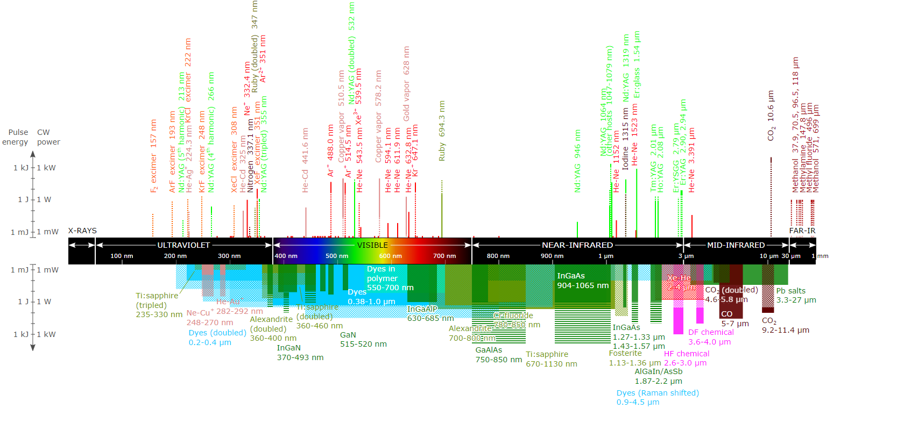
Commercially available – VUV – VIS – MID IR

Slide 6
Properties of laser radiation
Emissions of elementary oscillators(atoms, molecules…) narrow beam– spatial energy concentration
Δλ can be very small– spectral concentration of energy
Synchronous operation of elementary oscillators– time concentration of energy
Coherence length up to tens (in vacuum up to thousands) kilometers

Slide 7
Types of lasers by:
• emission wavelengths
• time mode of operation - continuous (cw) or pulse
• type of excitation – optical excited lasers, electric discharge, chemical, mechanical (particle collisions), injection of charge carriers, …
• type of active medium - solid, liquid (dye), gas, ion,
excimer, semiconductor (diode),…
• pulse duration (nanosecond, picosecond, femtosecond, ...) - the shorter pulse duration means higher the Peak power at the same Average Power

Slide 8
Types of lasers
Properties of Active laser medium (gain medium, lasing medium)
Excitation of atoms up to
metastable state
By collisions between two kinds of atoms (He-Ne, CO₂)
Optical excitation – pumping (ruby, neodymium glass)
Excitation in the chemical reaction (eximers)
By electric current (semiconductors,GaAs)
and other ways
Light output of lasers:
Continuous laser up to tens of mW
Pulse laser with an average power of 10 mW can have parameters:
pulse duration = 1 ns,
pulse energy = 1 mJ,
pulse power = 1 MW
repetition rate = 10 Hz

Slide 9
Radiation Processes
Strong transitions :
E1 (electric dipole)
A~10⁸ s⁻¹ for neutrals
Weak transitions:
M1 (magnetic dipole),
E2 (electric quadrupole),
some E1
A ~1-100 s⁻¹ for neutrals
E₁
hν = E₁-E₀
E₀
spontaneous
emission
absorption
stimulated
emission
A ~ ΔE² ~ λ⁻² (transition probability)
Radiation intensity : I(ν)=N_{u}·A·hν

Slide 10
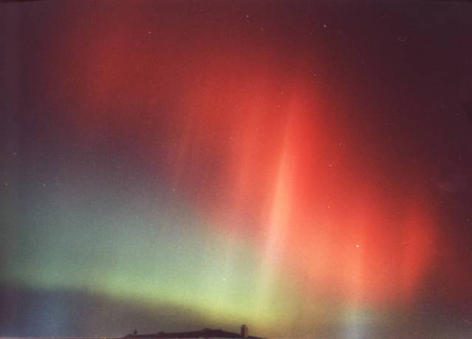
Radiative Processes cont’d
O I lines:
³P₁-¹D₂
³P₂-¹D₂
¹D₂-¹S₀
M1
630 nm
E2
mean lifetime exc. state 110 s
557,7 nm
mean lifetime exc. state 0,7 s

Slide 11
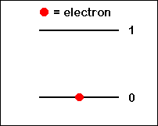
spontaneous emissions
Probability of photon absorption :
w₀₁=n₀ρ(ν)B₀₁
Probability of spontaneous emissions :
w₁₀=n₁A₁₀
ρ(ν) – spectral density of radiation with frequency ν
B₀₁ – Einstein coefficient of absorption
A₁₀ – Einstein coefficient of spontaneous emission

Slide 12
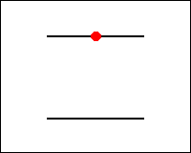
Stimulated emission
Probability of stimulated emission :
w₁₀=n₁ρ(ν)B₁₀
B₁₀ – – Einstein coefficient of stimulated emission
Process of interaction with radiation :
n₀ρ(ν)B₀₁=
n₁ρ(ν)B₁₀ +n₁A₁₀
1
1
0

Slide 13
Interaction with radiation
Two-level model in thermodynamic equilibrium :
From the equation we express ρ(ν):
Boltzmann distribution in TD equilibrium (exponential decrease in level occupation with increasing energy):
[1]

Slide 14
Relation between Einstein coefficients
Substituting the Boltzmann distribution [1] into the previous equation
for volume density of radiation we get:
For the spectral density of radiation we can use Planck relationship:
By combining the equations, it is possible to find the relationship between the Einstein coefficients:

Slide 15
What is the relative number of acts of stimulated and spontaneous emission per unit of time?
The number of stimulated emissions per second
R=
The number of spontaneous emissions per second
wavelength
wavenumber
(cm⁻¹)
frequency
(Hz)

Slide 16
Inverse population
The Einstein coefficients for stimulated emission and absorption are equal: B₀₁=B₁₀=B
For absorption:
dΦ_{A}=hνn₀Bρ(ν)dt
For stimulated emission:
dΦ_{E}=hνn₁Bρ(ν)dt
Total radiant flux change:
dΦ/dt=hν(n₁-n₀)B
Condition for amplification of radiation:
n₁- n₀ >0, tj. inverse population

Slide 17
Inverse population
The normal population distribution is shown in Figure a).
In order to create an active environment, it is necessary to intervene in the system in order to change the distribution of the energy level occupation in the way shown in Figure b).
The process is usually referred to as laser excitation or pumping. The basic method is optical excitation.

Slide 18
Three-level system
Application: ruby laser
Level 2 is metastable
The disadvantage is low efficiency - for reach the inverse population at least 50% of the particles have to be brought to level 2
1
relaxation
2
pumping
stimulated emission
0

Slide 19
Energy diagram of a ruby laser

Slide 20
Three-level system
Modified three - level system with excitation to metastable level 1.
1
stimulated emission
pumping
2
relaxation
0

Slide 21
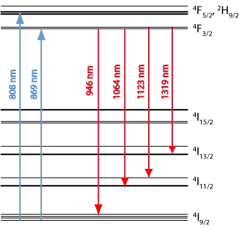
Four-level system
1
Fast decay
Example - laser Nd: YAG
High efficiency
An inverse population must only be reached between levels 2 and 3
2
Pump Transition
Laser Transition
3
Fast decay
0
21

Slide 22
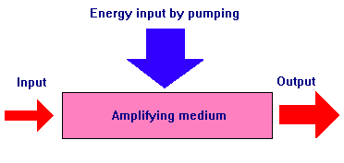
Radiation amplification - quantum amplifier
Active environment amplifies the incoming radiation:
Φ=Φ₀exp[-l(α+β)]
α - absorption coefficient (α‹0)
β - losses (β›0)
l - length of amplifying medium
α
Φ₀
Φ

Slide 23
Generation of radiation
By introducing positive feedback from the output to the input of the amplifier we get an oscillator whose frequency is given by the amplifier and the feedback circuit, usually realized by a Fabry-Perot resonator
+
F.-P.

Slide 24
Laser radiation generation
Feedback is usually realized by a Fabry-Perot resonator.
For short pulse generation, the amplifier frequency bandwidth must be at least:
Δf ≅ 1/(2τ)
where τ is the pulse width
(polychromaticity of short pulses)

Slide 25
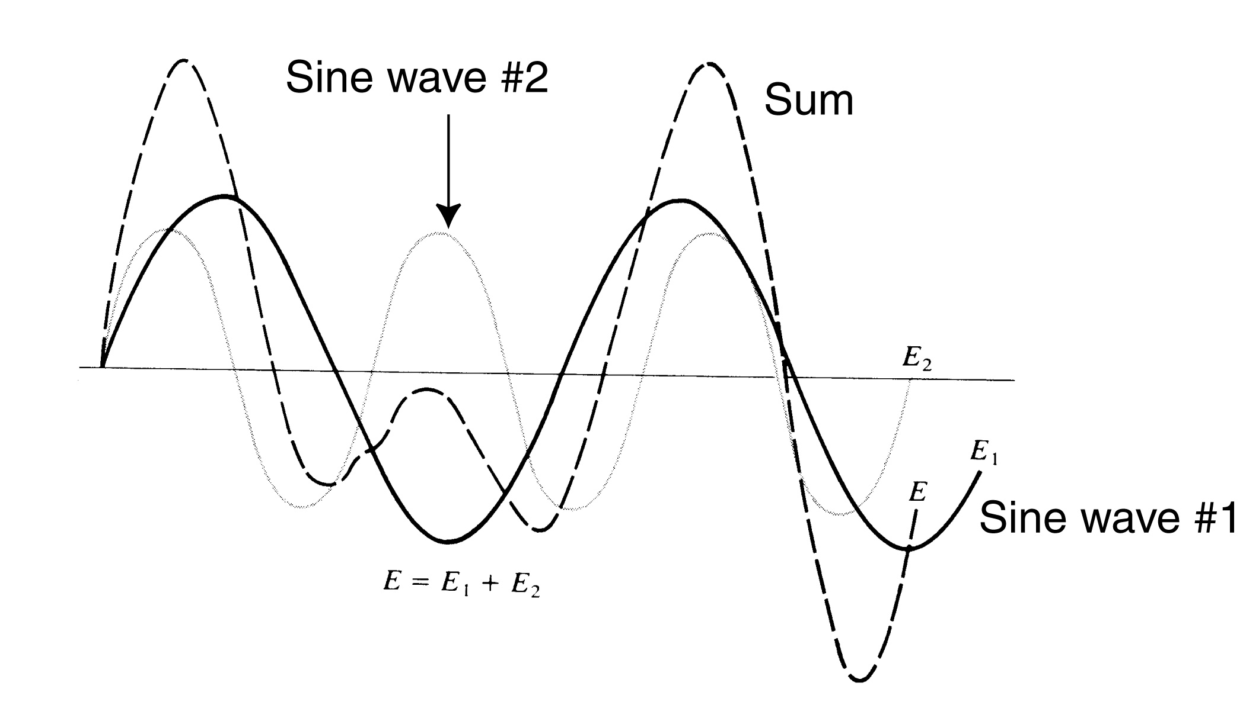
Fourier decomposing functions
Anharmonic waves are sums of sinusoids.

Slide 26
Conditions for radiation generation
The reflectance of the mirrors shall be chosen with regard to the amplification of the active environment so that the losses do not exceed the amplification of the active environment G:
R₁R₂exp[-2l(α+β)]≥1
pumping

Slide 27
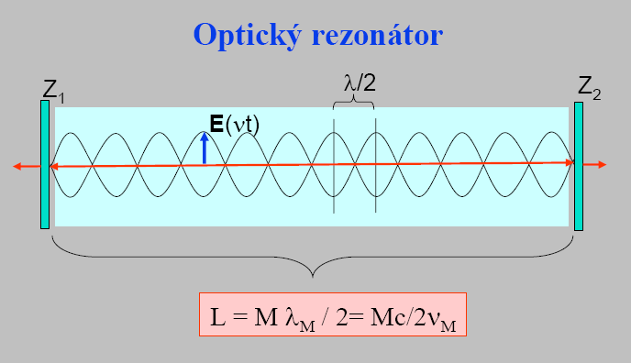
Optical resonator
The length of resonator L is M multiple of half-wave (M is an integer). The length L corresponds to given resonator frequencies νM (longitudinal laser modes). Inside the resonator is a standing wave of electric field E with frequency ν_{M} = c/λ_{M}

Slide 28
Fabry-Perot etalon
Quality of resonator Q
(Q_{FP}~10⁸-10⁹)
E_{m}- energy of the given mode
P_{z}- power dissipation
ω₀- angular frequency of oscillator
ω₀ = 2πν₀ =2π/T₀ [s⁻¹]
Notes:
Em energie daného módu v rezonátoru

Slide 29
Spectral line width and laser modes
generation threshold
Doppler line width
Δλ~1 pm – 10 nm
VIS, gas - semiconductor
The figure shows the individual resonances basic longitudinal mode.

Slide 30
Resonant modes and bandwidth gain of the active medium

Slide 31
Optical resonators
Volume of the optical (electric) field in resonator
Planparallel : r₁ = r₂ =
r₁
r₂
Concentric : r₁ = r₂ = L/2
F₁
_{focus}
S₁=S₂
_{center of curvature}
F₂
r
Confocal : r₁ = r₂ = r = L/4
S₂
S₁
F₁=F₂
r₁
Hemispherical : r₁ = L, r₂ =

Slide 32
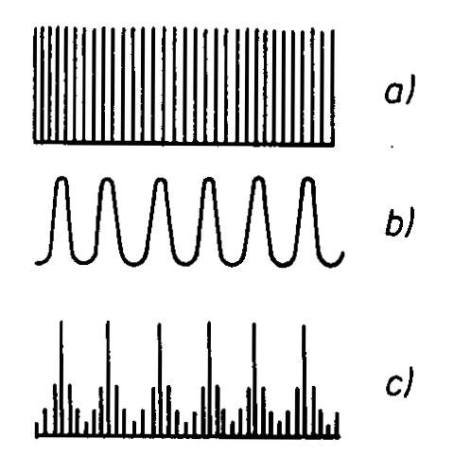
Coupled resonators
L – length of open resonator
l1,l₂ – distance of interior mirrors
open resonator modes Z1-Z3
internal resonator modes Z2-Z3
resulting spectrum of frequencies

Slide 33
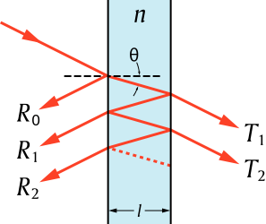
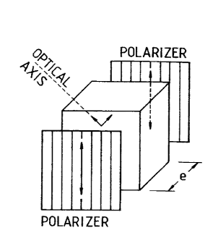
Single mode laser
Combination of resonant modes and internal FP standard
or Lyot filter (narrowband polarization filter)
and the gain bandwidth generates only one longitudinal mode
generation threshold
internal etalon

Slide 34
Open optical resonator
dielectric layer
glass support
Open resonator modes
Longitudinal modes: distribution of light radiation in the longitudinal direction
Transverse modes: distribution of light radiation in the transverse direction

Slide 35
Transverse modes of the resonator Transverse Electromagnetic Mode - TEM
Transverse modes are characterized by a pair of numbers m and n. These numbers represent the number of nodes of the standing wave on the axes (x, y) perpendicular to the optical axis.
The number of nodes of the standing wave in the optical axis L is high and is not given.
The basic mode is TEM₀₀, in which the radiation intensity profile has a Gaussian profile.

Slide 36
Transverse modes of the resonator

Slide 37
Gaussian beam (profile) mode TEM₀₀
w_{s} = distance from the resonator axis,
where the radiation intensity decrease to
1/e axis intensity

Slide 38
Profile of the focused laser beam in its focus

Slide 39
Coherence of radiation
coherence length lc- related to how long a continuous electromagnetic wave (sinusoidal wave) is emitted.
Heisenberg uncertainty principle : δE ⋅δt ≈ h ⁄ 2π
hδν=δE ⇒ hδν⋅δt ≈h ⁄ 2π ⇒δν ≈1 ⁄ 2π δt
coherence time– τ
where is the width of the spectral interval
In general, coherence can be understood as the ability of radiation to interfere with relative time shifts of the emitted radiation

Slide 40
Brewster’s angle
Exit windows separating the low pressure area from the atmosphere
they are inclined at Brewster's angle to form a lossless optical feedthrough, which, as a by-product, causes the output radiation to be linearly polarized, a feature useful for a variety of applications.
For the size of the Brewster angle, it can be deduced from the Fresnel equations (indicating the intensity of the reflected and refracted light) that:
Where α_{B} is the value of the Brewster angle and n relative refractive index between input and output medium.
discharge tube with active medium
polarization

Slide 41
He – Ne and CO₂ laser
Energy scheme of excitation
(so-called three-level system)
α_{Β}
If the exit windows are inclined at Brewster angle, the laser beam is linearly polarized
Glass discharge tube filled with He (pressure about 100 Pa) and Ne (pressure about 10 Pa).
For CO₂ laser: nitrogen takes over the function of He and molecule of CO₂ takes over the function of neon
1.
2.
3.
hν = E₂ – E₃
E₁
E
E₂
photon
E₃
He
Ne
Ne
He atom is excited to E1 by the discharge
By collisions He and Ne atoms - Ne atom is excited to a metastable state
In the presence of an electric field with a frequency ν_{M} the Ne emits stimulated photon, otherwise spontaneous
Typical continuous lasers.
λ(He-Ne) = 632.8 nm
λ(CO₂) = 10.6 μm

Slide 42
Semiconductor laser
-
Mirrored -
modified front surface
of crystal
hole flow
Al_{x}Ga_{1-x}As, n-typ
emission of stimulated photons
GaAs, p-typ
radiative recombination
Al_{x}Ga_{1-x}As, p-typ
electron flow
+
The external voltage of this polarity causes a large number of electrons and holes (with a sufficiently long lifetime) to accumulate simultaneously in the optically active layer of GaAs, which can only recombine together by radiative transitions.
The mirrored crystal surface forms a plan-parallel optical resonator of about 1 mm in length. This ensures that stimulated photon emission occurs when electrons and holes recombining.Vlnová délka emitovaného světla je z intervalu 700 až 900 nm podle obsahu Al.
Luminescent photodiodes (LEDs) work on a similar principle. They do not have a resonator and the electrons and holes in the active environment recombine almost immediately.

Slide 43
Summary
laser radiation has a much smaller line width than the emission line of the active medium
the laser emits radiation corresponding to the longitudinal (or transverse) modes, depending on the resonator configuration
the laser emits only in those modes whose gain is greater than the threshold
laser radiation has a high coherence
if the optical system includes an element supporting a particular polarization orientation, the output radiation is polarized.

Slide 44
Literature
G.M. Hieftje, J.C. Travis, F. E. Lytle. Lasers in Chemical Analysis, The HUMANA Press. Inc. 1981
D. L. Andrews, Lasers in chemistry, Springer – Verlag, Third edition, 1997
N. Omenetto, Analytical Laser Spectroscopy, John Wiley & Sons, 18. 1. 1979

