Slide 1



Functional Genomics and Proteomics
National Centre for Biomolecular Research
Faculty of Science Masaryk University
Protein characterization by mass spectrometry
C7250
Part III
Zbyněk Zdráhal
RG Proteomics, CEITEC-MU
Proteomics CF, CEITEC-MU
NCBR FS MU
zdrahal@sci.muni.cz
Notes:
nfsnf

Slide 2

Functional Genomics and Proteomics
National Centre for Biomolecular Research
Faculty of Science Masaryk University
Characterization of Protein Modifications

Slide 3
C7250
Why?
PTM type number > 400
number of PTM sites ≈ 90 000 (detected experimentally)
≈ 230 000 (prediction)
(SwissProt, per ≈ 530 000 proteins)
G. A. Khoury et al., Sci. Rep. 1, 90; (2011); http://selene.princeton.edu/PTMCuration
...PTMs are known to act alone and in combination to regulate nearly all aspects of protein function...
...Post-translational modifications (PTMs) occur on nearly all proteins. Many domains within proteins are modified on multiple amino acid sidechains by diverse enzymes to create a myriad of possible protein species. How these combinations of PTMs lead to distinct biological outcomes is only beginning to be understood...
A. P. Lothrop, M. P. Torres, S. M. Fuchs, FEBS Letters. 587 (2013) 1247–1257

Slide 4
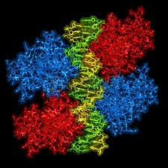
Protein p53
p53 tetramer bound to DNA
p53 exerts irreplaceable anti-neoplastic functions at homeostasis and thus is considered to be 'the guardian of the genome‘.
p53 is able to coordinate a regulatory network that supervises and responds to a variety of stress signals:
  DNA damage
  aberrant oncogenic activation
  telomere erosion
  ribosomal stress
  loss of cell-cell or cell-matrix adhesion
  hypoxia
Mutations of p53 or disruptions of p53 coordination,
to a lesser extent, can disturb the normal physiological balance,
if genome disarrangement reaches a critical value it leads to cancer
B. Gu et al, Int. J. Biol. Sci. 2012, 8, 672-684.

Slide 5
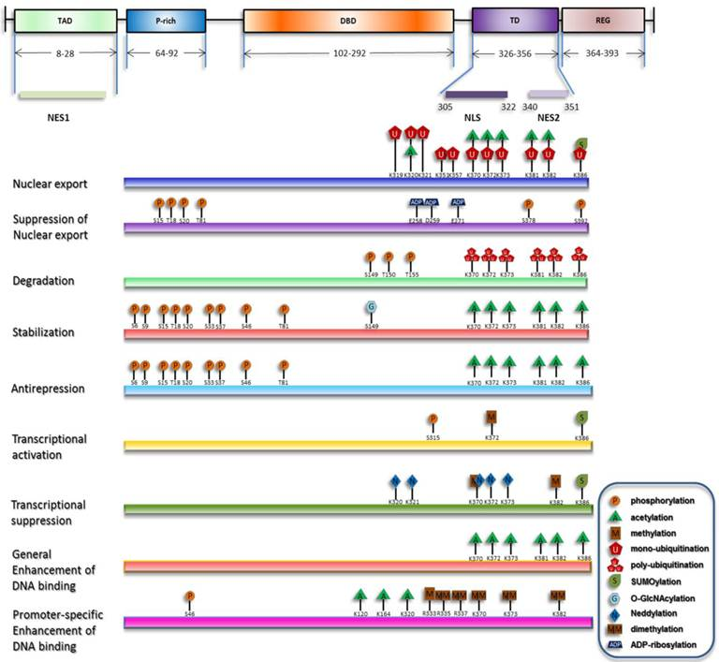
Overview of p53 PTMs
B. Gu et al, Int. J. Biol. Sci. 2012, 8, 672-684.

Slide 7
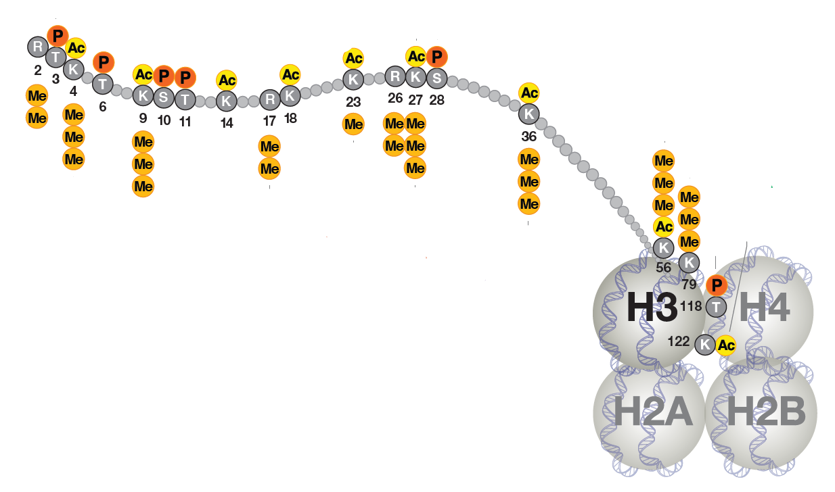
Histone H3 most frequent PTMs

Slide 8
C7250
Potential of MS in analysis of modifications
Type
Site localization
Site occupancy
demands
Western blot
detection of PTM type
localization of selected single modification
MS
“screening”
detailed characterization
of individual modification
Specific staining of gels
detection of PTM type without site localization
(phospho, glyco proteins)

Slide 9
C7250
Modification groups:
        mutation (AA replacement)
        chemical
        posttranslational
Mass shift
Overview of PTMs and prediction SW tools :
DeltaMass - https://www.abrf.org/delta-mass
ExPASy - http://www.expasy.org/proteomics/post-translational_modification

Slide 10
C7250
„Chemical modifications:
wanted modifications (carbamidomethylation Cys,
N –terminal acetylation, quantification tags, etc.)
unwanted modifications (Met oxidation, deamidation N → D during sample preparation, drug adducts, etc.)
Mass shift

Slide 11
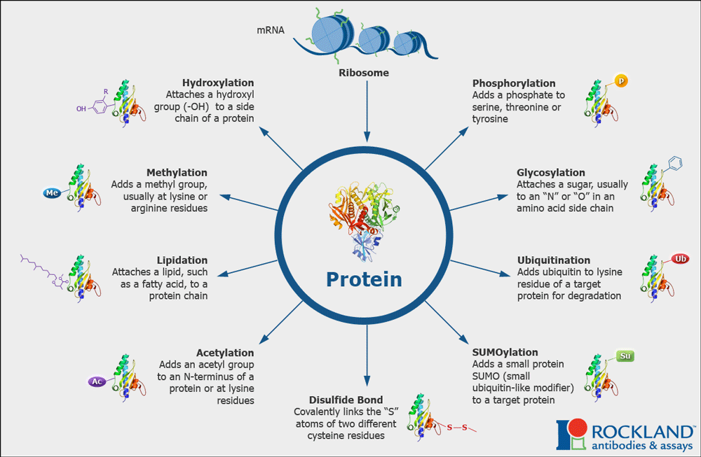
C7250
Common Posttranslational Modifications

Slide 12
C7250
Common Posttranslational Modifications
Amines
(K/N-terminus)
Methylation
+14.0269
Formylation
+28.0104
Acetylation
+42.0373
Lipoic acid
+188.3147
Farnesylation
+204.3556
Myristoylation
+210.3598
Biotinylation
+226.2994
Palmitoylation
+238.4136
Mass shift
Stearoylation
+266.4674
Geranylgeranylation
+272.4741
Acids & amides
(E/D/Q/N)
Pyroglutamic acid (Q)
-17.0306
Deamidation (Q/N)
+0.9847
Carboxylation (E/D)
+44.0098
Hydroxyl groups
(S/T/Y)
Phosphorylation
+79.9799
Sulphation
+80.0642
Carbohydrates
(S/T/N)
Pentoses
+132.1161
Deoxyhexoses
+146.1430
Hexosamines
+161.1577
Hexoses
+162.1424
N-acetylhexosamines
+203.1950
Sialic acid
+291.2579
Further details e.g.: http://themedicalbiochemistrypage.org/protein-modifications.php

Slide 13

MS/MS fragmentation of peptides
repetition

Slide 14
C7250
N-terminus
C-terminus
b- ion series
y- ion series
+
+
b₁
y₁
+
+
b₂
y₂
+
+
b₃
y₃
+
+
b₄
y₄

Slide 15
C7250
CID vs ETD
b, y c, z
C-terminus (z- series)
CID
ETD
N-terminus (c-series)

Slide 16
Functional Genomics and Proteomics
National Centre for Biomolecular Research
Faculty of Science Masaryk University
Characterization of mutations

Slide 17

C7250
Confirmation of AA replacement at peptide level Protein: Zm-p60 (position 186)
wild type 179 - 203 NWLTFNEPQTFTSFSYGTGVFAPGR 2824
E186Q Q 2823
peptide mass difference: - 1 Da
In-gel digestion
MALDI-TOF MS
2799.85
a.i.
1000
900
2823. 82
800
2799.73
Zm-p60.1 E186Q
700
600
1 Da
500
Zm-p60.1 wild type
2824. 65
400
300
2800
2810
2820
2830
m/z

Slide 18
C7250
Identification of AA replacement
Protein detected in two variants in on 2-DE spot
Initial information:
Detection of two variants of tryptic peptide with mass difference: –14 Da
...
DEEELQKENVKNTASLTGKITLSVTQSKPETGEVIGVFESIQPSDTDLGAKVPKDVKIQG
...
MALDI-MS confirmation of tryptic peptide mass difference (2 proteases)
localization of sequence region with the change
MALDI-PSD ambiguous results
LC-MS/MS mutation D/E in position 210 confirmed
...
DEEELQKENVKNTASLTGKITLSVTQSKPETGEVIGVFESIQPSDTDLGAKVPKDVKIQG
...

Slide 19
C7250
MS/MS of peptide LSVTQSKPXTGEVIGVFES, MW 2006.0 (1992.0)
„Modif“ - detail of MS/MS spectrum
EIC chromatogram
945.0
+MS2(997.4), 32.6min (#887)
„Modif“
MS2 (997.4, 2+)
m/z 956
300
D
1+
200
956.4
-14
100
927.2
0
m/z
suggestion
Ion b₉ LSVTQSKPX
D / E
EIC chromatogram
„Nemodif“
MS2 (1004.4, 2+)
„Nemodif“ – detail of MS/MS spectrum
m/z 970
+MS2(1004.0), 32.1min (#878)
300
E
1+
200
933.5
951.7
970.6
100
0
920
930
940
950
960
970
m/z
m/z
Rt (min)

Slide 20
C7250
Confirmation of D in position 210 by methylation and LC-MS/MS
after methylation exchange of H for CH3 in each carboxyl group
mass increase 14 Da/group
pouze
D, E a C-terminal
y₈
VTQSKPX*TGE*VIG*
y₈ nederiv m/z 787.2 pro D
y₈ methyl m/z 829.3 pro D
Δ = 42 Da

Slide 21
C7250
MS/MS spectrum of peptide VTQSKPXTGEVIG
before and after methylation
[Abs. Int.]
550
y₈
787.7
y₈
829.3
500
450
42 Da
400
350
300
250
200
150
100
50
0
750
760
770
780
790
800
810
820
830
840
850
m/z

Slide 22
Functional Genomics and Proteomics
National Centre for Biomolecular Research
Faculty of Science Masaryk University
C7250
Characterization of modifications
„chemical“

Slide 23
C7250
MALDI–MS spectrum of tryptic digests before a after modification
(spectrum detail)
unmodified peptide
2060
162 Da
Peptide + X
2222

Slide 24
C7250
MALDI–MS spectrum – Met oxidation
(spectrum detail)
a.i.
1200
1100
1000
Sample prep artefact
(Sypro Ruby)
900
16 Da
800
700
600
500
400
300
200
100
1256
1261
1266
1271
1276
m/z

Slide 25
C7250
Protein identification – MS/MS data (Mascot)
1. gi|15803837 Mass: 13532 Score: 487 Queries matched: 5
50S ribosomal protein L14 [Escherichia coli O157:H7]
Observed Mr(expt) Mr(calc) Delta Miss Score Peptide
…….
939.45 1876.89 1876.88 0.02 0 (125) MIQEQTMLNVADNSGAR
947.44 1892.87 1892.87 -0.01 0 159 MIQEQTMLNVADNSGAR + Oxidation (M)
947.45 1892.88 1892.87 0.01 0 (147) MIQEQTMLNVADNSGAR + Oxidation (M)
955.45 1908.89 1908.87 0.03 0 (118) MIQEQTMLNVADNSGAR + 2 Oxidation (M)
…….
(Petra P. Vz. 3, 080821)
Δ m/z 8 (16) ……. 16 (32)

Slide 26
LC-MS/MS
C7250
EIC:
m/z 939.5 (2+)
m/z 947.4 (2+)
m/z 955.4 (2+)
?
1x Ox
1x Ox
2x Ox

Slide 27
C7250
MS/MS spectrum of unmodified peptide - MIQEQTMLNVADNSGAR

Slide 28
C7250
y₁₁
y₁₀
MIQEQTMLNVADNSGAR
b₉
b₉ – M₁IQEQTM₇LN
y₁₀ – LNVADNSGAR
y₁₁ – M₇LNVADNSGAR
Shifts in m/z of selected fragments for individual M_{(ox)} peptide forms
 | no | 1 Ox | 1 Ox | 2 Ox
 |  | M₁ | M₇ | both
y₁₀ | 0 | 0 | 0 | 0
y₁₁ | 0 | 0 | 16 | 16
b₉ | 0 | 16 | 16 | 32

Slide 29
y₁₀
1016,5
C7250
unmodified
y₁₀ – LNVADNSGAR
y₁₁ – M₇LNVADNSGAR
b₉
1089,5
y₁₁
1147,6
b₉ – M₁IQEQTM₇LN
y₁₀
1016,5
M1 - ox
+ shift of the whole b series (b₃ - M₁IQ)
y₁₁
1147,6
+16
0
b₉
1105,5
y₁₀
1016,5
M7 - ox
+16
+16
y₁₁
1163,6
b₉
1105,5
y₁₀
1016,5
M1, M7- ox
+16
y₁₁
1163,6
b₉
1121,5
+32

Slide 30
C7250
LC-MS/MS spectrum (detail)
Confirmation of modification of Cys
…VC*AR
Intens.
Intens.
x10
4
y₄
y₃*
1.25
C + modification
3000
448.2
493.3
y₃
1.00
349.3
modification
2000
C
0.75
285.4
y₂
268.1
315.3
441.4
0.50
314.9
522.2
1000
y₂
285.5
200.3
0.25
200.4
246.1
384.0
428.2
383.3
468.1
478.5
410.5
246.4
300.0
410.1
455.9
0.00
0
200
250
300
350
400
450
500
m/z
200
250
300
350
400
450
500
m/z
Fryčák P. et al., J. Mass Spectrom., 40 (10), 1309-1318 (2005)

Slide 31
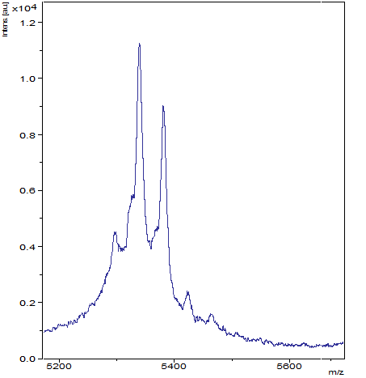
C7250
Histone H3, detection of acetylation (in-vitro)
MALDI-MS digestu (spectrum detail)
5340
Non-acetylated fragment
Ac
5382
Fragment with
one E Ac
5340
1500
Intens. [a.u.]
1250
1000
Ac ?
750
Fragment with
two E Ac
500
250
0
5250
5300
5350
5400
5450
5500
5550
5600
5650
5700
5750
m/z

Slide 32
c₁₄
C7250
c₁₃
Histone H3, localization acetylace K(14)
MALDI-ISD MS (spectrum detail) ARTKQTARKSTGGKAPR
T
G
G
K*
1360.4
c 13
1303.4
c 12
42 Da
1530.4
c 14
1246.4
c 11

Slide 33
Functional Genomics and Proteomics
National Centre for Biomolecular Research
Faculty of Science Masaryk University
Characterization of modifications
„posttranslational “

Slide 34
C7250
Phosphorylation
Protein Phosphorylation is of Fundamental Importance in Biological Regulation
cca 10-30% of all proteins are phosphorylated
S, T, Y 1800 : 200 : 1 ???
H ???
Whereas phosphorylation of serine, threonine or tyrosine results in the formation of a phosphoester linkage, phosphorylation of histidine residues occurs on nitrogen atoms, producing a phosphoramidate bond. Phosphohistidines have a large standard free energy of hydrolysis making them the most unstable of any known phosphoamino acid.
Klumpp et al, Eur. J. Biochem. 269, 1067-1071 (2002)
Phosphorylation sites db: http://www.phosphosite.org/homeAction.do
http://phospho.elm.eu.org
Phospho.ELM version 9.0 (September 2010) contains 8,718 substrate proteins from different species covering 3,370 tyrosine, 31,754 serine and 7,449 threonine instances.

Slide 35
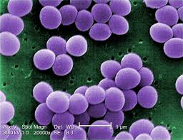
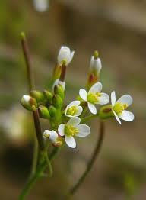
C7250
Phosphorylation
9 aminoacid, which might be phosphorylated
serine (Ser) > threonine (Thr) > tyrosine (Tyr)
histidine (His)
aspartic acid (Asp), glutamic acid (Glu)
lysine (Lys), arginine (Arg), cysteine (Cys)

Slide 36

C7250
Phosphoproteome - troublemaker
most of signaling proteins are low abundant
proteins are usually in several phospho variants
proteins can be easily dephosphorylated during sample preparation by phosphatases present in sample
signal suppression in MS
- preferential ionization of unmodified peptides
(only small portion out of total peptide content is phosphorylated; lower ionization efficiency of phosphopeptides)
enrichment
necessary

Slide 37
C7250
Sample preparation
phosphostatus stabilization
- phosphatase inhibitors (as soon as possible)
- denaturation (e.g. FASP - lysis in SDT buffer)
phosphopeptide(protein) enrichment
- TiO₂ (or other metal oxides, MOAC – „metal oxide affinity chromatography“)
- IMAC („immobilized metal affinity chromatography“)
- SCX resp. SAX or HILIC („ion exchange or hydrophilic interaction chromatography“)
- immunoprecipitation by specific antibody
I.L. Batalha, Trends in Biotechnology 30 (2), 100-110 (2012)
MS analysis
other types of MS/MS fragmentation
CID ETD (ECD)
electron transfer (capture) dissociation
HCD
higher-energy collision dissociation
EThcD
electron-transfer/higher-energy collision dissociation
Frese at al., J. Proteome Res., 12, 1520−1525 (2013)
neutral loss scan (different variants)
precursor scan

Slide 38
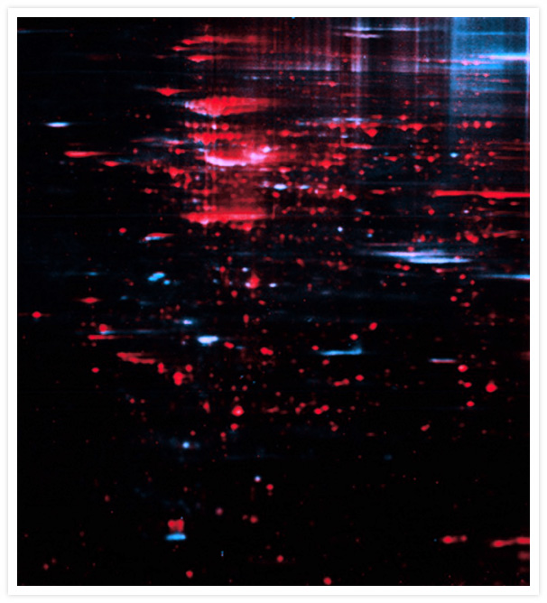
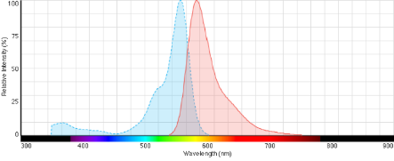
C7250
Specific staining of phosphoproteins, 2D GE
phosphoproteins
(Pro-Q Diamond , blue)
proteins
(SYPRO Ruby, red).
alternatives
Metabolic tagging by ³²P
radioactivity measurement
immunoblotting
phosphatase treatment
phosphoproteins display a basic shift in their pI after the dephosphorylation.
comparison 2D gels
(https://www.lifetechnologies.com/order/catalog/product/P33300)

Slide 39
C7250
Mobility Shift Detection of Phosphorylated Proteins
SDS-PAGE using an Phos-tagTM complex with two manganese(II) ions
Mn2+–Phos-tagTMTM
c(Mn²⁺) μM
E. Kinoshita et al., Molecular & Cellular Proteomics, 5, 749-757 (2006)

Slide 40
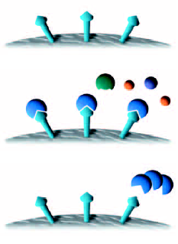
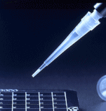
C7250
Immobilized metal affinity chromatography
(IMAC)
(Cu²⁺, Fe³⁺, Ga³⁺)
charging
specific binding
eluce

Slide 41
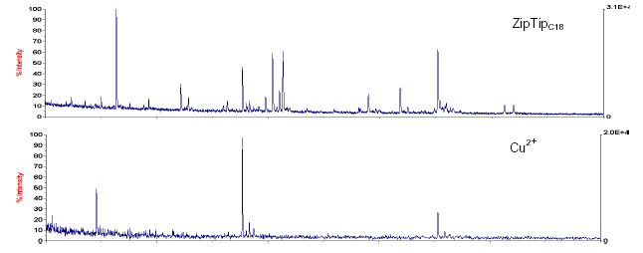
C7250
IMAC enrichment of -Casein phosphopeptides (1 pmol of tryptic digest)
Ziptip MC
Technical note - Millipore

Slide 42

C7250
Casein (1 ug) after tryptic digestion
Maldi-MS
w/o enrichment
peptides
phosphopeptides

Slide 43
C7250
Casein (1 ug) after tryptic digestion
Maldi-MS
enrichment
IMAC (Poros), Fe3+
peptides
phosphopeptides

Slide 44
C7250
Casein (1 ug) after tryptic digestion
Maldi-MS
TiO₂ enrichment
peptides
phosphopeptides

Slide 45
C7250
MALDI–MS spectrum of peptide w/o and with phosphorylation
a.i.
HRTSS*VPEY
2500
2000
80 Da
1500
1000
500
1070
1120
1170
m/z

Slide 46
C7250
Confirmation of phosphorylation by alkaline phosphatase
Casein digest
TiO₂
MALDI-MS
2 x Phos
1 x Phos

Slide 47
C7250
ESI–MS (IT) spectrum of peptide w/o and with phosphorylation
positive mode
Intens.
x10
7
2.5
538.3
m/z 538.3, 2+
m/z 578.3, 2+
40 Da
2.0
1.5
1.0
0.5
668.3
408.2
447.7
165.0
226.8
285.1
334.7
380.1
495.0
569.3
640.4
873.5
916.9
1076.4
0.0
200
400
600
800
1000
1200
m/z

Slide 48

C7250
Characterization of Histone H4 phosphorylation by Aurora B kinase
(K. Šedová)
Experimental procedure
protein phosphorylation in vitro
tryptic digestion
TiO₂ phosphoenrichment
LC-MS/MS analysis – neutral loss scan (ETD) in ion trap
design of MS analysis
selection of new precursors
no
MS
MS/MS
CID
neutral loss
detection
MS/MS
ETD
yes
precursor selection
based on intesity
fragmentation of selected
precursors
by CID
detection of neutral loss
in CID MS/MS spectra
corresponding to loss of H₃PO₄
(Δ m/z 49, 32.6)
fragmentation of precursors
displaying loss of H₃PO₄
by soft fragmentation
technique (ETD

Slide 49
LC-MS chromatogram
C7250
Intens.
TIC
x10
7
2.5
2.0
1
1.5
1.0
0.5
0.0
5
10
15
20
25
30
35
Time [min]
EIC chromatogram of selected ion - m/z 559.0
Intens.
EIC
6
x10
1.0
Intens.
2.
+MS, 21.9-22.1min #915-#923
x10
5
559.0
1.2
3+
1.0
0.3
0.8
0.8
559.3
0.6
559.6
0.6
0.4
560.0
0.2
0.4
0.0
557.0
557.5
558.0
558.5
559.0
559.5
560.0
560.5
561.0
561.5
m/z
m/z
0.2
0.0
5
10
15
20
25
30
35
Time [min]

Slide 50
C7250
m/z 559.0
MS/MS spectrum, CID
fragment of m/z 526.3, 3+
corresponds to neutral loss (32.7)
potential phosphopeptide
m/z 559.0
MS/MS spectrum, ETD

Slide 51
Identification of phosphopeptide by database searching
MS/MS Ion Search (MASCOT)
C7250
m/z Charge RT (min) Expect Mr
559.0 3+ 22.063 1674.0
MASCOT
gi|223582 Mass: 11230 Score: 74 Queries matched: 2
histone H4
Observed Mr(expt) Mr(calc) Delta Miss Score Expect Rank Peptide
558.98 1673.93 1673.86 0.076 2 (23) 7.8 1 K.RKTVTAMDVVYALK.R + Phospho (ST) CID
558.98 1673.93 1673.86 0.076 2 75 5e-05 1 K.RKTVTAMDVVYALK.R + Phospho (ST) ETD
Modifications: Optional: Phospho (ST)
Search Parameter: Charge=2+ and 3+, MS Tol.:0.500000 Da, MSMS Tol.:0.500000 Da, Trypsin
Mascot 2.2.03, NCBInr NCBInr_20081101.fasta
Biotools
Score Score
(Biotools) (Mascot)
CID
RKTVTAMDVVYALK 520 23
RKTVTAMDVVYALK 518 22
ETD
RKTVTAMDVVYALK 6149 75
RKTVTAMDVVYALK 774 47

Slide 52
RKTVTAMDVVYALK
C7250
m/z 559.0
MS/MS spectrum, CID
based on CID MS/MS data localization of phosphorylation is not possible

Slide 53
RKTVTAMDVVYALK
C7250
m/z 559.0
MS/MS spectrum, ETD
based on ETD MS/MS data phosphorylation is reliably assigned to T(3)

Slide 54
T(3) x T(5)
C7250
T3 + phospho (101 + 80)
T5 (101)
T3 (101)
T5 + phospho (101 + 80)
403.3
c3
502.3
c4

Slide 55
C7250
Li et al., Front. Plant Sci., 6, 430 (2015)

Slide 56
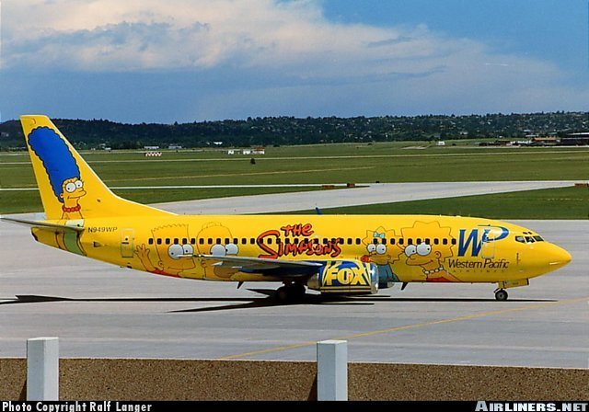

Slide 57
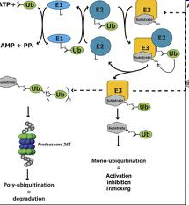
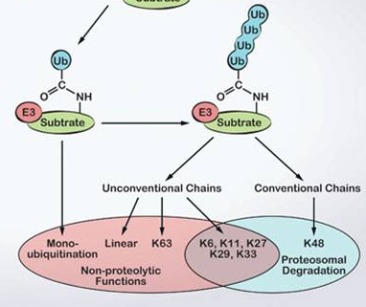
C7250
Ubiquitination
Ubiquitination is an enzymatic, protein post-translational modification (PTM) process in which the carboxylic acid of the terminal glycine from the di-glycine motif in the activated ubiquitin forms an amide bond to the epsilon amine of the lysine in the modified protein.
Protein ubiquitination regulates many cellular processes including transcription, endocytosis, cell cycle control, signal transduction, stress response, DNA
repair as well as proteasomal-mediated degradation
S. Liu, Z.J. Chen , Cell Research (2011) 21:6–21

Slide 58
Ubiquitination
The complex Ub code contains numerous variants of homotypic and heterotypic (mixed or branched) chains. Based on the eight possible linkages (M1, K6, K11, K27, K29, K33, K48, and K63) between two Ub moieties, at least 92 different Ub chain types exist.
Stolz A. et al., Trends in Cell Biology, 28 (1), 1-3 (2018)
Akutsu M. et al., J. Cell Sci., 129, 875-880 (2016)

Slide 59
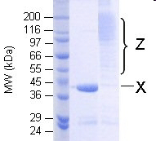
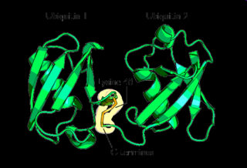
C7250
ubiquitin – protein 8.5 kDa (76 AA)
MQIFVKTLTGKTITLEVEPSDTIENVKAKIQDKEGIPPDQQRLIFAGKQLEDGRTLSDYNIQKESTLHLV LRLRGG
K
localization of modified AA sites
determination of polyubiquitin crosslinks
heterogeneity of modified forms
The most studied polyubiquitin chains - lysine48-linked - target proteins for destruction

Slide 60
C7250
Strategy of ubiquitinated site analysis
N.J. Denis, Proteomics 2007, 7, 868–874

Slide 61
C7250
False-positive identification or K(91) is really ubiquitinated ???
BBAP monoubiquitylates histone H4 at lysine 91 and selectively modulates the DNA damage response."
Yan Q., Dutt S., Xu R., Graves K., Juszczynski P., Manis J.P., Shipp M.A.
Mol. Cell 36:110-120 (2009)
Histone H4 (trypsin)
1 SGRGKGGKGL GKGGAKRHRK VLRDNIQGIT KPAIRRLARR GGVKRISGLI
51 YEETRGVLKV FLENVIRDAV TYTEHAKRKT VTAMDVVYAL KRQGRTLYGF
101 GG
Mascot
79 –100 658.6059 2630.3944 2630.4003 -2.23 0 45 0.0013 1 R.KTVTAMDVVYALKRQGRTLYGF.G + UBI_dT (K)
All matches to this query
Score | Mr(calc) | Delta | Sequence
45.2 | 2630.4003 | -0.0059 | KTVTAMDVVYALKRQGRTLYGF
45.2 | 2630.4003 | -0.0059 | KTVTAMDVVYALKRQGRTLYGFGG
0.3 | 2630.3792 | 0.0152 | KSAPAPKKGSKKAVTKAQKKD

Slide 62
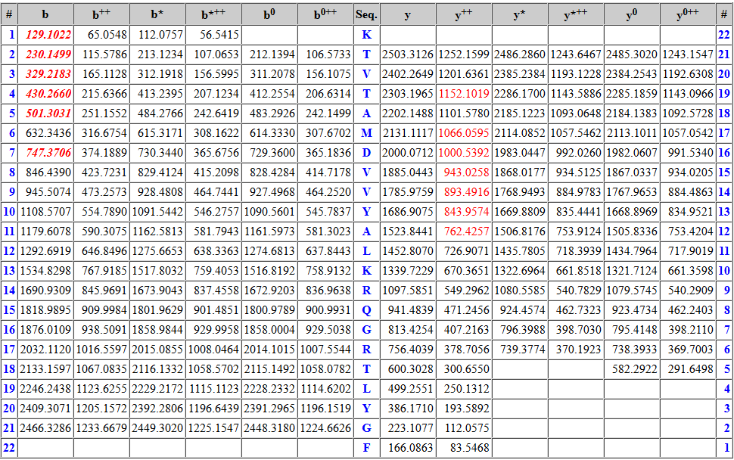
C7250
False-positive identification or K(91) is really ubiquitinated ???
K(1) is not ubiquitinated
based on hte MS/MS data is not possible to decide K(91)ubi or C-terminal GG

Slide 63
C7250
Characterization of ubiquitinations using immunoprecipitation
Scheme of experiment
D.Bustos, MCP, 2012 11: 1529-1540

Slide 64
C7250
Ubiquitination
Semiquantitative assessment of site occupancy
site occupancy of individual Ubi sites
sample vs control
site occupancy within polyubiquitin chains
sample vs control
de Groot R. E.A. et al., Sci. Signal., 7 (317), ra26 (2014)

Slide 65
Characterization of ubiquitinations using immunoprecipitation II
UbiSite antibody
C7250
method principle
the antibody recognizes 13 C-terminal aminoacids of ubiquitin
experimental scheme
two human cell lines
Hep2
Jurkat
proteasomal inhibitors treatment
BOR - bortezomib
AP15 - b-AP15
Nat. Struct. Mol. Biol., 25 (July), 631–640, (2018)

Slide 66
Characterization of ubiquitinations using immunoprecipitation II
UbiSite antibody
Numbers of ubiquitination sites and ubiquitinated proteins identified in the two cell lines (n = 3 independent biological replicates).
Numbers on the top of bars indicate identified ubiquitination sites; numbers within bars indicate identified proteins.
Overlap of ubiquitination sites and ubiquitinated proteins between Hep2 and Jurkat cells.
Numbers indicate the number of identified ubiquitination sites (left) or proteins (right).
Nat. Struct. Mol. Biol., 25 (July), 631–640, (2018)

Slide 67
C7250
Ubiquitin-like proteins

Slide 68


Slide 69
C7250
Glycosylation
one of the most common post-translational modifications of proteins in eukaryotic cells.
involved in a wide range of biological functions such as receptor binding, cell signaling, immune recognition, inflammation, and pathogenicity.
basic types of glycans:
        N-linked
        O-linked
        GPI anchors
        - C-linked
        - glykace
heterogeneity
Variation in the degrees of saturation at available glycosylation sites results
in heterogeneity in the mass and charge of glycoproteins
Signal Supression
http://www.uniprot.org/manual/carbohyd

Slide 70
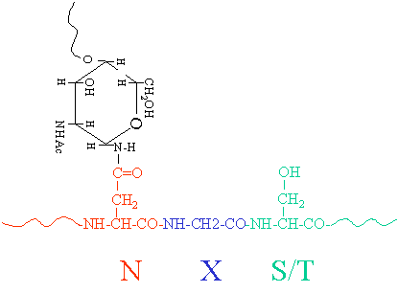
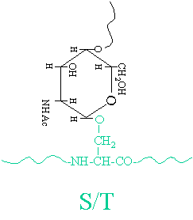
C7250
O - linked
N - linked

Slide 71
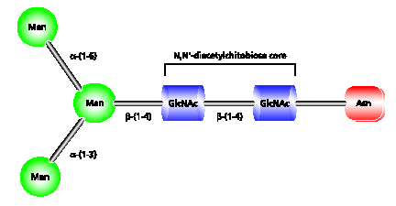
C7250
N-linked glycosylations
glycans are attached to the protein backbone via an amide bond to an asparagine during protein synthesis
N-X-S(T) X not to stand for P
subtypes:
  High-mannose
  Hybrid
  Complex

Slide 72
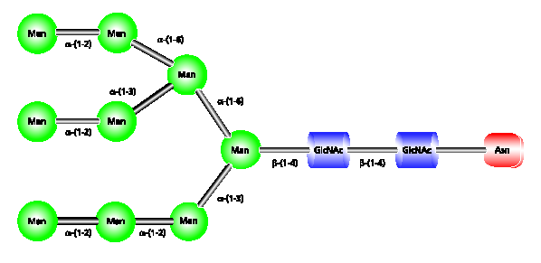


C7250
N-linked:High-mannose subtype
β-D-Mannose
β-D-N-Acetylglucosamine

Slide 73
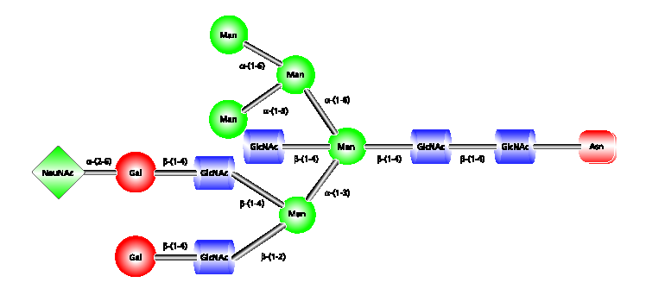


C7250
N-linked: Hybrid subtype
β-D-Galactose
α-N-Acetylneuraminic acid (Sialic Acid)

Slide 74
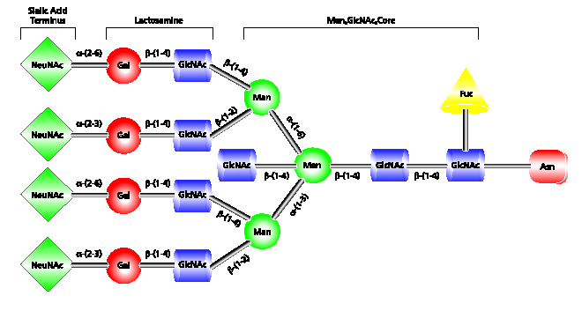

C7250
N-linked: Complex subtype
α-L-Fucose

Slide 75
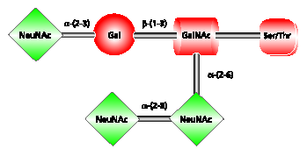
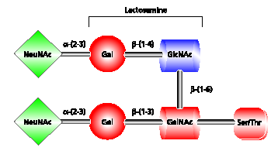

C7250
O-linked glycosylations
glycans are linked via the hydroxyl group of serine or threonine
examples:
β-D-N-Acetylgalactosamine

Slide 76
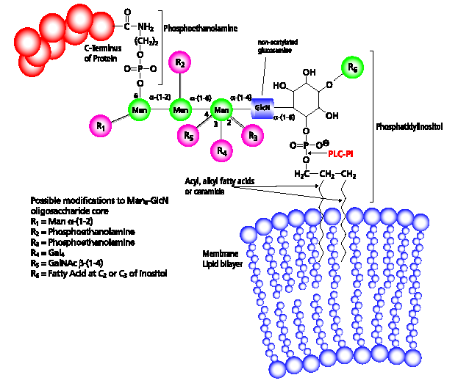
C7250
GPI (glycosylphosphatidylinositol) anchors
anchors are linked via C-terminus, membrane bound proteins

Slide 77
C7250
Characterization of glycoproteins
specific detection of glycosylated proteins
protein identification
site localization
determination of glycan structure

Slide 78

C7250
Specific detection of glycosylated proteins
Pro-Q Emerald 300 - glyco only
alternative detection techniques:
colorimetric detection
fluorescence detection
specific enrichment:
affinity chromatography
(lectins,
m-Aminophenylboronic Acid)
Sypro Ruby - all

Slide 79
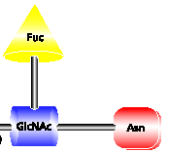
C7250
Deglycosylation
chemical:
Hydrazinolysis
Hydrazine hydrolysis has been found to be effective in the complete release of unreduced O- and N-linked oligosaccharides.
Alkaline β-Elimination - only O-linked (some exceptions)
Trifluoromethanesulfonic Acid - glycan destruction
enzymatic:
PNGase F N-linked, all removed, if not
PNGase A N-linked, all removed, if not
Endoglycosidase H N-linked, cleaves after first
Endoglycosidase F1, F2, F3 N-linked, cleave specifically with respect to glycane structure
O-Glycosidase O-linked. all removed
β-galactosidase cleaves before
...

Slide 80
C7250
Site assigment, glycan structure elucidation
glycosylation „only“ at S or T (O-linked)
NXS(T) (N-linked)
prediction of potential glyco site
combination of MS and MS/MS techniques
separation of glycoproteins or glycopeptides
deglycosylation strategies
glycan derivatisation

Slide 81
C7250
MALDI-MS spectrum of glycosylated and non-glycosylated protein
size of glycan part
a.i.
350
Δ = 2.8 kDa
300
250
heterogeneity
200
150
100
50
30000
40000
50000
m/z

Slide 82
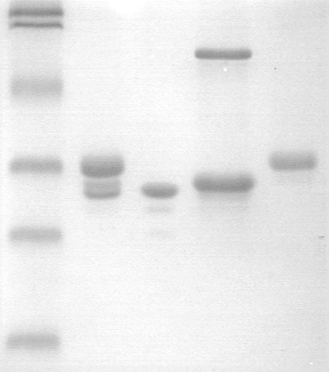
C7250
1D GE of protein before and after deglycosylation
confirmation of glycosylation
Endo H_{f}
glycosylated protein
protein after deglycosylation

Slide 83
C7250
MALDI-MS spectrum of deglycosylated protein
confirmation of glycosylation
a.i.
Endoglycosidase H_{f}
a.i.
a.i.
180
180
180
deglycosylated
160
160
160
140
140
140
120
120
120
100
100
100
80
80
80
60
60
60
40
40
40
20
20
20
30000
30000
30000
40000
40000
40000
50000
50000
50000
m/z
m/z
m/z

Slide 84
MALDI-MS of intact protein
C7250
a.i.
500
450
400
Δ_{aver} = 1.2 kDa
350
300
250
200
150
100
50
35000
40000
45000
50000
m/z

Slide 85
MALDI-MS of tryptic digests
C7250
identical protein
differential peptide

Slide 86
C7250
Detail of spectra of protein digest before and after deglycosylation
PNGase A
N-glycosylation
Δ_{aver} = 1169 Da
a.i.
500
new peptide 2797, overlapping peptide 2795
450
peptide 3966 disappeared
400
350
300
250
200
150
100
2900
3100
3300
3500
3700
3900
m/z

Slide 87
C7250
Detail of spectra of protein digest before and after deglycosylation
a.i.
500
450
400
350
300
250
200
150
100
2770
2790
2810
m/z

Slide 88
C7250
Summary
tryptic peptide - 2796 Da …PHIFDYSGS… ,
N is transformed to D during deglycosylation by PNGase A
original sequence is …PHIFNYSGS… (mass 2795 Da)
Peptide was also confirmed by LC-MS/MS analysis (original one was not found in sample before deglycosylation)
Glycan mass 1170 Da corresponds to already reported glycan
xylose+fucose+3*mannose+2*N-acetylglukosamin
So glycan structure was not confirmed by MS/MS.

Slide 89
…missing parts have potential N-glycosylation sites...
C7250
^{MLRNVCPVLILLIIGATA}QDPTDVGEAFANVEWSVAELKRVLVMGVPRDCGELFLSGQNHSGVYNIYPYKDSLLPVSAYCDMETDGGGWTVFQRRGQFGNPVYYFYKKWADYAHGFGDPAKEYWLGNNVLHALTSDKAMSLRIEKNHSLETLTAEYSVFKVASEEEYFKINVGGYIGSK
GSDAFSIANGSMFTASDQDHDTYTNNCAVEFKG
AWYTSCHGSNLNGLNLNGEHPSYADGIEWSAR
GGSTGLYYYSYPNVEMKVRDAHFISRVADGRAS
from lecture of Petr Man

Slide 90
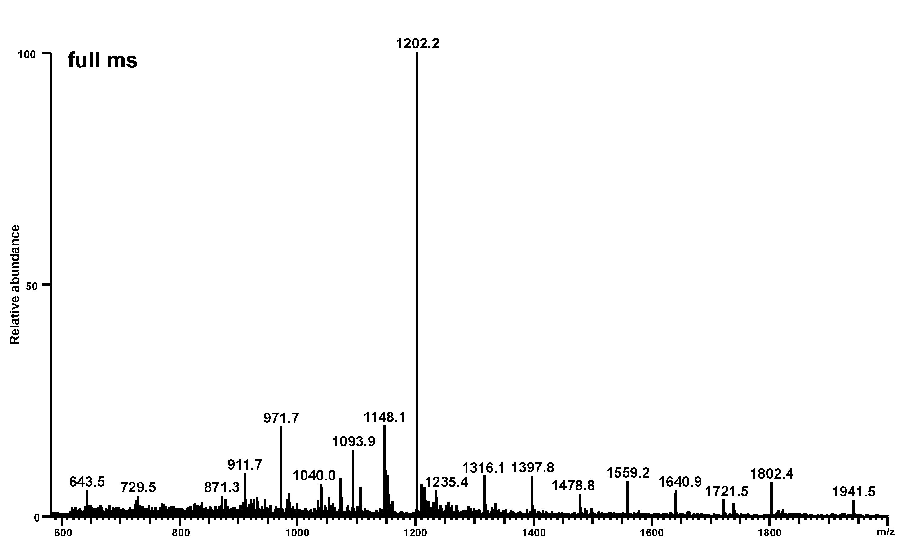
C7250
... glycopeptide...
MS/MS
from lecture of Petr Man
hexose increments

Slide 91
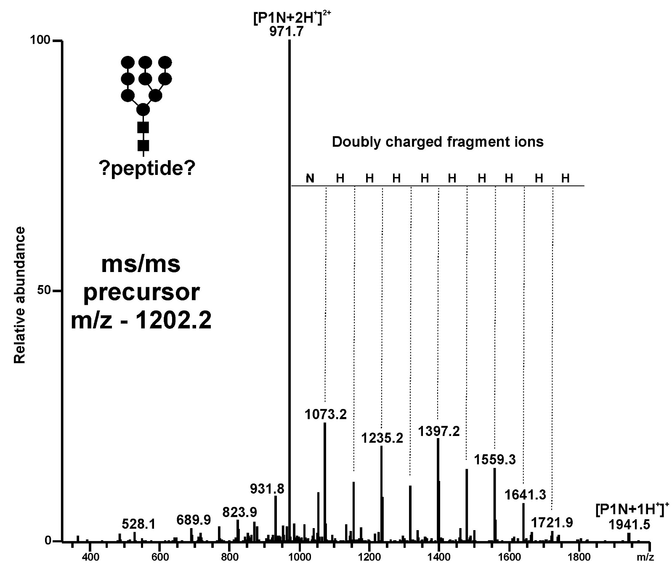
C7250
MS/MS from 1202.2 - – glycopeptide, type of glycan identified
from lecture of Petr Man
H – Hexose
N – HexNAc

Slide 92
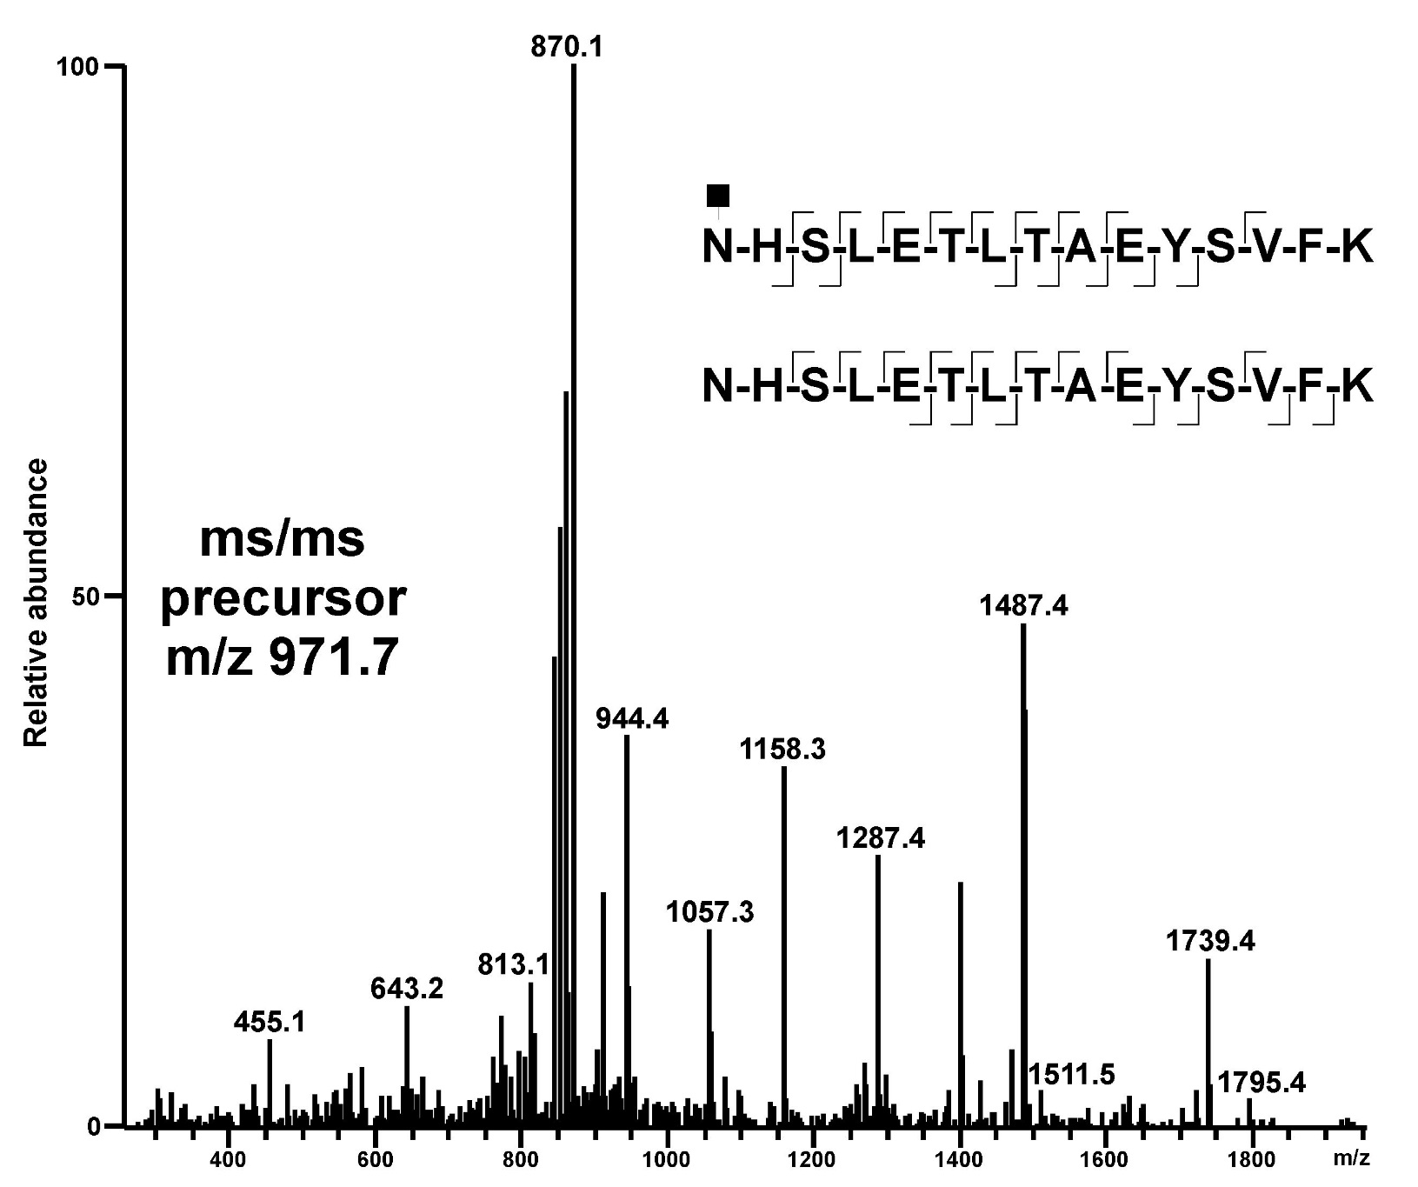
C7250
MS/MS from 971.7 – peptide with one HexNAc – site of glycosylation identified
from lecture of Petr Man
H – His
N – Asn
y₁₃
SLETLTAEYSVFK
b₂
N(HexNAc)H

Slide 93
C7250
^{MLRNVCPVLILLIIGATA}QDPTDVGEAFANVEWSVAELKRVLVMGVPRDCGELFLSGQNHSGVYNIYPYKDSLLPVSAYCDMETDGGGWTVFQRRGQFGNPVYYFYKKWADYAHGFGDPAKEYWLGNNVLHALTSDKAMSLRIEKNHSLETLTAEYSVFKVASEEEYFKINVGGYIGSK
GSDAFSIANGSMFTASDQDHDTYTNNCAVEFKG
AWYTSCHGSNLNGLNLNGEHPSYADGIEWSAR
GGSTGLYYYSYPNVEMKVRDAHFISRVADGRAS
from lecture of Petr Man

Slide 94
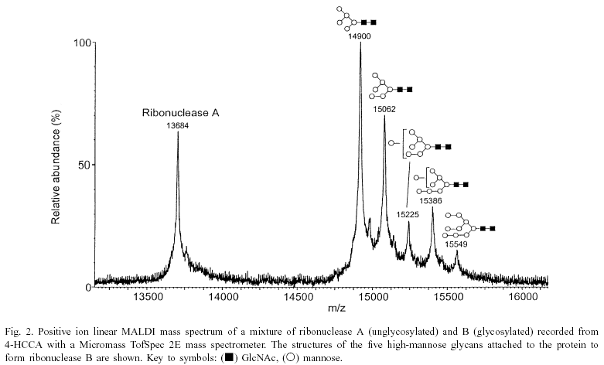
C7250
MALDI-MS spectrum of ribonuclease B
162 Da
163 Da
glycan

Slide 95
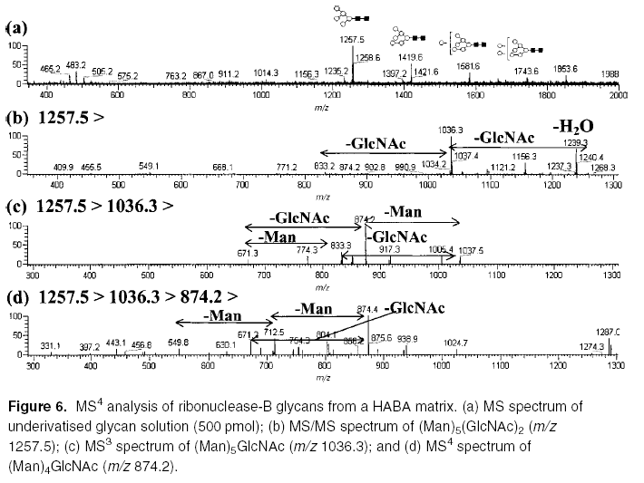
MSn of ribonuclease B glycans (AP-MALDI-IT MS)
C7250
MS
MS2
MS3
MS4

Slide 96
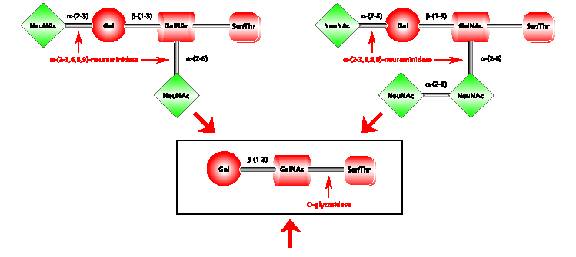
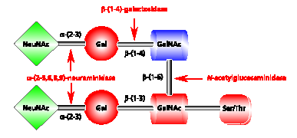
C7250
Combination of deglycosylation enzymes

Slide 97
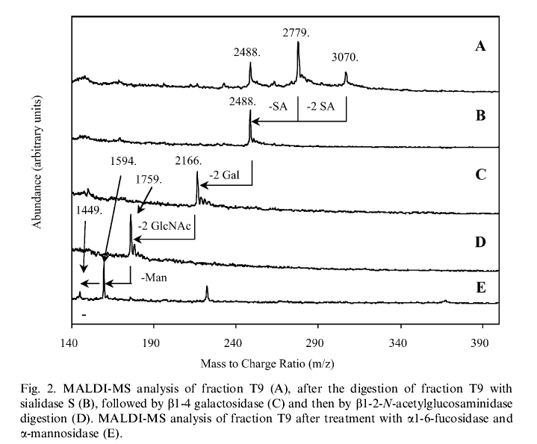
C7250
Sequential deglycosylation by different enzymes (MALDI-MS)

Slide 98
Glycan profiling and structural analysis of glycans
C7250
Lattová E. et al., J. Proteome Res., 15 (8), 2777-2786 (2016)
3x
4x
4x
5x
NSCLC - Bronchoalveolar Carcinoma
x10
4
1899.8
1.5
3x
5x
6x
Intens. [a.u.]
1.0
2264.9
0.5
2045.8
2191.8
2410.9
2630.0
2776.1
2995.2
3141.2
3360.3
3506.3
3871.5
4017.6
4090.5
3725.4
0
3x
Bronchoalveolar Adenocarcinoma
x10
4
1899.8
4x
5x
6x
6
3x
Intens. [a.u.]
2264.9
4
2630.0
2995.2
3360.3
3725.4
2
2118.8
2468.461
3141.2
4090.5
0
Large Cell Carcinoma
3x
4x
5x
3x
x10
4
2630.0
2776.1
3x
4
2410.9
4x
5x
2045.8
2264.9
2922.1
3
2557.0
MALDI-TOF-MS spectra of N-glycans after desialylation
Intens. [a.u.]
2118.9
2191.9
2
1899.8
2248.9
2395.0
3068.2
1954.8
2102.8
2467.9
2614.0
2703.1
2483.9
2760.1
3141.1
3287.3
3433.3
3506.3
3652.5
3798.5
4017.6
Man;
Gal;
GlcNAc;
Fuc
1
3944.5
4163.7
0
2000
2500
3000
3500
4000
m/z

Slide 99

And this is the end

