Slide 1
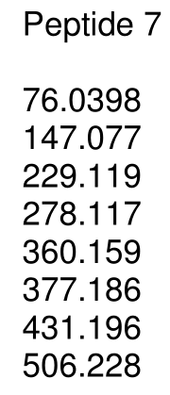
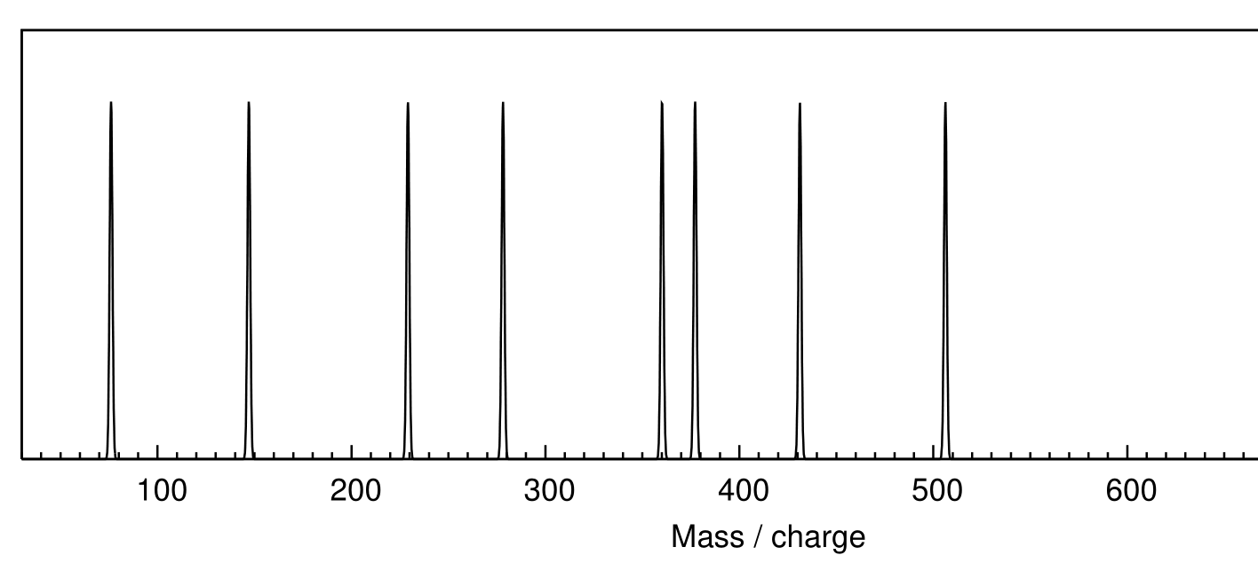
MS/MS sequencing example 1
75

Slide 2
MS/MS sequencing example 1
129

Slide 3
MS/MS sequencing example 1
E
y4
99.1
129

Slide 4
MS/MS sequencing example 1
E
V
y3
y4
49
99.1
129

Slide 5
MS/MS sequencing example 1
E
V
y3
y4
131
99.1
129

Slide 6
MS/MS sequencing example 1
E
V
M
y2
y3
y4
71
131
99.1
129

Slide 7
MS/MS sequencing example 1
E
V
M
A
y1
y2
y3
y4
71
131
99.1
129

Slide 8
MS/MS sequencing example 1
E
V
M
A
y1
y2
y3
y4
76
- 18
- 1
57
76
71
131
99.1
129

Slide 9
MS/MS sequencing example 1
E
V
M
A
G
y1
y2
y3
y4
57
71
131
99.1
129

Slide 10
MS/MS sequencing example 1
E
V
M
A
G
y1
y2
y3
y4
b4
75
57
71
131
99.1
129

Slide 11
MS/MS sequencing example 1
E
V
M
A
G
y1
y2
y3
y4
b4
71
75
57
71
131
99.1
129

Slide 12
MS/MS sequencing example 1
E
V
M
A
G
A
y1
y2
y3
y4
b4
b3
131
71
75
57
71
131
99.1
129

Slide 13
MS/MS sequencing example 1
E
V
M
A
G
M
A
y1
y2
b2
y3
y4
b4
b3
131
71
75
57
71
131
99.1
129

Slide 14
MS/MS sequencing example 1
E
V
M
A
G
M
A
y1
y2
b2
y3
y4
b4
129
+ 99
+ 1
229
b3
229
131
71
75
57
71
131
99.1
129

Slide 15
MS/MS sequencing example 1
E
V
M
A
G
E
V
M
A
y1
y2
b2
y3
y4
b4
b3
131
71
75
57
71
131
99.1
129

Slide 16
MS/MS sequencing example 1
E
V
M
A
G
E
V
M
A
y1
y2
b2
y3
y4
b4
b3
131
71
75
75
- 18
57
57
71
131
99.1
129

Slide 17
MS/MS sequencing example 1
E
V
M
A
G
E
V
M
A
G
y1
y2
b2
y3
y4
b4
b3
131
71
75
57
71
131
99.1
129

