Slide 1
Selective Catalytic Reduction
In Automotive
Zdeněk Král

Slide 2
Selective Catalytic Reduction …in general
Wide technique of NOx removal
Used everywhere, where NOx is produced (and undesired)
Used mainly for exhaust gases (chimneys, exhausts, …)
Selective
We can select which molecule will be reduced (NOx, CO, CO₂, SO₂)
Catalytic
Reaction needs to be catalysed.
Reduction
NOx to N₂

Slide 3
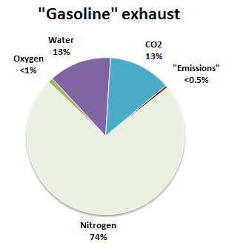
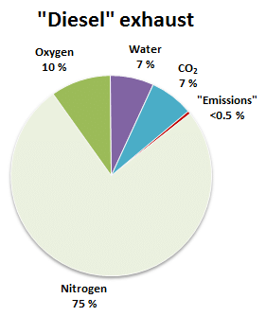
SCR in automotive
Reduction of NOx using reduction agent on a surface of solid catalyst in presence of oxygen
Summary equation: 4NO + 4NH₃ + O₂ → 4N₂ + 6H₂O
Other SCR reactions:
8NH₃+ 6NO₂ → 7N₂ + 12H₂O
… plus many side reactions 2NH₃ + NO + NO₂ → 2N₂ + 3H₂O „fast SCR“
Reduction agent
Needed for high conversion rates
NH₃, HC (hydrocarbons)

Slide 4
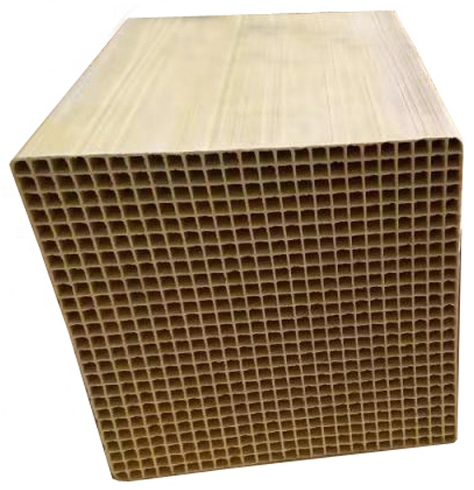
… a bit of History
SCR was developer for industrial applications
70s - applied in thermal power plants in Japan
Since 80s – widespread to Europe and USA
First mobile aplications (not powerplants)
90s Korean cargo ships (diesel engine = electric generator)
Reason for this application - similar application as in powerplants, steady state of engine operation

Slide 5
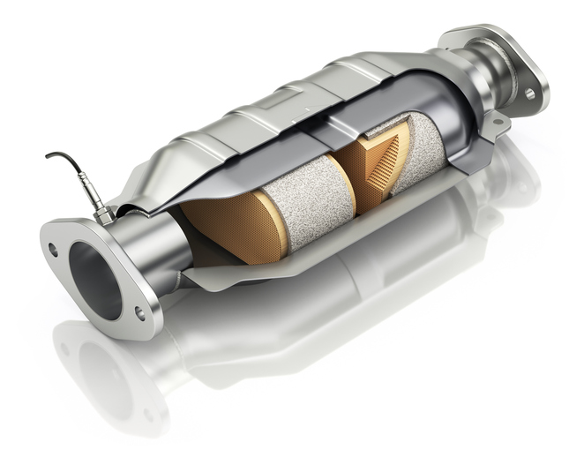
How does SCR catalyst look like?
Ceramics carrier with active substance
SiC, Cordierite
„Mate“
Heat resisting dense fibers
Spacer for thermal dilatation
Metal housing
Stainless steel
… of urea

Slide 6
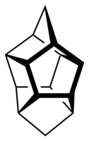
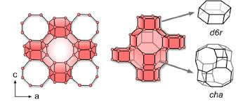
What is the active substance?
Several substances are catalytically active enough to be used for SCR
Cu and Fe zeolites (Cu-SSZ-13, Fe-ZSM5)
Metal oxides (V₂O₅)
… of urea

Slide 7
What is the mechanism?
Mechanism is strongly dependent on exact composition of the material

Slide 8
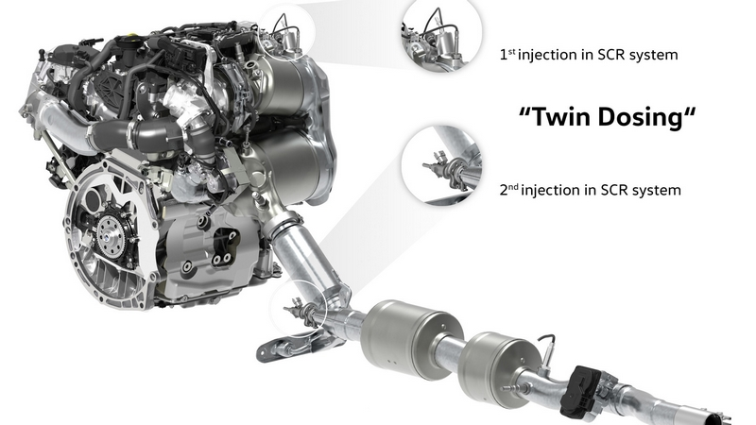
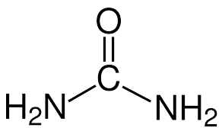
„State of the Art“
… of urea

Slide 9
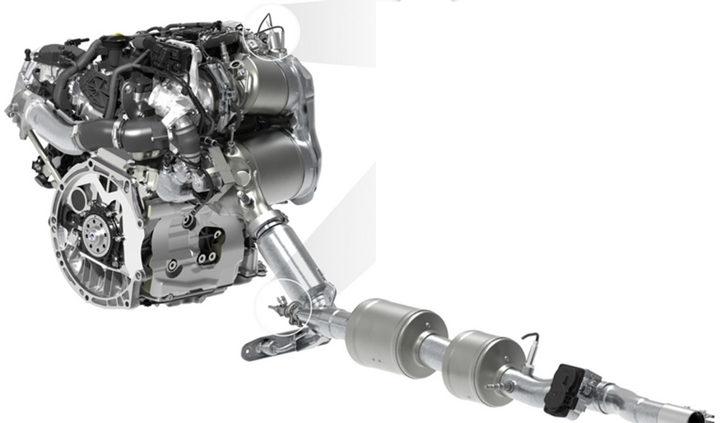
SCR in Automotive
Turbocharger
HOT END
Oxidation cat
DPF+SCR
SCR
ASC
COLD END

Slide 10
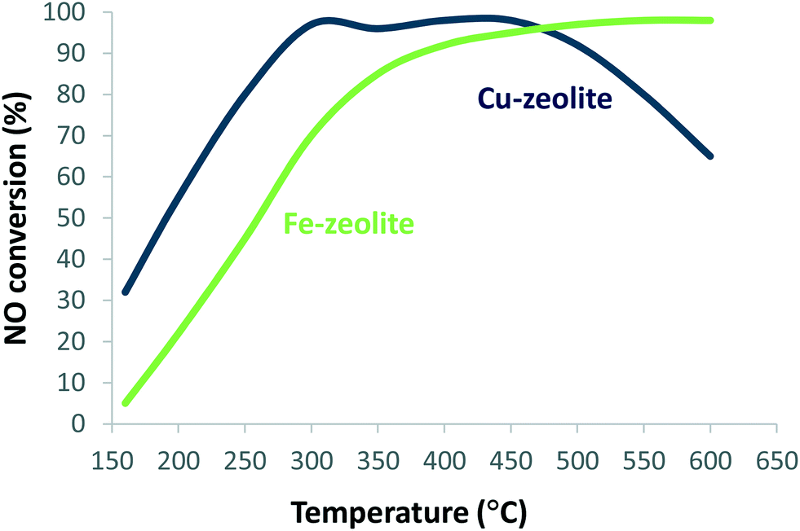
SCR in Automotive
ASC

Slide 11
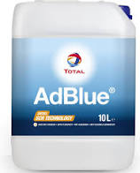
NH₃-SCR in Automotive
Injection of AdBlue (32,5 % solution of urea in distilled water)
Injection (200°C): H₂N-CO-NH₂ + H₂O → 2NH₃ + CO₂
1. hydrolysis: H₂N-CO-NH₂ + H₂O → NH₃ + HNCO
2. acid w. water: HNCO + H₂O → NH₃ + CO₂

