Slide 1
Heterogeneous catalysis (C9981)
Common Pitfalls of Catalysis Manuscripts Submitted to Chemistry of Materials

Slide 3

Active site/catalyst evaluation
Turn-over frequency (TOF; [s^{–1}])
= number of catalytic cycles performed by 1 active site per time unit
Precise numbers for homogeneous and enzymatic catalysis
Numbers for heterogeneous catalysis???
TOF [s^{–1}]
Hetero: ~1–100 s^{–1}
Homo: ~10–1000 s^{–1}
Enzymes: ~10000–1000000 s^{–1}

Slide 4
Active site/catalyst evaluation
Turn-over number (TON; [-])
= number of catalytic cycles performed by 1 active site before deactivation (~lifetime)
Precise numbers for homogeneous and enzymatic catalysis
Numbers for heterogeneous catalysis???

Slide 5
Common pitfalls - 1
Improper calculation of turnover frequencies (TOFs)
  Low conversion, early stage of the rxn
  Valid only for specific reactant concetration
Improper calculation of turnover numbers (TONs)
  A measure of catalyst’s stability
  Accurate determination requires measurements until the catalyst’s activity is completely lost

Slide 6
Common pitfalls - 2
Deactivation studies at full/equilibrium conversion
  Batch vs. continuous flow
  The available amount of reagents limit the conversion = the catalyst could be in fact more active
  Deactivation should be studied at intermediate conversions

Slide 7
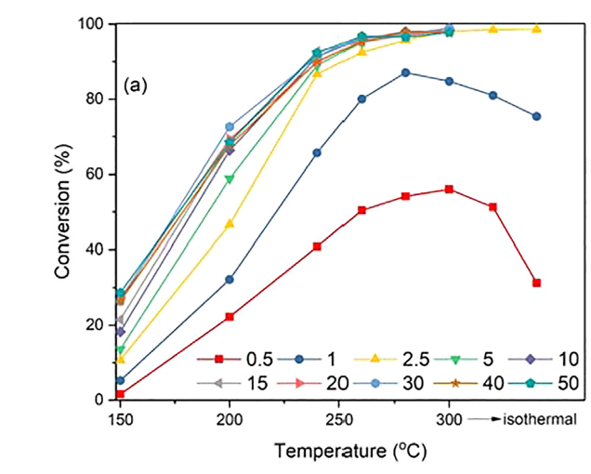
Common pitfalls - 2
Deactivation studies at full/equilibrium conversion

Slide 8
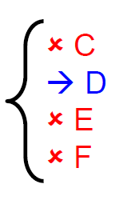
Active site/catalyst evaluation
Selectivity is ability of catalyst to form one product from a pool of products (possibly many)
Selectivity (S; [%])
= number of D molecules produced / R molecules converted
reactant R

Slide 9
Common pitfalls - 3
Comparison of selectivities at different conversion levels
  Selectivity does depend on conversion
  A→B→C
  Always compare at isoconversion

Slide 10
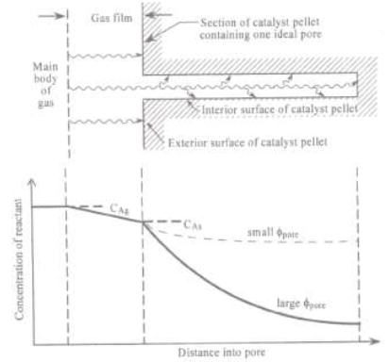
Diffusional limitation
Gradient of reactant concentration in
  Fluid film of particle (External diffusion)
  Inside the pore (Internal diffusion)

Slide 11
Common pitfalls - 4
Neglect of mass transfer (diffusional) limitations
  External (film) + Internal (pore) diffusion

Slide 12
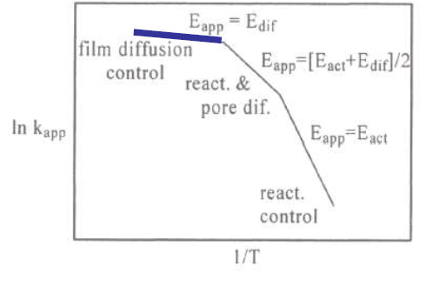
Rate determining step
High temperature
  The chemical reaction is fast
  There is no time for internal diffusion to take place, only external surface employed in catalysis
  Diffusional steps
  are limiting
  E_{app} = E_{a} of the diffusion
  in the fluid film
  (external diffusion)

Slide 13
Common pitfalls - 4
Neglect of mass transfer (diffusional) limitations
  Batch, both diffusions: stirring rates
  Continuous flow, external diffusion:
  Continuous flow, internal diffusion: particle size, pore volume, pore size

Slide 14
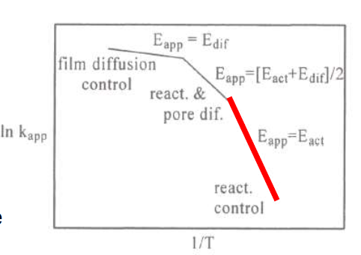
Diffusional limitations
Internal diffusional limitations always present to some extent
  We can diminish them at the time of catalyst preparation (pore volume, pore diameter, size of catalysts grains)
  Good practice is to compare a series of catalysts with similar pore volume, pore diameter, and size of catalysts grains
External can be avoided
at the time of catalytic
reaction
  Linear velocity of vector gas,…

Slide 15
Common pitfalls - 5
Failure to study the catalysts after reaction
  Catalysts can change dramatically during catalytic reactions
  Sintering, coking, pore collapse, poisoning,…
  It is not correct to justify the differences between the catalysts only based on the characterization of the starting material

Slide 16
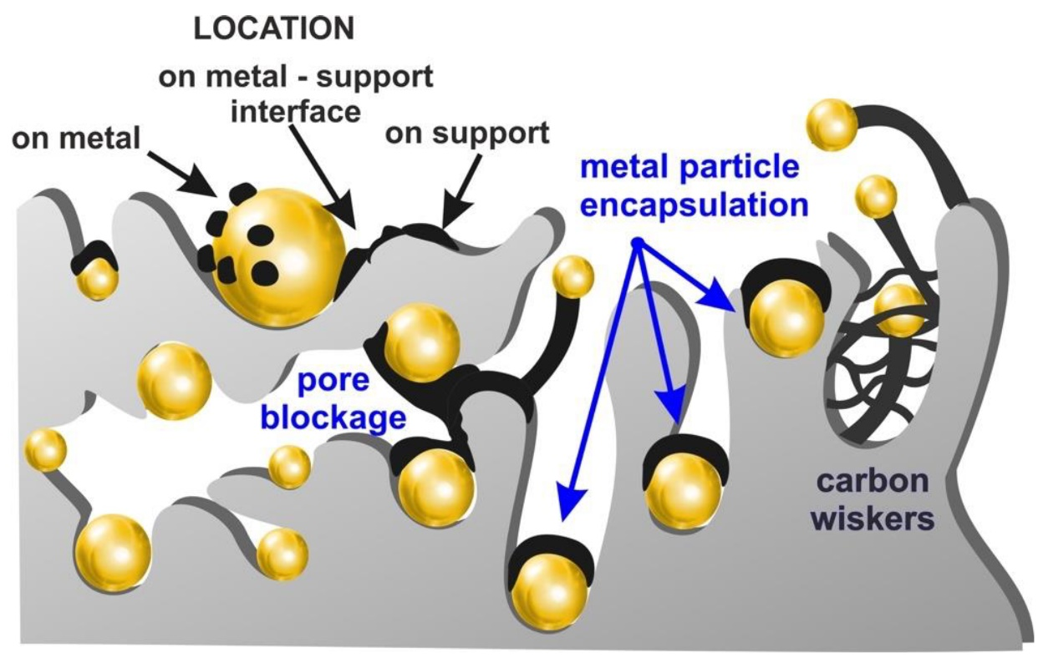
Common pitfalls - 5
Failure to study the catalysts after reaction
  Catalysts can change dramatically during catalytic reactions
  Coking

Slide 17
Common pitfalls - 5
Failure to study the catalysts after reaction
  Catalysts can change dramatically during catalytic reactions
  Sintering
Before cata
After cata

Slide 18
Common pitfalls - 6
Failure to consider differences in surface area of catalysts
  Catalytic activity scales with number of active sites
  Common sense: Number of active sites scales with the surface area
  Compare the activity of catalysts per m²

