Slide 1
BIOMARKERS AND TOXICITY MECHANISMS
03 – Mechanisms @proteins
Luděk Bláha, PřF MU, RECETOX
www.recetox.cz

Slide 2
Major mechanisms (modes of action) to be discussed in detail
Proteins and inhibition of enzymatic activities
Mitotic poisons & microtubule toxicity
Ligand competition – receptor mediated toxicity
Membrane nonspecific toxicity (narcosis)
Toxicity to membrane gradients
DNA toxicity (genotoxicity)
Complex mechanisms
  Oxidative stress – redox toxicity
  Defence processes as toxicity mechanisms and biomarkers - detoxification and stress protein induction
  Toxicity to signal transduction

Slide 3
Proteins and enzyme inhibitions
→ toxicity mechanisms

Slide 4
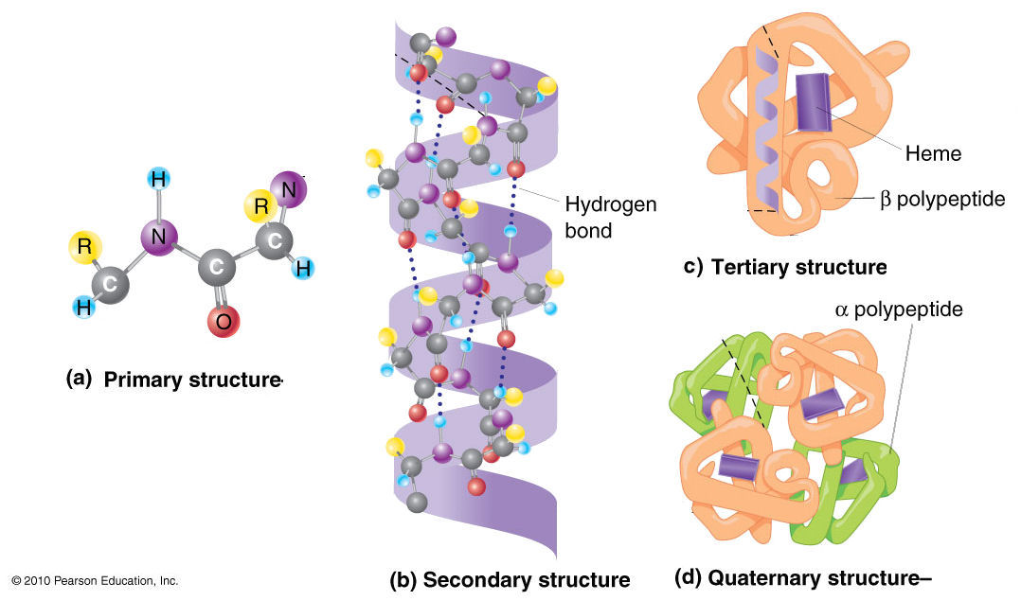
Proteins as targets to toxicants
Structure
– primary (sequence of aminoacids, AA),
- secondary, tertiary, quarternary (folding – important for functions)
Proteins - large/long – key target for number of toxicants!
= polypeptides - tens to thousands of AA
Peptides (small, “πεπτός, "digested“, 2x AA to e.g. 20x AA)
may have various functions (e.g. protective - glutathione)
Key functions of proteins
STRUCTURE and PROTECTION
CATALYSIS (enzymes)
TRANSFER (information and mass)
- receptors, channels, transporters
... student should know examples..

Slide 5
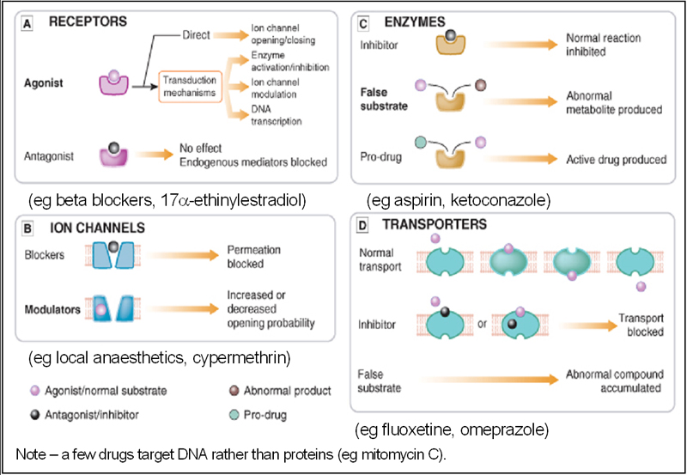
Overview - interactions of small molecules with proteins

Slide 6
CATALYTICAL PROTEINS = Enzymes
Catalysis - what is it?
... student should know
Thousands of enzymes (vs. millions of compounds)
  present in body fluids, membranes, cytoplasm, organelles..
  ... student should know key examples
Enzymology – science of enzymes
  includes also interactions of enzymes with small molecules (xenobiotics)

Slide 7
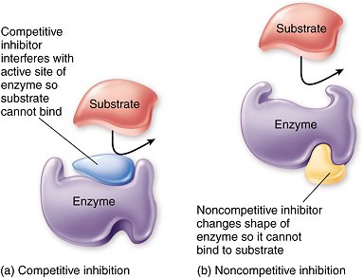
Enzymes vs toxicants
Interactions that make a chemical compound an enzyme (or protein) inhibitor
  Competitive vs. non-competitive
    active site vs. side domains
  Specific vs nonspecific
    affinity of the inhibition .... is determined by the effective concentration (lower the effective concentrations → higher the affinity)
  Nonspecific inhibitions
    Most of the chemical toxicants (!)
    Compound interacts
    with functional groups on
    the surface of the protein (reactive
    toxicity) or affects the environment
    (high osmomolarity, changing pH)

Slide 8
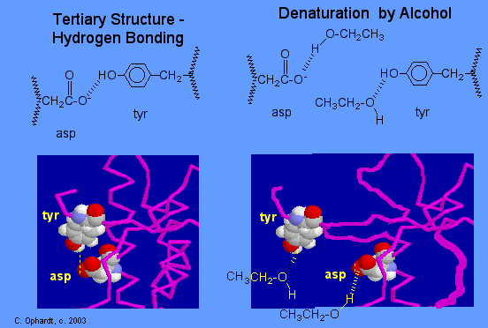
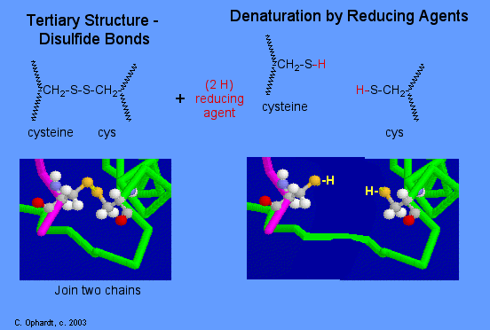
Non-specific interactions & denaturation
Most common interactions (and some examples)
Hydrogen bond disruption alcohols, amines
Ion bonds acids (COOH), alkalic compounds (amines)
toxic metals Hg⁺², Pb⁺², Cd⁺² , Ag⁺¹ Tl⁺¹,
carbonyls
S-S bonds toxic metals
See also http://www.elmhurst.edu/~chm/vchembook/568denaturation.html

Slide 9
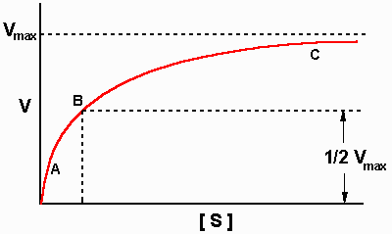
Kinetics of the enzyme reaction
(Michaelis Menten)

Slide 10
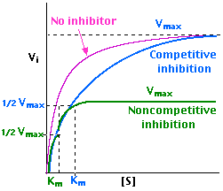
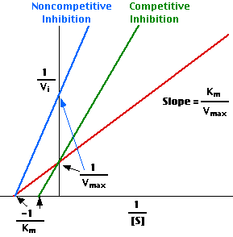
Michaelis Menten INHIBITIONS
The kinetics informs
about the nature of the interaction !

Slide 11
Enzyme inhibitions by toxicants – overview of key examples
Acetylcholinesterase (organophosphate pesticides)
Microsomal Ca²⁺-ATPase (DDE)
Inhibition of hemes – respiratory chains (cyanides)
d-Aminolevulinic Acid Dehydratase (ALAD) inhibition
(lead - Pb)
Inhibition of proteinphosphatases (microcystins)
Glyphosate (roundup) action
Enzyme inhibitions are beyond many other mechanisms
→ see e.g. CELL REGULATIONS etc.

Slide 12
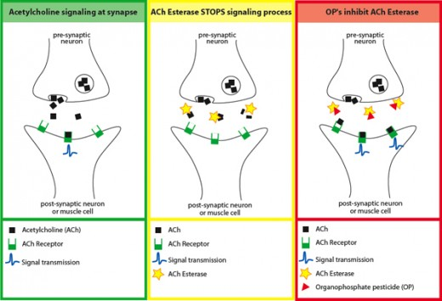
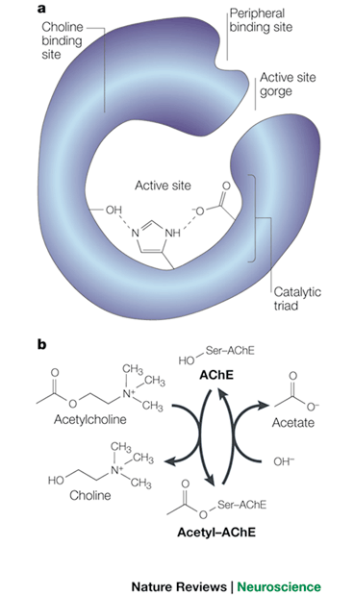
Acetylcholinesterase inhibition by organophosphates

Slide 13
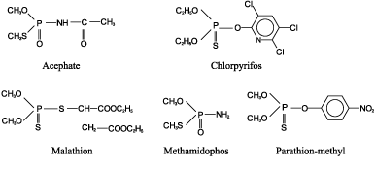
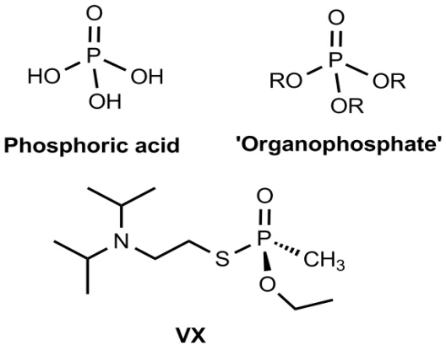
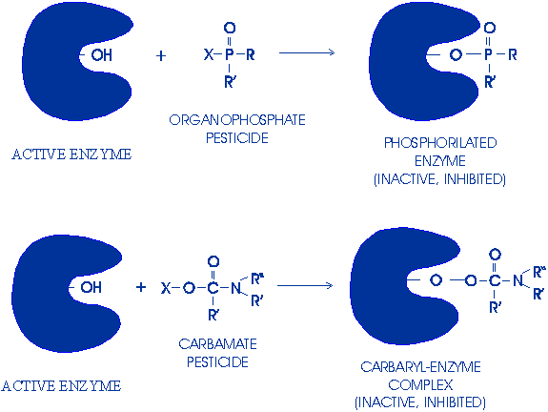
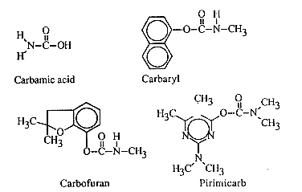
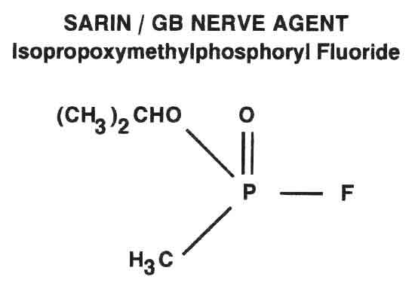
Acetylcholinesterase inhibition by organophosphates (and carbamates)
Insecticides - OPs
Nerve gases
Insecticides - Carbamates

Slide 14
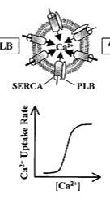
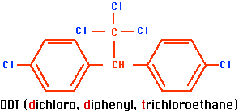
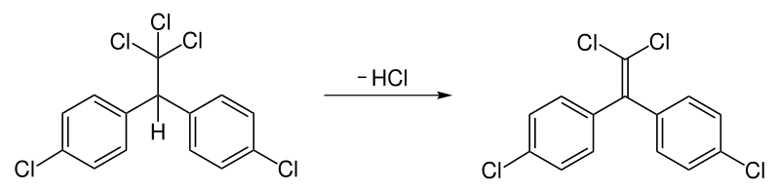
Inhibition of Ca²⁺-ATPase by DDE
Ca2+ in cells
* general signalling molecule (see later)
* stored in (endo-/sarcoplasmatic reticulum)
* assures contractility of muscles
* concentrations regulated by Ca²⁺-ATPase
DDE
→ calcium metabolism in bird eggs
→ egg shell thinning
DDE

Slide 15
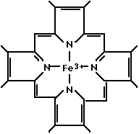
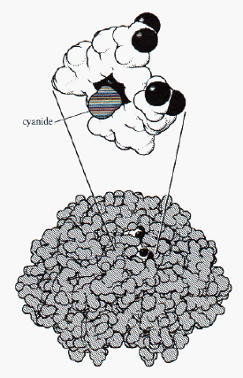
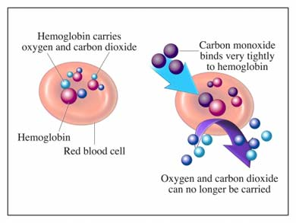
Inhibition of hemes – e.g. Haemoglobin, Mitchochondria, CYP450 etc.
(cyanide HCN, carbon monooxide – CO)

Slide 16
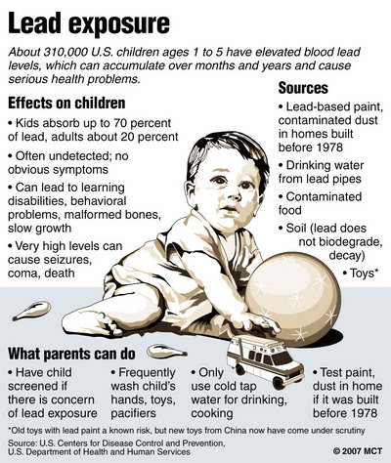
ALAD inhibition by lead (Pb)
Problem mostly in the USA
Ban of Pb-containg petrols

Slide 17
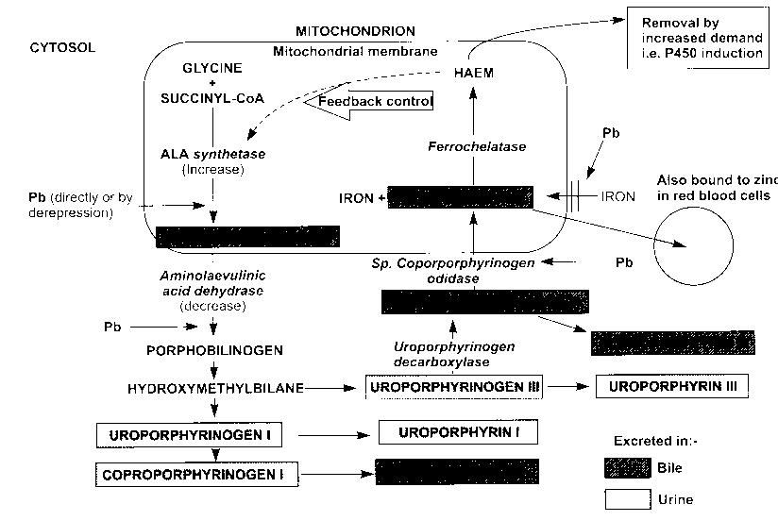
ALAD inhibition by lead (Pb) – inhibition of HAEM (!) synthesis

Slide 18
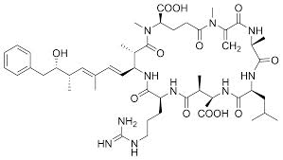
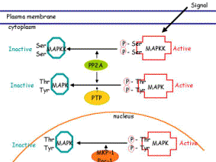
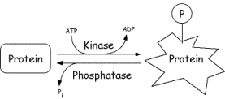
Inhibitions of PROTEINPHOSPHATASES by microcystins
Microcystins (7x AA – heptapeptides)
Cyanobacterial toxins produced in eutrophied waters (water blooms) up to tons/reservoir
PPases – signalling enzymes (see further)

Slide 19
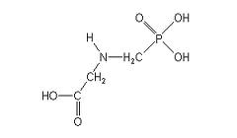
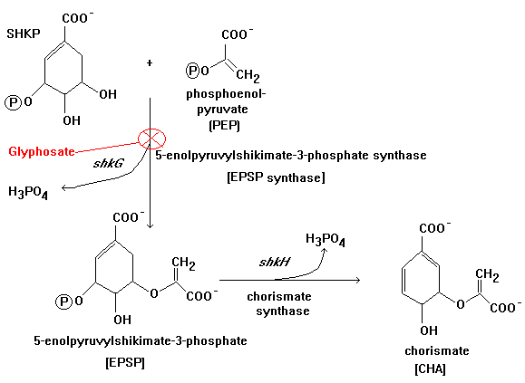

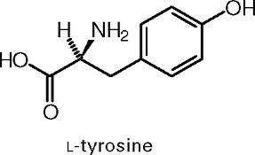
Glyphosate action
N-(phosphonomethyl)glycine
Broad-spectrum herbicide („RoundUp“)
Selective inhibition of ESPs 5-enolpyruvylshikimate-3-phosphate synthase;
(synthesis of aromatic AAs – Tyr, Trp, Phe)
Uptake via leafs - only to growing plants
„Non-toxic“ to other organisms (no ESPs in animals, AA-like chemical - rapid degradation)

Slide 20
Structural proteins (CYTOSKELETON) as target for toxicants

Slide 21
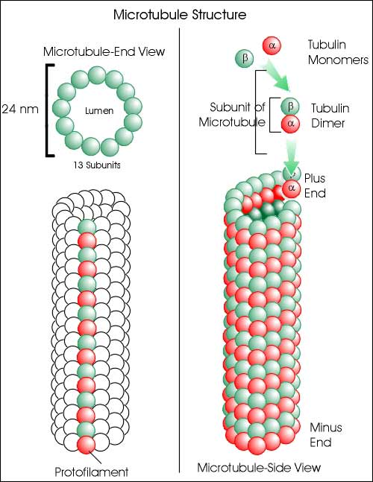
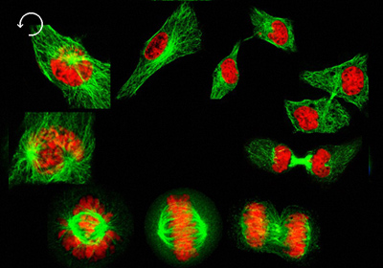
Structures of microtubules – dynamic de/polymerization
Visualization of microtubules during
cell division – separation of chromosomes

Slide 22
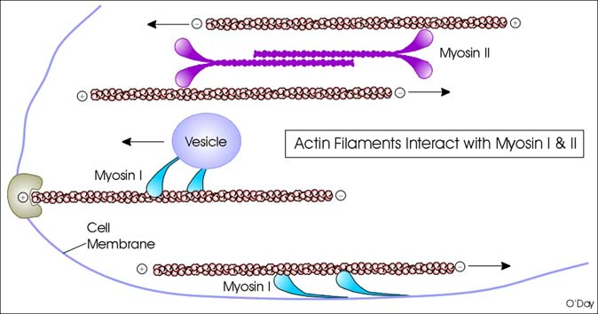
Structure of actin-myosin system

Slide 23
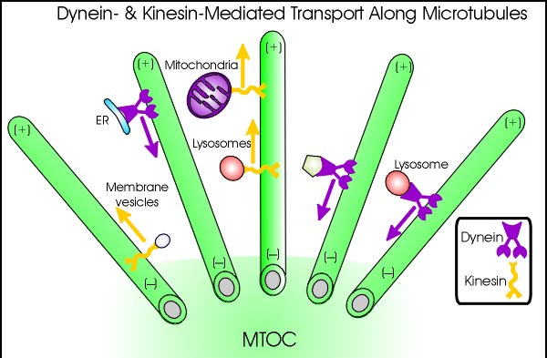
Cytoskeleton – functions
- intracellular transport
- cell replication and division (mitosis:chromosomes)
- muscle movement
- membrane (vesicles) fusion

Slide 24
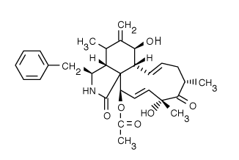
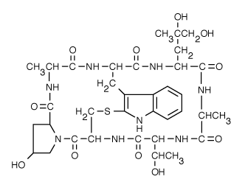
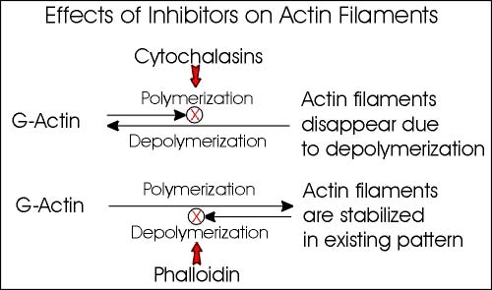
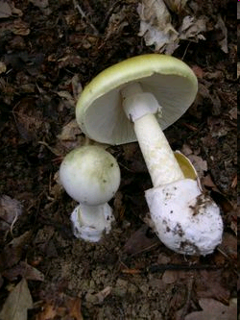
ACTIN – toxin effects on (DE)POLYMERIZATION
cytochalasin D
(fungal toxin)
Phalloidin
(death cap - Amanita phalloides)

Slide 25
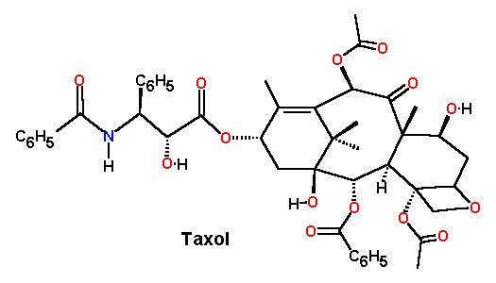
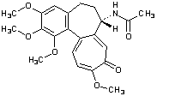

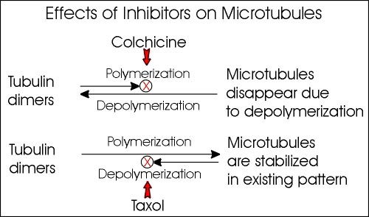
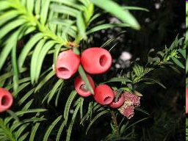
TUBULIN – toxin effects on (DE)POLYMERIZATION
Colchicine
taxol

Slide 26
Toxicity to RECEPTORs (key-lock) discussed later during the lectures: see „signalling“

Slide 27
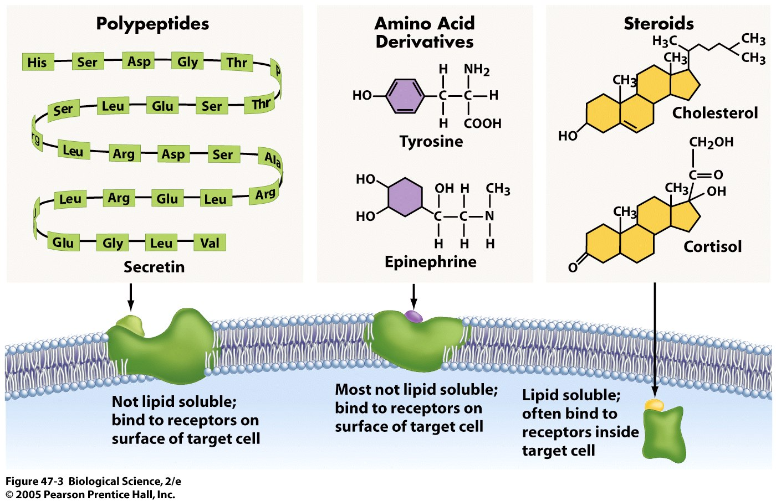
Various signalling types … now focus on nuclear receptors

