Slide 1
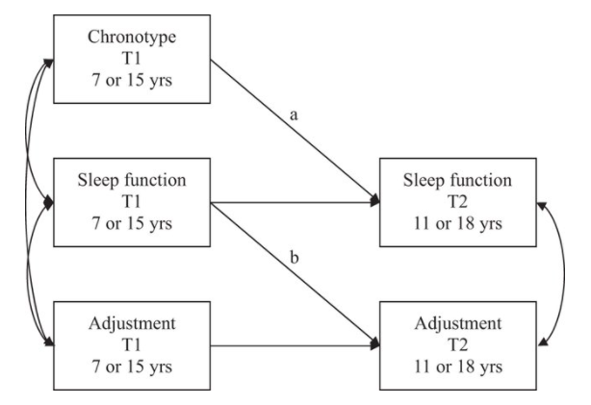
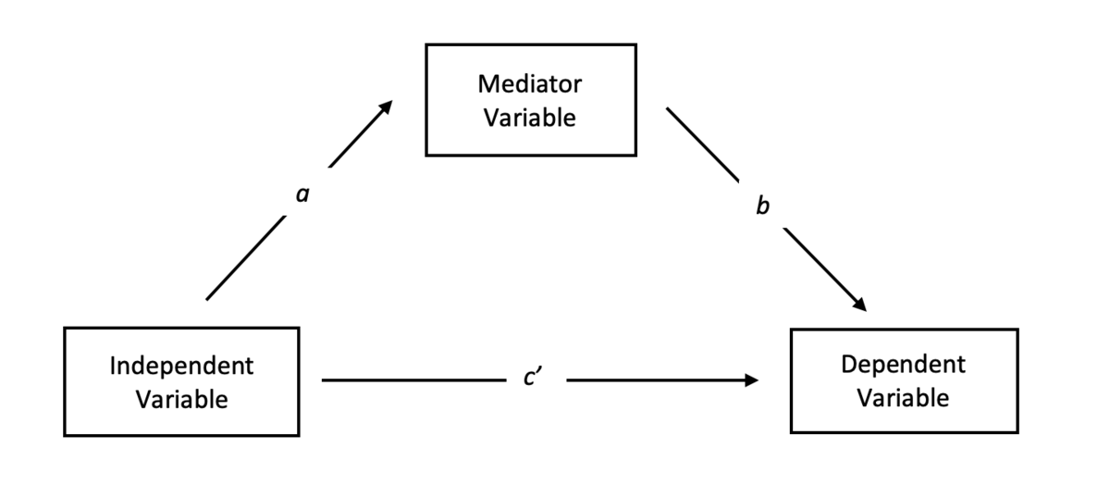
Mediation Analysis
E0420
Week 11

Slide 2
What is Mediation?
1. Conceptual issue
Hypothesis about the nature of the associations between variables
The relationship between exposure (X) and outcome (Y) can be explained by their relationship to a third variable (M)
Information about mechanism or process by which X and Y are linked

Slide 3
A Side Note - Mediation vs. Moderation
Mediator: middle-person, letter carrier, delivery agent
X→M→Y
Mediation answers questions about WHY or HOW a relation exists
Moderator: “changer”
variable that alters the strength of another relationship (i.e., an interaction!)
Moderation occurs when the effect of X on Y depends on Z
Moderation answers questions about for WHOM or WHEN a relation exists
Mediation can be moderated

Slide 4
What is Mediation?
There is relationship between X and Y (c path)
X (a path) and Y (b path) are also related to a third variable – mediator variable (M)
The relationship between X and Y is changed (attenuated) after including M into the model (c‘ path)
Perfect mediation occurs when c‘ path drops to 0
a, b, c, and c‘ represent B or β regression coefficients
Total effect
Indirect effect
Direct effect
Notes:
Picture from: Burgos Ochoa, L., Rijnhart, J.J., Penninx, B.W., Wardenaar, K.J., Twisk, J.W., & Heymans, M.W. (2019). Performance of methods to conduct mediation analysis with time‐to‐event outcomes. Statistica Neerlandica.

Slide 5
Real-life Example
Vazsonyi, A. T., Ksinan Jiskrova, G., & Ksinan, A. J. (2018). Sleep, low self-control, and deviance: Direct and indirect links across immigrant groups and socioeconomic strata. Journal of Adolescence, 68, 40-49.

Slide 6
What is Mediation?
2. Regression-based statistical procedure
Series of regression analyses/complex regression used to test the magnitude and significance of paths in our conceptual/hypothesized model
PROCESS macro for SPSS (OLS regression)
Structural equation modeling (SEM) approach (ML estimation)

Slide 7
Mediation Analysis Baron & Kenny (1986)
Traditional approach to testing mediation (“causal steps”)
1. Test the association between X and Y (path c)
2. Test the association between X and M (path a)
3. Test the association between X and Y, controlling for M (paths b and c’). B path must be sig. and c’ must be less than c
In the classic approach, mediation criteria are met when c’ is not significant
Notes:
Picture from: https://data.library.virginia.edu/introduction-to-mediation-analysis/

Slide 8
The problem with Traditional Approach
In the classic approach, mediation criteria are met when c’ is not significant
In practice, this rarely happens
Does it mean that there is no mediation?
How much of an effect there has to be to conclude that mediation is occuring?
More modern approaches test whether there is a significant indirect effect
The association between the X and Y that goes through M
The product of paths a and b in our model (a*b)

Slide 9
Partial vs. Full Mediation
In full mediation, adding M to the model predicting Y makes the association between the X and Y non-significant
Thus, M fully accounts for the association between X and Y
In partial mediation, there is a significant indirect effect, but the remaining direct effect is still significant
Thus, M is only one reason that the X is related to the Y (Which is OK!)
The determination between them is solely whether c’ is significant or not

Slide 10
Sobel (1982)
The most common test of the significance of the indirect effect is a z test developed by Sobel:
Where a and b are the estimates of the paths involved in the indirect effect, and s²_{a} and s²_{b} are the variance of the a and b paths

Slide 11
The problem with Sobel
The Sobel (1982) test assumes that the test statistic it produces follows a normal distribution (the z distribution)
Unfortunately, it does not
The indirect effect does not; nor does any product of two regression coefficients
What this means is that the significance test (or any CI we compute) will be inaccurate

Slide 12
Solutions
MacKinnon and colleagues (2002)
The statistic follows a gamma distribution, the shape of which depends on the values of a and b
MacKinnon’s test statistics performs well but it is unnecessarily complicated
Shrout and Bolger (2003)
Applied bootstrapping technique to the study of mediation
Bootstrapping turned out to be the best approach developed so far

Slide 13
Bootstrapping
Bootstrapping is a resampling method
Take a sample of size N
Randomly draw from this sample (WITH REPLACEMENT) another sample of size n
For this new (bootstrap) sample, compute the statistic of interest (e.g., the indirect effect a*b)
Repeat about 1000 times
Use the 1000 estimates of the indirect effect to compute a CI

Slide 14
Bootstrapping
The CI is computed by ordering all 1000 estimates from lowest to highest
You can then figure which one marks the bottom 2.5% (that would be the 25th value in your ordering)
This is the lower limit of the CI
The upper limit would be the 975th value in your ordering
Because the CIs are computed this way, it makes no assumptions about the shape of the distribution (it’s nonparametric)
Note this only works if your sample is representative

Slide 15
Testing Mediation Effect (with bootstrapped CIs)
PROCESS macro for SPSS
Preacher and Hayes have developed macros for SPSS, SAS, and R that will bootstrap the indirect effect
Free for download: https://www.processmacro.org/index.html
Structural equation modeling (SEM) software
R (Lavaan package - https://lavaan.ugent.be/), Mplus, STATA, AMOS
SEM approach uses different estimation method than PROCESS macro and is more versatile

Slide 16
Conceptual Considerations
Mediation is key to developing and testing theoretical models
Correlation does not imply causation STILL APPLIES!
Establishing causality is a methodological issue, not a statistical one
Mediation is best tested with longitudinal or experimental data
Experimental manipulation of the mediator
Temporal sequence

Slide 17
Mediation with Cross-sectional Data
Good theory behind the hypothesized direction of the paths needed
Support for each of the hypothesized paths
Test of competing hypotheses/models
Bidirectional associations
Reverse direction of the effect

Slide 18
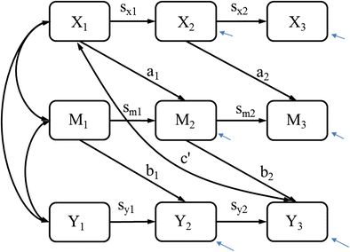
Longitudinal and Half-longitudinal Mediation Model
Explicitly models change in both Y and M
Permits experimental manipulation of both X and M
Wu, W., Carroll, I. A., & Chen, P. Y. (2018). A single-level random-effects cross-lagged panel model for longitudinal mediation analysis. Behavior research methods, 50(5), 2111-2124.
Ksinan Jiskrova, G., Vazsonyi, A. T., Klánová, J., & Dušek, L. (2019). Sleep quantity and problems as mediators of the eveningness-adjustment link during childhood and adolescence. Journal of youth and adolescence, 48(3), 620-634.
Notes:
Parenting example

Slide 19
The Term Mediation
The term mediation is sort of a loaded word, because there is so much controversy about the best method
For many, you cannot use “mediation” unless you follow the traditional Baron & Kenny (1986) approach, or at least if all the steps have been conducted in some way
Some of the controversy regards the first step, whether you can find a direct association between X and Y
For others, the term mediation should only be applied for longitudinal or experimental data
When full criteria for mediation have not been met, use alternative terms instead of „mediation“ (indirect effect, mechanism, etc.)

Slide 20
Mediation Write-up
To analyze whether the association between cyberbullying victimization and cybergrooming victimization was mediated by self-esteem, a mediation model was tested. Results revealed both significant direct effects of cyberbullying victimization on self-esteem (B = -0.149, p < .001, 95% CI [-0.19, -0.11]) and on the likelihood of experiencing cybergrooming victimization in the past (OR = 2.45, p < .001, 95% CI [2.02, 2.96]). Additionally, higher self-esteem decreased likelihood of ever being cybergroomed (OR = 0.77, p = .021, 95% CI [0.61, 0.96]). The indirect effect of cyberbullying victimization on cybergrooming victimization through self-esteem was small, but statistically significant (B = 0.04,95% bootstrapped 95% CI [0.01, 0.09]). In the mediation analysis, we controlled for age, sex, and dichotomized nationality (Western vs. Southeast Asian country, Figure 1).
Wachs, S., Ksinan Jiskrova, G., Vazsonyi, A. T., Wolf, K. D., & Junger, M. (2016). A cross-national study of direct and indirect effects of cyberbullying on cybergrooming victimization via self-esteem. Psicologia educativa, 22(1), 61-70.

