Slide 1
Multiple (hierarchical) regression
E0420
Week 8

Slide 2
Multiple (linear) regression
Uses more than one explanatory/independent variable
Y_{i} = β₀ + β₁X₁ + β₂X₂ …+ β_{n}X_{n} + ε
The estimates now reflect the relationship accounting for the effect of other variables (conditional effect – partial regression coefficient)
Multiple regression also accounts for the correlation between the IVs

Slide 3
IV 1
β₁
DV
r
β₂
IV 2

Slide 4
Example
y = B₀ + 983x₁ + 122x₂ + e
For any given level of x₂, when there is a one unit increase in x₁ then y will increase by 983

Slide 5
Assumptions
Just like simple regression
Linear relationship
Normally distributed residuals
Independent residuals
Homoscedasticity
AND
Absence of multicollinearity – independent variables should not be highly correlated with each other

Slide 6
Multicollinearity
When IVs are too intercorrelated
r ~ 0.70 and more
The model as a whole still “works”, but the estimates for individual predictors cannot be trusted
Large SEs (non-significant estimates), improbable Bs (too high, different sign)
Diagnostics
Variance inflation factor (VIF) – how much the variance is inflated due to multicollinearity
Tolerance (1/VIF)

Slide 7
Hierarchical linear regression
Enter the IVs in steps (models)
Steps can include 1 or more IVs
Order of entry – variable is entered after the variables that might be source of spurious relation have been entered
Typically: control variables first, the variable of interest last

Slide 8
Example
H1: happiness will be related to number of pets
Model 1:
Happiness = intercept + gender + age
Model 2:
Happiness = interecept + gender + age + number of friends
Model 3:
Happiness = interecept + gender + age + number of friends + number of pets
https://data.library.virginia.edu/hierarchical-linear-regression

Slide 9
R² change
The total % of variability in DV explained by IVs
We can assess the incremental R² of each Model (step)
The F-test is used to statistically assess the change in model R² after adding more variables
Sometimes the IV estimate (B) is significant but the R² is not
The effect of the IV might be spurious

Slide 10
Interactions
Used for testing moderation
When two variables affect the DV beyond their additive effect
Y = β₁X₁ + β₂X₂ + β₃X₁X₂
The interaction term should be entered in a separate step

Slide 11
Adjusted R²
R² either increases or remains the same (if it decreases, you have a problem!)
Selecting a model based on R² would then always prefer the model with more predictors
Adjusted R² takes into account the number of predictors entered and increases only when the variables explain meaningful amount of variance

Slide 12
Stepwise regression
Not to be confused with hierarchical linear regression
The order of variables entered is selected by the computer to maximize the R² at each step
Forward selection, backwards elimination, bidirectional
Atheoretical, might be too dependent on the specific sample (cannot be reproduced), capitalizing on chance

Slide 13
Plotting
Cannot be easily plotted due to the fact that there can be only one X variable
Plotting can use grouping variable (e.g., sex)
For interactions
Plot the focal variable (with partial coefficient)

Slide 14
Two IVs
https://aegis4048.github.io/mutiple_linear_regression_and_visualization_in_python

Slide 15
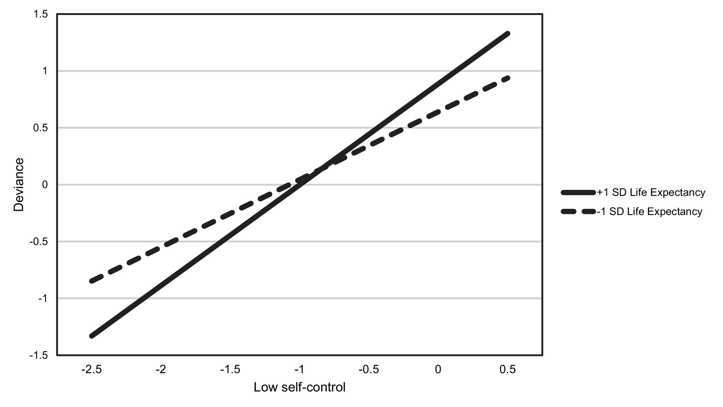
Interaction
Vazsonyi, A. T., Ksinan, A. J., & Javakhishvili, M. (2021). Problems of cross-cultural criminology no more! Testing two central tenets of Self-Control Theory across 28 nations. Journal of Criminal Justice, 101827.

Slide 16
Write-up
The results of multiple regression analysis showed that both age (β = .12, p<.001) and extraversion (β = .56, p<.001) were significant positive predictors of aggressive tendencies. The full model explained 35.8% of the variance (F(2,55)=5.56, p<.01) .

