Slide 1
Introduction to the ‘-omics’
Elliott J. Price

Slide 2
Outline
What are the ‘omics’?
Common ‘-omics’ technologies
Multi-omics in environmental chemistry

Slide 3
What is “-omics”?
Layer 3
Layer 2
Layer 1
Part 3.2
Part 3.3
Part 3.1
Systematic and comprehensive analysis [of a cellular/ molecular layer]
i.e. a subset of [molecular] phenotyping
Part 2.1
Part 1.1
Part 1.2

Slide 4


Phenotype
Phenotype = characteristics [traits]
displayed by an entity [organism]
Phenotype is dynamic i.e. changes over time [development]
Further material: 10.1006/jtbi.1996.0335

Slide 5
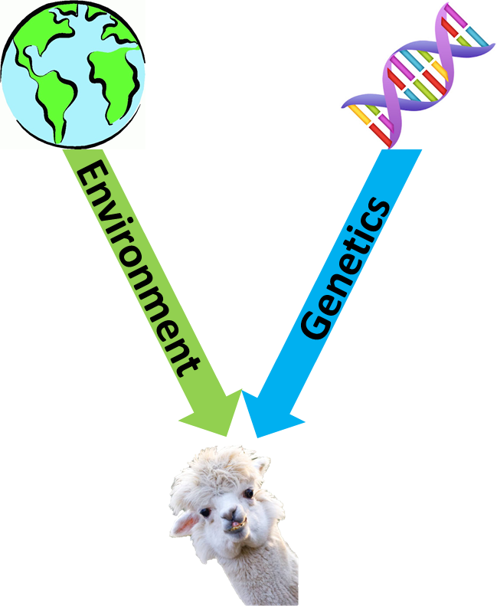
Nature and nurture
Phenotype is the results of genetics & environment
GxE
i.e. need to understand:
Genotype
Environment
Genotype x Environment interaction (GxE)
Further material: Nature via nurture

Slide 6
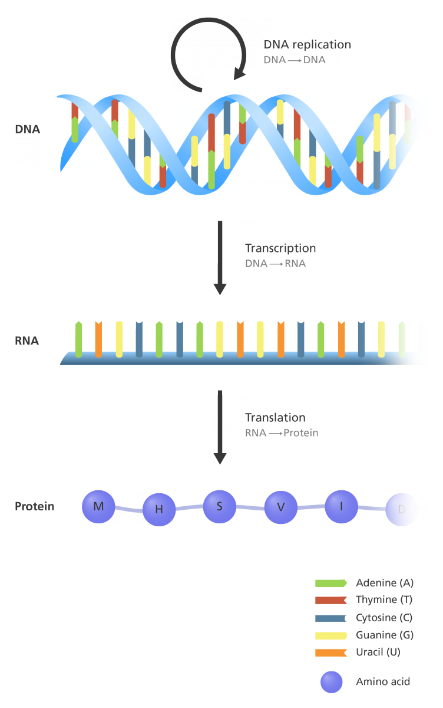
Central dogma of molecular biology
Instructions
Genome = all inherited genetic material [DNA] of an organism
Transcriptome = all the transcribed genetic material [RNA] of an organism i.e. all expressed genes
Messenger
Proteome = all the proteins/peptides of an organism i.e. all translated genetic material
Functional product
Image: Genome Research Limited

Slide 7
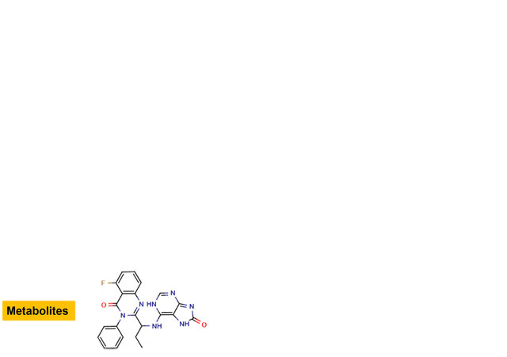
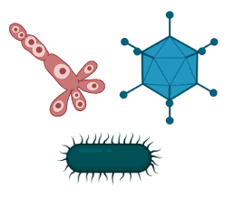
Additional layers of molecular biology
Metabolome = all the metabolites (small molecules) of an organism i.e. all small substances active in cellular processes
Microbiome = all the microorganisms [in direct contact with an organism]
each with their own genes-to-functions
Microorganisms
Image: Biorender

Slide 8



Functional genomics - driven analysis
g₁
g₂
g₃
Genome
t₁
t₂
t₃
Transcriptome
p₁
p₂
p₃
Proteome
met₁
met₂
met₃
Metabolome
mi₁
mi₂
mi₃
Microbiome
phe₁
phe₂
phe₃
Phenotype development
Further material: https://youtu.be/D-Ljd5Uex0s
Online course: 10.6019/TOL.FunGenI-c.2016.00001.1

Slide 9

What is the environment?
Image: iStock by Getty images

Slide 10
Environmental exposure and the exposome
Environmental exposure: contact between an external factor (agent) and an entity.
Contact occurs at an [exposure] interface. Agent includes [external] psychosocial factors. The entity is any subject experiencing contact. A single exposure event is a continuous contact (exposure period).
Exposome: the totality of environmental exposures

Slide 11
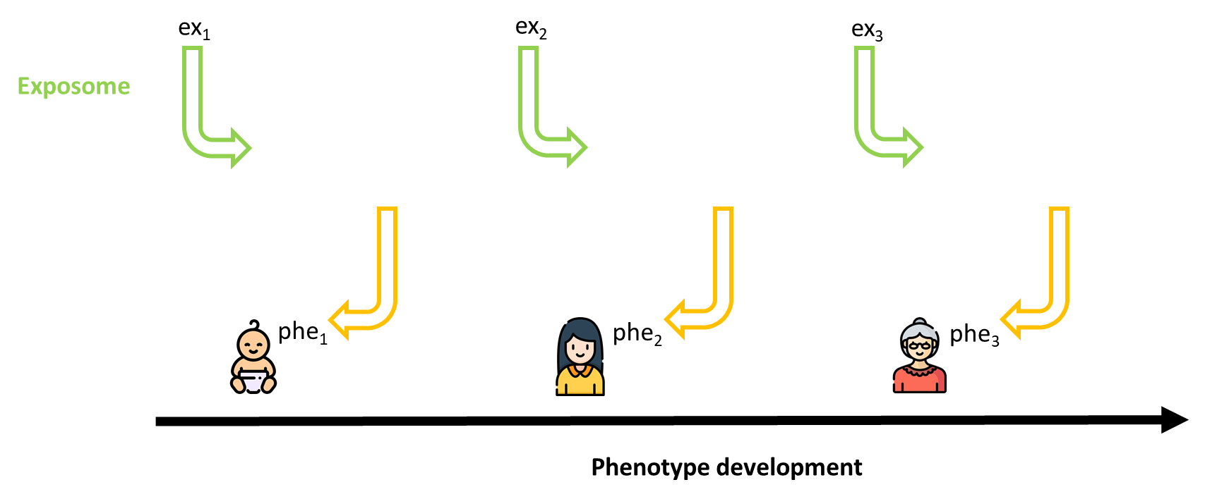
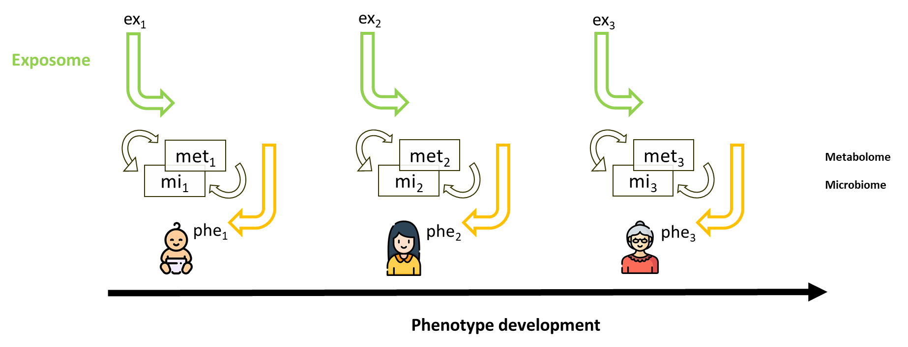
Functional exposomics
Environment-to-phenotype mapping?
Further material: 10.1073/pnas.1903232116

Slide 12
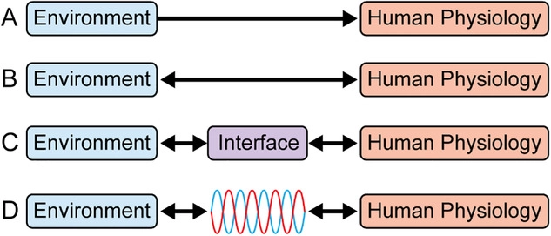
Biodynamic interfaces & GxE measurement
Entity
Entity
Modified from: 10.1002/bies.202000017
GxE interaction – need to understand both sides equally
Further material: https://youtu.be/XeyjeZeyo4o

Slide 13
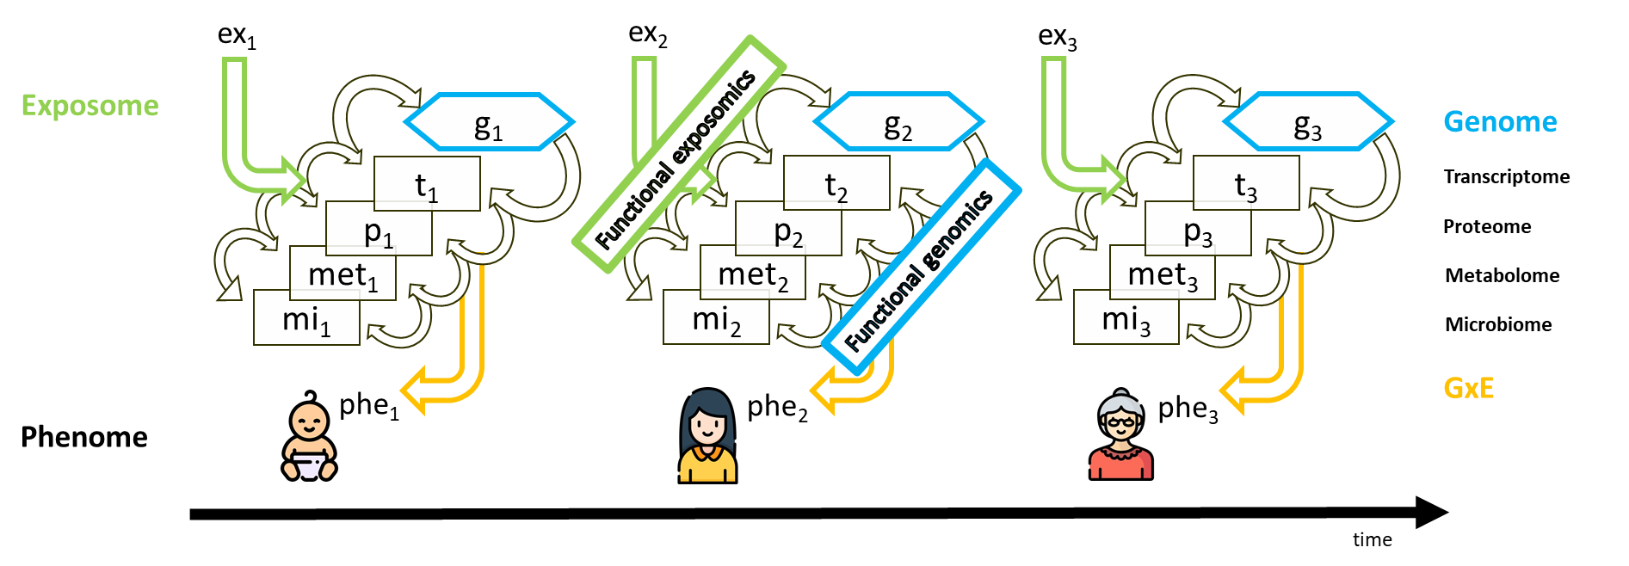
Multi-omics analysis
Further material: https://doi.org/10.5281/zenodo.5579746

Slide 14
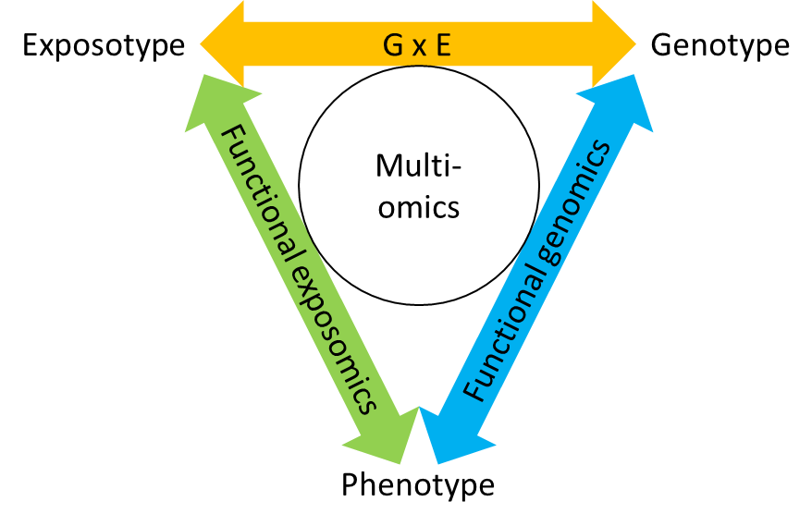
Multi-omics integrated framework
“More extensive characterization of the exposome and integration with molecular multi-omics profiling is set to advance the factoring of phenotypic variance into genetic and environmental components. Studying their interplay places
genotype-environment interaction at the center of integrative biology towards deepening our understanding of phenotype development and adaptation to further personal, population and ecosystem health.”

Slide 15
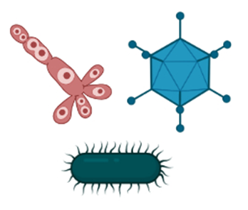
Consideration for ‘omics’ analysis
Hypothesis or observation?
Which layer(s)?
Environmental influence
Temporal stability
Metabolites
Microorganisms

Slide 16

High-throughput technologies - NGS
Next-generation sequencing (NGS)
Measure genetic material (i.e. DNA, RNA, [microbiome])
Measured via physical properties (e.g. optical fluorescence / electro-conductivity)
Image: LabManager
Online course: 10.6019/TOL.FunGenII-c.2016.00001.1

Slide 17
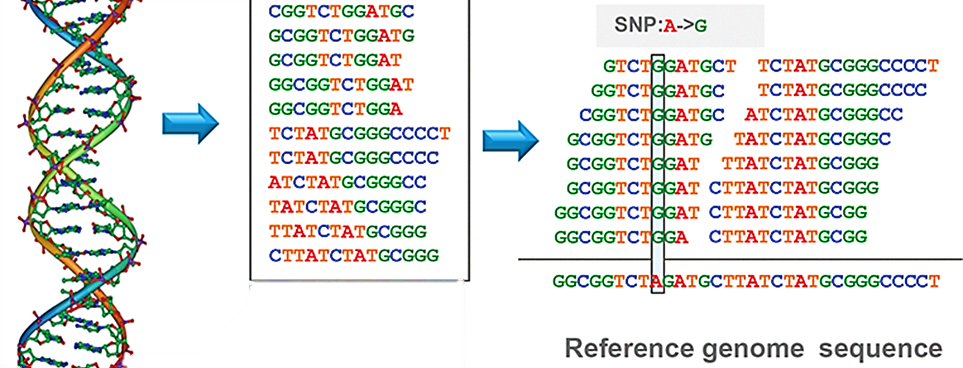
High-throughput technologies - NGS
Image from DOI: 10.5772/66732
What genetic material are present?

Slide 18
High-throughput technologies - NGS
Short reads
Relatively affordable
Accurate base-pair identifications
Difficult to assemble / map to scaffold
Long reads
Relatively expensive (~5 times more)
Less accurate base-pair identification
Easy to assemble / map to scaffold
Further material: 10.1038/s41576-021-00367-3
How much genetic material is active (expressed)?
Typically achieve relative amounts
Absolute quantification is possible, otherwise use [RT]-qPCR

Slide 19
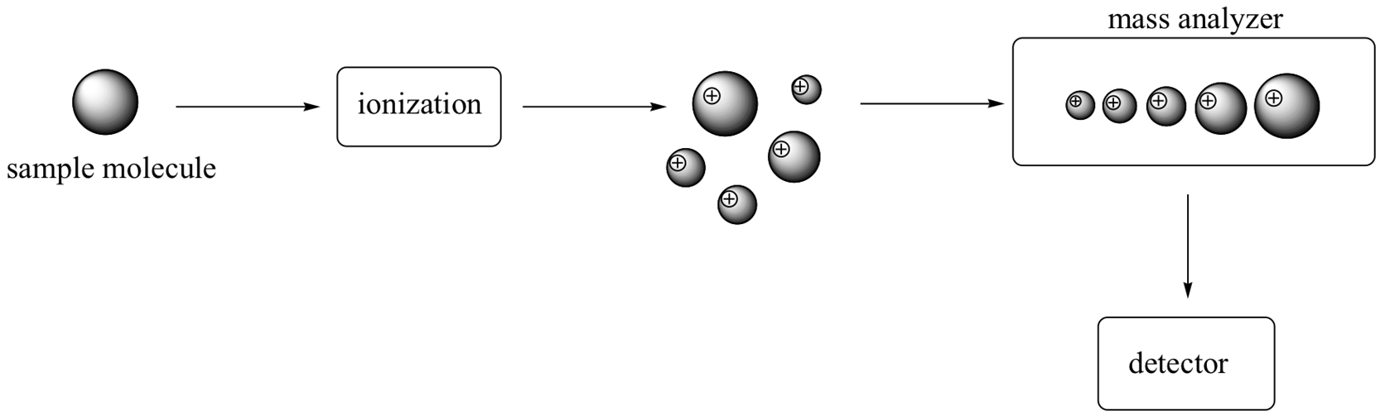
High-throughput technologies - MS
Mass Spectrometry (MS)
Measure electromagnetic properties (mass-to-charge ratio [m/z]) of ions to calculate mass & elucidate structure
Widely applied for peptide/proteins & small molecules

Slide 20
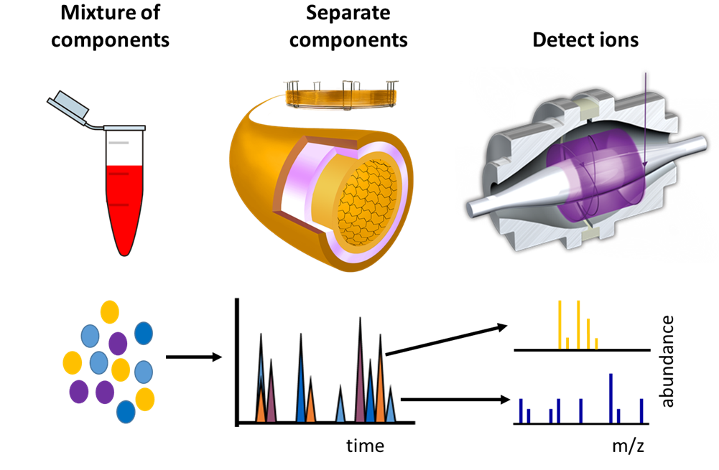
High-throughput technologies – MS coupling
MS is often preceded by chromatography
Major approaches are:
  Full-scan (non-target)
  Selective (target)

Slide 21
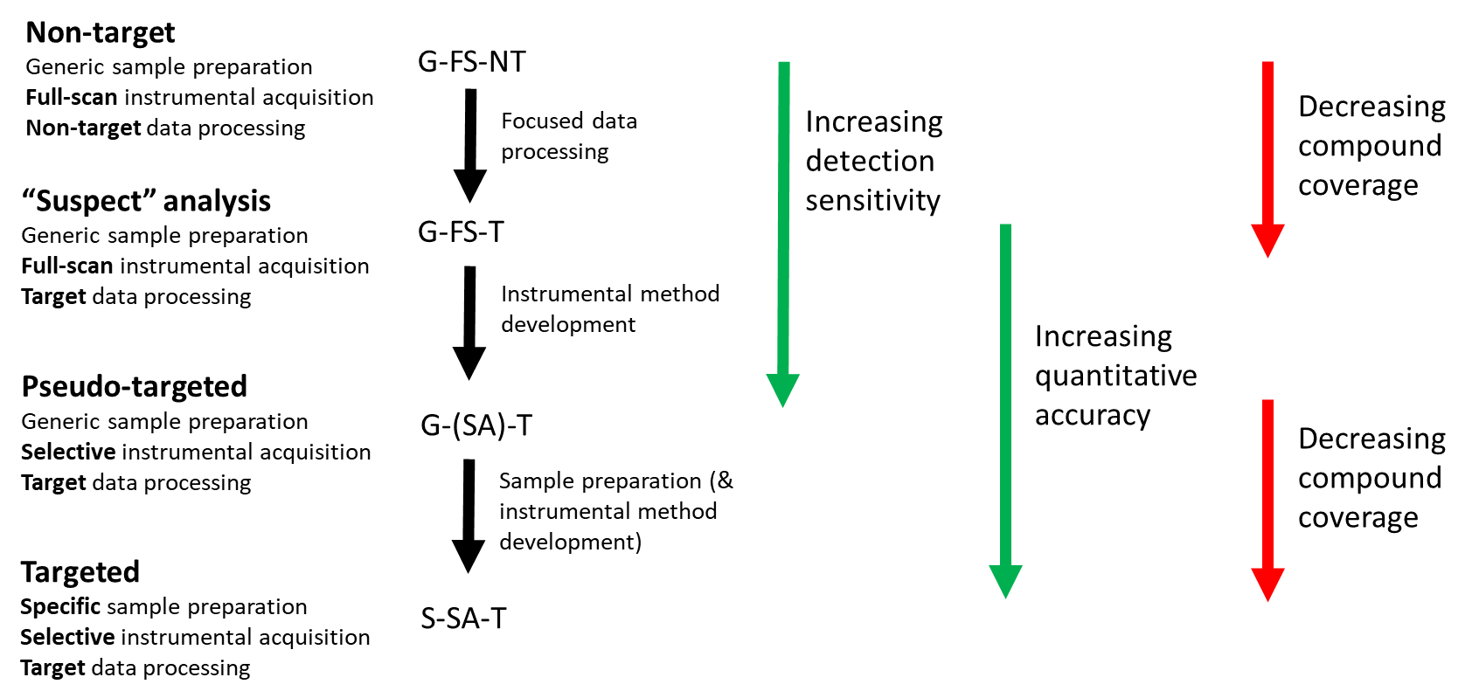
High-throughput technologies - MS
Further material: https://nontargetedanalysis.org/

Slide 22
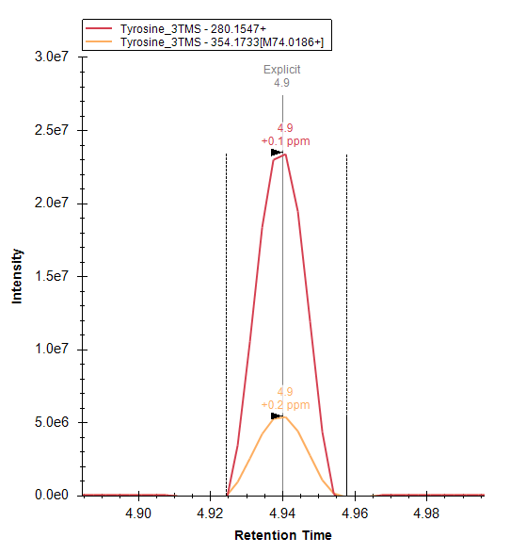
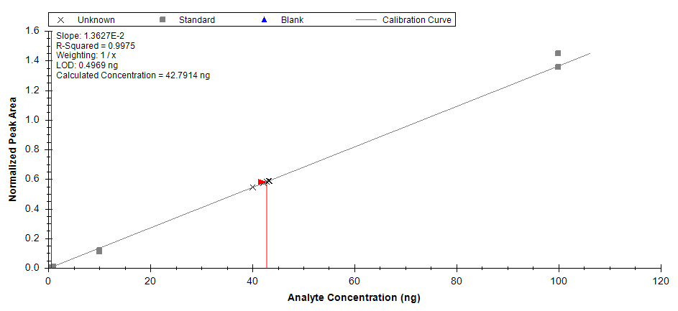
Selective acquisition
Scan selected ions (m/z) specific to molecules of interest
How much of molecule is present?

Slide 23
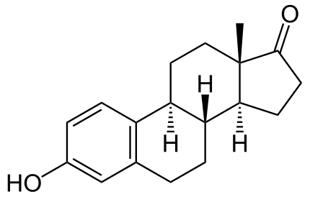
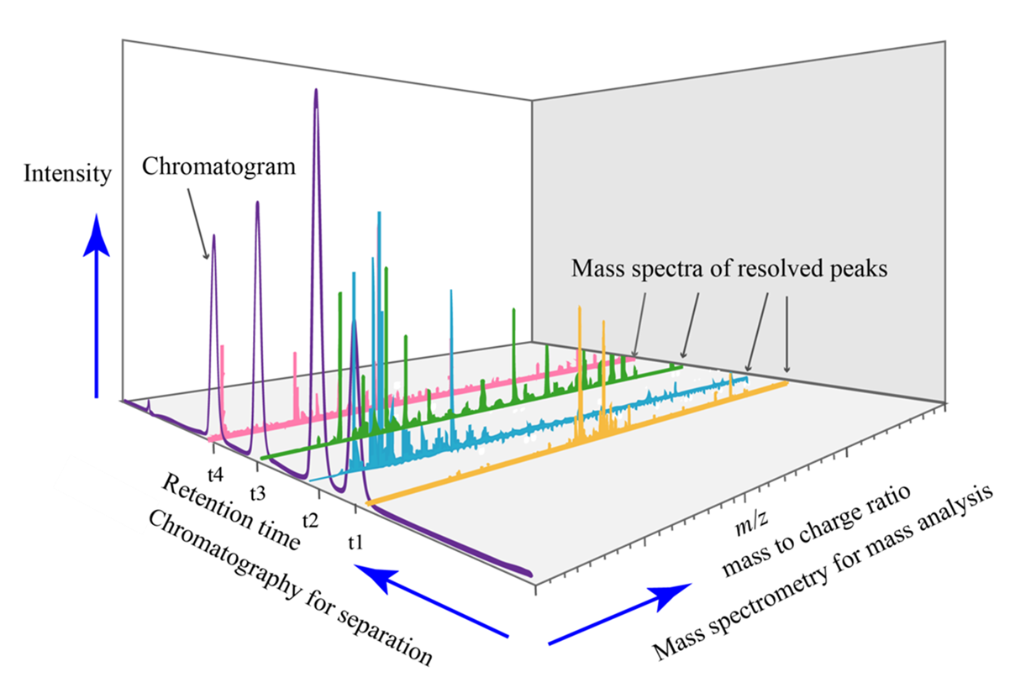
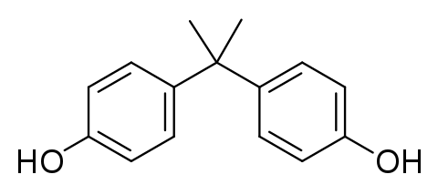
Full-scan analysis
Identify what chemicals are present?
Quantification (even relative) is difficult

Slide 24
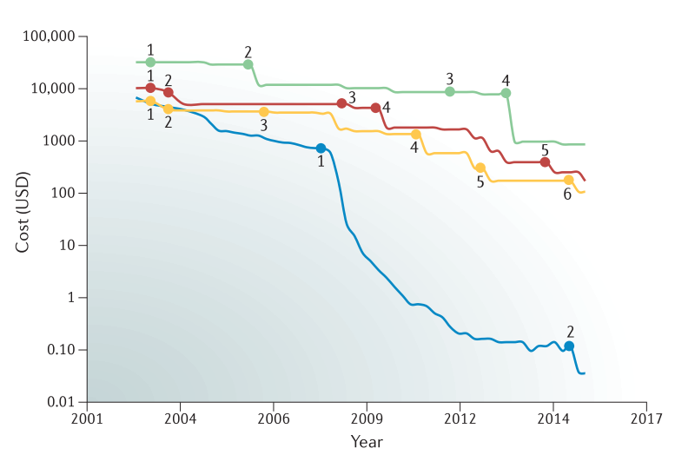
Sequencing & mass spectrometry
High-resolution MS (100,000 scans)
Mid-resolution MS (100,000 scans)
Low-resolution MS (100,000 scans)
1000 to 10000 x more costly
Sequencing 1 million bases
Image: 10.1038/s41570-017-0054
Large-scale sequencing remains cheaper & easier than large-scale MS

Slide 25
Sequencing & mass spectrometry
Sequencing is more robust than MS
MS methods provide finer details about phenotype due to greater inclusion of external factors
Sequencing shows all potential biological reactions that can occur
MS shows biological and non-biological reactions that occur
Further material: 10.1038/s41437-019-0209-z & 10.1038/s41570-017-0054

Slide 26

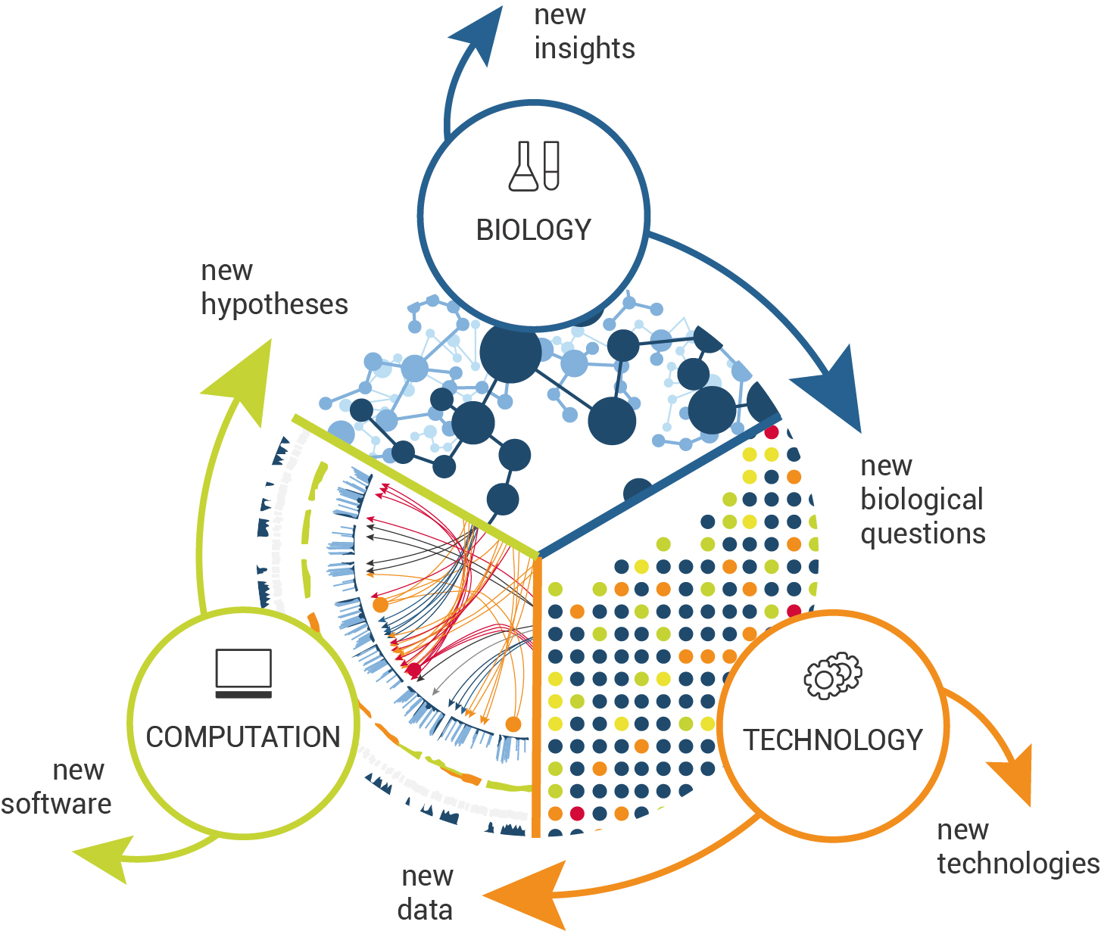
Network biology
Informatics to integrate and understand big data is the major advance of ‘omics’ technologies
Image: 10.1016/B978-0-12-813762-8.00002-5

Slide 27
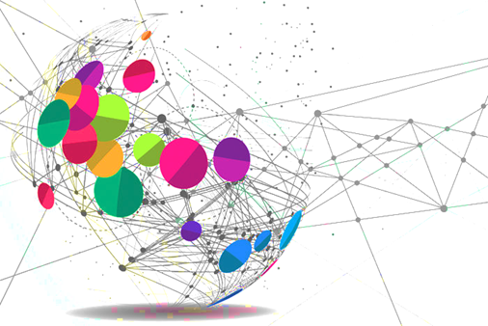
Systems biology
‘Omics’ technologies enable more observations but more observations does not equal more understanding
Benefit of the ‘-omics’ all depends on study design being correct for the hypothesis you want to test / question you wish to explore

Slide 28
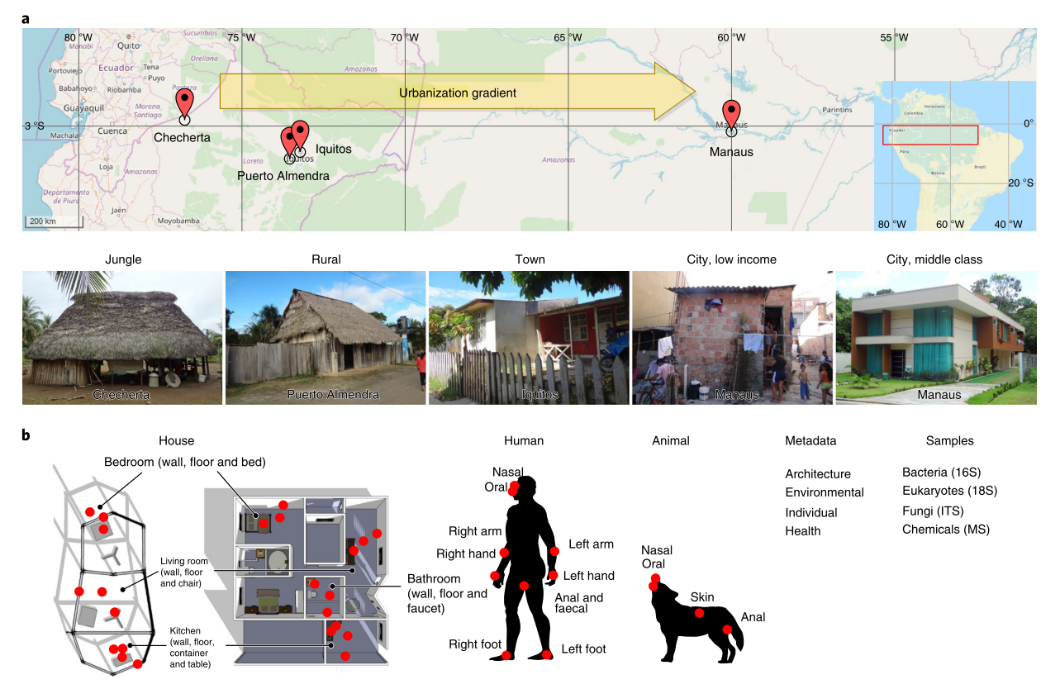
Multi-omics in environmental chemistry
McCall et al. Home chemical and microbial transitions across urbanization. Nat Microbiol 5, 108–115 (2020). https://doi.org/10.1038/s41564-019-0593-4
Took swab samples from inside homes and from their inhabitants across gradient of rainforest – city in Brazil
NGS (microbiome) & MS (chemicals)

Slide 29
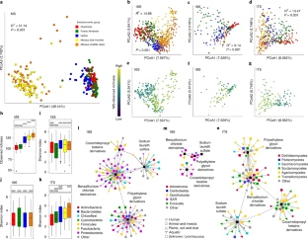
Multi-omics in environmental chemistry
https://doi.org/10.1038/s41564-019-0593-4
Urban homes showed higher levels of irritant cleaning products / detergents
Urban homes had much greater fungal diversity & biomass

Slide 30
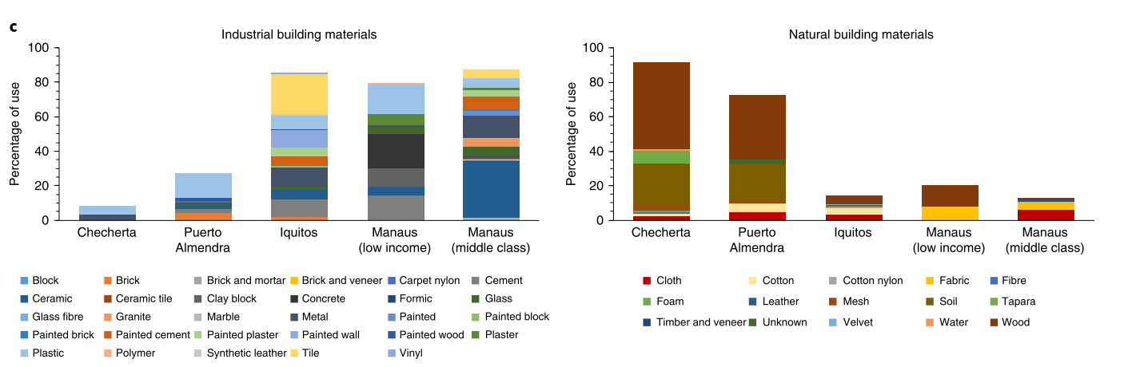
Multi-omics in environmental chemistry
https://doi.org/10.1038/s41564-019-0593-4
Industrial materials cover more surfaces in urban homes & were cleaned with antimicrobials more frequently
Fungus inside urban homes speculated to have developed resistance
Allergenic load higher in urban homes

Slide 31
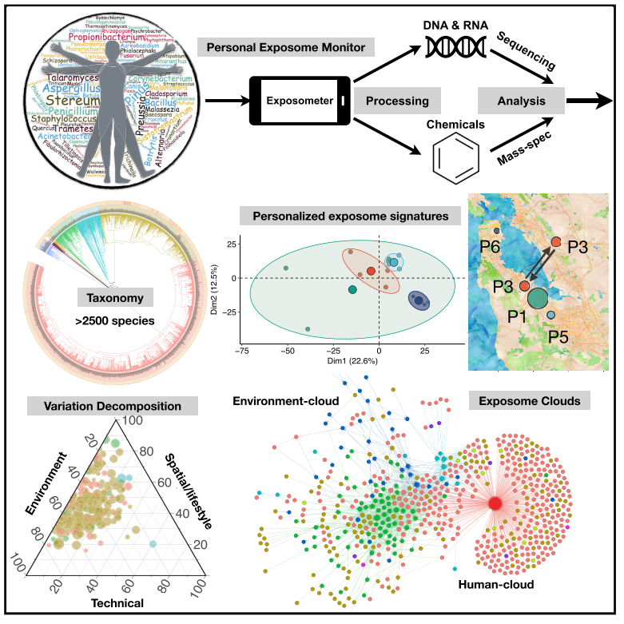
Multi-omics in environmental chemistry
Jiang et al. Dynamic Human Environmental Exposome Revealed by Longitudinal Personal Monitoring. Cell 175, 277–291 (2018). https://doi.org/10.1016/j.cell.2018.08.060
15 people monitored for 800 days’
Tracked location & air monitoring
Analysed airborne microbes (NGS) and chemicals (MS)

Slide 32
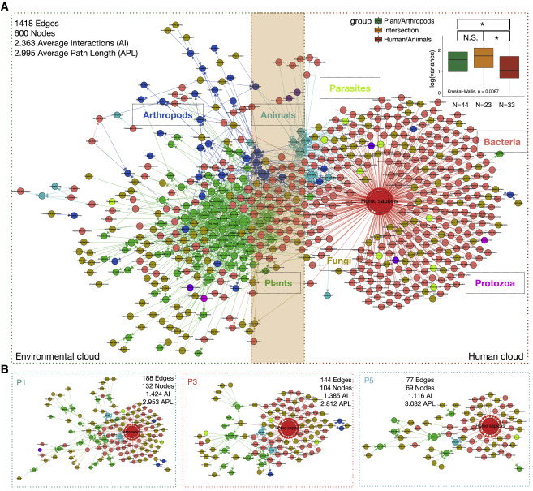
Multi-omics in environmental chemistry
https://doi.org/10.1016/j.cell.2018.08.060
Identified plant centric & human centric ‘exposure clouds’ with constant interaction mediated by bacteria & fungi
Identified many location/ lifestyle specific airborne pathogens & harmful toxins

Slide 33
‘omics’ takeaway messages
‘omics’ focus on systems/network study
‘omics’ techniques can easily collect lots of data
Theory and research questions are crucial for understanding
Need to study the genetic – environment interface in order to understand phenotype development, adaptation, evolution etc.
  i.e. to fully investigate why anything is what it is

