Slide 1

Transport of heat by
classical and quantum turbulent flows
in cryogenic helium ⁴He
Michal Macek, Pavel Urban, Věra Musilová,
Tomáš Králík, Pavel Hanzelka, Aleš Srnka
The Czech Academy of Sciences
Institute of Scientific Instruments, Brno
Group of Cryogenics and Superconductivity
PřF MUNI: F3250 - Moderní témata fyziky kondenzované fáze :: 05.10.2021
Projekt MŠMT OPVVV [qCULTURA] CZ02269/00/00/18_070/0009944

Slide 2
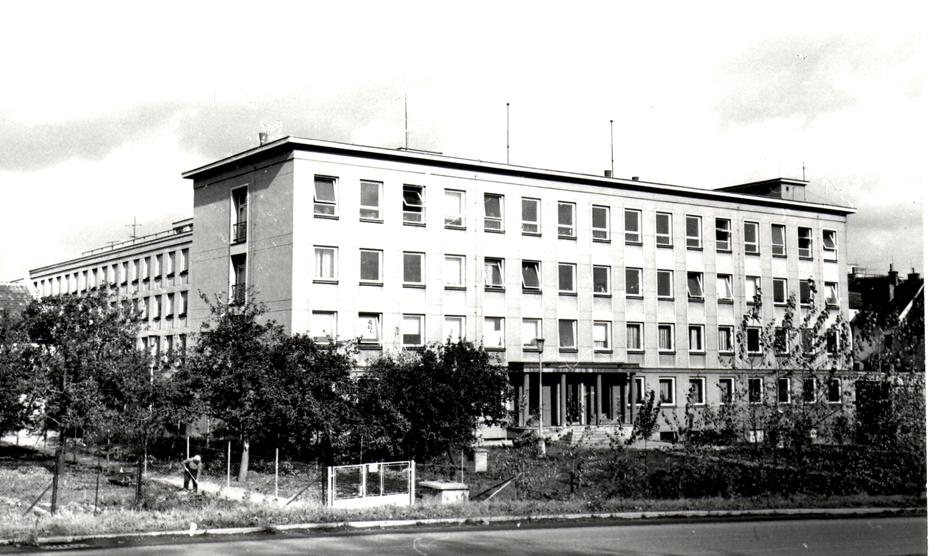
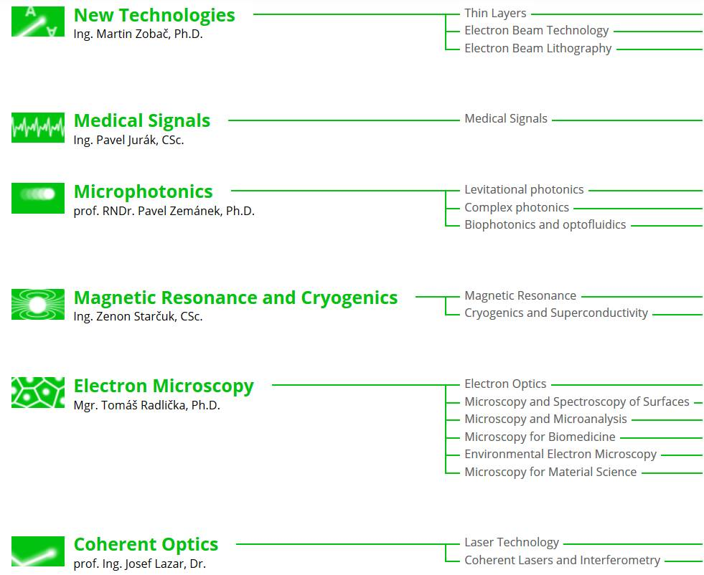
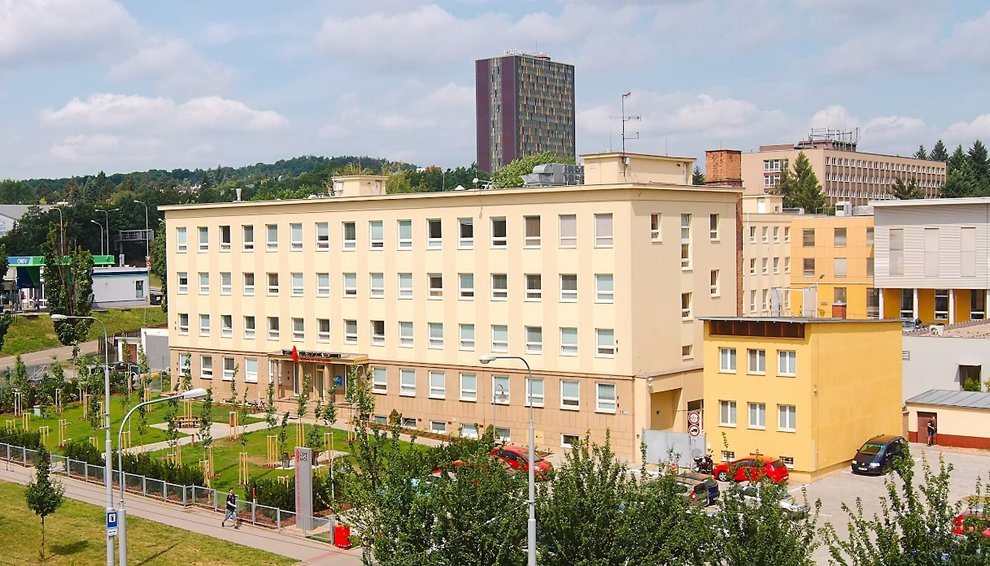
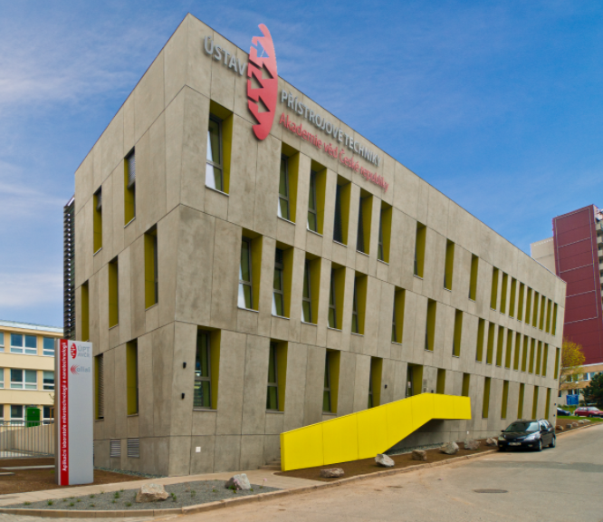
Institute of Scientific Instruments of the CAS
In 1967
research departments
U
In 2021
ALISI
www.isibrno.cz

Slide 3
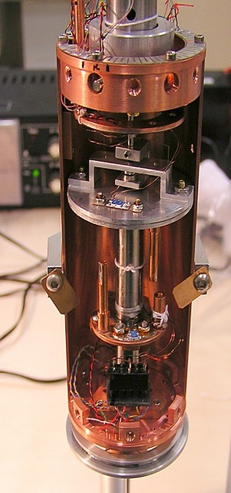
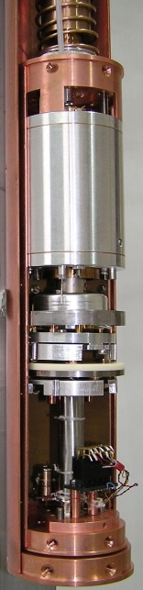
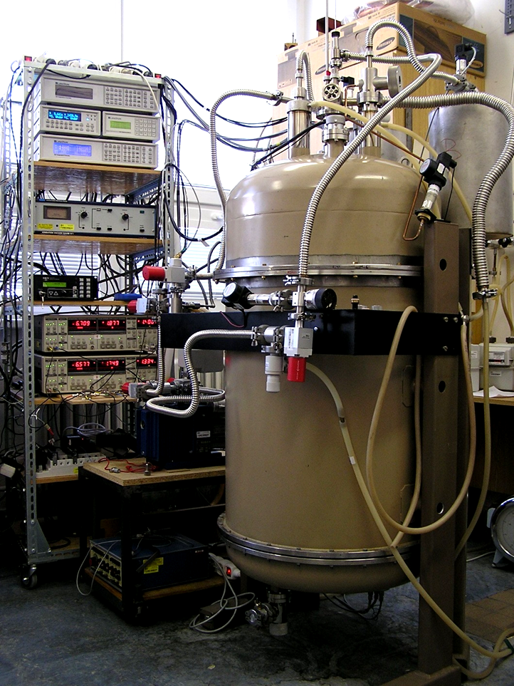
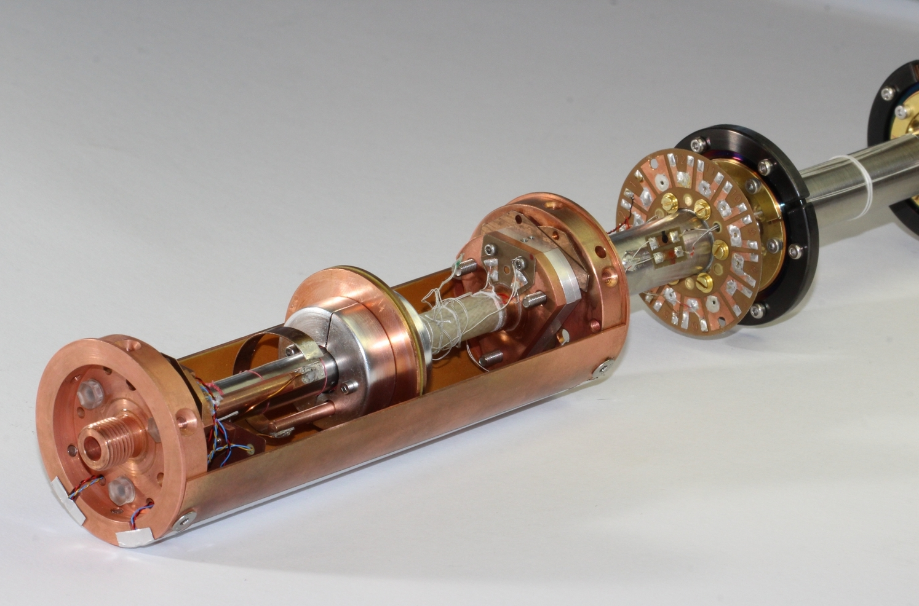
Heat Transport at Low Temperatures (~5K)
Basic Research:
Heat transport by Radiation
Heat transport by Convection
Emister apparatus
(far-field regime)
EWA apparatus
(near-field regime)
ConEV apparatus (Rayleigh-Bénard convection)
PRL 109, 224302 (2012), PRB 99, 024511 (2019)
… discussed in detail today

Slide 4
Outline
Basic aspects: Turbulence, Convection and Helium ⁴He
2. Some results: Classical turbulent convection - at ISI Brno
3. Outlook:
[1 a] Turbulent Flow
[1 b] Heat Transfer
[1 c] Helium ⁴He – many say a miraculous fluid
[2 a] Nu(Ra) - Heat transfer efficiency
[2 b] Re(Ra) - Dynamics of coherent structures (wind)
[3 a] Visualization of ⁴He flows by metastable triplet excimers
[3 b] Analogy of Classical and Quantum heat transfers
[3 c] Interplay of Convection and Rotation
Notes:
There’s never too much good art…

Slide 5
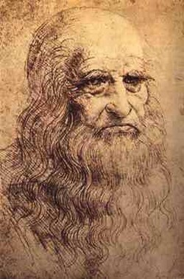
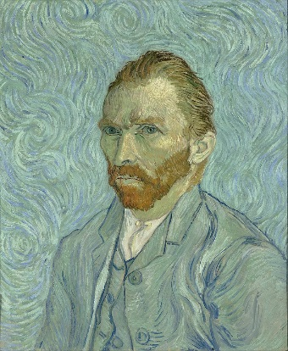
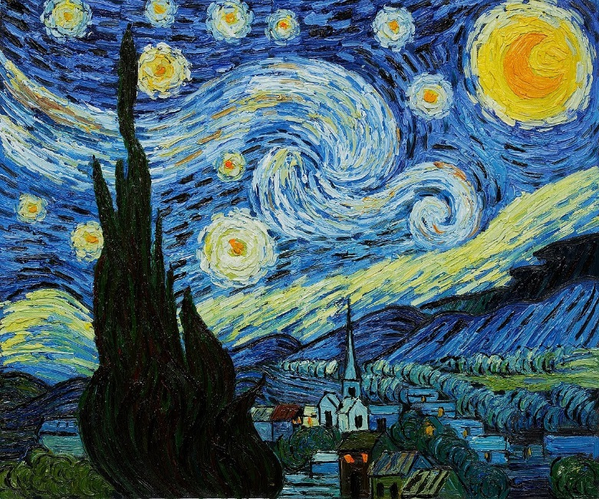
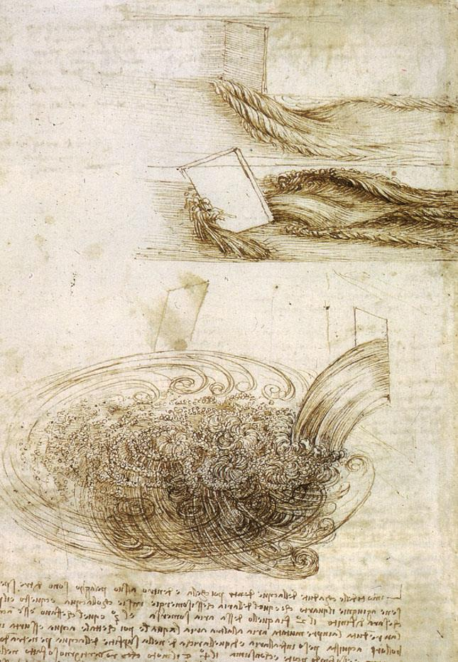
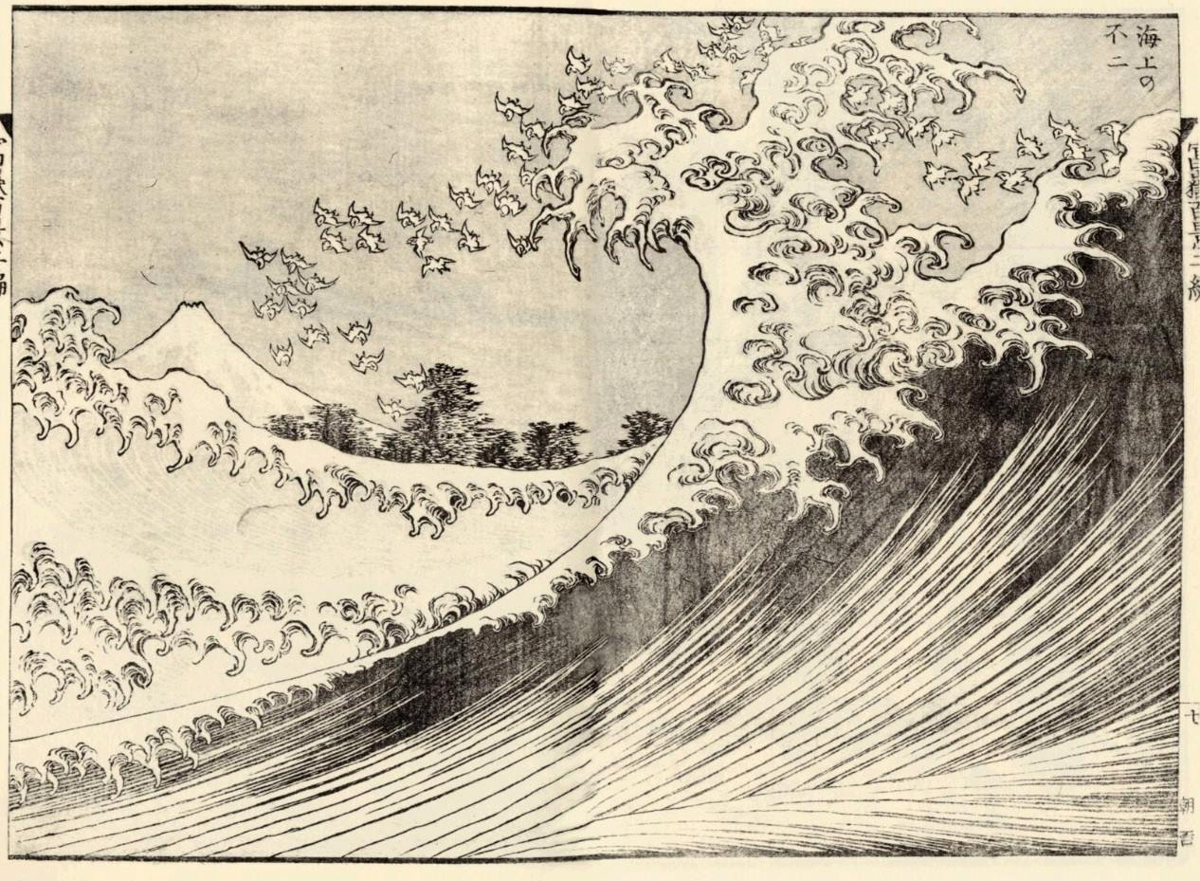
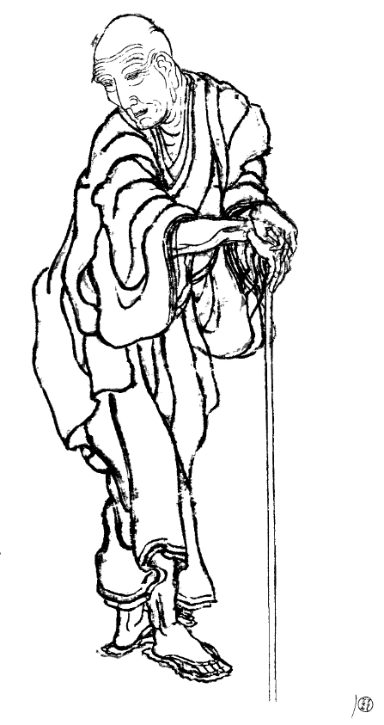
Turbulence
1.1
3/40
Leonardo da Vinci (1452-1519)
‘Drawing of Water Vortex,’
cca. 1510 - 1513.
Royal Collection Windsor, UK
Vincent van Gogh (1853-1890)
‘Starry Night’ 1889.
MoMA, New York
‘Mount Fuji viewed from the sea,’
from One Hundred Views of Mount Fuji, ca. 1834.
British Museum
Katsushika Hokusai
(1760-1849)
Notes:
There’s never too much good art…

Slide 6
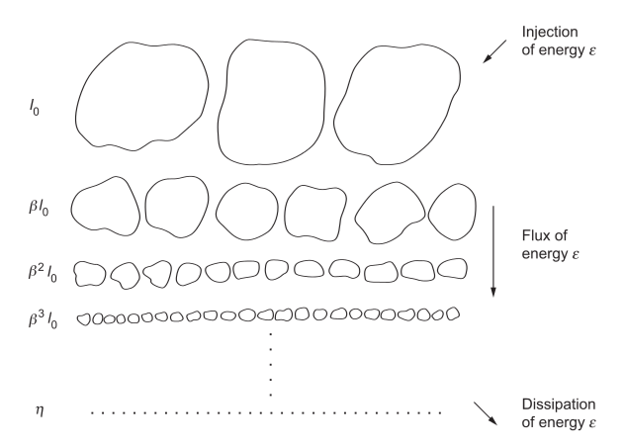
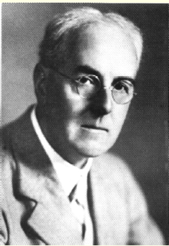
1.1
4/40
Turbulence: Scales And Cascades
“Big whirls have little whirls,
That feed on their velocity,
And little whirls have lesser whirls,
And so on to viscosity.”
Lewis Fry Richardson
(1881 – 1953)
[a take/parody on Jonathan Swift’s "On Poetry: a Rhapsody" (1733)]
Richardson cascade
Starting at forcing scale
Ending at viscous dissipation scale
Leonardo da Vinci (1452-1519)
‘Drawing of Water Vortex,’
cca. 1510 - 1513.
Royal Collection Windsor, UK
time
space
Adapted from: Uriel Frisch. 1995. Turbulence: The Legacy of A. N. Kolmogorov.
Notes:
There’s never too much good art…

Slide 7
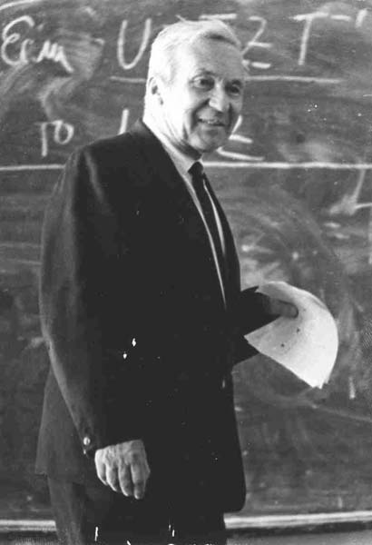
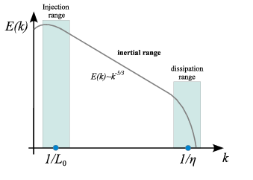
1.1
5/40
Turbulence: Scales And Cascades
“Big whirls have little whirls,
That feed on their velocity,
And little whirls have lesser whirls,
And so on to viscosity.”
Lewis Fry Richardson
(1881 – 1953)
[a take/parody on Jonathan Swift’s "On Poetry: a Rhapsody" (1733)]
Richardson – Kolmogorov cascade
Andrey Nikolaevich
Kolmogorov
(1903-1987)
Andrey Nikolaevich
Kolmogorov
(1903-1987)
Starting at forcing scale
Ending at viscous dissipation scale
Starting at forcing scale
Ending at viscous dissipation scale
Broad and smooth kinetic energy spectrum
For L₀ > r > η, inertial cascade of vortices.
viscosity negligible flow is turbulent
log E(k)
E(k) ~ k ^{-5/3}
time
Kolmogorov scale:
η = (ν³/ε)^{1/4}
At r < η viscosity dominates, flow is laminar
space
Adapted from: Uriel Frisch. 1995. Turbulence: The Legacy of A. N. Kolmogorov.
log(k)
Notes:
There’s never too much good art…

Slide 8
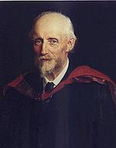
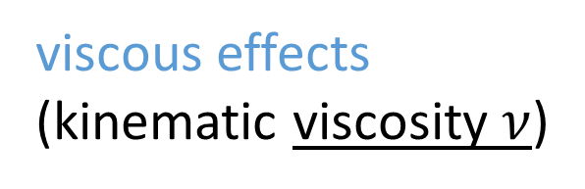
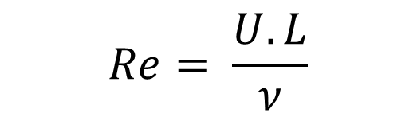
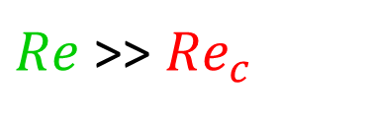
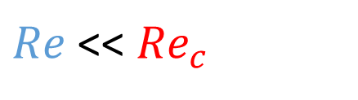
1.1
7/40
Turbulence onset and development:
Reynolds number
inertial effects
(characteristic scales of
velocity U and length L)
Osborne Reynolds (1842-1912)
$$Re= \frac{U.L}{ν}$$
viscous effects
(kinematic viscosity $ν$)
Dimensionless “flow-similarity” number
Critical value ${Re}_{c}≈1000$
(precise value depends mostly on boundary conditions and boundary geometry)
$Re$ << ${Re}_{c}$
$Re$ >> ${Re}_{c}$
Laminar flows – viscosity dominates
Turbulent flows – inertia dominates

Slide 9
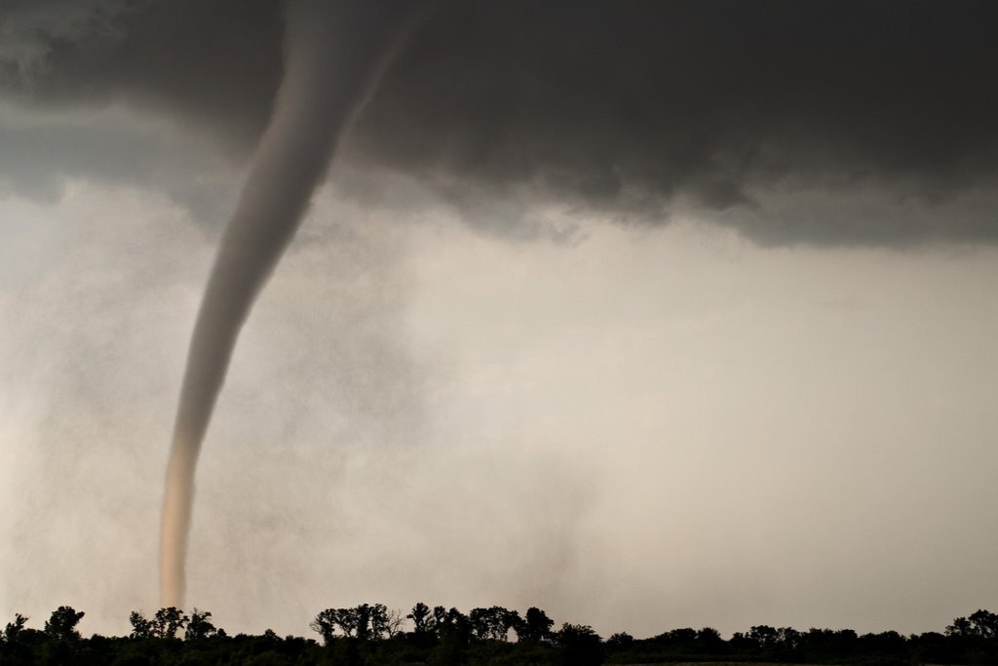
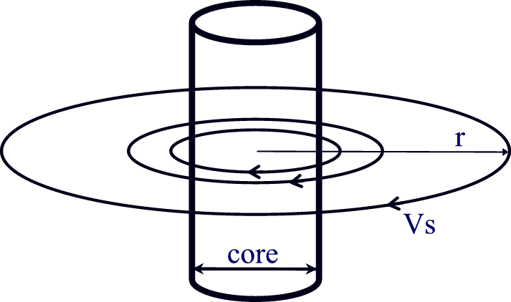
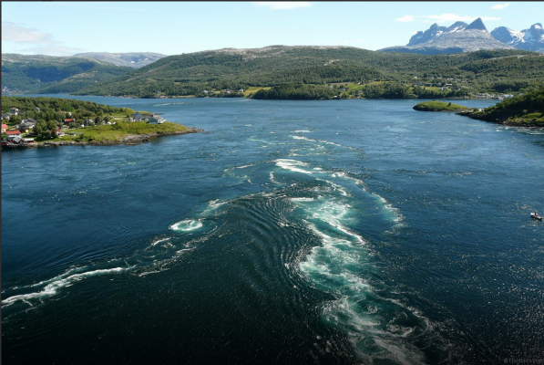
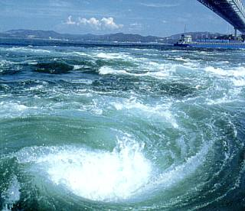
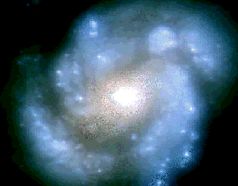
1.1
8/40
Characteristic scales of turbulence in Nature
Quantum vortex in superfluid He II
M100 galaxy
as seen through Hubble telescope
Maelstrom, Saltstraumen, Norway

Slide 10
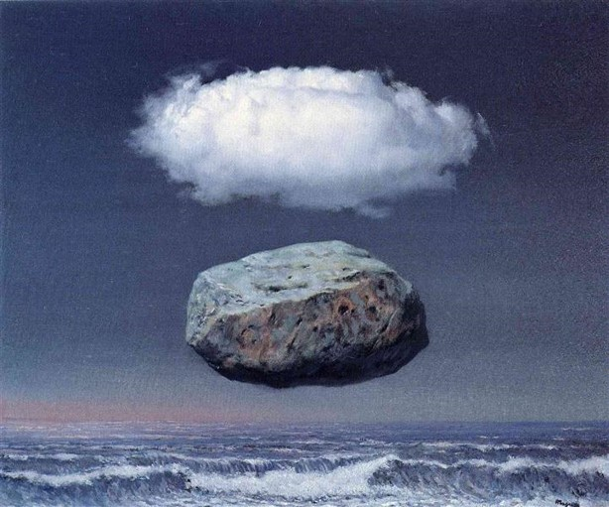
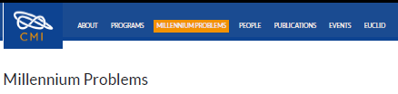
Turbulence: Major open scientific problem
1.1
9/40
As part of the course: “Modern topics in physics of condensed phase”
Why do I talk about old stuff all the time?
Clay Mathematics Institute $1 000 000 prize:
Navier–Stokes existence and smoothness problem:
Even basic properties of the solutions to Navier–Stokes have never been proven. For the three-dimensional system of equations, and given some initial conditions, mathematicians have not yet proved that smooth solutions always exist, or that if they do exist, they have bounded energy per unit mass.
Clear Ideas
by Rene Magritte, 1958

Slide 11
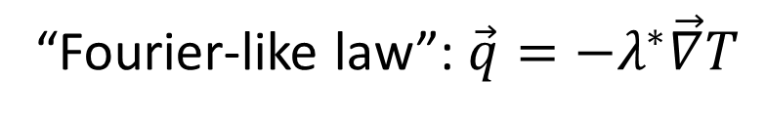


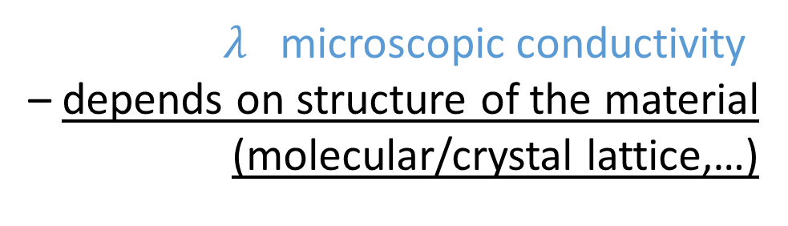
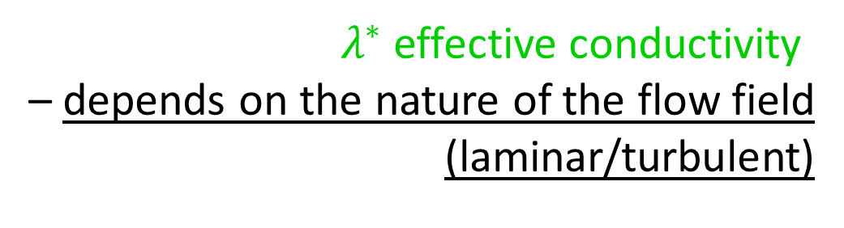
Basic Heat transport mechanisms: Recall…
1.2
10/40
Radiation (everywhere, including vacuum):
Stefan-Boltzmann’s law: $\vec{q}=σε{T }^{4}\vec{n}$
Conduction (in rigid matter or motionless fluids):
Fourier’s law:$\vec{q}=−λ\vec{∇}T$
Convection (in flowing matter):
$σ$ black-body constant
$ε$ surface emissivity
$λ$ microscopic conductivity
– depends on structure of the material
(molecular/crystal lattice,…)
“Fourier-like law”:$\vec{q}=−λ^{∗}\vec{∇}T$
$λ^{∗}$effective conductivity
– depends on the nature of the flow field
(laminar/turbulent)

Slide 12
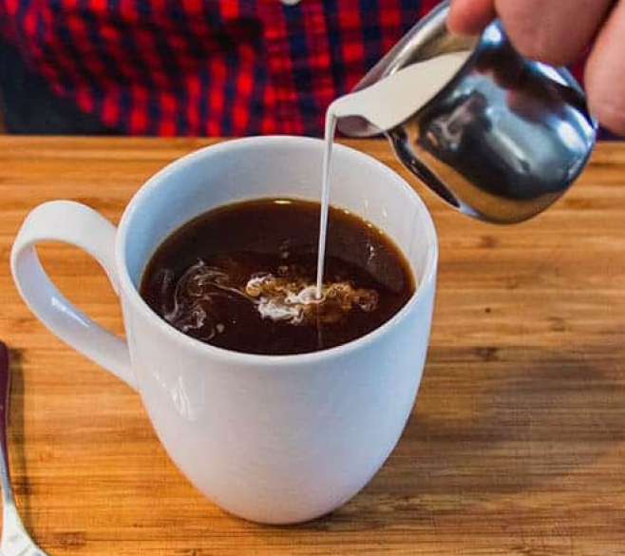
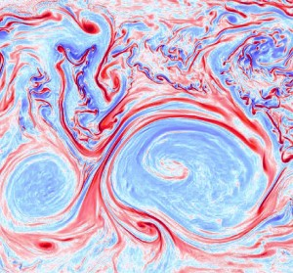
Turbulent mixing: very efficient heat transport
1.2
11/40
Surface of the drop deforms and grows in area rapidly, due to turbulent flow fluctuations.
Compared to transport by molecular diffusion,
mixing by turbulent flows is thus able to
enhance scalar transport by many orders of magnitude.
Example: In a 1km thick atmospheric boundary layer,
turbulent convection transfers heat at least
10⁵ more efficiently(!)
Temperature is a scalar quantity (of course),
like e.g. concentration of cream in coffee
– it is governed by similar (advection-diffusion) equations.
Velocity of the fluid flow is a vector field (of course).

Slide 13
1.2
12/40
Helium

Slide 14
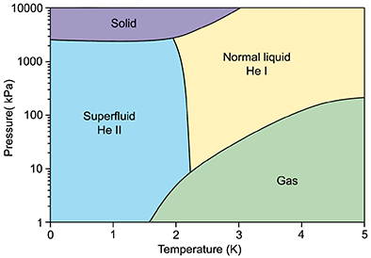
Helium ⁴He: Three fluid phases
1.3
13/40
“Quantum flows”
in superfluid (He-II) phase
“Classical flows”
in liquid (He-I) and gaseous (GHe) phases
⁴He Critical point (CP):
P_{c} =227 kPa, T_{c} = 5.20 K
Notes:
A Liquid That Pours Itself! The Self-Siphoning Fluid: Polyethylene Glycol
: https://www.youtube.com/watch?v=t3neqUhoDRA

Slide 15
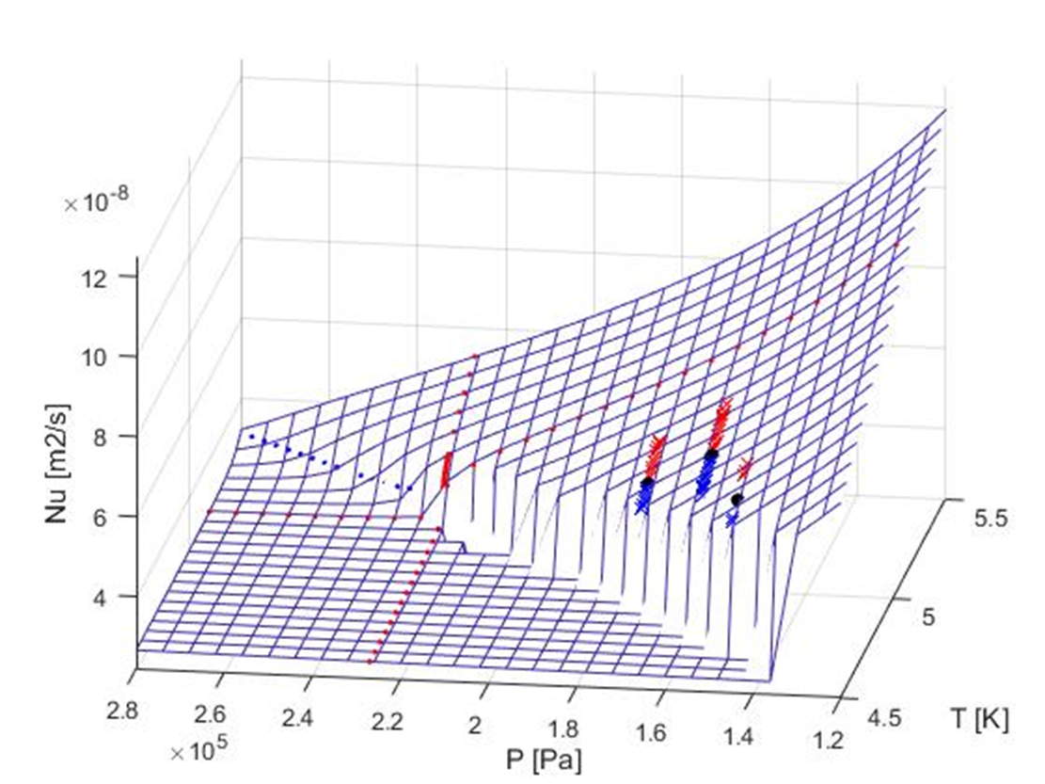
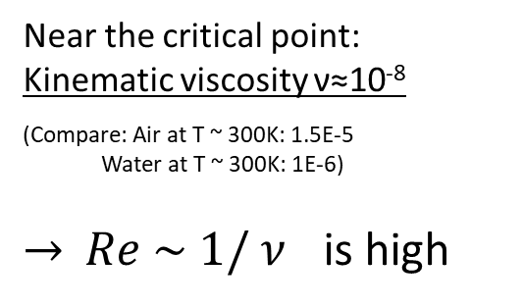
Helium ⁴He: Three fluid phases
1.3
14/40
“Classical flows”
in liquid (He-I) and gaseous (GHe) phases
GHe
He-I
⁴He Critical point (CP):
P_{c} =227 kPa, T_{c} = 5.20 K
Near the critical point:
Kinematic viscosity ν≈10⁻⁸
(Compare: Air at T ~ 300K: 1.5E-5
^{Water at T ~ 300K: 1E-6)}
$→ Re \sim 1/ ν$ is high
Notes:
A Liquid That Pours Itself! The Self-Siphoning Fluid: Polyethylene Glycol
: https://www.youtube.com/watch?v=t3neqUhoDRA

Slide 16
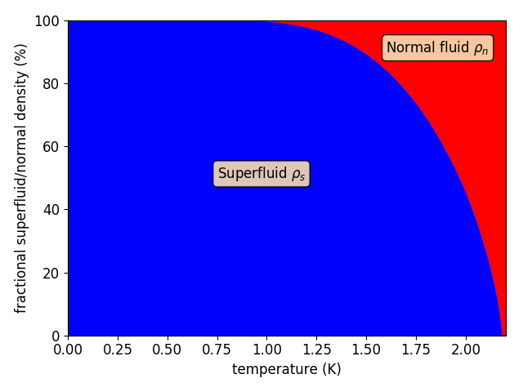
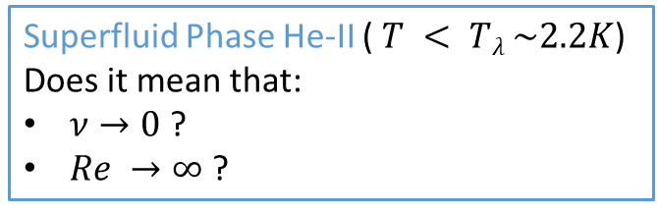
Helium ⁴He: Three fluid phases
1.3
14/40
Superfluid Phase He-II ($T < Tλ \sim 2.2K$) Does it mean that:
$ν→0$ ?
$Re →∞$ ?
“Quantum flows”
in superfluid (He-II) phase
Actually NOT quite simply:
Two-fluid model of He-II (Tisza, Landau)
⁴He Critical point (CP):
P_{c} =227 kPa, T_{c} = 5.20 K
Notes:
A Liquid That Pours Itself! The Self-Siphoning Fluid: Polyethylene Glycol
: https://www.youtube.com/watch?v=t3neqUhoDRA

Slide 17
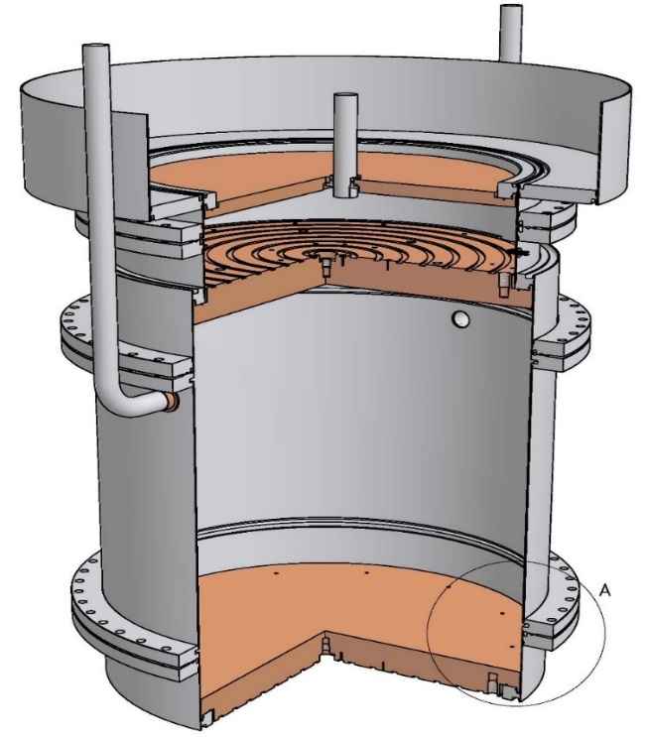
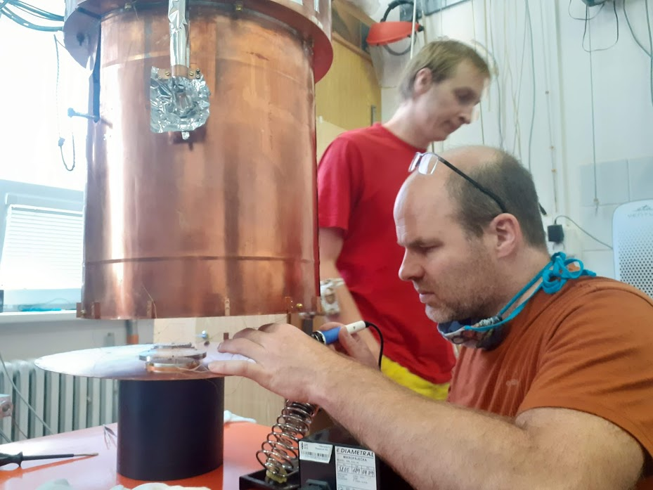
Group of Cryogenics and Superconductivity
Cryogenics and Superconductivity group at ISI Brno
2.1
15/40
Long-time tradition in development and construction of cryogenic instruments for Basic Research:
Heat transport by Convection
ConEV apparatus (Convection Experimental Vessel)
Rayleigh Bénard convection (RBC) cell
Size L = H = 30 cm
Rayleigh Bénard convection (RBC) cell
Size L = H = 30 cm
PRL 107 014302 (2011),
PRL 109 154301 (2012),
PRL 110 199402 (2013),
RSI 81 085103 (2010),
PNAS 110 8036 (2013),
JFM 785 270 (2015),
JFM 832 721 (2017),
PRE 99 (R) 011101 (2019),
…
RBC cell
inside the cryostat
RBC cell
inside the cryostat
discussed in this talk

Slide 18
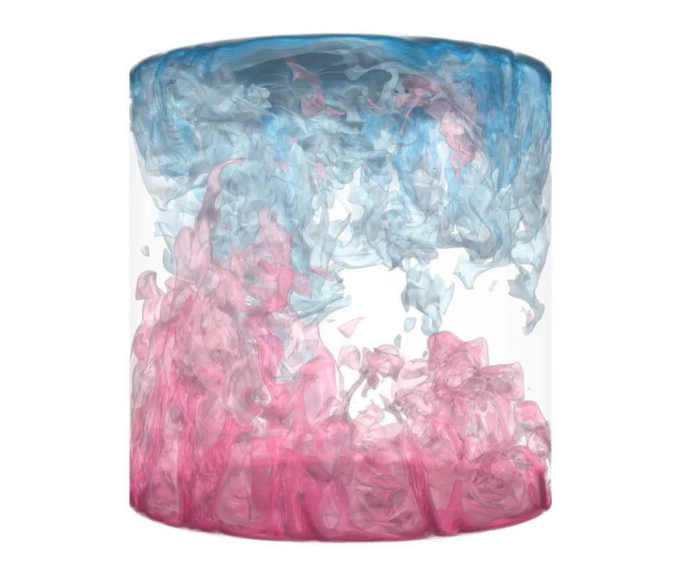
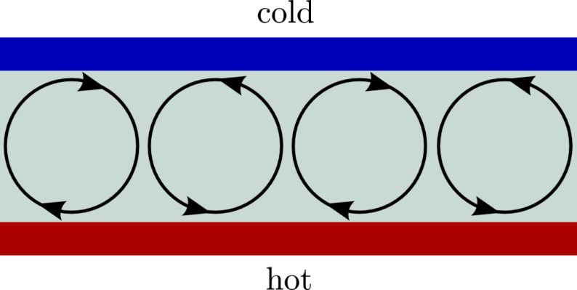
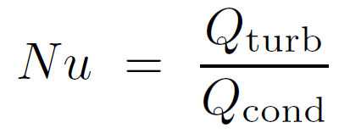
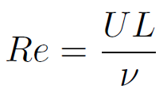

2.1
16/40
Rayleigh-Bénard convection –
Rayleigh-Bénard model of convection
Oberbeck-Boussinesq (OB) fluid:
constant fluid properties within ΔT:
density ρ is assumed to linearly depend on temperature T
Finite Cell: Diameter D
$$Ra={10}^{9},Pr=1$$
α - thermal expansion coefficient
ν - kinematic viscosity
λ - fluid thermal conductivity
κ - thermal diffusivity
Ra > Ra_{c} = 1708
~
∞
Height L
Height L
Adiabatic sidewalls
Control parameters for RBC (adjustable):
heat
∞
T_{b} = T_{t} + ΔT
Rayleigh number
Prandtl number
Aspect ratio
simulation from
Shishkina et al. PRL 114 (2015)
Order parameters for RBC (response of the system):
Ra, Pr, Nu, Re: Dimensionless numbers related to intensity of turbulence
Nusselt number
Reynolds number

Slide 19
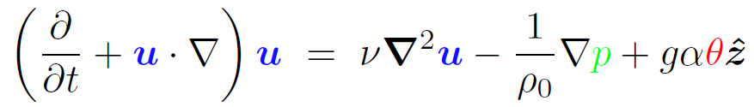
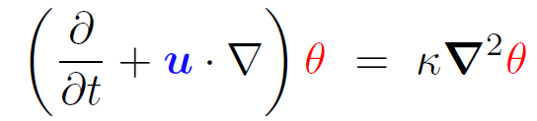

a simple
model system
2.1
17/40
Rayleigh-Bénard convection –
Equations and Scale-Similarity of solutions
Navier-Stokes equation = Newton equation for continuum - a viscous fluid with pressure and upward buoyancy forcing:
Heat advection
Incompressibility condition:
Heat conduction: (Fourier’s law)
Oberbeck-Boussinesq (OB) fluid:
constant fluid properties within ΔT
density ρ is assumed to linearly depend
on temperature
Dynamical variables:
α - thermal expansion coefficient
ν - kinematic viscosity
κ - thermal diffusivity
λ - fluid thermal conductivity
α - thermal expansion coefficient
ν - kinematic viscosity
κ - thermal diffusivity
λ - fluid thermal conductivity
u - velocity field
θ - temperature field
p - pressure field
equation:
Fluid properties:
(considered constant!)
α - thermal expansion coefficient
ν - kinematic viscosity
κ - thermal diffusivity
λ - fluid thermal conductivity ρ₀ - mean density g - gravity acceleration
“Boussinesq equations”
of RBC

Slide 20


2.1
18/40
Rayleigh-Bénard convection –
Equations and Scale-Similarity of solutions
“Non-dimensionalize” using
spatial, temporal, velocity, temperature and pressure scales:
Character of RBC solutions depends only on 2 essential parameters – Ra & Pr - instead of 5!
α ,ν, κ, ρ₀ (and g) Ra, Pr
Notes:
Zastav sa a diskutuj Ra!!!!

Slide 21



Large-scale Convection in Nature
2.1
19/40
Natural convection often occurs on large scale distances L and thus is characterized by very high values of Ra number.
Ocean: Ra ≈ 10²⁰
Sun: Ra ≈ 10³⁰
working fluid
properties
system size
Atmosphere: Ra ≈ 10¹⁷

Slide 22
2.1
20/40
Ra values attainable with different fluids
Examples | Ra
Atmosphere | ≈ 10¹⁷
Ocean | ≈ 10²⁰
Laboratory | ≈ 10¹⁷
Computer | ≈ 10¹¹
Laboratory experiments: high Ra at low L.
Fluid | Temperature | α/νκ
Air | 20°C | 0.122
Water | 20°C | 14.4
Helium ⁴He (gas) | 5.5 K | 1.41×10⁸
Helium I (liquid) | 2.25 K | 3.25×10⁻⁵

Slide 23


2.1
21/40
Rayleigh-Bénard Convection in ⁴He
Brno cell L = 30 cm, Ra from 10⁶ up to 10¹⁵
CI
⁴He Critical point (CP): P_{c} =227 kPa, T_{c} = 5.20 K
HIGHEST Ra
near the critical
point
CP
Liquid
Vapor
SVC
Gas
Other interesting regions besides CP:
Saturated Vapor Curve (SVC)
Critical Isochore (CI)

Slide 24

History
detour
#1:
Shadowgraph seen from above
Coherent structures / patterns observed in a fluid-filled pot heated from below
…it is not as simple …

Slide 25
History
detour
#2:
2.1
17/40
Formulated eqations for system with ∞ plates
Predicted critical value of the control parameter (now “Rayleigh number”) for conduction - convection transition
Ra_{c} = 1708
Experimentally confirmed with high accuracy

Slide 26


History
detour
#3:
Edward Lorenz: computer-ready model for weather prediction
(PhD Thesis, 1948, MIT)
“butterfly wing effect”
– sensitivity to initial conditions:
deterministic chaos
{\color{red}\rho_0
Simple 3D dynamical system derived from Boussinesq equations of RBC
strange attractor

Slide 27

Grenoble ⁴He cryogenic experiment
2.1
19/40
Regimes of RBC: Heat Transport
Nusselt number Nu
(dimensionless heat transfer coefficient):
“Critical point #2”:
Transition to Turbulence
Critical point #1:
Onset of (laminar) Convection
Power law dependences in turbulent regime(s) are good approximation
X. Chavanne, F. Chilla, B. Castaing, B. Hébral, B. Chabaud and J. Chaussy, Phys. Rev. Lett. 79, 3648 (1997)
Conduction
Laminar convection
Turbulent convection
Ra
Transition in the vicinity of Ra ~ 10¹¹ - interpreted as regime with Nu ~ Ra^{1/2}.
Transition observed also in the cell geometry Γ = 1.14 and 0.23.

Slide 28
Grenoble ⁴He cryogenic experiment
2.1
20/40
Regimes of RBC: Heat Transport
Nusselt number Nu
(dimensionless heat transfer coefficient):
“standard RBC turbulence” regimes
“ultimate RBC turbulence”
regime
Nu ~ Ra^{1/3}
Nu ~ Ra^{1/2}
Nu ~ Ra^{2/7}
transitions?
X. Chavanne, F. Chilla, B. Castaing, B. Hébral, B. Chabaud and J. Chaussy, Phys. Rev. Lett. 79, 3648 (1997)
Turbulent convection
Ra
Transition in the vicinity of Ra ~ 10¹¹ - interpreted as regime with Nu ~ Ra^{1/2}.
Transition observed also in the cell geometry Γ = 1.14 and 0.23.
Notes:
Interesting dynamical transitions: In the seemingly trivial laminar regime, many transitions connected to bifurcations. On the other hand, in the seemingly random turbulent regime, appearance of coherent structures

Slide 29



Ultimate regime of heat transport in RBC
2.1
21/40
“Standard turbulent” RBC
Malkus, Priestley, Spiegel (1954)
Shraiman and Siggia (1990)
laminar boundary layers (BL) + weak or no dependence on Pr
Ultimate / asymptotic turbulent RBC
$$Nu \sim {Ra}^{1/2}$$
weak dependence on Pr
Ra* ≈ 10²¹ – 10²⁴
ballistic heat transfer independent of κ an ν
fully turbulent boundary layers

Slide 30

Extrapolations to large-scale flows?
exponents γ = 1/3 and γ = 1/2
2.1
22/40
γ = 1/2
γ = 1/3
Confirmation of existence of the ultimate regime is great challenge in this field of study!

Slide 31
OBSERVED…?
2.1
23/40
NO…?
Motivation for this talk
Clanky ktore tvrdia ze vidia~!
PRL (Grenoble)
PRL (Goettingen)
….
Cryogenic ⁴He experiment (Oregon)
Cryogenic ⁴He experiment (Grenoble)
Cryogenic ⁴He experiment (Brno)
Room-temperature high-pressure SF₆ experiment (Goettingen)
Cryogenic ⁴He experiment (Brno)
…
Numerical simulation in 2D (Twente, Rome, Goettingen)

Slide 32

OBSERVED…?
2.1
24/40
NO…?
Cryogenic Experiments with aspect ratio Γ = 1:
Nusselt no.
reduced by Ra^{1/3}
Grenoble (triangles)
Trieste (squares)
Brno (circles)
Urban et al.
Phys. Rev. Lett. 014302 (2011) and
New J. Phys. 16, 053042 (2014)
Data sleduju 2/7 zavislost az do…Potom niektore prechadzaju na ½ (Grenoble, ..v SF6 tiez Goettingen…) a niektore na 1/3 (Brno, Oregon) a niektore (Terst) na nieco medzi)
PRL (2011) – prvy clanok ISI Brno
Dolezita vhodna korekcia na ne-adiabatickost stein -> kolaps dat!
Zdorazni Ra~~ 1E11! – potom ve Reynoldsovi sa odkaz…

Slide 33


Transitions observed at ISI Brno:
1. Transition at Ra >~ 10¹⁴: Ultimate regime transition or NOB effects ?
2. Transition at Ra~ 10¹⁰-10¹¹: ?
2.1
25/40
NOB: T_{m} ≠ T_{c}: BL asymmetry
NOB effects near the Critical Point of ⁴He
Γ = 1
J.Drahotský, P. Hanzelka, V. Musilová,
MM, R. du Puits and P. Urban
EPJ Conf S. 180, 02020 (2018)
P. Urban, P. Hanzelka, T. Kralik, V. Musilova, A. Srnka and L. Skrbek, Phys. Rev. Lett. 109, 154301 (2012).
P. Urban, P. Hanzelka, T. Králík, MM, V. Musilová, L. Skrbek
Phys. Rev. E 99, 011101 (R) (2019).

Slide 34

2.1
26/40
Goettingen – SF₆
Brno – ⁴He
NOB effects
near the Saturation Curves of ⁴He and SF₆

Slide 35
Results: Global heat transfer – Nu(Ra)
Transitions observed at ISI Brno:
1. Transition at Ra >~ 10¹⁴: Ultimate regime transition or NOB effects ?
2. Transition at Ra~ 10¹⁰-10¹¹: ?
2.2
27/40
Transition: Nu ~ Ra^{2/7} - Ra^{1/3}
Change in shape of the coherent flow structure - the mean wind
V. Musilová, T. Králík, M. La Mantia, MM., P. Urban, L. Skrbek. J. Fluid. Mech. 832, 721 – 744 (2017).
Notes:
What is the possible nature of this transition will be discussed now…
We measure temperature fluctuations in the bulk, at four positions near the midplane…

Slide 36



Grenoble ⁴He cryogenic experiment
2.2
28/40
Regimes of RBC: Coherent structures
Low Ra - instant. snapshot (spiral defect chaos - SDC)
Shadowgraph images seen from top
Transition to Turbulence:
Coherent structures persist!
(on average - mean flows)
Moderate Ra - instant. snapshot (disorder, strong fluctuations)
Onset of (laminar) Convection:
Different forms of coherent structures seen (Pattern formation)
Increasing Ra
L = 20 cm
X. Chavanne, F. Chilla, B. Castaing, B. Hébral, B. Chabaud and J. Chaussy, Phys. Rev. Lett. 79, 3648 (1997)
Moderate Ra - averaged image
(SDC recovered)
Regimes near onset of convection:
Studied in cells with Γ >> 1.
Adapted from Bodenschats et al.,
Annu.Re.Fluid.Mech (2000)
High Ra regimes:
Studied in tall cells with Γ < 1.
D = 10 cm
Conduction
Zwirner & Shishkina, JFM 850, 984 (2018)
~
Laminar convection
Turbulent convection
Emran, Schumacher, JFM 776, 96 (2015)
MM, Schumacher, in preparation

Slide 37
Reynolds measurements at ISI Brno:
Temperature fluctuations in the turbulent bulk
2.2
30/40
Four small cubic Ge thermistors (T₁ – T₄) near sidewalls
with respect to LSC direction:
T₁, T₃ – “leading sensors”
T₂, T₄ – “trailing sensors”
Temperature fluctuations time series (δT ~ 1mK)
Statistical analysis (see next slide)
Temperature fluctuations PDFs
(in turbulence: non-Gaussian, heavy tails, rare events)
Power spectra
(in turbulence: broad due to “Richardson cascade”
transferring energy over wide range of scales)
Auto- and Cross-correlations
(Fourier transform of spectra)
Reynolds numbers (different types)
Notes:
In the same experiments simultaneously.. Four sensors near sidewalls… Properties of LSC …

Slide 38


Temperature fluctuations in the turbulent bulk

Slide 39

Reynolds numbers (one-point measurements)
2.2
31/40
One-point measurements:
Frequency Reynolds number
Brno data fitted by a two-fold power law
where
above / below the transition point
Ra = Ra_{c}
V. Musilová, T. Králík, M. La Mantia, MM., P. Urban, L. Skrbek. J. Fluid. Mech. 832, 721 – 744 (2017).
Notes:
Oscilace + stochastics of LSC: sideward sloshing seen here (okrem toho twisting, ktory v strede nevidime…atd… Brown, Ahlers, Weiss…V zavislosti na polohe snimacov, su merania citlive na rozne vlastnosti velkych struktur (LCS, plumy…)

Slide 40
Reynolds numbers (two-point measurements)
2.2
32/40
Two-point measurements:
“Elliptic approximation Reynolds numbers”
G.W. He & J.B.Zhang Phys.Rev. E 73 055303 (2006)
Brno data compared with SF₆ data by
X. He et al. New J. Phys 17 063028 (2015)
V. Musilová, T. Králík, M. La Mantia, MM., P. Urban, L. Skrbek. J. Fluid. Mech. 832, 721 – 744 (2017).
Notes:
Oscilace + stochastics of LSC: sideward sloshing seen here (okrem toho twisting, ktory v strede nevidime…atd… Brown, Ahlers, Weiss…V zavislosti na polohe snimacov, su merania citlive na rozne vlastnosti velkych struktur (LCS, plumy…). Na rozdiel od predchadzajuceho slidu – Re_p - nemame porovnanie s kryo, len s SF_6…

Slide 41


Fluctuation PDFs: Evidence for LSC shape change
2.2
33/40
M₄ (Flatness)
M₄ (Flatness)
Trailing sensors outside main LSC roll for :
Tilted elliptical LSC
“leading sensors”
M₃ (Skewness)
M₃ (Skewness)
“trailing sensors”
All sensors inside
the main LSC roll for :
Squarish LSC shape
See also Niemela, Sreenivasan
Europhys. Lett. (2003) 62, 859
V. Musilová, T. Králík, M. La Mantia, MM., P. Urban, L. Skrbek. J. Fluid. Mech. 832, 721 – 744 (2017).
Notes:
Co tu vidime… V GL teorii prechod nie je bud vobec (novy fit Stevens), alebo velmi slabo/nevyrazne. Podla GL by prechod v Nu(Ra) mal suvisiet s chovanim medznych vrstiev (stary fit predpoveda v danom mieste prechod v BL typu IV_u – IV_l),
Odpoved moze naznacit chovanie LSC,

Slide 42



Wind reversals
2.2
34/40
Bulk temperature fluctuations – measurement #f078:
Ra = 8.86*10¹² , Pr = 1.34, <Nu> = 1280
T1
PDF skewness
T2
X-corr
delay
T3
X-corr
delay
T4
PDF skewness
sliding window analysis

Slide 43





Outlook: Flow visualization at high Ra
3.1
35/40
Many visualization methods exist:
Smoke, Ink or Dye…
Particle Tracking Velocimetry,
Particle Image Velocimetry,
Laser Doppler Velocimetry
Shadograph, Schlieren, etc…
None allow to reach “ultimate” Ra!
(enabling direct velocity information in RBC)
Ernst Mach &Peter Salcher, cca. 1890
Tracer “Clouds”
(may be more cvonvenient for RBC BL)
Tracer Line

Slide 44

Outlook 1: Flow visualization at high Ra
3.1
35/40
A promissing visualization method was developed McKinsey et al. Phys. Rev. Lett. 95, 111101 (2005)
W. Guo et al. Phys. Rev. Lett., 105, 045301 (2010)
Quantum counter-flow (CF) of superfluid He-II:
Thermally induced relative flow of the normal and superfluid components
Analogous heat transfer scaling laws experimentally observed for CF and classical RBC [Skrbek, Gordeev, Soukup, PRE (2003)]
Analogous roles of gravitational potential in RBC and chemical potential in CF;
Detailed theory being developed (MM) …
Long-living (> 10s) molecular triplet excimer He2*
McKinsey et al. Phys. Rev. A 59, 200 (1999)
- Excimers form after He ionization (by fs-lasers, radioactivity, intense electric field ionization, etc…)
Can be visualized by molecular tagging via laser-induced fluorescence (LIF)
W. Guo et al. PNAS (2013)
J. Gao et al. Rev. Sci. Instrum. 86, 093904 (2015)

Slide 45




R&D for turbulent flow visualization in helium gas at ISI Brno
Laser ionization of Helium gas by the Brilliant nanosecond laser succesfully accomplished
Many visualization methods exist: PTV, PIV, shadograph…
None has so far been realized in fluids allowing to reach “ultimate” Rayleigh numbers (ultimate turbulent heat transport).
Besides (and more importantly):
At high Ra, only temperature information is experimentally known;
Visualization technique would enable measuring velocity field too!
Thanks to: Jan Ježek, Minh Tuan Pham, Jakub Grim

Slide 46

3.2
38/40
Outlook 2:
Rotating platforms for Classical RBC and Quantum Counterflow
Prof. Ladislav Skrbek (Prague)
Rotating RBC experiment under preparation at ISI Brno and Charles University Prague

Slide 47
Outlook #2:
Rotating platforms for Classical RBC and Quantum Counterflow
3.2
38/40
Rotating RBC simulation from Richard Stevens
https://stevensrjam.github.io/Website/research_rrb.html]

Slide 48












Big Thanks to My ISI Cryo - Colleagues!
3.2
37/40

Slide 49


and colleagues in Prague, Ilmenau, Florida…
39/40
Prague group of prof. Ladislav Skrbek
and
prof. Ronald du Puits
Ilmenau group of
prof. Joerg Schumacher

Slide 50
37/40
Summary:
Turbulence is an open theoretical and experimental problem
One of major open questions: Existence of the ultimate regime, relevant e.g. at extremely large spatial scales in Nature
Can be studied in Lab in cryogenic Helium
Information on velocity field missing at high Ra - Need for high Ra visualization experiments, possibly with He₂* excimers
Analogous transitions laws in classical and quantum heat transfer not well understood…
Thank You!

Slide 51
Open BSc. and MSc. Thesis Topics:
[Experiment]
Rotating Rayleigh-Benard Convection (with Pavel Urban)
[Theory]
Classical-Quantum Analogy for heat transport laws in Rayleigh-Benard Convection in GHe
and Counter-Flow in He-II (with Michal Macek)
[Data Analysis]
Ultimate Regime of Convection or NOB Convection? (with Michal Macek)
Analyze and compare classical Rayleigh-Benard Convection data from:
Cryogenic GHe experiments at ISI Brno
Dry air experiments at Barrell of Ilmenau by group of prof. De Puits (DE)
Highly parallel direct numerical simulations by group of prof. Schumacher (TU Ilmenau, DE)

