Slide 1
English for Physicists III
Unit 3

Slide 2
Unit 3
JOB INTERVIEW
Stages of a job interview
Describing people and their behaviour
Presenting yourself
Questions – interviewers and interviewees

Slide 3
I. Stages of a job interview?
Stage 1:
Stage 2:
Stage 3:
Stage 4:

Slide 4
I. Stages of a job interview?
Stage 1: general info: education + experience
Stage 2: specific: examples of actual problems solved
Stage 3: questions to the employer
Stage 4: short presentation on how you see the Webware (?) company
progressing, and how you see yourself taking the company there

Slide 5
II. Describing people and their behaviour
Example: decisive – indecisive, determined – doubtful/hesitant/reluctant

Slide 6
II. Describing people and their behaviour
decisive determined
energetic – passive enthusiastic – apathetic, disinterested
open-minded – narrow-minded flexible - inflexible
friendly – unfriendly hard-working - lazy
helpful – unhelpful imaginative - unimaginative
independent – dependent patient - impatient
persistent – hesitant, quitter rational- irrational

Slide 7
II. Describing people and their behaviour
reliable – unreliable self-disciplined - indulgent
straightforward – insincere, tricky well organized - disorganized
modest – arrogant big-headed - modest
honest – dishonest polite - impolite
impulsive – calm, sensible tolerant - intolerant
responsible – irresponsible tactless - tactful
predictable - unpredictable

Slide 8
III. Complete the sentences about yourself.
I think I’m quite ………………
I’m not at all ………………….
I’m sometimes ………………..
I tend to be rather ……………..
People say I’m…………………
I can’t stand people who are ………………

Slide 9
IV. Presenting oneself
Interviews usually start with a question: What can you tell us about yourself? Think about a short introduction to present yourself in an interview. Incorporate some sentences from the previous exercise. Be ready to talk about yourself for cca 2 minutes.
Things NOT TO BE INCLUDED there: where you come from, marital status, your hobbies, etc. -2min. SS -write it down first to ensure they speak fluently (careful not to overuse your notes! Just look into them from time to time) in the delivery stage. Fdbk – roleplay the beginning of an interview with 3-4 ss

Slide 10
V. Being diplomatic – polite disagreeing
Did you use the last sentence from ex.III in your presentation? Transform it, so that it sounds more polite, using the structures below (beginnings are given).
1) I’d rather…
2) I’d rather you…
2) I wish I…
3) Well, I was hoping to/for…
4) It’s definitely an inspiring/interesting/invaluable… but I’m afraid I have no experience with…

Slide 11
Transform the sentences
I don’t know any other foreign language.
I wish … I knew…
2. I didn’t know your company moved headquarters to the Czech Republic last year.
If only… I had known…
3. An idea of travelling on business sounds good to me, but I didn’t have this option in the previous
job.
I wish… I had had this option…
4. I really want you to give me this job!
I wish… you would give me…
Can you think of any other examples of polite disagreement with the use of those structures?

Slide 12
VI. Job interview Qs
5 examples
1.
2.
3.
4.
5.

Slide 13
VII. Any matches? Any illegal or rude?
7. What is your race?
9. Do you have physical or mental disabilities?
20. Have you ever been arrested?
21. Would working on weekends conflict with your religion?

Slide 14
VIII. Questions by the interviewee
Typical working day:
Is overtime expected or accepted?
More infor about the position:
Where would I be based - is this job function located only in ...?
Perks:
Would I be provided with a company car?
Company profile:
What is the company's management style?

Slide 15
VIII. Questions by the interviewee
Travels:
How much travel is expected?
Prospects for growth and advancement:
How does one advance in the company?
Outcomes of the interview:
When will you let me know about the results of the interview?

Slide 16
IX. Indirect - Polite questions
I wonder… (I was wondering – even more polite)
whether/if I would be provided with a company car.
I would like to know…
Can you tell me… (Could you tell…/Could you possibly tell…)
Would you mind telling me…
Do you mind if I ask…
Do you happen to know…

Slide 17
X. Body language – do´s and don´ts
DO | DO NOT
mirror | move about
smile | touch your face
make eye contact | wave your hands
sit up straight | sit with your arms crossed
lean forward when asked questions | slouch
have a balanced handshake | scratch yourself

Slide 18
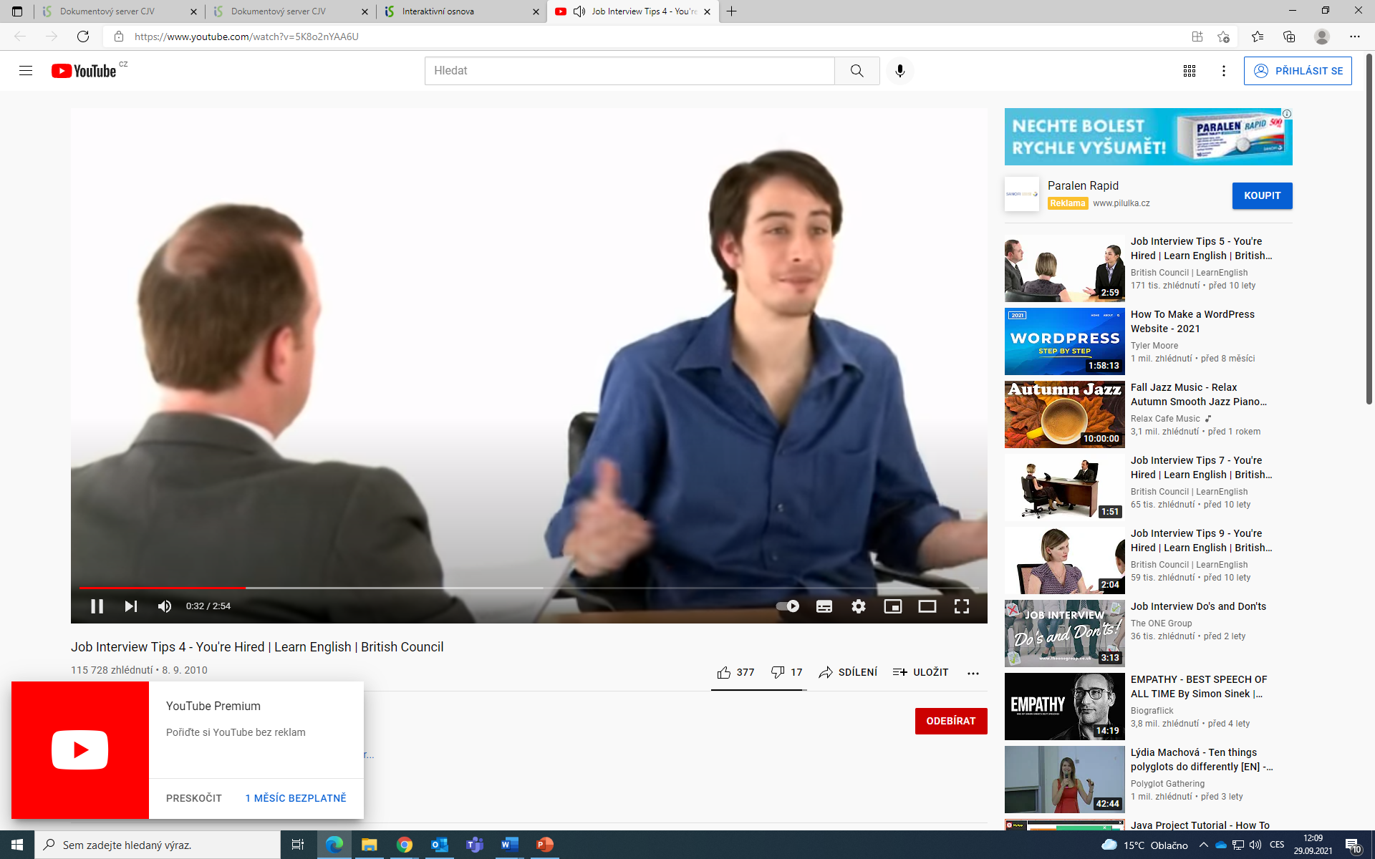
XI. Interview with Daniel – comment using adj. from ex. II.

Slide 19
XII. Homework
Watch an interview with Sara and decide what makes her performance successful

