Slide 1
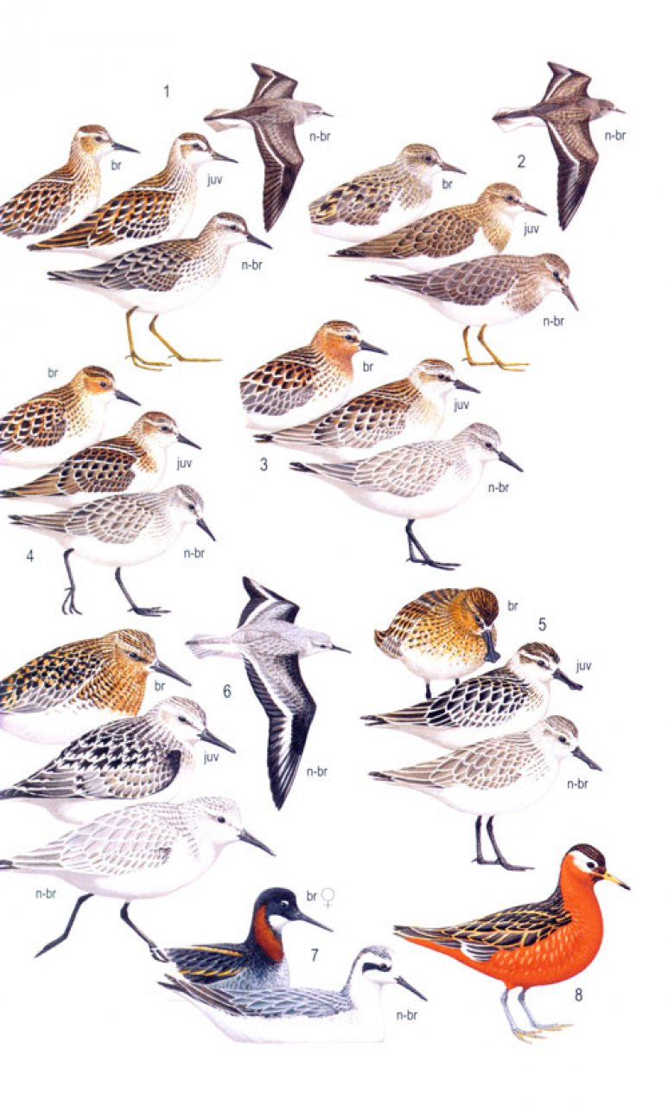


Molecular identification
Species, individual, sex

Slide 2

Identification of species
DNA barcoding

Slide 3
WHAT THE SPECIES IS AND DO WE NEED THEM?

Slide 4
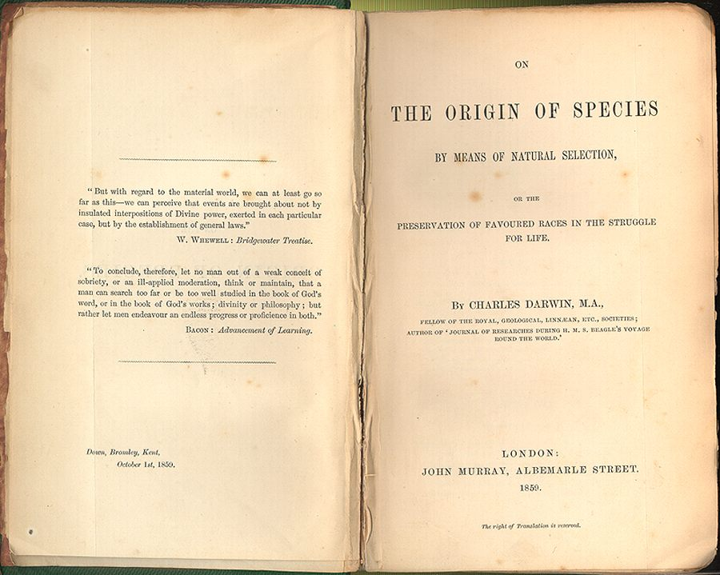
Is it possible to define a species?
It is really laughable to see what different ideas are prominent in various naturalists minds, when they speak of „species“; ... It all comes, I believe, from trying to define the indefinable.
C. Darwin, 24 Dec 1856
(Letter to J.D. Hooker)

Slide 5
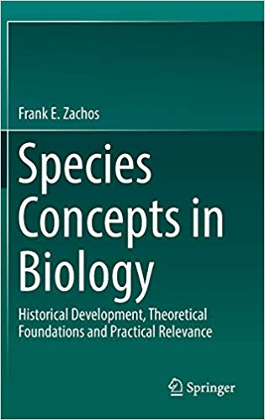
Species concepts in biology
Agamospecies
Biological
Biosimilarity
Cladistic
Cohesion
Compilospecies
Differential Fitness
Ecological
Evolutionarily Significant Unit
Evolutionary
Genealogical
Genealogical Concordance
General Lineage
Genetic
Genic
Genoypic cluster
Hennigian
Internodal
Least Inclusive Taxonomic Unit
Morphological
Non-dimensional
Nothospecies
Phenetic
Phylogenetic (Diagnosability Version)
Phylogenetic (Monophyly Version)
Phylo-Phenetic
Pragmatic
Recognition
Reproductive Competition
Successional
Taxonomic
Unified

Slide 6
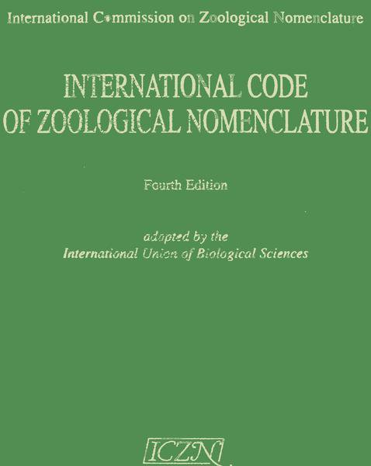
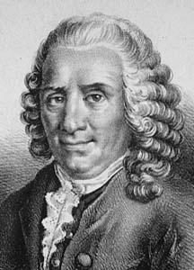
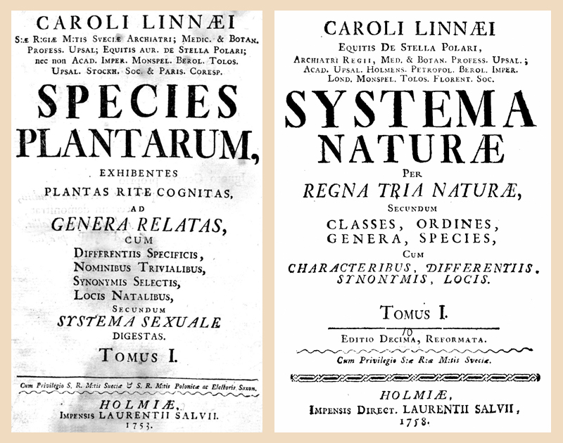
Morphological Species Concept
= the smallest groups that are consistently and persistently distinct, and distinguishable by ordinary means
Aristoteles → Linnaeus → rules of zoological nomenclature
does not take evolution into account
Linnaeus, Carolus (1707 - 1778)

Slide 7
Biological Species Concept
= interbreeding natural populations reproductively isolated from other such group
reproductive isolation mechanisms (RIM) = post- or prezygotic barriers of reproduction
most popular – it is intuitive and it was promoted most successfully (e.g. by influential evolutionary biologists of the 20th century as main concept of Modern Synthesis)
problems: allopatric and allochronic populations/species, ...
Mayr, 1942

Slide 8
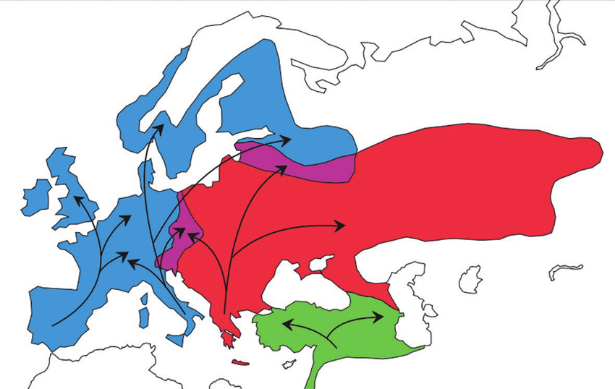
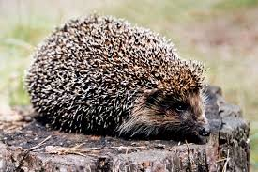
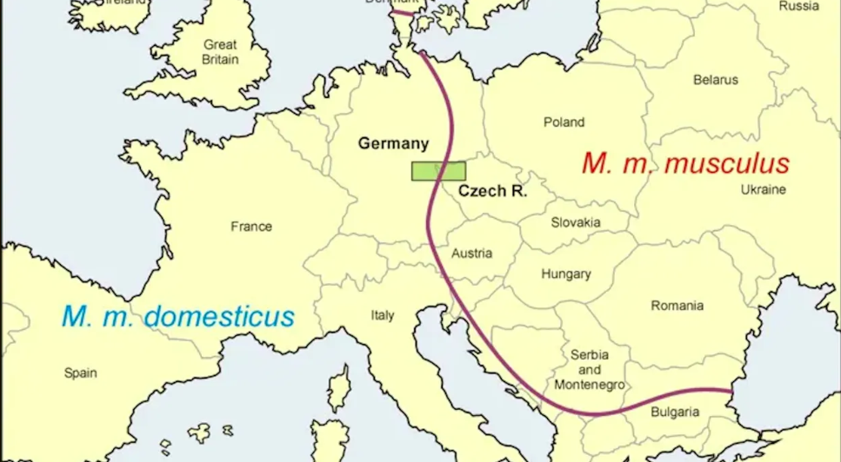
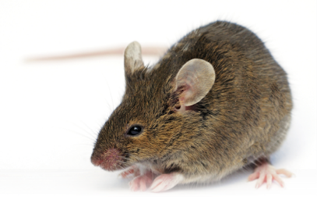
Complications: Parapatric contact zones
Erinaceus – distinct species (minimal hybridization)
house mice – distinct subspecies (substantial hybridization)
E. roumanicus
E. europaeus
Bolfiková and Hulva 2012
Macholán et al. 2008

Slide 9
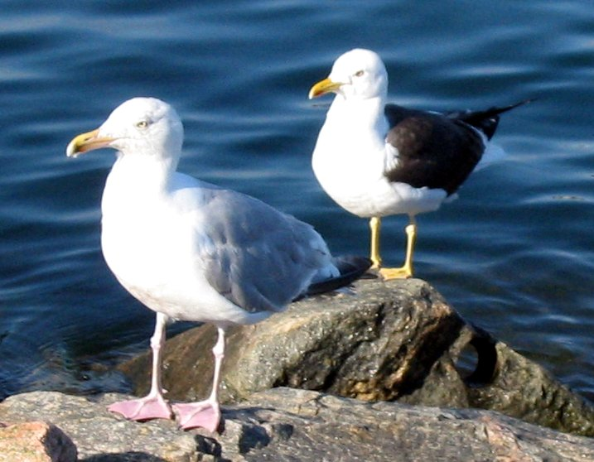
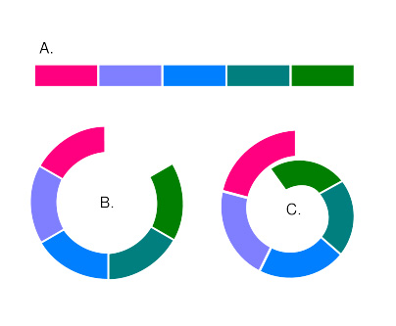
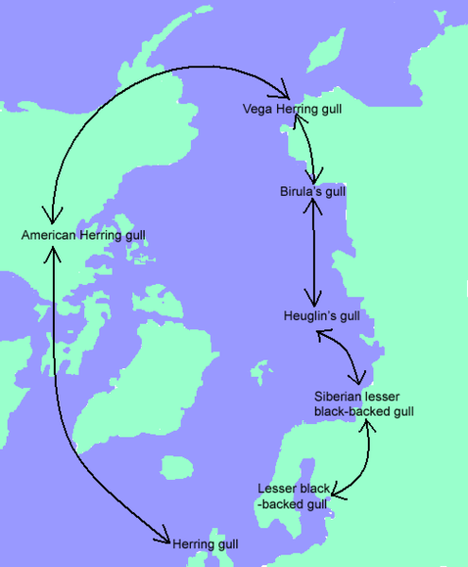
Complications: Ring species
Larus

Slide 10
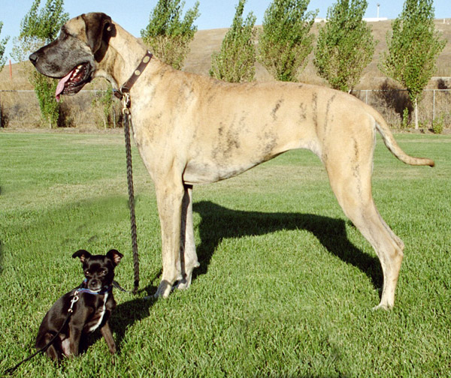
Complications: Physical constraints

Slide 11
Phylogenetic species concept (Diagnosability Version)
= the smallest population or group of populations, within which there is a parental pattern of ancestry and descent
two populations are considered species if they are 100% diagnostic (e.g. discriminant analysis of morphometric data or allele frequency data)
recent paradigmatic shift from the Biological Species Concept to Phylogenetic Species Concept
extreme cases: descendants of a single mother with a mutation at mtDNA can be 100% diagnosed (i.e. should be considered species)
Cracraft, 1983, Cracraft 1997

Slide 12
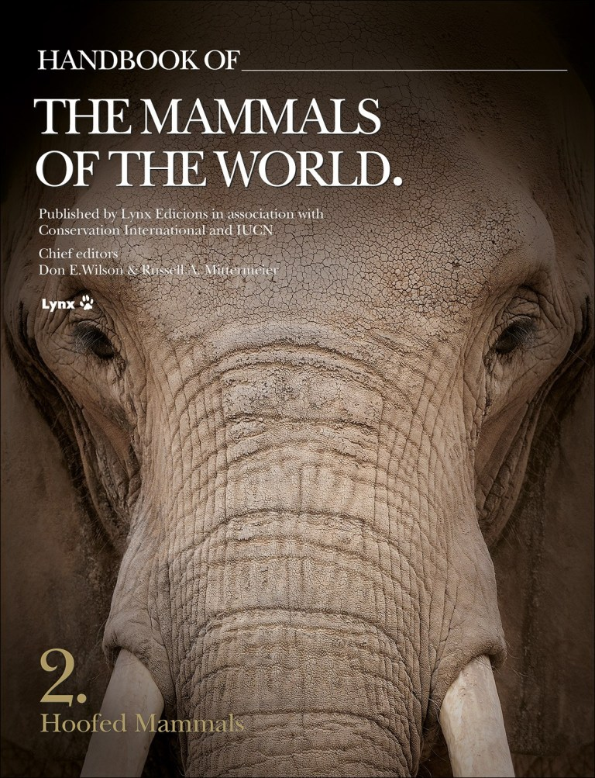
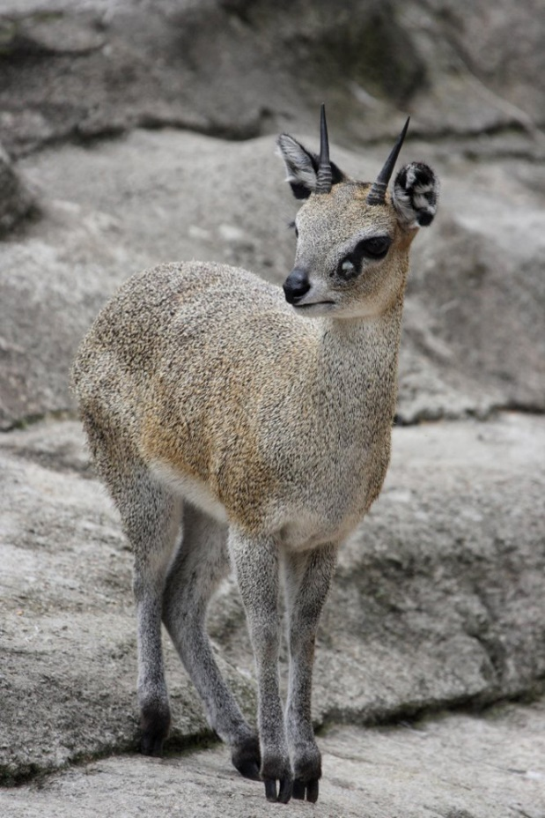
Example: Taxonomy of ungulates
increase from 143 (Grubb 2005) to 279 (Groves and Leslie 2011 -Handbook of the Mammals of the World) species of bovid ungulates
klipspringers Oreotragus – from one to 11 species

Slide 13
Consequences intensively debated
„pros“papers
„cons“ papers

Slide 14
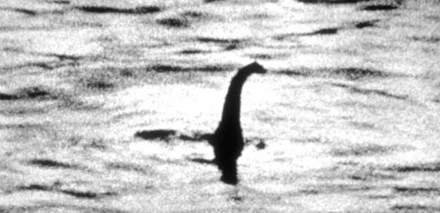
Why does it matter? The power of names!
description of Nessiteras rhombopteryx in Nature
„the Loch Ness monster“ – if indeed it does exist, it exists in small numbers and deserves protection
to be protected it must have a taxonomic name
Rinnes and Scott 1975, Nature

Slide 15
Why does it matter? Taxonomic inflation.
inflation leads to devaluation
tigers (Panthera tigris) have been split into two species based on 3 diagnostic bp in the mitochondrial cytochrome b (P. tigris and P. sumatrae) (Cracraft et al. 1998)
genetic drift of some other populations in India has already led to the fixation of unique haplotypes
„The fact that tigers are dwindling towards extinction will thus cause a multitude of new tiger „species“ – before they all vanish“ (Zachos 2016)
PSC → increase of threatened species – many species will have low population sizes and distribution ranges (IUCN RED List criteria) – e.g. US Endangered Species Act – increase from US$4.6 billion to US$7.6 billion for full recovery of all species

Slide 16
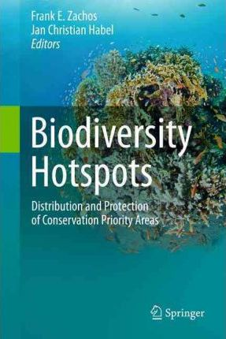
Why does it matter? Biodiversity research.
species richness is a function of the underlying species concept
often comparing „apples and oranges“
36 biodiversity hotspots (at least 1500 endemic vascular plants species and 70% of primary vegetation has been destroyed)
more than US$1 billion for conservation in biodiversity hotspots
Mittermeier et al. 2011

Slide 17
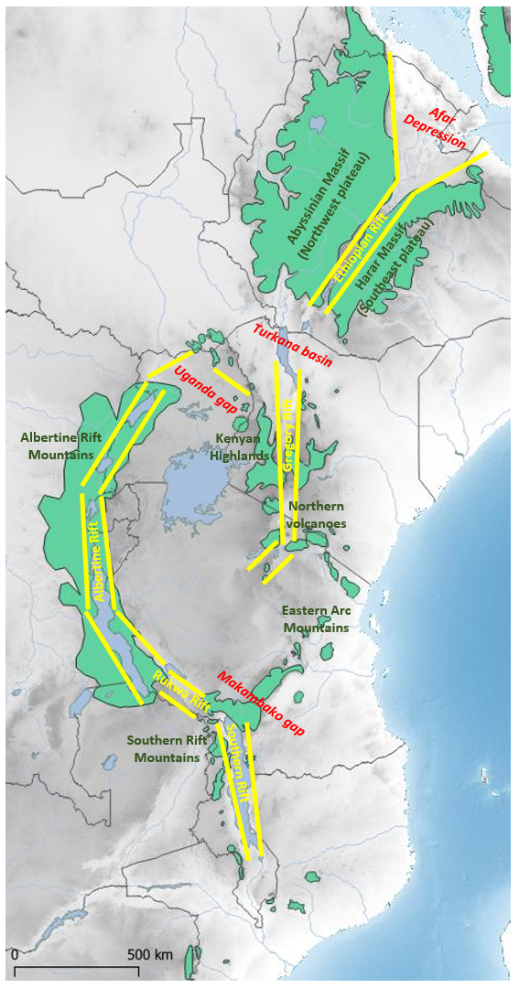
Eastern Afromontane Biodiversity Hotspot (EABH)
ARABIAN
PLATE
NUBIAN PLATE
SOMALIAN PLATE
Albertine Rift – considered as the most diverse part of EABH
Ethiopian Highlands – the most neglected part of EABH despite the large area and geomorphological diversity
examples from rodents

Slide 18
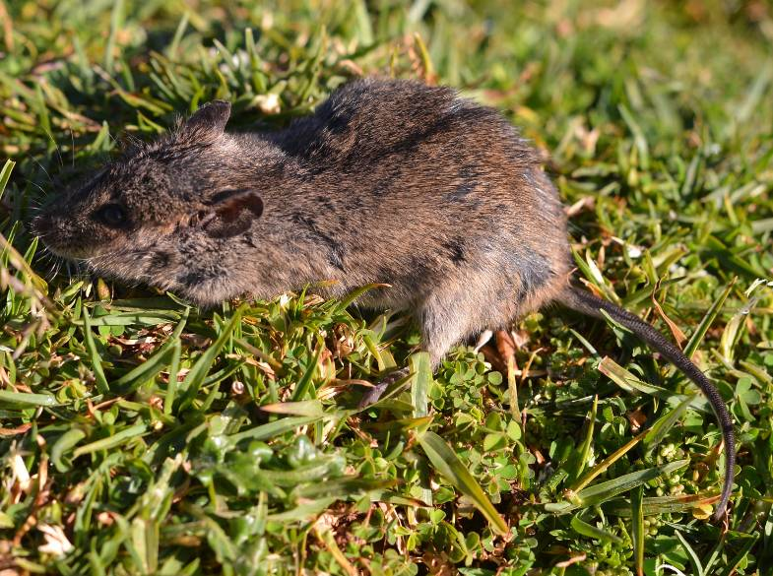
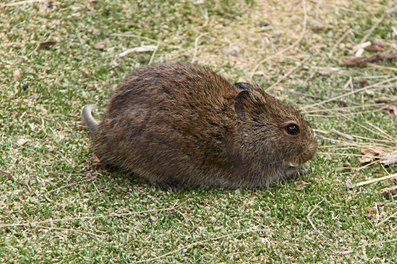
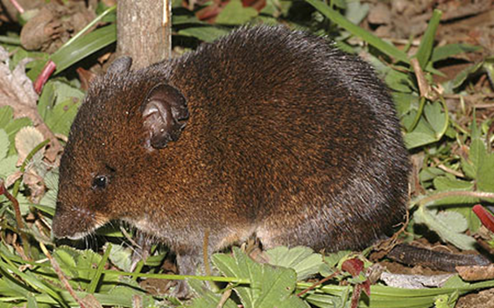
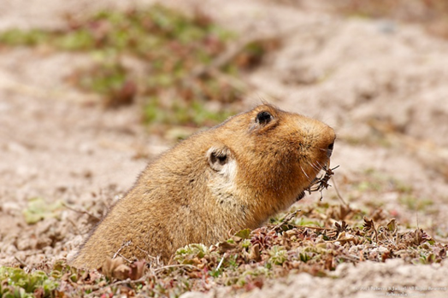
„Ethiopian craddle“
ARABIAN
PLATE
Mus (Nannomys)
NUBIAN PLATE
SOMALIAN PLATE
Otomys typus group
Lophuromys flavopunctatus group
Tachyoryctes
e.g. Bryja et al. 2019, Folia Zoologica

Slide 19
„out of Ethiopia“
root rats (Tachyoryctes)
T. macrocephalus (ETH)
T. „splendens“ (1 sp. in Ethiopia, 12 spp. in Kenya and Albertine rift )
the highest evolutionary diversity in Ethiopia (5 species using PSC)
a single colonization of Kenyan Highlands and Albertine Rift Mts.
Šumbera, ..., Bryja 2018, Mol Phyl Evol

Slide 20
HOW CAN GENETICS BE HELPFUL IN SPECIES IDENTIFICATION?

Slide 21
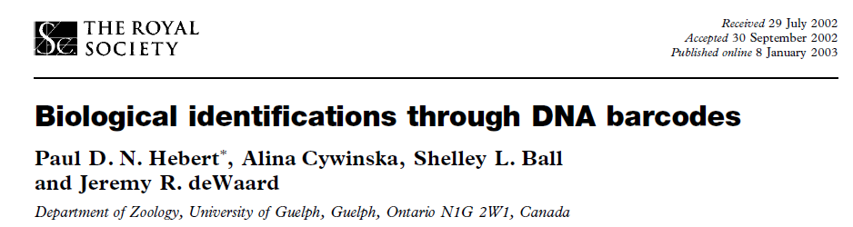


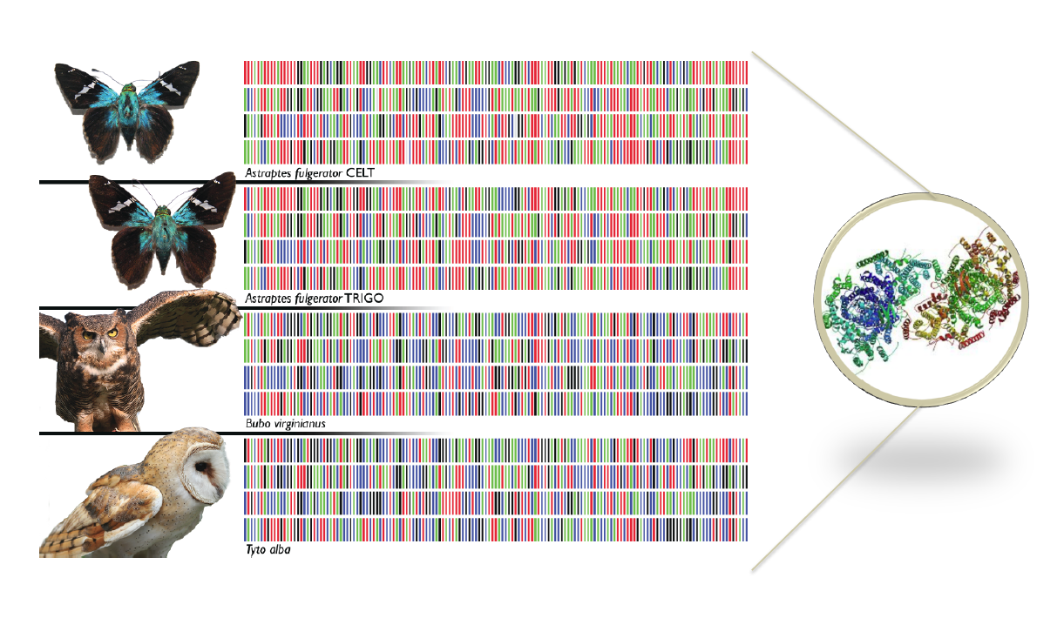
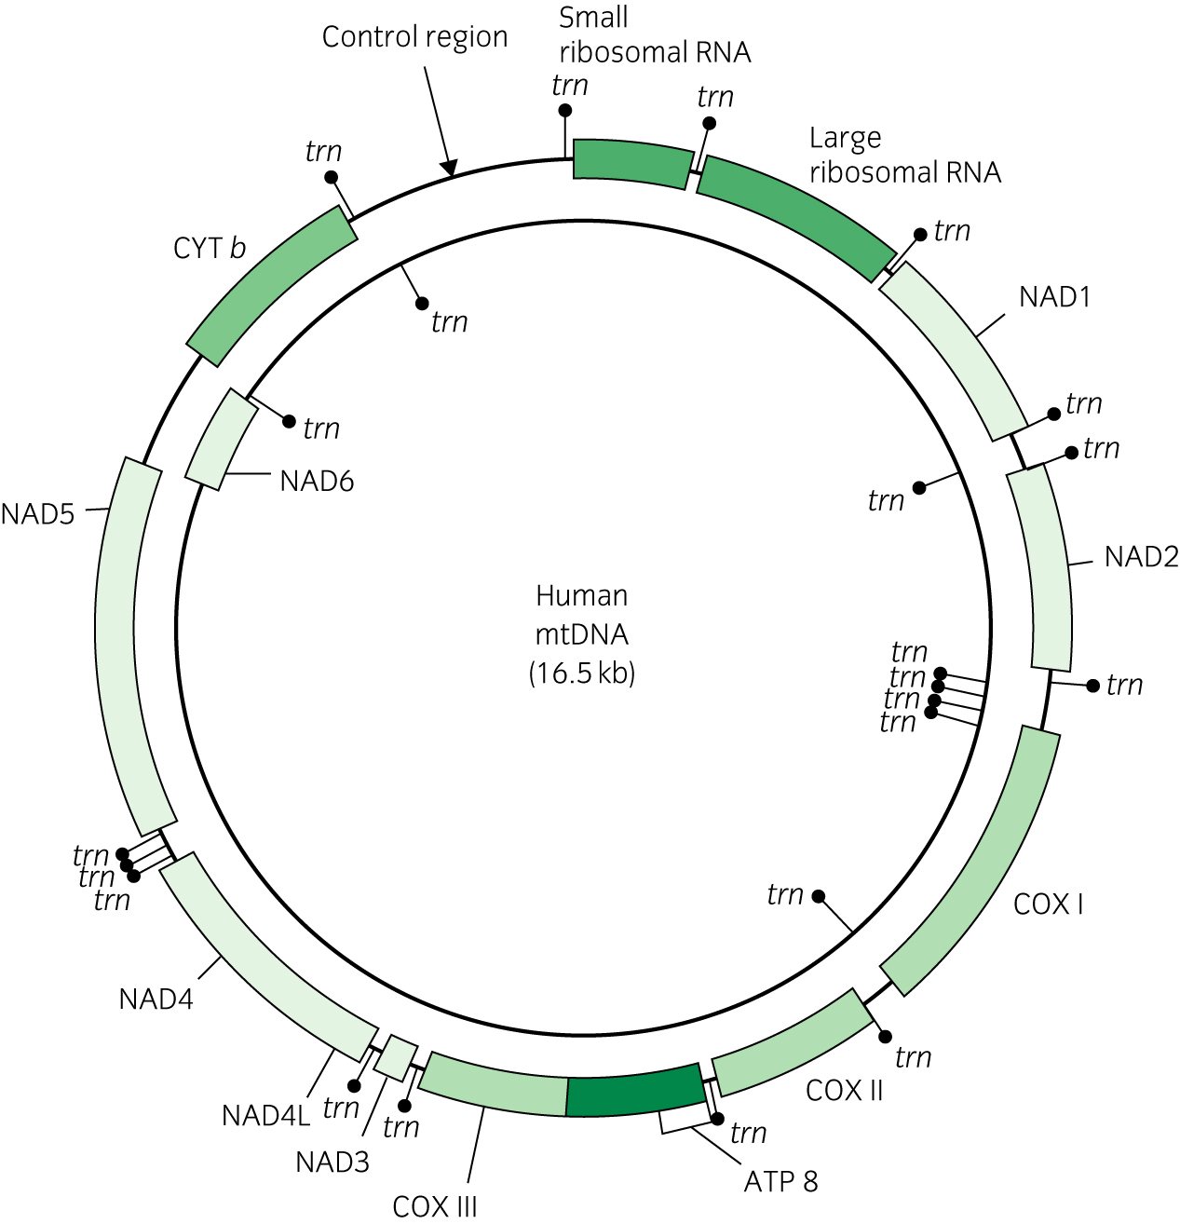
CBOL in 2005
iBOL 2010-2015
first idea in 2003
500 000 species barcoded in 2015
„DNA barcode“ – short fragment of mitochondrial DNA

Slide 22
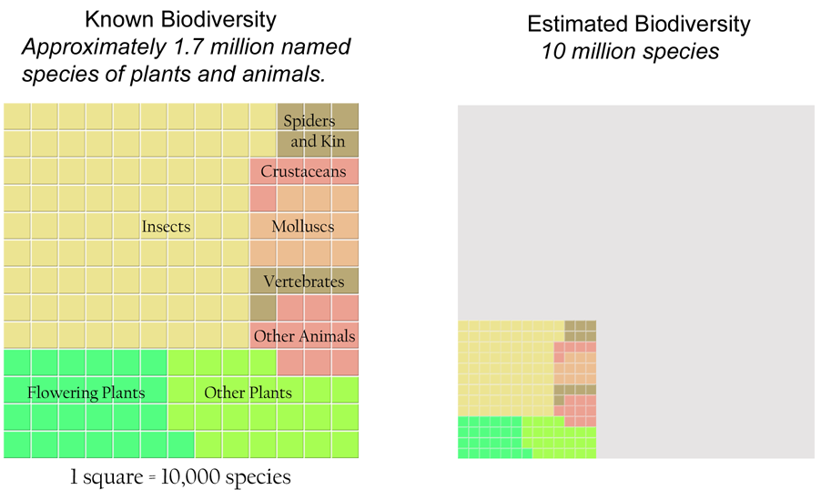
Why barcode animal and plant species?

Slide 23
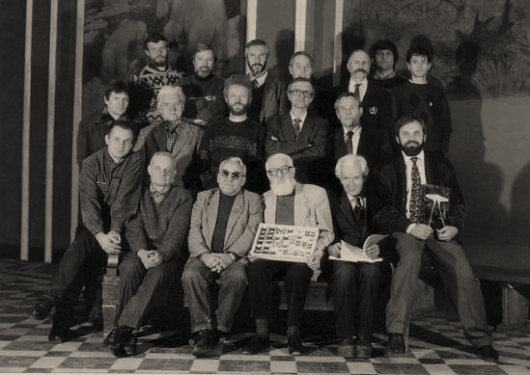
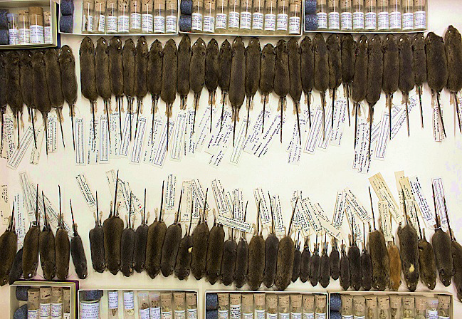
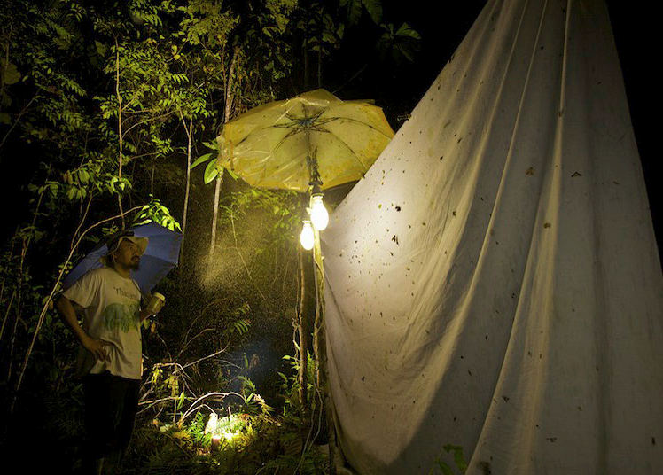
Crisis of biodiversity and classical taxonomy
DNA barcoding is important part of „integrative taxonomy“

Slide 24
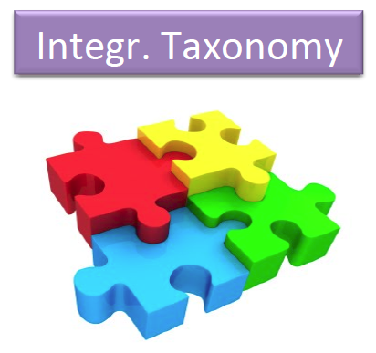
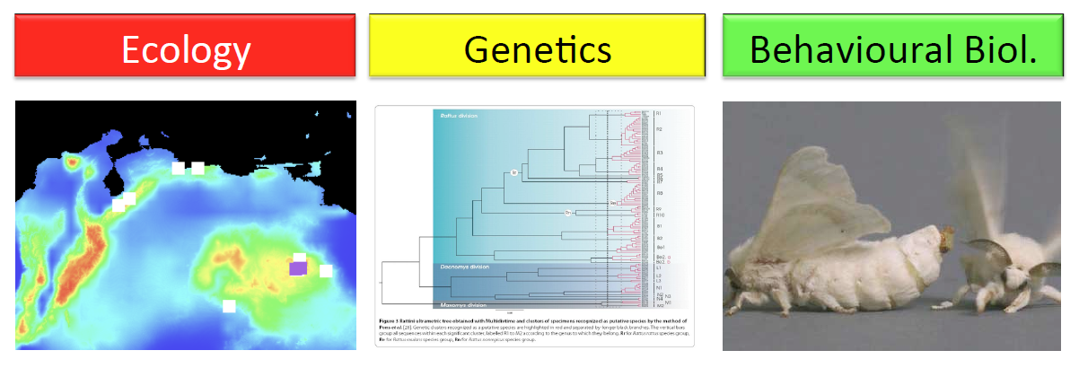
Integrative taxonomy

Slide 25
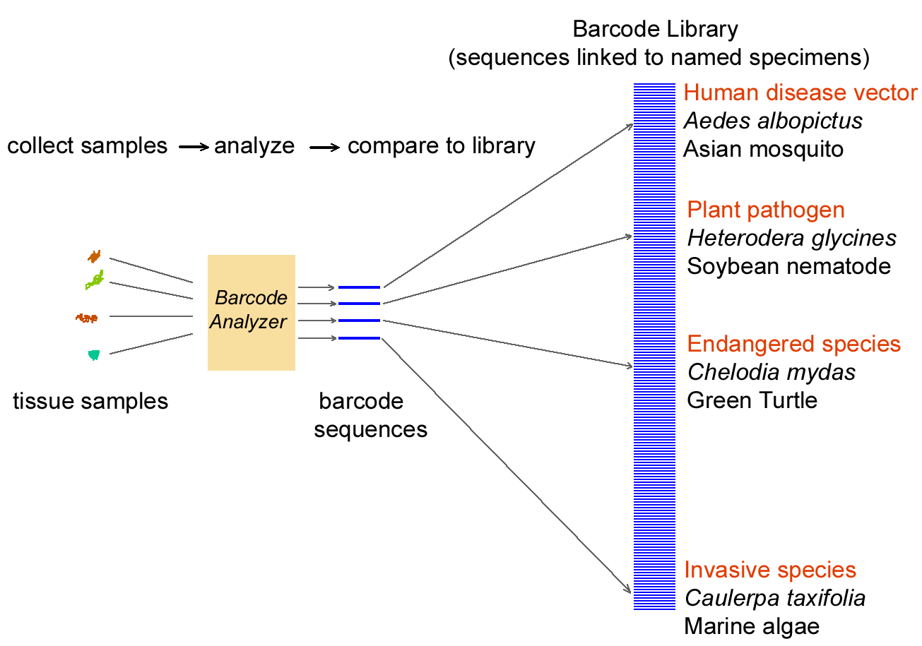
What are the benefits of standardization?
Suitable standard for animals → mtDNA

Slide 26
Why barcode animals with mitochondrial DNA?
Four properties make mitochondrial genomes especially suitable for identifying species

Slide 27
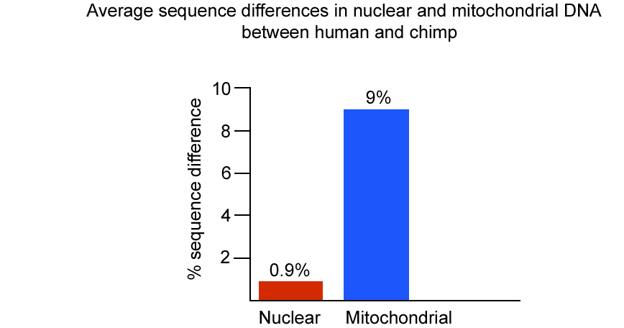
1. Greater differences among species, on average 5- to 10-fold higher in mitochondrial than in nuclear genes (lower N_{e} for mtDNA). Thus shorter segments distinguish among species, and because shorter, less expensively.

Slide 28
2. Relatively few differences within species in most cases. Small intraspecific and large interspecific differences signal distinct genetic boundaries between most species, enabling precise identification with a barcode.
3. Copy number There are 100-10,000 more copies of mitochondrial than nuclear DNA per cell, making recovery, especially from small or partially degraded samples, easier and cheaper.
4. Introns, which are non-coding regions interspersed between coding regions of a gene, are absent from mitochondrial DNA of most animal species, making amplification straightforward. Nuclear genes are often interrupted by introns, making amplification difficult or unpredictable.

Slide 29
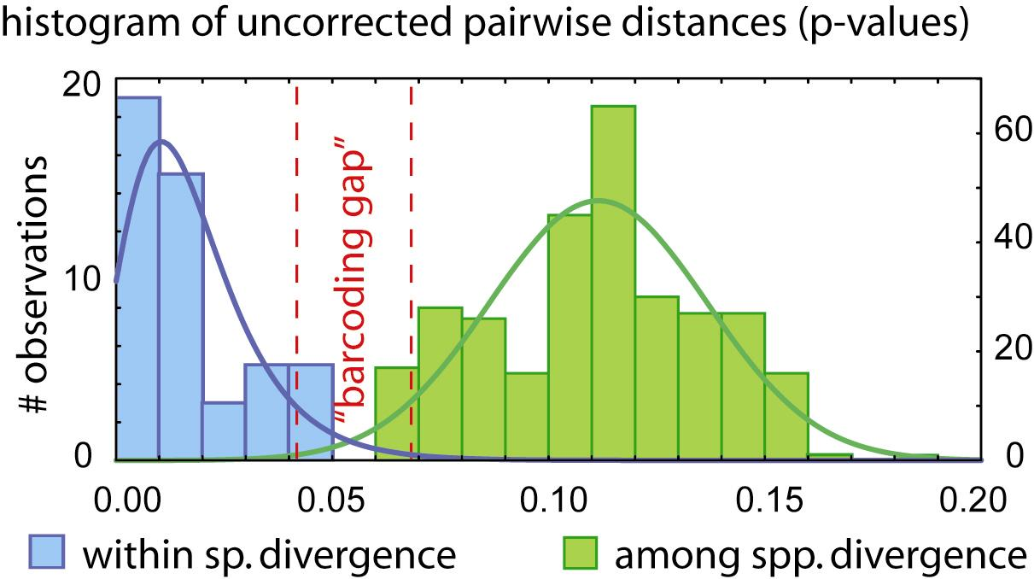
Barcoding principle

Slide 30
Barcoding principle

Slide 31
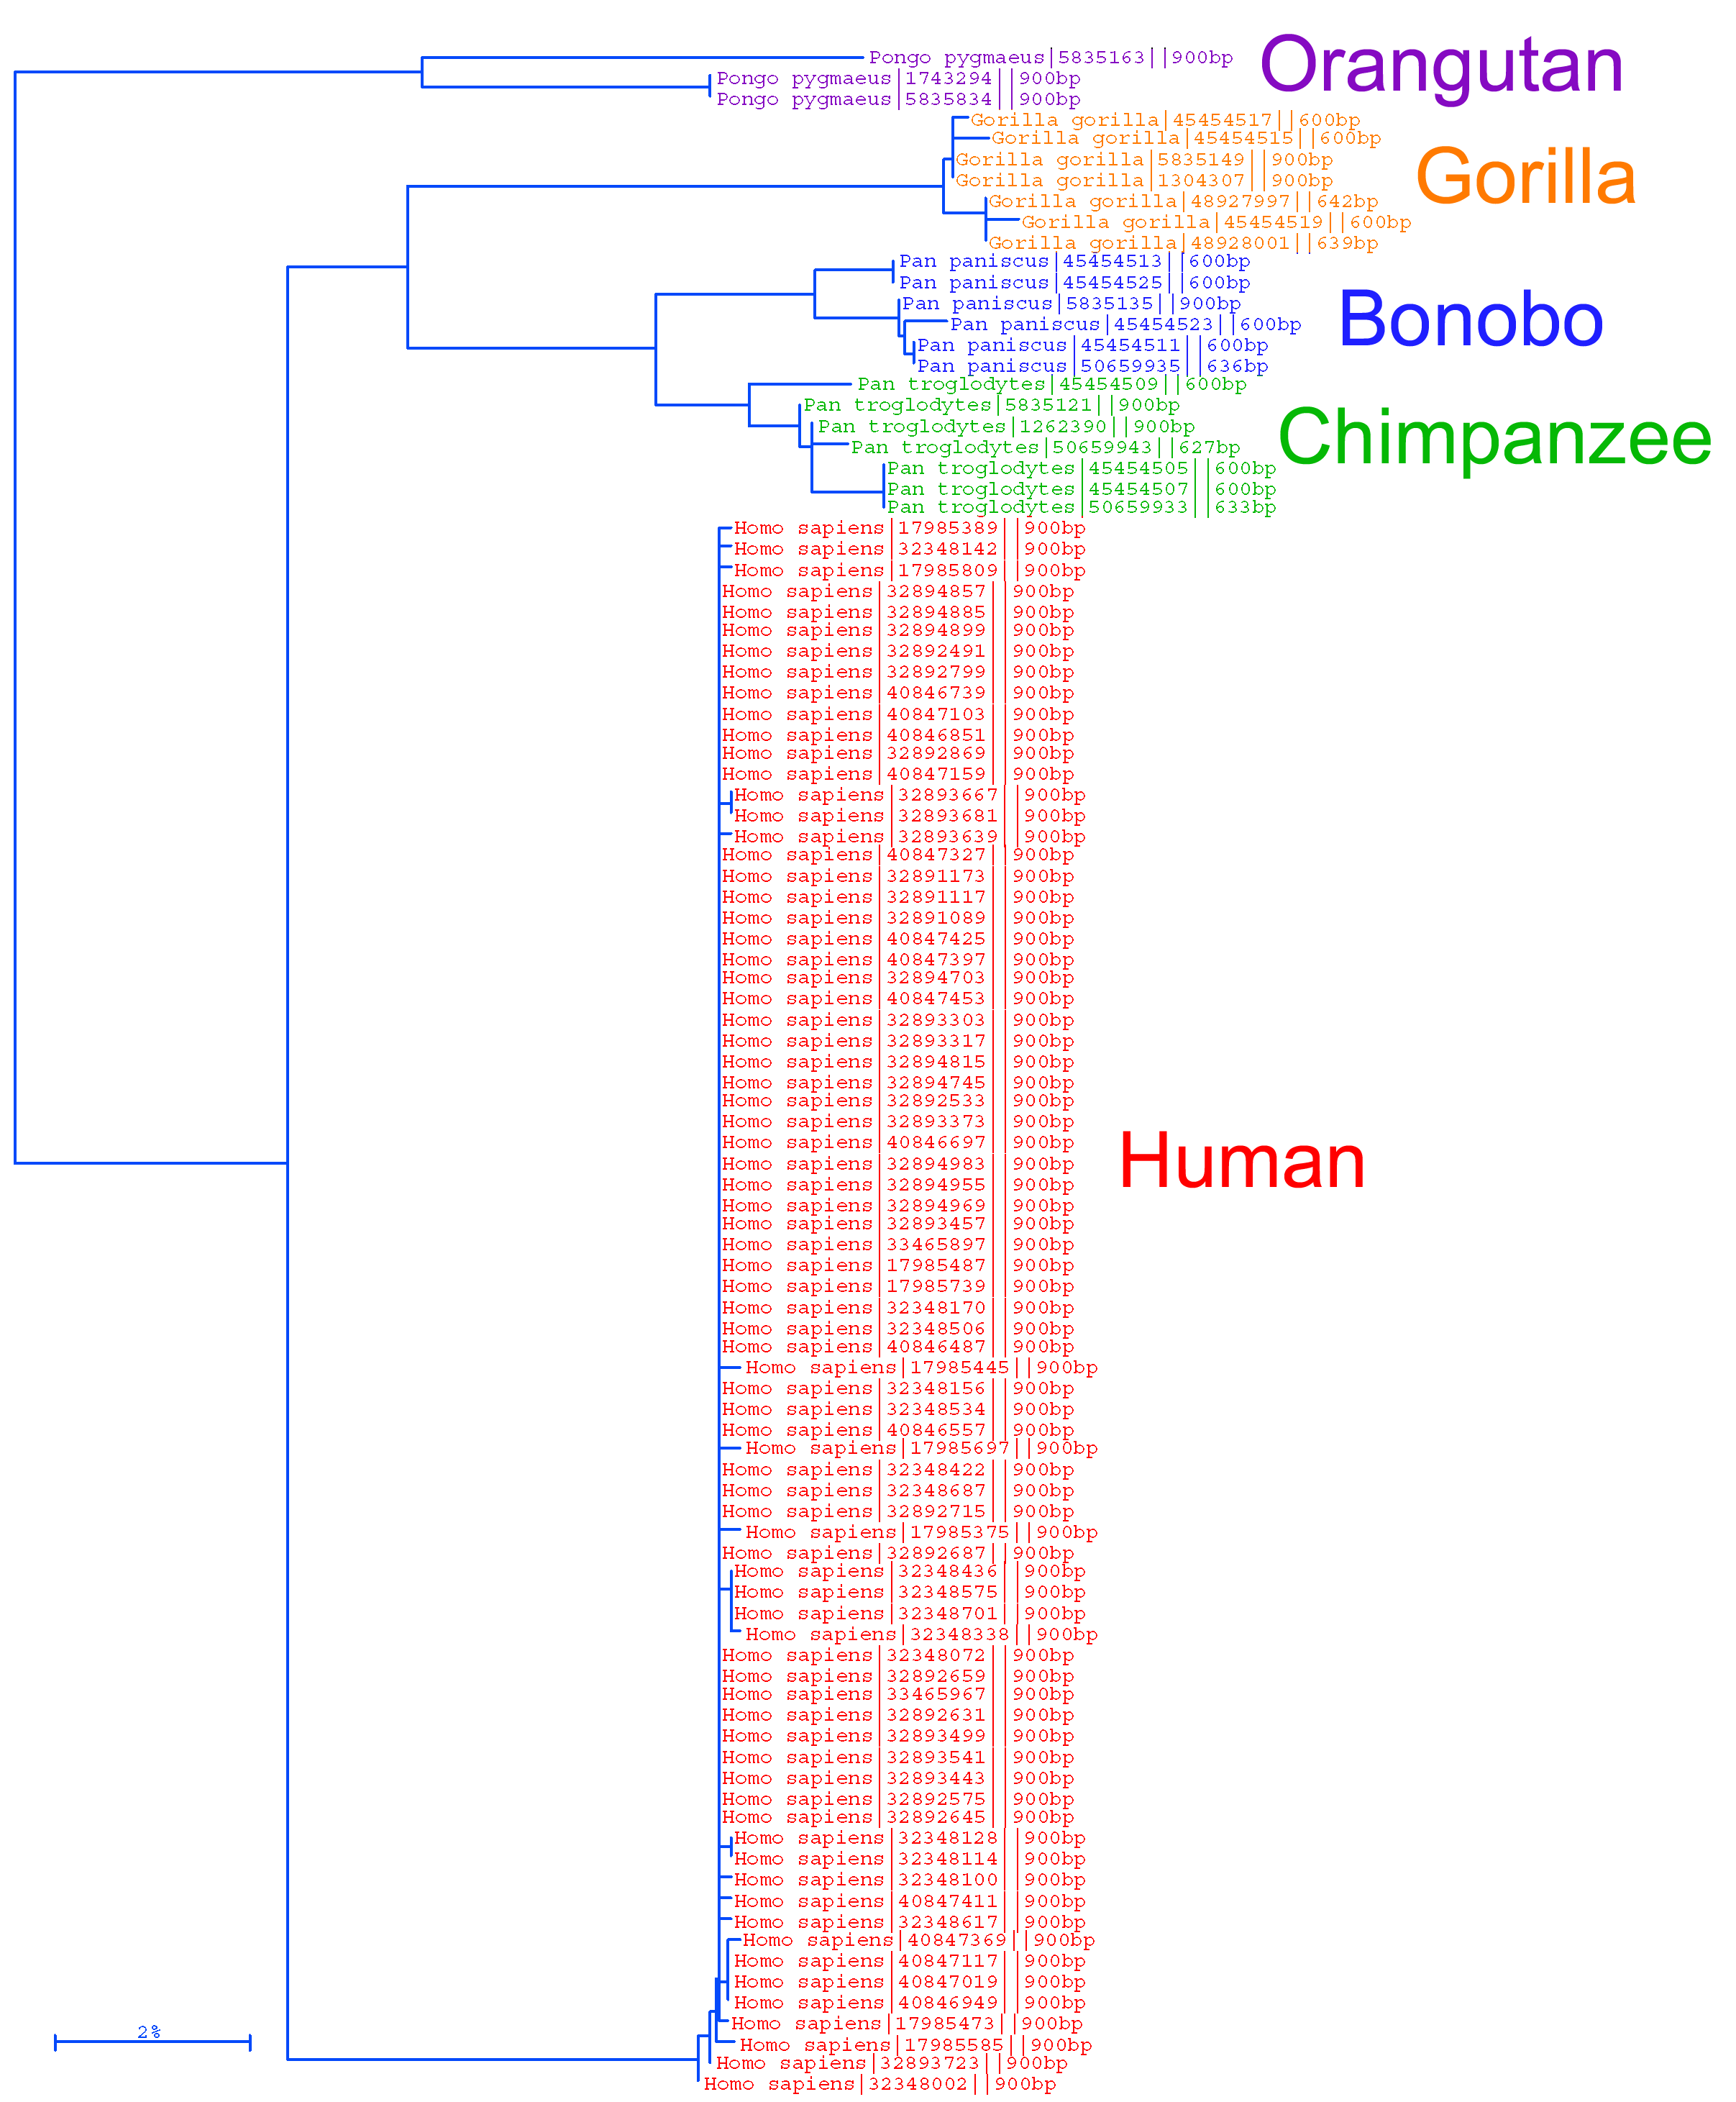
Barcodes affirm the unity of the species Homo sapiens
Comparisons show we differ from one another by only 1 or 2 nucleotides out of 648, while we differ from chimpanzees at 60 locations and gorillas at 70 locations.
For animals, a 658 base-pair fragment of the mitochondrial gene, cytochrome oxidase subunit I (mtCOI) – consensus for iBOL consortium
for particular taxonomic groups, also other barcodes are widely used - e.g. cytochrome b for mammals

Slide 32
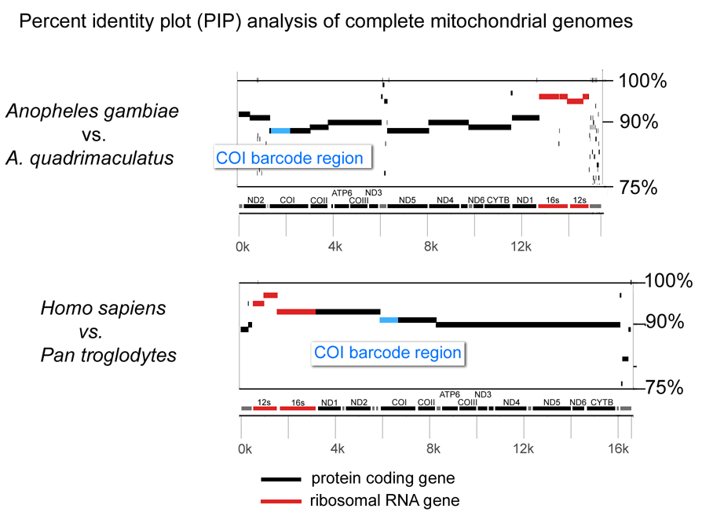
Cytochrome c oxidase I (COI or CoxI) contains differences representative of those in other protein-coding genes
Possible gains in accuracy or cost using a different protein-coding gene would likely be small.

Slide 33
Focus to date
For animals, a 658 base-pair fragment of the mitochondrial gene, cytochrome oxidase subunit I (mtCOI) – consensus for iBOL consortium
For plants, mitochondrial genes do not differ sufficiently to distinguish among closely related species. Promising markers are genes on cpDNA: matK and rbcL
For bacteria, a 16S-rDNA emerges as very useful marker (especially when using next-generation sequencing)

Slide 34
What do barcode differences among and within animal species studied so far suggest?
barcodes identify most animal species unambiguously
approximately 2-5% of recognized species have shared barcodes with closely-related species - many of them hybridize regularly
in all groups studied so far, distinct barcode clusters with biological co-variation suggest cryptic species

Slide 35
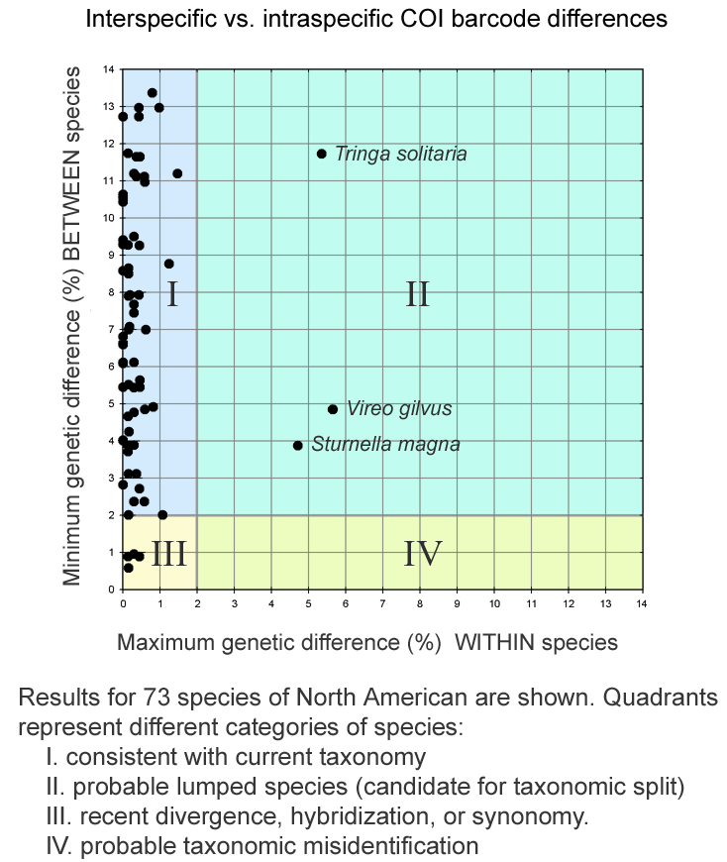
Barcoding North American birds

Slide 36
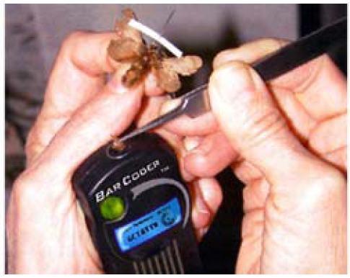

A barcoder?

Slide 37
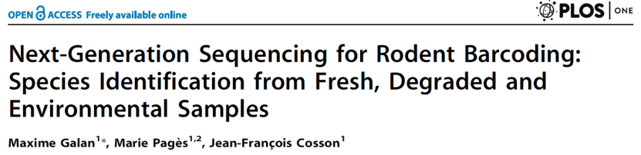
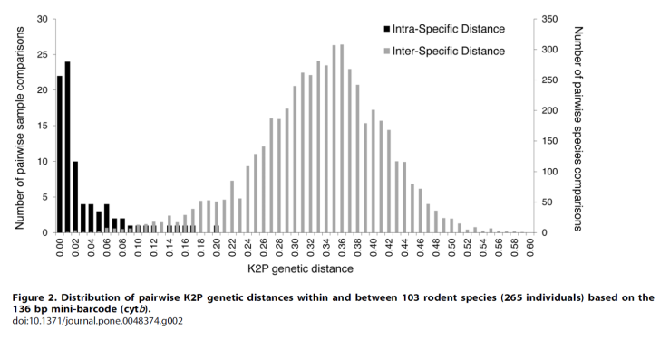

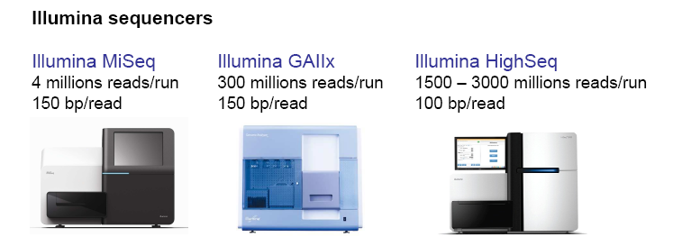
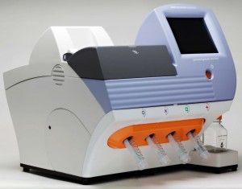
Next generation sequencing of amplicons
Metagenomics
community of microorganisms
PCR of 16S (18S) rRNA
it is also possible to quantify (to some extent)
3. Analysis of contaminated samples
2. Diet composition
COI barcoding (carnivores)
chloroplast (cp)DNA (herbivores)

Slide 38
A barcoder? ... COMING SOON

Slide 39
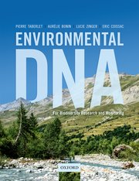
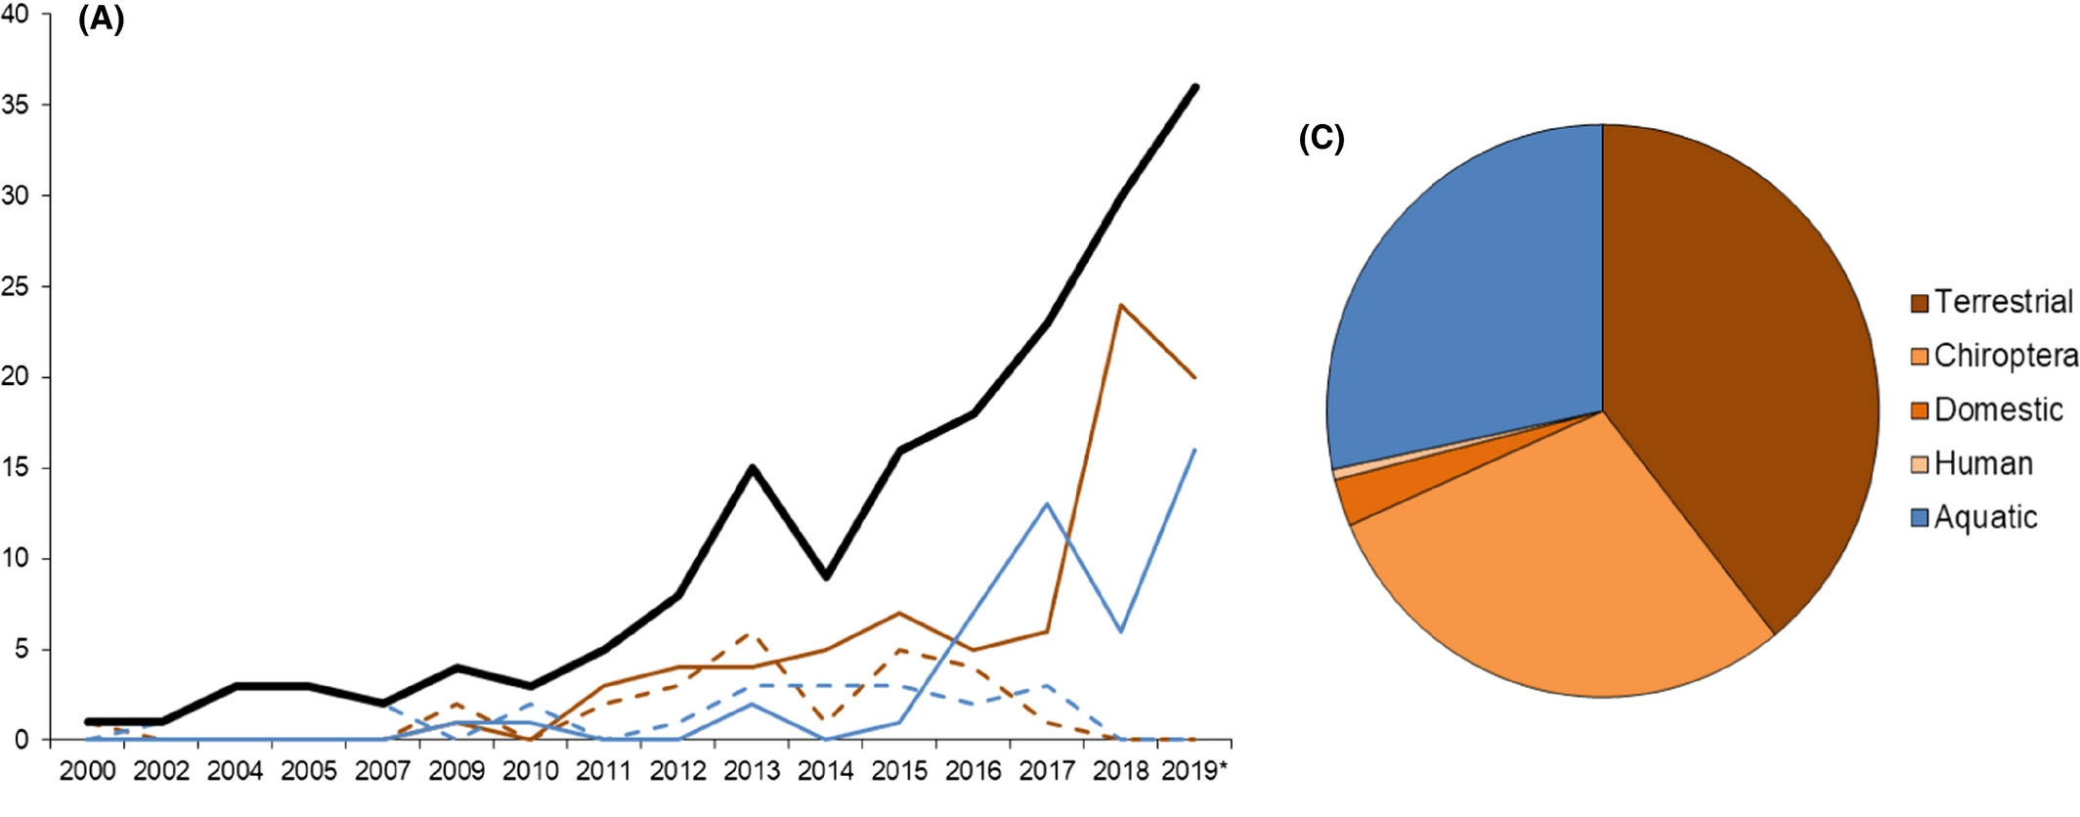
Metabarcoding/eDNA
Diet analysis
Bold black line = Total number of studies per year; thin straight lines: high‐throughput next‐generation sequencing techniques; thin dashed lines: Sanger sequencing method or other traditional molecular technique, e.g., RFLP)
identification of MOTUs („molecular operational taxonomic units“)

Slide 40
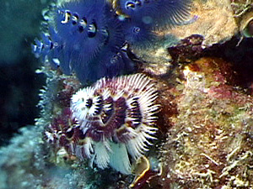
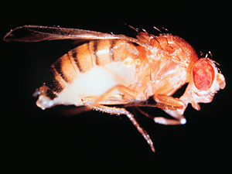
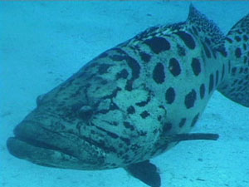
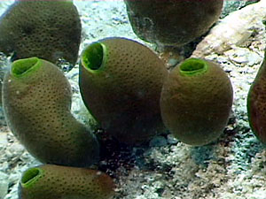
What isn’t DNA Barcoding?
it is not intended to, in any way, supplant or invalidate existing taxonomic practice
it is not DNA taxonomy; it does not equate species identity, formally or informally, with a particular DNA sequence
it is not intended to duplicate or compete with efforts to resolve deep phylogeny (e.g., Assembling the Tree of Life, ATOL)

Slide 41
DO WE REALLY BARCODE SPECIES?

Slide 42
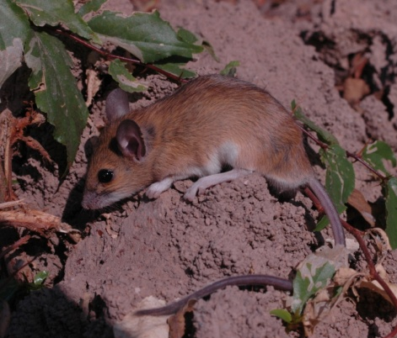
What is a species?
mtDNA tree
(=DNA barcoding)
Five species based on mtDNA barcoding – min. 7% divergence (cyt b)
Two species based on phenotype?
daltoni - paraphyletic
derooi - commensal
Praomys daltoni complex
Bryja et al. 2010 Mol Ecol; Mikula, ..., Bryja 2020 Biol J Linn Soc

Slide 43
Phylogeographic structure at mtDNA
M
D
B
C1
A
C2
Dahomey gap
Bryja et al. 2010 Mol Ecol; Mikula, ..., Bryja 2020 Biol J Linn Soc

Slide 44

Partial mtDNA introgression in Dahomey gap
nuclear microsatellites
mtDNA of Clade A („daltoni“)
mtDNA of Clade C2 („derooi“)
mtDNA
Bryja et al. 2010 Mol Ecol

Slide 45
Morphological differentiation
Skull size
Skull shape
Mikula, ..., Bryja 2020 Biol J Linn Soc

Slide 46
What is a species?
M
D
B
C1
A
C2
Bryja et al. 2010 Mol Ecol; Mikula, ..., Bryja 2020 Biol J Linn Soc

Slide 47
Morphology and ecology
Remaining clades = P. daltoni (paraphyletic; mostly non-commensal)
M
D
B
C1
A
C2
Clade C2 = P. derooi
(exclusively commensal)
2 species
Bryja et al. 2010 Mol Ecol; Mikula, ..., Bryja 2020 Biol J Linn Soc

Slide 48
Karyotypes
M
D
B
C1
A
C2
2 species
Bryja et al. 2010 Mol Ecol; Mikula, ..., Bryja 2020 Biol J Linn Soc

Slide 49
MtDNA phylogeny + microsatellites + karyotypes
M
D
B
C1
A
C2
4 species
Bryja et al. 2010 Mol Ecol; Mikula, ..., Bryja 2020 Biol J Linn Soc

Slide 50
Phylogenetic species concept – splitting approach
M
D
B
C1
A
C2
6 species
Bryja et al. 2010 Mol Ecol; Mikula, ..., Bryja 2020 Biol J Linn Soc

Slide 51

What is a species?
„A fundamental difficulty facing biologists interested in genetic delimitation of species is that in order to delimit species they must first be defined. Species definitions intermingle with species concepts and the lack of consensus in this field poses a serious dilemma for the „delimiters“. If systematists cannot agree on what defines a species, how can geneticists possibly develop objective methods to identify one?“
Bruce Rannala, Current Zoology 2015

Slide 52
What are the main limits to barcoding encountered so far?

Slide 53
What are the main limits to barcoding encountered so far?
horizontal gene transfer
nuclear pseudogenes
heteroplasmy (paternal leakage)
gene tree vs. species tree
hybrids – mtDNA introgression

Slide 54



1. Horizontal gene transfer
Wolbachia within an insect cell
(25-70% species of insects)

Slide 55


Results of nuclear and mitochondrial DNA do not match
AFLP
mtDNA
Ellipses = candidates for horizontal gene transfer
Horizontal transfer of mtDNA through Wolbachia
(among closely related species, at the level of genera the barcoding is OK)
Symbols correspond to the type of Wolbachia infection

Slide 56



2. Pseudogenes
Heterozygotes in mtDNA → be careful!
NUMTS = „nuclear copy of mtDNA sequences
Relatively often for cytochrome b

Slide 57

How to recognize numt?
- ultracentrifugation (fresh samples required)
- the use of tissues with high proportion of mitochondria (e.g. muscles)
- long-range PCR (or sequence complete mtDNA)
- RT-PCR (pseudogenes are not transcribed)
- indels, stop codons
- cloning
cryptic numts

Slide 58
number of suggested barcoded taxa based on 3% divergence on COI with/without numts (identified by stop-codons and indels)

Slide 59

3. Heteroplasmy
paternal leakage
well studied mitochondrial disorders in human
low N_{e} of mtDNA → usually fast fixation of new mutations – mitochondrial bottleneck

Slide 60
Paternal leakage
allele-specific real-time quantitative PCR (RT-qPCR) → heteroplasmie je asi častý jev
14 % jedinců, ale velmi nízká frekvence druhého haplotypu
paternal leakage 6 %

Slide 61
4. GENE TREES VS. SPECIES TREES
STATISTICAL MULTI-LOCUS SPECIES DELIMITATION

Slide 62
Allopatric speciation model
time
Mayr 1942

Slide 63
Dobzhansky-Muller incompatibility
a
B
a
B
a
B
A
B
a
B
A
B
A
b
A
B
A
b
A
b
A
B
genetic incompatibility
(negative epistatic interaction)
A
b
Dobzhansky 1936, Muller 1942

Slide 64

Phylogeny at the level of populations and species
Species are metapopulation lineages > new methods for DNA-based species delimitation
Gene trees
Vital to understanding the process of speciation
Span intraspecific and interspecific evolution
A
B
C
A
B
C
>>
(Wright-Fisher process)
Species phylogeny
Population genetics:
coalescence process
Notes:
The idea that species are metapopulation lineages has led to the development of new DNA-base species delimitation methods.
Genes that show variation within species will be phylogenetically informative below and above the species level.
Gene trees are vital to understanding the process of speciation because they span intraspecific and interspecific evolution.
When we think about a phylogeny, we typically think about species relationships in a tree. But within the branches of this tree there is population genetics going on, which can be modeled as a coalescence process.

Slide 65




Phylogeny at the level of populations and species
Barriers to gene flow
coalescence process
: individual organisms / allele copy
Notes:
This is how the process runs:
Each circle may represent an individual organism, but in this case it represents an allele copy of a specific gene.
You start out with a set of allele copies in the first generation.
Then you create the next generation by selecting copies from the first generation at random
For the next generation you do the same, but this time you sample from the second generation
… and so on. This is how the process runs within a population or species.
When populations become separated by a barrier to gene flow, you can sample allele copies only from individuals within the same population, ...

Slide 66

Phylogeny at the level of populations and species
separately evolving metapopulation lineages
A
B
C
Time
T2
T1
Notes:
... and this well eventually result in separately evolving metapopulation lineages
So this figure illustrates two speciation events at time T1 and T2.
This process, running inside the species tree, has two consequences: …

Slide 67

Phylogeny at the level of populations and species
A
B
C
Trans-species polymorphism
Notes:
When we colour the entire figure, we can see two important things:
- First we see that in the course of time allele frequencies will change within one species, and that in some cases alleles will be lost alltogether. For example in this case the yellow allele was initially dominant and was gradually lost in time and replaced by the blue allele.
- Secondly, when new species are formed, newly formed species will largely contain ancestral alleles. As a result identical alleles are shared between different species, known as trans-species polymorphism. For example, initially all three newly formed species contained the dominant blue allele. In present time, the “green” alleles are shared between species A&B, and the “blue” alleles between species B&C.

Slide 68

Phylogeny at the level of populations and species
A
B
C
>>
Trans-species polymorphism
3 species:
Not reciprocally monophyletic
Notes:
When we would construct a gene tree at this stage, we would find that early diverging species are not necessarily monophyletic in their alleles at a studied locus.
In this case species C is paraphyletic because it includes all descendant alleles from this common ancestor here, except for this blue one here.
Species B is polyphyletic because for one set of alleles it shares a common ancestor with species A, while the other alleles are more closely related to species C.
- Species A is in principle monophyletic because it contains all the descendant alleles of a common ancestral allele from the same species. However, in practice, a phylogenetic analysis might not recover species A as monophyletic as it shares the green alleles with species B.

Slide 69


Phylogeny at the level of populations and species
A
B
C
Reciprocal monophyly
>>
Fixation of alleles
3 species:
Reciprocally monophyletic
Notes:
As time goes by, alleles will become fixed in the species, which will result in reciprocal monophyly. The relationships between the alleles of a studies locus will correspond to the species.
So in this example, species A, B and C are monophyletic because in each species the alleles share a single common ancestor, which

Slide 70
Phylogeny at the level of populations and species
A
B
C
Gene genealogies below and above the species level are different in nature
species delimitation
population genetics
phylogenetics
Notes:
Now what this figure shows is that although gene genealogies below and above the species level are different in nature, young lineages reside within a zone where both processes meet.
Therefore species delimitation should incorporate aspects of both population genetics and phylogenetics.

Slide 71
Single-locus delimitation methods
gene tree lineages that are found in different species cannot coalesce to a common ancestor („no interspecific gene flow“)
general mixed Yule coalescent model (GMYC) – model the transition point between cladogenesis and allele coalescence
prone to over-delimitation
similar appraches: mPTP, ABGD („automated barcoding gap detection“)
should be combined with other approaches

Slide 72


Generalized mixed Yule-coalescent model (GMYC; Pons et al. 2006)
red = intraspecific branching (coalescent process)
black = branching between species (Yule model including speciation and extinction rates)
Mus (Nannomys) mattheyi
Senegal, Dar Salam, 2006
Photo by J. Červený
→ splitting of species („taxonomic inflation“)
Bryja et al. 2014, BMC Evol Biol

Slide 73

Mus minutoides
Bryja et al. 2014 BMC Evol Biol

Slide 74



Mus minutoides
monophyletic clade M. minutoides
12 „species“ identified by GMYC approach (3.27-6.96% K2P-distance among lineages)
mostly parapatric distribution
spatial genetic structure is similar to other widely distributed savanna species = intraspecific phylogeographic structure
Bryja et al. 2014 BMC Evol Biol
type locality

Slide 75
→ Correction of number of possible taxa
„GMYC identified species“ collapsed to MOTUs (= putative species) if:
(1) parapatric distribution of sister lineages
AND
(2) genetic distances among sister lineages lower than 7% (treshold based on M. minutoides)

Slide 76
MOTUs vs. genetic distances
27 MOTUs
(collapsed from 49 species identified by GMYC)
7% on cytochrome b
(suggested as the arbitrary treshold by the genetic species concept for mammals; Baker and Bradley, 2006)
„barcoding
gap“
Between
species
Within
species

Slide 77

27 MOTUs after correction of GMYC delimitations
27 MOTUs (7.2-19.2% distance)
Mus minutoides

Slide 78
How many species of Nannomys?
NOT INCLUDED (4)
indutus
Sp. 1 (gratus?)
oubanguii
orangiae
setzeri
tenellus?
Sp. 2 (gerbillus?)
minutoides
musculoides
mattheyi
Sp. 3 (kasaicus?)
haussa
Sp. 4 (Tchad)
baoulei
Sp. 5 (cf. baoulei?)
neavei
Sp. 6 (Dakawa)
sorella
Sp. 7 (Harena)
triton
Sp. 8 (Kikwit)
imberbis
Sp. 9 (Kenya)
Sp. 10 (proconodon?)
Sp. 11 (cf. setulosus?)
setulosus
bufo
mahomet
VALID NAMES (14-15)
NEW SPECIES (11-12)
Bryja et al. 2014 BMC Evol Biol

Slide 79
Multi-species coalescence for species delimitation
multi-locus data
BPP (joint estimates of species delimitation and species tree)
spedeSTEM
STACEY
and others

Slide 80
Multilocus data, multi-species coalescence
A
B
C
A
B
C
locus 1
locus 2
Notes:
Now what this figure shows is that although gene genealogies below and above the species level are different in nature, young lineages reside within a zone where both processes meet.
Therefore species delimitation should incorporate aspects of both population genetics and phylogenetics.

Slide 81

Example: 6 nucler loci in Stenocephalemys
STACEY - species delimitation
Bryja et al. 2018, Mol Phyl Evol

Slide 82
Example: 6 nucler loci in Stenocephalemys
StarBEAST – species tree
Bryja et al. 2018, Mol Phyl Evol

Slide 83


Integrative taxonomy of Stenocephalemys
anchored phylogenomics (388 nuclear loci)
Mizerovská et al. 2020

Slide 84


Incongruent results from empirical systems
Aliatypus spiders
Acomys spiny mice
Carstens et al. 2013
Aghová, ..., Bryja 2019, BMC Evol Biol

Slide 85
MSC identifies population structure, not species
„until we develop genomic-based species delimitation approaches that are able to discriminate between population- and species-level structuring, it is important not just to recognize, but to treat and report the units delimited under MSC at best as tentative hypotheses of species“
Sukumaran and Knowles, 2017, PNAS

Slide 86
Is it possible to define a species?
It is really laughable to see what different ideas are prominent in various naturalists minds, when they speak of „species“; ... It all comes, I believe, from trying to define the indefinable.
Darwin 1856

Slide 87
THE RISE OF GENOMICS – CAN IT HELP?

Slide 88



High-throughput sequencing (HTS)
unprecedented increase of genetic data
„several-loci“ approaches for species delimitation applicable with difficulties – computationally demanding → new approaches for HTS data are highly required (and are intensively developed)

Slide 89







Alternative approaches for species delimitation from genomic data
ancestral lineage in Ethiopian highlands, where diversified and sourced the colonization of other mountains (mostly in Pleistocene)
Lophuromys flavopunctatus complex
V. Komarova
D. Kostin
O. Mikula
A. Bryjová
D. Čížková

Slide 90

Nine endemic species in Ethiopia

Slide 91


Lophuromys flavopunctatus group in Ethiopia
Are there really nine well-delimited species?
What is their distribution, co-occurrence patterns, ecological requirements? -> IUCN assessment, etc.
cca 500 specimens from all major mountain ranges barcoded at mtDNA
4 nuclear markers (two introns + two exons)
genomic approach (ddRAD sequencing) → thousands of SNPs across the genome

Slide 92


ddRADseq: co-ancestry matrix
209 individuals
15 623 informative loci
9 „gene pools“
by InfoMap algorithm
Mikula et al., in prep.

Slide 93
Maximum likelihood analysis of concatenated nuclear dataset
Sanger sequencing
ddRADseq
97
menageshae
100
2n = 70
92
77
100
100
chercherensis
77
100
94
pseudosikapusi
100
86
94
simensis
100
100
44
flavopunctatus
100
88
2n = 68
100
83
95
91
brunneus
100
99
100
100
brevicaudus
100
100
100
100
100
2n = 60
melanonyx
98
2n = 54
chrysopus
100
4 nuclear markers
(2 604 bp concatenated dataset)
15 623 informative loci
Komarova, Kostin, Bryja et al., Mol. Ecol., 2020

Slide 94












2n = 70
2n = 54
2n = 68

Slide 95
5. MITOCHONDRIAL INTROGRESSION AND A UNIFYING SPECIES CONCEPT (?)

Slide 96
Dobzhansky-Muller incompatibility
genetic incompatibility
(negative epistatic interaction)
„MAGIC TRAITS“
a
B
A
B
a
B
a
B
A
b
X
A
B
A
b
A
b
a
a
m
m
A
M
a
A
X
A
M
a
M
A
A
A
Hill, 2019
mitonuclear incompatibility

Slide 97
Oxidative phosphorylation (OXPHOS) by electron transport system (ETS)
red = mt genes blue = N-mt genes
(mtDNA) (nDNA)
Rand et al. 2004

Slide 98
Co-adaptation of mt and N-mt genes
mitonuclear incompatibility
Hill 2019

Slide 99

Mitonuclear coevolution as the genesis of speciation
Hill 2016, 2017

Slide 100
Mitonuclear compatibility species complex
= a species is a population that is genetically isolated from other populations by incompatibilities in uniquely coadapted mt and N-mt genes
the need of mitonuclear coadaptation is universal among eukaryotes
species boundaries become objective and defensible
determining species boundaries would no longer be an esoteric intellectual exercise
„species“ is exclusively a eukaryotic concept
Hill 2016, 2017, 2018, 2019

Slide 101
CBOL in 2005
iBOL 2010-2015
first idea in 2003
500 000 species barcoded in 2015
„DNA barcode“ – short fragment of mitochondrial DNA

Slide 102


Introgression/replacement of mtDNA in Myotis
Myotis blythii - Asia
Myotis myotis - Europe
Berthier et al. 2006

Slide 103
Myotis blythii vs. Myotis myotis
- mtDNA replacement
male
M. myotis - Europe
M. blythii - Asia

Slide 104
Myotis blythii vs. Myotis myotis
- mtDNA replacement
male
M. blythii - Asia
M. myotis - Europe
Tendency to back-crosses with males of M. blythii led to increase of proportion of M. blythii in Europe
Colonizing (invasive) species often adopt mtDNA of original speices (Currat et al. 2008)

Slide 105
Hares in Spain and Portugal
three species of Lepus in Iberia have often mtDNA of L. timidus
but L. timidus dissappeared from Iberia at the end of last glacial period
neutral process – consequence of spatial expansion

Slide 106
Interspecific mtDNA introgressions in Lophuromys
ddRADseq
mtDNA
100
100
menangeshae
2n = 70
96
100
100
100
chercherensis
96
100
97
100
pseudosikapusi
82
93
100
simensis
96
100
89
100
100
flavopunctatus
100
2n = 68
100
99
100
100
brunneus
88
100
100
brevicaudus
100
100
100
100
melanonyx
100
100
2n = 60
100
2n = 54
97
chrysopus
15 623 informative loci
cytochrome b (1140 bp)
Komarova, Kostin, Bryja et al., Mol. Ecol., 2020

Slide 107
Interspecific mtDNA introgressions in Lophuromys
ddRADseq
mtDNA
100
100
menangeshae
96
100
100
100
chercherensis
96
100
97
100
pseudosikapusi
82
93
100
simensis
96
100
89
100
100
flavopunctatus
100
100
99
100
100
brunneus
88
100
100
brevicaudus
100
100
100
100
melanonyx
100
100
100
97
chrysopus
15 623 informative loci
cytochrome b (1140 bp)

Slide 108

Interspecific mtDNA introgressions can be surprisingly frequent
Borena Saynt National Park (central Ethiopia)
Photo: D. Mizerovská

Slide 109


Stenocephalemys
(Ethiopian endemics)
(A) anchored phylogenomics
(388 nuclear loci)
(B) complete mitogenomes
Mizerovská et al. 2020, J. Vert. Biol.

Slide 110



Borena Saynt NP
Lake Tana
Borena Saynt NP
Blue Nile
Awash
Stenocephalemys
Distribution of S. sokolovi sp. nov.

Slide 111



Borena Saynt NP
3500 m a.s.l.
sokolovi
Lake Tana
Borena Saynt NP
Blue Nile
albipes
2800 m a.s.l.
Distribution of S. sokolovi sp. nov.
Stenocephalemys
Distribution of S. albipes

Slide 112


Borena Saynt NP
anchored phylogenomic
ddRADseq
morphology
sokolovi
simensis
thalia
albipes
menageshae
yaldeni
Stenocephalemys
Lophuromys
Crocidura
(Mizerovská et al. 2020)
(Komarova et al. 2021)
(Konečný et al. 2020)

Slide 113
Borena Saynt NP, 3700 m a.s.l.
Is there somebody with „own“ mtDNA?

Slide 114




Borena Saynt NP, 3700 m a.s.l.
Otomys simiensis
Otomys typus
Arvicanthis abyssinicus
Dendromus
sp. n. 1
Crocidura
makeda n.sp.

Slide 115
Borena Saynt NP, 3700 m a.s.l.
Otomys simiensis
Arvicanthis abyssinicus
(ddRADseq)
Dendromus
sp. n. 1
Crocidura
makeda n.sp.
Otomys typus
(ddRADseq)

Slide 116
Possible evolutionary explanations
Non-adaptive explanation
rodents have male-biased dispersal – expanding males captures mtDNA of local species (see example with hares)
expansion due to climate change → low-elevation species should move up and capture high-elevation mtDNA
♂

Slide 117
Possible evolutionary explanations
Adaptive explanation no. 1
advantageous OXPHOS genes of low-elevation taxon
→ studies of energetic metabolism and co-introgression are required
co-introgression of N-mt genes (?)
climate change → increase of temperature
„speciation in reverse“

Slide 118
Possible evolutionary explanations
Adaptive explanation no. 2
„mutational erosion“ - replacement of non-functional high-elevation mtDNA (accumulation of mutations in small populations in fragmented Afroalpine habitats) – „best of bad options“
higher mutation rate (UV?)
lower N_{e} – higher fixation rate
lower mutation rate
higher N_{e}

Slide 119
CONCLUSIONS

Slide 120
Conclusions
species concepts and species delimitations are crucial parts of biodiversity studies
enormous value in applied conservation biology
genomics can be useful tool for species delimitation (analytical approaches still in development) – once they will be able to discriminate between population- and species-level structuring
mitonuclear compatitibility species concept is a good candidate for a unifying species concept

