Slide 1
Vítězslav Bryja
Buněčné regulace III:
Reakce na změny chemických a fyzikálních parametrů prostředí

Slide 2
Reakce tkání na změny v dostupnosti kyslíku a regulace angiogeneze
A) Detekce nedostatku kyslíku - Hypoxia inducible factor (HIF)
B) iniciace angiogeneze - vaskulární endotheliální růstový faktor VEGF/VEGFR
C) buněčné mechanismy angiogeneze (role Notch a angiopoetinové signalizace)

Slide 3
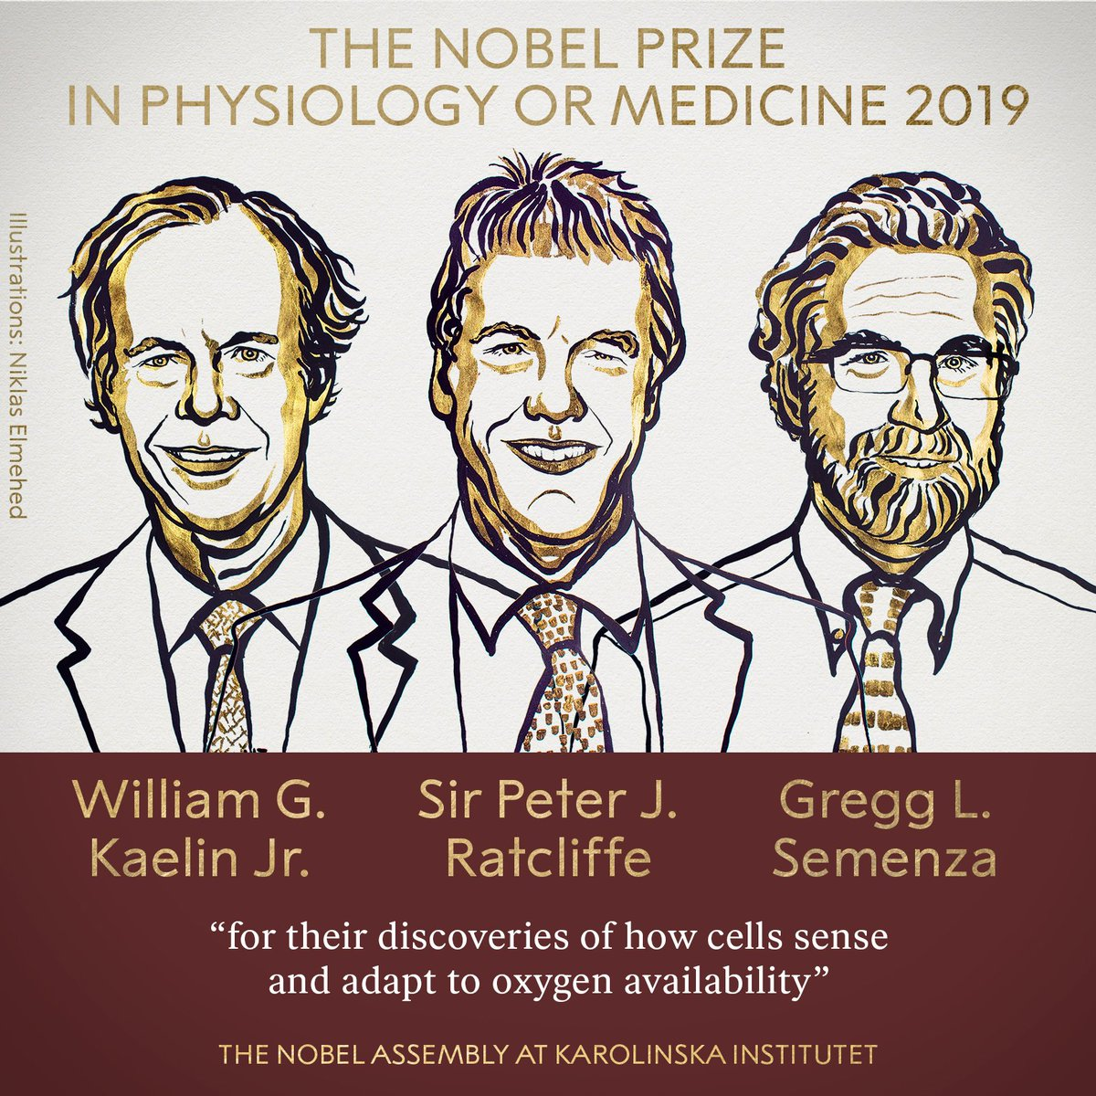

Slide 4
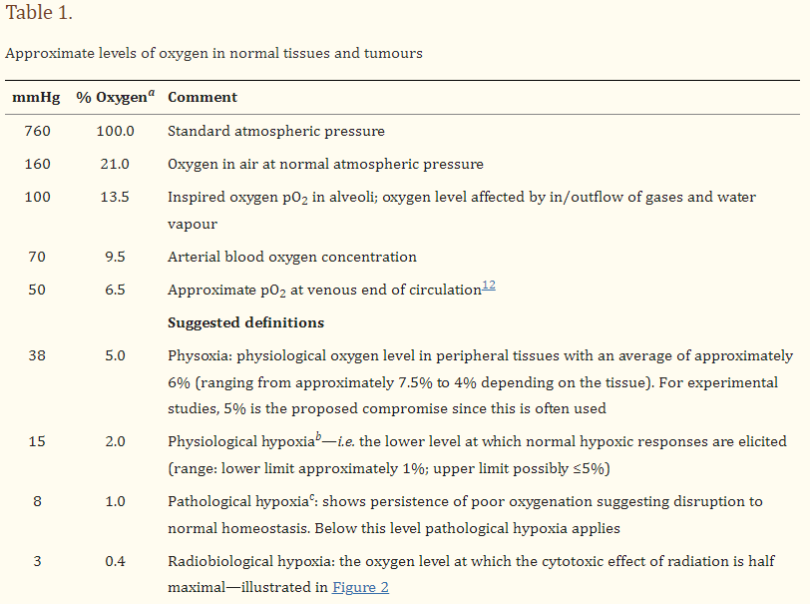
Hypoxie a HIF
O₂ se difuzí šíří asi na 150 µm
Hypoxie: snížený parciální tlak O₂ ve tkáni x normoxie

Slide 5
Hypoxie a HIF
O₂ se difuzí šíří asi na 150 µm
Hypoxie: snížený parciální tlak O₂ ve tkáni x normoxie
HIF – Hypoxia-Inducible Factor:
  Heterodimerický transkripční faktor aktivující geny obsahující v promotorové sekvenci HRE (Hypoxia response element), vlastní transkripce je iniciována pomocí koaktivátorů p300 a CBP (CREB-binding protein)
  Prozatím je známo kolem 60 (100) genů regulovaných HIF, řada z nich reguluje odpověď na hypoxii (angiogeneze, proliferace, metabolismus glukózy, migrace, apoptóza, erytropoeza, metabolismus Fe)
  Heterodimer sestává ze tří α podjednotek (HIF1α, 2α, 3α) a jedné podjednotky β (HIFβ=ARNT)
  α podjednotky jsou při normoxii silně labilní, podjednoteka β je na koncentraci O₂ nazávislá

Slide 6
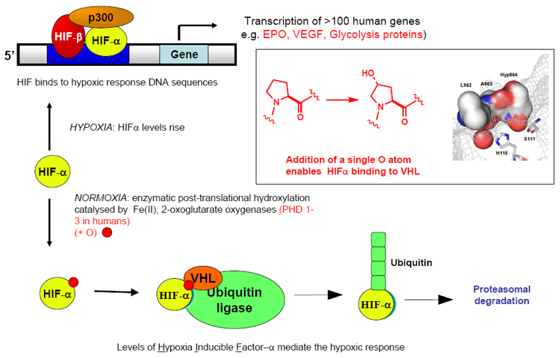
HIF při normoxii a hypoxii – význam hydroxylace prolinu
VHL (von Hippel-Lindau) - tumor supresorový gen
http://www.chem.ox.ac.uk/oc/cjschofield/images/new-2.png

Slide 7
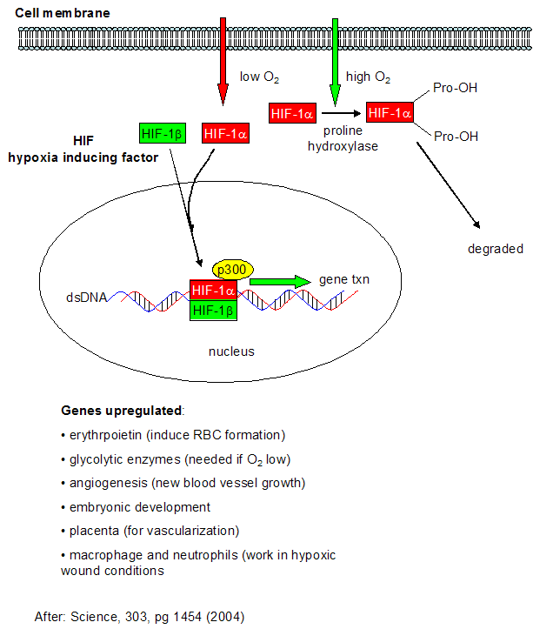
Modelové změny spojené s hypoxií/HIF systémem
embryonální vývoj
angiogenese
růst chrupavek
krvetvorba – aktivace EPO genu

Slide 8
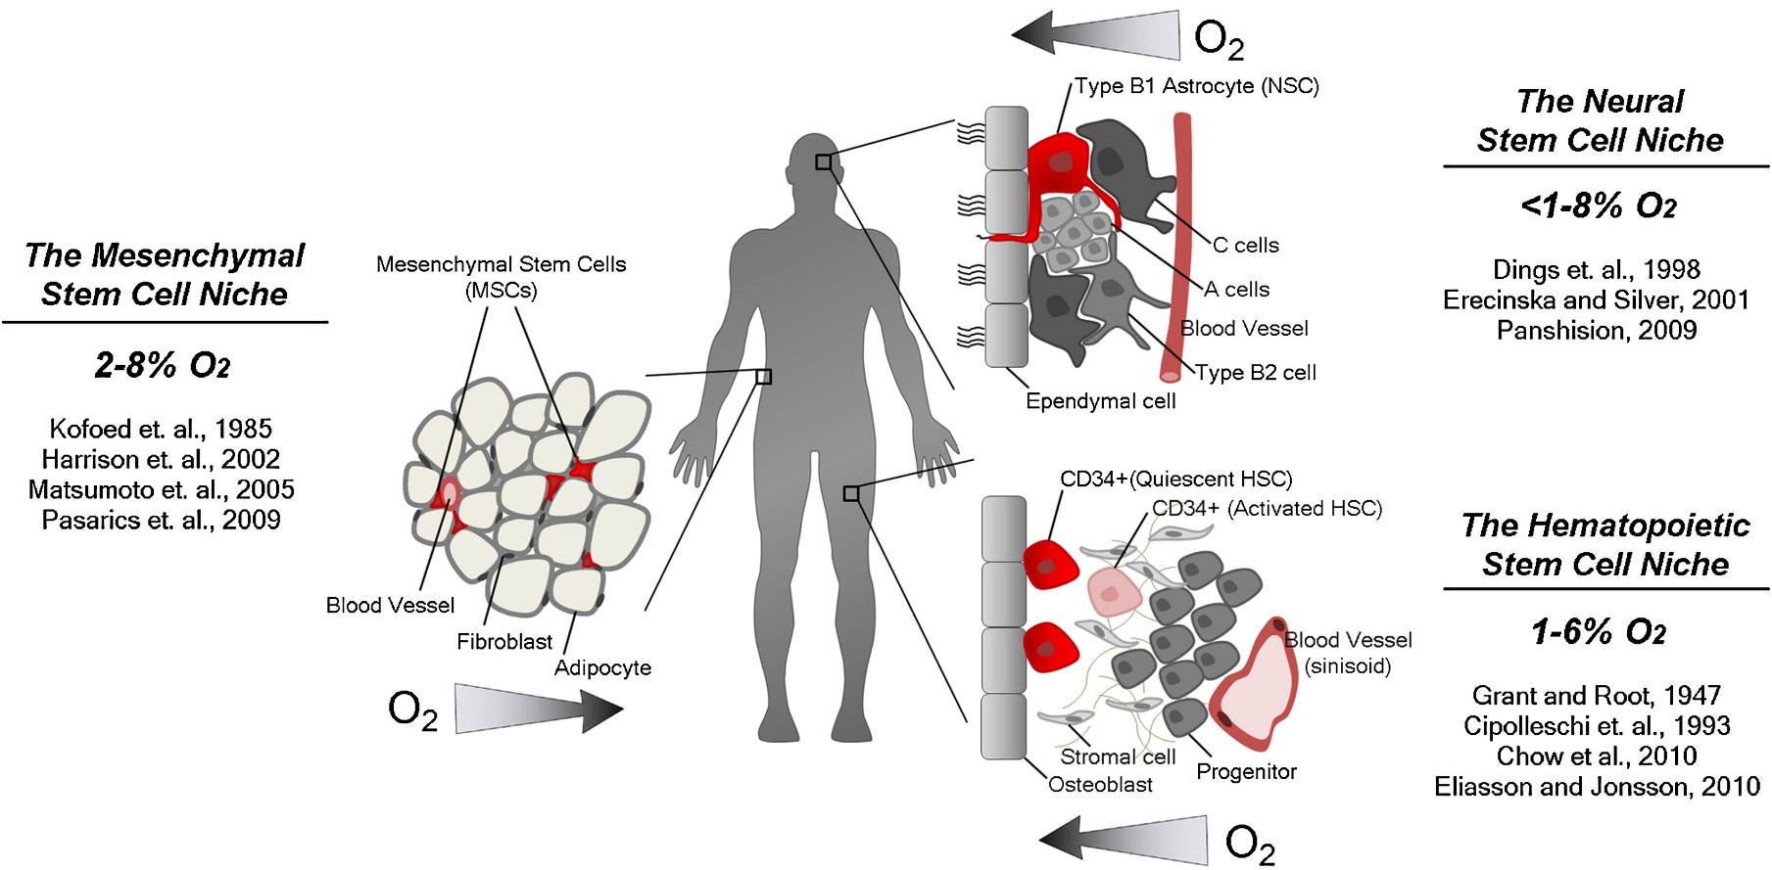
Hypoxie je přítomna/reguluje niku kmenových buněk

Slide 9
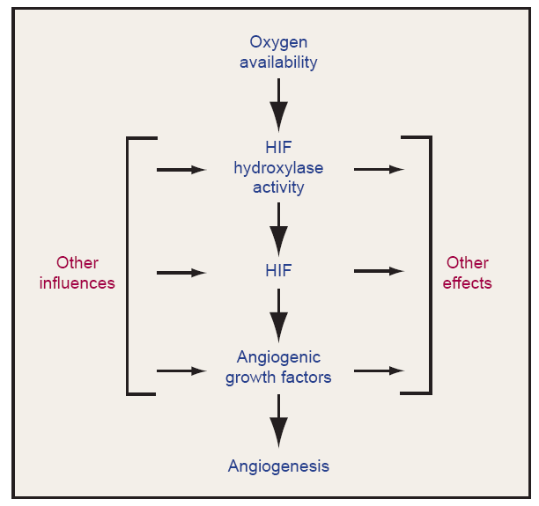
Angiogenese
Angiogenese
  tvorba nových krevních cév
HIF se váže do oblasti promotoru a iniciuje transkripci receptoru VEGFR 2 i expresi VEGF(Vascular Endothelial Growth Factor)
  hlavní faktor angiogenese
v normálním vývoji ale i během nádorového růstu

Slide 10
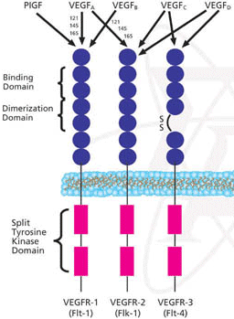
Vascular endothelial growth factors (VEGF) a jejich receptory (VEGFR)

Slide 11
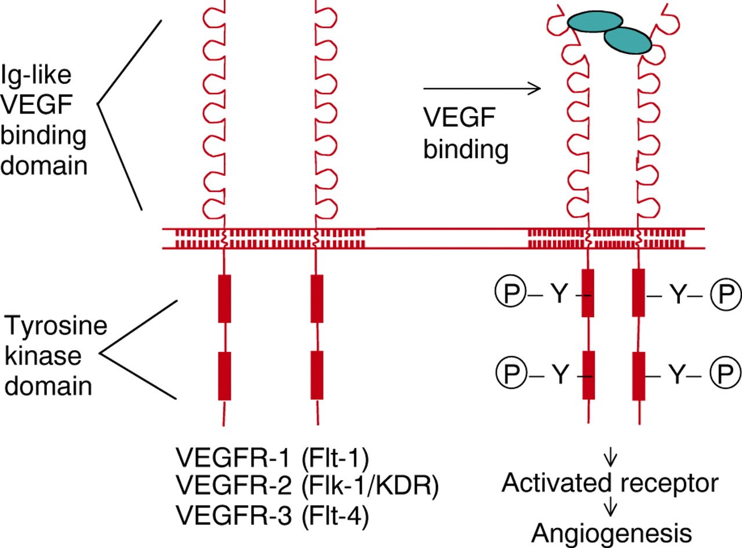
VEGFR2
Obr. 5

Slide 12
VEGF/VEGFR ve vývoji
reguluje vznik a vývoj cévní soustavy
master regulátor angiogeneze (vývoje cév)
hypoxie (=nedostatek kyslíku) indukuje HIF (hypoxia-induced factor), který reguluje produkci VEGF.
VEGF je schopen regulovat vznik de novo cév v hypoxické části embrya
- podobný mechanismus se uplatňuje i při onkogenezi, kde VEGF podporuje prokrvení nádorů a tím podporuje jejich růst

Slide 13
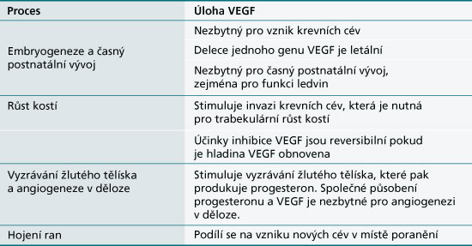
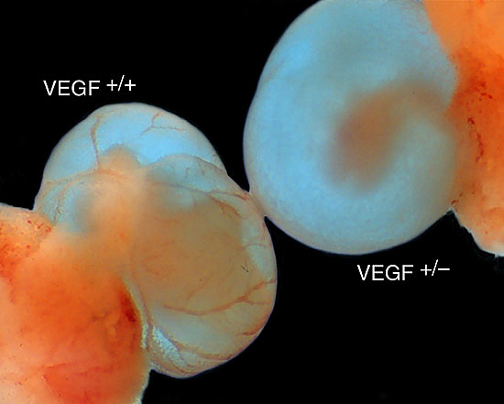
Shrnutí
VEGF je signální protein (ligand) schopný indukovat genovou expresi
Primárním cílem VEGF jsou vaskulární ECs
VEGF přispívá k zachování stávajících cév
a indukuje vznik a růst cév nových
Významná role VEGF v embryonálním vývoji
i v nádorové transformaci

Slide 14
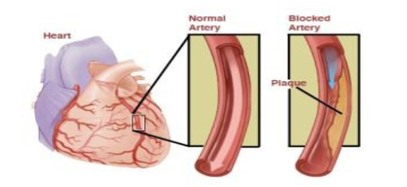
Angioterapie
využití léků k regulaci angiogeneze
proangiogeneze u ischemických chorob srdečních
Obr. 6

Slide 15
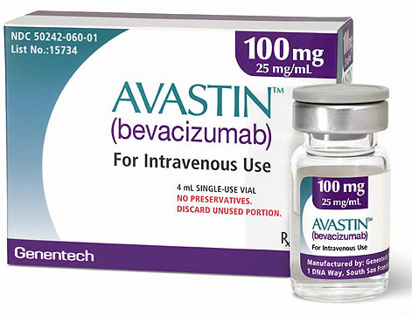
Angioterapie
patologická angiogeneze:
  rakovina
  diabetická retinopatie
Bevacizumab (Avastin)
The second option is direct VEGF blocking. Nowadays, this line already has a grounded position in medicine. Drugs acting in this way are:
Bevacizumab (Avastin, Genentech, San Francisco, CA, USA), a full-length humanised recombinant monoclonal IgG anti-VEGF-A antibody. It binds and inhibits all VEGF-A isoforms [11, 23, 24]. Its molecular weight is 148 kDa, so it is a large molecule with twice the half-life of ranibizumab [12, 13]. It has been approved for the treatment of several solid tumours (colorectal, non-epithelial lung, breast, ovarian, and renal cancers) and glioblastomas [3, 24–26]. In ophthalmology it is used as an off-label procedure [11, 12, 27, 28]. Furthermore, it is probably still the most widely used anti-VEGF drug in ophthalmology due to much lower costs of therapy, compared with other medicines [12, 24, 29].
Ranibizumab (Lucentis, Genentech, San Francisco, CA, USA/Novartis Ophthalmics, Basel, Switzerland) is a (Fab) fragment of a humanised monoclonal anti VEGF-A antibody, also against all VEGF-A isoforms [10, 13, 23]. Its molecular weight is 48 kDa [24]. This drug was designed for eye diseases, and it was approved for intra-ocular use in neovascular AMD, macular oedema (ME) after retinal vein occlusions (RVO), diabetic macular oedema (DME), and diabetic retinopathy (DR) with DME [30]. In any other ocular diseases it is also used off label.
Pegaptanib (Macugen, Phizer, New York), a 28-base ribonucleic acid aptamer, covalently linked to two branched 20-kd polyethylene glycol moieties [10, 23]. It specifically binds and blocks activity of extracellular VEGF-A165 isoform [11, 23]. It was used in wet AMD treatment, but it was found to be weaker than the drugs listed above. This is probably due to its specificity for binding only one isoform of VEGF [16].
Aflibercept (Eylea, Regeneron, Tarrytown, NY, USA), a VEGF-trap: a 115-kDa recombinant fusion decoy protein consisting of VEGF binding domains of human VEGFR-1 and VEGFR-2 fused to the Fc domain of human immunoglobulin G1 [23]. It binds all forms of VEGF-A but also PlGF-1 and PlGF-2 with a very high affinity, greater than bevacizumab or ranibizumab [10, 11, 16]. It was approved for colorectal metastasising carcinoma treatment (Zaltrap). In ophthalmology it has already been approved as a therapy for neovascular AMD, macular oedema after RVO, and diabetic macular oedema [31].

Slide 16
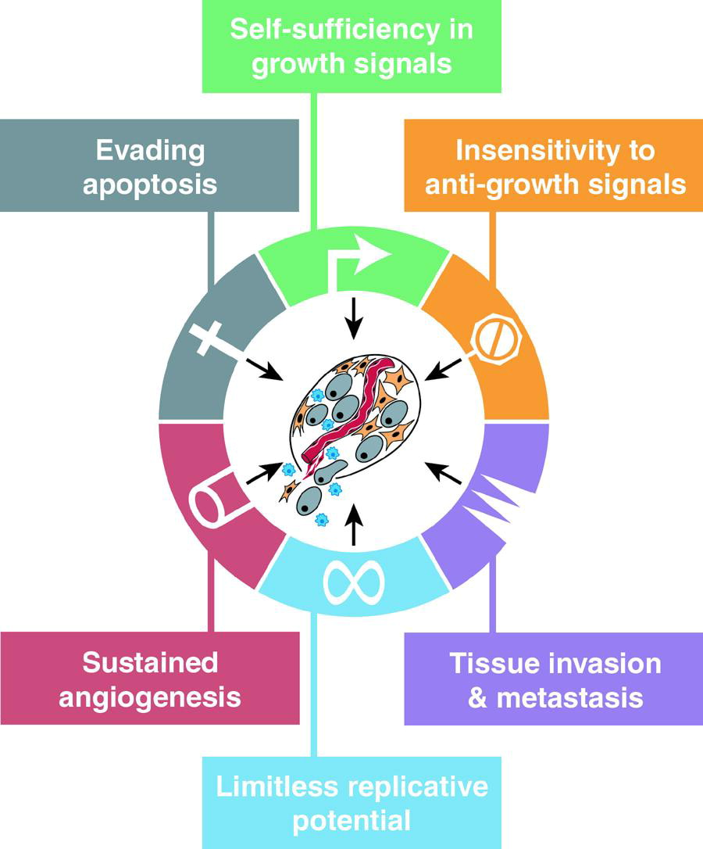
Rakovina a angioterapie

Slide 17
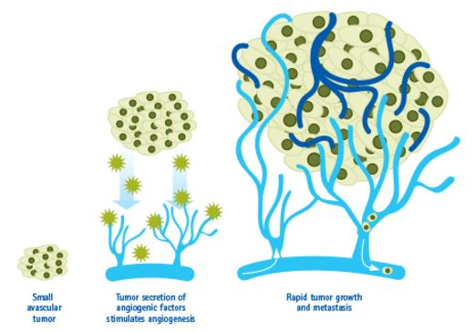
Rakovina a angioterapie

Slide 18
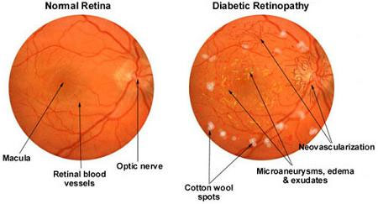
Diabetická retinopatie
Diabetic retinopathy, also known as diabetic eye disease, is a medical condition in which damage occurs to the retina due to diabetes mellitus. It is a leading cause of blindness.
Diabetic retinopathy affects up to 80 percent of those who have had diabetes for 20 years or more.
Depends on VEGF signaling

Slide 19
Angiogeneze vs. vaskulogeneze
vaskulogeneze = vznik a vývoj cév při embryonálním vývoji (de novo)
angiogeneze (neokapilarizace) = z cév již existujících

Slide 20
Angiogeneze
v embryogenezi
iniciovaná:
  poranění tkáně
  menstruační cyklus
  hypoxická tkáň
sprouting x intususceptive (spliting)

Slide 21
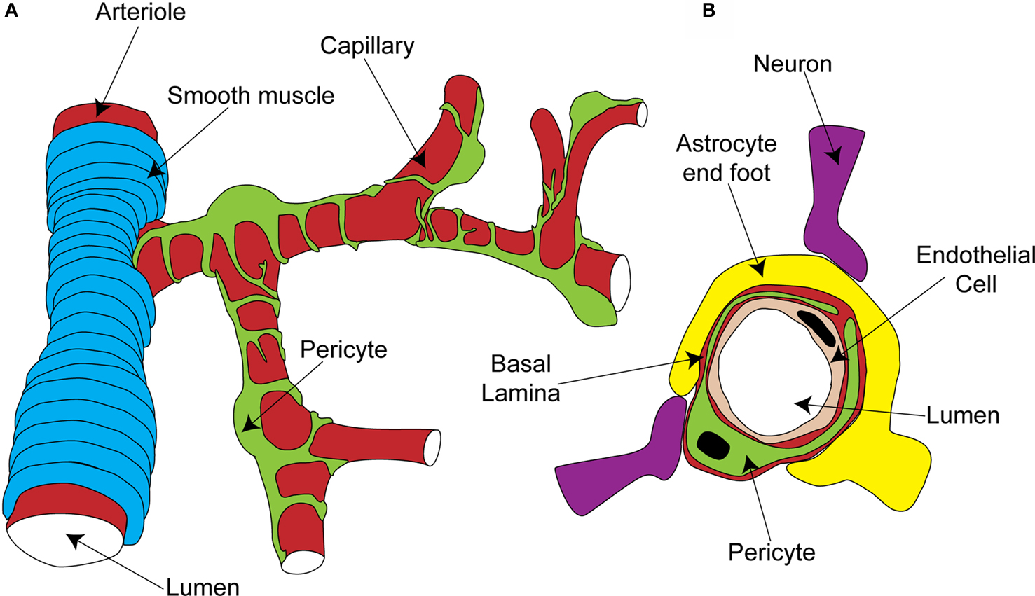
Anatomie cévy

Slide 22
Základní kroky angiogeneze po poranění
(sprouting angiogeneze)
dilatace cév (eNOS)
EC kontrakce
„Tip-cell“ selekce (Notch signalizace)
Ustavení „stalk cell“ a jejich proliferace
Vakuolizace (vytvoření lumenu)
Spojení „výhonků“ (anastomóza)
Pericytární stabilizace

Slide 23
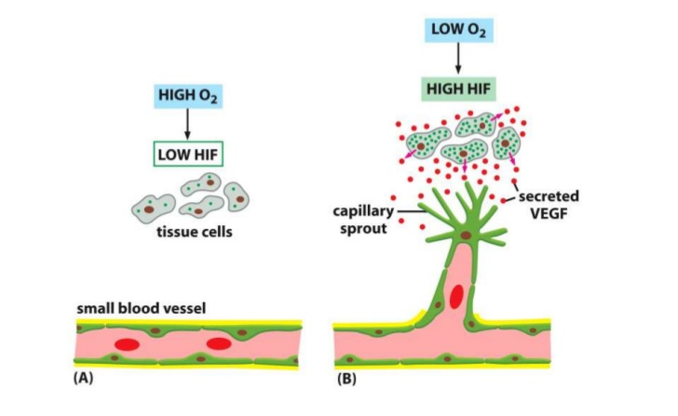
Sprouting (klíčení) cév
Obr. 2

Slide 24
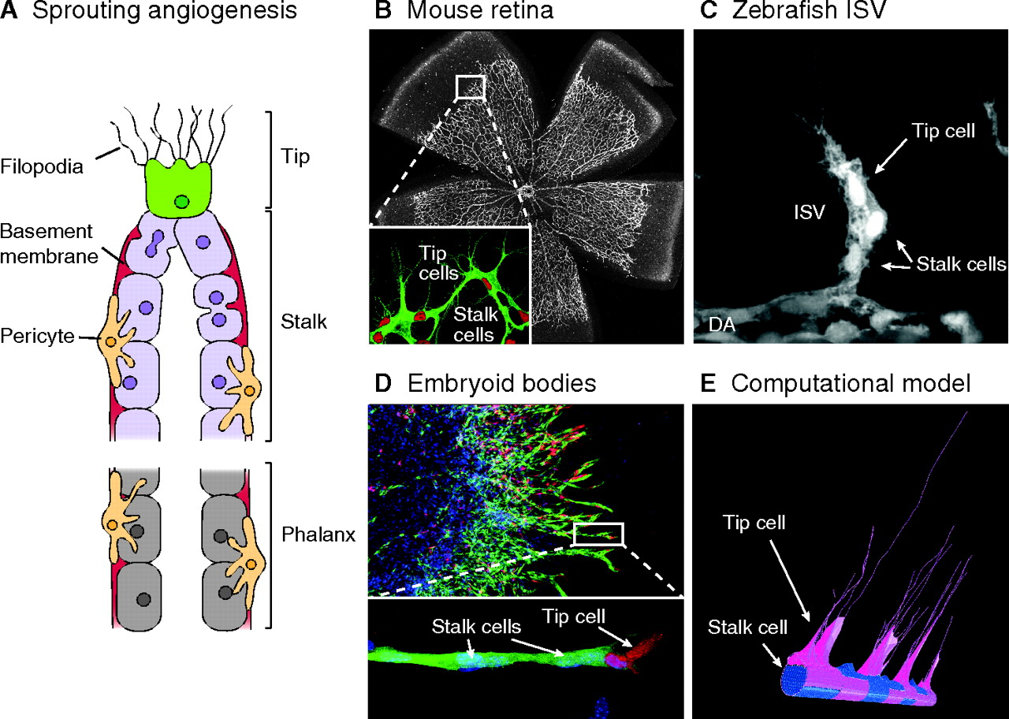

Cell analysis in sprouting angiogenesis models.
Ilse Geudens, and Holger Gerhardt Development 2011;138:4569-4583
© 2011.
Notes:
Cell analysis in sprouting angiogenesis models. (A) Schematic illustration of a growing sprout. The sprout is guided by a tip cell (green), which uses filopodia to scan the environment for attractive and repulsive cues. Stalk cells (purple) proliferate, form a lumen, deposit a basement membrane (red) and attract pericytes (orange). Both tip and stalk cells are activated endothelial cells (ECs). By contrast, phalanx ECs (grey) represent quiescent cells that do not proliferate. (B-D) Representative images of vessel networks and sprouts in different model systems, highlighting tip and stalk cells. (B) The mouse retina at post-natal day (P) 5. Inset shows higher magnification of sprouting front showing tip cells with filopodia and stalk cells. Red, endothelial nuclei (Erg); green, Isolectin-B4. (C) A growing intersomitic vessel (ISV) in a 28 hours post-fertilisation (hpf) old transgenic Fli1:eGFP^{y1} zebrafish embryo. (D) Sprouts growing from a mosaic embryoid body in vitro, which comprises DsRed-expressing wild-type (WT) cells (red) and VEGFR2^{EGFP/+} cells (green). Nuclei are also counterstained (blue). (E) Tip (pink) versus stalk (blue) cell selection simulated in a computational model.

Slide 25
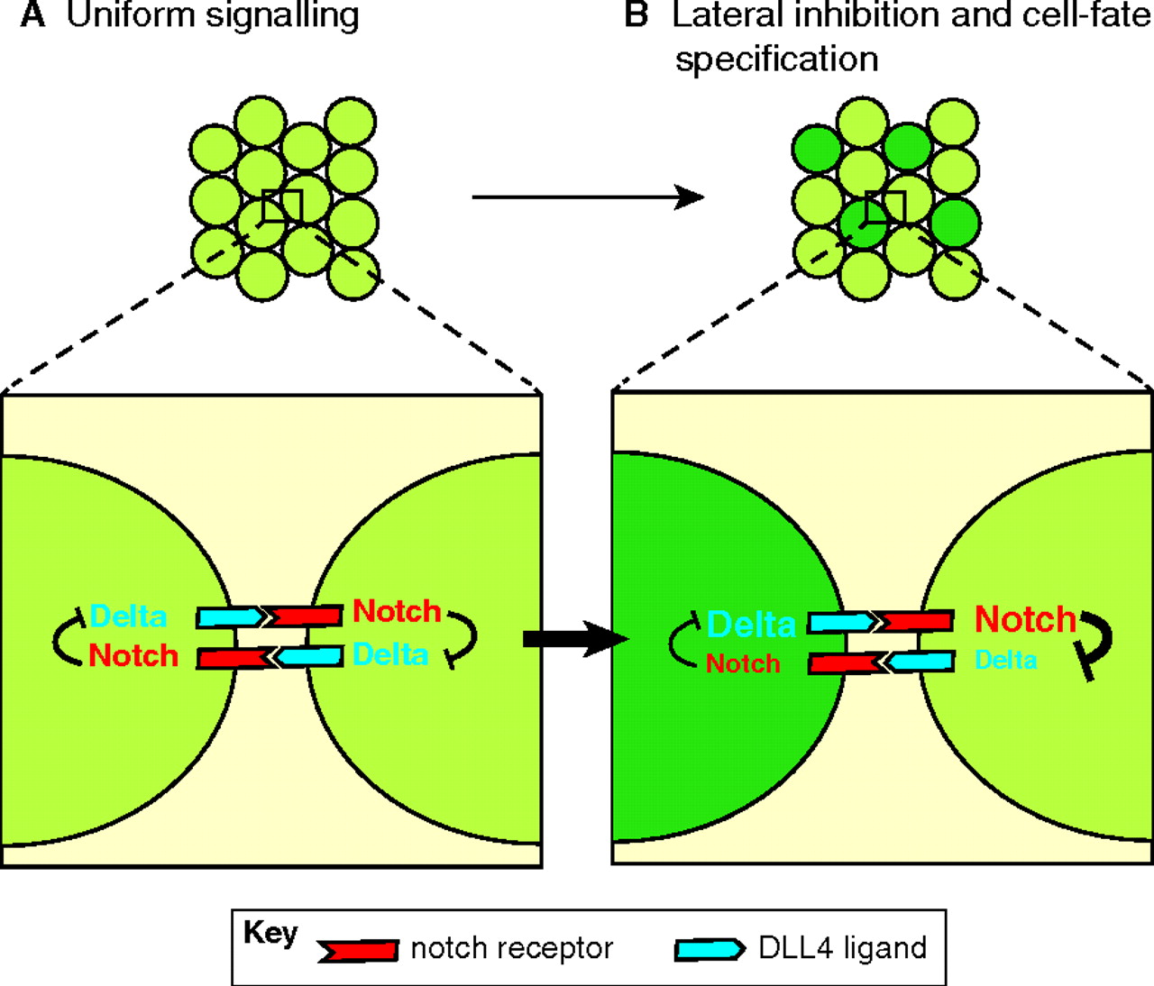
Ilse Geudens, and Holger Gerhardt Development 2011;138:4569-4583
© 2011.

Slide 26
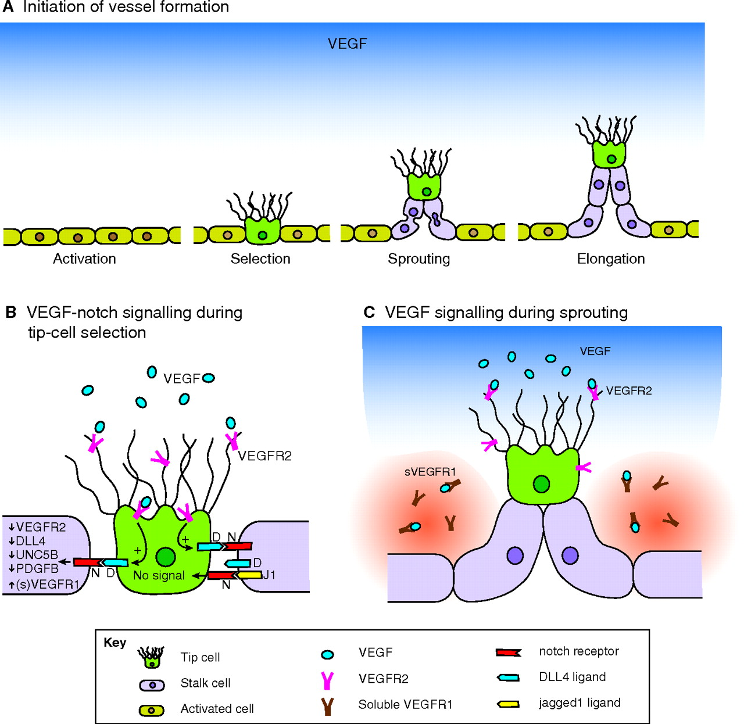
Sprout induction.
Ilse Geudens, and Holger Gerhardt Development 2011;138:4569-4583
© 2011.
Notes:
Sprout induction. (A) The initiation of blood vessel formation. The presence of VEGF (blue gradient) activates the endothelium (yellow cells) of existing blood vessels. A VEGF/notch-dependent regulatory mechanism ensures the selection of a limited number of tip cells (green) by blocking tip cell formation in the immediate neighbours (via lateral inhibition). Tip cells sprout towards the VEGF gradient, and the adjacent stalk cells follow the guiding tip cell and proliferate to support sprout elongation. (B) VEGF/notch regulatory feedback during tip cell selection. The activation of VEGFR2 (pink) by VEGF (blue circles) induces the expression of the notch ligand DLL4 (D; blue). The subsequent activation of notch (N; red) by DLL4 in contacting cells reduces their expression of VEGFR2 and DLL4, thereby making them less sensitive to VEGF-mediated activation and limiting their ability to activate notch signalling in neighbouring cells. The expression of other tip cell-enriched genes, such as UNC5B and PDGFB is reduced in stalk cells, whereas the expression of the non-signalling VEGF decoy receptors VEGFR1 and soluble (s) VEGFR1 is increased, further reducing the likelihood of VEGFR2 activation in these cells. Furthermore, jagged1 (J1; yellow), which is selectively expressed in stalk cells, competes with DLL4 in cis for binding to notch receptors on tip cells. Jagged1 binds, but does not activate the notch receptor, thereby preventing notch activation in the tip cells. (C) VEGF signalling during sprouting. Soluble VEGFR1 (sVEGFR1; brown) produced by the cells immediately next to the outgrowing vessel branch sequesters VEGF molecules, thereby creating a corridor of higher VEGF levels perpendicular to the parent vessel. This corridor might act to optimise spreading of the vascular network and to avoid contact with nearby emerging sprouts.

Slide 27
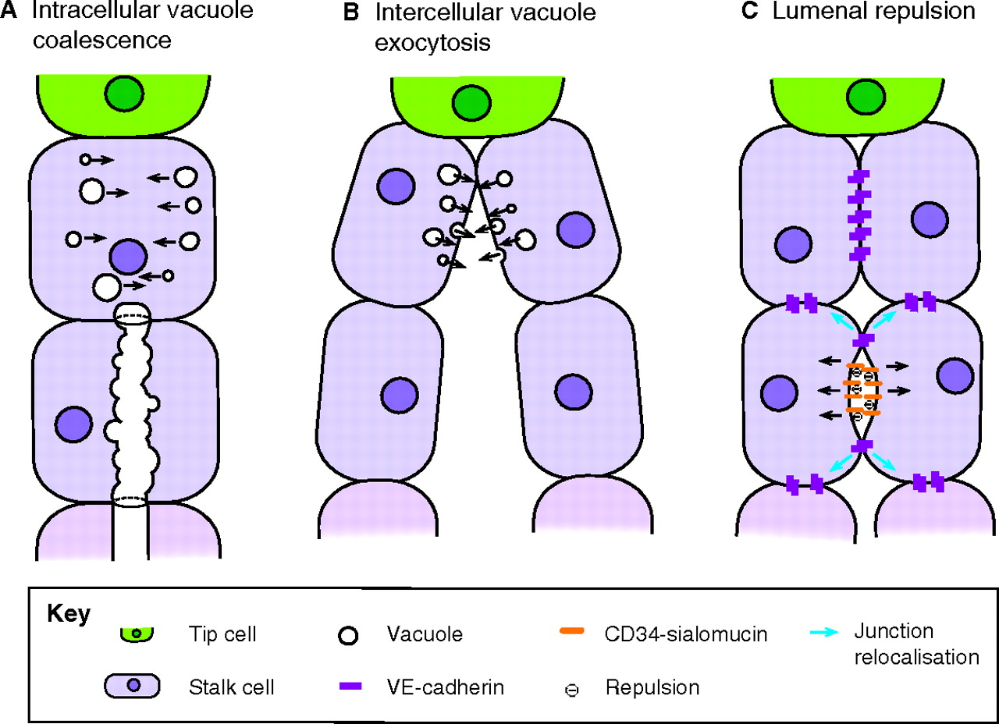
Models of lumen formation during sprout outgrowth.
Ilse Geudens, and Holger Gerhardt Development 2011;138:4569-4583
© 2011.
Notes:
Models of lumen formation during sprout outgrowth. (A) Intracellular vacuole coalescence. Endothelial cells (ECs) can form a lumen by forming intracellular vacuoles that coalesce and connect with each other and with vacuoles in neighbouring cells. (B) Intercellular vacuole exocytosis. ECs can form a lumen by producing exocytotic vacuoles that are released into the intercellular space. (C) Luminal repulsion. Alternatively, an intercellular lumen can be created by apical membrane (lumenal) repulsion. VE-cadherin (purple) establishes the initial apical-basal polarity in the ECs and localises CD34-sialomucins (orange) to the cell-cell contact sites. The negative charge of the sialomucins induces electrostatic repulsion and initial separation of the apical membranes, thereby relocalising the junctional proteins to the lateral membranes. Further separation and establishment of the lumen is based on F-actin-mediated cell-shape changes (not shown).

Slide 28
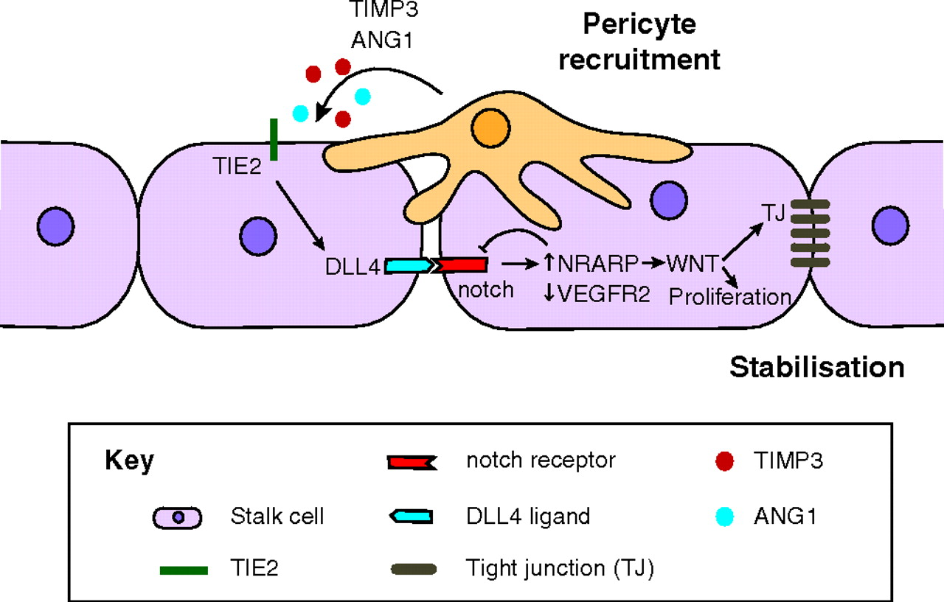
Vessel stabilisation.
Ilse Geudens, and Holger Gerhardt Development 2011;138:4569-4583
© 2011.
Notes:
Vessel stabilisation. Stalk cells (purple) recruit pericytes (orange) to stabilise the vasculature, possibly through the production of stabilising factors such as TIMP3 and ANG1. ANG1 signalling through the TIE2 receptor stabilises the vasculature, in part via inducing DLL4 expression in the endothelial cells (ECs) and activating notch signalling. Notch activation then plays a dual role in vascular stabilisation: first, it downregulates VEGFR2 expression, thereby preventing further sprouting through activation of the VEGF/notch signalling pathway; second, it induces the expression of NRARP, which promotes WNT signalling leading to increased proliferation and tight junction (TJ) stabilisation.

Slide 29
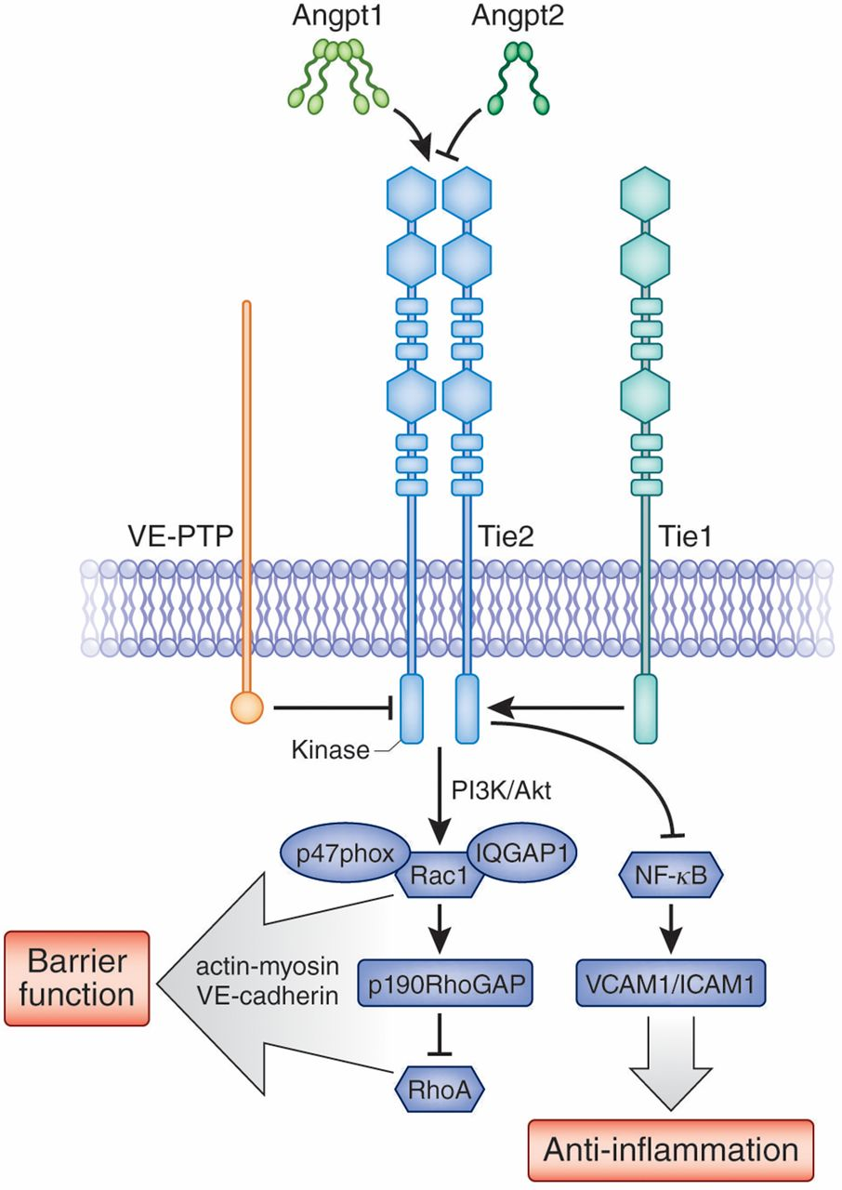
Angiopoetin-Tie RTK systém

Slide 30
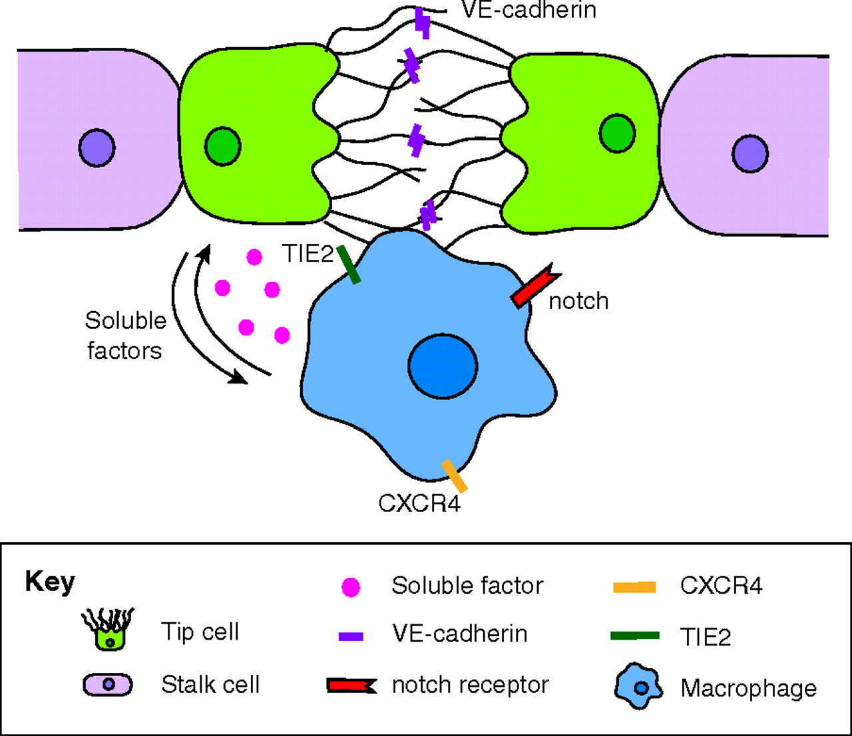
Current concepts of anastomosis.
Ilse Geudens, and Holger Gerhardt Development 2011;138:4569-4583
© 2011.
Notes:
Current concepts of anastomosis. Schematic illustration of tip cell fusion. For simplicity, the vascular lumen is not illustrated. The formation of new connections between growing vessels is facilitated by vessel interactions with macrophages (blue) that can act as bridge cells that promote filopodia contact between tip cells (green). Upon contact, adhesion junctions are formed by VE-cadherin, first at the tips of filopodia and later also along the extending interface of the contacting cells. The precise role of macrophages and the molecular regulation of anastomosis are not understood. Possible candidate pathways involved are the notch, TIE2 and CXCR4 signalling pathways; the notch receptors (red), the TIE2 receptor (green) and the CXCR4 receptor (yellow) are expressed on macrophages and their cognate ligands are expressed on tip cells (not shown). A two-way interaction between ECs and macrophages through (unknown) soluble factors (pink) has been also described.

Slide 31
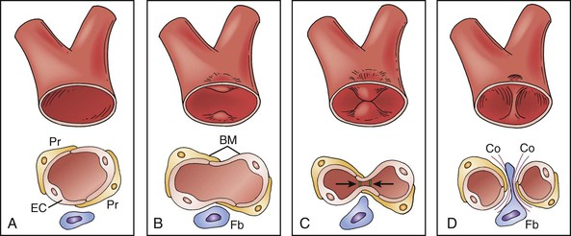
Spliting
protruze dovnitř lumenu
rozdělení kapilár
„vpáčení“ fibroblastu
Obr. 3

Slide 32
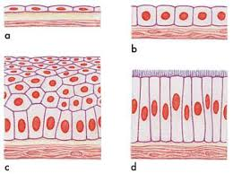
Mechanické vlivy a jejich detekce
Buňky fungují v tkáních
Koncept: kontaktní inhibice proliferace (contact inhibition of proliferation – CIP):
Hustota buněk vysoká – dělení je silně inhibováno
Hustota buněk nízká (ale i při natažení tkáně) – buněčné dělení je umožněno
Prerekvizita pro CIP: existence mechanismu, který umožní vnímat tenzi v tkáni a přenášet ji do „rozhodnutí buněk“ zda- se dělit nebo ne

Slide 33
1.

Slide 34
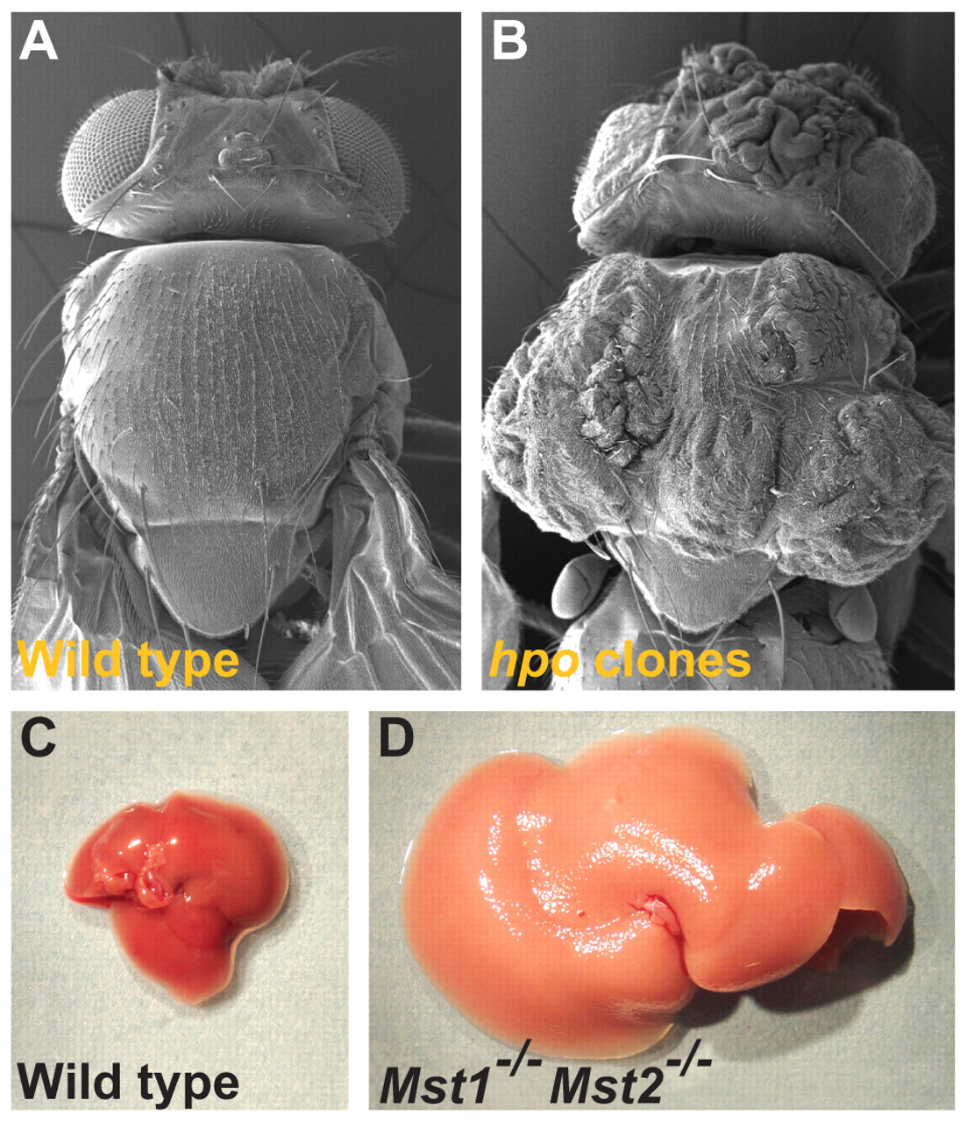

Slide 35
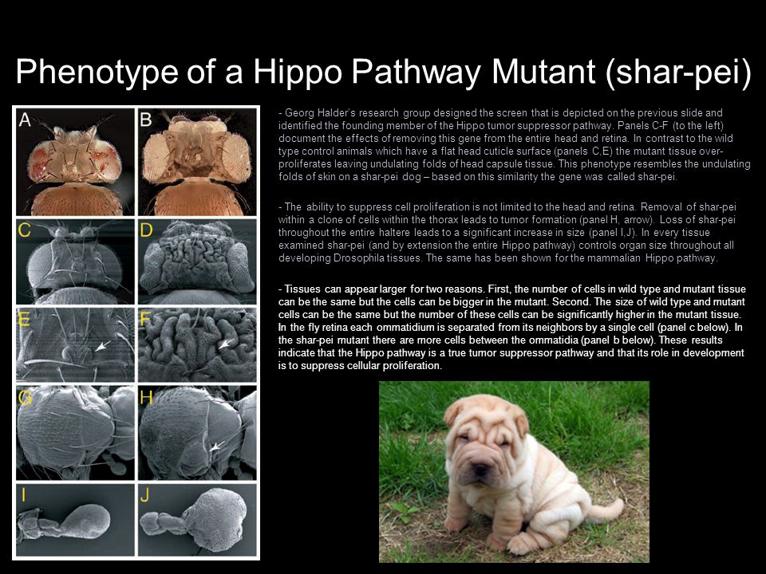

Slide 36
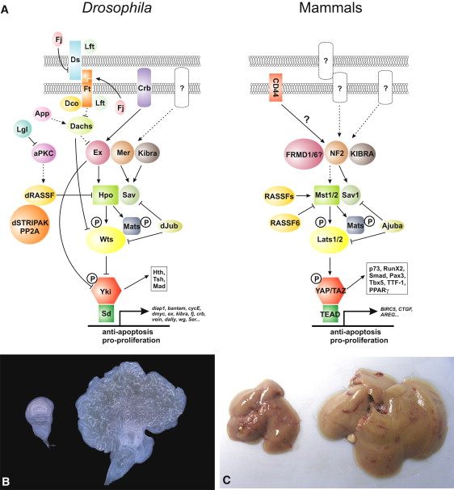
Hippo (Drosophila) = Yap/Taz (obratlovci)

Slide 37
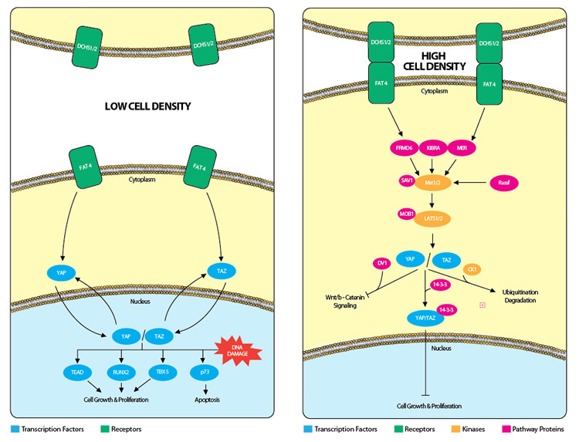
Hippo nebo též Yap/Taz signální dráha jako senzor

Slide 38
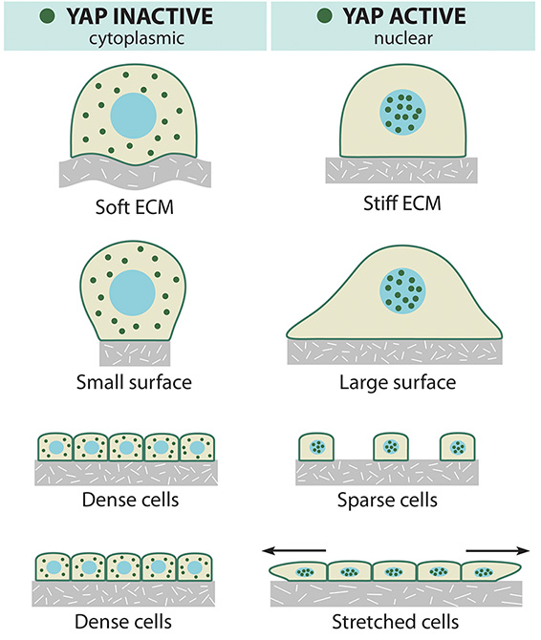

Slide 39
2.

Slide 40
Citlivost iontových kanálů k mechanickým vlivům

Slide 41
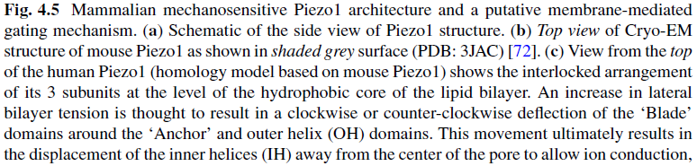
Iontový kanál Piezo1
Otvírá se při zvýšeném namáhání membrány

Slide 42
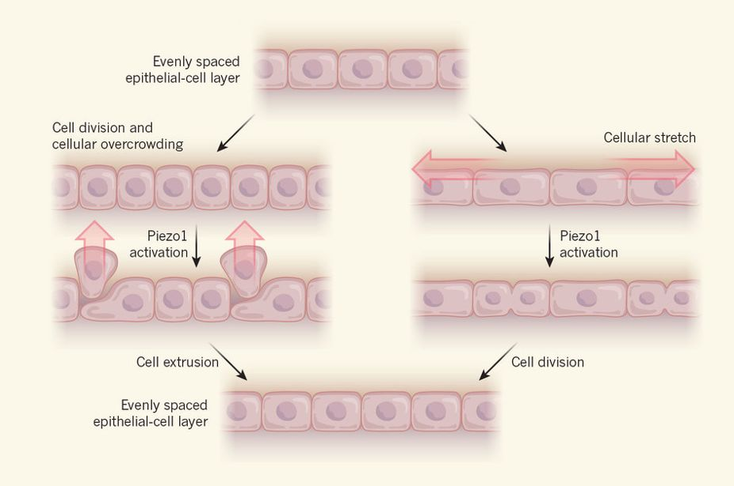
Role Piezo1 v regulaci „density“ epitelu

