Slide 1
Lecture 1
The Basics of Heredity

Slide 2
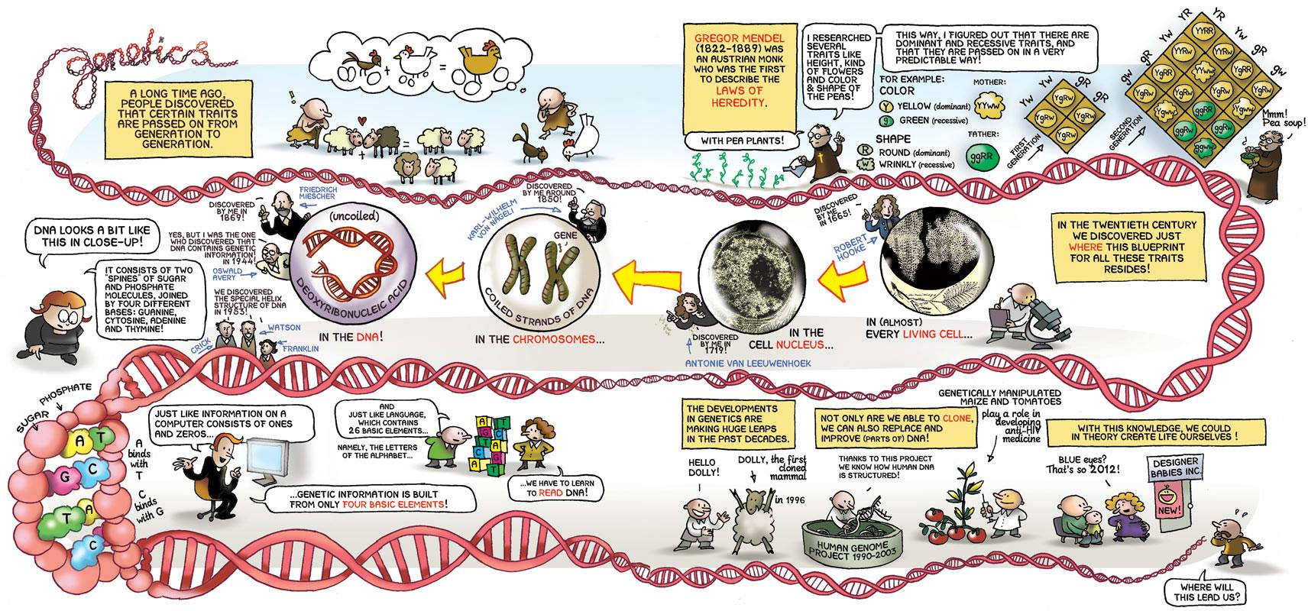
History of genetics

Slide 3
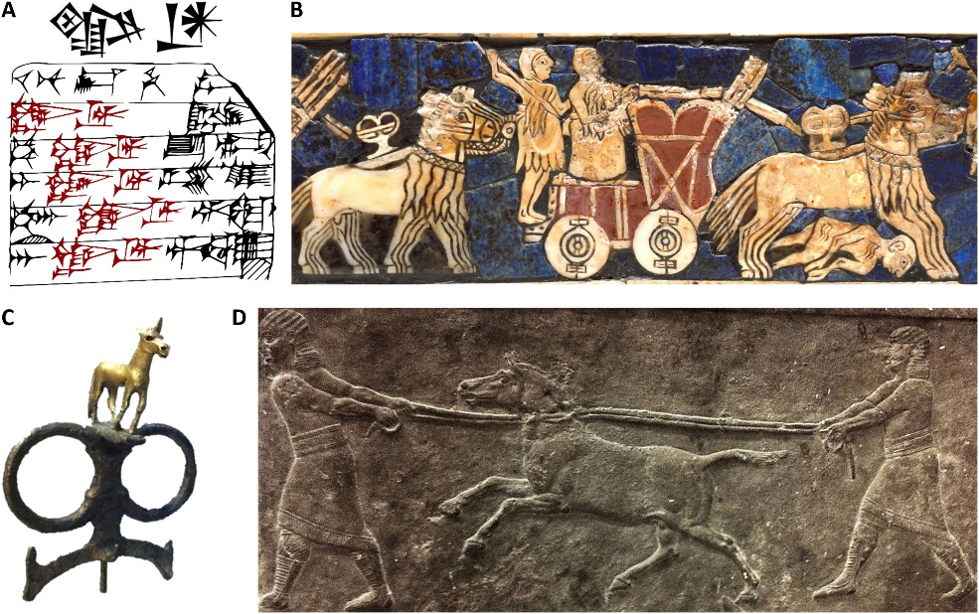
History of genetics „pre-mendelian era“
The effects of heredity are observed by human kinds form its down
  Children resembles of their parents
  Domestication of animals and plants,
  selective breeding for better traits
  People of Mesopotamia used hybrids of domesticated and wild donkeys to pull their war chariots about 4,500 years ago ( Y-chromosomal and mitochondrial DNA)
  Sumerians horse breeding records

Slide 4
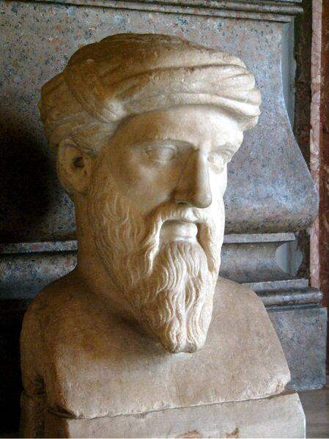
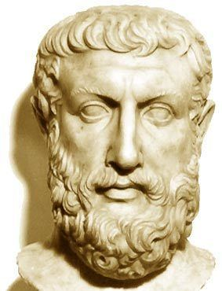
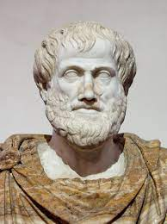
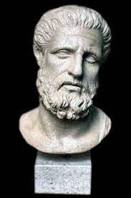
History of genetics: early Greek philosophers
  Vapour theory (Pythagoras)
    man body – embryo – uterus of female)
  Fluid theory (Empedocles)
    fluid from all parts of each parent create embryo
  Spontaneous generation (Aristotle)
    Origin of live from decaying matter
    Reproductive Blood Theory- embryo is produced due to the mixing of reproductive blood of the two parents
  Pangenesis (Hypocrates)
    invisible “seeds ,” from organs of parents are like miniaturized building components and are transmitted during sexual intercourse, reassembling themselves in the mother’s womb to form a baby

Slide 5
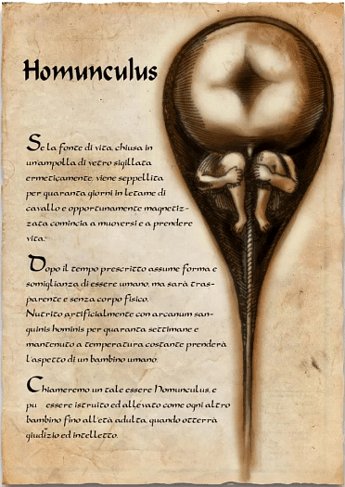
History of genetics: Middle age theories
1) Preformation theory (Malphigi, Swammerdan, Bonnet)
miniature individual of extremely small size is present in sperm or egg, grows into a new individual after it receives nourishment in the womb of a female
Spermists vs ovists – which cells bear key components for gender development?
  Da Vinci – proposed equal contribution of parent´s traits to of spring
  Van Leeuwenhoek - animacules (aka sperms of mammals nad frog) are associated with eggs
  Malphigi, Swammerdan, Bonnet miniature individual of extremely small size is present in sperm or egg (hommunculus)

Slide 6
History of genetics: Middle age theories
2) Particluate theories – 18 - 19th century
  Theory of Acquired Characters (Lamarck)
    new character once acquired by an individual shall pass on to its progeny (neck of giraffes x Wiesmann – progeny of mices with cut tails had long tails…)
  Theory of Pangenesis (Darwin)
    gemmules or pangene partilces (of given, oragn, tissue etc) are carried by the blood to the reproductive organ and are deposited in the sex cells, which again carry them to the next generation.
  Theory of Germplasm (Wiesmann)
    Organisms with sexual reproduction carry two types of cells
    - somatic cells make up body (somatoplasm)
    - reproductive cells make up sperms and ovas (germplasm)

Slide 7
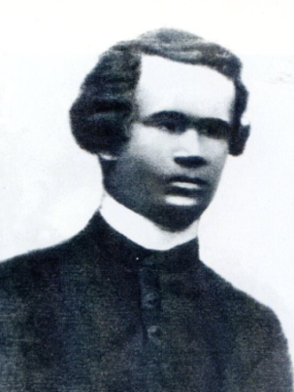
Gregor Johann Mendel
(1822-1884)
* 20th July 1822 Hynčice, North Moravia,
1840 – 1843 Philosophy at Olomouc University
1843 – join the Augustinian Abbey in Brno
1849 – 1851 - teacher at high school in Znojmo (Greek, Latin and German language, mathematics)
1851 – 1853 University of Vienna (math, – Doppler, deep understanding of statistics, Dawrin´s work (but Darwin did not known Mendel cause wrote in German language)
1854 – 1868 – teacher at Realschule at Brno (physics, biology)
1854 – 1863 first experiments with pea in abbey garden
1865 – series of lessons about his experiments in conference of biologists in brno (2nd and 3th of March)
1866 – publication „Versuche über pflanzen-hybriden“ (Experiments on Plant Hybridization)
1868 - abbot of St. Thomas' Abbey in Brünn
1881 – director of Moravian bank in Brno
6.1. 1884 – Mendel died from chronic nephritis, buried at Central Cemetery of Brno, Leoš Janáček played the organ at his funeral

Slide 8
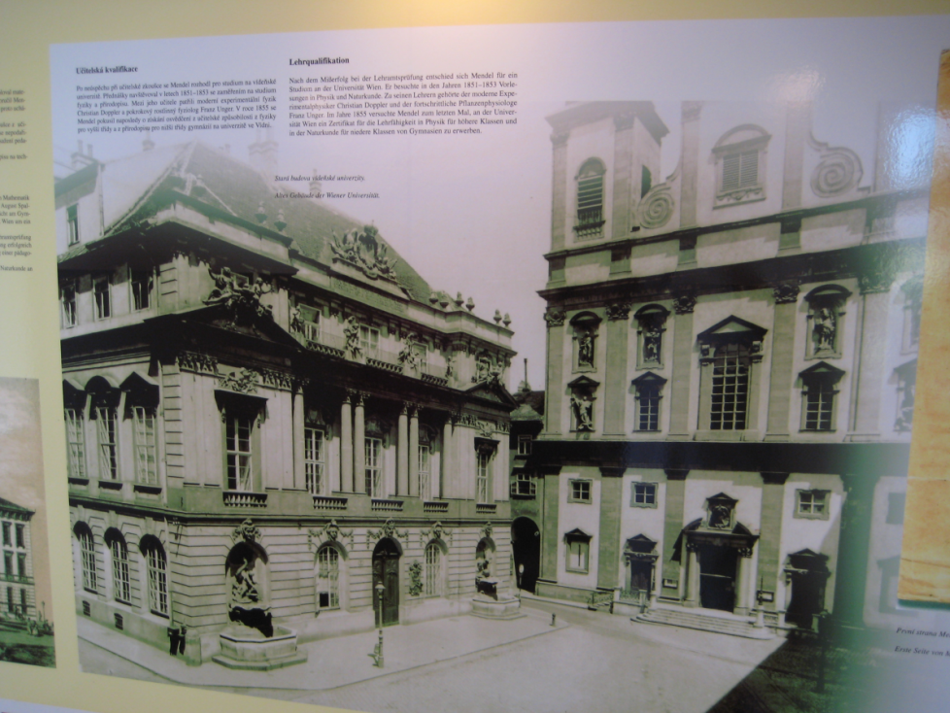
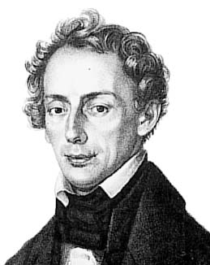
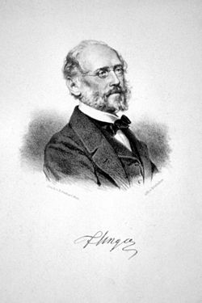
Mendel´s education – Natural science at university of Vienna (1851-1853)
Experimental physics
(prof. Doppler)
Combinatorics, probability theories, mathematical description of results…
Plant physiology (prof. F. Unger)
„continuity of cells and cell lineage is necessary for birth to other organisms“

Slide 9
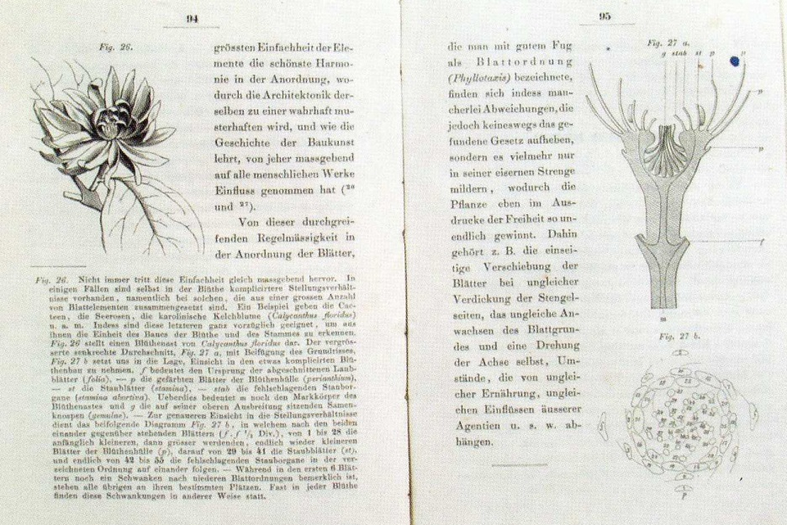
Prof. Franz Unger: Botanische Briefe (1852)
Knowledge of basic principles of plant physiology, hybridization and plant selection combined with methodology of „hard data“ collection bring Mendel to idea of existence of discreet particles, which are located inside cells and responsible for expression of different traits
During his studies, he developed a theoretical model of transfer of the traits from one generation to another with the use of those particles
He returned to Brno with this „project“

Slide 10
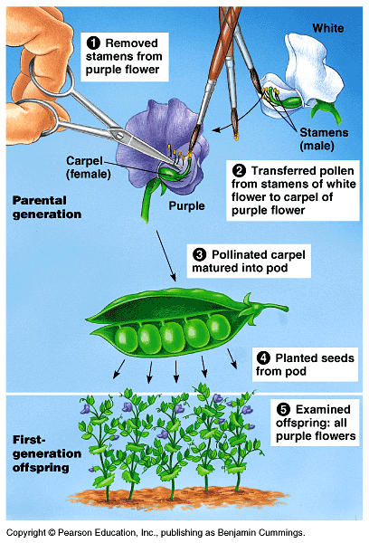
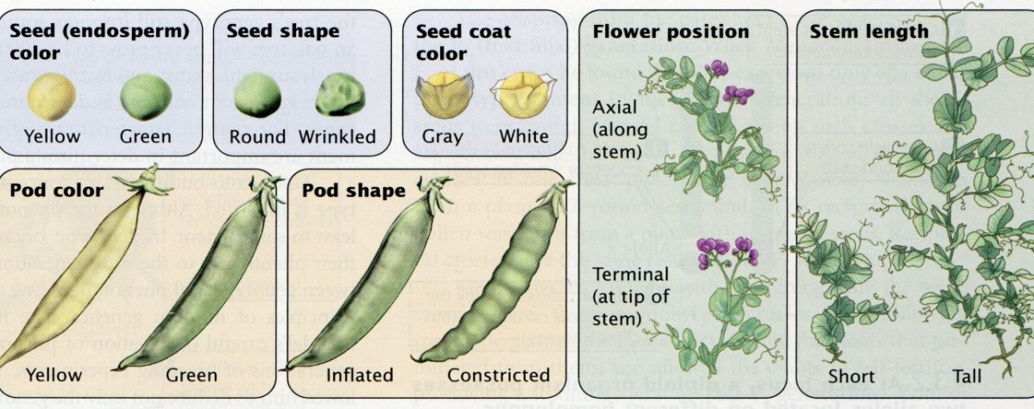
Wild pea (Pisum sativum) - model object of Mendel´s experiments
Breeding
True - breeding, self - pollinating plant with big blooms
large number of varieties
easy to grow, regular and steady yield
possible control of plant fertilization
7 pairs of chromosomes (2n = 14)

Slide 11

Mendels´ s experiments - character of traits
7 traits – stand alone, binar („yes or no“)
34 varieties – 2 years of observing - 22 varieties with steady difference of traits
Parental varieties = homozygotes (AA, aa) - differences:
Seed shape: round / wrinkled (chromosome 7)
Seed color: white / bright yellow or green (chromosome 1)
Bloom color: white / purple (chromosome 1)
Pod shape: inflated / constricted (chromosome 4)
Pod color: green / yellow (chromosome 5)
Flower position: axial / terminal (chromosome 4)
Stem length: 1,9 – 2,2 m / 0,24 – 0,46m (chromosome 4)

Slide 12
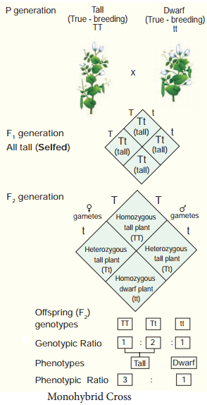
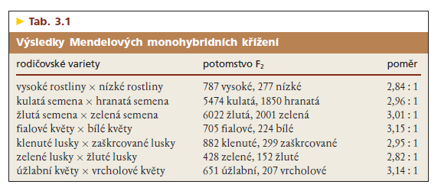
1 pair of trait observed in parental (P) generation offspring - 1st (F₁ ) and second (F₂) generation
Example of monohybrid crossing: height of the pea plants (tall / dwarf)
DOMINANT trait overcome in F₁
RECESIVE trait,
which shows itself in generation F₂

Slide 13
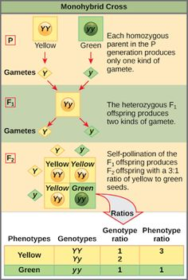
2 identical copies of gene (alleles) segregate into gametes
F₁ monohybrid (heterozygote) carry 2 different unique alleles in given proportion 50% (0,5)
gametes are joining randomly YY (0,25), Yy (0,25)*2, yy (0,25)

Slide 14
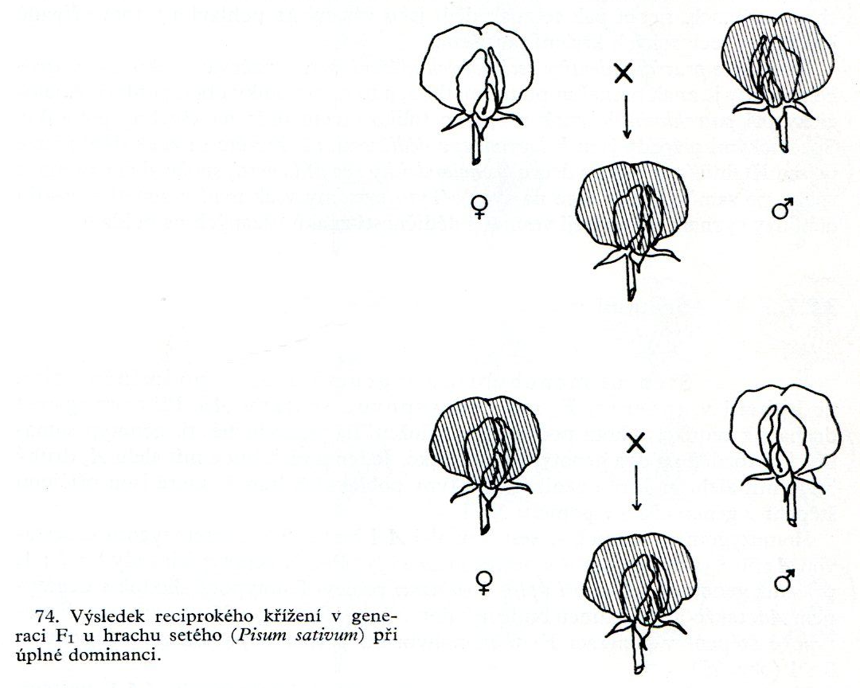
Identity of reciprocal crossing
There is no difference if trait comes from mother or father!
A cross, with the phenotype of each sex reversed as compared with the original cross, to test the role of parental sex on inheritance pattern
identical results in F₁
F₁
F₁

Slide 15
dominant homozygote x
recessive homozygote
P: AA x aa
heterozygote x heterozygote
P: Aa x Aa
gametes
 | a | a
A | Aa | Aa
A | Aa | Aa
 | A | a
A | AA | Aa
a | Aa | aa
recessive homozygote x heterozygote
P: aa x Aa
dominant homozygote x heterozygotee
P: AA x Aa
 | a | a
A | Aa | Aa
a | aa | aa
 | A | a
A | AA | Aa
A | AA | Aa

Slide 16
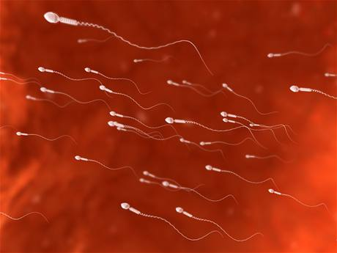
A
Gametes of a monohybrid - Aa
Mendel identified that heterozygote parents create gametes with one of their two allele with same exact probability … but how can prove this?
50 % A, 50 % a
a
a
A
A

Slide 17

Backcrossing - what kind of gametes and in what ratio are present in hybrids?
B₁ z – backcrossing of F₁ hybrid with parent with recessive alleles for given trait (Aa x aa)
B₁ Aa x aa
Gametes of hybrid will join with gametes of a parent carrying recessive alleles = highlighting the combination of alleles in gametes of the offspring!

Slide 18
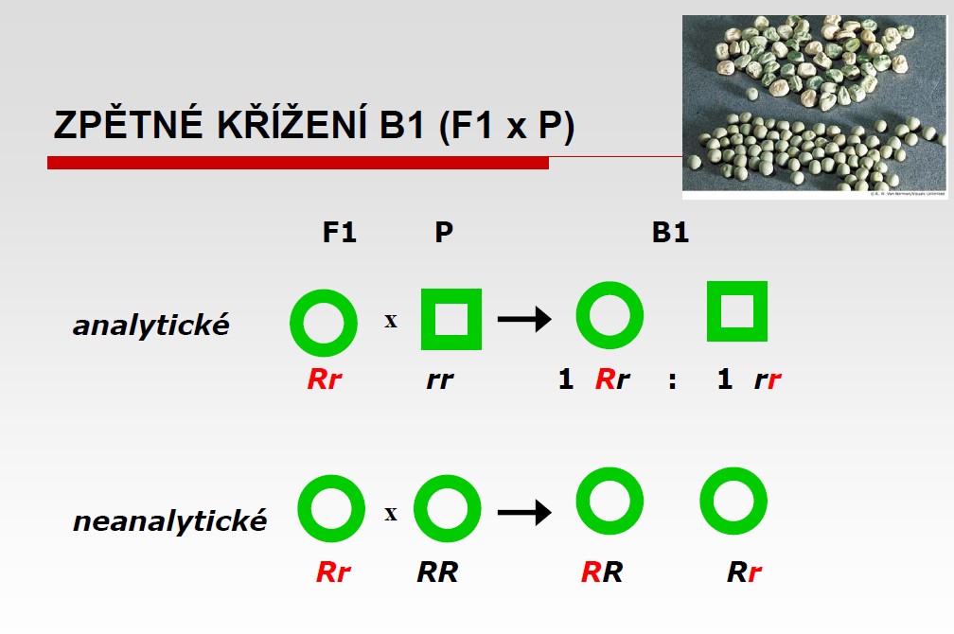

P: RR x rr F₁ Rr
Round Wrinkled Round
Backcrossing B1
B1 „analytical“
With recessive parent
2 types of gametes R, r ; ratio 1 : 1 B1 – 2 phenotypes; ratio 1 : 1
B1 „non-analytical“
With dominant parent
Only 1 type of phenotype

Slide 19
Mendel´ s conclusions from the monohybrid crossing
Each trait (f.e. shape of the seed –round/wrinkled) is controlled by a some form of inheritance factor or determiner (now known as genes)
Every parent has a pair of genes in for every trait in all cells of the organism
Genes are transferred to the next generation by sex cells
F1 generation from two true-breeded varieties has one allele dominant over another, which is recessive. Those tow together create allelic pair
F1 offsprings show only one parental trait - dominant
The results of reciprocal crossing were all the same no matter whether which parent transferred dominant or recessive allele

Slide 20
Mendel´ s conclusions from the monohybrid crossing
only one of the two gene copies present in an organism is distributed to each gamete (egg or sperm cell) that it makes, and the allocation of the gene copies is random.
LAW of SEGREGATION
Gametes fuse randomly and without regard to other associated gene pairs
Trait not shown in F₁ generation reappeared in F₂ generation in 25 % offsprigns and the most importantly
Traits had qualities same in offsprings, did not blended and behaved as distinct units!

Slide 21
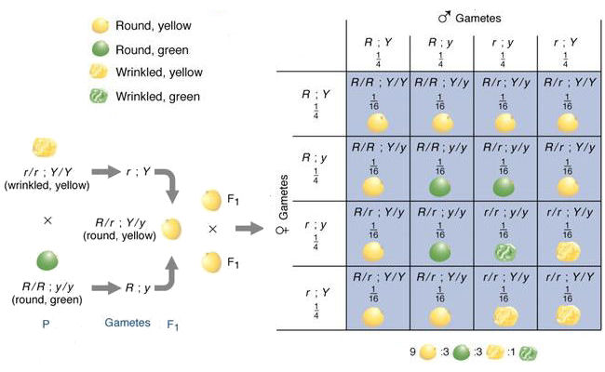
Dihybrid Cross – 2 traits, are they inherited independently?
Connection of two dominant and two recessive traits
Each parent is homozygous for 2 genes = 2 allelic pairs
Gametes – one allele from each pair
Alleles of both pairs segregates INDEPEDENTLY =
Dihybrid RrYy creates 4 types of gametes

Slide 22
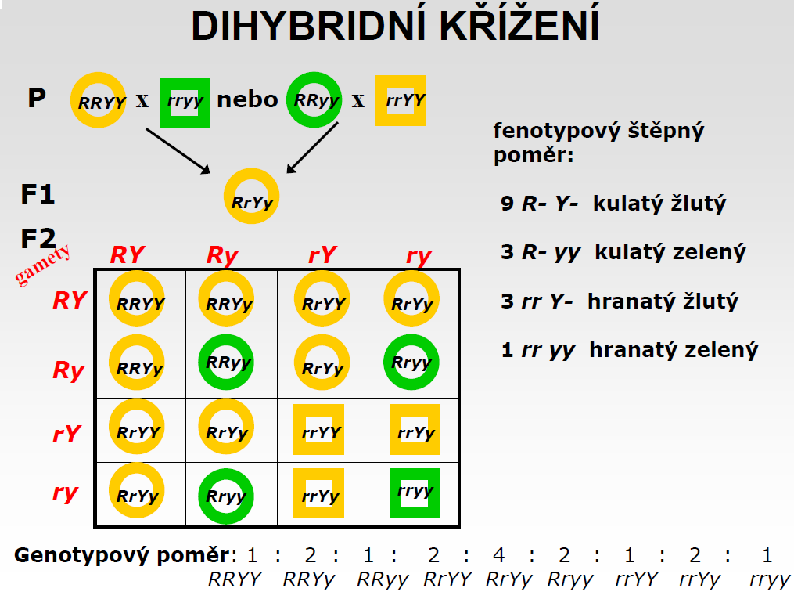
Dihybrid cross
Two possibilities pf parental crossing !!!
Punett square
Phenotype ratio
9 R-Y- Round yellow
3 R- yy Round green
3 rr Y - wrinkled yellow
1 rr yy – wrinkled green
Gametes: RY ry Ry rY
Diagonals of heterozygotes and homozygotes
Breed novelties
novel homozygous combinations different from parents
Genotype ratio

Slide 23
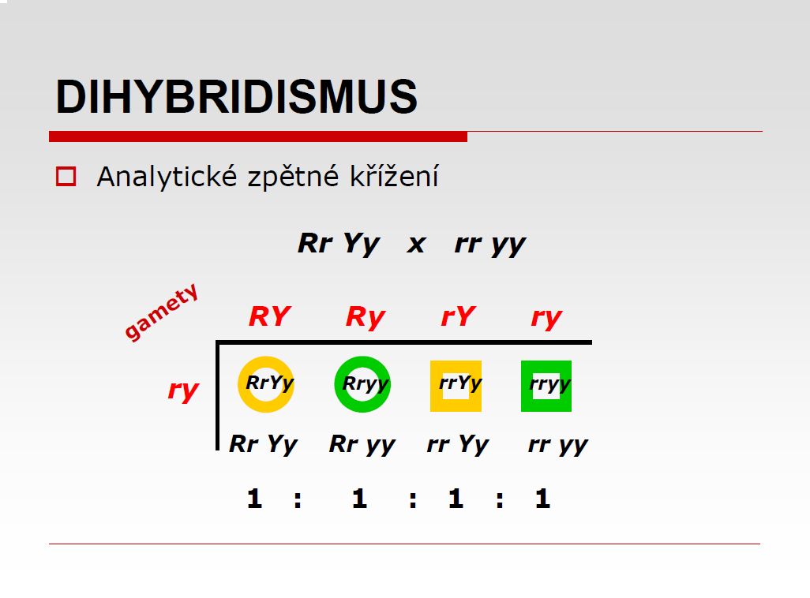
Dihybrid cross
Backcrossing
gametes
4 phenotypes

Slide 24
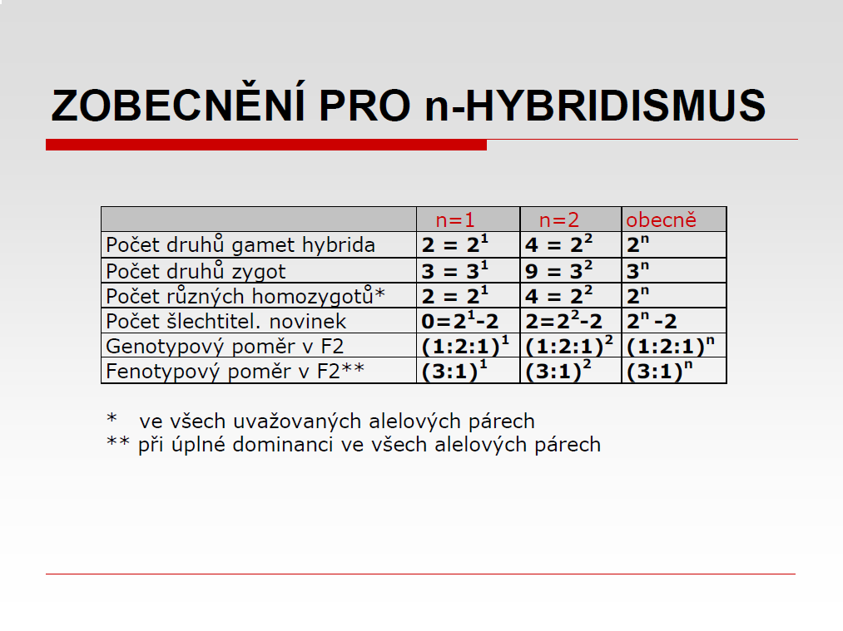
Generalization for n-hybridism
General
Nr. of gametes of hybrid
Number of different genotypes
Nr. of different zygotes
Nr. of different homozygotes *
Nr. of raising novelties
Genotype ratio of F2 generation
Phenotype ratio of F2 generation**
In all given allelic pairs
In case of complete dominance in all allelic pairs
n- level of hybridism
Aa – n=1
AaBb – n=2
AaBbCc – n=3

Slide 25
Mendel's conclusions from dihybrid crossing
F₁ hybrids express only one variant from both parental traits – always dominant.
F₂ generation present novel variants completely different from parents ( in our example yellow-wrinkled and round-green seeds). The exist because of new combinations of parental genetic material = recombinants
Recombination of hereditary factors (genes) is made according to laws of probability. Alleles of given genes are in each generation chosen randomly (alleles of different genes are combined independently)
LAW OF INDEPENDENT ASSORTMENT
Hybrid F₂ generation showed all combinations of parental traits in specific ratio 9:3:3:1 (full dominance)

Slide 26
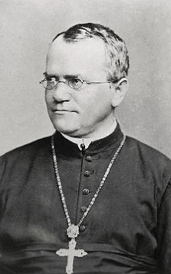
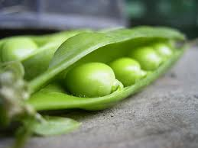
Mendel´s discoveries: overview
Traits are inherited as discreet pieces (elements)
Units of heredity (genes)
  are material in nature
  come in pair (inherited from mother and father)
  they are twofold: dominant or recessive (hidden)
  they are transmitted to the next generation via sex cells
  they are inherited separately - they are not blended in nature
F₁ offsprings show only one parental trait (dominant one)
Heterozygous alleles segregate into gametes in random fashion
Alleles of different genes segregate (combine itself) independently of each other

Slide 27
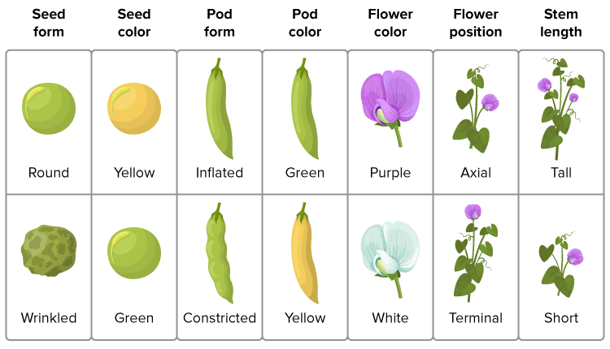
Mendel´s sweet pea traits… nowadays
Dominant alelle
...ATCGGGAATCGGACCCGATG…
...ATCGGGAATCGTGACCGATG…
Recessive alelle - mutant
Mutation in pea genes create new allele!

Slide 28
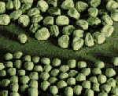
Seed shape – round x wrinkled
RR x rr
Cause of creation of r allele (wrinkled):
Mutation (transposone insertion) in gene which encode enzyme participating on creation of starch in seeds (SBEI) – development of inactive version of the enzyme
Result:
Accumulation of sacharose in seeds – change of osmotic pressure – wrinkled shape of the seeds after drying
Bhattacharyya et al. (1993)

Slide 29
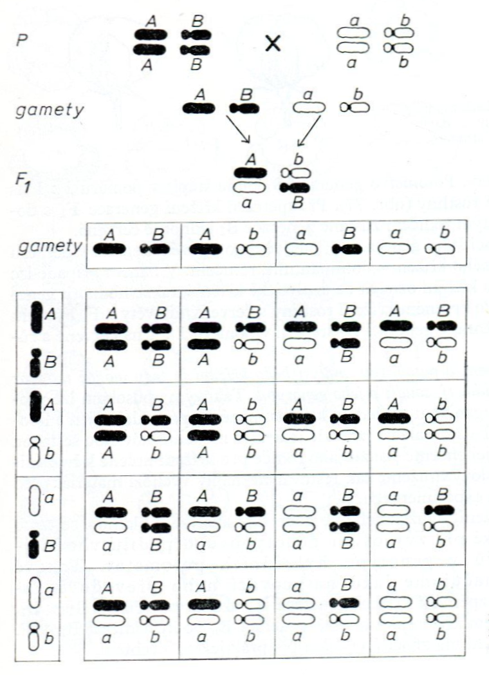
a) The reason for segregation and combination of alleles is the behavior of chromosomes during meiosis I (spacing of chromosomes during anaphase I of first meiotic division) b) The principle of combination apply for genes located on different chromosomes
Mendel´s principles and chromosomes
P
Pp
p
Meiose I -
Anapahse spacing of homolouge chromosomes

Slide 30
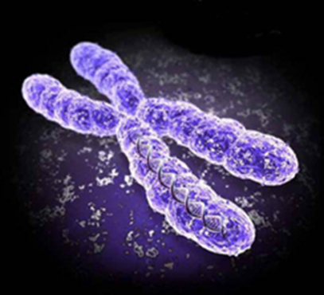
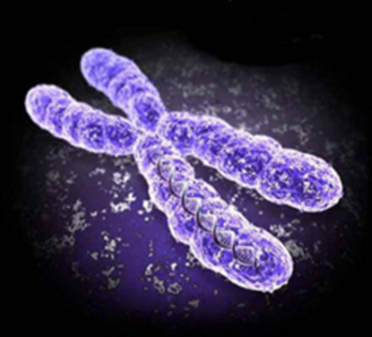

Description of genes and alleles on metaphase chromosomes
Gene A
Genotype AA
A
A
A
A
A
A
Genotype Aa ?
Metaphase chromosome = 2 identical chromatids!

Slide 31
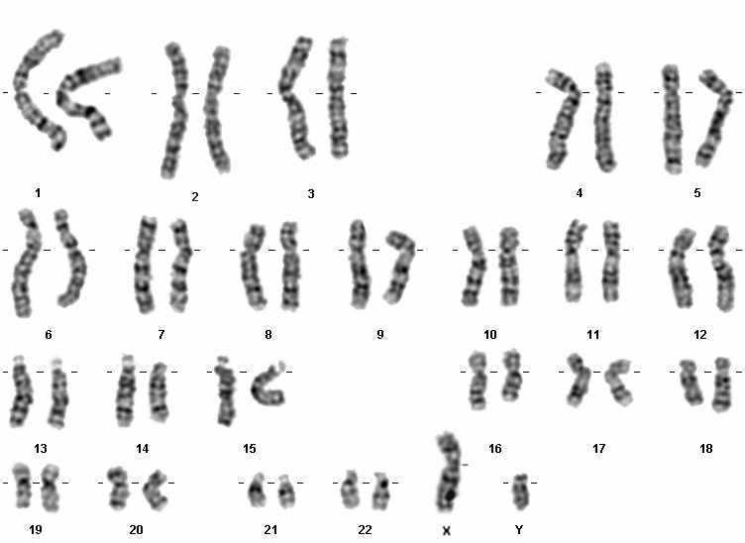
AaBb
dihybrid
CcDd
A
A a
a
B B
b b
C C c c
D D d d
Genes freely combinated
Linked genes (on same chromosome
EE f f monohybrid Ef
Human Karyotype - mitosis

Slide 32
Exceptions from Mendel´s ratios
Incomplete dominance
Codominance
Multiple allelism
Lethal alleles
Penetrance
Expressivity
Pleiothropy
Phenocopy
Effect of alelles of one gene
Gene interactions
Gene linkage

Slide 33
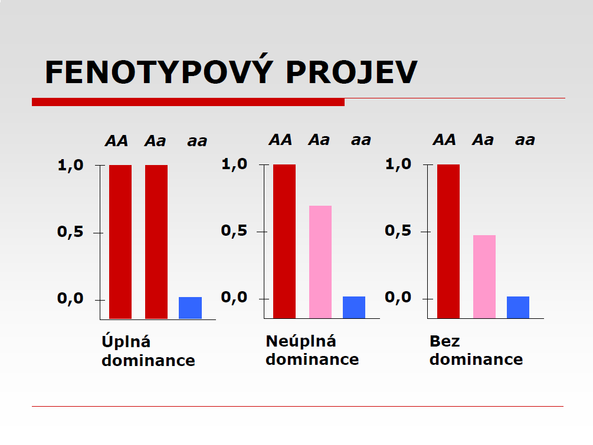
Phenotype effects of dominance exceptions
Aa – not in half
Aa – exactly 50%
Full dominance
Incomplete dominance
Codominance

Slide 34
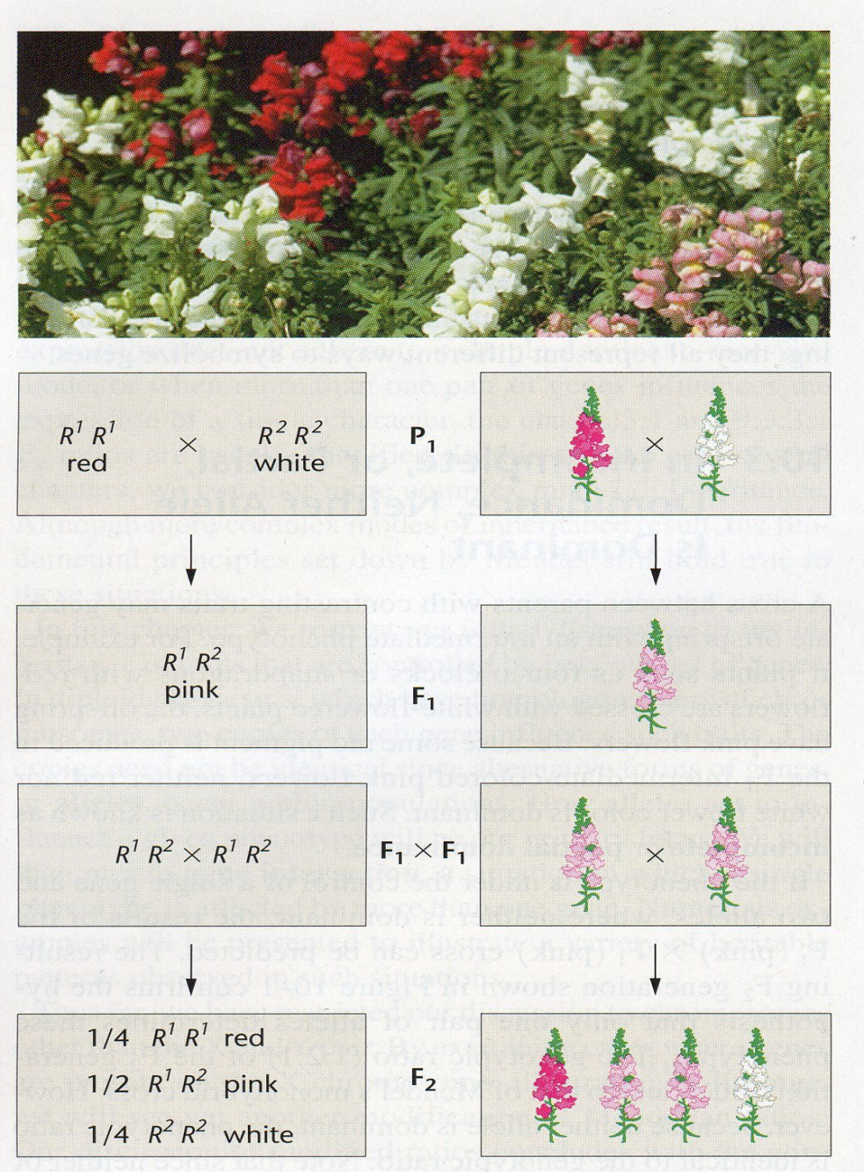
Incomplete dominance – Antirrhinum majus
Explanation
Color of bloom depends on amount of product
Allele R¹ - color production
Heterozygote R¹R² – approx.. half amount of color production compared to R¹R¹
R²R² - no color

Slide 35
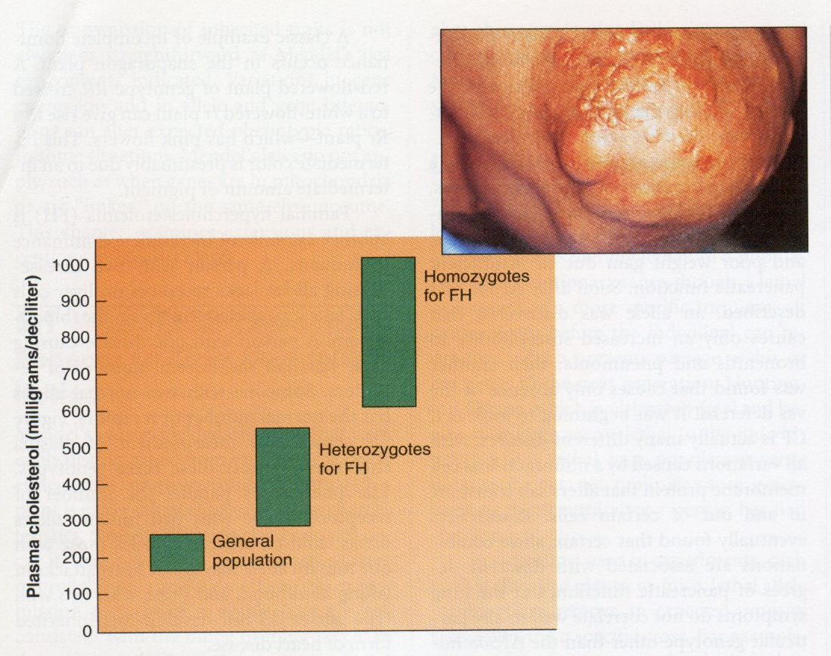
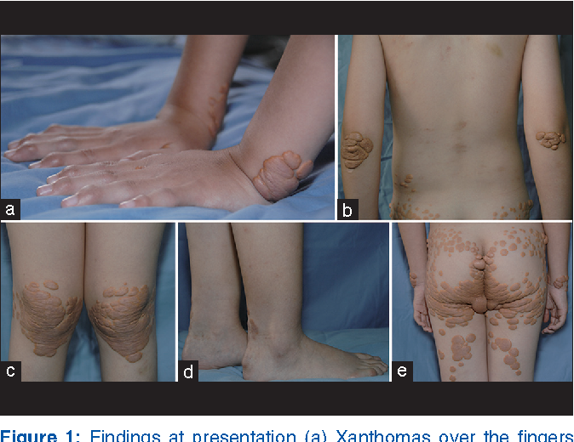
Incomplete dominance – human familial hypercholesterolemia
xanthomas
Hereditary disease, incidence 1/250 in CR, cca 500 mutations described
Caused by high levels of LDL (low density lipoprotein) cholesterol
FH gene heterozygotes have approx.. only half amount of LDL receptors responsible for cholesterol
Homozygotes in FH gene have no receptors – very rare
Brain and heart attacks risk at age 20 years

Slide 36
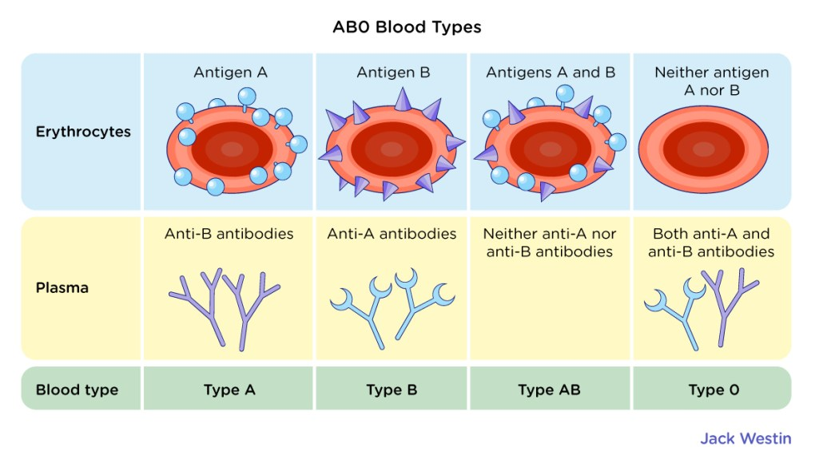
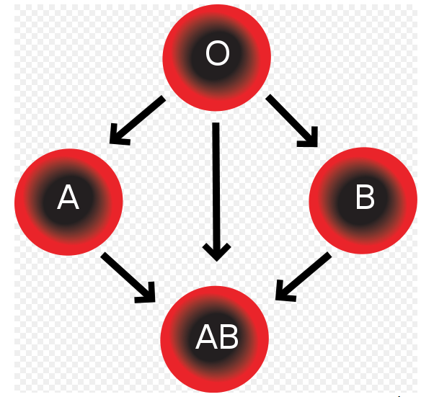
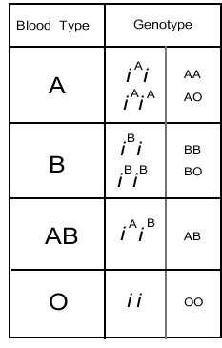
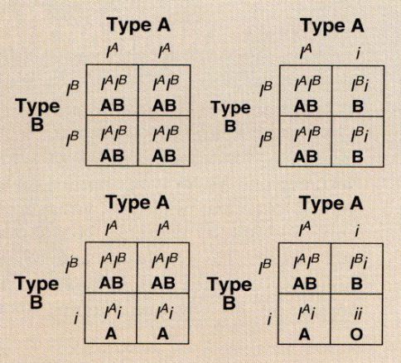
Codominance – human blood groups
Gene I – chromosome 9, 3 alleles I^{A}, I^{B}, I
Total of 6 genotypes
Heterozygotes AB express both antigens (both alleles active)
Codominant alleles A and B, both recessive to i
Importance – blood transfuses, paternity testing, ..

Slide 37
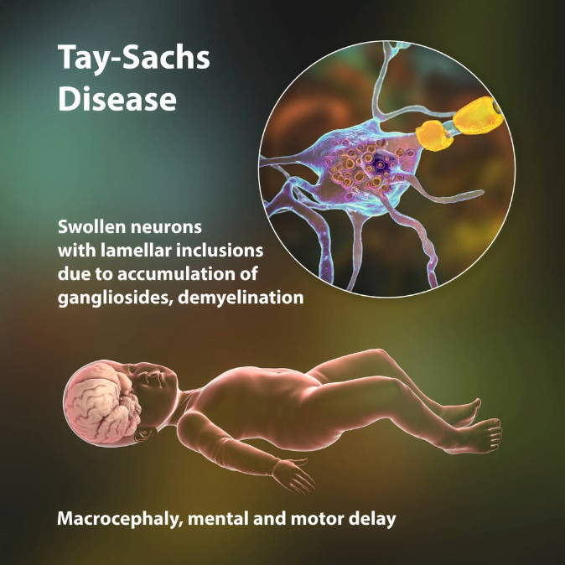
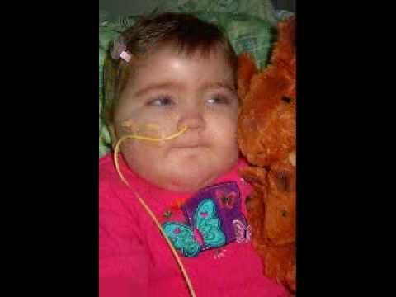
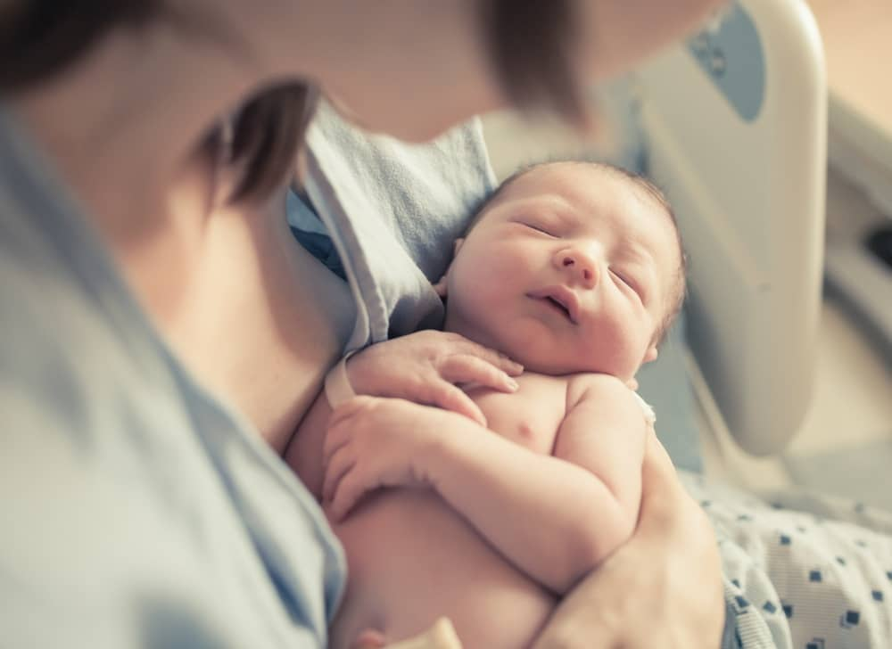
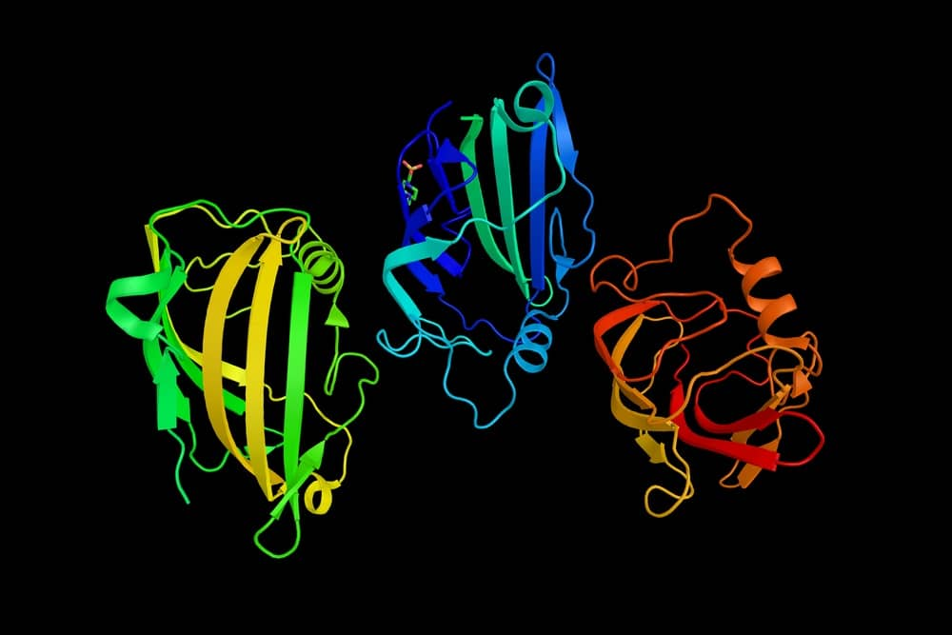
Recessive lethal allele in humans – Tay Sachs disease
Mutation genu HEXA (enzyme hexozaminidase A absent)
Abnormal accumulation of lipid complex G_{M2} ganglioside on the surface of neurons (function: protection of cells) due to absence of degradation process of G_{M2}
Newborns are normal
After 6 moths of age – neurological degradation, mental retardation, deafness, blindness, at 2 years unable to move, death usually 3-4 years
Ashkenazi Jews - heterozygotes Aa 1 : 30 (incidence 1:3600)

Slide 38
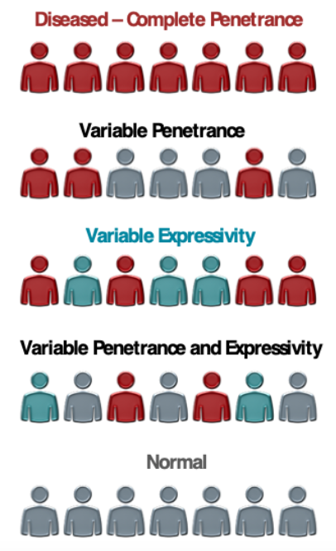
Penetrance and expresivity
Incomplete penetrance – individuals do not show given trait, even though they have given genotype
Variable expressivity - the of expression of gene differs in individuals carrying same trait (different phenotype
Reason – effect of environment, genetic background…1

Slide 39
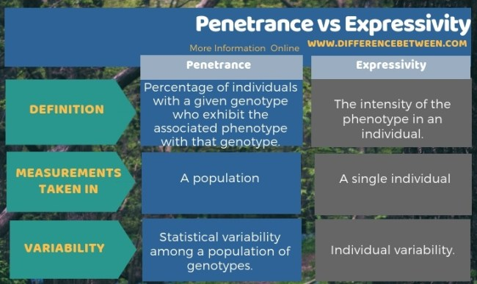

Slide 40
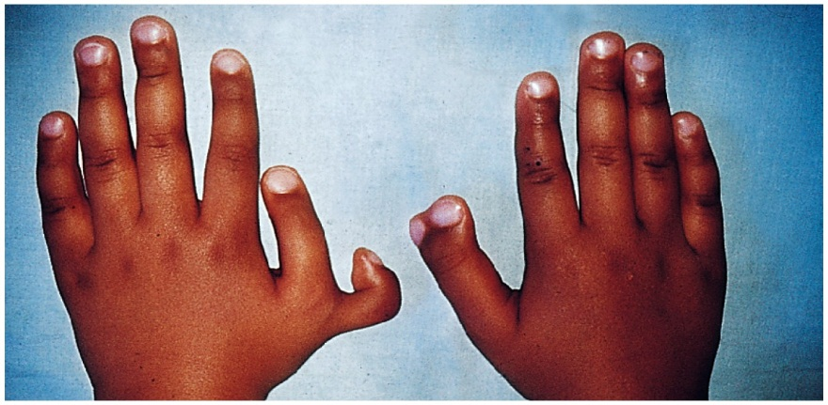
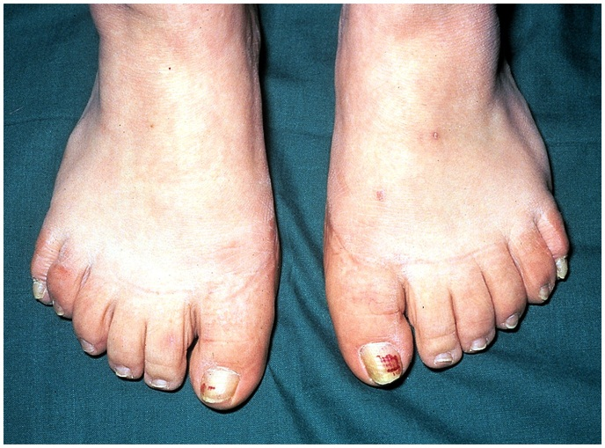
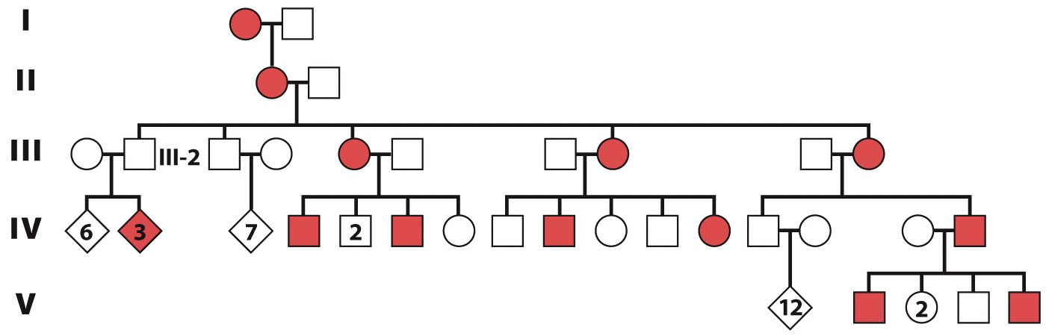
Incomplete penetrance: polydactyly
The trait is conditioned by a dominant mutant allele P
Its expression is showed in just a few individuals expresses
Influenced by genetic background
Mutation effect not expressed – healthy individuals

Slide 41
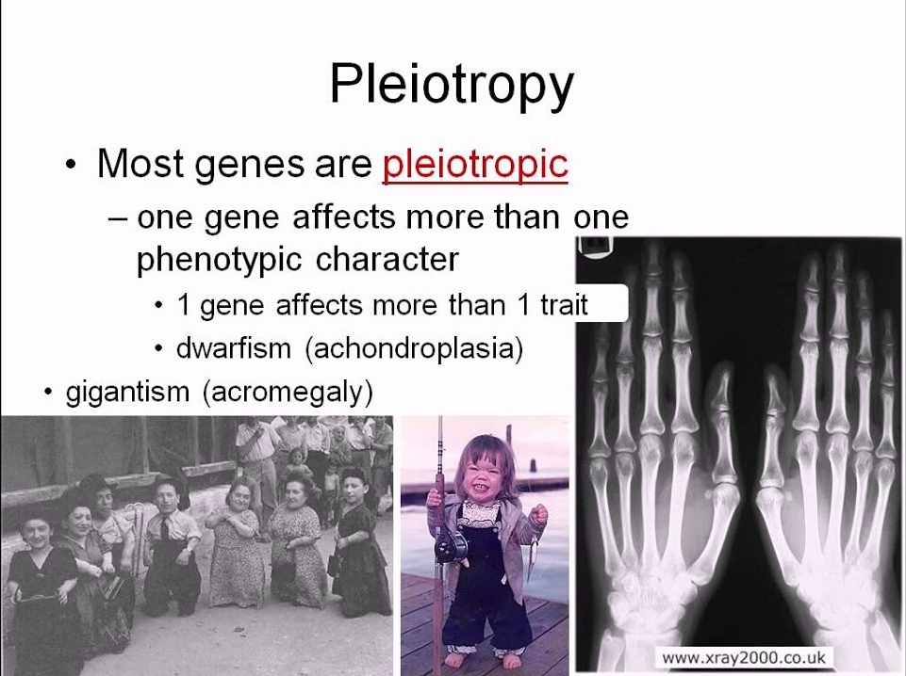
https://www.youtube.com/watch?v=OxehHPwTFtk&ab_channel=Shomu%27sBiology

Slide 42

Phenocopy traits induced by environmental effects are identical to phenotypes caused by genotypes
Phocomelia –
inherited malformations of human arms and legs
Teratogenic effect of thalidomide taken during early pregnancy

Slide 43
Gene interactions
Traits are based on cooperation of more genes (pathways)
Gene interactions – quantitative traits arise from cooperation of two and more allelic pairs from different genes
If two genes interact with each others, same rules as in dihybridism applies (same for n – hybridism)
Differences are detectable in phenotypes – in cases gene interactions there is lower number of phenotype classes

Slide 44
Gene interactions
Epistasis dominant / recessive
  in dominant epistasis, the dominant allele of one gene masks the expression of all alleles of another gene, while in recessive epistasis (Dahlia variablis bloom colors)
  the recessive alleles of one gene mask the expression of all alleles of another gene.
  Typical example – color of dogs coat
Complementarity -
  both dominant alleles are necessary for creation a product ( L. odoratus)
Inhibition
  inhibitive allele has not another effect on phenotype than ability to suppress an effect of dominant allele (Feathers color of domestic fow)
Multiplicity
  bilateral relation of alleles of interactive genes, but in comparison with complementarity, each single dominant allele of any of these genes, even in itself, is sufficient for expression of a corresponding trait.
  a) non-cumulative (Siliqua shape of shepherd’s purse) - phenotype is determined any dominant allele
  b) cumulative: (number Caryopsis color of wheat) - expression of phenotype is based on number of dominant / active alleles

Slide 45

Interaction of two genes changes in F2 ratios
Dihybrid crossing
Inhibition
Complementarity
Recessive epistasis
Dominant epistasis
Duplicity non-cumulative
Duplicity cumulative (dominant)

Slide 46
Heredity of sexuality and sex-linked traits
Evolution – asexual to sexual and haploid to diploid organisms
Reason = to maximize to genotype variability
Sexual organisms – change of haploid / diploid stage, reduction of diploid number of chromosomes (meiosis)
Some organisms can reproduce asexually or can change periods of sexual /asexual reproduction
The most of the eukaryotic organisms use sexual reproduction

Slide 47

Heredity of sexuality and sex-linked traits
Basic features of sexuality are the same in all eukaryotes – there are two types of sex (sexual organs with production of male or female gametes) and new generation arise from connection of both gametes
Anisogamy - difference in size of male / female gametes
Evolution of separate sex leads to creation
of haploid gametes - meiosis
Man 10¹² sperms per life
Woman 2,5 millions of oocytes only 400 will mature

Slide 48
Heredity of sexuality and sex-linked traits
Sexual differentiation
Primary differentiation
  Include creation of reproduction organs (gonads)
Secondary differentiation
  Include differentiation of other organs (mammary glands, genitalia, etc.)
Organisms can carry
  A) just one type of gonads (male / female) dioecious (plants) , gonochorism (animals, higher mammals)
    - The sex in gonochorism is determined by genetic traits (GSD) or by environmental factors (ESD)
  B) both male and female gonads at same time - monoecious, hermaphrodites

Slide 49


Discovery of sex chromosomes
1891: H. Henking – „additional“ chromosome in Pyrrhocoris males
1902: McClung - two types of sperm in several kinds of insect
1905: N. Stevens - discovery of sex chromosomes in Tenebrio
- small one (Y) is responsible for male sex determination
1906: E.B. Wilson – XY designation of sex chromosomes
              Protenor AAXX – females, AAXY males
1913: Seiler: butterflies AAXY – females, AAXX males

Slide 50
Chromosomal determination of sex
Autosomes (somatic) x gonosomes (sex chromosomes)
Humans 22 pairs of autosomes + 1 pair of gonosomes
Designation of sex chromosomes: X and Y (or Z and W)
XX: homogametic sex (one type of gametes)
XY: heterogametic sex (two types of gametes)
AA: two batches of autosomes
There are 3 basic systems of chromosomal determination of sex
mammal type – (Drosophila)
bird type – (Abraxas)
type Protenor

Slide 51



Chromosomal determination of sex: Mammal type
Female sex: AA XX - homogametic
Male sex: AA XY – heterogametic
Each pair produce 50% of sons and 50% of daughters = sex ratio 1:1
Carriers of the sex traits are males
Two types of sperms are produced with
same probability
Eggs are always of same genotype (X)
Mammals, insect, reptiles, several plants

Slide 52




Mammal type of sex determination in plants – dioecious type of plants
XX female and XY male plants

Slide 53






Chromosomal determination of sex – bird type
Designation of genotypes ZW - females, ZZ males
Carriers of sex traits – females (2 types of eggs – Z,W
Males produce only one type of sperm (Z)
Chromosome Z – locus of DMRT1 gene – development of male gonads require 2 copies
If one copy is disabled – females

Slide 54


Chromosomal determination of sex – type Protenor
Protenor (Lygaeus kalmii)
Female sex: AA XX - homogametic; Male sex: AA X - heterogametic
Mostly insect species
Sex ratio 1 : 1
Females – 14 chromosomes
Males – 13 chromosomes
Protenor (Lygaeus kalmii)

Slide 55


Chromosomal determination of sex: haplo - diplpoidy
Females: AA - diploid
Males: A - haploid
Order Hymenoptera
(bees, ants, wasps)
Bees
  no sex chromosomes
  sex is determined by total number of chromosomes
  Fertilized eggs (2n) produce females
  Un-fertilized eggs (1n) - parthenogenesis = males
  Females have on average 75 % of common genes – higher genetic affinity – high level of social cooperation
50 %
100 %
75 %
n=16, 2n=32

Slide 56





Environmental sex determination (ESD)
Sex is determined by external factors f. e.
  Temperature (reptiles) - genetics (XX/XY or ZZ/ZW)+TSD (temperature dependent sex determination)
  Social factors - Bonellia viridis
      If egg develops in isolation = females
      If egg migrates into the tract of female = males
      Males 1000x smaller than females
M. Crighton - Jurassic park (Spielberg movie 1993)

Slide 57
Genetic determination in humans
Presence of different sex chromosomes and product of one specific gene SRY (sex-related region Y) determine the phenotype (sex) of the individual
Expression of SRY activate the cascade of events leading to development of female or male gonads (master-switch sex determining gene)

Slide 58




Determination of sex in humans – significance of chromosome Y
Karyotype:
Male 46,XY Female 46,XX
X - 1669 genes
Y – 200 genes
(50-60 genes protein-coding)
45,X – females
47,XXY- males
Proof of chromosome Y is responsible for sex determination

Slide 59


Genes located on chromosome Y
Sex differentiation, sperm production
10-15% sequences comes from chromosome X
Cca 60 millions of base pairs
Spermatogenesis - genes encode 9 protein families in 2-35x copies

Slide 60


Development of sex in humans
long-term process – start at 1st trimester
activation of 37 proteins + sex hormones
Ended after individual sexual maturation

Slide 61

Differences in development of gametes in humans
Women – 24 cell divisions
Men – 25 years
sperms – 265 divisions
Men - 50 years
sperms - 840 divisions !!!
Spermatogenesis - 64 days
DNA replication – errors in the process - mutations in older men

Slide 62


Slide 63


Heredity of sex-linked genes
Gonosomes (X,Y) are consisted of two regions carrying genes – heterologous and homologous
Non-homologous regions - determine genes with full sex-linked inheritance
Homologous regions - determine genes with incomplete sex-linked inheritance (= Mendel´s laws)
  Genes with loci of Y non-homologous regions determine holandric traits (father to son – Y-linked inheritance)
  Genes with loci in non-homologous regions of X chromosome - X-linked inheritance
XY
XY

Slide 64


Slide 65


T.H. Morgan 1910
Sex-linkage heredity
“Certain factors follow the distribution of the X chromosome and are therefore supposed to be contained in them.”
Genes lie on chromosomes !!!

Slide 66

Sex-linked heredity
D. melanogaster
Genes located on non-homologous region of chromosome Y
CROSS heredity !
Non-uniform!
Mendel´s law of uniformity of F1 hybrids and identity of reciprocal cross does not apply here !!!

Slide 67
Rules of sex-linked inheritance (Morgan 1910)
If an individual carry dominant sex-linked trait (gene), whole F1 population will show same trait as dominant parent regardless of sex. In F2 there will be ratio 3:1 in this trait and individuals carrying recessive variant (allele) will be same sex as recessive
If individuals with homogametic sex carry recessive sex-linked trait (gene), there will be shown both dominant and recessive variants but in opposite sex than in parents. In F2 regeneration the both variants will manifest with same frequency in whole population and in population of given sex

Slide 68


X-linked recessive inheritance
Recessive allele in males – hemizygous (only one member of chromosome pair)
Produce affected males in most times
1) X^{A}X^{A} x XªY (women healthy)
  Healthy sons; daughters = carriers of the disease
X^{A}Xª x X^{A}Y (women carrier, man healthy)
  ½ sons affected, ½ carriers
  Rare cases in women: daughters of affected man + woman carrier; women with 45,X karyotype
Examples: DMD, Hunter disease

Slide 69




Haemophilia: 1/10000 in men; 1/100 000 in women žen – pedigree of europeanm ruling houses
Alexej
Porucha koagulace – deficit srážlivého faktoru v krvi !

