Slide 1
Medical genetics III
Duplications, marker chromozomes, other CHAs

Slide 2
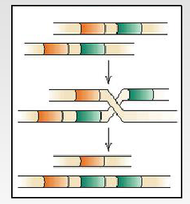
Duplications (dup)
Origin:
NAHR
abnormal segregation (carriers of inversion or translocation)
Errors in replication

Slide 3
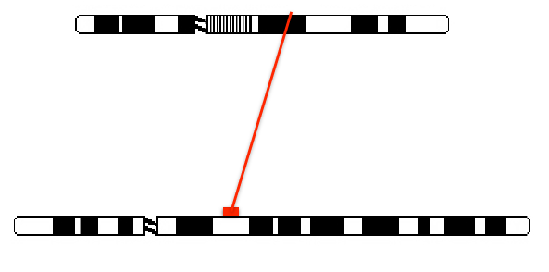
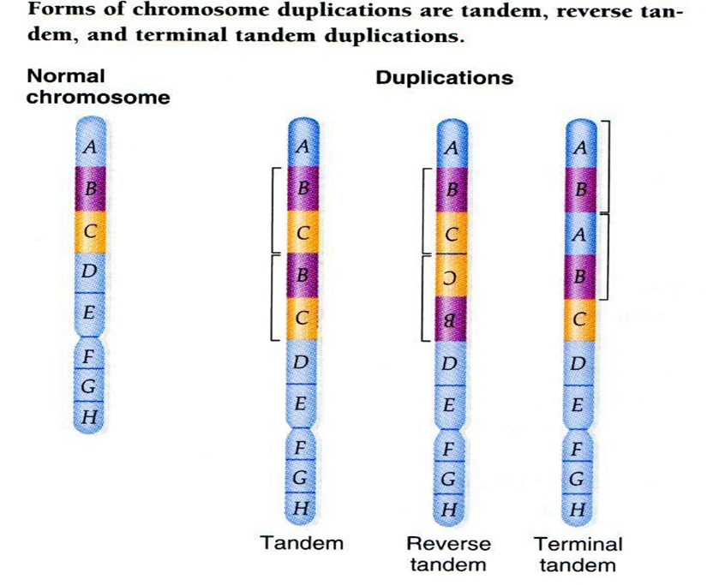
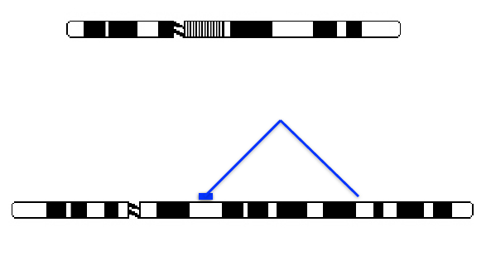
Inter- a intrachromozomal duplication
Tandem and reverse tandem duplication
Size: hunderds pb till Mbs

Slide 4
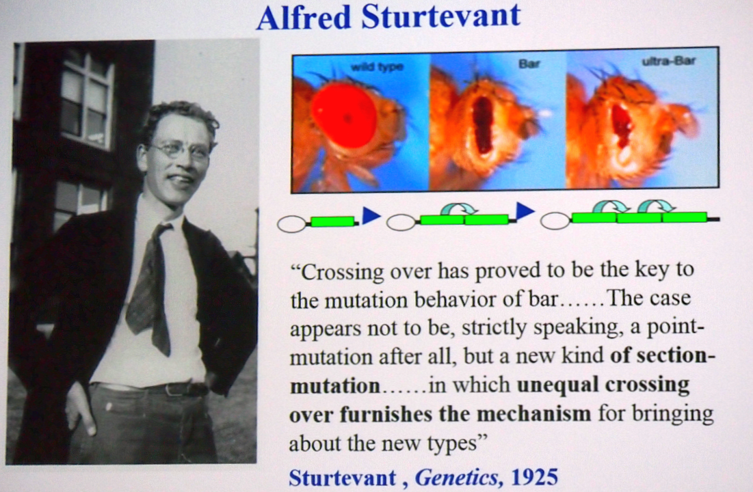
Unequal crossing-over, duplication and muation of Bar gene in Drosophila

Slide 5
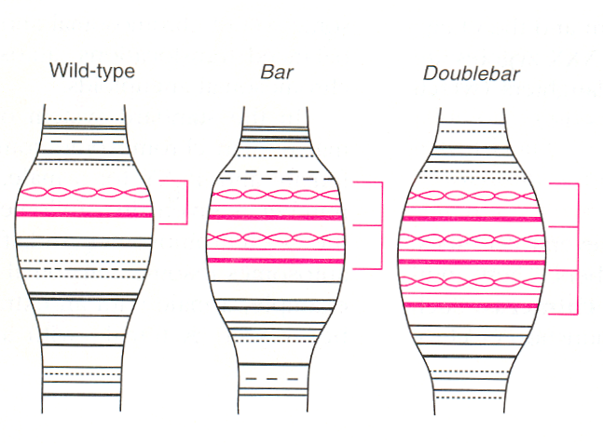
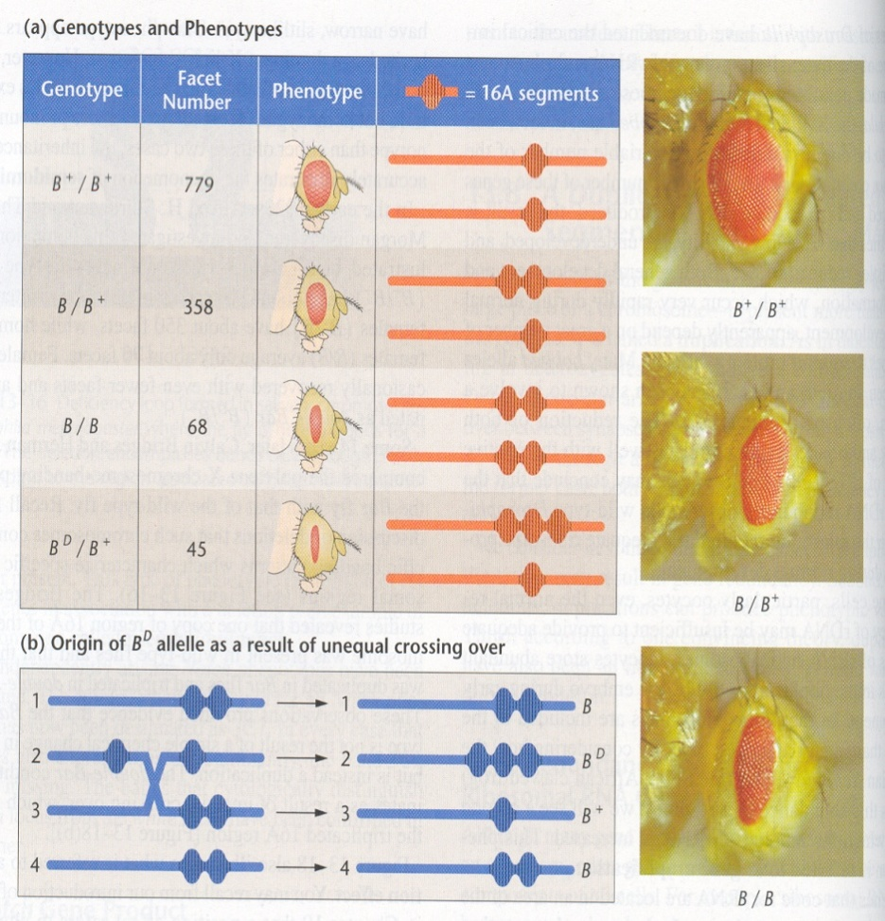
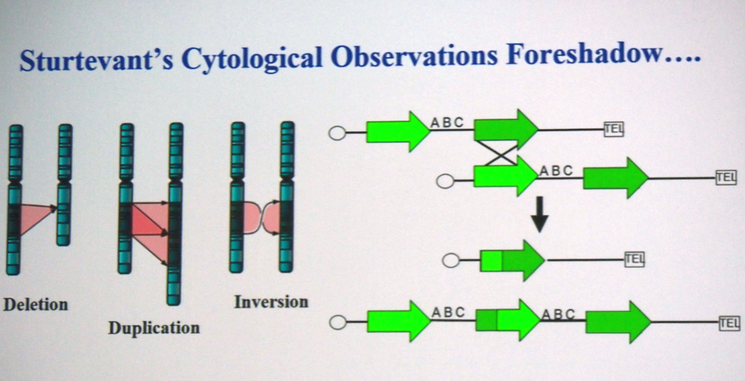
Bar duplication in Drosophila B+,B affects facet number in compound eyes

Slide 6
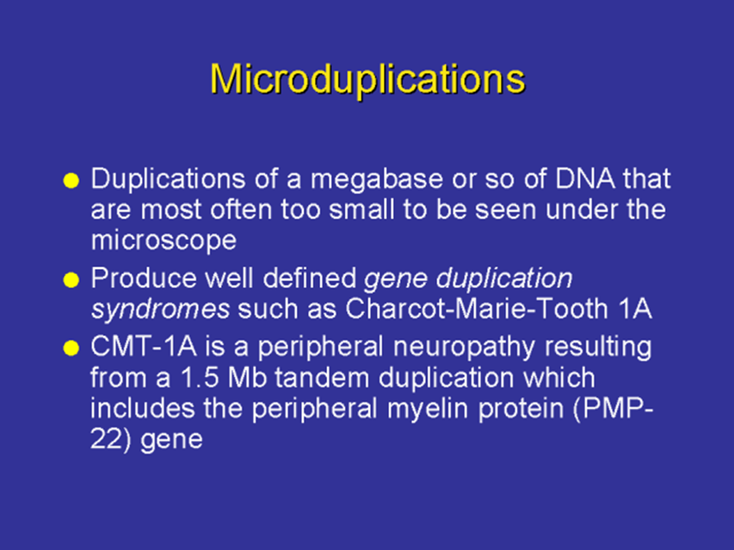
there are about 80 microduplication syndromes
Microduplications - milder influence on phenotype, variable expressivity, can often be inherited from healthy parents

Slide 7
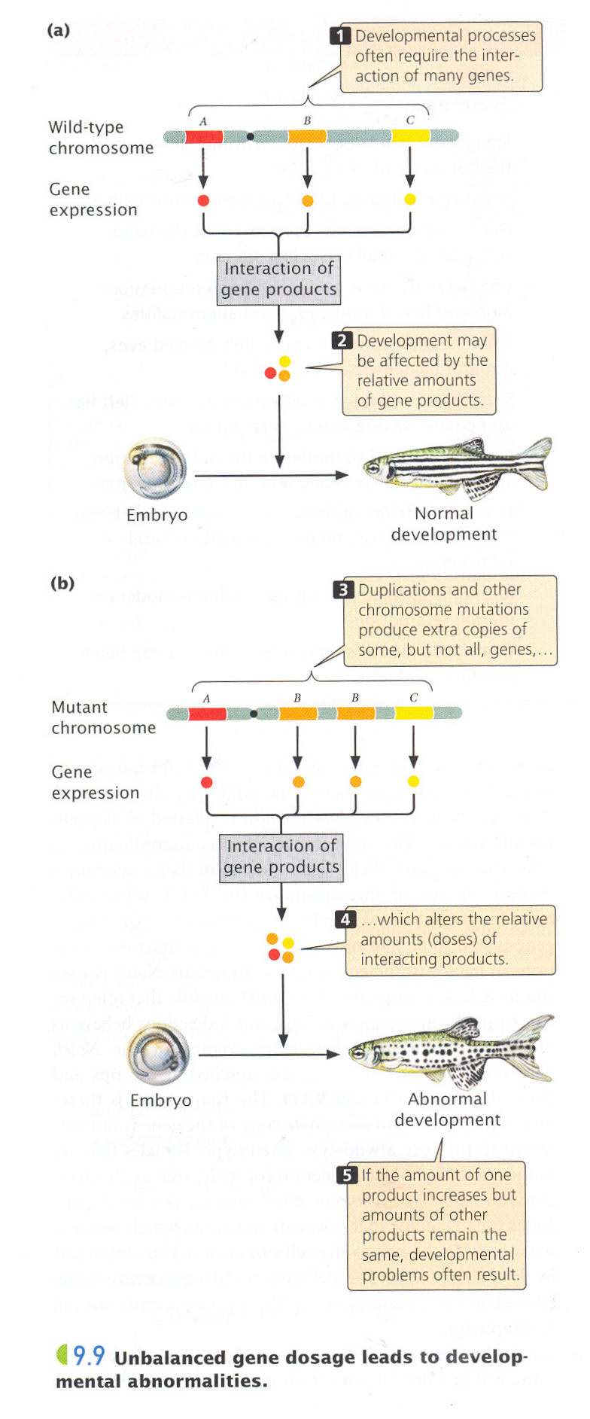

Duplications – effect of gene dosage!
increased gene expression
disorders of gene regulation and function
emergence of fusion genes
gene disruption (breaks)

Slide 8
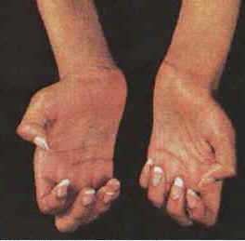

Charcot-Marie-Tooth (CMT1A) – duplication of cca 1,5 Mb
AD neurological disorder
incidence: 1 : 2500
gene dose effect - duplication of the myelin protein gene symptoms: muscle atrophy
Clinical features
Weakness in your legs, ankles and feet
Loss of muscle bulk in your legs and feet
High foot arches, curled toes (hammertoes)
Decreased sensation or a loss of feeling in your legs and feet
90% arise in male meiosis (recombination between repetitive sequences)

Slide 9
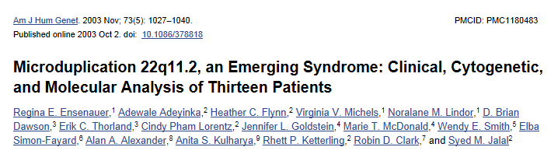
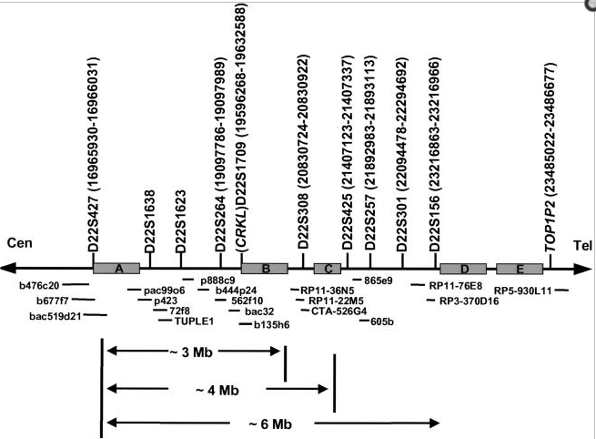
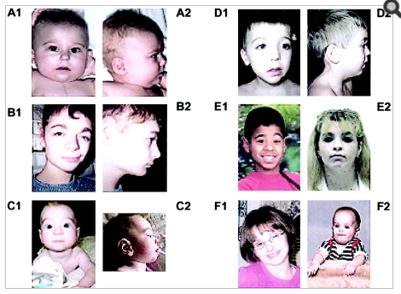
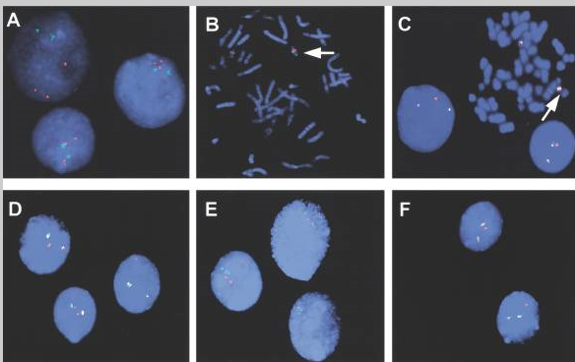
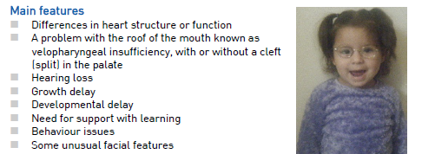
Microduplication syndrome 22q11

Slide 10
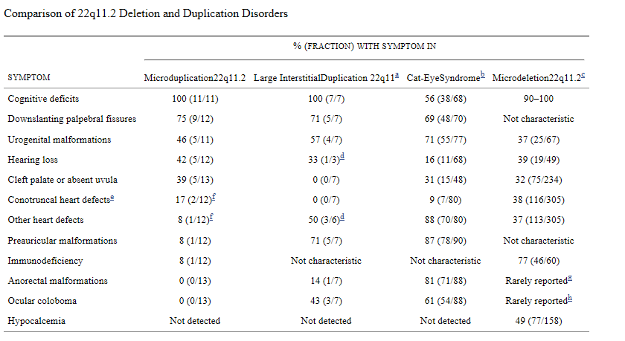
Comparison of clinical features in deletion/duplication 22q11.2 - milder involvement, incomplete penetrance, high variable expressivity

Slide 11
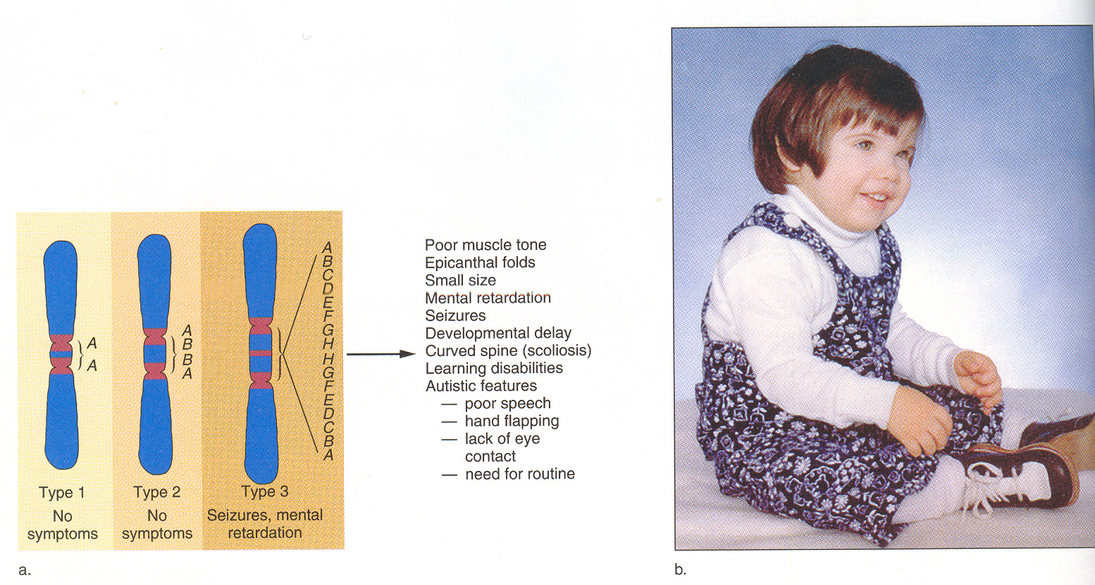
Syndrome inv dup(15) – ofen as marker chromosome !!!

Slide 12

Small supernumerary marker chromosomes (sSMC)
it is a small redundant chromosome that cannot be analyzed by cytogenetic banding method

Slide 13
Characterization of sSMCs
chromosome - carries functional kinetochores, mostly regular inheritance
small - size usually smaller than G chromosomes;
redundant - exceptions are markers derived from gonosomes;
absence of banding pattern - cannot be analysed by conventional cytogenetic methods !!!
markers sometimes do not contain centromeric DNA sequences - yet they are stable - neocentromeres
often without telomeres - circular chromosomes

Slide 14
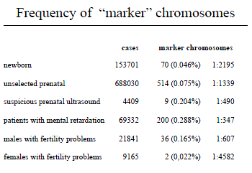

Slide 15
Classification of sSMCs
1) Satellite marker chromosomes (up to 80%)
Distamycin A/DAPI positive - most often from chromosome 15 idic(15) - "inverted duplication 15 syndrome"
Distamycin A/DAPI - negative - frequent 13, 14, 21, 22
idic(22) - "cat eye syndrome„
2) Non-satellite marker chromosomes (often ring-ring chromosomes)
Distamycin A/DAPI - positive – frequent chr. 1, 9, 16
Distamycin A/DAPI - negative chr. 5, 8, 9, 12, 18
3) Marker chromosomes derived from gonosomes
frequent r(X)

Slide 16
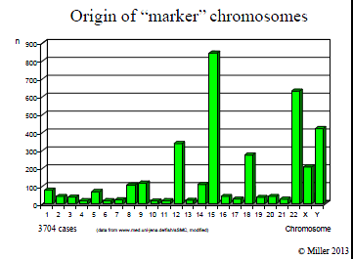

Slide 17
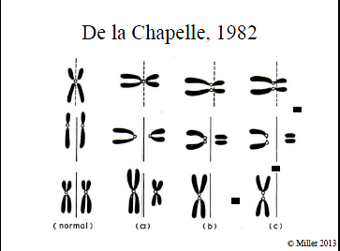
Origin of sSMCs

Slide 18
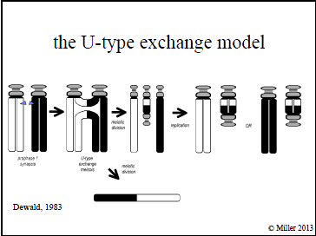
Origin of sSMCs

Slide 19
Techniques used for identification of marker chromosomes
Marker chromosomes:
without euchromatin - may not affect the phenotype
with euchromatin - partial trisomy !!!
banding (C-, Ag-NOR banding)
FISH (CEP, WCP)
SKY, M-FISH, M-BAND
Mikrodisection – reverse FISH
array-CGH (the most effective)

Slide 20
Finding of a marker chromosome in the fetal karyotype is always a serious problem for prognosis estimation and further genetic counselling !!!It is necessary to determine the origin !!!
sSMCs and genetic counselling

Slide 21
sSMC - case report PATIENT 1 - reason for cytogenetic examination and its result
boy (born 1984) - indicated due to mild psychomotor retardation and short stature;
karyotype determined 47,XY,+mar;
marker origin: de novo, contains centromere and satellites;

Slide 22
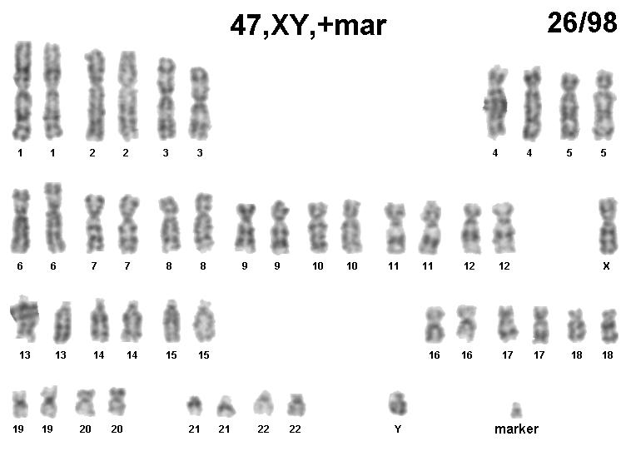

Slide 23
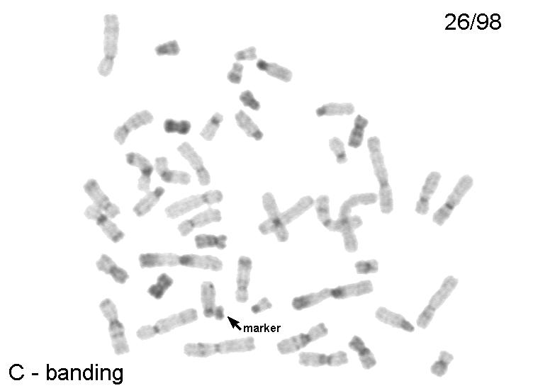

Slide 24
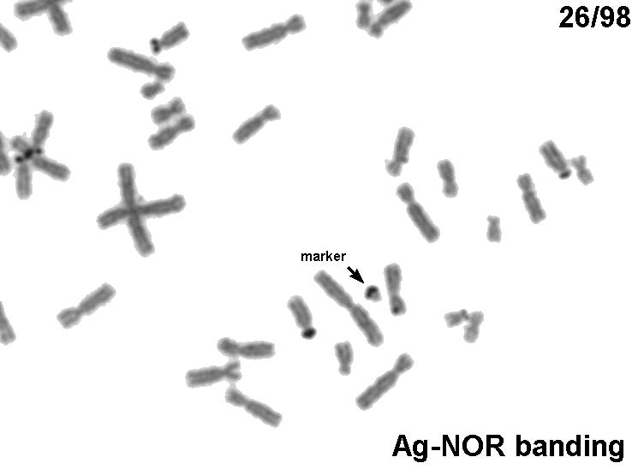

Slide 25
PATIENT 1 - FISH investigation
centromeric probe and whole chromosome probe 15 both negative;
centromeric probe: 14/22 positive;
whole-chromosome probe: 22 negative;
whole-chromosome probe: 14 positive;
We've determined the origin, but we don't know what genes the marker contains...

Slide 26
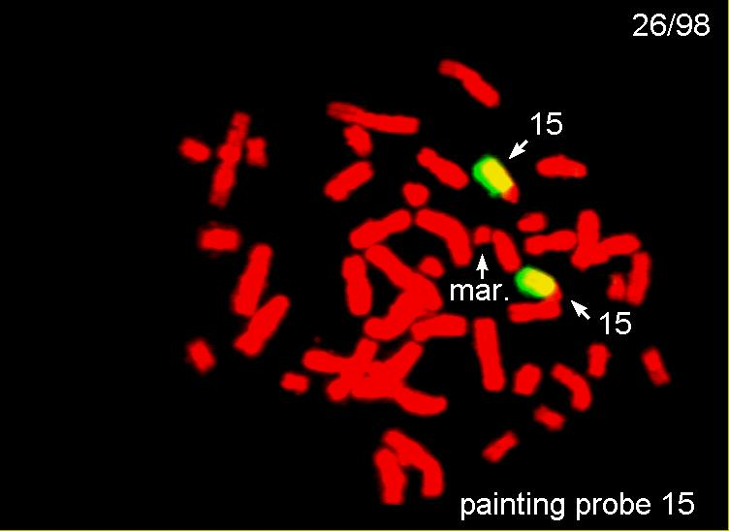

Slide 27
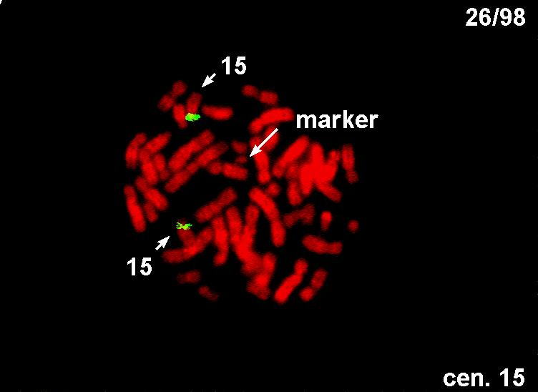

Slide 28
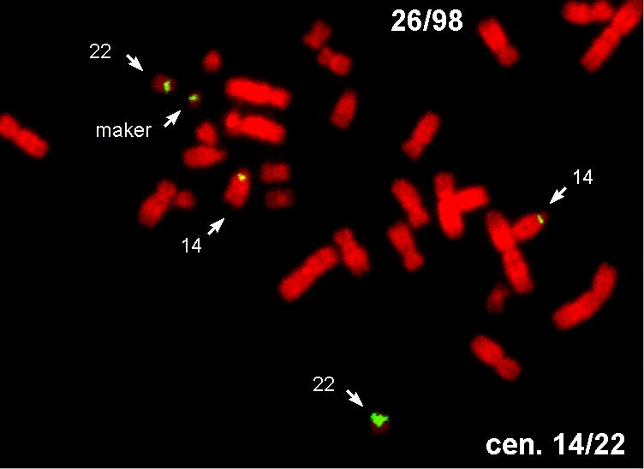

Slide 29
sSMC PACIENT 2
Child from first pregnancy
findings: hearing loss in the P ear, complete deafness in the L ear
born 2001
both parents and younger sister healthy

Slide 30
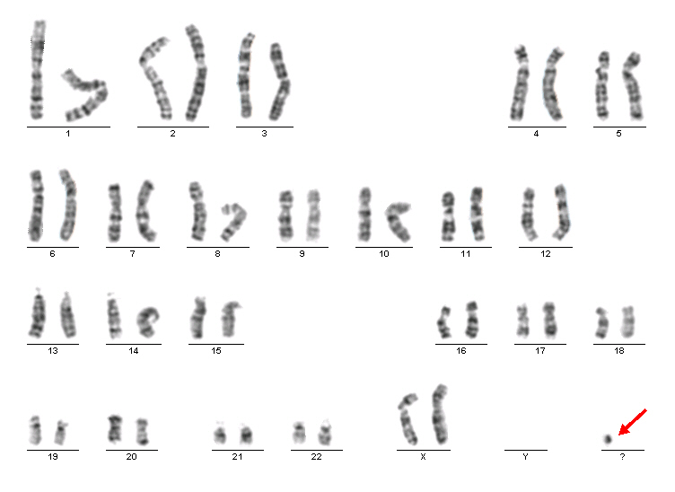
Karyotype:
47, XX, + mar [18] / 46, XX [12]
Origin of sSMC unknown

Slide 31
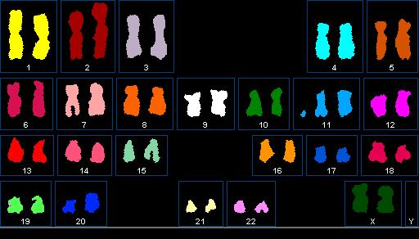
SKY: 47, XX, + mar(11)

Slide 32
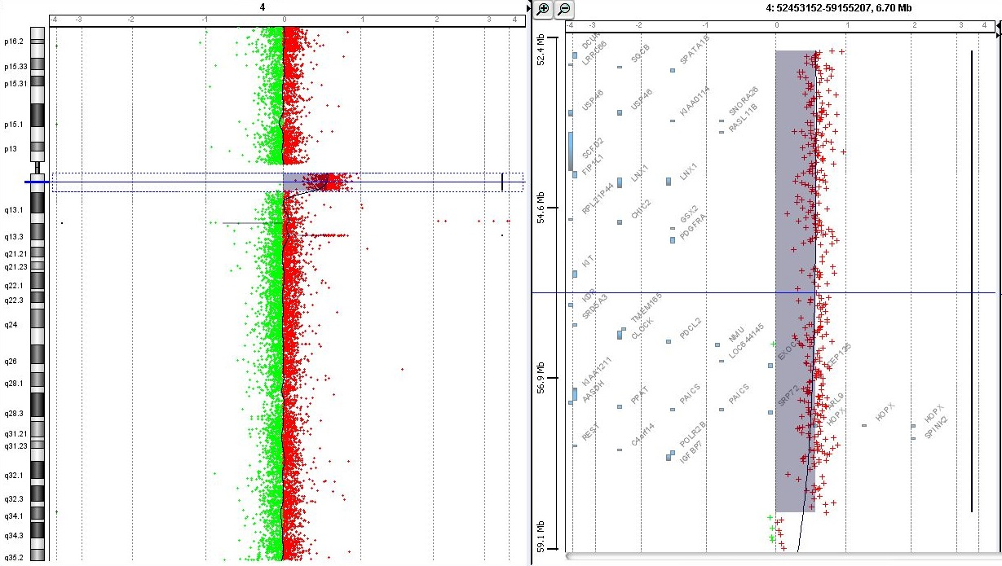
Identification of sSMCs nowadays
array CGH + karyotype
on the array-CGH profile, the marker chromosome appears as a gain of genetic material
it is necessary to know the karyotype - differentiation of the marker from tandem duplication
Determination of which genes the marker contains
Profile of array-CGH with sSMC orginated from 11q12 area (5,96 Mb)

Slide 33
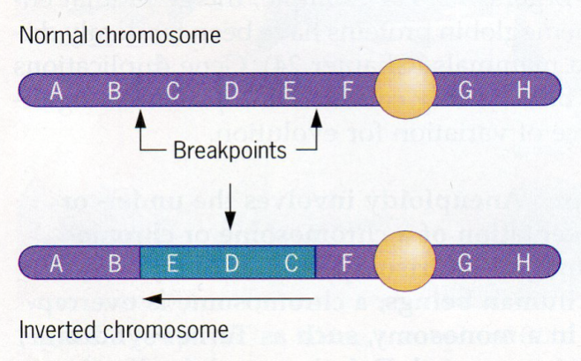
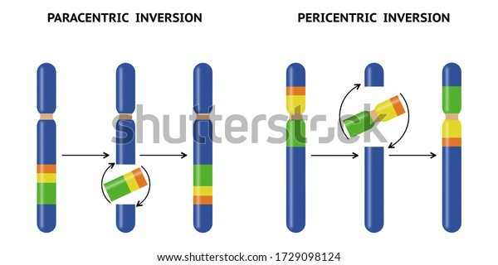
Inversions (i)
Origin: breaks on chromsosme
2 possible types

Slide 34
Genetic significance of inversions
Inversions does not cause an abnormal phenotype in its carriers....but creates problems in heterozygotes....
an inversion loop is created in meiosis!
reduction of crossing-over frequency - reduction of contact sites within the loop - blockage of crossing-over - evolutionary significance of inversions (genes do not separate by c.o. and are transmitted together...)
In humans - clinical significance for offspring - carrier of any inversion has increased risk of abnormal gametes arising after c.o. - unbalanced CHA in offspring (dicentric chromosomes, acentric chromosomes, duplications, deletions)....abortions, affected children.... STERILITY !

Slide 35
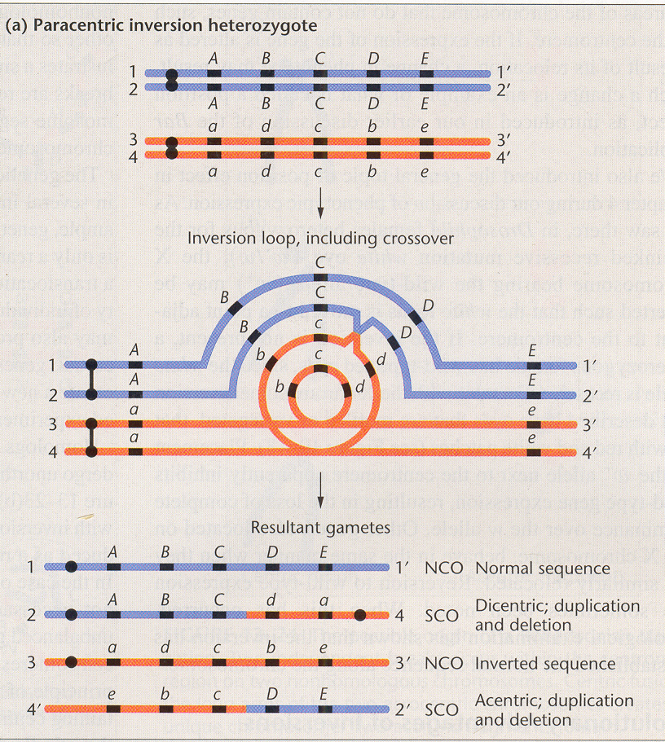
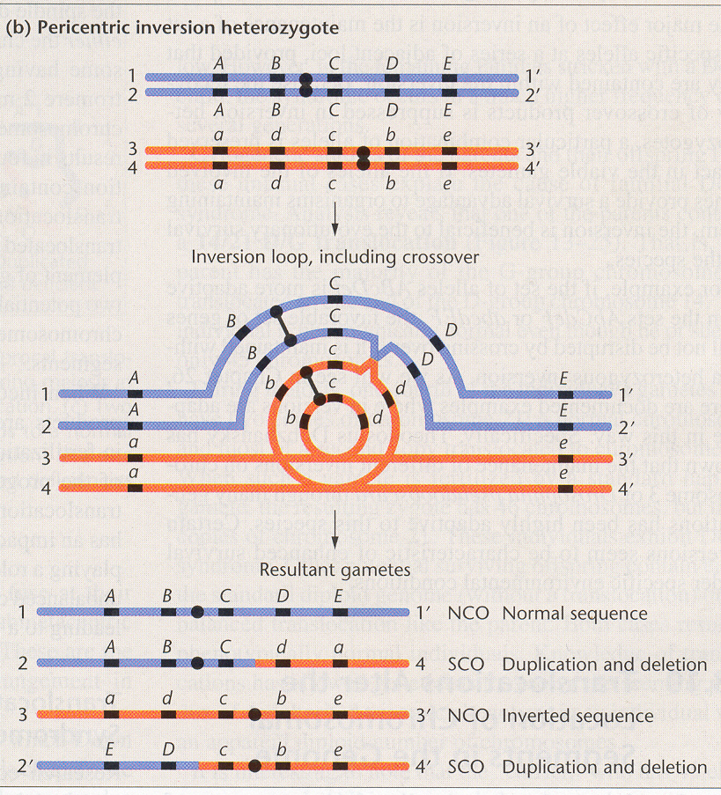
Inversion and consequence of crossing-over in inverted heterozygotes unbalanced chromosome aberrations in gametes after crossing-over - duplication - deletion (peric.) or dicentric - acentric fragment (parac.) - gametes unviable !
C.O.

Slide 36
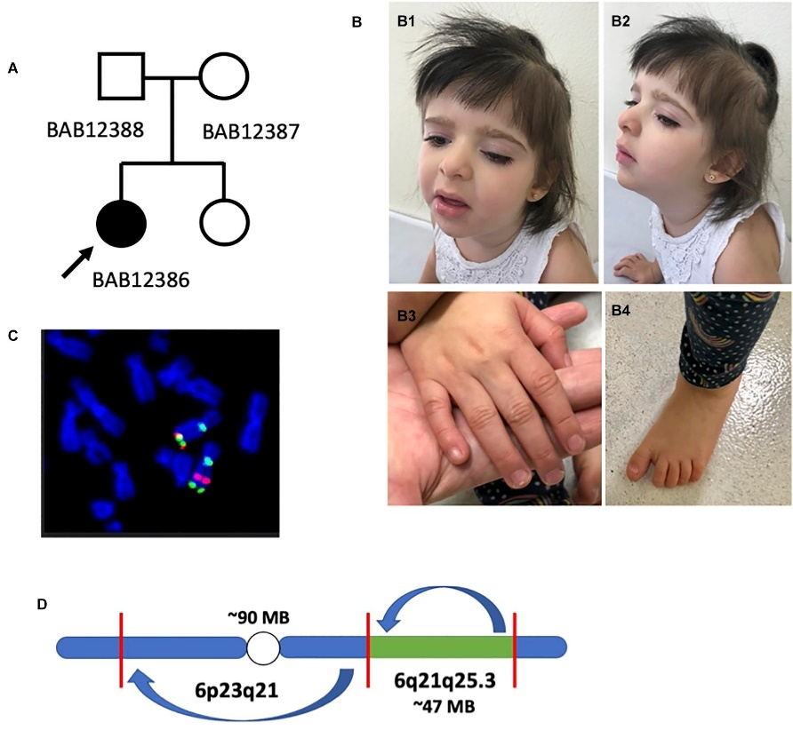
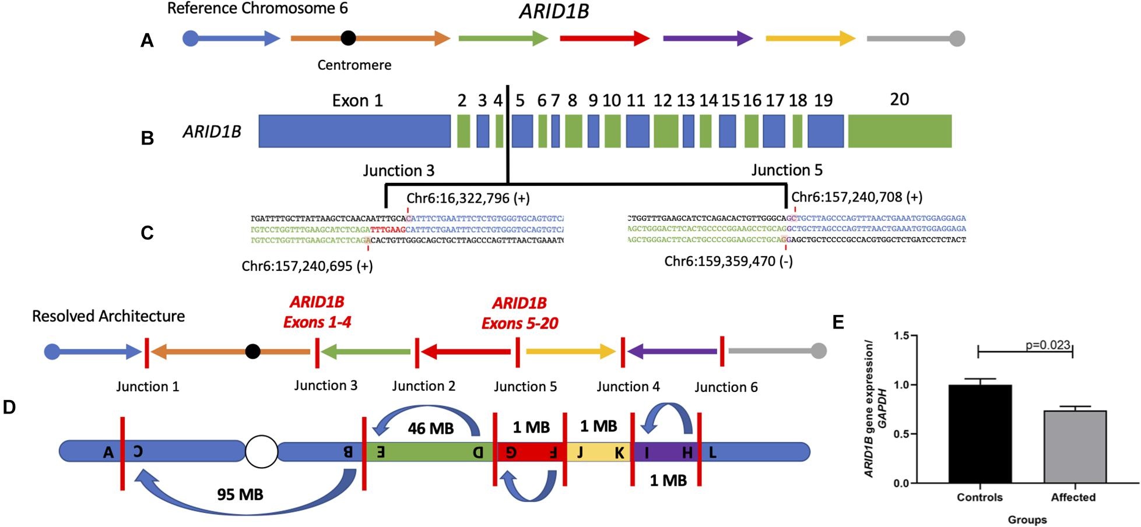
Inversions – case report
Disruption of chr. 6
Chromoanagenesis Event Underlies a de novo Pericentric and Multiple Paracentric Inversions in a Single Chromosome Causing Coffin–Siris Syndrome“ . Grochowski et, Front. genetics

Slide 37
Translocations
exchange of chromosome segments between two or more chromosomes
reciprocal x simple
Robertsonian translocations - acrocentric chromosomes
complex translocations (affecting three or more chromosomes)

Slide 38
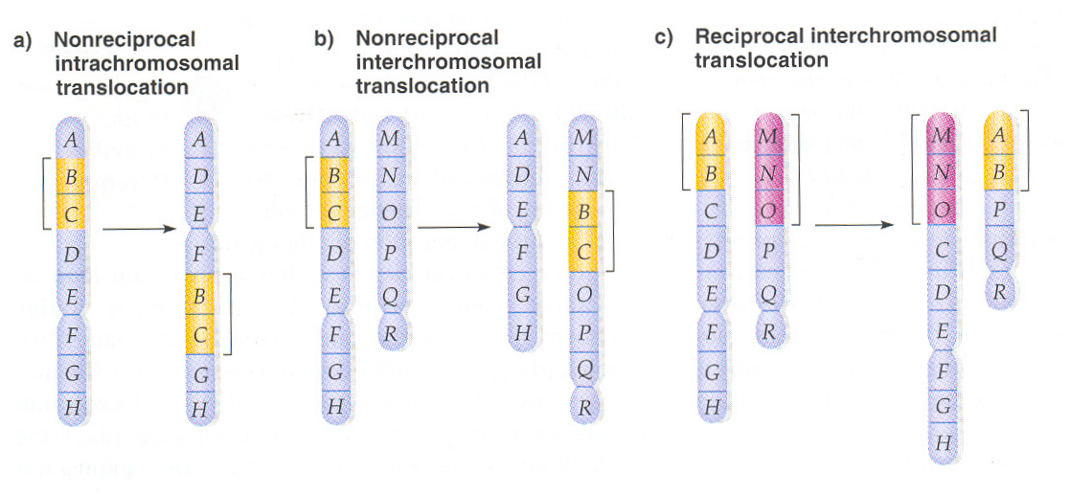
Types of chromosomal translocations

Slide 39
Congentital reciprocal translocations in humans
occurrence in the population with a frequency of about 1 : 500
do not clearly affect the carrier phenotype (5 times higher incidence in the mentally retarded population)
significant cause of sterility in carriers
  due to aberrant meiotic segregation
  formation of gametes with unbalanced rearrangements (duplication, deletion)
acquired translocations - positional effect in tumors - activation of oncogenes, deregulation of gene expression !
fusion genes (e.g. Ph chromosome)

Slide 40
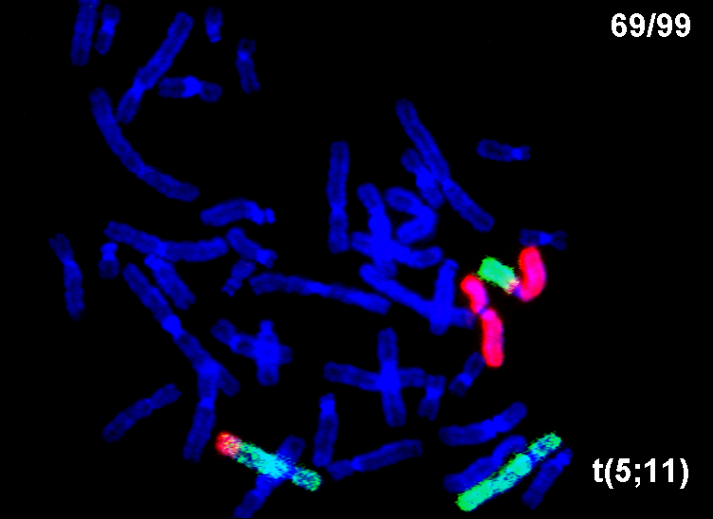
Translocation – two color FISH

Slide 41
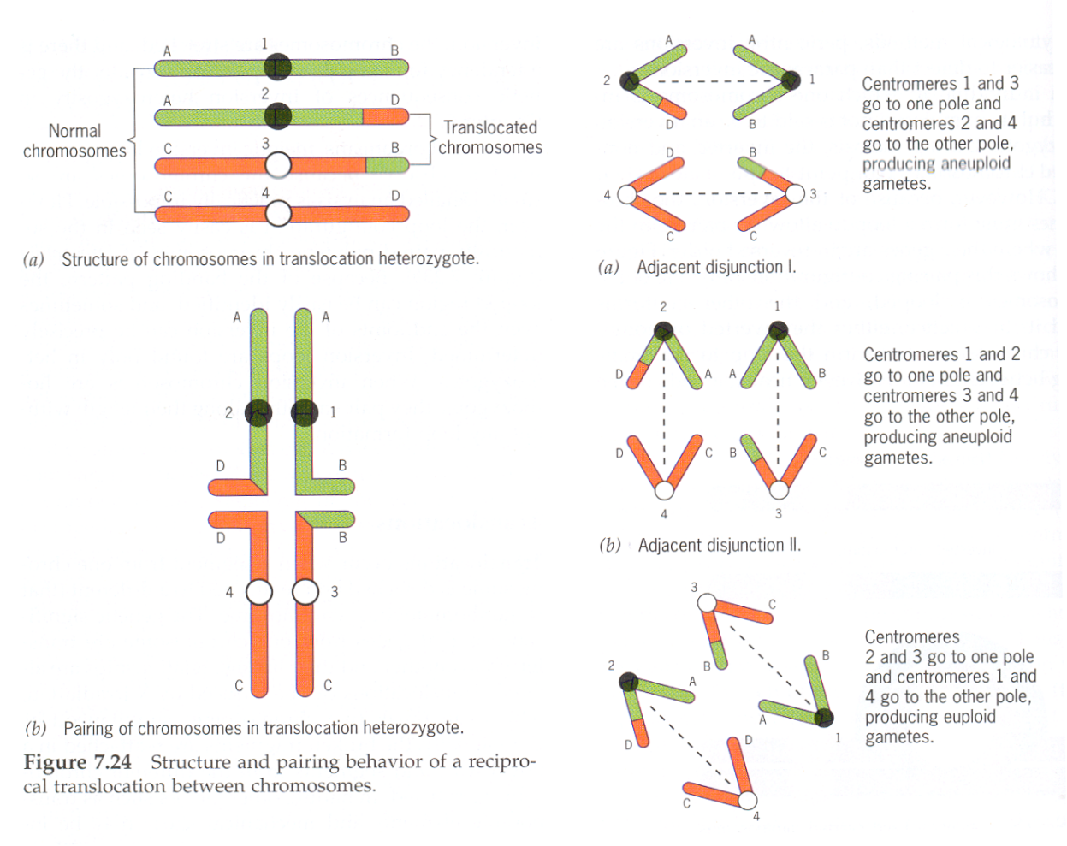
Segregation in translocation heterozygotes - possible formation of gametes with unbalanced assemblies - with duplication, deletion...
Reciprocal translocations - problems in meiosis - formation of cross structures at synapsis
Segregation of adjacent chromosomes type I
(homologous centromeres diverge into different daughter cells)
Segregation of adjacent chromosomes type II
(homologous centromeres diverge into the same daughter cell)
Alternate segregation (gametes with a normal chromosome set or with two chromosomes with a reciprocal translocation)
Gametes with unbalanced changes – dels, dups
I.
II.
3 possible segregation patterns

Slide 42
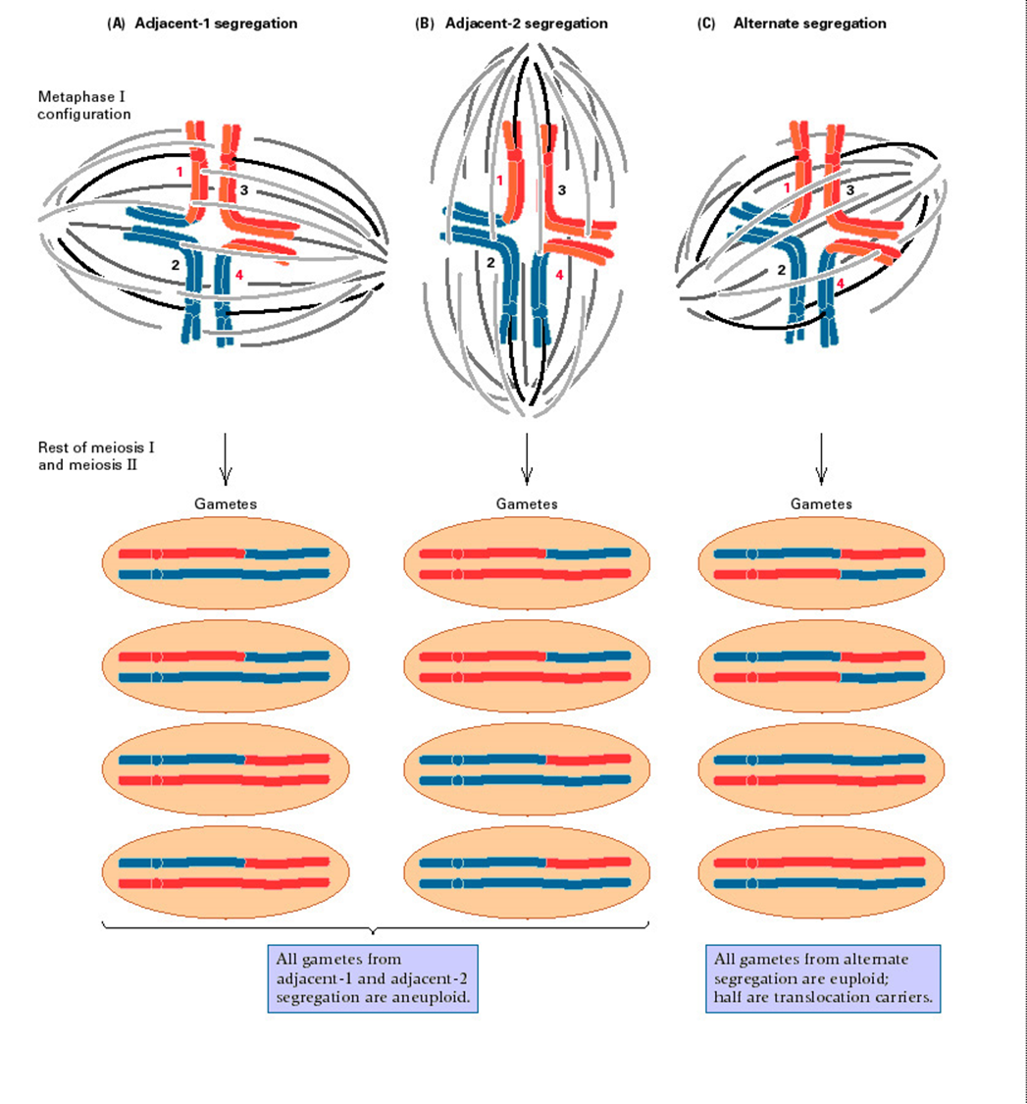
Alternate segregation
balanced
normal
Unbalanced gametes

Slide 43
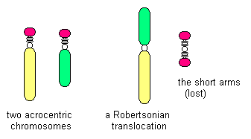
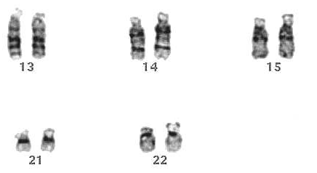
Robertsonian translocations are connected with acrocentric chromosomes in human
45,XX,der(13;21)(q10;q10) or 45,XX,rob(13;21)(q10;q10)
–ISCN description 45 chromozomes in karyotype !
2 akrocentric 1 metacentric
loss of short arms

Slide 44
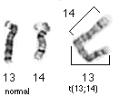
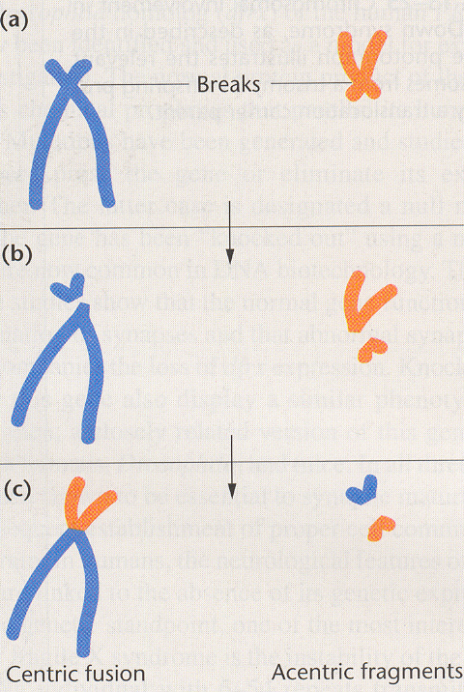
der(13;14) – the most common Robertsonian translocation in humans 1 / 1300 individuals

Slide 45
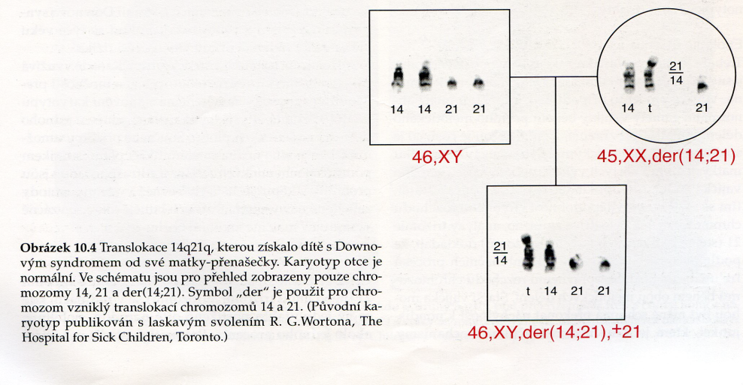
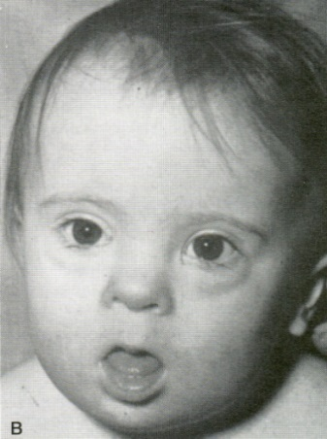
Robertsonina translocations and Down syndrome
about 4% of Down syndrome cases - a consequence of Robertsonian translocations affecting chromosome 21
the parent carrier der(14;21) is normal ! but the child inherits chromosome 14 with 21!
the theoretical risk of the child being affected by D.S. is 33% !
population studies - 10 to 15% in carrier mothers

Slide 46
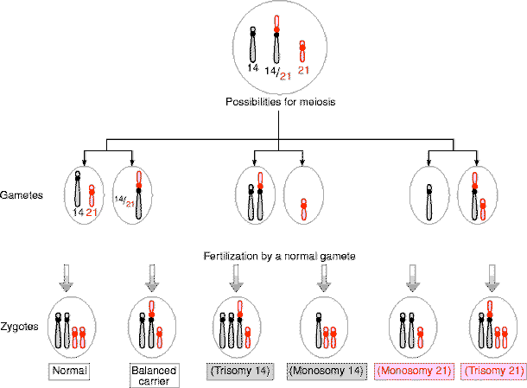
Karyotype of male with Down syndome casused by translocation t(14;21)
Normal 14;21
3 viable zygotes = 33% chance
https://slidetodoc.com/presentation_image_h/366d746f8c7c9e10c87cc3733ac79162/image-36.jpg

Slide 47
45,XX,der(21;21)
100% cases of Down syndrome in offsprings

