Slide 1
Bi9393 Analytická cytometrie
Karel Souček, Ph.D.
Oddělení cytokinetiky
Biofyzikální ústav AVČR, v.v.i.
Královopolská 135
612 65 Brno
e-mail: ksoucek@ibp.cz
tel.: 541 517 166
K. Souček Bi9393 Analytická cytometrie

Slide 2
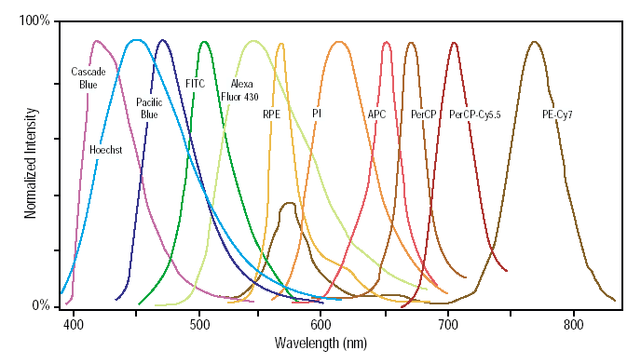
Emission Spectra–Spectral Overlap

Slide 3
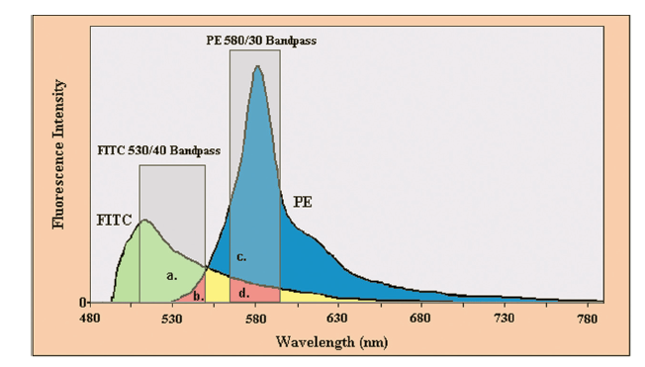
Co je problém při vícebarevné detekci?
K. Souček Bi9393 Analytická cytometrie

Slide 4
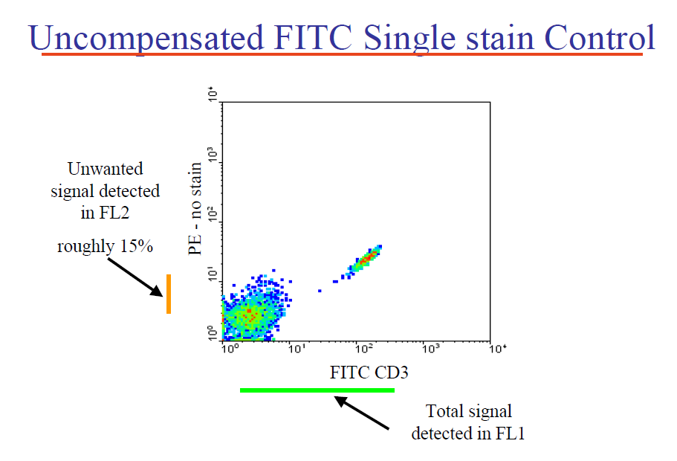


Slide 5
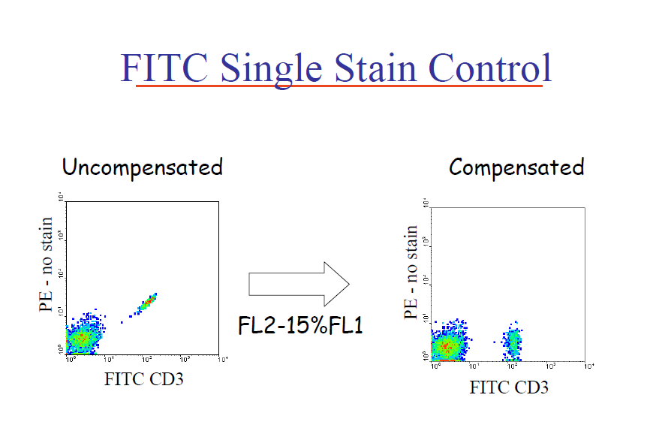

Slide 6
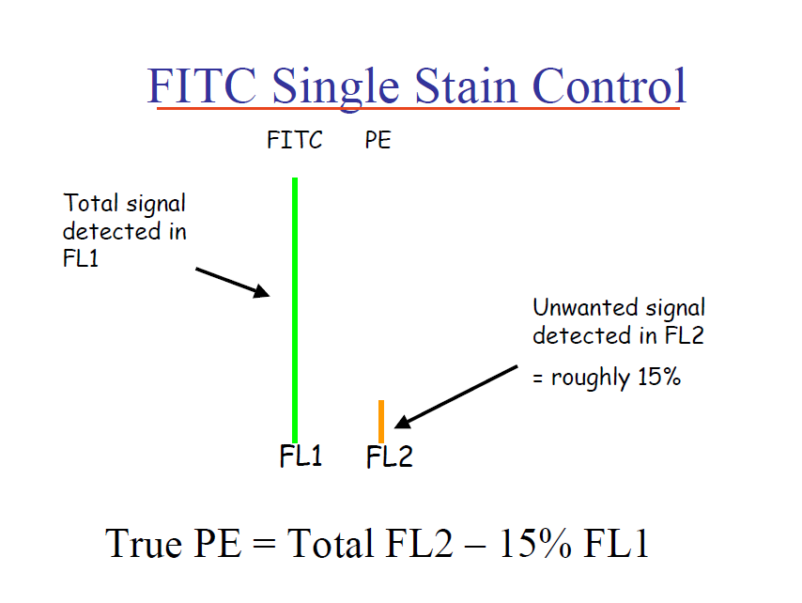

Slide 7
Kompenzace fluorescenčního signálu

Slide 8
Which marker for compensation?
Small errors in compensation of a dim control (A) can result in large compensation errors with bright reagents (B & C).
Use bright markers to setup proper compensation.

Slide 9
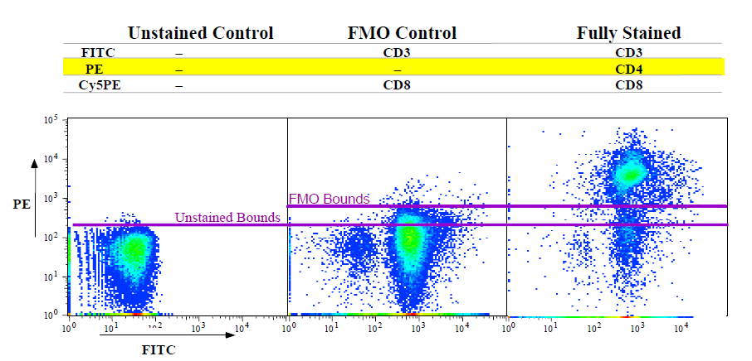
Fluorescence Minus One
PBMC were stained as shown in a 3-color experiment. Compensation was properly set for all spillovers
Courtesy Mario Roederer

Slide 10
Factors that Effect Compensation
Reagent Lot-to-Lot Variation
Fluorochrome Stability
Sample-to-Sample Variation
Assay Staining Conditions
Notes:
Many factors can effect compensation, including reagent lot-to-lot variation (especially in tandem dyes, which we will talk about in the next few slides), fluorochrome stability (degradation caused by light, temperature, and time), sample to sample variation (if you get a specimen that is much brighter than your usual samples), and assay staining conditions (fixative)

Slide 11
Jiné řešení?
  #1

Slide 12
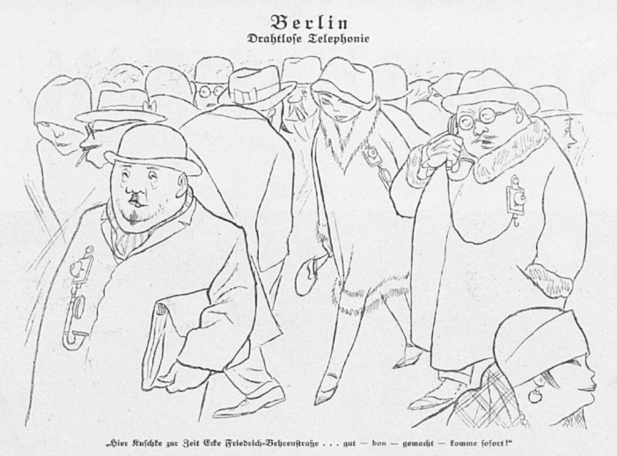
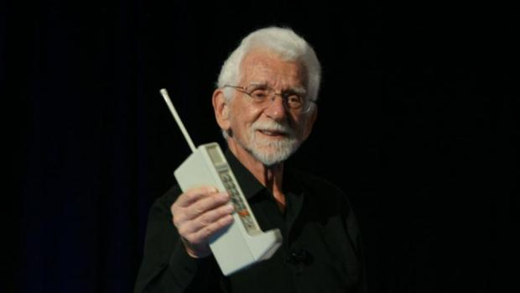

Idea (1931)
Invention (1973)
Martin Cooper, Motorola
"Simplicissimus Karl Arnold Mobile Telephony" by Source (WP:NFCC#4). Licensed under Fair use via Wikipedia
Innovation (2007)
Steve Jobs, Apple

Slide 13
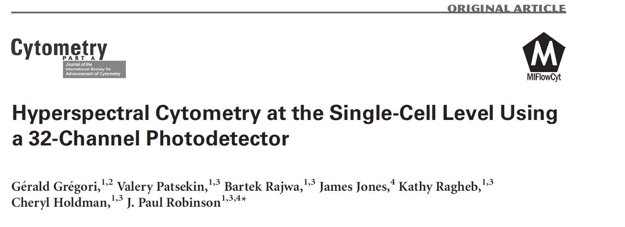
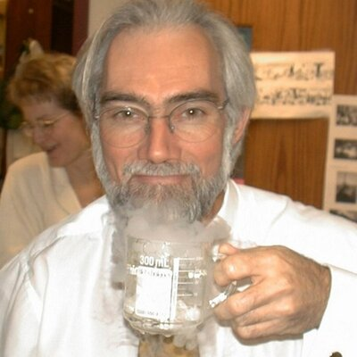
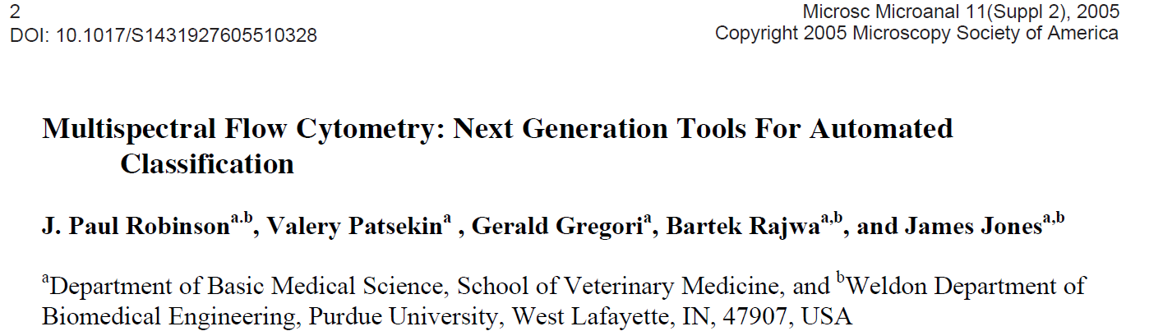
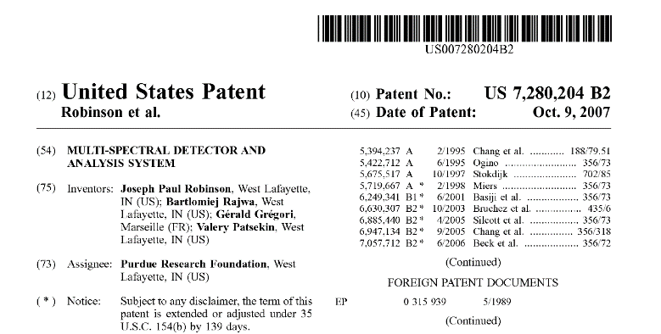
Spectral flow cytometry
J.P. Robinson, Purdue University

Slide 14
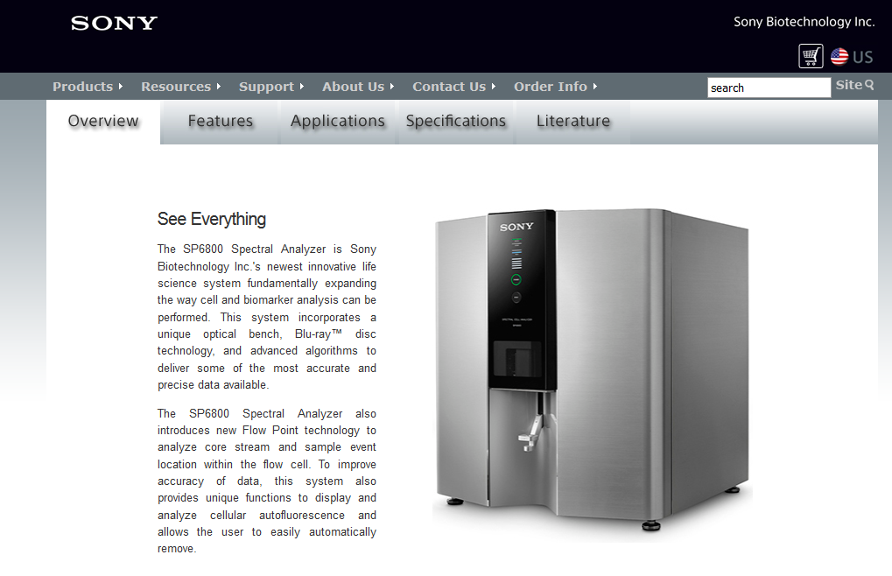
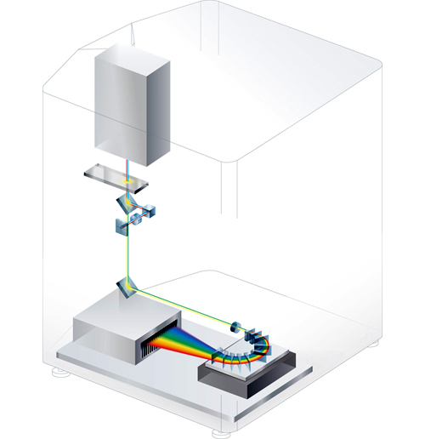
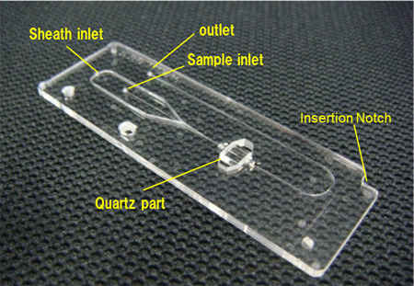
Spectral flow cytometry

Slide 15
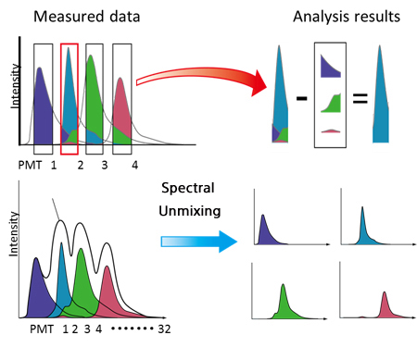
Conventional vs. spectral analysis

Slide 16
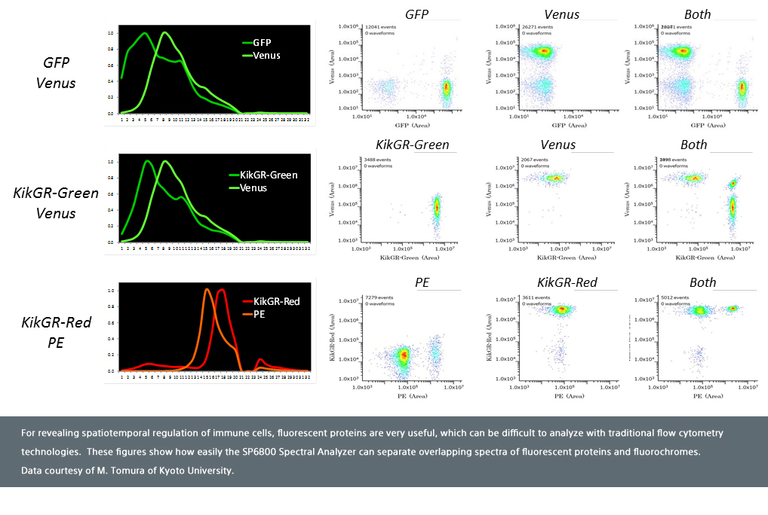
http://www.sonybiotechnology.com/images/sp6800/Fluorescent_Proteins_and_Fluorochromes.jpg

Slide 17
Jiné řešení?
  #2

Slide 18
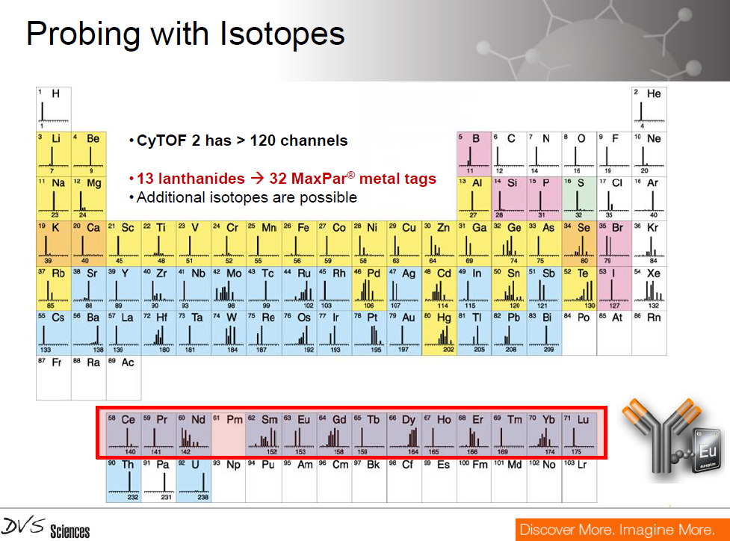

Slide 19
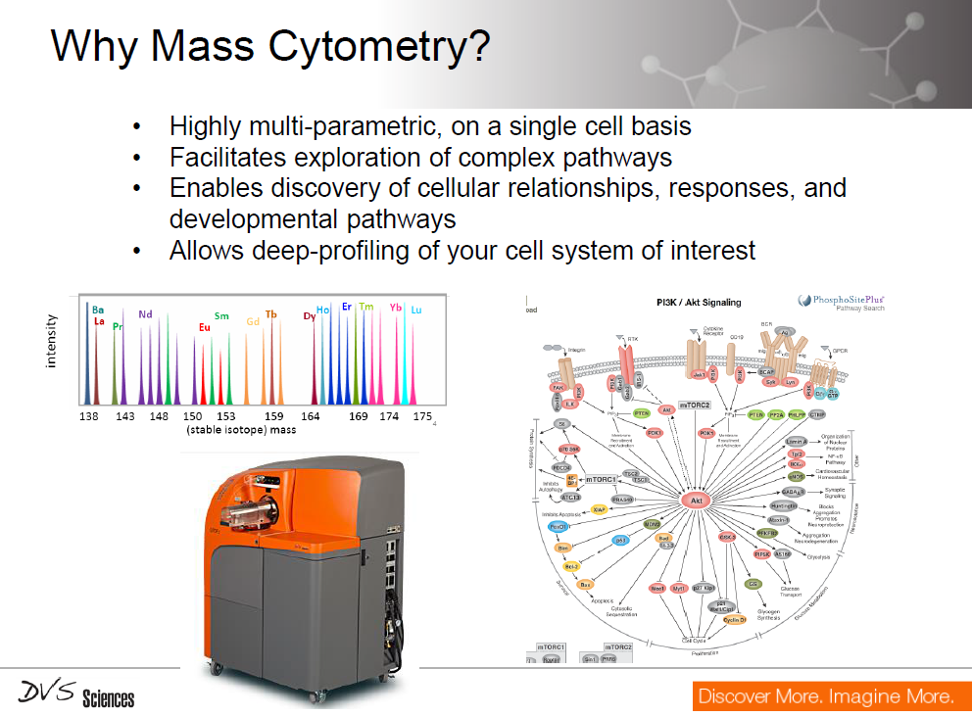

Slide 20
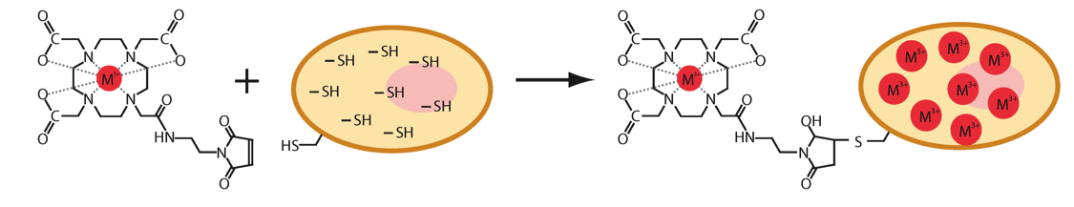
Single Cell Mass Cytometry
Cells were covalently labeled with a bifunctional compound, maleimido-mono-amide-DOTA (mDOTA). This compound can be loaded with a lanthanide(III) isotope ion, and reacts covalently with cellular thiol groups through the maleimide moiety.

Slide 21
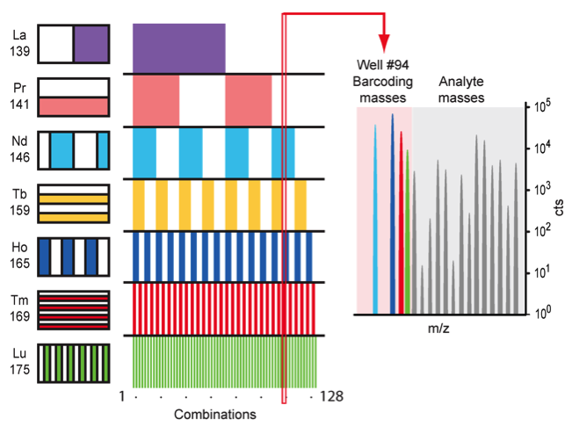
Single Cell Mass Cytometry
Seven unique lanthanide isotopes were used to generate 128 combinations, enough to barcode each sample in a 96-well plate. The seven lanthanide isotopes, their masses and their locations on the 96-well plate are shown.

Slide 22
Single Cell Mass Cytometry

Slide 23
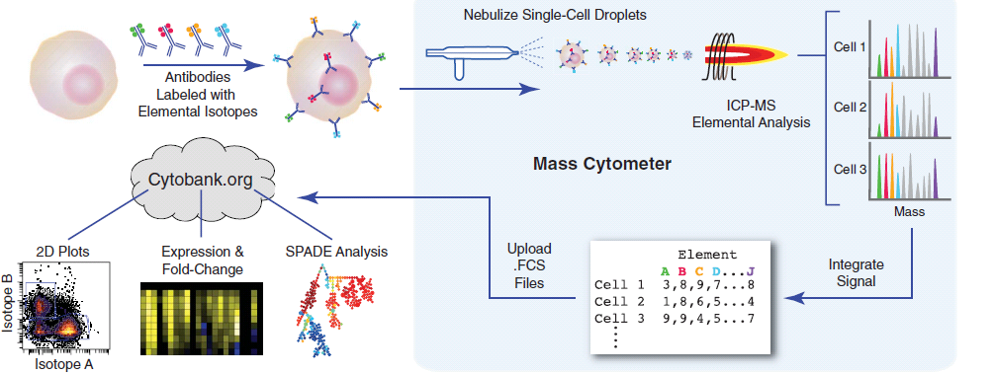
Single Cell Mass Cytometry

Slide 24
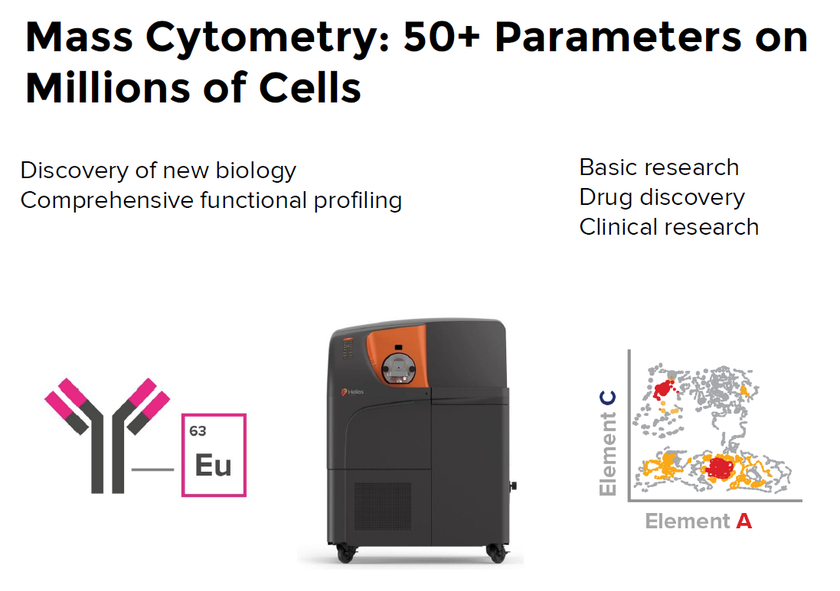


Slide 25
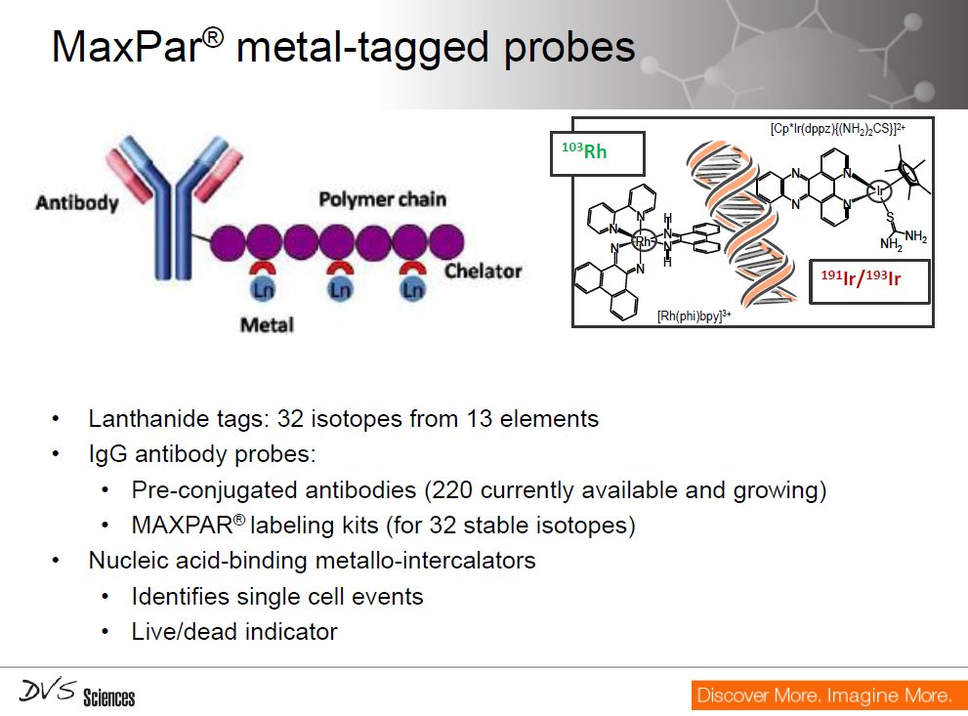

Slide 26
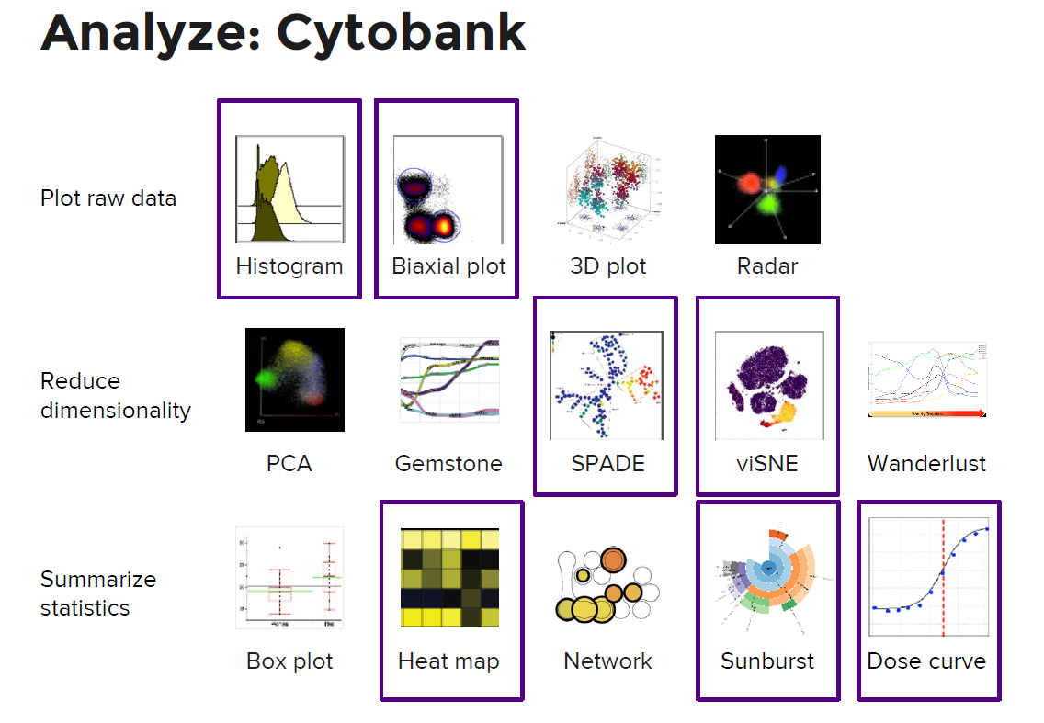

Slide 27
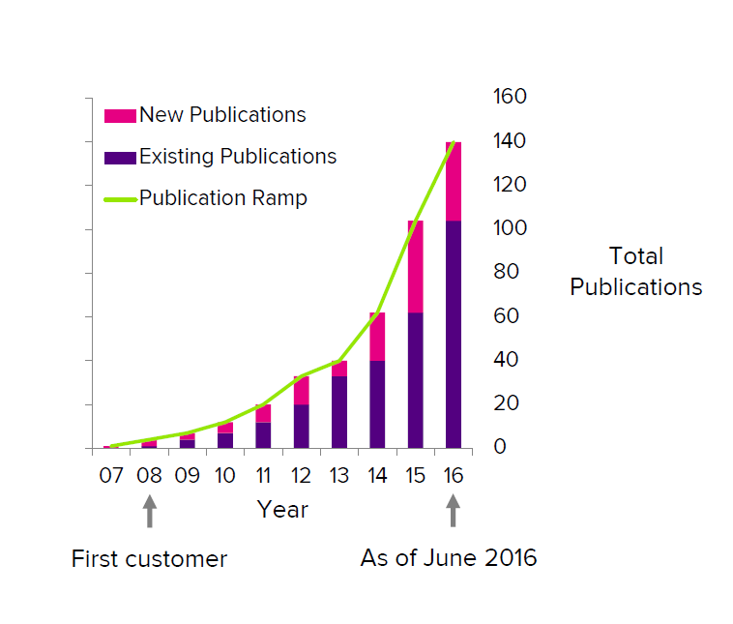

Slide 28
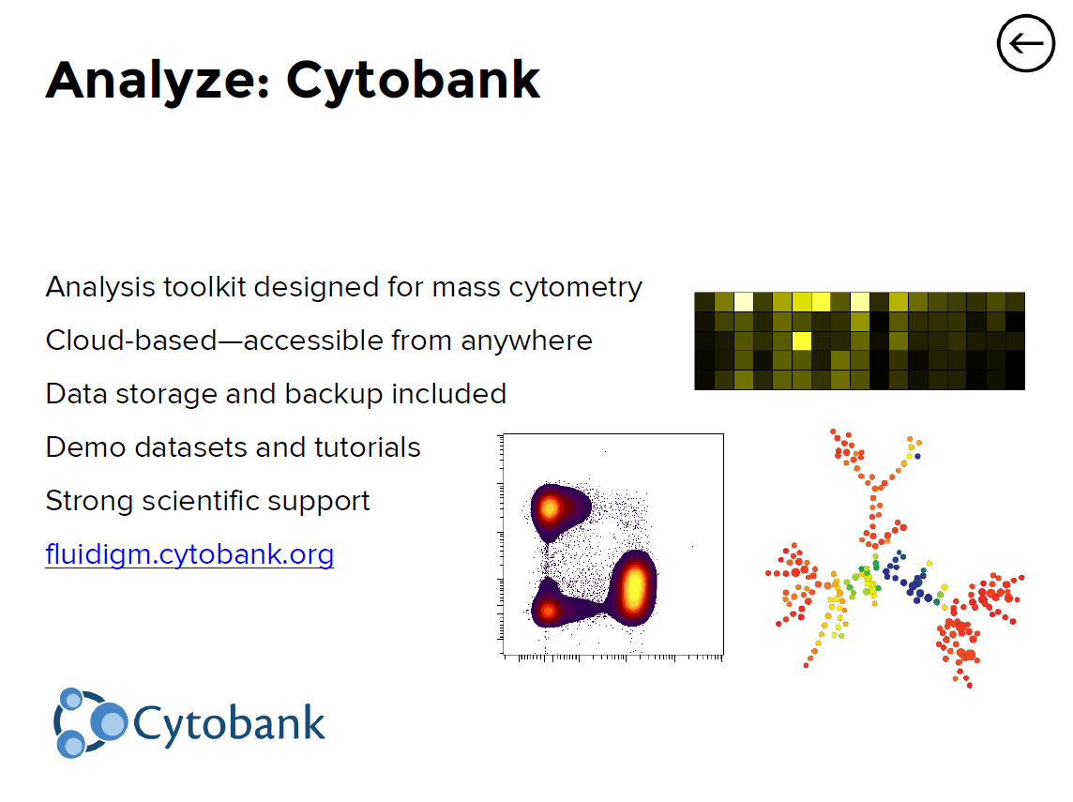

Slide 29
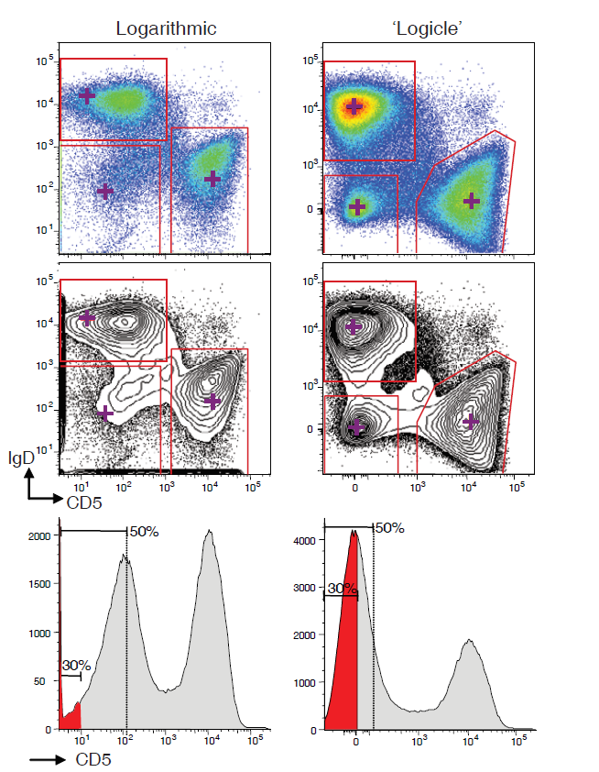
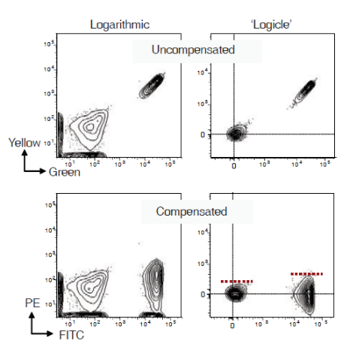
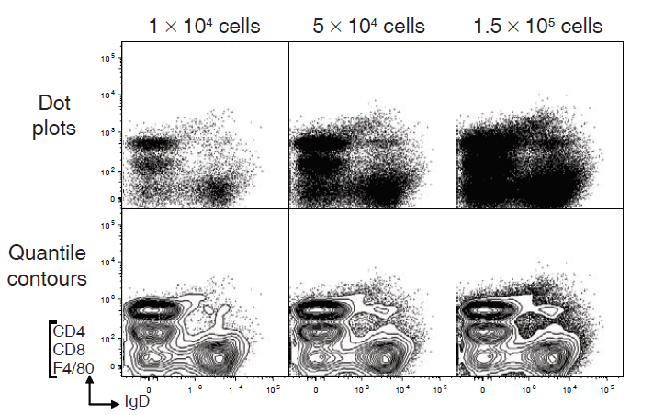
Vizualizace dat a intepretace dat
Herzenberg LA, Tung J, Moore WA, Herzenberg LA, Parks DR (2006) Interpreting flow cytometry data: a guide for the perplexed. Nat Immunol 7: 681-685

Slide 30
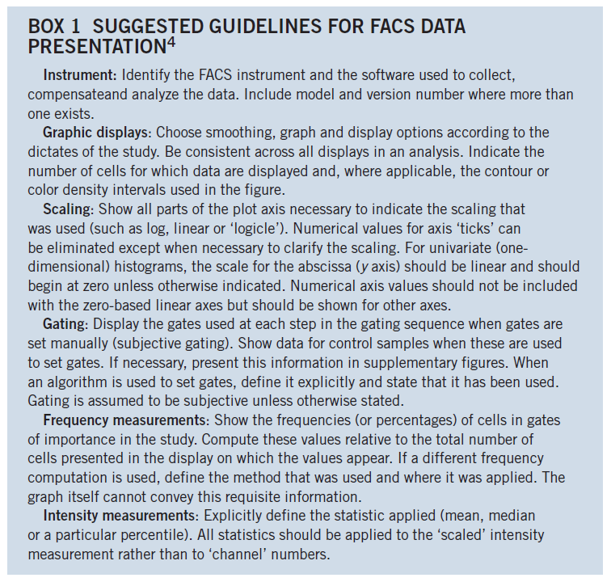
Herzenberg LA, Tung J, Moore WA, Herzenberg LA, Parks DR (2006) Interpreting flow cytometry data: a guide for the perplexed. Nat Immunol 7: 681-685

Slide 31
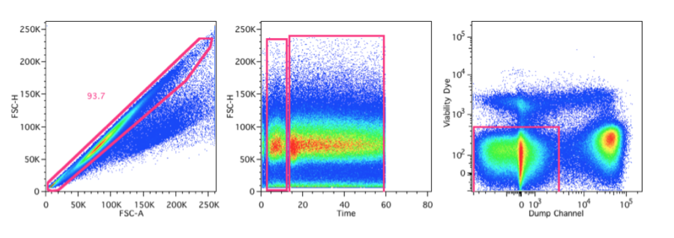
Gating a kontrola kvality
Singlets
Time
viabilita
http://expertcytometry.com/3-flow-cytometry-gates-that-will-improve-the-accuracy-of-your-facs-data-analysis/

Slide 32
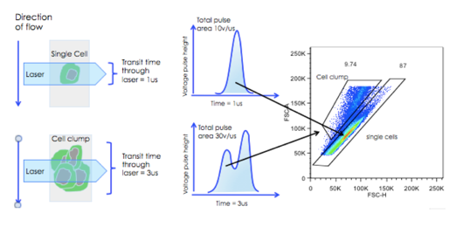
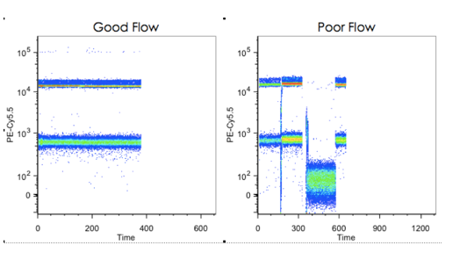
Gating a kontrola kvality
http://expertcytometry.com/6-flow-cytometry-gating-tips-that-most-scientists-forget/

Slide 33
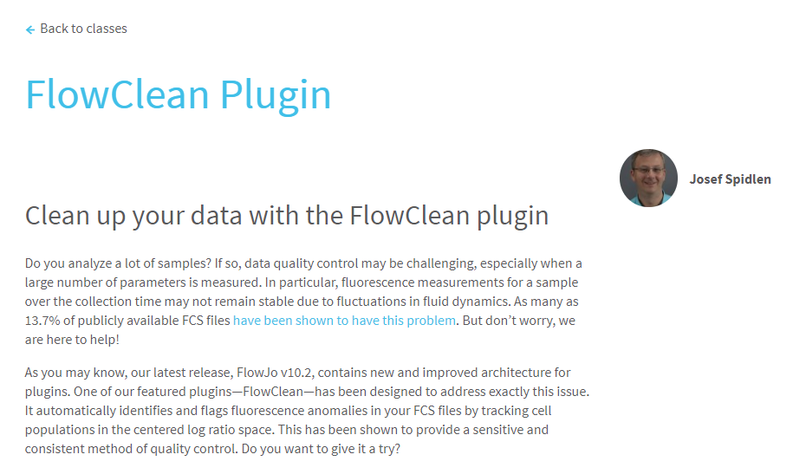

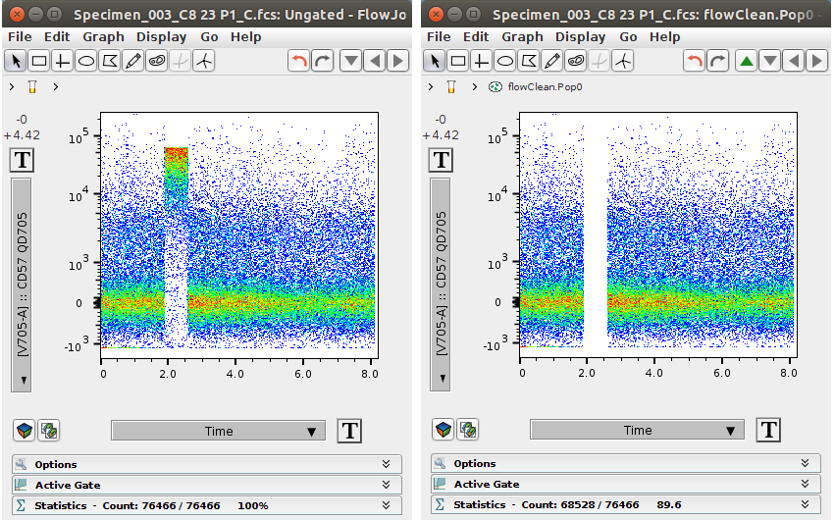
https://www.flowjo.com/learn/flowjo-university/flowjo/tutorial/33

Slide 34
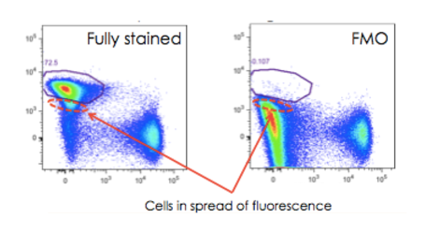
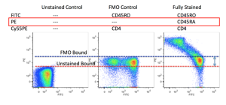
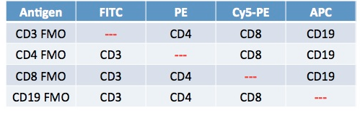
Gating a kontrola nastavení
FMO ~ Fluorescence Mines One
http://expertcytometry.com/6-flow-cytometry-gating-tips-that-most-scientists-forget/

Slide 35
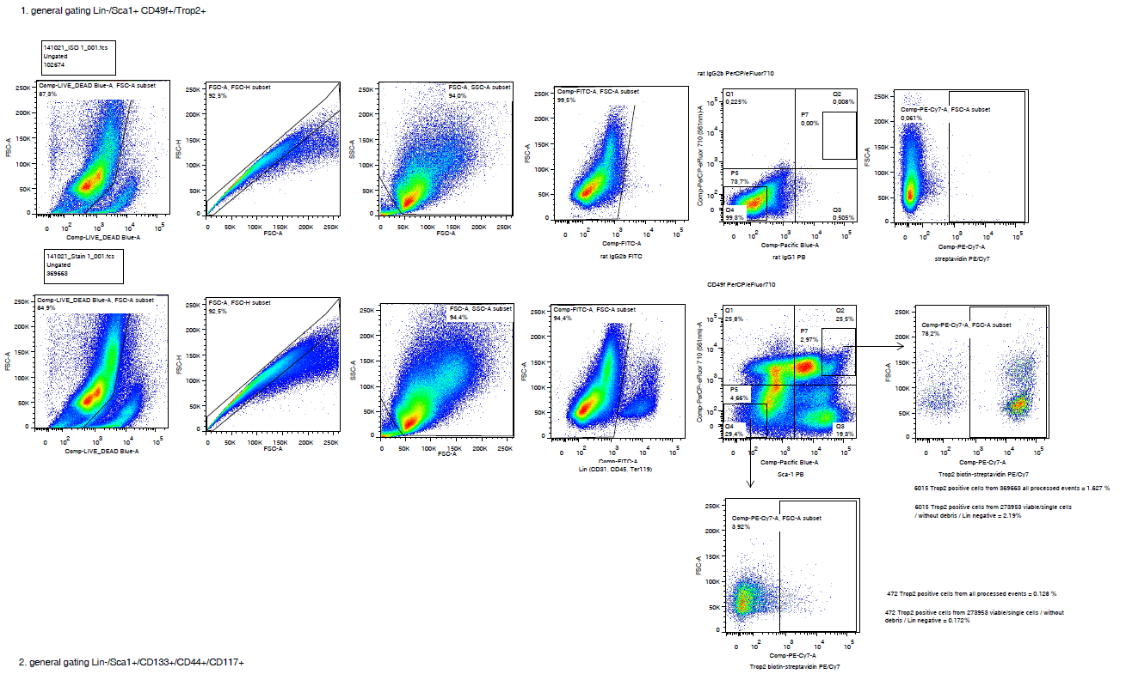
Gating – příklad hodnocení

Slide 37
Aplikace průtokové cytometrie

Slide 38
ANALÝZA NUKLEOVÝCH KYSELIN
buněčný cyklus a ploidyta
analýza zlomů DNA
inkorporace BrDU
exprese cyklinů
analýza denaturace DNA
ANALÝZA BUNĚČNÉHO FENOTYPU
imunofenotypizace pomocí CD antigenů
(detekce diferenciačních a nádorových markerů)
detekce cytokinových receptorů
CYTOGENETIKA
analýza chromozómů
STUDIUM BUNĚČNÝCH FUNKCÍ
viabilita
stanovení intracelulárního pH
analýza organel a cytoskeletu
stanovení membránového potenciálu
oxidativní vzplanutí
stanovení intracelulárního Ca2+
stanovení intracelulárních cytokinů
Natural Killer ligace značených buněk
analýza reportérových genů
K. Souček Bi9393 Analytická cytometrie

Slide 39
Biologické aplikace průtokové cytometrie
analýza proliferace
fluorescenční proteiny
K. Souček Bi9393 Analytická cytometrie

Slide 40
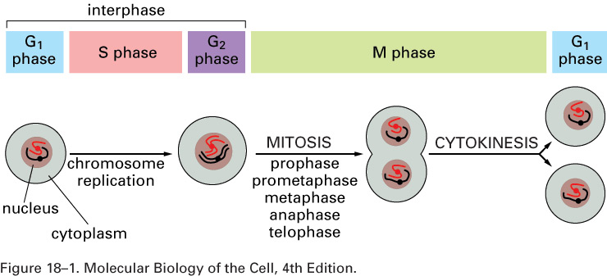
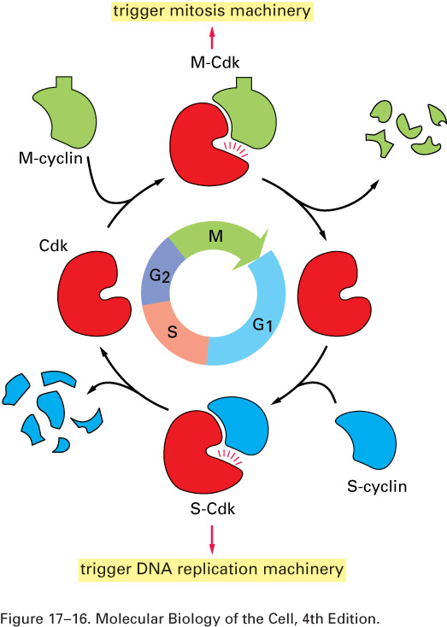
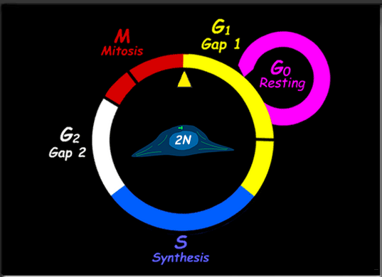
Buněčný cyklus

Slide 41
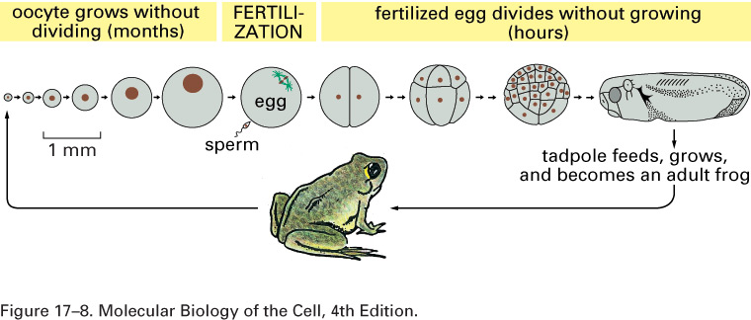
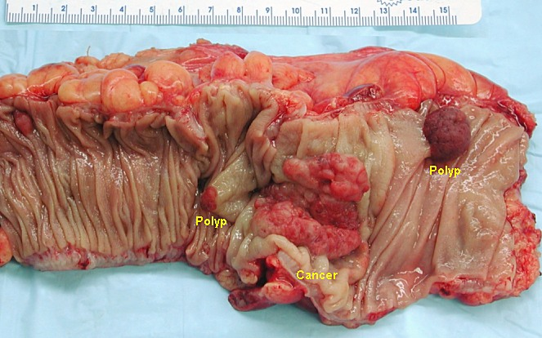

Slide 42
Co je důležité při přípravě vzorku a značení…
Postup přípravy vzorku a značení nelze zobecnit – závisí na typu buněk a konkrétní analýze
  suspenze jednotlivých buněk
  vitální značení
  fixace (etanol, formaldehyd)
  permeabilizace (detergenty)
  difúze
  aktivní transport

Slide 43
Analýza buněčného cyklu
jedna z nejstarších aplikací flow cytometrie, stanovení fáze buněčného cyklu podle množství DNA
průtoková cytometrie je vhodná metoda pro rychlou a přesnou determinaci buněčného cyklu
jednoduchým způsobem je DNA obarvena fluorescenční barvou specifickou pro DNA.
Propidium iodide
4′,6-diamidino-2-phenylindole (DAPI)
- dramaticky zvyšují fluorescenci po vazbě na DNA. Je nutná permeabilizace cytoplasmatické membrány .
Hoechst 33342
Vybrant® DyeCycle™
DRAQ5
Quaternary benzo[c]phenanthridine alkaloids (QBAs)
I. Slaninova, J. Slanina and E. Taborska, "Quaternary benzo[c]phenanthridine alkaloids--novel cell permeant and red fluorescing DNA probes," Cytometry A, vol. 71, no. 9, pp. 700-708, 2007.
- mohou být používány pro značení viabilních buněk.
K. Souček Bi9393 Analytická cytometrie

Slide 44
Normal Cell Cycle
M
G₀
G₂
DNA Analysis
G₁
G₀
G₁
s
Count
s
G₂
M
0
200
400
600
800
1000
- propidium iodide
- DAPI
- Hoechst 33342
- 7-AAD
2N
4N
DNA content
Purdue University Cytometry Laboratories

Slide 45
Analýza histogramu buněčného cyklu
nepoužívá se běžná analýza pomocí úseček (regionů) v histogramu
je nutné používat speciální software pro modelovaní analýzu distribuce jednotlivých fází

Slide 48
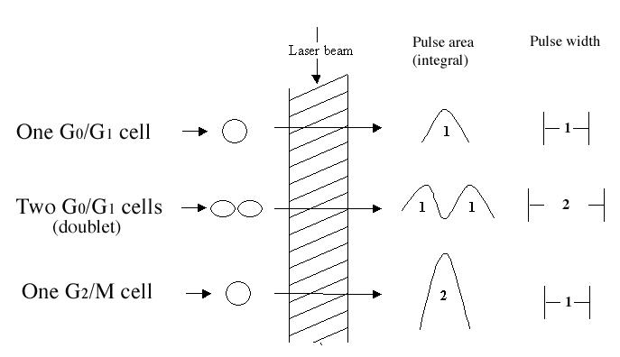

Slide 49
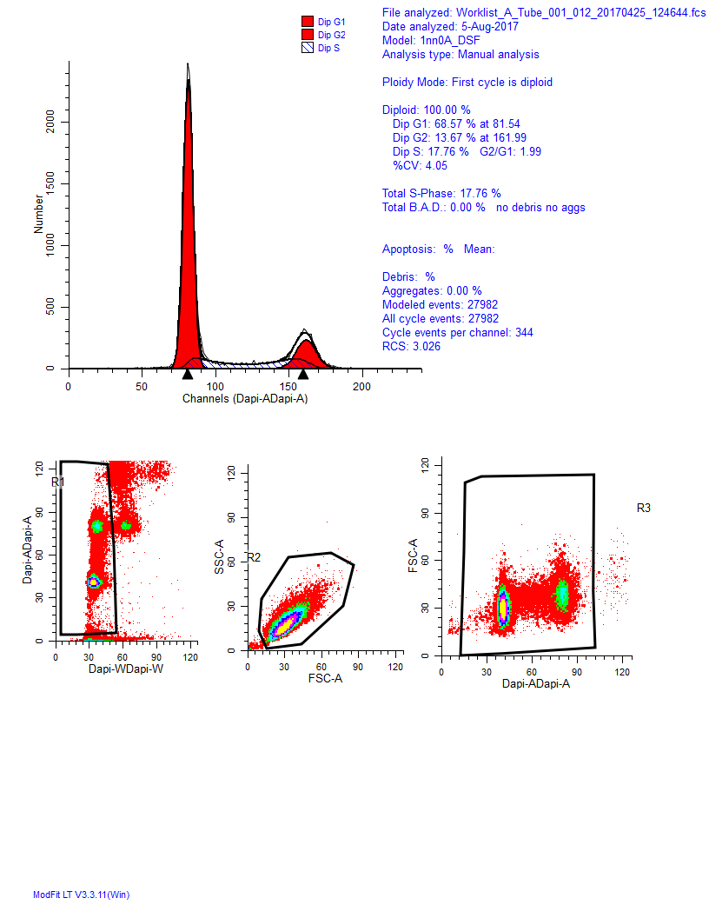
Cell cycle histogram: gating strategy

Slide 50
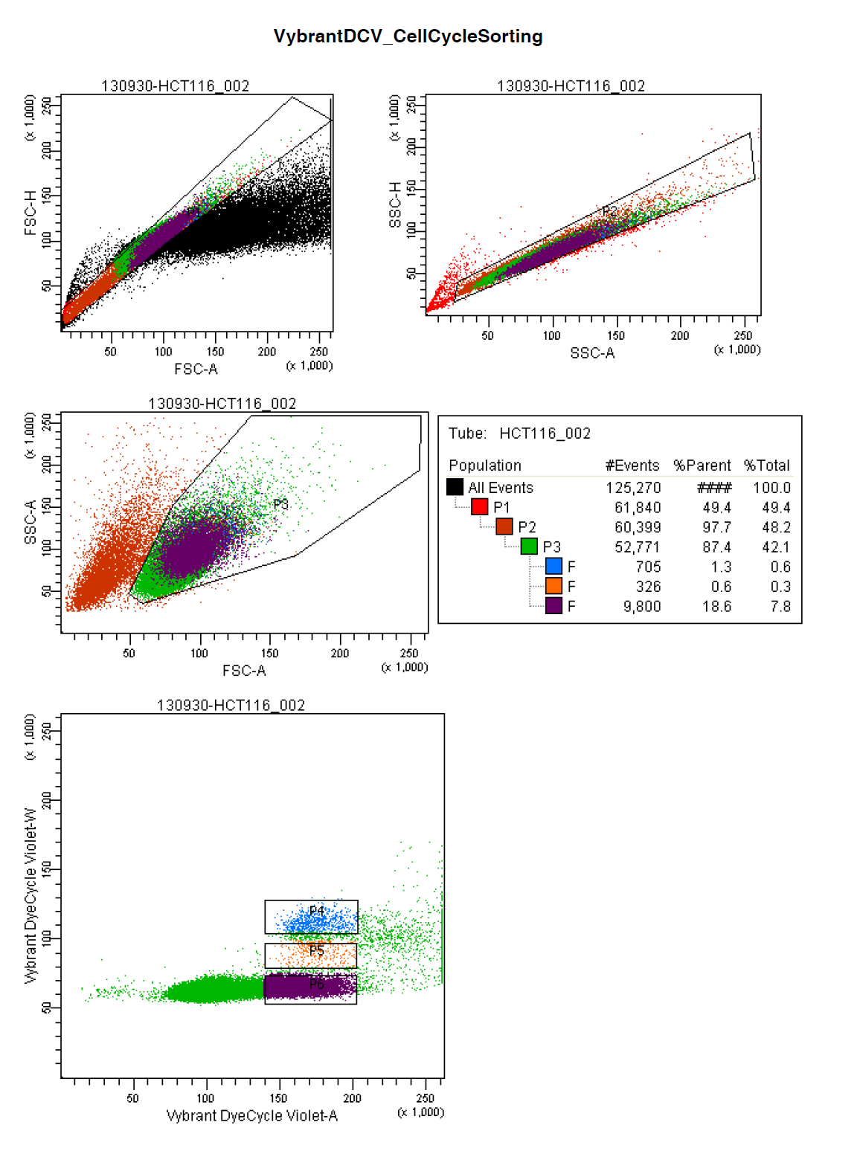
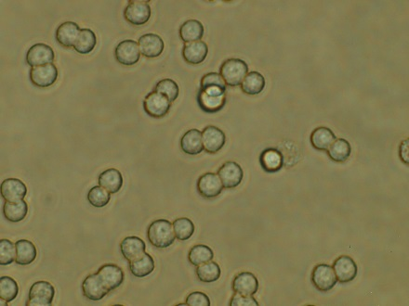
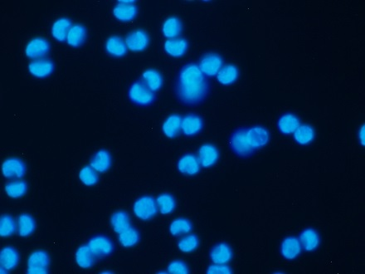





Slide 51
Detekce buněk v synchronizovaném buněčném cyklu

Slide 52
Aneuploidie je významný diagnostický marker
File analyzed: SAMPLE2.FCS
Date analyzed: 16-Oct-2006
Model: 2DA0n_DSD_ASD
Analysis type: Automatic analysis
Diploid: 57.22 %
Dip G1: 70.35 % at 75.05
Dip G2: 5.60 % at 150.10
Dip S: 24.05 % G2/G1: 2.00
%CV: 3.02
Aneuploid 1: 42.78 %
An1 G1: 83.63 % at 100.15
An1 G2: 5.87 % at 200.30
An1 S: 10.50 % G2/G1: 2.00
%CV: 5.02 DI: 1.33
Total Aneuploid S-Phase: 10.50 %
Total S-Phase: 18.25 %
Total B.A.D.: 11.22 %
Debris: 19.13 %
Aggregates: 3.96 %
Modeled events: 31253
All cycle events: 24037
Cycle events per channel: 190
RCS: 0.842

Slide 53




Analýza ploidity u vyšších rostlin
Nicotiana tabacum
Alstroemeria caryophyllacea
Zea mays
http://en.wikipedia.org/wiki/Image:Native_American_tobacco_flower.jpg
http://en.wikipedia.org/wiki/Image:Corntassel_7095.jpg
endosperm 28 dní po opylení

Slide 54












Cell cycle analysis- limitations

Slide 55
Analýza inkorporace BrdU
bromodeoxyuridin se inkorporuje do DNA namísto tymidinu během S-fáze
po fixaci a částečné denaturaci DNA je možné BrdU detekovat pomocí specifické protilátky značené fluorochromem
v posledním kroku můžeme obarvit DNA
K. Souček Bi9393 Analytická cytometrie

Slide 56
Analýza inkorporace BrdU
K. Souček Bi9393 Analytická cytometrie

Slide 57




Click azide/alkyne reaction

Slide 58

Aplikace Click-IT (Invitrogen)
Multiplex imaging with Click-iT® RNA assays.
NIH3T3 cells were incubated with 1 mM EU, formaldehyde-fixed, and permeabilized with Triton® X-100. EU incorporated into newly synthesized RNA (red) in some cells was detectied using the Click-iT® RNA Alexa Fluor® 594 Imaging Kit. Tubulin (green) was detected with anti-tubulin mouse IgG9 and visualized with Alexa Fluor® 488 goat anti-mouse IgG. Nuclei (blue) were stained with Hoechst 33342.

Slide 59
Aplikace Click-IT (Invitrogen) analýza syntézy DNA (proliferace)

Slide 60


³H-thymidine
Tritiated (3H) thymidine

Slide 61
³H-thymidine
Original method for measuring cell proliferation
Radioactive
Not compatible for multiplexed analyses

Slide 62

BrdU
Br
Br
Br
BrdU (5-bromo-2'-deoxyuridine)
Br

Slide 63



BrdU
Br
Br
Br
Br

Slide 64

BrdU
Br
Br
Acid or DNase
Br
Br

Slide 65
BrdU
Br
Br
Br
Br

Slide 66
BrdU
Br
Br
Non-radioactive
Multiplex compatible but, strand separation requirement for anti-BrdU access, can affect:
  Ability for other antibodies to bind
  Morphology
  Ability for dyes that require dsDNA to bind efficiently, i.e., cell cycle dyes
Br
Br

Slide 67

Click-iT™ EdU
EdU (5-ethynyl-2'-deoxyuridine)

Slide 68





Click-iT™ EdU

Slide 69
Click-iT™ Edu
Non-radioactive
No DNA denaturation required
Simplified protocol
Small molecule detection
Multiplex compatible, including
  Other antibodies
  Dyes for cell cycle analysis

Slide 70
Analýza DNA a RNA
Pyronin Y vs. Hoechst 33342
- Pyronin interaguje s ds RNA a DNA ale jeho vazba na DNA je inhibována přítomností Hoechst 33342
Acridine orange
- při interakci s RNA emituje červené světlo a při interakci s DNA zelené

Slide 73

Detekce intracelulárních proteinů v kombinaci s detekcí DNA

Slide 74




Detekce mitotických buněk
Histone H3 je specificky fosforylován během mitózy (Ser10, Ser28, Thr11)
dvojité značení DNA vs. H3-P identifikuje populaci buněk v M-fázi

Slide 75







Flow cytometry most common applications
Immunophenotype characterisation of the cells
(CSCs markers, differentiation, …)
Cell Cycle (DNA content, Cell cycle modulation after treatment)
Cell Death analysis (AnnexinV, Cleaved Caspase3, …)
Proliferation (BrdU, EdU, mitosis - pH3)
DNA damage ( yH2AX,…)
Viability assays (propidium iodid, Calcein AM, …)

Slide 76

IMMUNOPHENOTYPING
Principle: cells are stained with monoclonal antibodies conjugated to various fluorescent dyes and analyzed with using flow cytometry
Pros: simple, standard, broad spectrum of tested reagents, multiplexing
Cons: not every epitope is fixable, compensation, possible artefacts from dying cells, dissociation of solid tissue may affect results
Ermann, J. et al. (2015) Immune cell profiling to guide therapeutic decisions in rheumatic diseases
Nat. Rev. Rheumatol. doi:10.1038/nrrheum.2015.71

Slide 77


VIABILITY using LIVE/DEAD fixable stains
Principle: reaction of a fluorescent reactive dye with cellular amines, in necrotic cells react with free amines both in the interior and on the cell = intense staining, live cells stained on surface only = dim signal
Pros: simple, wide spectrum of dyes, fixable, The ArC™ Amine Reactive Compensation Bead Kit
Cons: live cells have signal, stain only in buffers w/o BSA or serum, Tris or azide

Slide 78
CELL CYCLE
Principle: DNA content measurement by fluorescent nucleic-acid-binding dyes
Pros: simple, wide spectrum of dyes, in both native and fixed samples
Cons: doublets > G2/M, single parameter≠ DNA synthesis, > CV if not fixed by organic solvents

Slide 79



DNA SYNTHESIS using click azide/alkyne reaction
5-Ethynyl-2'-deoxyuridine
triazol
alkyne
Principle: direct measurement of DNA synthesis via visualization of incorporation of nucleoside analogue
Pros: no DNA denaturation required, simplified protocol, small molecule detection, multiplex compatible
Cons: high concentration of Cu in reaction = not compatible with all fluorochromes
azide

Slide 80




DNA DAMAGE using γH2A.X
Principle: Phosphorylation of the Ser-139 residue of the histone variant H2A.X, forming γH2A.X, is an early cellular response to the induction of DNA double-strand breaks
Pros: in theory simple immuno-staining after fix&perm
Cons: DSBs can also be intrinsic, occurring in healthy, nontreated cells, DSBs are formed in the course of DNA fragmentation in apoptotic cells
CTRL
GEM
Huang X, Darzynkiewicz Z: Cytometric Assessment of Histone H2AX Phosphorylation. In DNA Repair Protocols: Mammalian Systems. Edited by Henderson DS. Totowa, NJ: Humana Press; 2006: 73-80

Slide 81





APOPTOSIS detected via PARP cleavage or caspase-3 activation
Principle: Cleaved Caspase-3 (Asp175) Antibody detects endogenous levels of the large fragment (17/19 kDa) of activated caspase-3. Cleaved PARP (Asp214) detects endogenous levels of the large fragment (89 kDa) PARP1 protein produced by caspase cleavage.
Pros: simple immuno-staining after fix&perm, validated antibodies available
Cons: not every cell type or signal necessary activates cp-3 or leads to PARP cleavage, timing
Untreated
MG-132

Slide 82

Workflow
Possible issues
Need of optimization
Incompatibility of Fluorochrome with Click-iT reaction
Permeabilization
Over cross-linked
Insufficient/too high concentration
Sufficient permeability
Antibody/ marker selection
Sufficient permeability
Antibody specificity
Compatibility with other fluorochromes

Slide 83



Permeabilization
Goal: Sufficient for intracellular markers, gentle for surface markers
Apoptosis - Cleaved Caspase 3
DNA damage – yH2AX
DMSO
DMSO
MG-132
MG-132
85,9 %
75,6 %
75,3 %
59,2 %
78,8 %
34,6 %
25,9 %
19,5 %
Surface marker – Trop-2
DMSO
Trop-2 BV421
Trop-2 BV421
Trop-2 BV421
Trop-2 BV421
92,0 %
75,2 %
80, 8 %
83,8%
The best solution: 0,25% Triton x-100

Slide 84



DNA stain
Violet laser DAPI, Hoechst 33342
FxCycle Violet, …
Blue laser Vybrant Dyes, PI, …
Red laser FxCycle Far Red
  7-AAD
Broad spectrum of the dyes
Problems:
High concentration of dye, no wash
Spillover & Compensations

Slide 85
Compensation
Antibody conjugates:
anti-rat and anti-hamster Igκ/negative control compensation beads (BD Biosciences),
SpheroTM Biotin Polystyrene Particles (Spherotech, Lake Forest, IL, USA)
Live/Dead fixable dyes:
ArcTM Amine Reactive Compensation Bead Kit beads (Thermo Fisher Scientific)
DNA stain:
fixed and permeabilized cells with/without appropriately diluted DNA probe
Isotype controls were recorded for all samples. Gates were set according to isotype controls and control untreated cells (for γH2AX and cleaved caspase-3)
Gating strategy included viability, discrimination of doublets (FSC-H vs. FSC-A) and debris (FSC vs. SSC). In samples with DNA marker, doublets we further discriminated using DNA marker (PO-PRO-1 A vs. PO-PRO-1 W) .
In the process of protocol optimization, FMO controls were measured and revealed DNA dye spillover.

Slide 86
Example of final set-up
Parametr | Marker | Fluorochrome
Cell Surface Marker | CD44 | APC/Cy7
Cell Surface Marker | Trop-2 | AF488
Viability | LIVE/DEAD kit | Yellow
DNA synthesis | Click-iT EdU | AF647
Cell Cycle | DNA content | PO-PRO-1
DNA damage | yH2AX | PE
Apoptosis | Cleaved Caspase 3 | AF494

Slide 87

Flow Cytometric Multiparametric Assay was established
Viability
Surface Markers
Cell Cycle
DNA synthesis
DNA damage
Apoptosis

Slide 88

Examination of small subpopulation (Trop-2⁺) in response to experimental treatment

Slide 89



Detekce počtu buněčného dělení

Slide 90



The Nobel Prize in Chemistry 2008
"for the discovery and development of the green fluorescent protein, GFP"
http://nobelprize.org/nobel_prizes/chemistry/laureates/2008/

Slide 91



Fluorescenční proteiny
bioluminescence resonance energy transfer (BRET)
  Aequorea victoria - medúza žijící ve vodách na pobřeží Severní Ameriky.
  je schopna modře světélkovat (bioluminescence). Ca²⁺ interaguje s fotoproteinem aequorinem.
  modré světlo excituje green fluorescent protein.
  Renilla reniformis – korál žijící ve vodách na severním pobřeží Floridy.
  luminescence vzniká degradací coelenterazinu za katalytického působení luciferázy.
  modré světlo excituje green fluorescent protein.
Aequorea victoria “Crystal jelly “
Renilla reniformis "Sea Pansy"
http://www.mbayaq.org/efc/living_species/default.asp?hOri=1&inhab=440
http://www.whitney.ufl.edu/species/seapansy.htm

Slide 92


Fluorescenční proteiny
Osamu Shimomura
  1961 objevil GFP a aequorin
http://www.conncoll.edu/ccacad/zimmer/GFP-ww/GFP2.htm

Slide 93



Fluorescenční proteiny
Douglas Prasher
Martin Chalfie
Science. 1994 Feb 11;263(5148):
Green fluorescent protein as a marker for gene expression.
Chalfie M, Tu Y, Euskirchen G, Ward WW, Prasher DC.
Department of Biological Sciences, Columbia University, New York, NY 10027.
A complementary DNA for the Aequorea victoria green fluorescent protein (GFP) produces a fluorescent product when expressed in prokaryotic (Escherichia coli) or eukaryotic (Caenorhabditis elegans) cells. Because exogenous substrates and cofactors are not required for this fluorescence, GFP expression can be used to monitor gene expression and protein localization in living organisms.

Slide 94


Fluorescenční proteiny
http://www.conncoll.edu/ccacad/zimmer/GFP-ww/GFP2.htm

Slide 95



in vivo molekulární vizualizace
KODAK X-SIGHT 650 and 761 Nanospheres, KODAK In-Vivo Multispectral Imaging System
KODAK X-SIGHT 640 LSS Dyes in vivo with x-ray overlay
Hasegawa, S., Yang, M., Chishima, T., Miyagi, Y., Shimada, H., Moossa, A. R., and Hoffman, R. M. In vivo tumor delivery of the green fluorescent protein gene to report future occurrence of metastasis. Cancer Gene Ther, 7: 1336-1340, 2000.

Slide 96


Fluorescenční proteiny
Sergey A. Lukyanov
  Objevil „GFP-like“ proteiny u nesvětélkujících korálů

Slide 97





Roger Tsien
~ 2002 – mutace FP = barevné spektrum
http://www.tsienlab.ucsd.edu/

Slide 98


Slide 100
Detekce buněk v synchronizovaném buněčném cyklu

Slide 101

Licensing control by Cdt1 and geminin
J Cell Sci 2012 125: 2436-2445; doi: 10.1242/jcs.100883

Slide 102


Fucci
(fluorescent ubiquitination-based cell cycle indicator) cells
Ubiquitin E3 ligase complexes
G1 - APC^{Cdh1}
^{substrate:} Geminin, inhibitor of DNA replication inhibits Cdt1
S, G2, M- SCF^{Skp2}
substrate: DNA replication factor Cdt1 – key licensing factor
Fucci sensors - 1st generation, coral FP
monomeric Kusabira orange 2 – hCdt1 (30/120)
Monomeric Azami-Green – hGeminin (1/110)
Fucci sensors – 2nd generation, Aequorea FP
red monomeric fluorescent protein - mCherry -hCdt1 (30/120)
yellowish green monomeric variant of GFP –mVenus – hGeminin (1/110)

Slide 103


Fucci
http://cfds.brain.riken.jp/Fucci.html

Slide 104




Slide 105






CONTROL
SCH900776
MU380
VEHICLE
GEMCITABINE

Slide 106
…lot of questions, but how to answer them?
How many times cells divided?
What is a length of cell cycle phases?
Is there a difference in time between first and second division?
How it is all affected by my drugs?

Slide 107

Branches (dvisions) analysis
02_02_01_01

Slide 108


02_02_01_01
Median 14 hours

Slide 109


Slide 110


Slide 111


Slide 112
Shrnutí přednášky
Kompenzace
Kontrola kvality, zásady
analýza proliferace
fluorescenční proteiny
Na konci dnešní přednášky byste měli:
Jaké jsou základní principy multispektrální a hmotnostní cytometrie
vědět jakým způsoben je možné analyzovat buněčný cyklus.
umět navrhnout další parametr kombinovatelný s DNA analýzou.
znát příklady buněčných funkcí které je možné analyzovat na průtokovém cytometru.
vědět co jsou to fluorescenční proteiny a jaké jsou výhody jejich využití v buněčné biologii.
co je to click-IT.
K. Souček Bi9393 Analytická cytometrie

