Slide 1


Computer Modeling of Genetic Circuits for Synthetic Biology
Panagiotis Alexiou
PřF: Bi9690en
Synthetic Biology
(Autumn 2020)
Notes:
Welcome to the lecture on computer modelling of genetic circuits for synthetic biology. Today we are going to talk about how computer programming language can be used to help design genetic circuits for synthetic biology. This is the first part of a two part module, the second part which should also be available at the syllabus, will deal with the use of machine learning in synthetic biology design.

Slide 2


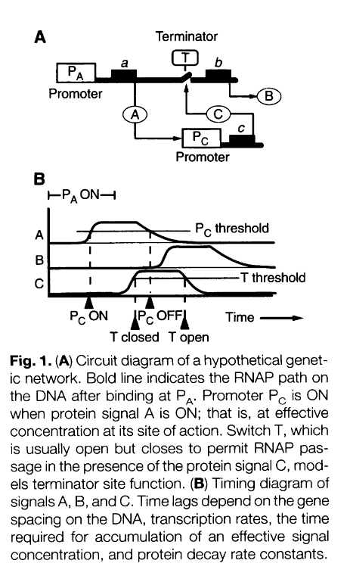
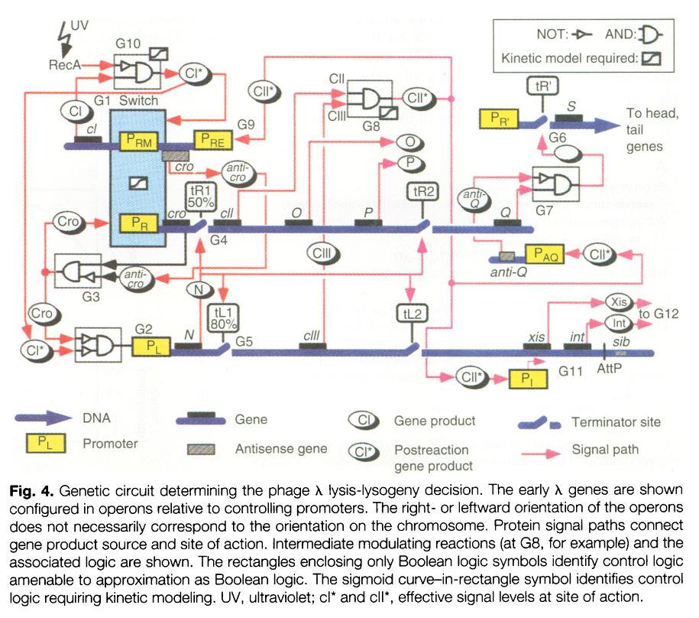
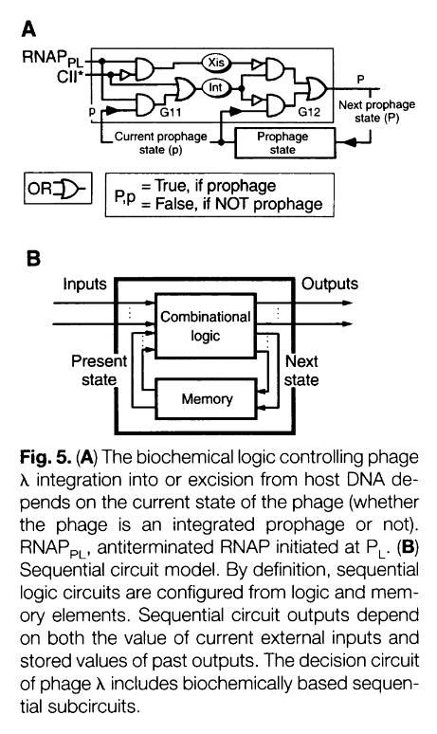
Life as a computation
Notes:
In some ways you can think of living systems as a type of analog computation machine. Complex genomic networks can be analysed using circuit logic language: gates connecting gene products, control loops and so on. In the middle here, you can see such an analysis of a viral decision mechanism that may push a virus towards one of two genetic programs: lysis or lysogeny. What is the difference between living systems and electronic computers as we know them?

Slide 3


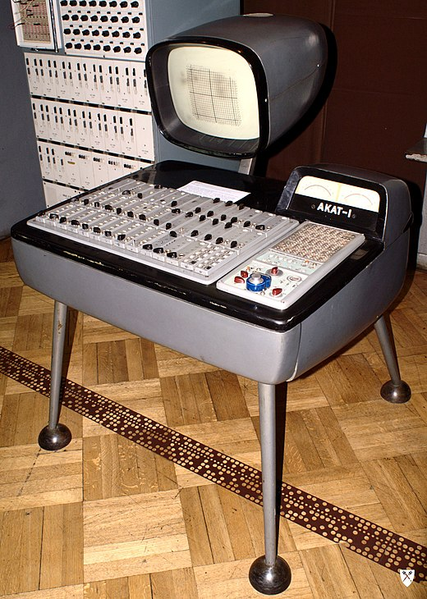
Analog Computing
Notes:
Life is analog. Analog computing predates electronic computing by over a thousand years – the first known examples coming from medieaval India and Persia and using elaborate water flow circuits and weights to tell time. Another famous example are complex medieaval clocks, such as the one in Prague, that use weights and counterweights to tell time and do other complex mechanical processes. Starting from the 50s, analog _electrical_ computers were designed, in which a flow of electricity can be modulated and computations can be performed. The unifying theme of these analog computers and genomic circuits is that input is continuous within a range, and after it goes through such a computational machine, a continuous output is produced.

Slide 4
Logic Gates
Logic gates are the basic building blocks of any digital system. They are simple circuits having one or more inputs and only one output.
The relationship between the input and the output is based on a certain logic.
Examples: AND gate, OR gate, NOT gate etc.
A combinational circuit is a circuit which combines multiple gates
Combinatorial
Circuits
A combinational circuit can have multiple inputs and outputs.
The output at any instant of time, depends only on the inputs
Notes:
What are the parts of these type of computing circutis? The most basic small units are called logic gates. You have seen these before in previous lectures, so just as a quick refresher: Logic gates are simple circuits with the characteristic that they only have one output. They may have multiple inputs, but always only one output. The relationship btw input and output is based on a specific certain logic. For example an AND gate will take two inputs and produce TRUE if either one of the inputs is TRUE. It will produce FALSE if both inputs are FALSE.
A combinatorial circuit is a way to combine multiple gates together and can have multiple inputs AND multiple outputs. The way the gates feed into each other creates the logic of the circuit we want. The important point is that in any instant in tine the output of the combinatorial cirvuit depends only on the inputs. In other words, the circuit does not have a memory

Slide 5
Biological Parts and Devices
A biological part (or simply, part) is a sequence of DNA that encodes for a biological function, for example a promoter or protein coding sequence.
At its simplest, a basic part is a single functional unit that cannot be divided further into smaller functional units. Basic parts can be assembled together to make longer, more complex composite parts, which in turn can be assembled together to make devices that will operate in living cells.
Parts and devices can be potentially connected together into circuits.
Registry of Standard Biological Parts can be found at http://parts.igem.org/
Notes:
A useful resource for this type of work is the registry of standard biological parts which is a library, or repository, for basic biological parts. These parts may be the equivalent of gates or simple composite parts. They have all been tested in some ways to make sure they mostly work well together and can be combined inside living cells to make more complex synthetic biology devices in living cells.
These parts can be manually combined to make Genetic Circuits

Slide 6
Genetic Circuit
DNA-encoded circuit that processes information and controls functions
Manual construction is expensive and time-intensive
Design, Construction, Debugging are complicated processes
Standardization and automation of the process is needed
Notes:
A genetic circuit is a DNA encoded circuit that processes some information and can control a cellular function.
A genetic circuit could have for example over 2-5 genes, but bigger ones can have 50-100 or even more genes.
Manual construction is very time-intensive and expensive.
Designing, construction and Debugging are complicated and its really important to have standardized and as much automated process to do this process.

Slide 7



Genetic circuit design automation
Notes:
We are going to talk about a process for automating genetic circuit design, based on this important paper in the field. You can find a PDF of the paper at the online syllabus, as well as a video overview of the paper by the main author. I suggest you read the paper and watch the overview, to help you further understand the importance of automation in design.

Slide 8

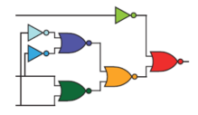

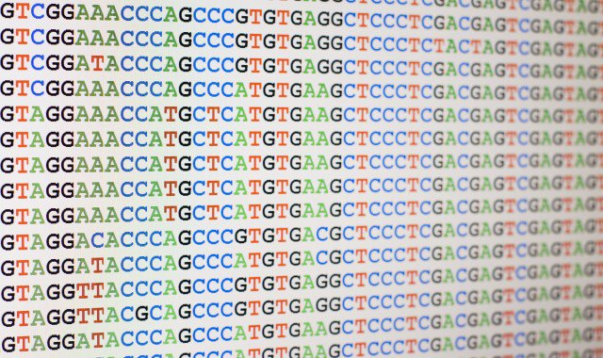
Computer program
Genetic Circuit
DNA Sequence
Living Cells
Notes:
The goal of this work is to produce an easy way of going over the complete design process for synthetic biology systems (in this case a bacterial system).
In the first step, a computer program can be written using a programming language that the authors have devised.
Then, the system takes a library of available _Biological Parts_ (gates) and combines them into a Genetic Circuit architecture which should produce the desired logic output.
This circuit is then _compiled_ into a DNA sequence. Taking into account various constraints of DNA and the fact that this needs to be a viable sequence within a bacterial genome.
Finally, the sequence is imported in living cells, and the output is measured and calibrated or debugged.

Slide 9
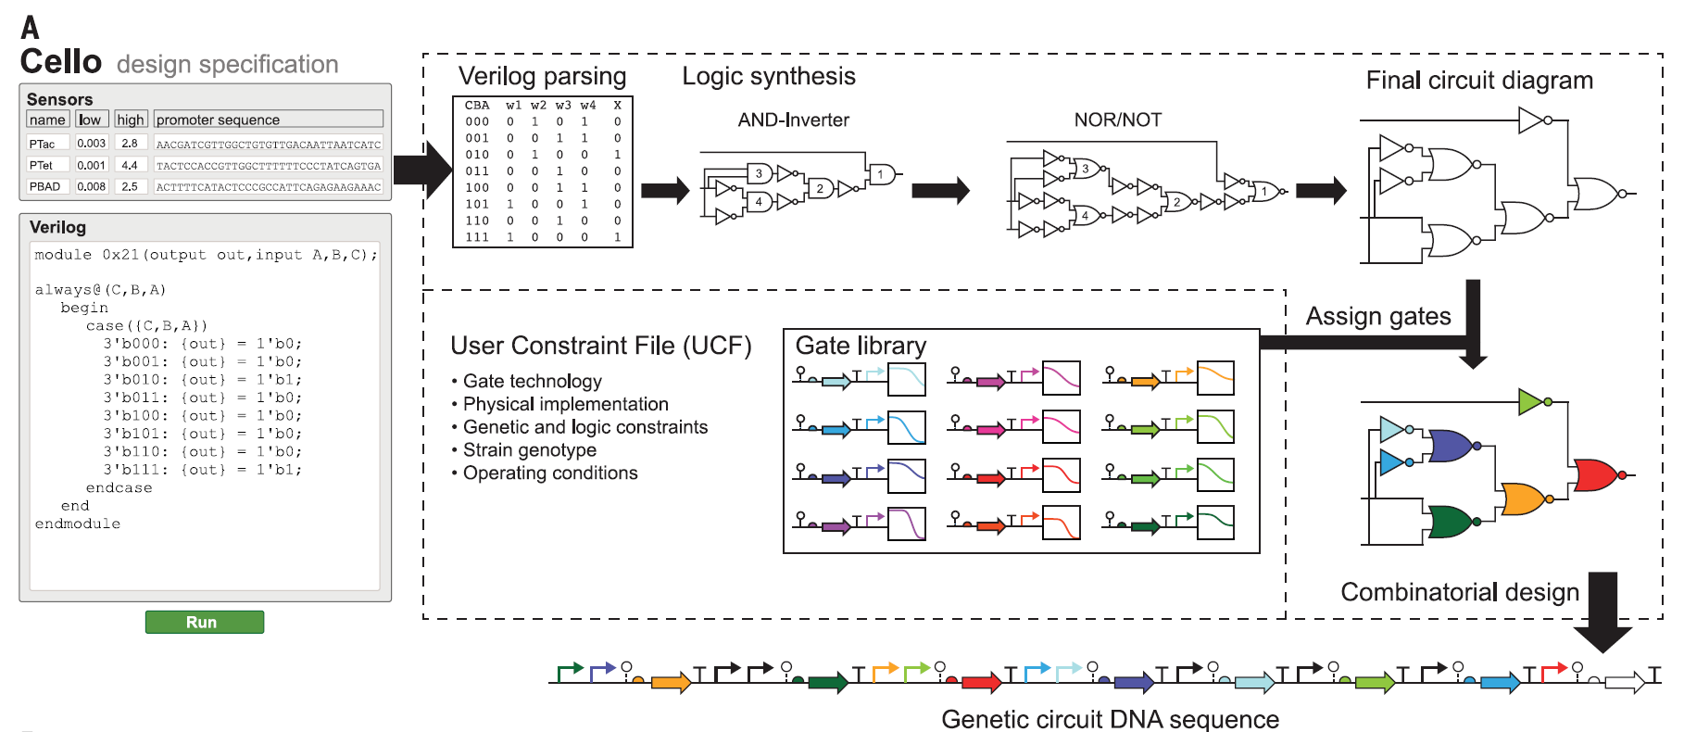
Genetic circuit design automation
Notes:
This is how this looks in real life. Here we can see the design of a simple genetic circuit.
On the left side, a configuration file is inputed with the desired logic output. The part of the process within the dotted lines is completely hidden from the user, as the system synthesizes the circuit diagram, and assigns gates (from the available ones) to create the final design. Ultimately this is compiled into DNA which is the output of this process.

Slide 10
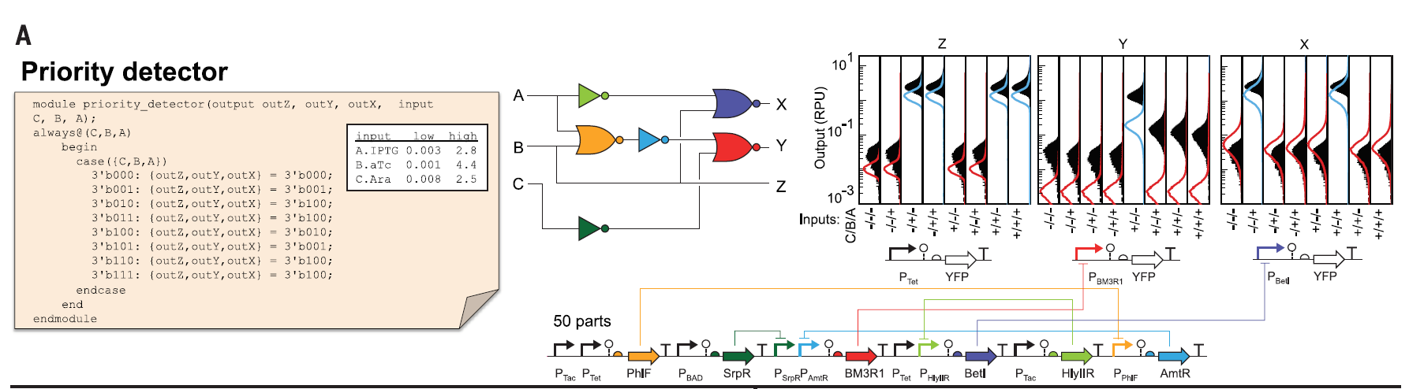
Modules Design
Notes:
Here we can see a real example of a priority detector module. This is a 3 input and 3 output module that prioritizes the inputs and selects which output
is ON based on the highest-priority input that is ON. . This module has 50 biological parts to encode 3 inputs, 6 logical gates, and 3 outputs. So it’s not a very complicated type of module but still needs a large number of parts to operate. Having a way to automate this process with standardized parts simplifies the development. In the paper itself you can see 60 examples of such modules that were produced and tested, a task would be almost impossible if the DNA code needed to be produced by hand.

Slide 11
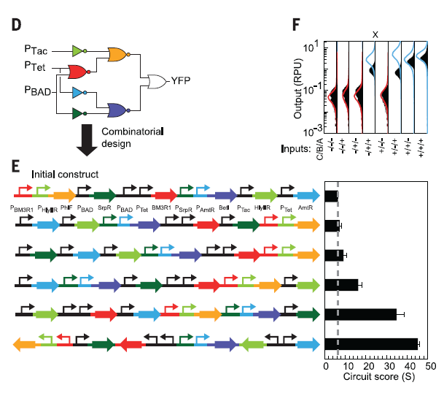
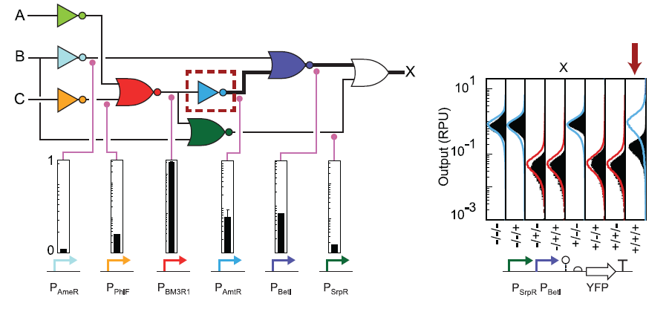
Debugging using intermediate product levels
Variations of the design can be quickly tested
Notes:
Another important feature of having such tools available, is the ability to quickly produce and test variations of the circuit. What can be seen in the left here, is a circuit and six different ways of encoding it. Some of them will score better than others, based on how accurately the output matches the expected values. What can be shown with red and blue curves in figure F is such an expected and actual (shown with black curves) output of this circuit.
Of course sometimes a circuit will fail for unexpected reasons. Maybe one of the gates misfires, or there is some issue with crosstalk between parts. This can be easily debugged by measuring not only the final product, but also the levels of intermediate products. In the example here on the right, the far right condition where all inputs are ON should give an ON output, but the measured output is somewhere in between the ON and OFF ranges. By measuring intermediate product levels, we can see that the inverter NOT gate in light blue doesn’t work properly. The measurement before it is high and after it should be almost zero, but it is instead a midpoint between one and zero. This bug propagates down the circuit and creates the wrong result. Fiddling with the gate itself (or even substituting it for a different part) can more easily solve the problem. Such debugging if done manually would be much more difficult and costly.

Slide 12
General benefits of design automation
Rapid design of large circuits
Testable predictions: DNA sequence
Easier debugging of failures
Allows for further automation using Machine Learning (next lecture)
Notes:
To sum up, the benefits of automated design for genetic circuits are:
The ability to rapidly design large circuits
The output is a DNA sequence which is readily testable. It just needs to be imported in a bacterial system and then outputs and intermediates can be easily measured
Debugging of failures is easier, since discrete intermediates are produced in each step
And finally, such tools allow for further automation at a higher level, using machine learning techniques. You will learn about such methods in the next lecture of this module.

Slide 13
CEITEC
@CEITEC_Brno
Thank you for your attention!
www.ceitec.eu
Notes:
Thank you very much for your attention.

