Slide 1
E5080 / E0323
Ecotoxicology
Ecotoxicology in Field Studies
Jakub Hofman

Slide 2
Introduction

Slide 3
What is going on?
organisms
populations
toxic substances
(+ other stressors)
community
ecotoxicology
ecosytem
complexity
habitat
interactions
mixtures
aquatic
terrestrial

Slide 4
Why?
real problems are in real ecosystems !
lot of problems already happened !
how to address ecotoxicity in real situation?
how to find causality between degradation and ekosystem state?
Challenges

Slide 5
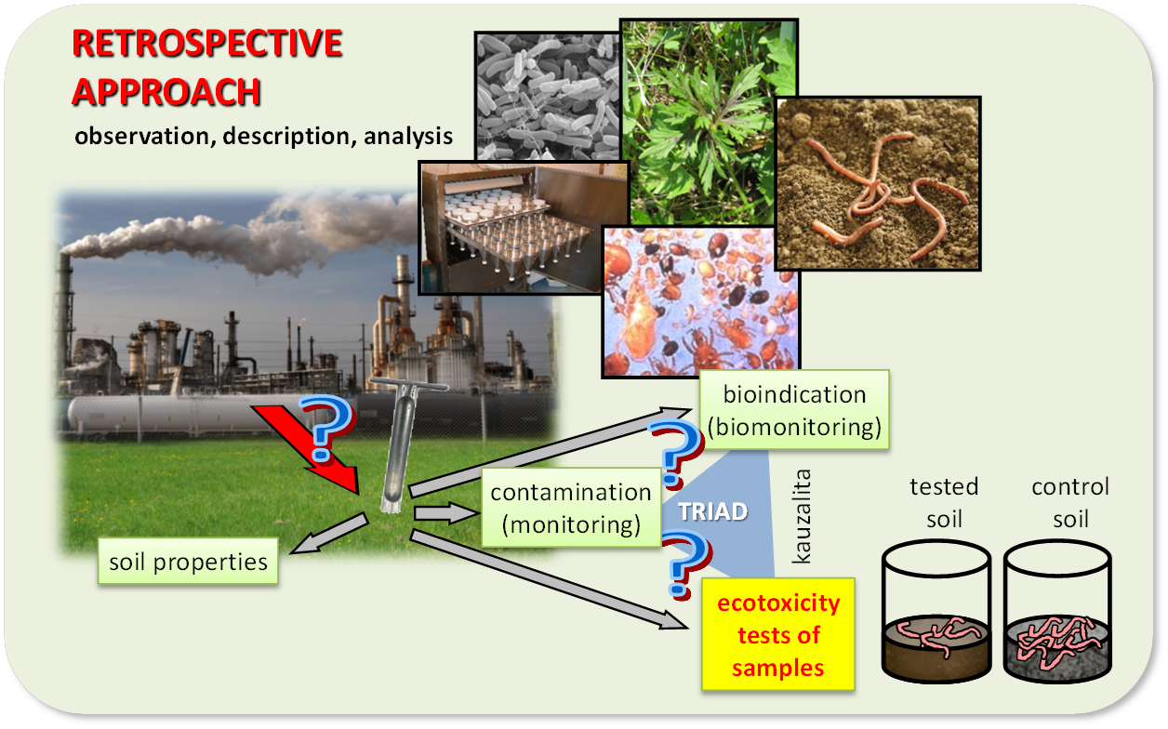
How?
measurements (observations) directly in the field
sampling + analyses
bioindication, biomonitoring
causality, correlations, weight of evidence, TRIAD approach

Slide 6
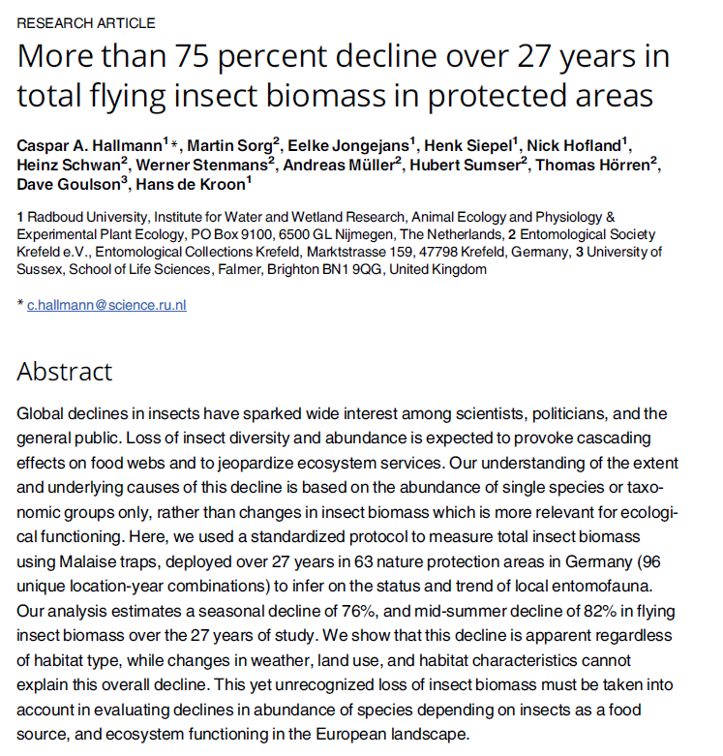
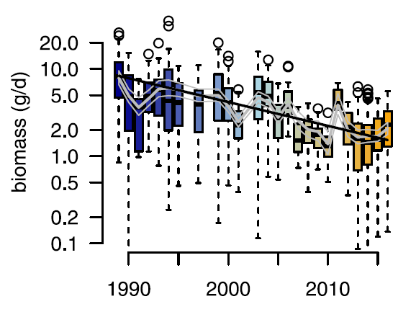
Bioidication – example of alarming results
https://journals.plos.org/plosone/article?id=10.1371/journal.pone.0185809

Slide 7
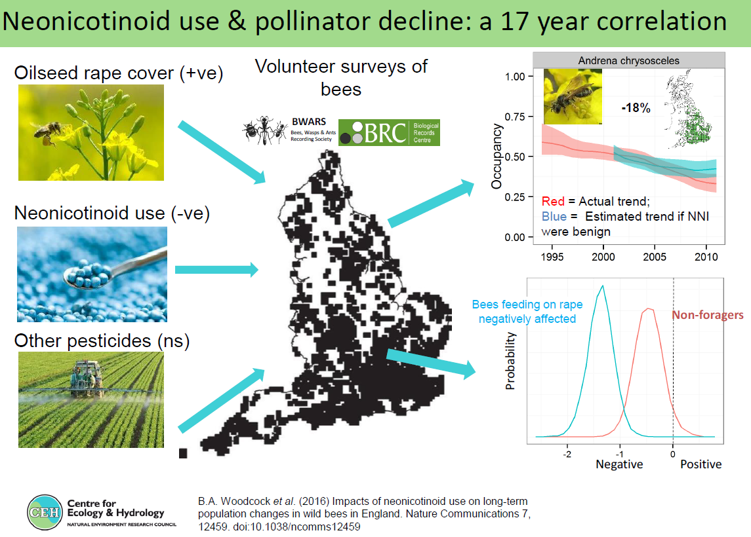

Slide 8
How to?

Slide 9
General scheme
site characterization, survey directly in the field
assessment parameters selection for the given ecosystem in relation to the stress impact
  abiotic components
  biotic components
    structure parameters (eg species composition – diversity, abundances ...)
    functional parameters (eg flows of energy / materials, processes, bilances, resilience/resistence ...)
sampling plan (sampling frequency, numbers ...)
  abiotic components (water, sediments, soil air)
  biotic components (producers – consumers – destruents)
sampling campaign + analyses
assessment and interpretation, comparison of exposure vs control (!), conclusions

Slide 10
1) Site characterization
depending on:
  terrestrial ecosystem: terrain influences – slopes, vegetation ...
  aquatic ecosystem: flowing – static (lentic / lotic), depth, size, flow speed, fragmentation (macrophyta, benthos ...)
other properties needed to be recorded:
  main weather conditions, wind directions, light intensity ...
  specific parameters (any antrhopogenic activities nearby?, sources of pollution? ...)
  map records ...
  what else ?
  ...

Slide 11
2) Parameters selection
abiotic components
where (water, sediment, soil, air) the stressor does occur / act ?
where the residues are expected ?
biotic components
which organisms will be evaluated to see the impacts of stressors:
  relation to stressor’s influence (eg planktonic – substances dissolved in the water column, ie hydrophilic versus sediments - hydrophobic)
  evaluated groups (eg producers – algae, consumers – zooplancton, fish; destruents – planktonic bacteria)
  key species, bioindicators ...
  parameters evaluated
    structural (taxonomic parameters, biomass, abundance ...)
    functional (production / respiration, food chains ...)

Slide 12
3) Sampling and analyses
A: sampling and analyses of abiotic components
plan and design of sampling plots / sites
  areal, vertical – depth, air sampling
merging and creating mixed samples („average" sample from the site)
assessment of the fundamental chemical and physical parameters (organic carbon, pH, particle sizes ....)
characterization and determination of the contamination
  analytical chemistry and environmental chemistry
ecotoxicological bioassays of the real matrices .... special use of bioassays

Slide 13
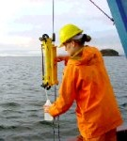
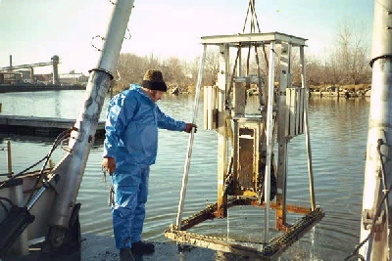
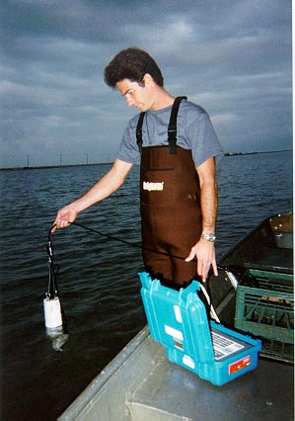
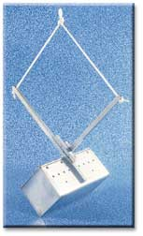
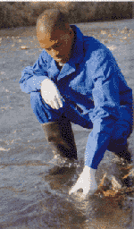
3) Sampling and analyses
A: sampling and analyses of abiotic components
Water
Sediment
Eckmans sampler

Slide 14
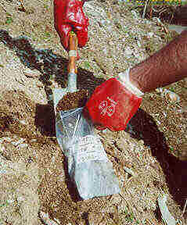
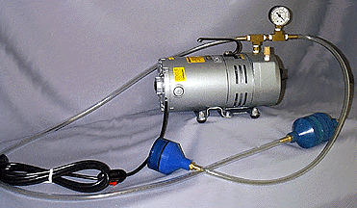
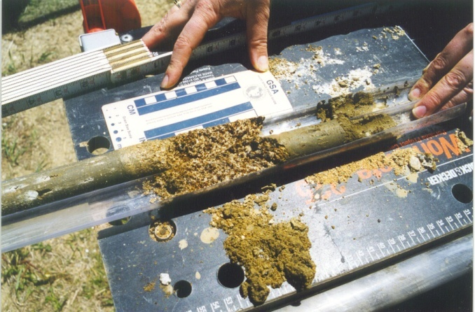
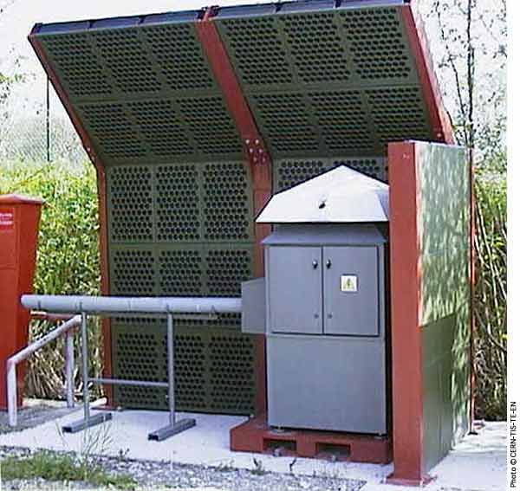
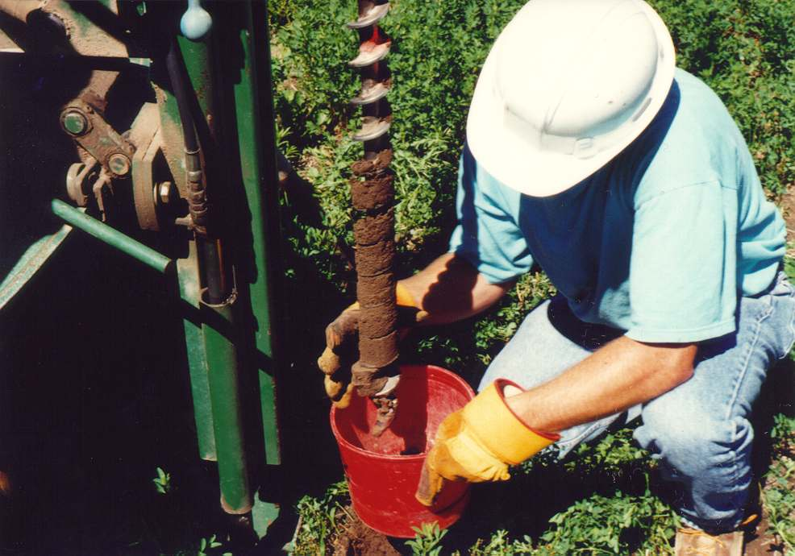
3) Sampling and analyses
A: sampling and analyses of abiotic components
Soil
Air
Soil core

Slide 15
3) Sampling and analyses
B: sampling and analyses of biota
plan and distribution of the sampling plots / sites
sampling – variable according to organisms...
characterization of defined biotic parameters
  techniques of botanical, zoological, microbiological and ecological disciplines
characterization and determination of contamination of biota
  techniques of analytical chemistry and environmental chemistry

Slide 16
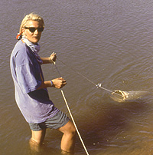
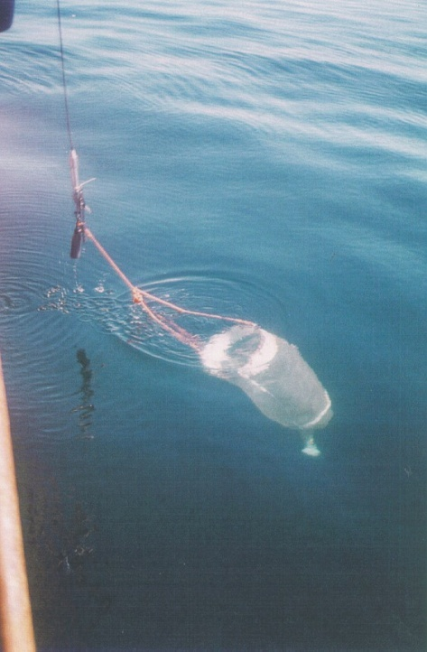
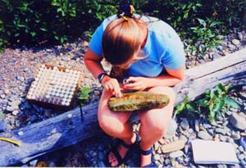
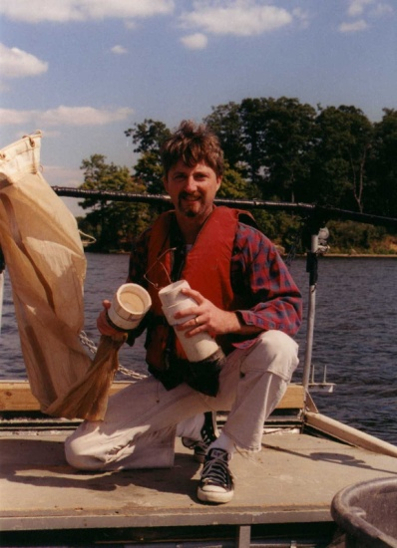
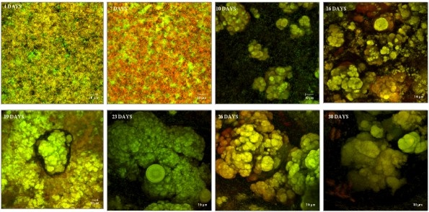
3B) Sampling - biota
water
Planctonic nets
Periphyton – biofilm

Slide 17
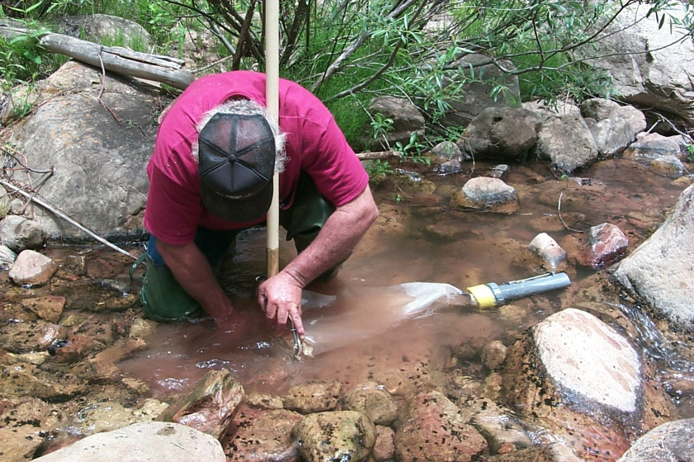
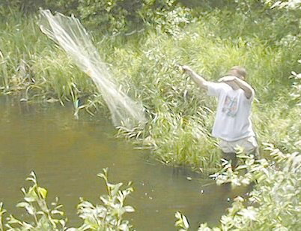
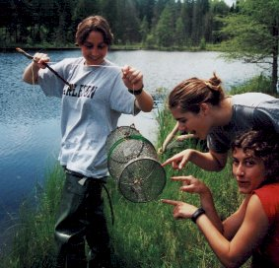
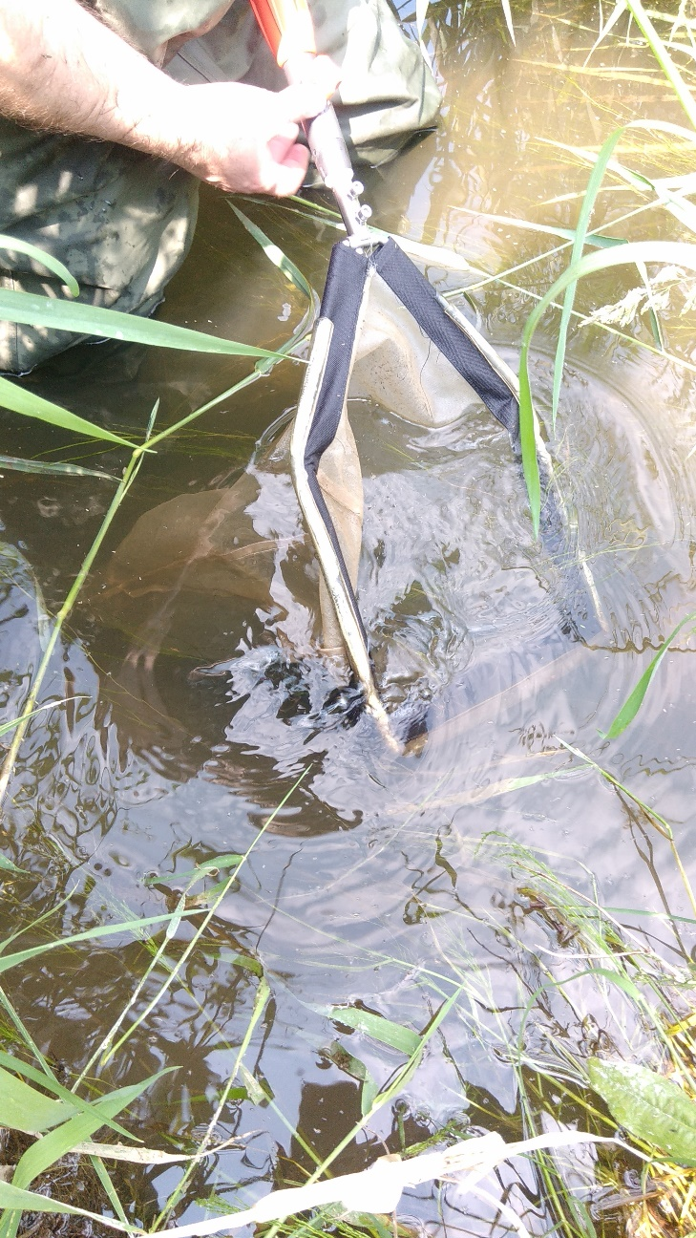
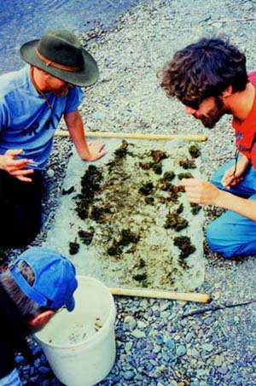
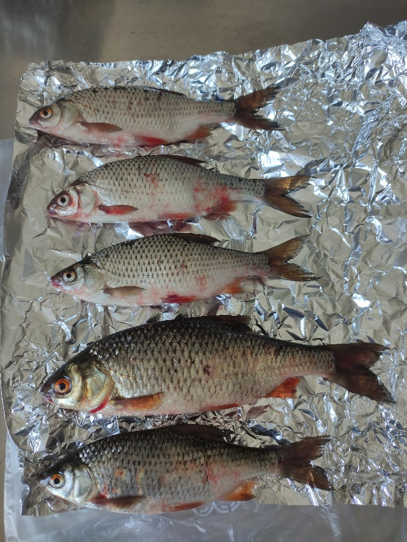
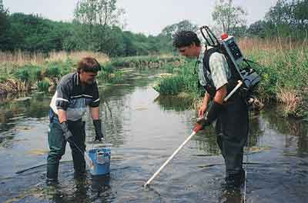
3B) Sampling - biota
water
Benthic invertebrates
Fish

Slide 18
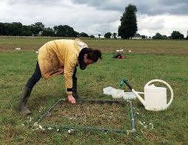
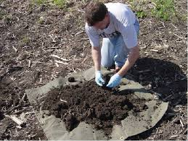
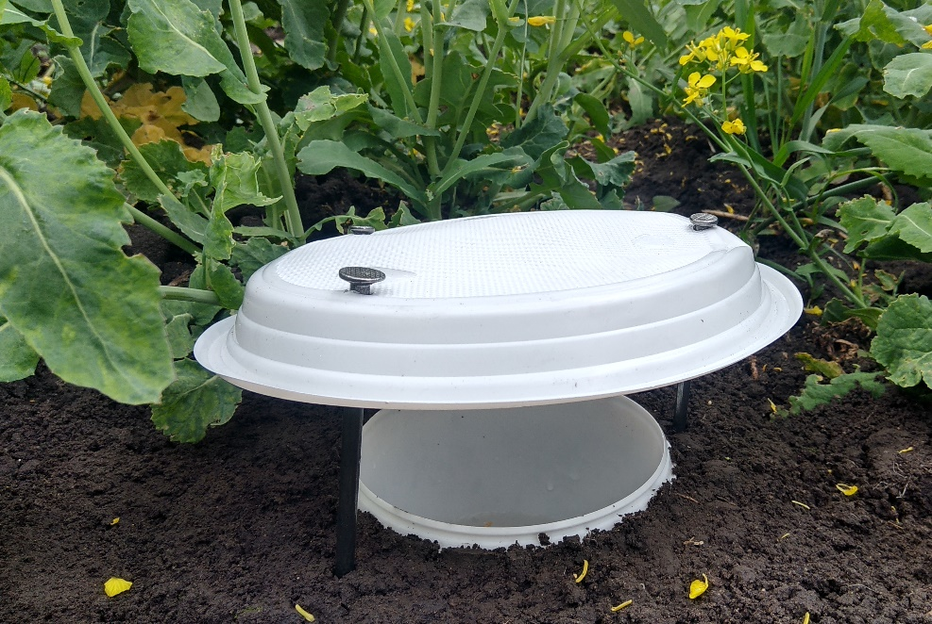
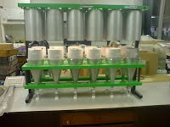
3B) Sampling – biota – soil biota
different according to type and especially the size of organisms
manual sorting, picking
pitfall traps
extracting methods: Tulgren's extraction, O'Connor's extraction ...

Slide 19
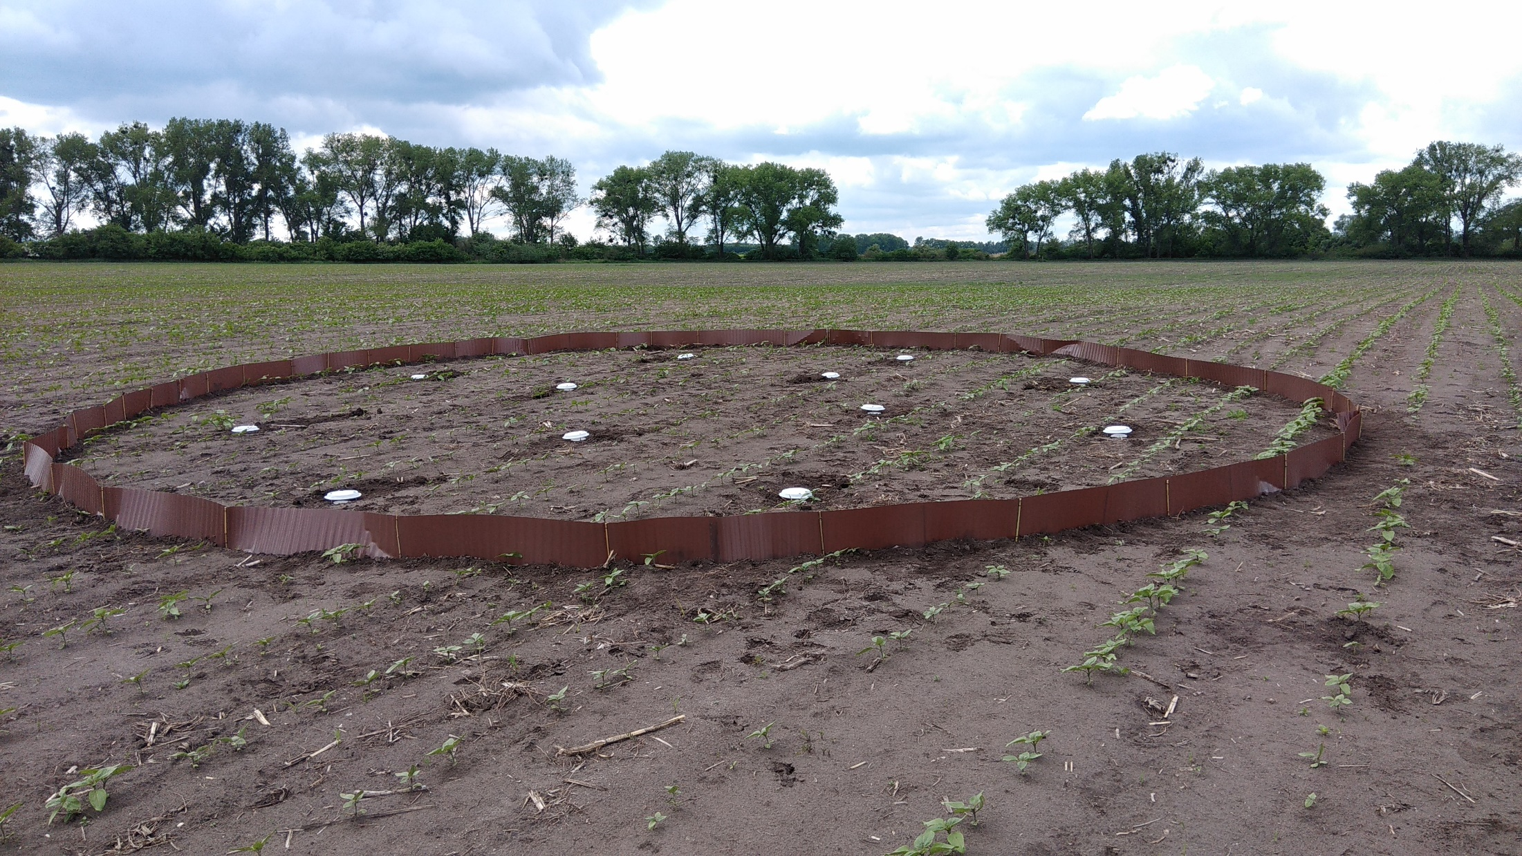
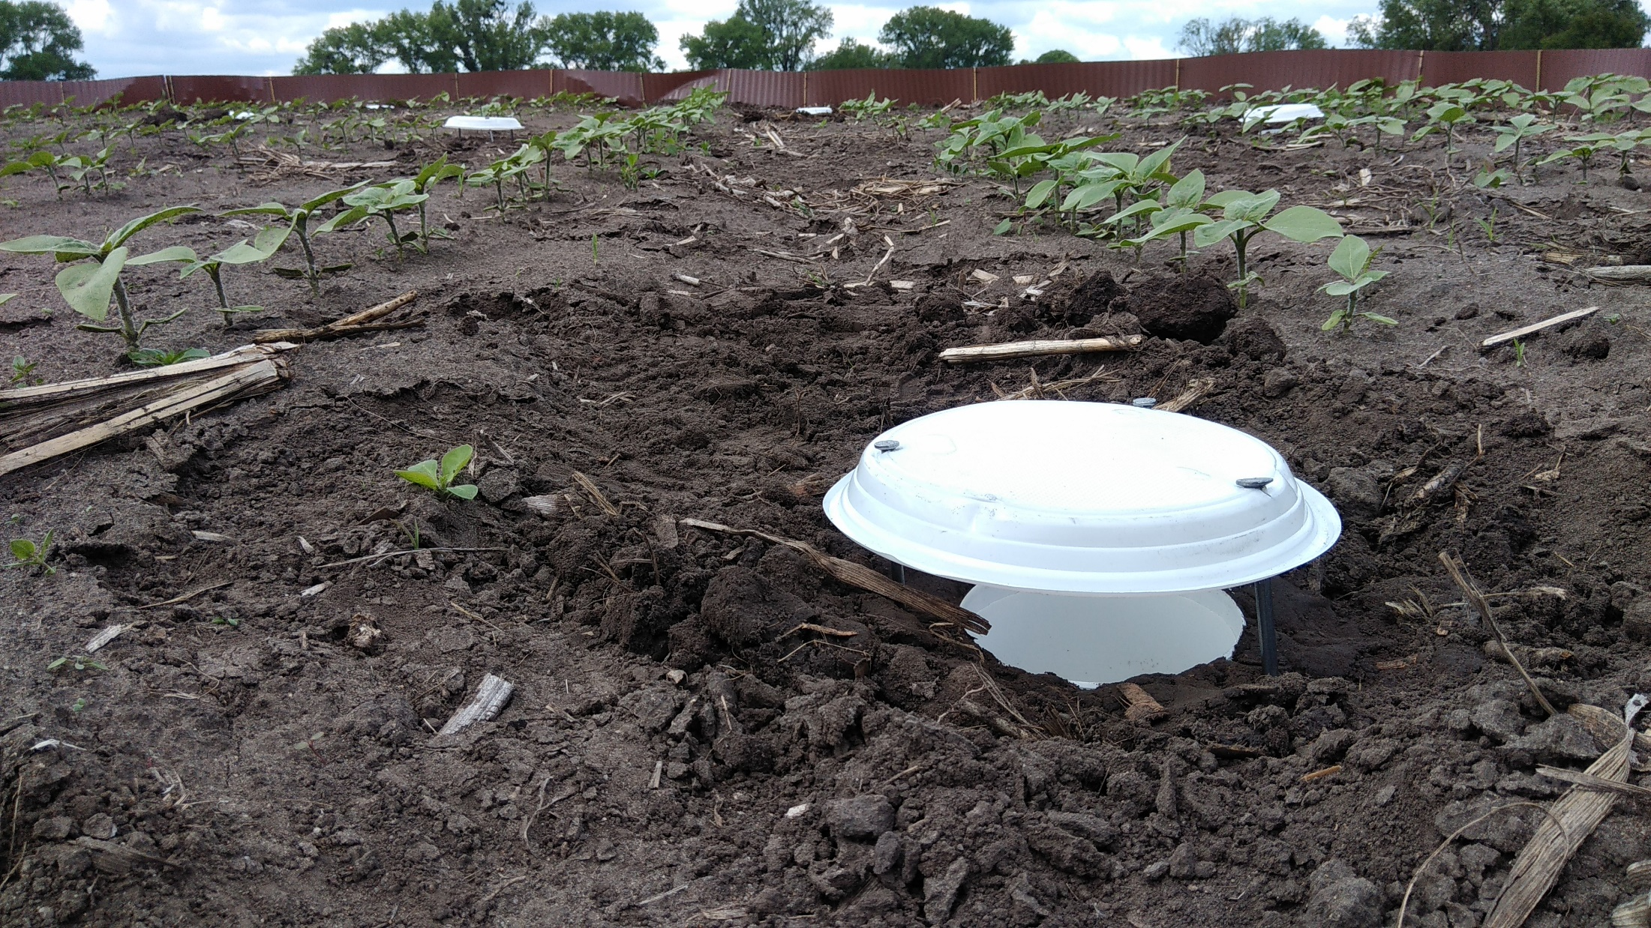
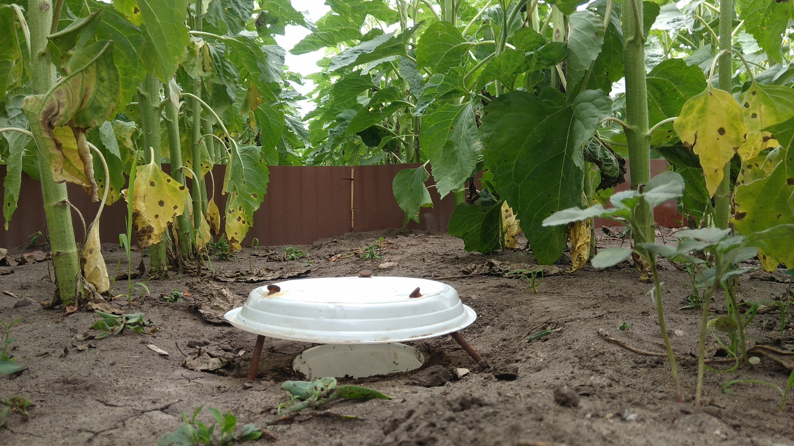
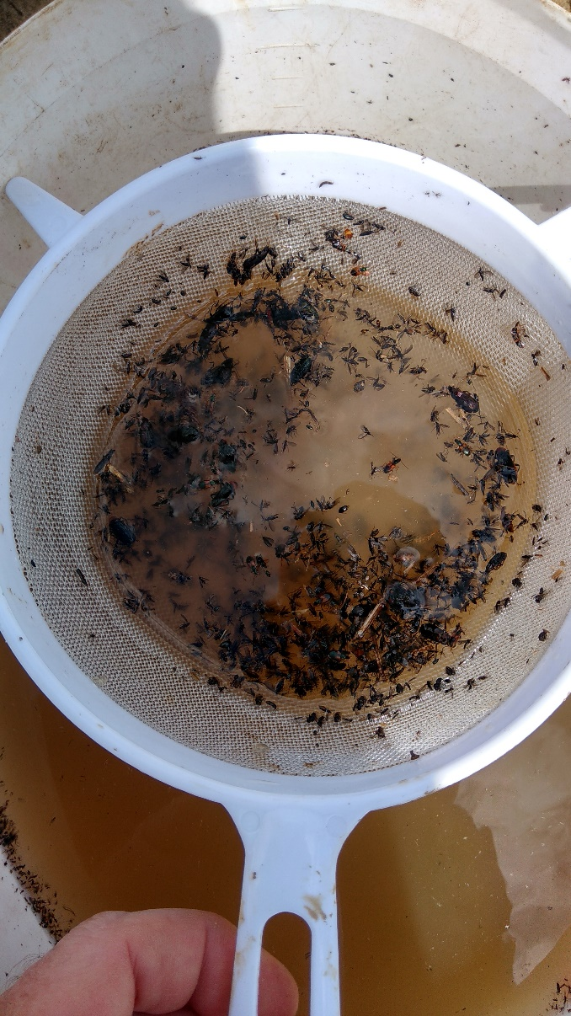
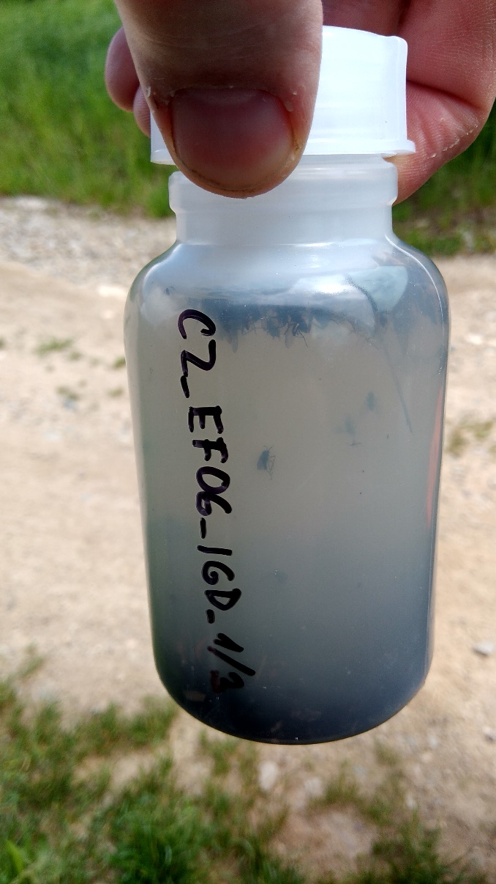
3B) Sampling – biota – soil biota

Slide 20
3B) Sampling – biota – soil biota
ISO 23611-1:2006 | Soil quality -- Sampling of soil invertebrates – Part 1: Hand-sorting and formalin extraction of earthworms
ISO 23611-2:2006 | Soil quality -- Sampling of soil invertebrates – Part 2: Sampling and extraction of micro-arthropods (Collembola and Acarina)
ISO 23611-3:2007 | Soil quality -- Sampling of soil invertebrates – Part 3: Sampling and soil extraction of enchytraeids
ISO 23611-4:2007 | Soil quality -- Sampling of soil invertebrates – Part 4: Sampling, extraction and identification of soil-inhabiting nematodes
ISO/DIS 23611-5 | Soil quality -- Sampling of soil invertebrates – Part 5: Sampling and extraction of soil macro-invertebrates
ISO/DIS 23611-6 | Soil quality -- Sampling of soil invertebrates – Part 6: Guidance for the design of sampling programmes with soil invertebrates

Slide 21
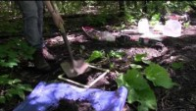
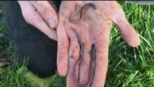
3B) Sampling – biota – soil biota
earthworms

Slide 22

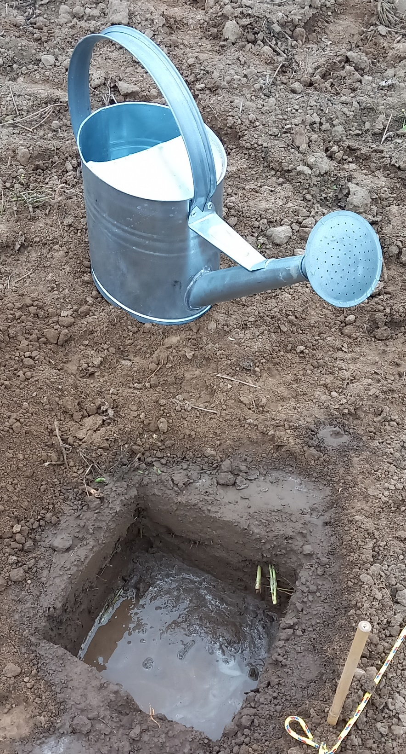
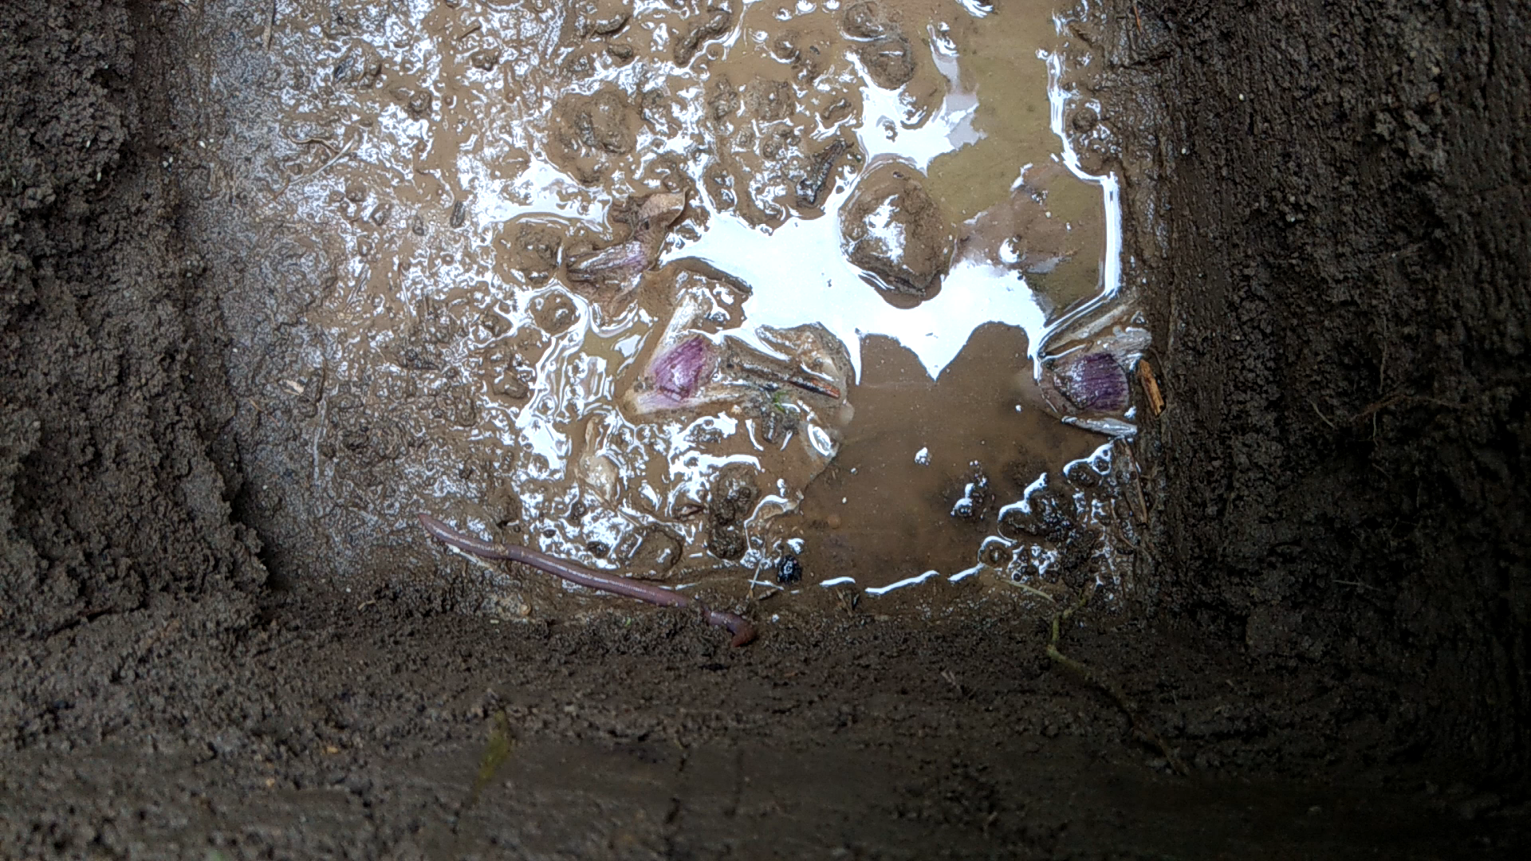
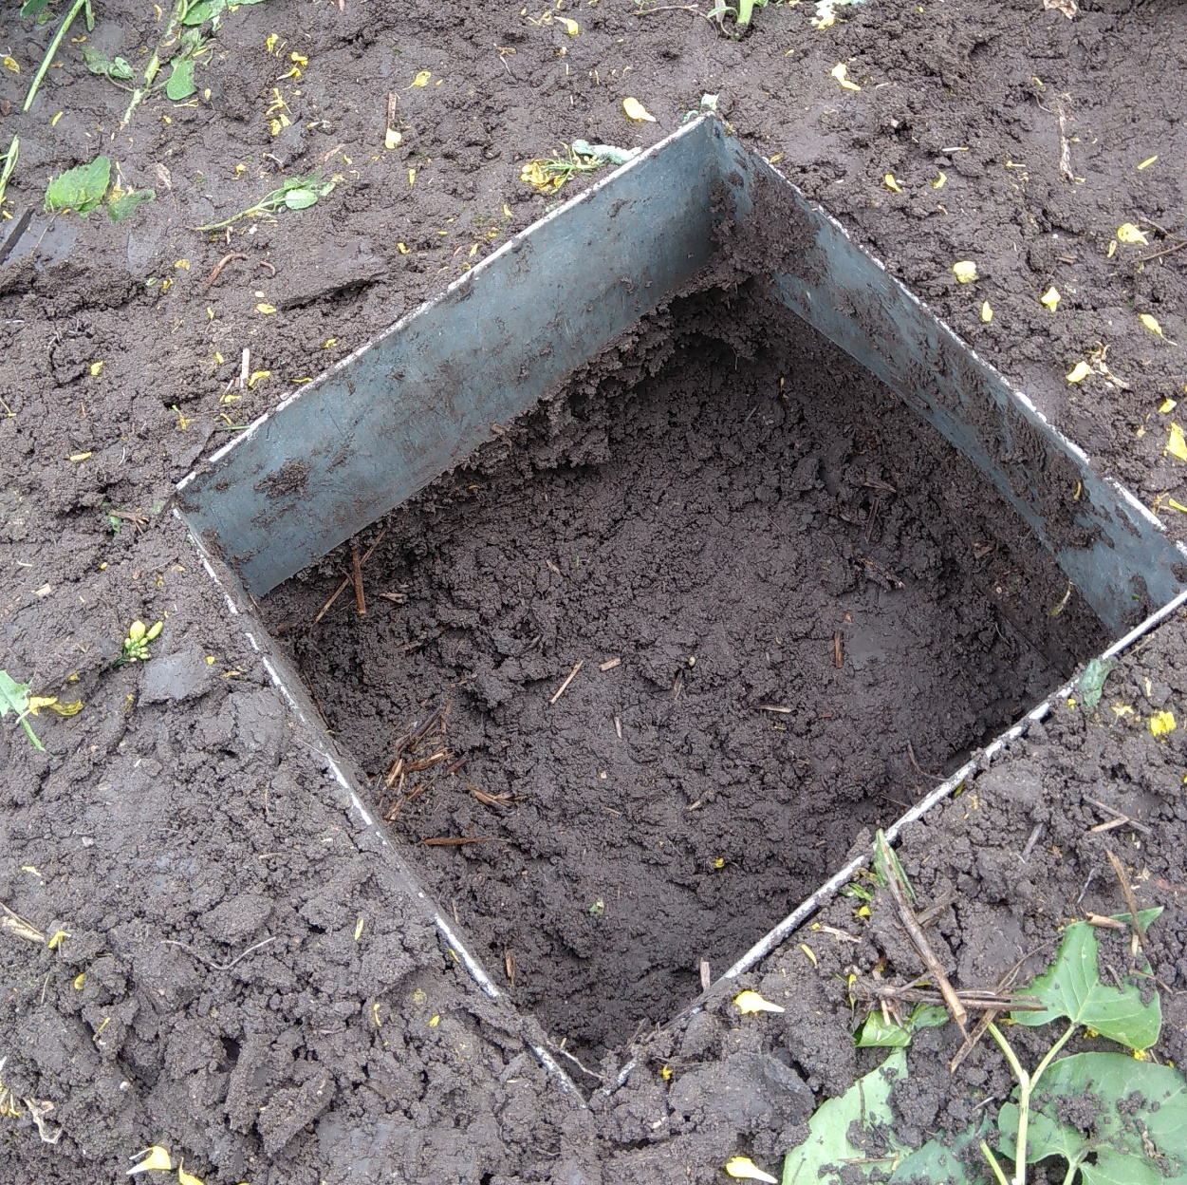
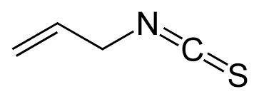
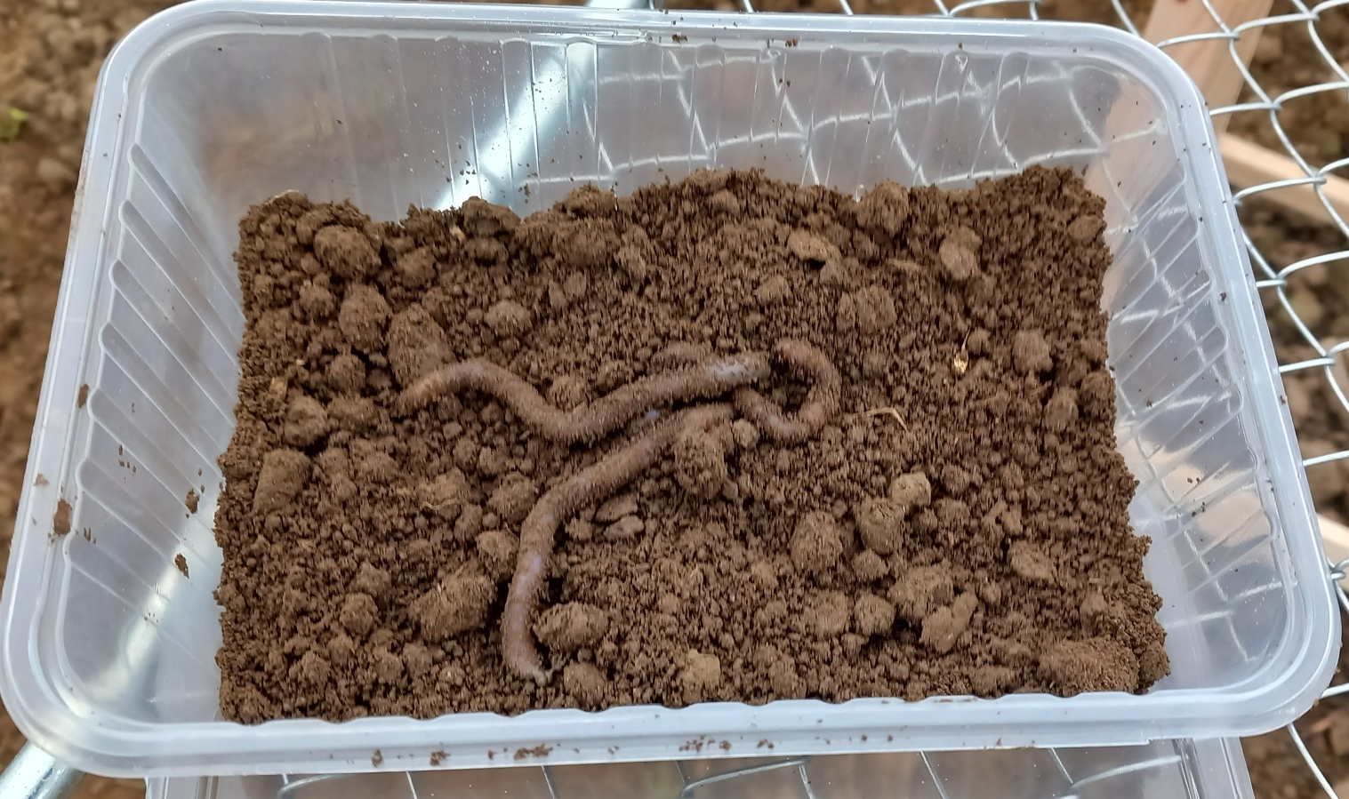
3B) Sampling – biota – soil biota
earthworms
alyl isothiocyanate

Slide 23
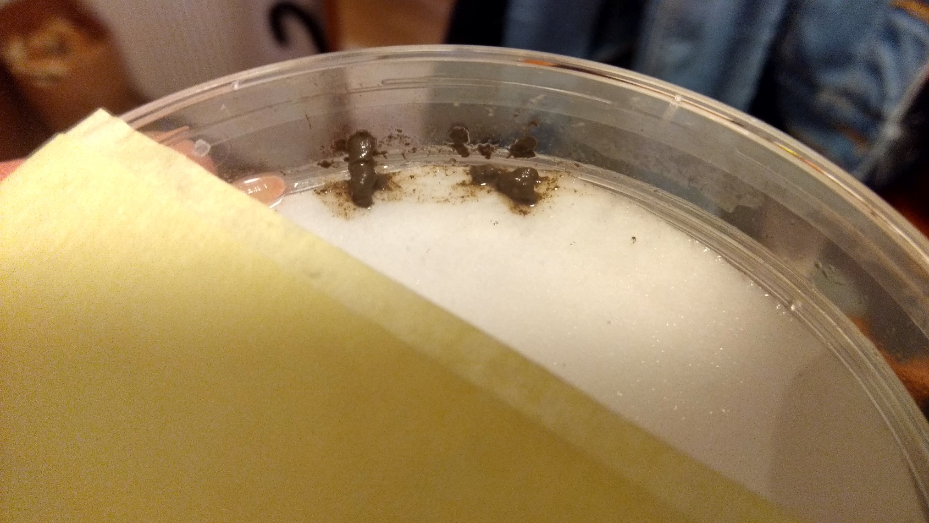
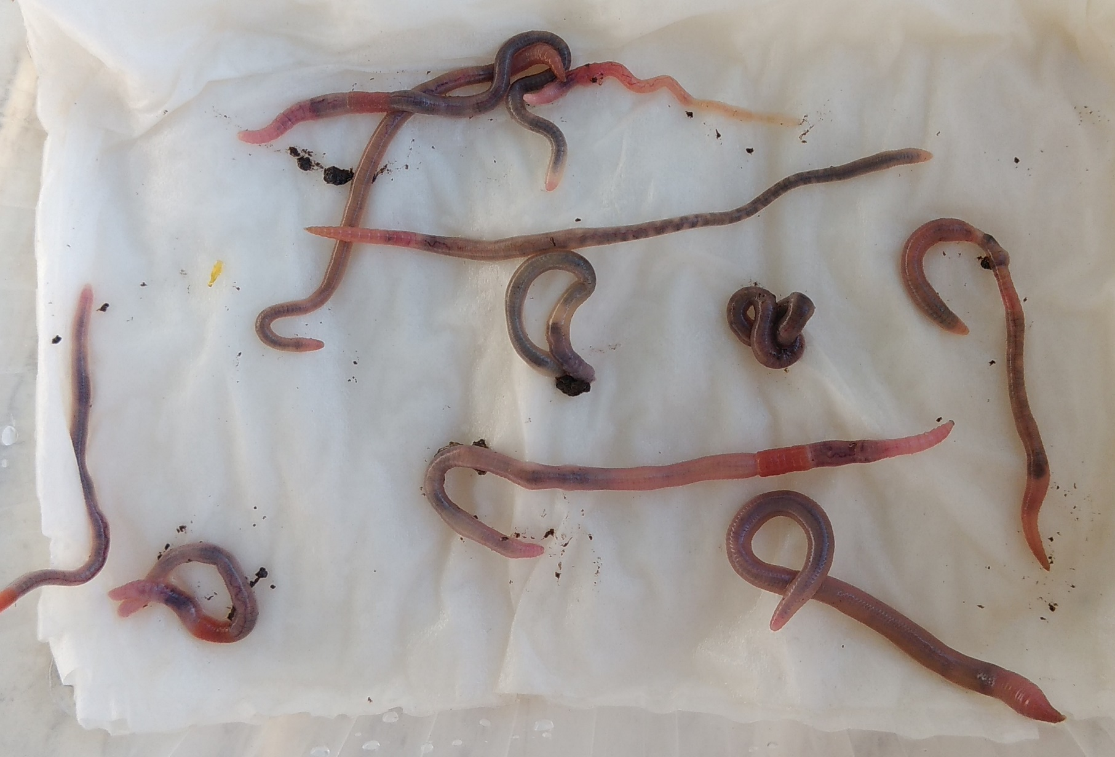
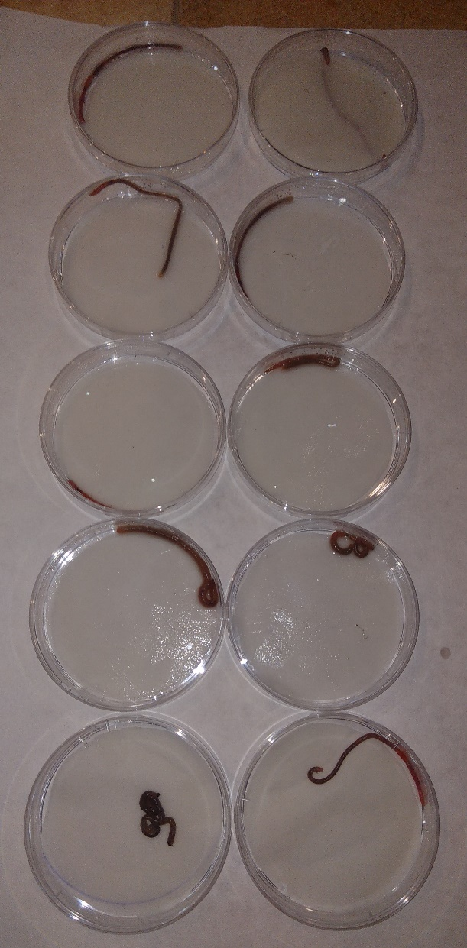
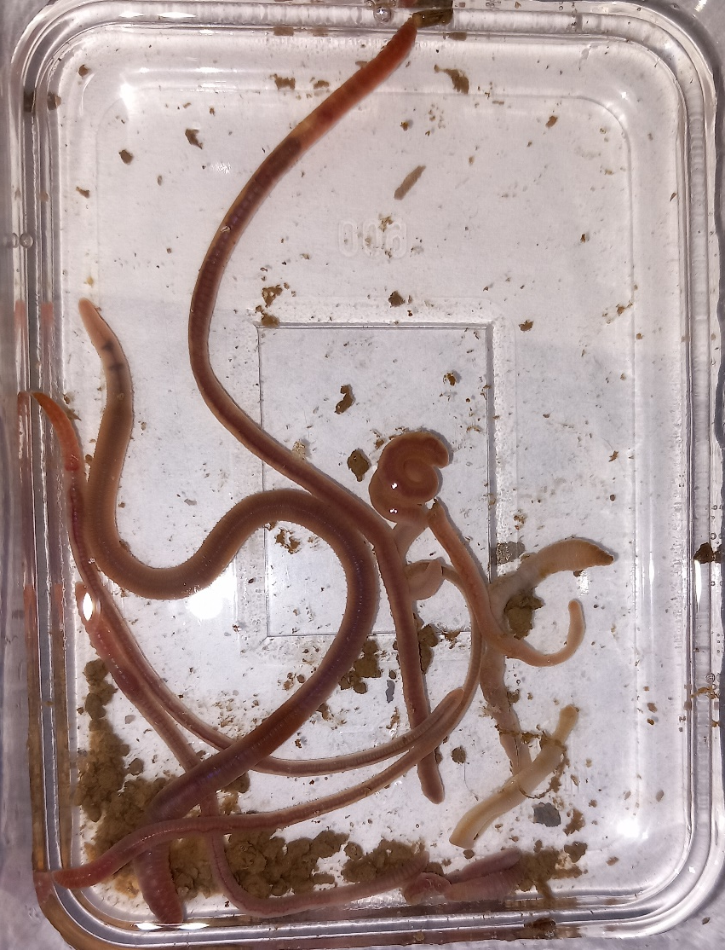
3B) Sampling – biota – soil biota
earthworms

Slide 24
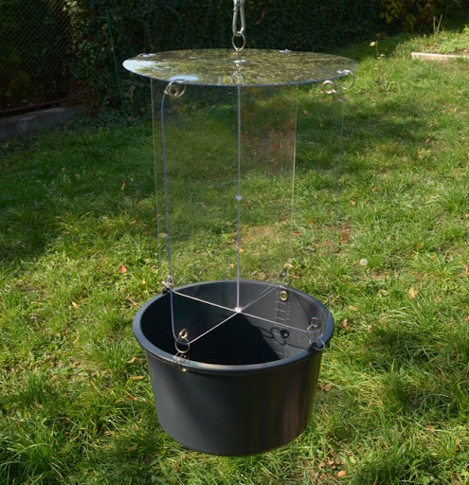


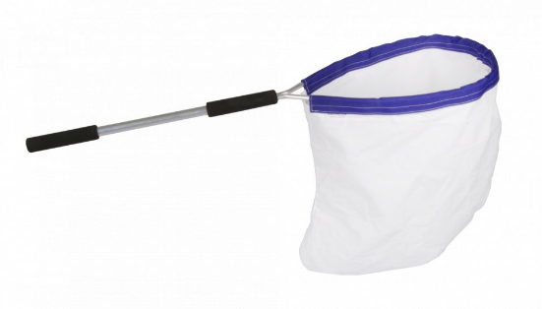
3B) Sampling – biota – insects
capture into pitfall traps - those living on the surface of the soil
capture using exhaustor
by sweeping with an entomological net - from vegetation or from air
collection or falling from vegetation
Malaise trap
impact traps (without or with attractants, pheromones)
... and many other methods

Slide 25
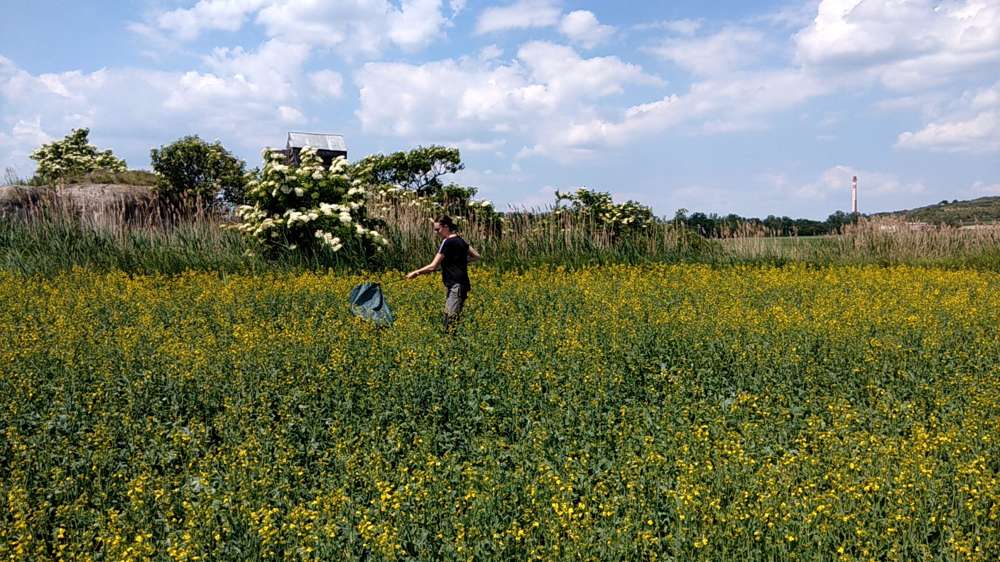
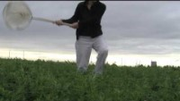
3B) Sampling – biota – insects

Slide 26


3B) Sampling – biota – terrestrial plants
Phytocoenological snapshot
defining area, square or rectangle
units or hundreds of m²
plants are divided according to height into several vegetation floors:
  bryophytes and lichens
  herbs, seedlings of trees
  shrubs and trees with possible epiphytes
estimation of the coverage of individual floors
on each floor, all species, including an estimate of the area they cover (in percent or special scale – 7-point Braun-Blanquet or 11-point Domino)
other information is recorded, of course the exact location and date, but also the slope and its orientation
soil samples can also be taken for later analyzes (eg pH and other chemical analyzes)

Slide 27


3B) Sampling – biota – terrestrial plants
Quadrat method

Slide 28




3B) Sampling – biota – mammals
Direct methods
sampling - capture the representative part of the population
dead-traps (animal is killed) – clap-traps, wire eyes, “pitfall traps” with water and other traps, shooting
alive traps - corridors, fall-doors, baits; Sherman's or Longworth trap; tagging (rings, ears, color ...), release and re -capture (CMR - Catch, Mark, Release)

Slide 29




3B) Sampling – biota – mammals
Direct methods
observation – big animals or cameras or phototraps
labelling – bands, collars, telemetry (GPS)

Slide 30




3B) Sampling – biota – birds
catching – nets, rings, blood sampling, feathers sampling etc.

Slide 31



3B) Sampling – biota – birds
observation (individuals, nests, singing...)

Slide 32
4) Assessment and interpretation
comparision of the exposed and control ecosystem
fundamental parameters of the compared ecosystems should be SIMILAR / COMPARABLE (eg pH values, water hardness, similar geochemical parameters – subsurface ...)
chemical contamination of the environmental compartments versus biota in the compared ecosystems
  are there differences in the concentrations of the toxic compounds?
  is there any relationship between concentrations in the environment and in biota?
comparing biotic parameters in both compared ecosystems
  are there differences in the taxonomic composition of the communities?
  are there differences in the coverage – abundance – biomass?
  are the food relationships different?
  what about rezistence and resilience (how long the stress has acted and how long it does not act any more?)
correlation is NOT equal to causality !

Slide 33
Bioindication, biomonitoring

Slide 34
Bioindication
method, when the Environmental status is assessed on the basis of the properties of biological systems
in broader context, we mean all methods when we observe reactions of organisms present in the environment (from individuals to communities) on stress
temperature
the environment is forming the living systems
electromagnetic radiation
water
env. factors
biota
env. factors
chemical composition
radioactivity
living systems provide information about the environment
noise

Slide 35
Bioindication versus biomonitoring
bio + monitoring
bioindication is an approach
biomonitoring is the use of this approach in the field studies, especially at number of sites and repeatedly in time

Slide 36
Bioindication
monitoring of chemicals in the collected biota samples
  in anything, preferentially so -called bioacumulators or bioindicator species / samples (eg needles)
tracking biota and its response to the environmental factors
  biochemical markers
    of effects (stress proteins - HSP - Heat Shock Proteins, chromosome aberations ...)
    of exposure (Methalothioneins, EROD – Ethoxyresorufin-O-Deethylase ...)
  indicator species - presence/absence indicates a certain feature of the ekosystém
    sensitive species (eg stoneflies, mountain Tubellaria, lichens)
    oportunist species (eg chironomids, leeches ...)
  the condition and function of organisms
  population - numbers of organisms, distribution, age composition ...
  community - species composition and representation, biodiversity
  state of ecosystem or landscape - structure, dynamics, function
different levels of biological organization

Slide 37

Accumulation bioindicators - example
SETAC 2020: 1.04.8 Deciphering the molecular mechanisms of pesticide tolerance of the soil engineer biodiversity

Slide 38
Indicator species – example: Saprobity index
sapros = rot, blight, decomposition ...
organic "non-toxic" substances (fecal pollution, „nutrients“ for microbes)
many organic chemicals → nutrients for bacteria → degradation of organic substances and consumption of oxygen → impacts on aquatic biota
Increased saprobity
one of the major threats for water quality (and indicator of water pollution / purity) in Europe
not the direct toxicity, rather oxygen depletion (!)
assessment = categorization
polysaprobity / mesosaprobity (alfa-, beta-) / oligosaprobity
(new: catarobity / limnosaprobity / eusaprobity / transsaprobity)

Slide 39


Indicator species – example: Saprobity index
Indicator species for saprobity - examples
Xeno & oligosaprobity Polysaprobity

Slide 40



Indicator species – example: Saprobity index
Community shift
Ai – abundance of species i
Si – individual saprobity value of species i
gi – indikative value of species i

Slide 41
How to choose the bioindicator ?
Procedures used to monitor biological endpoints in real ecosystems should ideally be:
virtually applicable
easily interpreted by the executive body
ecologically relevant to multiple ecosystems
the resulting parameter should be separable from natural fluctuations
should give a causal relationship between substance and effect
fast and cheap
standardizable

Slide 42


How to choose the bioindicator ?
Kelly J. & Harwell M. (1990).

Slide 43

Selection of parameters - pros and contras
EC (2010): Soil biodiversity: functions, threats and tools for policy makers. https://core.ac.uk/display/29245351

Slide 44


Bioindication
example of soil quality bioindicators – are there related to soil ecosystem services?
Doelman & Eijsackers (2004)
Jensen J. & Mesman M. (2006). Ecological risk assessment of contaminated land. Decision support for site specific investigations. Report 711701047. RIVM, Netherlands

Slide 45

Bioindication
Example of available methods to measure soil microbial properties
ISO 14238:2012 | Soil quality — Biological methods — Determination of nitrogen mineralization and nitrification in soils and the influence of chemicals on these processes
ISO 15685:2012 | Soil quality — Determination of potential nitrification and inhibition of nitrification — Rapid test by ammonium oxidation
ISO 18187:2016 | Soil quality — Contact test for solid samples using the dehydrogenase activity of Arthrobacter globiformis
ISO 17155:2012 | Soil quality — Determination of abundance and activity of soil microflora using respiration curves
ISO/TS 10832:2009 | Soil quality — Effects of pollutants on mycorrhizal fungi — Spore germination test
ISO/CD 23265 | Soil quality — Test for estimating organic matter decomposition in contaminated soil
ISO 16072:2002 | Soil quality — Laboratory methods for determination of microbial soil respiration
ISO 14240-1:1997 | Soil quality — Determination of soil microbial biomass — Part 1: Substrate-induced respiration method
ISO 14240-2:1997 | Soil quality — Determination of soil microbial biomass — Part 2: Fumigation-extraction method
ISO 23753-1:2019 | Soil quality — Determination of dehydrogenases activity in soils — Part 1: Method using triphenyltetrazolium chloride (TTC)
ISO 23753-2:2019 | Soil quality — Determination of dehydrogenases activity in soils — Part 2: Method using iodotetrazolium chloride (INT)
ISO/TS 29843-1:2010 | Soil quality — Determination of soil microbial diversity — Part 1: Method by phospholipid fatty acid analysis (PLFA) and phospholipid ether lipids (PLEL) analysis
ISO/TS 29843-2:2011 | Soil quality — Determination of soil microbial diversity — Part 2: Method by phospholipid fatty acid analysis (PLFA) using the simple PLFA extraction method
ISO 11063:2020 | Soil quality — Direct extraction of soil DNA
ISO 17601:2016 | Soil quality — Estimation of abundance of selected microbial gene sequences by quantitative PCR from DNA directly extracted from soil
ISO 20130:2018 | Soil quality — Measurement of enzyme activity patterns in soil samples using colorimetric substrates in micro-well plates
ISO/TS 20131-1:2018 | Soil quality — Easy laboratory assessments of soil denitrification, a process source of N2O emissions — Part 1: Soil denitrifying enzymes activities
ISO/TS 20131-2:2018 | Soil quality — Easy laboratory assessments of soil denitrification, a process source of N2O emissions — Part 2: Assessment of the capacity of soils to reduce N2O
ISO 11266:1994 | Soil quality — Guidance on laboratory testing for biodegradation of organic chemicals in soil under aerobic conditions
ISO 15473:2002 | Soil quality — Guidance on laboratory testing for biodegradation of organic chemicals in soil under anaerobic conditions
ISO 14239:2017 | Soil quality — Laboratory incubation systems for measuring the mineralization of organic chemicals in soil under aerobic conditions
biomass
enzyme activity
diversity
structural
genetic
functional
denitrification

Slide 46


Bioidication
Example of available methods to measure soil invertebrates
Doelman P. & Eijsackers H.J.P. (2004): Vital Soil - Function, Value and Properties. Elsevier. 358 p. ISBN: 0-444-51772-3

Slide 47


Bioidication
Example of available methods to measure soil invertebrates
Doelman P. & Eijsackers H.J.P. (2004): Vital Soil - Function, Value and Properties. Elsevier. 358 p. ISBN: 0-444-51772-3

Slide 48


Bioidication
Example of approaches for plants
composition of plant communities – phytocenology
function and condition of plants
  measurement of photosynthesis (oxygen production, fluorescence of photosynthetic pigments)
  biochemical markers
  genotoxicity (micronuclei, chromosome aberations)
  functioning of nitrogen fixation, mycorrhiza
leaf coverage
monitoring the occurrence of indicator organisms
  mycorrhitic fungi
  lichens
  diseases
pollutants in plants

Slide 49
Bioidication
Example of approaches for mammals
from practical reasons often focused on „small mammals“
  presence / absence
  repeated catch
  activity
  abundance
  density
  richness
  diversity
  dynamics of the population / community...

Slide 50
TRIAD approach

Slide 51


TRIAD
long tradition
ISO 19204 (2017): Soil quality - Procedure for site-specific ecological risk assessment of soil contamination (soil quality TRIAD approach)
site-specific risk assessment with 3 lines of evidence (LoE)
their evaluation = „weight of evidence“ - WoE

Slide 52


TRIAD
there is scaling step
and finally integration of all results
Jensen J. & Mesman M. (2006). Ecological risk assessment of contaminated land. Decision support for site specific investigations. Report 711701047. RIVM, Netherlands

Slide 53




TRIAD - příklad
Jiang et al. (2015)

Slide 54


TRIAD - příklad
Jiang et al. (2015)

Slide 55
Problems in field ecotoxicology

Slide 56
Problems in the field studies
natural fluctuations, large influence of environmental factors
Contamination data in most cases focus on total content
  biota, however, reacts only to bioavailable fraction that depends on many factors (cannot be well modeled)
  as a result, we often do not see the causality between pollution and the condition of biota, except of very high concentrations
The observed phenomena have a stochastic character
  There is a natural scattering in space and time!
  Do we have a sufficiently representative sample? What do we really sample and measure?
Contamination often acts as a selection pressure
  Long -term load can lead to creating adaptations and tolerances or even stimulation (especially in microorganisms)
  Do we know the history of the locality contamination well?

Slide 57
Problems in the field studies
Total interconnection by food and ecological links, continuity of processes
  Changes in the activity of one community or population in relation to other communities and functions that are linked
  Inhibition of one ecosystem component can stimulate another component
Organisms themselves can affect chemical forms of pollutants
  For example, sorbed forms of substances may be mobilized again, or microbial degradation may come
The problem of optimal field study design (biomonitoring)
  Need of a reference state – non-contaminated / non-impacted site (comparison with control)
  or a large dataset (correlation, causality)
  or time trends (BACI

Slide 58

A reference state is needed
BACI = comparing Before and After Control Impact
a control = state of ekosystém before the impact
it needs a monitoring before the impact happens (both biotic and abiotic components must be observed)
ie background values and „natural“ state

Slide 59

A reference state is needed
Comparison of an exposed ecosystem with another ("control„ – un-impacted) ecosystem
The key is the choice of a control ecosystem:
  Both ecosystems have comparable abiotic properties (terrain, geology, altitude ...)
  Similar biological properties are expected in normal state (ie the same communities, food relations ...)
The derivation of the conclusions in this case is always complicated (there are no two same / equally evolving ecosystems)

Slide 60
„Normal“ state in the ecosystems
stationary state
long term state, no disturbances
this is often not „normal“: ecosystems are naturally „variable“ and „changing“
stable state
surrounding conditions / factors do not change the major features (functions, overal performance ...), but inside there might be changes and fluctuations
dynamic stability / ekvilibrium = homeostasis
using action/reaction, positive and negative feedback it keeps long-term stable state
succession
ecosystems are never „stationary“ – the go through development in time: so, the Protection should not simply aim on „conservation of the current state“

Slide 61
„Normal“ state in the ecosystems
regulatory approach – example: water framework directive EU (WFD)
EU WFD aims at good status of all surface waters in EU till 2020
2 components of quality assessment (“good state”) - „ecological“ and „chemical“
Chemical component
3 lists of defined substances
  Priority substances list
    good quality = concentration of each individual chemical < EQS (Environmental Quality Standards), AA-EQS – annual average concentration, MAC-EQS – maximum acceptable concentration
  watch list – these should be measured for the future assessment, they may become Priority substances
  specific pollutants – according to the plans of the river basins „river basin specific pollutants)

Slide 62

„Normal“ state in the ecosystems
regulatory approach – example: water framework directive EU (WFD)
EU WFD aims at good status of all surface waters in EU till 2020
2 components of quality assessment (“good state”) - „ecological“ and „chemical“
Ecological component

