Slide 1
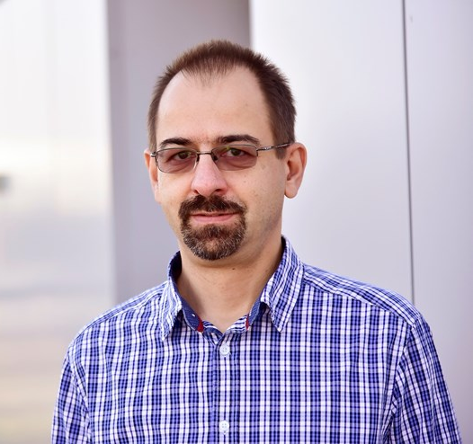
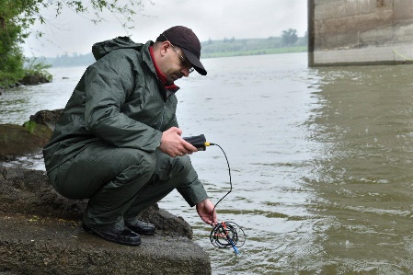
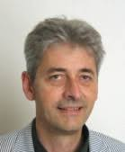
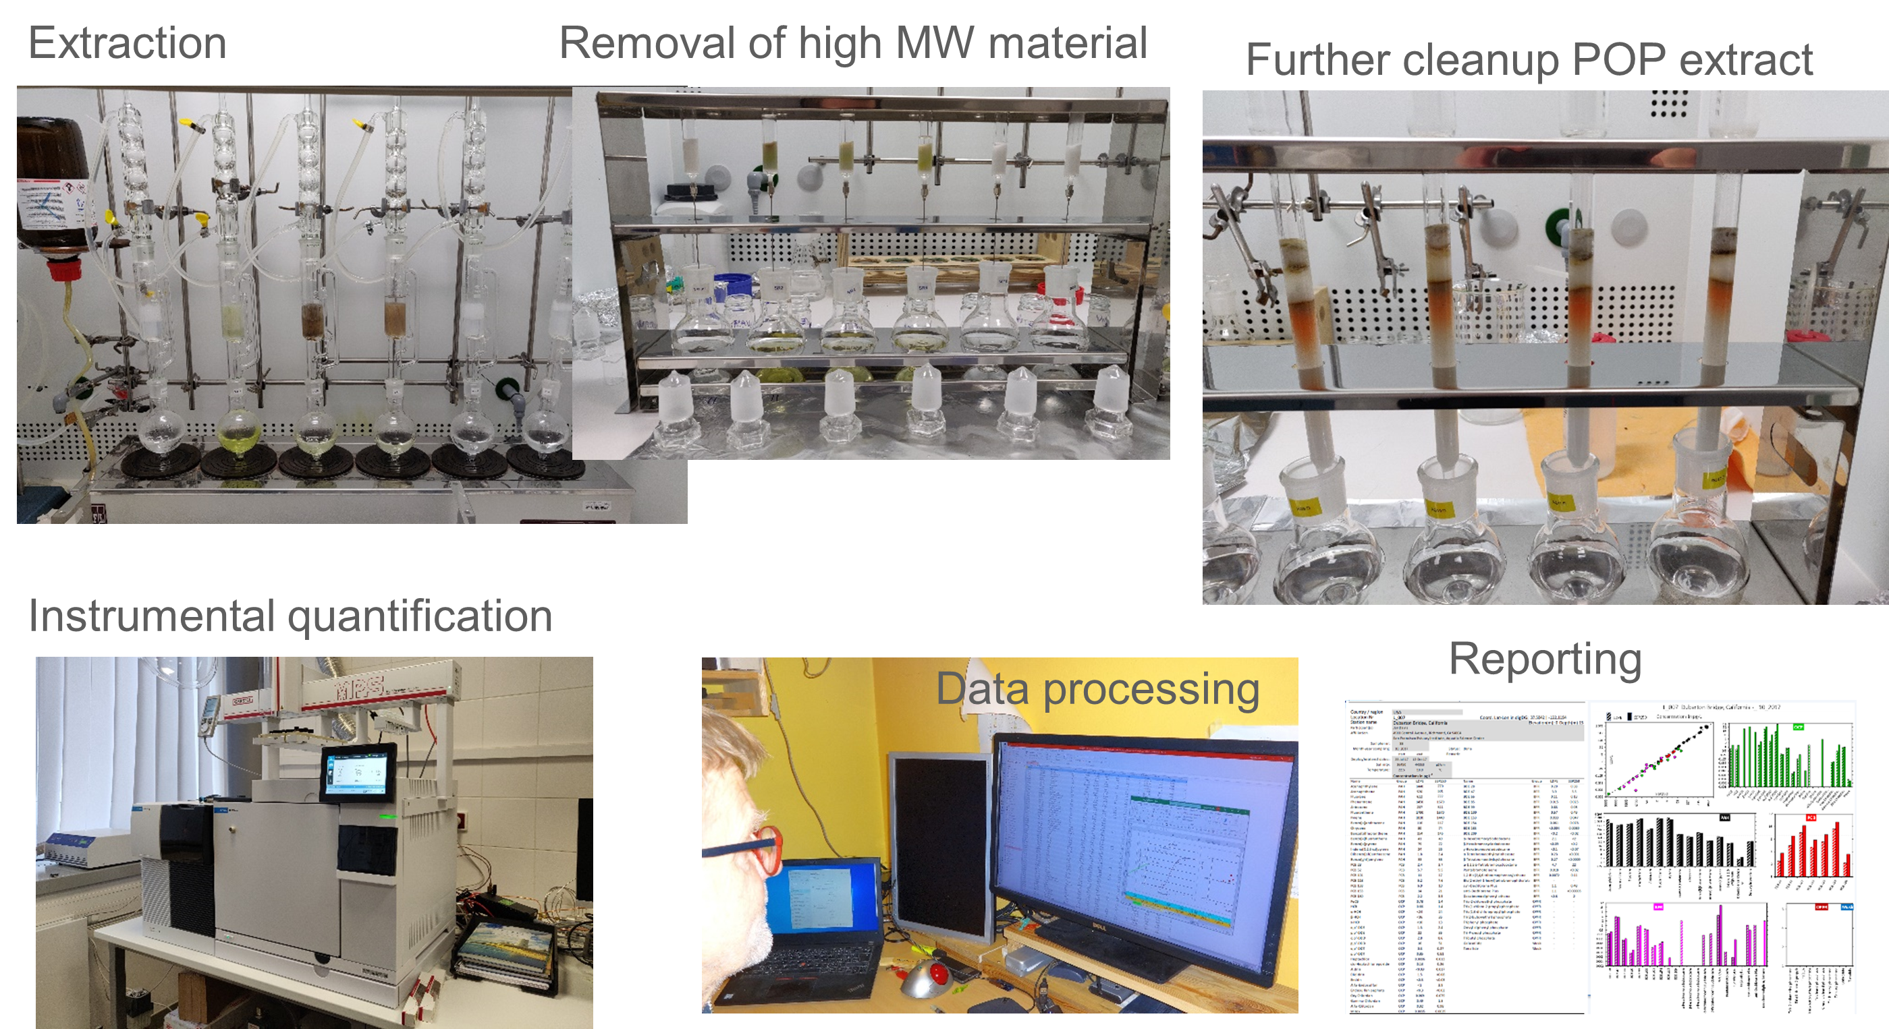
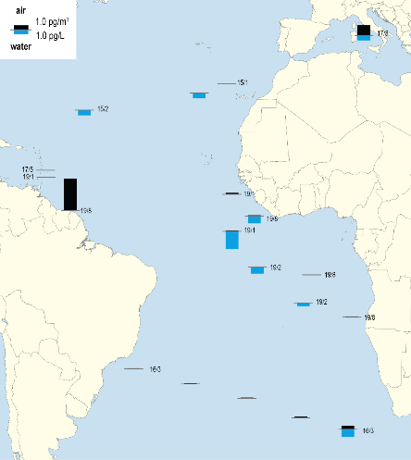

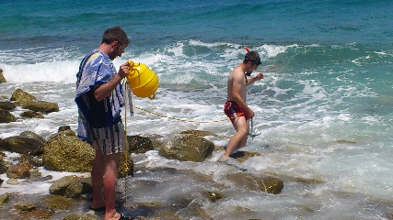
"Chemodynamika znečištění životního prostředí“
Chemodynamics of environmental pollution" research group
branislav.vrana@recetox.muni.cz; gerhard.lammel@recetox.muni.cz
Doc. Branislav Vrana: Aquatic Chemistry/Akvatická chemie
Prof. Gerhard Lammel: Air pollution / atmospheric cycling of pollutants
Courses/Výuka doc. Vrana
E5040 Environmental Compartments and their Pollution/ Složky životního prostředí a jejich znečištění
E5041 – Cvičení k E5040
E0330 Good Laboratory Practice/Správná laboratorní praxe
C3705 Správná laboratorní praxe v chemické laboratoři
Research topics/výzkumná témata
Bioaccumulation and biomagnification of POPs in aquatic food chains
Relationship between composition and effects of complex mixtures of aquatic pollutants
Global distribution of POPs and other organic pollutants in the hydrosphere
Accumulation in textiles and release by laundry as an emission pathway for aromatic amines
from indoor environments to waste- and surface waters
Effectiveness of wastewater treatment to remove organic contaminants
Human exposure: Permeation of polycyclic aromatic hydrocarbons through protective clothing
Human exposure: Silicone wristbands to assess dermal exposure to chemicals
26

Slide 2
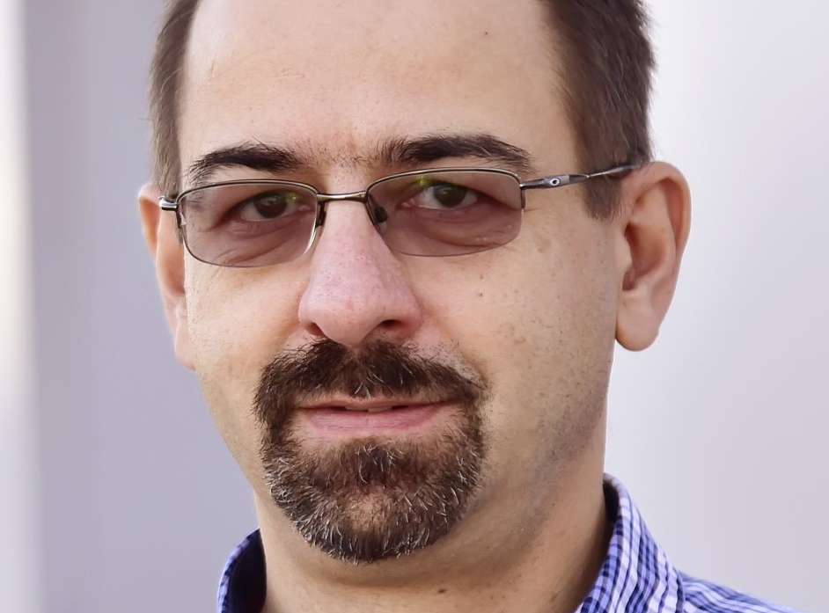

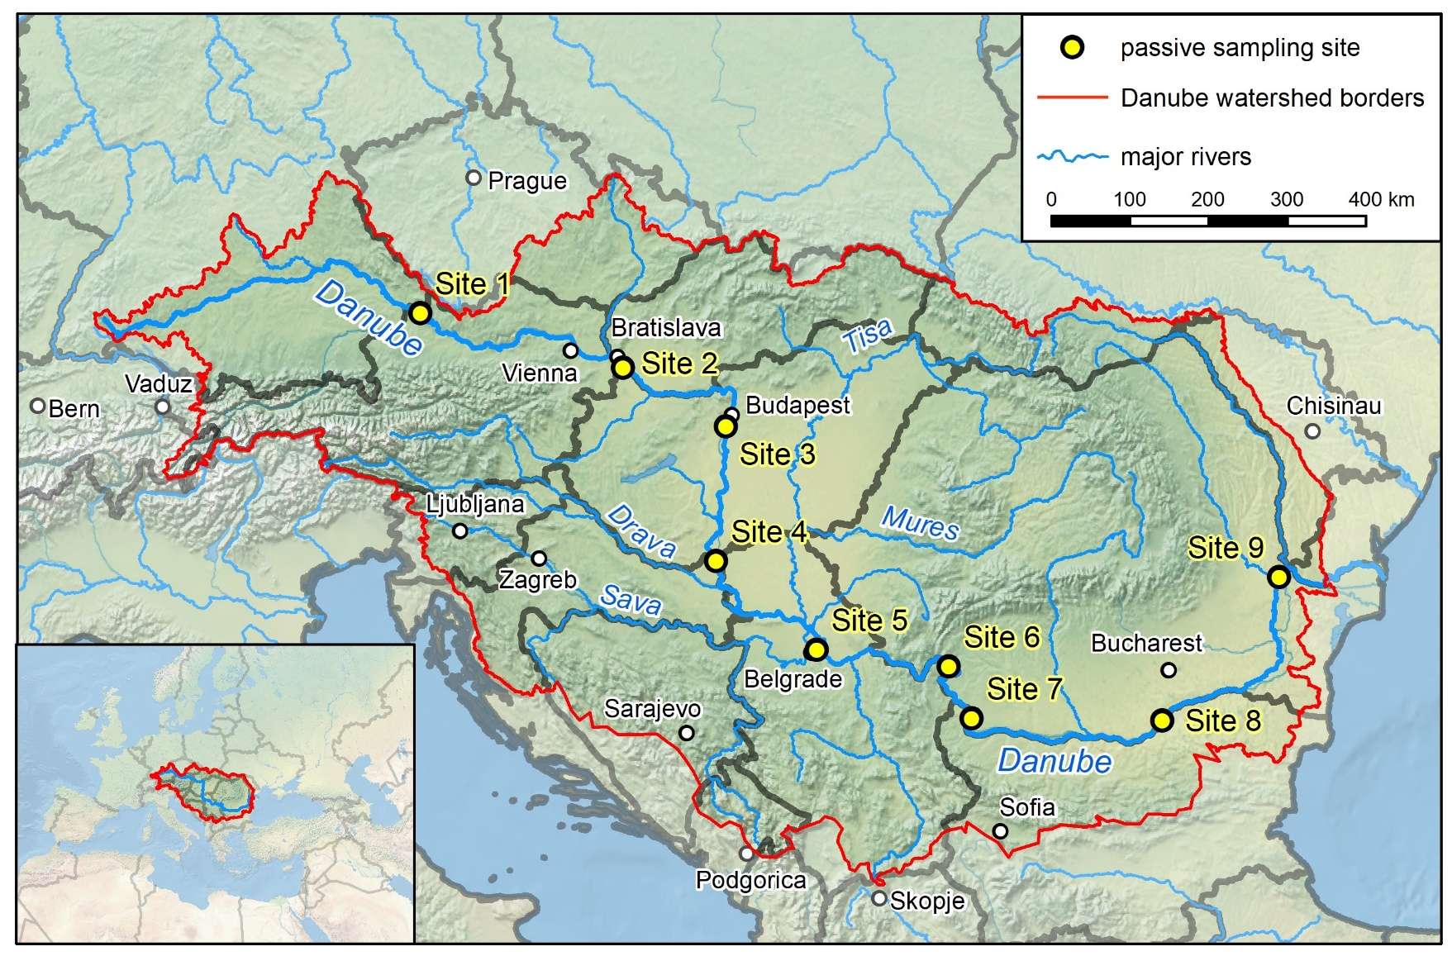
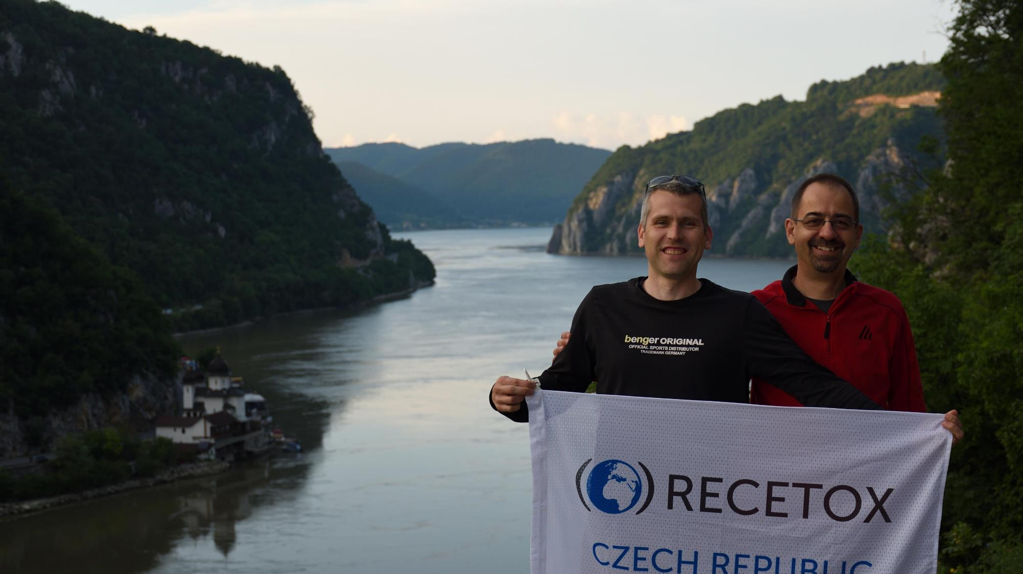
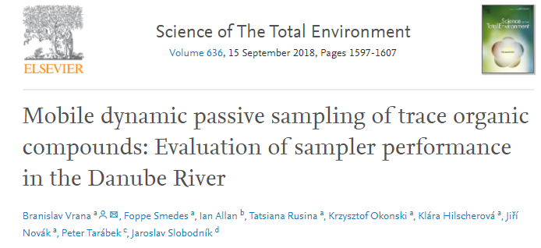
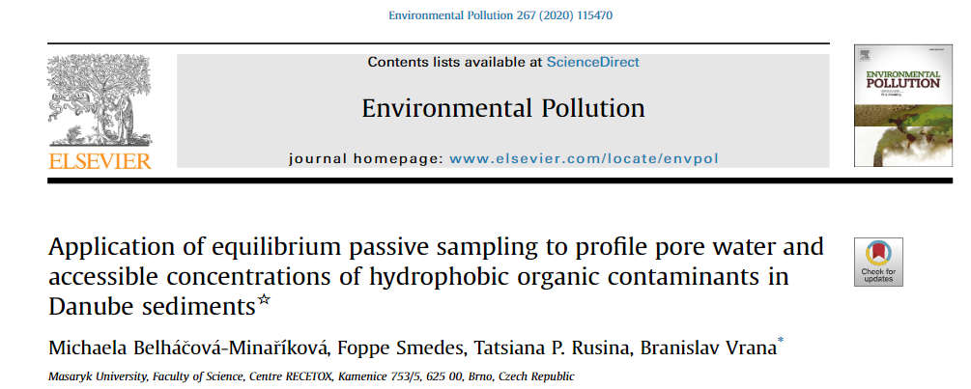
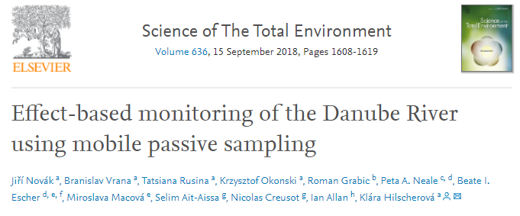
Chemodynamics of environmental pollution
Cooperations with: University of South Bohemia in České Budějovice – Roman Grabic,
RECETOX – Assoc. Prof. Hilscherová
NORMAN association, International Commission for the Protection of the Danube River (ICPDR), NIVA (Norway) and others
PI: Branislav Vrana
Aim: Analytical and bioanalytical assessments of organic micropollutants using a combination of passive sampling, bioassays and non-target screening
Methodology: field measurements, passive sampling in water and sediment, target and suspect screening chemical analysis, bioanalytical tools
Achievement: Setting up the baseline for representative monitoring of trace organic pollutants in large water bodies. Identification of toxicity drivers in complex mixtures.
Notes:
2

Slide 3
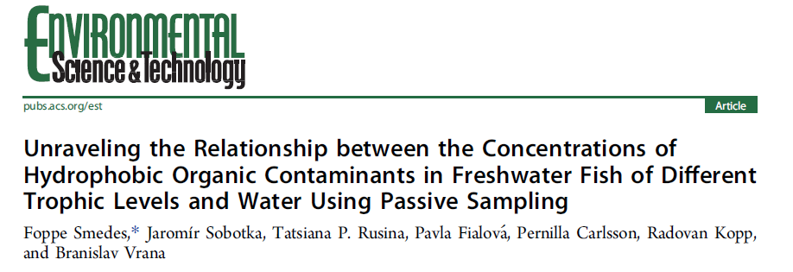
Chemodynamics of environmental pollution
Cooperations with: University of South Bohemia in České Budějovice, NORMAN association, International Commission for the Protection of the Danube River (ICPDR), NIVA (Norway) and others
PI: Branislav Vrana
Aim: Investigation of the relationship between concentrations of hydrophobic organic contaminants (HOCs) in freshwater fish at different trophic levels and in water using passive sampling
Methodology: field measurements, passive sampling in water and fish, chemical analysis
Achievement: The trophic magnification in freshwater food chains rarely amplifies levels of persistent HOCs in fish above those in the surrounding environment.
Notes:
3

Slide 4
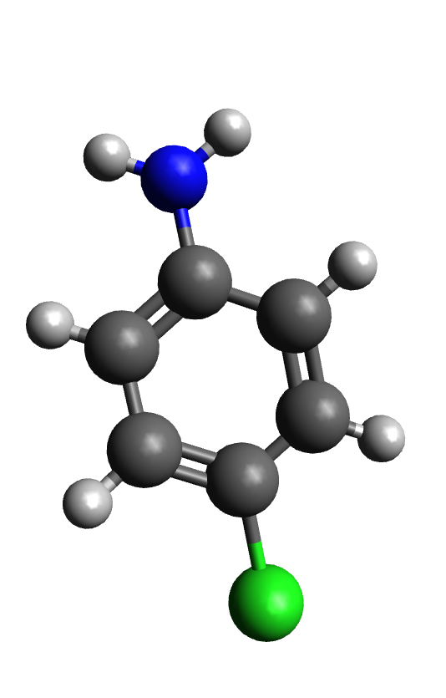
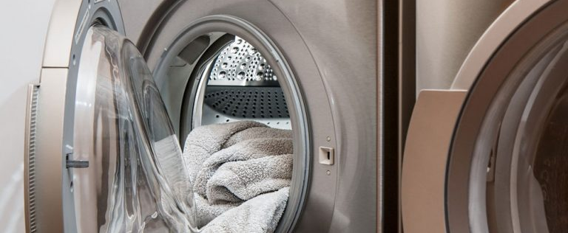
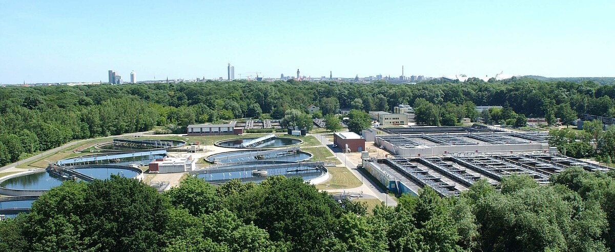
Investigating pathway of mutagenic amines to surface waters
Chemodynamics of environmental pollution
Cooperations with: UFZ Helmholtz Centre for Environmental Research Leipzig
PI: Branislav Vrana
Sorption to textiles
Distribution in laundry water
Reach sewer system
Reach surface waters

Slide 5
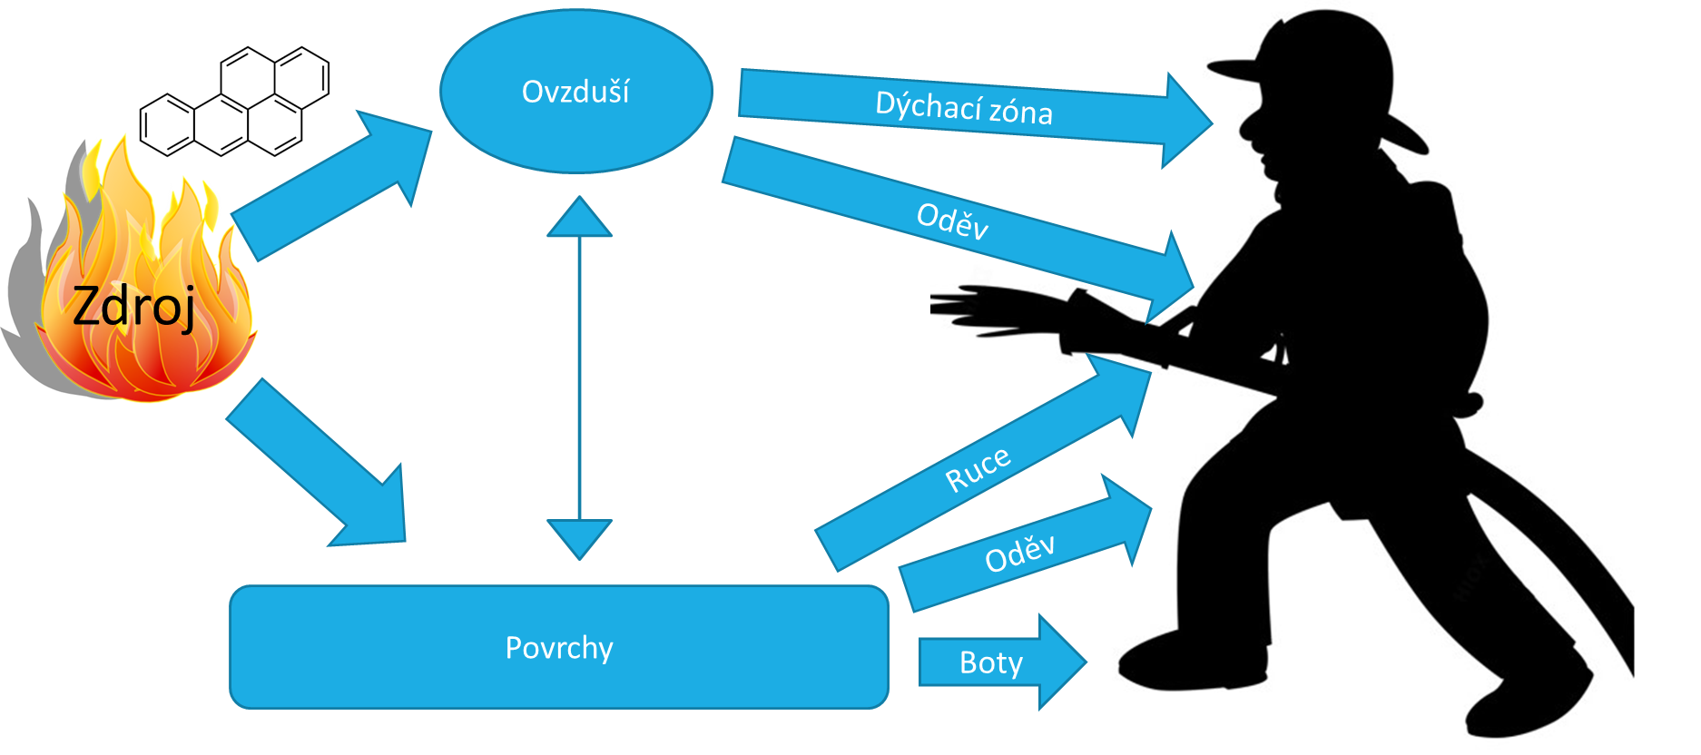
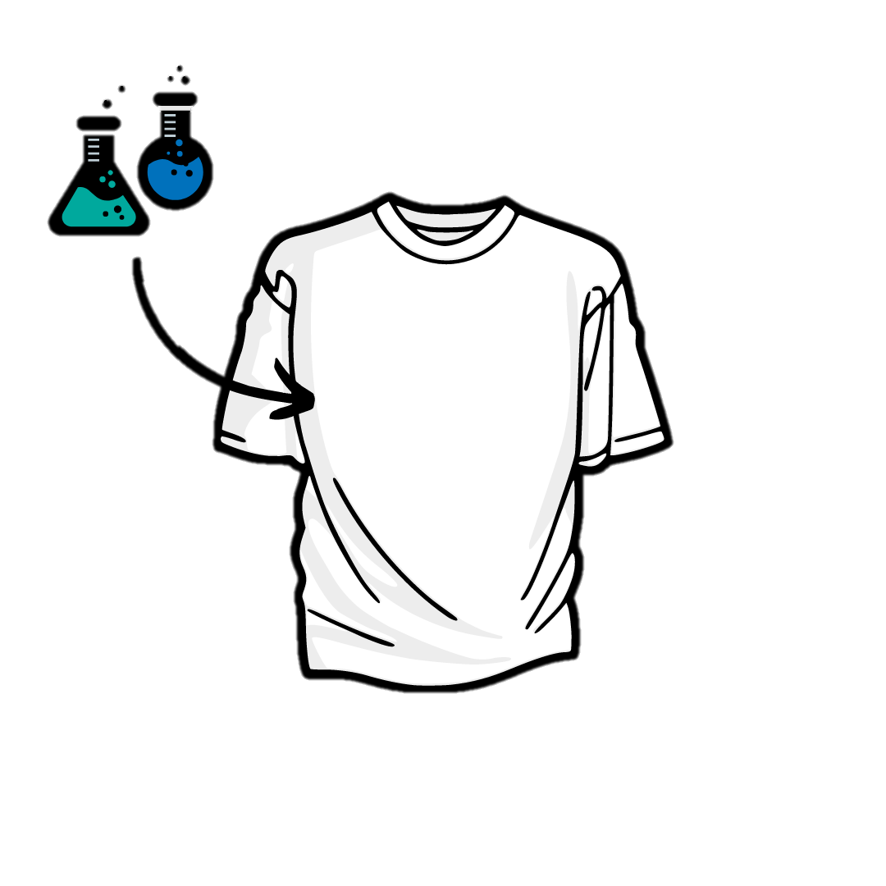
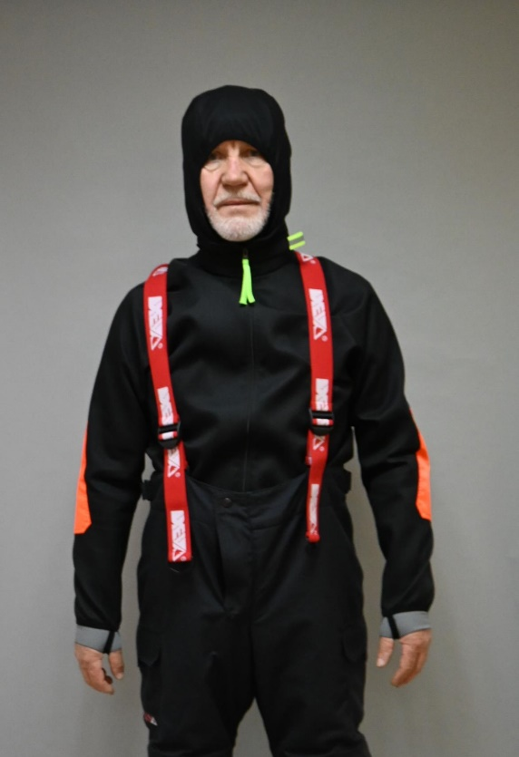
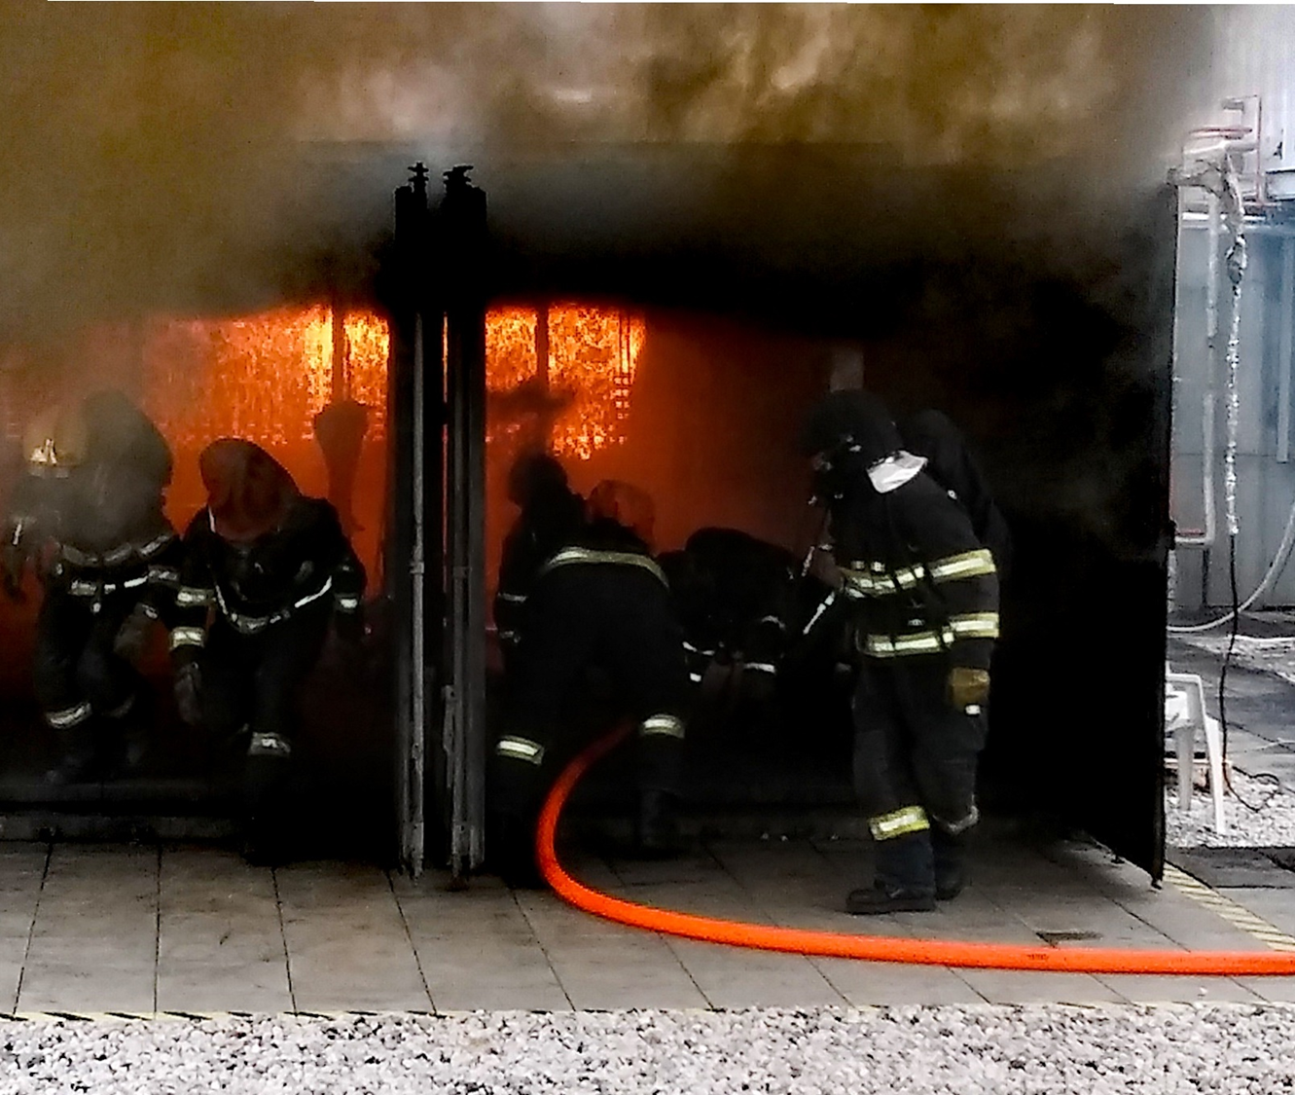
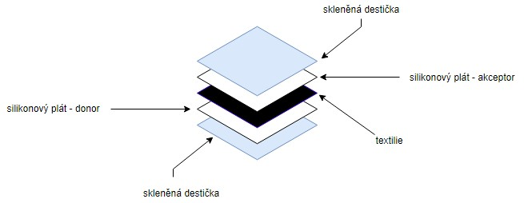
Testování přestupu polycyklických aromatických uhlovodíků textiliemi
Chemodynamics of environmental pollution
Cooperations with: Dekonta, a.s.
PI: Branislav Vrana
Textil může sorbovat chemické látky z prostředí
bariéra mezi vnějším prostředím a kůží
možnosti ochrany před rizikovými látkami při expozici při výkonu povolání příklad – hasiči (PAHs)
=> potenciální sekundární zdroj kontaminace

Slide 6
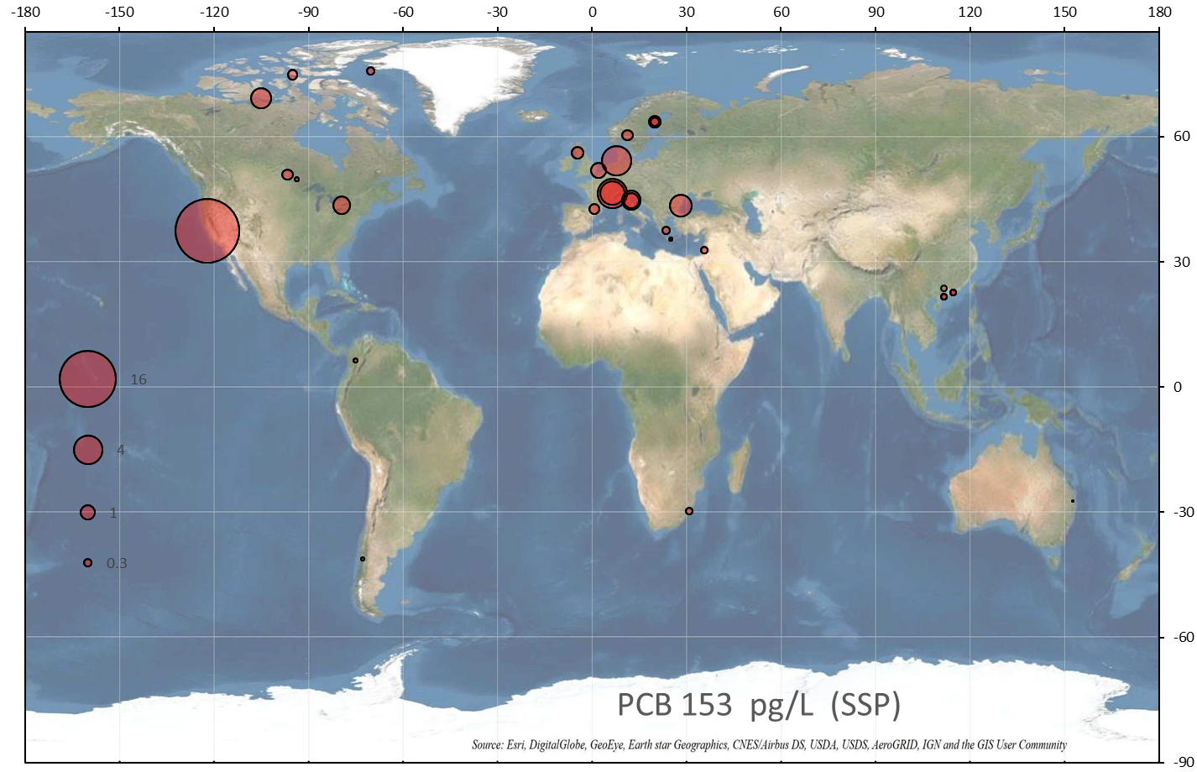
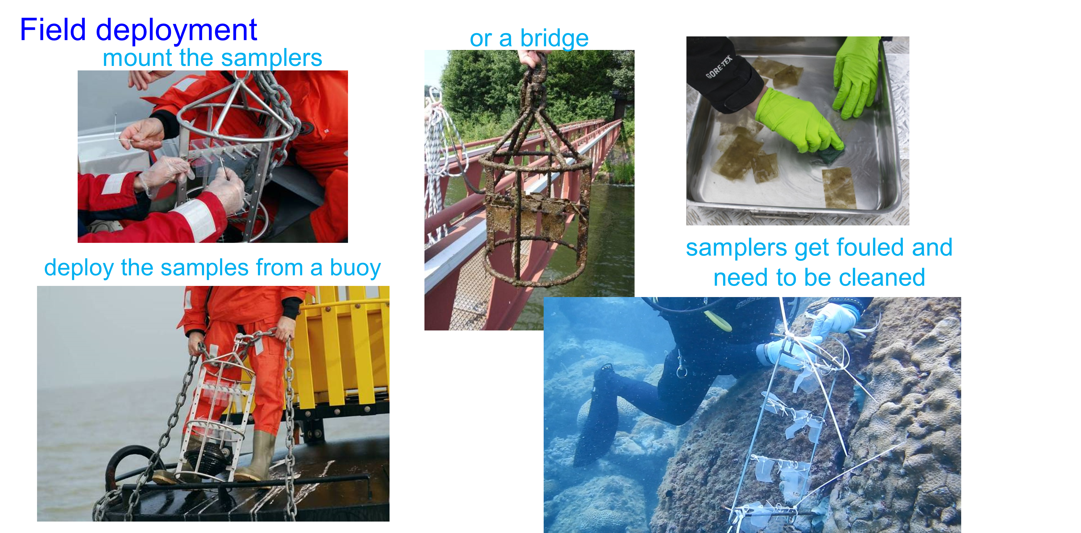
PCB 153
Chemodynamics of environmental pollution
Cooperations with: Univeristy of Rhode Island, Environment Canada, multiple international partners
Aim: Global distribution of POPs and other organic pollutants in the hydrosphere
Methodology: field measurements, passive sampling in water, chemical analysis
Achievement: Established global monitoring network AQUA-GAPS/MONET
PI: Branislav Vrana
Notes:
6

Slide 7
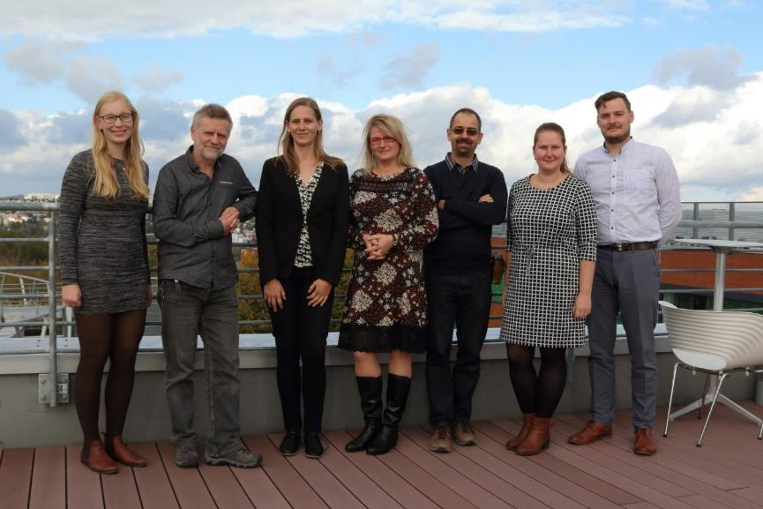
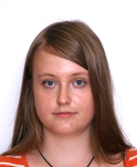
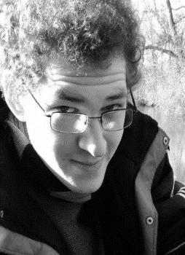
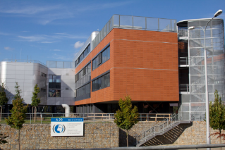
RECETOX
Science Faculty
Masaryk University
Brno, Czech Republic
Simona
Krupčíková
Jakub
Urík
Foppe
Smedes
Tanya
Rusina
Míša
Minaříková
Pavla
Fialová
Lenka
Sedlačková
Brano
Vrana
Jaromír
Sobotka

