Slide 1
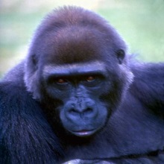
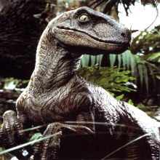
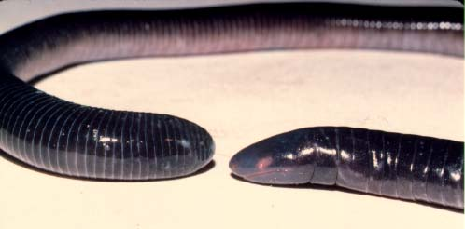
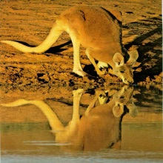
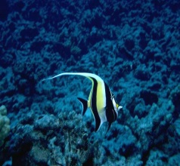
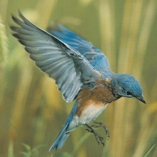
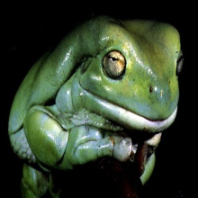
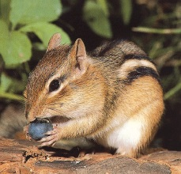
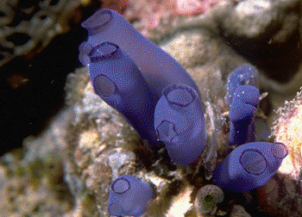
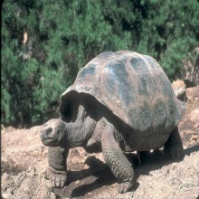
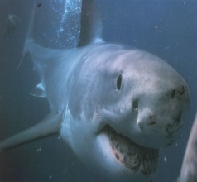
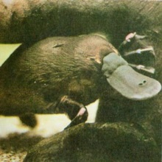
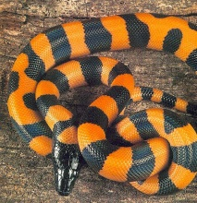
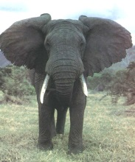
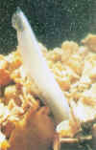
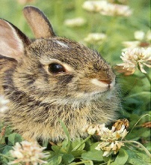
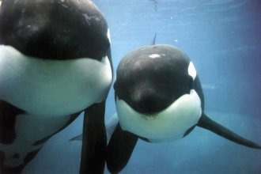
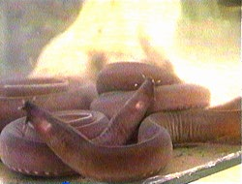
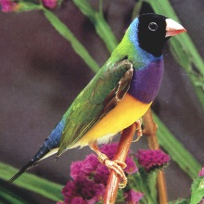
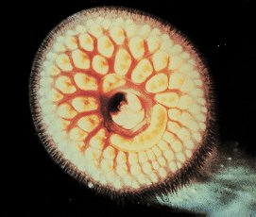
Subphylum Vertebrata
Subphylum Vertebrata has several divisions you need to be familiar with:
Superclass Agnatha – Jawless Fish; Ostracoderm (fossil)
Superclass Gnathostomata
Class Placodermi – First Jawed Fish (Fossils)
Class Chondricthyes – Cartilagenous Fish; Sharks; Rays
Class Osteichthyes
Subclass Actinopterygii – Ray-finned Fish; Goldfish; Sea Horse
Subclass Sarcopterygii – Lobe-finned Fish; Coelocanth

Slide 2
Vertebrata
Vertebrates originated about 525 million years ago during the Cambrian explosion, which saw the rise in organism diversity. The earliest known vertebrate is believed to be the Myllokunmingia.[1] Another early vertebrate is Haikouichthys ercaicunensis. Unlike the other fauna that dominated the Cambrian, these groups had the basic vertebrate body plan: a notochord, rudimentary vertebrae, and a well-defined head and tail.[17] All of these early vertebrates lacked jaws in the common sense and relied on filter feeding close to the seabed.[18] A vertebrate group of uncertain phylogeny, small-eel-like conodonts, are known from microfossils of their paired tooth segments from the late Cambrian to the end of the Triassic

Slide 3
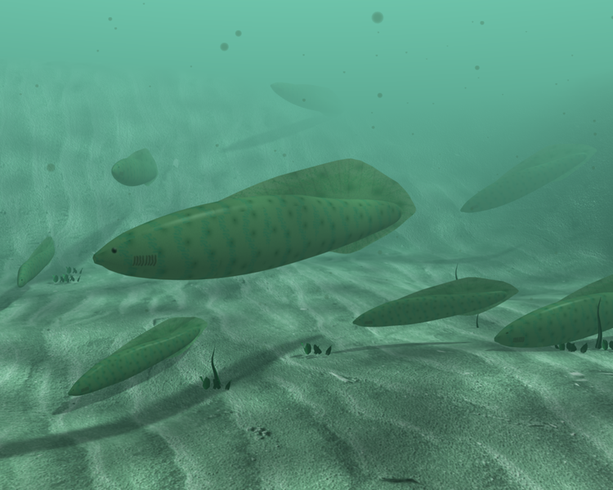
Haikouichthys ercaicunensis

Slide 4
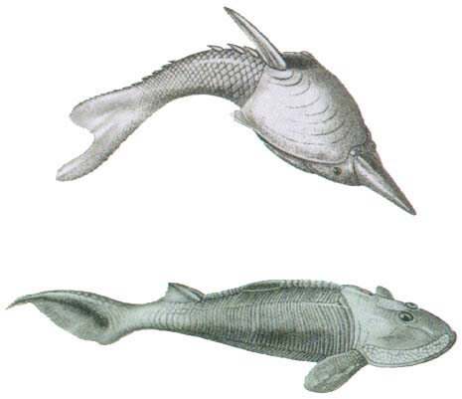
Devonian Jawless Fish
~20 cm

Slide 5
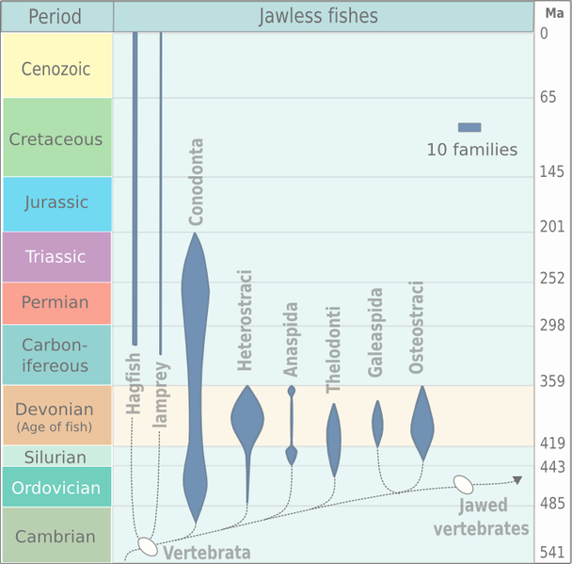
Agnatha

Slide 6
CONODONTS
conodonts are small tooth shaped structures
have been found in fossil record for many years
important biostratigraphically
made of phosphate (like most vertebrate bones)
Ordovician conodont over 1 foot long (1995)
probably a predator in Chordata

Slide 7
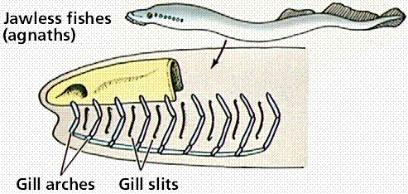
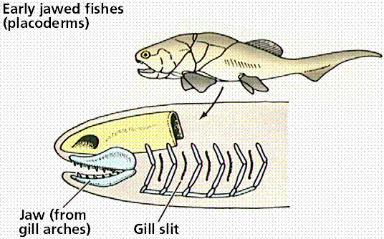
Vznik čelistí z žaberních
podpor

Slide 8
KINGDOM: ANIMALIA
PHYLUM: CHORDATA CRANIATA (vertebrates) CAMB. CLASSES: CONODONTA* CAMB. AGNATHA (jawless fish) CAMB.
Gnathostomata
ACANTHODI (spiny sharks)* SIL. PLACODERMI (armored fish)* SIL. CHONDRICHTHYES (cartilaginous sharks) DEV OSTEICHTHYES (bony fish) SIL.
Subclass Actinopterygii (paprskoploutví)
Subclass Sarcopterygii (nozdratí) AMPHIBIA (amphibians) DEV. REPTILIA (reptiles) CARB. AVES (birds) JURASSIC MAMMALIA (mammals) TRIASSIC

Slide 9
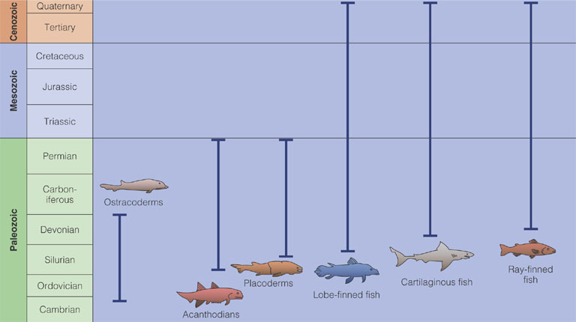
Geologic Ranges of Major Fish Groups

Slide 10
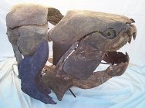
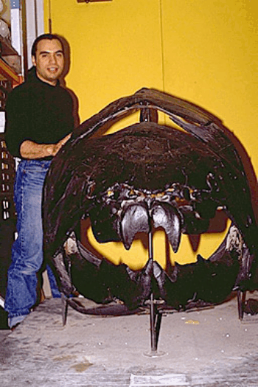
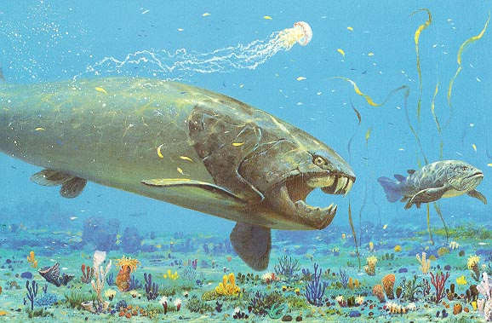
EARLY PALEOZOIC LIFE
Vertebrates
Fish
Placodermi (Placoderms)
Dunkleosteus

Slide 11
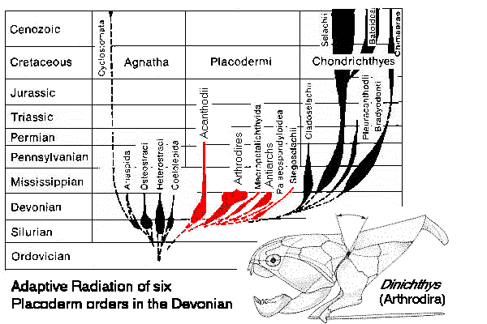
Placodermi

Slide 12
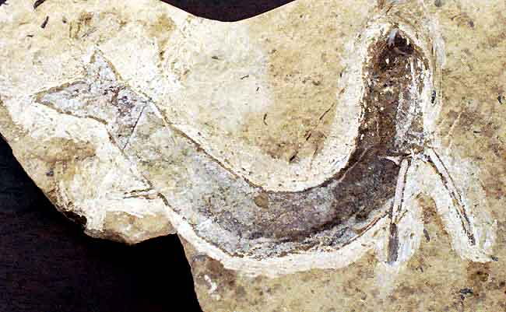
EARLY PALEOZOIC LIFE
Vertebrates
Fish
Acanthodii (Acanthodians)
Early jawed fish
Late Silurian to Permian

Slide 13
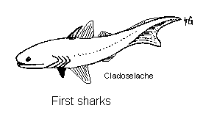
Chondrichtyes -Paryby
Elasmobranchii - žraloci
Ctenacanthus sp, a Late Devonian and Carboniferous shark
The very earliest signs of sharks are minute fossil scales and teeth which are found in rocks from the late Silurian to early Devonian period {around 400 million years ago). It becomes more and more difficult, however, to identify shark scales in older rocks because they closely resemble those from jawless fishes called the lodonts, which lived at the same time. Only microscopic differences separate shark and the lodont scales, and the two kinds seem to become more and more alike the further one goes back.

Slide 14
OSTEICHTHYES (bony fish) SIL.
Subclass Actinopterygii (paprskoploutví)
Subclass Sarcopterygii (nozdratí)

Slide 15
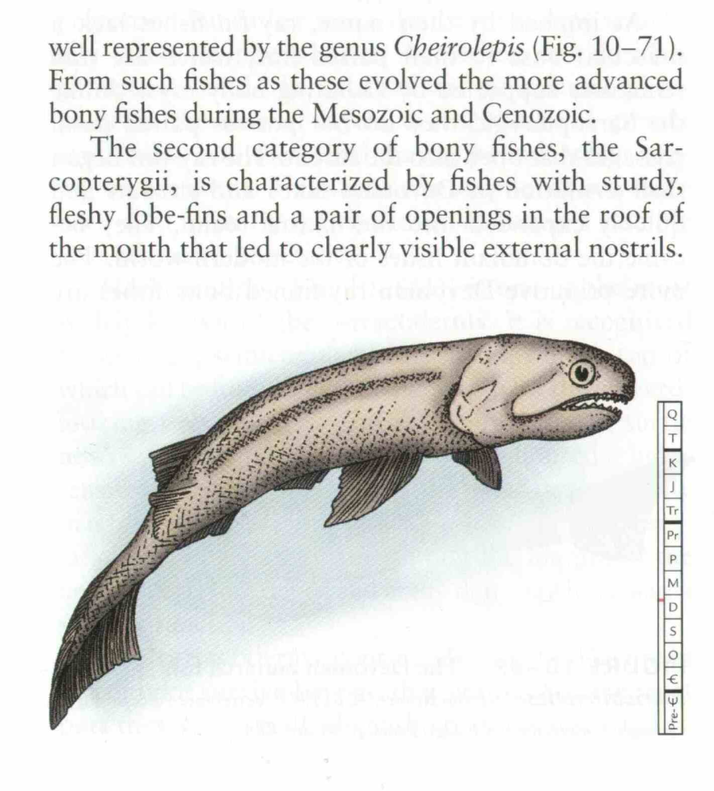
Actinopterygii
Chondrostei - chrupavčití

Slide 16
Sarcopterygii -nozdratí
Mezi charakteristické hlavní znaky těchto tzv. živých fosílií patří vyvinutí choanů (vnitřních nozder), které umožňují vdechování atmosférického vzduchu se zavřenou tlamou. A také rozvinuté plicní dýchání
podtřída lalokoploutví (Coelacanthimorphes)
podtřída dvojdyšní (Dipnoi)
Původ obojživelníků, a tedy všech čtyřnožců, je zahalen tajemstvím. K předkům obojživelníků mohly patřit lalokoploutvé ryby dýchajících vzduch, jejichž ploutve se postupně přeměnily na končetiny schopné podpírat tělo. Možná se však obojživelníci vyvinuli z ryb dvojdyšných (Dipnoi). Fosilní záznam je ale poměrně kusý a je obtížné rozhodnout, jestli je daný živočich ještě rybou nebo už obojživelníkem

Slide 17
Dipnoi

Slide 18
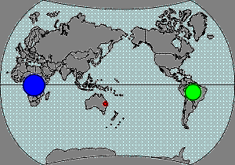
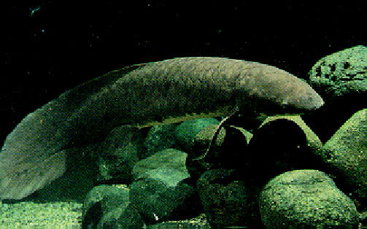
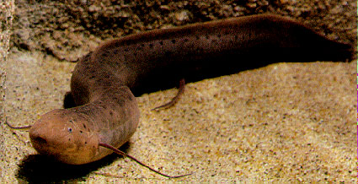
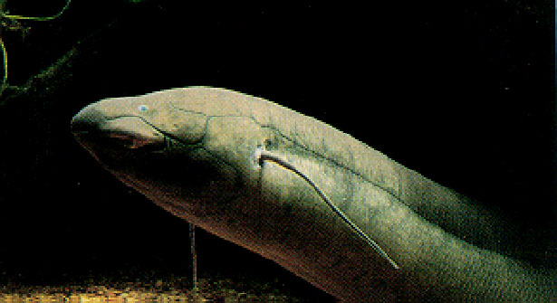
Neoceratudos forsteri
Protopterus ssp
Lepidosiren paradoxa

Slide 19
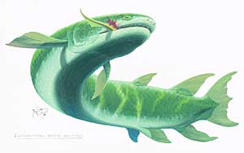
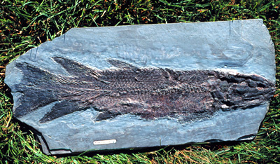
lalokoploutví (Coelacanthimorphes)
Eusthenopteron

Slide 20
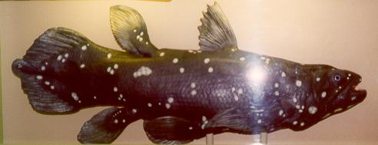
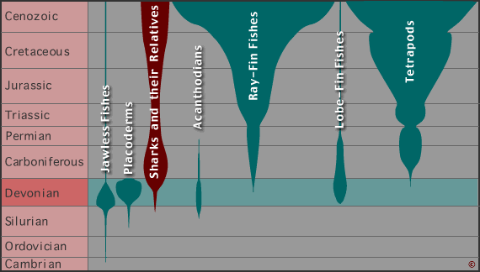
Latimeria chalumnae

Slide 21
Tiktaalik roseae lived approximately 375 million years ago. Paleontologists suggest that it is representative of the transition between non-tetrapod vertebrates (fish) and early tetrapods such as Acanthostega and Ichthyostega, known from fossils about 365 million years old. Its mixture of primitive fish and derived tetrapod characteristics led one of its discoverers.
Tiktaalik roseae, has a skull, a neck, ribs and parts of the limbs that are similar to four-legged animals known as tetrapods

Slide 22
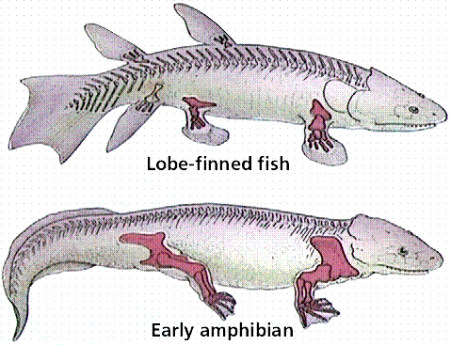

Slide 24
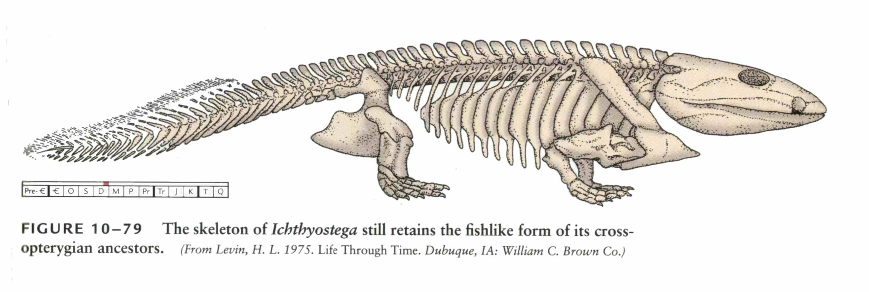
Amphibia

Slide 25
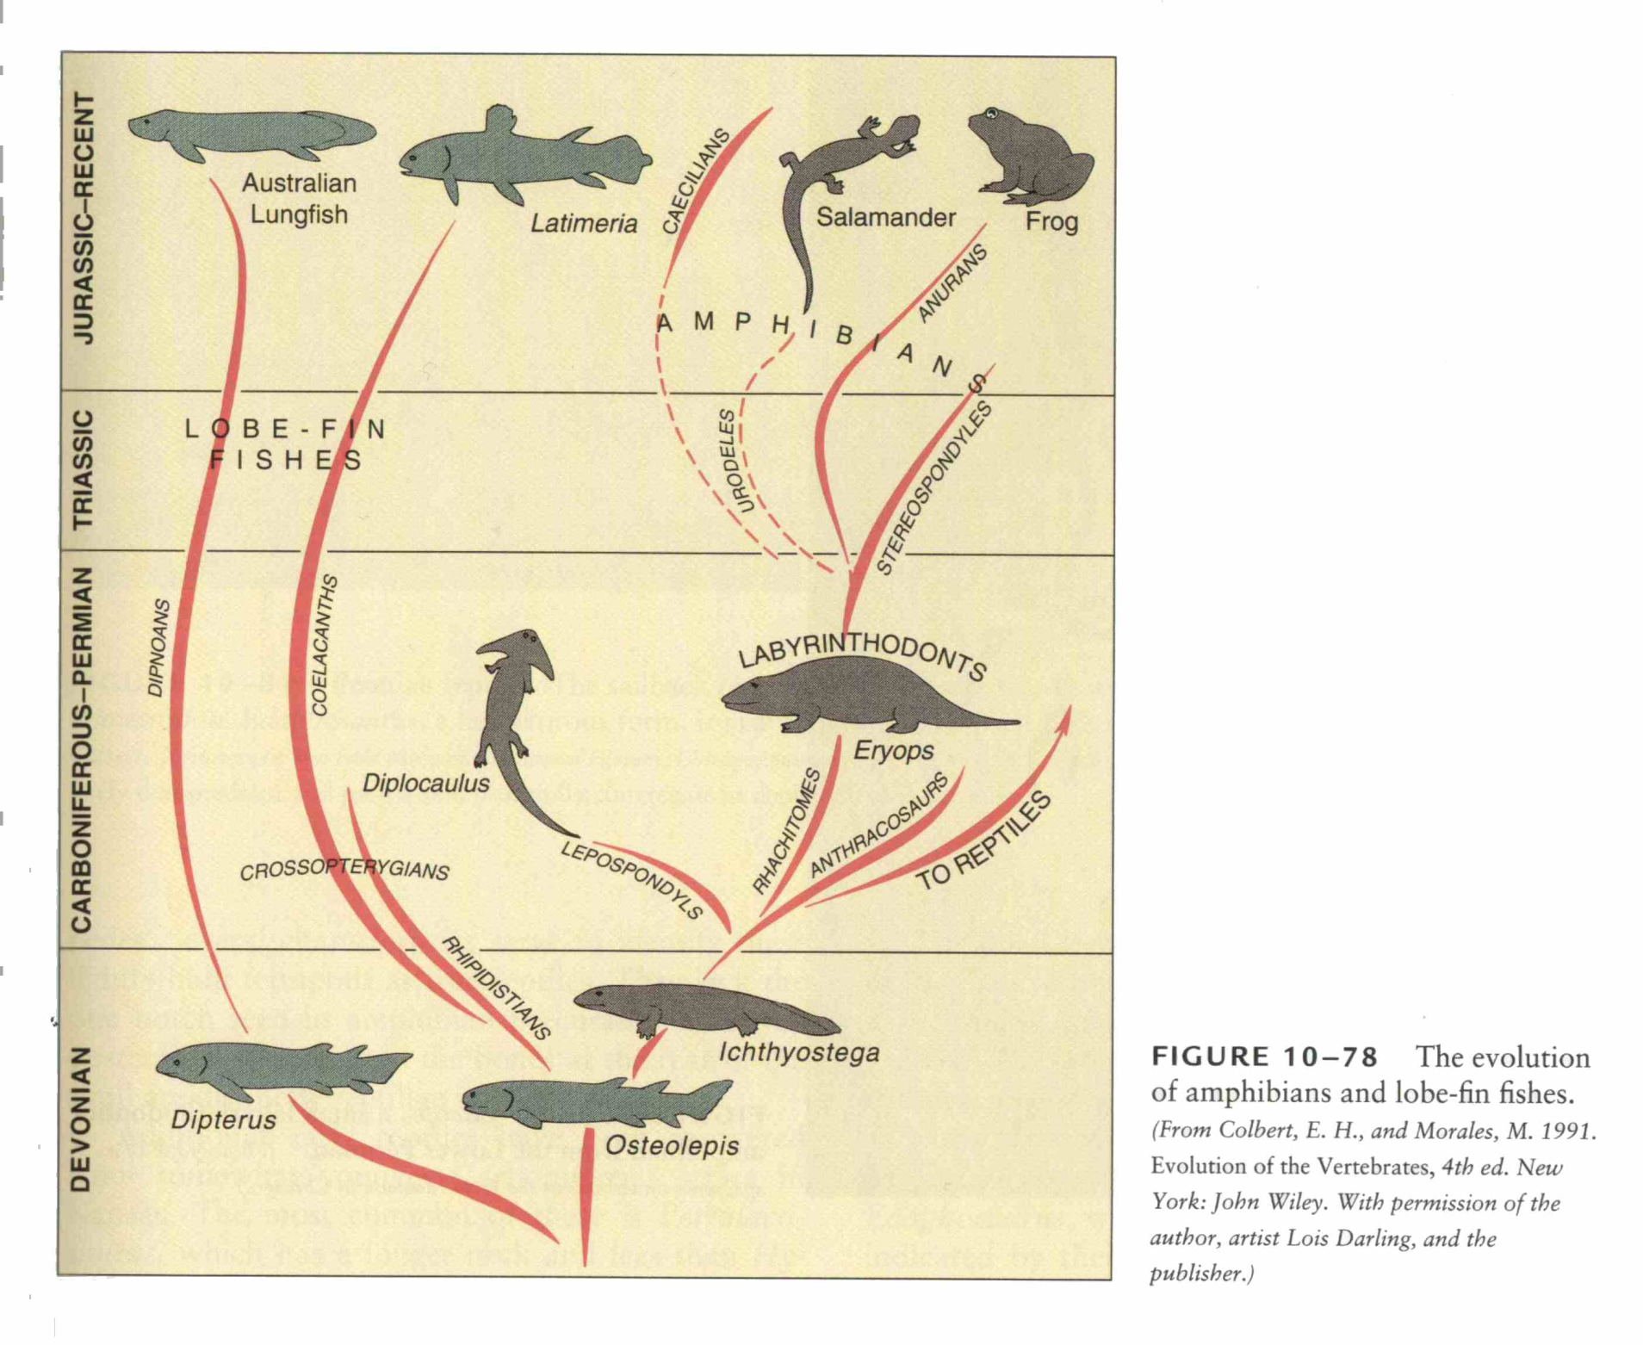

Slide 26
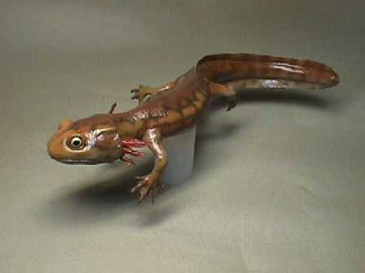
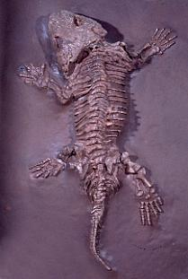
Amphibia – Labyrithodonts. Carboniferous – age of amphibians.
Discosauriscus

Slide 27
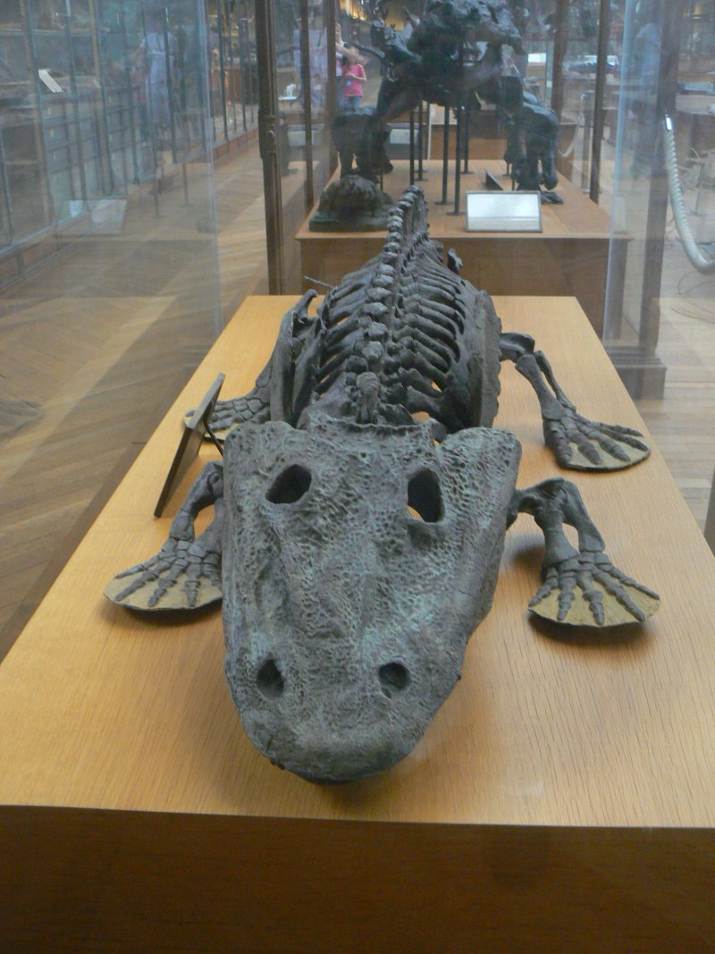
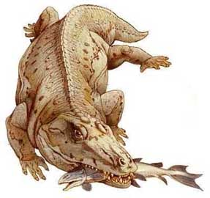
Eryops 2m-lower Permian

Slide 29
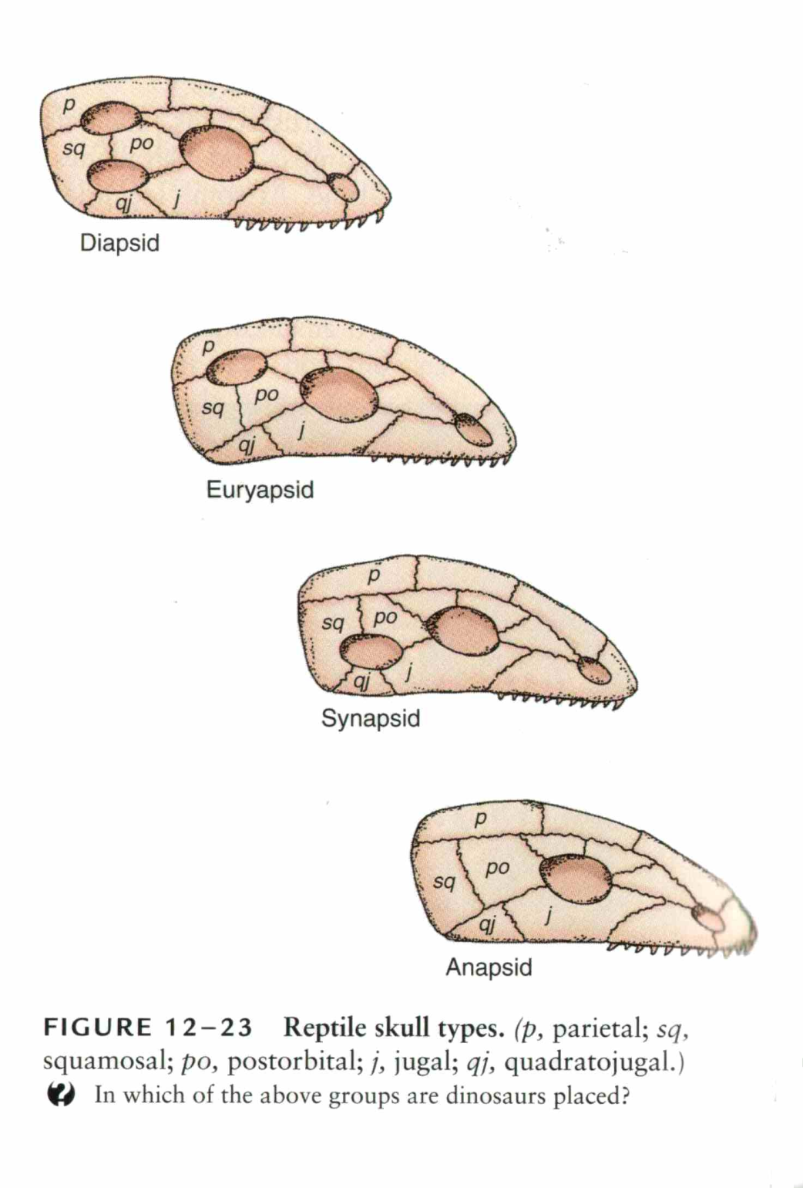

Slide 30
Reptiles
Cotylosauria (anapsids) - first reptiles in middle Carboniferous)
Pelycosauria mammal-like reptiles, synapsids, first in
Late Carboniferous, extinct in middle Permian
Therapsida – synapsids, predecessors of mammals, middle Triassic
First diapsids – late Carboniferous
Thecodonts, ancestors of dinosaurs – late Permian
Notosaurs (euryapsids),

Slide 31
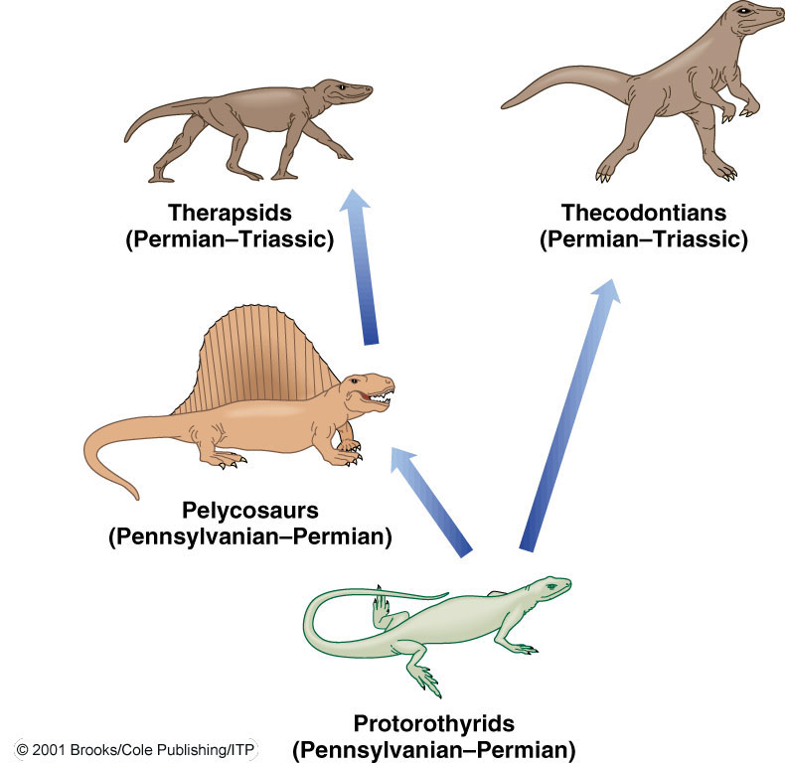
Paleozoic Reptile Evolution
Evolutionary relationship among the Paleozoic reptiles
Cotylosauria

Slide 32
One of the Oldest Known Reptiles
Reconstruction and skeleton of Hylonomus lyelli from the Pennsylvanian Period
Hylonomus lyelli was about 30 cm long
Cotylosauria

Slide 34
Pelycosauria

Slide 35
Therapsids
Der Sauroctonus wies bereits ein mächtiges, differenziertes Gebiss auf und wird eines der großen Raubtiere des Perms gewesen sein.(Werk des Künstlers Z. Burian)

Slide 36
The bear-sized gorgonopsid Inostrancevia alexandri assaulting the ox-sized armoured pareiasaur herbivore Scutosaurus karpinski

Slide 37
Moschops
Lystrosaurus

Slide 39
Aves

Slide 40
Euryapsida
Notosaurs -

Slide 42
Diapsida
insectivorous lizard-like diapsid reptiles,
Petrolacosaurus was a small, 40-centimetre (16 in) long, reptile, and the earliest diapsid known. It lived during the late Carboniferous period

