Slide 1
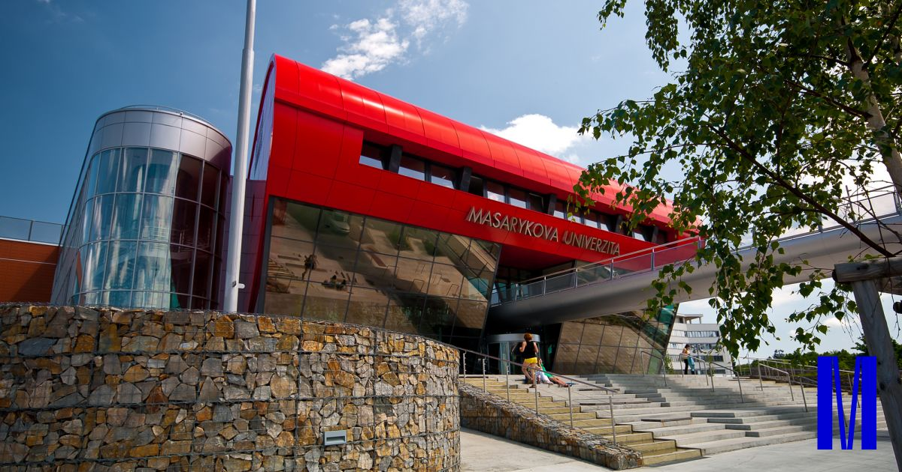

Slide 2
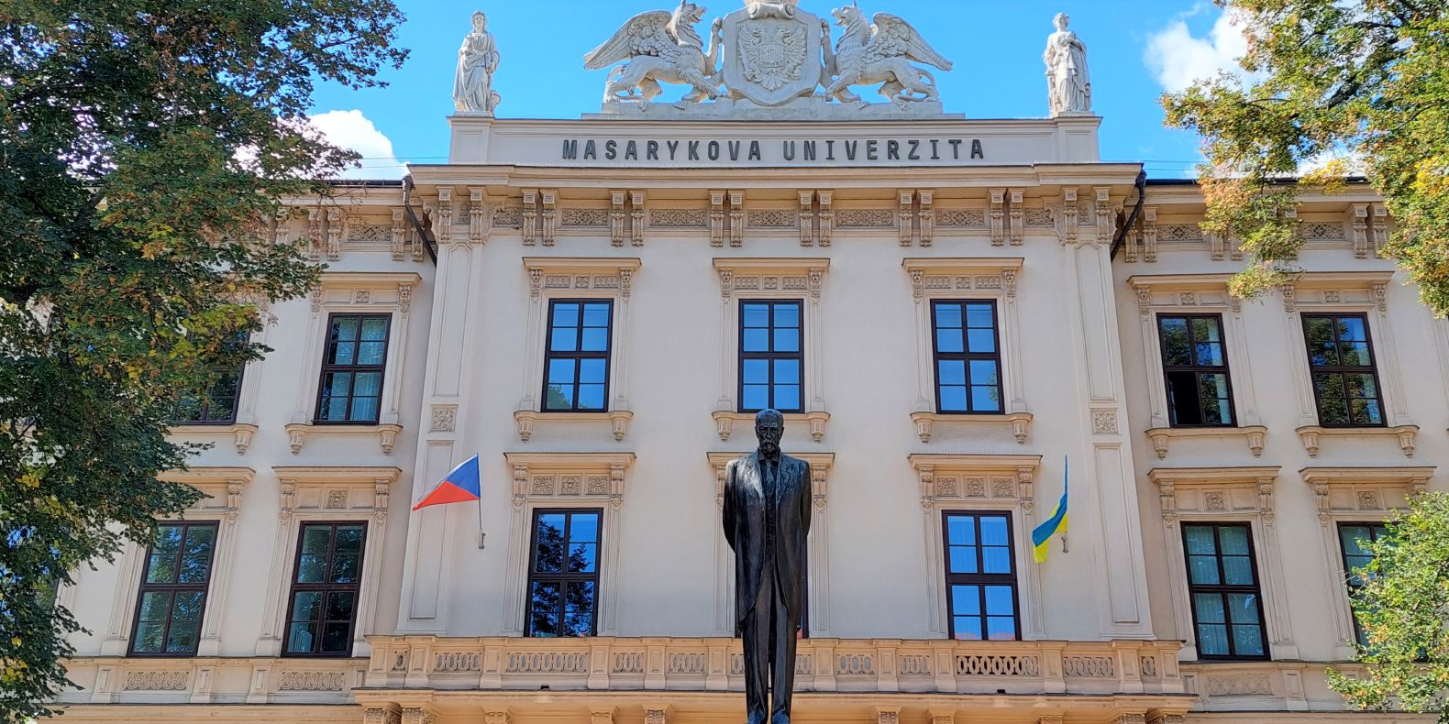
Introduction
Established in 1919 in Brno
One of the 100 top universities in the world
10 faculties:
Faculty of Law
Faculty of Arts
Faculty of Medicine
Faculty of Science
Faculty of Social Studies
Faculty of Economics and Administration
Faculty of Sports Studies
Faculty of Education
Faculty of Informatics
Faculty of Pharmacy

Slide 3
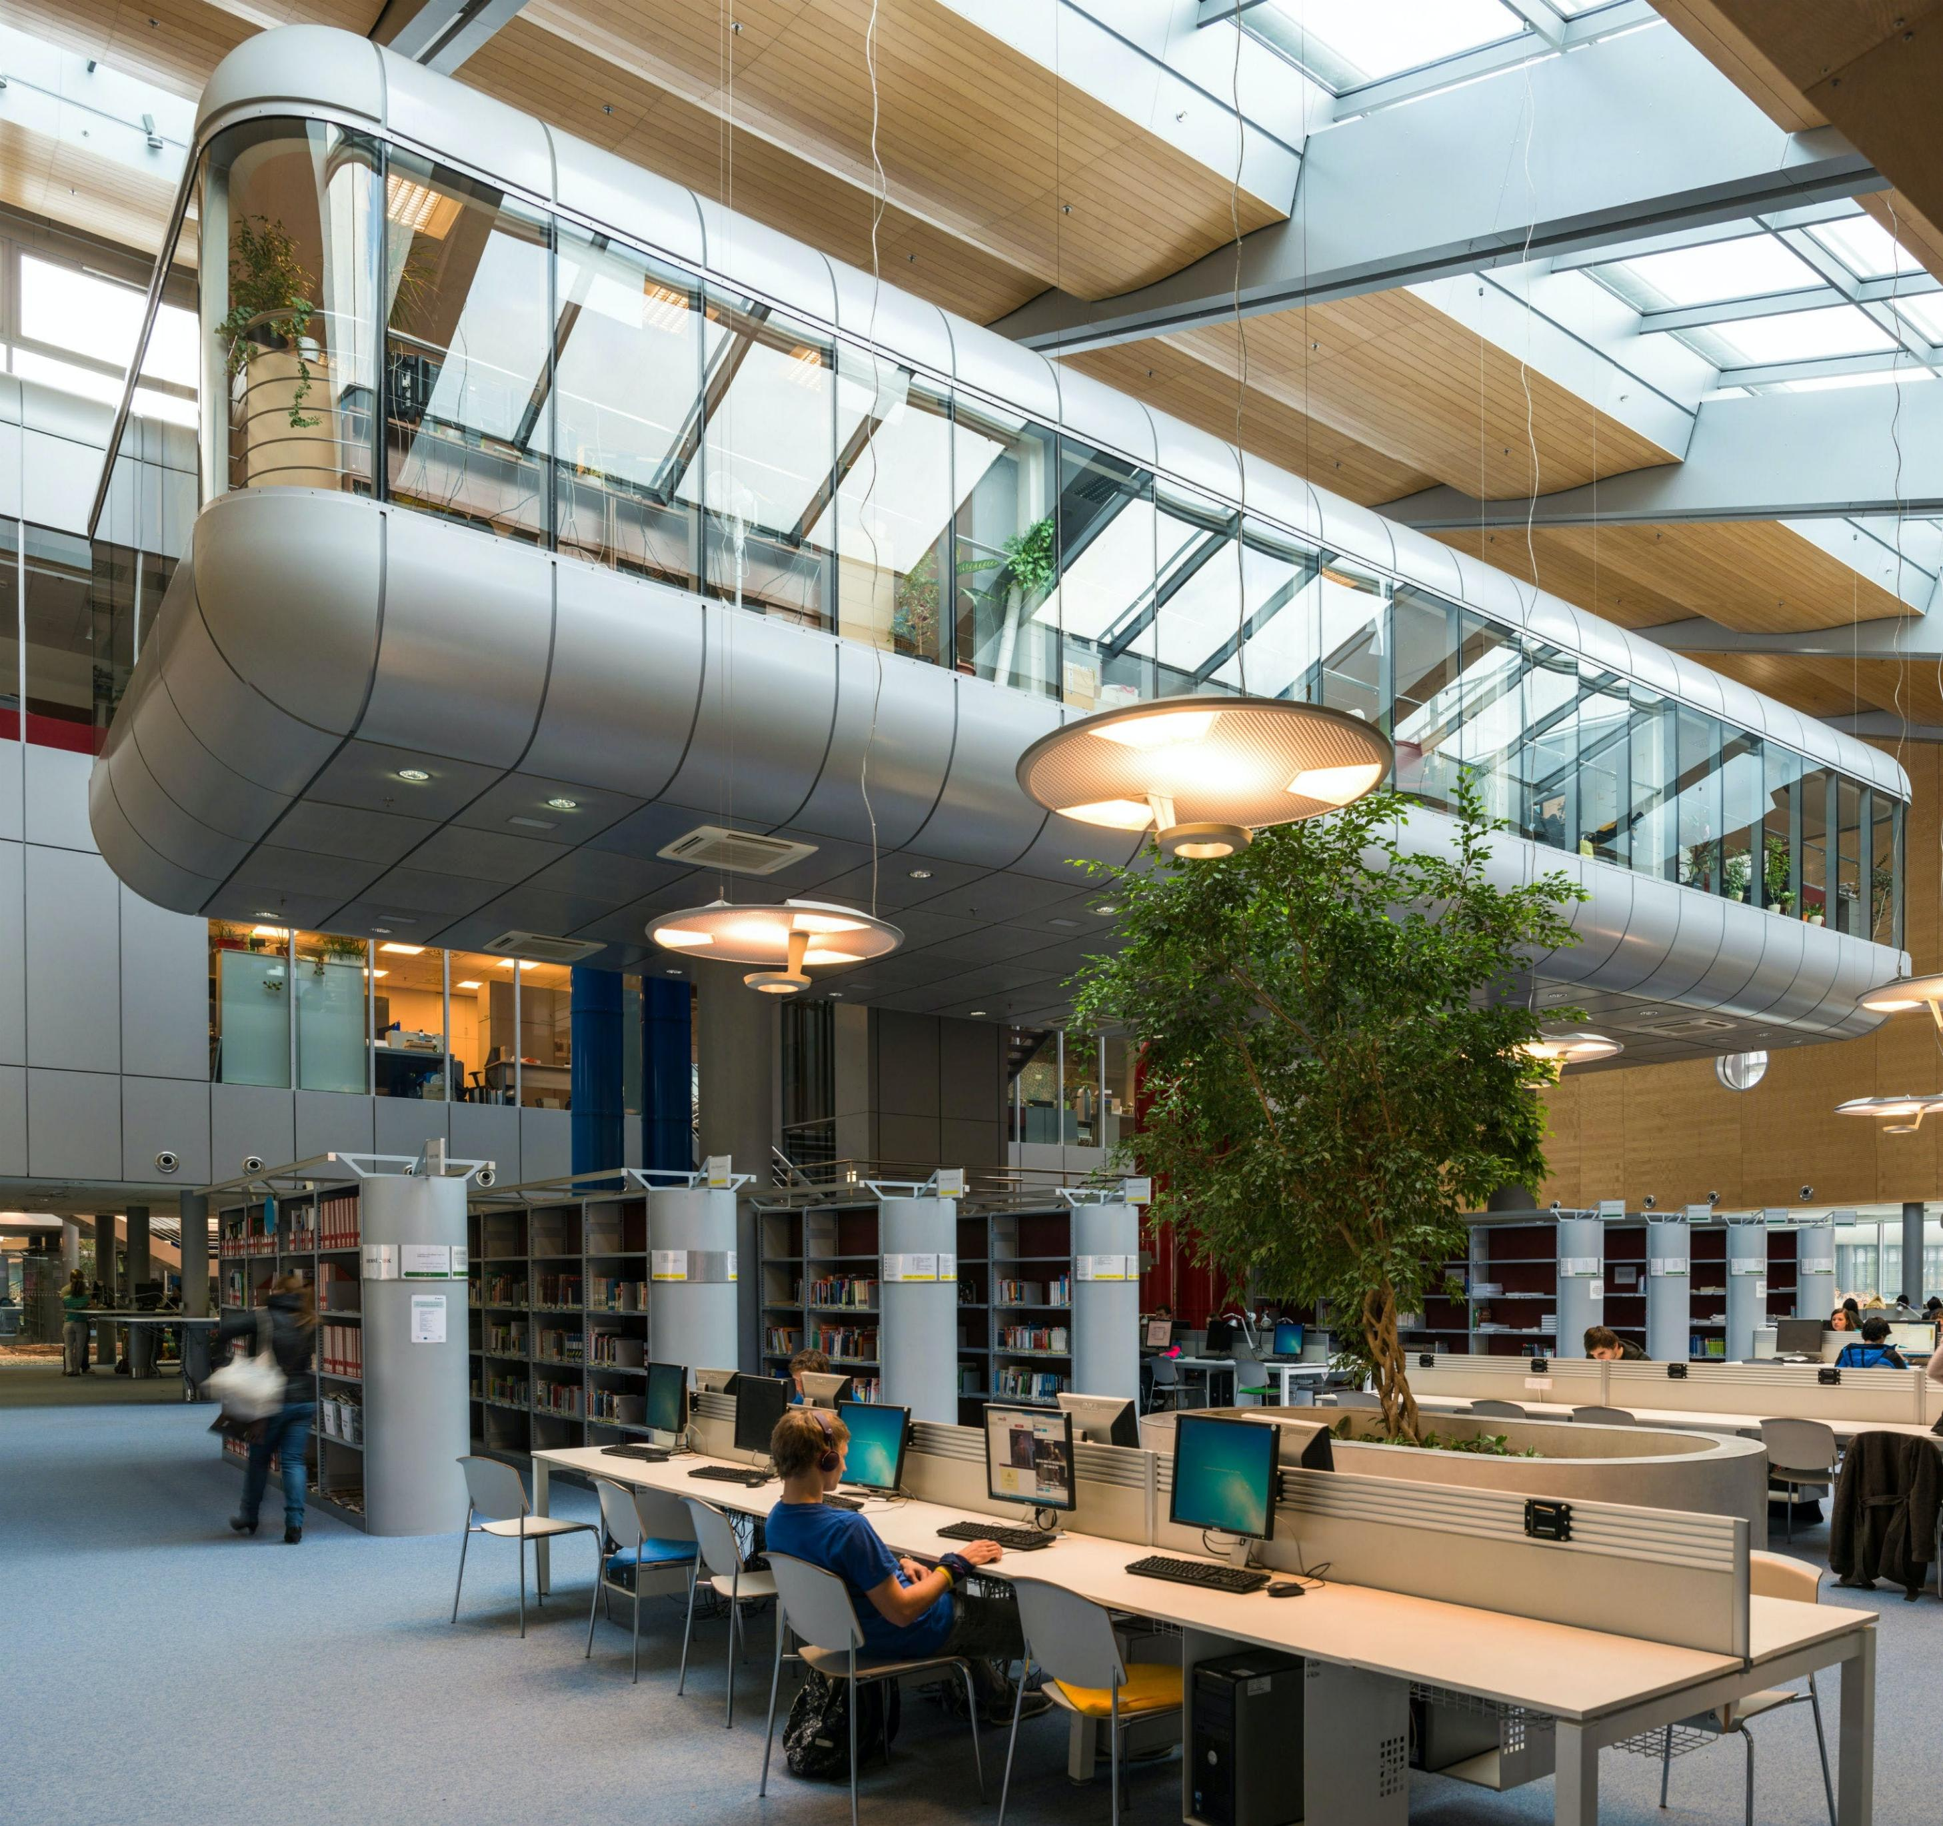
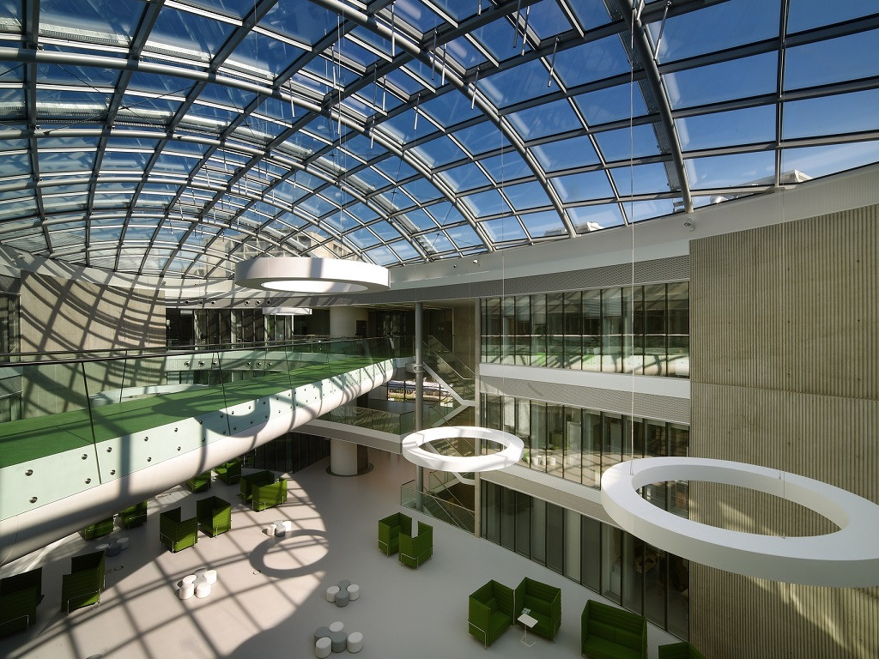
The best features of our university
Research (CEITEC, Loschmidt laboratories)
Modern approach to studying
Wide range of programmes and subjects
Open to international students – some subjects are taught in English
Easy administration - IS
Events, conferences
Encouragement in sports – obligatory PE, hockey tournaments…

Slide 4
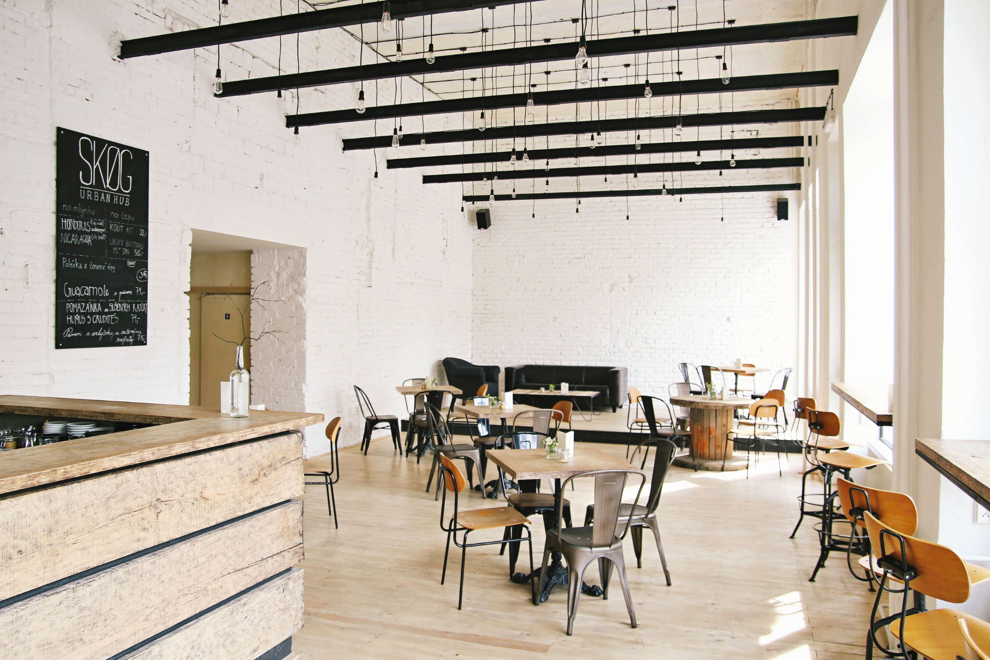
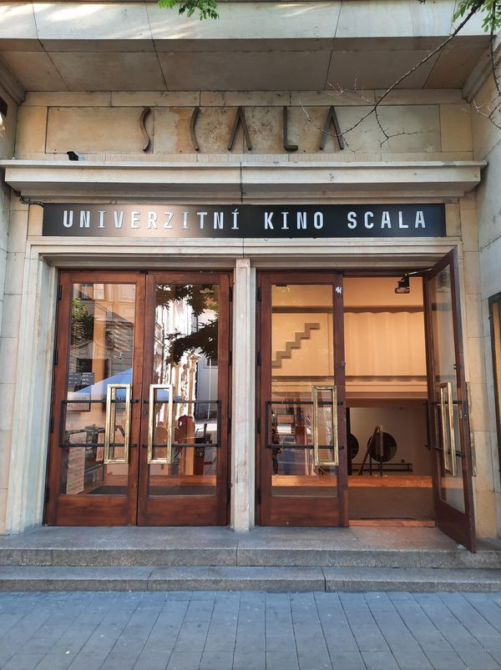
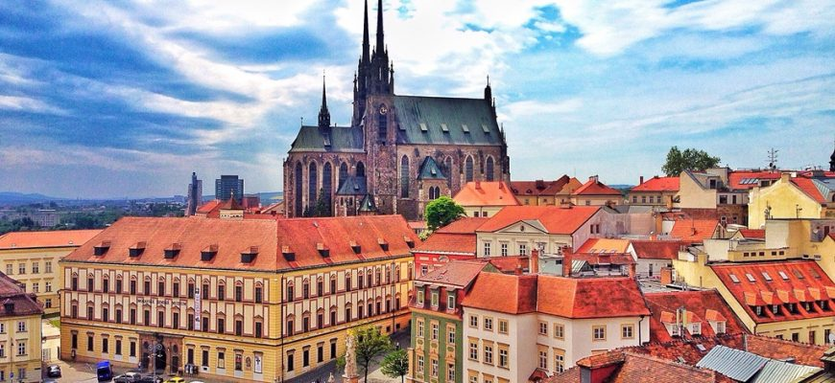
Brno
Great access – public transport
Reasonable prices
Great culture and number of events
Theatres, museums, cinemas (university cinema Scala)
Lots of pubs, cafés and restaurants
www.gotobrno.cz

