Slide 1
English for Mathematicians I
Week 11 – Functions

Slide 2
Unit 10
Functions – definition, vocab
Periodic functions
  Listening
  Reading
  Useful phrases
  Practice
Revision and Language Focus
  however, whatever
HW check – gap-fill, spoken X written language

Slide 3
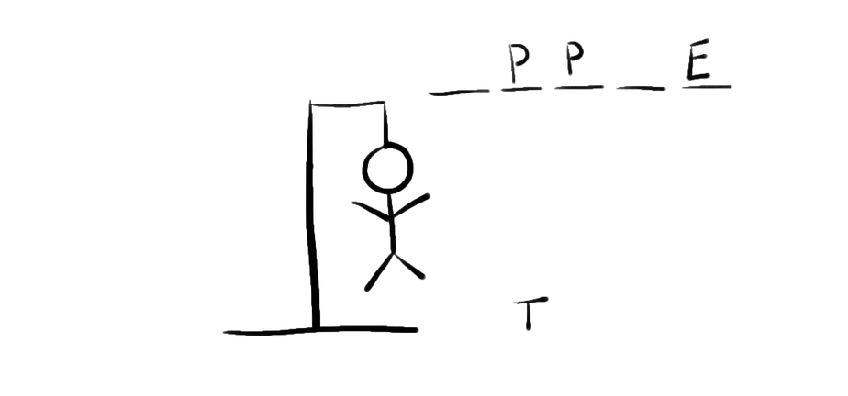
What is a function?
A rule that assigns to every _ _ _ _ _ _ _ x of a set X a unique element y of a set Y, written y=f(x) where f _ _ _ _ _ _ _ the function. X is _ _ _ _ _ _ the domain and Y the _ _ _ _ _ (or codomain).

Slide 4
What is a function?
A rule that assigns to every element x of a set X a unique element y of a set Y, written y=f(x) where f denotes the function. X is called the domain and Y the range (or codomain).

Slide 5
Articles - ex. 2 – fill in the gaps individually
In mathematics, a function is (1)___ relation between a set of inputs and a set of permissible outputs with (2)___ property that each input is related to exactly one output. (3)___ example is the function that relates each real number x to its square x². (4)___ output of a function f corresponding to an input x is denoted by f(x) (read "f of x"). In this example, if the input is −3, then (5)___ output is 9, and we may write f(−3) = 9. The input variable(s) are sometimes referred to as the argument(s) of the function and (6)___ output is called the value. There are many ways to describe or represent a function. Some functions may be defined by (7)___ formula or algorithm that tells how to compute the output for (8)___ given input. Others are given by (9)___ picture, called the graph of the function. In (10)___ science, functions are sometimes defined by a table that gives the outputs for selected inputs.

Slide 6

Articles
ex. 2 – fill in the gaps individually
go to kahoot.it

Slide 7
In mathematics, a function is (1)_a_ relation between a set of inputs and a set of permissible outputs with (2)_the_ property that each input is related to exactly one output. (3)_An_ example is the function that relates each real number x to its square x². (4)_The_ output of a function f corresponding to an input x is denoted by f(x) (read "f of x"). In this example, if the input is −3, then (5)_the_ output is 9, and we may write f(−3) = 9. The input variable(s) are sometimes referred to as the argument(s) of the function and (6)_the_ output is called the value. There are many ways to describe or represent a function. Some functions may be defined by (7)_a_ formula or algorithm that tells how to compute the output for (8)_a_ given input. Others are given by (9)_a_ picture, called the graph of the function. In (10) _-_ science, functions are sometimes defined by a table that gives the outputs for selected inputs.

Slide 8

Periodic function - listening
a function whose graph repeats itself identically
(from left to right)
What is a Periodic Function?
What is the Period of a function?
Which periodic functions does the speaker mention and what is their period?
What is the Frequency of a function?
What is the Phase Shift of a function?
What is the Amplitude of a function?
What is the Vertical Shift of a function?
f(x) = f(x + p) for all x)
the horizontal distance required for a complete cycle
sine, cosine – period 2π (360°), tangent - period π
the reciprocal of the period; Frequency = $\frac{1}{Period}$
the horizontal shift of a periodic function
the “radius” of a periodic function
the half of distance between the maximum and minimum values / of the range of a periodic function
the shift of a periodic function along y-axis

Slide 9
4. Look, read and underline key verbs and nouns
Figure 6.1 is a graph of the function y=sin x. As x goes from 0° to 90°, sin x increases from 0 to 1. As x goes from 90°to 270°, sin X decreases from 1 to =1, crossing the x-axis at 180°. As x goes from 270°to 360°, sin x increases from -1 to 0. When x reaches 360° the graph repeats itself. The sine function is a periodic function, with a period of 360°, i.e. the graph repeats itself every 360°.

Slide 10
4. Look, read and underline key verbs and nouns
Figure 6.1 is a graph of the function y=sin x. As x goes from 0° to 90°, sin x increases from 0 to 1. As x goes from 90°to 270°, sin x decreases from 1 to -1, crossing the x-axis at 180°. As x goes from 270°to 360°, sin x increases from -1 to 0. When x reaches 360° the graph repeats itself. The sine function is a periodic function, with a period of 360°, i.e. the graph repeats itself every 360°.

Slide 11
4. Look, read and underline key verbs and nouns
Figure 6.2 is a graph of the function y=tan x. As x approaches 90°, tan x tends to infinity. After 90°, tan x reappears on the negative side. As x goes from 90°to 180°, tan x increases to 0. As x approaches 270°, tan x again tends to infinity, reappearing again after 270°on the negative side. The tangent function is a periodic function, with a period of 180°, i.e. the graph repeats itself every 180°.

Slide 12
4. Look, read and underline key verbs and nouns
Figure 6.2 is a graph of the function y=tan x. As x approaches 90°, tan x tends to infinity. After 90°, tan x reappears on the negative side. As x goes from 90°to 180°, tan x increases to 0. As x approaches 270°, tan x again tends to infinity, reappearing again after 270°on the negative side. The tangent function is a periodic function, with a period of 180°, i.e. the graph repeats itself every 180°.

Slide 13
5. Now use these verbs and nouns to write a short description

Slide 14
Group work - posters
study your graph and start writing a description (in the poster)
when the teacher says stop, they stop writing (even in the middle of a sentence) → forward the poster to another group → read a new poster, checks if everything is correct (you can make changes) → continues in the description → …
check your original poster – you are responsible for the content → present the description

Slide 15
6. Revision & Language Focus. Read the following:
In the set of real numbers, how large is the highest number? However large a number is, there is always a higher number.
In the set of numbers ˂ 1, what number is the highest member of the set? Whatever number we choose, there is always a higher number in the set.
How many points are there on a line? However many points we choose, there are always more points.
What is the difference in usage between whatever and however?

Slide 16
7. Now make correct statements from the table:
In the set of real numbers | however whatever | large we make one angle, | there is always a smaller value.
On a line |  | distance we take between two points, | the sum does not reach one.
In the set x ˃ 0 |  | small a number is, | there is always a shorter distance.
In the series ½+1/4+1/8+… |  | many values we add, | it cannot be more than 180°.
In the series √2, ³√2, ⁴√2, ⁵√2… |  | root of 2 is taken, | there is always a smaller number.
In a triangle |  | value of x we take, | its value is always greater than one.

Slide 17
7. Now make correct statements from the table:
In the set of real numbers | however whatever | large we make one angle, | there is always a smaller value.
On a line |  | distance we take between two points, | the sum does not reach one.
In the set x ˃ 0 |  | small a number is, | there is always a shorter distance.
In the series ½+1/4+1/8+… |  | many values we add, | It cannot be more than 180°.
In the series √2, ³√2, ⁴√2, ⁵√2… |  | root of 2 is taken, | there is always a smaller number.
In a triangle |  | value of x we take, | its value is always greater than one.

Slide 18
7. Now make correct statements from the table:
In the set of real numbers | however whatever | large we make one angle, | there is always a smaller value.
On a line |  | distance we take between two points, | the sum does not reach one.
In the set x ˃ 0 |  | small a number is, | there is always a shorter distance.
In the series ½+1/4+1/8+… |  | many values we add, | It cannot be more than 180°.
In the series √2, ³√2, ⁴√2, ⁵√2… |  | root of 2 is taken, | there is always a smaller number.
In a triangle |  | value of x we take, | its value is always greater than one.

Slide 19
7. Now make correct statements from the table:
In the set of real numbers | however whatever | large we make one angle, | there is always a smaller value.
On a line |  | distance we take between two points, | the sum does not reach one.
In the set x ˃ 0 |  | small a number is, | there is always a shorter distance.
In the series ½+1/4+1/8+… |  | many values we add, | It cannot be more than 180°.
In the series √2, ³√2, ⁴√2, ⁵√2… |  | root of 2 is taken, | there is always a smaller number.
In a triangle |  | value of x we take, | its value is always greater than one.

Slide 20
7. Now make correct statements from the table:
In the set of real numbers | however whatever | large we make one angle, | there is always a smaller value.
On a line |  | distance we take between two points, | the sum does not reach one.
In the set x ˃ 0 |  | small a number is, | there is always a shorter distance.
In the series ½+1/4+1/8+… |  | many values we add, | It cannot be more than 180°.
In the series √2, ³√2, ⁴√2, ⁵√2… |  | root of 2 is taken, | there is always a smaller number.
In a triangle |  | value of x we take, | its value is always greater than one.

Slide 21
7. Now make correct statements from the table:
In the set of real numbers | however whatever | large we make one angle, | there is always a smaller value.
On a line |  | distance we take between two points, | the sum does not reach one.
In the set x ˃ 0 |  | small a number is, | there is always a shorter distance.
In the series ½+1/4+1/8+… |  | many values we add, | It cannot be more than 180°.
In the series √2, ³√2, ⁴√2, ⁵√2… |  | root of 2 is taken, | there is always a smaller number.
In a triangle |  | value of x we take, | its value is always greater than one.

Slide 22
7. Now make correct statements from the table:
In the set of real numbers | however whatever | large we make one angle, | there is always a smaller value.
On a line |  | distance we take between two points, | the sum does not reach one.
In the set x ˃ 0 |  | small a number is, | there is always a shorter distance.
In the series ½+1/4+1/8+… |  | many values we add, | it cannot be more than 180°.
In the series √2, ³√2, ⁴√2, ⁵√2… |  | root of 2 is taken, | there is always a smaller number.
In a triangle |  | value of x we take, | its value is always greater than one.

Slide 23
HW: p. 2 Completing the square –transcript of a video
… fill in the missing verbs. Write down the equations …
happens completed subtract take add figure include solve make keep change foiled isolate turn
Solving a quadratic equation by completing the square. So we already know how to use these square root properties to 1)……… a quadratic. So if we're ever given an equation with something already squared, all we want to do is isolate that term, so in this case x-3 squared is equal to 5. 2)….. the square root of both sides. So we end up with x-3 is equal to plus or minus root 5. Remember whenever you use the square root as a tool we have to 3)……… plus or minus. Then solve for x we just to add 3 to both sides leaving us with x is equal to 3 plus or minus root 5, okay.

Slide 24
solve
take
include
turn
isolate
change
figure
foiled
9) happens
10) keep
11) add
12) make
13) subtract
14) completed

Slide 25
Video task
Thank you for your videos
HW - prepare for sharing in week 12:
  summarize why you have chosen it
  be ready to explain the vocabulary
  choose the best 30 seconds ☺ (bring an online device)

