Slide 1
English for Mathematicians I Week 7 – Sets and Operations on Sets

Slide 2
Lesson 7
paragraph writing
number systems - revision
sets
examples
relations between sets
solving problems – using appropriate language
listening

Slide 3
Paragraph writing
What is a paragraph?
What does unity and coherence mean?

Slide 4
A paragraph always needs a 1. ______________________ that clearly states what the main idea is for that particular paragraph. This topic sentence will 2. ____________________________ know what will be discussed in that paragraph. When the topic sentence is written clearly, it is easier to write 3.________________________. Each sentence should add more information about the main idea by either adding 4. _____________________________, or other details necessary to support the main idea. All of the sentences in the paragraph should 5. ______________________ the main idea. Do not add any 6. _________________ information into the paragraph.

Slide 5
A paragraph always needs a 1. ______________________ that clearly states what the main idea is for that particular paragraph. This topic sentence will 2. ____________________________ know what will be discussed in that paragraph. When the topic sentence is written clearly, it is easier to write 3.________________________. Each sentence should add more information about the main idea by either adding 4. _____________________________, or other details necessary to support the main idea. All of the sentences in the paragraph should 5. ______________________ the main idea. Do not add any 6. _________________ information into the paragraph.
topic sentence
help the reader
an explanation or an example
the rest of the paragraph
unrelated
help to develop

Slide 6
Example paragraph: Why do you think this paragraph is united? Can you identify individual parts of this paragraph?

Slide 7
Writing in English can be difficult for many foreign students. For some students, the English grammar can be a challenge as it is different from their own language. For example, the placement of the verb can be at the end of the sentence in many languages, whereas in English it usually comes at the beginning of a sentence. Also, the way that ideas are presented in an English paragraph may be different from their own language. This makes it difficult to write well-developed English paragraphs. All of these things can make writing in English a challenge for many students.

Slide 8
Writing in English can be difficult for many foreign students. For some students, the English grammar can be a challenge as it is different from their own language. For example, the placement of the verb can be at the end of the sentence in many languages, whereas in English it usually comes at the beginning of a sentence. Also, the way that ideas are presented in an English paragraph may be different from their own language. This makes it difficult to write well-developed English paragraphs. All of these things can make writing in English a challenge for many students.

Slide 9
How to achieve coherence?
linking words

Slide 10
Writing in English can be difficult for many foreign students. For some students, the English grammar can be a challenge as it is different from their own language. For example, the placement of the verb can be at the end of the sentence in many languages, whereas in English it usually comes at the beginning of a sentence. Also, the way that ideas are presented in an English paragraph may be different from their own language. This makes it difficult to write well-developed English paragraphs. All of these things can make writing in English a challenge for many students.

Slide 11
Complete the linking words
Adding information/ examples | Cause and effect | Contrast | Same | Conclusion
In addition | Consequently | On the other hand | Similarly | Finally
Also | Thus | However | Also | In summary
For example | In order to | Whereas | Moreover | As shown above
Another key point | Provided that | Conversely | Additionally | To summarize

Slide 12
Complete the linking words
Adding information/ examples | Cause and effect | Contrast | Same | Conclusion
In addition | Consequently | On the other hand | Similarly | Finally
Furthermore | Therefore | In contrast | In the same way | In conclusion
Also | Thus | However | Also | In summary
Additionally | Accordingly | On the contrary | Likewise | On the whole
For example | In order to | Whereas | Moreover | As shown above
In other words | If | Unlike | Equally | For the most part
Another key point | Provided that | Conversely | Additionally | To summarize

Slide 13
A new paragraph
What is the main idea of this paragraph? What is the topic sentence?
What examples does the writer give to support the main idea?
Which linking words does he use to make the paragraph coherent?

Slide 14
F. Connectors. Try to supply the missing connectors in sentences.
1) Official attendance figures for the protest stand at 5,000. It is clear, however, that the true figure is much higher.
2) In addition to eating smaller fish, the tiger shark has been known to consume weaker members of his own family.
3) Some peoples, for example, the French, are renowned for the quality of their restaurants.
4) The company was declared bankrupt; moreover, the CEO was imprisoned for fraud.
5) Finally, on retirement, she began a second career as an author of detective novels.
6) Sales rapidly declined and, consequently, Bailey Brothers were forced to close their factories.
7) Internet marketing can automatically measure its own success because, if websites provide convenient access data.
8) In order to understand the causes of the infection, a team of scientists began a series of laboratory tests.

Slide 15
HW: Choose any topic you like (related to your specialization or anything you find interesting) and write a paragraph eight to ten sentences in length.
Begin with a topic sentence.
Write several supporting sentences.
Include at least one specific example.
Use at least four linking words to connect your ideas.
End with a concluding sentence.
Upload your paragraph into the corresponding odevzdávárna.

Slide 17
Describe the chart using appropriate expressions, not consulting the text. ☺
imaginary
irrational
negative
integers
natural
numbers

Slide 18
Re-draw this classification using sets …
imaginary
irrational
negative
integers
natural
numbers

Slide 19
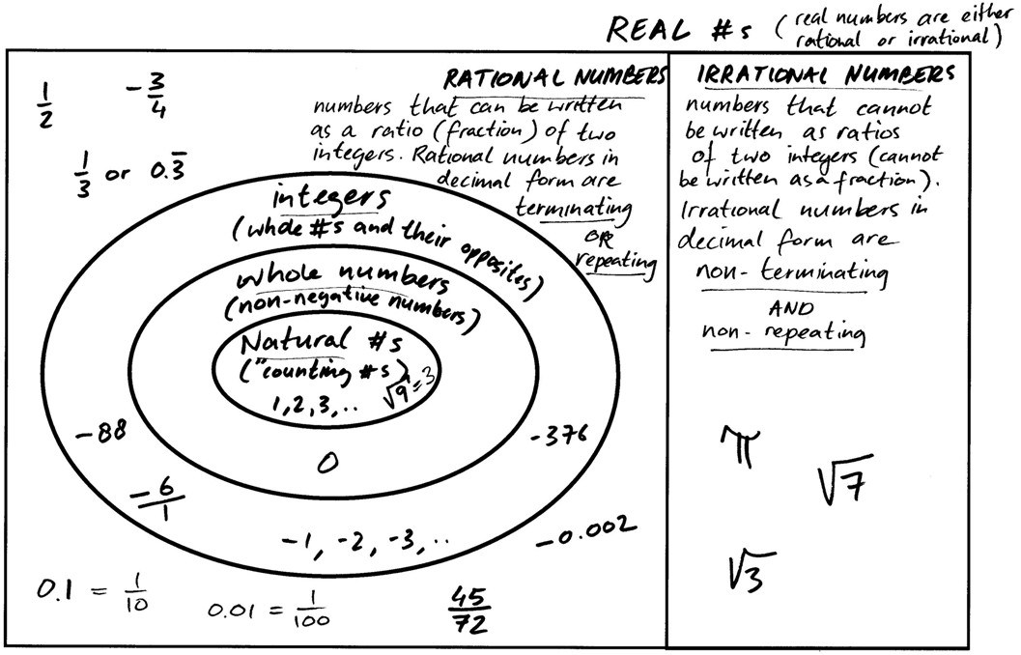
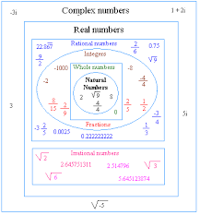
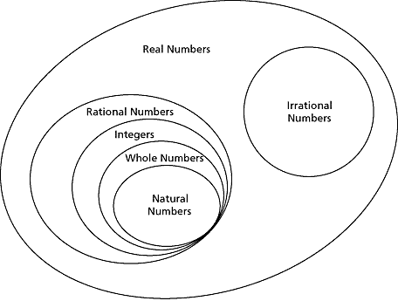

Slide 20
brainstorming vocab related to sets

Slide 21
1. Relations between sets a) A set is any collection of things which we want to consider together. We use braces { }, when we want to describe, or make a list of, the elements of a set, and we use capital letters to denote sets.
Let set A be {all animals}
Let set B be {lions}
Let set C be {all animals except lions}
Let set D be {all human beings}
Let set E be {all solid figures}
Let set F be {all geometrical figures}
Let set G be {positive integers ˂10}
Let set H be {1,2,3,4,5,6,7,8,9}
Let set I be {1,2,3}
Let set J be {} (This set is called the empty set)
Let set K be {3,4,5}
Can you name any relations between
any of these sets?

Slide 22
Have you mentioned
any of these relations?
Can you „read“ the relations?

Slide 24
c) express the following relations:
A and D
E and F
H – I
H ∩ I
H ∪ I
All triangles are plane figures.
No triangles are solid figures.
The set {figures with straight sides} and the set {figures with curved sides} have some members in common.

Slide 25
2. Match the terms to their definitions:
1. The union of two sets … b) | Is | a) a set which contains all the elements which do not belong to A.
2. The intersection of two sets … e) |  | b) a third set which contains all the members of both sets.
3. The difference between two sets … d) |  | c) a set in which every member of A is also in B, but there is at least one member in B but not in A.
4. The complement of a set A … a) |  | d) a third set which contains all the members of one set which are not common to both sets.
5. The subset A of a set B … f) |  | e) a third set which contains all the members common to both sets.
6. The proper subset A of a set B … c) |  | f) a set in which every member of A is also in B.

Slide 26
3. Explain the relations between the sets of numbers:
all integers and all natural numbers
all real and all imaginary numbers
all whole numbers and all positive integers
all real and all irrational numbers

Slide 27
4. Solve these problems (draw a Venn diagram to show these data) GROUP WORK
(a) 65 persons were polled. 47 liked calculators. 15 liked computers and calculators How many liked computers? How many liked only calculators?
(b) The total membership in the chess and badminton club is 57. Eleven students belong to the chess club and also the badminton club. Thirty-five students belong to the badminton club only. How many students belong to the chess club?
(c) In a recent poll of 91 students, it was found that 34 students liked chocolate K and chocolate C. Sixty-two students liked chocolate C. How many students liked only chocolate K?
(d) 185 persons liked only T.V. 463 persons liked T.V. and movies. 832 persons liked movies. How many persons were interviewed?
Solve the problem (individually) -> prepare “a youtube tutorial” with
a sheet of paper

Slide 28
Form new groups
“play” your tutorial
Hello.
We have ….
if/because we know …., we can add …
Now we subtract …
The next step is to …
Finally, we get …
Thank you ….
others: appreciate, ask questions, notice nice vocabulary/phrases and write them down

Slide 29
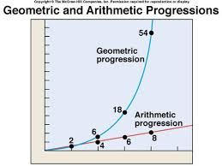
Listening
pre-listening
What is a set?
What is the difference between arithmetic and geometric progression?
How do we denote sets of numbers?
What are sum-free sets?

Slide 30
Listening
What does the speaker do with the sets of positive integers? ……………………………………………………..
What does he do with the repeated members in the set A + B? ……………………………………..
What is the usual size of the resulting set when you add up two P sets? …………………………………………
How are G and P sets different in relation to overlaps? …………………………………………………
What is the usual size of the resulting set when you add up two G sets? ………………………………………….
How common are sum-free sets? …………………………………………
What did Paul Erdős show? ……………………………………………………….
He adds the sets.
He strikes them out.
The overlap is smaller with a G set.
If we make the sum A+A, all numbers in the sum set
are different from the numbers of A.
Any set of positive integers includes a subset which is sum-free.

Slide 31
Revision: draw – describe
intersecting, transversal
concentric
parallel/equidistant
perpendicular
chord
tangent
secant
…
2 circles k, l
points A, B
3 lines/line segments
(+ more if you like)
draw individually
Student A: describe (circles, points, lines)
Student B: draw + describe the result (any figures?, types of angles)

Slide 32
Read:
a) $\frac{1}{3}x− \frac{5}{6} \sqrt{y^{5}}$ …
b) $\frac{2}{5} \sqrt[3]{7} : \frac{1}{13} x^{100}$ …
c) $\sqrt[n]{\frac{a}{b}}= \frac{\sqrt[n]{a}}{\sqrt[n]{b}}$ …
d) $\frac{1}{\sqrt{a}−\sqrt{b}}= \frac{\sqrt{a}+ \sqrt{b}}{a−b}$ …
one third (of) x minus five sixth (of) square root of y to the power of five
two fifths (two over five) times the third root of seven
divided by one thirteenth (of/times) x to the power of a hundred
the n-th root of the fraction a over b is equal to the n-th root of a,
that quantity over the n-th root of b (… is equal to the fraction whose…
one over the square root of a minus the square root of b
is equal to the fraction whose numerator is the square root of a
plus the square root of b and whose denominator is a minus b

