Slide 1
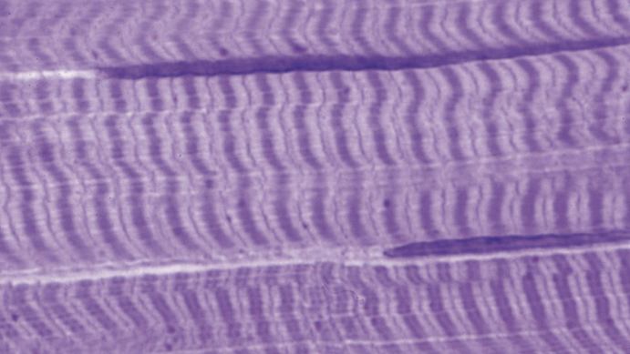
MUSCLE TISSUE

Slide 2
MUSCLE TISSUE
GENERAL CONCEPTS
Muscle tissue is specialized for the ability to shorten or contract. While all cells possess the cellular machinery necessary for shape change and contraction, these structures are significantly more prominent in muscle cells. For some muscle types, the cells are non-proliferative due to this high degree of specialization and differentiation.
Muscle contraction is accomplished by the reciprocating sliding of intracellular filaments composed of actin and myosin.
Muscle tissue comprises the "flesh" of the body and much of the walls of hollow organs. Due to its high degree of specialization, unique terms are used for certain structures in muscle cells.
Muscle fibers, Myocytes. Individual muscle cells.
Sarcoplasm. The cytoplasm of muscle fibers.
Sarcolemma. The muscle fiber plasma membrane.
Sarcoplasmic reticulum. The smooth endoplasmic reticulum.
„sarco-“ from Greek sarkos – flesh; „myo-“ from Greek mys – muscle

Slide 3
MUSCLE TISSUE
CLASSIFICATION OF MUSCLE
Functional classification is based on the type of neural control.
Voluntary
Involuntary
Structural classification is based on the presence or absence of cross striations.
Striated
Nonstriated (smooth)
Combined functional and structural classification
Skeletal muscle
Striated and voluntary
Found mostly attached to the skeleton
Cardiac muscle
Striated and involuntary
Composes the majority of the heart wall (myocardium)
Smooth (visceral) muscle
Nonstriated and involuntary
Found mostly in the walls of hollow organs and vessels

Slide 4
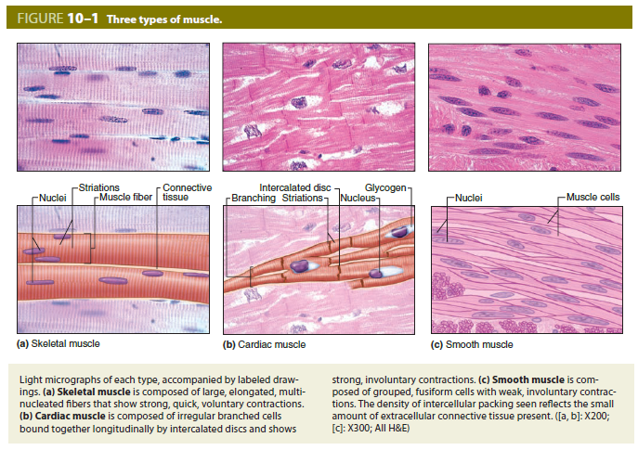
MUSCLE TISSUE

Slide 5
 | Skeletal | Cardiac | Smooth
Location | Near bones | Heart wall | Walls of hollow organs and blood vessels
Nuclei | Many. Flat. Peripheral. | 1-2 per cell. Plump. Central. | One per cell. Central.
Cell diameter | Largest | Intermediate | Smallest
Striations | Yes | Yes | No
Sarcoplasmic reticulum | Yes | Yes | No
T tubules | At junction of A-I bands. Form triads. | At Z lines. Form diads. | None
Motor control | Volunary | Involuntary | Involuntary
Contraction | Quick and strong | Quick, strong, rhythmic | Slow, in waves
Blood supply | Moderate | Extensive | Less abundant
Other features | Prominent fascicles | Intercalated disks, branching cells | Cells overlap; can synthesize collagen and elastin

Slide 6
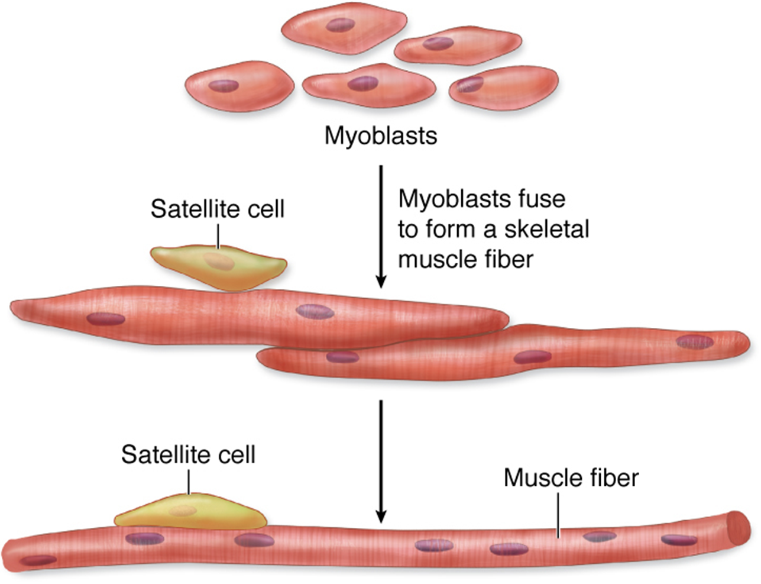
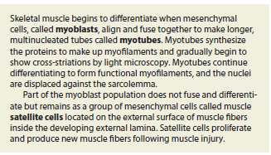
MUSCLE TISSUE
SKELETAL MUSCLE
Histogenesis
Skeletal muscle cells derived from mesenchymal cells, which give rise to myoblasts.
Myoblasts are spindle-shaped. Fuse to form multinucleated myotubes which elongate.
Mature skeletal muscle cells (fibers): long, unbranched tubes with many flattened nuclei.
Sarcoplasm (cytoplasm) contains mitochondria, glycogen, and myoglobin.
Mature skeletal muscle cells can’t divide.

Slide 7
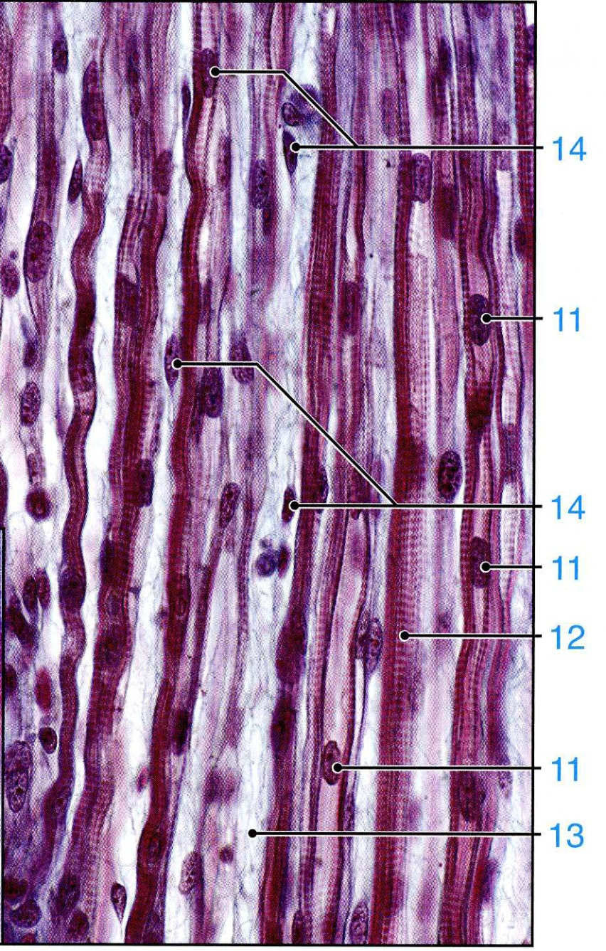
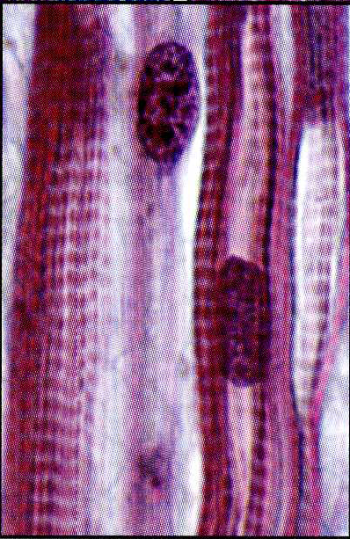
Myotubes

Slide 8
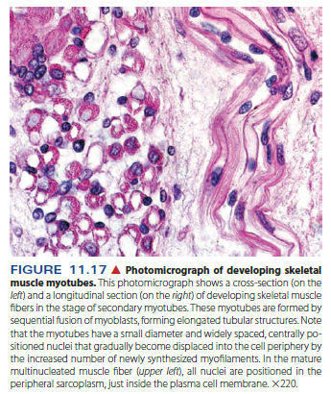

Slide 9
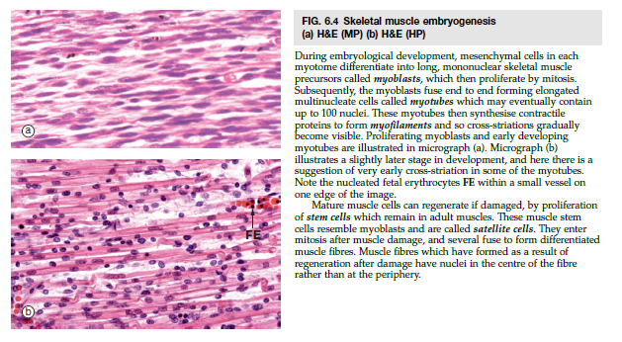

Slide 10
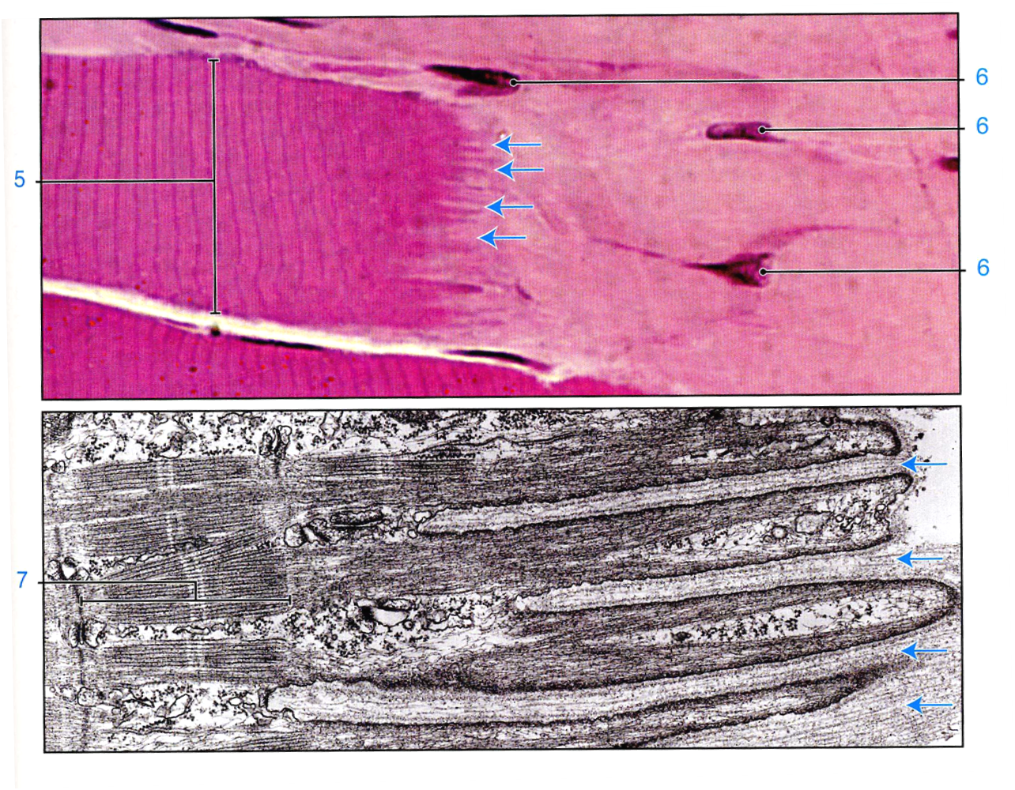
MUSCLE TISSUE
SKELETAL MUSCLE
Myotendinous junction
Tendons develop together with skeletal muscles and join muscles to the periosteum of bones.
The dense collagen fibers of a tendon are continuous with those in the connective tissue layers around muscle fibers, forming a strond unit that allows muscle contraction to move other structures.

Slide 11
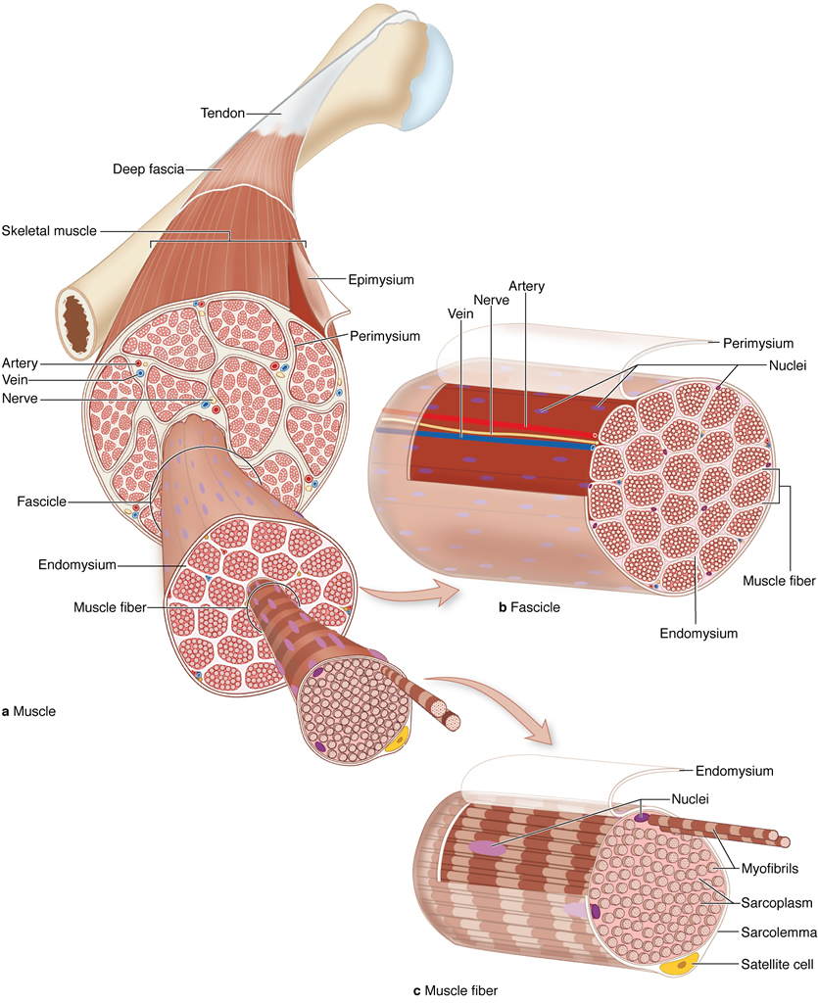
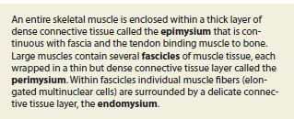
MUSCLE TISSUE
SKELETAL MUSCLE
Connective tissue investments of a skeletal muscle
Function:
Separate muscle into compartments
Transmit the force of contraction to insertion points
Components:
Endomysium. Reticular fibers surrounding each muscle fiber plus the external lamina produced by the muscle fiber
Perimysium. Dense connective tissue surrounding groups of fibers and dividing the muscle into fascicles
Epimysium. Dense connective tissue surrounding the entire muscle, blends with the deep fascia and tendons

Slide 12
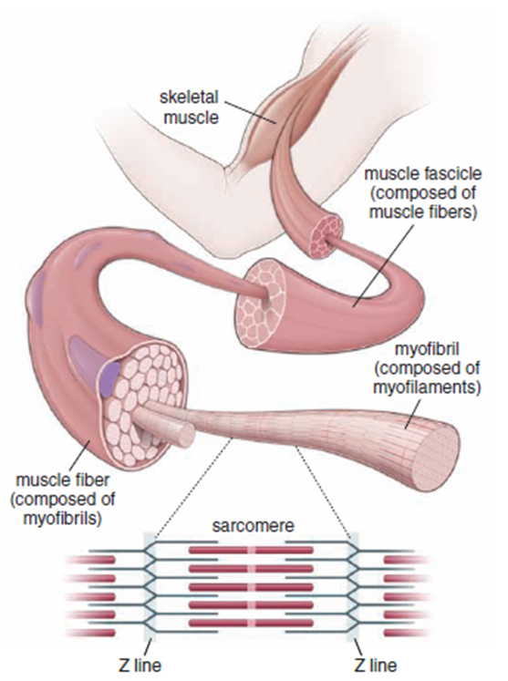
MUSCLE TISSUE
Hierarchy of skeletal muscle organization
Myofilaments. Visible only with the electron microscope; composed primarily of actin, which forms 5-nm wide thin filaments, and myosin, which forms 15-nm wide thick filaments
Myofibrils. Visible with the light microscope, 1-2 microns wide, oriented parallel to the long axis of the cell; composed of bundles of overlapping myofilaments that are arranged in register, producing an alternating light-dark, striated banding pattern
Muscle fiber. Specialized term for a muscle cell, 10-100 microns wide; sarcoplasm is filled with hundreds of myofibrils, which are oriented parallel to each other and to the long axis of the muscle fiber.
Muscle fascicle. Collection of muscle fibers surrounded by perimysium; collections of muscle fascicles are surrounded by the epimysium and form a named muscle such as the biceps brachii or latissimus dorsi.

Slide 13
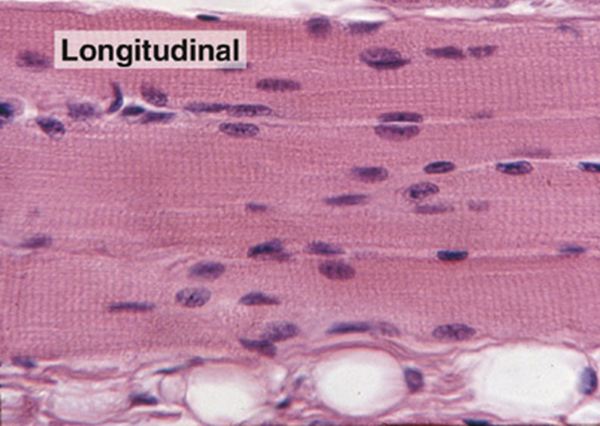
MUSCLE TISSUE
Structure of skeletal muscle fibers
Largest fiber type, fibers can be 1-30 mm in length and 10-100 microns in diameter.
Each muscle fiber is cylindrical, unbranched, and multinucleated.
The multiple nuclei are located at the periphery of the muscle fiber immediately beneath the sarcolemma.
Extensive smooth endoplasmic reticulum is called the sarcoplasmic reticulum.
Each fiber is surrounded by an external lamina which contributes to the endomysium of the muscle fiber.
Fibers can increase in size (hypertrophy) but not in number (hyperplasia).
Fibers show prominent, alternating light and dark bands (cross-striations) due to the alignment and overlap of the myofilaments within myofibrils.

Slide 14
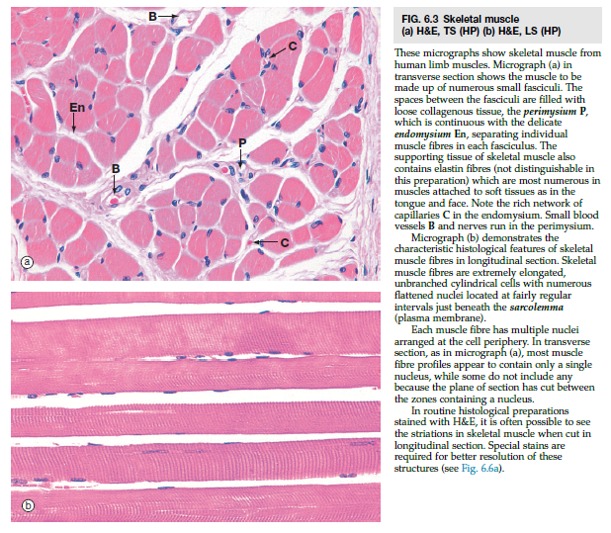

Slide 15
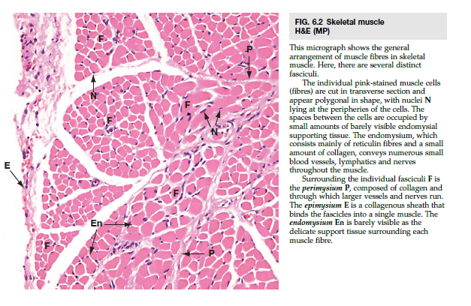

Slide 16
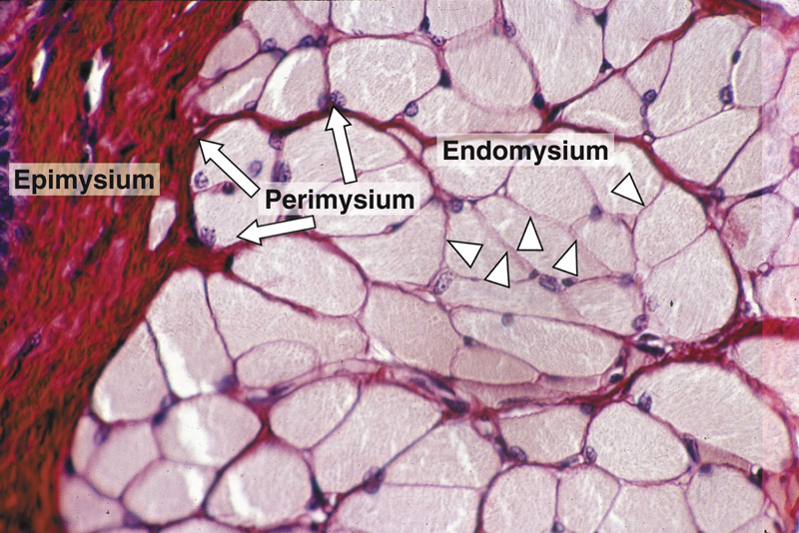

Slide 17
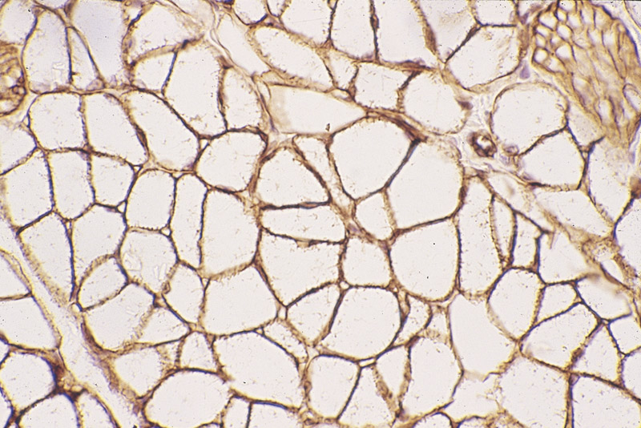
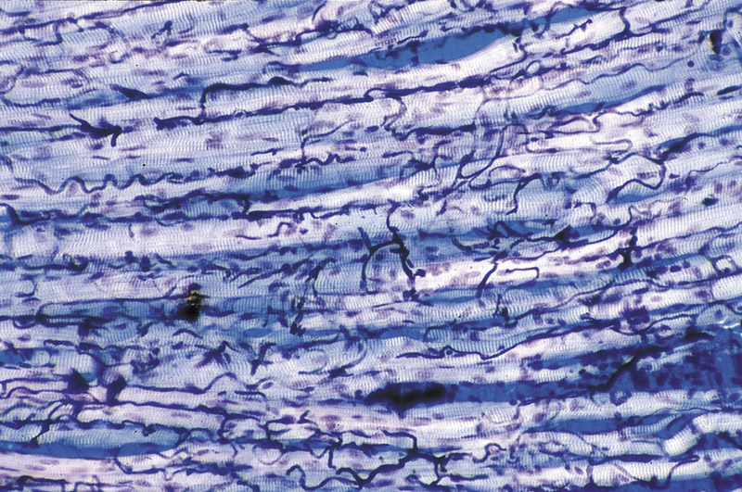

Slide 18
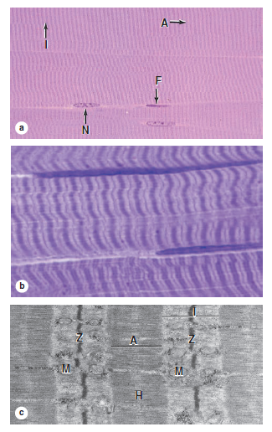
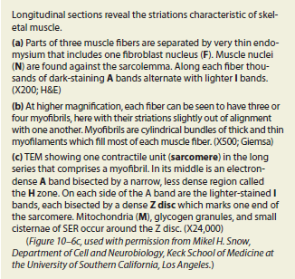
MUSCLE TISSUE
Structure of skeletal muscle fibers
Myofilaments within a myofibril are arranged in register and adjacent myofibrils are similarly aligned, causing the banding pattern seen at both the light and electron microscopic levels.
A band appears dark and contains both actin and myosin myofilaments.
I band appears light and contains actin myofilaments only.
Z line, composed of alpha-actinin and Cap Z proteins, is located in the center of the I band and serves as the attachment site for actin myofilaments.
H band is located in the center of the A band and represents the area where actin myofilaments are not present.
M band is located in the center of the H band and represents areas of cross-connections between myosin myofilaments.

Slide 19
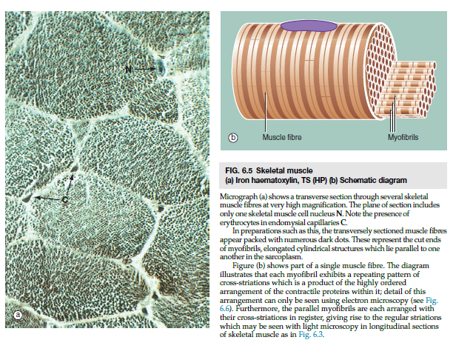

Slide 20
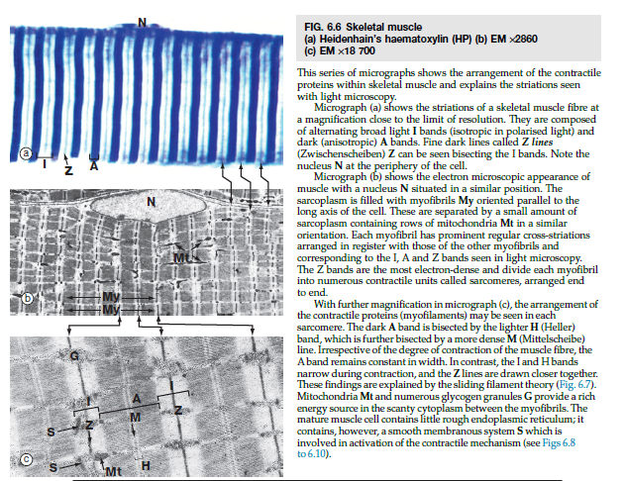

Slide 21
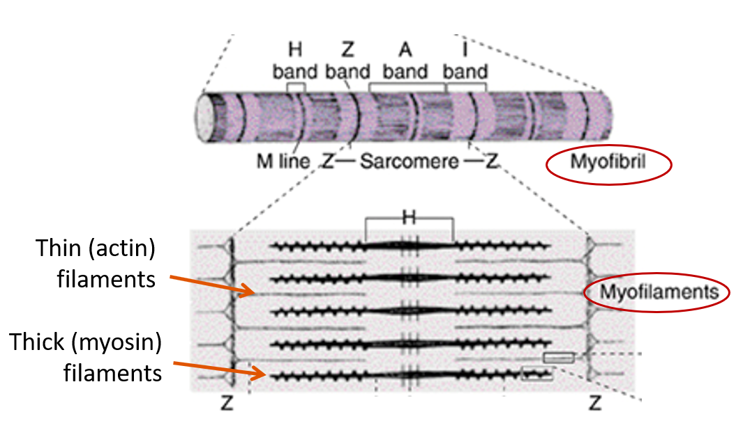
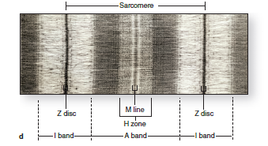
MUSCLE TISSUE
Structure of skeletal muscle fibers
Sarcomere
Contractile unit of striated muscle fibers, seen in both skeletal and cardiac muscle fibers
Extends from Z line to Z line
Sarcomeres are repeated in series along the length of each myofibril. Adjacent myofibrils maintain the alignment of sarcomeres.

Slide 22
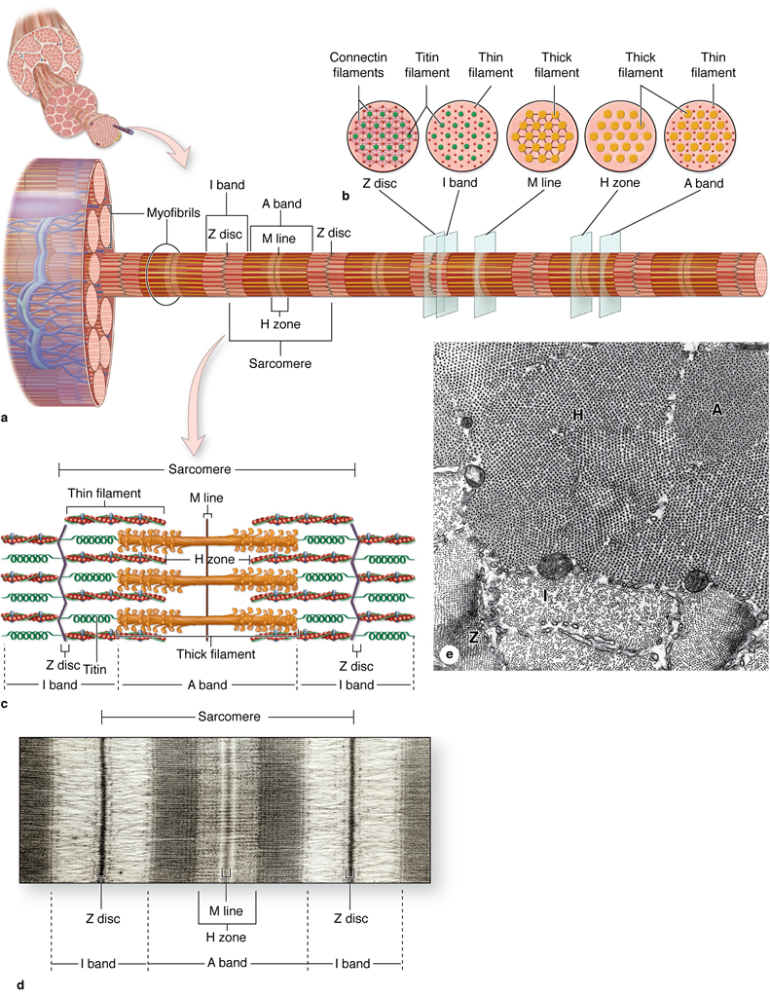

Slide 23
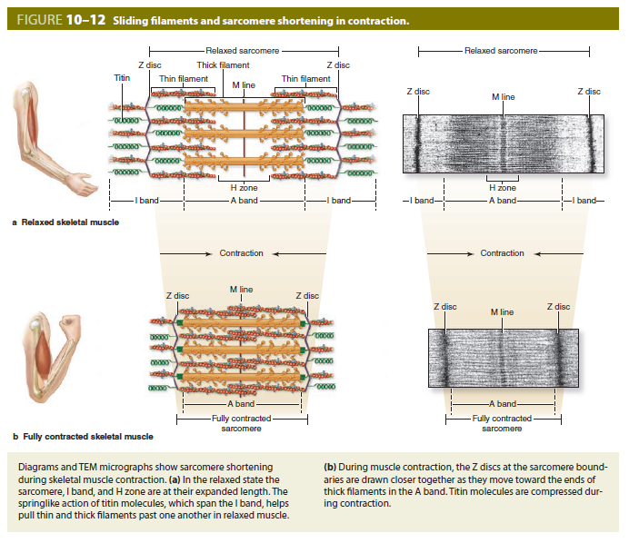
MUSCLE TISSUE
Structure of skeletal muscle fibers
Alterations in sarcomeres during contraction
Sarcomeres shorten as actin myofilaments are pulled past the myosin myofilaments.
Z line interval narrows.
Width of H and I bands decreases.
A band width remains unchanged.

Slide 24
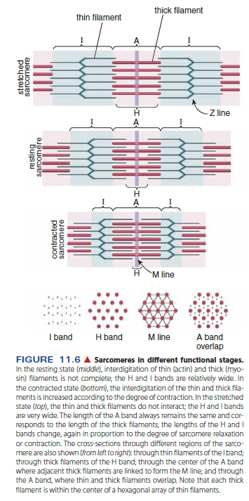

Slide 25
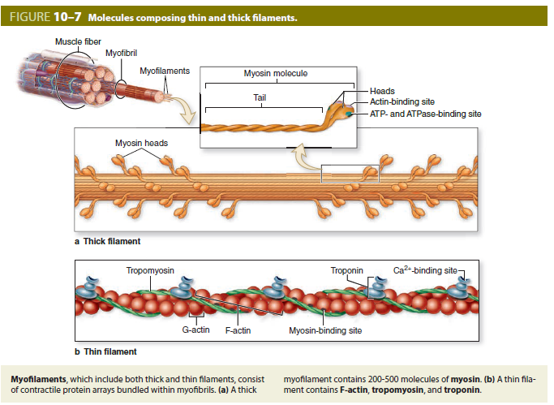
MUSCLE TISSUE

Slide 26
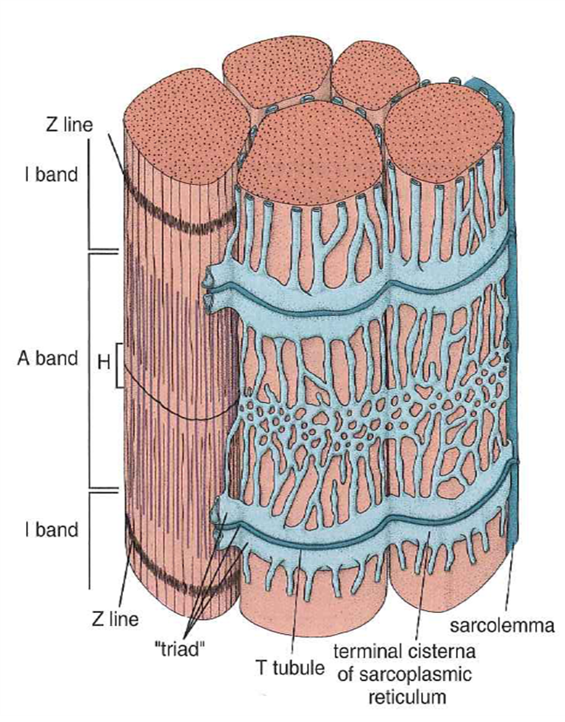
MUSCLE TISSUE
Coordination of skeletal muscle fiber contraction
A complex system of intracellular, membranous structures called the triad ensures coordinated contraction throughout the muscle fiber by:
Allowing the nervous impulse to penetrate and simultaneously reach all parts of the muscle fiber.
Releasing calcium in response to the nervous impulse.
Triads. Composed of one T-tubule plus two adjacent terminal cisterns of the sarcoplasmic reticulum.
T-tubules are invaginations of the sarcolemma that occur at the junction between A and I bands of the myofibrils.
Terminal cisterns are expanded portions of the sarcoplasmic reticulum that lie adjacent to the T tubule and release calcium to initiate contraction.

Slide 27
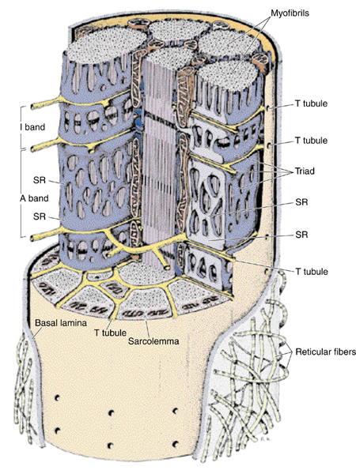
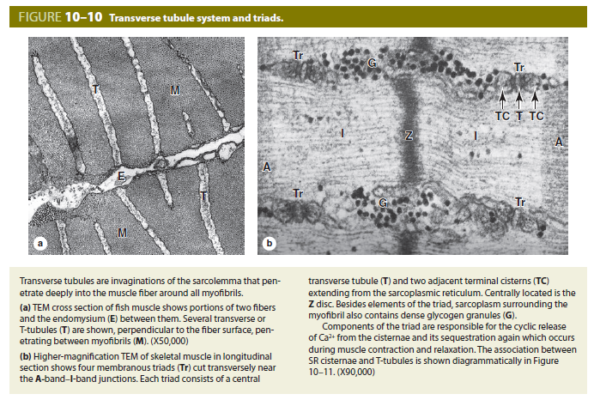
Notes:
Příčný řez svalem ryby – dvě buňky povrch a intercelulární prostor, invaginace sarkolemy tvořící T-tubuly (šipky)
Glykogenové částice - tmavé shluky
A a I proužek
Šipky na dolním obrázku – triáda, T tubulus a po stranách přilehlé terminální cisterny

Slide 28
MUSCLE TISSUE
Coordination of skeletal muscle fiber contraction
Role of triad in muscle contraction
A nerve impulse arriving at the muscle fiber depolarizes the sarcolemma at the neuromuscular junction.
The membrane depolarization propagates along the sarcolemma and extends down the T-tubules.
T-tubule depolarization is transmitted to the terminal cisterns and the remainder of the sarcoplasmic reticulum, causing release of stored calcium.
Calcium initiates the interaction between actin and myosin myofilaments, leading to muscle contraction.
Calcium is recaptured by sarcoplasmic reticulum during relaxation

Slide 29
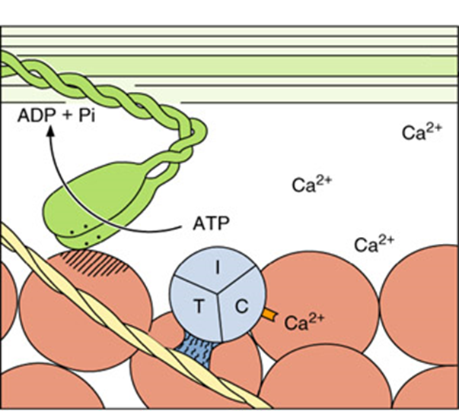
MUSCLE TISSUE
Mechanism of contraction, sliding filament model
Increased calcium concentration triggers the initiation of contraction by allowing the myosin head groups to contact the actin myofilaments.
A conformation change of the myosin head groups associated with the hydrolysis of ATP and the release of ADP results in a sliding of the actin myofilament past the myosin. Since the actin filaments are anchored at the Z line, the result of the sliding is shortening of the sarcomere.

Slide 30
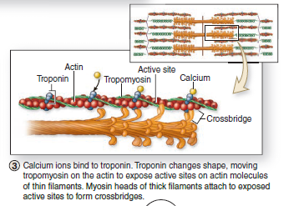
MUSCLE TISSUE

Slide 31
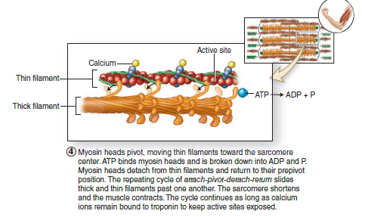
MUSCLE TISSUE

Slide 32
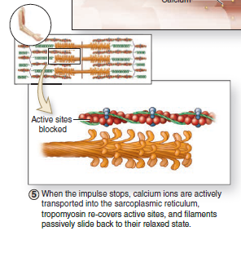
MUSCLE TISSUE

Slide 33
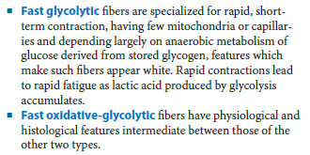
Skeletal muscle fibers types:
S = SO; F = FG; I = FOG

Slide 34
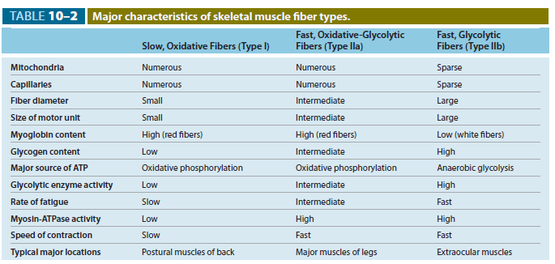

Slide 35
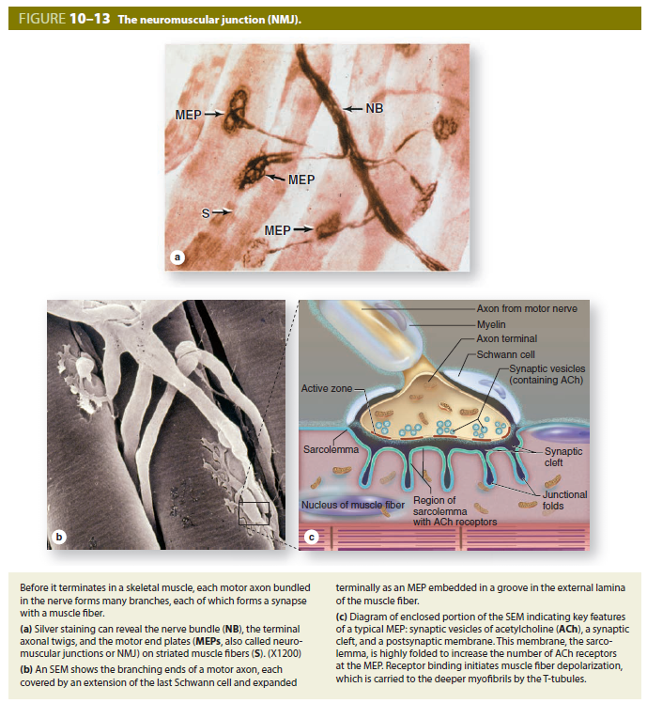
MUSCLE TISSUE
Associated structures
Neuromuscular junction (motor end plate)
Specialized "synapse" between the terminals of a motor axon and the sarcolemma of a muscle fiber
Motor unit. Consists of the motor neuron, its axon, and all the muscle fibers it innervates

Slide 36
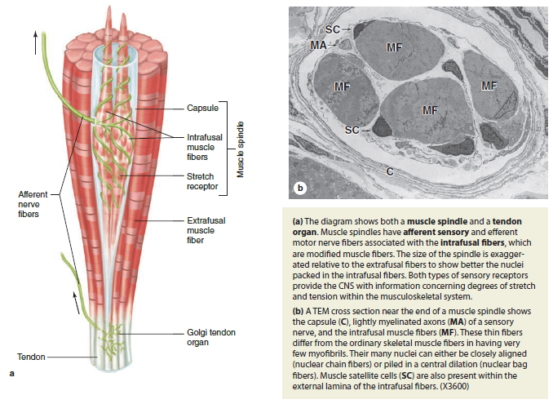
MUSCLE TISSUE
Associated structures
Proprioceptors
Sensory receptors, encapsulated by connective tissue, serve to regulate muscle tension and tone.
Types:
Muscle spindle. Highly modified skeletal muscle fibers, intra¬fusal fibers, are aligned with and surrounded by normal skeletal muscle fibers.
Golgi tendon organs. Located within tendons

Slide 37
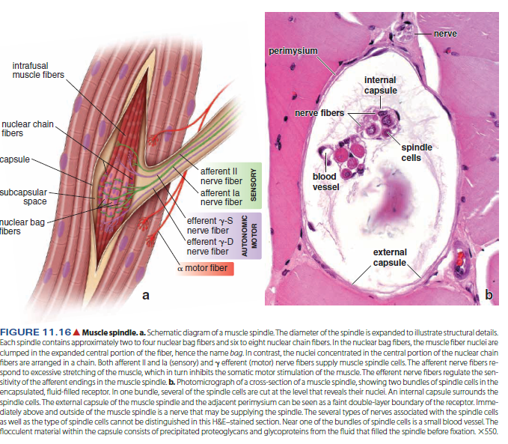

Slide 38
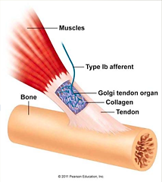
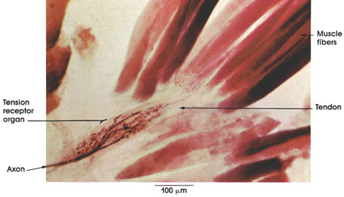

Slide 39
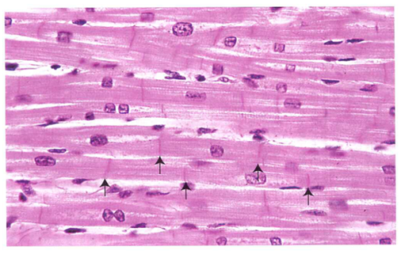
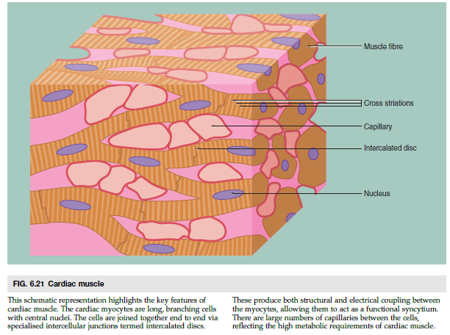
MUSCLE TISSUE
CARDIAC MUSCLE
Cardiac muscle occurs only in the myocardium of the heart and, to a variable extent, in the roots of large vessels where they join the heart.
During embryonic development, the mesoderm cells of the primitive heart tube align into chainlike arrays. No fusion, cardiac muscle cells form complex junctions between extended processes.
Structure of cardiac muscle cells
Intermediate in size between skeletal and smooth muscle
Cells are cylindrical, branch, and form interwoven bundles.
Usually, one nucleus per cell is located in the center.
Organelles are clustered at the poles of the nucleus.
Myofilament organization into myofibrils is identical to skeletal muscle. Cross-striations and bands identical to skeletal muscle are present, but not as prominent.

Slide 40
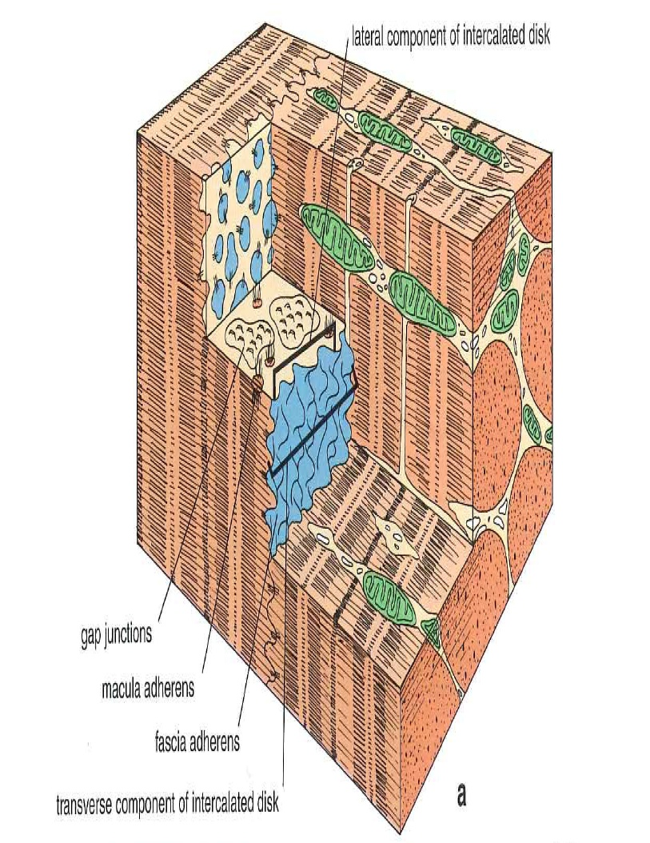
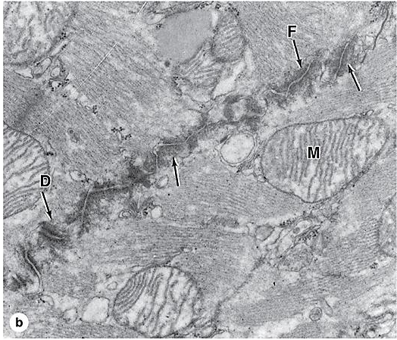
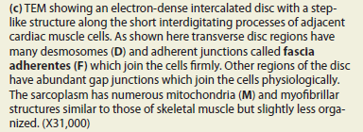
MUSCLE TISSUE
CARDIAC MUSCLE
Intercalated discs
Junctional complexes that are unique to cardiac muscle cells
Consist of specialized cell junctions and interdigitations of the sarcolemma at the ends of the cells.
Contain three types of junctions:
Fascia adherens. Similar to zonula adherens of epithelia; serve to attach cardiac muscle fibers and anchor actin filaments of the terminal sarcomeres at the ends of the cell. Acts as a hemi-Z line.
Desmosomes. Bind ends of fibers together
Gap junctions. Provide ionic coupling between fibers
Highly vascular with large numbers of mitochondria reflecting the high metabolic requirements of cardiac muscle fibers.
Fibers are capable of hypertrophy but not hyperplasia.

Slide 41
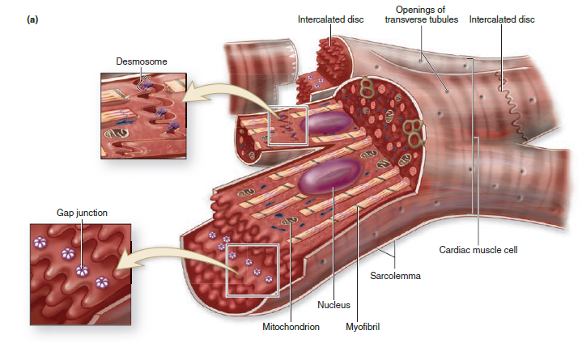
Notes:
Macula adherens
gap junction
Fascia adherens

Slide 42
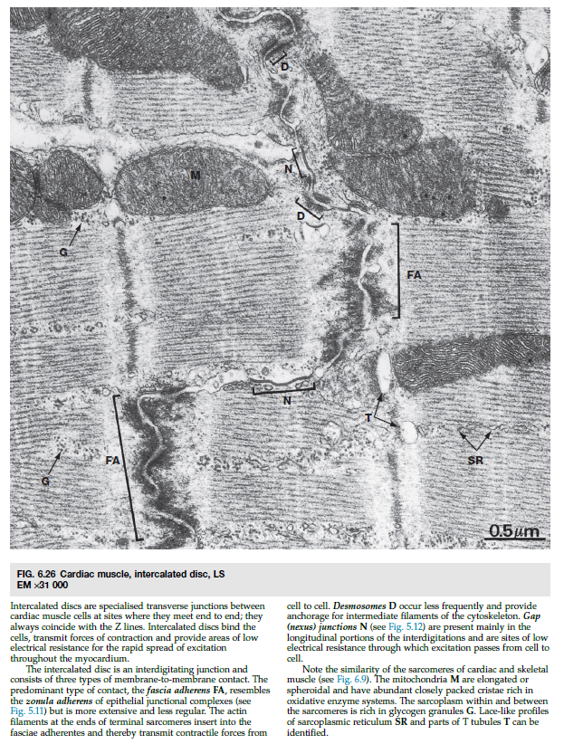

Slide 43
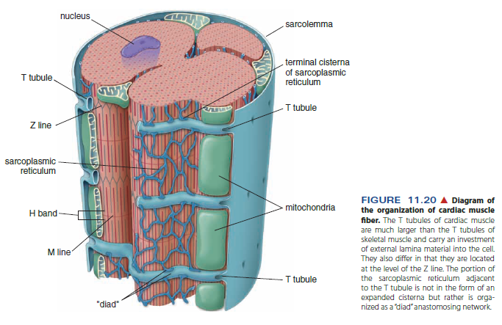
MUSCLE TISSUE
CARDIAC MUSCLE
Coordination of cardiac muscle contraction
Sarcomeres, myofibrils, and myofilaments are the same as skeletal muscle fibers.
T-tubules are located at the level of the Z lines, rather than at junction of A and I bands as in skeletal muscle.
No triads. Sarcoplasmic reticulum is not as well developed as in skeletal muscle fibers and does not form terminal cisterns. Contraction is initiated by intracellular calcium release.
Contraction can spread through the myocardium due to the presence of gap junctions which allow current to flow from one cell into another. Heart beat is initiated and regulated by specialized conducting cardiac muscle cells.

Slide 46
MUSCLE TISSUE
SMOOTH MUSCLE
Smooth muscle is present in walls of most hollow organs, including most blood vessels, many respiratory passageway, genital ducts and the ureter. The wall of the heart is an exception, as the myocardium is composed of cardiac muscle.
Histogenesis: from mesoderm
Structure of smooth muscle cells
Smallest type, length varies from 20 microns in blood vessels to 500 microns in the uterus
Unbranched spindle-shaped cells are elongated with tapering ends.
Possess a single, centrally placed, oval nucleus, which can appear spiraled or „kork-screw„ shaped when the cell is contracted.
Organelles are clustered at the poles of the nucleus.
Nonstriated; no myofibrils are present.
External lamina is present along with reticular fibers.
Abundant gap junctions
Capable of both hypertrophy and hyperplasia
In addition to their contractile properties, smooth muscle cells produce collagen, elastin, proteoglykans.

Slide 48
MUSCLE TISSUE
SMOOTH MUSCLE
Organization of the contractile proteins
Actin and myosin myofilaments are present, but they are not organized into myofibrils.
Myofilaments overlap as in striated muscle and crisscross throughout the sarcoplasm, forming a reticulum.
Dense bodies
Serve as insertion points for myofilaments to transmit the force of filament sliding
Comparable to Z-lines of skeletal and cardiac muscle.
Present in the cytoplasm and associated with the sarcolemma

Slide 49
MUSCLE TISSUE
SMOOTH MUSCLE
Coordination of smooth muscle contraction
There’s no real sarcoplasmic reticulum (no T-tubules are present). Just a few little storage areas (pinocytotic vesicules) for calcium right under the sarcolemma.
Sliding filament mechanism. Regulated by intracellular release of calcium but with some differences from striated muscle fibers

Slide 51
MUSCLE TISSUE
SMOOTH MUSCLE
Types of smooth muscle:
Visceral smooth muscle
Occurs in sheets in the wall of hollow organs (e.g., digestive tract)
Minimally innervated; contraction spreads in peristaltic waves facilitated by large numbers of gap junctions.
Specialized for slow, prolonged contraction
Multiunit smooth muscle
Richly innervated, fewer gap junctions than visceral smooth muscle
Specialized for precise, graded contraction (e.g., iris of the eye)

Slide 52
MUSCLE TISSUE
REGENERATION OF MUSCLE TISSUE
Cardiac muscle has no regenerative ability. Death of cardiac muscle leads to replacement by dense connective tissue scar.
Skeletal muscle can undergo limited regeneration.
Satellite cells are inactive myoblasts. After an injury, they can become activated and make new muscle cells.
Smooth muscle is capable of active regeneration.
Muscle fibers undergo mitosis and replace damaged tissue.

