Slide 1
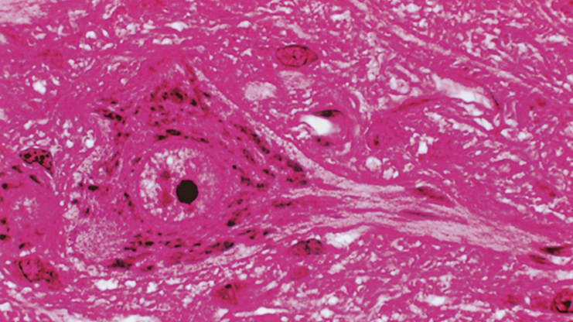
NERVE TISSUE

Slide 2
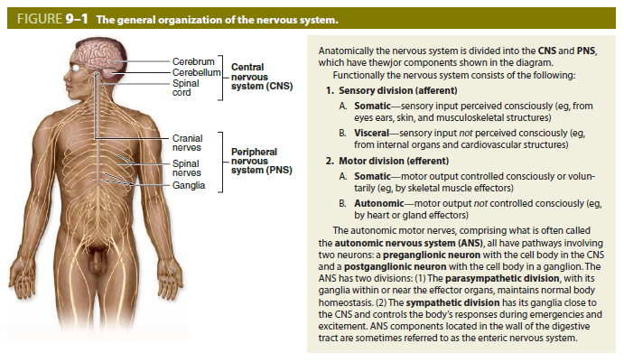
NERVE TISSUE
GENERAL CONCEPTS
Nerve tissue is highly specialized to employ modifications in membrane electrical potentials to relay signals throughout the body. Neurons form intricate circuits that:
  Relay sensory information from the internal and external environments.
  Integrate information among millions of neurons
  Transmit effector signals to muscles and glands.
Anatomical subdivisions of nervous tissue
  Central nervous system (CNS)
    Brain
    Spinal cord
  Peripheral nervous system (PNS)
    Nerves
    Ganglia (singular, ganglion)
    Motor and sensory components

Slide 3
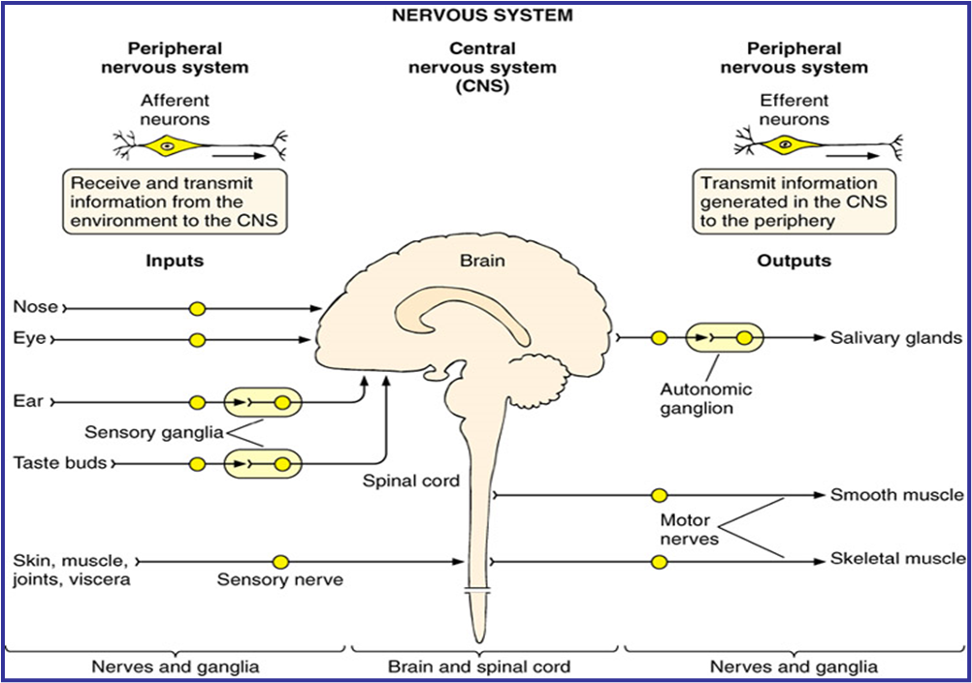

Slide 4
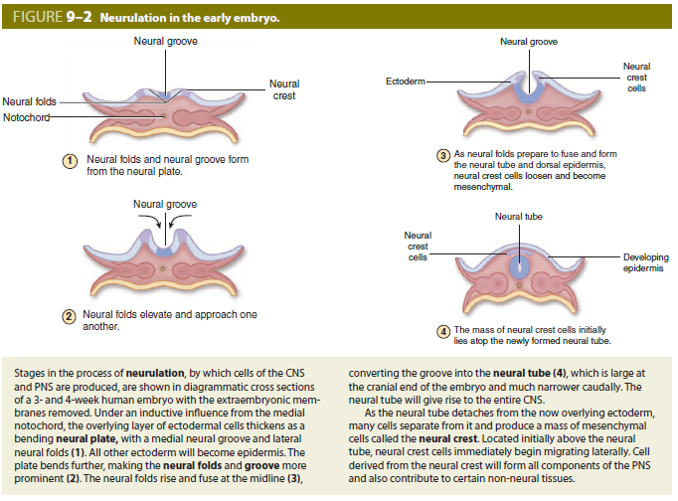
NERVE TISSUE

Slide 5
NERVE TISSUE
CELLS OF NERVE TISSUE
Neurons
  Functional units of the nervous system; receive, process, store, and transmit information to and from other neurons, muscle cells, or glands
  Composed of a cell body, dendrites, axon and synapses
  Form complex and highly integrated circuits
Supportive (glial) cells
  Provide metabolic and structural support for neurons, insulate neurons via a myelin sheath, maintain homeostasis, and perform phagocytic functions
  Comprised of:
    Astrocytes
    Oligodendrocytes
    Microglia
    ependymal cells in the CNS
    Schwann cells in the PNS

Slide 6
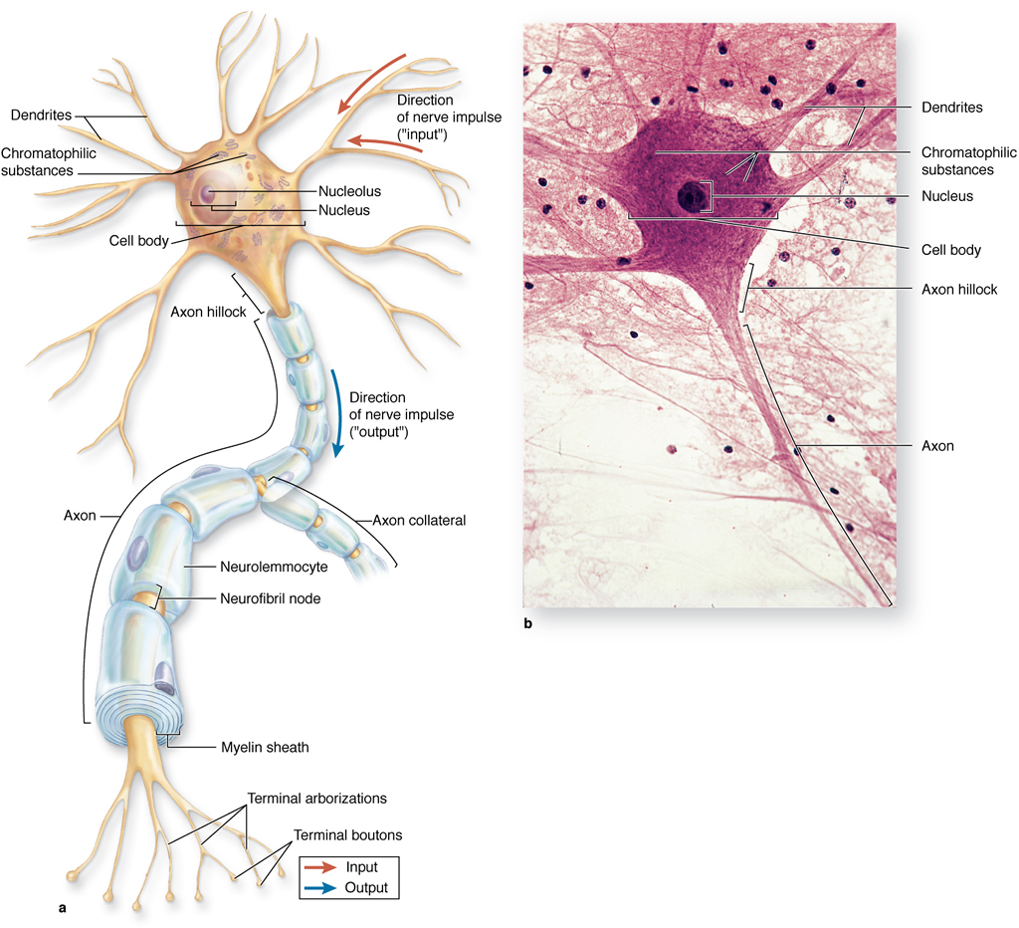
NERVE TISSUE
STRUCTURE OF A "TYPICAL" NEURON
Cell body (soma, perikaryon)
  Nucleus
    Large, spherical, usually centrally located in the soma
    Highly euchromatic with a large, prominent nucleolus
  Cytoplasm
    Well-developed cytoskeleton
      Intermediate filaments (neurofilaments)
      Microtubules
    Abundant rough endoplasmic reticulum and polysomes (Nissl substance)
    Well-developed Golgi apparatus
    Numerous mitochondria

Slide 7
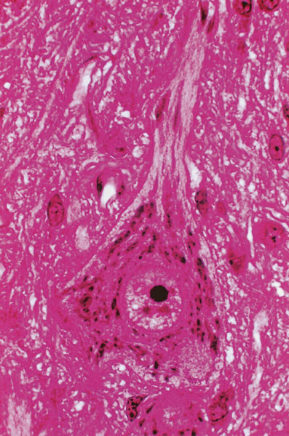
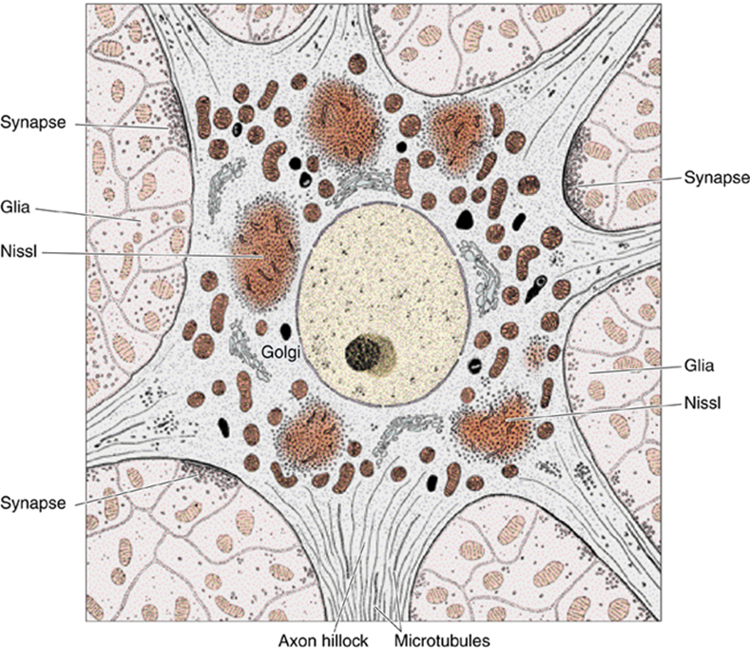

Slide 8
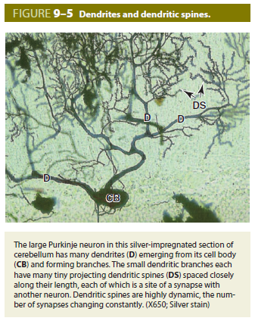
NERVE TISSUE
STRUCTURE OF A "TYPICAL" NEURON
Dendrite(s)
  Usually multiple and highly branched at acute angles
  May possess spines small membranous elevations which form excitatory synapses
  Collectively, form the majority of the receptive field of a neuron; conduct impulses toward the cell body
  Cytoplasmic components
    Microtubules and neurofilaments
    Rough endoplasmic reticulum and polysomes
    Smooth endoplasmic reticulum
    Mitochondria

Slide 9
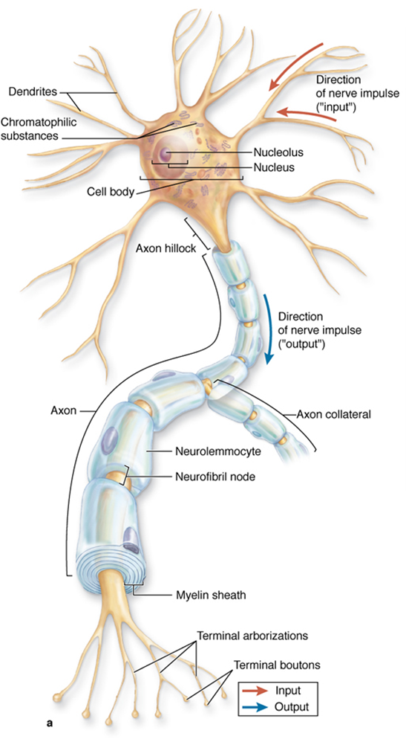
NERVE TISSUE
STRUCTURE OF A "TYPICAL" NEURON
Axon
Usually only one per neuron
Generally, of smaller caliber and longer than dendrites
Branches at right angles, fewer branches than dendrites
Cytoplasmic components
  Microtubules and neurofilaments
  Lacks rough endoplasmic reticulum and polysomes
  Smooth endoplasmic reticulum
  Mitochondria
Axon hillock. Region of the cell body where axon originates
  Devoid of rough endoplasmic reticulum and so stains pale
  Continuous with initial segment of the axon that is a highly electrically excitable zone for initiation of nervous impulse
Usually, ensheathed by supporting cells
Transmits impulses away from the cell body to
  Neurons
  Effector structures such as muscle and glands
Branches extensively near its target, each branch ends in a swelling, the terminal bouton, which is the presynaptic element of a synapse

Slide 10
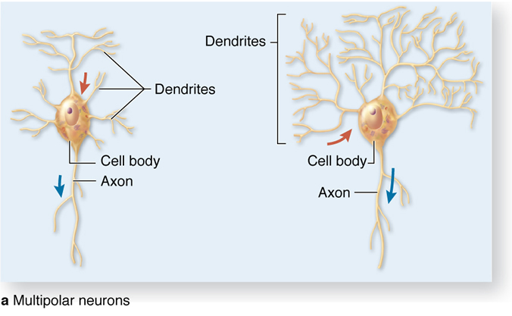
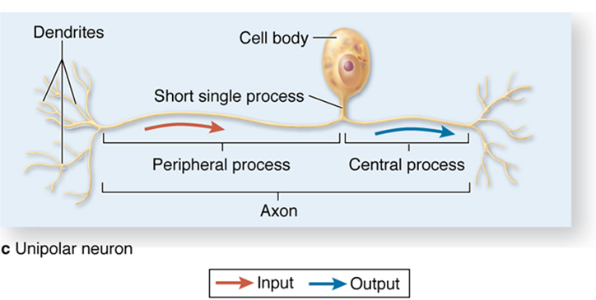
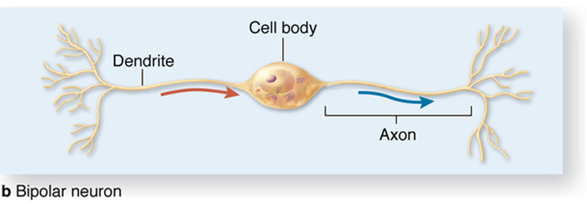
NERVE TISSUE
TYPES OF NEURONS BY SHAPE AND FUNCTION
Multipolar neuron. Most numerous and structurally diverse type
  Efferent. Motor, carrying impulses out of the CNS or innervating smooth muscle from autonomic ganglia
  Integrative function, axons remain in the CNS
  Found throughout the CNS and in autonomic ganglia in the PNS
(Pseudo)unipolar neuron
  Afferent. Sensory function, carrying impulses from peripheral receptors into the CNS
  Found in selected areas of the CNS and in sensory ganglia of cranial nerves and spinal nerves (dorsal root ganglia)
Bipolar neuron
  Afferent. Sensory function
  Found associated with organs of special sense (retina of the eye, olfactory epithelium, vestibular and cochlear ganglia of the inner ear)
  Developmental stage for all neurons

Slide 11
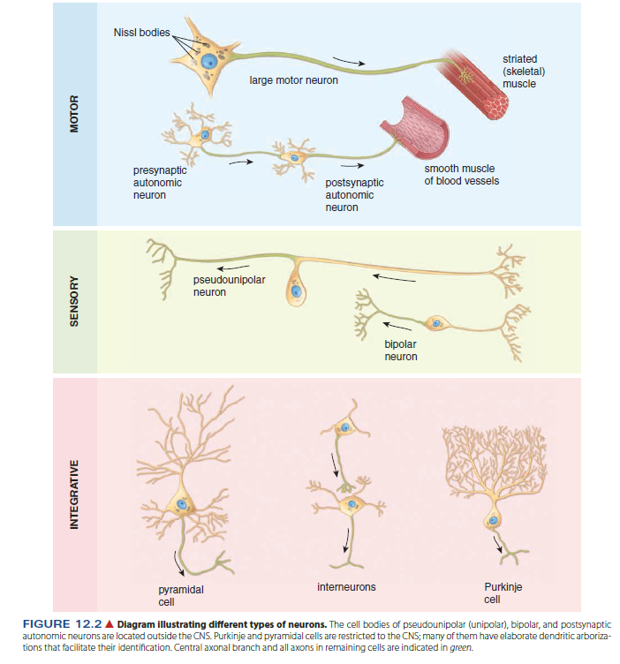

Slide 12
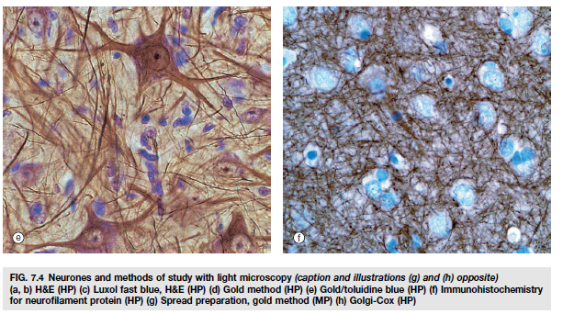
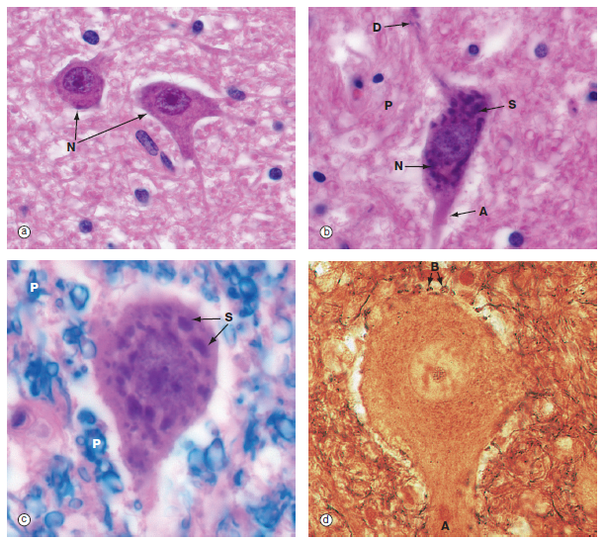
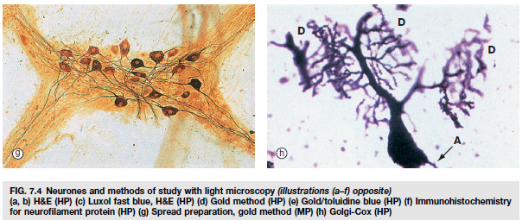

Slide 13
NERVE TISSUE
ARRANGEMENT OF NEURONAL CELL BODIES AND THEIR PROCESSES
In both CNS and PNS, cell bodies are found in clusters or layers and axons travel in bundles.
These groupings are based on common functions and/or common connections.

Slide 14
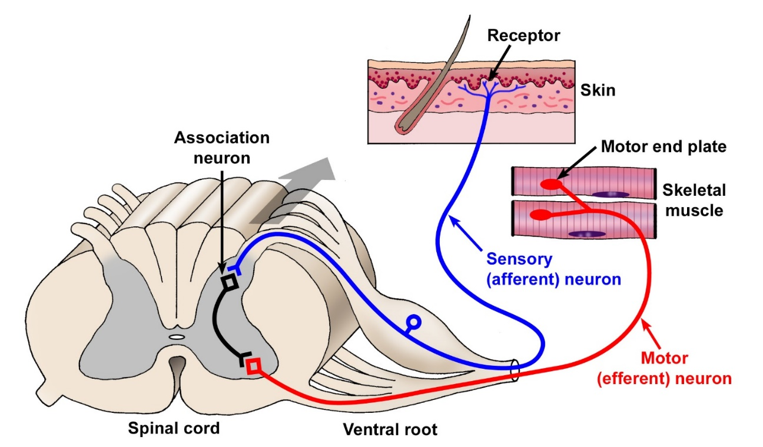
NERVE TISSUE
THE REFLEX ARC
The reflex arc is the simplest neuronal circuit.
These circuits provide rapid, stereotyped reactions to help maintain homeostasis.
To begin the reflex, a pseudounipolar, sensory neuron is activated by a receptor.
The axon carries an afferent signal from the skin into the spinal cord where it synapses on a multipolar association neuron or interneuron.
The interneuron signals a multipolar, motor neuron whose axon then carries an efferent signal to skeletal muscle to initiate contraction.

Slide 15
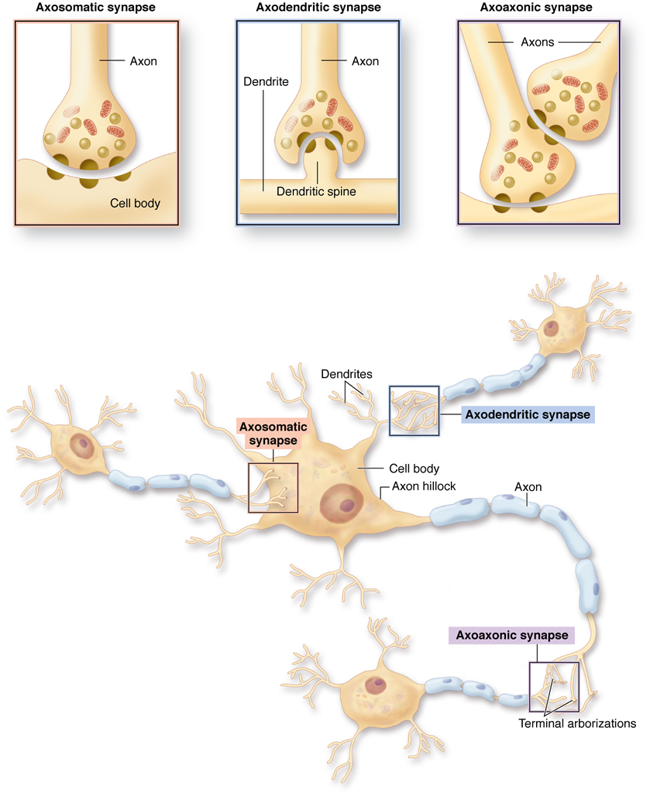
NERVE TISSUE
SYNAPSE
The function of the synapse is to alter the membrane potential of the postsynaptic target cell to either facilitate or inhibit the likelihood of the stimulus to be propagated by the postsynaptic cell. Most neurons receive thousands of synaptic contacts, both stimulatory and inhibitory, and the algebraic sum of these inputs determines whether the postsynaptic cell will depolarize.
Classified according to postsynaptic target:
  Axodendritic. Most common
  Axosomatic
  Axoaxonic. Occur mostly at presynaptic terminals
  Neuromuscular junction

Slide 16
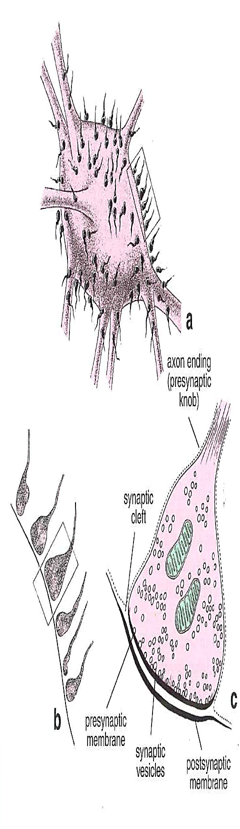
NERVE TISSUE
SYNAPSE
Structure of the synapse
  Presynaptic component
    Distal end of the axon branches, each branch terminating in a swelling or button called the terminal bouton.
    Boutons with neurotransmitter-containing synaptic vesicles and numerous mitochondria.
  Synaptic gap/cleft. Separation (20-30 nm) between pre- and postsynaptic cells.
  Postsynaptic component
    Formed by the membrane of the postsynaptic neuron or muscle cell and contains receptors for neurotransmitters
    Membrane shows a postsynaptic density or thickening on its cyto-plasmic side.
  "Bouton-like" swellings along the length of an axon, allow a single axon to contact many distant cells. Common in smooth muscle innervation.

Slide 17
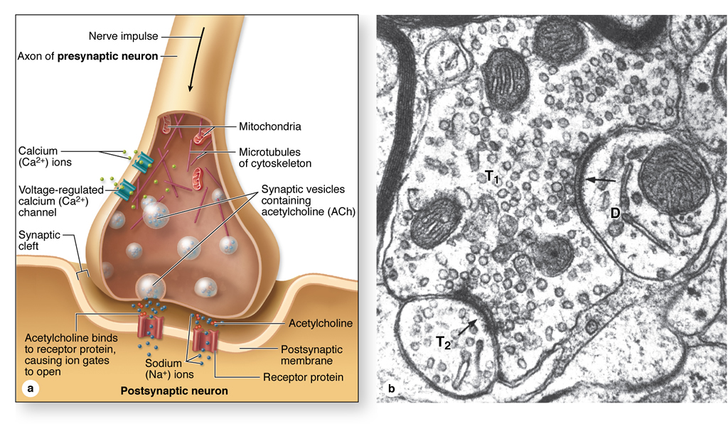
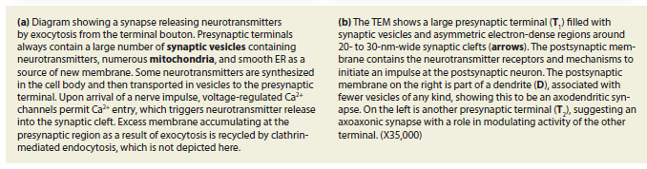

Slide 18
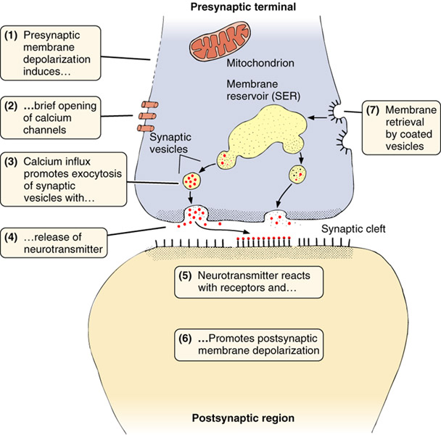
Notes:
Kromě chemických synapsí ještě ELEKTRICKÉ – signály přenášeny ionty, které pronikají spojovacím komplexem podobným nexu
Excitační synapse – viz výše
Nebo hyperpolarizace bez přenosu nervového impulzu – inhibiční synapse

Slide 19
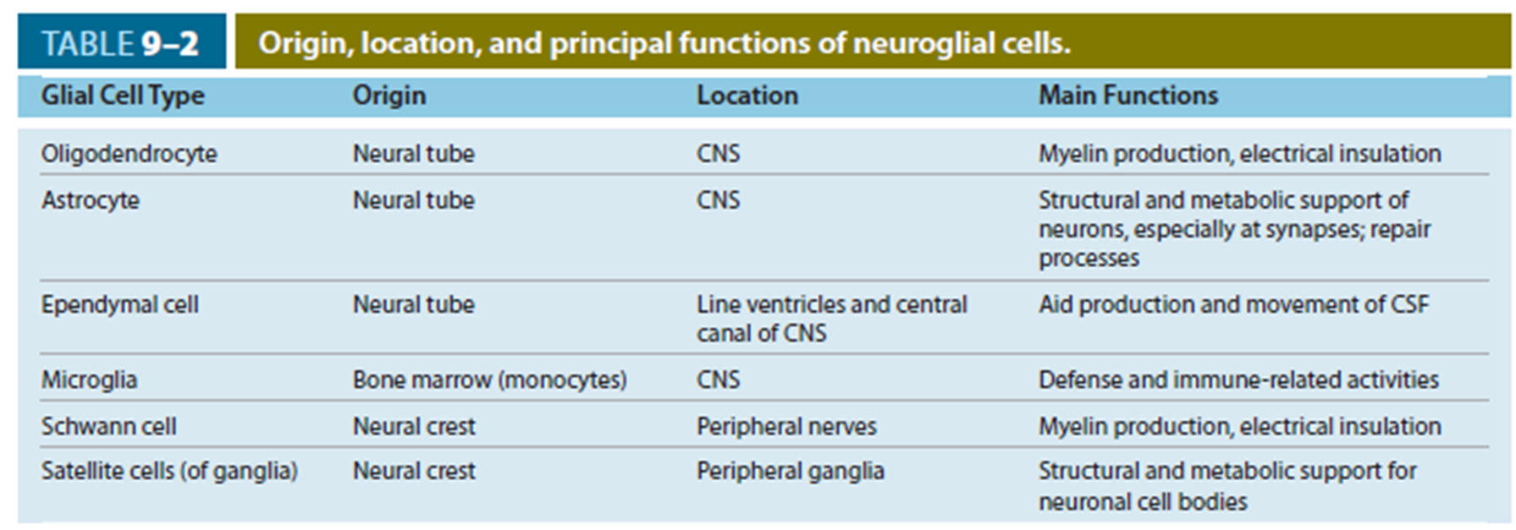
NERVE TISSUE
SUPPORTIVE (GLIAL) CELLS
10x more abundant than neurons
Support and protect neurons
Supporting cells of the CNS
Astrocytes
Oligodendrocytes
Ependymal cells
Microglial cells
Supporting cells of the PNS
Schwann cells
Satelite cells

Slide 20
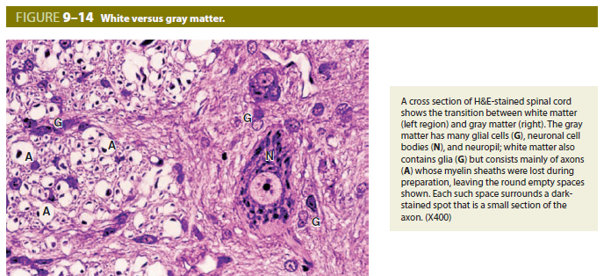
White matter – axons, glial cells
Grey matter – glial cells, neuronal cell bodies, neuropil

Slide 21
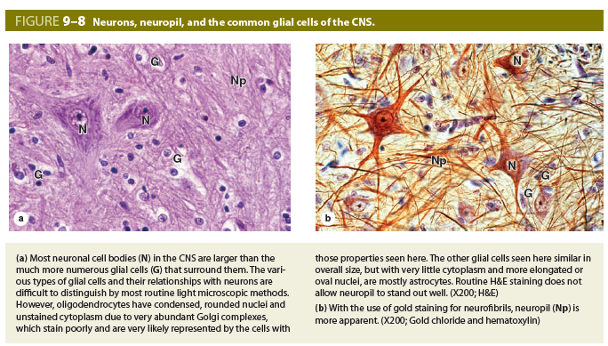
Neuropil – dense network of astrocyte processes, axons and dendrites in gray matter.

Slide 22
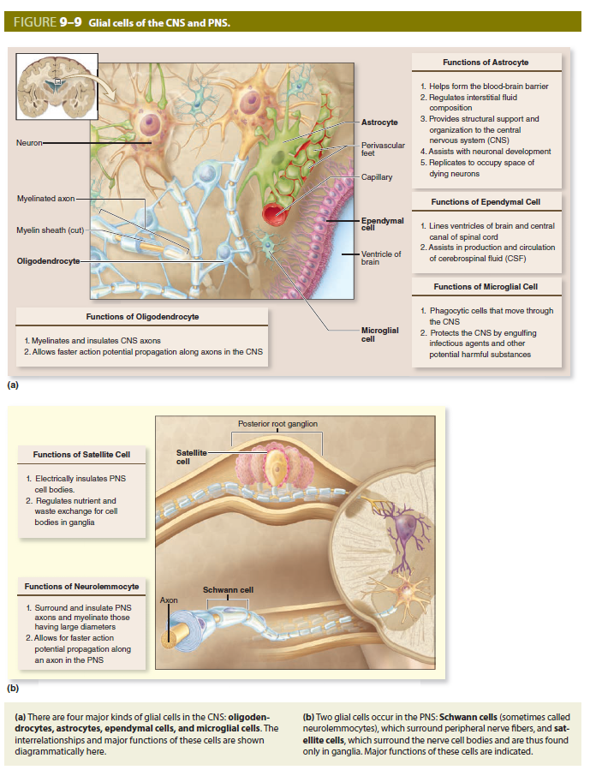

Slide 24
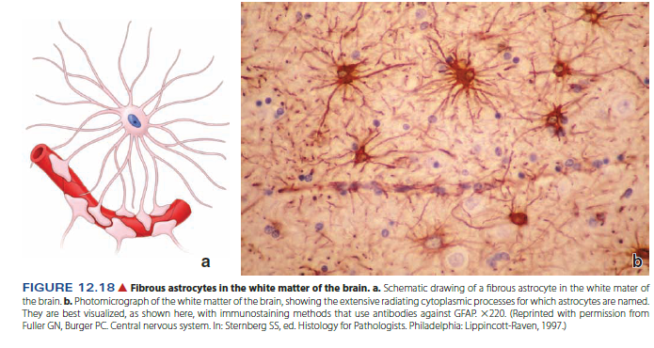
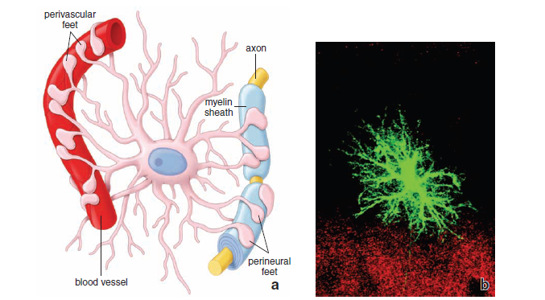
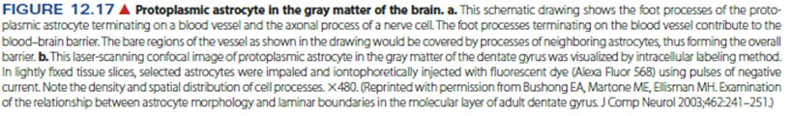
NERVE TISSUE
SUPPORTIVE CELLS
Supporting cells of the CNS
Astrocytes
  Stellate morphology
  Types:
    Fibrous astrocytes in white matter
    Protoplasmic astrocytes in gray matter
  Functions:
    Physical support
    Transport nutrients
    Maintain ionic homeostasis
    Take up neurotransmitters
  Form glial scars (gliosis)

Slide 25
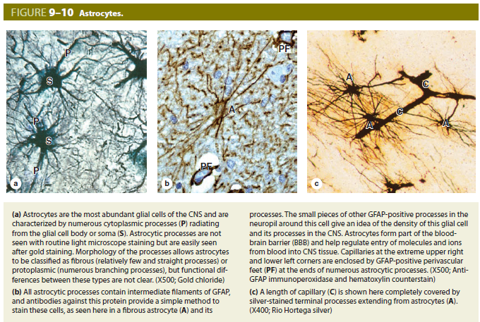

Slide 26
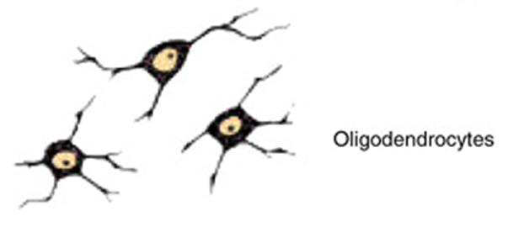
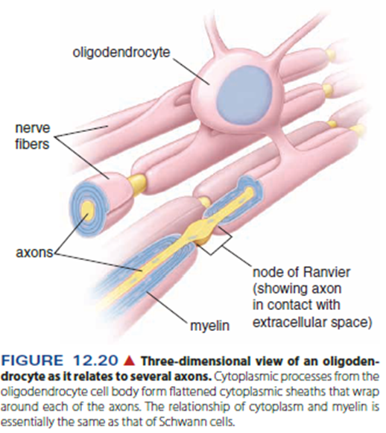
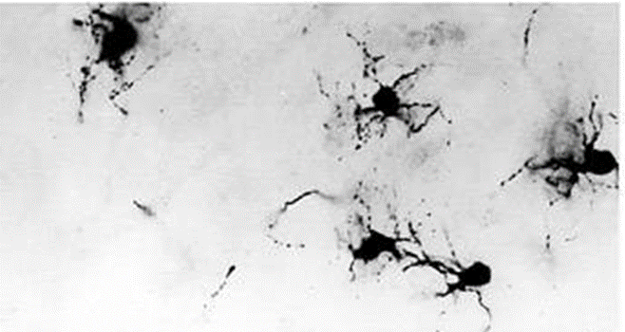
NERVE TISSUE
SUPPORTIVE CELLS
Supporting cells of the CNS
Oligodendrocytes
  Present in white and gray matter
  Oligodendrocytes located in the white matter of the CNS produce the myelin sheath.
  They can myelinate multiple axons

Slide 27
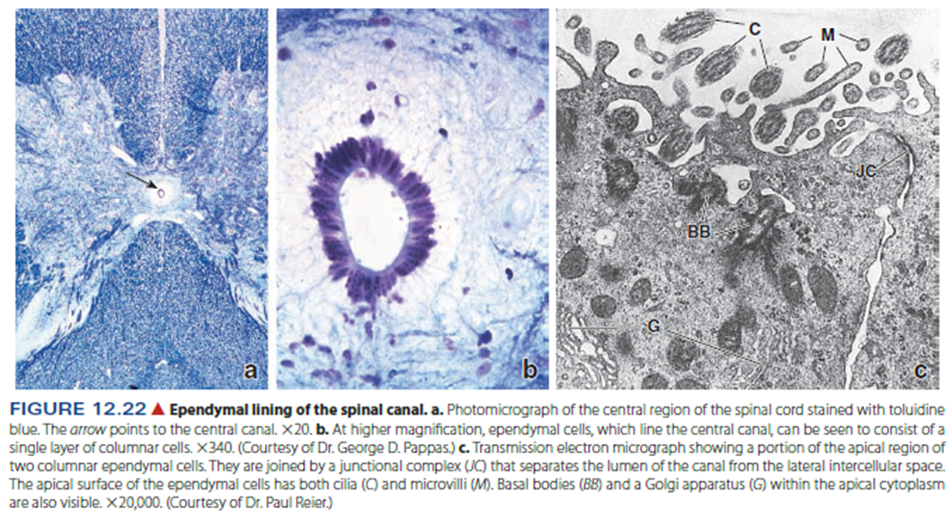
NERVE TISSUE
SUPPORTIVE CELLS
Supporting cells of the CNS
Ependymal cells
  Line central canal of spinal cord and ventricles of brain
  Cuboidal to columnar, with cilia and microvilli

Slide 28
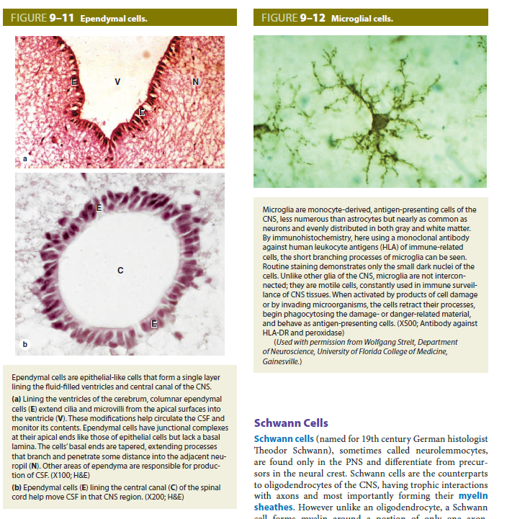
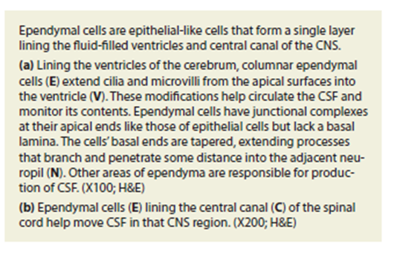

Slide 29
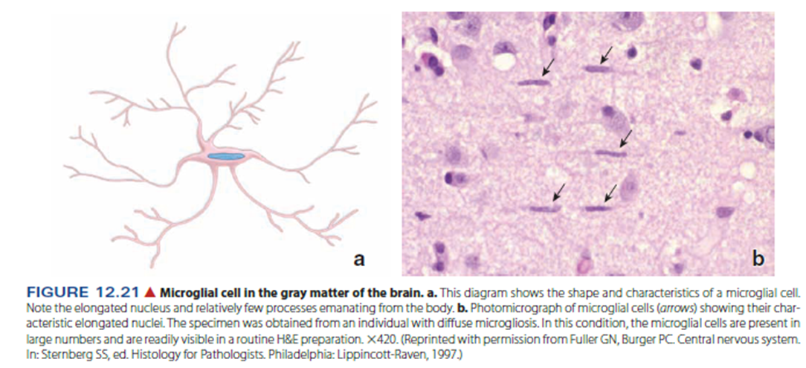
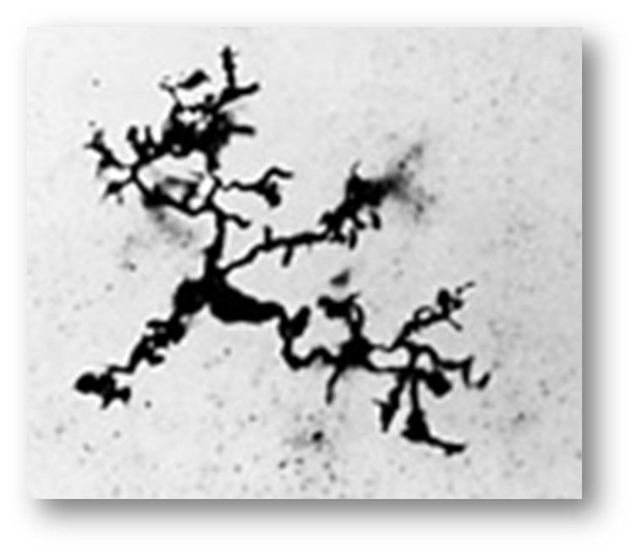
NERVE TISSUE
SUPPORTIVE CELLS
Supporting cells of the CNS
Microglia
  Small cells with short irregular precesses, elongated nuclei
  Originate from monocytes and have similar phagocytic function
  Provide immune surveillance and produce immunomodulatory compounds

Slide 30
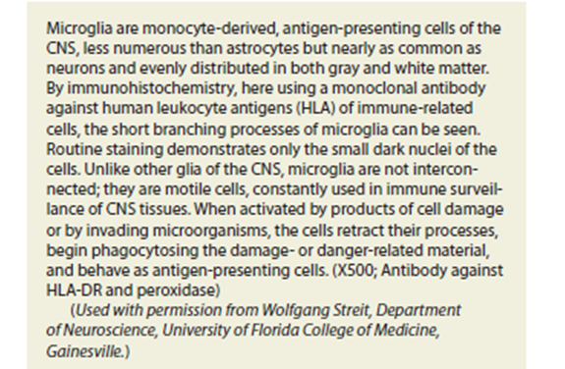

Slide 31
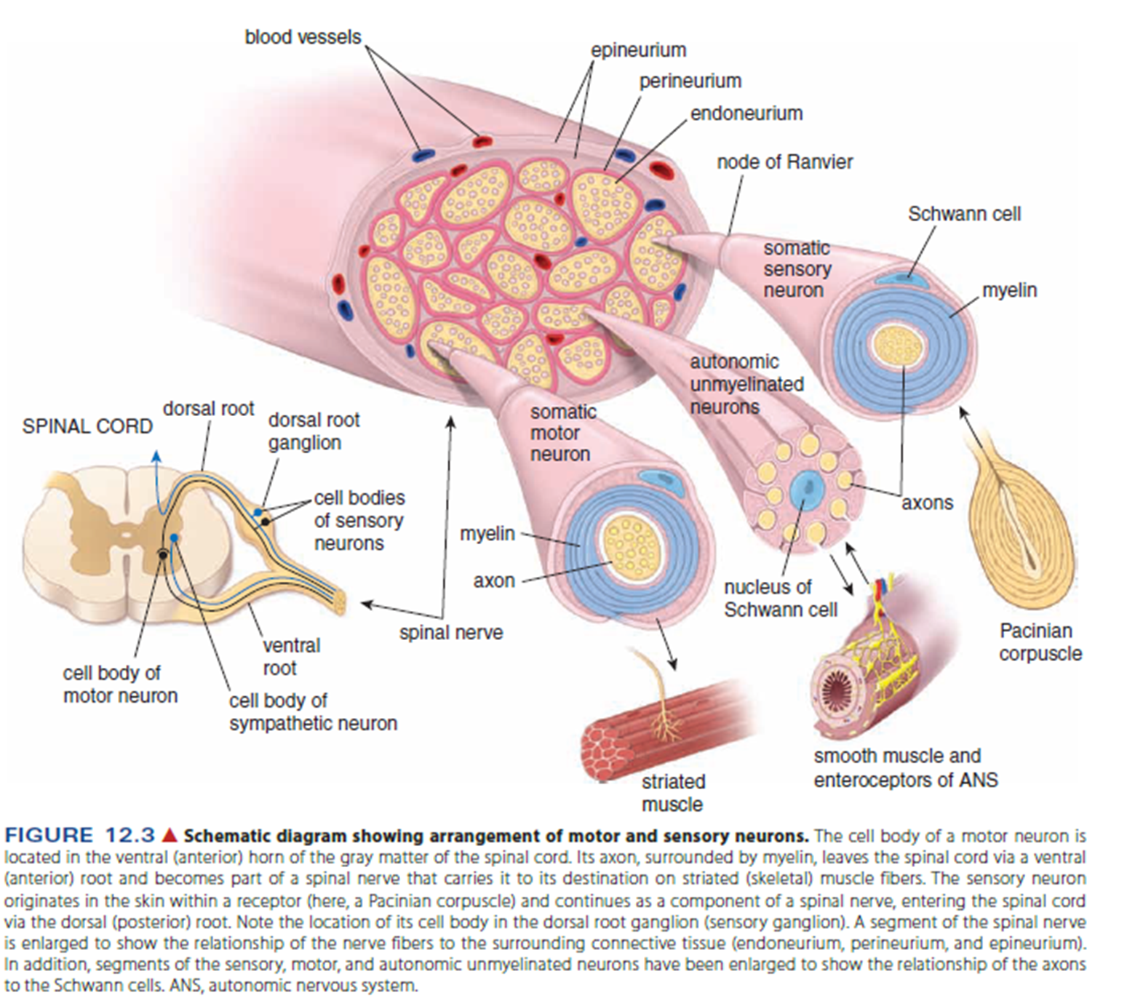
NERVE TISSUE
Main components of the peripheral nervous system
Nerves.
  Bundle of nerve fibres (axons) surrounded by glial cells (Schwann cells) and connective tissue
Ganglia.
  Collections of neuron cell bodies
Specialized nerve endings

Slide 32
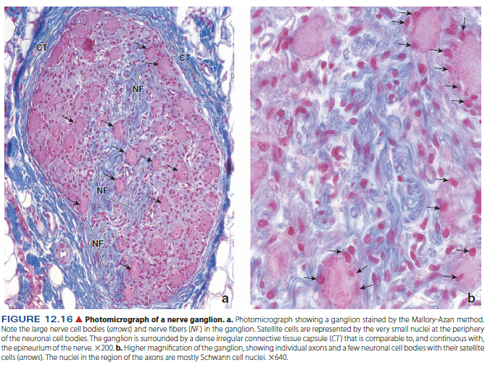
NERVE TISSUE
SUPPORTIVE CELLS
Supporting cells of the PNS
  Satellite cells
    surround cell bodies in ganglia

Slide 33
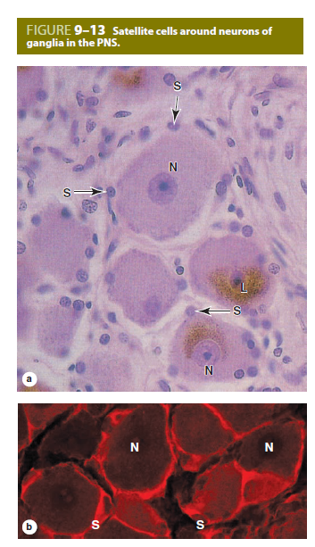
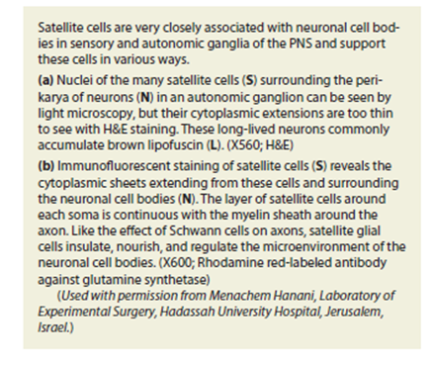

Slide 34
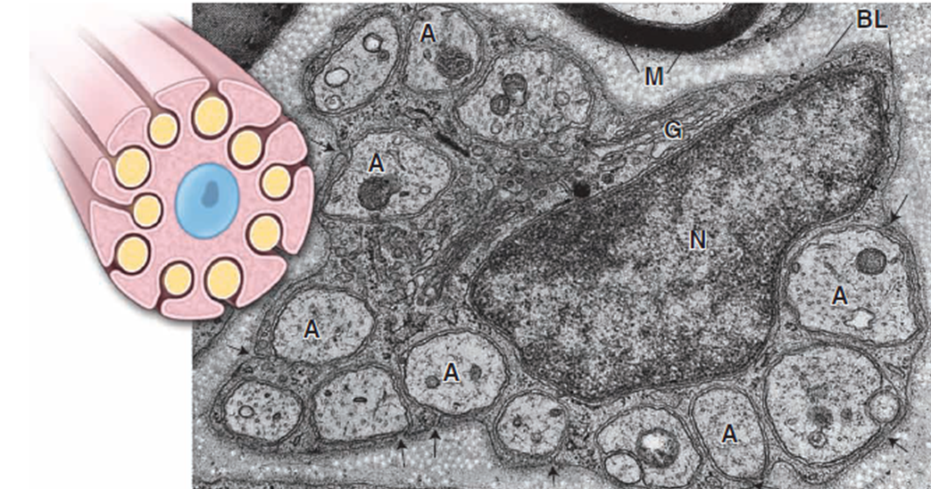
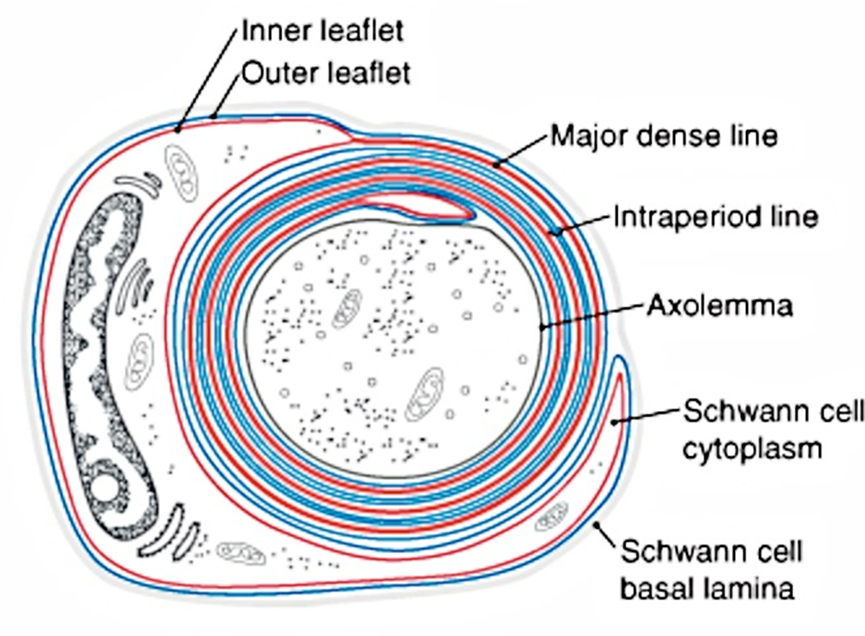
NERVE TISSUE
SUPPORTIVE CELLS
Supporting cells of the PNS
  Schwann cells
    Surround unmyelinated axons. Numerous axons indent the Schwann cell cytoplasm and, therefore, are surrounded by a single plasma membrane.
    Produce the myelin sheath around axons

Slide 35
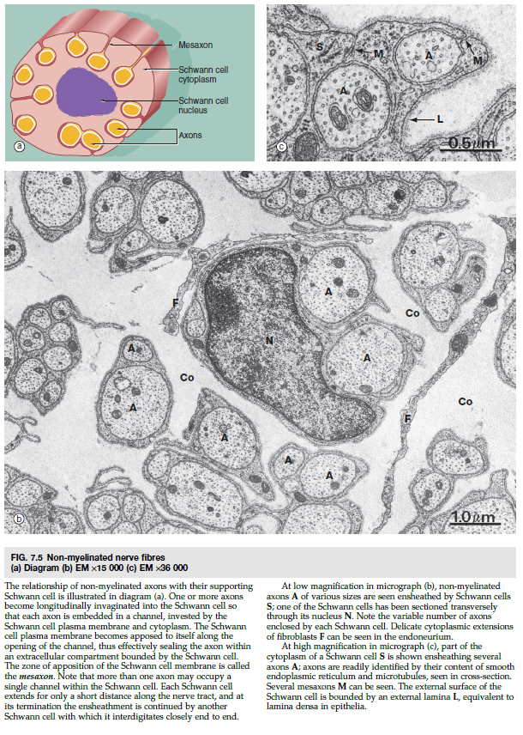
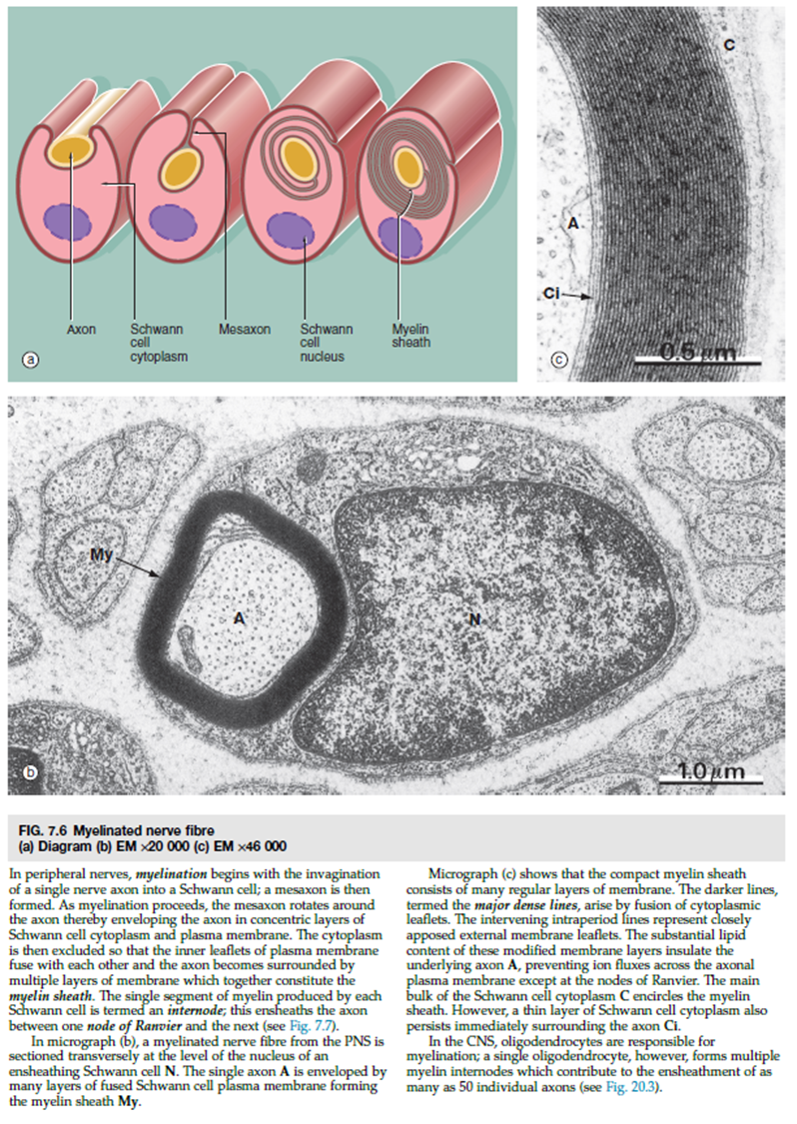

Slide 36
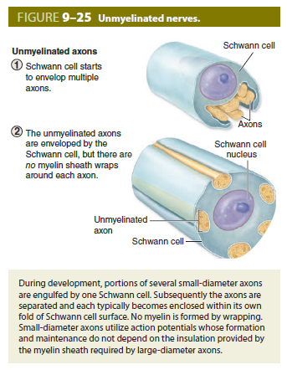
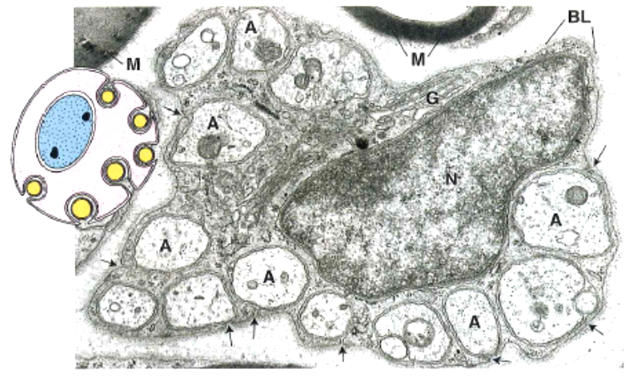
NERVE TISSUE
Unmyelinated axons

Slide 37
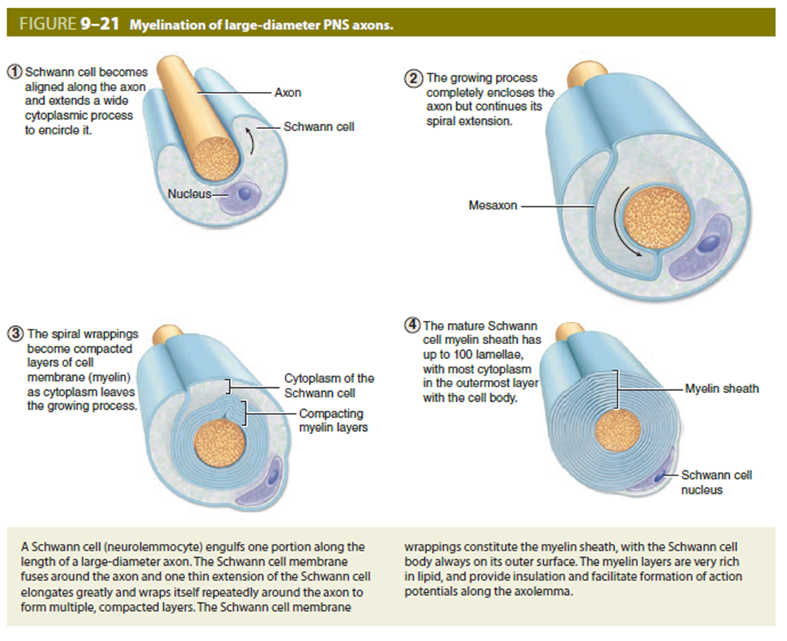

NERVE TISSUE
Myelinated axons

Slide 38

NERVE TISSUE
MYELIN SHEATH
The myelin sheath is formed by the plasma membrane of supporting cells wrapping around the axon. The sheath consists of multilamellar, lipid-rich segments produced by Schwann cells in the PNS and oligodendrocytes in the CNS.
Functions:
  Increases speed of conduction (saltatory conduction)
  Insulates the axon
Similar structure in CNS and PNS with some differences in protein composition
Organization:
  Internode. Single myelin segment
  Paranode. Ends of each internode where they attach to the axon
  Node of Ranvier. Specialized region of the axon between myelin internodes where depolarization occurs
In the PNS, each Schwann cell associates with only one axon and forms a single internode of myelin.
In the CNS, each oligodendrocyte associates with many axons (i.e., each oligodendrocyte forms multiple internodes on different axons).

Slide 39


Slide 40


Slide 41



Slide 42
NERVE TISSUE
CONNECTIVE TISSUE INVESTMENTS OF NERVOUS TISSUE
Central nervous system (meninges)
  Pia mater
    Thin membrane lying directly on the surface of the brain and spinal cord
    Accompanies larger blood vessels into the brain and spinal cord
  Arachnoid membrane
    Separated from pia mater by connective tissue trabeculae
    Encloses the subarachnoid space, which contains blood vessels and the cerebrospinal fluid (CSF) produced by the cells of the choroid plexus
    Together with pia mater, constitute the leptomeninges; inflam¬mation of these membranes produces meningitis
  Dura mater
    Outermost of the meninges
    Dense connective tissue that includes the periosteum of the skull

Slide 43


NERVE TISSUE
CONNECTIVE TISSUE INVESTMENTS OF NERVOUS TISSUE
Peripheral nervous system
  Epineurium. Dense connective tissue surrounding fascicles and the entire nerve
  Perineurium. Dense tissue surrounding groups of axons and their surrounding Schwann cells, forming fascicles; forms the blood-nerve barrier
  Endoneurium. Delicate connective tissue surrounding Schwann cells; includes the basal lamina secreted by Schwann cells as well as reticular fibers

Slide 44



Notes:
Příčný řez nervem EM – epineurium (hustá vazivová síť bohatá na Col – kolagenní vlákna a F – fibroblasty), perineurium (několik vrstev plochých buněk pevně k sobě vázaných, hráz průniku makromolekul do nervu), endoneurium (hlavně retikulární vlákna – RF syntetizovaná Schwannovými buňkami – SC)
Periferní nerv obsahující myelinizovaná M i nemyelinizovaná vlákna U; RF na příčném řezu – z endoneuria, S – jádro S.buňky; P, šipky - buňky perineuria – bariéra
Výřez –část axonu s četnými neurofilamenty a mikrotubuly
Histo dva malé nervy a tenká krycí vrstva; arrowheads – jádra S.buňky, šipka – axon, C - kapilára

Slide 45


Slide 46



Notes:
Příčný řez nervem EM – epineurium (hustá vazivová síť bohatá na Col – kolagenní vlákna a F – fibroblasty), perineurium (několik vrstev plochých buněk pevně k sobě vázaných, hráz průniku makromolekul do nervu), endoneurium (hlavně retikulární vlákna – RF syntetizovaná Schwannovými buňkami – SC)
Periferní nerv obsahující myelinizovaná M i nemyelinizovaná vlákna U; RF na příčném řezu – z endoneuria, S – jádro S.buňky; P, šipky - buňky perineuria – bariéra
Výřez –část axonu s četnými neurofilamenty a mikrotubuly
Histo dva malé nervy a tenká krycí vrstva; arrowheads – jádra S.buňky, šipka – axon, C - kapilára

Slide 47


Slide 48


