Slide 1

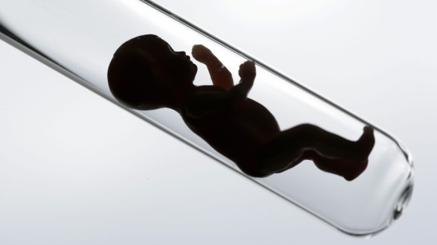
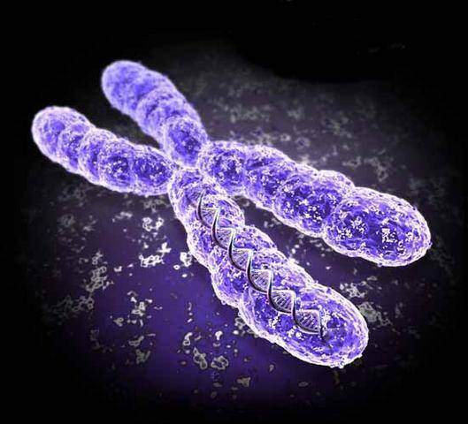
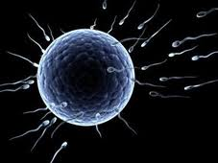


Utilization of genetic analyses in human assisted reproduction process
Mgr. Jan Smetana, Ph.D
Ústav Experimentální Biologie, PřF MU
Laboratoř molekulární cytogenetiky
OLG FN Brno
Notes:
1

Slide 2

Assisted human reproduction (AHR)
Assisted reproduction is the name given to medical procedures and methods in which germ cells or embryos are manipulated, including their storage, for the purpose of treating infertility in women or men
The complex process is now mostly based on in vitro fertilization techniques
In addition to couples with a diagnosis, couples with normal fertility also benefit, due to the risk of transmitting genetic defects or pathological markers
Specialized centers - clinics, sanatoriums
Goal - birth of healthy offspring = "infertility treatment“

Slide 3

Fertility
Fertility - definition
The ability of an individual to reproduce sexually
A complex trait that results from the ability of males and females to produce healthy offspring in optimal numbers over time
Demographic indicator expressing the average number of offspring per female

Slide 4
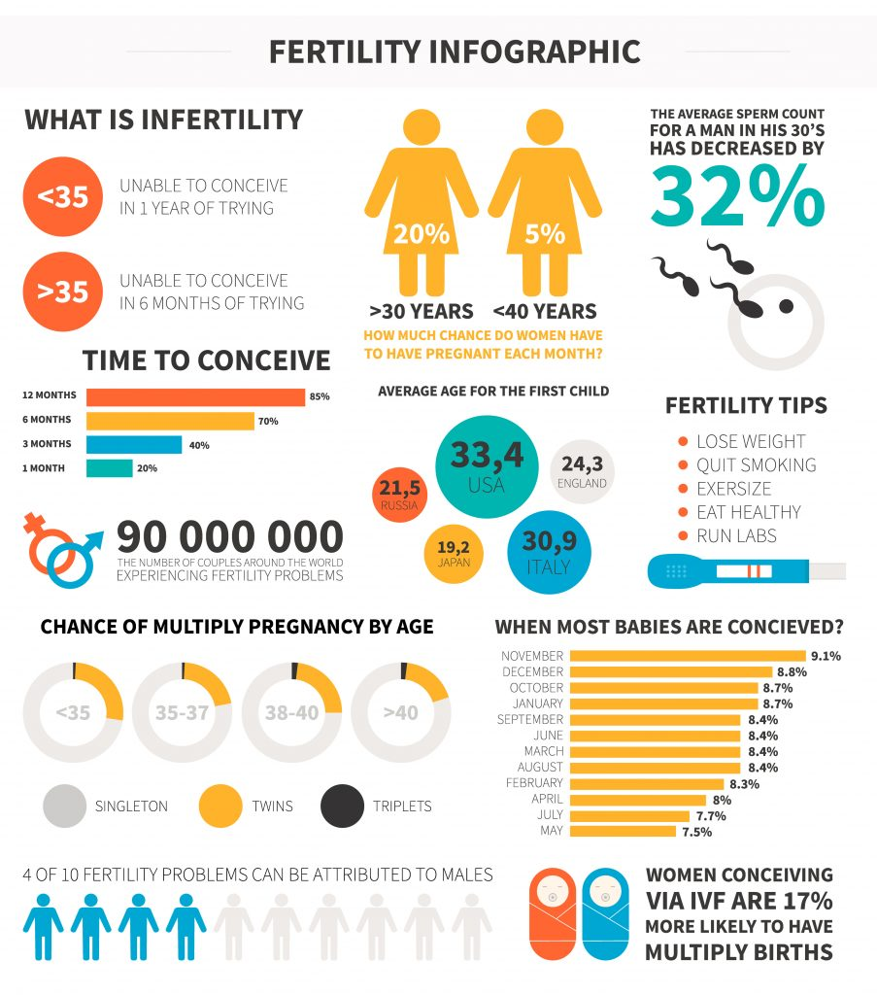
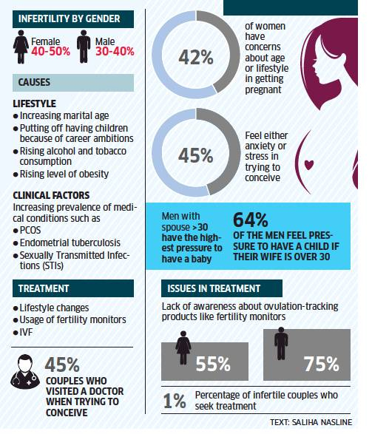
Infertility
Failure to achieve clinical pregnancy after 12 months or more of unprotected regular sexual intercourse (WHO)

Slide 5
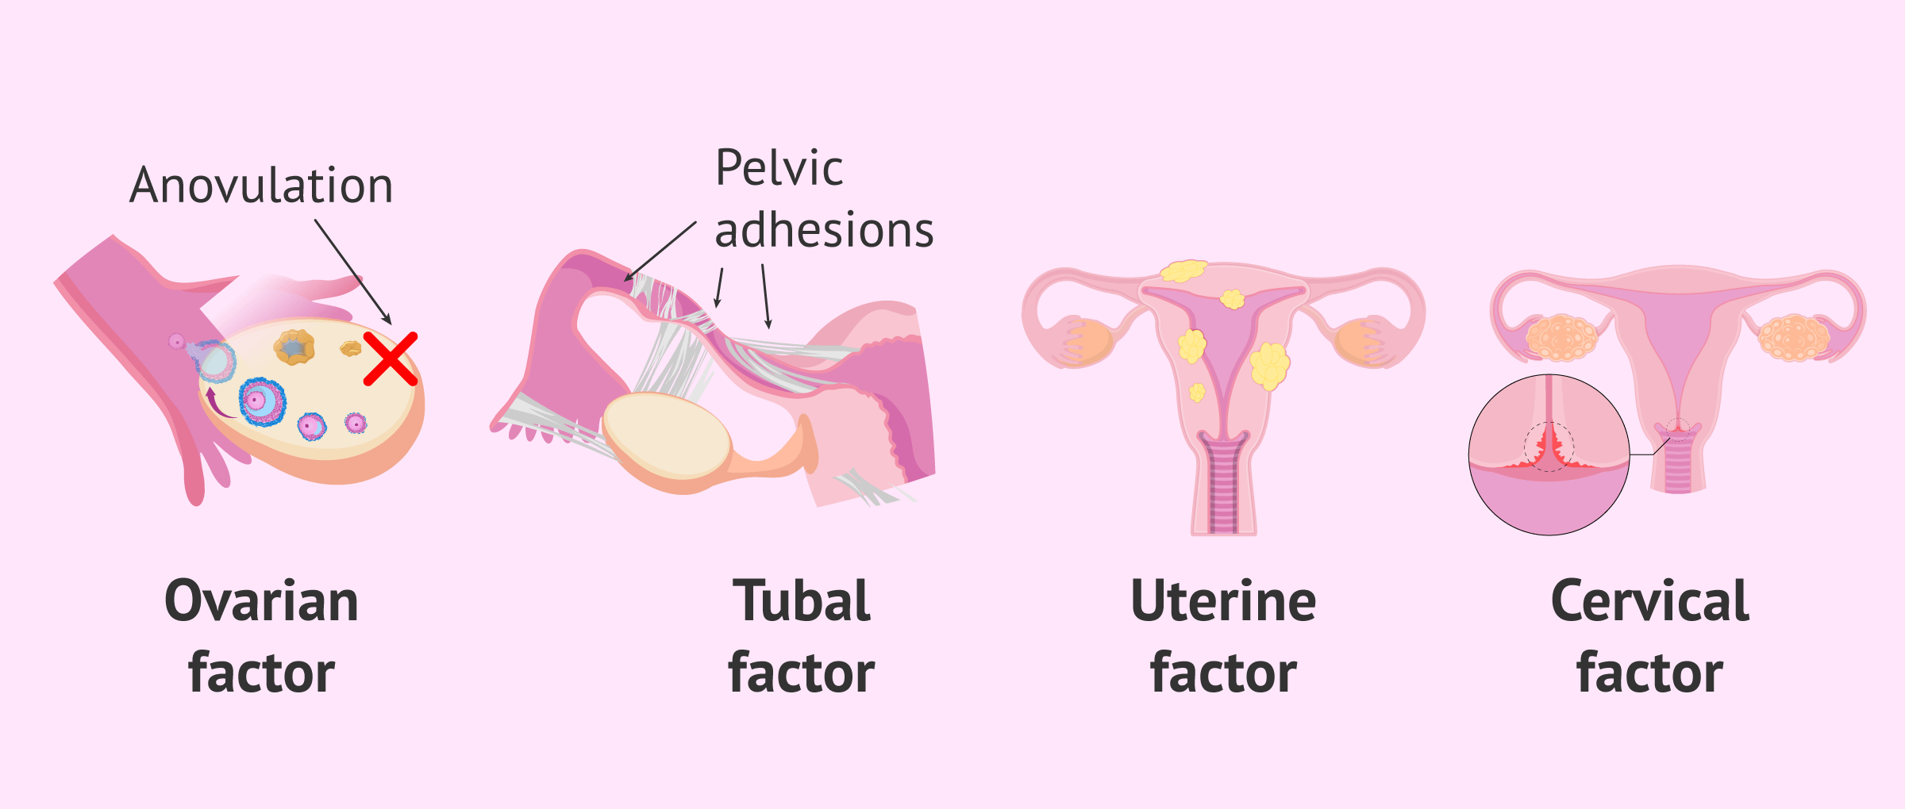
Causes of female infertility
ovarian factor - the ovary does not form or does not release a quality viable egg
tubal factor - damage to the fallopian tubes, missing fallopian tubes, obstructed fallopian tubes
endometriosis - presence of uterine lining outside the uterine cavity

Slide 6
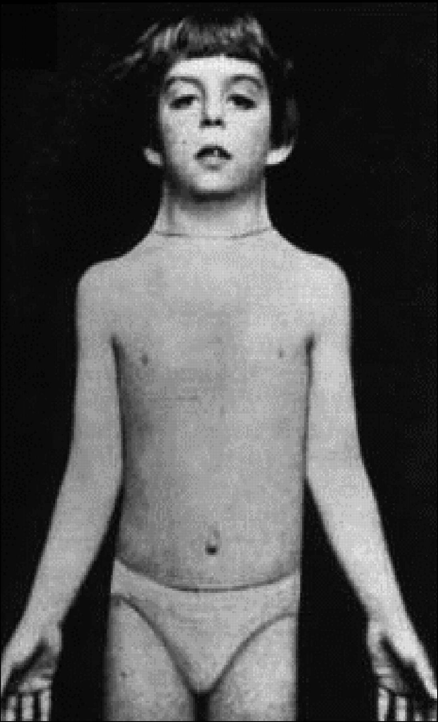
Genetic causes of female infertility
Chromosome aberrations – structural ornumerical
Turner syndrome - 45, X
"Superwomen" - 47, XXX
Aneuploidy in gametes
Robertsonian translocations, centromeric fusion acrocentric chromosomes (13-15, 21, 22)
Mutations - genes affecting blood clotting
MTHFR (1p36.3)
Leiden mutation (F5 - 1q23),
G20210A in the thrombin gene
CFTR

Slide 7
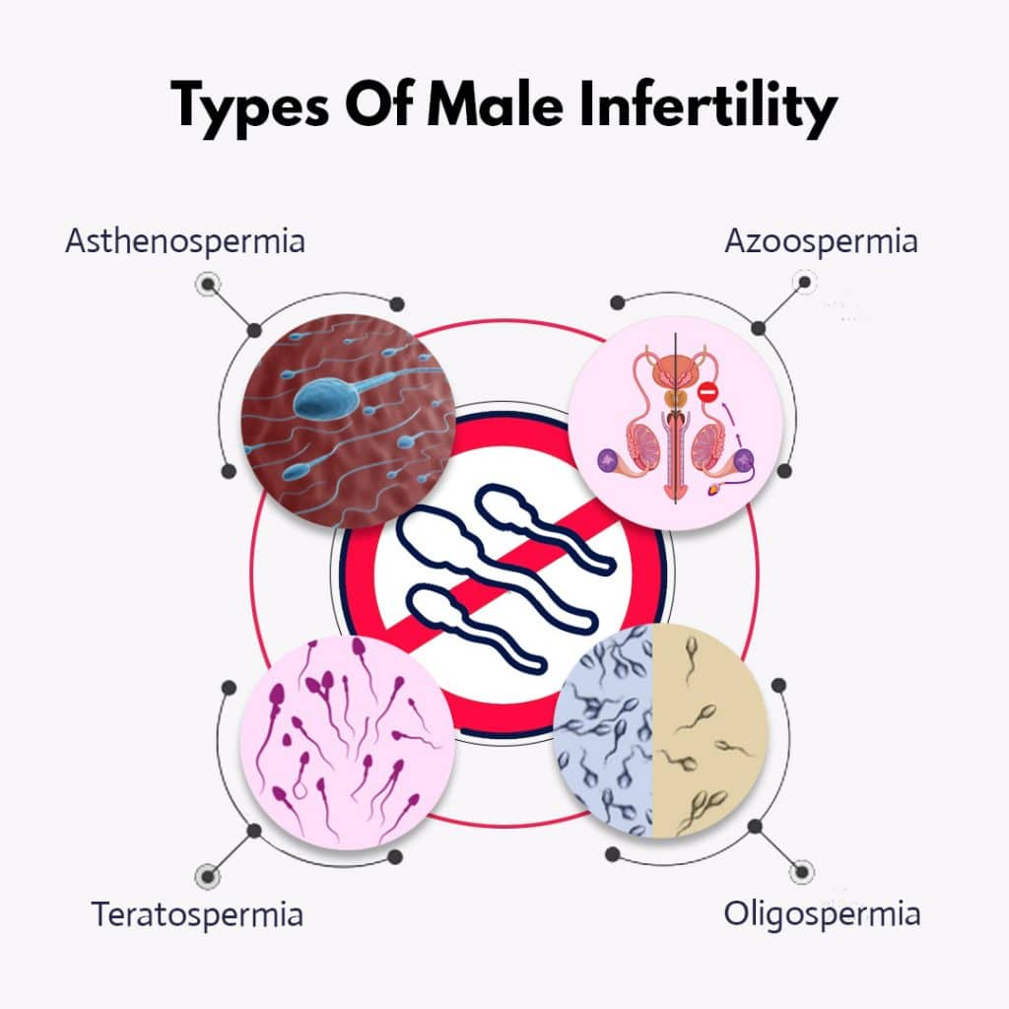
Causes of male infertitlity
Male factors
poor sperm function – sperm incompetence to penetrate and fertilize a woman's egg
Oligozoospermia
  (<15*10⁶ in ejaculate)
Asthenozoospermia
  lack of motility
Teratozoospermia
  abnormal morphology
Azoospermia
  absence of sperm in the ejaculate

Slide 8
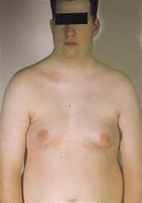
Genetic causes of male infertility
Chromosomal aberrations
Klinefelter syndrome - 47, XXY
Males - 47, XYY
Structural abnormalities chr. Y
  Deletion in (Yp)(11.3) - SRY - disorder of genitourinary
  development
  Deletion Yq11 - AZF - azoosperima factor = disorder
  of sperm development
Autosomal translocations, Y/A, Robertsonian translocations
- centromeric fusion of acrocentric chromosomes (13-15, 21, 22)
Aneuploidy in gametes (X,Y, 21, 13,18)
Gene mutations
Cystic fibrosis - F508 mutation in CFTR1, 97% of men infertile

Slide 9


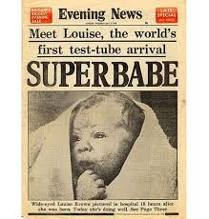
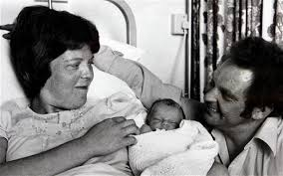

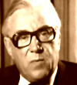
History of IVF
17th century- van Graaf - Graaf follicles, van Leeuwenhoek - observation of
mammalian sperm
19th century - first scientific papers on in vitro fertilization in animalsSchenk (1878),
W. Heape - birth of 6 rabbit pups after vitro fertilization (1890).
1944 - Rock, Menkin - in vitro fertilization of human oocyte
1951 - Austin, Chang - the fertilizing ability of sperm is essential for its
previous residence in the female genital tract (sperm capacitation)
2nd half of the 20th century - Cambridge University - R.G. Edwards
Description of oocyte maturation and in vitro fertilization, possibility of
embryo culture
1971 - Steptoe, Purdy: Nature - possibility of in vitro culture of human embryos
to the blastocyst stage
Late 70s - improvements in culture media, laparoscopic techniques, Cryopreservation
1978 - Lancet - clinical applications of in vitro fertilization
L. Brown 2010 - R.G. Edwards - Nobel Prize
A. van Leeuwenhoek
R.G. Edwards
P.C. Steptoe

Slide 10
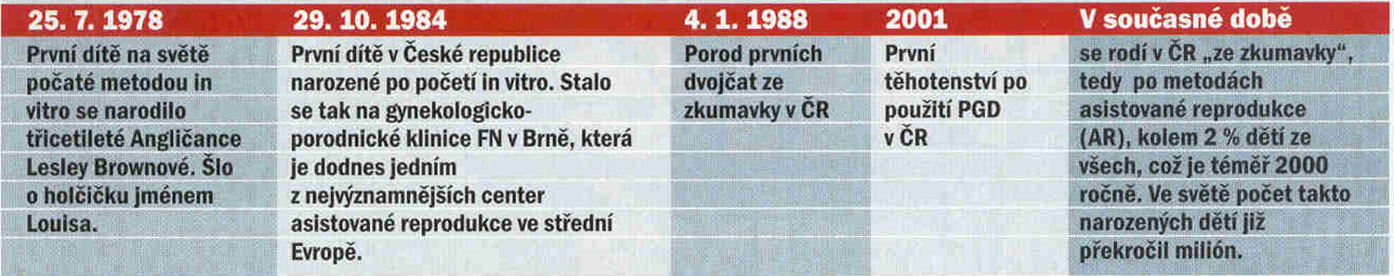

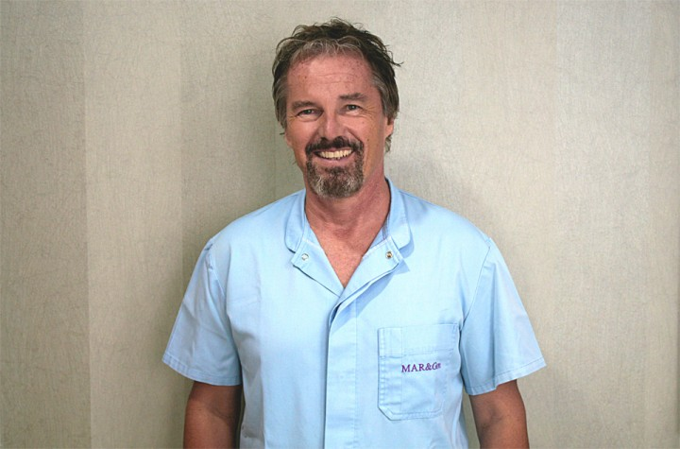

Historie IVF Č(SS)R
MUDr. J. Tesarik
Prof. P. Trávník
Prof. L. Pilka

Slide 11

IVF centers in Brno

Slide 12
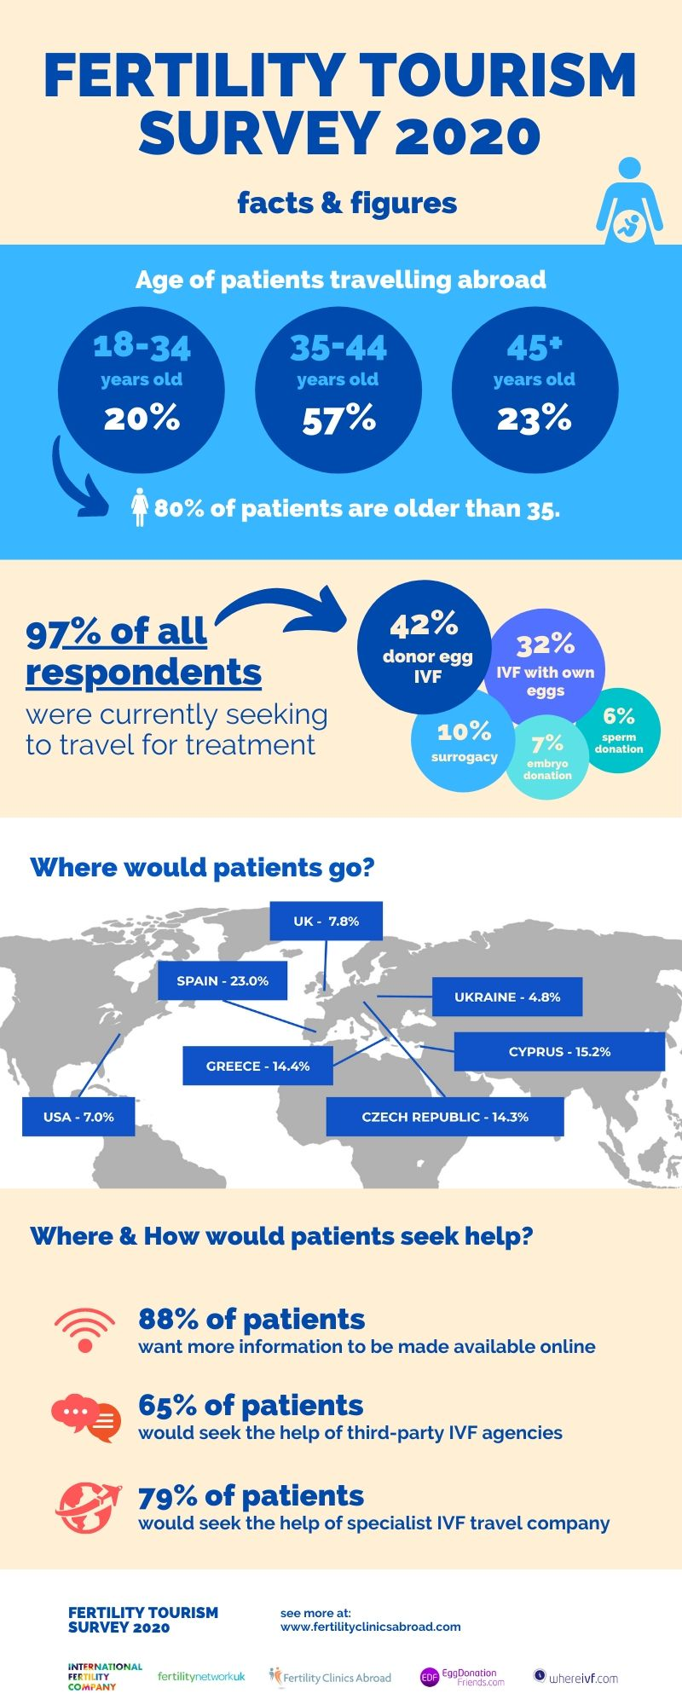
IVF centers in Czech rep.
There are currently over 45 registered IVF centres in the Czech Republic (6x Brno, 8x Prague)
Private IVF centers, (gynecology, obstetrics, reproductive medicine, genetics, biochemistry)
Annually over 20,000 IVF cycles
Over 50% covered by health insurance companies
Specialization on foreign clientele - "reproductive tourism„

Slide 13
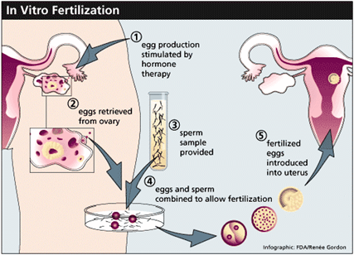
IVF process

Slide 14
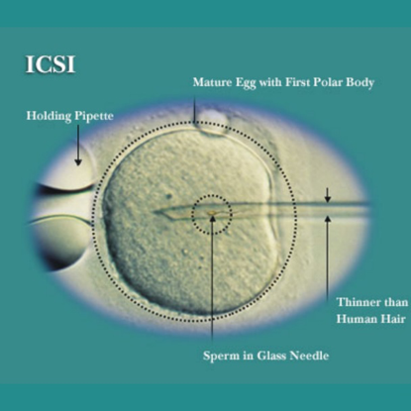
Methods of AHR
Intrauterine insemination (IUI)
= concentrated, purified sperm are introduced through a special catheter into the uterine cavity during ovulation
In vitro fertilization (IVF)
= classical method of ectopic fertilization,
in which sperm are cultured with
oocytes in vitro.
3. ICSI - intracytoplasmic sperm injection
through the zona pellucida into the egg
4. PICSI - enhanced ICSI
allows only the sperm to be selected and injected into the oocyte mature sperm through the attachment to the oocyte complex (hyaluronan)
www.gipom.com

Slide 15
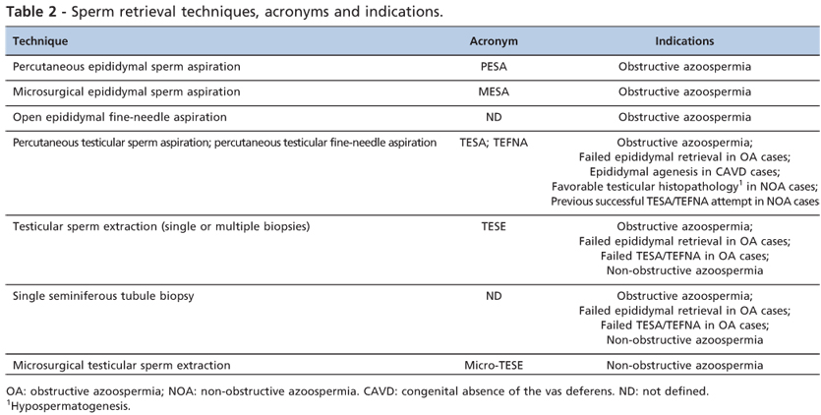
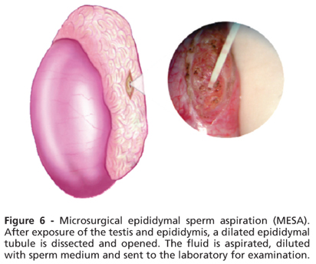
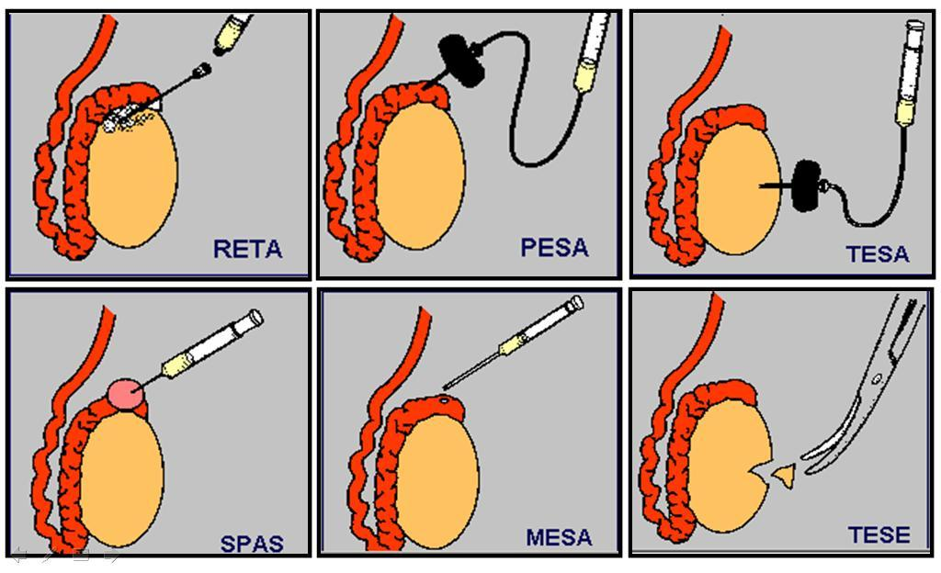
Chirurgical sperm aspiration

Slide 16
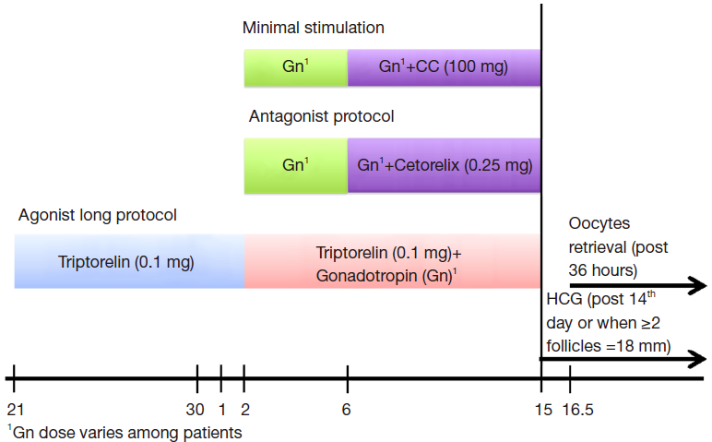
Hormonal stimulation – harvesting of oocytes
GnRH - gonadorelin, gonadotropin-releasing hormone
CC - clomiphene citrate, synthetic estrogen, ovulation support

Slide 17
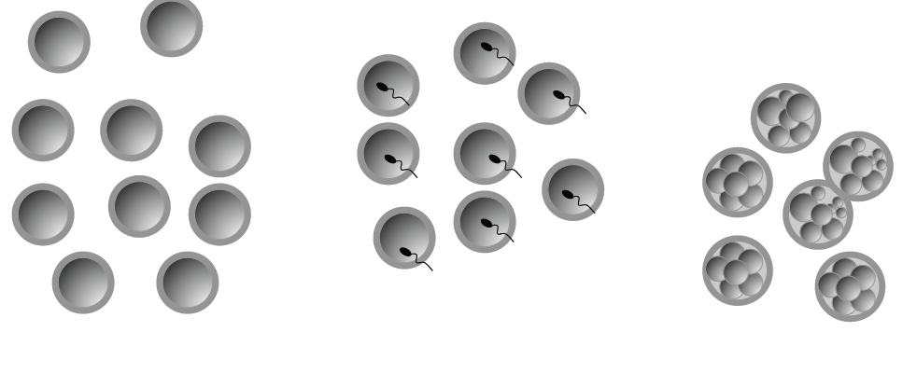
IVF cycle
In the process of an IVF cycle, we usually obtain several embryos...
Ideally, a single embryo transfer is performed
x selection...which is „the best“ - morphology, genetics?

Slide 18
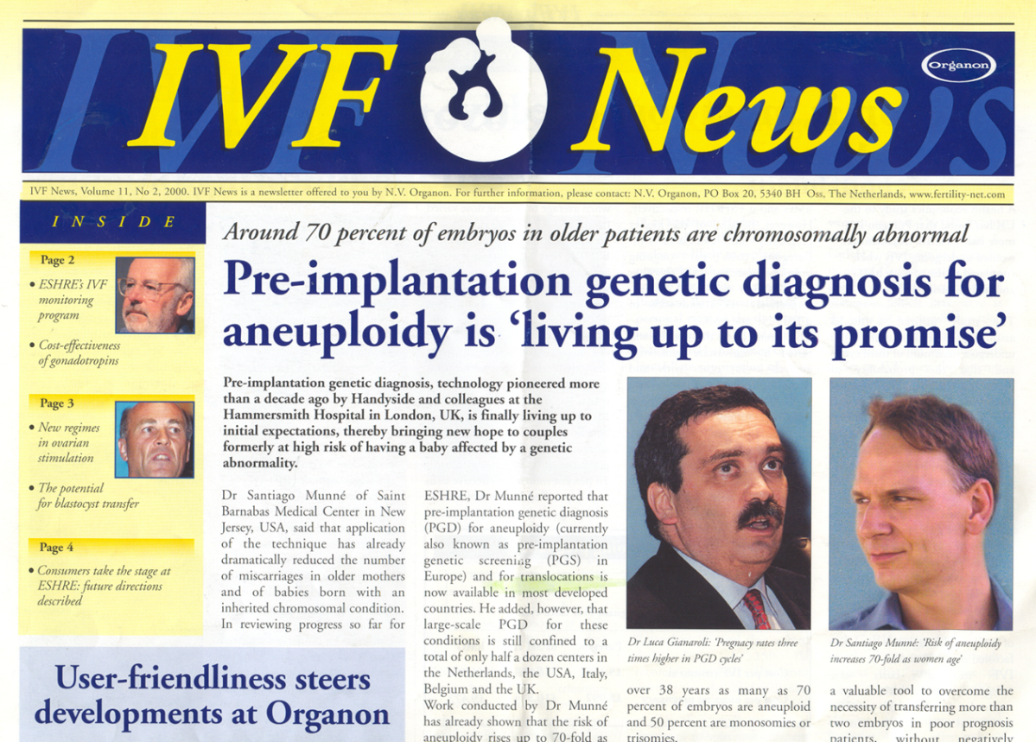
Genetic aberrations and IVF
a large proportion of embryos, regardless of the age of the mother, are aneuploid (54% under the age of 35, 82% aged 40 and over)
Reason = disruption during meiosis

Slide 19
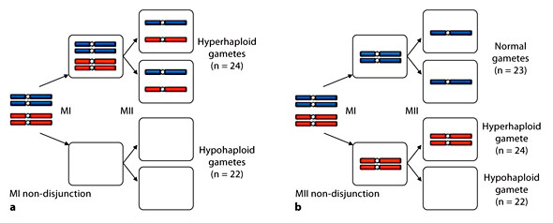
Chromosomal aberrations in embryos
~ 90% of aneuploidies occur during meiosis I in women
= gradual degradation of cohesin leads to
violation of bivalent integrity
Aberration of segregation during Meiosis I

Slide 20
Preimplantation genetic analyses (PGA)
PGT-M: Preimplantation genetic testing of monogenic diseases
  Previously PGD = monogenic diseases
    Sex selection in X-linked diseases
    Congenital structural abnormalities (Robertsonian translocations, balanced translocations
    PGT-A: Preimplantation genetic testing for aneuploidies
    Screening of the most common congenital chromosomal aneuploidies

Slide 21
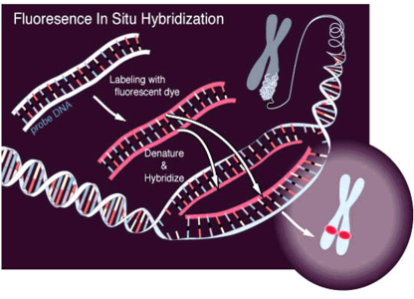
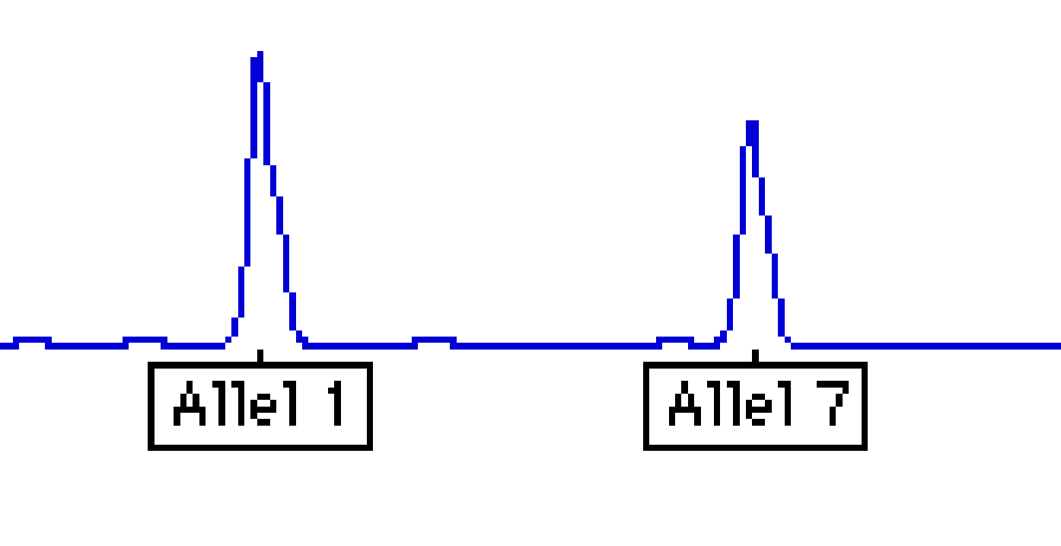
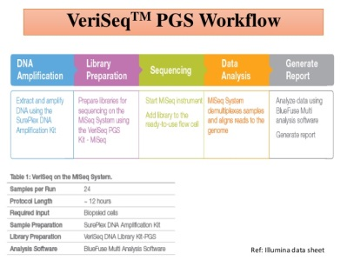
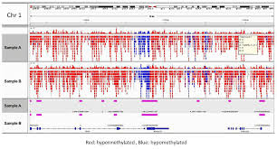
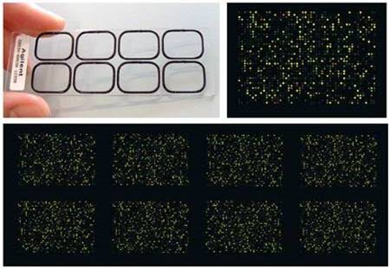
PGA methods
Molecular cytogenetics (I-FISH, CGH)
aneuploidy, translocations, microdeletion syndromes, etc.
PCR - monogenic diseases
  specific mutations - CF, thalassaemia, sickle cell
anemia, hemophilia, DMD.....
  QF PCR - +13,16,18,21, X,Y
Screening techniques - "PGD 2.0" - whole genome coverage
  array-CGH (DNA chips) - numerical and structural CHA
  SNP chips - KARYOMAPPING
  NGS - comprehensive approach, PGD+PGS combination

Slide 22
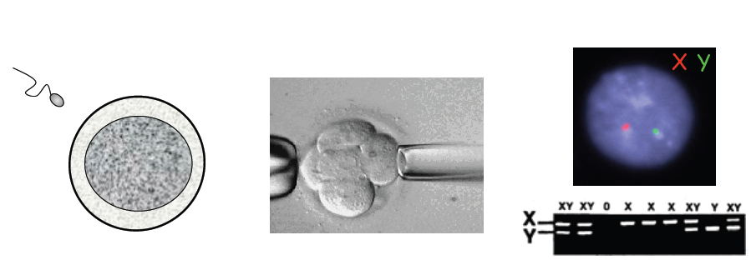
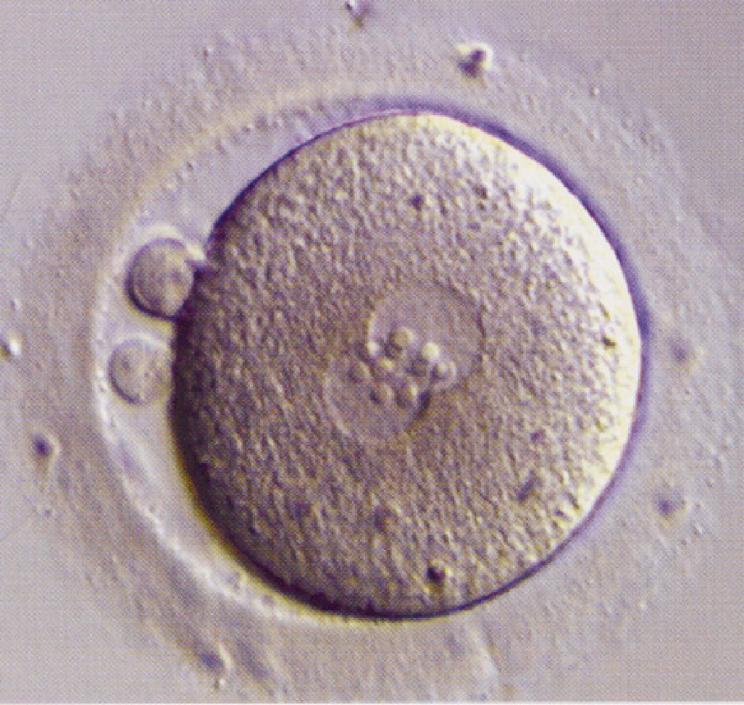
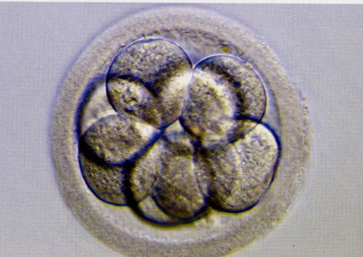
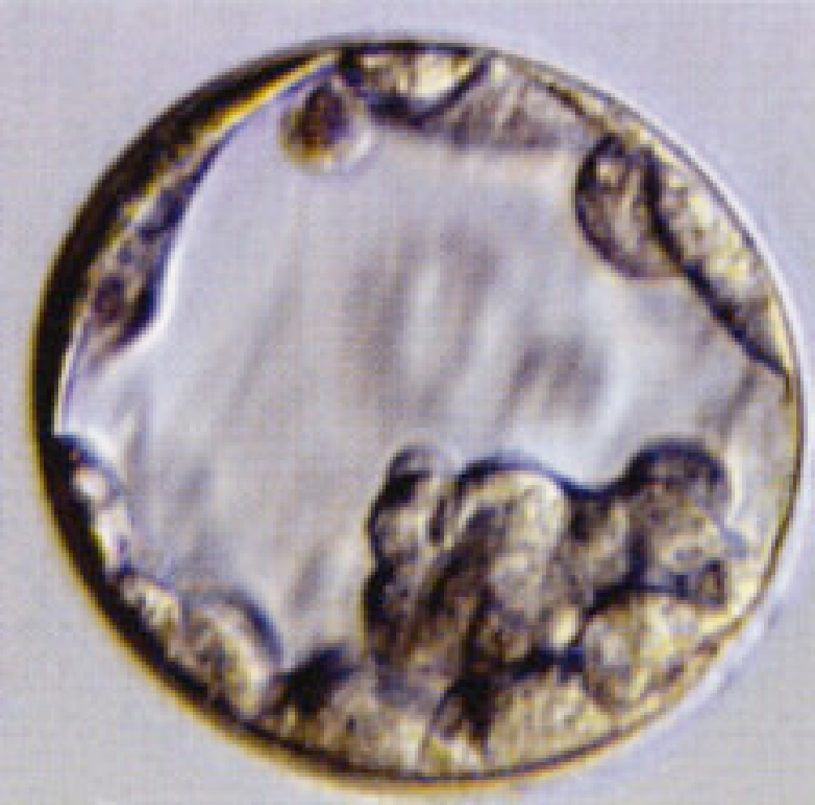
PGA – biological material
Oplození in vitro
Biopsie embrya
Genetický test
Polární tělísko
Blastomera (3. den)
Blastocysta (5-6. den)

Slide 23
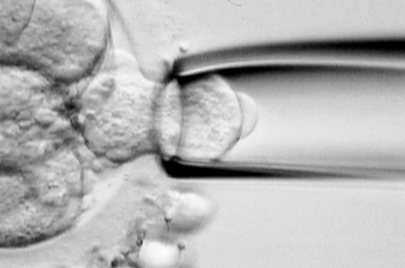
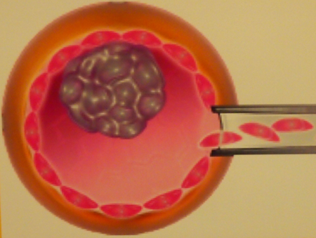
Embryo biopsy difference between 3rd and 5th harvest day
Day 3 embryo biopsy (blastomeres)
analysis of 1 - 2 cells
30 - 60% loss of implantation potential
higher risk of mosaicism
time constraint (24 hours)
Embryo biopsy day 5-6 (blastocyst)
analysis of 5 - 10 cells
less risk of mosaicism
possibility of embryo vitrification = sufficient time for examination
not all embryos reach the stage blastocysts = slection
Notes:
23

Slide 24
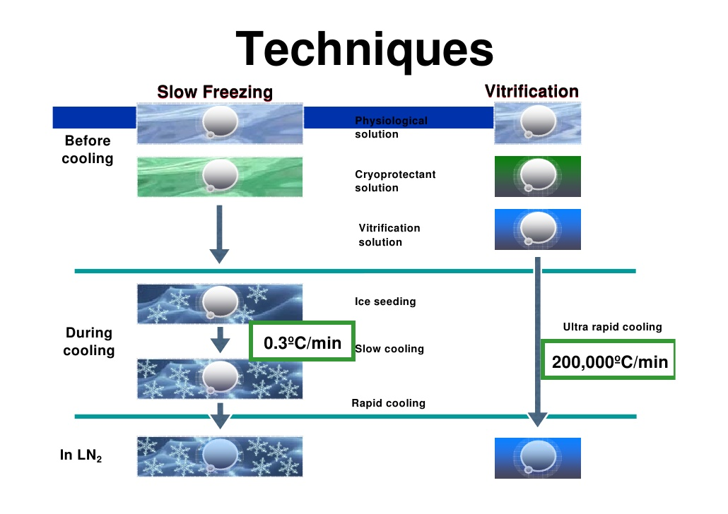
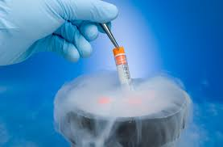
Vitrification of embryos
Vitrification
modern method of effective cryopreservation of embryos, oocytes and sperm
Superfast freezing of biological material with a mixture of suitably selected cryoprotectants (sucrose, dimethylsulfoxide) at -196C
Viablity after thawing approx. 98%

Slide 25
Chromosomal aberrtaions in embryos
Multiple chromosome aberrations (aneuploidy)
are the most common genetic alteration in human embryos
aneuploidies often occur in morphologically normal developing embryos (A. Mertzanidou, 2013)
reduce the success rate of assisted reproductive techniques
Structural chromosome aberrations
postzygotic mitotic disorders are very common in embryos
Chromosomal instability - duplication, amplification, deletion, UPD - has been demonstrated in up to 70% of embryos using SNP chips (Vanneste et al., 2009)
SCREEINING OF MERE ANEUPLOIDIES IN EARLY EMBRYOS IS NOT ENOUGH!

Slide 26
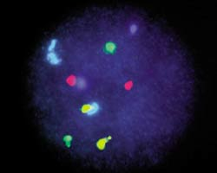
PGA with the use of I-FISH
Screening - AneuVysion Vysis MultiVysion Probe Panel (13,18,21,X,Y,16,22)
SpectrumGreen 21
SpectrumRed 13
SpectrumBlue X
SpectrumGold Y
SpectrumAqua 18
Multiple chromosomes on one cell - repeated FISH (FISH - evaluation, washout, new FISH - evaluation)

Slide 27
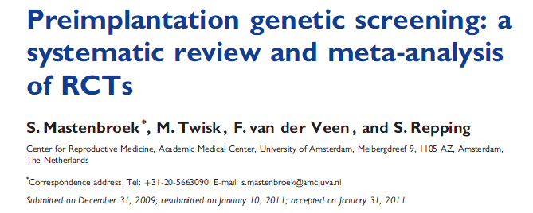
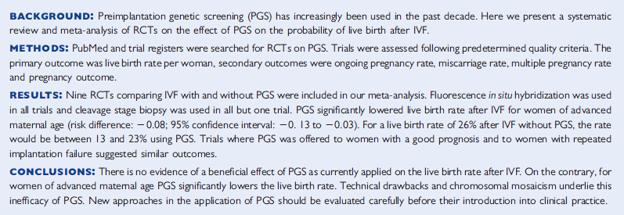
PGA with I-FISH does not improve IVF success.....why?

Slide 28
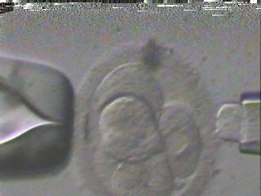
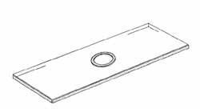
Problems of PGA I
examination of single cell - possibility of diagnostic error ?

Slide 29
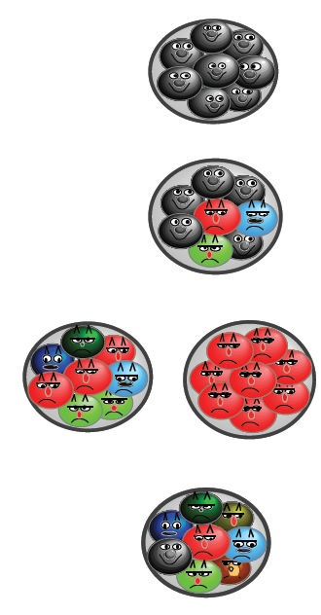
Problems of PGA II
EMBRYA:
normal (all diploid cells)
Mosaic (diploid + aneuploid cells)
abnormal (all cells
abnormal)
chaotic (each cell contains
different number of chromosomes)
One cell does not have to represent the whole embryo !!!

Slide 30
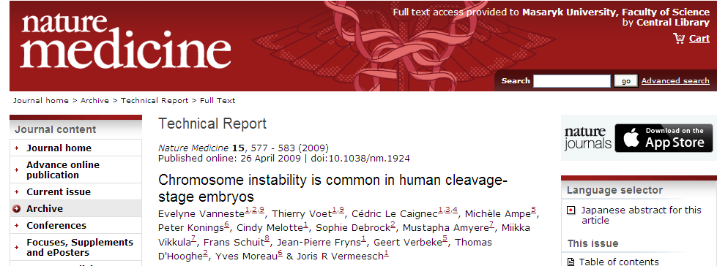
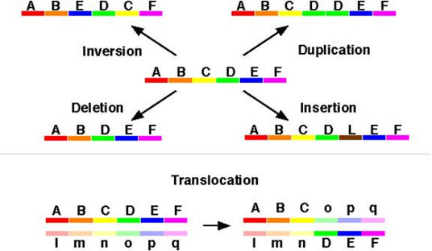
Problems of PGA I – structural CHAs
It's not enough to investigate aneuploidy!
Whole genome testing!
structural aberrations (deletions, duplications, UPD etc...) also occur in embryos ...post-zygotic mitotic disorders are more frequent than meiotic ones...

Slide 31
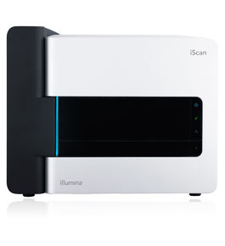
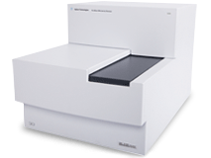
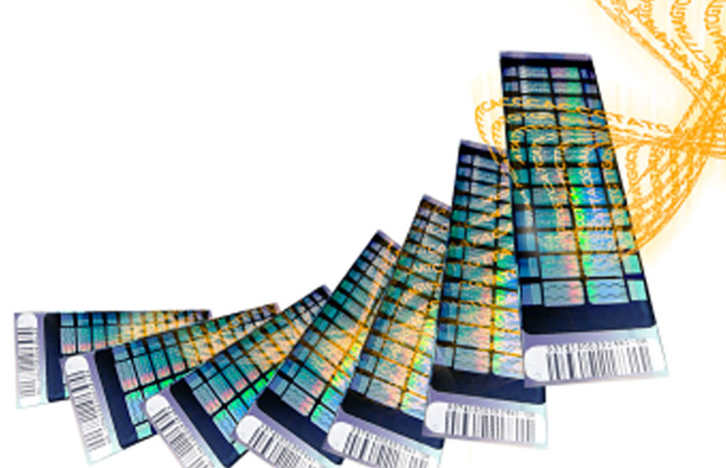
Use of whole genome screening techniques in PGA
Isolation of one - several cells + whole genome amplification
Use of array-CGH microarray techniques, SNP chips, NGS
Possibility to examine the whole genome - necessary in a short time interval (24 h) X frozen embryos (vitrification)

Slide 32
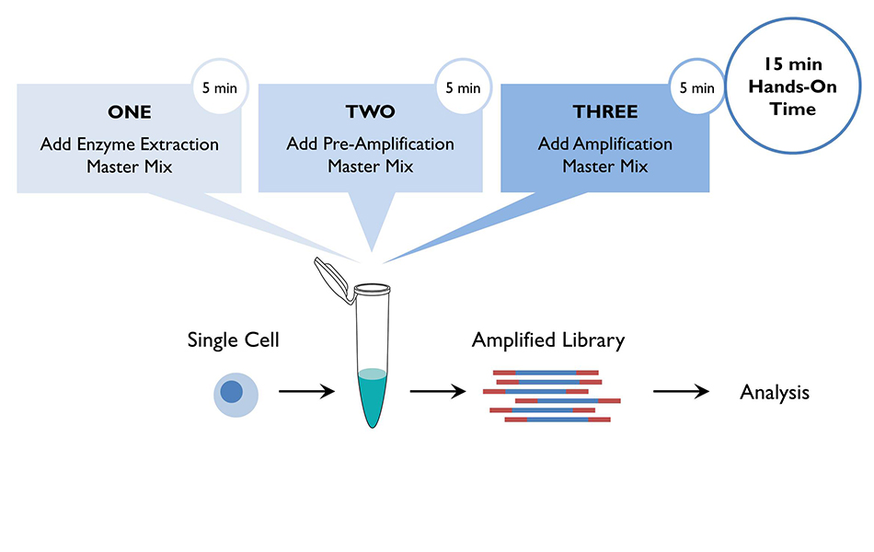
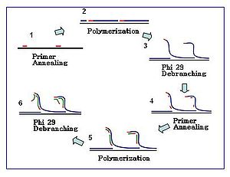
DNA amplification – key step in complex PGA
Genomic methods – hunderts ng of DNA needed, = 10⁶cells
XX
trophoectoderm aspirate 20 cells = pg DNA, DNA amplification required
Notes:
32

Slide 33



Notes:
33

Slide 34


PCR based WGA amplification
Single cell WGA principy – PCR
Multiple displacement amplification
Advantages:
higher yield, simple protocol, less time consuming
XXX
creates artifacts, ADO
Applications: array-CGH, QF - PCR
Circular amplification using the thermostable phage mutant Phí29
Advantages - lower ADO rate, no amplification products x more challenging, lower yield
Applications: NGS, methylation analysis (PWS/AS)

Slide 35



BAC array CGH – PGS in 12 hours
Aneuploidy and structural changes (deletions, duplications) in the whole genome ; Resolution ~ 5 Mbp

Slide 36

Metodika screeningových technik u PGT
Array-cgh workflow

Slide 37

PGA using high-resolution array-CGH
Material: cells from trophoectoderm of 5-day-old embryos
Amplification protocol: PicoPLEX WGA Kit (Rubicon Genomics, USA)
Microarrays: 8x15K - CytoSure™Single Cell Aneuploidy Array, OGT UK
8x60K - Agilent SurePrint G3 Oligo CGH Microarray
Software: CytoSure Interpret Software, Genomic Workbench
Notes:
37

Slide 38

Comparison of chromosome 19 profile on Agilent and OGT platform
Agilent 8x60k
OGT 8x15
Higher false positivity of the 15k platform, most commonly chr. 11, 16 and 19

Slide 39

Porovnání profilu chromozomu 22 na platformě Agilent a OGT
Agilent 8x60k
OGT 8x15
Agilent 8x60k
OGT 8x15k
Higher density of 60k microarrays gives more robust results compared to 15k

Slide 40

Mikulášová A. et al, SLG konference 2014, Praha

Slide 41

Results of PGS array-CGH screening
most common monosomy: chromosome 22 (7.7%; 5/65), 7, 8 and 18 (6.1% each; 4/65)
most common trisomy: chromosome 15, 21 and 22 (4.6% each; 3/65)

Slide 42


Results of PGS array-CGH screening
Visualization of 8.4 Mb segmental deletion in chromosome 13q21.32 - q22.2 affecting loci ofCDH9, KLHL1, ATXN8OS, DACH1, C13orf37, C13orf34, DIS3, PIBF1, KLF5, KLF1 gene.

Slide 43




Slide 44

Karyomapping – PGA-M

Slide 45

Karyomapping – PGA-M

Slide 46

Karyomapping – PGA-M

Slide 47

Karyomapping – PGA-M

Slide 48

Karyomapping – PGA-M
https://els-jbs-prod-cdn.jbs.elsevierhealth.com/cms/attachment/87c0990f-7465-402a-a562-20be1ed5580d/rbmo1376-fig-0001.jpg

Slide 49
Kubeciek et al, Incidence and origin of meiotic whole and segmental chromosomal aneuploidies detected by karyomapping. 2018. https://doi.org/10.1016/j.rbmo.2018.11.023

Slide 50



Karyomapping – PGA-M

Slide 51
Karyomapping – PGA-M
Benefits
Fast and efficient method for complex PGA-M if we have a suitable reference
Detection of structural deletions, aneuploidies and monogenic diseases
Disadvantages
Patented technology (Illumina), no competition for chemistry, costly, closed system
Potential for problems in the absence of reference DNA

Slide 52

Next generation (massive parallel) sequnincg in PGS

Slide 53
Massive parallel sequencing technology (MPS) in IVF
NGS technologies are starting to make their way into PGS
Processing of a larger number of samples in one experiment compared to microchip techniques
Currently used in large IVF clinics mainly for screening of aneuploidies x possibility of a comprehensive view (ploidy, structural changes, mutations)
Most often a form of closed systems - Illumina, Ion Torrent, or a form of library preparation (e.g. Agilent, Roche, etc.)

Slide 54


VeriSeq PGS (Illumina)
Sequenicng by synthesis
Anueploididy detection in 12 hours
Up to 24 samples, resolution 16 Mbp

Slide 55

VeriSeq PGS (Illumina)

Slide 56

VeriSeq PGS (Illumina)

Slide 57

VeriSeq PGS (Illumina)
BlueFuse analytický SW

Slide 58


VeriSeq PGS (Illumina)

Slide 59

Ion Torrent Semiconuctor Sequencing

Slide 60



Ion Torrent Aneuploidy Analysis
(Life Tech Inc.)

Slide 61

Ion Torrent Aneuploidy Analysis
"Semiconductor" sequencing
Based on the detection of the pH change that occurs when H+ is released during base binding to deoxyribose
Protocol within 24 hours
Resolution ~10 Mbp
Cost $70/embryo for 32 embryos analyzed together

Slide 62
NGS in IVF
Routine use is still hampered by cost and algorithm in laboratories (3 vs. 5 day embryos, vitrification technology, etc.)
Advantages - more robust compared to array-CGH, higher capacity,
Higher "dynamic interval" - detection of mosaicism
Development - exome level detection - "all in"
= CHA, mutations for monogenic diseases

Slide 63

NGS u PGD

Slide 64

NGS u PGD

Slide 65

NGS u PGD

Slide 66




NGS in IVF

Slide 67


NGS in IVF – problems?
With more robust screening methods, the volume of data is increasing - interpretation?
Detection of mosaicism in embryos - transfer yes or no?
PGD 2.0 - does it really improve IVF outcomes?

Slide 68
After PGA…
After PGD, the results should be consulted with a clinical geneticist
+
Follow-up with prenatal genetic diagnosis should be performed

Slide 69

Thank you for attention

