Slide 1
Induced pluripotent stem cells (iPSC)
Kseniya Bobryshava and Marina Vasenko

Slide 2
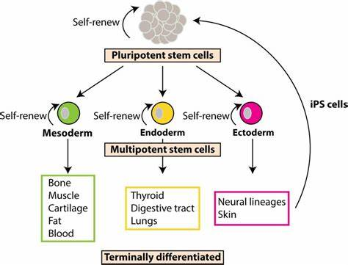
Pluripotent stem cells
Embryonic stem cells
We can find them in blastocyst (5-9 days)
Are able to differentiate to 220 types of cells
Have the ability to reproduce indefinitely in culture, and incorporate into host embryos

Slide 3
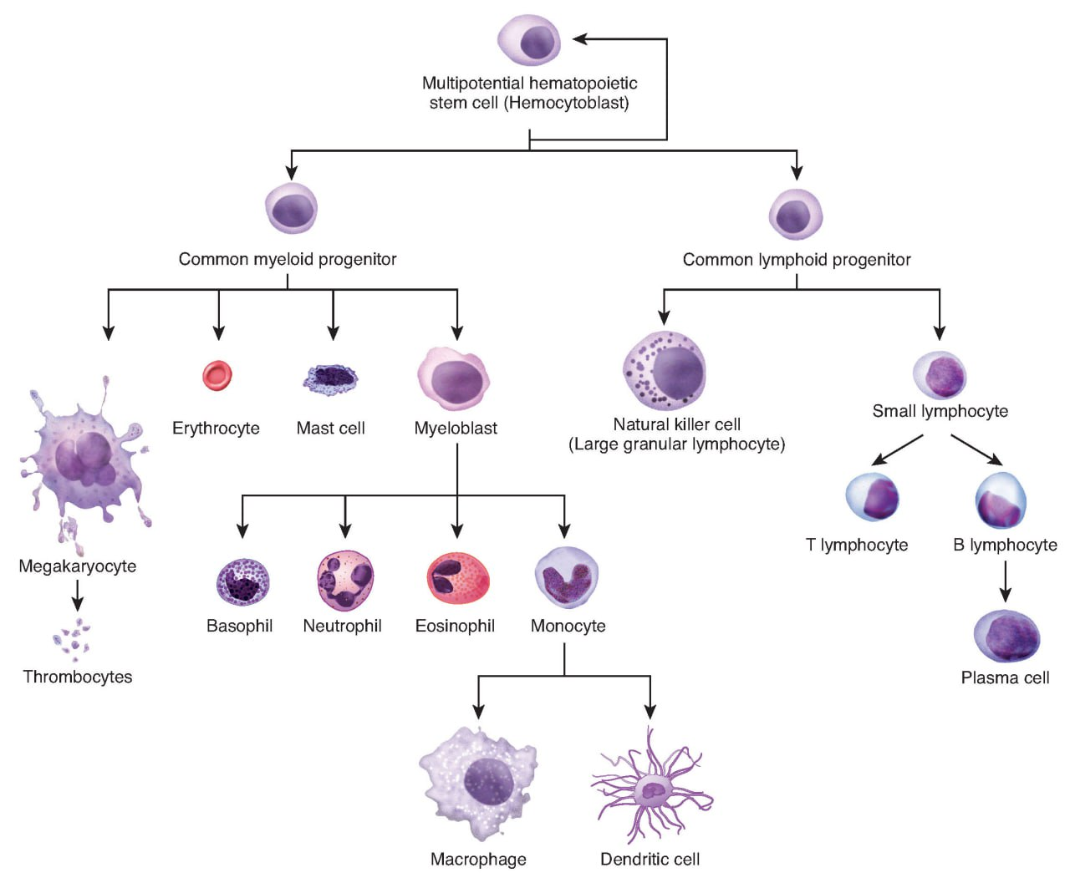
Multipotent stem cells
Adult or somatic stem cells that can differentiate into numerous related cells
Differentiate from endoderm
Classical example: hematopoietic stem cells
Most blood stem cells can be found in the bone, but the small number can be found in the bloodstream

Slide 4
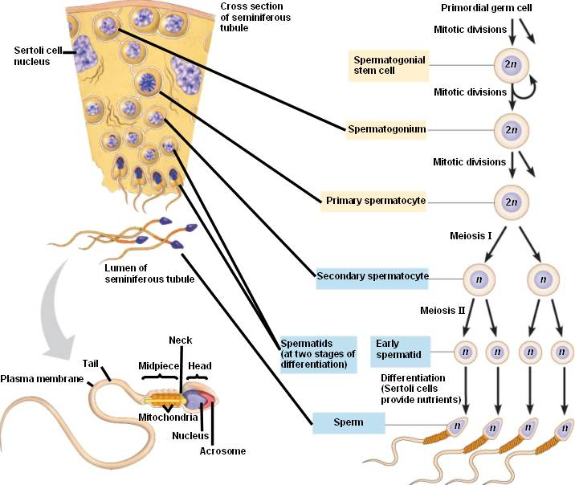
Unipotent stem cells
These stem cells can produce only one cell type.
Have the property of self-renewal that distinguishes them from non-stem cells.
Examples of a unipotent stem cell are a germ line stem cell (producing sperm) and an epidermal stem cell (producing skin).

Slide 5
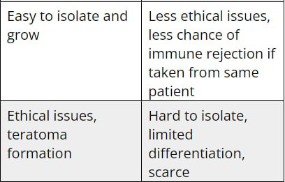
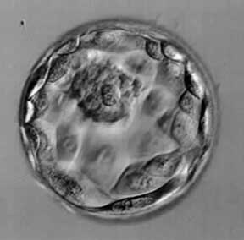
Embryonic stem cells vs adult stem cells
You call it
life?

Slide 6
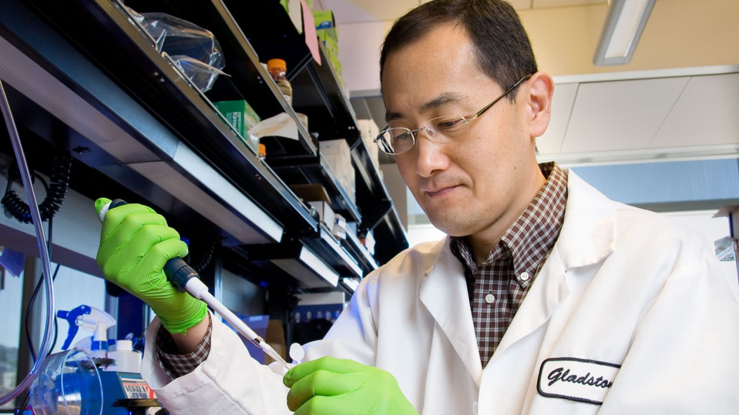
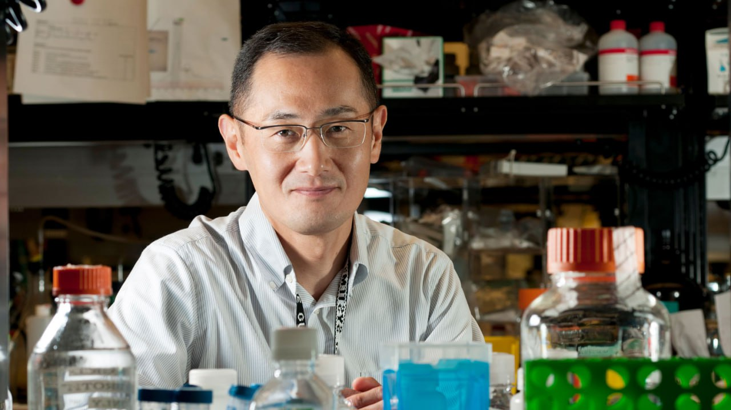
Shinya Yamanaka
Shinya Yamanaka was born on September 4, 1962.
As a young man Yamanaka was a resident in orthopedic surgery.
Yamanaka states in his interviews that he decided to devote himself to research after his father’s death. He was devastated about the fact, that he was a doctor, but he couldn’t help his own father.
The next 10 years Yamanaka spent in his PhD studies and postdoc work and in 2006 he presented induced pluripotent stem cells for the first time.

Slide 7
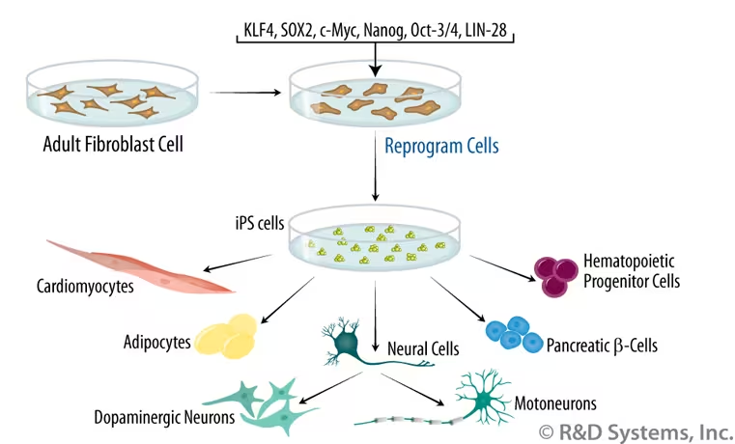
Yamanaka’s experiment
24 transcription factors
The four Yamanaka factors are Oct4 (O), Sox2 (S), Klf4 (K), and c-Myc (M).
Yamanaka and his team used retroviral vectors to deliver the reprogramming factors into the cells. This process is often referred to as transduction.

Slide 8
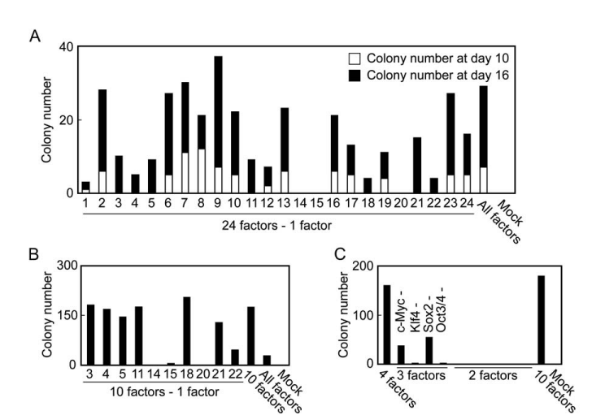
Induction of Pluripotent Stem Cells from Mouse Embryonic and Adult Fibroblast Cultures by Defined Factors
After successful transduction cells became resistant to G418 (Geneticin), antibiotic that blocks polypeptide synthesis by inhibiting the elongation step in both prokaryotic and eukaryotic cells.
The reprogrammed cell was determined as an iPSC if it had round shape, large nucleoli, and scant cytoplasm and also expressed embryonic stem cell markers.
To determine the optimal combination of transcription factors, the researchers took one factor at a time and monitored the difference in the number and morphology of outstanding colonies.

Slide 9
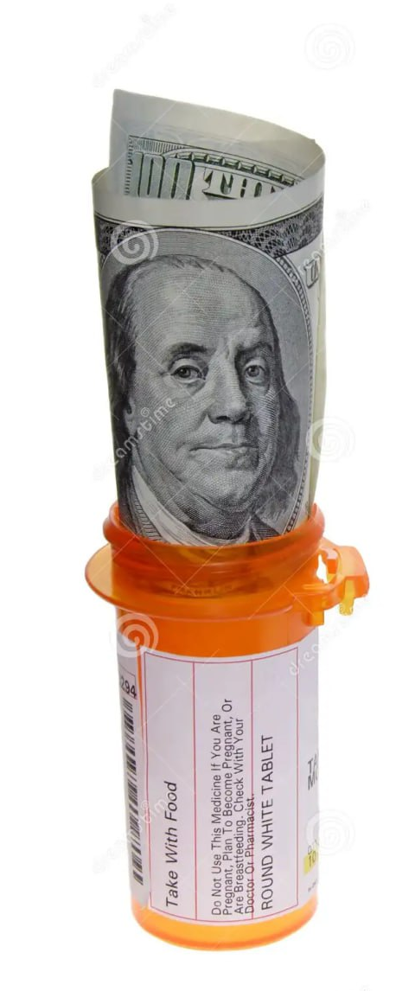
Disadvantages of iPSC
The initial idea of using IPSC for creating organoid, tissue or whole organs was really ambitious but in reality had a lot of issues.
The process is time-consuming and is manually done by well-trained technicians.
Since each technician can only comfortably prepare cells for a few patients in one experiment cycle, large numbers of technicians will be required for large-scale production. This raises the production cost and limits the production capacity.

Slide 10
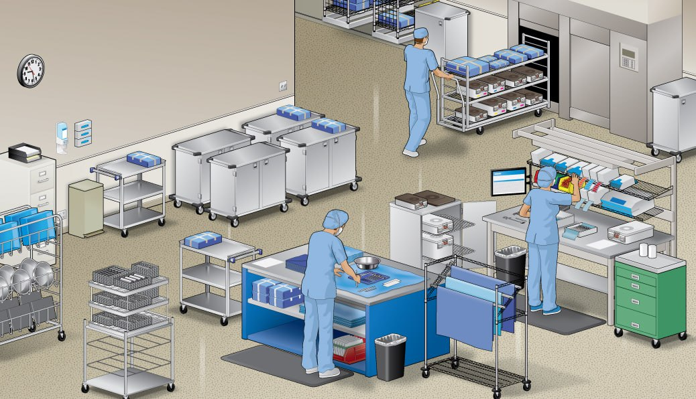

Disadvantages of iPSC
Additionally, manual operation brings in human errors, which can result in production failure.
Only one patient's cells can be handled in each clean room at any given time to avoid cross-contamination leads to limited production capacity per cGMP facility.
The risk of viral DNA mess with genome
The risk of teratoma formation or appearance of cancer (one of Yamanaka’s factors is onco factor)

Slide 11
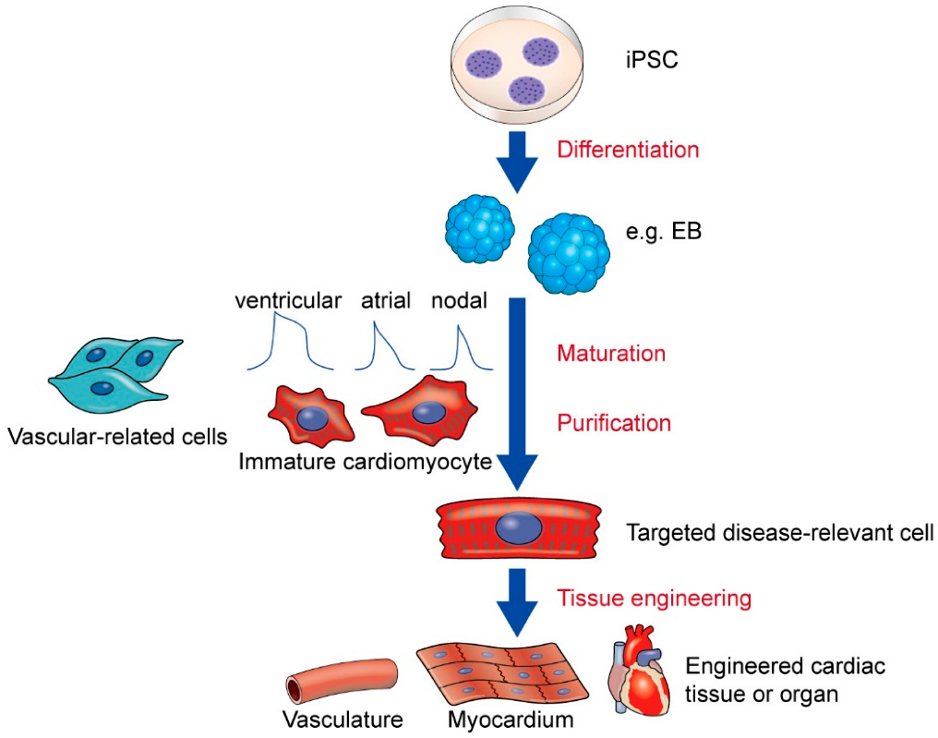
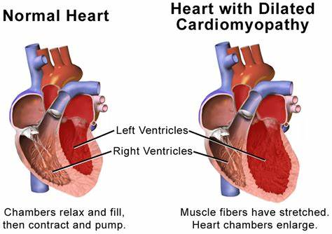
Heart Diseases
Many heart diseases manifest due to changes in the mechanical strain of cardiac tissue.
Direct transplantation of cell sheets derived from iPSCs cardiomyocytes onto the damaged heart areas has been proven to improve cardiac function in damaged hearts. Unfortunately, this method has still some issues like low percentage of injected cells successfully engrafting in the host heart or occurrence of ventricular arrhythmia.
Nowadays iPSCs are mostly used for studying different diseases in vivo like Long QT syndrome, hypertrophic/dilated cardiomyopathy or arrhythmogenic cardiomyopathy.

Slide 12
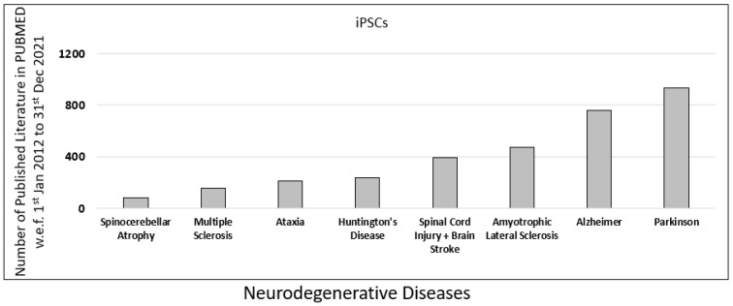
Neurological Disorders
There are many neurological diseases, that potentially could be cured thanks to iPSCs.
Parkinson's disease is associated with gene mutations such as SNCA, LRRK2, VPS35, Parkin, PINK1, DJ-1, and CHCHD2. Researchers successfully generated iPSC lines from patients with all different mutations
allowing for the study of disease
mechanisms, drug testing, and
potential personalized therapies.

Slide 13
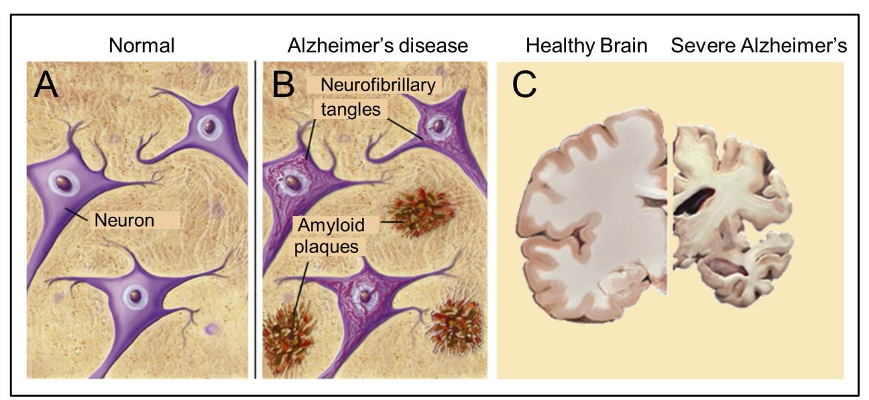
Neurological Disorders
In case of Alzheimer's disease iPSCs were used not only for studying and treating this disorder, but also for searching a preventing method for amyloid-beta aggregation and plaque formation of neurons to improve neuronal viability.

Slide 14
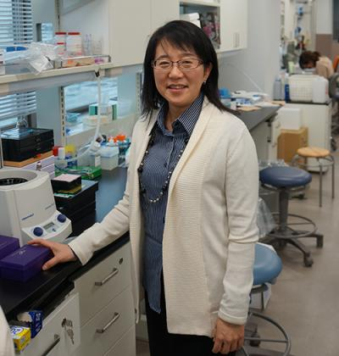
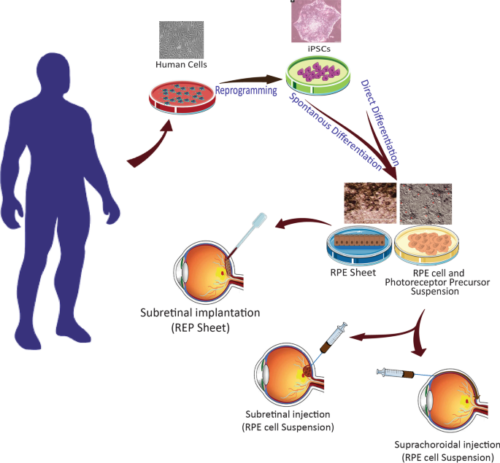
Ophthalmic Diseases
Stem cell treatments appear to offer hope to people with forms of age-related macular degeneration (AMD), retinitis pigmentosa (RP), and Stargardt disease.
In 2013, an ophthalmologist Masayo Takahashi and her team made iPS cells from the skin cells of two people with age-related macular degeneration and used them to create sheets of retinal pigment epithelium (RPE) cells for a clinical trial.
In 2014, they implanted these sheets into the right eye of a woman in her seventies, effectively halting macular degeneration and improving her vision.

Slide 15
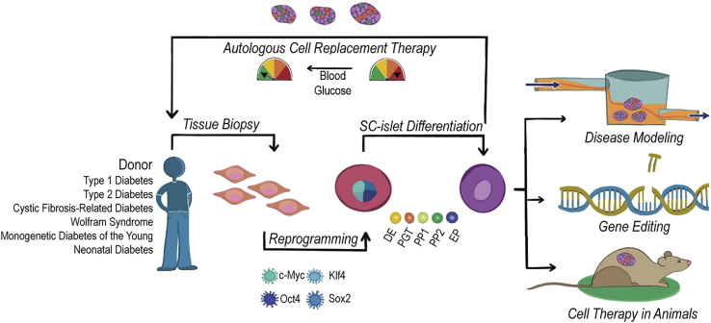
Diabetes
Patient tissue biopsies can be reprogrammed into iPSCs and differentiated into stem cell-derived islets (SC-islets) that contain insulin-secreting β cells. These SC-islets have applications in disease modeling, gene editing, and cell therapy in animal models. They also provide a source for autologous cell replacement therapy for patients with diabetes.

Slide 16
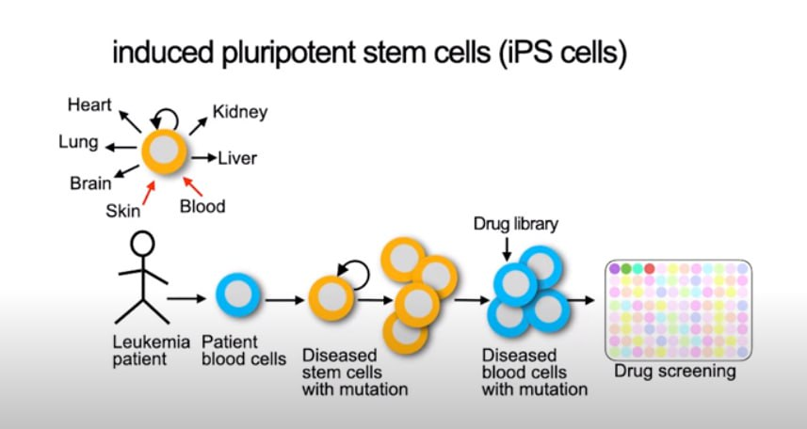
Personalized medicine - treatment of leukemia
Usually the patients have to spend months in the hospital just to find the right medicine for them.
Many of these treatments have a lot of negative side effects that may make the patient’s condition even worse.
In the case of leukemia the mutation appears only in diseased cells so we can isolate patient blood cells, reprogram them into stem cells, and then observe how the treatment affects them.

Slide 17
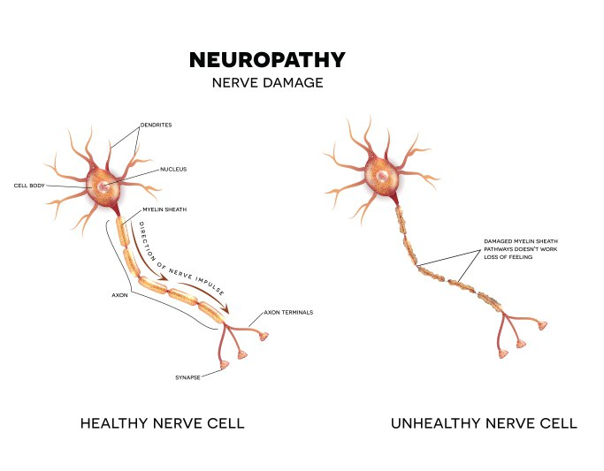
When modern methods meet together…
Many diseases are associated with mutations in the genome of all somatic cells, for instance, neuropathic pain.
CRISPR in iPSC can be used to generate healthy cells.

Slide 18
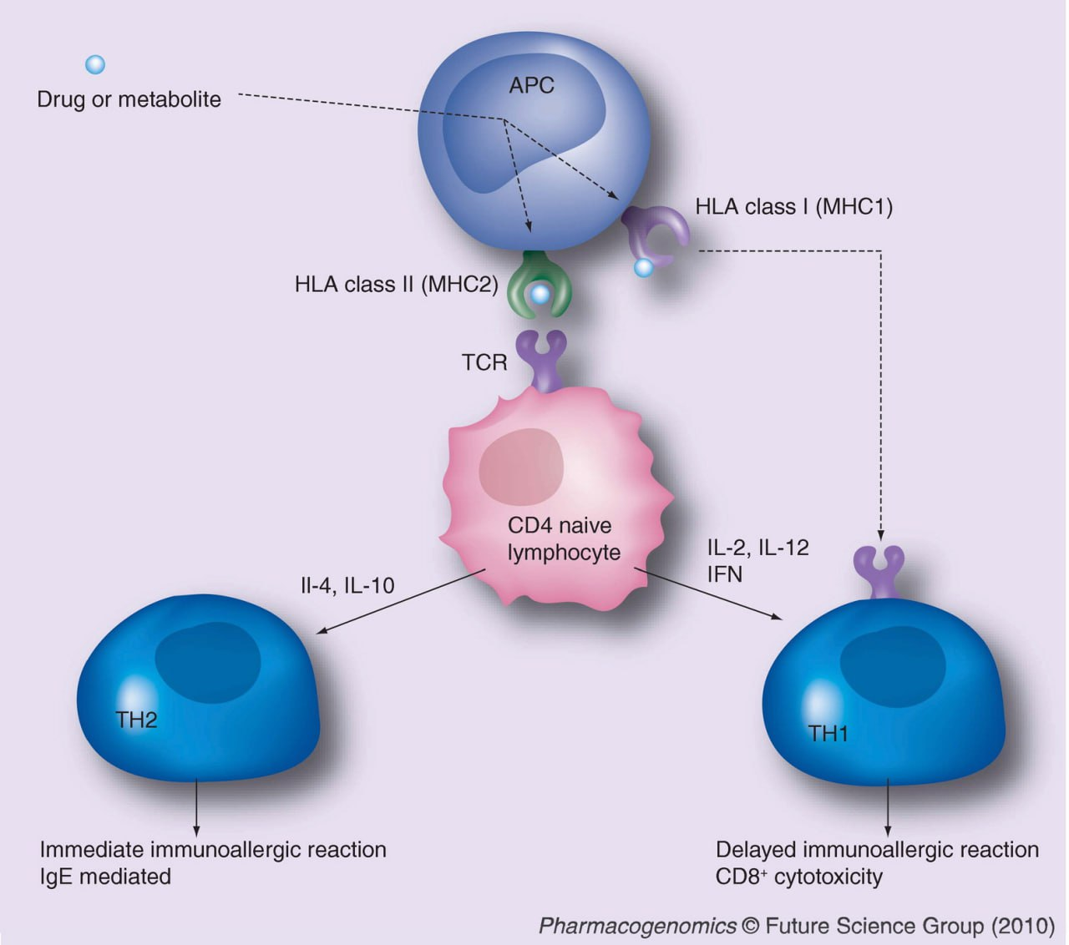
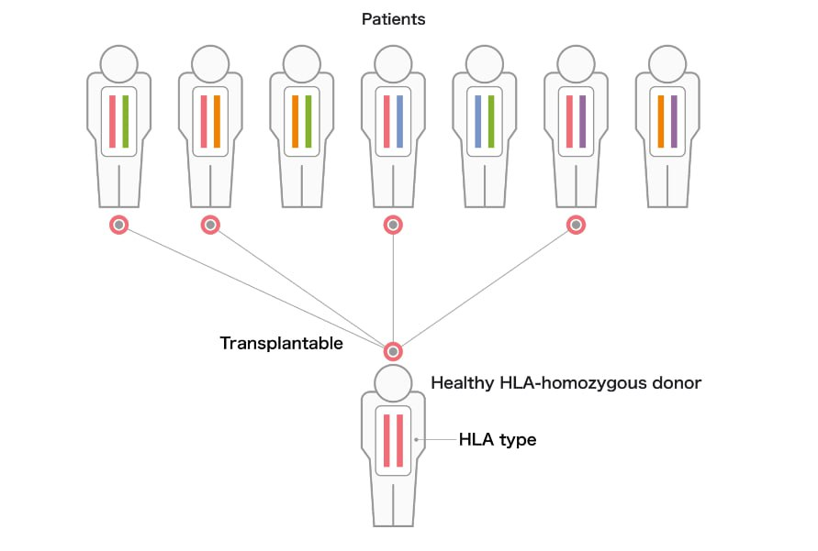
HLA stock project
iPS cells are being made to express the most frequent HLA in Japan.
Currently, a total of 27 iPS cell lines made from 7 donors who together are homozygous for 4 HLA types have been prepared. These lines cover approximately 40% of the Japanese population.
The different lines give versatility in HLA typing and differentiation capacity for different diseases.
Some of these cell lines have already been used in iPS cell-based clinical cell therapies.

Slide 19
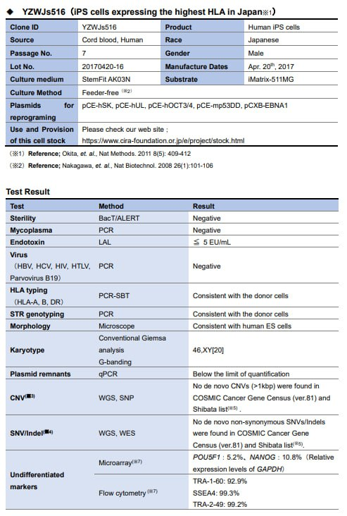
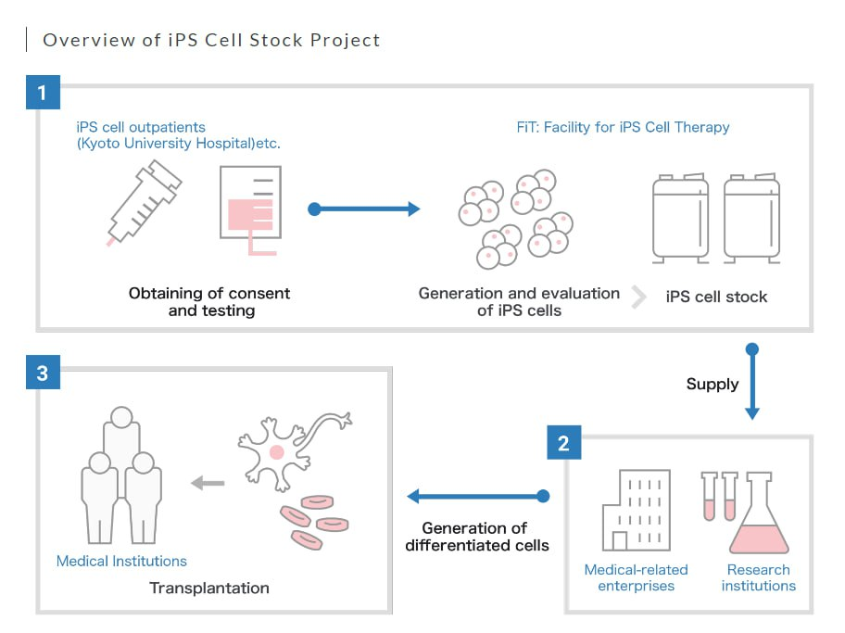
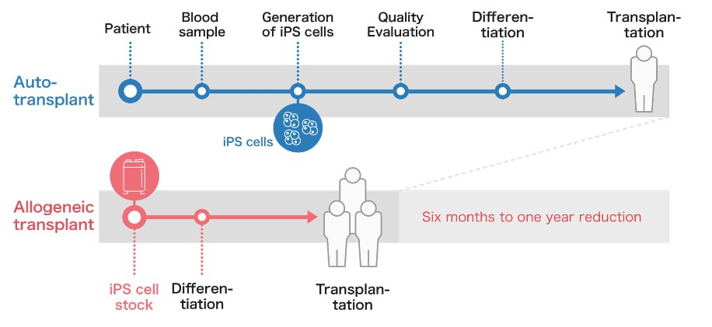
HLA stock project

Slide 20
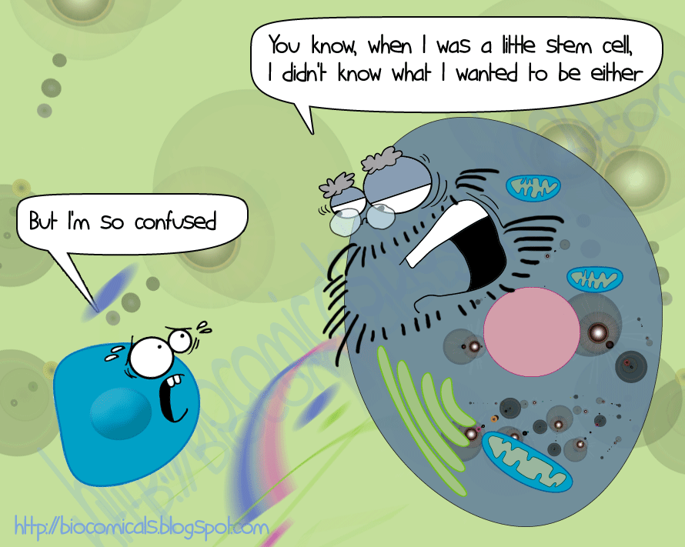
Thank you for attention

